Slide 1

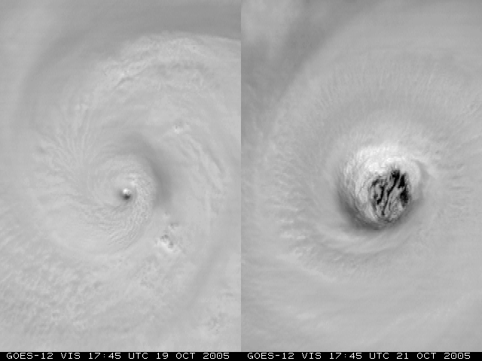
Predictability of Tropical Cyclone Intensity Forecasting
Mark DeMaria
NOAA/NESDIS/StAR, Fort Collins, CO
CoRP Science Symposium
Fort Collins, CO
August 2010

Slide 2
Outline
Overview of tropical cyclone intensity forecasting
Charlie Neumann (1987) methodology
Use of statistical-dynamical models for predictability estimates
Predictability results

Slide 3
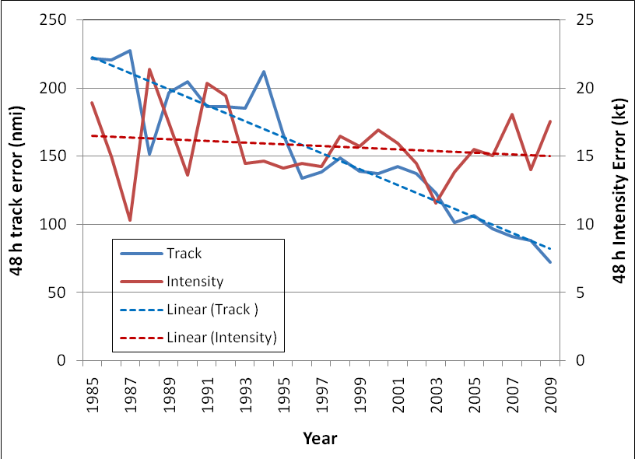
NHC 48 h Atlantic Track and Intensity Errors 1985-2009
Track 63% Improvement in 24 yr
Intensity 9% Improvement in 24 yr
HFIP Goals: 20% in 5 yr, 50% in 10 yr
Notes:
Summary of GLM compared to ground based and polar systems

Slide 4
Types of TC Intensity Forecast Models
Statistical Models:
SHIFOR, 1988 (Statistical Hurricane Intensity FORecast) : Based solely on historical information - climatology and persistence (Analog to CLIPER)
Statistical/Dynamical Models:
SHIPS,1991 (Statistical Hurricane Intensity Prediction Scheme): Based on climatology, persistence, and statistical relationships to current and forecast environmental conditions
LGEM, 2006 (Logistic Growth Equation Model): Variation on SHIPS, relaxes intensity to Maximum Potential Intensity (MPI)
Dynamical Models:
GFS, UKMET, NOGAPS, ECMWF
GFDL, 1995; HWRF 2007 Solves the governing equations for the atmosphere (and ocean)
Ensemble, Consensus Models
Notes:
No change for 2009

Slide 5
Statistical / Dynamical Intensity Models SHIPS (Statistical Hurricane Intensity Prediction Scheme)
Multiple regression model
Predictors from climatology, persistence, atmosphere and ocean
Atmospheric predictors from GFS forecast fields
SST from Reynolds weekly fields along forecast track
Predictors from satellite data
Oceanic heat content from altimetry
GOES IR window channel brightness temperatures
Decay SHIPS
Climatological wind decay rate over land
Notes:
2009 Update: OHC now included in Atlantic and east Pacific (previously only Atlantic)

Slide 6
The SHIPS Model Predictors*
(+) SST POTENTIAL (VMAX-V): Difference between the maximum potential intensity (depends on SST) and the current intensity
(-) VERTICAL (850-200 MB) WIND SHEAR: Current and forecast, impact modified by shear direction
(-) VERTICAL WIND SHEAR ADJUSTMET: Accounts for shear between levels besides 850 and 200 hPa
(+) PERSISTENCE: If TC has been strengthening, it will probably continue to strengthen, and vice versa
(-) UPPER LEVEL (200 MB) TEMPERATURE: Warm upper-level temperatures inhibit convection
(+) THETA-E EXCESS: Related to buoyancy (CAPE); more buoyancy is conducive to strengthening
(+) 500-300 MB LAYER AVERAGE RELATIVE HUMIDITY: Dry air at mid levels inhibits strengthening
*Red text indicates most important predictors
Notes:
2010 Update: Reference to new shear predictor that includes levels besides 850 and 200 hPa
2009 Update: Reference to new shear direction predictor

Slide 7
The SHIPS Model Predictors (Cont…)
(+) 850 MB ENVIRONMENTAL RELATIVE VORTICITY: Vorticity averaged over large area (r <1000 km) – intensification favored when the storm is in environment of cyclonic low-level vorticity
(+) GFS VORTEX TENDENCY: 850-hPa tangential wind (0-500 km radial average) – intensification favored when GFS spins up storm
(-) ZONAL STORM MOTION: Intensification favored when TCs moving west
(-) STEERING LAYER PRESSURE: intensification favored for storms moving more with the upper level flow – this predictor usually only comes into play when storms get sheared off and move with the flow at very low levels (in which case they are likely to weaken)
(+) 200 MB DIVERGENCE: Divergence aloft enhances outflow and promotes strengthening
(-) CLIMATOLOGY: Number of days from the climatological peak of the hurricane season
Notes:
No Change for 2010
No Change for 2009

Slide 8
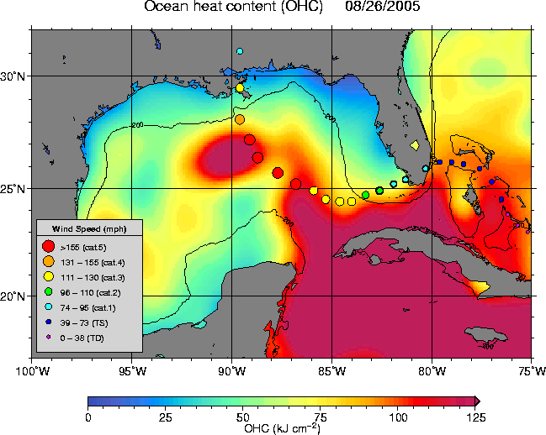
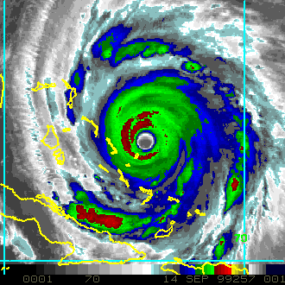
Satellite Predictors added to SHIPS in 2003
1. GOES cold IR pixel count 2. GOES IR T_{b} standard deviation
3. Oceanic heat content from satellite altimetry
(TPC/UM algorithm)
Cold IR, symmetric IR, high OHC favor intensification
Notes:
No change for 2009

Slide 9
Factors in the Decay-SHIPS Model Center over Water
Normalized Regression Coefficients at 48 hr for 2010 Atlantic SHIPS Model
Notes:
2010 Update. Predictors from 2010 model used.
New for 2009, shows relative magnitudes of predictors at 48 hr, generally grouped by 1) Clim/Per, 2) Motion, 3) GOES, 4) Ocean, 5) Shear, 6) other dynamical factors, 7) Other thermodynamic factors

Slide 10
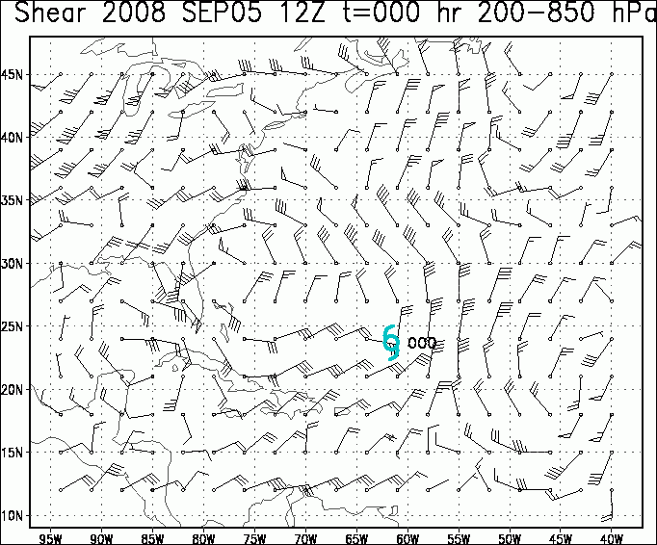
Regions with Most Favorable Shear Directions for Hurricane Ike (New SHIPS Model Predictor in 2009)
Notes:
New for 2009, shows NE shear favorable in low latitudes, SW shear in high latitudes

Slide 11
New LGEM and SHIPS Input for 2010
Generalized Shear (GS)
P₂
GS = 4/(P₂-P₁)∫ [(u-u_{b})² + (v-v_{b})²]^{1/2} dP
P₁
P₁=1000 hPa, P₂=100 hPa, u_{b},v_{b} = mean u,v in layer
GS = 2-level shear for linear wind profiles

Slide 12
The Logistic Growth Equation Model (LGEM)
Applies simple differential equation to constrain the max winds between zero and the maximum potential intensity
Based on analogy with population growth modeling
Intensity growth rate predicted using SHIPS model predictors
More responsive than SHIPS to time changes of predictors such as vertical shear
More sensitive track errors
More difficult to include persistence
Notes:
No change for 2009

Slide 13
The Logistic Growth Equation Model
Uses analogy with population growth modeling
dV/dt = κV - β(V/V_{mpi})^{n}V
(A) (B) (C)
(A) = time change of maximum winds
Analogous to population change
(B) = growth rate term
analogous to reproduction rate
(C) = Limits max intensity to upper bound
Analogous to food supply limit (carrying capacity)
β, n = empirical constants
V_{mpi} = maximum potential intensity (from empirical SST function)
κ = growth rate (estimated empirically from ocean, atmospheric predictors GFS, satellite data, etc)

Slide 14
LGEM Improvement over SHIPS 2006-2009 Operational Runs
Notes:
2010 Update, 2009 cases added
2009 Update, 2008 cases added

Slide 15
Dynamical Intensity Models
GFS: U.S. NWS Global Forecast System < relocates first-guess TC vortex
UKMET: United Kingdom Met. Office global model < bogus (syn. data)
NOGAPS: U.S. Navy Operational Global Atmospheric Prediction System global model < bogus (synthetic data)
ECMWF: European Center for Medium-range Weather Forecasting global model (no bogus)
GFDL: U.S. NWS Geophysical Fluid Dynamics Laboratory regional model <bogus (spin-up vortex)
HWRF: NCEP Hurricane Weather Research and Forecast regional model (vortex relocation and adjustment)
Notes:
No changes for 2009

Slide 16
Dynamical Intensity Model Limitations
Sparse observations, especially in inner core
Inadequate resolution, especially global models
Data assimilation on storm scale
Representation of physical processes
PBL, microphysics, radiation
Ocean interactions
Predictability
Notes:
2009 Update: Small format changes

Slide 17
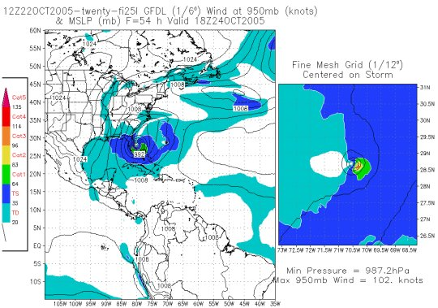
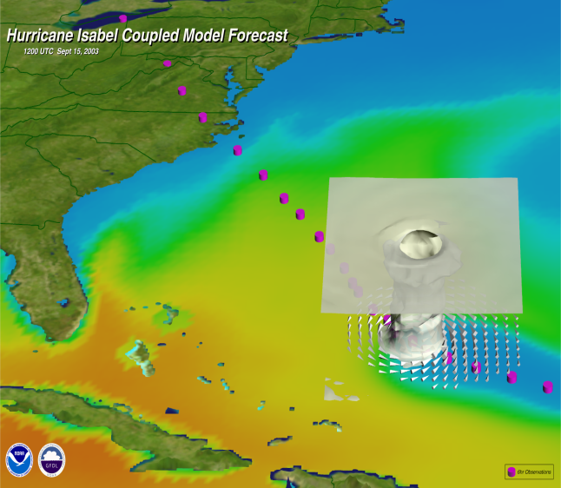
The Geophysical Fluid Dynamics Laboratory (GFDL) Hurricane Model
Dynamical model capable of producing skillful intensity forecasts
Coupled with the Princeton Ocean Model (POM) (1/6° horizontal resolution with 23 vertical sigma levels)
Replaces the GFS vortex with one derived from an axisymmetric model vortex spun up and combined with asymmetries from a prior forecast
Sigma vertical coordinate system with 42 vertical levels
Limited-area domain (not global) with 2 grids nested within the parent grid
Outer grid spans 75°x75° at 1/2° resolution or approximately 30 km.
Middle grid spans 11°x11° at 1/6° resolution or approximately 15 km.
Inner grid spans 5°x5° at 1/12° resolution or approximately 9 km
Notes:
2009 Update

Slide 18
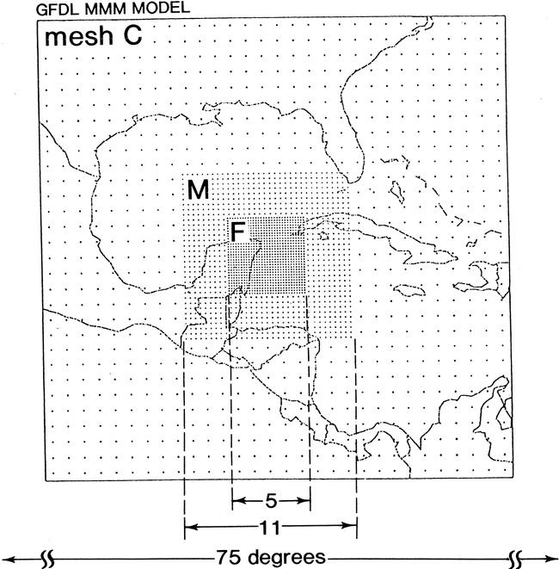
GFDL Model Nested Grids
Notes:
No change for 2009

Slide 19
The Hurricane Weather Research & Forecasting (HWRF) Prediction System
Next generation non-hydrostatic weather research and hurricane prediction system
Movable, 2- way nested grid (9km/27km; 42 vertical levels; ~75°x75°)
Coupled with Princeton Ocean Model
POM utilized for Atlantic systems, no ocean coupling in N Pacific systems
Vortex initialized through use of modified 6-h HWRF first guess
3-D VAR data assimilation scheme
But with more advanced data assimilation for hurricane core
Use of airborne and land based Doppler radar data (run in parallel)
Became operational in 2007
Under development since 2002
Runs in parallel with the GFDL
Notes:
Changed resolution (75x75) per Vijay T for 2010, also used http://www.emc.ncep.noaa.gov/HWRF/index.html
2009 Update

Slide 20
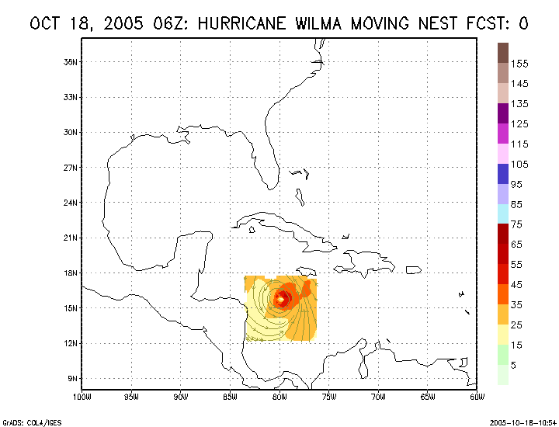
Notes:
No change for 2009

Slide 21
*HWRF *GFDL
Grid configuration | 2-nests | 3-nests
Nesting | Force-feedback | Interaction thru intra-nest fluxes
Ocean coupling | POM (Atlantic only) | POM
Convective parameterization | SAS mom.mix. | SAS mom.mix.
Explicit condensation | Ferrier | Ferrier
Boundary layer | GFS non-local | GFS non-local
Surface layer | GFDL (Moon et. al.) | GFDL (Moon et. al.)
Land surface model | GFDL slab | GFDL slab
Dissipative heating | Based on D-L Zhang | Based on M-Y TKE2.5
Gravity wave drag | YES | NO
Radiation | GFDL (cloud differences) | GFDL
*Configurations for 2010 season
Notes:
2010 Update from IHC (Vijay T)
2009 Update
Note: This may be a good place to mention GFDN is starting to diverge from GFDL (although M. Bender said all the above is the same between the two)

Slide 22
Operational Intensity Model Verification (2007-2009 Atlantic)

Slide 23
Most Accurate Atlantic Early Intensity Models 1995-2009 (48 and 96 hr forecast)
Year 1995 1996 1997 1998 1999 2000 2001 2002 2003 2004 2005 2006 2007 2008 2009
48-hr SHFR SHIP SHIP SHIP SHIP DSHP DSHP DSHP DSHP DSHP DSHP GFDL DSHP LGEM LGEM
96 hr SHIP GFS SHIP GFDL DSHP GFDL DSHP GFDL LGEM
Statistical Statistical -Dynamical Global-Dynamical Regional-Dynamical
Notes:
2010 Update (NHC verif report)
Updated for 2009: Data directly from NHC verification reports, sample restricted to 1995-2008, when GFDL first became operational

Slide 24
C. J. Neumann (1987) Prediction of Tropical Cyclone Motion: Some Practical Aspects
Most accurate track models were statistical-dynamical
Track error improvement ~0.5% per year
Error reductions leveling off
How much can track forecasts be improved?
Run NHC83 statistical-dynamical model with “perfect prog” input and compare runs with operational input
Showed 50% improvements were possible

Slide 25
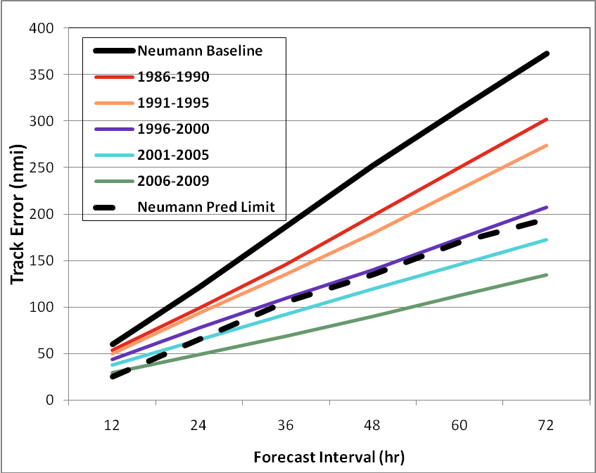
Neumann Track Predictability Results

Slide 26
Intensity Predictability Study
Use LGEM statistical-dynamical model
Run 4 versions
V1. NHC forecast tracks, GFS forecast fields
Operational input
V2. NHC forecast tracks, GFS analysis fields
V3. Best track positions, GFS forecast fields
V4. Best track positions, GFS analysis fields
V1. Provides current baseline
V4. Provides predictability limit
V2. Evaluates impact of large-scale improvement
V3. Evaluates impact of track improvement

Slide 27
Forecast Sample and Procedure
Use 2010 version of LGEM fitted to 1982-2009 developmental sample
Predictability analysis for Atlantic 2002-2009 sample
135 tropical cyclones
2402 forecasts to at least 12 h
859 forecasts to 120 h
Compare LGEM with operational input to combinations of “perfect prog” track and GFS
Forecast verification using standard NHC rules
Notes:
Summary slide.

Slide 28
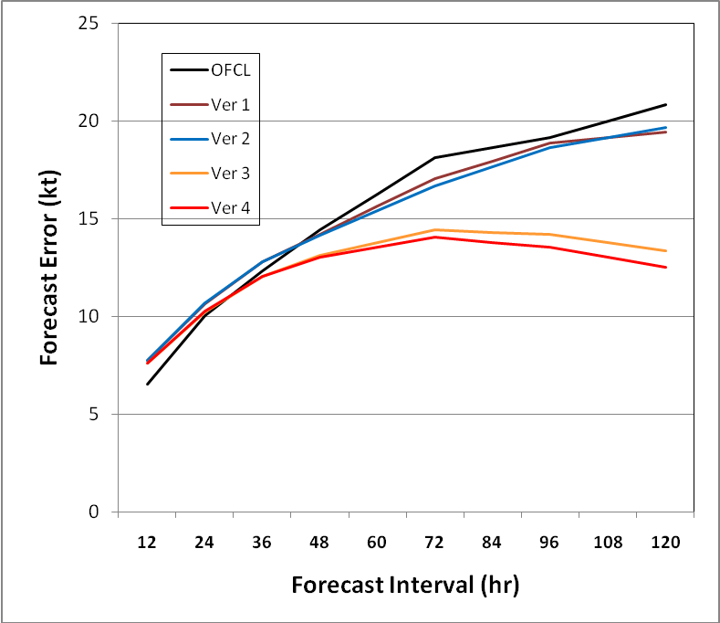
2002-2009 Intensity Errors
OFCL = NHC operational forecasts
Ver 1 = LGEM w\ oper input
Ver 2 = LGEM w\ perfect GFS
Ver 3 = LGEM w\ perfect tracks
Ver 4 = LGEM w\ perfect tracks + GFS

Slide 29
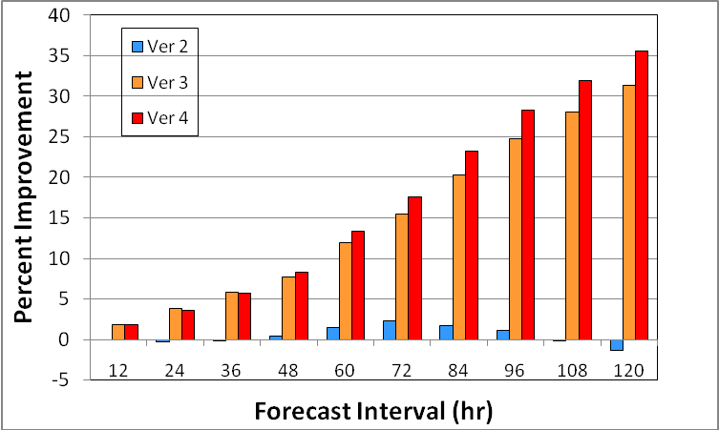
LGEM Improvements over LGEM w\ Operational Input
Perfect GFS
Perfect track
Perfect GFS & track

Slide 30
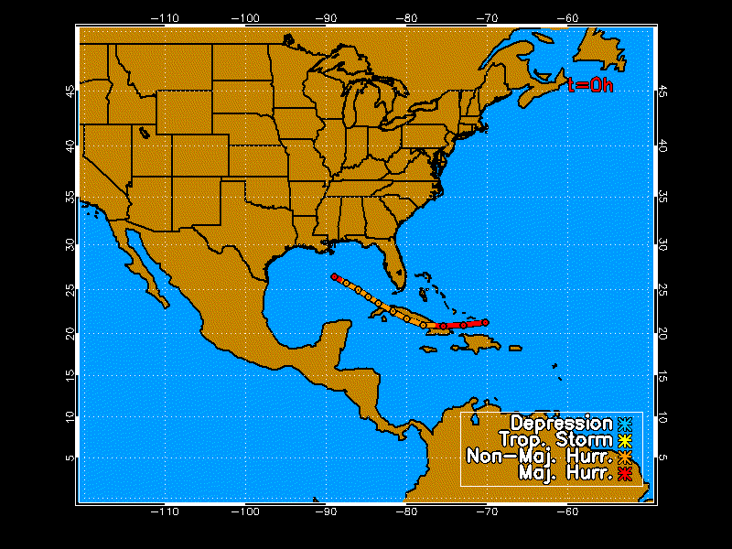
Illustration of Track Error 1000 plausible Hurricane Ike tracks/intensities based on recent NHC forecast errors

Slide 31
Additional Improvements
TPW , Lightning density, µ-wave imagery input
Adjoint of LGEM to include storm intensity history up to forecast time
Consensus/ensembles
Dynamical model improvements under HFIP
Resolution, physics, assimilation

Slide 32
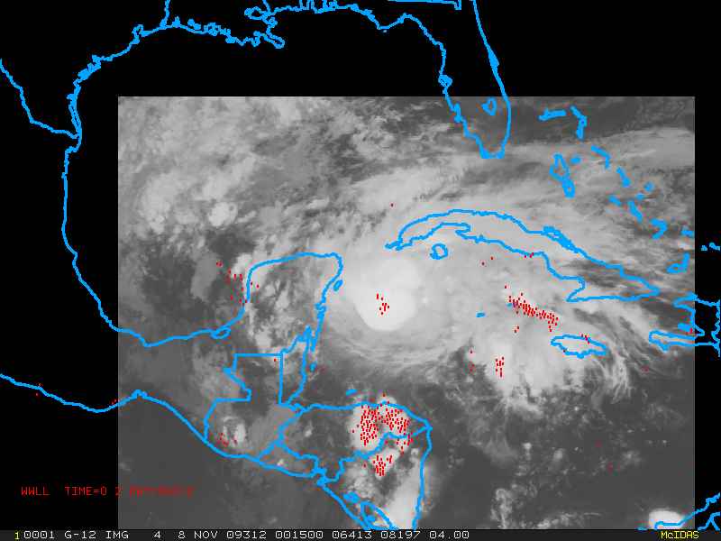
2-hourly Composite Lightning Strikes Hurricane Ida 8 November 2009

Slide 33
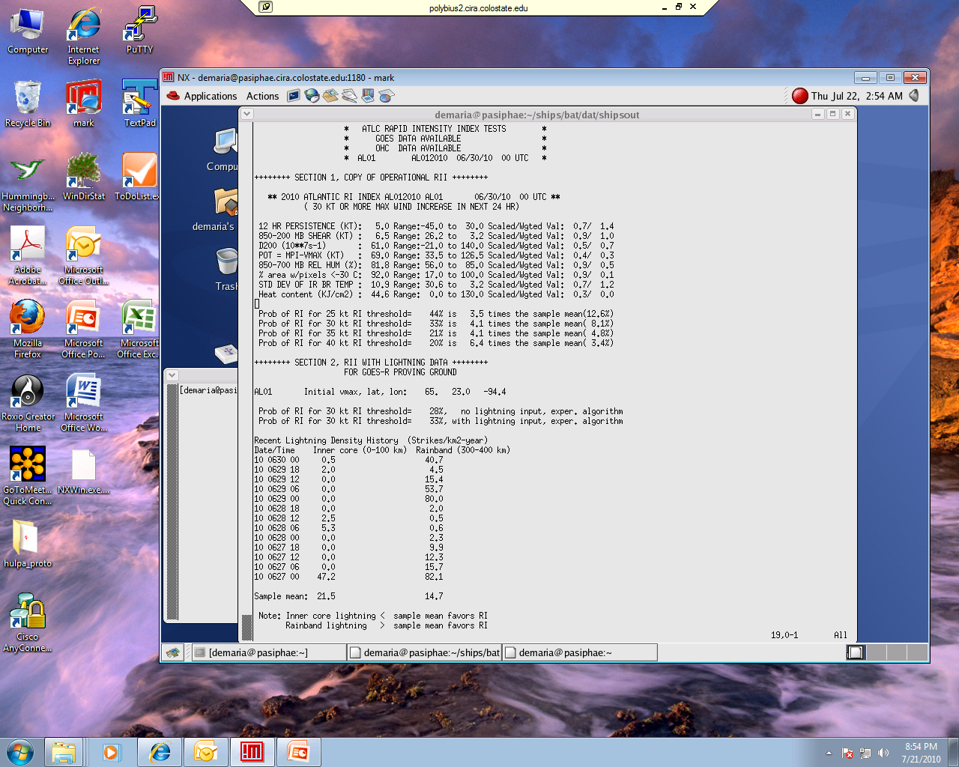
Sample Text Output
Lightning-Based Rapid
Intensity Forecast Algorithm
Hurricane Alex
30 June 2010 00 UTC

Slide 34
Conclusions
Current intensity forecast properties similar to those for track in 1980s
Neumann (1987) track predictability framework applied to intensity problem
LGEM statistical-dynamical model run with “perfect prog” input
4%, 8%, 17%, 28%, 36% improvement at 1-5 day
About ½ might be realizable
Majority of intensity improvement from reducing track errors
Better dynamical models needed to achieve 10 year HFIP goal of 50% improvement

