Slide 1

Introduction to the Cooperative Research program
Ingrid Guch
Director, Cooperative Research Program
NOAA/NESDIS
7th Annual CoRP Symposium
Aug 10-11 2010

Slide 2
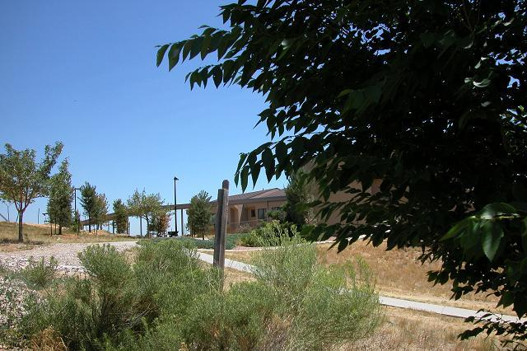
CIRA is expanding

Slide 3
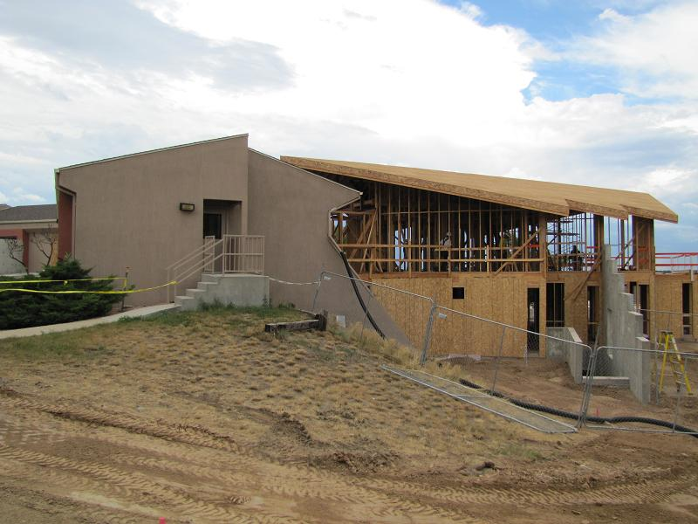
And a little muddy…

Slide 4
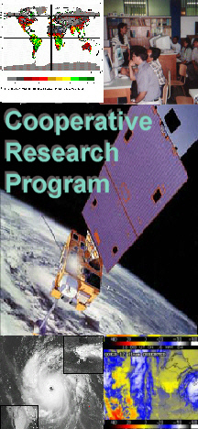
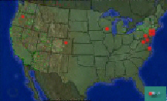
Cooperative Research Program Challenge
To be a Coast-to-coast government and university-based research coalition for remote sensing in the environment

Slide 5
The Federal Side
Three Federal Branches collocated with universities
Regional Atmospheric Mesoscale Meteorology Branch here at CSU – “The RAMMBranch”
Advanced Satellite Products Branch at UW
Satellite Climate Studies Branch at UMD

Slide 6
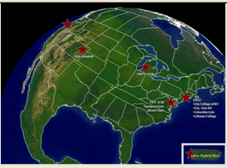
The Academic Side
5 Cooperative Institutes and Centers
CSU – Cooperative Institute for Research in the Atmosphere
UW – Cooperative Institute for Meteorological Satellite Studies (CIMSS)
UMD – Cooperative Institute for Climate and Satellites
OSU – Cooperative Institute for Oceanographic Satellite Studies
CCNY – Center for Remote Sensing Science and Technology

Slide 7
Research Partnerships
Driven by interests, knowledge, abilities, funding, relationships, requirements, challenges
Effectively using the billion-dollar satellite constellation is a complex, multi-disciplinary problem that requires partnerships
Limited funding and resources
Limited time
Partnerships with the international community, government and non-government organizations and the private sector are as critical as federal/academic partnerships, but not the focus of current CoRP Program

Slide 8
CoRP Engagement Strategies
This Annual Symposium to bring federal and academic partners together on topics of mutual interest
Student and Early Career Scientist exchanges (2-day if first meeting, up to 2-weeks if follow-up) to encourage communication, multi-disciplinary studies and proposal development
Annual Directors meeting for strategic planning
STAR/CIRA/CIMSS/CICS/CIOSS/CREST
Satellite Algorithm Test Bed, National Climate Service and Satellite Data Assimilation current topics of high interest
Job and Internal Funding Opportunity Blog www.corpblogspot.org

Slide 9
Goal of This Symposium
Identify synergies between Mesoscale Meteorology and Mesoscale Oceanography using satellite remote sensing data
Potential New Proposal Development?
Link to Student/Early Career Exchanges
Work of interest identified here could be followed up with a exchange
Some work facilitated by previous exchanges will be seen here
Continual learning at all levels

Slide 10
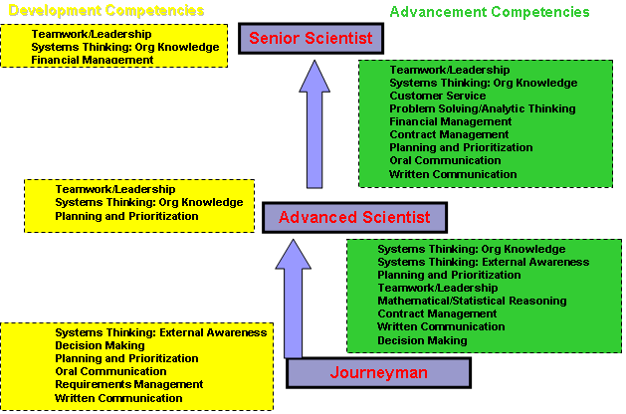
Full-Time Science Competency Development Model

Slide 11
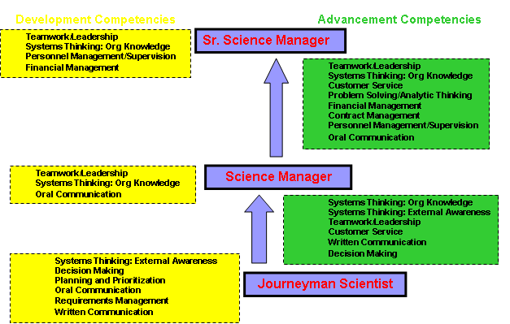
Science Management Competency Development Model

Slide 12
Ultimate Goal
Highly successful scientists and science managers making revolutionary progress using the next generation of earth observation satellites for societal benefits

