Slide 1




GOES-15 Science Test: Starting 11 August 2010
Don Hillger, John Knaff, Dan Lindsey, Deb Molenar
NOAA/NESDIS/STAR/Regional And Mesoscale Meteorology Branch (RAMMB)
Dave Watson, Kevin Micke, Mike Hiatt
CIRA, Colorado State University
Fort Collins CO
Don Hillger and Tim Schmit co-lead the NOAA Science Tests

Slide 2
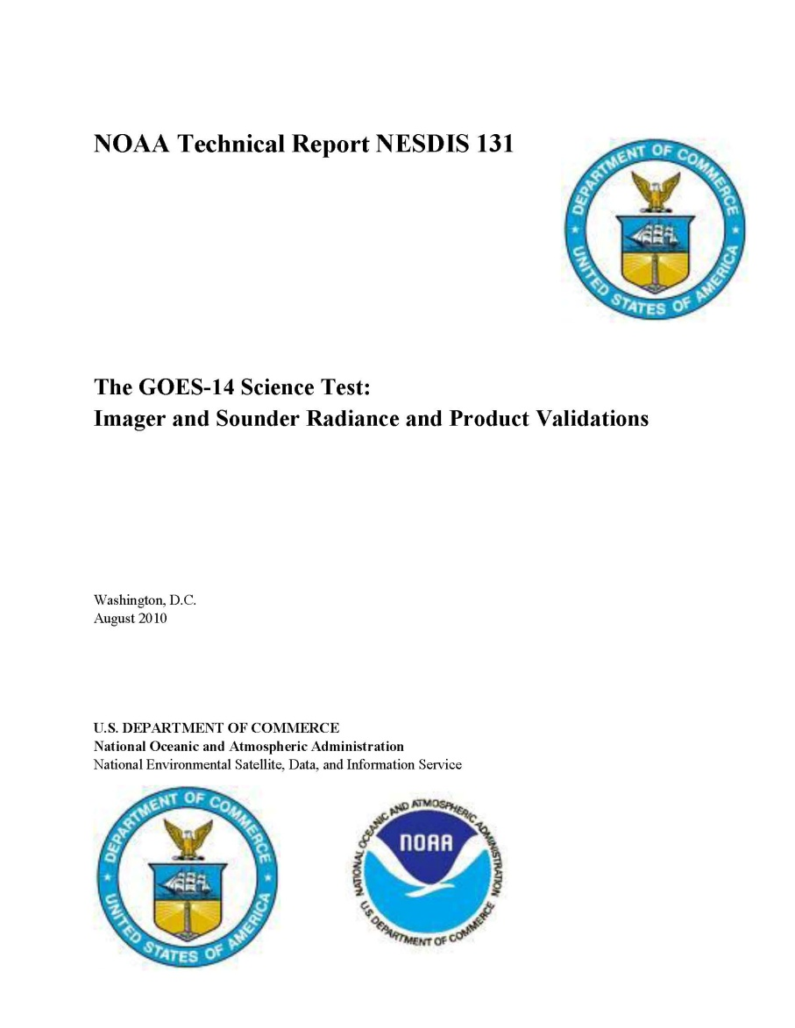
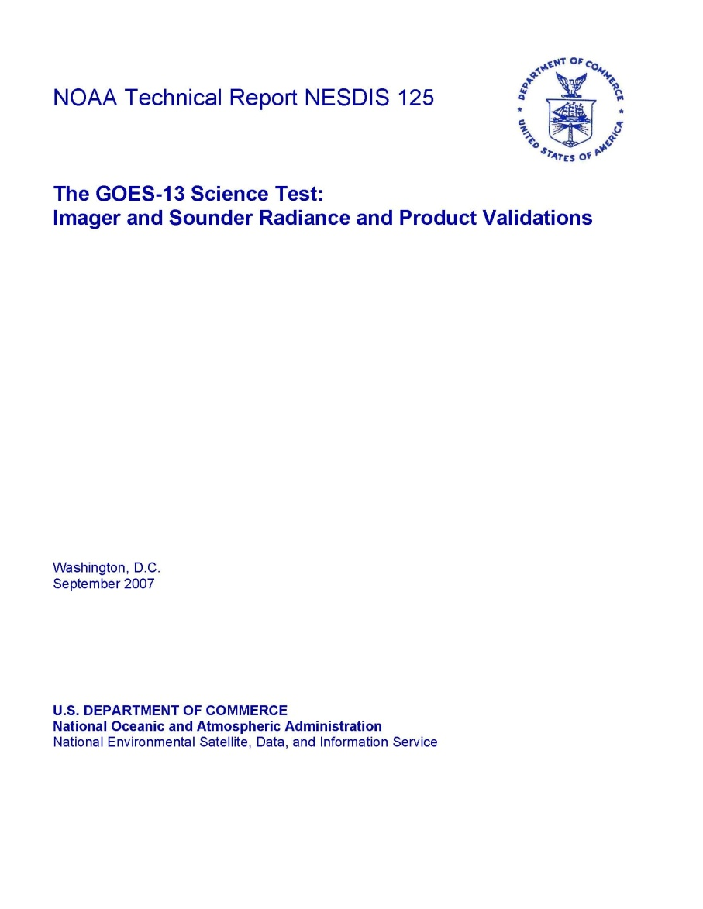
Last couple tests: GOES-13 and 14 Science Tests December 2006 and December 2009, respectively

Slide 3
Previous GOES Science Tests
GOES-11
Daniels, J.M., T.J. Schmit, and D.W. Hillger, 2001: GOES-11 Imager and Sounder Radiance and Product Validations for the GOES-11 Science Test, NOAA Tech. Rep. NESDIS 103, (August), 49 pp.
GOES-12
Hillger, D.W., T.J. Schmit, and J.M. Daniels, 2003: Imager and Sounder Radiance and Product Validation for the GOES-12 Science Test. NOAA Tech. Rep., NESDIS 115, (September), 70 pp.
GOES-13
Hillger, D.W., and T.J. Schmit, 2007: The GOES-13 Science Test, NOAA Tech. Rep., NESDIS 125, (September), 88 pp.
Hillger, D.W., and T.J. Schmit, 2009: The GOES-13 Science Test: A Synopsis. Bull. Amer. Meteor. Soc., 90(5), (May), 6-11.
GOES-14
Hillger, D.W., and T.J. Schmit, 2010: The GOES-14 Science Test, NOAA Tech. Rep., NESDIS 131, (August), 106 pp. [soon to be completed]
Acknowledgements
The GOES Science Tests occur at the end of long Post Launch Test (PLT) periods for each satellite and are possible because of the cooperation of NASA and NOAA/OSD and OSO personnel, who in particular prepare the satellite schedules and enable the daily changes that are requested by the science team. Thanks as well to all who contribute to the analysis of the data collected during the Science Tests.

Slide 4
GOES Science Test Goals
For all GOES check-outs, the goals of the Science Test include the following:
To assess the quality of the GOES radiance data. This is accomplished by comparison to other satellite measurements or by calculating the signal-to-noise ratio compared to specifications, as well as assess the striping in the imagery due to multiple detectors.
To generate products from the GOES data stream and compare to those produced from other satellites. These included several Imager and Sounder products currently used in operations.
Rapid-scan and other special imagery of interesting weather cases are collected with temporal resolutions as fine as every 30 seconds for severe weather, a capability of rapid-scan imagery from GOES-R that is not implemented operationally on current GOES. For GOES-15 we plan to include a 5-minute CONUS-size sector for capturing hurricane imagery.

Slide 5
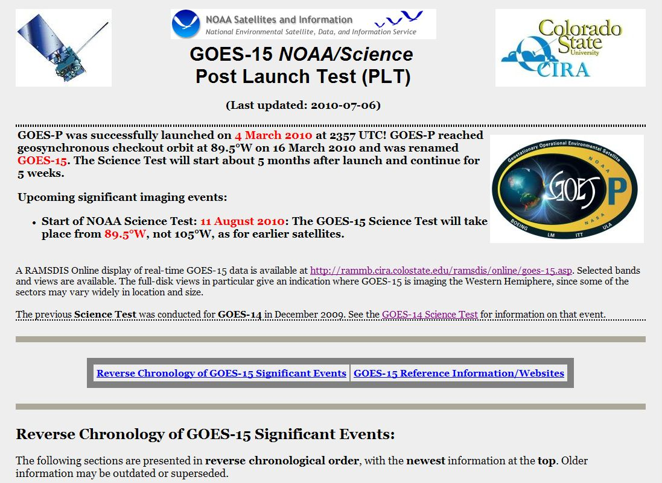
GOES-15 NOAA/Science Test website
http://rammb.cira.colostate.edu/projects/goes-p/

Slide 6
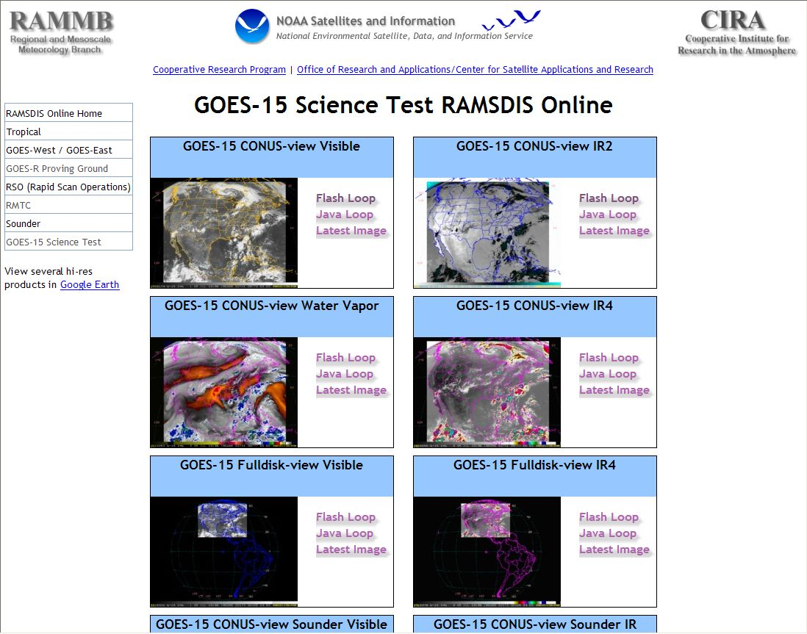
GOES-15 RAMSDIS Online
http://rammb.cira.colostate.edu/ramsdis/online/goes-15.asp

Slide 7
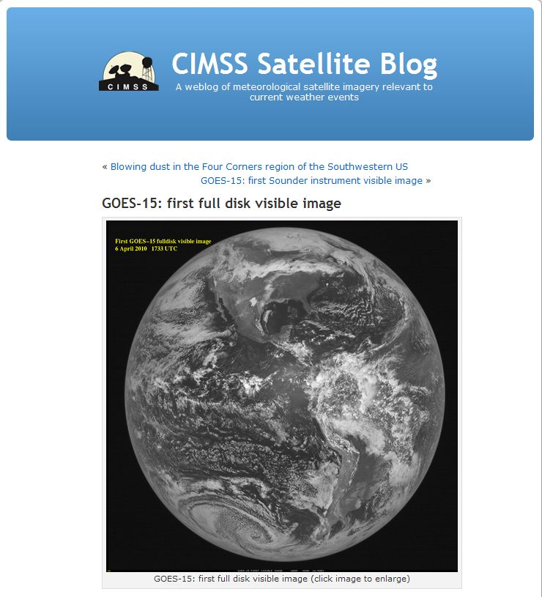
GOES-15 CIMSS Satellite Blog
http://cimss.ssec.wisc.edu/goes/blog/archives/5005

Slide 8
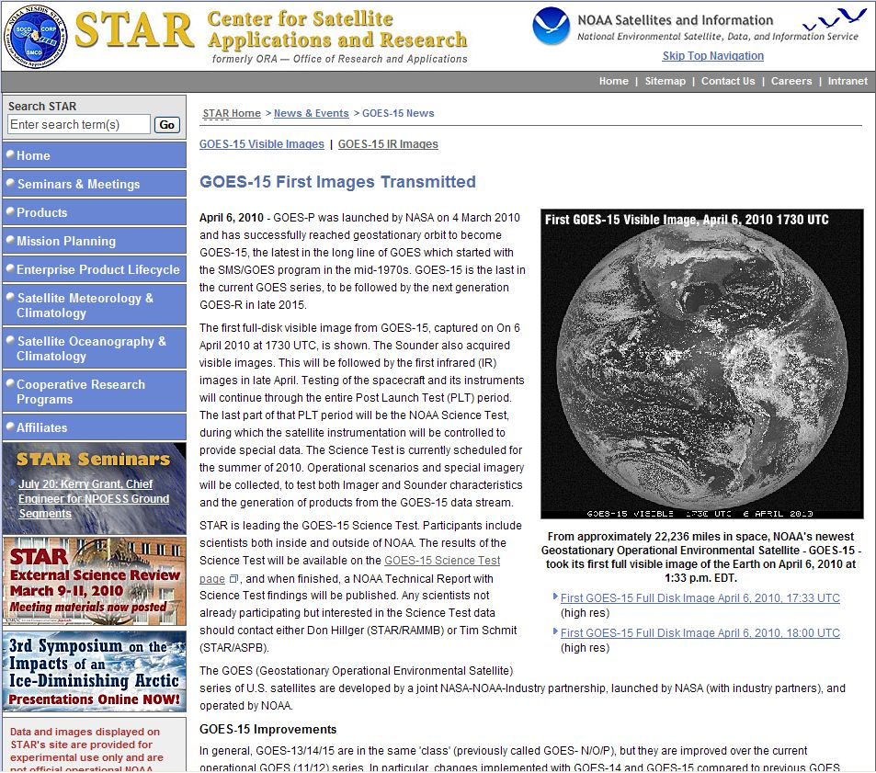
GOES-15 publicity from NESDIS/STAR
http://www.star.nesdis.noaa.gov/star/news2010_201004_GOES15.php

Slide 9
GOES-P/15 baseline plan – 2010 June
Upcoming significant events (subject to revision):
2010-06-30 Stray Light Correction Algorithm ITT Technical Review with NOAA
2010-07-14 GOES-15 yaw flip #2 to upright
2010-07-28 GOES-15 NSSK #2
2010-08-01 GOES-15 thruster flushing
2010-08-11 GOES-15 Science Testing Starts for 5 weeks
2010-08-25 GOES-P Operational Acceptance Review and Final MSR
2010-09-15 Stray Light Correction Algorithm Preliminary Design Review by ITT

Slide 10
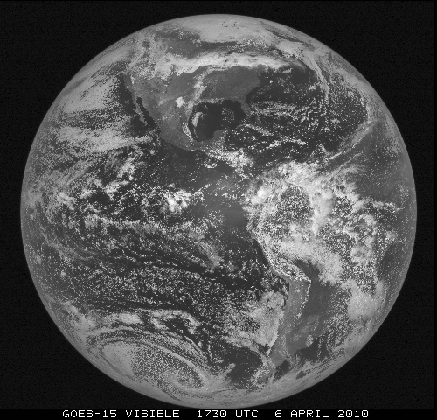
First GOES-15 Visible Image 1730 UTC – 6 April 2010

Slide 11
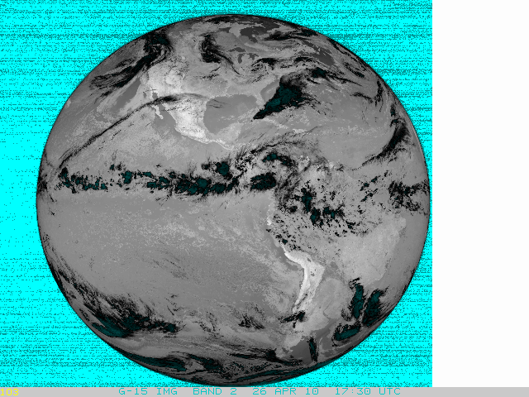
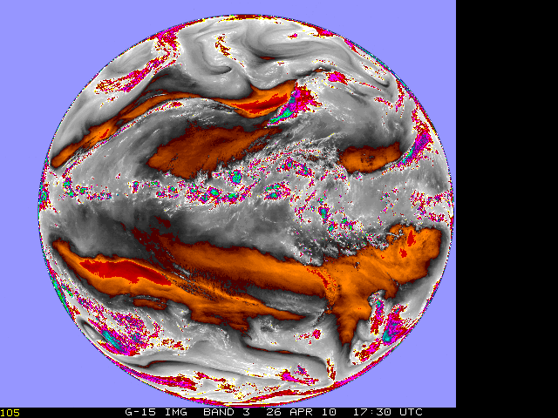
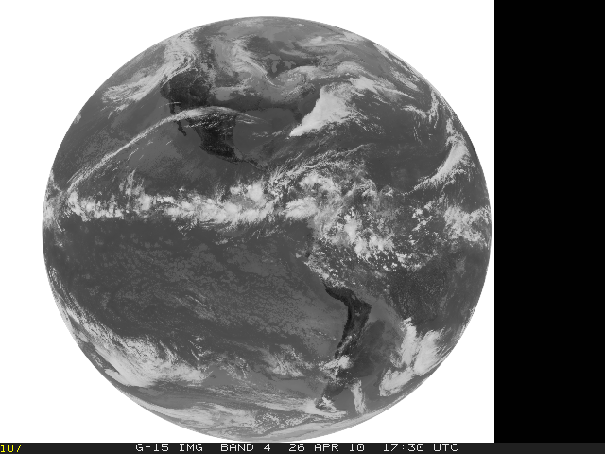
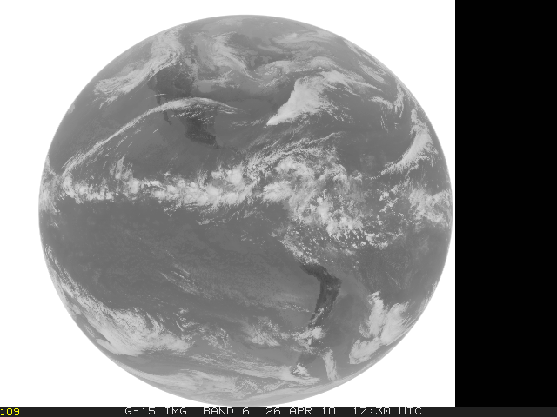
First GOES-15 IR Images 1730 UTC – 26 April 2010

Slide 12
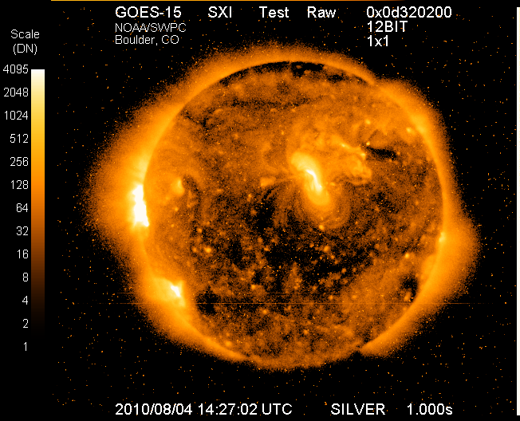
First GOES-15 Solar X-ray Image 1427 UTC – 4 August 2010 (Just in!)
The NOAA Science Test does not involve the solar instrumentation.

Slide 13
GOES-15 Science Test: 11 August – 15 September 2010
Five (5) weeks:
Starting: 11 August 2010
Ending: 15 September 2010
Eight (8) pre-determined schedules (See http://rammb.cira.colostate.edu/projects/goes-p/#schedules
Daily schedule changes (at 1630 UTC), determined by test coordinators, based on feedback from participating scientists
GOES-15 will be located at 89.5°W, not 105°W, during the Science Test
Afterwards, GOES-15 will likely be used before GOES-14, because of the SXI capabilities.

Slide 14
GOES-P/15 Test Schedules
Test Schedule | Imager | Sounder | Purpose
C5RTN | Emulation of GOES-East routine operations | Emulation of GOES-East routine operations | Radiance and product comparisons
C4RTN | Emulation of GOES-West routine operations | Emulation of GOES-West routine operations | Radiance and product comparisons
C1CON | Continuous 5-minute CONUS sector | 26-minute CONUS sector every 30 minutes | Test navigation, ABI-like (temporal) CONUS scans
C2SRSO | Continuous 1-minute rapid-scan (with center point specified for storm analysis) | 26-minute sector every 30 minutes (with center point same as Imager) | Test navigation, ABI-like (temporal) mesoscale scans
C3SRSO | Continuous 30-second rapid-scan (with center point specified for storm analysis) | 26-minute sector every 30 minutes (with center same as Imager) | To coordinate with lightning mapping arrays in Huntsville AL, Norman OK, or Washington DC
C6FD | Continuous 30-minute Full Disk (including off-earth limb/space view measurements) | Alternating east and west limb/space views every hour | Noise, detector-to-detector striping, fires, etc.
C7MOON | Capture moon off edge of earth (when possible) | Emulation of GOES-East routine operations | Test ABI lunar calibration concepts
C8HUR | Continuous 5-minute CONUS-size sector over the Atlantic, centered at ?? | Emulation of GOES-East routine operations? | For hurricane field experiments (NASA GRIP and NSF PREDICT)

Slide 15
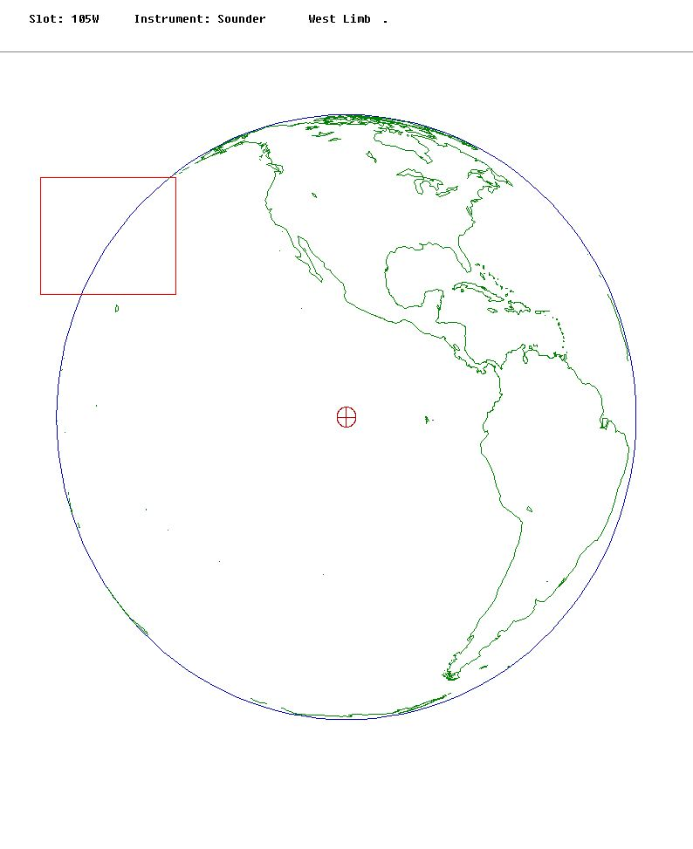
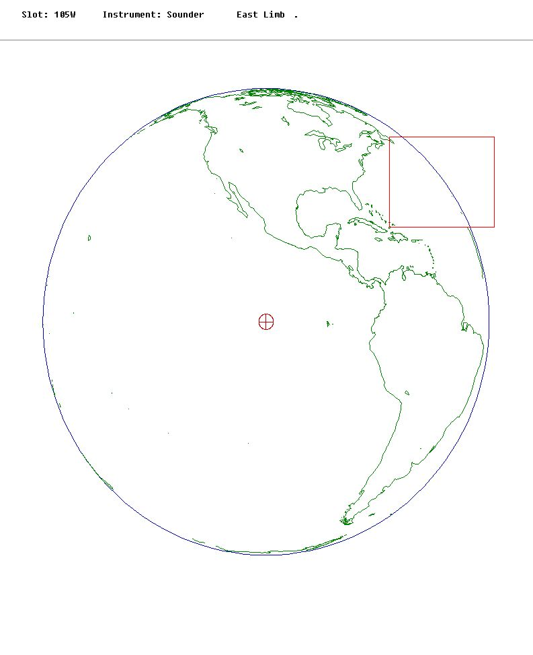
30-minute Limb Sounding (for noise/striping)

Slide 16
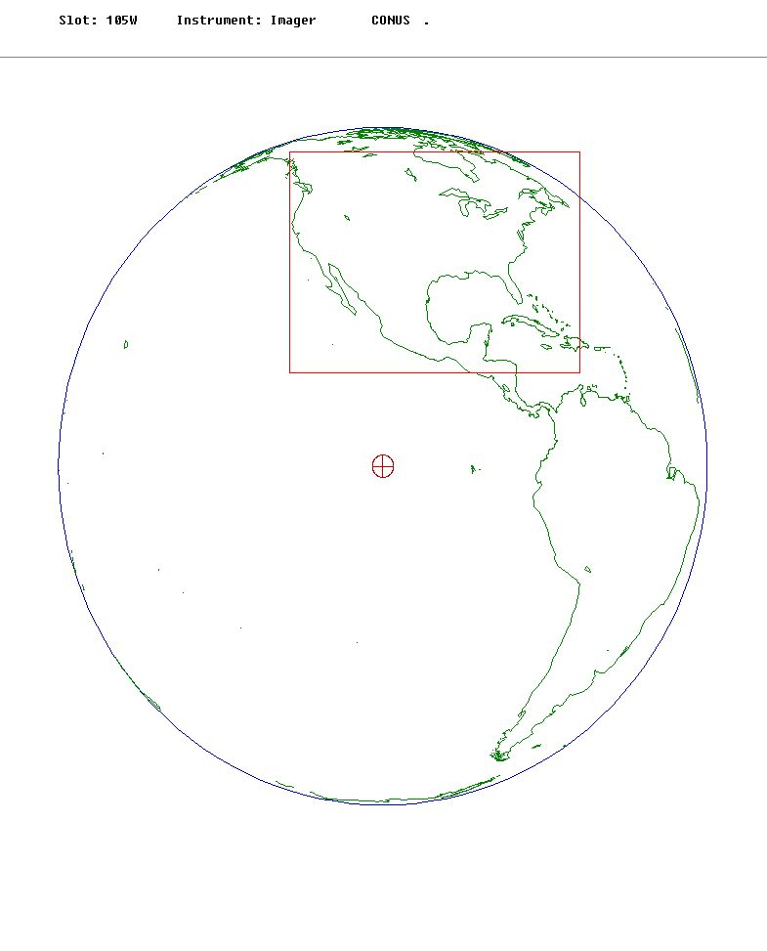
5-minute CONUS Imager (ABI-like product generation)

Slide 17
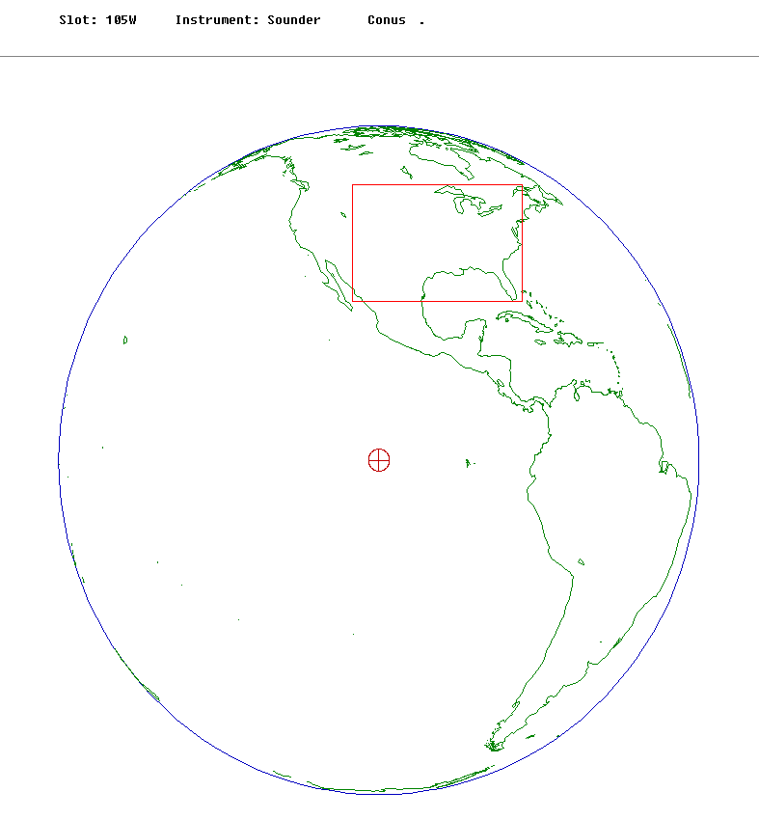
30-minute CONUS Sounding (product generation)

Slide 18
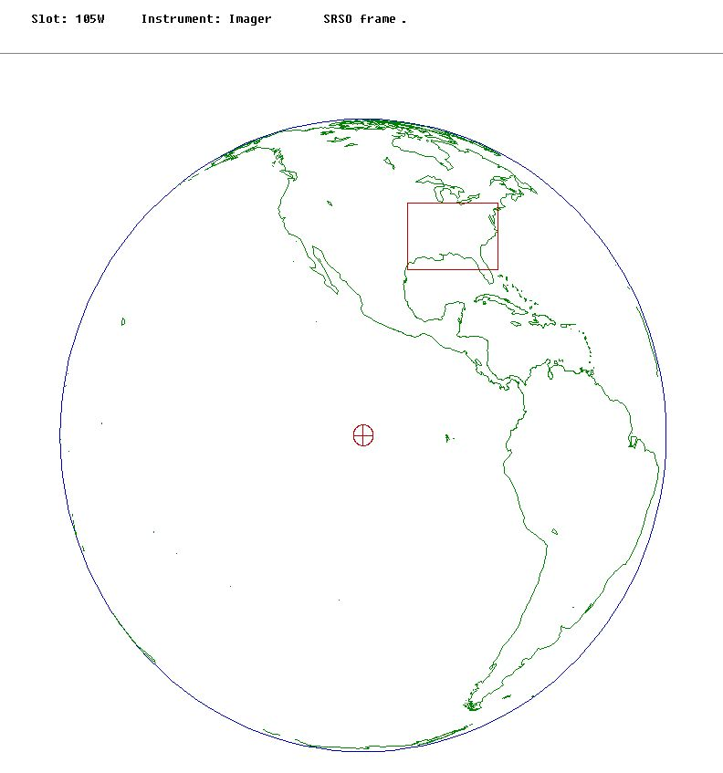
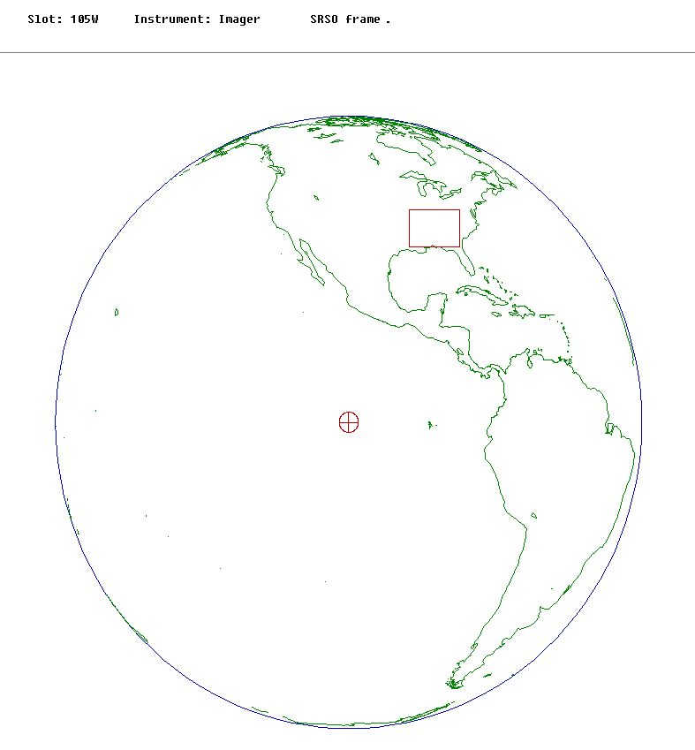
Imager rapid-scan (lightning/radar)
Example of center location over Huntsville AL
1-minute interval
30-second interval

Slide 19
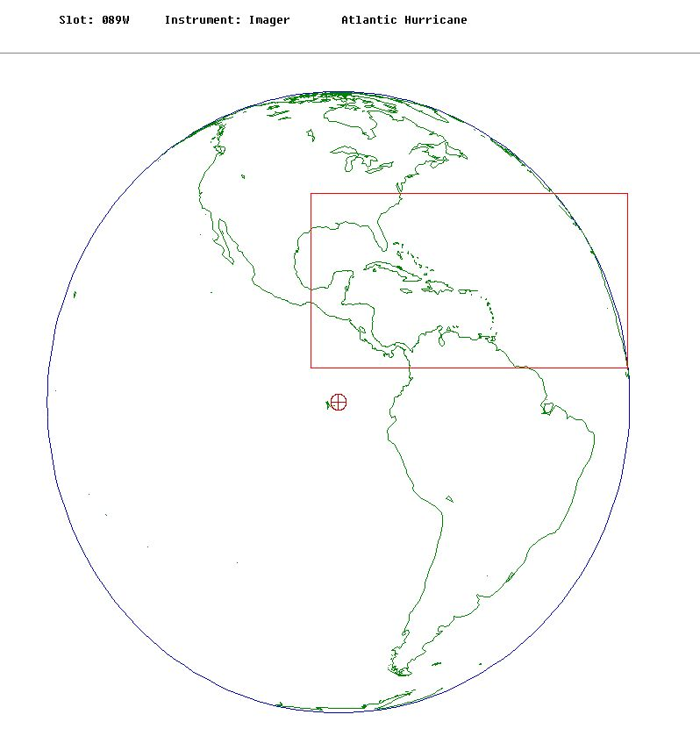
5-minute CONUS-size hurricane sector over Atlantic Ocean

Slide 20
GOES-15 Coordination/Timing
Event | Time (UTC) | Time (EDT) Washington DC | Time (CDT) Wisconsin/CIMSS Huntsville/NASA | Time (MDT) Colorado/CIRA
Coordinators send schedule requests (1 h 30 min before schedule start) | 1500 UTC | 1100 EDT | 1000 CDT | 0900 MDT
Primary coordinators request daily schedule (1 h before start) | 1530 UTC | 1130 EDT | 1030 CDT | 0930 MDT
Start of new daily schedule (specified by operations) | 1630 UTC | 1230 EDT | 1130 CDT | 1030 MDT

Slide 21
Participating Sites
Site | Primary Coordinators | Other Coordinators
RAMMB/CIRA/Colorado | Don Hillger | Dan Lindsey, John Knaff (including hurricane input)
ASPB/CIMSS/Wisconsin | Tim Schmit | Gary Wade, Scott Bachmeier
NASA/MSFC/Huntsville (mainly for rapid-scan imagery, coordination with radar/lightning mapping arrays) |  | Walt Petersen
OSDPD (mainly for operational imagery testing, products into AWIPS) |  | Lou Cambardella

Slide 22
GOES-15 Science Test Preliminary Results
First official GOES-15 images were collected from Imager (visible and IR) and Sounder
Improved (4 km) resolution of 13.3 µm band required changes to GVAR format (starting with GOES-14).
Several issues with GOES-15 data:
An issue with the first “official” Sounder images not being received correctly at CIMSS and CIRA.
Excessive striping in Sounder band-15.
Stray light testing continuing thru Science Test.

Slide 23
GOES-15 Science Test
Questions? (Don.Hillger@NOAA.gov)
One-stop GOES-15 Science Test shopping: http://rammb.cira.colostate.edu/projects/goes-p/

