Slide 1
Overview of Tropical Cyclone Research and Development at CIRA/RAMMB
Presented by
John Knaff, NOAA/NESDIS
Contributions from
Mark DeMaria, Robert DeMaria, Kevin Micke, Greg DeMaria, Jack Dostalek, and Andrea Schumacher

Slide 2
Current Sponsored Projects
GOES- R Risk Reduction/ Algorithm Working Group (GOES-R3/AWG)
GOES-R Proving Ground
GOES I/M Product Assurance Plan (GIMPAP)
Joint Hurricane Testbed (JHT)
Product System Development and. Implementation (PSDI)
Navy’s National Oceanographic Partnership Program (NOPP)
NOAA’s Hurricane Forecast Improvement Project (HFIP)

Slide 3
What We Do
Research Operational Products (R2O)
Satellite Risk Reduction
Applied Science

Slide 4
R2O Examples
TC formation product
TC surface wind analysis
TC intensity forecasting
TC wind-pressure relationships
TC intensity estimation (AMSU)
TC structure estimation

Slide 5
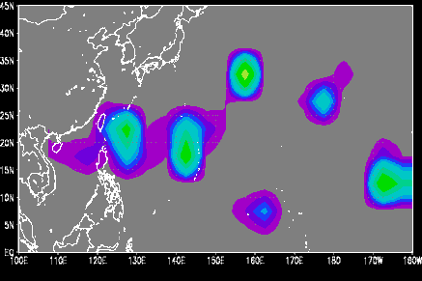
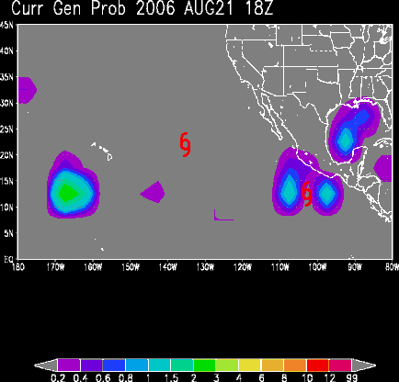
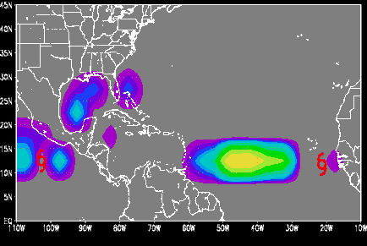
Tropical Cyclone Formation Probability Product
Product Description
Northern Hemisphere Domain
Estimates the 24-hr probability of TC formation within 5x5 grid boxes
Uses predictors from these sources
Environmental (GFS analyses and ATCF TC positions)
Convective (geostationary satellite water vapor imagery)
Displays
TC formation probability (top right)
Climatological probability of formation
Predictor values
Cumulative/average sub-basin values
http://www.ssd.noaa.gov/PS/TROP/TCFP/index.html
Current Predictors
Climatology
Latitude
Distance to existing TC
Climatological SST (Levitus)
Land coverage
850-hPa Circulation
850-200 hPa Vertical Shear
Vertical Instability
850-hPa Horiz. Divergence
Cold Cloud Coverage
Average Brightness Temp

Slide 6
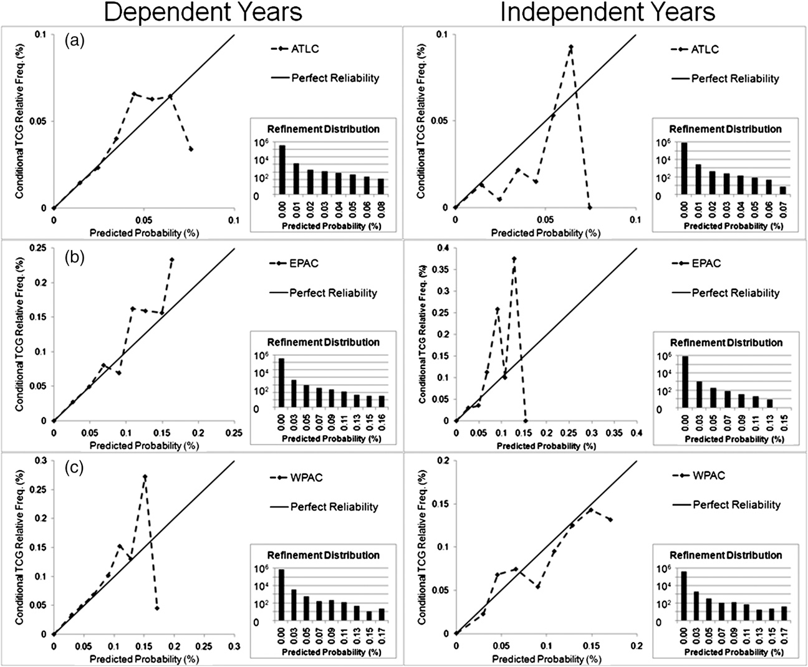
Schumacher et al. (2009)

Slide 7
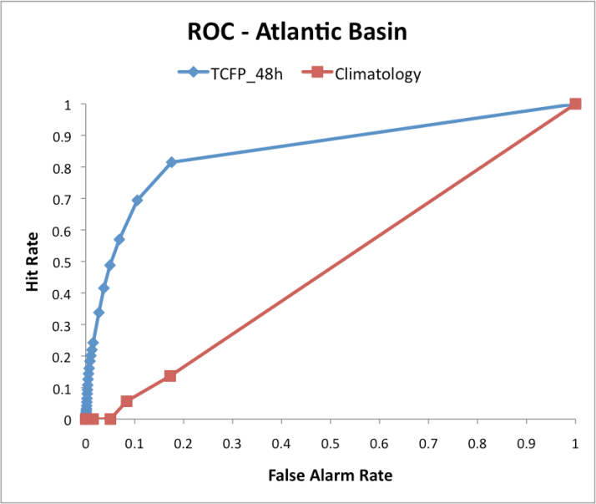
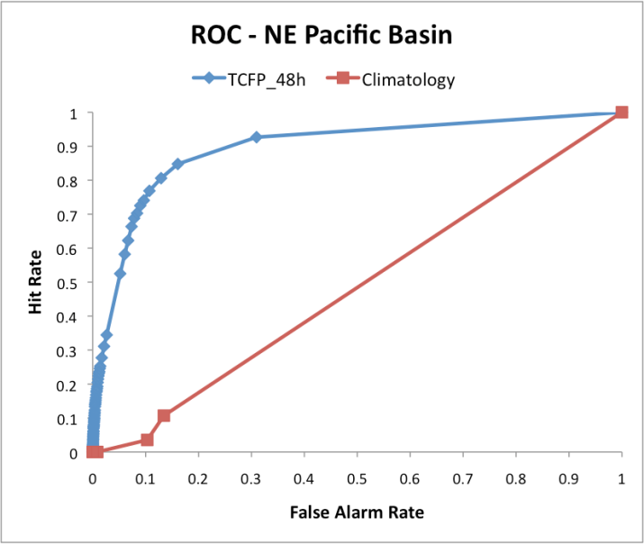
Future Plans
This algorithm is being
Expanded to include the Indian Ocean and Southern Hemisphere
Extended to 48-hours
Preliminary study suggests current algorithm will possess forecast skill when extended to 48 hours
Basin | Brier Skill Score* | ROC Skill Score*
N Atl | 0.016 | 0.52
NE Pac | 0.039 | 0.60
NW Pac | 0.024 | 0.65
N IO | 0.030 | 0.51
S Hem | 0.025 | 0.46
*Climatology is reference forecast for skill scores

Slide 8
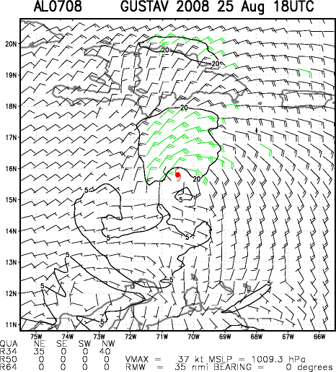
Multi-platform Tropical Cyclone -Surface Wind Analysis (MTCSWA)
Product Description
Six-hourly Analyses ( life cycle of Hurricane Gustav
Global Product
6-hourly provided to JTWC and NHC via ATCF
Being transitioned to/running at NESDIS
Produced at CIRA (Parallel)
Input Data
Scatterometry
A-Scat
QuikSCAT (died Nov 2009)
Cloud/Feature Drift Winds
JMA via NRL & NESDIS
AMSU 2-D Winds (Bessho et al. 2006)
NCEP
IR Flight-Level Proxy Winds (Mueller et al. 2006)
http://www.ssd.noaa.gov/PS/TROP/mtcswa.html
Past/real-time cases available at http://rammb.cira.colostate.edu/products/tc_realtime/

Slide 9
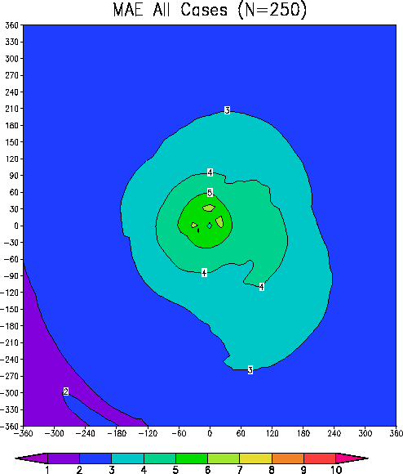
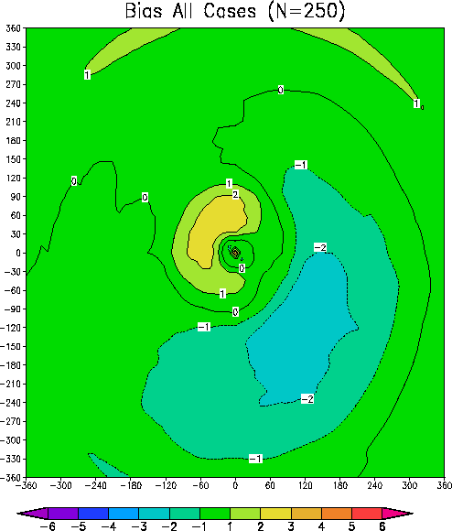
MTC-SWA vs. H*Wind Analyses (2008-2009)

Slide 10
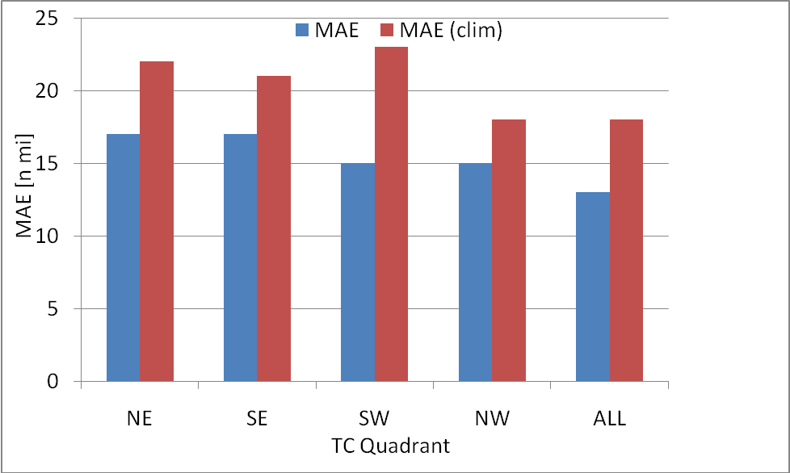
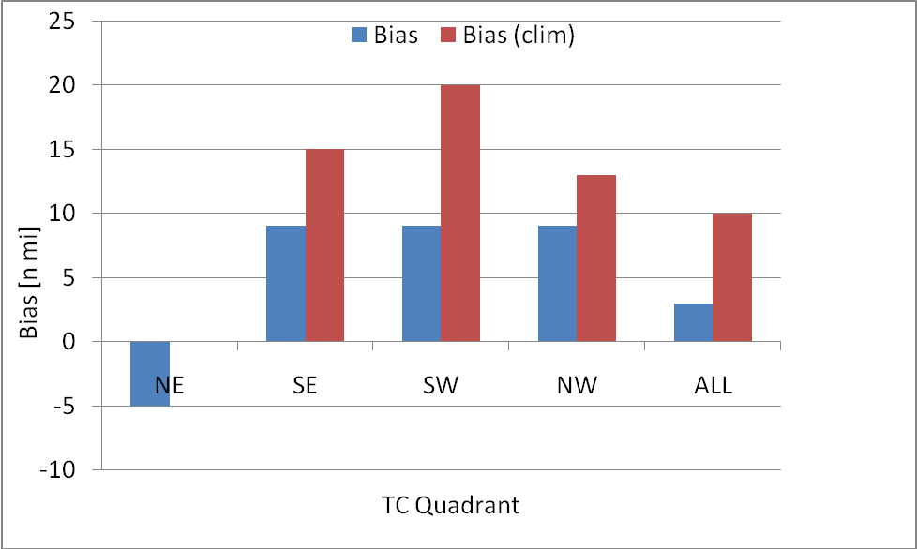
Wind Radii Estimates
64-kt wind radii
Wind radii estimates (34-,50-, 64-kt) are shown to outperform climatology (Knaff et al. 2007) for a two-year sample
Generally lower MAE
Generally smaller biases
Larger variance explained
64-kt wind radii

Slide 11
Statistical Intensity Forecast Models SHIPS, STIPS, LGEM, RII
Statistical Hurricane Intensity Prediction Scheme (SHIPS) – NE Pacific and Atlantic Basins
Statistical Typhoon Intensity Prediction Scheme (STIPS) – S. Hemisphere, NW Pacific, N. Indian Basins
Logistic Growth Equation (LGEM) –Atlantic & NE Pacific
New proposal to the National Ocean Partnership Program to
Develop LGEM for the NW Pacific
Parameterize the TC Maximum Potential Intensity as a function of Oceanic Heat Content in all basins.
Rapid Intensification Index – Atlantic & NE Pacific (2010)
New JHT Project to incorporate
Total Precipitable Water (NESDIS/CIRA , AMOL, MRLMRY)
Ocean Heat Content (NE Pacific)
Improved parameterization of Ocean cooling (AOML)
Improved IR-predictors (RAMMB/CIRA)
NEW GOES-R project to incorporate lightning & microwave imagery information
New GIMPAP studies on Rapid Weakening and Extra-Tropical Transitions

Slide 12
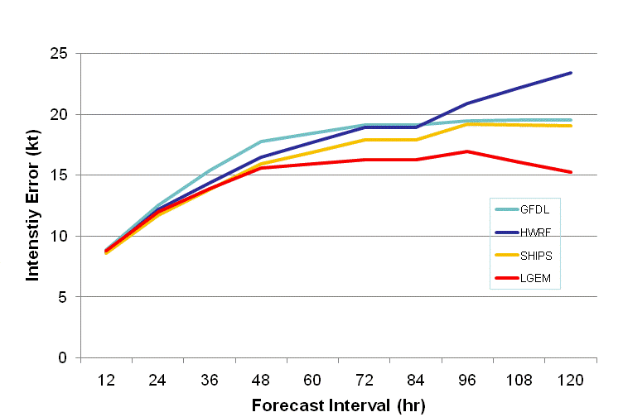
NHC Operational Model Intensity Forecast Errors 2007-2009

Slide 13
Risk Reduction Examples
Development and Use of Proxy Datasets
Simulated ABI
Lightning Proxies
GOES-R Proving Ground Demonstration
Dvorak Intensity Estimation Sensitivity to image resolution

Slide 14
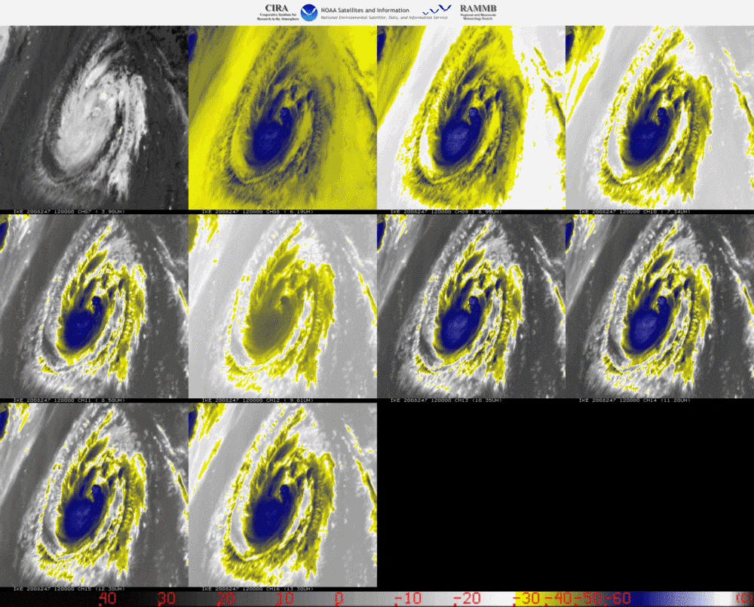
Hurricane IKE
3 September 2008 12 UTC
Through
4 September 2008 00 UTC
Proxy for 10 of 16 ABI Channels
Notes:
Loop of 10 MSG-based ABI channels. The scene shows a period of intensification associated with Hurricane Ike late on 3 September 2008.
We have 11 cases with similar proxy data available (2006-2009)

Slide 15
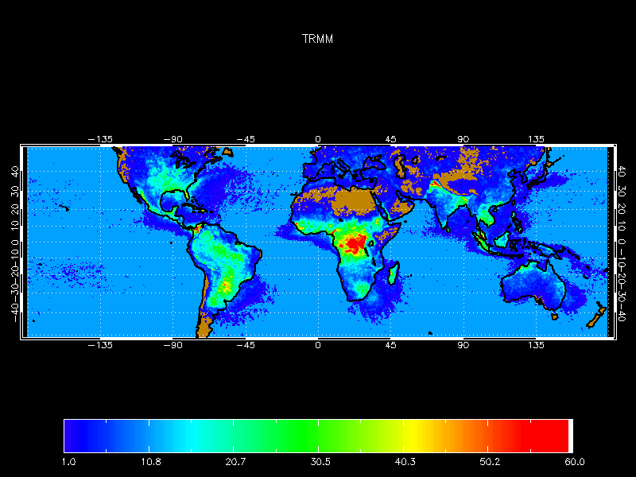
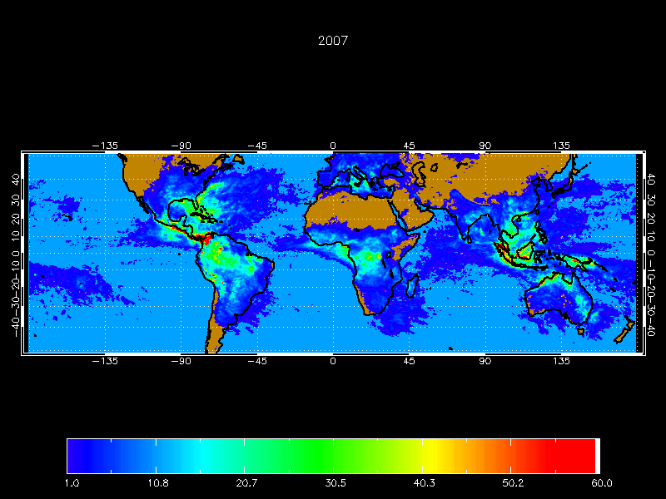
GOES Lightning Mapper Proxy
World Wide Lightning Location Network (WWLLN) provides nearly global lightning data
Low detection rate
Use only reprocessed data with new UW algorithm
2005-2009
Calibrated by making annual lightning density match that from the TRMM annual climatology (LIS/OTD)
Working with Vaisala GLD360 product for the GOES-R Proving Ground demonstration at NHC, Summer 2010
LIS/OTD
WWLLN - Adjusted

Slide 16
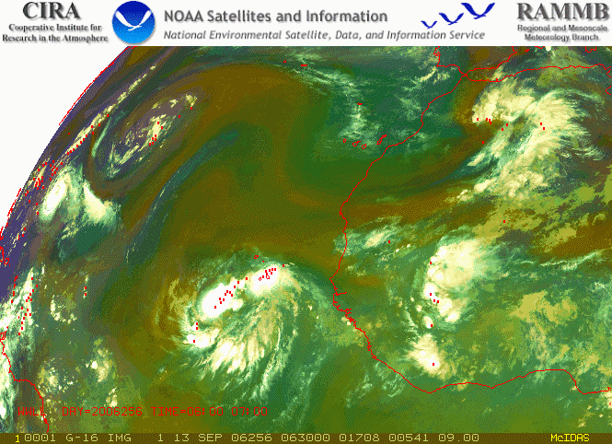
RGB Air Mass Product with Lightning
Notes:
This is an example of the ABI-based AIR MASS product again patterned after similar products available from MSG. The green areas are tropical air masses characterized by low ozone levels, the red colors are associated with dryer regions and the blue colors indicate the temperature associated with the air.
This ABI – based product is created by
Red – shows the difference between Channel 8 (6.2um) and Channel 10 (7.3um) scaled from -29C to -4C
Green – shows the difference between channel 11 (9.7um) and channel 15 (12.2um)
Blue – is the channel 8 scaled from 243 K to 208 K
Hourly lightning from WWLLN is show in red.

Slide 17
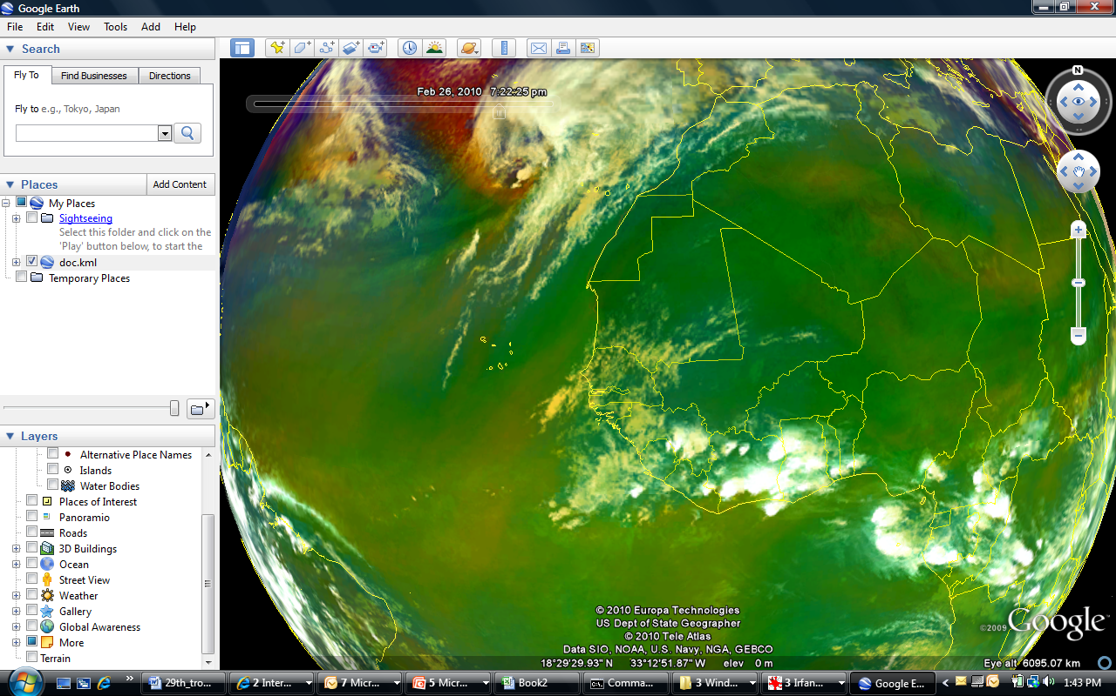
Imagery in Google Earth, GOES-R Proving Ground Demo at NHC: RGB Air Mass, RGB Dust, SAL

Slide 18
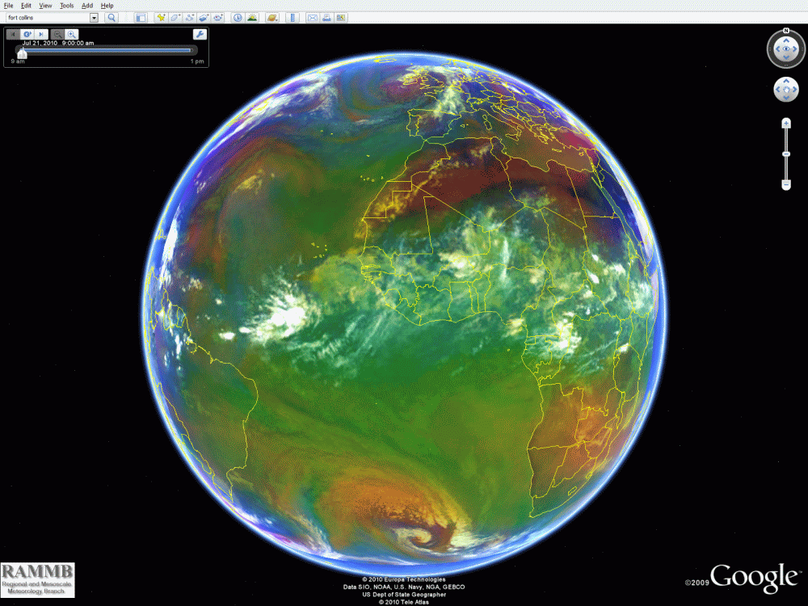

Slide 19
Applied Science Applications
Tropical Cyclone (TC) Wind Probabilities
TC pressure-wind relationships
Using ocean heat content to predict TC intensity changes
Diagnosis/forecasting of Annular Hurricanes
Logistic growth equation for TC intensity forecasting (Multiple TC basins)
Exploring the utility of total precipitable water (TPW) data to improve TC analysis/forecasting
Ensemble intensity forecast methods/improvements
Calibration/Validation of the Dvorak TC Intensity Estimation Technique
Exploring the utility of lightning data to improve TC analysis/forecasting
Tools to anticipate non-landfalling rapid TC weakening

Slide 20
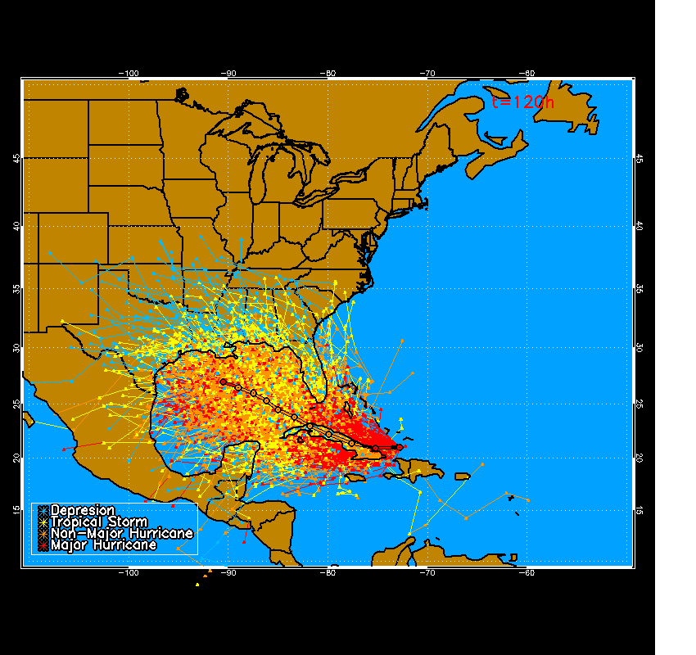
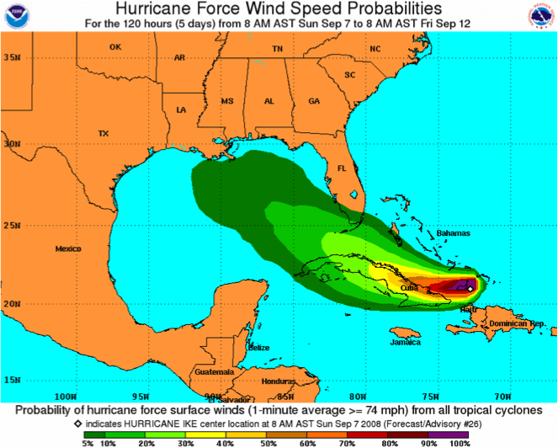
The Monte Carlo Wind Speed Probability Model
Hurricane Ike 7 Sep 2008 12Z
Methodology
Samples errors from NHC track and intensity forecasts over last 5 years to generate 1,000 forecast realizations
Wind radii of realizations from radii CLIPER model
Calculates probabilities over domain from realizations
Versions for Atlantic, NE and NW Pacific
Current products
Cumulative and incremental probabilities
34, 50 and 64 kt winds
0, 12, …, 120 hr
Text and graphical products
Distributed via NHC web page, NDFD, AWIPS
64 kt 0-120 h cumulative probs

Slide 21
Tropical Cyclone Wind Probabilities
Recent Improvements
Utilizations
Use the model ensemble track spread to modify the error distributions
Use the NOAA Hurricane Forecast Improvement Program’s multi-model ensemble tracks to drive the track uncertainty
Objective TC watches & warnings
DOD TC conditions of readiness
NHC watches and warnings
Landfall timing/intensity
Sensitivity studies related to track and intensity improvements

Slide 22
Estimated Impact of HFIP Forecast Goals on Hurricane Warnings
HFIP goals: Reduce track/intensity errors by 20% in 5 yr and 50% in 10 yr
NHC wind probability model provides link between errors and hurricane warnings
Artificially reduce forecast errors from 2004-2008 seasons
20 U.S. landfalls with warnings
Calculate reductions is hurricane warning size
Ballpark cost of warning
$600,000 per mile
Caption: Estimated reduction in hurricane
warning size and cost savings per storm if
HFIP forecast goals are met

Slide 23
Calibrating Subjective Dvorak Intensity Estimates (1989-2008)
How accurate is the subjective technique?
Are there systematic biases?
Are estimates from various agencies systematically different?
Can the estimates be better calibrated using conditional information?

Slide 24
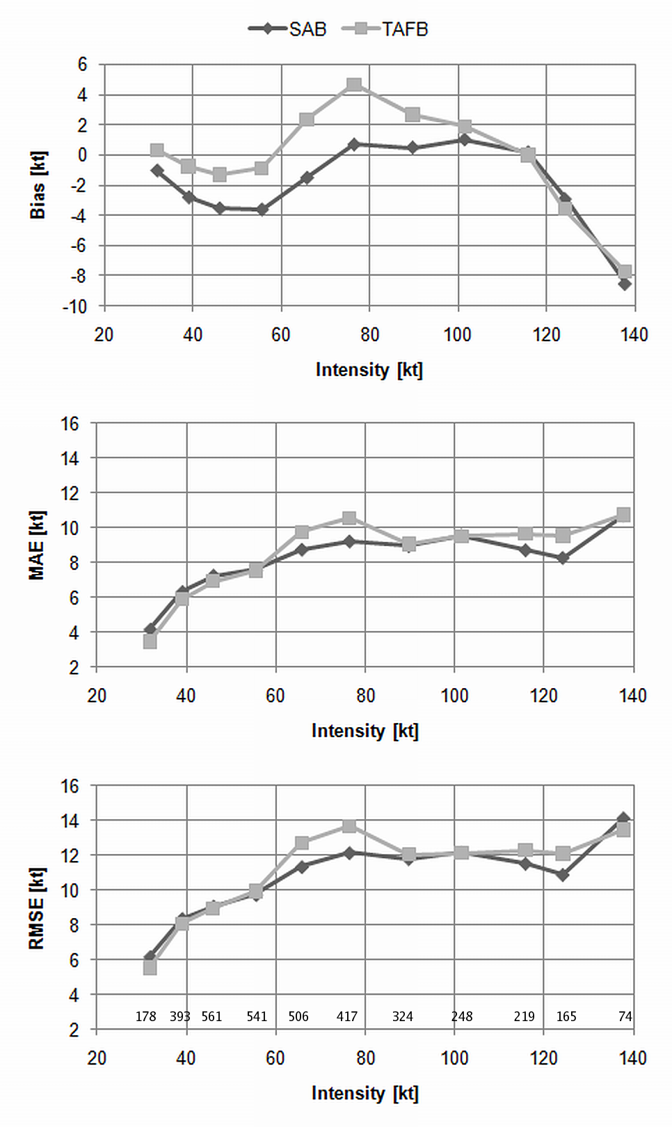
Errors and Biases (1989-2008)
Low biases 35-55 kt, and above 125 kt
High biases 75- 90 kt
Best performance 90 -125 kt

Slide 25
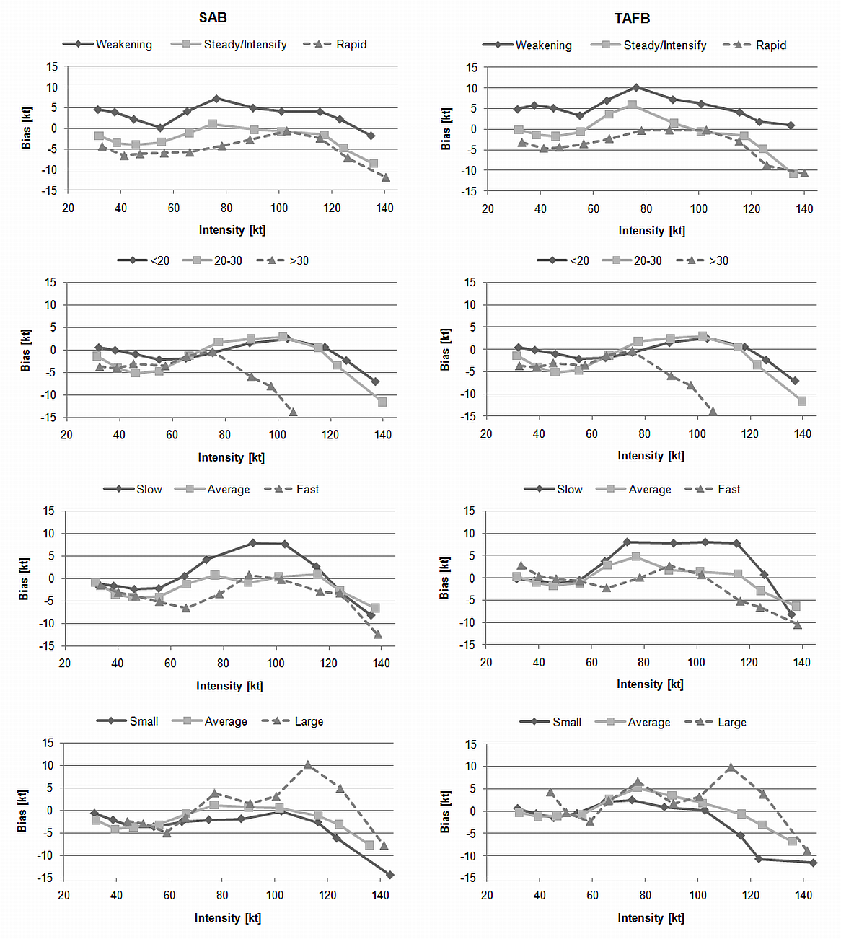
Key Findings
The Dvorak Tech. has relatively small errors and biases, but…..
Biases are related to
Intensity
Translation speed
Intensification trend
Size
Latitude
These biases are correctable using routinely available information

Slide 26
Lightning & TC Intensification
Eyewall Lightning (negative)
Rainband Lightning (positive)
Observed near/at peak intensity
Occurs in strongly sheared situations
Increases prior to/during intensification

Slide 27
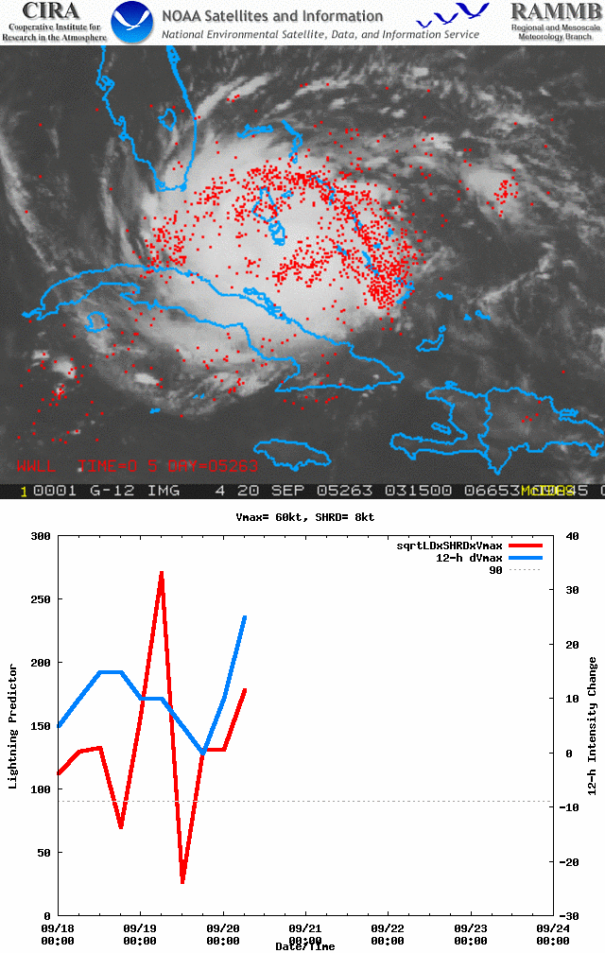
Visual Example
Notes
Most widespread lightning is early in the storm development
Peak lightning in the eyewall is also near/coincident with peak intensity
12-h intensity change (blue) is inversely related to our lightning predictor (red)

Slide 28
Lightning Improvements in SHIPS Dependent (2005-2009)

Slide 29
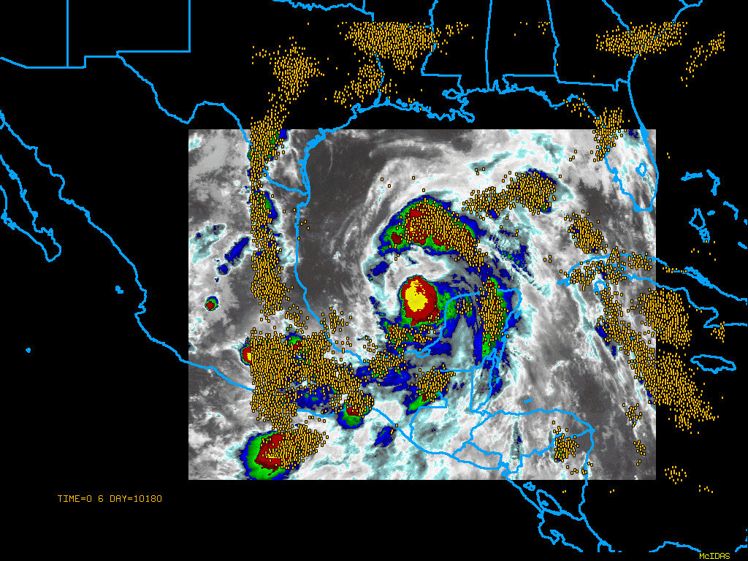
6 hour Lightning Strikes -- Hurricane Alex 29-30 June 2010

Slide 30
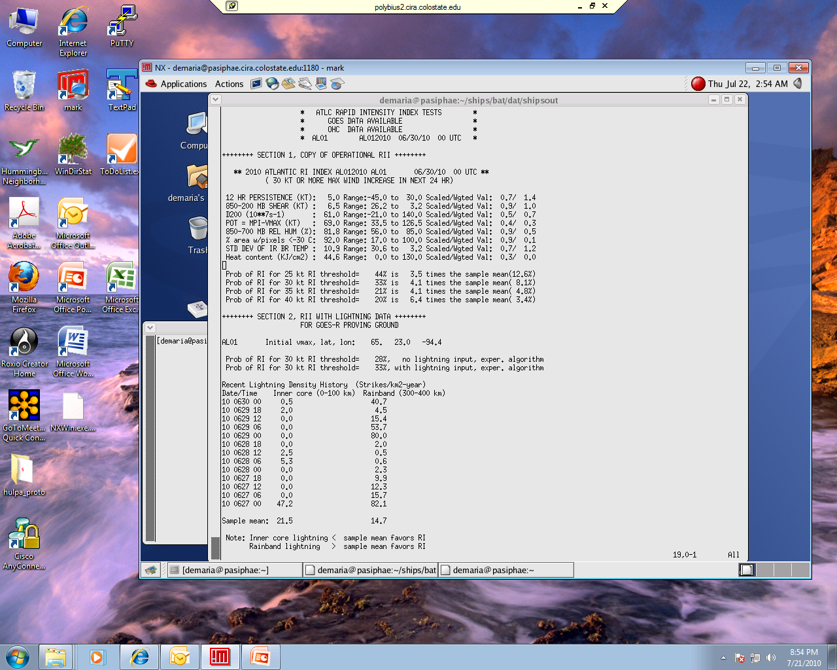
Sample Text Output
Lightning-Based Rapid
Intensity Forecast Algorithm
For the GOES-R Proving
Ground Demonstration
NHC, Summer 2010
Hurricane Alex
30 June 2010 00 UTC

Slide 31
Anticipating Rapid Weakening
Five Factors
Interpretation
12-intensity change (persistence)
Storm & Direction Relative IR Principle Component #4 (8.4%) – warm central feature/symmetric ring structure.
Potential intensity (empirical on SST along TC track)
850 to 500-hPa wind shear
200-hPa Northerly winds
Rapid weakening often involves the collapse of the existing eyewall complex in an environment characterized by decreasing intensification potential/SST, increasing vertical wind shear and occasionally strong northerly flow.

Slide 32
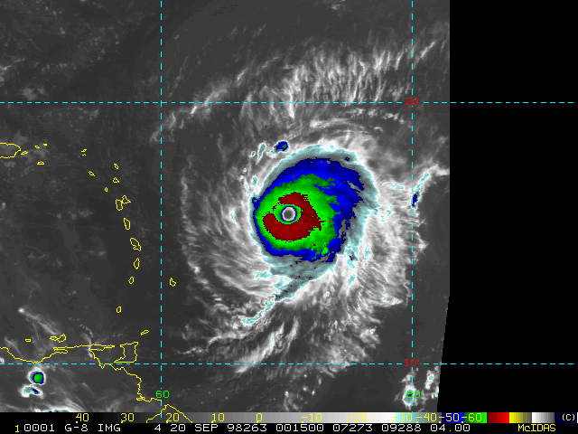
Examples: Hurricane Georges (1998)
Predictor | 9/20 00 UTC | 9/20 06 UTC
PER | 5 | -5
POT | 26 | 29
SHRS | 7.0 | 5.4
200hPa North | -7.6 | -13.3
IR PC 4 | 2.6 | 1.5
Discriminant | 2.2/ 21% | 2.4/ 23%
Positive factors
Negative factors

Slide 33
Summary
Three primary task:
Research Operational Products (R2O)
Satellite Risk Reduction
Applied Science
Supported Primarily by
GOES-R3/AWG
GIMPAP
JHT
PSDI
HFIP
Other (NOPP, ONR, NASA, etc.)

Slide 34
Questions?
Need more information?
Go to http://rammb.cira.colostate.edu/

