Slide 1
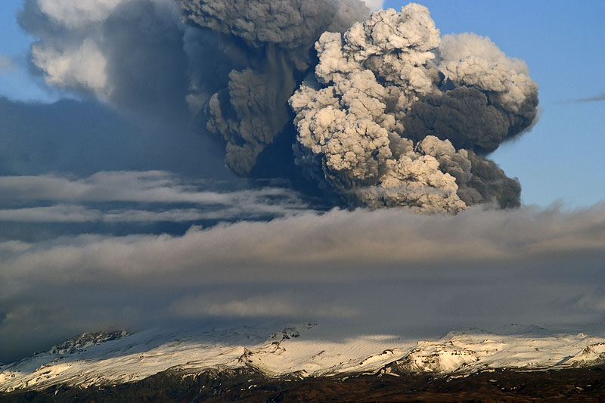
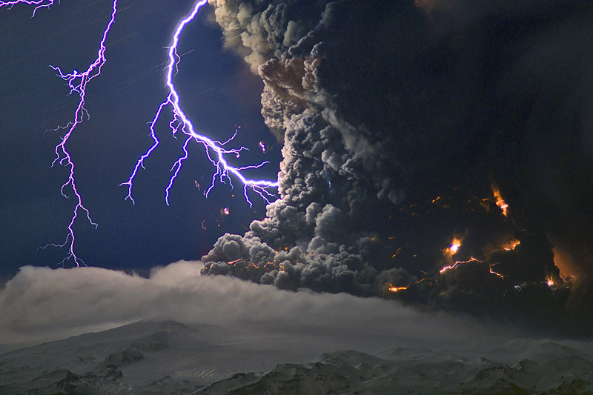
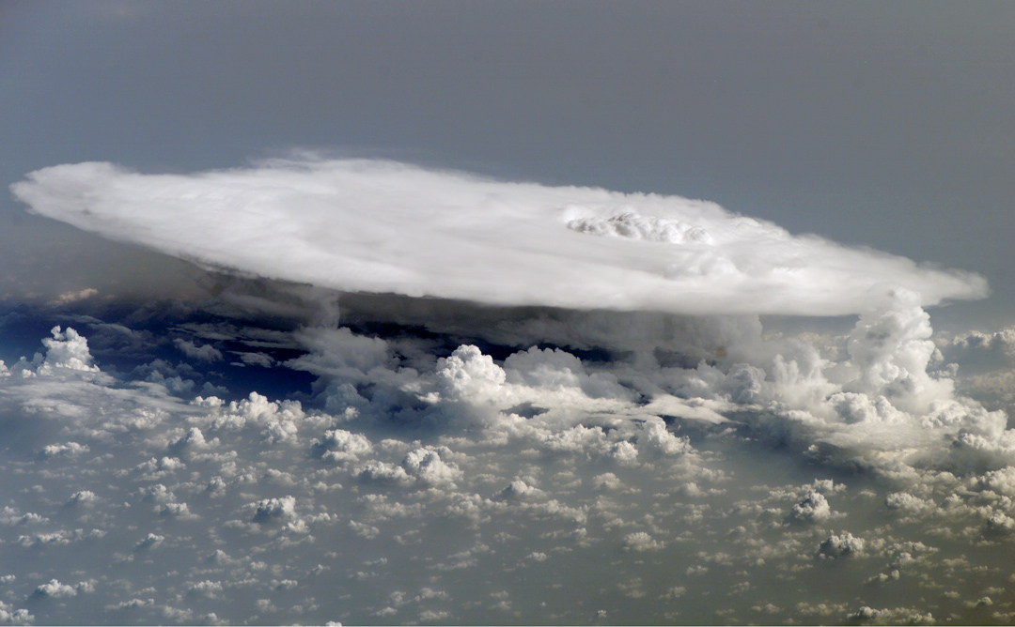
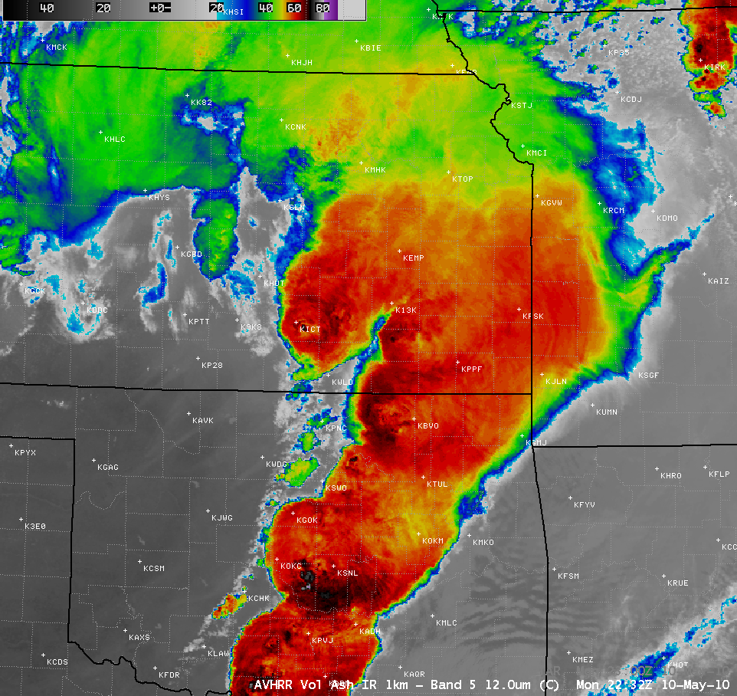



The Evolution of Convective Cloud Properties: Meteorological vs. Volcanically Driven Convection
Marco Fulle - www.stromboli.net
Michael Pavolonis
(NOAA/NESDIS/STAR)
Justin Sieglaff
(CIMSS)
Notes:
Aya (day)-fee-ought-lie-urkell
-I would like to talk about a relatively unknown phenomena, volcanic convection (and I will explain what I mean by volcanic convection on the next slide) and how a few of it’s satellite observed physical characteristics compare to commonly observed meteorologically forced convection.

Slide 2
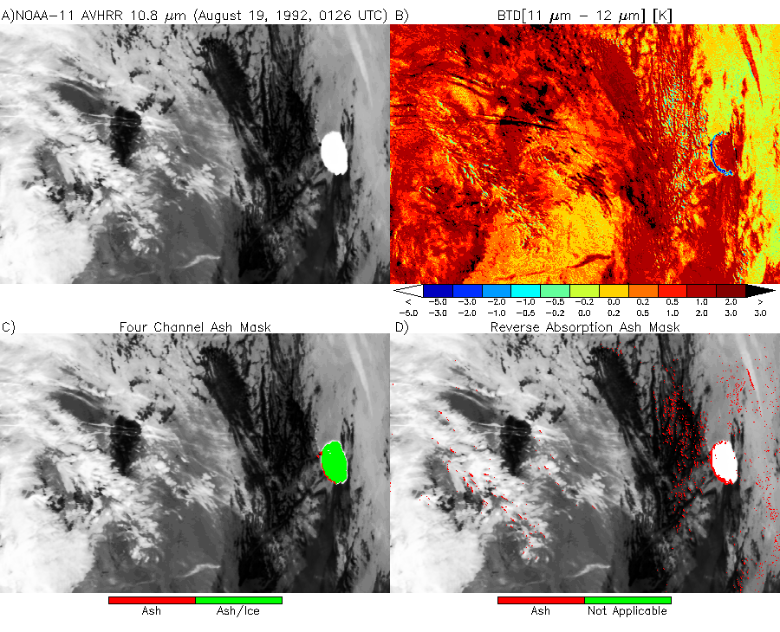
Volcanic Convection
Volcanoes may contain large reservoirs of water
As such, soon after an eruption many volcanic clouds are “ice topped” or contain a mixture of ice and ash, which masks the spectral signatures used to detect ash
Volcanic ash is a huge threat to aircraft and the aviation industry has established the need for a 5-minute warning capability
In this talk, ice topped (sometimes mixed with ash) volcanic clouds are referred to as volcanic convection
Ice topped volcanic cloud
Pavolonis et al. (2006)

Slide 3
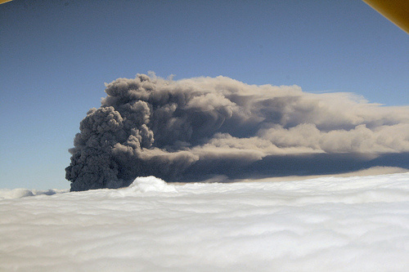
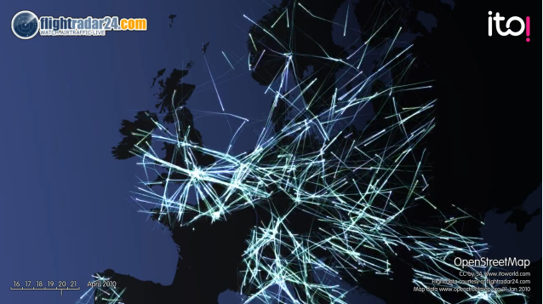

Why is Volcanic Ash Monitoring Important?
The Eyjafjallajökull Eruption:
Nearly 100,000 canceled flights
Airlines were losing $200 million/day
Total economic impact - $2 billion
Before Ash Event
During Ash Event
Notes:
A visual appreciation for the impacts on aviation in Europe.

Slide 4
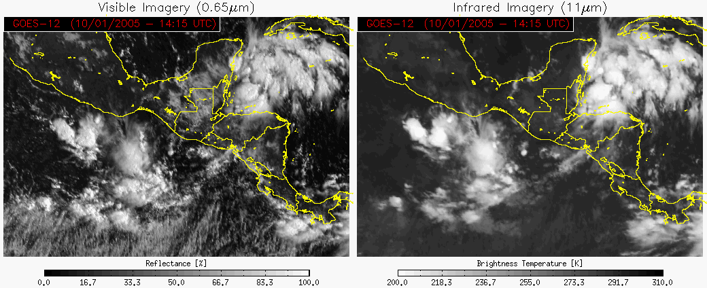
Which cloud is volcanic in nature?

Slide 5
Which cloud is volcanic in nature?
From the 1544 UTC VAAC message:
“REMARKS: WE HAVE RECEIVED A REPORT FROM NAVY AVIATION IN THE AREA INDICATING AN ERUPTION OF SANTA ANA TO FL460.”
From the 1601 UTC VAAC message:
“REMARKS: THE ERUPTION IS NOW BELIEVED TO HAVE STARTED AT ABOUT 1400Z AND AN AREA PREVIOUSLY THOUGHT TO BE THUNDERSTORMS IS NOW IDENTIFIED AS THICK ASH. A FORECAST WILL BE ISSUED AS SOON AS POSSIBLE”
Notes:
This case proves that there is a need for an automated and objective procedure for detecting volcanic convection.

Slide 6
Can Volcanic and Meteorological Convection Be Differentiated?
We have identified 3 relevant pieces of information:
    Temporal trend in cloud “top” temperature*
    Effective particle size
    Location of cloud relative to volcano
To exploit the above properties, we identify convective cloud objects and track them in time.
Notes:
A cloud object is simply a collection of spatially connected pixels that meet a certain criteria (in this case, cumuliform clouds).
*New research will be the focus of this talk.

Slide 7
The change in the minimum cloud object 11 μm brightness temperature over 30 minutes is much larger for the volcanic cloud than the other convective clouds in this scene.

Slide 8
While small ice crystals are not unique to volcanic Cb, most volcanic Cb are characterized by small ice crystals (e.g. Pavolonis et al., 2006).
Occasionally, a volcanic Cb will have an extreme small particle signature.
Not all meteorological Cb have small ice crystals.

Slide 9
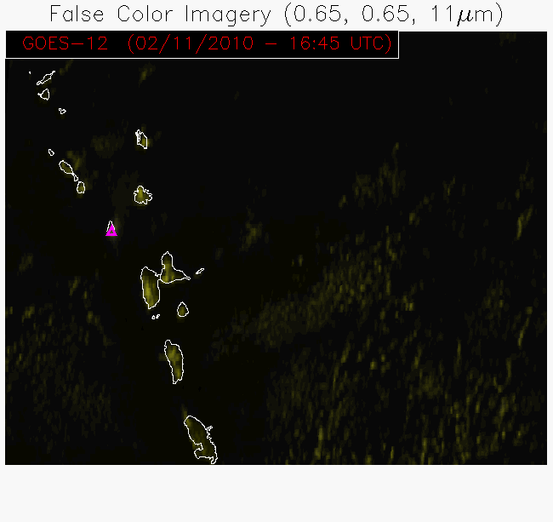

Slide 11
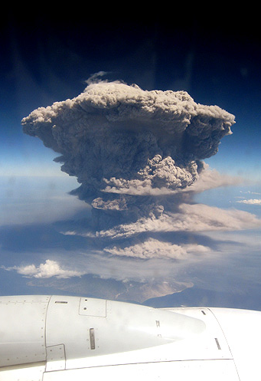
Notes:
Information on volcanic clouds needs to be conveyed to air traffic controllers and pilots ASAP using automated techniques.

Slide 12
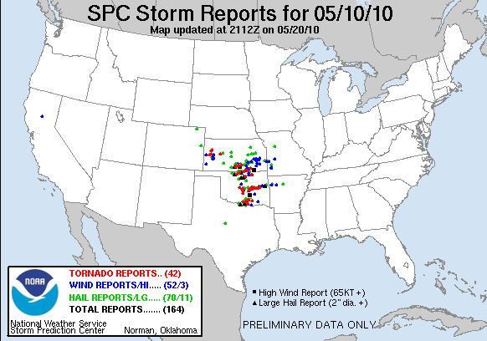
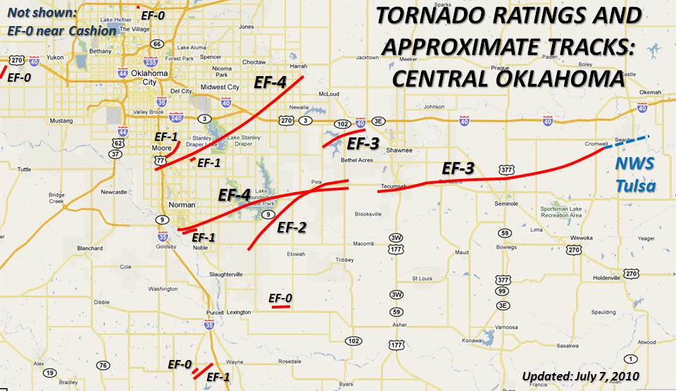
May 10, 2010 SGP Severe Weather Outbreak
EF-4 storm in northern Norman

Slide 13
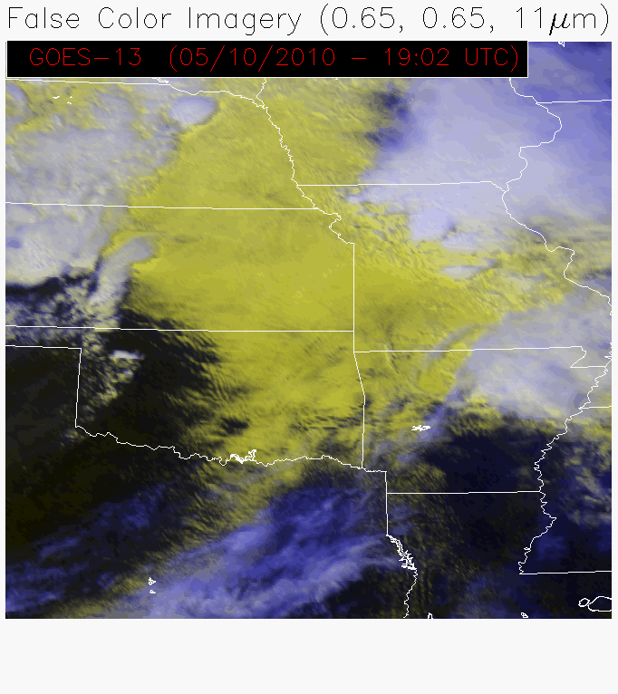

Slide 14
-8.35 K in 15 minutes

Slide 15
-20.46 K in 15 minutes

Slide 16
-29.46 K in 30 minutes

Slide 17
-2.35 K in 15 minutes

Slide 18
-1.74 K in 15 minutes

Slide 19
Even a supercell thunderstorm does not exhibit decreases in BT(11 μm) as large as those from relatively weak volcanic eruptions in a conditionally unstable environment (Santa Ana).

Slide 20
The combination of BT(11 μm) time trends, ice effective particle size, and volcano location can be used to detect volcanic convection.
Extreme 30 minute decreases are associated with volcanic convection events.

Slide 21
Redoubt, AK (March 23, 2009)

Slide 22
Automated Volcanic Convection Alerts Without Temporal Dependent Information

Slide 23
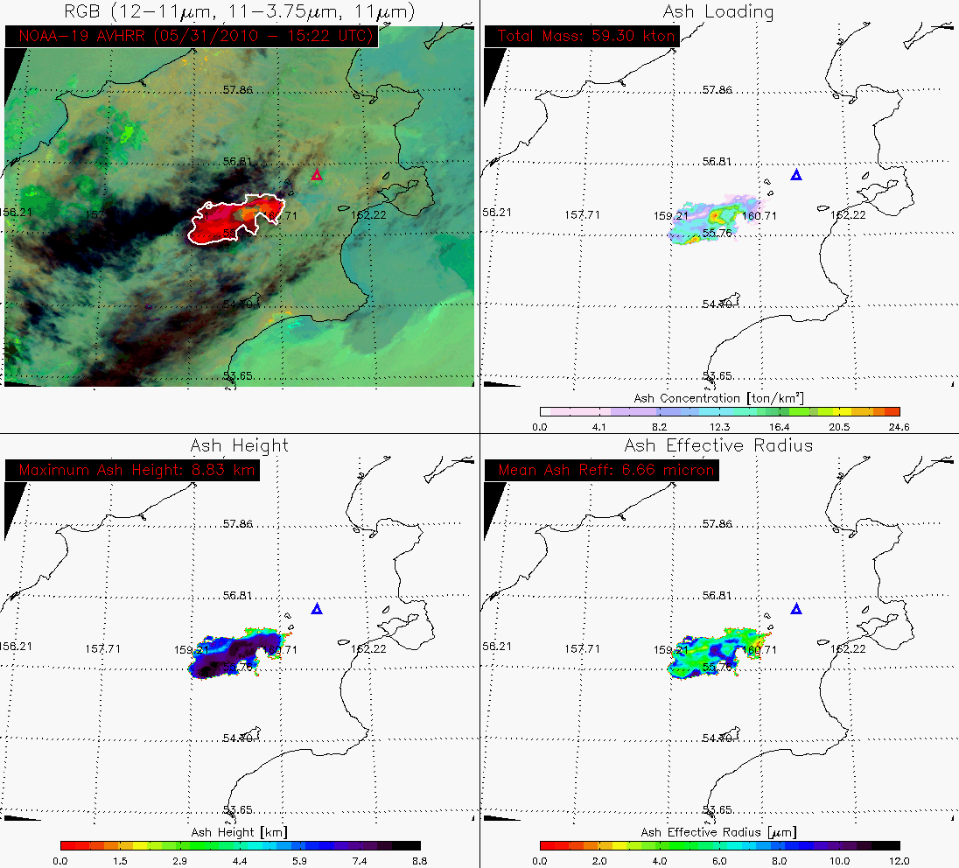
Automated Ash Cloud Alerts

Slide 24
The Advanced Baseline Imager:
ABI Current
Spectral Coverage
16 bands 5 bands
Spatial resolution
0.64 μm Visible 0.5 km Approx. 1 km
Other Visible/near-IR 1.0 km n/a
Bands (>2 μm) 2 km Approx. 4 km
Spatial coverage
Full disk 4 per hour Every 3 hours
CONUS 12 per hour ~4 per hour
Mesoscale Every 30 sec n/a
Visible (reflective bands)
On-orbit calibration Yes No
Slide courtesy of Tim Schmit

Slide 25
Summary
Automatically differentiating between meteorological and volcanic convection is important, as volcanic convection often contains volcanic ash, which is a significant additional aviation hazard.
The temporal evolution of the cloud “top” temperature is critical for identifying volcanic convection.
We are using the analysis techniques described in this talk to develop metrics aimed at predicting convective initiation and severe weather events in advance of radar signatures.
We welcome collaboration.

Slide 26
Bonus Material

Slide 27
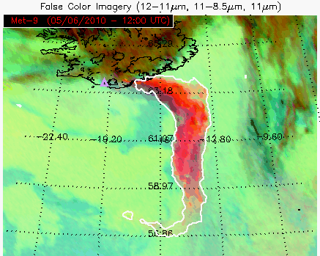
False Color Image Interpretation
Ice topped clouds
Volcanic ash
Liquid water clouds

Slide 28
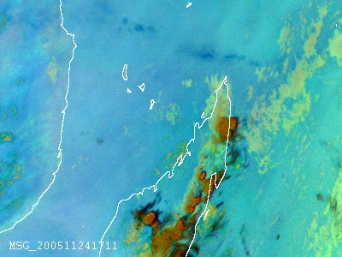
What happens when volcanic ash and thunderstorms interact?

Slide 29
