Slide 1
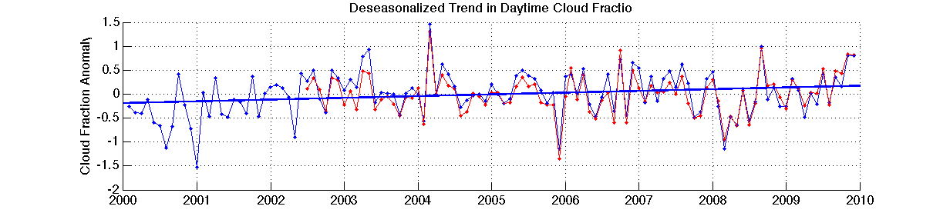
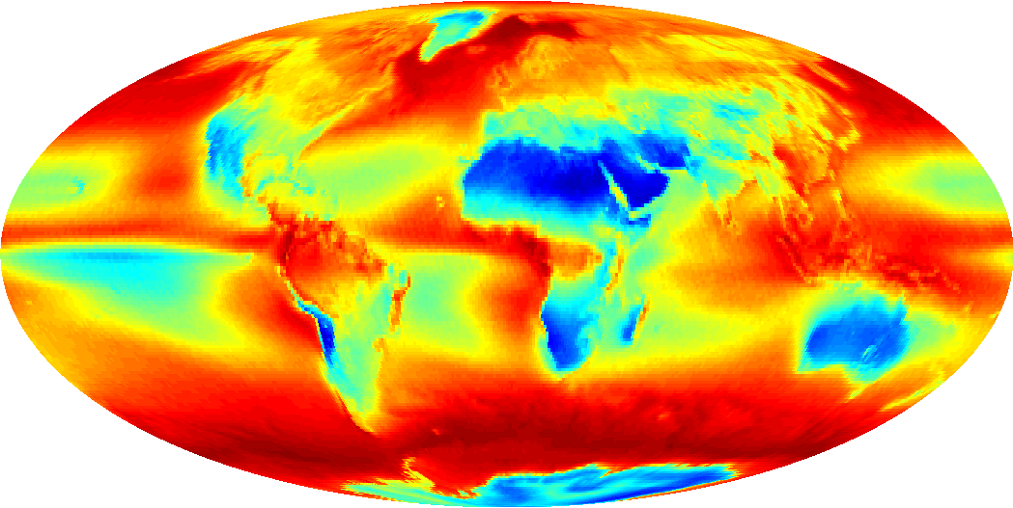
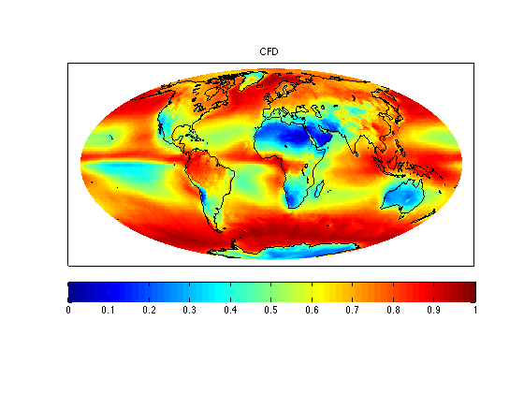
10-Years of MODIS Cloud Properties
Brent Maddux, CIMSS/UW
Steve Ackerman, Paul Menzel, and Steven Platnick
Deseasonalized Global Cloud Fraction Anomaly
10 Year Mean Cloud Fraction
Global cloud properties have been stable for ten years
  Cloud fraction global trend ~.35%/dec
Variability is much greater on regional scales
0 .25 .5 .75 1.0

Slide 2

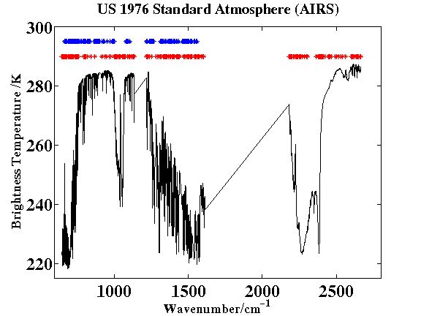
Selecting AIRS Channels for Data Assimilation : An Application for Convective Initiation Forecast
Agnes LIM, Allen HUANG, Elisabeth WEISZ, Steve ACKERMAN
Cooperative Institute for Meteorological Satellite Studies (CIMSS)
Iterative channel selection based maximizing a figure of merit, the Degrees of Freedom of Signal
A channel is selected if the calculated DFS is maximum when this channel is added.
Increase in information is taken into consideration in the next channel selection
Channel selection trained using potentially convective soundings
324 most significant channels selected.
88 overlapping channels
Comparison of analysis and forecast due to the assimilation of the AIRS NRT and the DFS selected channel set.
AIRS Near Real Time Channels
DFS Selected Channels

Slide 3
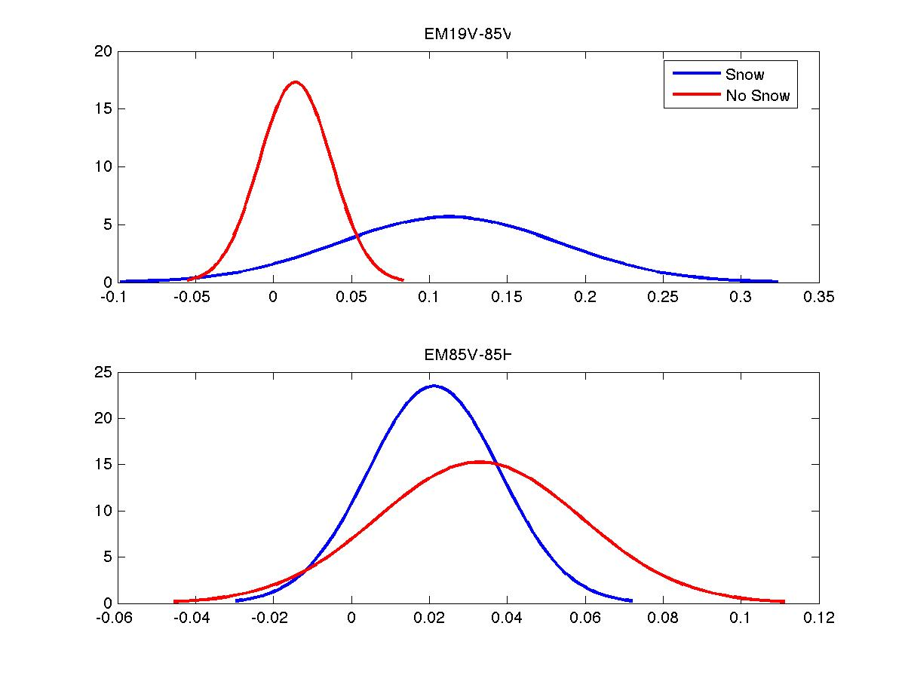
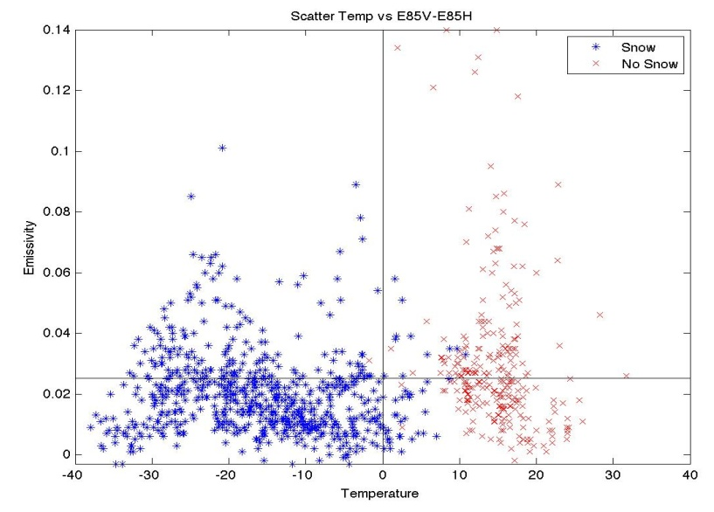
Validation of Microwave Emissivities of Land Surfaces: Detection of Snow and Surface Matters
Narges Shahroudi, NOAA-CREST
Advisor: Dr. William Rossow, NOAA-CREST
E19V-E85V
Temp vs.E85V-E85H
E85V-E85H
Objective: Detect Snow Cover using Microwave Emissivity data
Snow cover flag and Vegetation flag was used to separate the emissivity and their behavior at each vegetation has been observed.
A snow cover classification has been proposed.

Slide 4


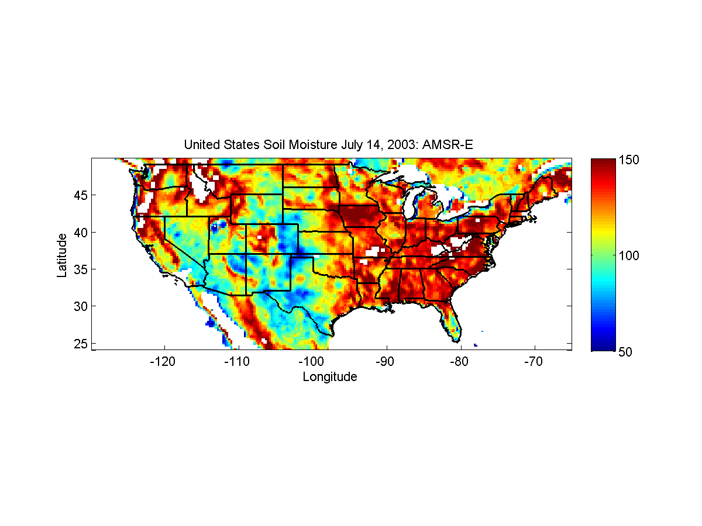
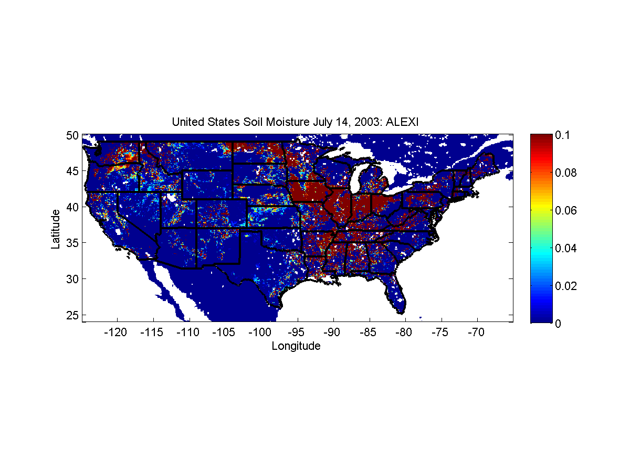

Towards a Better Monitoring of Soil Moisture Using a Combination of
Estimates from Passive Microwave and Thermal Observations
Zulamet Vega-Martinez¹, Marouane Temimi¹, Martha C. Anderson², Christopher Hain³, Nir Krakauer¹, Reza Khanbilvardi¹
¹NOAA-CREST, City University of New York|² USDA-ARS-Hydrology and Remote Sensing Lab|³ The University of Alabama in Huntsville
Figure 1. AMSR-E Soil Moisture in July 14th, 2003 (cloudless day of the month). This data is in gcm-³
Figure 2. ALEXI Average Soil Moisture data at the surface in July 14th , 2003. This data is in inches of water per foot of soil
The main objective of this work is to implement a multi-satellite approach which combines soil moisture estimates from passive microwave and thermal observations to improve the monitoring of its variability on a continental scale.
ALEXI mainly uses GOES data to calculate soil moisture in clear sky days on a continental scale. In cloudy days, when visual imagery is affected by clouds, it estimates the soil moisture based on gap filling technique.
This project aims to use AMSR-E product to enhance ALEXI sensitively to soil moisture over cloud covered pixels. A preliminary visualization of the soil moisture products from ALEXI and AMSR-E have been conducted including daily evaluations for the different combinations of data at different regions.
Notes:
Soil moisture is a key variable in hydrological processes. It exhibits significant temporal and spatial variation and therefore considerably affects evaporation and land exchange heat fluxes to the atmosphere. The use of satellite imagery based techniques to monitor this variability is crucial.
Ultimately, a statistical combination of these two products would overcome their individual limitations and allows for better monitoring of soil moisture.

Slide 5
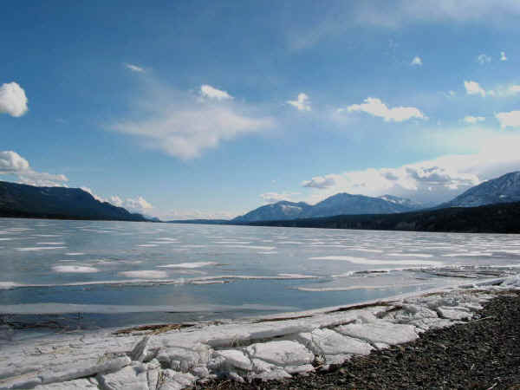
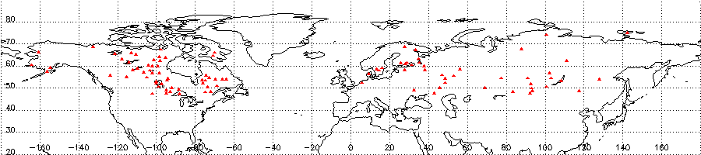
Lake Ice Phenology Analysis Using AVHRR Data
Roya Nazari, Dr. Marouane Temimi, Dr. Naira Chaouch and Dr. Reza Khanbilvardi, NOAA-CREST
The influences of lake ice on the environment
Ice identification methods

Slide 6


Aerosol Impact on Cloud Water Path
Ousmane Sy Savane, Brian Vant- Hull, Shayesteh Mahani, Reza Khanbilvardi
CE Dept at City College of New York 140 St at Convent Avenue, Steinman Hall e-mail: Osy_Savane@gc.cuny.edu
NOAA Collaborators: Robert Rabin (NSSL)
Objectives:
Assess the response of Cloud Liquid Water Path(CWP) in term in term of Aerosol(AOD) loading for 2 pairs of meteorological conditions:
1) Full dataset vs. Rain free dataset
2) High Water Vapor Ranges vs. Low or Moderate Water Vapor Ranges
Cloud Water Path Response to Aerosol
Cloud Liquid Water Response to Aerosol loading is the result of two conflicting processes
(Droplet moistening which allow it to grow and its evaporation which tends to destroy it)
Their respective strength may be dictate by the prevailing meteorological conditions

Slide 7
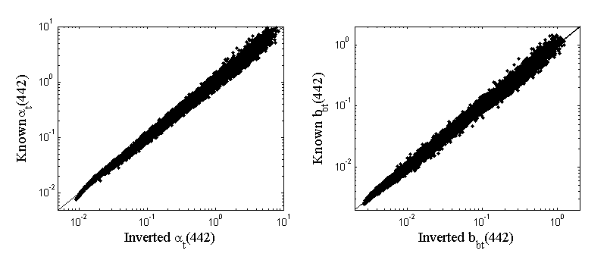
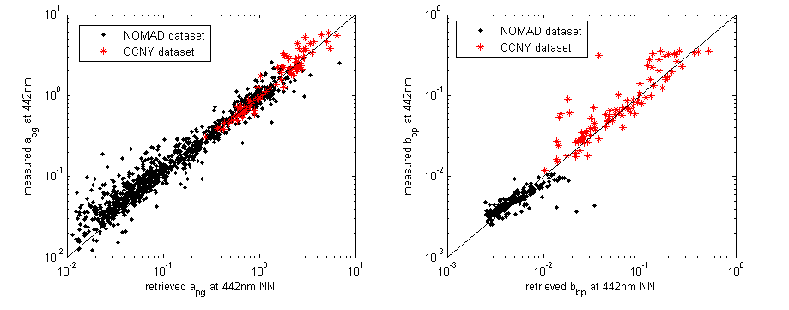
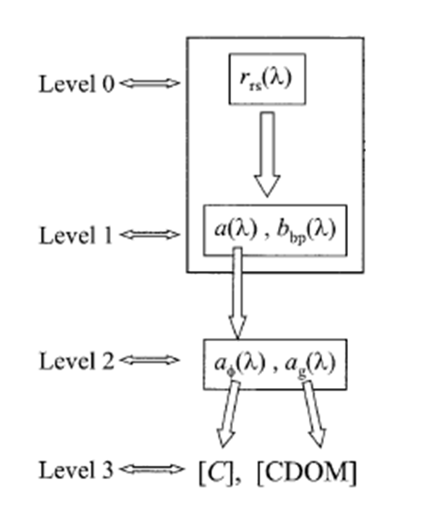
A neural network approach to retrieve the IOPs of the OCEAN from the MODIS sensor
I. Ioannou, A. Gilerson, B. Gross, F. Moshary, S. Ahmed
Optical Remote Sensing Laboratory
The City College of the City University of New York
Objective
We design a Neural Network to retrieve the total absorption and backscattering at 442nm
from the above water Reflectance as measured from the MODIS sensor
Simulated dataset
Field dataset
 | Simulated dataset α known vs. α retrieved | Simulated dataset bb known vs. bb retrieved | Field dataset α known vs. α retrieved | Field dataset α known vs. α retrieved
R²(log10) | 0.9951 | 0.9945 | 0.9489 | 0.9306
slope(log10) | 0.9968 | 0.9978 | 0.8978 | 1.0260
Intercept(log10) | - 0.0024 | -0.0042 | -0.006 | 0.0598
RMSE(log10) | 0.0569 | 0.0576 | 0.1720 | 0.1573
Lee et. al. 2002

Slide 8

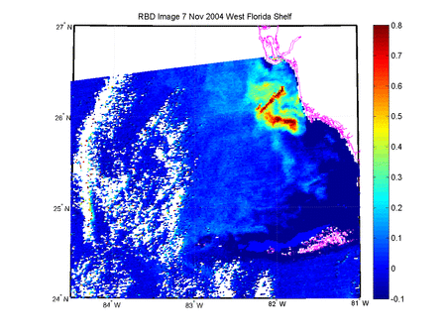
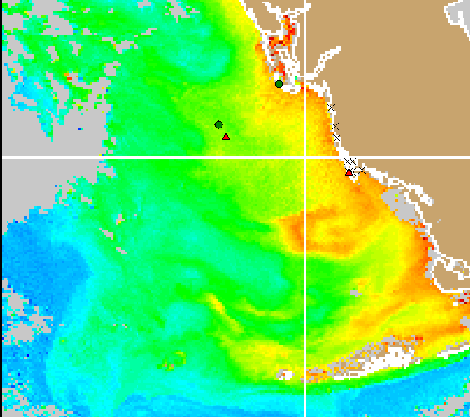
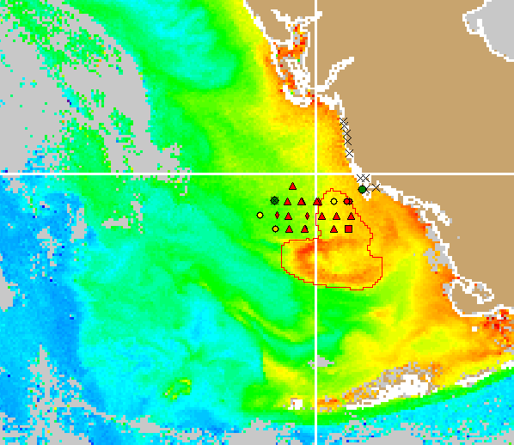
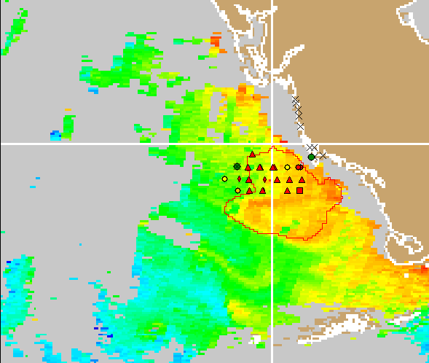
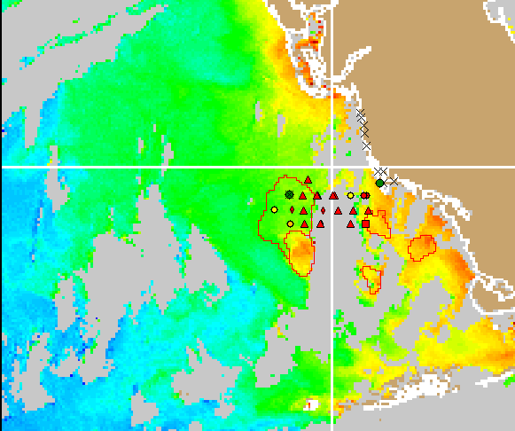
Enhanced Bio-Optical Algorithm and Statistical Classifier
for Detections of Harmful Algal Blooms:
Evaluating the Retrieval Accuracies
Soe Hlaing
Tracing of Harmful Algae Bloom
Animation of the Blooms of 13 Nov – 06 Dec 2004 detected by RBD technique
Blooms of 18 Nov – 02 Dec 2004 identified by in-situ measurements
18 Nov 2004
22 Nov 2004
22 Nov 2004
02 Dec 2004
Source: http://tidesandcurrents.noaa.gov/hab/bulletins.html

Slide 9
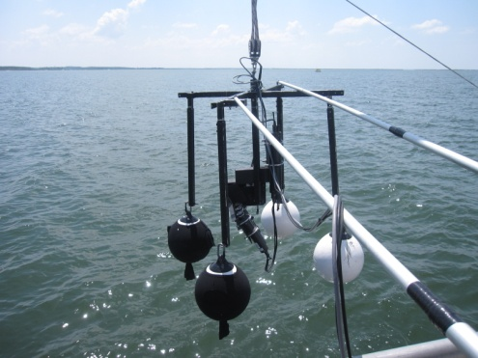
Polarization Measurements and Analysis of Case I & II Water
A. Ibrahim, A.Tonizzo, A. Gilerson, B. Gross, F. Moshary, and S. Ahmed
Optical Remote Sensing Laboratory, the City College of the City University of NY,
New York, NY, 10031, United States
Case I water
Case II water
Comparison between MC simulations and measurements of DOP
A new hyperspectral multiangular polarimeter was developed to accurately measure the underwater polarized light field.
Polarization characteristics of under and above water light contain useful additional information on inherent optical properties (IOP), which can be accurately measured using Seaborne or Spaceborne instruments that can greatly contribute to the Research of Ocean Color community.
The results were confirmed by the Monte Carlo simulations.

Slide 10


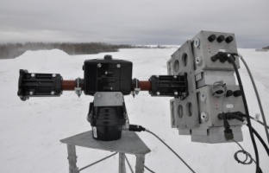
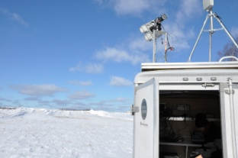
Estimation of Surface Snowpack Properties using Multi-Frequency Microwave Remote Sensing Data
Jonathan Muñoz¹, Tarendra Lakhankar¹, Peter Romanov ² and Reza Khanbilvardi¹
¹ NOAA-CREST, City College of New York, ² NOAA/NESDIS Silver Spring, MD
Snow Depth
Snow-Pack
Properties
Snow Grain Size
HUT
(Emissivity Model)
Emissivity
In Situ Data
Snow Density
Temperature
Analysis Validation & Improvement
Brightness
Temperature
NOAA CREST
Multi-Frequency
Radiometer
Snow-Pack
Properties
Snow Depth
CRTM
(Snow Module)
Emissivity
Temperature
Radiometer Site
Caribou, ME
Validation of satellite microwave remote sensing data using the NOAA-CREST Multi Frequency Microwave Radiometer for Snowpack properties.
Temporal analysis of in-situ snow-covered microwave brightness temperature to improve previously developed algorithm for snow cover and snow emission models for early and mid-winter, spring (melt-freeze period) and melting period.
Sensitivity Analysis of HUT snow model (Helsinki University of Technology) and CRTM (Community Radiative Transfer Model) Snow module for snow pack parameters.

Slide 11

Validation of NOAA IMS product with NCDC and EC Ground-based Data
Christine Chen¹, Tarendra Lakhankar¹, Peter Romanov², and Reza Khanbilvardi¹
¹ NOAA-CREST, The City College of New York, ² NOAA/NESDIS/ORA Silver Spring, Maryland
Validation of NOAA’s interactive multisensory snow and ice mapping system (IMS) product using National Climatic Data Center (NCDC) and Environment Canada (EC) snow depth.
Statistical analysis of validation process using:
  Snow classification (e.g. ephemeral, prairie, warm taiga) data,
  Land classification (e.g. forest, mountain, flat plains) data, and
  Snow depth (e.g. 1 inch, 2 inches, 3 inches).

Slide 12
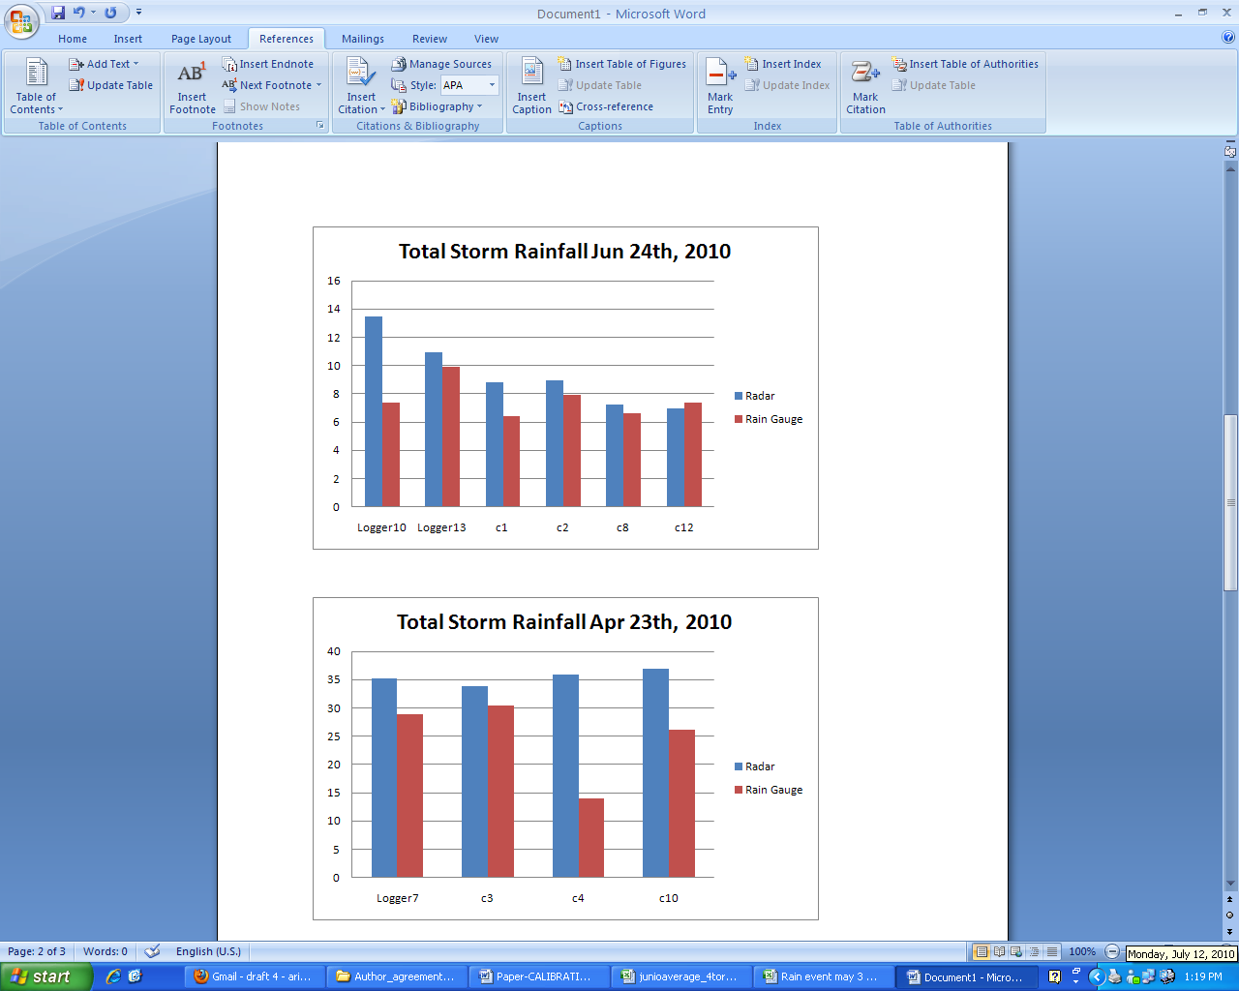
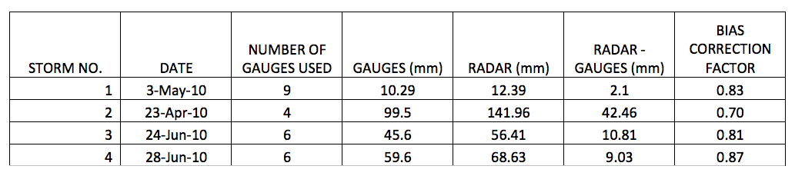
Calibration and Validation of CASA Radar Rainfall Estimation
Sionel A. Arocho-Meaux, UPRM NOAA-CREST
Ariel Mercado-Vargas, Gianni A. Pablos-Vega, Eric W. Harmsen, Sandra Cruz-Pol, and José Colom-Ustáriz
Reliable and consistent weather data is needed in order to evaluate potential climate change and be able to take informed decisions in order to lessen the negative effects of natural disasters. Events like flash floods can be predicted by using models, however these require current and consistent rainfall information.
The Collaborative Adaptive Sensing of the Atmosphere (CASA) program at the University of Puerto Rico-Mayaguez is currently working with compact and low cost radars in order to estimate rainfall in western Puerto Rico.
These radars provide very high-resolution rainfall information; however, this method requires validation and calibration in order to be useful for monitoring weather events. For this purpose, a 28 rain gauge network in a 16-km² area near the radar location was used as ground truth measurements. Various rain events were compared to the radar rainfall estimates and a mean bias correction factor of 0.8 was developed for total storm rainfall.

Slide 13
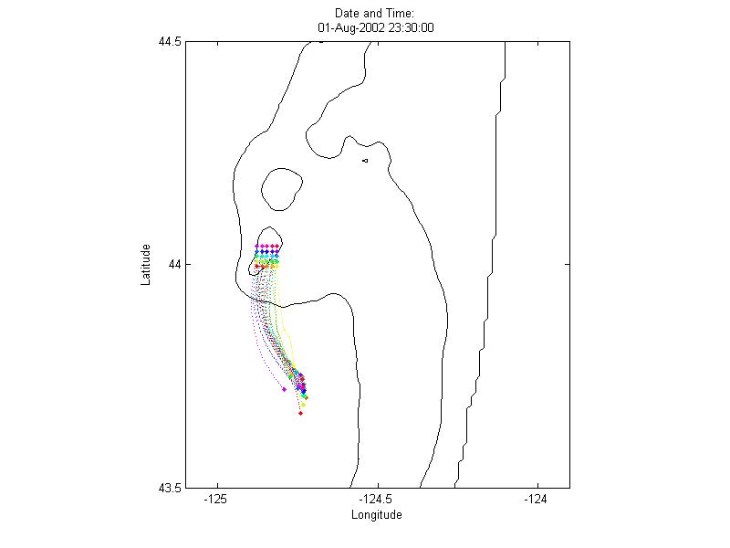
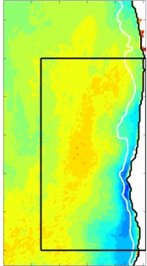
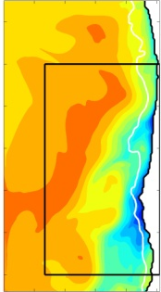
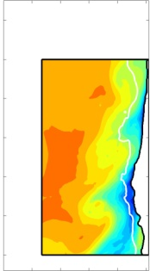
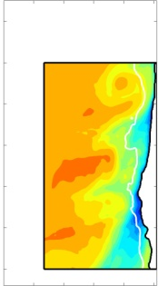
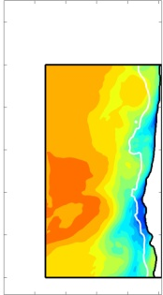
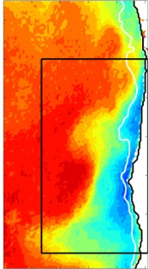
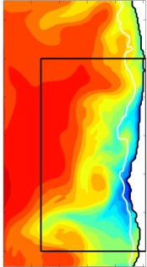
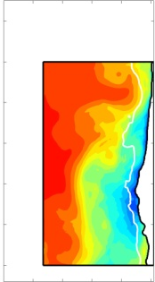
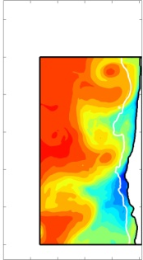
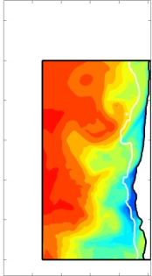
Geometry of the Sea Surface Temperature Front off the Oregon Coast
Comparisons are made between observed sea surface temperature and various models over . A 3- km horizontal resolution model performs as well or better than 1-km models. For the 1-km models, models with tidal forcing are qualitative improvements over the winds-alone model.
Lagrangian particle tracking analysis is done to study the potential effect of near-surface internal tides on cross-shore transport.
GOES
1 km Winds-Only
1 km Winds +
8 Tidal Cons.
44.5
3 km Winds-Only
1 km Winds +
M₂ Tide
47
18
45
July
43
Latitude [ºN]
44
41
Latitude [ºN]
August
43.5
125 124.5 124
Longitude [ºW]
128 124
Longitude [ºW]
128 124
Longitude [ºW]
128 124
Longitude [ºW]
128 124
Longitude [ºW]
128 124
Longitude [ºW]

Slide 14


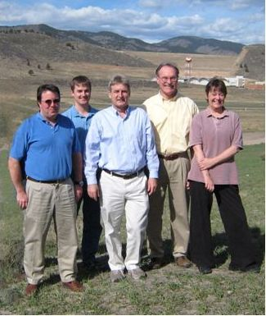
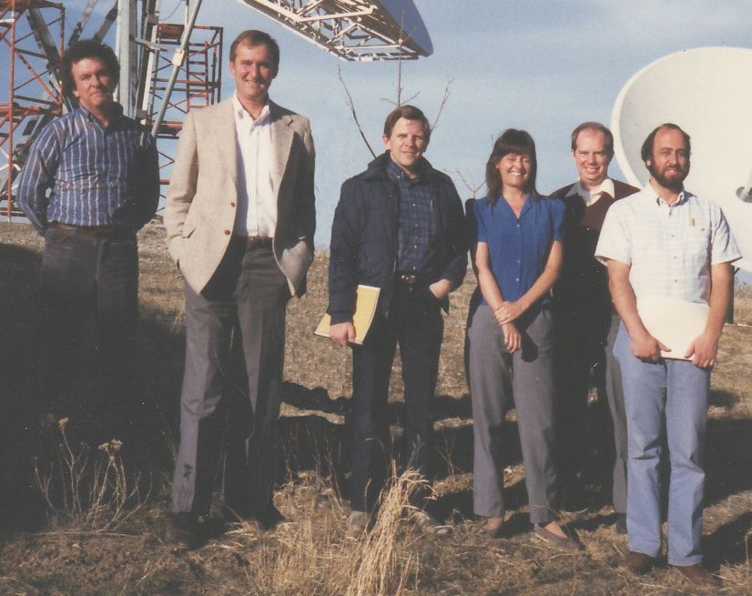
A History of RAMMB-NOAA at CSU: Cooperating in Atmospheric Science
Don Hillger, NOAA/NESDIS/STAR/RAMMB
(with contributions from the remainder of the RAMMB)
Oct 2009
Mar 1987
Then
Now
Roger, Jim, John, Deb, Bob, Ray
John, Dan, Mark, Don, Deb
The Regional and Mesoscale Meteorology Branch (RAMMB) has been at Colorado State University since 1980, at the inception of CIRA*
All 5 original RAMMB feds are retired, replaced one-by-one by a new set of 5 feds
A timeline with RAMMB history and events is provided
*RAMMB works closely with many others at CIRA, to accomplish their research.

