Slide 1
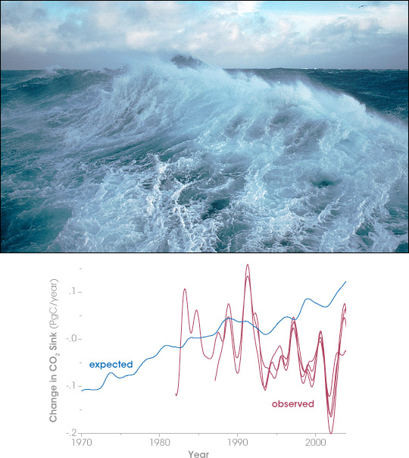

REMOTE SENSING OF SOUTHERN OCEAN AIR-SEA CO₂ FLUXES
A.J. Vander Woude
Pete Strutton and Burke Hales

Slide 2
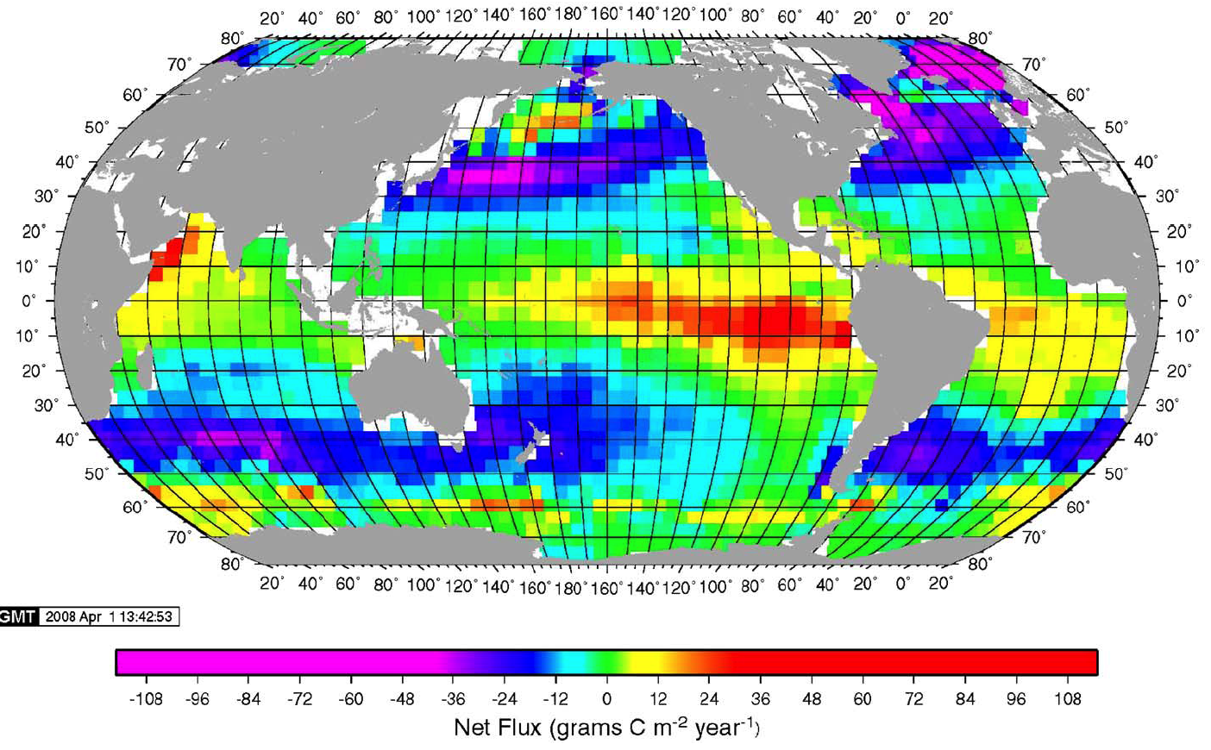
Global CO₂ flux
Takahashi et al., DSR I, 2009: 4.5 million data points
Takahashi et al., DSR I, 2009: 3 million data points
Notes:
Turn towards a 4 by 5 degree data set instead of 1 degree, we can compare the climatological observations by Takahashi from 3 million datapoints.
And even though he has monthly estimates of CO2 fluxes, our goal is to provide monthly and interannual esitmates of CO2 flues from .25 degree resolution.
Furthermore, this data set also has inherent gaps in data coverage for the southern ocean.

Slide 3
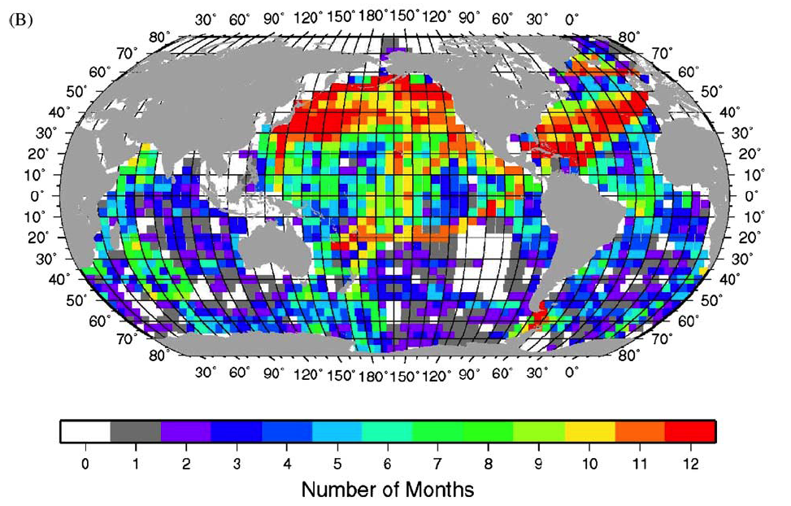
Global CO₂ data coverage
Notes:
Data coverage poor
Coasts ignored
Only 1 or 2 for calendar month..
At least 2 ways to rectify: more measurements and satellite proxies. We’re doing both.

Slide 4
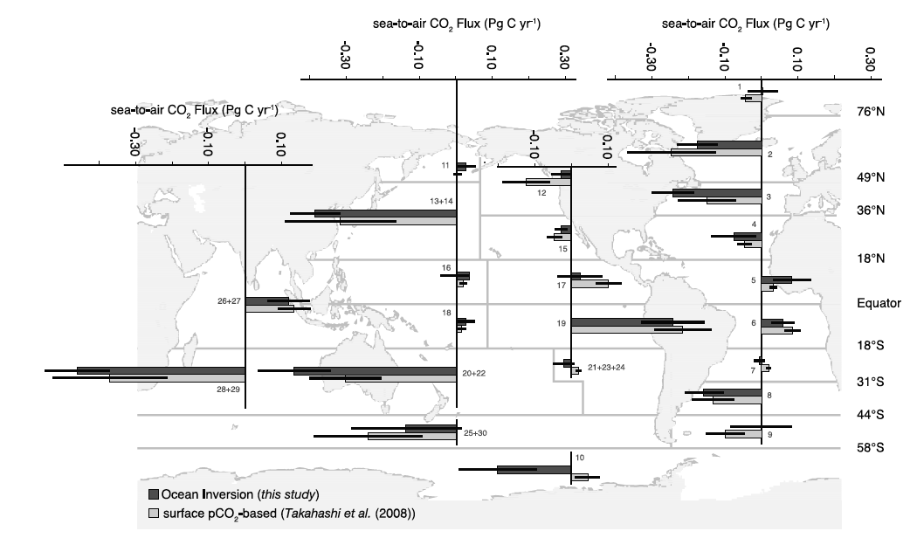
Southern Ocean & atmospheric CO₂
_{Observations versus models}
Gruber et al. 2009
Notes:
Covers 18% of the global oceans and the contemporary measurements of (anth + natural CO2 fluxes), with the anthropogenic co2 going in everywhere over the SO, but the natural CO2 export outgassing in the tropics and uplake in the mid and northern high latitudes. Southern Ocean takes up a third of the glboal anthropogenic CO2. This is almost equally balanced by the natraul co2 outgassed to the atmosphere.
SOUTHERN OCEAN IS POOREST IN THE SOUTHERN OCEAN, CONTEMPORY A SINK, SMALLER, DISAGREE BETWEEN MODEL AND OBSERVATION
Taka 02 paper was revised with 10 meter wind speeds to .35 to .45 PgC/yr sink instead of the overestimated values.
By better harnessing the temporal and spatial variability of CO2 fluxes we can :
significantly improve our estimates of regional and total CO2 fluxes
serve as a validation products for current and future models of Southern Ocean biogeochemistry.
Influenced by a combination of physical, biological and chemical processes on varying spatial and temporal scales.

Slide 5
Why this may be better than observational methods?
In some places there are no observations:
pCO₂ from co-varying parameters is a way forward
We can investigate smaller spatial scales: Limited by the resolution of the satellite data (kilometers), not sparse observations (~10² to 10³ km)
We can investigate seasonal and interannual variability: Links to long term changes in forcing: Southern Ocean winds
Notes:
Explain interannual variability

Slide 6
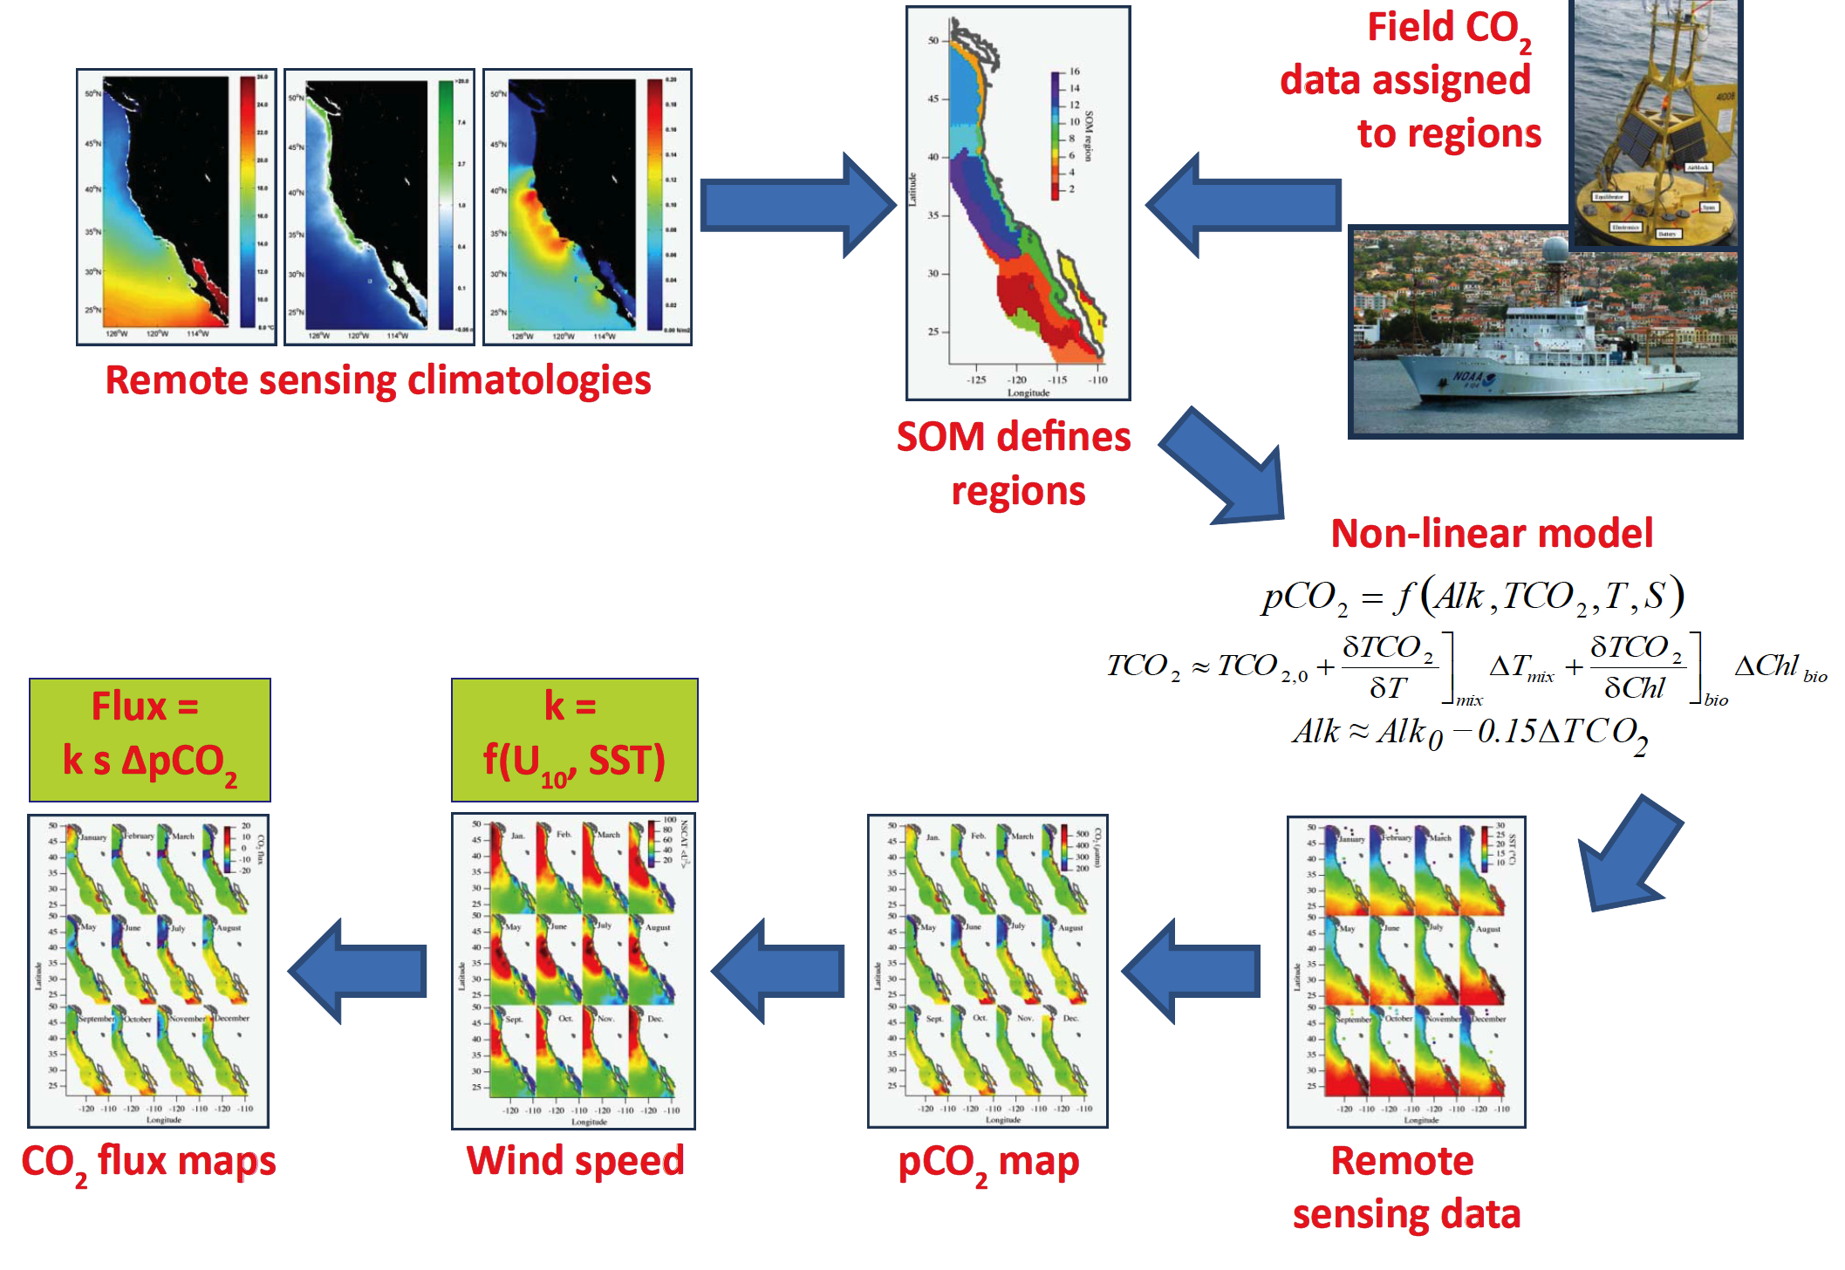
Steps to Create Predictive Satellite Algorithms: West Coast Example
Notes:
Classically MLR techniques have been used as we have seen with McNeil’s climatologies. To get at CO2 also from parameters that we can measure from satellite but chlorophyll in general is not a good predictor of CO2, even when added with temperature measurements from satellite. Here we have developed a predictive algorithm for co2 using shipboard data and then applying these algorithms to the satellite data.
Using Powell’s optimization to minimize the particular function based upon a set of directions that are preprescribed.
K=gas transfer coefficient
s=solubility of CO2 in seawater
Deltapco2=difference between ocean and atmospheric CO2

Slide 7
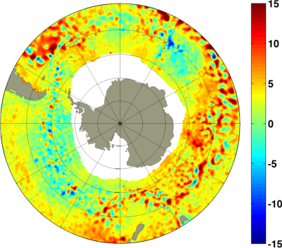
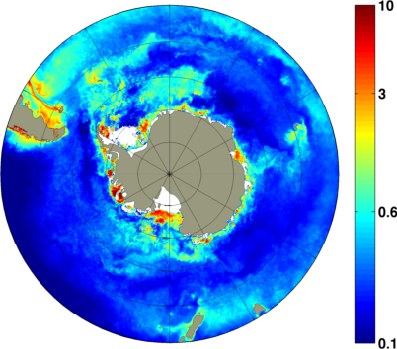
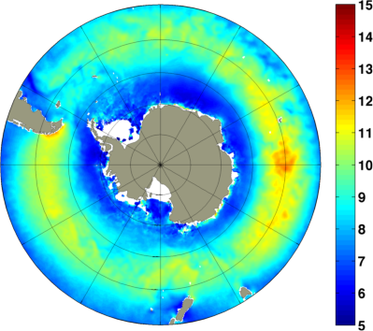
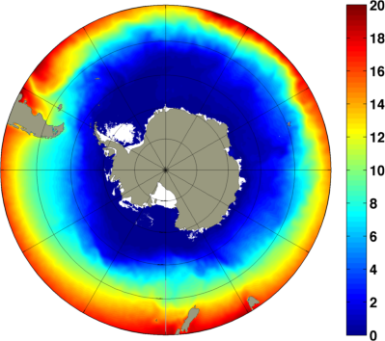
Remote Sensing Climatology
_{Monthly Data}
Sea Surface Height (cm)
Chlorophyll a (mg/m³)
Sea Surface Height:
AVISO Multimission 1999-2008
Chlorophyll:
SeaWiFS 1999-2002, MODIS/Aqua + SeaWiFS Merged 2003-2007, MODIS/Aqua 2007-2008
Wind speed:
QuickSCAT 1999-2008
OI Reynolds SST:
AVHRR 1999-2002, AVHRR+AMSR 2002-2008
Wind speed (m/s)
OI Reynolds Sea Surface Temperature (°C)
Notes:
AVISO– Topex Posieden ERS 1 and 2 satellite altimeters

Slide 8
Steps to Create
Predictive Satellite Algorithms

Slide 9
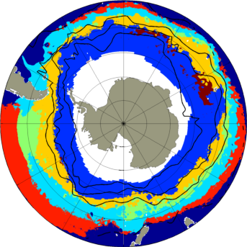
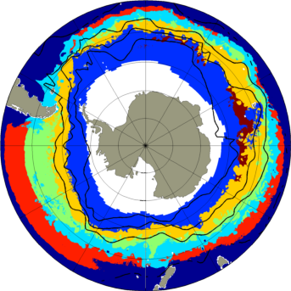
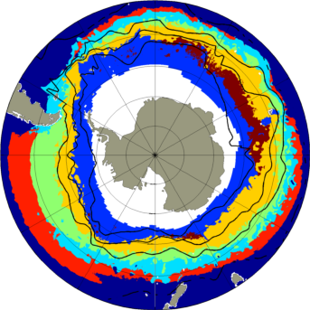
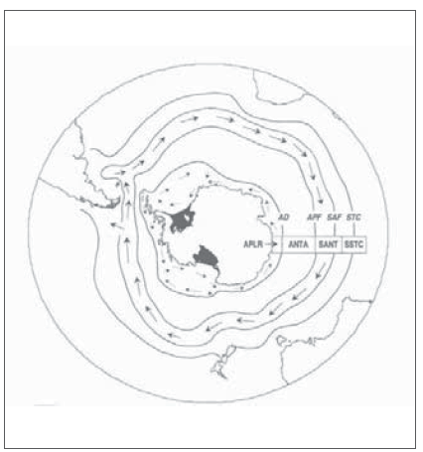
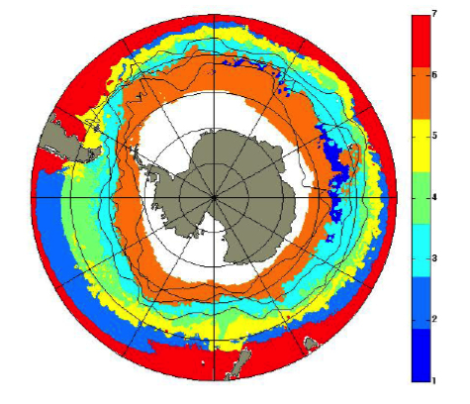
Probablistic Self-Organizing Maps
January
February
March
region number
There is some correspondence between SOM regions and the fronts
Spatial and temporal coherence of the fronts from month to month
Longhurst 1998
Notes:
Now going to apply similar techniques to the southern ocean
So far we’ve done the SOM, this version uses sst, chl, winds and ssh, note big ice band due to ssh
Have also done another som without ssh that gets closer to the coast, and will compare with just using Orsi

Slide 10
Overview of Predictive Satellite Algorithms
Powell’s Optimization
A
Alkalinity and DIC from the McNeil climatologies
Optimizing: Alk, DIC, T_{i,} Heating/Mixing term, T_{cr}
Chlorophyll term
Each has a constant, longitude, latitude & seasonal signal
Notes:
The idea is that a region ‘inherits’ water with certain initial conditions (Alk₀, TCO_{2,0}, T₀) and then biology, mixing, and thermal processes act to change the pCO₂.
Five parameters (Alk₀, TCO_{2,0}, T₀, γ, β) are optimize-able, and can be time- and space dependent.
Limiting to no Lon dependence; Lat dependence only for Alk₀, and TCO_{2,0}; no seasonality dependence in b yields areally-weighted
;%intial guesses ('g_' for intial guess) for parameters: A+B*lat+C*lon+D*sin(sesn+phase)
;%__________________________________________________________________________
;% g_alk0_a=2250; g_alk0_b=0; g_alk0_c=0; g_alk0_d=0; ALKALINITY
;% g_TCO20_a=2000; g_TCO20_b=0; g_TCO20_c=0; g_TCO20_d=0; TOTAL CO2 OR DIC
;% g_T0_a=20; g_T0_b=0; g_T0_c=0; g_T0_d=0; INITIAL TEMPERATURE
;% g_phi_a=0.5; g_phi_b=0; g_phi_c=0; g_phi_d=0; Value of 0.0 means NO
;% heating; 1 means no mixing.
;% g_gradmix_a=-10; g_gradmix_b=0; g_gradmix_c=0; g_gradmix_d=0;value of 0
;%
;% will give no mixing effect.
;% g_Tc_a=28; g_Tc_b=0; g_Tc_c=0; g_Tc_d=0; CRITICAL TEMPERATURE
;% g_sqru_a=-7; g_sqru_b=0; g_sqru_c=0; g_sqru_d=0; BETA
;% g_Rf_a=0; g_Rf_b=0; g_Rf_c=0; g_Rf_d=0; REVELLE FACTOR

Slide 11
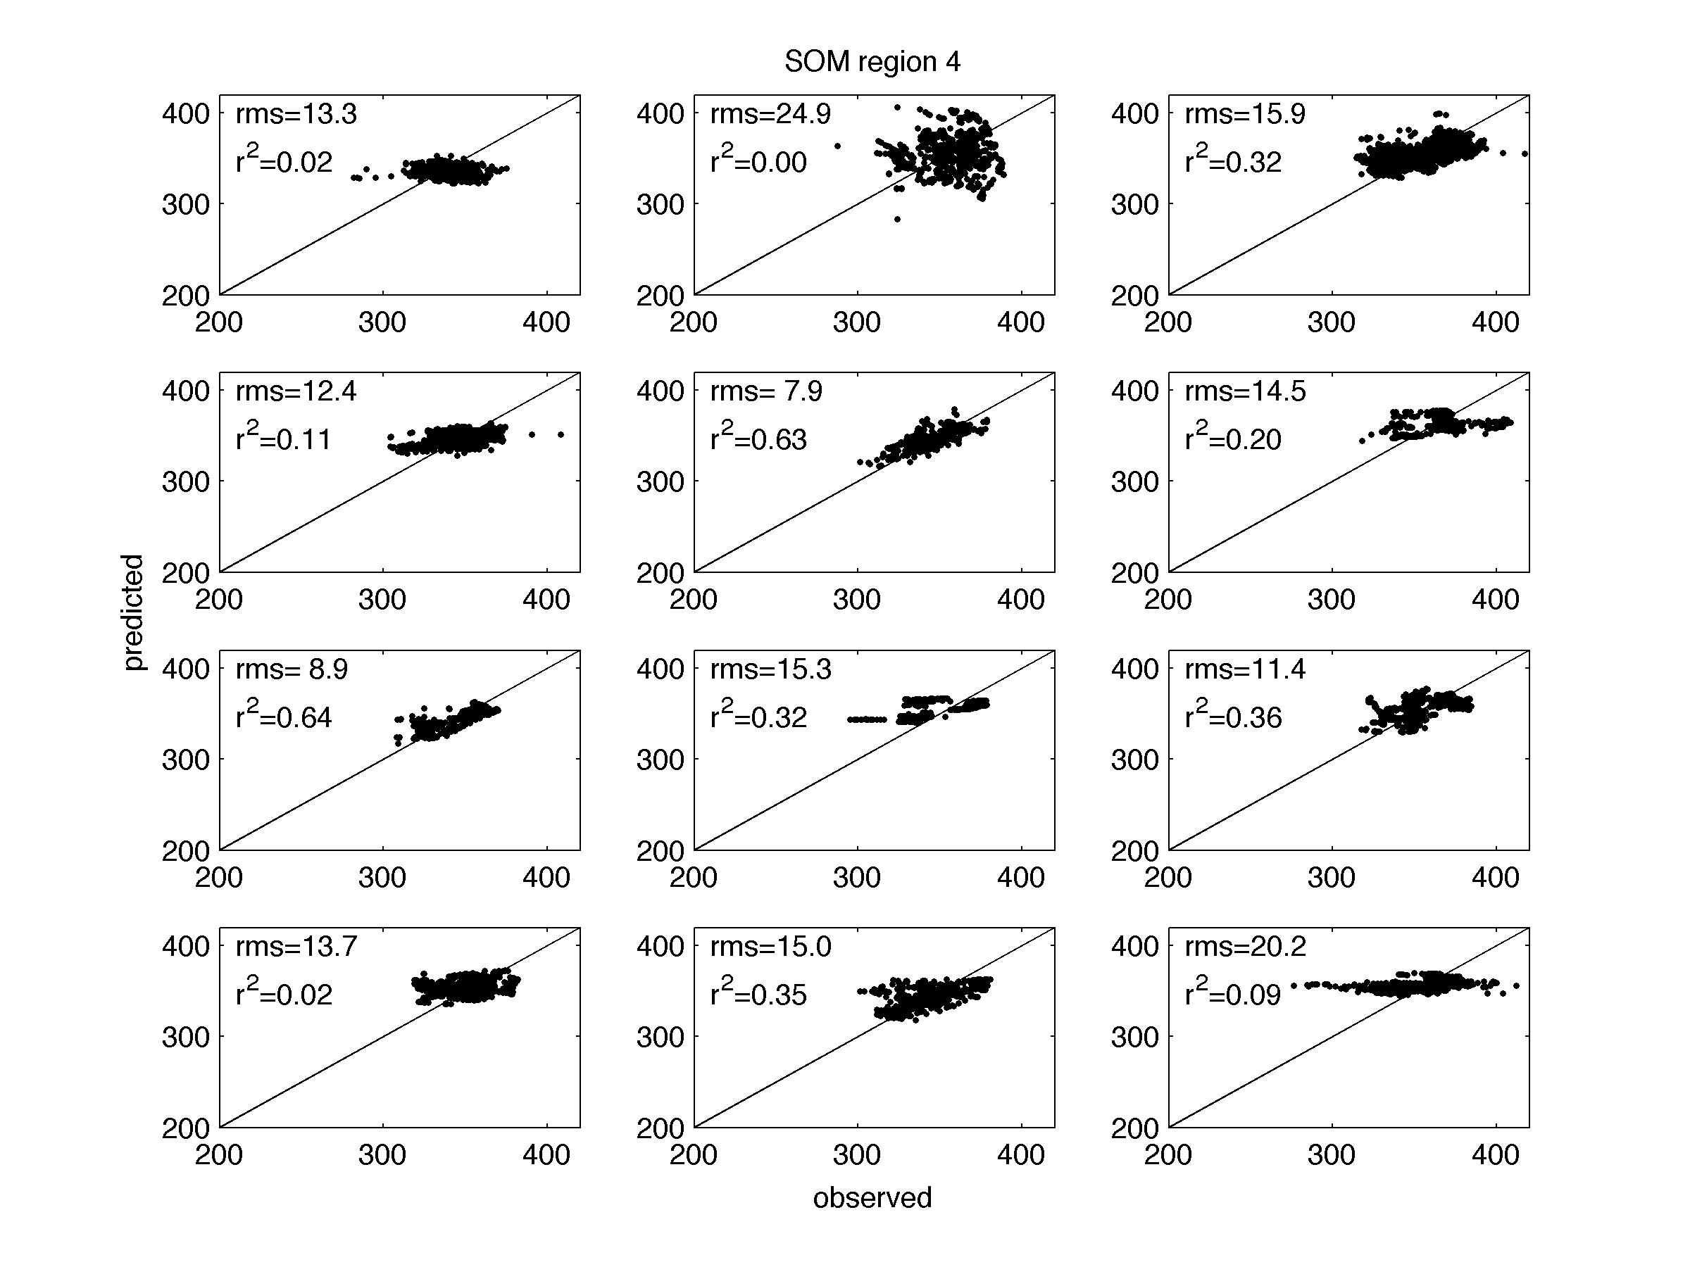
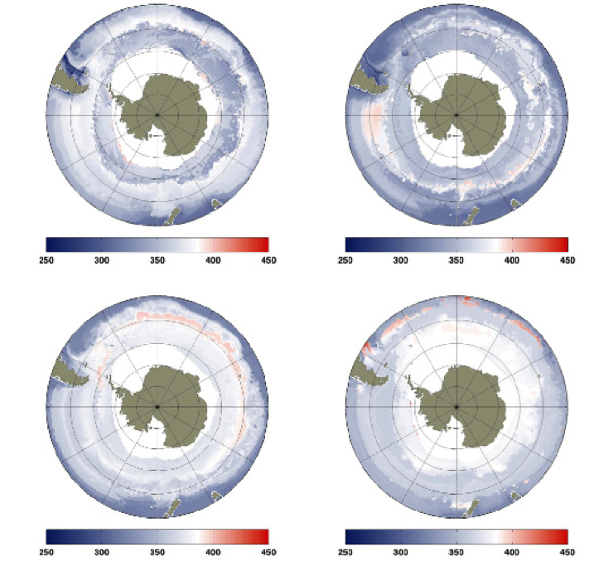
pCO₂ Results & Accuracy of Regional Model
Spring
Summer
Predicted
Observed
Obo
Region 4
May and June
pCO₂ (ppm)
pCO₂ (ppm)
Red is a source to the atmosphere
White is at atmospheric
Blue is a sink, into the ocean
Autumn
Winter
pCO₂ (ppm)
pCO₂ (ppm)
Notes:
Seasonal climatologies
White about atmospheric, red is a source, blue is a sink.

Slide 12
Conclusions
and future work
Satellite algorithms offer a way to fill gaps and better quantify spatial and temporal variability of CO₂
Next:
-- Finishing the monthly algorithms, by region as well as Seasonal and interannual variability and produce maps of CO₂ fluxes for the Southern Ocean
-- More rigorous comparison with climatologies and
models.

Slide 13
Thank you!
NASA for funding for this project
Maria Kavanaugh for her help with the PRSOM analysis and Ricardo Letelier’s lab use of their PRSOM/HAC code

Slide 14
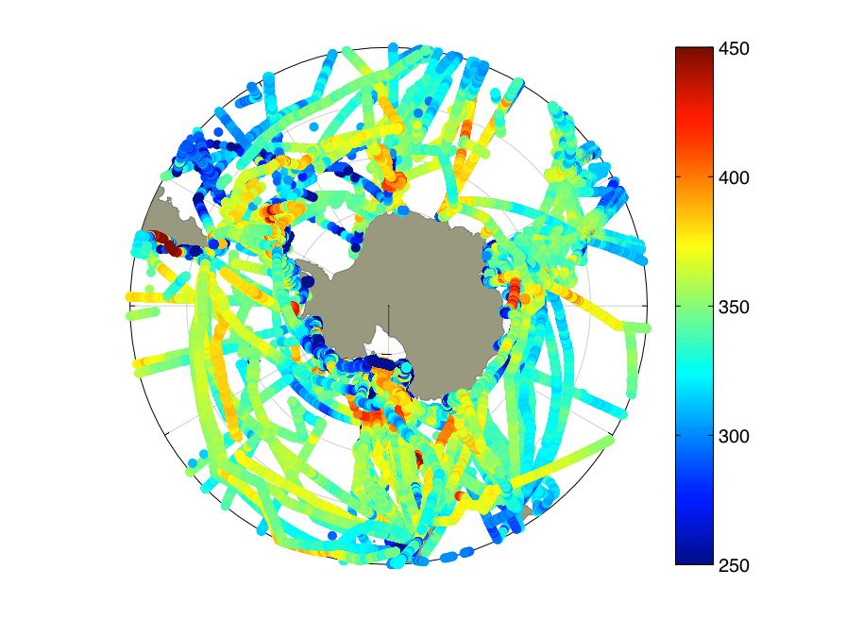
CDIAC in situ pCO₂ Coverage
1.4 million data points in the Southern Ocean, south of 40° S
Notes:
1st step, SOM: Rather than one algorithm for the whole area, we use SOM to break it down.
SOM regions make sense
Within each SOM region we match CO2 data with potential predictors (SST and chl)
Develop relationships between predictors and CO2
Then use satellite data, say climatologies, or seasonal, or monthly to apply algorithms
Use satellite winds to calculate fluxes

Slide 15
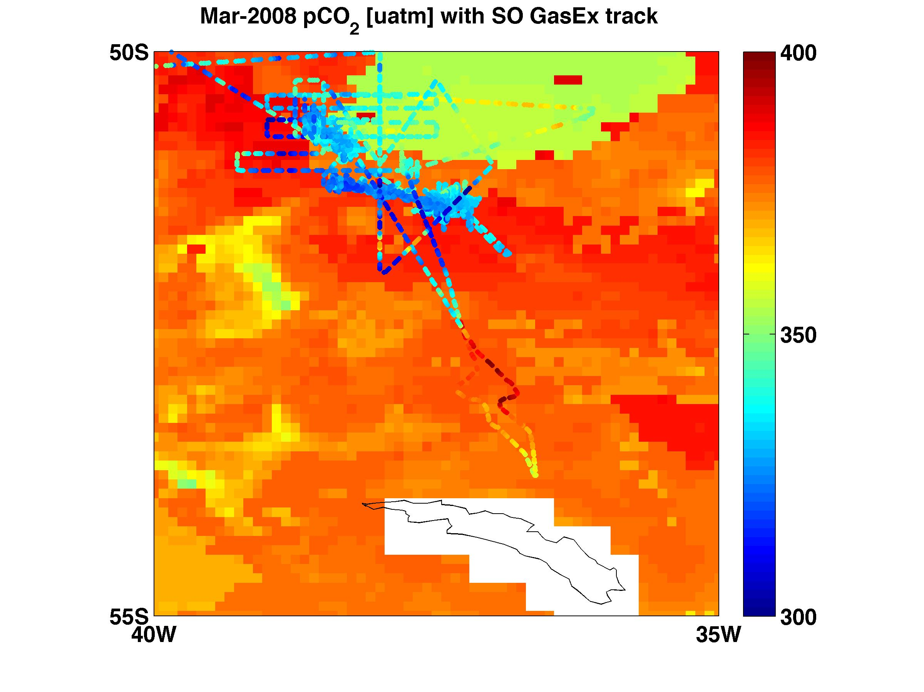
SO GasEx observations and satellite predictions
Notes:
March 20008 estimate of pCO2 from SOgasEX, images provided from Pete, places estimating
South georgia and underway co2 measurements

Slide 16
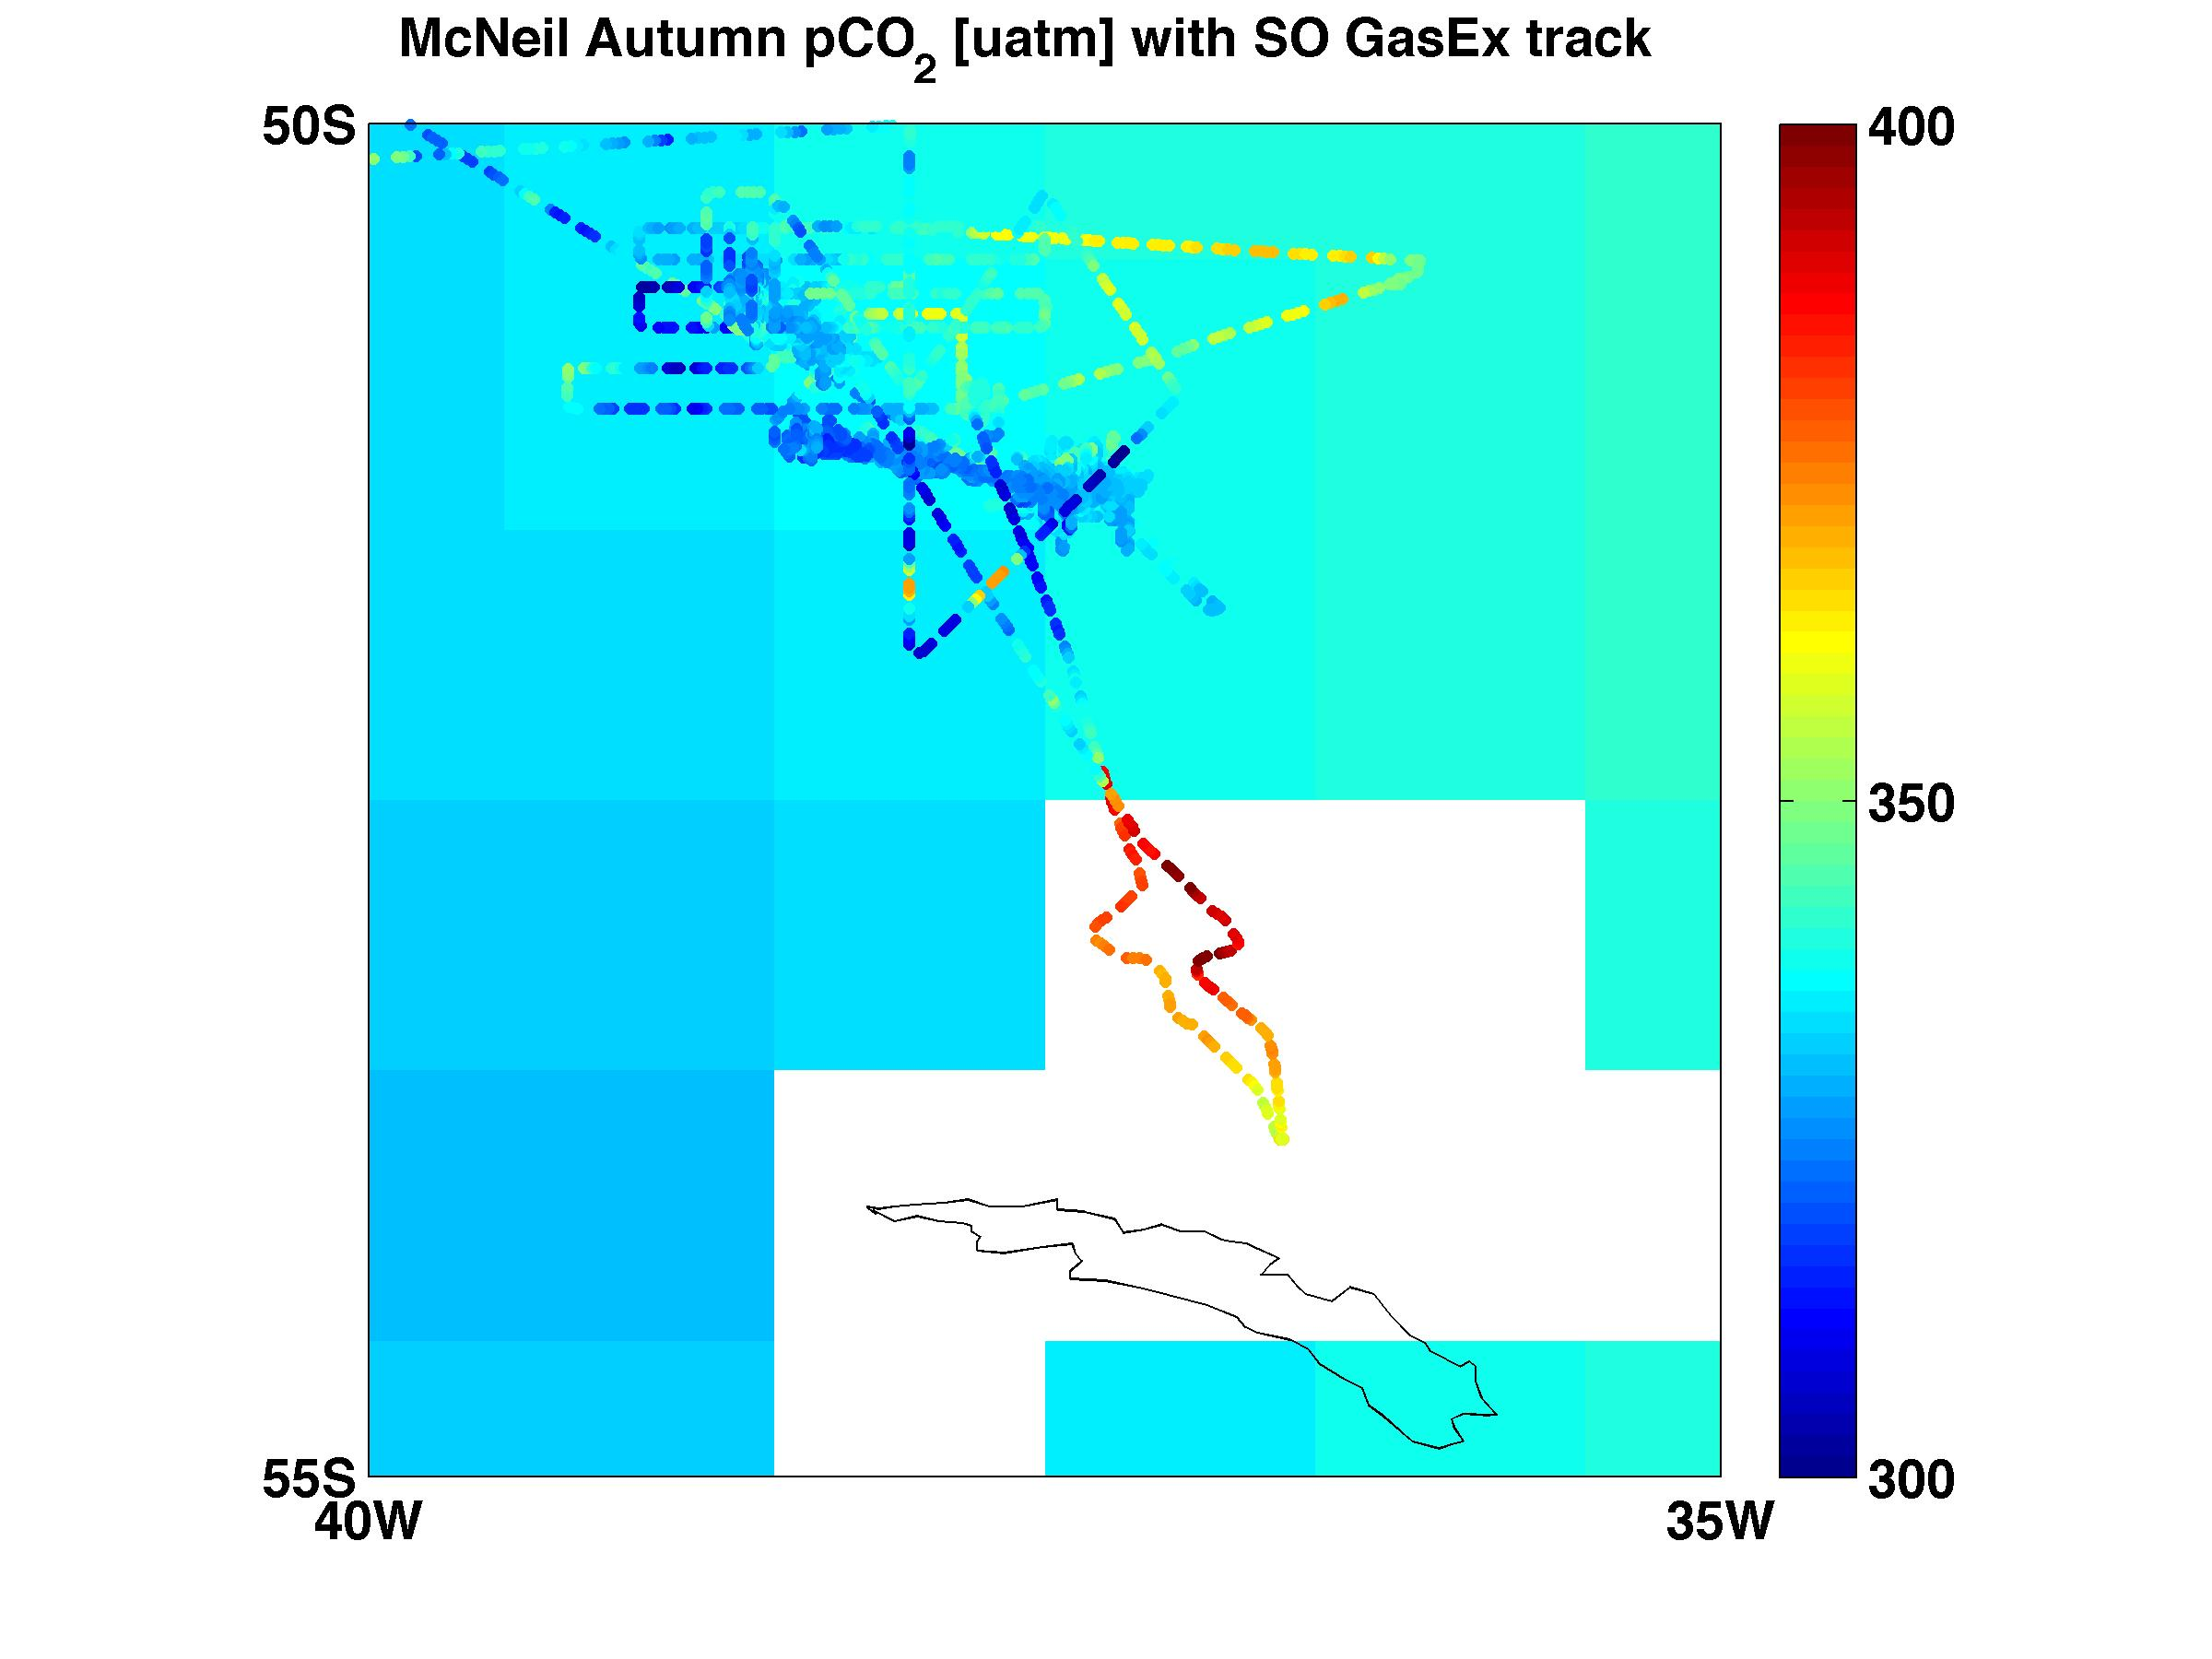
SO GasEx observations and
McNeil predictions
Notes:
Mcneil there are places where it is closer, lower spatial resolution

Slide 17
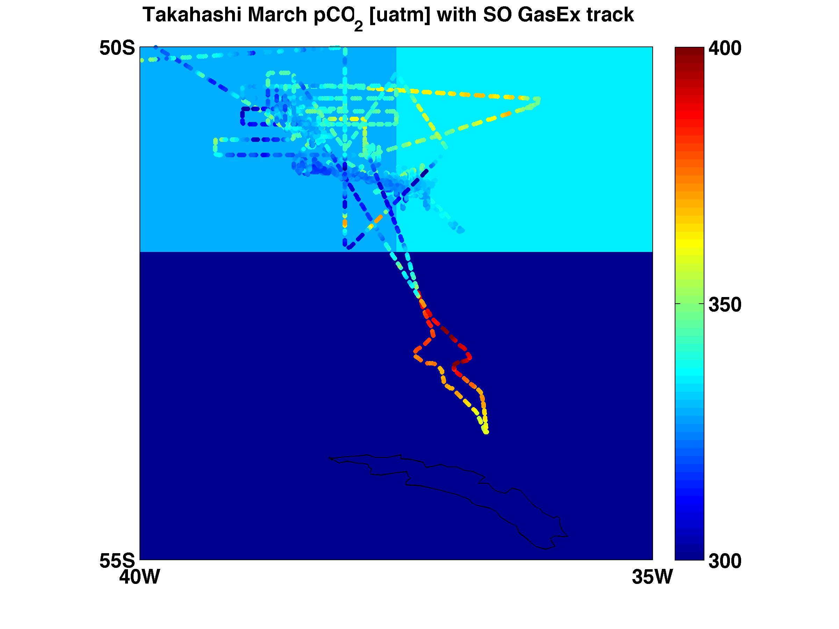
SO GasEx observations and
Takahashi predictions
Notes:
Trueer of takahashi and underestimating in many of the cases.

Slide 18
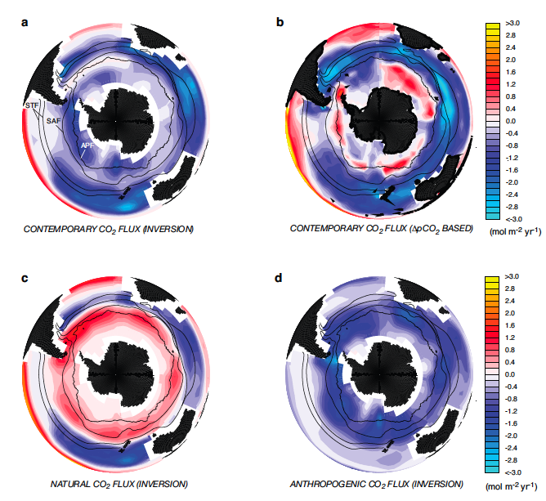
Southern Ocean & atmospheric CO₂
Contemporary sink of:
.1 to .5 PgC/yr
(circulation models & atm and oceanic inversion models)
.5 to .7 PgC/yr
(pCO₂ measurements, Takahashi et al. 2002)
.15 to .65 PgC/yr
(empirical estimated pCO₂, McNeil et al., 2007)
Gruber et al. 2009
Notes:
Covers 18% of the global oceans and the contemporary measurements of (anth + natural CO2 fluxes), with the anthropogenic co2 going in everywhere over the SO, but the natural CO2 export outgassing in the tropics and uplake in the mid and northern high latitudes. Southern Ocean takes up a third of the glboal anthropogenic CO2. This is almost equally balanced by the natraul co2 outgassed to the atmosphere.
SOUTHERN OCEAN, CONTEMPORY A SINK, SMALLER, DISAGREE BETWEEN MODEL AND OBSERVATION, check taka 2009
Taka 02 paper was revised with 10 meter wind speeds to .35 to .45 PgC/yr sink instead of the overestimated values.
By better harnessing the temporal and spatial variability of CO2 fluxes we can :
significantly improve our estimates of regional and total CO2 fluxes
serve as a validation products for current and future models of Southern Ocean biogeochemistry.
Influenced by a combination of physical, biological and chemical processes on varying spatial and temporal scales.

