Slide 1
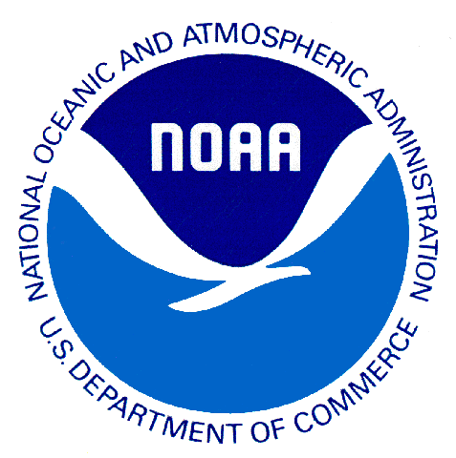
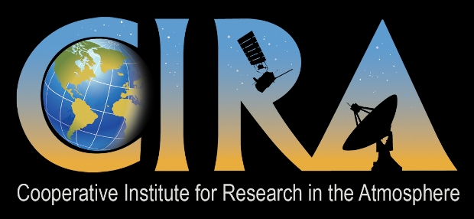
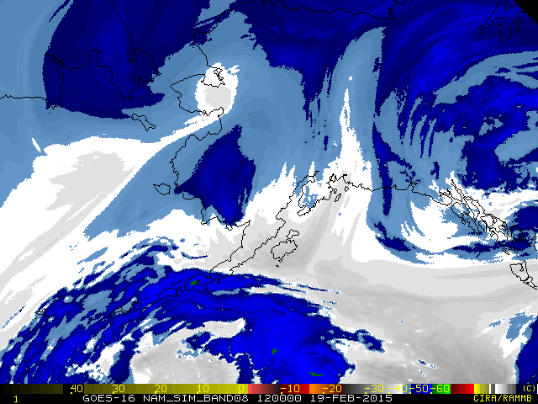
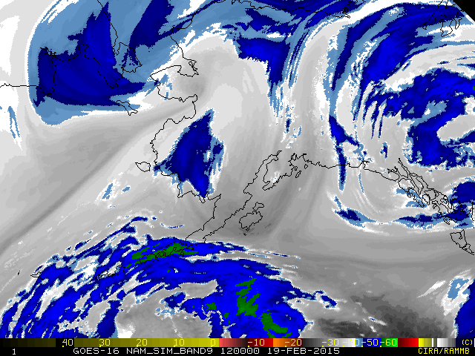
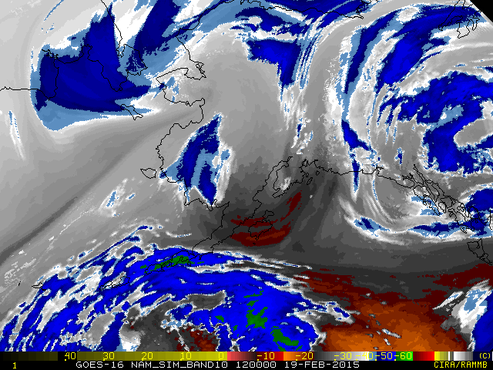
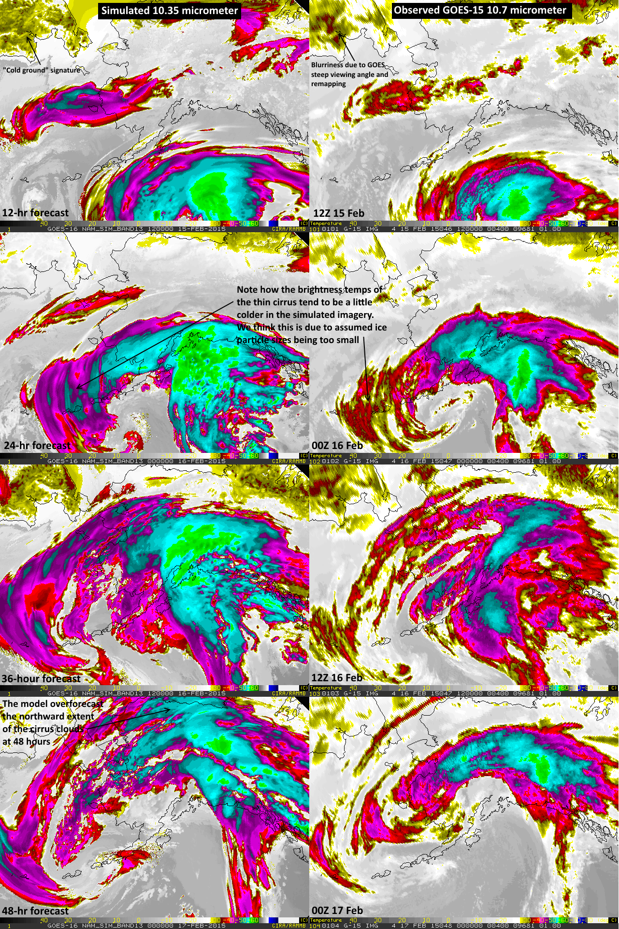
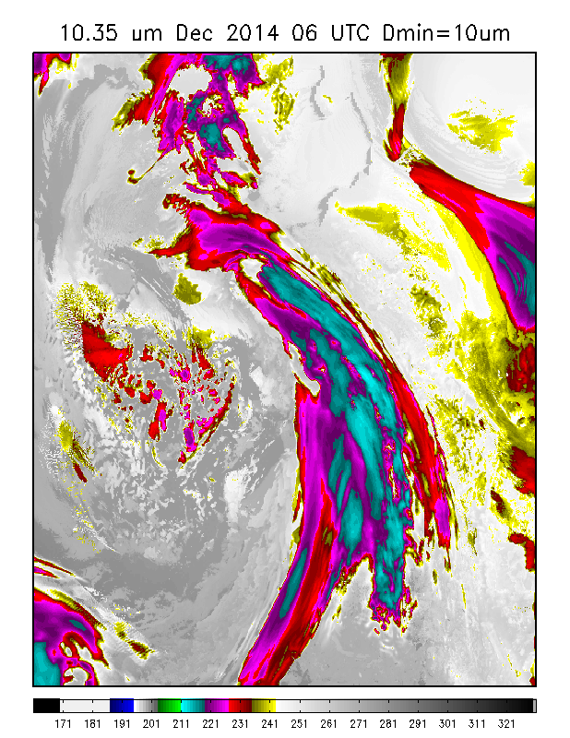
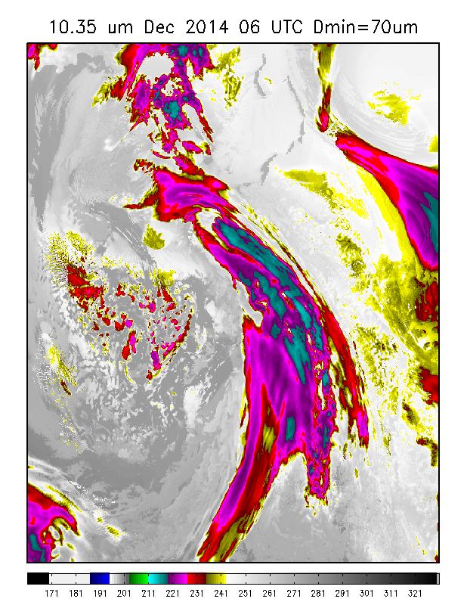
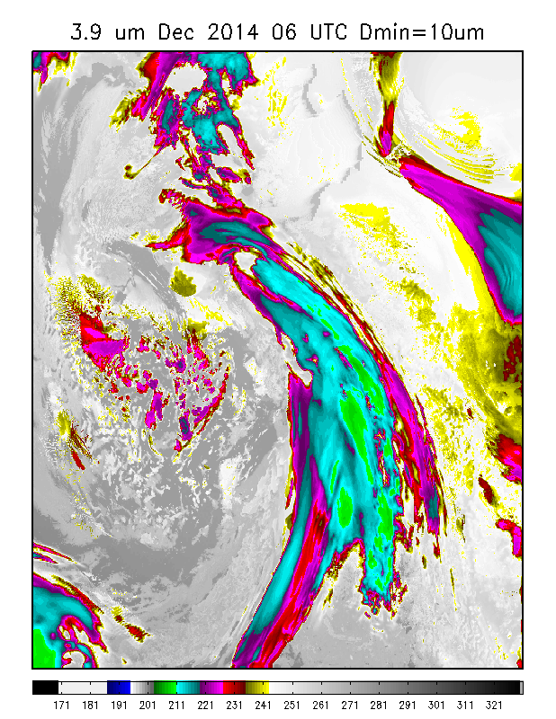
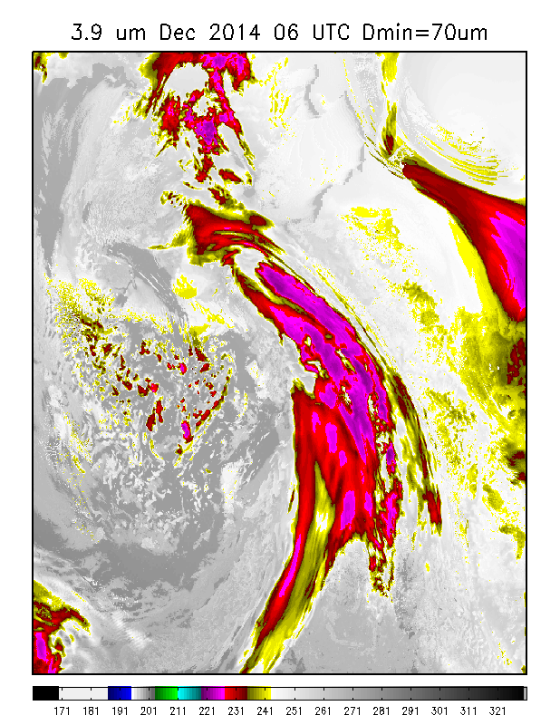
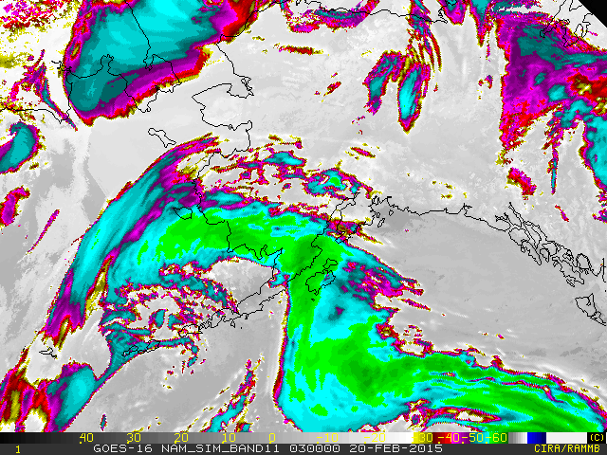
GOES-R Synthetic Imagery over Alaska
Dan Lindsey
NOAA/NESDIS, SaTellite Applications and Research (STAR)
Regional And Mesoscale Meteorology Branch (RAMMB)
Louie Grasso
CIRA/Colorado State University, Fort Collins, CO 80523-1375
Fort Collins, CO 80523-1375
E-mail: Dan.Lindsey@noaa.gov
Introduction
The generation of GOES-R synthetic Advanced Baseline Imager (ABI) data over the Continental U.S. (CONUS) began a few years ago and has provided several major benefits, including: 1) It serves as proxy data for the GOES-R ABI and can therefore be used to develop GOES-R products using the new ABI spectral bands, 2) Forecasters have provided overwhelmingly positive feedback on the helpfulness of synthetic imagery in visualizing Numerical Weather Prediction (NWP) model forecast output, and 3) Forecasters can become accustomed to how the new bands on the ABI will look. Up to this point, all synthetic imagery from high resolution NWP models has been over the CONUS and has excluded both Alaska and Hawaii. Forecasters in Alaska asked for synthetic imagery over their region in 2013, and in 2014 GOES-R Risk Reduction funds were secured to do this.
Synthetic Imagery Production
Output from the 5-km NAM Alaska Nest, including geopotential height, temperature, water vapor, and microphysical variables such as cloud water and ice are sent to CIRA
This data is used as input to the Community Radiative Transfer Model, which then outputs simulated satellite brightness temperatures at various wavelengths/bands
The brightness temperature fields are converted to various formats to be used by the National Weather Service’s operational display software
Currently the Alaska imagery is being converted to AWIPS-2 format and sent to the LDM for use by the NWS
Example Synthetic Imagery over Alaska
Figure 3: These 3 images show simulations of the 3 new water vapor bands on the ABI: 6.2 μm (top left), 6.95 μm (top right), and 7.34 μm (bottom left). They are based on 36-hour forecasts of the NAM Alaska Nest from 00Z on 18 Feb. 2015. Note that the clear-sky region in the Gulf of Alaska is increasingly warmer as the wavelength increases. This is because the weighting function shifts to lower (warmer) in the atmosphere as you go from 6.2 to 7.34 μm. Work is underway to fully understand what new information can be gleaned from the additional water vapor bands.
Figure 1: A comparison of the simulated 10.35 μm band (left column) with the corresponding observed GOES-15 10.7 μm band (right column). The images on the left are all based on forecasts from the NAM Alaska Nest from 00Z on 15 Feb. 2015. Some features of interest are denoted on the figure.
Figure 2: Synthetic 8.5 μm image from the NAM Alaska Nest based on the 51-hour forecast from 00Z run on 18 Feb. 2015. This is an example of a band that does not currently exist on the operational GOES imagers but will be available on GOES-R. Simulated data from these “new” bands will be used to assist algorithm developers in finding new an innovative uses of the additional spectral information.
Figure 4: As noted in Figure 1, synthetic infrared brightness temperatures of cirrus clouds appear to be too cold relative to observations. Our hypothesis to explain this is that the assumed particle sizes are too small. The Ferrier microphysics predicts the ice mass and riming rate, but not number concentration or particle size. Instead, a parameterization is used to assign ice particle size based on temperature only. To test our hypothesis, the minimum ice diameter in this parameterization was increased from 10 μm (left figures above) to 70 μm (right figures above). The top row shows simulated 10.35 μm and the bottom simulated 3.9 μm at night. Note the significant warming of the ice cloud brightness temperatures for both bands, but especially for 3.9 μm, when a minimum of 70 μm is used. The plan to address this issue is to compare the simulated imagery to observed imagery at 3.9 μm and 10.7 μm from GOES-13; we can then constrain the particle size and select the parameterization that best matches observations. Results from these tests will be shared with Brad Ferrier and the NAM developers.
http://rammb.cira.colostate.edu/ramsdis/online/goes-r_proving_ground.asp
Questions? Send email to Dan.Lindsey@noaa.gov . The views, opinions, and findings in this report are those of the authors, and should not be construed as an official NOAA and or U.S. Government position, policy, or decision.

