Slide 1


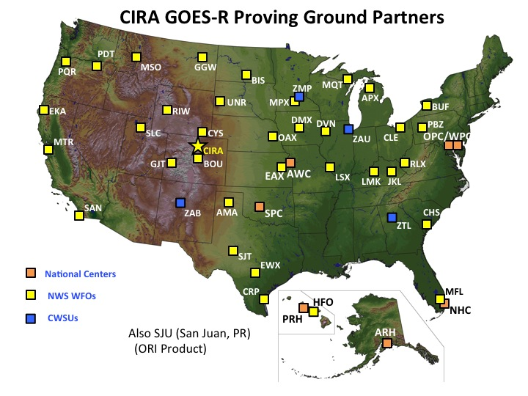
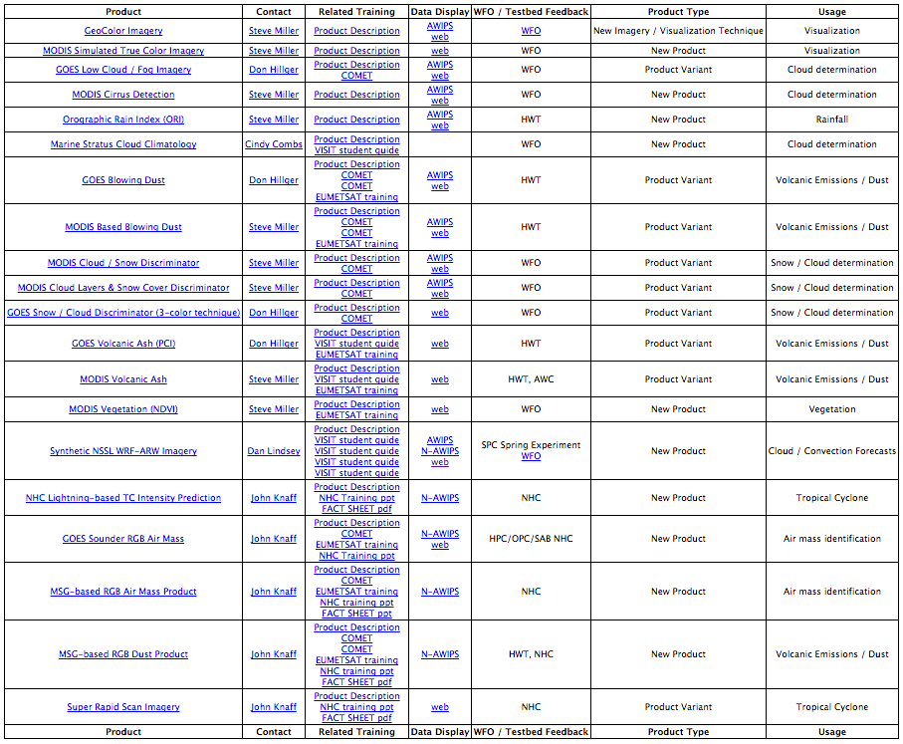
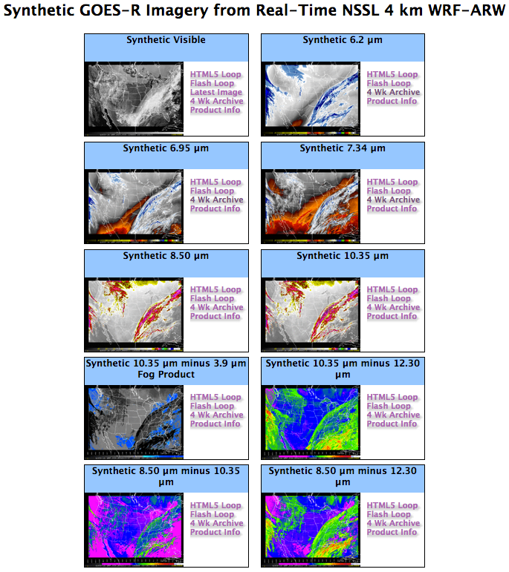
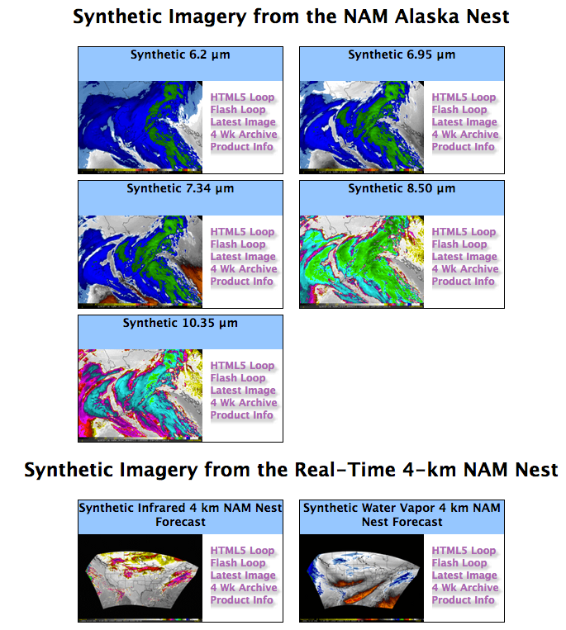
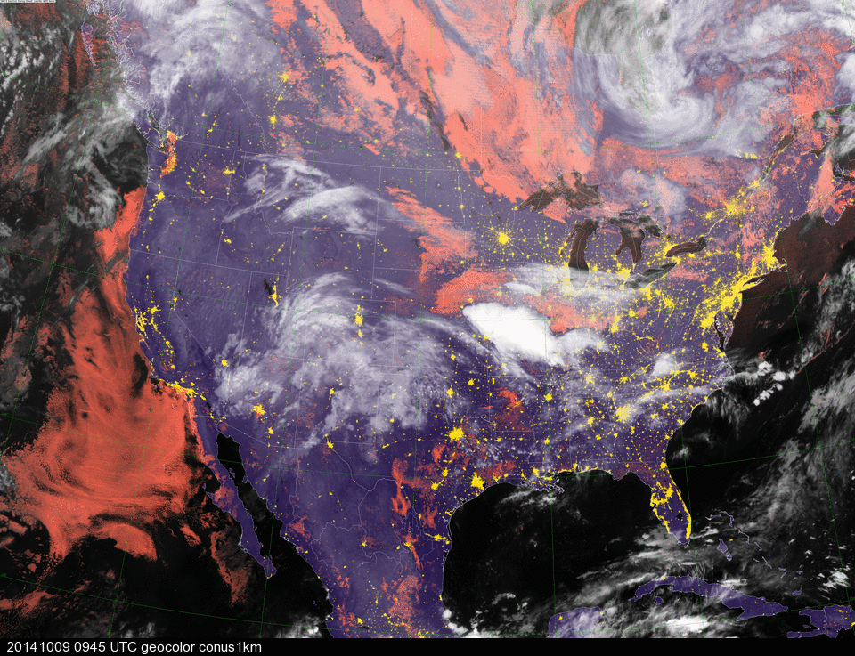
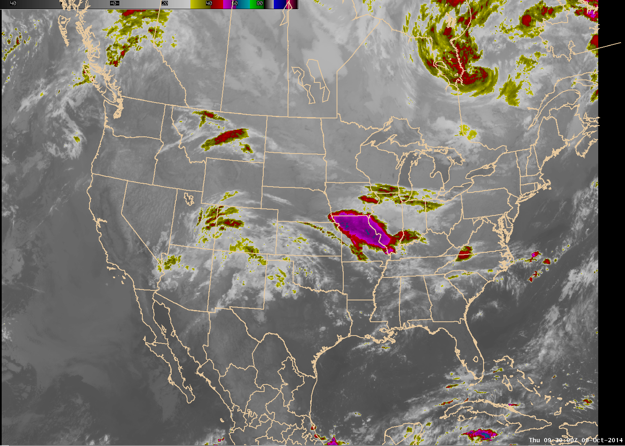
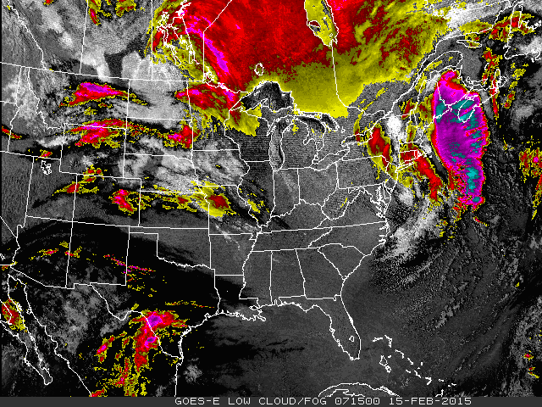
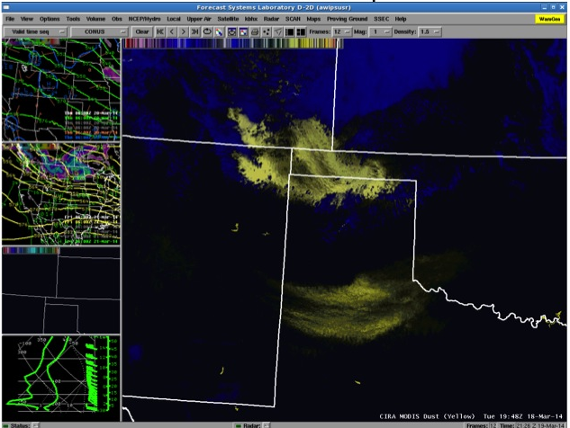
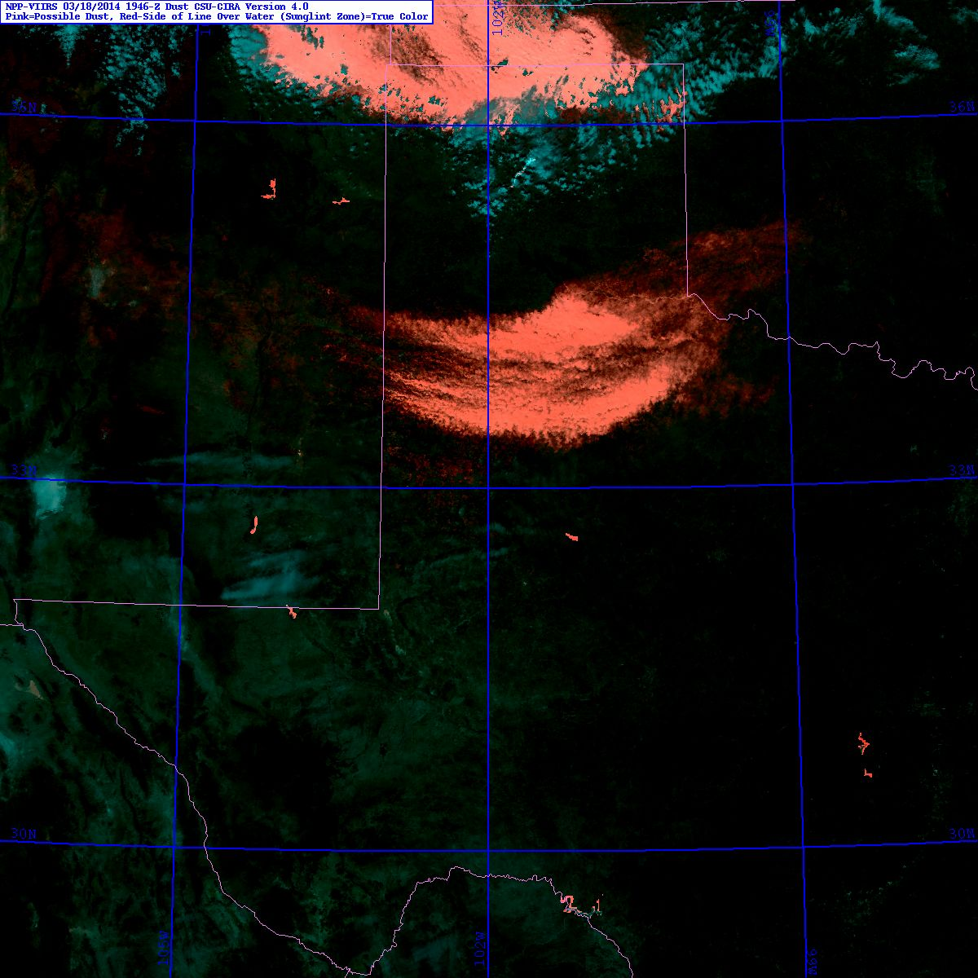
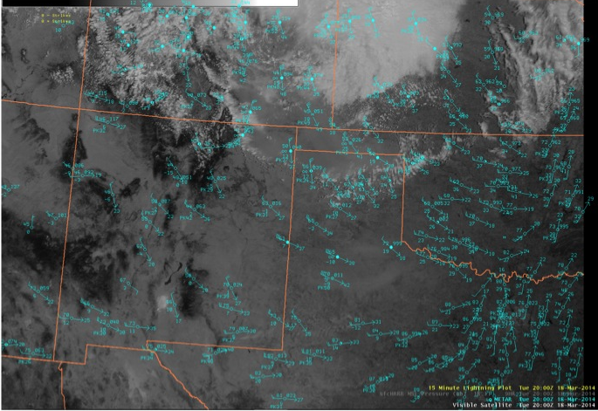
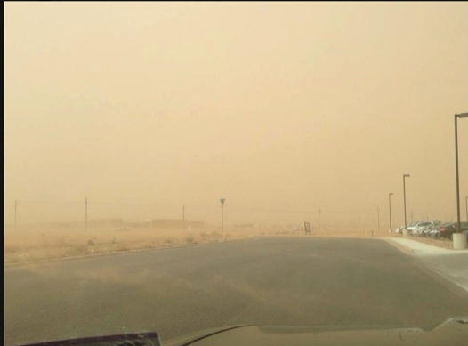
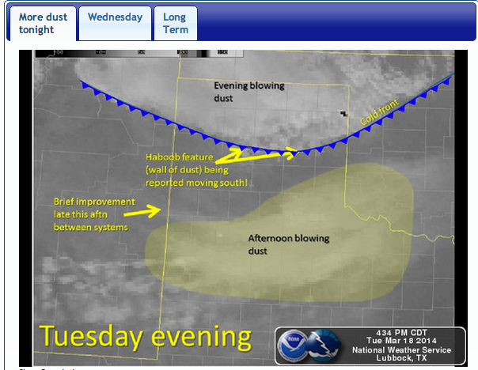
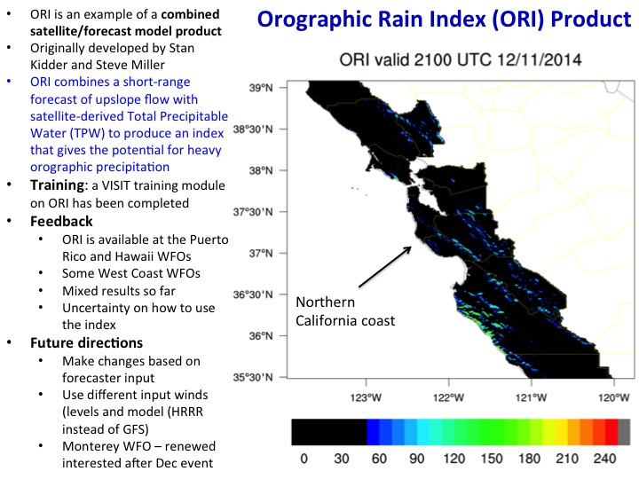
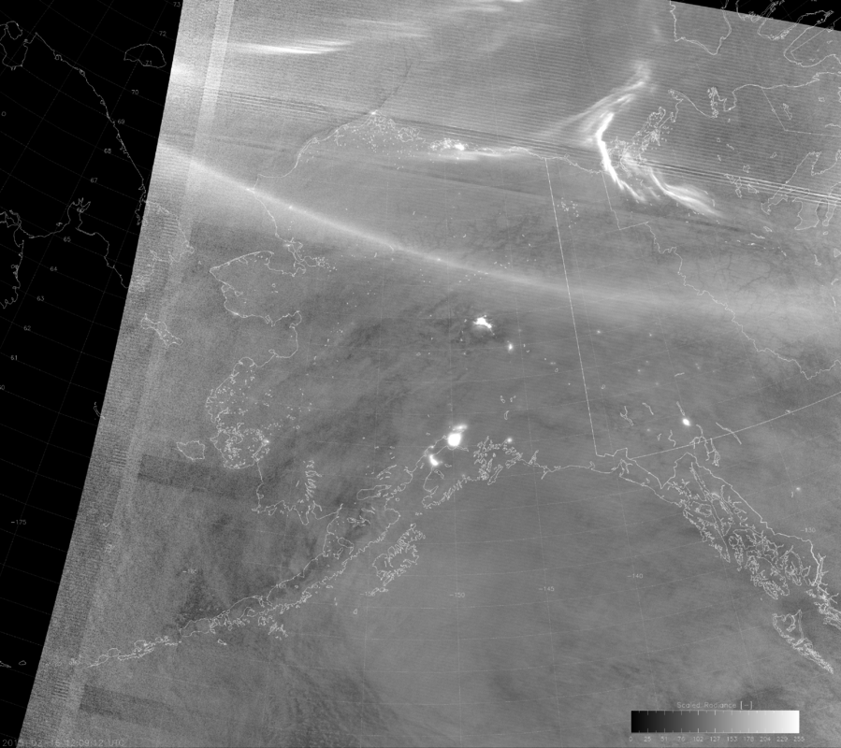
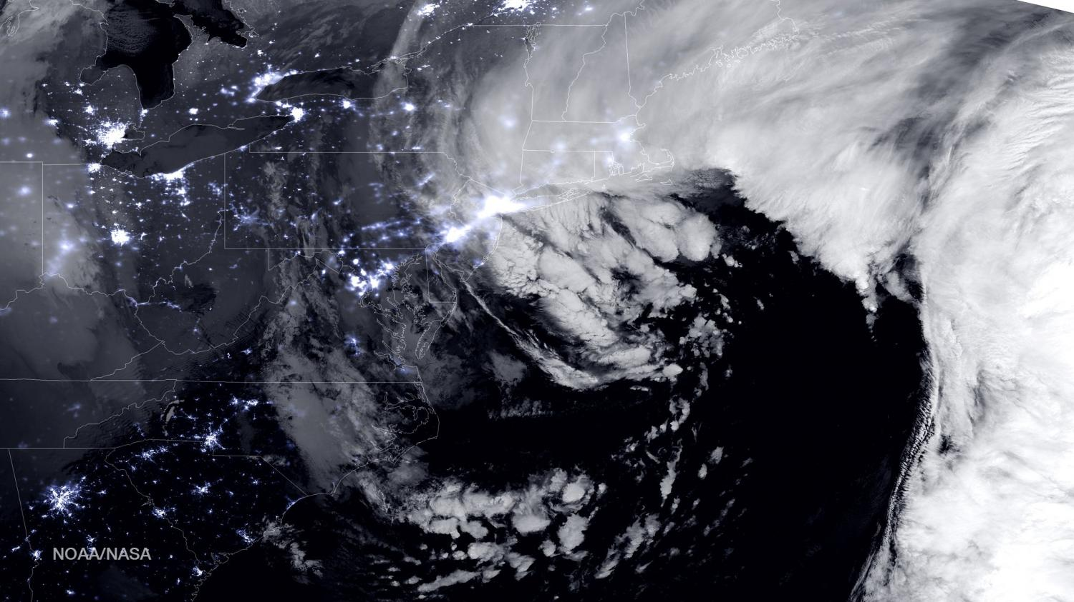
An Update of CIRA’s GOES-R and JPSS Proving Ground Activities
Ed Szoke^{1,2}, Dan Bikos¹, Renate Brummer¹, Hiro Gosden¹, Steve Miller¹, Curtis Seaman¹, Dan Lindsey³, Don Hilger³ and Deb Molenar³
¹Cooperative Institute for Research in the Atmosphere (CIRA)
²NOAA/Earth System Research Laboratory (ESRL)/Global Systems Division (GSD) (email edward.j.szoke@noaa.gov)
³NOAA/National Environmental Satellite, Data, and Information Services, Center for Satellite Applications and Research (NESDIS/STAR)
CIRA is an active Proving Ground (PG) partner along with CIMSS and SPoRT. The groups interact with a number of National Weather Service (NWS) Weather Forecast Offices (WFOs), and National Centers. This poster shows who we interact with, some of our products and forecaster feedback, and some thoughts on training as we prepare for the launch of GOES-R.
CIRA Proving Ground Products
CIRA Synthetic Imagery
(Dan Lindsey and others)
Intent is to use model generated imagery to replicate GOES-R bands.
Strategy:
Introduce forecasters to bands that they are familiar with (IR and Water Vapor currently from GOES on AWIPS).
Then add different bands and band differences to mimic GOES-R.
What happened:
The basic synthetic imagery became very popular as a way to visualize model output (akin to model radar reflectivity).
Useful for forecasting clouds & helping to populate sky cover grids
Not so much interest in using “other” bands”, but hope to improve on this with an effort to be launched by Chad Gravelle.
CIRA JPSS Proving Ground Products
CIRA uses data from the Suomi NPP satellite, which was launched in October 2011. CIRA uses the VIIRS (Visible Infrared Imaging Radiometer Suite) to demonstrate JPSS-like products. Real-time imagery can be found at
http://rammb.cira.colostate.edu/ramsdis/online/npp_viirs.asp
Future Directions:
Work with Satellite Liaison Chad Gravelle to make a more formal assessment of the 3 water vapor bands that will be available in the GOES-R era.
Examples of CIRA Proving Ground Products
Overview Products
How does CIRA create Proving Grounds products for evaluation? There are 3 methods:
Use current GOES bands and/or combined info.
From Polar orbiting satellites (MODIS and Suomi NPP) that have many of the bands that will be on GOES-R (but at much lower temporal resolution).
With model-generated “synthetic” imagery.
GeoColor at 0945z/9 Oct 2014
IR image at the same time
Low/cloud fog product at 0715z/15 Feb 2015
GeoColor imagery is an overview product that provides a seamless transition from daytime (visible) to nighttime (IR) imagery. The background is true color (daytime) or nighttime lights. In addition, low clouds and fog are highlighted during the night (pinkish color) while other clouds appear white. Compare to the IR image at about the same time.
The Low-cloud/fog product uses GOES imager data from the 3.9 and 10.7 micron bands to highlight fog and low clouds as white during both day and night, and color higher clouds.
Problem-specific products created with Polar (Suomi NPP or MODIS) imagery
Dust storm near Lubbock on 18 Mar 2014
Dust Discriminator Product example for Texas Panhandle dust storm on 18 Mar 2014 – presented in a CIRA blog post in March
Dust can be a high impact problem. Shown is a photo from the WFO Lubbock (LBB) Facebook page during this event. On the right is a WFO “Weather Story” graphic from about the time of the satellite and CIRA dust product images.
CIRA MODIS-based Yellow Dust Discrimination from product on AWIPS at 1948z on 18 Mar 2014
CIRA VIIRS-based Pink Dust Discrimination product at 1946z on 18 Mar 2014
Visible image at 2000z on 18 Mar 2014
A combined product: ORI
Day/night band imagery
A visible image at night. An algorithm developed at CIRA uses the Suomi NPP VIIRS instrument and moonlight to produce this image that has all the benefits of a visible image but at night.
Here we see the rapidly deepening low off of Cape Cod on Sunday morning, 15 Feb, as yet another storm brings heavy snow and blizzard conditions to New England.
Aurora over Alaska in the Day/night band imagery at 1205z on 16 Feb 2015
Day/night band image of the first big Nor’Easter of the remarkable last month – at 0645z on 27 Jan 2015
Looking ahead: Evaluation of potential new products through the GOES-R and JPSS Proving Grounds will continue.
Some things we have learned in our interactions as part of the Proving Ground:
Feedback - Input from forecasters is critical to help improve products. A variety of methods are used to gather feedback.
Forecasters do not all agree on the same look to a given product
- Different RGB products, for example (like the dust products)
- We had differing reactions to the GeoColor product
- Color blind issues with certain RGB combinations
We do not always anticipate the use of products
- An example is synthetic imagery – we initially introduced bands currently on AWIPS so forecasters could directly compare them to model imagery and gain confidence in the model’s ability to produce realistic imagery. This worked so well that forecasters now like synthetic imagery as a new way to look at model output, akin to radar reflectivity from high-resolution models.
Continue to work with the PG Liaisons to help evaluate products
- Expected new push with Chad Gravelle to use synthetic imagery to expose forecasters to the new
water vapor bands that will be on GOES-R
Training for the new satellite data
A lot is happening and will be ramping up as we approach the launch of GOES-R (and then JPSS-1).
We anticipate that several groups will be involved including VISIT, WDTB and COMET.
All the Proving Ground activities will make the transition easier for many forecasters who have seen some of the new products.
Still to be decided is the type and extent of training required for NWS forecasters
CIRA has been part of the VISIT (Virtual Institute for Satellite Integration Training) program for many years
Interacting directly with forecasters through live and recorded sessions and monthly “satellite chats”
Including new GOES-R products

