Slide 1


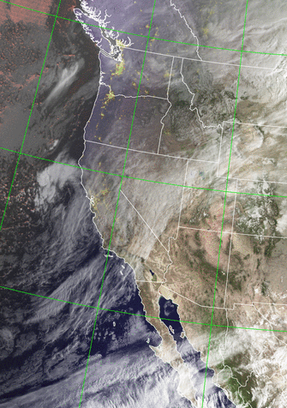
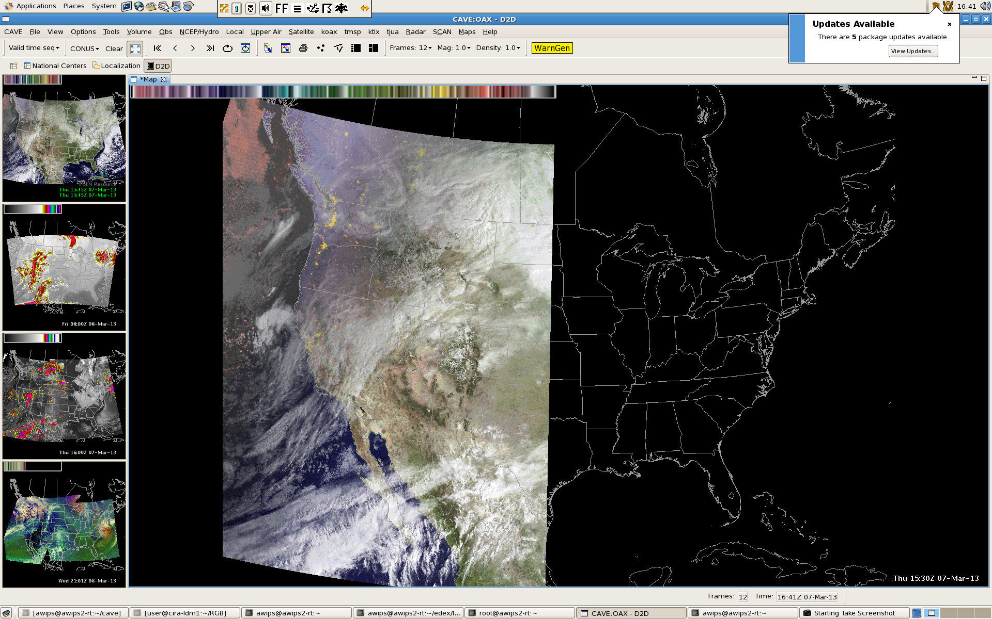
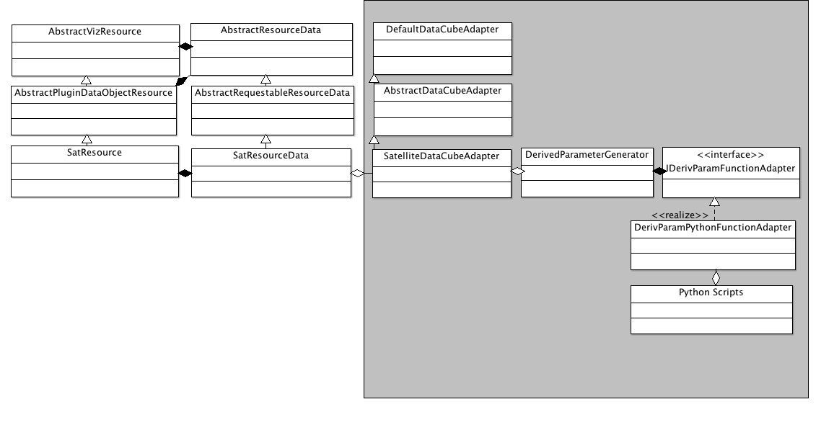
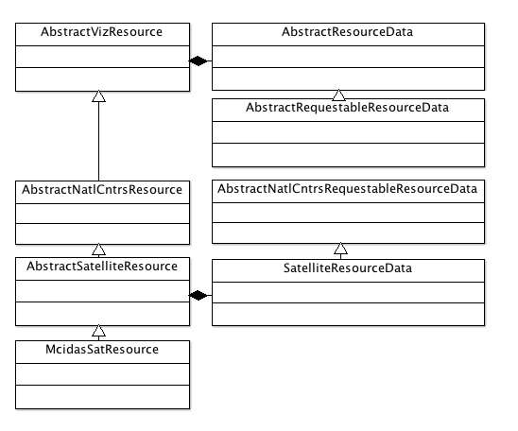
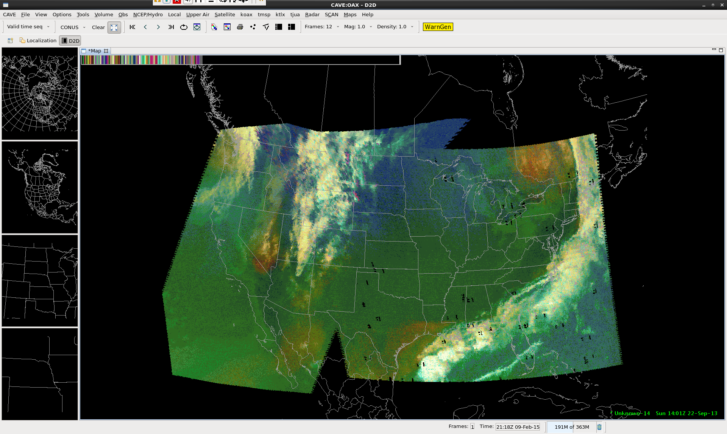
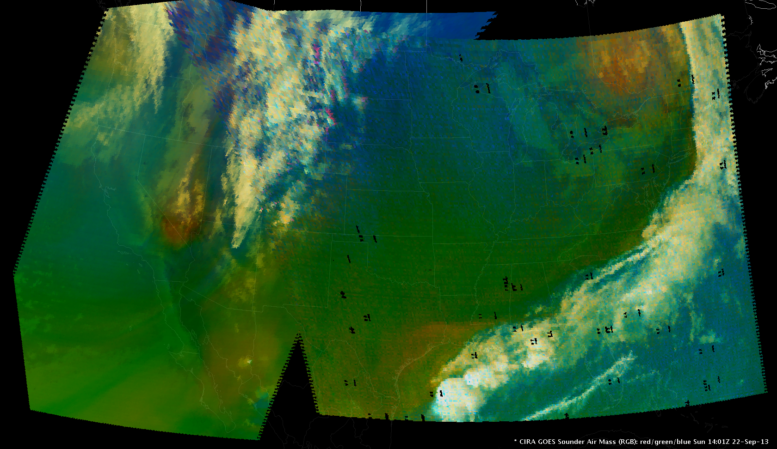
#37
CIRA GOES and JPSS RGB Product Development Updates
for AWIPS II D2D and NCP
Debra A. Molenar¹, Scott P. Longmore²
¹National Oceanographic and Atmospheric Administration (NOAA)/National Environmental Satellite, Data, and Information Service (NESDIS)/ Satellite Applications and Research (StAR), Fort Collins, Colorado
²Colorado State University (CSU)/ Cooperative Institute for Research in the Atmosphere (CIRA)/ Regional and Mesoscale Meteorology Branch (RAMMB), Fort Collins, Colorado
  Sponsored by GOES-R Proving Ground
Introduction
Artifacts in 8 bit AWIPS II GeoColor Product Due to Color Sampling
AWIPS II Current D2D Satellite RGB Visualization Implementation
With the introduction of the National Weather Service’s (NWS) Advanced Weather Interactive Processing System version 2 (AWIPS II), satellite imagery display fidelity has significantly improved from 256 colors (8-bit Red/Green/Blue (RGB)) to the possibility of over 16 million colors (32-bit with 24-bit RGB (True Color) and 8-bit overlay/transparency). This allows greater diversity and flexibility in satellite imagery display.
AWIPS II has 2 satellite image display components or perspectives. Display 2-Dimensions (D2D) has the same look and feel as AWIPS I D2D and is used primarily in the NOAA National Weather Service Forecast Offices. The National Centers Perspective (NCP) has the same look and feel as NAWIPS and will be used primarily in the NOAA National Centers. True Color visualization was already available in the AWIPS II D2D but not in NCP.
The NASA Short-Term Prediction Research and Transition Center (SPoRT) -led Experimental Products Development Team (EPDT) has developed additional software needed to extend the D2D True Color resource and leverage the D2D python derived parameter calculation capabilities to provide on-the-fly application of RGB formulas to real-time AWIPS II satellite imagery. This also allow users to manipulate RGB channels through custom python routines.
The National Center’s AWIPS II NCP RGB Development Team consists of NCEP, CIRA, SPoRT and Cooperative Institute for Meteorological Satellite Studies (CIMSS) staff. The group’s goal is to determine the best pathway to add True Color and derived parameter capabilities to the NCP leveraging existing software infrastructure in D2D.
Low cloud/fog
Low cloud/fog
D2D RGB 24bit True Color implementation:
    TrueColorResourceGroup class (not shown)
    Extends base AWIPS II visualization AbstractVizResource class
D2D Derived Parameter (macro/on the fly) capability:
      DataCubeAdapter / Derived Parameter Generator classes (grey box)
      Multi-parameter derived parameter python functions available v14.4
Artifact of color limitations
showing low clouds/fog
where none exists
AWIPS II Possible NCP Satellite RGB Visualization Implementation
24 bit GeoColor Product
8 bit AWIPS II GeoColor Product
AWIPS II D2D Display of 8 bit GOES Sounder RGB Airmass Product
AWIPS II D2D Display of 24 bit GOES Sounder RGB Airmass Product
CIRA /SPoRT GOES Sounder Air Mass Sun 14:01Z 22-Sep-13
CIRA /SPoRT GOES Sounder Air Mass Sun 14:01Z 22-Sep-13
AWIPS II D2D RGB Experimental Products Development Team:
  Kevin McGrath - NASA/SPoRT
  Jason Burks – NASA/SPoRT
  Nate Smith – NWS
  Matt Smith – NASA/SPoRT
  Debra Molenar – NOAA/NESDIS/StAR/RAMMB
  Nancy Eustice – NOAA/NWS
AWIPS II NCP RGB Development Team:
  Michael Folmer - National Centers - WCP, OCP, TAFB, SAB
  Stephen Gilbert - National Centers – NCWCP
  Kaba Bah – UW-Madison/CIMSS
  Scott Longmore - CSU/CIRA
  Kevin McGrath - NASA/SPoRT
  David Plummer - National Centers - NCWCP
EPDT members held several multi-day programming sessions at SPoRT in Huntsville, AL.
  Each session resulted in the discovery of software changes which needed to be implemented by the Raytheon AWIPS II developers before the group could continue to the next development step.
  Initial efforts resulted in an AWIPS II plugin that would require Raytheon code review before it could be implemented by users – a lengthy process.
  The current EPDT RGB capabilities can be implemented in the AWIPS II OB 14.4.1+ Localization Perspective eliminating the need for a code review.
The NCP development group met in September, 2014 at the National Center for Weather and Climate Prediction in College Park, MD
  Additional planning sessions have been held via telecon.
  Implementation method and personnel requirements for implementation still in evaluation stage.
NCP RGB 24bit True Color capability possibilities:
Leverage/Expand D2D TrueColorResourceGroup class or
Extend AbstractVizResource into new class using TrueColorResourceGroup functionality
  Significant development time needed for each approach
  1st Priority, True Color plug-in available in 14.2 which is already deployed operationally
NCP Derived Parameter possible capability:
Extend SatelliteResourceData using D2D DataCubeAdapter/DerivParamGenerator classes
Significant development time needed
2nd Priority, Multi-parameter python functions not available till 14.4
Disclaimer: The views, opinions, and findings contained in this article are those of the authors and should not be construed as an official National Oceanic and Atmospheric Administration (NOAA) or U.S. Government position, policy, or decision.
ACKNOWLEDGEMENTS:
The authors would like to thank the GOES-R Proving Ground and GOES-R Program Office for funding travel and resources needed by both projects.
Corresponding author address: Debra Molenar NESDIS/StAR, Fort Collins, Colorado 80523-1375. E-mail: Debra.Molenar@noaa.gov

