Slide 1
Diagnosing Tropical Cyclone Structure
Presented by John Knaff
with input and efforts from A. Schumacher, R. DeMaria, G. Chirokova, C. Slocum

Slide 2
Science Issue: Diagnosing Tropical Cyclone Structure
“That the research community explores automated analysis techniques, including remotely sensed and in situ observations, to specify the entire TC vortex structure.” – Recommendation to the Research Community from the WMO’s Eighth International Workshop on Tropical Cyclones
Current efforts to improve TC structure Diagnosis
IR techniques using decades of data (VIIRS and GOES-R will have the same channels)
Microwave Sounders and Imager-based techniques
Combined multi-satellite platform surface wind analyses
These methods make use of years of best-tracked wind radii from NHC/CPHC, and analyses of past aircraft reconnaissance data.

Slide 3
Enhancements with GOES-R and/or JPSS
Infrared window channels on GOES-R will have higher spatial and temporal resolution
The GLM on GOES-R is unexplored, but has potential for several applications
JPSS, like SNPP will have an ATMS and CRIS. Both offer higher spatial resolution than previous instruments.

Slide 4
Fusing ancillary data (satellite data, other data, and model analyses/forecasts)
Training datasets:
Model analyses can resolve the outer circulation of TC vortices and pre-TC disturbances.
Aircraft reconnaissance data is used to provide detailed information about the inner TC wind structure.
Wind radii or the maximum extent of 34-, 50-, and 64-knot winds are available in advisories and in best tracks
Scatterometry provides additional and independent assessment of surface winds.
Model-bases synthetic imagery can be used with the modeled TC vortex in regional hurricane models (e.g., HWRF)
Source of environmental information:
Model analyses provide boundary conditions (SST, pressure) for hydrostatic integration of satellite derived temperatures
Model analyses are routinely used to estimate large scale diagnostics (e.g. vertical wind shear, RH). Forecasts can extend that information.

Slide 5
Science or Technological Gaps
In situ observations are the greatest obstacle to understanding and diagnosing TC structure (i.e., the wind field)
Maximum 1-minute wind is never observed – this is a key parameter!
There are few observations of the radius of maximum winds – this is a key parameter!
Typically aircraft reconnaissance data needs to be composited over time to produce an analysis and that analysis can only capture some of the features and observations are at flight-level. - results in smooth products
The surface coastal network is too sparse and typically fails during hurricane events. - makes verification nearly impossible.
Satellite observations are indirect, but readily available.

Slide 6
User Demonstrations
MIRS-based ATMS and AMSU TC intensity and structure algorithms are being transitioned to OSPO operations. Fixes should make their way to the NHC/CPHC/JTWC ATCFs
Multi-Platform TC surface wind analyses v2.0 is being run at CIRA and is available via web.
Code has been written to convert these to NAWIPS format, inquires have been made to NHC.
A product that uses the operational Dvorak intensity estimates along with information derived from the matching IR image to estimate wind radii is being discussed with JTWC and NHC.

Slide 7
Examples of products

Slide 8
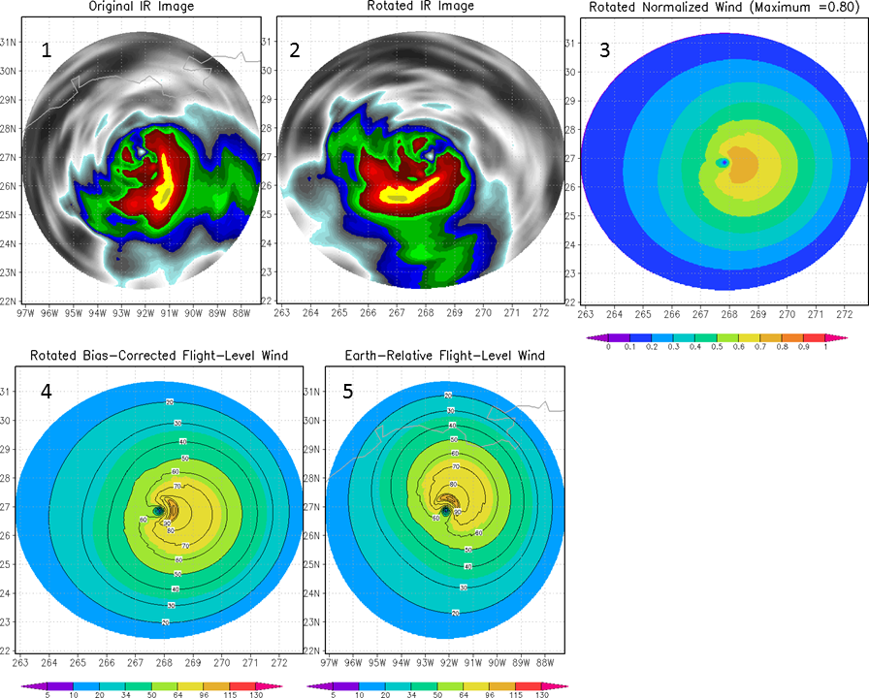
2-D Winds from IR Image, and operational data
Inputs
Procedure & Output
Intensity
Storm motion
Latitude
IR image
Knaff et al. (2015)
Uses Aircraft Reconnaissance
Single Field Principle Component Analysis
Predicts wavenumber 1&2 as a function of radius
An illustration of the steps taken to estimate the wind field. Imagery are mapped to a polar grid (1) and then rotated with respect to direction (2). Rotated imagery (via principle components), translation speed, latitude and intensity are then used to estimate the normalized wind field (3). The observed intensity is then applied to create a wind speed field (4). Finally the wind field is rotated back to its earth relative directional component (5). This case is from Hurricane Ike (2008) on September 12 at 1145 UTC.

Slide 9
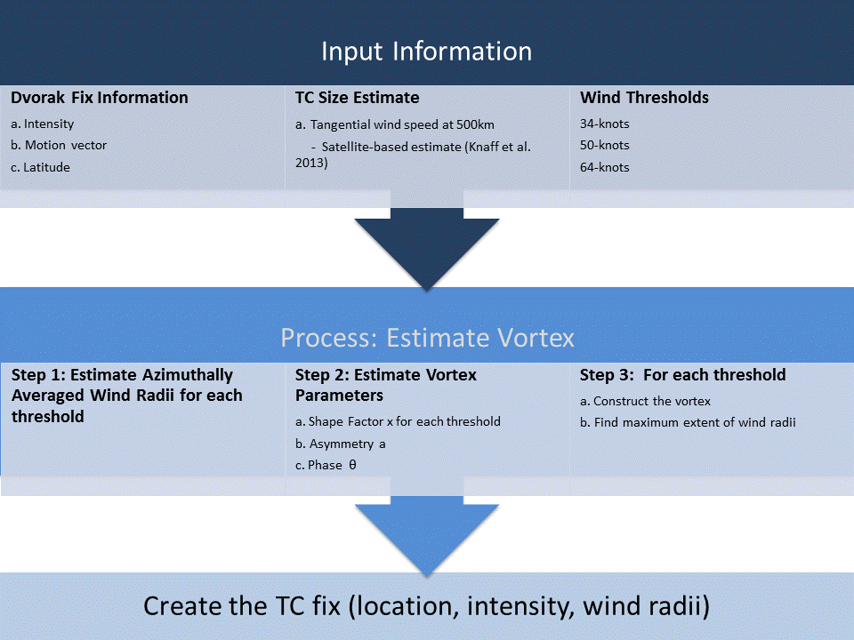
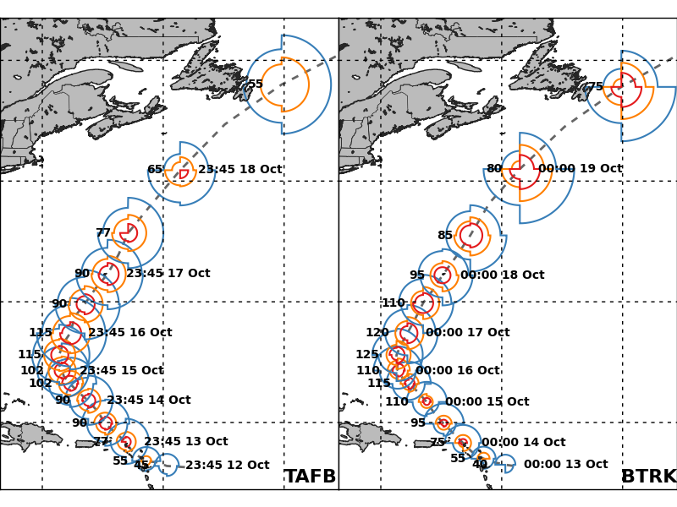
Adding Wind Radii to Dvorak Fixes
Dvorak provides
Location/motion
Intensity
Image time
Build a vortex using
TC size via imagery (Knaff et al. 2014)
Statistical relationships between TC size and the azimuthal mean wind radii
Climatological RMW (Knaff et al. 2015)
Vortex asymmetries via climatology and persistence (Knaff et al. 2007)
Fix goes to ATCF
Hurricane
Gonzalo
12-hourly
Notes:
Working Best track used.

Slide 10
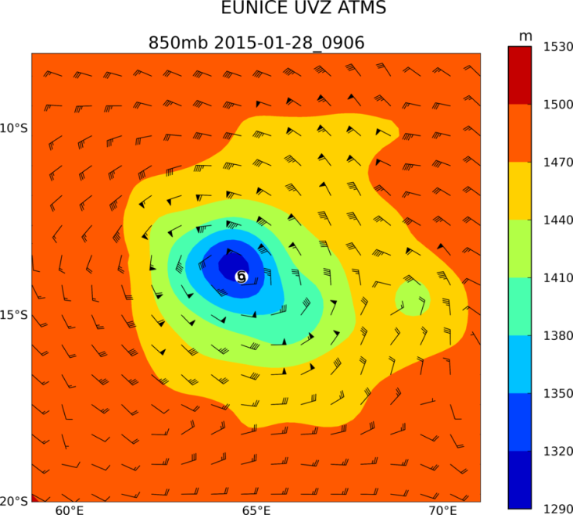
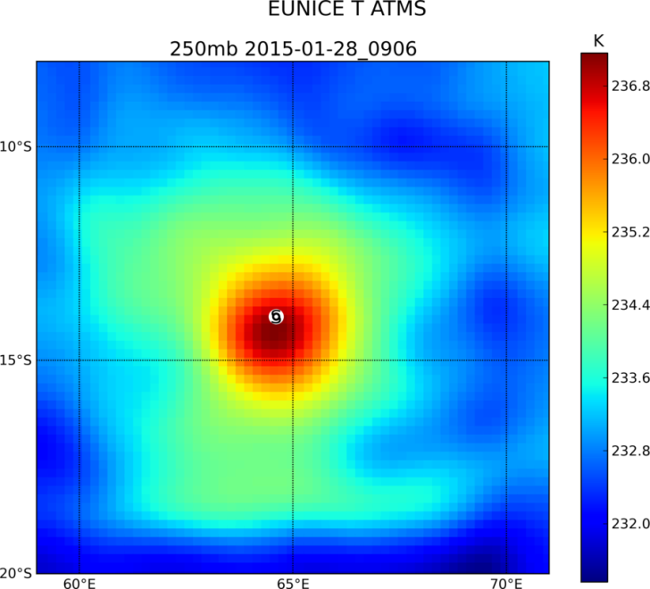
Intensity and Structure from ATMS
Inputs
Output
ATMS MIRS-based Retrievals
Storm location
NCEP SST and MSLP (edge boundary conditions)
ATCF formatted fix containing intensity (Vmax), central pressure and wind radii estimates
2-D non-linear balanced wind solutions at standard pressure levels

Slide 11
How Satellite Synthetic Imagery is Being Used
Inputs (Motion-Relative)
Method
Advantages/Disadvantages
Maximum SFC wind and storm motion (model)
Synthetic IR images from HWRF
Winds from HWRF (any pressure level & SFC) decomposed into Azimuthal wavenumber 1, 2,… Amplitudes and phases
Use the Single Field Principle component analysis technique to estimate wavenumber 1, 2,… amplitude and phase as a function of radius
Construct winds
Rotate to earth coordinates
The entire wind (other) field is represented
The entire vortex can be developed which is in balance with model resolution
Could also be used for DA
Model imagery and winds may not be representative of nature (e.g., too big, RMW too large, etc…)

Slide 12
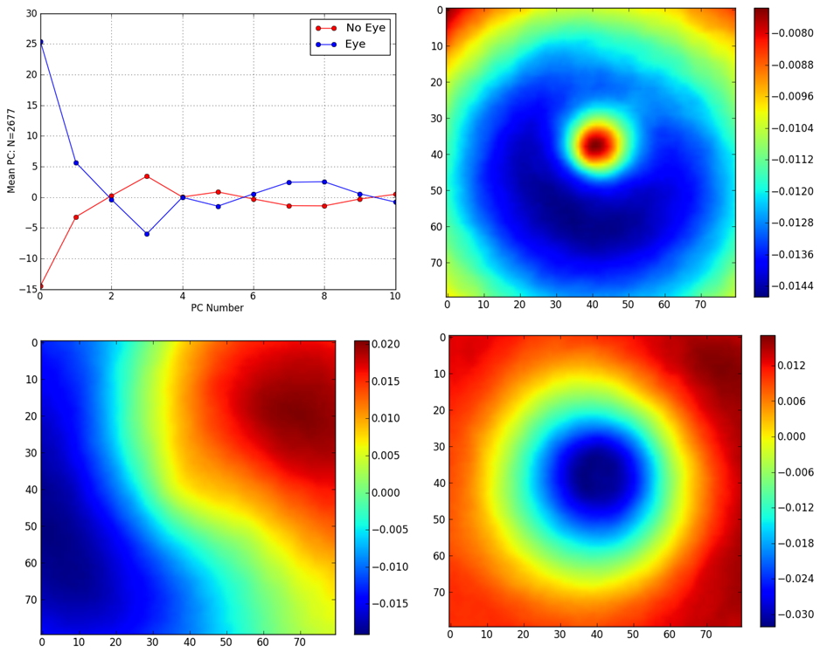
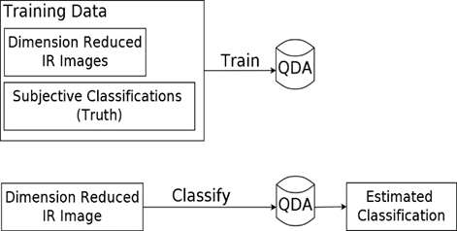
Eye Detection … and beyond
0
Eye detection algorithm has been developed (DeMaria et al. 2015)
Uses six-hourly subjective Dvorak eye classification information
Reduces dimensions via PCA
Uses Quadratic Discriminant Analysis(QDA) to provide YES/NO
Next Steps:
Refine current estimates (get the best)
Run on all images (~ 500,000)
Investigate VIIRS
Create probabilities based on QDA
Add this information to statistical Intensification tools
Begin exercise to anticipate eye formation, eye diameter (6 to 12 hours lead times)
1
3

Slide 13
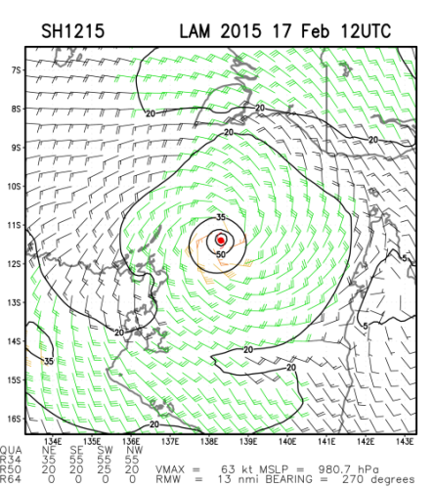
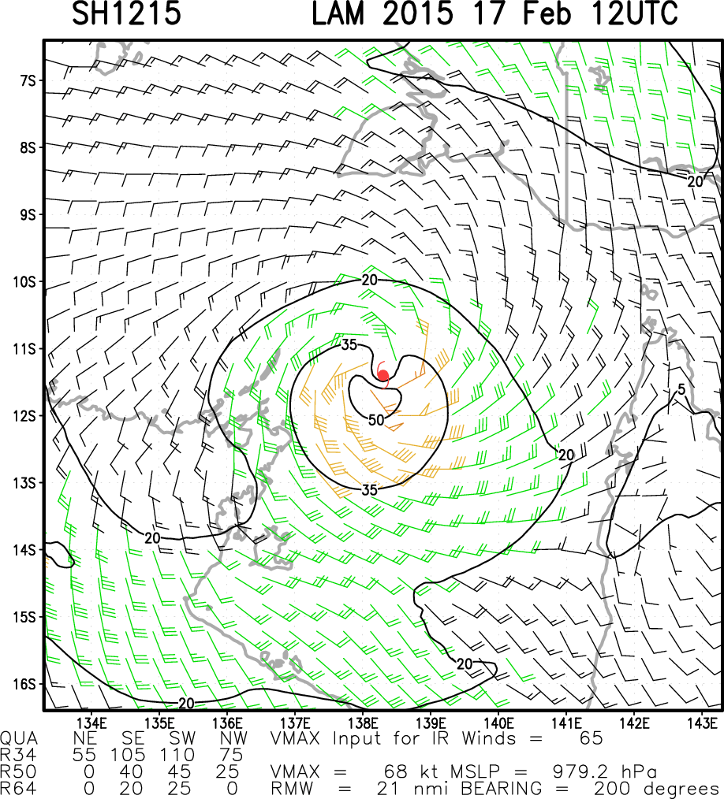
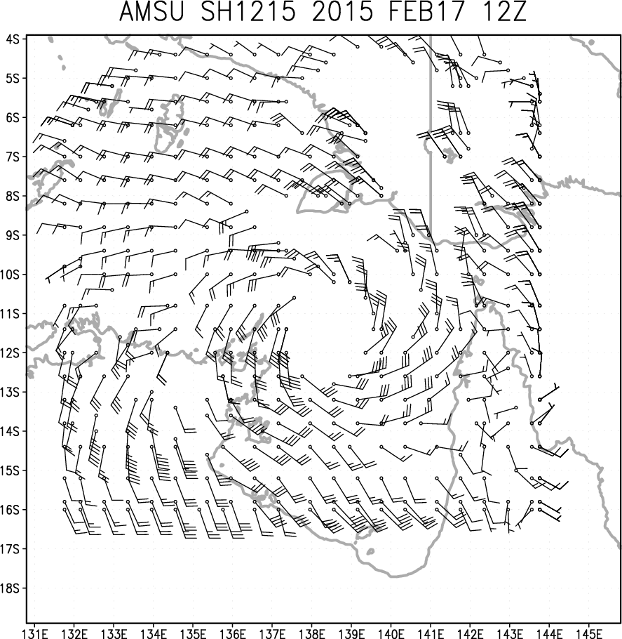
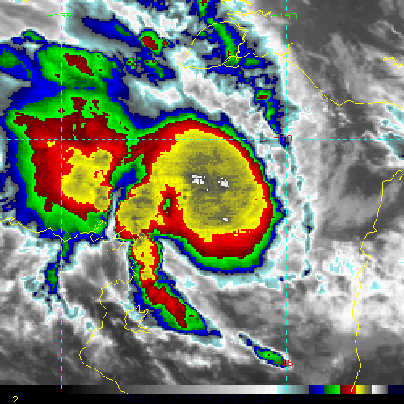
Using Multiple Satellite Inputs & Updating MTCSWA (Knaff et al. 2011)
MTCSWA V1.0 Operational MTCSWA V2.0
Uses a new technique to estimate flight-level proxy winds based on IR imagery ( single field principle component analysis)
Inflow angles provided by a new parameterization (Zhang and Uhlhorn 2012)
Flight-level-to-surface wind reductions and pressure-level-to-flight-level normalization provided by a new scheme developed in collaboration with NHC
Testing underway on the TC-Realtime Web Page

Slide 14
References:
DeMaria, R.T., G. Chirokova, J.A. Knaff, and J.F. Dostalek, 2015: Machine Learning Algorithms for Tropical Cyclone Center Fixing and Eye Detection. 20th Conference on Satellite Meteorology and Oceanography, 4-8 January, Phoenix, AZ.
Knaff, J.A., S.P. Longmore, R.T DeMaria, and D.A. Molenar, 2015: Improved tropical cyclone flight-level wind estimates using routine infrared satellite reconnaissance. Accepted to J. App. Meteor. Climate.
Knaff, J.A., S.P. Longmore, and D.A. Molenar, 2014: An Objective Satellite-Based Tropical Cyclone Size Climatology. J. Climate, 27, 455-476.
Knaff, J.A., M. DeMaria, D.A. Molenar, C.R. Sampson and M.G. Seybold, 2011: An automated, objective, multi-satellite platform tropical cyclone surface wind analysis. J. App. Meteor. Climate. 50:10, 2149-2166.
Knaff, J.A., C. R. Sampson, M. DeMaria, T. P. Marchok, J. M. Gross, and C. J. McAdie, 2007: Statistical Tropical Cyclone Wind Radii Prediction Using Climatology and Persistence, Wea. Forecasting, 22:4, 781–791.
Zhang, J. and E. W. Uhlhorn 2012: Hurricane sea-surface inflow angle and an observation-based parametric model. Mon. Wea. Rev., 140, 3587-3605.

Slide 15
Diagnosing Tropical Cyclone Structure by John Knaff with input from others
Science Issue: Diagnosing Tropical Cyclone Structure (for operations or climate)
Current efforts to improve TC structure Diagnosis include:
IR techniques
Microwave Sounders and Imager-based techniques
Combined multi-satellite platform surface wind analyses
GOES-R and JPSS provide higher spectral, temporal, and spatial datasets and maintain the legacy of previous satellite missions
Fusing ancillary data is a necessity
Training data (best track wind radii, aircraft reconnaissance, model analyses for outer structure, scatterometry)
Source of environmental information (Model analyses for large-scale diagnostics, synthetic imagery)
In situ observations are the greatest obstacle to understanding and diagnosing TC structure
User Demonstrations will be done through operational transition, ATCF fixes, and web products this year

