Slide 1

GOES-R Risk Reduction Status
Dan Lindsey and Andy Heidinger
Cooperative Research Program (CoRP)
NOAA/NESDIS/STAR
NOAA SATELLITE SCIENCE WEEK, 2015
February 23, 2015

Slide 2
FY14-15 GOES-R Risk Reduction Projects
Blue shading = poster on this topic at Science Week
Green shading = oral presentation on this topic at Science Week
Five Projects are in the their final funding cycle:
GOES-R Future Capability Proposal: Advancement of Satellite-Detected Overshooting Top (OT) Decision Support Products (Bedka and Velden) (Poster #3 on Tuesday)
GOES-R Future Capability: Fog and Low Cloud Detection and Characterization (Pavolonis)
RGB Product development in AWIPS-2 (Molenar, Jedlovec, and Schmit) (Poster #37 on Thursday)
The GOES-R GLM Lightning Jump Algorithm: A National Field Test for Operational Readiness (Carey and Calhoun) (Wed. 10:50am talk)
Convective Initiation and 0-6 hr Storm Nowcasting for GOES-R (Mecikalski and Weygandt) (Poster #16 on Tuesday)

Slide 3
FY14-15 GOES-R Risk Reduction Projects
19 Projects were awarded funding last year for FY14 new starts:
Development and Optimization of Mesoscale Atmospheric Motion Vectors (AMVs) using Novel GOES-R Processing Algorithms on 1-5 min. SRSO Proxy Data, and Demonstration of Readiness for GOES-R Applications via Impact Studies in Mesoscale Data Assimilation and NWP Systems (Velden and Weygandt) (Poster #20 on Tuesday)
Synthetic Imagery Generation over Alaska and Hawaii for GOES-R Product Development (Lindsey and Grasso) (Poster #26 on Thursday)
Satellite Product Analysis and Distribution Enterprise System (SPADES) (Denig) (Tuesday afternoon oral presentations)
Diagnosis and anticipation of tropical cyclone behavior from new and enhanced GOES-R capabilities (Knaff) (Thursday afternoon 1:30pm oral presentation)
Using total lightning data from GLM/GOES-R to improve real-time tropical cyclone genesis and intensity forecasts (Schumacher and Fierro) (Poster #33 on Thursday)
GOES-R Volcanic Ash Risk Reduction: Operational decision support within NOAA's Rapid Refresh (RAP) (Stuefer and Webley)

Slide 4
FY14-15 GOES-R Risk Reduction Projects
19 Projects were awarded funding last year for FY14 new starts:
Development of real time all-weather layer precipitable water products in AWIPS-2 by fusing the GOES-R and NWP for local forecasters (Li)
Improving Real-time GOES-R Rainfall Rate Estimates through Infusion of Ground Radar and Gauge Data and Evaluating the Impacts on NWS Flash and River Flood Prediction (Zhang)
Developing Integrated Satellite and Gauge-Radar-Satellite-Model Fused Precipitation Estimates for Real-time Weather, Hydrometeorology and Hazards Monitoring (Xie)
Assimilation and forecast impact of high temporal resolution Leo/Geo AMVs in the high-latitude data-gap corridor (Hoover)
Toward an operational use of stroke level lightning data in severe weather forecasting (Bitzer)
Applications of concurrent super rapid sampling from GOES-14 SRSOR, radar and lightning data (Rabin)

Slide 5
FY14-15 GOES-R Risk Reduction Projects
19 Projects were awarded funding last year for FY14 new starts:
Using Multi-sensor Observations for Volcanic Cloud Detection, Characterization, and Improved Dispersion Modeling (Pavolonis)
Real-Time Monitoring and Short-term Forecasting of Phenology from GOES-R ABI for the Use in Numerical Weather Prediction Models (Yu)
Development of GOES-R ABI Hail Validation and Assessment Products (Gallo)
Enhance NCEP-NAM Model Forecasts via Assimilating Real-time GOES-R Observations of Land Surface Temperature and Vegetation Dynamics (Zhan)
Development of a Near Real-time Satellite Verification and Forecaster Guidance System for the High-Resolution Rapid Refresh (HRRR) Model (Otkin and Sieglaff)
Towards providing forecasters with better identification and analysis of severe pyroConvection events using GOES-R ABI and GLM Data (Baum and Bachmeier)
Improving Hurricane and Coastal Quantitative Precipitation Forecasts through Direct Assimilation of GOES-R ABI Radiances in HWRF (Weng)

Slide 6
FY14-15 GOES-R Risk Reduction Projects
4 Projects were awarded funding for FY15 new starts:
Probabilistic Forecasting of Severe Convection through Data Fusion (Pavolonis) (Wed. afternoon 1pm talk)
Development and Demonstration of a Coupled GOES-R Legacy Sounding NearCast with Convective Initiation Products to Improve Convective Weather Nowcasts (Cronce)
Advanced RGB Visualization Products for GOES-R ABI (Miller)

Slide 7
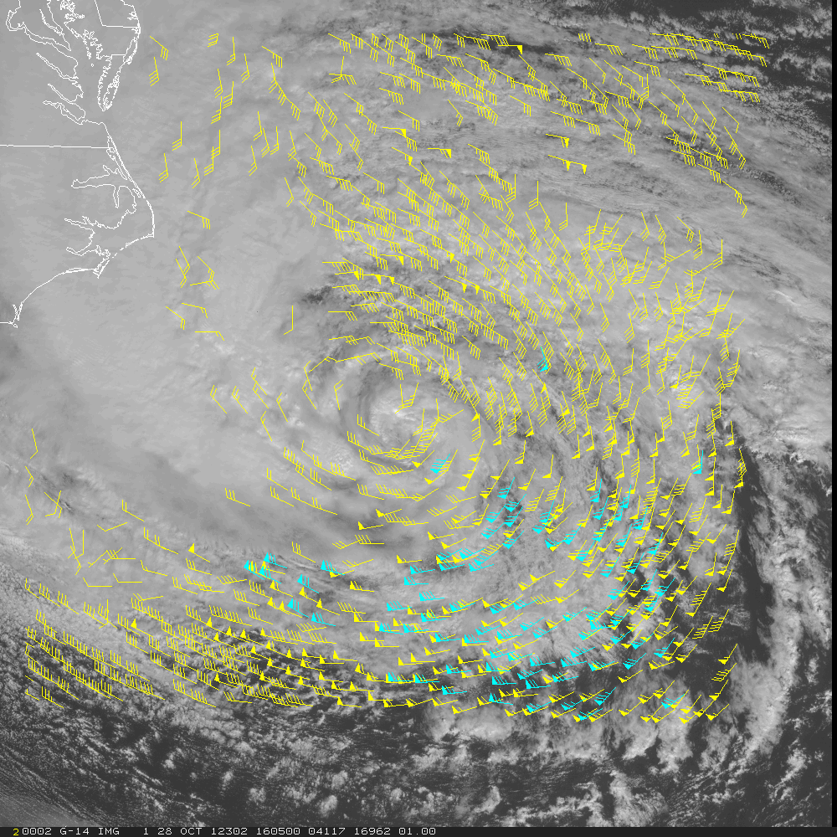
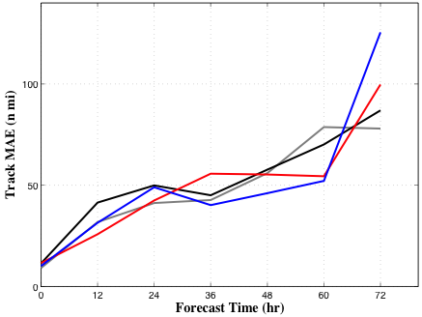
Some Selected Preliminary Results
Development and Optimization of Mesoscale Atmospheric Motion Vectors (AMVs) using Novel GOES-R Processing Algorithms on 1-5 min. SRSO Proxy Data, and Demonstration of Readiness for GOES-R Applications via Impact Studies in Mesoscale Data Assimilation and NWP Systems (Velden and Weygandt)
H214 CTL AMV1 AMV3
Hurricane Sandy 1-minute mesoscale AMVs (left), and results of Sandy assimilation experiments (above)
Hurricane force winds (> 75 mph)

Slide 8
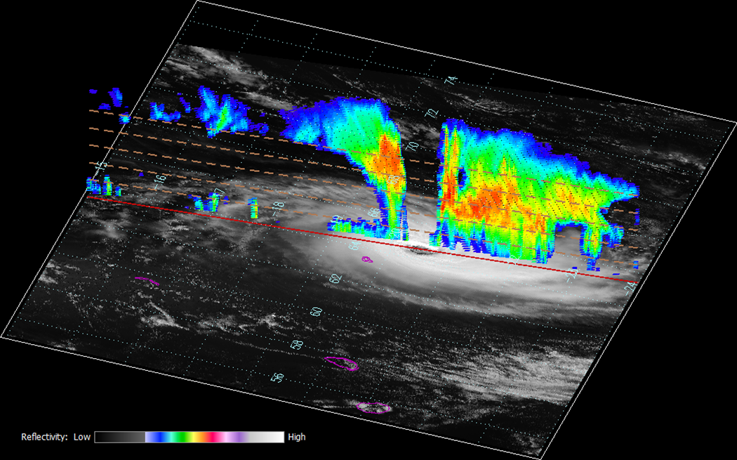
Some Selected Preliminary Results
Diagnosis and anticipation of tropical cyclone behavior from new and enhanced GOES-R capabilities (Knaff)
Tropical Cyclone Amara on December 21, 2013 at 0937 UTC in the southwest Indian Ocean MODIS imagery with 3-D cross track of CloudSat reflectivity. Vertical brown dashed lines are 2 km height lines.

Slide 9
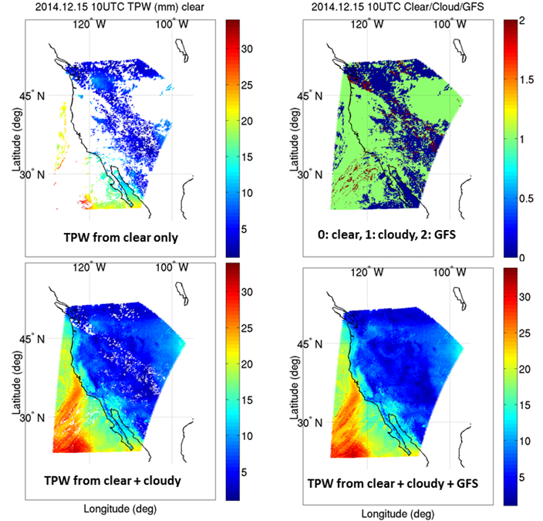
Some Selected Preliminary Results
Development of real time all-weather layer precipitable water products in AWIPS II by fusing the GOES-R and NWP for local forecasters (Li)
Example of GOES-15 Sounder TPW (mm) retrievals under clear skies only (upper left), under both clear and some cloudy skies (lower left), the distribution of each type (clear, cloudy, and GFS, upper right), and the TPW including clear, cloudy, and GFS (bottom right).

Slide 10
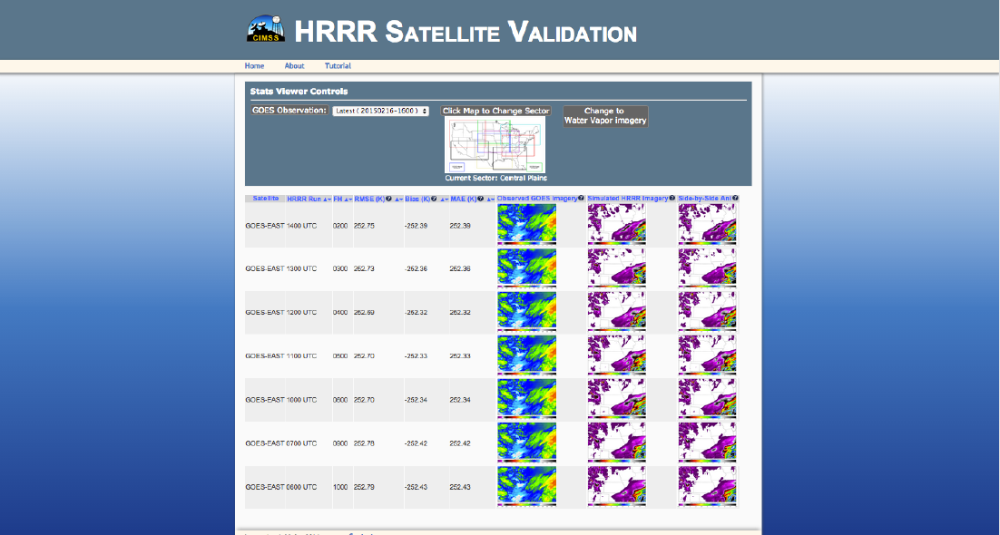
Some Selected Preliminary Results
Development of a Near Real-time Satellite Verification and Forecaster Guidance System for the High-Resolution Rapid Refresh (HRRR) Model (Otkin and Sieglaff)
A screen capture showing the end-user’s visualization of the simulated HRRR output on the
prototype project webpage. After selecting a sector of interest, a user can choose the GOES observation time and band to analyze for a given model sector and then sort the table by various validation metrics.

