Slide 1


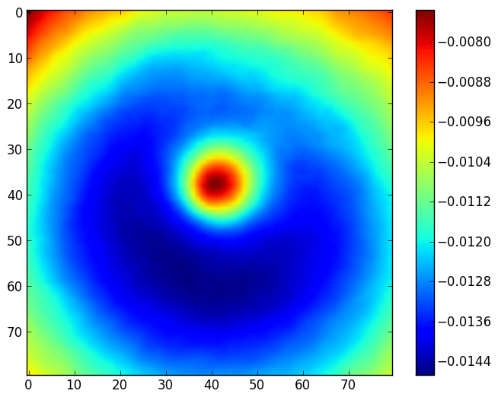
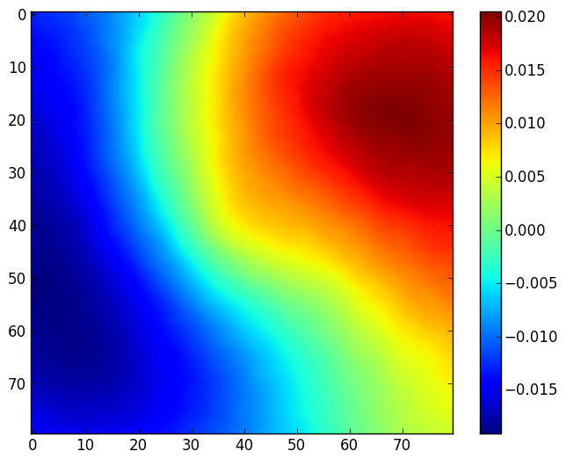
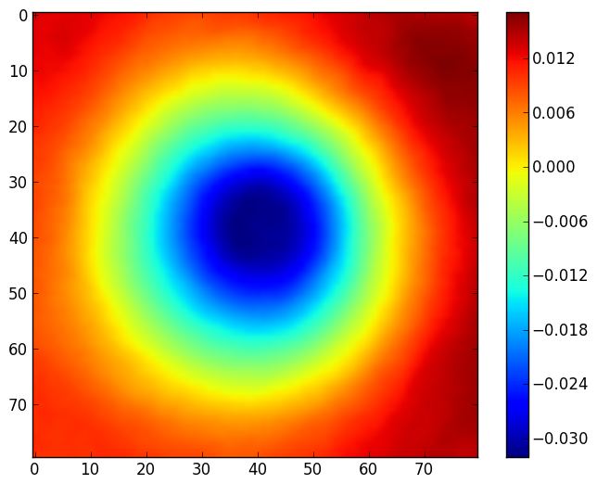
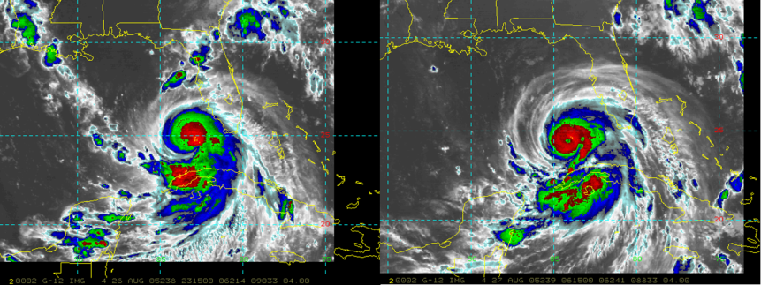
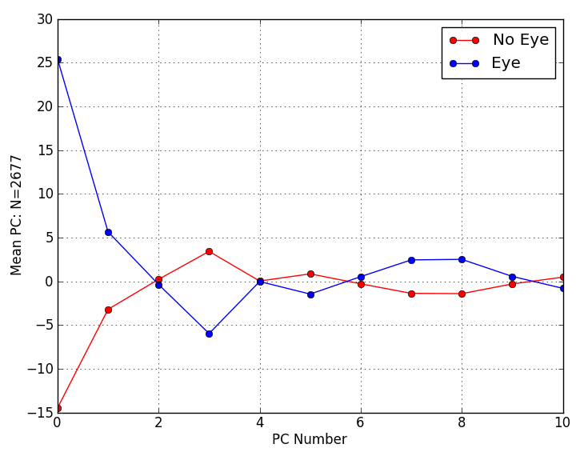
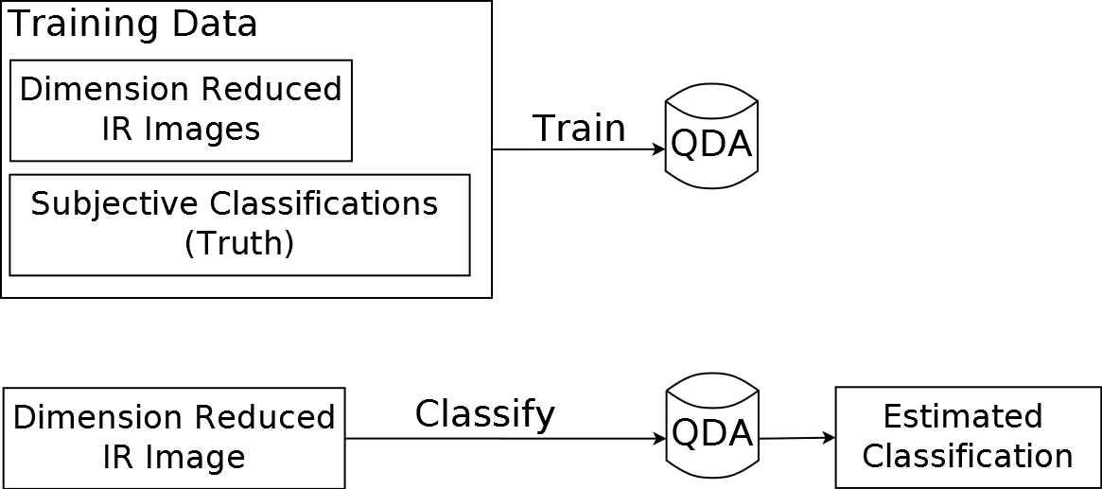
Objective Methods for Tropical Cyclone Center
Fixing and Eye Detection
P2-31
Robert DeMaria¹, John Knaff², John Dostalek¹, and Galina Chirokova¹
(1) CIRA, Colorado State University, Fort Collins, CO (2) NOAA/NESDIS/StAR, Fort Collins, CO
Contact: Robert.DeMaria@colostate.edu
Introduction
Principle Component Analysis/Class Separability
Preliminary Results
Formation of a tropical cyclone eye is often associated with intensification [1]. Currently, determination of eye formation from satellite imagery is generally performed subjectively. Thus, not all available imagery is utilized. An automated method of performing eye detection would be highly desirable to improve forecasts sensitive to this information. This development would also assist with automated tropical cyclone center fixing algorithms using ATMS data. Additionally, the eye detection algorithm may be improved by using VIIRS data.
In order to gain an accurate view of how well the eye-detection algorithm performs, the algorithm was run 1200 times. Each time, the input data was shuffled and then partitioned into different training and testing sets. Figures 5 and 6 show the accuracy/error statistics averaged over all of these runs. Figure 5 shows that, on average, roughly 75% of the images were correctly classified.
Images with eyes in them were correctly classified approximately 78% of the time and images without eyes were correctly classified about 72% of the time. Figure 6 illustrates that, on average, 28% of the images without eyes were incorrectly classified (False Positive). Additionally, roughly 22% of the images with eyes were incorrectly classified (False Negative).
Eye Detection Data
Figure 2. Eigenvectors produced from the IR dataset. Eigenvector 0 (top), eigenvector 1 (left), eigenvector 3 (right)
Using Principle Component Analysis (PCA) [4] on the training dataset, 11 eigenvectors were found that account for 90% of the variance of the data. By projecting the training and testing data onto these eigenvectors, the dimension of the data is reduced. This allows for the separability of the two classes to be inspected (Figures 2 and 3). Additionally, this allows machine learning algorithms to more easily perform classification.
Figure 5. Average probability an image will be correctly classified.
Figure 6. Average probability an image will be incorrectly classified
Future Plans
Figure 3. Mean principle components for the “Eye-Absent” and “Eye Present” classes. Eigenvectors 0, 1 and 3 seem to separate the two classes the best.
Work will be performed to determine which cases the algorithm performs poorly on. A confidence measure will be added to the output. Additional data may be added to the input. The estimated classifications may be used as input to a forecast and evaluated to determine if it improves the accuracy of the forecast. The eye detection estimates may also be used as input to an automated center-fixing routine and statistical intensity forecast models. Since the eye may be a small feature, the algorithm may be improved by using high resolution VIIRS imagery.
Figure 1. Example IR images from Hurricane Katrina. Boxes show the selection of pixels used with the algorithm. Image classified as “eye absent” (top). Image classified as “eye present” (bottom)
Quadratic Discriminant Analysis
A dataset of 2677 IR images [2] containing tropical cyclones with wind speeds >50kt has been assembled for use with this project.
Within each of these images, a small selection of pixels near the storm center were included for use with the algorithm. Produced as part of the Dvorak method [3] applied by the National Hurricane Center, each image has a subjective classification of whether an eye is present at the time of the image. These subjective classifications are considered truth in this project. To evaluate the quality of the eye detection, these data were randomly shuffled and partitioned so 70% of the data would be used for training and 30% would be used for testing.
Figure 4: Once trained, the QDA implementation can be used to perform classification on new images not belonging to the training set.
References
[1] Vigh, J. L., J. A. Knaff, W. H. Schubert “A Climatology of Hurricane Eye Formation”, 2012: Mon. Wea. Rev., 140, pp. 1405-1426
[2] Knaff, J. A., S.P. Longmore, D. A. Molenar, 2014: An Objective Satellite-Based Tropical Cyclone Size Climatology. J. Climate, 27, 455-476.
[3] Velden, C., B. Harper, F. Wells, J. L. Beven II, R. M. Zehr, T. Olander, M. Mayfield, C. Guard, M. Lander, R. Edson, L. Avila, A. Burton, M. Turk, A. Kikuchi, A. Christian, P. Caroff, P. McCrone. 2006: The Dvorak Tropical Cyclone Intensity Estimation Technique. Bull. Amer. Meteor. Soc., pp. 1195-1210.
[4] Zito, T., N. Wilbert, L. Wiskott, and P. Berkes, 2009: Modular toolkit for Data Processing (MDP): a Python data processing frame work. Front. Neuroinform. 2:8. doi:10.3389/neuro.11.008.2008.
Disclaimer: The views, opinions, and findings contained in this article are those of the authors and should not be construed as an official National Oceanic and Atmospheric Administration (NOAA) or U.S. Government position, policy, or decision.
The training set with reduced dimension was used to train a Quadratic Discriminant Analysis (QDA) implementation [4]. Estimated classifications were then generated for each of the images in the testing set. These estimated classifications were then compared to the subjective classifications to measure the error.

