Slide 1
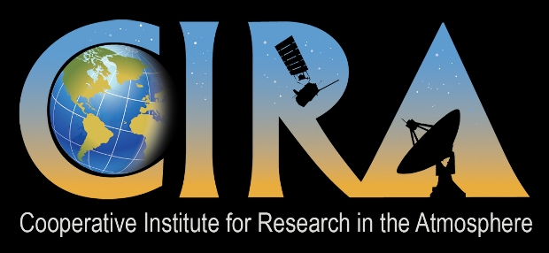
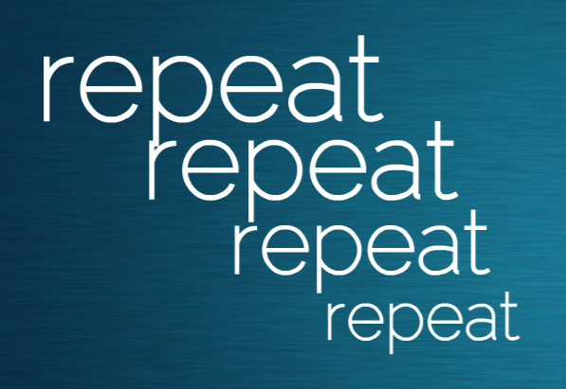
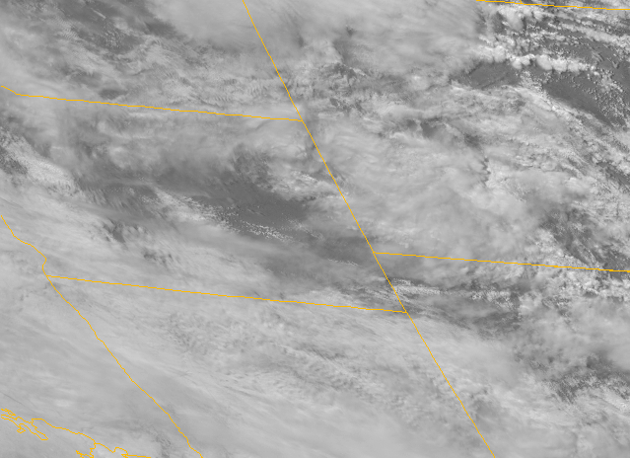
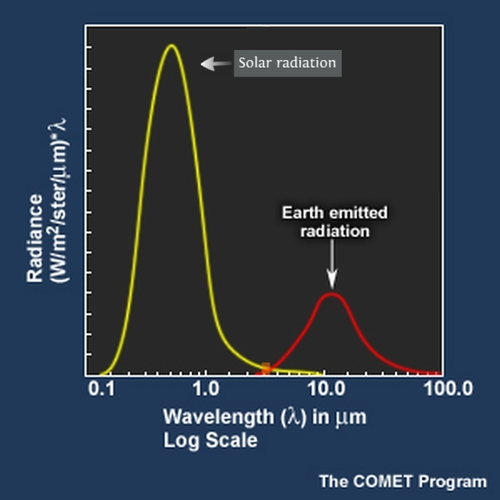
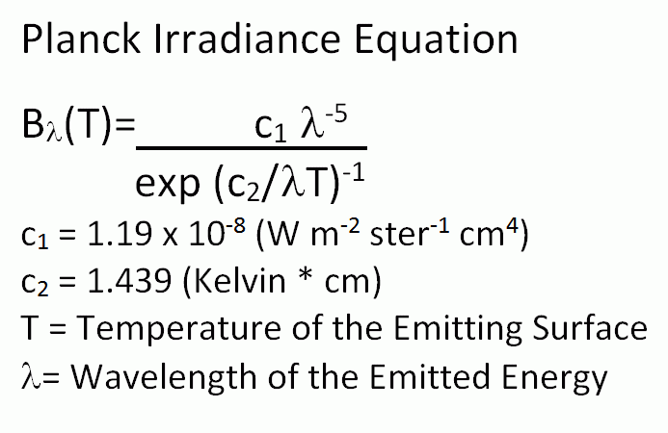
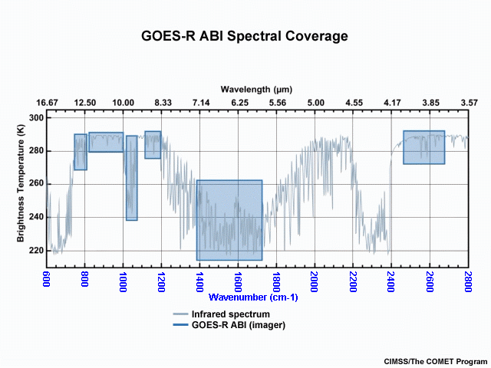
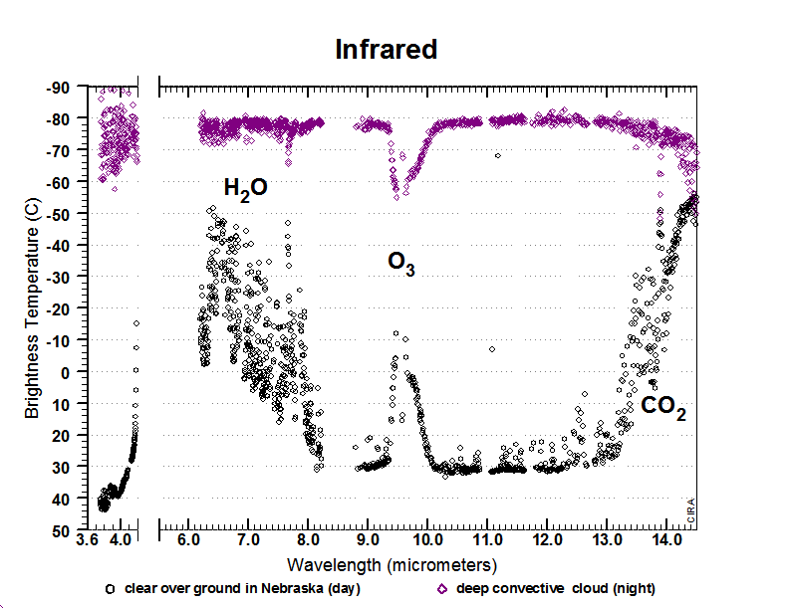
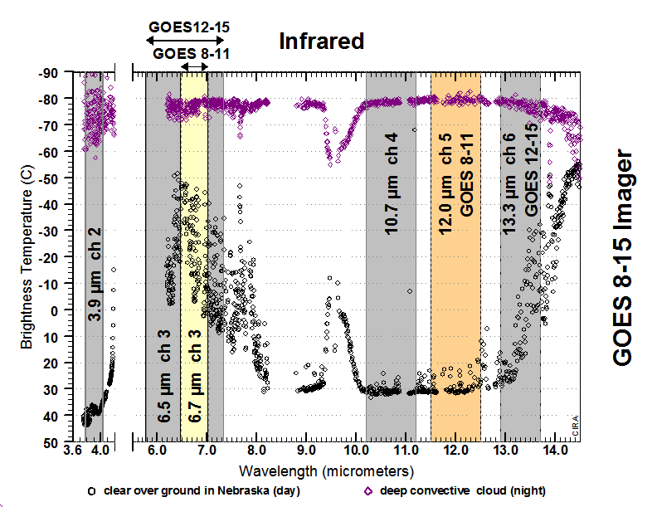
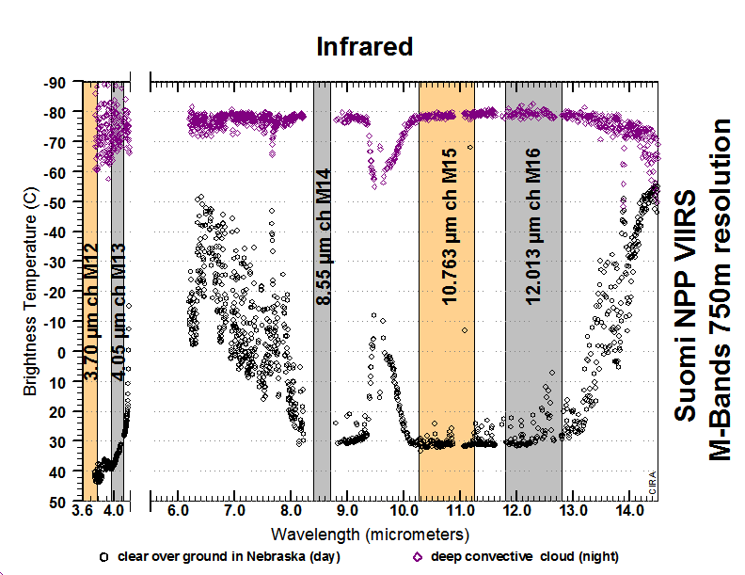
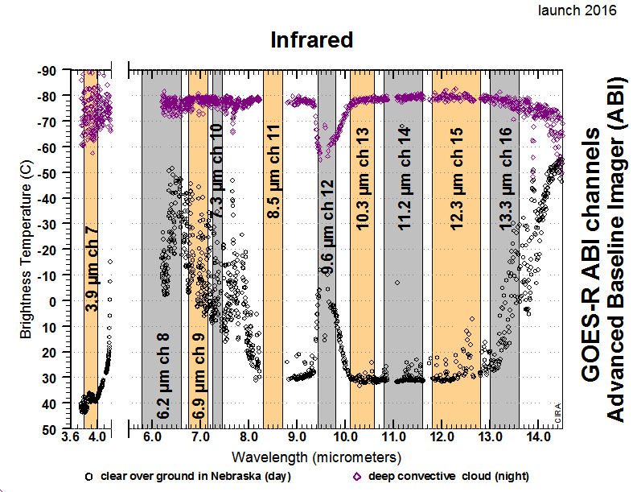
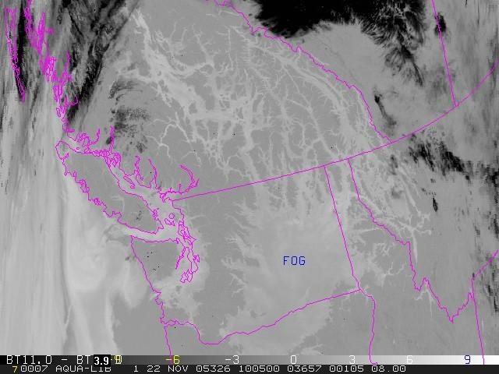
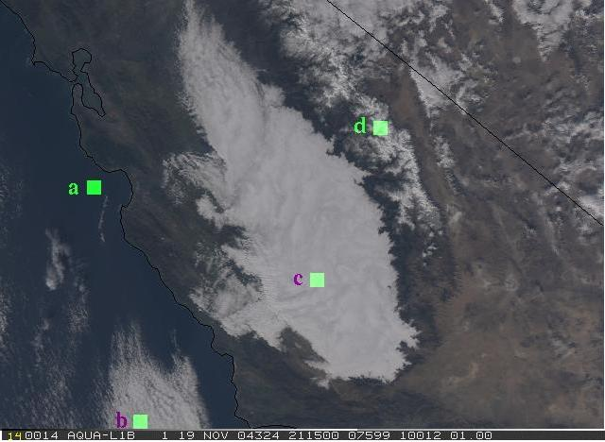
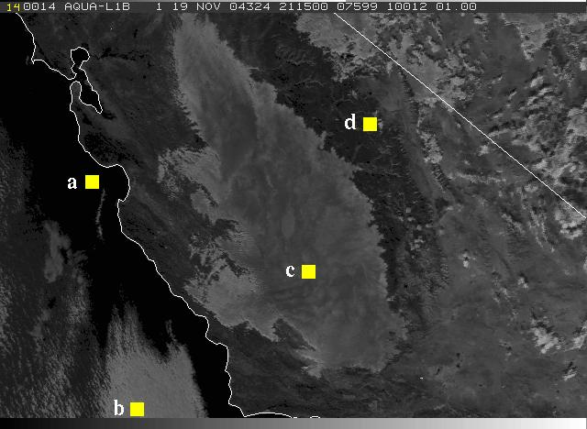
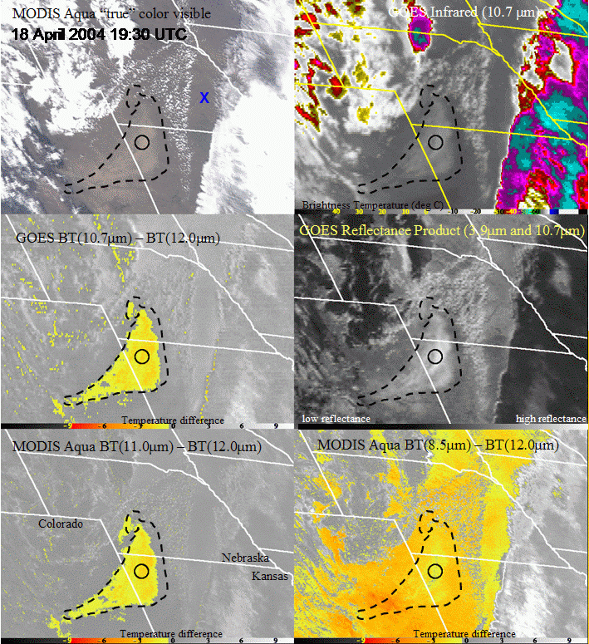
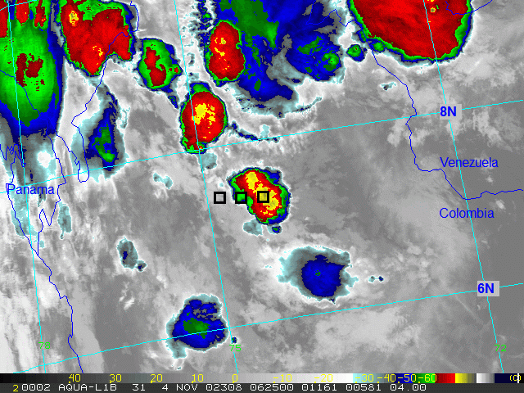
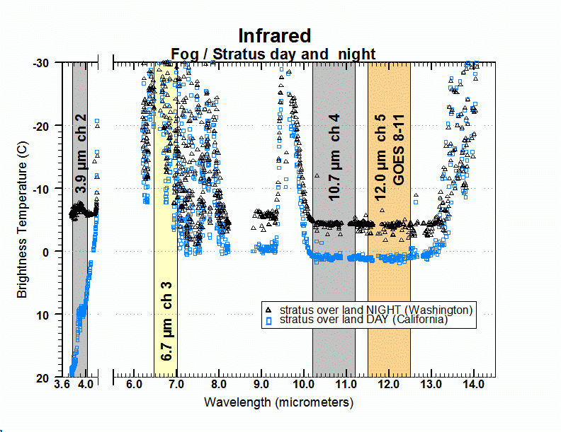
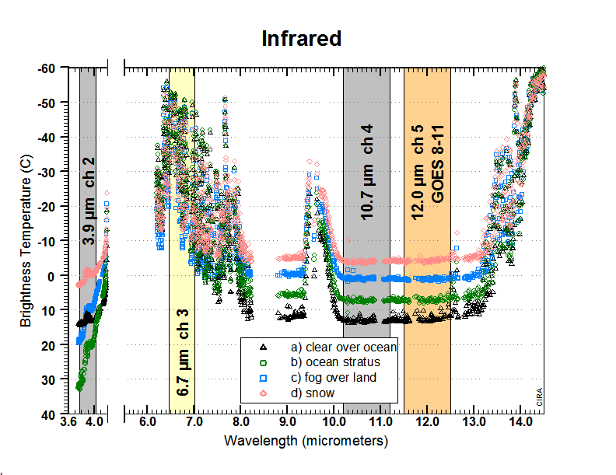
An Observational Approach for Training to Enhance User Understanding of New Channels on VIIRS and GOES-R
Bernie Connell bernie.connell@colostate.edu
Cooperative Institute for Research in the Atmosphere
What matters in the presentation and the learning process?
Training
Face to face versus virtual
Lecture versus module versus discussion
Quick examples
Encounter different types of learners at different stages of learning.
Familiar Language
and Orientation
South or North?
Familiar Language / Units
Example - Back to Radiation Basics
Trainers Observation/ Example:
Simple Fog Product:
Users want:
high contrast
yes/no
contextual
how and why
Training to "how and why" promotes a deeper subject understanding.
Research to Operations…
Do Units and Orientation Matter?
Which graph is easier to interpret? or Why? Does it depend on familiarity?
Night
Day
Snow
Reflectivity Product
3.9 µm and 11.0 µm
Ocean
Stratus
Stratus
Brightness Temperature Difference 11.0µm-3.9µm
Stratus
RGB True Color
http://rammb.cira.colostate.edu/training/rmtc/newsat.asp
http://prezi.com/qyjxg3kqec3e/?utm_campaign=share&utm_medium=copy&rc=ex0share
Acknowledgments
This work is supported by NOAA Grant NA14OAR4320125.

