Slide 1



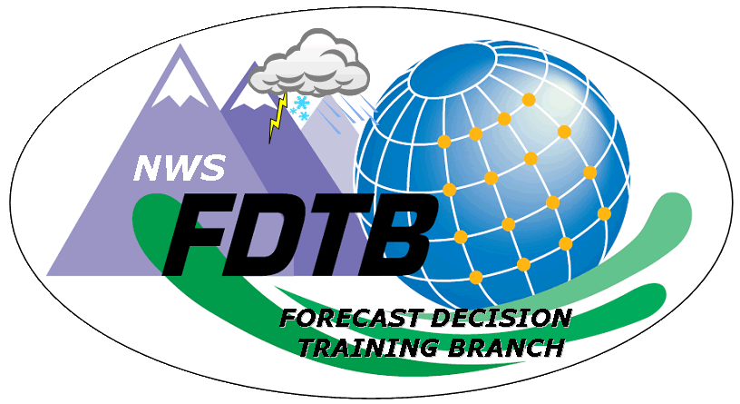

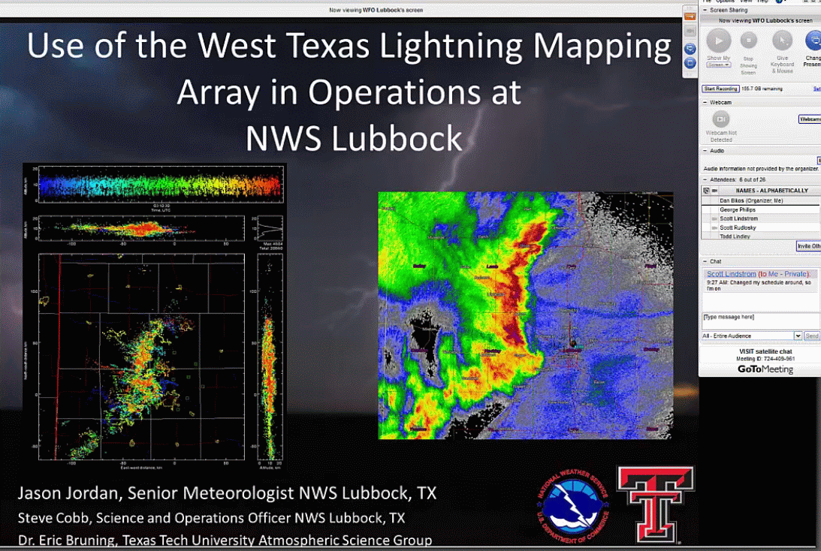
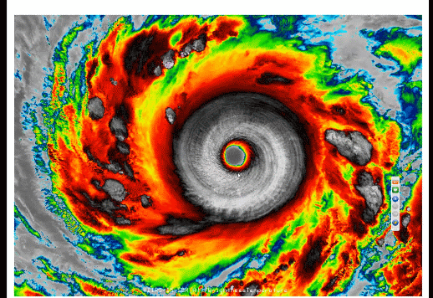
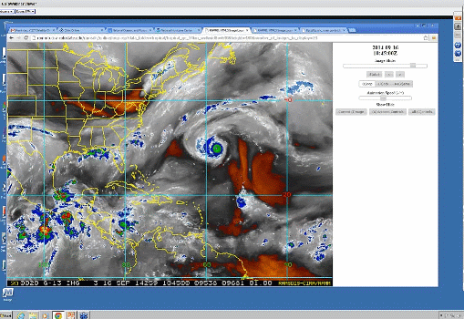
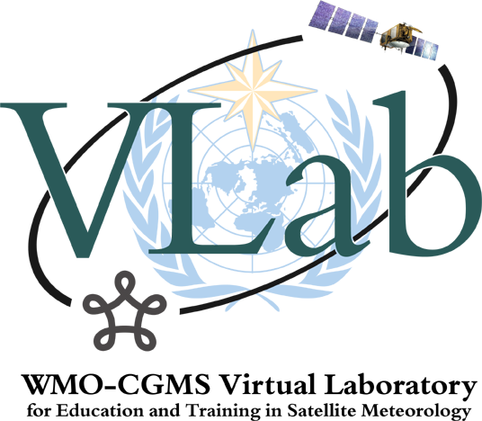
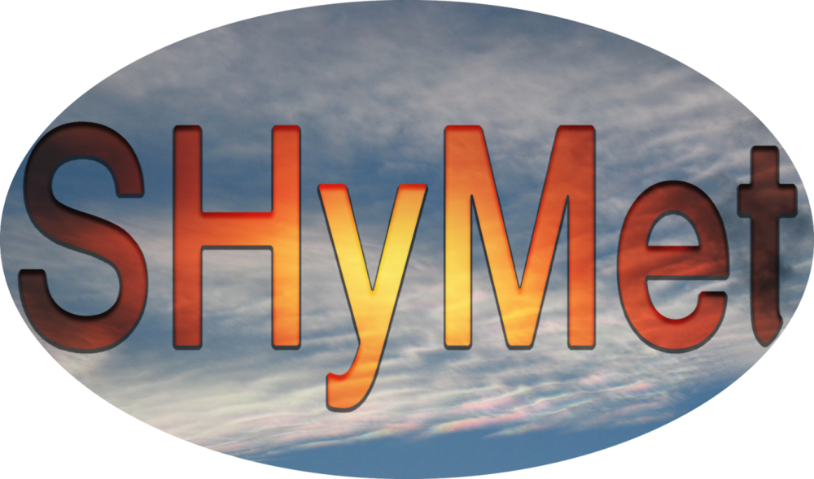

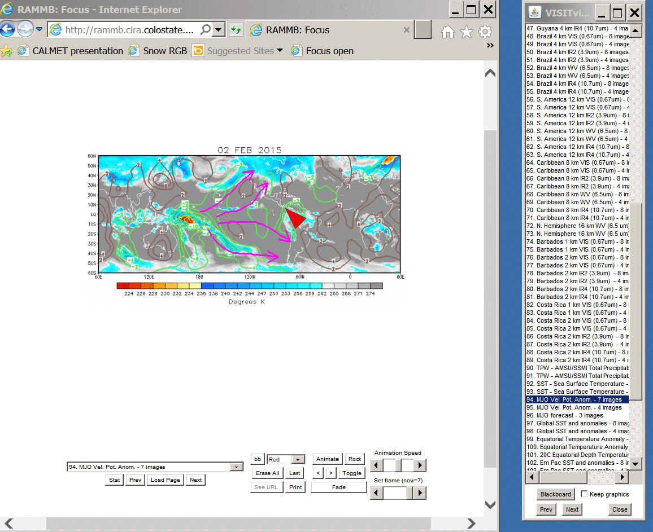
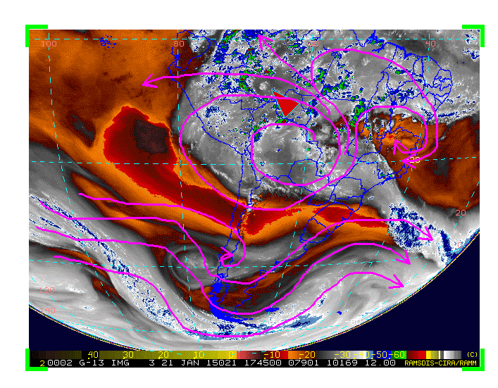

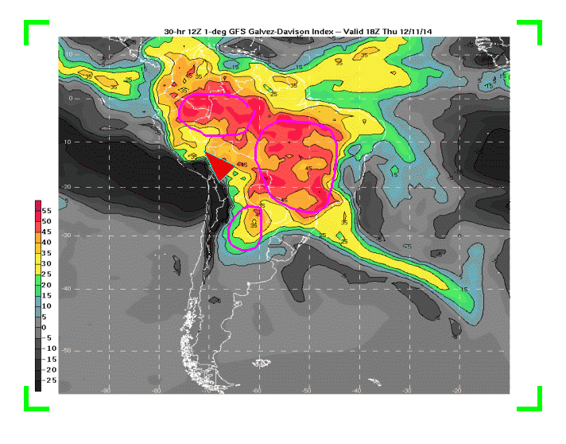

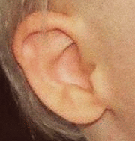
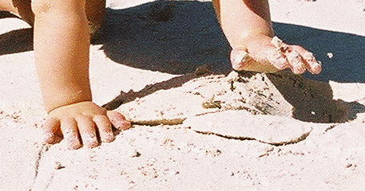
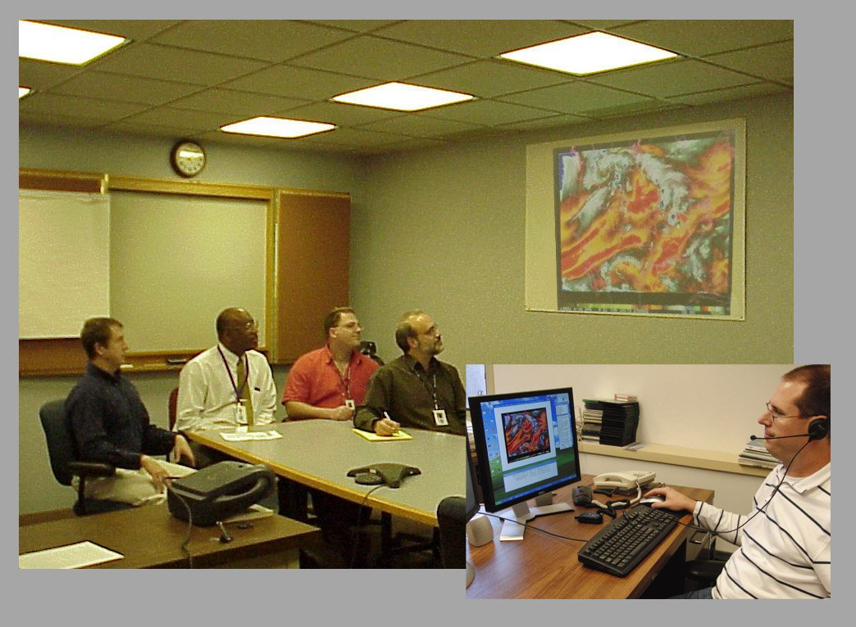
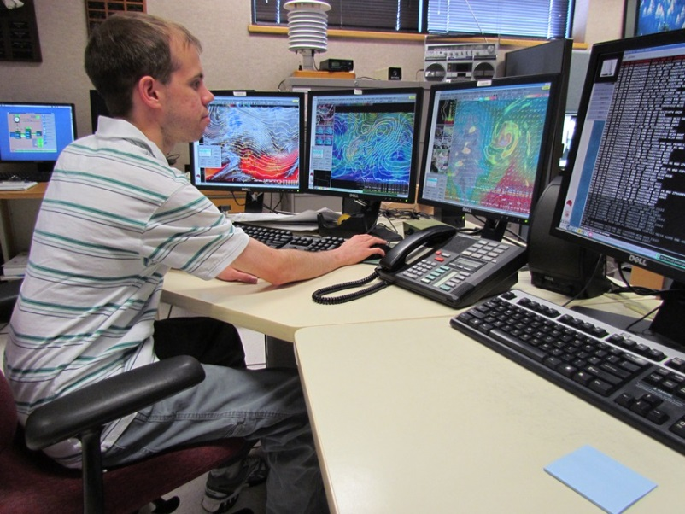
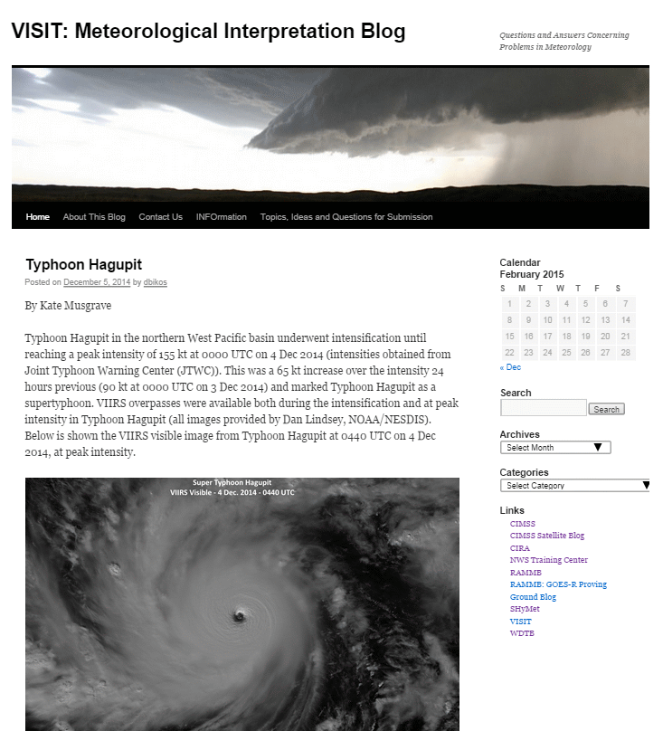
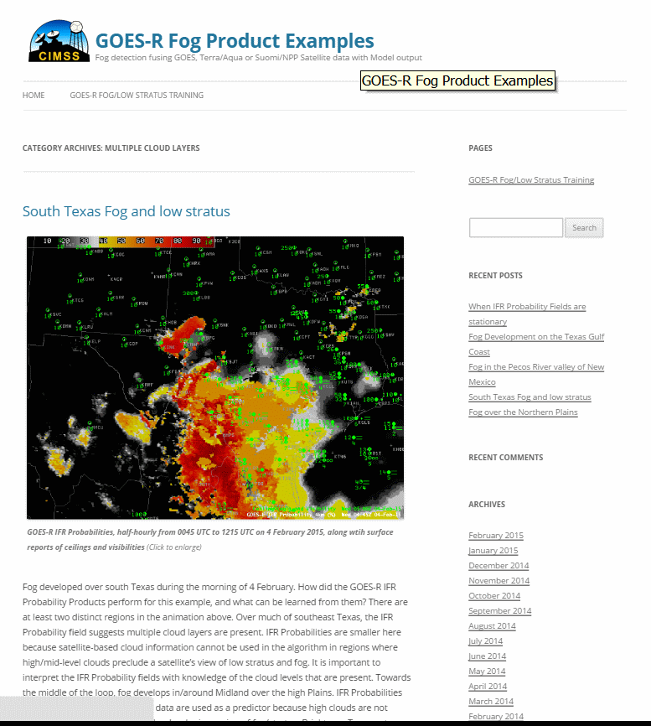
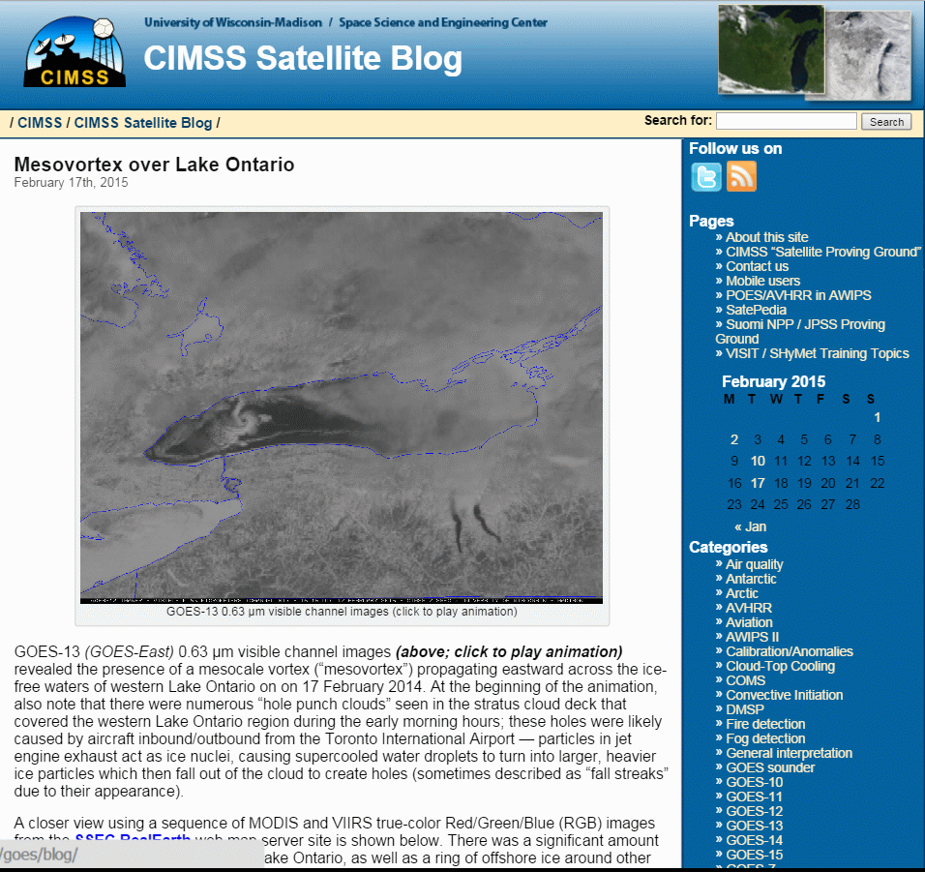
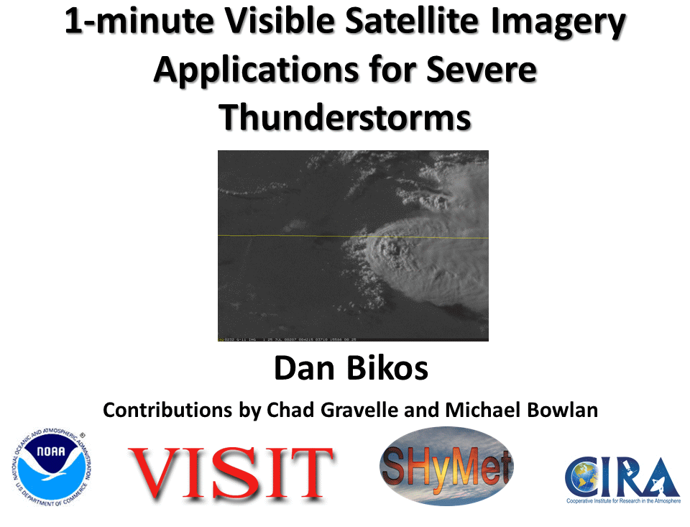
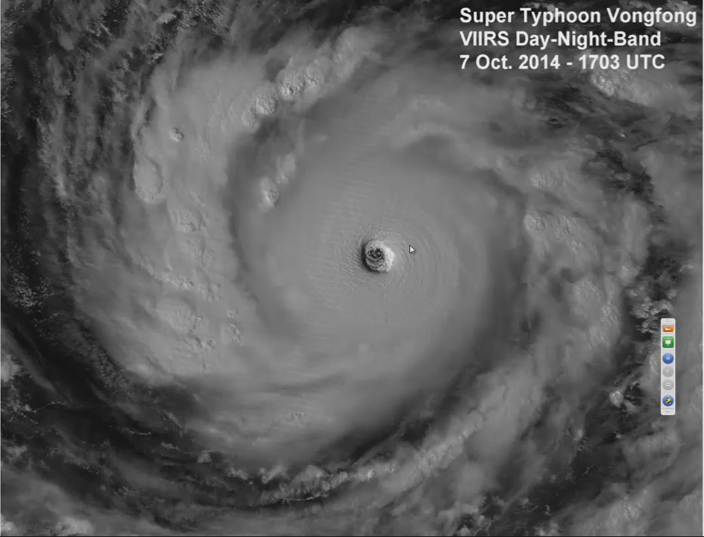
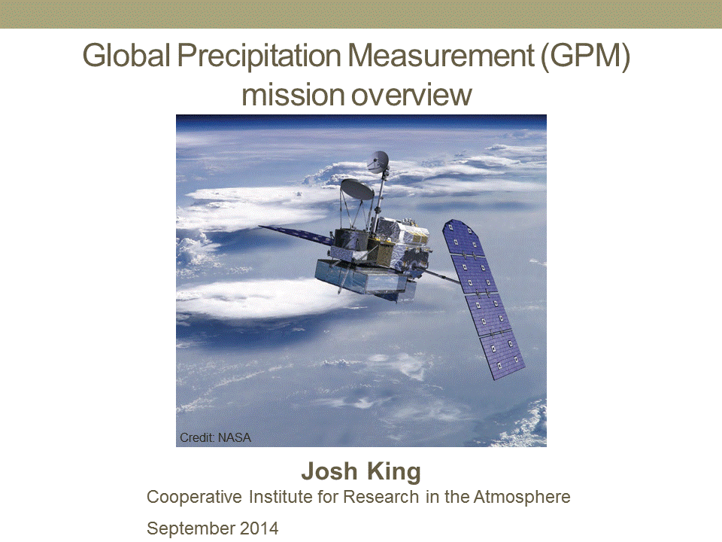
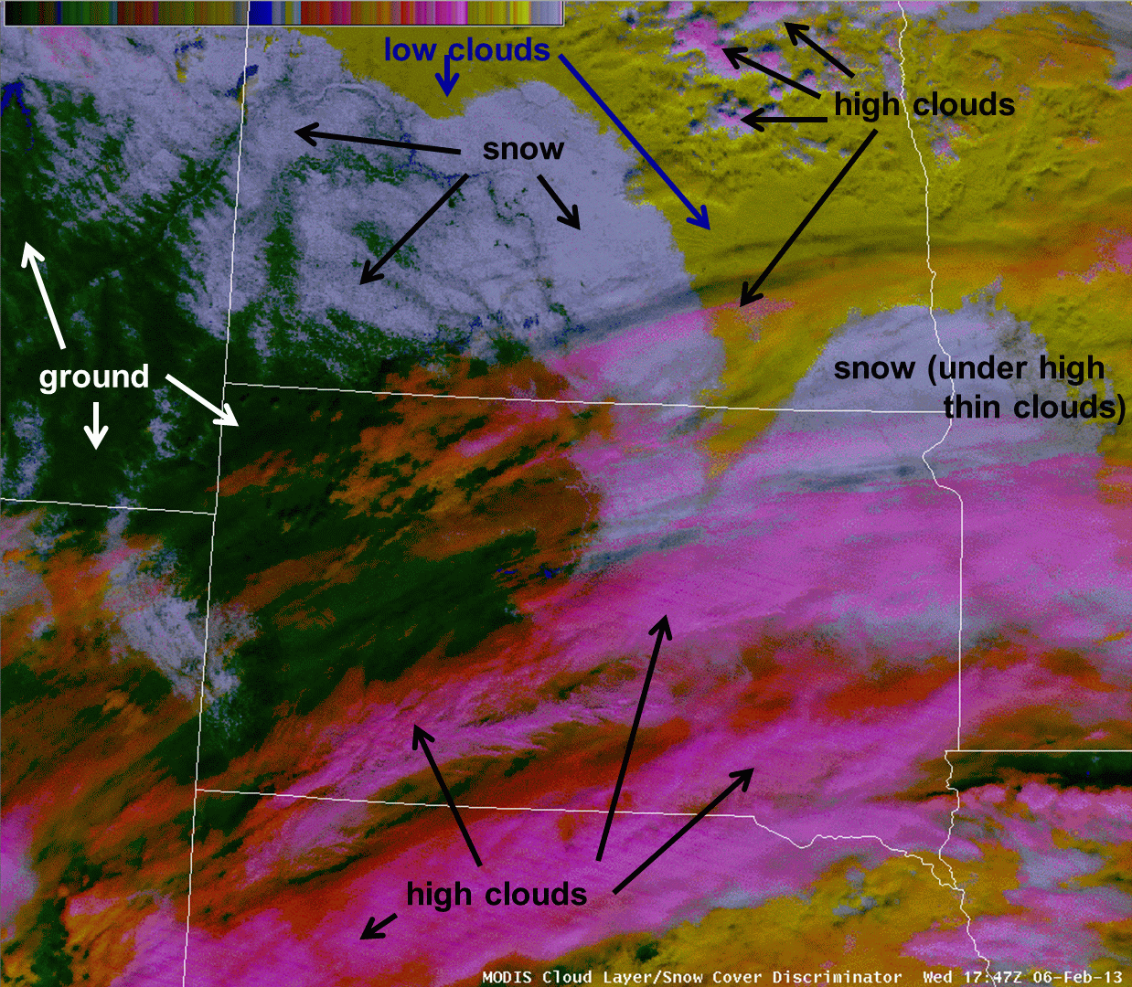
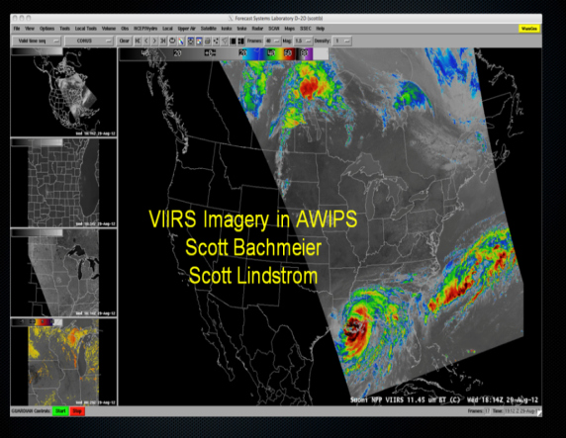
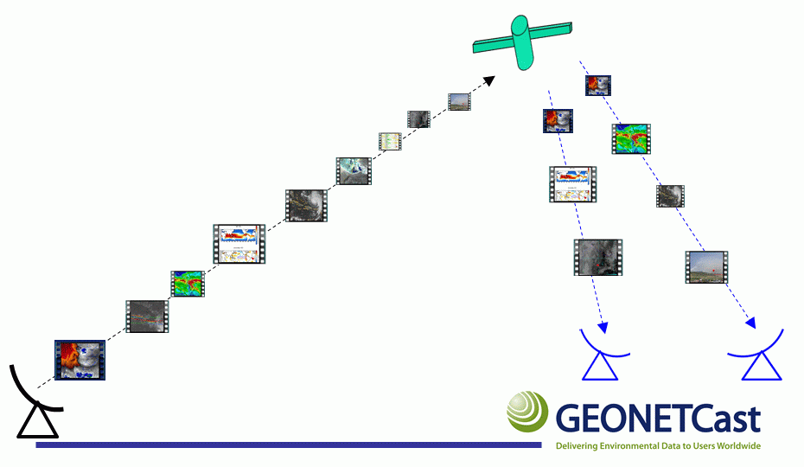
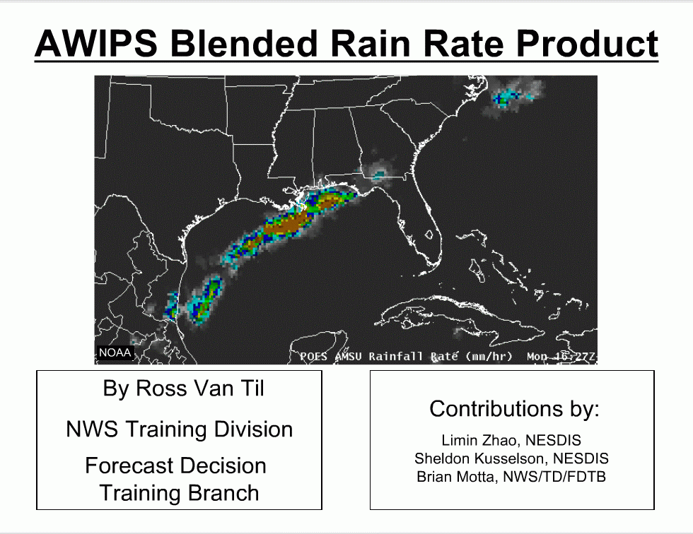
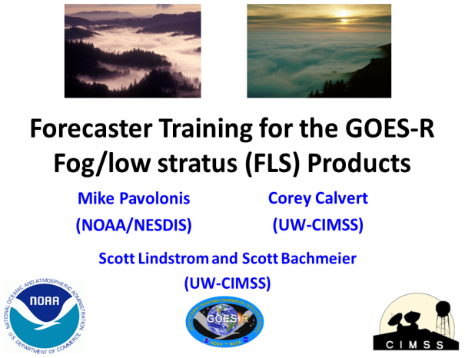
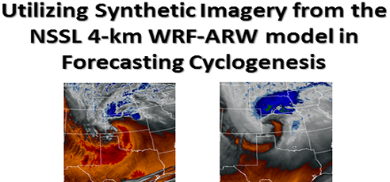
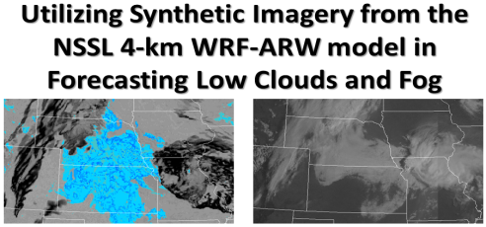
Satellite Training Activities: VISIT, SHyMet, and WMO VLab
B. Connell¹, D. Bikos¹, E. Szoke¹, S. Bachmeier²,
S. Lindstrom², T. Mostek³, B. Motta³, and L. Veeck^{1,4}
VISIT Focus:
* Single topic teletraining
& online modules
* Monthly Virtual Discussions
* Blogs
MONTHLY VIRTUAL DISCUSSIONS
VISIT Satellite Chat - 30 minutes
WMO Regional Focus Group of the Americas and the Caribbean ~ 1 hour
Since March 2004
Virtual Institute for
Satellite Integrated Training
Sep. 2014
http://rammb.cira.colostate.edu/visit/
Varied approaches to training
Feb. 2015
Oct. 2014
Varied approaches to training are driven by:
Different users at different levels (intern, advanced, expert)
Schedule
Varied learning styles: visual, auditory, hands-on
Dec. 2014
http://vlab.wmo.int
Satellite Hydrology
and Meteorology
http://rammb.cira.colostate.edu/shymet/
Feb. 2015
Jan. 2015
SHyMet Focus: Development Plan
Intern (most popular),
Forecaster , Tropical,
Severe Thunderstorm
Coming this Summer:
GOES-R Instruments, Products, and Operational Applications
http://rammb.cira.colostate.edu/vlab
.. Blogs
VISIT Meteorological Interpretation Blog
RAMMB: GOES-R Proving Ground Blog
VIIRS Imagery and Visualization Team Blog
CIMSS Satellite Blog
GOES-R fusedfog Blog
Training leads to new product acquisition
Keep in mind…
It’s only intuitive when it is familiar.
It’s not obvious until it has been made obvious.
Recent and Relevant Teletraining and Modules
1-minute Visible Imagery Applications for Severe Thunderstorms
By Dan Bikos
VIIRS Imagery Interpretation of Super Typhoon Vongfong
By John Knaff
GPM Mission Overview
By Josh King
Identifying Snow with Daytime RGB Imagery
by B. Connell
VIIRS Satellite Imagery in AWIPS
S. Bachmeier and S. Lindstrom
AWIPS Blended Rain Rate Product
by R. Van Til
GOES-R Fog/low stratus Products
by M. Pavolonis and C. Calvert
Synthetic Imagery in Forecasting Cyclogenesis
Synthetic Imagery in Forecasting Low Clouds and Fog
by D. Bikos
GEONETCast
Can your product be broadcast over GEONETCast?
GEONETCast is a near real time, global network of satellite-based data dissemination systems designed to distribute diverse data sets, products, and training to diverse communities.
It can be a vital resource in emergency and disaster situations.
Is there something you need to know or are curious about that is related to JPSS or GOES-R?
Do you have information or a product to share with other users?
¹ Cooperative Institute for Research in the Atmosphere,
Colorado State University, Fort Collins, Colorado, USA contact: bernie.connell@colostate.edu
² Cooperative Institute for Meteorological Satellite Studies,
University of Wisconsin, Madison, Wisconsin, USA
³ NOAA, NWS Training Division Boulder, Colorado, USA
⁴ World Meteorological Organization (WMO) Coordination
Group for Meteorological Satellites (CGMS)
Virtual Laboratory (VLab)
Acknowledgments
This work is supported by NOAA Grant NA14OAR4320125.
We are grateful to all contributors to the training, online
Sessions, and modules. (They would take more than a poster to list!)

