Slide 1


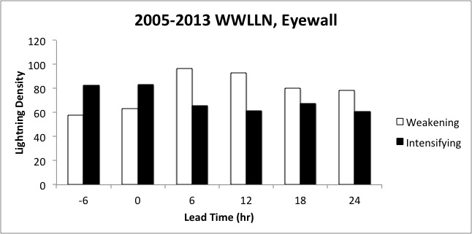
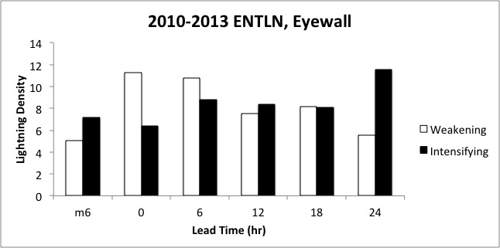
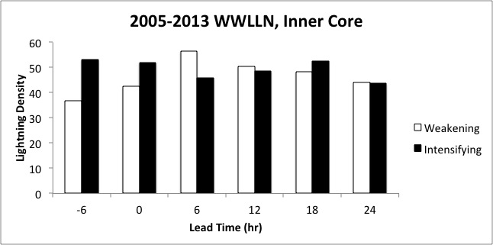
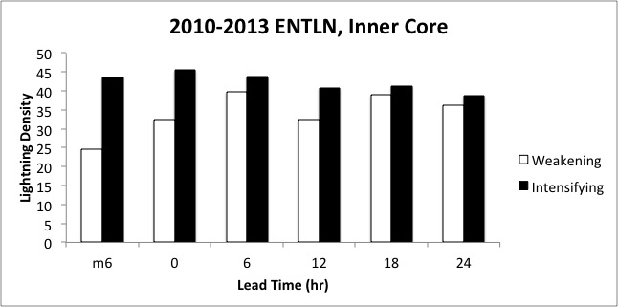
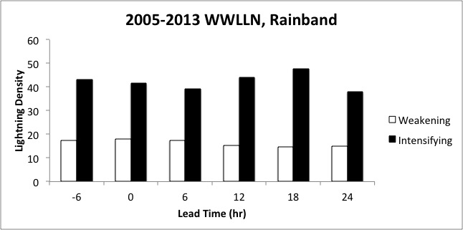
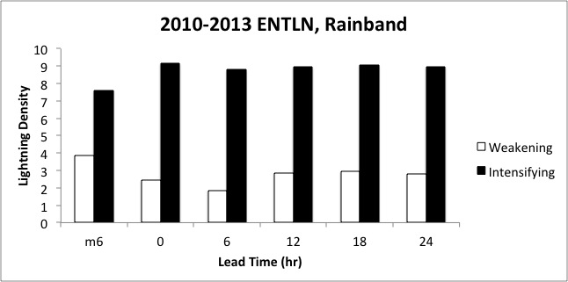
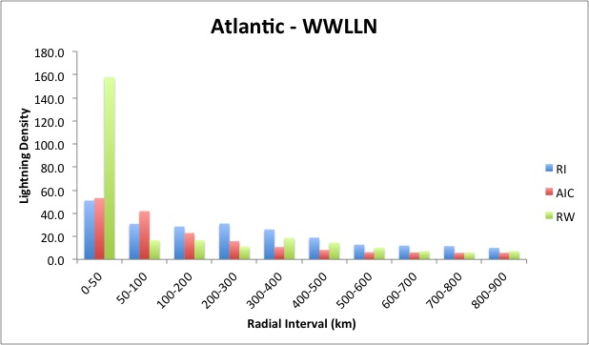
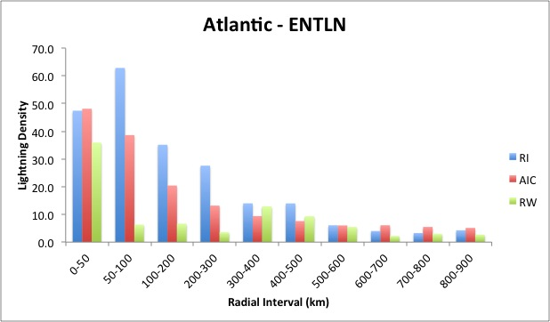
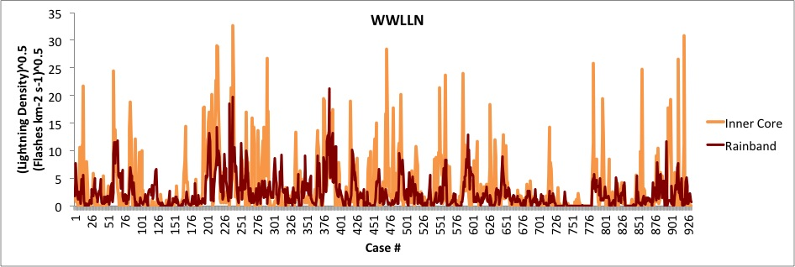
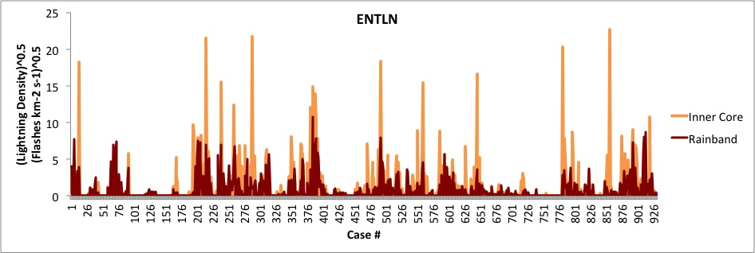
Using Total Lightning Data to Improve Real-Time Tropical Cyclone Intensity Forecasts
Andrea Schumacher¹, M. DeMaria², and R. DeMaria¹
CIRA / Colorado State University, Fort Collins, CO
NOAA/NWS/National Hurricane Center, Miami, FL
Motivation and Background
Lightning and TC Intensity Change
The relationship between lightning activity and tropical cyclone (TC) intensity change is still unclear
  Some studies show inner core lightning bursts precede TC intensification
  Other studies show inner core lightning activity may indicate intensification is coming to an end and subsequent weakening (e.g., DeMaria et al. 2012)
  Most studies suggest other environmental factors (e.g., vertical shear, sea surface temperature) influence both lightning activity and TC intensity change
Limitations of current lightning data for TC research
  Ground-based networks have low flash detection efficiency away from land
  Low earth orbiting sensors (e.g., TRMM LIS) have low temporal frequency
GOES-R Geostationary Lightning Mapper (GLM) will provide continuous lightning flash data with high (est. 75%) total lightning detection efficiency
In preparation for the GLM, the goal of this work to further examine relationship between total lightning activity and TC intensity change
  Total lightning has been found to be better correlated with convective strength than cloud-to-ground, hence is hypothesized to be better indicator of TC intensity change
  Past TC-lightning studies have used the World Wide Lightning Location Network (WWLLN), but we will use Earth Networks Total Lightning Network (ENTLN) because it’s higher total lightning detection efficiency (Rudlosky 2015) may be a better proxy for the GLM
Eyewall (r = 0-50 km) - WWLLN and ENTLN provide conflicting signals
Increase in lightning → TC currently intensifying, weakening expected in next 4-24 hours
Increase in lightning → TC currently weakening, intensification expected in ~24 hours
Inner Core (r = 0-100 km) - WWLLN and ENTLN provide similar signals
Increase in lightning → TC currently intensifying, possibly weakening in short term (next 6 hours)
Increase in lightning → TC currently intensifying,
Rainband (r = 200-300 km) - WWLLN and ENTLN patterns very similar
Data and Methodology
World Wide Lightning Location Network (WWLLN)
  Global flashes, 2005-2013
  Provided by B. Callahan and S. Prinzivalli, Earth Networks Inc.
Earth Networks Total Lightning Network (ENTLN)
  Global flashes, 2010-2013
  Provided by the University of Washington
National Hurricane Center Best Tracks
  TC locations and intensity estimates every 6 hours
Azimuthal average of lightning density (LD) will be examined at various radial intervals
  Eyewall, r = 0-50 km
  Inner core, r = 0-100 km
  Rainband, r = 200-300 km
Increase in lightning → TC currently intensifying, continuing to intensify
Increase in lightning → TC currently intensifying, continuing to intensify
Lightning and Rapid Intensification / Weakening
Rapid intensification defined as Δv_{max} ≥ 30 kt in 24 hours
Rapid weakening defined as Δv_{max} ≤ -20 kt in 24 hours
Once again, the signals are mixed…
Increased lightning in eyewall may signal rapid weakening is occurring / about to occur
Increased lightning in 50-300 km may signal rapid intensification is occurring / about to occur
WWLLN vs. ENTLN, 2010-2013 Atlantic TCs
Correlation between inner core and rainband LD, by network
  r_{WWLLN} = 0.3
  r_{ENTLN} = 0.5
Correlation between WWLLN & ENTLN in different radial intervals
  r_{IC} = 0.5
  r_{RB} = 0.6
Summary and Future Work
Similarities between WWLLN and ENTLN analyses
  Lightning activity in TCs is episodic, more so in inner core than rainbands
  Intensifying TCs have more lightning in rainband region than weakening TCs
Differences between WWLLN and ENTLN analyses
  Largest differences in eyewall region analyses
  WWLLN suggests increase in eyewall lightning → weakening / RW
  ENTLN suggests increase in inner core lightning → intensification / RI
Future work
  Examine asymmetric lightning density and relationship to TC intensity change
  Explore relationships between LD, TC intensity change, and other environmental and storm-related conditions (shear, SST, storm motion)
  Using variable radial intervals, based on TC size (currently fixed)
  Incorporate ENTLN LD into the Rapid Intensification Index (RII)
Low r_{WWLLN} and r_{ENTLN} suggest lightning in inner and outer parts of TC may provide independent information
Low r_{IC} and r_{RB} suggest different networks are providing different data (i.e., ENTLN may be providing more IC lightning flashes than WWLLN)
DeMaria, M., R. T. DeMaria, J. A. Knaff, and D. Molenar, 2012: Tropical Cyclone Lightning and Rapid Intensity Change, Mon. Wea. Rev., 140, 1828-1842.
Rudlosky, S. D., 2015: Evaluating ENTLN performance relative to TRMM/LIS. J. Operational Meteor., 3 (2), 11–20.
Abarca, S. F., K. L. Corbosiero, and D. Vollaro, 2011: The World Wide Lightning Location Network and convective activity in tropical cyclones, Mon. Wea. Rev., 139, 175-191.

