Slide 1

GEONETCast Virtual Event Week
December, 2013
GEONETCast AMERICAS
REGIONAL BROADCAST
Paul Seymour, NOAA, NESDIS, OSPO, SPSD, DSB
Bernie Connell, CIRA, Colorado State University
Eric Madsen, NOAA, NESDIS GEONETCast Point of Contact

Slide 2
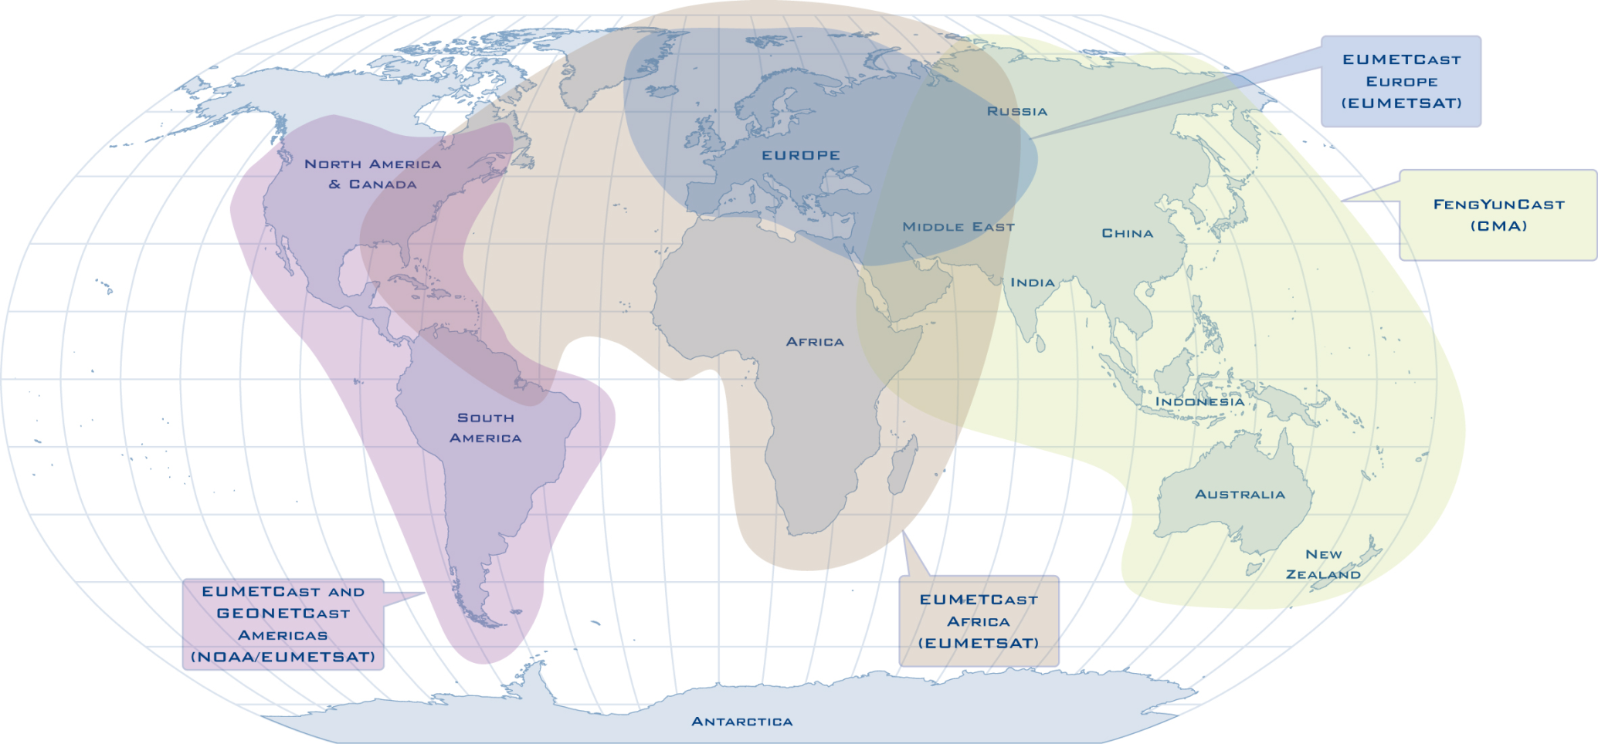
GEONETCast - Global Coverage

Slide 3
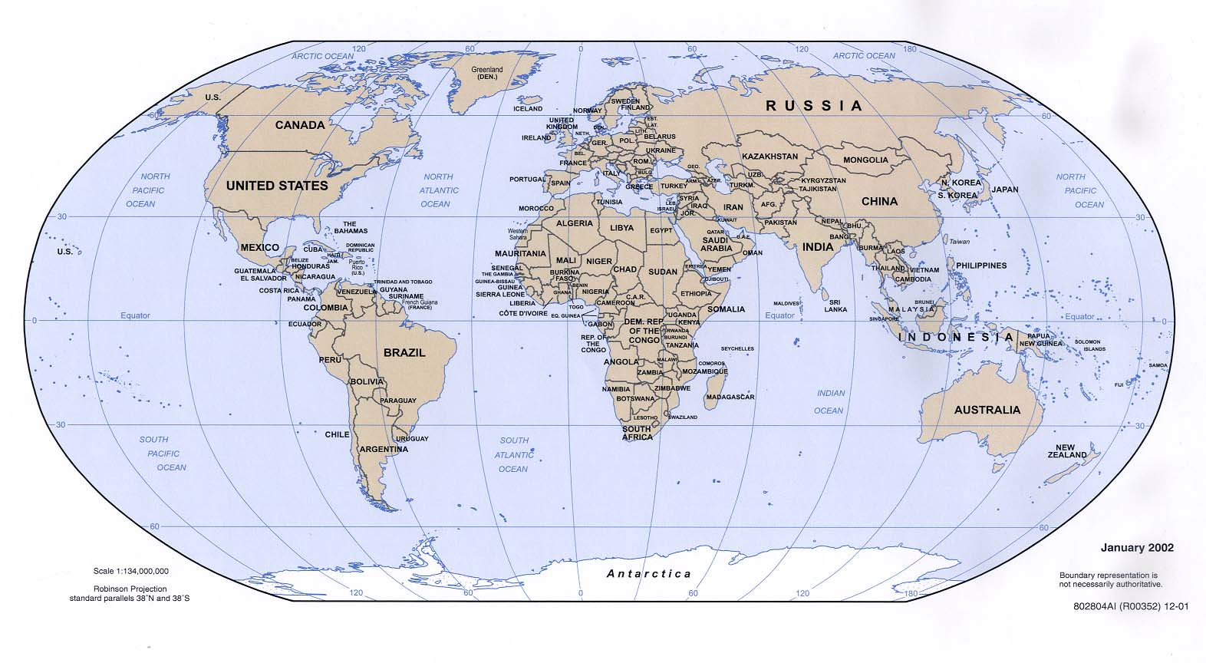
GEONETCast Americas - Coverage
Regional component of GEONETCast
Provided by USA/NOAA
Coverage for North, Central, and South America and the Caribbean

Slide 4
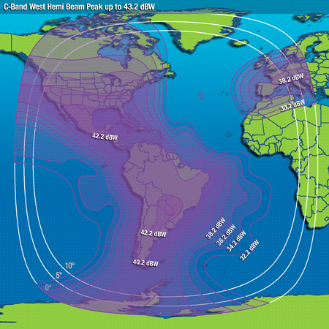
GEONETCast Americas - Broadcast
Coverage Area: Purple Isolines
2 megabits per second data rate
Options to expand to 12 Megabits
Intelsat-21 (IS-21) geostationary satellite
Multiplexed C-band DVB-S transponder at 58 deg W
>99.5% availability
Notes:
What’s an analogy for 2 megabits per second – how much data and information is that?
Transmission rates for 1 Mbps = 1000000 bps = 1000 kbps (kb/s) = 125000 Bps (B/s) = 450000 kBph (kB/h) = 7500 kBpmin (kB/min)
Or 7.5 MegaBytes per minute.
But; you also have to consider the following that affect latency:
Internet connection out of the provider
Internet connection between the provider and GNC-A
Internet connection into GNC-A
Processing of the files within the Kencast based data center
Uplink to the satellite

Slide 5

GEONETCast - System Architecture
Other GEONETCast
Systems
GEONETCast Americas System
Data Providers
Data Management
System Server &
Datacast Software
Internet
OSPO
EPA
IP Encapsulator
MPEG-2 Encoder
NCDC
NWS/GTS
DVB-S/DVB-S2 Modulator
Teleport
User Receive Terminals
RANET
INT’L
Web-enabled NOAA Access
Intelsat Teleport in Ellenwood, Georgia, USA
Data Providers
GEONETCast Americas
System Users

Slide 6
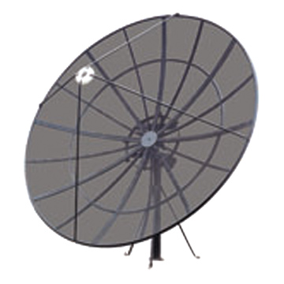
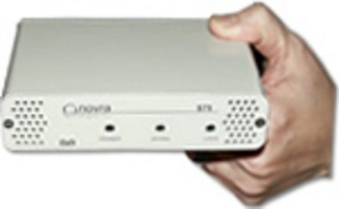
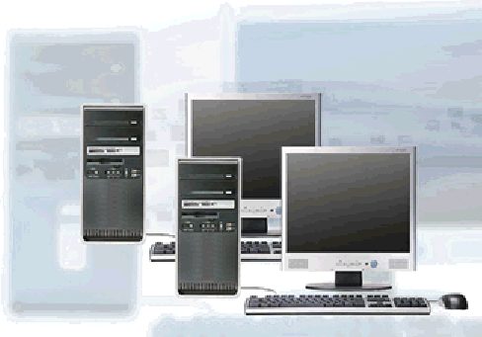
GEONETCast Americas - Receive Station
- Personal computer with client software
- Satellite antenna: 1.8 m - 2.4 m depending on location
- DVB-S (2) receiver card or box
Notes:
1.8 meter or 2.4 meter depending on location relative to the satellite

Slide 7
GEONETCast Americas – Receive Station
Users responsible for station purchase and operation
Standard commercial off-the-shelf components
Estimated user costs ~$2000-$5000 US
  Personal computer - ~$500
  Client datacasting software - $400 one-time license
  1.8 to 2.4 meter antenna depending on location
  including LNB - $1000-2000
  DVB-S (S2) receiver - ~$100
  No recurring subscription costs for Kencast
  Installation costs vary by location
Notes:
1.8 meter or 2.4 meter depending on location relative to the satellite

Slide 8

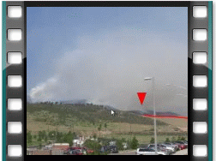
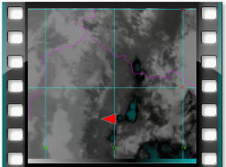
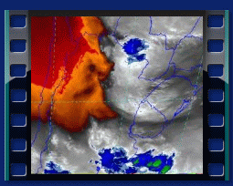
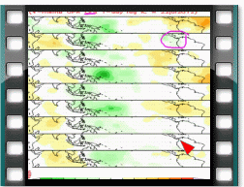
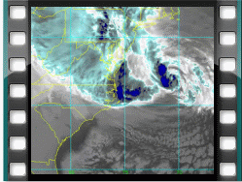
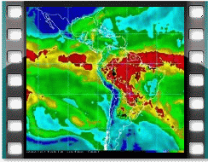
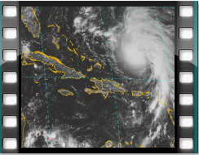
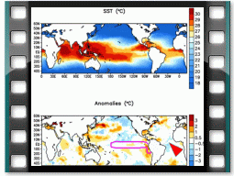
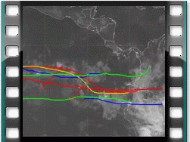

GEONETCast Americas - Content
Product broadcast channels
  Separate broadcast channels by data provider
  Users can choose channels they wish to receive
  Training Channel and Alert Channel Included
Product formats
  There is no restriction on the format of products

Slide 9
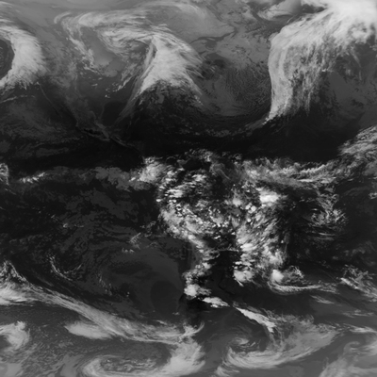
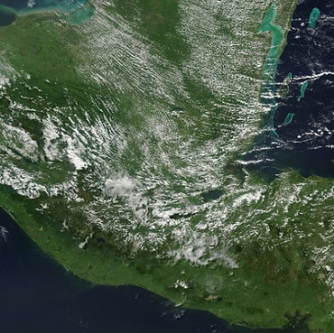
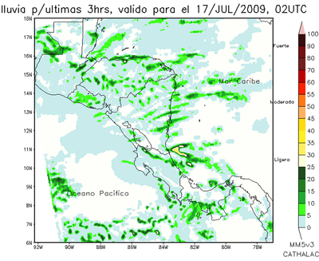
GEONETCast Americas Providers
Brazil National Institute for Space Research (INPE)
  Derived regional products including fire monitoring, lightning, rainfall nowcasting, UV Index, vegetation, GOES imagery based products in GEOTIFF format
NASA/USAID SERVIR Project
  MODIS fire images over Guatemala and short-term rainfall model forecasts
More info on Wednesday!
Global GOES IR 10.7µm – geotiff format
true color RGB
+
fire spots
rainfall

Slide 10
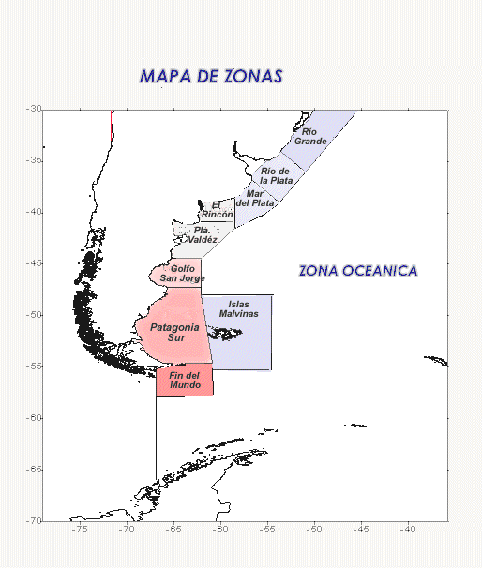
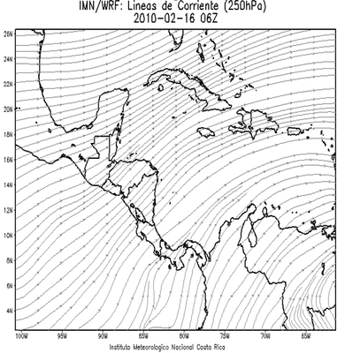
GEONETCast Americas Providers
Argentina National Space Activities Commission (CONAE)
  Sea height and significant wave height and direction.
  More products being considered.
National Meteorological Institute of Costa Rica
  Flash Flood Alert Products
  WRF model output for Central America
Zones for sea height and significant wave height and direction information
WRF model 250 hPa streamlines
Notes:
Patricia and Lucia tell me that SAC-C stopped broadcasting ~2 months ago. The only thing they broadcast now is sea height and significant wave height and direction.

Slide 11
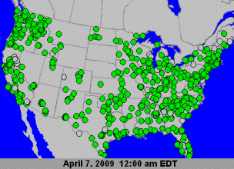
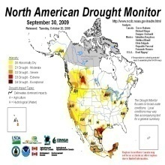
GEONETCast Americas Providers
U.S. Environmental Protection Agency (EPA)
  Hourly animated air quality maps of ozone and particulates
NOAA/National Climate Data Center (NCDC)
  North American Drought Monitor
Air Quality Product

Slide 12
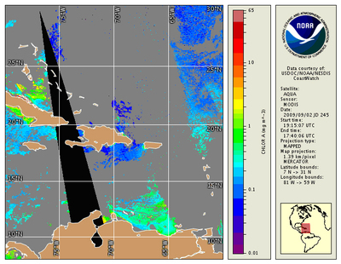
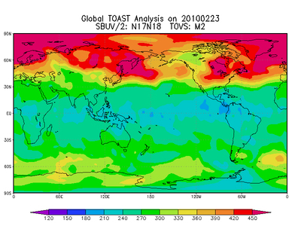
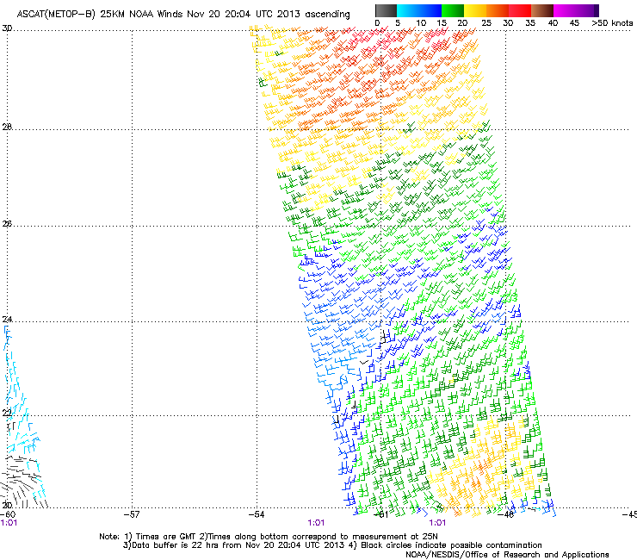
GEONETCast Americas Providers
NOAA/National Environmental Satellite Data and Information Service (NESDIS)
and USAID/NOAA RANET Project
  Chlorophyll concentration, vegetation index and health, snow cover and depth, total ozone, total precipitable water
  Environmental products, Alerts, Watches and Warnings
European Organisation for the Exploitation of Meteorological Satellites (EUMETSAT)
  GEONETCast Product Navigator, satellite winds from Advanced Scatterometer (ASCAT METOP A and B)
Caribbean chlorophyll concentration
Total Ozone Analysis using SBUV/2 and TOVS (TOAST)
ASCAT METOP-B winds

Slide 13
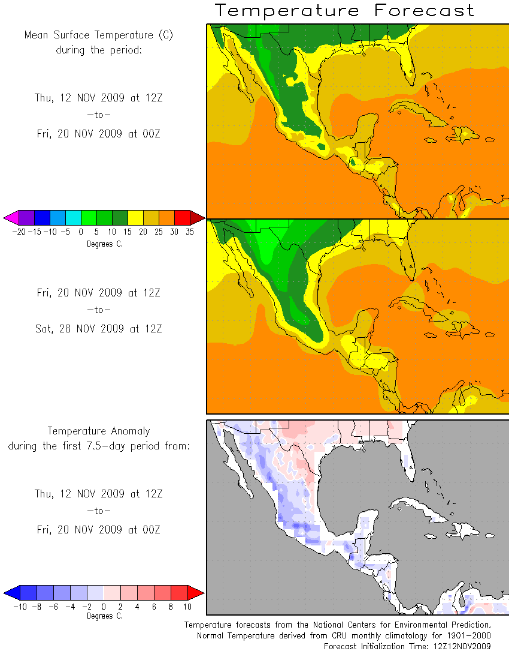
Potential Providers
International Center for the Investigation of the El Niño Phenomenon (CIIFEN)
  Monthly Eastern Pacific Ocean Analyses, Seasonal Western South American Forecast
Caribbean Institute for Meteorology and Hydrology
  Caribbean channel for natural disaster preparedness and response.
NCEP Forecast from
RANET Broadcast
FOZNT23 KNHC 121458
FFNT3
OFFSHORE WATERS
FORECAST FOR THE SW AND TROPICAL N ATLANTIC AND
CARIBBEAN SEA
NWS TPC/NATIONAL HURRICANE CENTER MIAMI FL
1130 AM EDT SUN JUL 12 2009
More info from Barbados on Wednesday!
Notes:
Bernie; we were supposed to have started this after the April meeting but have not . . . .

Slide 14
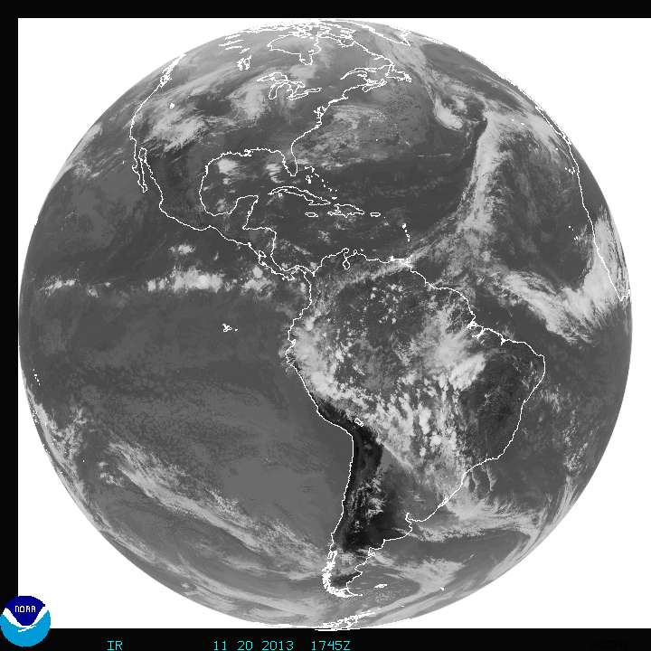
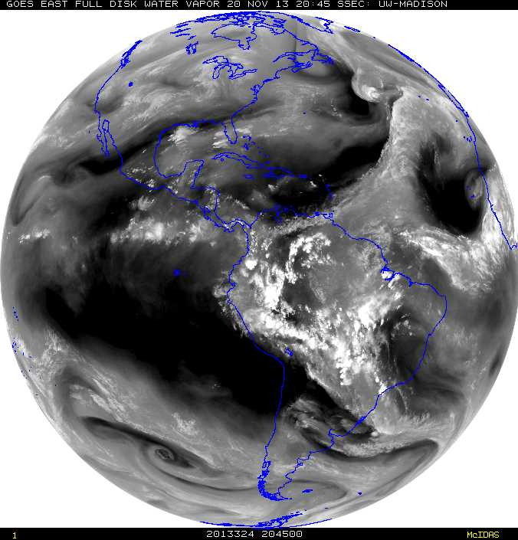
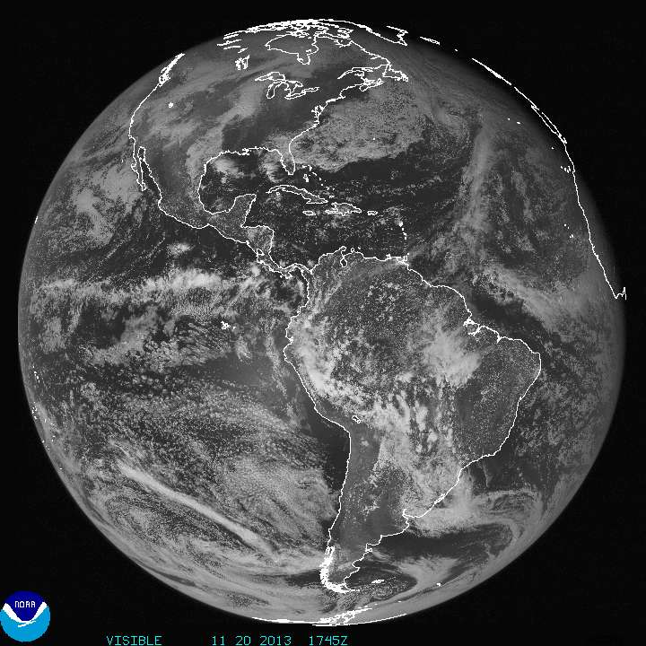
New Products for 2014
GOES-East Full Disk Imagery in GEOTIFF format
  Visible
  Water Vapor (6.5 µm)
  Infrared (10.7 µm)

Slide 15
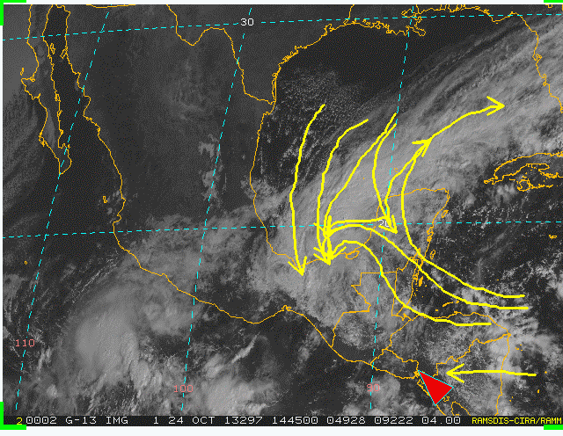
GEONETCast Americas – Training Channel
Recordings of the Monthly Virtual Sessions
under WMO VLab from
CIRA / NOAA / Barbados / Costa Rica
  Training is directly relevant to the
  meteorology and hydrology community
New initiative with VLab Management Group and with the Committee on Earth Observation Satellites (CEOS) Working Group on Capacity Building & Data Democracy
  Development of distance learning courses to be sent through GNC-A
October 2013 session
Notes:
Bullet 1 - For NOAA, the contribution is from NWS Weather Prediction Center International Desk. Contributions from the WMO Centers of Excellence in Barbados and Costa Rica.
In cooperation with the CEOS Working Group on Capacity Building and Data Democracy, developing distance learning courses to be disseminated via GEONETCast-Americas.

Slide 16
Disaster Charter
GEONETCast Americas and EUMETCast approved for use as auxiliary data distribution systems by the International Charter “Space and Major Disasters.”
Brazilian Center for Monitoring and Alerts of Natural Disasters (CEMADEN) to use portable GNC-A Receive stations for disaster response where Internet is unavailable.
Ongoing efforts: work with the GEONETCast Americas Implementation Group and regional partners on establishing the use of GEONETCast by the disaster management community to receive data from the International Charter
More info on Wednesday!
Notes:
GEONETCast-Americas has been approved for a couple years as a distribution system for Charter. EUMETCast was approved just in the last few weeks. CMACast has not been approved yet. I am not sure if they looking to be approved.
Status – This is an on going effort. We will be attending a meeting of disaster managers next week in Mexico and in December in Jamaica.

Slide 17
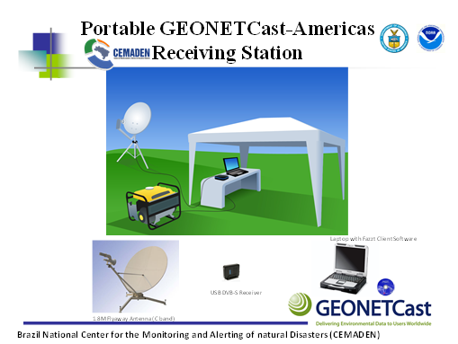
Capabilities for Disaster Response
Only need power for the computer and receive card / box
No internet connection needed
Ability to add data to the GNC broadcast on a ad-hoc basis – no format restriction
Ability to add data prepared within or outside of the region of interest
GEONETCast stations can be
portable!

Slide 18



User Engagement
Each region works directly with its Users
  In Europe there are over 3560 EUMETCast stations;
  In Africa, there are about 358 EUMETCast stations;
  In the Asia/Pacific region, there are approx 2600 CMACast stations;
  In the Americas there are about 121 including 99 EUMETCast and GNC-A 22 stations deployed.

Slide 19
Why are there many
EUMETCast stations?
In 2002, Meteosat-8 was launched.
  Data rebroadcast failed
  Solution: a commercial satellite provider to rebroadcast the data – EUMETCast
In 2005, Meteosat-9 was launched.
  The majority of Meteosat data users (over 1200 at that time) chose to remain with EUMETCast
Additions to EUMETCast data stream:
  Metop-A (2006) and Metop-B (2012)
Future additions: Meteosat Third Generation (MTG)
Notes:
EUMETSAT made the decision to use EUMETCast as it prime delivery mechanisms for Near Real Time data because of the positive feedback from the user community. In the next generation of satellites, e.g. Meteosat Third Generation (MTG), EUMETCast will also be the backbone delivery mechanism for the NRT service. The MTG satellites will not have rebroadcast capabilities.

Slide 20
Why are there many CMACast stations and few GEONETCast-A stations?
China upgraded to CMACast in 2008
  Combined FENGYUNCast and PCVSAT services.
US relies on NOAAPort, GOES GVAR, POES, HRPT, LRIT re-broadcast, APT, and the Internet
  GEONETCast currently distributes products, not “raw” data.
Notes:
NOAAPort run by NWS ~130 users It is hard to estimate real usage because anyone can tap into the data stream and use the data and no one is required to register. For example, UNIDATA taps into the NOAAPort feed and distributes to many many others via its servers.

Slide 21
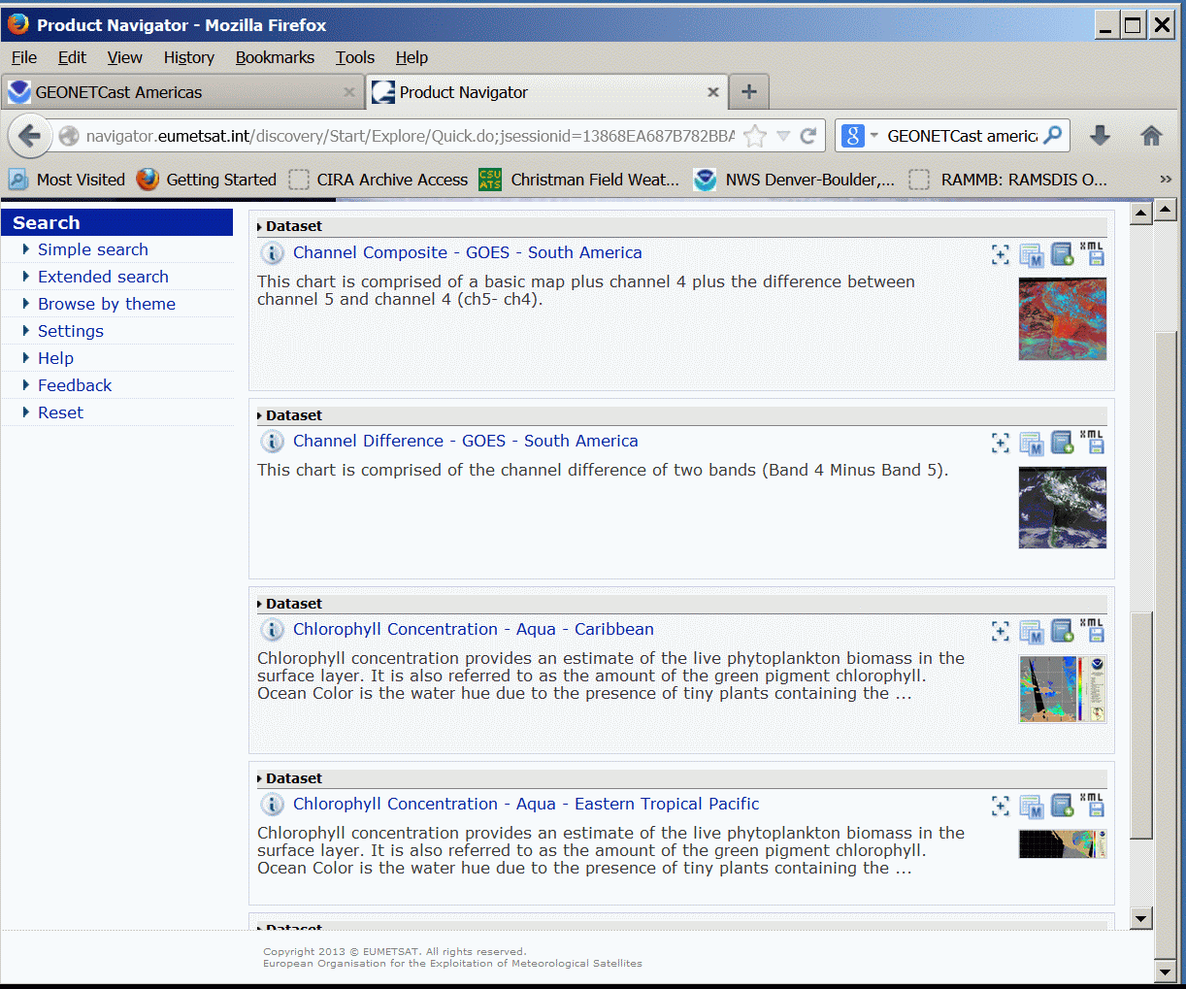
What’s available?
GEONETCast Product Catalog with associated metadata
Same “look and feel” across regional systems
Distributed via GEONETCast broadcast
AND viewable on the Internet.
GEONETCast Product Navigator on NOAA site:
http://www.geonetcastamericas.noaa.gov/products/navigator/indexer.html
EUMETSAT Product Navigator:
http://www.eumetsat.int/Home/Main/DataProducts/ProductNavigator/index.htm

Slide 22
Develop Partnerships To Fund Stations
GEONETCast Americas continues to work to develop new partnerships to fund user receive stations in the North, Central, and South America and the Caribbean
Current efforts include proposals to the World Bank / Caribbean Disaster Emergency Management Agency (CDEMA) to fund stations in key sites.
More info on Wednesday from Barbados

Slide 23
GEONETCast Americas Product Suite
We will…
Continue to work with partners to expand product suite
Meet requirements identified by regional met services using regional providers
Continue outreach to prospective users

Slide 24
GNC-A - Contacts and Links
Yana Gevorgyan – Yana.Gevorgyan@NOAA.Gov
Eric Madsen - Eric.Madsen@NOAA.Gov
Paul Seymour - Paul.Seymour@NOAA.Gov
Rich Coley - Rich.Coley@NOAA.Gov
www.geonetcastamericas.noaa.gov

