Slide 1
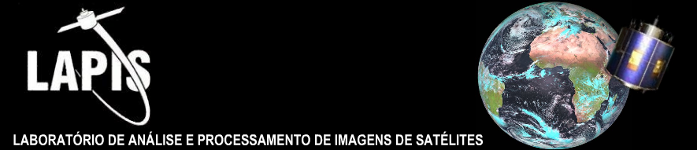





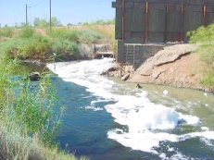

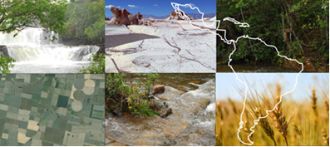
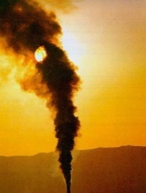
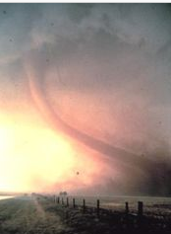
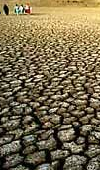
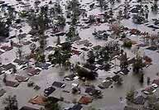
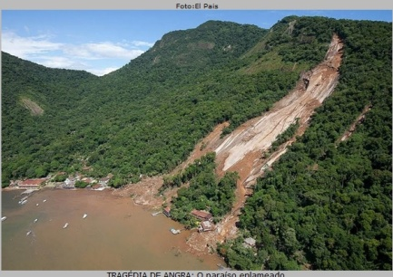
Disaster Mitigation: From the Perspective of the Research and Environmental Community
Humberto A. Barbosa
  Outline:
  South American Group of EUMETCast Operators
  SAGEO: 4 core activities
  Setting up receiving stations
  Training and Capacity building
  Sharing EO products using EUMETCast
GEONETCast Event Week 3, 4, 5 December 2013

Slide 2
  SAGEO: South American Group of EUMETCast Operators
  SAGEO has been established in September 2009 as a starting point for collaborative effort between EUMETSAT workshops and EUMETCast Brazil Operators to strengthen regional capacities of use MSG satellite data and products in Latin America.
SAGEO activities:
  The installation of a “standard” EUMETCast station, with an appropriate training for the operation of the station;
  Network of experts across the Brazil;
  Facilitating the EUMETCast operators with the visualization;
  Seeking mechanisms for regional partnership.

Slide 3
SAGEO: 4 core activities
The ultimate goal of EUMETcast is
to embed the provided products into
every day research, environmental monitoring, planning and decision making processes
Monitoring drought
Crop modeling (Brazil)
Severe weather monitoring
Key message: data dissemination, training and free software are all nice.
Sharing cross-cutting
Earth Observation products
Setting up receiver and hub infrastructure
Capacity building: supporting & training user communities
Building on capacity: Making everyday use of EUMETCast

Slide 4
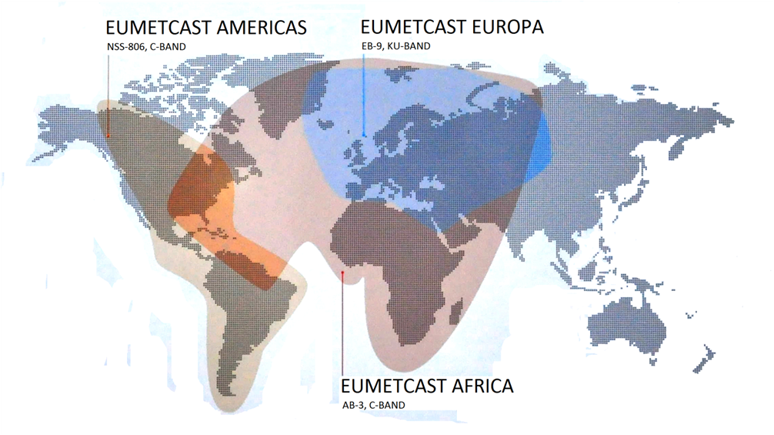
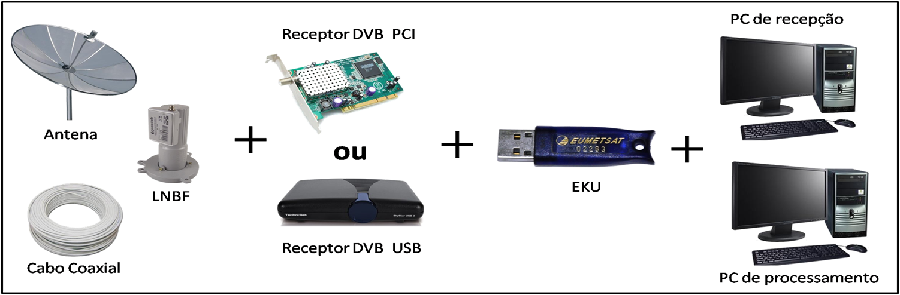
SAGEO: Setting up receiving stations
  SAGEO: Sharing EO products using EUMETCast service
The use of Satellites to quantitatively observe the Earth's atmosphere for research and operations has made steady, and in some cases spectacular progress over the last five decades. Several professors and their graduates from the Brazilian’s universities have utilized Meteosat. I will describe personal experiences involved in SAGEO's group and how under and grad studies contributed to these experiences.

Slide 5
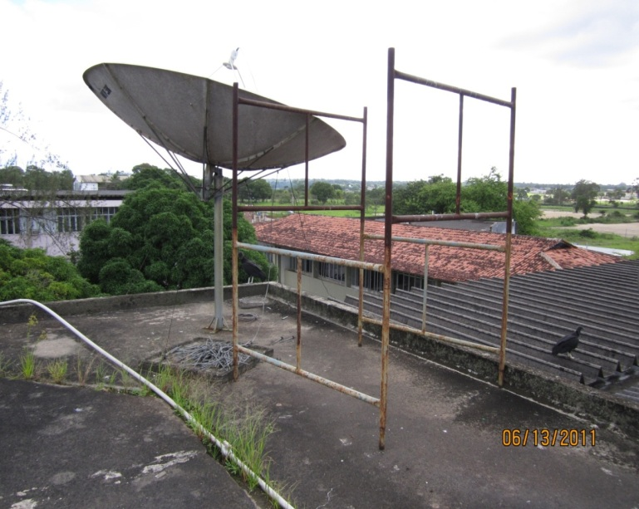
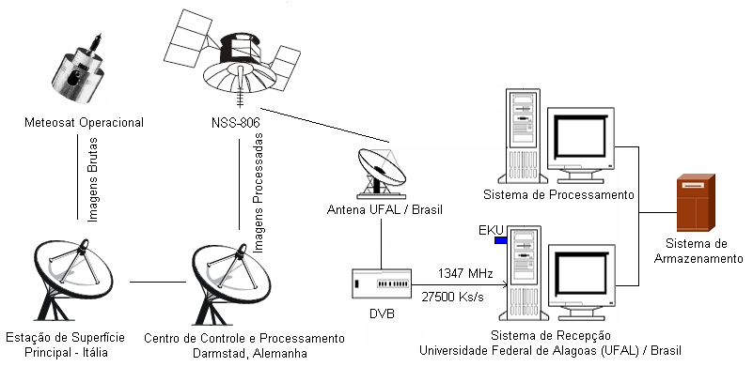
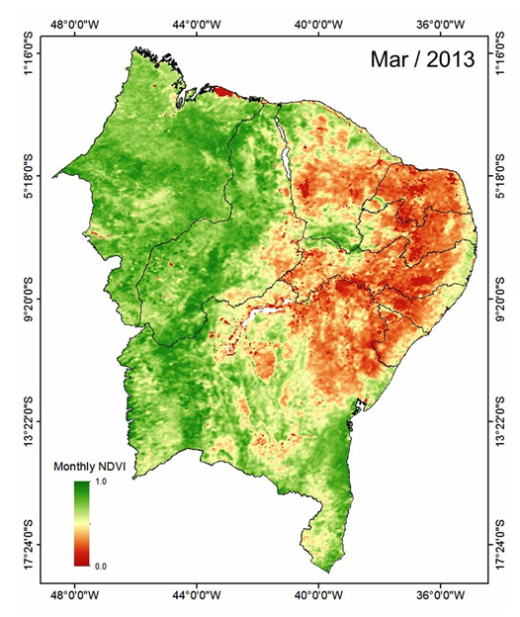
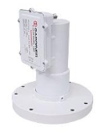
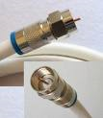
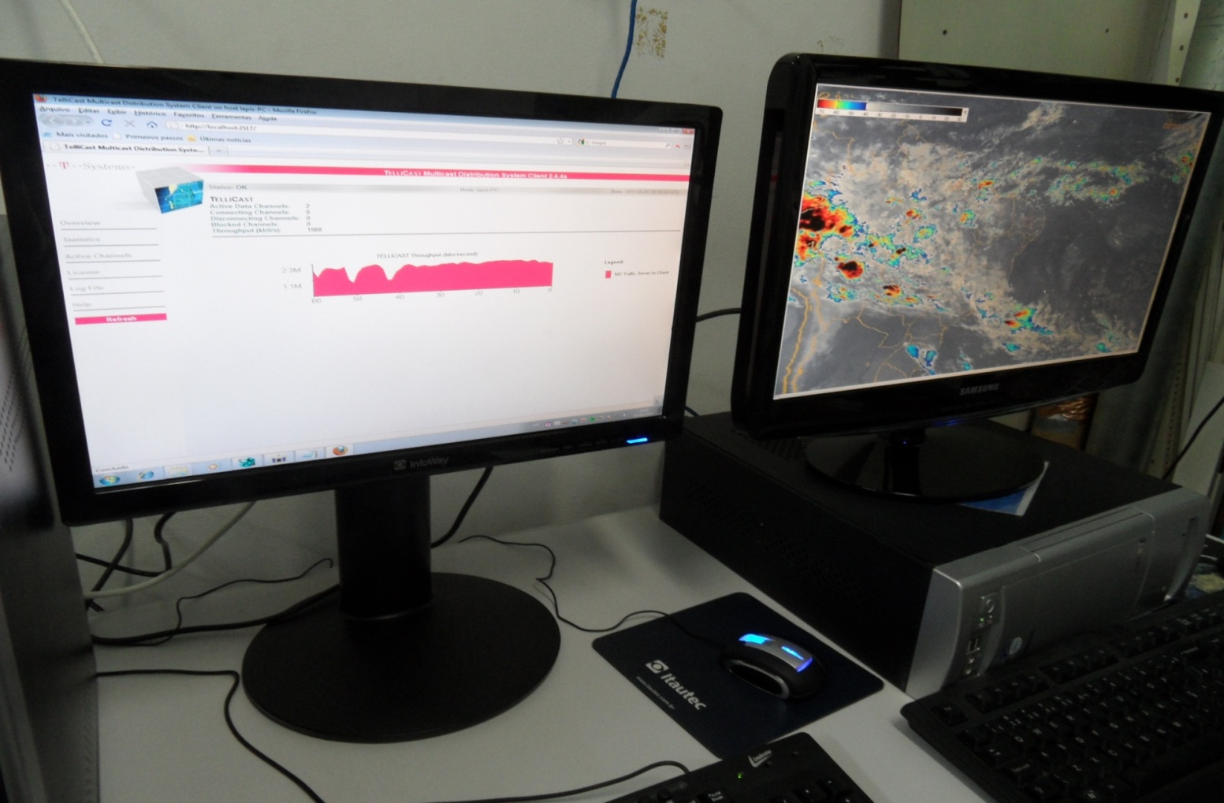
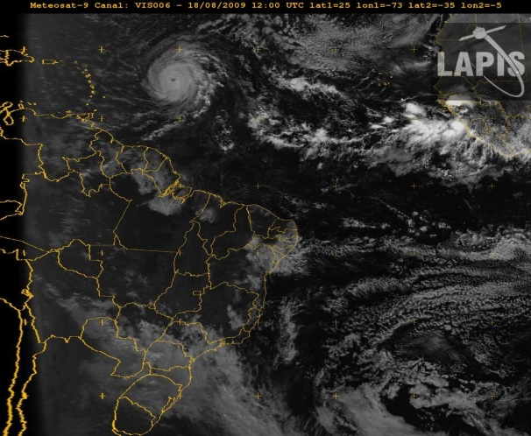
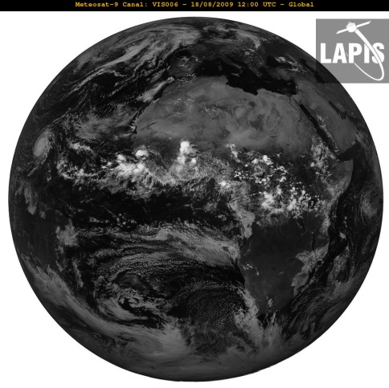
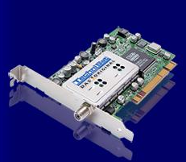

EUMETCast Lapis

Slide 6
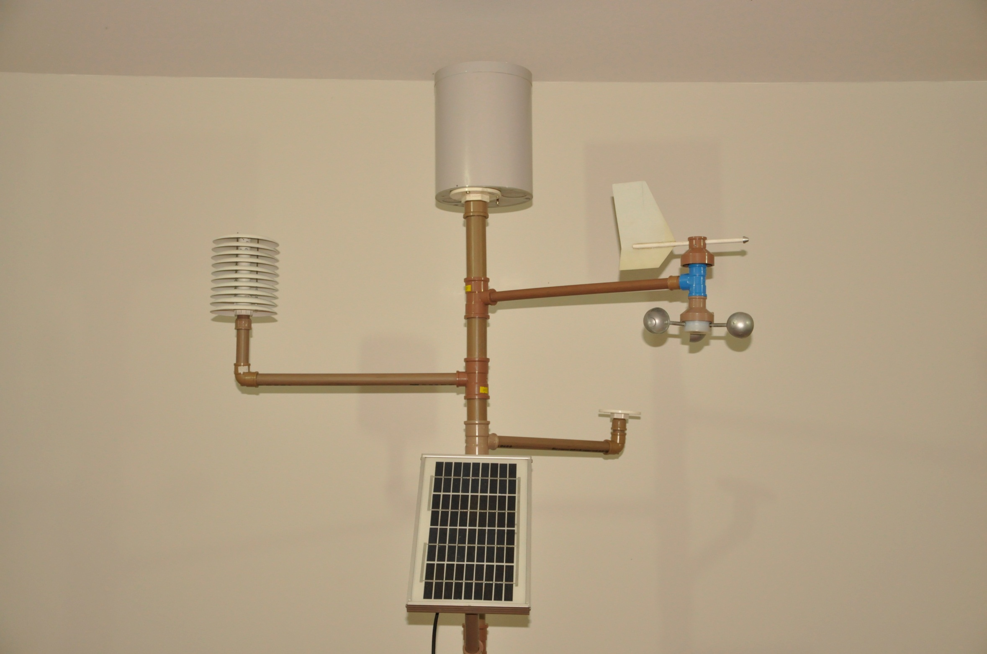
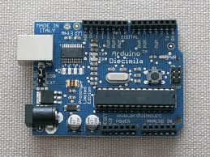
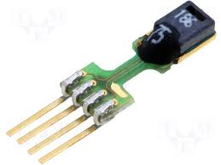
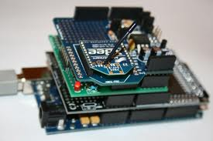
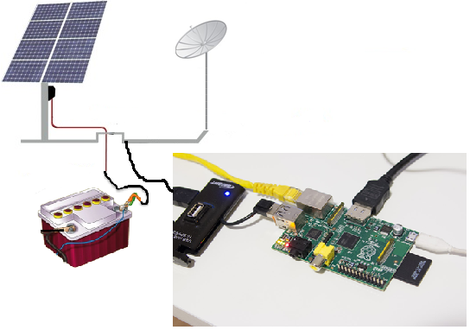

Automatic Weather Receiving Station (low cost)
Research and Operations
Experiences of SAGEO operators with EUMETCast: Receive stations
sensors
sensors
Portable EUMETCast-Americas
Receiving Station (low cost)
Raspberry
Processador ARM 700MHZ
Video 1080p30
256 Mb RAM
700 mA (3.5 watts)
Linux (Debian/Fedora)
R$ 170,00 in Brasil

Slide 7
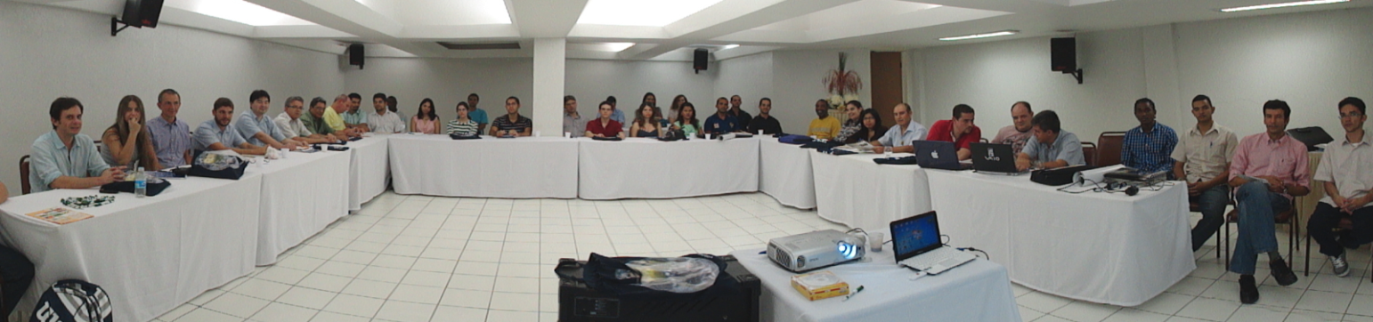
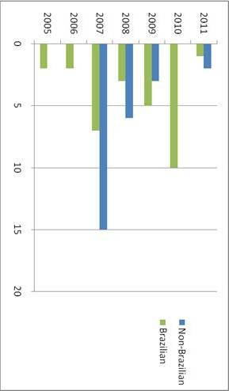
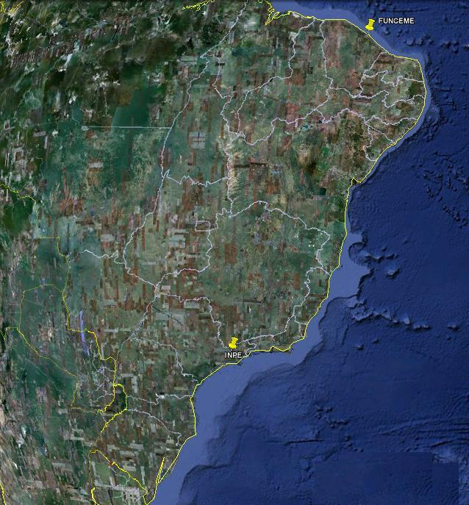
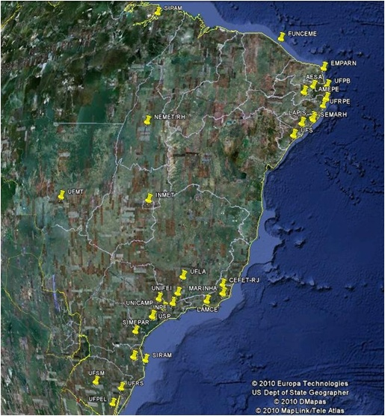
SAGEO: III Meeting, Aug. 2011, Brazil
  SAGEO: Training and Capacity building
2 EUMETCast stations
2 Brazilian States
+45 EUMETCast stations
19 Brazilian States
2007
2011

Slide 8
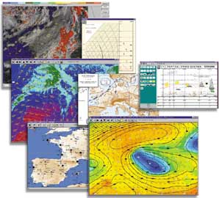
Sharing EO products using EUMETCast
Need of “ translate the information””
Operational
Education
FORMAT ASC
TYPE of DATA
STANDARD IMAGERY FORMAT (bmp, jpg, gif, png, tiff, etc)
ENCRIPTED
FORMATS (bufr, hdf, grib, xrit...)
2007
2011
“suppliers"
“end-users "

Slide 9
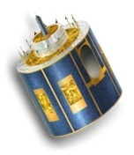
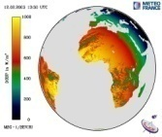
University engagements on MSG in Brazil
MSG
User
For each pixel
do
derive data
done
end
User
Helpdesk
Workshops
  Regular EUMETSAT trainings
Beta user
programme

Slide 10
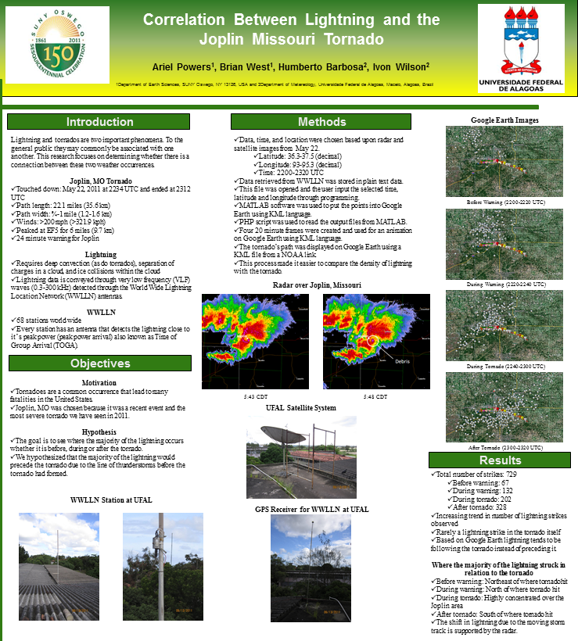
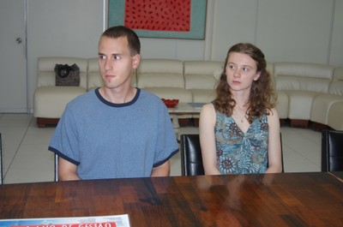
Motivation
Tornadoes are a common occurrence that lead to many fatalities in the United States.
Joplin, MO was chosen because it was a recent event and the most severe tornado we have seen in 2011.
Hypothesis
The goal is to see where the majority of the lightning occurs whether it is before, during or after the tornado.
We hypothesized that the majority of the lightning would precede the tornado due to the line of thunderstorms before the tornado had formed.

Slide 11

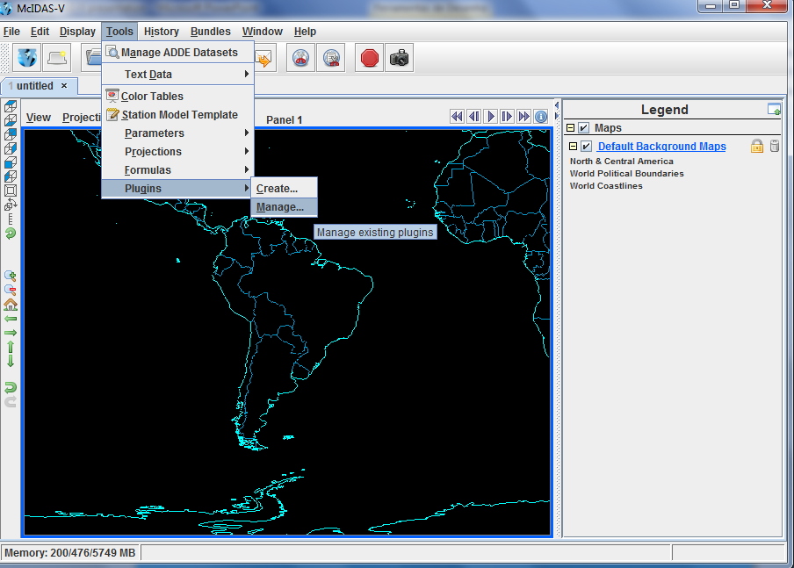
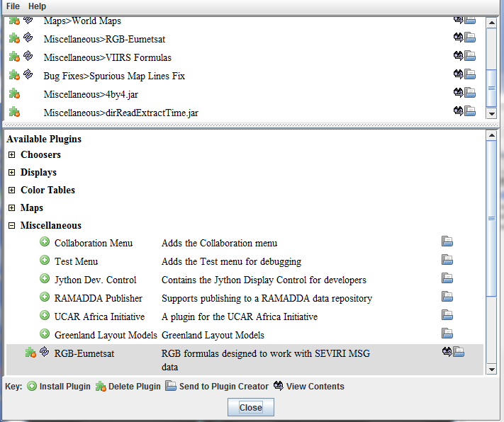
McIDAS-V
PLUGIN RGB-EUMETSAT
University engagements on open geospatial technologies in Brazil

Slide 12
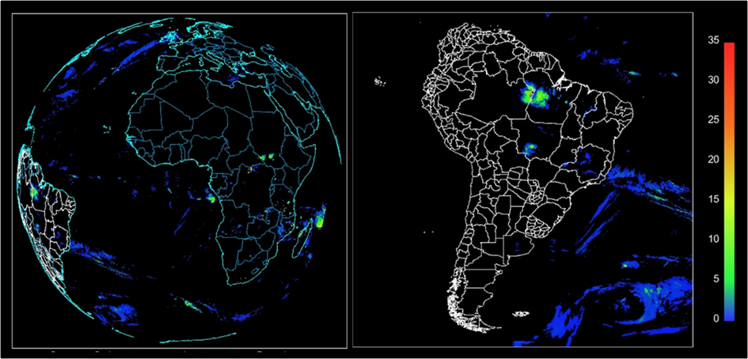
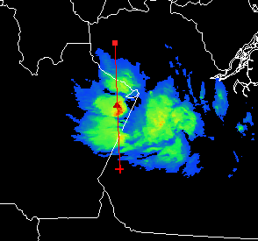
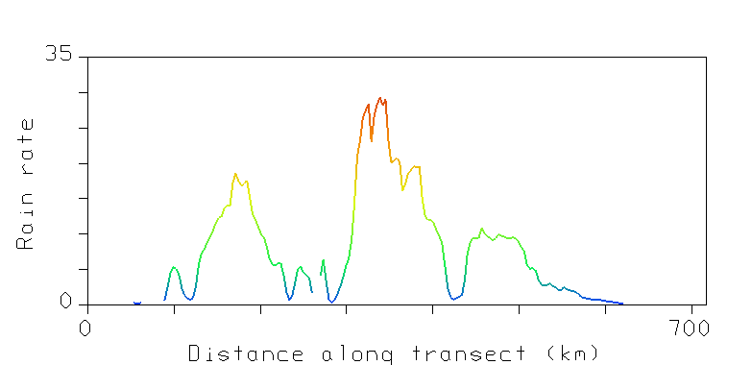
Utilização do McIDAS-V
Imagem MPE
mm/hr

Slide 13

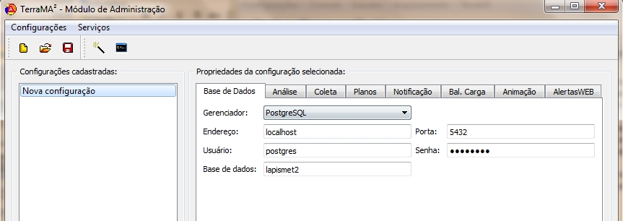

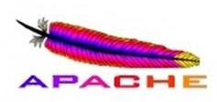



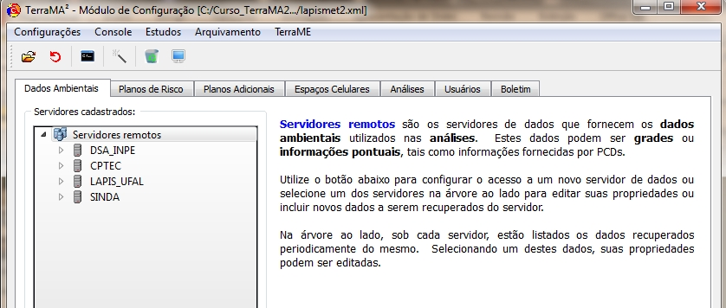

Terra MA²
Terra OGC

Slide 14
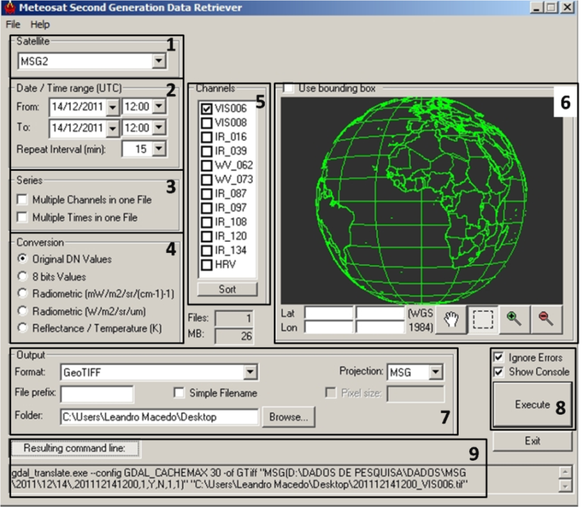
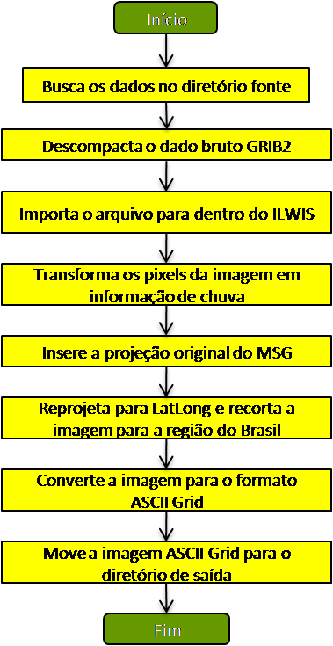
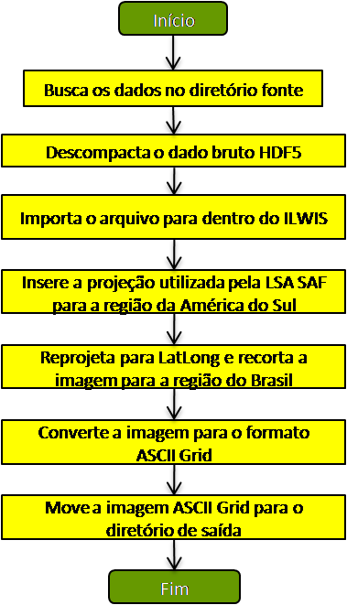
ILWIS - Geonetcast Toolbox
MSG
NDVI
MPE

Slide 15
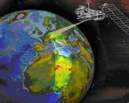
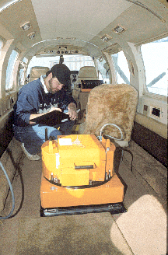
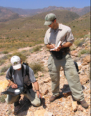
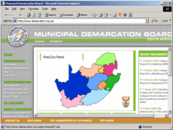
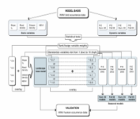
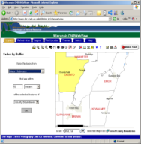




  Building on existing capacities and applications
Satellite imagery
Derived, added value data
Model outputs (forecasts) and bulletins
All products are free-of-charge, may not be (re-)sold
TerraMA2 is generic RS/GIS software that helps
to import and process the data distributed on EUMETCast.
It is the most comprehensive, freely available software
and can handle nearly all of EUMETCast data.
DATA COLLECTION
Digital maps
Tabular data
Satellite data
Aerial data
Field measurements
Web portals
Terra MA2 INPE’s own tools are used too, but they should require little introduction for Brazil audience.
G I S
DISSEMINATION
Modelling
Internet GIS
Processing
Synthesis
Internet GIS

Slide 16






Sfc. Temp. (C)
850 mb Winds
AEJ
925 mb RH (%)

Slide 17

EUMETcast Book for sale:
http://www.ebxlivros.com.br/SISTEMA-EUMETCAST:-UMA-ABORDAGEM-APLICADA-DOS-SATELITES-METEOSAT-DE-SEGUNDA-GERACAO--/
Are you interested in using the EUMETCast Americas receiving technology?
Do you have a specific product in mind that you would like to use? Let me know by filling out, and submitting via
www.lapismet.com

Slide 18
Summary
The joint initiative between the EUMETSAT and the LAPIS/UFAL. Three characteristics of the SAGEO appear to be contributing to its success, which are:
(1) to bring together the EUMETCast network operators to identify areas for regional cooperation;
(2) to provide a technical and scientific exchange in environmental and atmospheric sciences between various Brazilian research institutes, while they broaden the knowledge about their applications;
3) tools used are freeware and are at disposal of the group;
4) Strong interest and commitments from universities and others institutions with weather, climate a/o natural resources monitoring mission;
5) Increasing interest by national operational authorities e.g. National Met Services, Gvt. agencies, NGO’s;
6) Joint ventures of European with Brazilian and other research partners are increasing.

Slide 19

The End
•Thank you for listening!
•Questions?
Contact info:
  Prof. Humberto Barbosa
  barbosa33@gmail.com

