Slide 1
Potential Applications of GEONETCast at the National Meteorological Service of Belize (NMSB).
Presented by Ronald Gordon
Webinar on GEONETCast
December 4th 2013.

Slide 2
The NMSB relies heavily on the internet for various forecasting and diagnostic products.
Services are therefore severely affected in the event of internet failure or interruptions
GEONETCast will therefore be a very useful alternative in such situations.
The following slides list some of the most crucial products used operationally on a daily basis and the URLs at which they can be found.

Slide 3
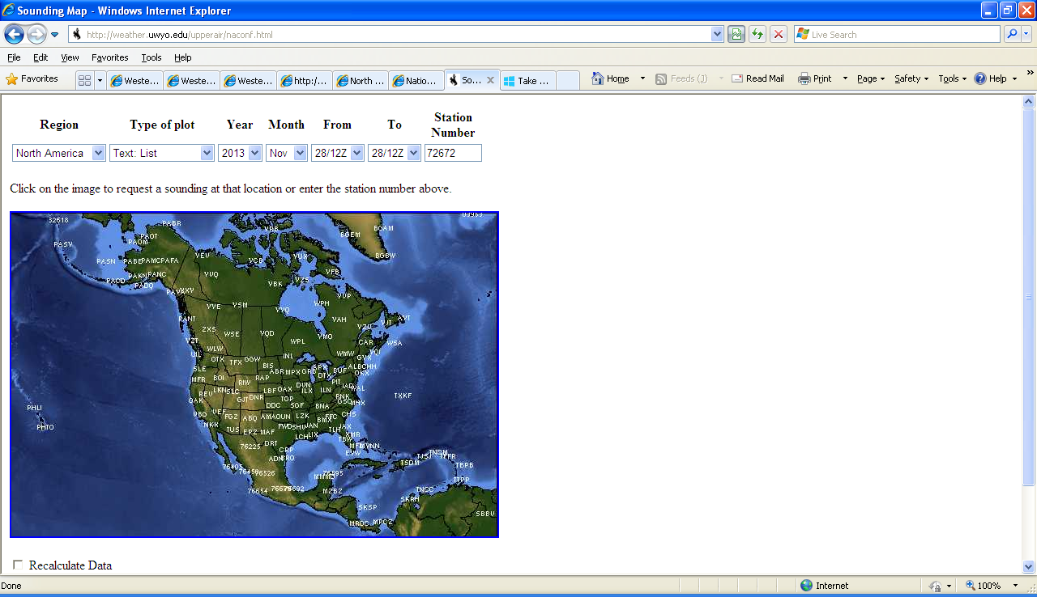
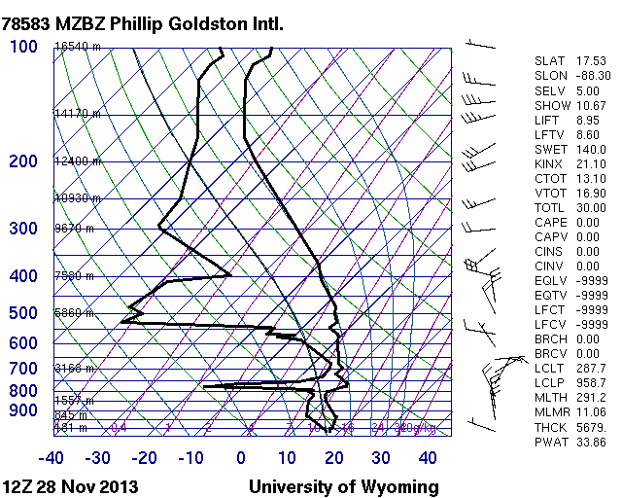
Upper-air sounding profile and stability indices
Useful to diagnose stability of the atmosphere
Can also be used for short-term forecast
http://weather.uwyo.edu/upperair/naconf.html

Slide 4
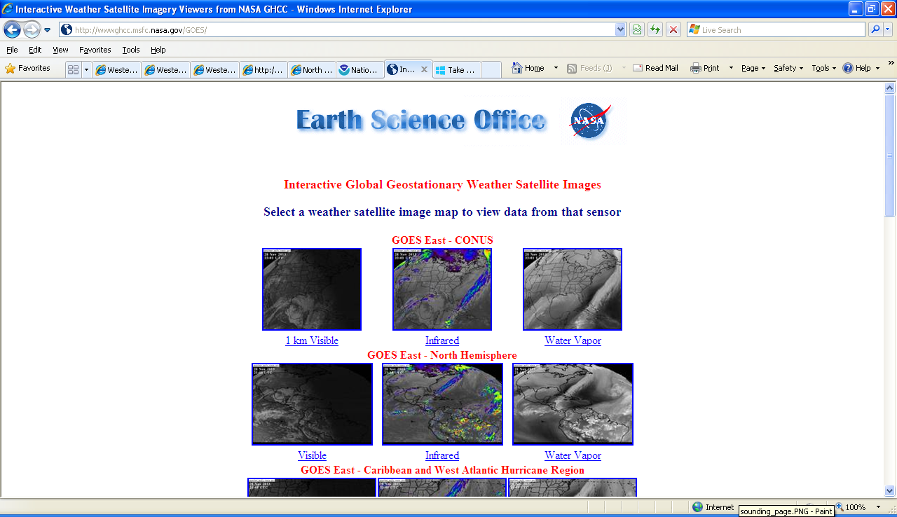
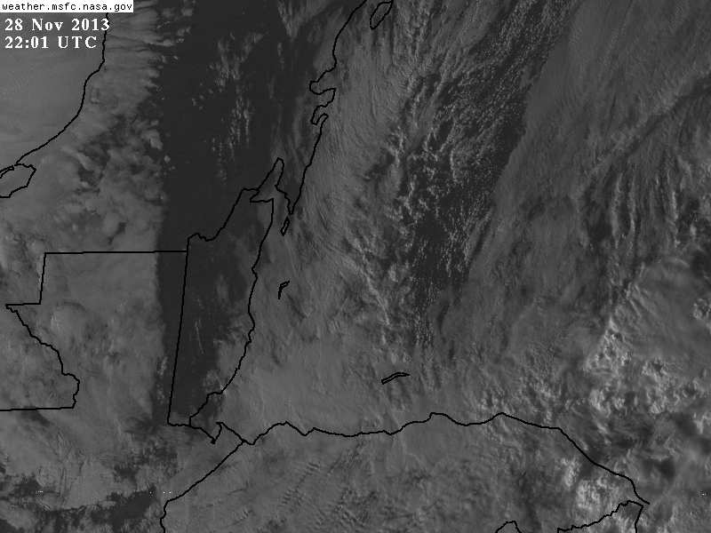
High resolution satellite imagery
Useful for short-term forecast (to compliment radar) or when radar images are unavailable.
http://wwwghcc.msfc.nasa.gov/cgi-bin/post-goes

Slide 5
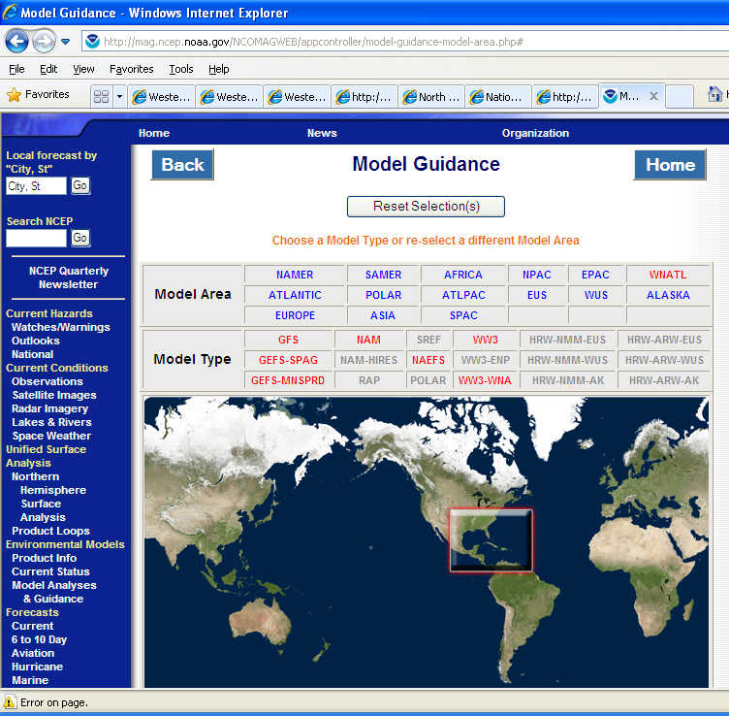
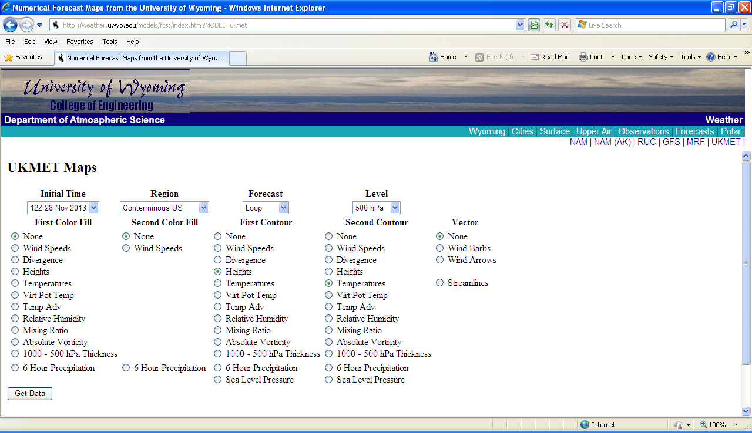
Global Models
Several Global Models are used for long-term forecasts including the GFS, NAM and UKMET
http://mag.ncep.noaa.gov/NCOMAGWEB/appcontroller/model-guidance-model-area.php
http://weather.uwyo.edu/models/fcst/index.html?MODEL=ukmet

Slide 6
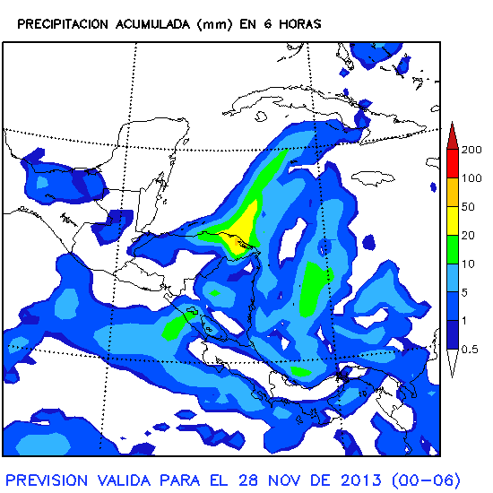
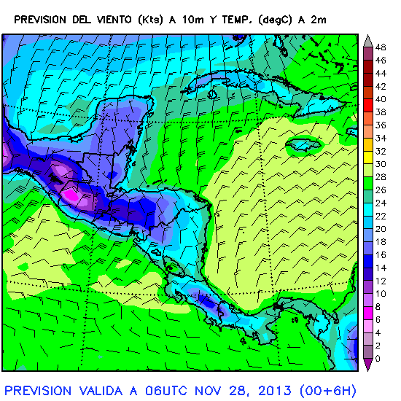
Regional Models
The MM5 Regional Model run by the instituto Nicaraguense de Estudios Territoriales is also often used
http://www.meteocatclients.com/nicaragua/run.00.45.html

Slide 7
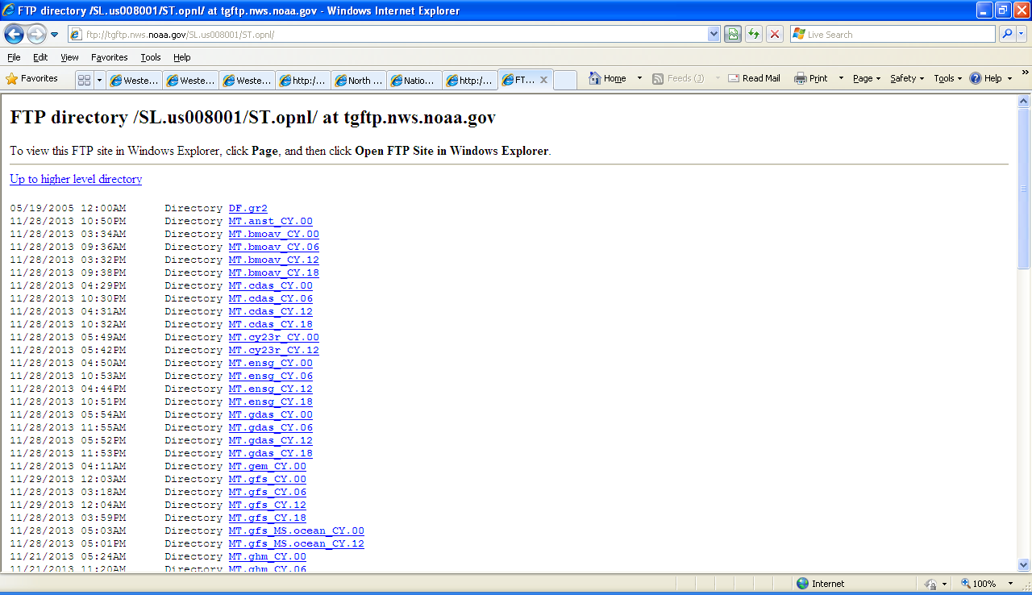
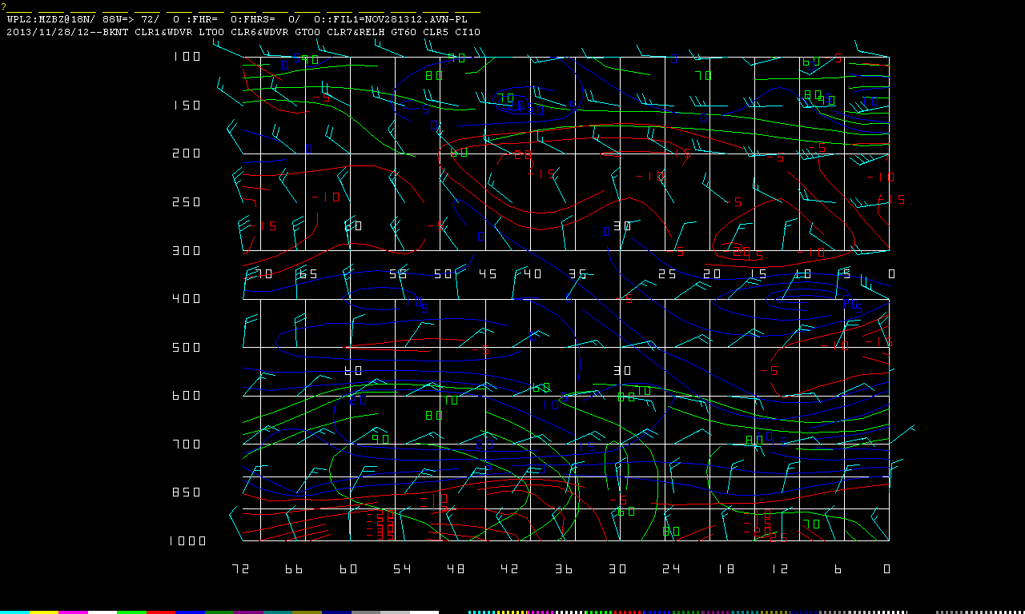
/
PC-Grids is used operationally on a daily basis, especially for generating the Terminal Aerodrome Forecasts (TAFS).
ftp://tgftp.nws.noaa.gov/SL.us008001/ST.opnl

Slide 8
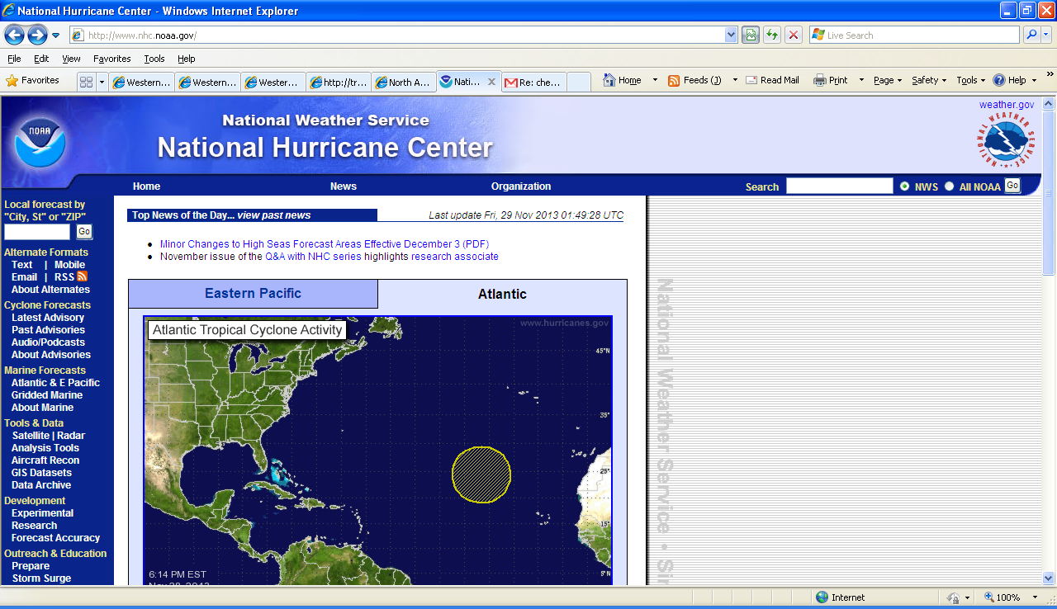
National Hurricane Center
Products issued by the National Hurricane Center are important guiding tools especially in the Hurricane Season.
http://www.nhc.noaa.gov/

