Slide 1
Satellite Foundational Course for JPSS (SatFC-J)

Slide 2
Introduction to Microwave Remote Sensing
(with a focus on passive sensing)

Slide 3
Learning Objectives
Provide a general introduction to microwave remote sensing that covers imagers vs. sounders, passive vs. active sensors, and microwave frequency channels
Understand how microwave remote sensing complements visible and infrared observation and why this is important
Briefly examine how absorption/emission, transmission, and scattering influences the usage and interpretation of microwave measurements

Slide 4
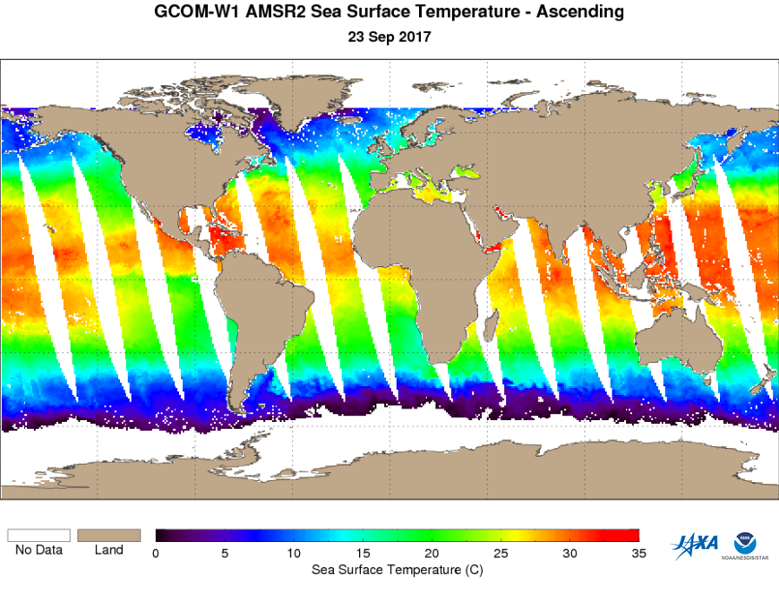
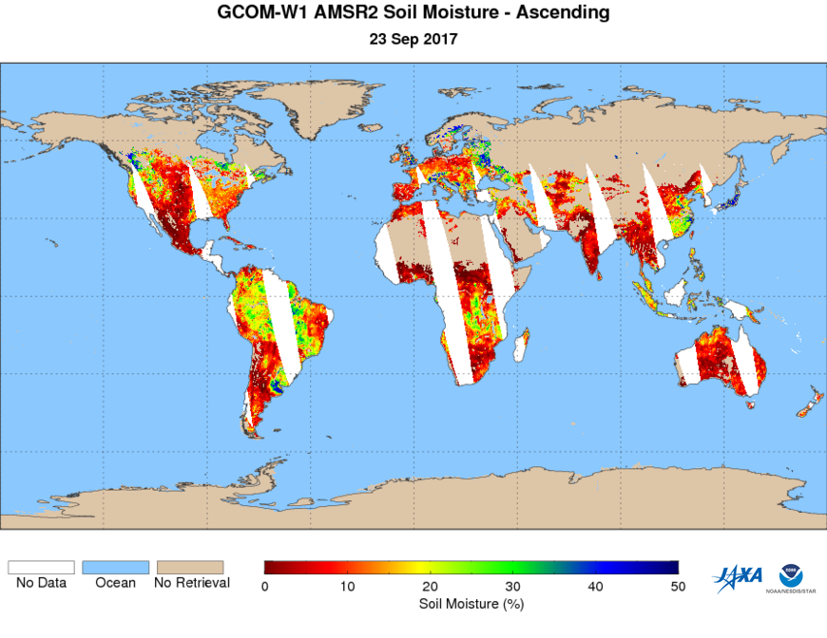
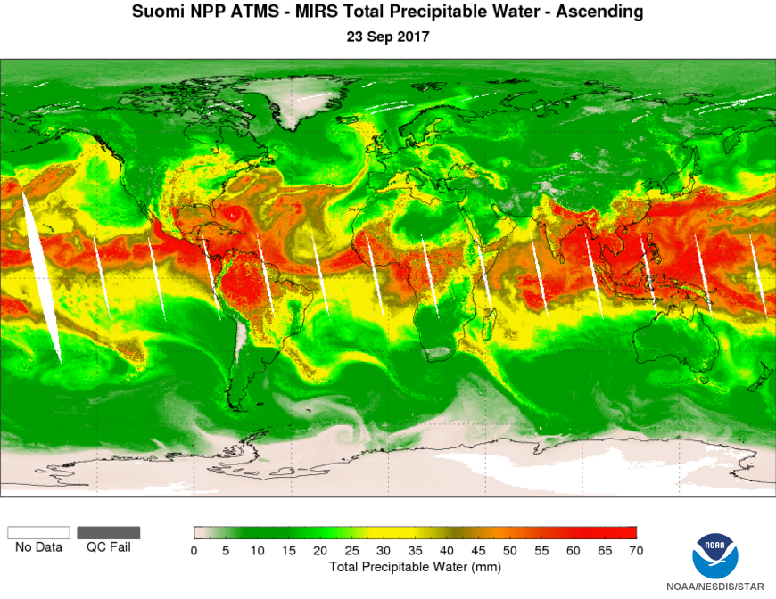
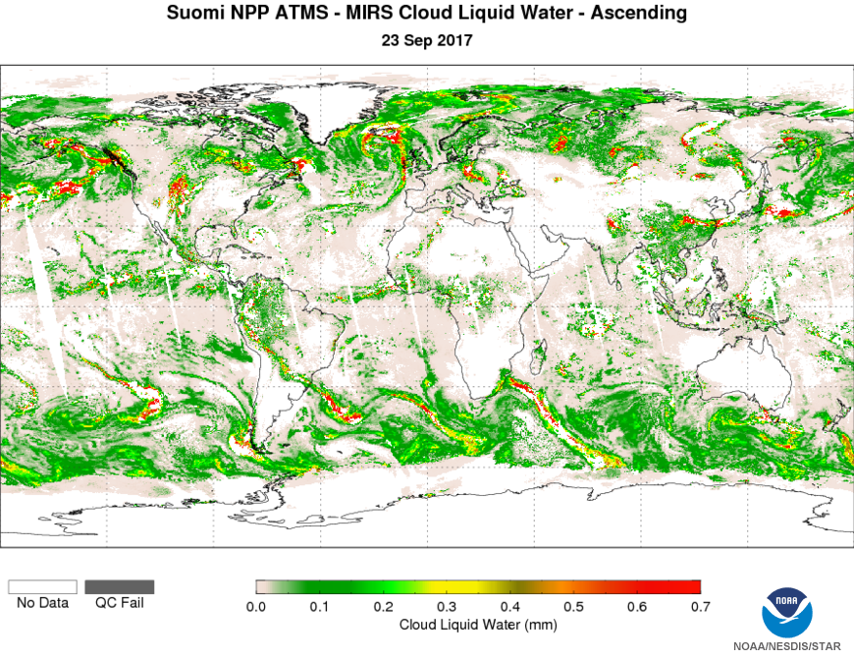
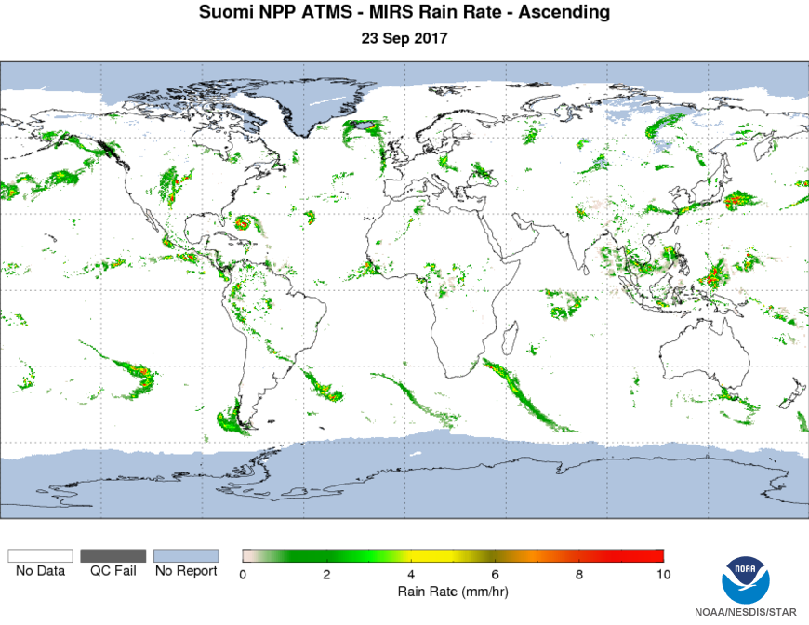
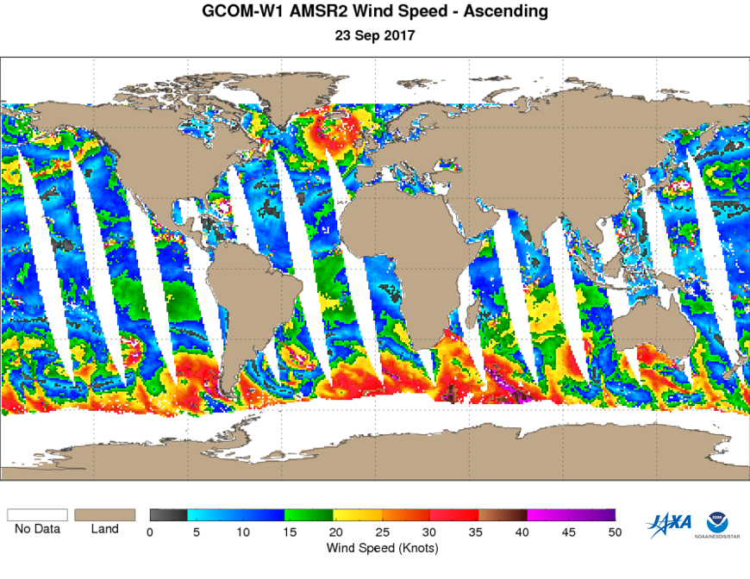
Product Preview
AMSR2 Sea Surface Temperature 2017-09-23
AMSR2 Soil Moisture 2017-09-23
ATMS MIRS Total Precipitable Water 2017-09-23
ATMS MIRS Cloud Liquid Water 2017-09-23
ATMS MIRS Rain Rate 2017-09-23
AMSR2 Wind Speed 2017-09-23
A combination of channels are used to create products
  total precipitable water
  cloud liquid water
  rain rate
  wind speed
  sea surface temperature
  soil moisture
NOAA MiRS Products: https://www.star.nesdis.noaa.gov/jpss/EDRs/products_MiRS.php

Slide 5
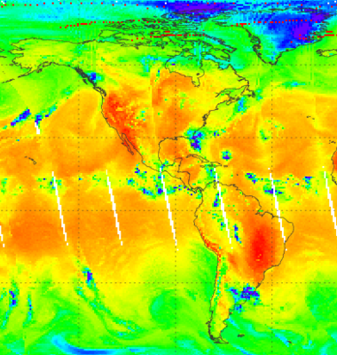
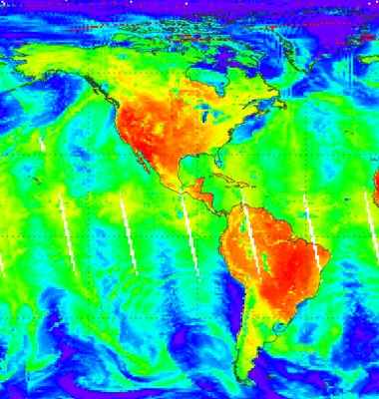
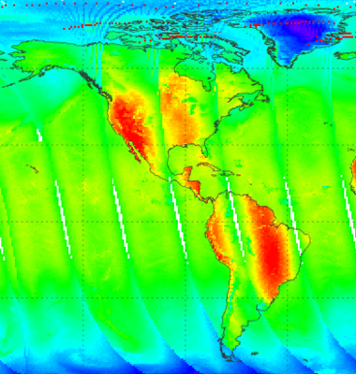
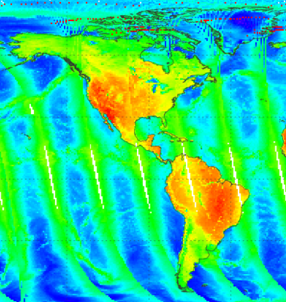
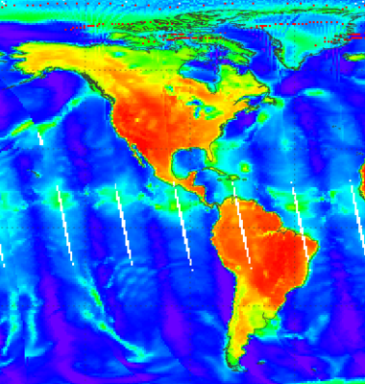
Types of Microwave Instrumentation
Imager Horizontal detail 2-D view Ex: Advanced Microwave Scanning Radiometer-2 (AMSR-2) 7 channels | Sounder Vertical detail “3-D view” Provides atmospheric profiles Ex: Advanced Technology Microwave Sounder (ATMS) 22 channels
vs
vs

Slide 6
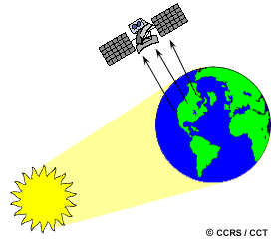
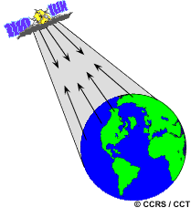
Types of Microwave Sensors
Passive Detects natural emission Used to measure atmospheric profiles Radiometers and scanners | Active Provides source of radiation and measures backscattered signal Influence of other sources complicates interpretation

Slide 7
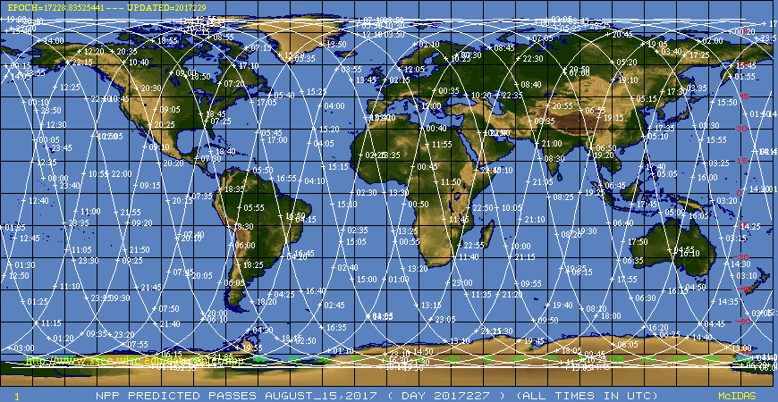
Global Coverage 2x Daily
Suomi National Polar–orbiting Partnership (S-NPP) Orbit Tracks
ascendingg
descending

Slide 8
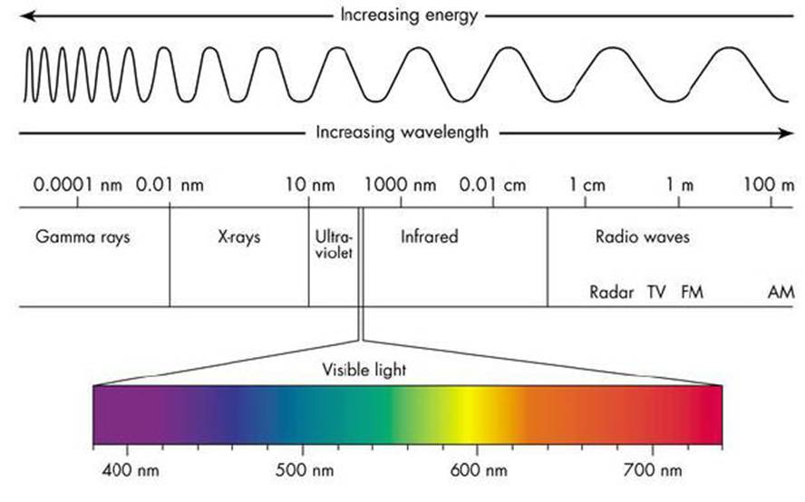
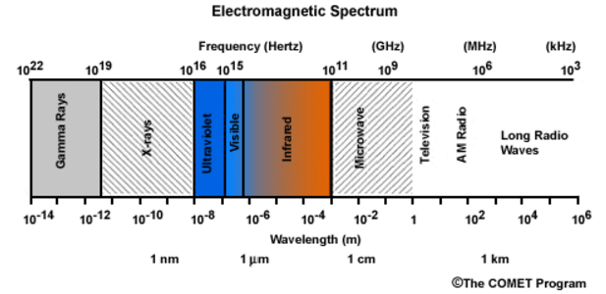
Electromagnetic Spectrum
Microwave wavelength = 0.1-30 cm (300-1 GHz)
Increasing: wavelength, sensor footprint
Decreasing: frequency, energy
10⁹ Hz = 1 GHz
Additional Resource: SatFC-G Basic Principles of Radiation
https://www.meted.ucar.edu/training_module.php?id=1239#.WEcPZfkrKUl

Slide 9
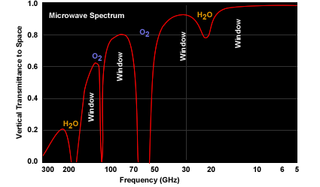
Microwave Spectrum
Vertical Transmittance to Space
In general:
Window regions are used to sense surface features
Absorption regions are used to derive temperature and moisture profiles
Frequency (GHz)
source: COMET

Slide 10
Measured Brightness Temperature
Window Regions
absorption / emission
Absorption Regions
Clear Sky or
Non-Precipitating Clouds
Land surface temp.
Sea surface temp.
Sea ice
Soil moisture
Cloud droplets
(< .1 mm radius)
Ocean winds
Clear Sky or
Non-Precipitating Clouds
Temperature profiles
Moisture profiles
transmission
Precipitating Clouds
Ice particles
scattering
Precipitating Clouds
Precipitation type
Rain rate

Slide 11
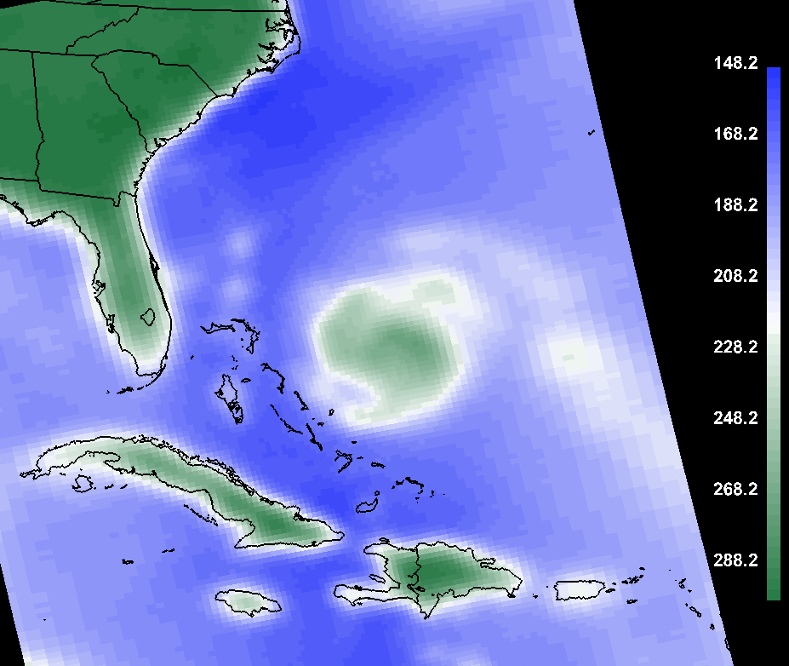
Window View of Surface Features
ATMS Ch 2 (31.4 GHz) 2017-9-23 1806Z
Ocean
Low emissivity (~0.5) provides a uniform, cold background
Land
Variable emissivity (~0.95)
°C
K
-125
150
-105
170
-85
190
-65
210
-45
230
-25
250
-5
270
15
290

Slide 12
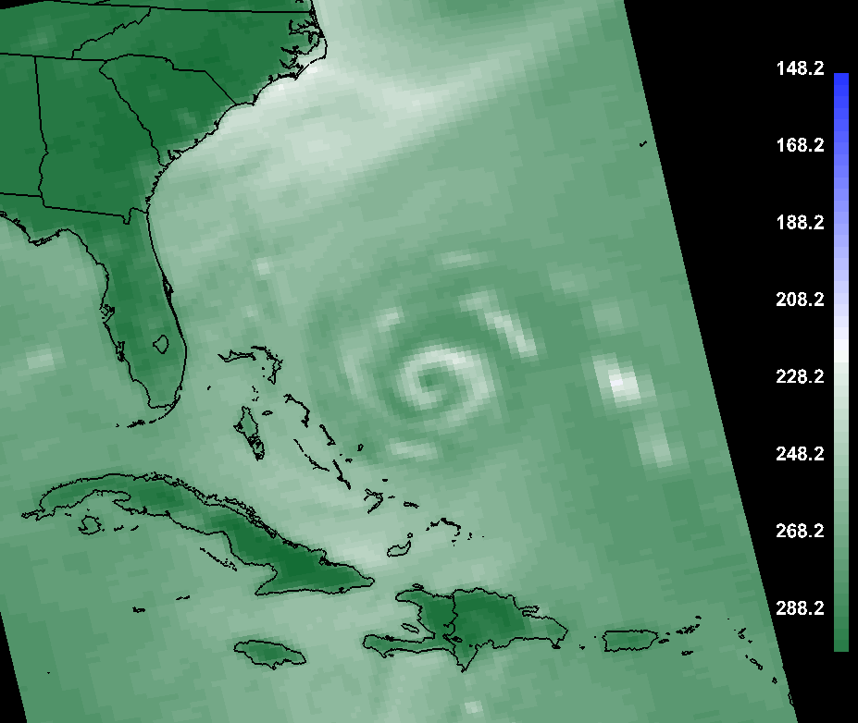
“Dirty” Window View
ATMS Ch 16 (88.2 GHz) 2017-9-23 1806Z
Non-precipitating clouds are transparent
Total atmospheric column can be observed
°C
K
-125
150
-105
170
-85
190
-65
210
-45
230
-25
250
-5
270
15
290

Slide 13
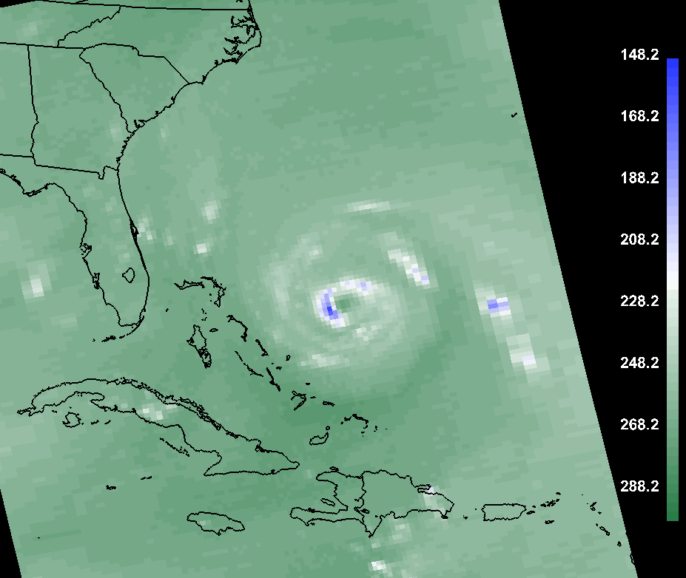
Water Vapor Absorption
ATMS Ch 20 (183.3 GHz) 2017-9-23 1806Z
Used to sense the moisture at various levels in the atmosphere
°C
K
-125
150
-105
170
-85
190
-65
210
-45
230
-25
250
-5
270
15
290

Slide 14
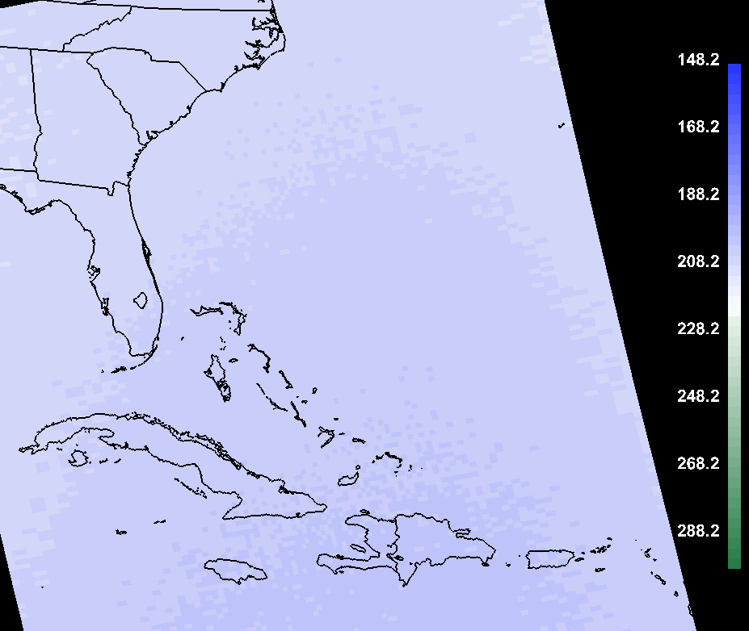
Oxygen Absorption
ATMS Ch 10 (57.3 GHz) 2017-9-23 1806Z
Used to sense the temperature at various levels in the atmosphere
°C
K
-125
150
-105
170
-85
190
Small temperature variation across the image
(~300 mb level)
-65
210
-45
230
-25
250
-5
270
15
290

Slide 15
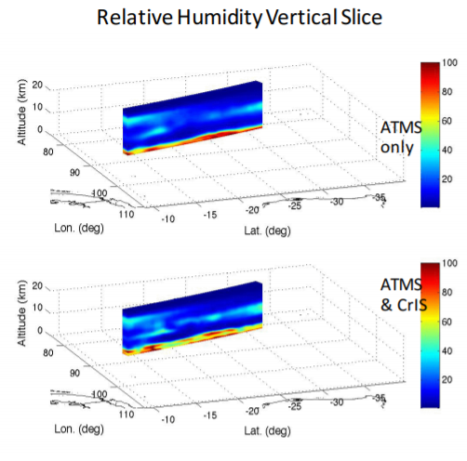
Vertical Profiles
Displayed in AWIPS as NUCAPS soundings
NUCAPS = NOAA Unique Combined Atmospheric Processing System

Slide 16
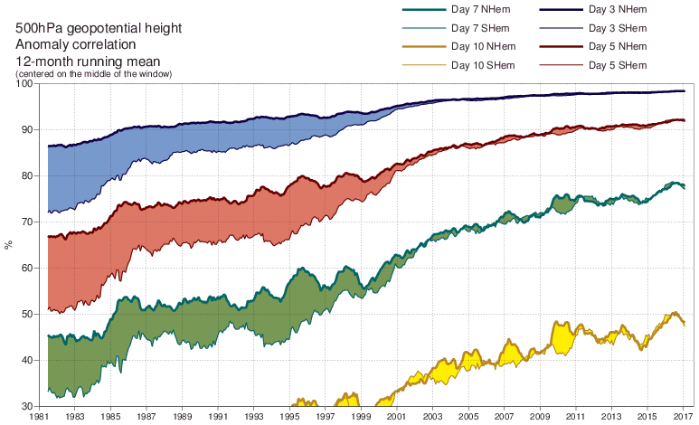
Assimilation into Numerical Models
Microwave and infrared sounders have huge impacts in forecasts through assimilation into numerical weather prediction models
500 hPa geopotential height anomaly correlation
12-month running mean
%
1981
2017

Slide 17
Advantages and Limitations
Microwave Advantages
  Non-precipitating clouds are transparent
  Precipitation rate estimation, ocean winds, soil moisture
  Atmospheric temperature and moisture profiles
  Blended with other high resolution measurements in products and assimilated into models
Microwave Limitations
  Longer wavelength limits spatial resolution
  Variations in surface emissivity complicate interpretation
  Infrequent observations: 2x daily passes per satellite

Slide 18

Resources
Microwave Remote Sensing: Overview (2nd Edition)
https://www.meted.ucar.edu/training_module.php?id=979
A First Course in Atmospheric Radiation, 2nd Ed. (Petty 2006)
Satellite Meteorology: An Introduction (Kidder and Vonder Haar 1995)
Basics of Visible and Infrared Remote Sensing
https://www.meted.ucar.edu/training_module.php?id=1096#.WEmPA_krKUk
SatFC-G Basic Principles of Radiation
https://www.meted.ucar.edu/training_module.php?id=1239#.WEcPZfkrKUl
Questions? Email: Bernie.Connell@colostate.edu
Narrator: Bernie Connell
Editors: Erin Dagg, Bernie Connell
Other Contributors: John Forsythe

