Slide 1
Satellite Foundational Course for JPSS (SatFC-J)

Slide 2
Microwave Surface Emissivity

Slide 3
Learning Objectives
Describe differences in microwave surface emissivity that aid in the characterization of land surfaces, snow and ice cover, and ocean and water surfaces.
Identify key parameters that affect emissivity.
Provide single channel and product examples demonstrating strengths and limitations.

Slide 4
Advantage of Microwave Remote Sensing
  Non-precipitating clouds
  are transparent.

Slide 5
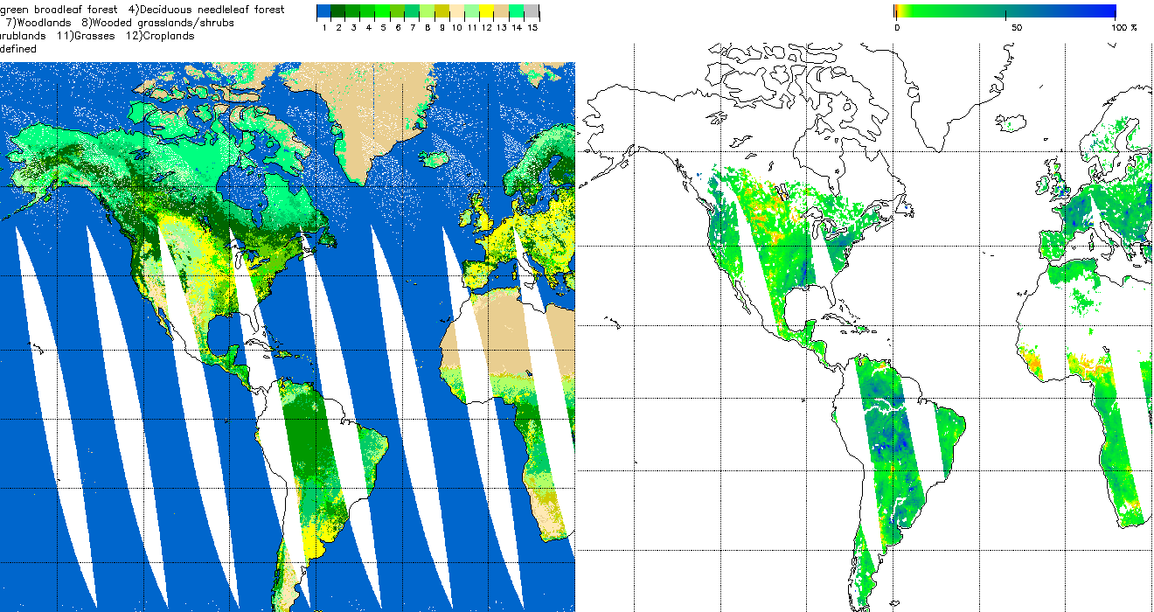
Land Products for Input to Models
AMSR-2 Land Cover
11 Feb 2018
AMSR-2 Soil Moisture
11 Feb 2018
1 – water
2 – evergreen needleleaf forest
3 – evergreen broadleaf forest
4 – deciduous needleleaf forest
5 – deciduous broadleaf forest
6 – mixed forests
7 – woodlands
8 – wooded grasslands/shrubs
9 – closed bushlands, shrublands
10 – open shrublands
11 – grasses
12 – croplands
13 – bare
14 – mosses and lichens
15 – other/undefined
Imagery Source: NOAA Operational GCOM-W1 AMSR-2 Product Maps (GPs)
http://www.ospo.noaa.gov/Products/atmosphere/gpds/maps.html?GPLCT#gpdsMaps

Slide 6
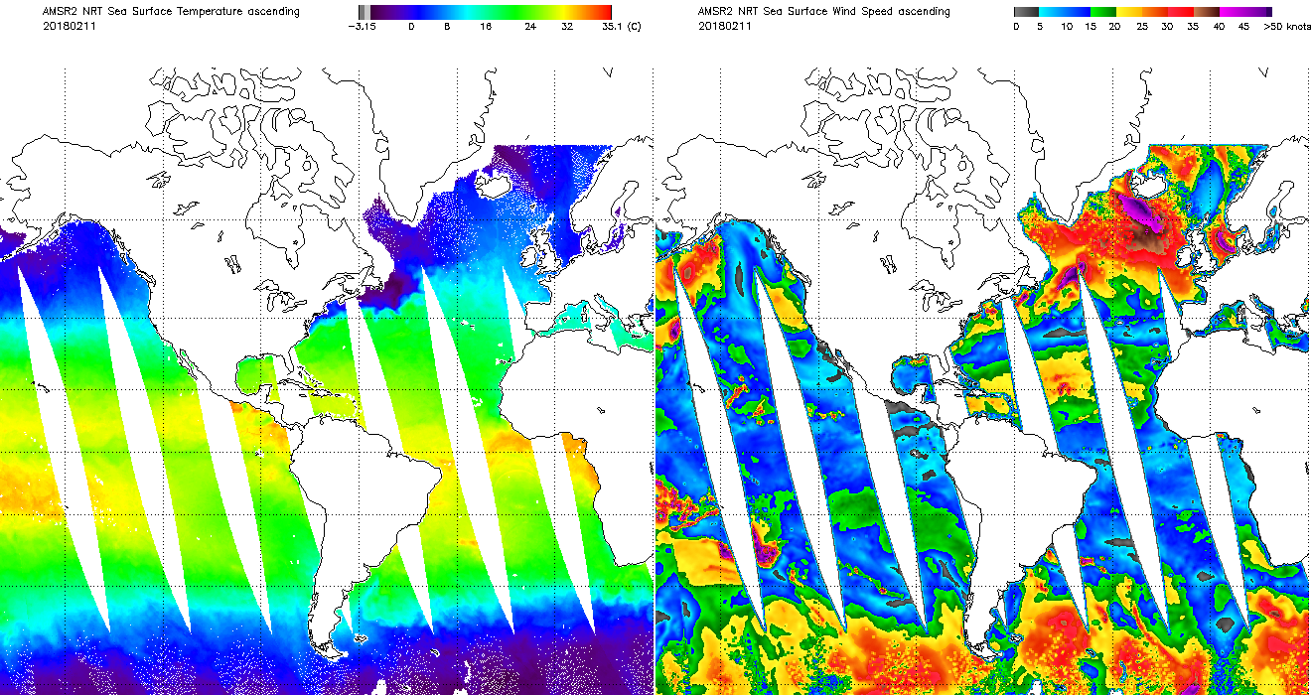
Sea Surface Products
AMSR-2 Sea Surface Temperature
11 Feb 2018
AMSR-2 Sea Surface Wind Speed
11 Feb 2018
Imagery Source: NOAA Operational GCOM-W1 AMSR-2 Product Maps (GPs)
http://www.ospo.noaa.gov/Products/atmosphere/gpds/maps.html?GPLCT#gpdsMaps

Slide 7
Why Is Learning About Emissivity Important?
Emissivity characteristics strongly affect the interpretation of microwave imagery.
Operations
Research

Slide 8
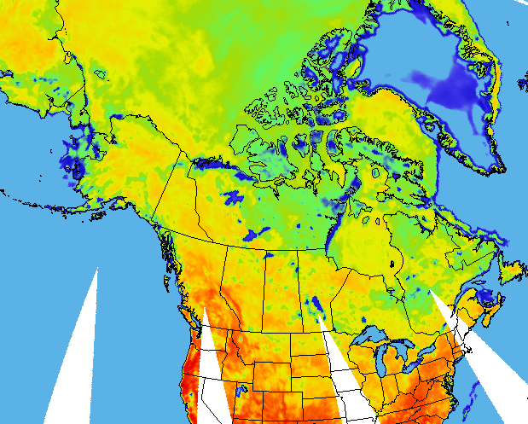
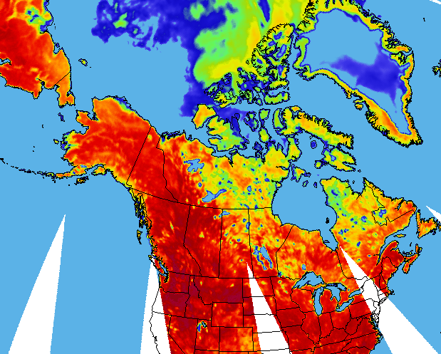
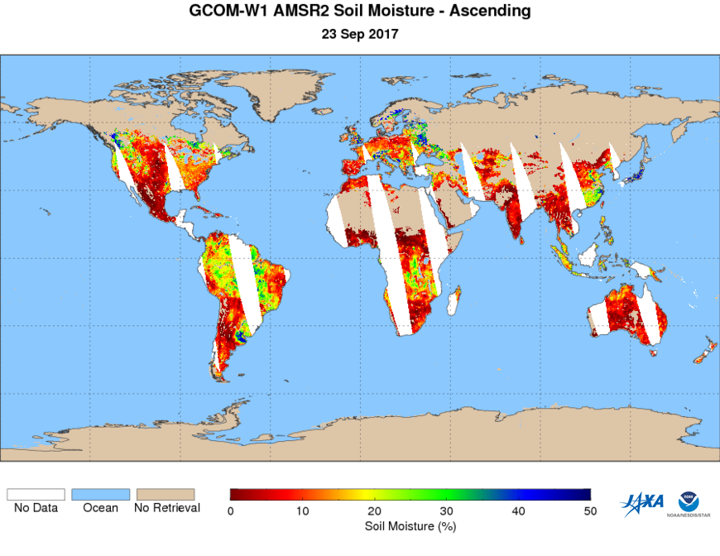
Summer vs. Winter
Winter
AMSR-2 10.65 GHz (H-pol)
Summer
29 Jan 2018
11 Aug 2017
[°C]
[K]
-105 -85 -65 -45 -25 -5 15
Brightness Temperature

Slide 9
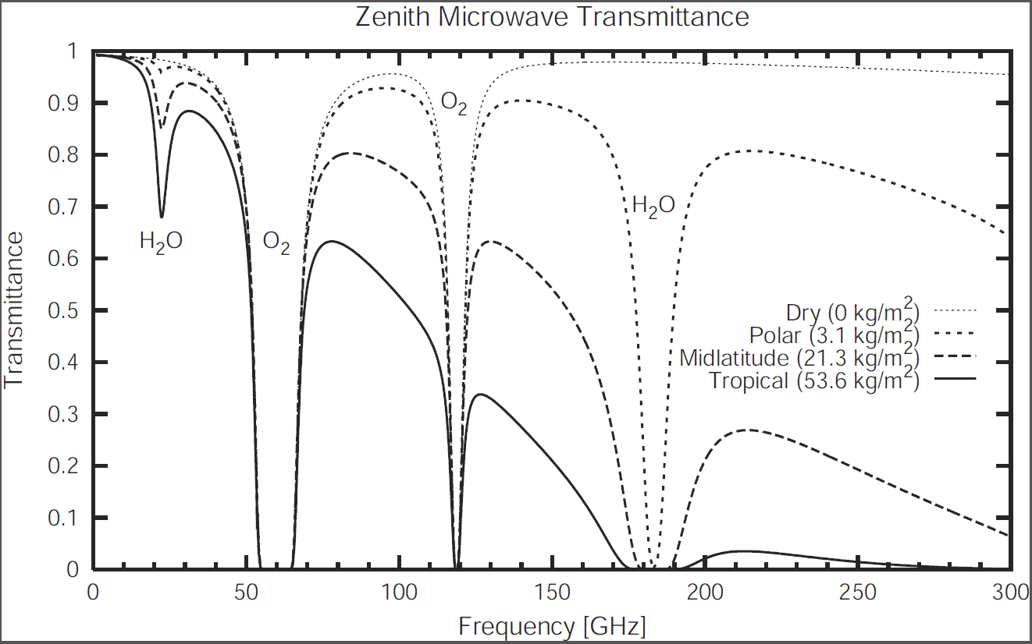
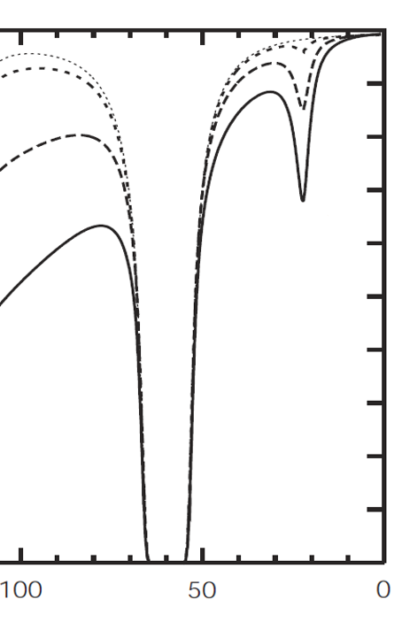

Window Viewing Regions
x
Petty 2006 (modified)
window
H₂O absorption
Transmittance
window
x
Dry (0 mm)
Polar (3.1 mm)
Midlatitude (21.3 mm)
Tropical (53.6 mm)
O₂ absorption
Frequency [GHz]

Slide 10
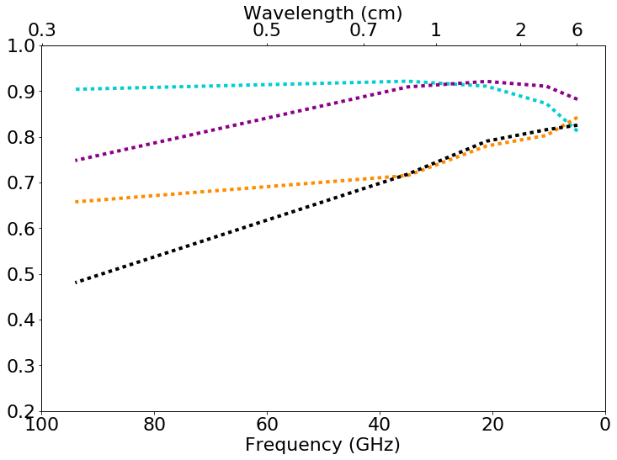
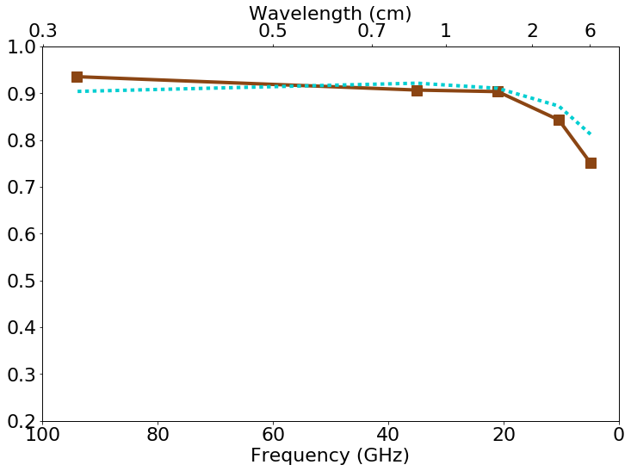
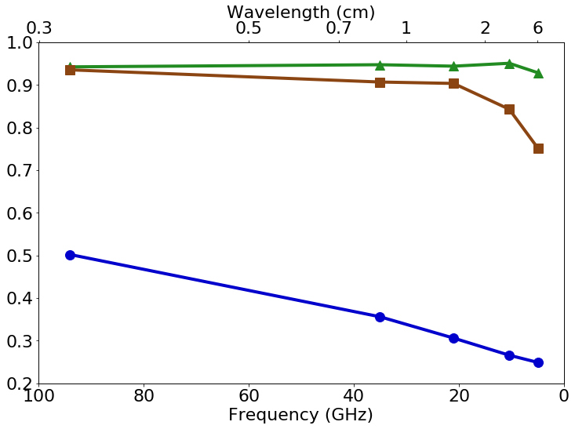
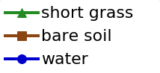
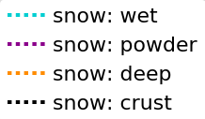
Emissivity
Surface Emissivity Spectra
Parameters:
wavelength
material characteristics
polarization
surface roughness
viewing angle
Emissivity at H-Polarization
37 GHz
19 GHz
Data Source: C. Matzler, "Passive Microwave Signatures of Landscapes in Winter", Meteorol. Atmos. Phys. (1994)

Slide 11
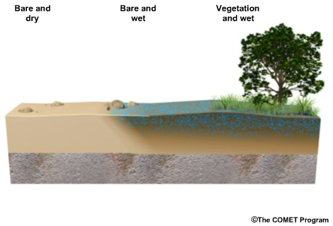
Land Surfaces
Factors that influence measurements:
  soil type
  vegetation type and amount of coverage
  moisture content
Typical emissivity:
  bare soil < vegetation
  moist < dry
0.6 – 0.8 emissivity
emissivity > 0.9
(modified)
vegetation and wet conditions
vegetation and dry conditions
wet soil
dry soil

Slide 12
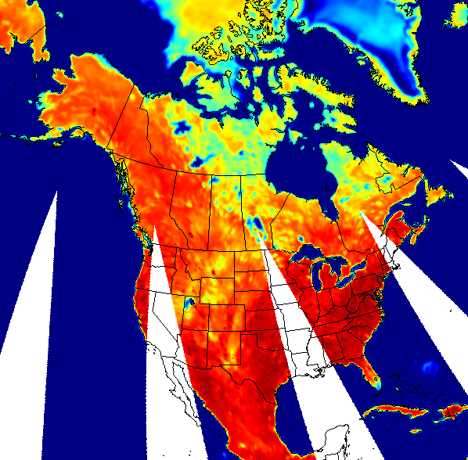
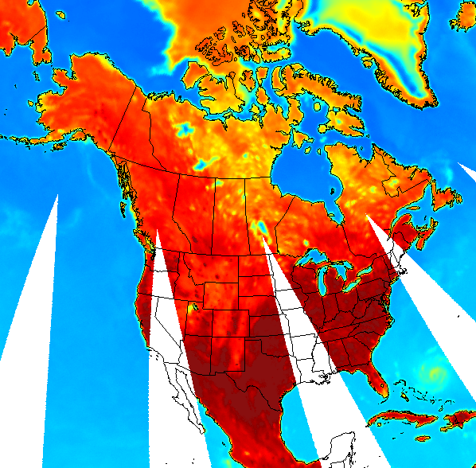
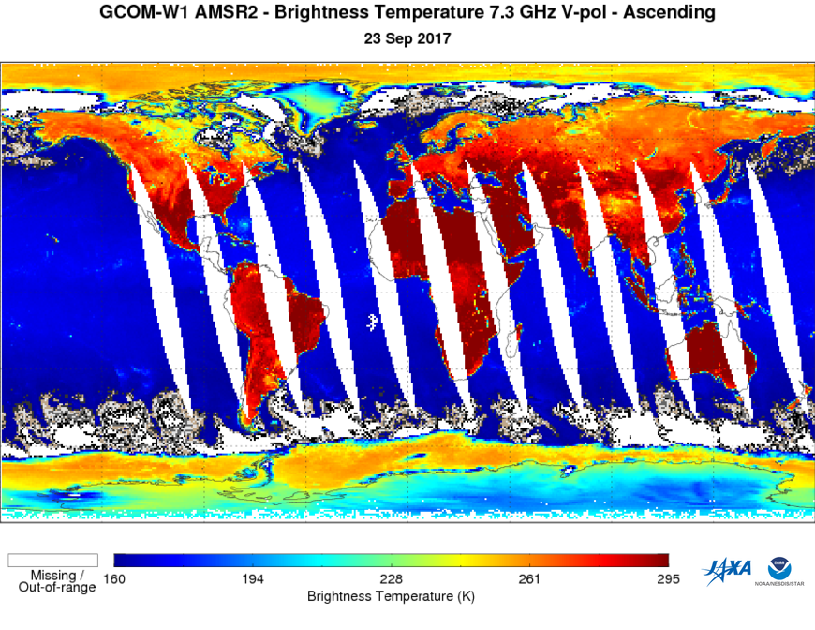
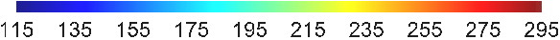
Horizontal vs. Vertical Polarization
Surface emissivity and the resulting measured brightness temperature (T) is strongly dependent on polarization in the microwave
AMSR-2 6.9 GHz H-pol
23 Sep 2017
AMSR-2 6.9 V-pol
23 Sep 2017
land
weak
polarization
ΔT ≈ 20 K
water
strong
polarization
ΔT ≈ 86 K
82
168
245
265
Brightness Temperature (K)

Slide 13
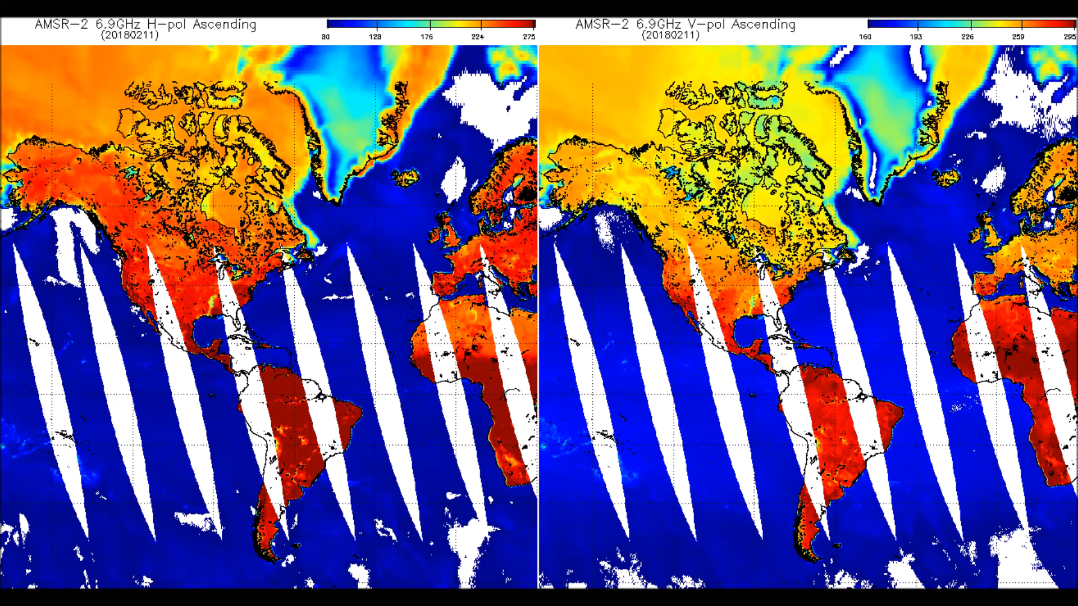
Animation of AMSR-2 H-pol and V-pol Brightness Temperature – 11 Feb 2018
http://rammb.cira.colostate.edu/templates/loop_directory.asp?data_folder=visitview/custom/AMSR2_20180211_Hpol_Vpol
Imagery Source: NOAA Operational GCOM-W1 AMSR-2 Product Maps (BTs)
http://www.ospo.noaa.gov/Products/atmosphere/gpds/maps.html?GPLCT#gpdsMaps

Slide 14
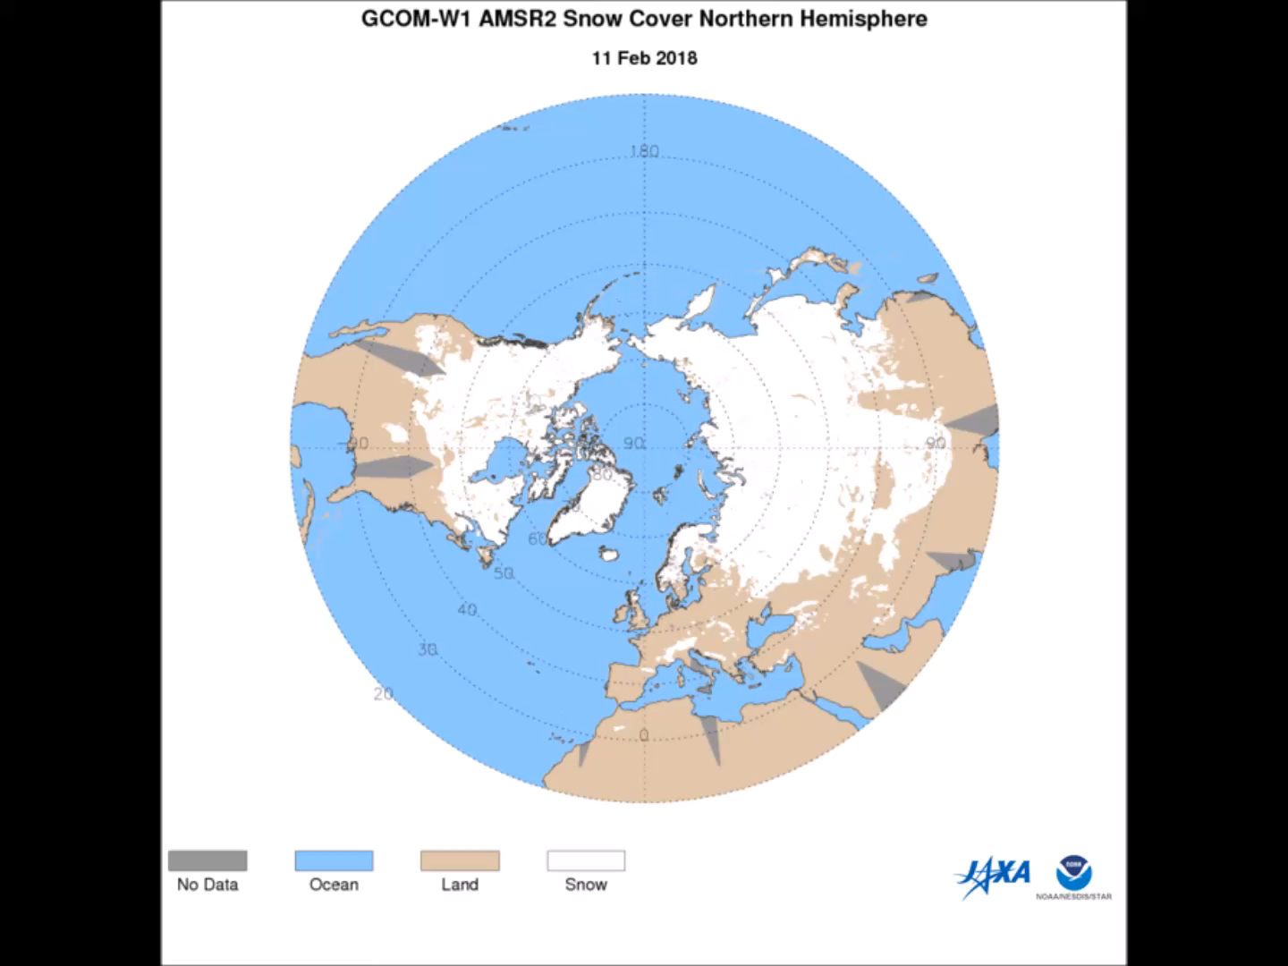
Animation of AMSR-2 Snow and Ice Products – 11 Feb 2018
http://rammb.cira.colostate.edu/templates/loop_directory.asp?data_folder=visitview/custom/AMSR2_20180211_NH_seaice_snow
Imagery Source: NOAA/NESDIS/STAR JPSS Environmental Data Records (GCOM AMSR2 Products)
https://www.star.nesdis.noaa.gov/jpss/EDRs/products_gcom.php

Slide 15
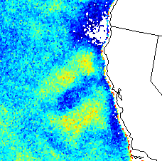
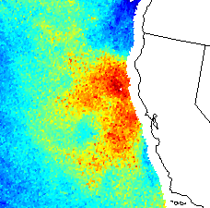
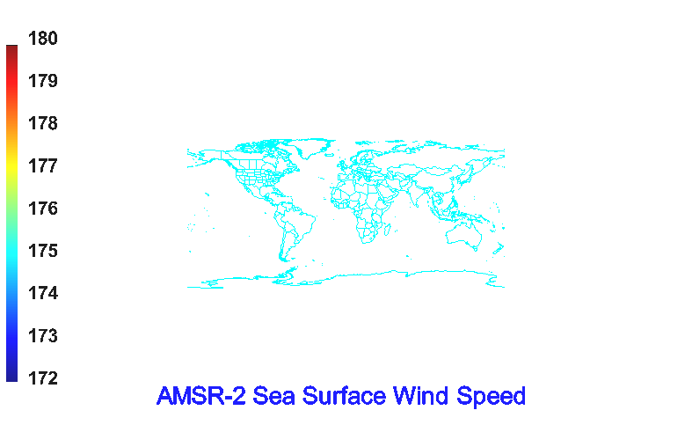
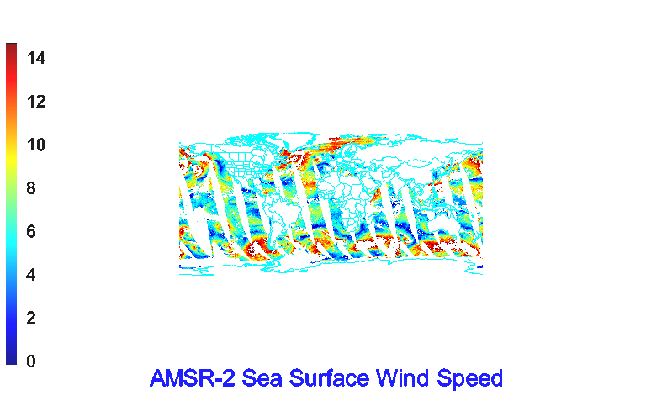
Ocean & Water Surfaces
Typical emissivity: 0.25-0.5
  calm < small waves < foam
Emissivity differences used in sea surface wind estimation (± 2 m/s)
Sensitive to sea surface temperature (± 0.2 °C)
AMSR-2 10.65 GHz V-pol
29 Oct 2017
AMSR-2 Sea Surface Wind Product
29 Oct 2017
K
m/s

Slide 16
Summary
Microwave emissivity varies considerably by surface type and accounts for the large differences in observed brightness temperature imagery.
In general…
  dry land surfaces and vegetation covered surfaces are the strongest emitters
  snow- and ice-covered surfaces are moderate emitters
  ocean and water surfaces are the weakest emitters
Observations at multiple frequencies and polarizations (vertical, horizontal) helps in the characterization of various surface properties.
  land cover
  soil moisture
  sea surface temperatures
  near-surface ocean wind speed
  snow cover, depth, and water equivalent
  ice concentration and age

Slide 17

Resources
Microwave Remote Sensing: Land and Ocean Surface Applications, 2nd Ed.
https://www.meted.ucar.edu/training_module.php?id=1100
Microwave Remote Sensing Resources
https://www.meted.ucar.edu/training_module.php?id=260
A First Course in Atmospheric Radiation, 2nd Ed. (Petty 2006)
Questions? Email: Bernie.Connell@colostate.edu
Narrator: Erin Dagg
Editors: Erin Dagg, Bernie Connell
Other Contributors: Jorel Torres

