Slide 1
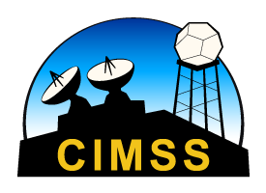
NUCAPS Soundings
Scott Lindstrom
UW Madison/CIMSS
Notes:
Welcome to the Satellite Foundational Course for JPSS module on NUCAPS Soundings. I'm Scott Lindstrom from CIMSS.

Slide 2
What will you learn?
What are NUCAPS Soundings?
When and where are NUCAPS Soundings available?
Why might you use data from NUCAPS Soundings?
How can NUCAPS Soundings be changed?
Thanks to the following:
  Chris Barnet NOAA / STC
  Antonia Gambacorta NOAA / STC
  Nadia Smith NOAA / STC
  Tony Reale NOAA / SMCD
  Dan Nietfeld NOAA / OAR
  Dan Lindsey NOAA / STAR
  Others!
Notes:
What will you learn - or maybe just be reminded of -- in this module? I'd also like to acknowledge the help of people listed -- and others.

Slide 3
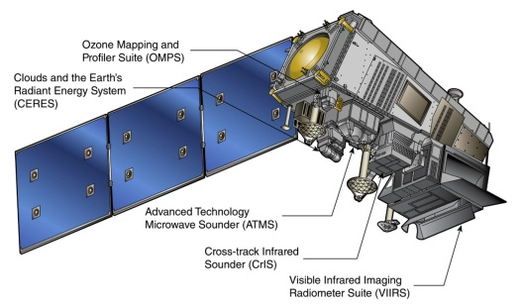
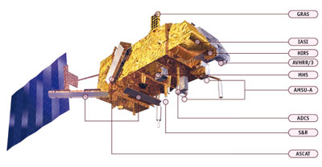

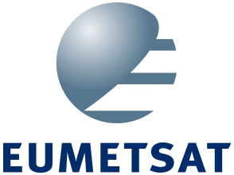
NUCAPS
NOAA-Unique Combined Atmospheric Processing System
  What is Combined? Infrared and Microwave Sounder Data
    Sensors on Suomi NPP/NOAA-20
      CrIS: Cross-track Infrared Sounder (1305 channels)
      ATMS: Advanced Technology Microwave Sounder (22 channels)
    Sensors on Metop-A/Metop-B
      IASI: Infrared Atmospheric Sounding Interferometer (8461 channels)
      AMSU: Advanced Microwave Sounding Unit (12 channels)
      MHS: Microwave Humidity Sensor (5 Channels)
S-NPP/JPSS
Metop
Notes:
NUCAPS is an acronyym. NOAA-Unique Combined Atmospheric Processing System. It uses data from the US's NOAA-20 or Suomi NPP satellites or from Eumetsat's Metop A and B. The different instruments that provide data to NUCAPS from the satellites are noted. NUCAPS combines information from both infrared sounders and from microwave sounders.

Slide 4
Polar Orbiters: When do they overfly?
Suomi NPP
  Crosses the Equator at 1330 Local Time “Afternoon Pass”
NOAA-20
  Half an orbit ahead of Suomi NPP, that is, ~50 minutes earlier.
Metop-A
  “Morning Pass”
Metop-B
  About an hour behind METOP-A
Notes:
The satellite data used comes from polar orbiters, so it's important to know when the Satellite is passing overhead. As you use the data, you'll become aware of when the data are generally available; it doesn't vary much from day to day. There are generally two passes overhead per satellite each day in mid-latitudes - more if you live in Alaska.

Slide 5
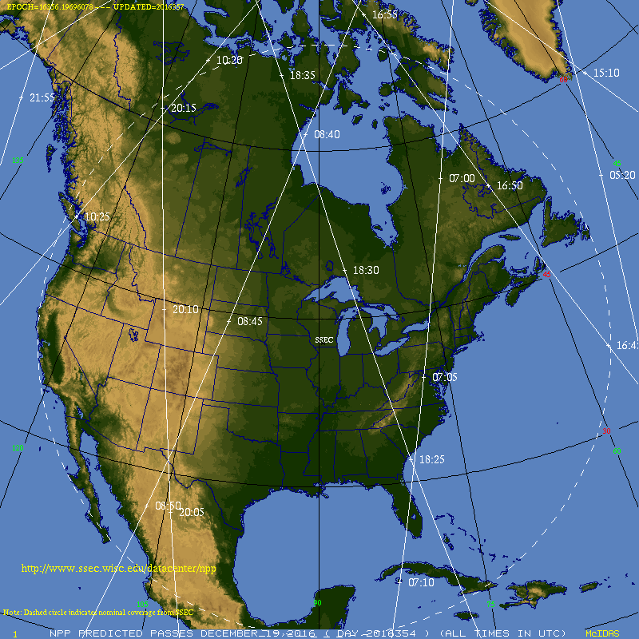
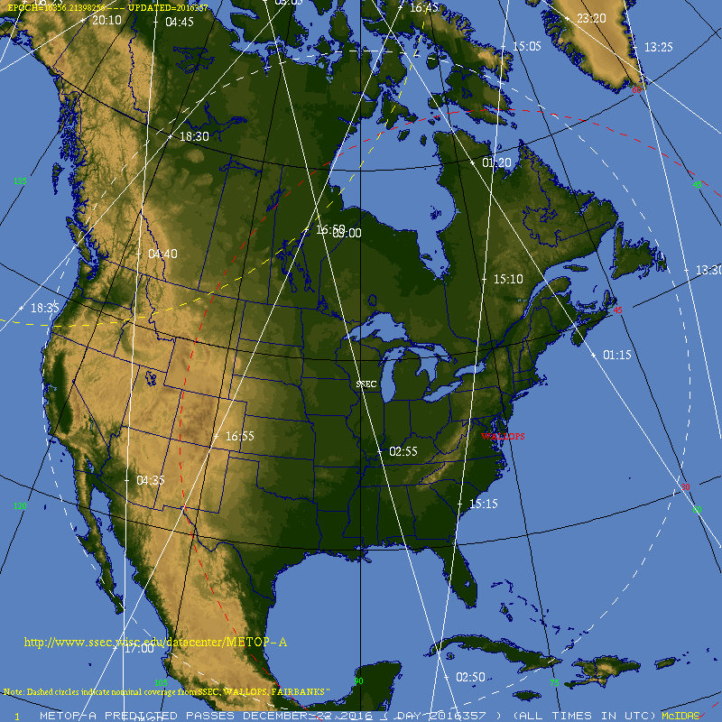
Polar Orbiters: When do they overfly?
6 days of orbits: they shift eastward with time
(about 1/5th of a swath width per day)
Notes:
THis shows how things shift from one day to the next. A series of days for NPP is shown on the left. Note that the orbital paths shift eastward, and are a bit earlier, from one day to the next.

Slide 6
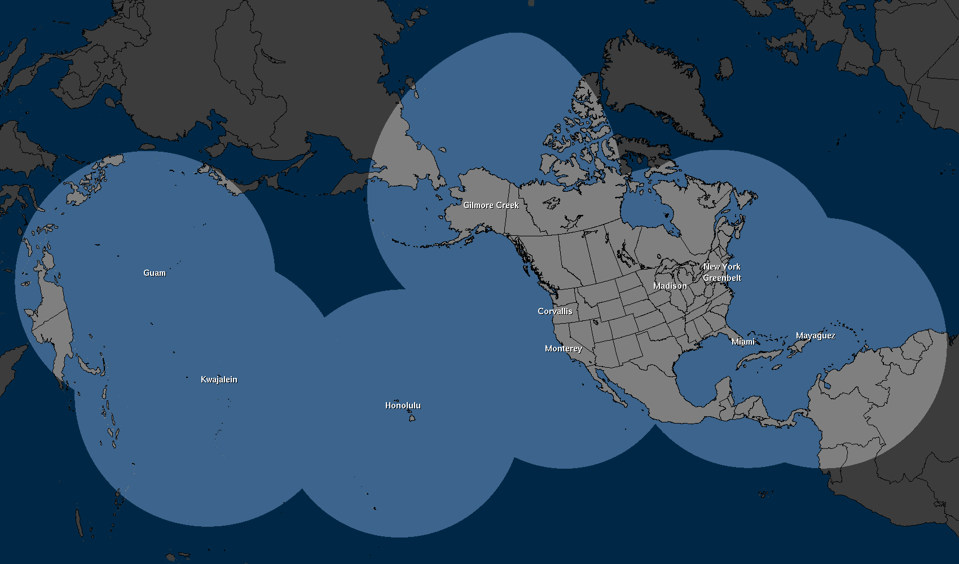
How does data get to AWIPS
Svalbard
Downlink
NSOF
(NDE)
NWS
Gateway
SBN
WFO
Local Antenna Downlink
CONUS Data Flow
60-90 minutes
Antenna Data Flow
CSPP 30 minutes
Notes:
How do NUCAPS data get into AWIPS? At present, NOAA gets data from the Svalbard downlink, and then it is processed as it moves through different computers and systems, and it takes anywhere from 60-90 minutes for data to get into AWIPS. There are initiatives underway to shorten that, by including a downlink at McMurdo Station. *If* you have access to a direct broadcast antenna, the data latency is better, it is often less than 30 minutes.

Slide 7
How are Vertical Profiles Generated?
Regression
Retrieval
Creates a first guess field for Retrieval
First-guess used for to determine if the scene is clear (“cloud-clearing”)
Uses ALL Sounder and Microwave Channels
Static coefficients are derived from ECMWF output for four focus days [2014: 6/18, 9/15, 12/20; 2015: 3/21])
Uses a Radiative Transfer Model
Minimizes Observation-Calculation value
If this doesn’t converge to a solution, sounding is still produced, but flagged
Retrieval uses a subset of channels
Shape-preserving; adjusts regression to the solution
Microwave-only Retrieval fails in regions of precipitation
Notes:
Vertical Profiles are generated in a two-step method.
First a regression is run using static coefficients from 4 focus days that generated the best statistical fit between the observations and the vertical profiles on those days. These regressions use data from all infrared and microwave channels. This Microwave/Infrared regression is used to determine if the scene is clear or not.
The Retrieval uses a Radiative Transfer Model to iterate to a solution that minimizes the observation-calculation value. The Calculation is the top-of-atmosphere radiance spectrum calculated with the Radiative Transfer model; the observation is top of atmosphere radiance spectrum; intially this is computed using the Regression output.
In regions of clouds, where the infrared retrieval typically fails, microwave data can still produce a retrieval. MW retrievals can fail where precipitation is falling.

Slide 8
How are Vertical Profiles Generated?
Which of the 1305 CrIS channels are used for the physical retrieval step? 399 of them
24 for surface temperature
87 for atmospheric temperature
62 for water vapor
Other channels are chosen for sensitivity to other gases of interest: Ozone, NOx, etc.
Channels chosen are sensitive to one gas only, not sensitive to other gases
All ATMS channels (22 of them) are used in NUCAPS for SNPP
(There is a similar type of channels selection for Metop)
Notes:
Not all infrared channels are used in the retrieval. The channels that are chosen are sensitive to only one gas, not multiples gases. In addition, neighboring channels that are highly correlated are not used.
CrIS and IASI have many many channels, and not all are used in the retrieval that creates vertical profiles. There's a balance between adding information and adding computations; two very close channels need not be included because they won't give independent information but they'll have to be processed. The channels chosen are those that are sensitive to only one gas, not to more than one. In addition, adjacent channels that are highly correlated are not used.

Slide 9
Vertical Resolution
Parameter in Profile | Precision | Vertical Levels | Interfering Parameters | Sensitivity
Temperature Profile, T(p), SST, LST | 1.5K/km | 6-10 | Emissivity, H₂O, O3, N2O | surface to ~1 mb
Water Profile, H₂O(p) | 15% | 4-6 | CH4, HNO3 | surface to ~300 mb
So: 6-10 layers of temperature information and 4-6 layers of moisture information for the troposphere: That is not a lot of resolution!
Notes:
NUCAPS vertical profiles are usually smooth and typically have 6-10 layers of temperature information, and 4-6 layers of moisture information in the troposphere. Don't expect to see very thin layers -- hot or cold, dry or moist -- in the NUCAPS vertical profile.

Slide 10
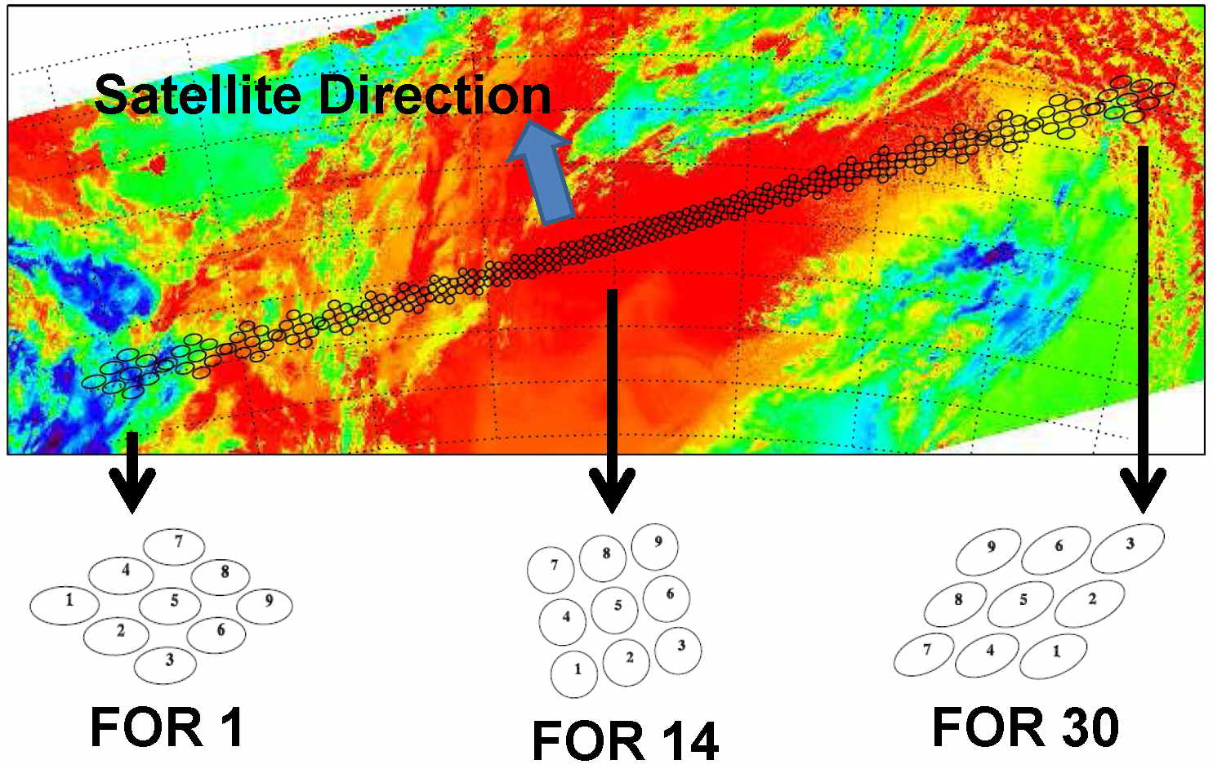
Cloud Clearing
Clouds cause problems with Satellite-based Retrievals
Biggest problem: Uniform clouds!
  NUCAPS Footprints contain either 9 CrIS (NPP/N20) or 4 IASI (Metop) Fields-of-Regard.
Cloud Clearing uses data from a Regression using all Infrared and Microwave data and coefficients from an ECMWF-based training
Note: There are 30 CrIS Footprints across the scan, and each footprint has 9 Fields of Regard
Notes:
Fields of Regard from the CrIS are combined to create a NUCAPS sounding. The figure shows CrIS scan across a VIIRS scene. There are 30 footprints, each containing 9 fields of regard (FORs) One FOR that's cloudy isn't a problem. As long as there is clear field of regard. This figure also shows that a NUCAPS profile is actually a volume of air, not a single point like a radiosonde.
It's important to remember from this graphic that a NUCAPS Sounding represents information from a Volume of Air measured by up to 9 CrIS or 4 IASI fields of Regard!
If it's cloudy across all scenes, that's an issue, but partly cloudy is not.

Slide 11
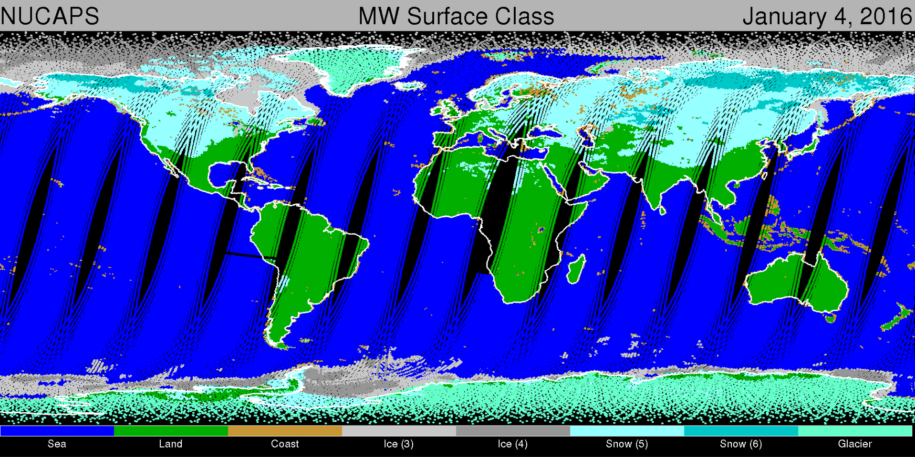
NUCAPS Coverage in 12 hours
Overlap in swaths near the Poles
Holes in coverage Equatorward of ~35 N
Notes:
NUCAPS data from just one satellite covers almost all of the midlatitudes. THere are gaps near the Equator, and overlap near the Poles. When you get overlap, you get profiles about 90 minutes apart.
AWIPS coverage. Note that there are holes over the southern CONUS - these gaps shift eastward from one day to the next. There are regions over northern CONUS (and Alaska!) where sequential swaths overlap! So you can have two vertical profiles about 90 miles apart.

Slide 12
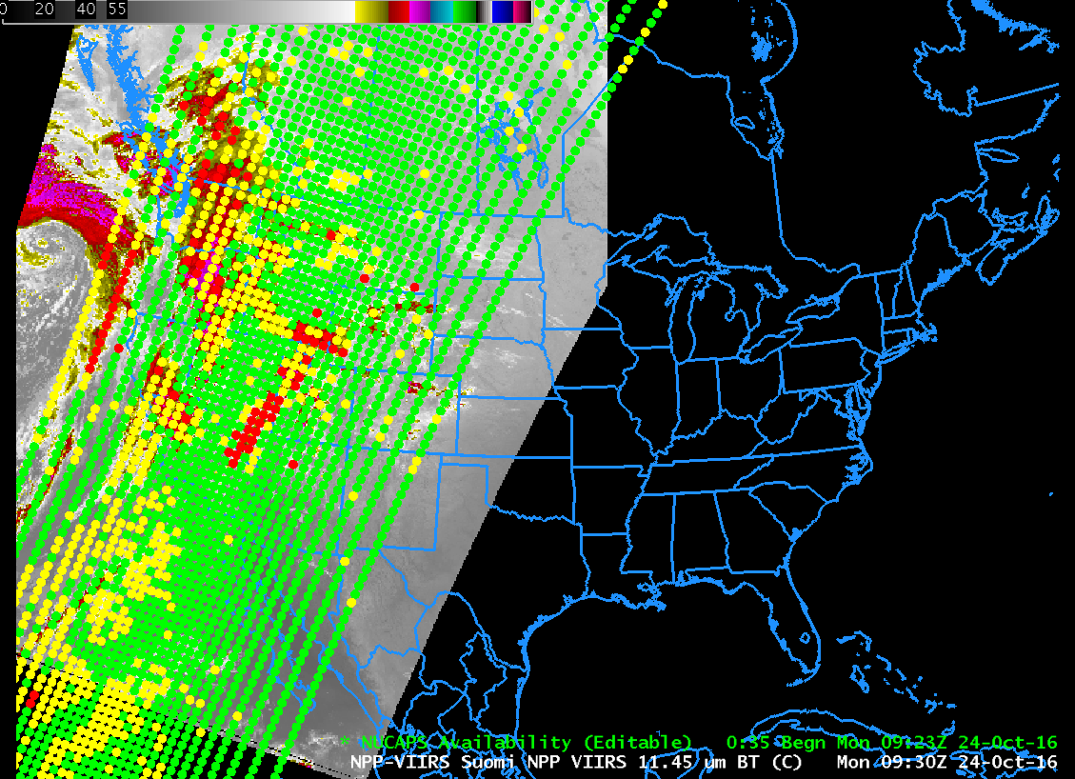
What does NUCAPS data look like in AWIPS?
Plotting points on satellite imagery
helps you anticipate what you’ll see
Green Dots: IR + MW Retrievals Successful
Yellow Dots: IR Retrieval Failed, MW Successful
Red Dots: IR + MW Retrievals failed
Note: All points were green for the first years in AWIPS
Notes:
What does the data look like in AWIPS? That's shown here. The color of the profile location tells you something about the data there. For Green Dots, both retrievals were successful, and you probably have a reasonable profile to view. If the dot is yellow, then the IR retrieval failed, but the microwave retrieval was successful. If the dot is red, then both retrievals failed, and the sounding probably won't give good information. I like to overlay the NUCAPS points on a satellite imagery, as shown here, so I can anticipate what I'll see.
Note that NUCAPS soundings - from CrIS and ATMS -- do not cover the full VIIRS swath width.

Slide 13
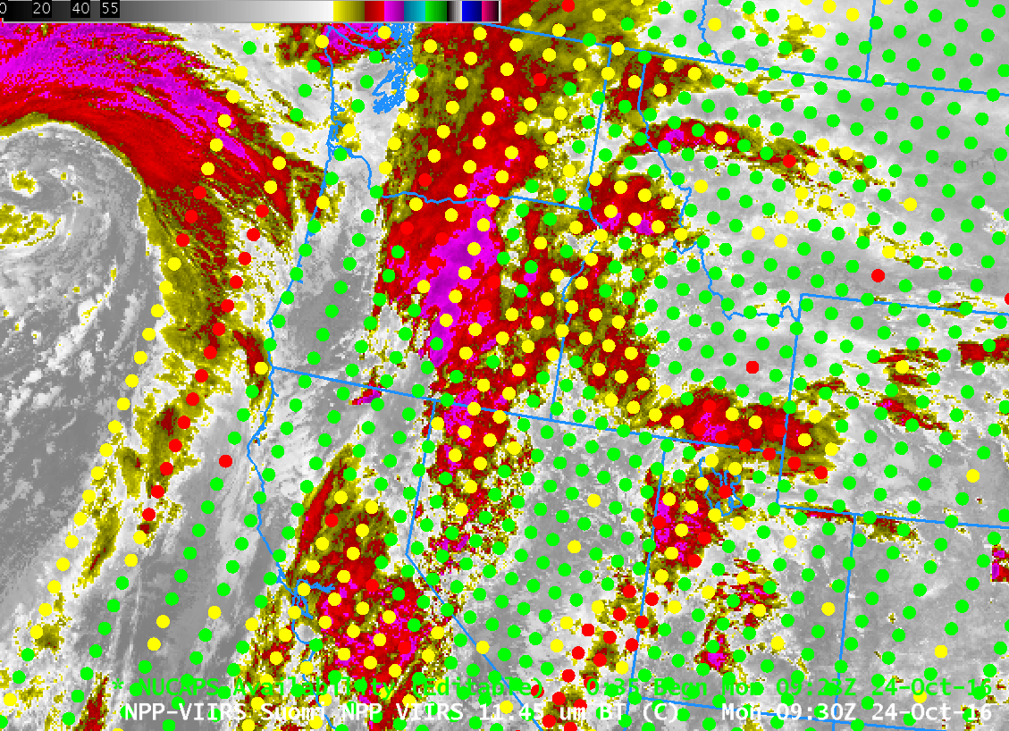
NUCAPS soundings as in AWIPS
NUCAPS Sounding Locations overlain on a Visible or IR Suomi NPP Image
Notes:
Zooming in on the image, you can see that there's pretty good spatial correlation between thick clouds and red and yellow sounding locations.

Slide 14
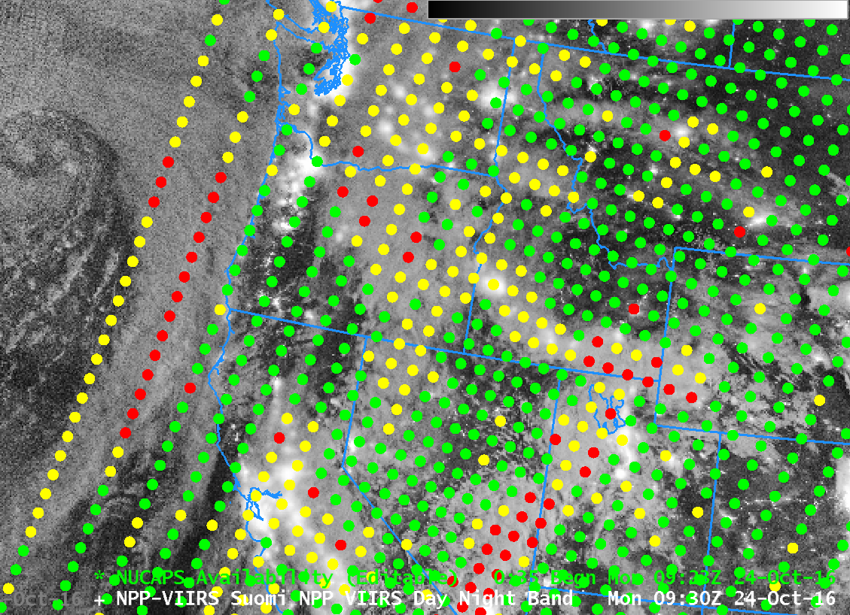
NUCAPS soundings as in AWIPS
NUCAPS Sounding Locations overlain over a Visible Suomi NPP Image (Day Night Band)
3 Dots to examine:
OR in clear air
OR near cloud edge
Ocean with deep clouds
Notes:
Let's look at soundings from 3 locations in close proximity to one another. Two green, one red.

Slide 15
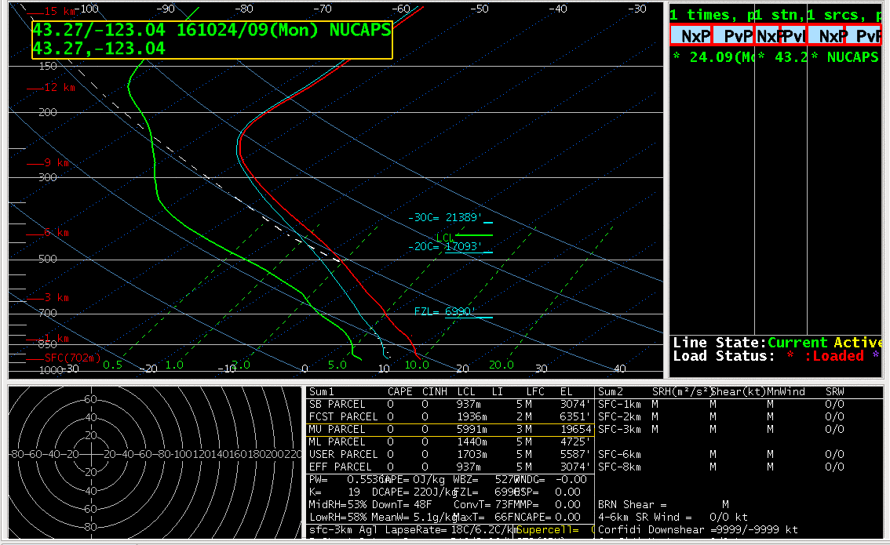
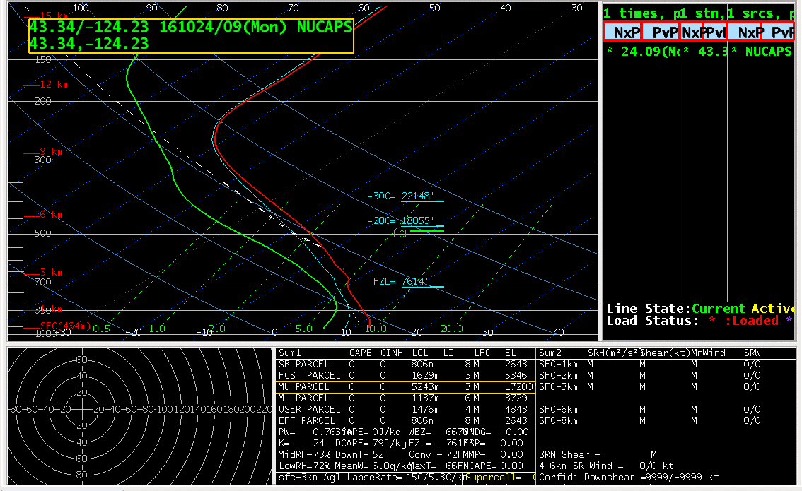
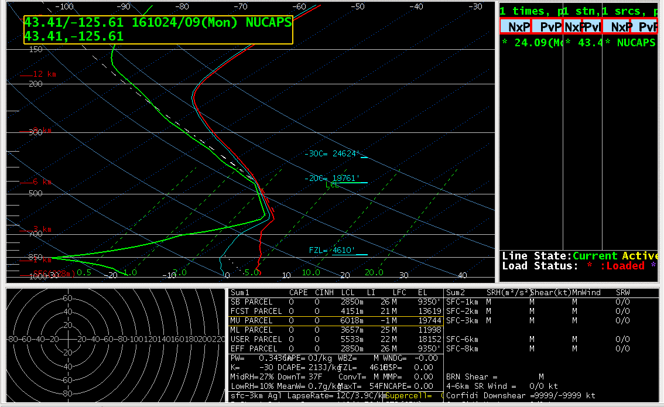
NUCAPS Soundings
Clear Air, Oregon
Cloud Edge, Oregon
Deep Clouds, Over Ocean
Notes:
Green dot location profiles are smooth, but plausible. The profile from the red dot has features that should make you wonder if it's correct.
Note: Profiles are smooth! Given that these are 9 Fields of View, this is a sample of a volume of air. From the red points, you can get very unphysical profiles.

Slide 16
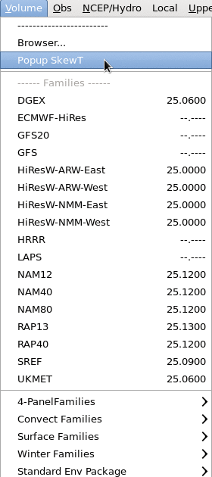
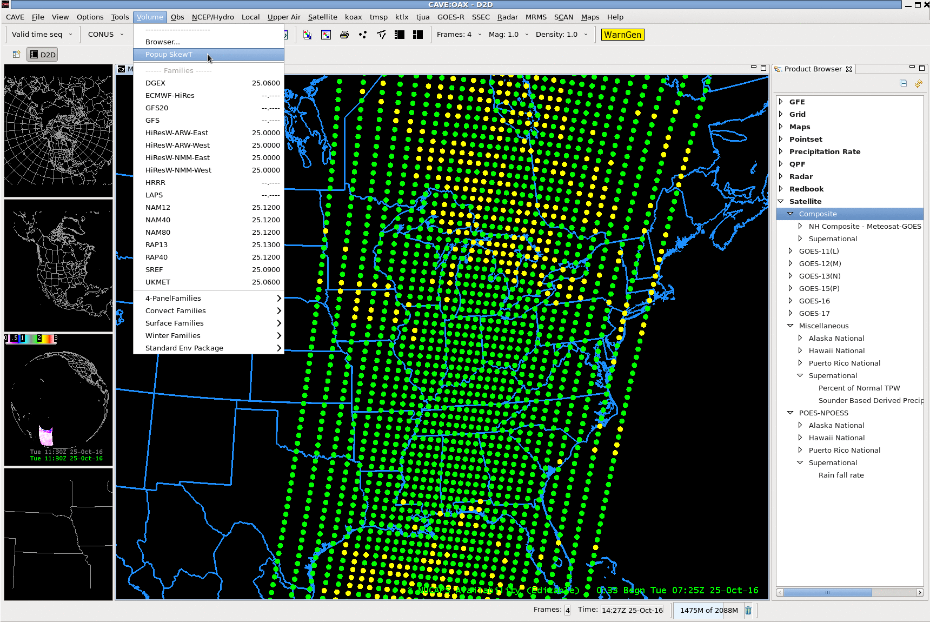
Pop-up SkewT plots
After you load the Soundings, enable Popup SkewT under Volume Tab so you can browse quickly through many Skew-Ts
Notes:
There are lots of soundings! It's important to be able to scan through them quickly to find atmospheric structures that could be important. The way to do that is with Pop-Up SkewTs. This is something that's selected in the Volume Browser.

Slide 17
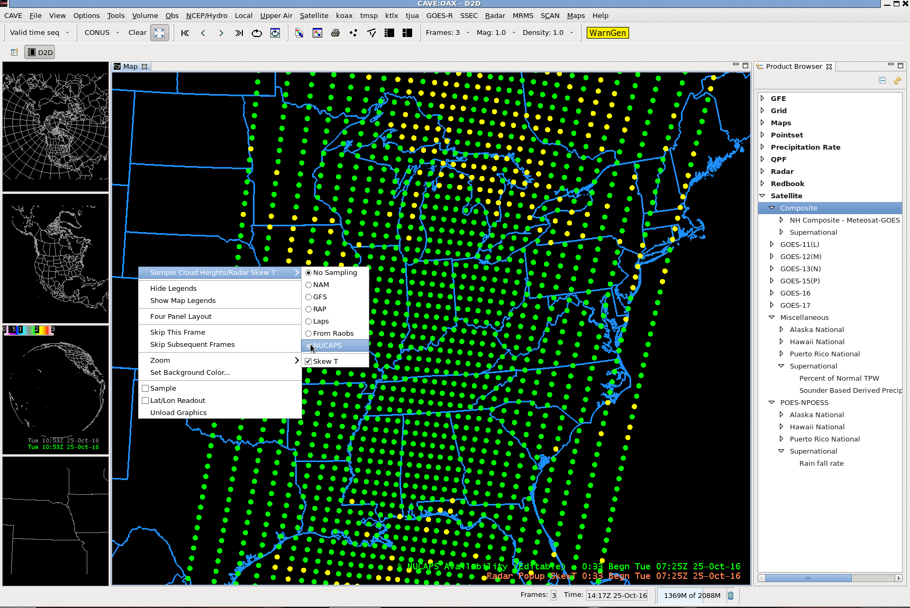
Pop-up SkewT plots
Right-click anywhere in image
Also: TURN ON
Sampling!
Notes:
Right click on the image, choose NUCAPS Soundings, and turn on Sampling.
Turn on Sampling. Then right-click in the image and click on NUCAPS.

Slide 18
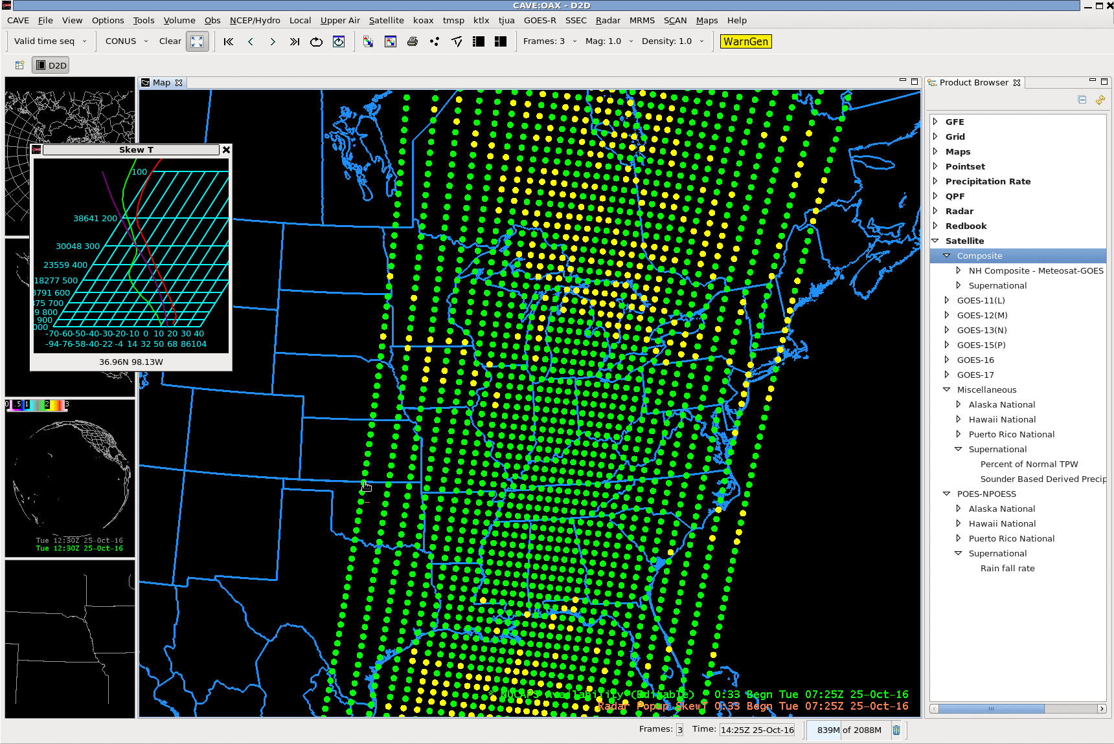
Pop-up SkewT plots
Notes:
Then you move your mouse over the points, and the sounding appears. You should be able to fine interesting or noteworhy events. If you find one you want to investigate further, click on the actual point and the nsharp sounding will appear.

Slide 19
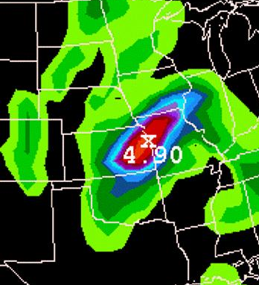
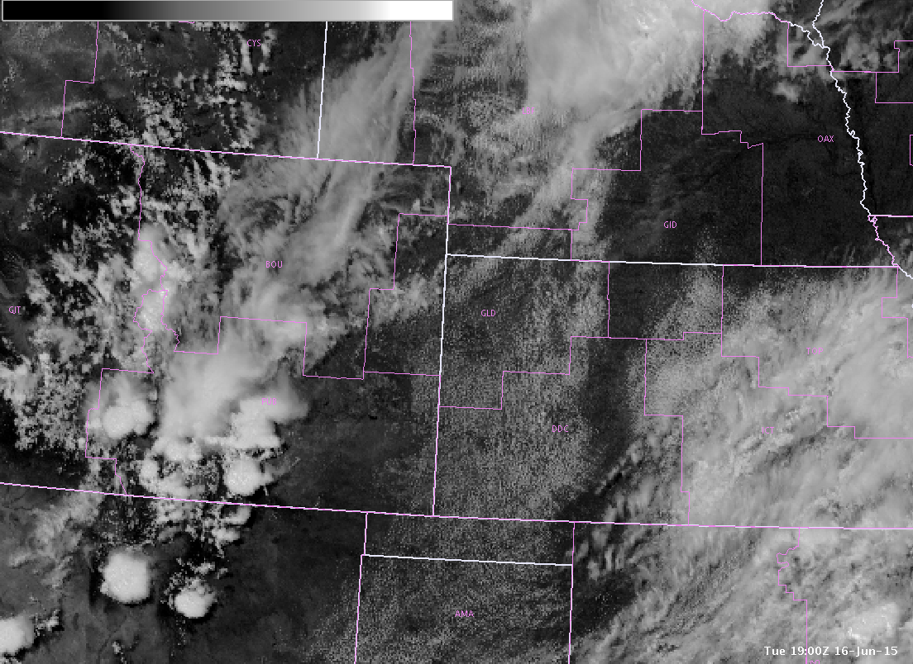
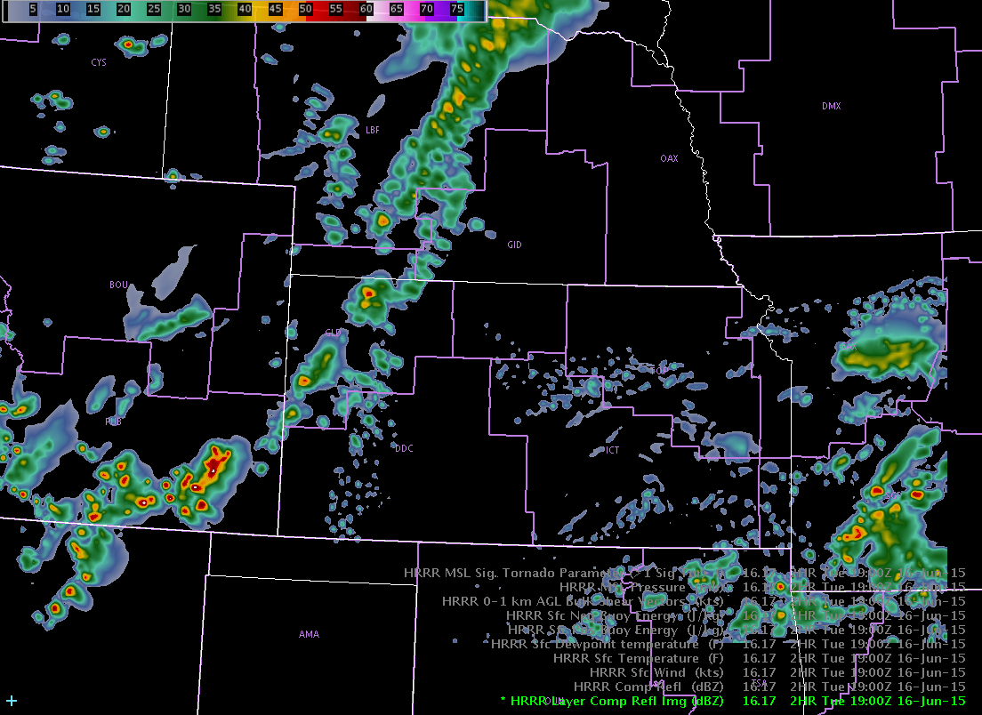
Why not use the NWP sounding?
NWP soundings are influenced by convectively-driven errors sometimes, or timing issues
2 hr fcst
from 17Z run
1900 UTC June 16, 2015
Atmosphere with clear, blue sky
1900 UTC June 16, 2015
Atmosphere with deep convection
Modeled Profile would be unrealistic
NUCAPS profile (observations!) would give better representation of atmosphere
Notes:
If you want a thermodynamic profile, they are readily available from NWP sources. NAM Nest, WRF, GFS… Why not use those? Well, you can have a convective feedback occurring that gives a profile that is not representative of the environment.
IN addition, Models can have timing issues: Convection might be early, or late. In this case over SE Colorado, wouldn't you rather have something based on observations that is independent of model data?

Slide 20
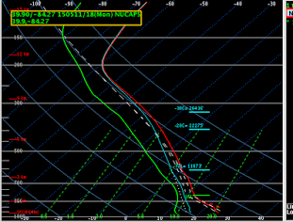
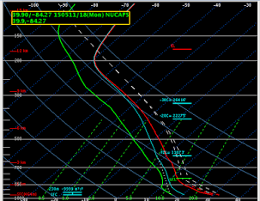
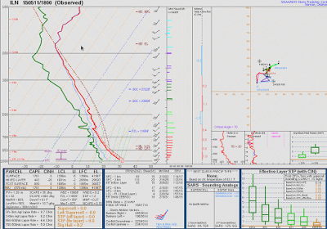
Blog Post: “Observed Radiosonde Data/
NUCAPS Comparison” May 11 –
Wilmington, OH
http://goesrhwt.blogspot.com/2015/05/observed-radiosonde-datanucaps.html
(All NUCAPS posts: http://goesrhwt.blogspot.com/search/label/NUCAPS)
Unmodified NUCAPS
Modified NUCAPS
Special Sounding at 18z
Sfc: 77/55
Sfc: 85/61
Don't just modify the surface values; modify the whole mixed layer or you’ll have unrealistic lapse rates. Modify with METAR observations and SBCAPE is more representative to the observed sounding (1761 vs. 1688 J/kg)”
Notes:
NUCAPS information is most robust in the mid-troposphere; there are challenges for a satellite to view the surface through an atmosphere that is opaque to radiation at different wavelengths. Thus, it’s necessary to adjust the NUCAPS soundings so that the lower portions are more in line with observations. It’s on the forecaster’s shoulders to decide whether or not the NUCAPS boundary layer is representative (sometimes it is!)

Slide 21
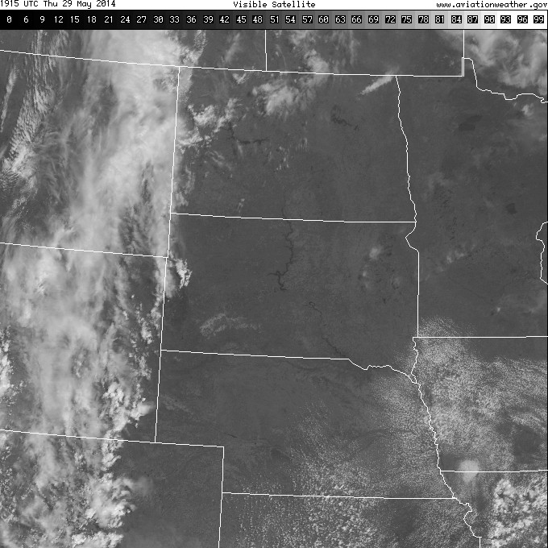

NUCAPS : a Forecast Decision Aid
GFS 9 hour forecast
From 12UTC 29 May
Valid 21 UTC 29 May
1915 UTC
Visible
Will the Cumulus Field develop further? (As suggested by the GFS)
Notes:
Here's an example from several years ago. There's a broken cumulus field over the Missouri River valley, and the GFS is suggesting QPF. What do you think will happen?

Slide 22
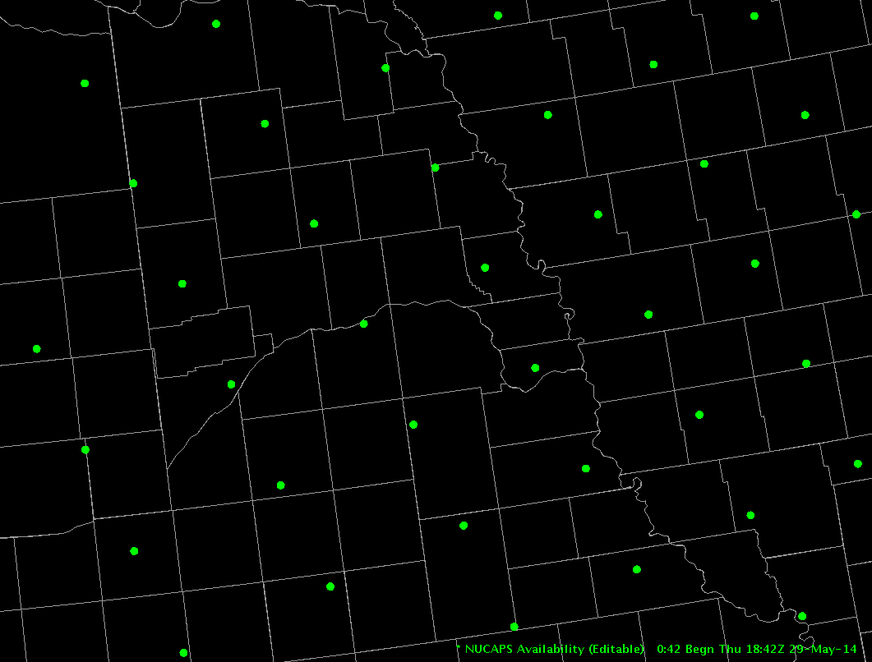
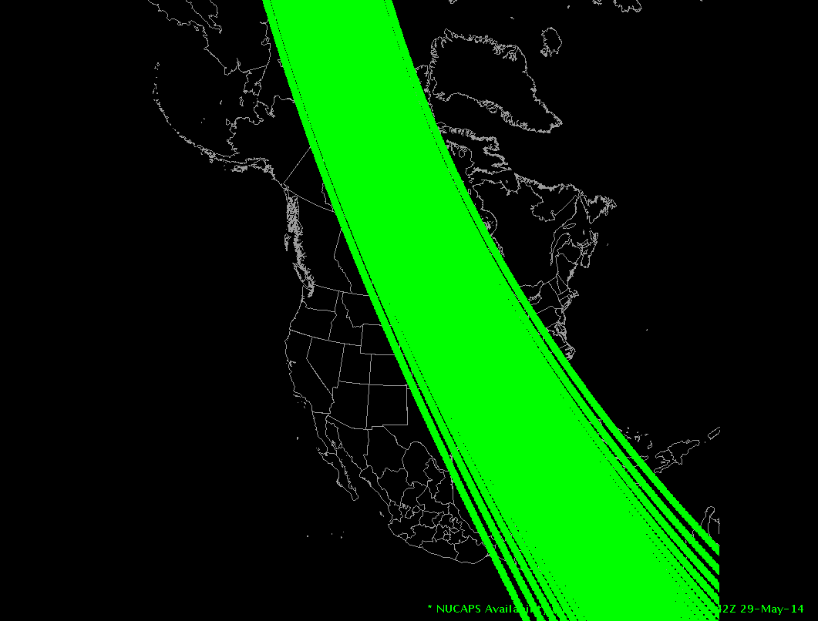
NUCAPS : a Forecast Decision Aid
Note: The implementation of NUCAPS in 2014 – the time of this event – did not color-code the display points based on retrieval outcome
1842 UTC S/NPP pass
Notes:
NUCAPS data can be used as a forecast decision aid. THere was a pass shortly after noon. Let's look at the point in eastern Nebraska

Slide 23
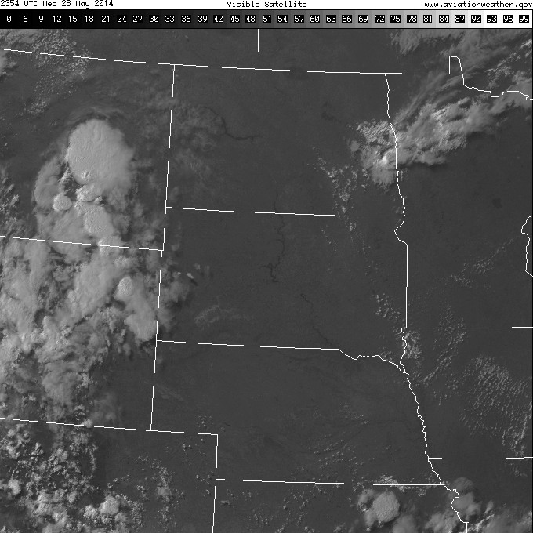
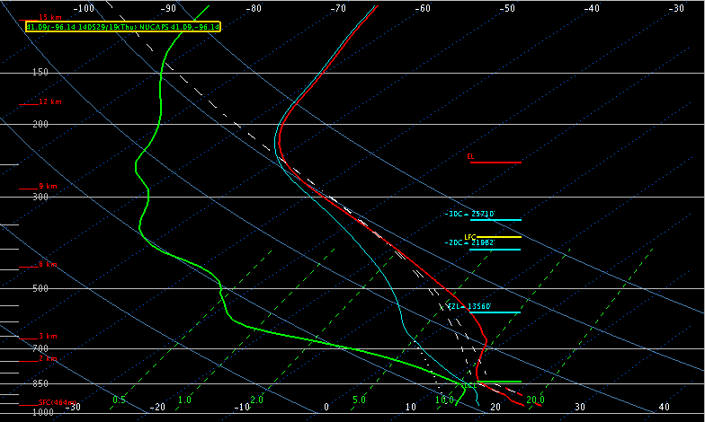
NUCAPS : a Forecast Decision Aid
T = 79F (METAR = 80F)
Td = 60F (METAR = 63F)
CAPE ~ 50 J/KG
2354 UTC
Visible
NUCAPS Sounding 1842 UTC 29 May 2014
Would you expect convective development?
Notes:
Here's the vertical profile from that point. Near-surface values in this sounding are near the values observed via METARs, so adjustment was not necessary. Would you expect convection here? Probably not.

Slide 24
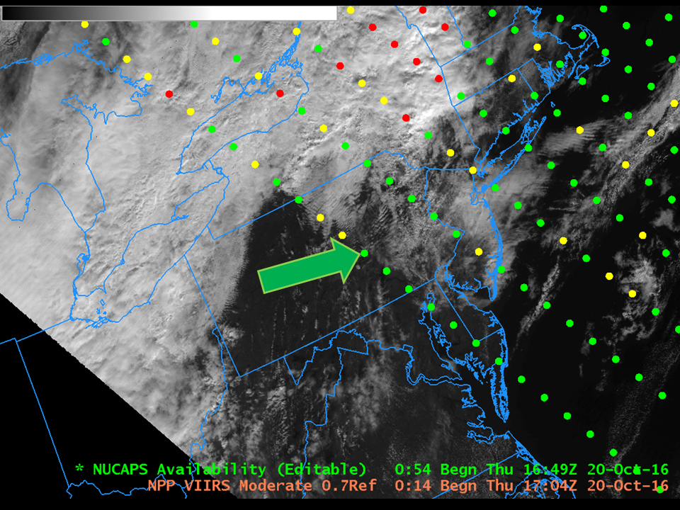
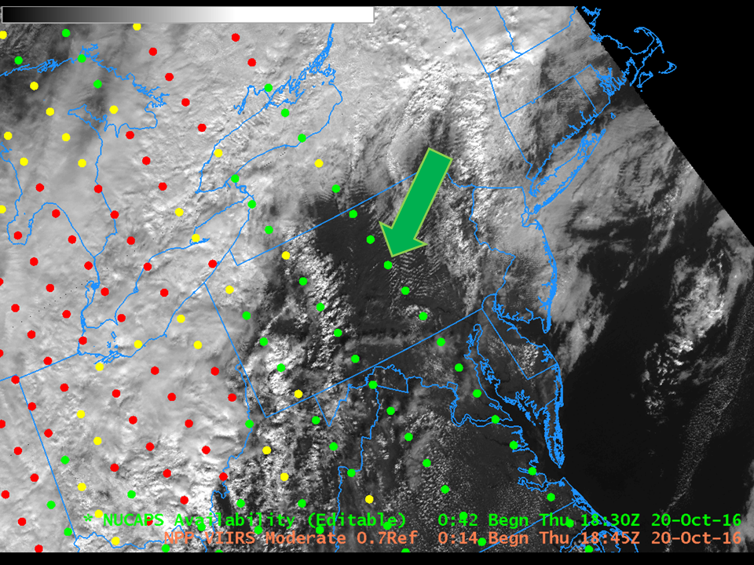
NUCAPS : a Forecast Decision Aid
Western-most scan at ~1700 UTC
Eastern-most scan at ~1830 UTC
What can consecutive passes get you?
Two samplings of a destabilizing atmosphere
90 minutes apart!
Notes:
If you live north of about 40 N, sometimes you will be lucky and receive NUCAPS soundings about 90 minutes apart. THis is handy in convectively threatening situations, because you have a good measure of destabilization.
As noted, you can be fortunate up north in CONUS, and have sequential profiles about 90 minutes apart. That can be a handy way to visualize destabilization. We will look at the two profiles indicated.

Slide 25
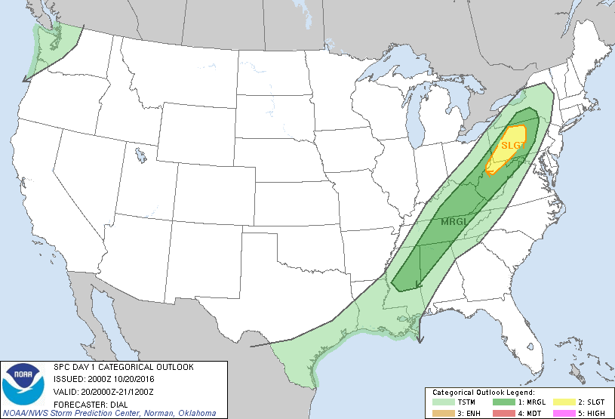
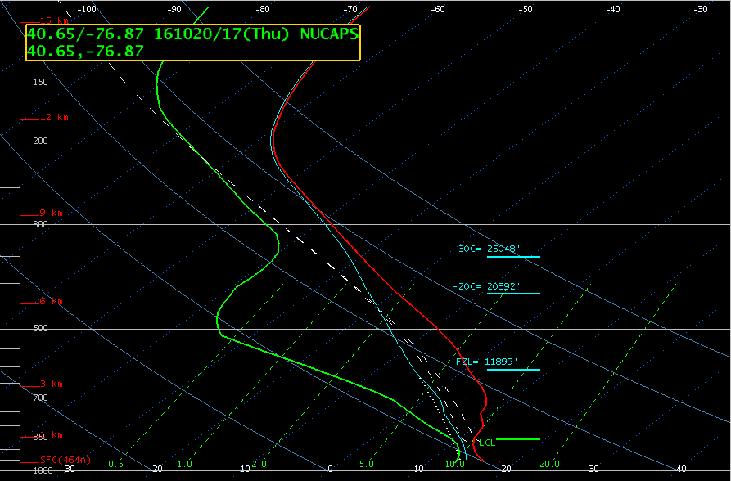
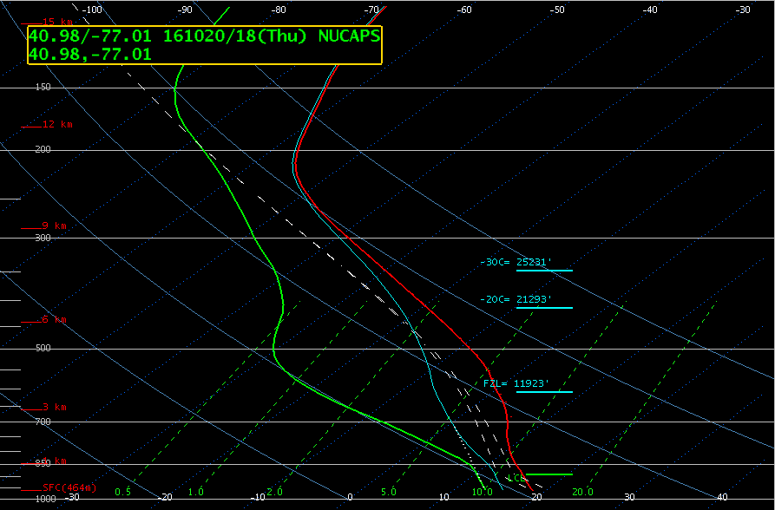
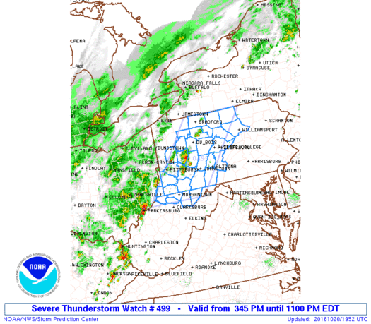
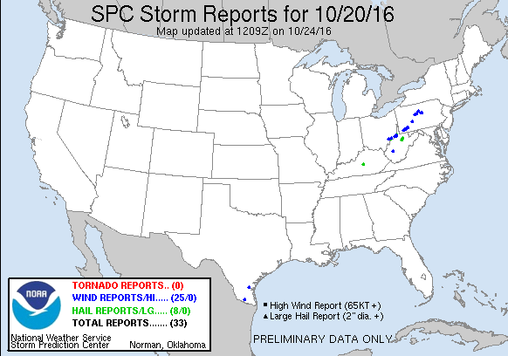
NUCAPS : a Forecast Decision Aid
1700 UTC
1830 UTC
Note the change in the strength of the inversion
Note the change in the lapse rates
Remember: NUCAPS has poor vertical resolution
Notes:
The biggest change in these soundings 90 minutes apart might be the change in the inversion strength. This small change on a SLGT RSK day might inform your decision making. (The line of convection did produce damaging winds)

Slide 26
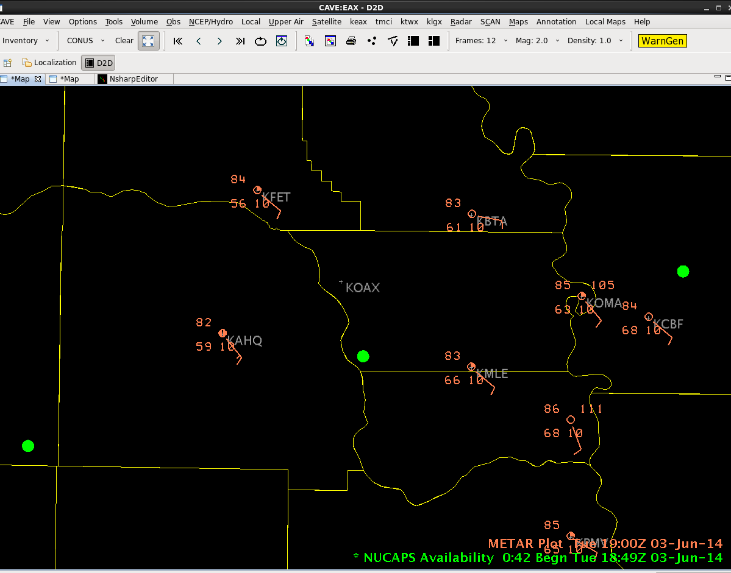
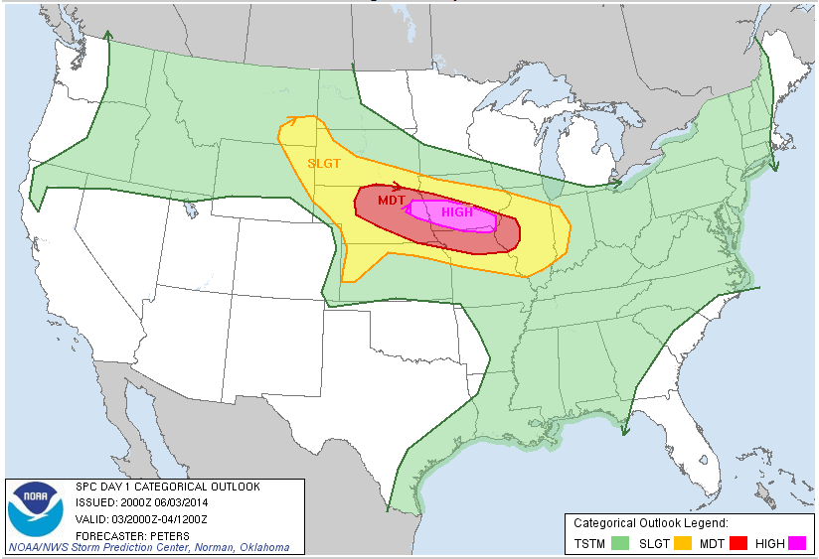

NUCAPS : a Forecast Decision Aid
June 3, 2014 High Risk
Notes:
Here's another example from a High Rsk day. Note a couple things here: There's a dewpoint gradient across the region, so the NUCAPS profile that you choose with respect to the gradient will be important. Let's look at this point -- at the northern edge of the most moist air.
Let's look at this point first -- at the northern edge of the moist air.

Slide 27
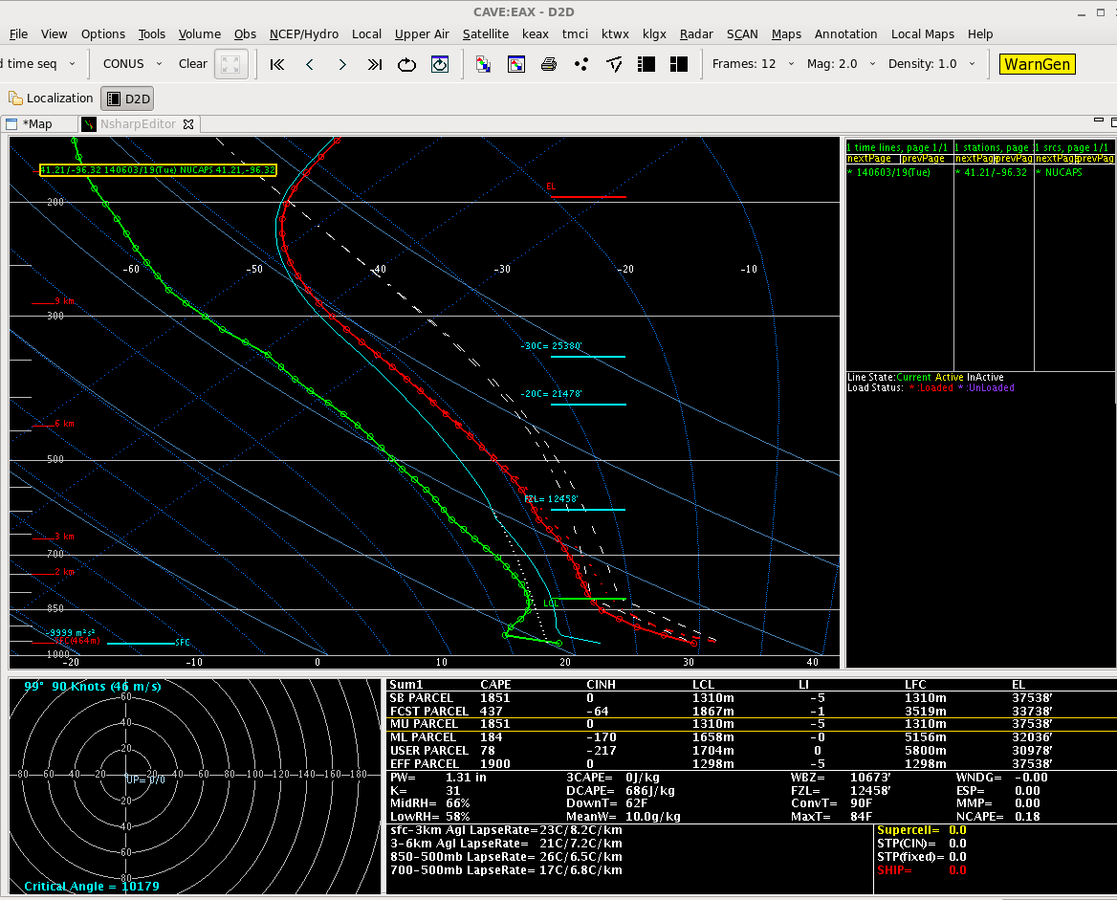
NUCAPS : a Forecast Decision Aid
June 3, 2014 High Risk
NUCAPS 1849Z June 3 2014 – cloudy scene, but not uniformly cloudy
Surface METAR showed T=83, Td=63
MODIFY sounding to match surface
SB CAPE = 1851
*Best* information in NUCAPS soundings comes from mid-troposphere
Notes:
THis profile did not match nearby surface METARs, so the bottom part of the profile was adjusted in AWIPS. THe modifies sounding has a surface-based CAPE around 1800 J/kg.

Slide 28
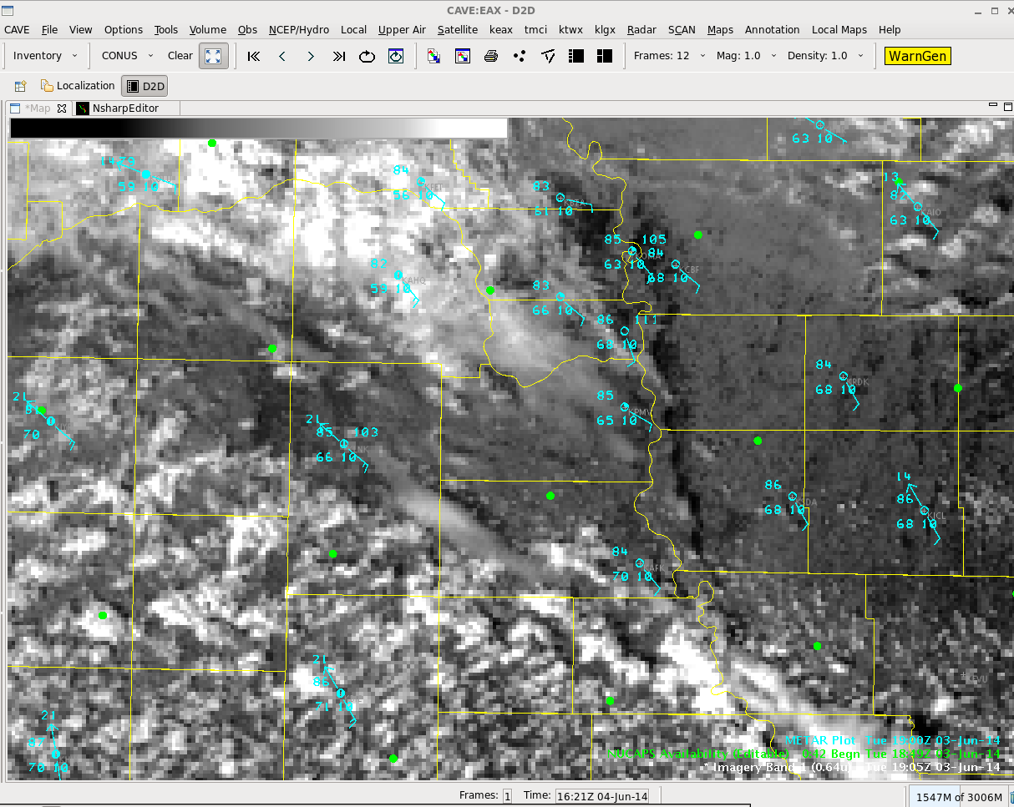
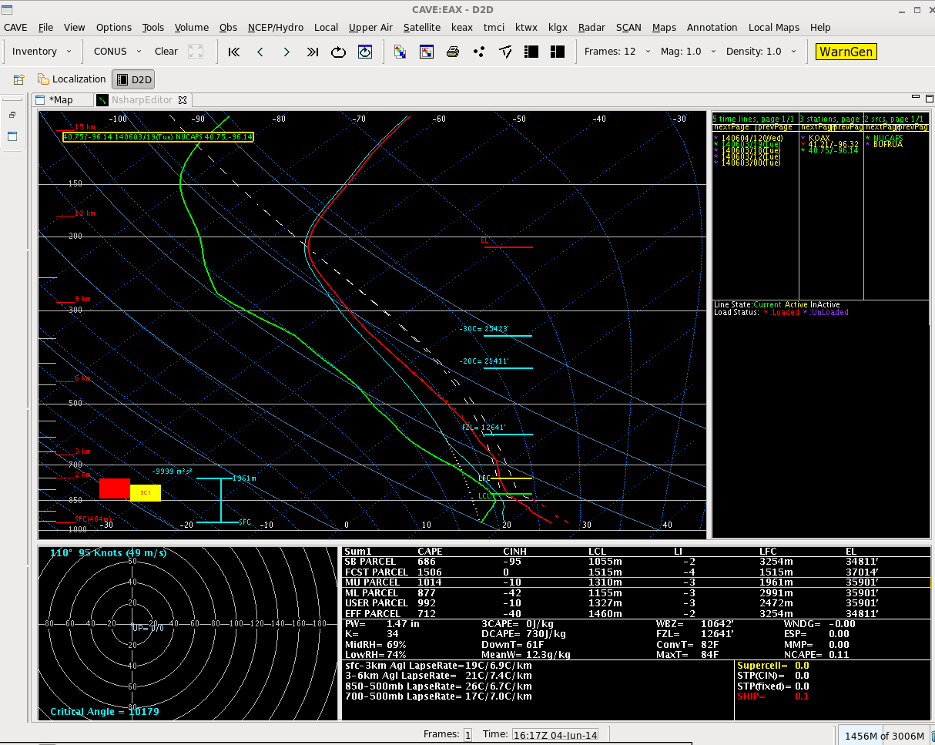
NUCAPS : a Forecast Decision Aid
June 3, 2014 High Risk
Unmodified
SB CAPE = 686
Notes:
You just the profile from the green box. Let's look at the profile to the south -- in higher dewpoints. THe sounding there is shown, with a surface based CAPE of around 700. But its surface properties do not align with observations, so it should be adjusted.

Slide 29
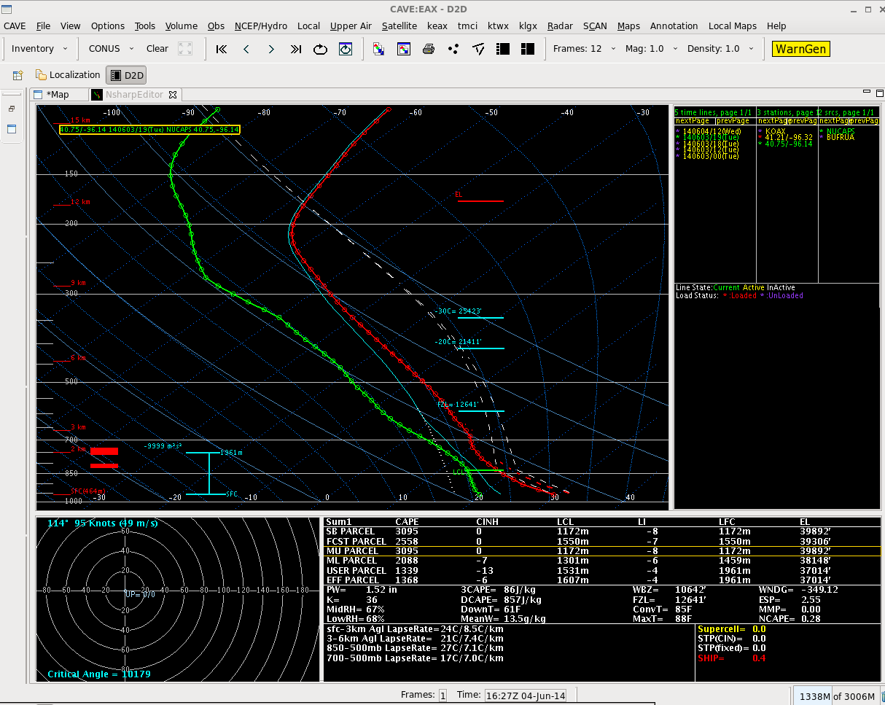
NUCAPS : a Forecast Decision Aid
June 3, 2014 High Risk
Modified to match surface METAR
Ob of T=85, Td=68
SB CAPE = 3095
Notes:
Once modified, the surface based CAPE exceeds 3000. This should help your decision making.

Slide 30
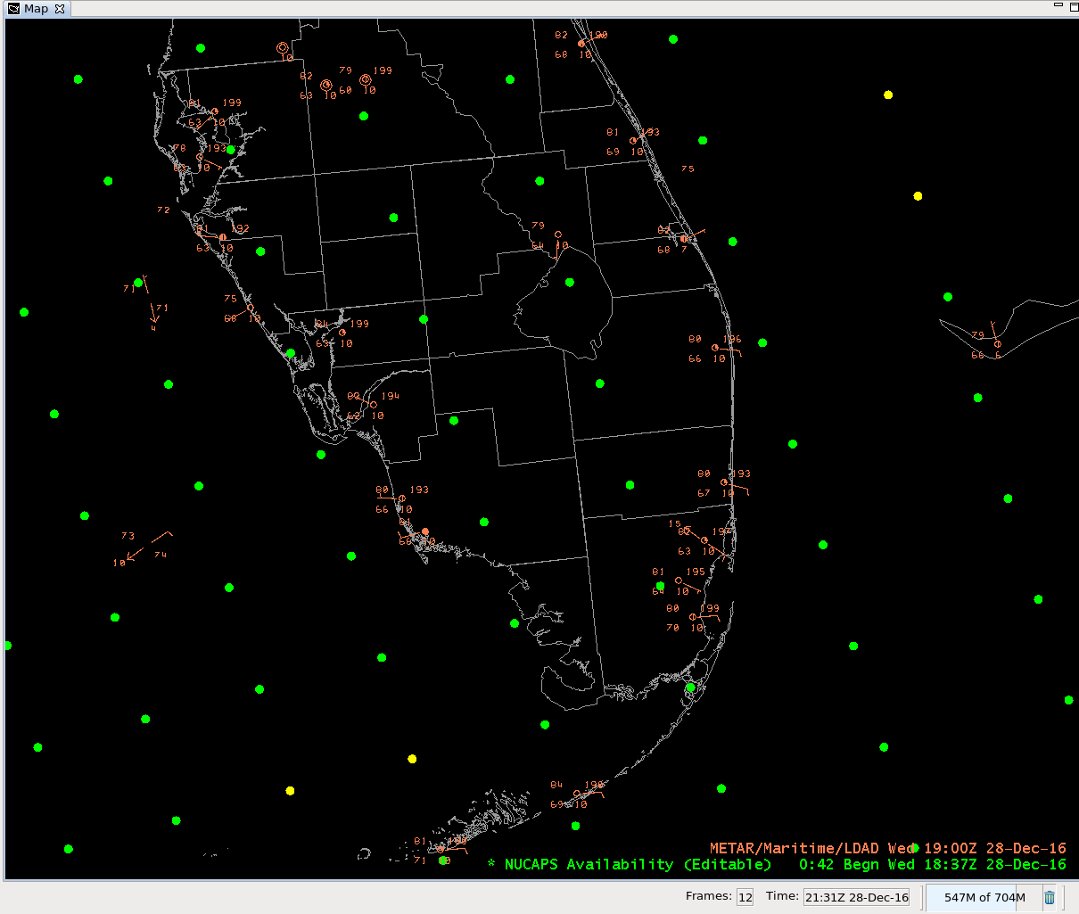
How do you modify soundings?
Adjust Sounding Boundary Layer to reflect observed conditions
This feature can be done automatically in AWIPS
For now: Choose your sounding, and note the surface conditions nearby – in this case: T near 80, Td near 68 (27 C, 20 C)
Notes:
So how do you adjust soundings? First, you need to be aware of surface observations! Then click on a point to view it.

Slide 31
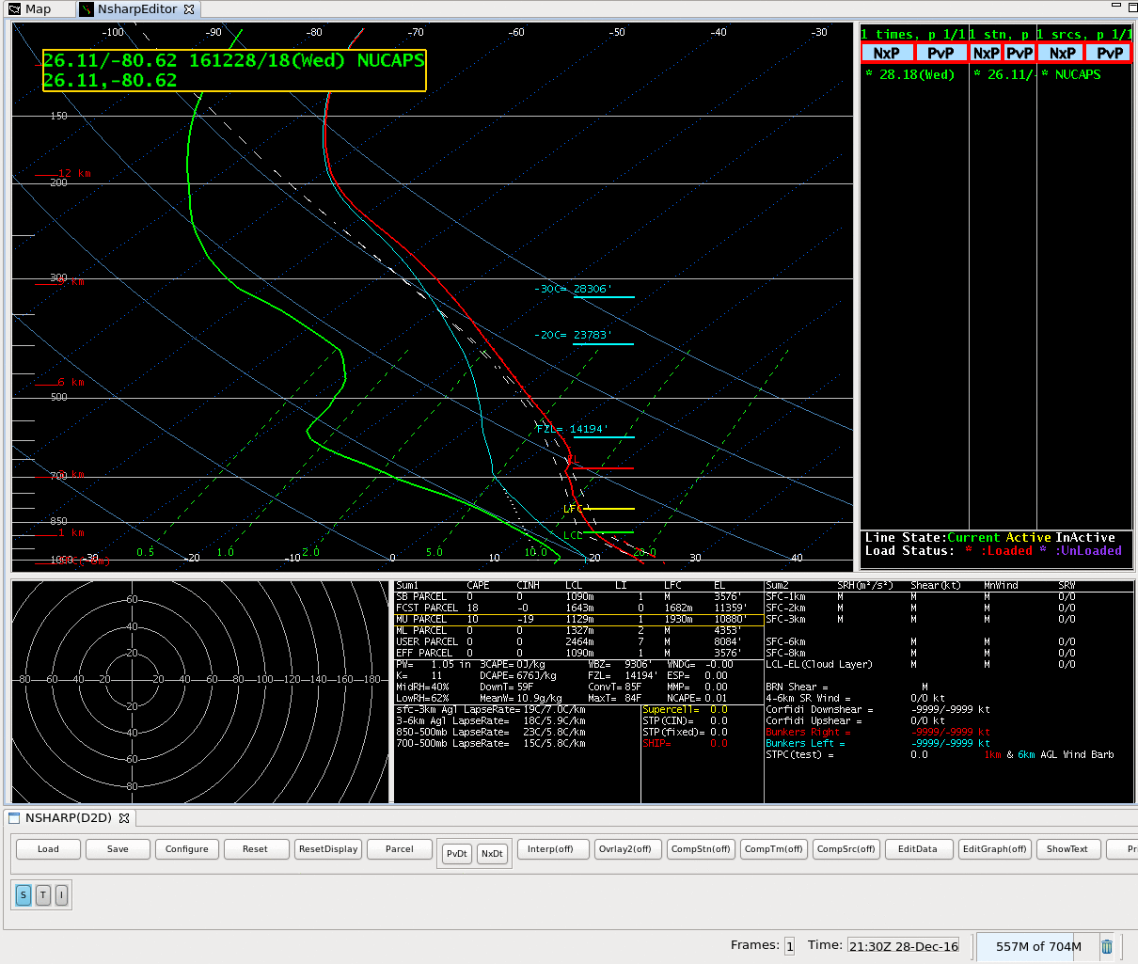
How do you modify soundings?
Note that the surface temperature and dewpoint in this NUCAPS Profile are too cool.
This sounding should be edited so that a better understanding of the atmospheric thermodynamics is produced
Notes:
This sounding does not match the neaby observations of temperature/dewpoint.

Slide 32
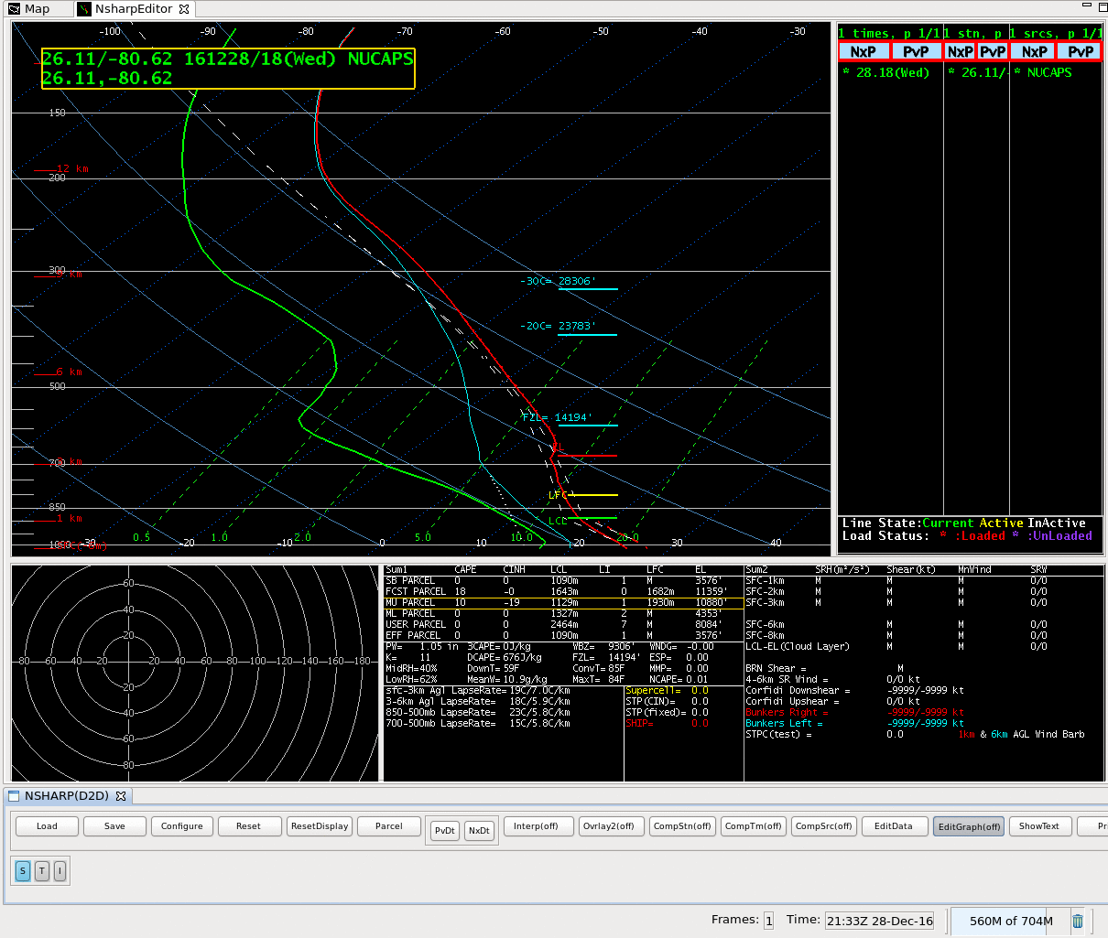
How do you modify soundings?
Toggle EditGraph to ‘On’
Notes:
So Toggle EditGraph to 'On'

Slide 33
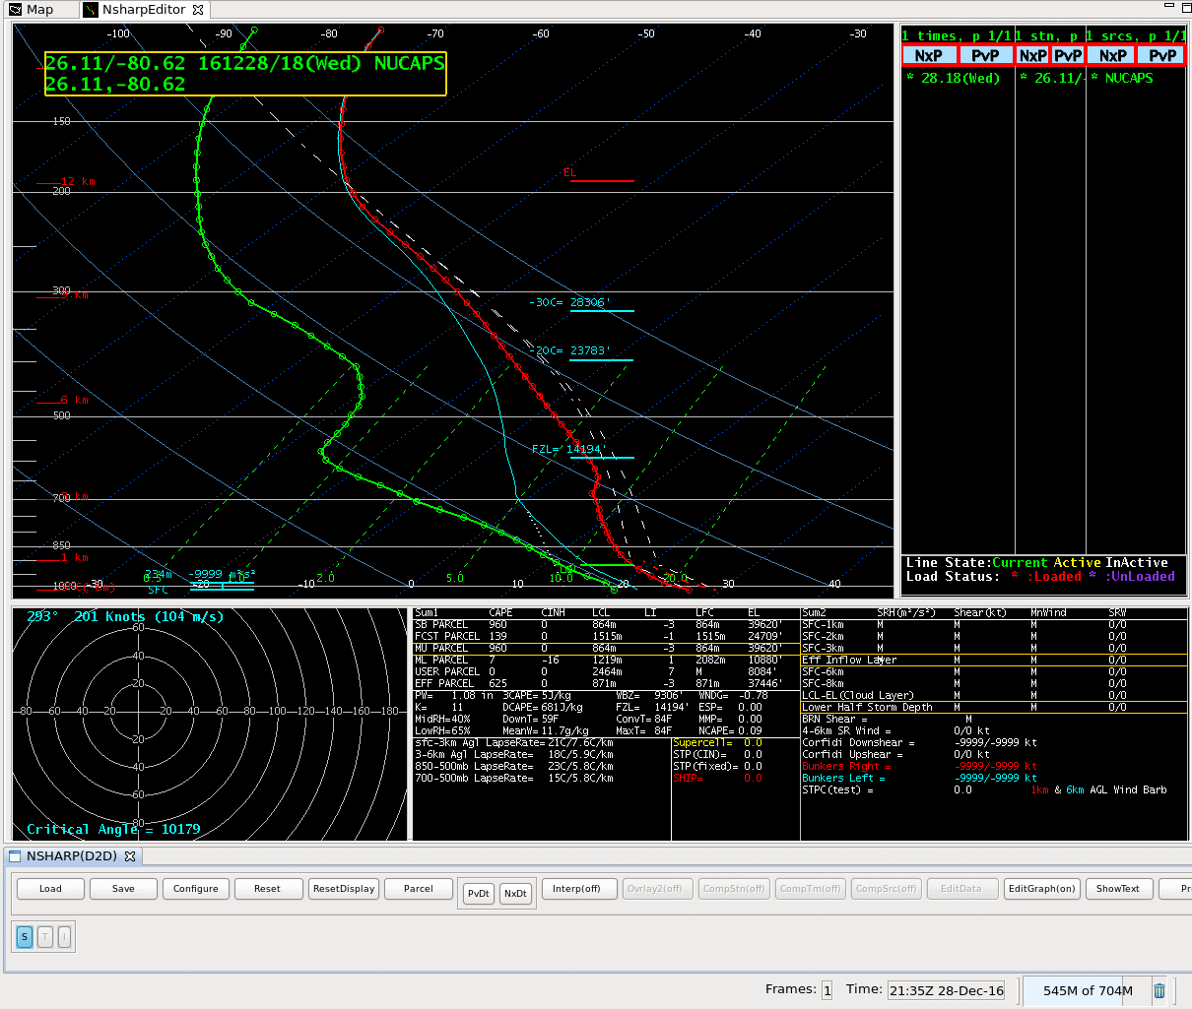
How do you modify soundings?
Draggable points appear on the sounding – click and drag so that the lower part of the sounding more closely conforms with the surface.
Again, in the future, this procedure will be automated.
When you’re satisfied (you can ‘Reset’ if you err), toggle EditGraph back to ‘Off’
Notes:
Draggable points appear that you can move around, and once you're satisfied with the result, toggle EditGraph back to 'off'

Slide 34
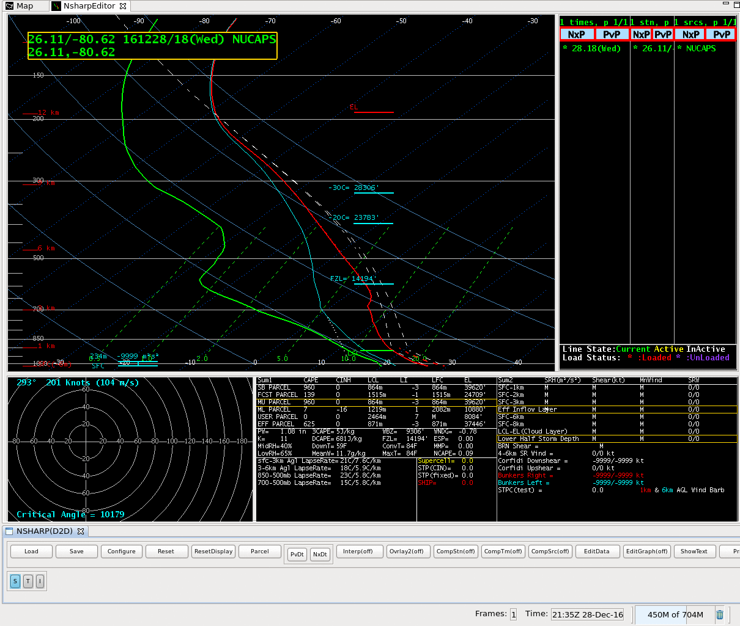
How do you modify soundings?
Now you have a new sounding – note how the different parameters (such as LCL, LFC, EL, SBCAPE) changed
Notes:
THe modified sounding will then have different thermodynamic parameters that should help make your nowcast more accurate.

Slide 35
Automatic Profile
Modification
An Experimental Feature tested at HWT
This is desirable if the near-surface observations in the sounding do not match the RTMA analysis.
Assumption: The sounding that is modified becomes well-mixed. Is this a valid assumption in the case you’re monitoring?
Experimental Feature is done for afternoon soundings from NPP only.
Notes:
COming in the future; Something that's been tested at the Hazardous Weather Testbed: Automatic adjustment of the NUCAPS soundings to match RTMA analyses. The sounding produced with this adjustment have well-mixed boundary layers, so ask yourself as this is done: Is that a valid assumption?

Slide 36
Other NUCAPS features
Horizontal fields that use information from all the vertical profiles are being created.
  Convective Available Potential Energy
  Temperature/Dewpoint at Pressure Levels
Notes:
Other NUCAPS fields include temperature and dewpoint on pressure levels. These are coming to AWIPS after 2018. THere is separate training available for that.

Slide 37
NUCAPS Soundings
Available now in AWIPS from S/NPP data
Coming soon: Soundings from NOAA-20.
Soundings from Metop A and Metop B are also produced.
Many soundings available at High Latitudes. Soundings available at useful times in mid-latitudes.
Notes:
NUCAPS Soundings are now available in AWIPS -- but only with data from Suomi NPP.
But coming soon are NUCAPS soundings from NOAA-20 which satellite also carries the CrIS and ATMS instruments.
In addition, NUCAPS soundings are produced for MetopA and B - but they do not yet flow to AWIPS.
Soundings at many different times are available at high latitudes; in mid-latitudes, there soundings are available at fewer times, but those times are useful.
This concludes the Satellite Foundational Course for JPSS on NUCAPS soundings. Thanks for listening.

