Slide 1
CMM Short Course
Joint Satellite Data
Lake Applications
Aug 7, 2022

Slide 2


Welcome!
Those attending remotely, please mute during talks
  During Q&A, place your question in the chat and/or raise your hand
Those in person, please silence your phones
  During Q&A, use the microphone so others can hear you
Breaks and Lunch
  Boxed lunches available
Monona Terrace Guest is the WiFi
Emergency Exit / Restroom

Slide 3
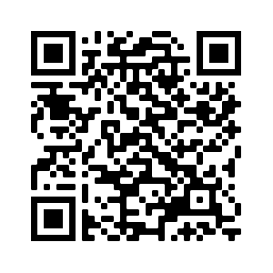
Administrative Notes
Short Course Website: https://rammb2.cira.colostate.edu/training/2022-ams-cmm-short-course/
Presentations, handout posted after short course
Spanish and Portuguese translated slides available
after the short course
The hands-on exercises will be done in groups of 2-3
  near each other in-person
  Zoom room(s) will be set up
The course is being recorded and will be available on AMS CMM website

Slide 4
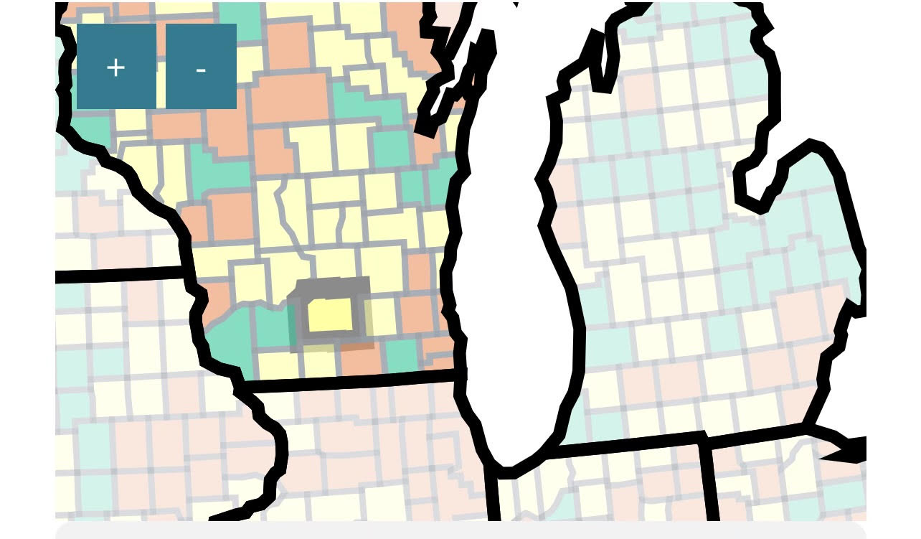
COVID Protocols
Masks required regardless of CDC Levels and vaccination status
Dane County is at medium

Slide 5
AGENDA
ALL TIMES CENTRAL TIME
8:30AM Introductions - Padlet
  https://padlet.com/cmm_satellite/8xzkehbraa8xaejb
8:40AM GOES-R Series and JPSS Satellites Data, Products and Capabilities
  Dr. Andy Heidinger, NOAA/NESDIS, GOES Senior Scientist
  Dr. Satya Kalluri, NOAA/NESDIS JPSS Program
9:10AM Lightning Session on Satellite Lake Data and Products
  Scott Lindstrom, CIMSS, Andrea VanderWoude, GLERL and CoastWatch, Mark Kulie, NOAA/NESDIS, Rachel Albrecht, Universidade de São Paulo
10:20AM Break (15 min)

Slide 6
AGENDA
ALL TIMES CENTRAL TIME
10:35AM Lake Products: Lake surface temperatures, algal blooms, meteotsunamis
  Andrea VanderWoude, GLERL and CoastWatch
  Scott Lindstrom, CIMSS
11:05AM Case Studies Hands-on Exercises: Lake surface temperatures, algal blooms, meteotsunamis
  Andrea VanderWoude, GLERL and CoastWatch
  Scott Lindstrom, CIMSS
12:10PM Lunch (60 minutes)

Slide 7
AGENDA
ALL TIMES CENTRAL TIME
1:10PM Convection Initiations and Thunderstorms Over Lakes
  Rachel Albrecht, Universidade de São Paulo
1:40PM Case Studies Hands-on Exercises: Convection Initiations and Thunderstorms Over the Lakes
  Rachel Albrecht, Universidade de São Paulo
  Scott Lindstrom, CIMSS
2:40PM Using Satellite Lake Products in WMO RA III/IV
  Lake Maracaibo - Tropical Lake Rachel Albrecht, Universidade de São Paulo
  CIMSS Blog: The Great Lakes, viewed using GOES-16 and NOAA-20 imagery - William Straka, CIMSS

Slide 8
AGENDA
ALL TIMES CENTRAL TIME
3:00PM Participant groups present results of hands-on exercises
  Share your screen
3:30PM Wrap up and Survey

Slide 9
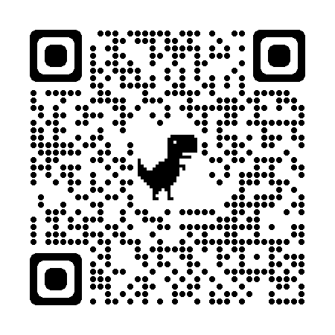
INTRODUCTIONS
Padlet
  https://padlet.com/cmm_satellite/8xzkehbraa8xaejb
  Please post
Where are you from?

Slide 10
GOES-R Series and JPSS Satellites Data, Products and Capabilities
AUTHORS:
Dr. Andy Heidinger, NOAA/NESDIS, GOES Senior Scientist
Dr. Satya Kalluri, NOAA/NESDIS JPSS Program
Aug 7, 2022

