Slide 1
CMM Short Course
Joint Satellite Data
Lake Applications
WRAP UP
Aug 7, 2022

Slide 2

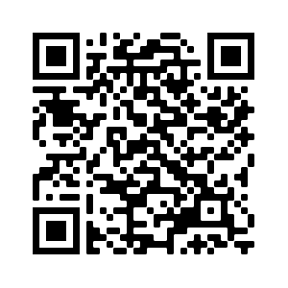
AMS will send out certificates and a survey
Please answer the survey to help us plan future training sessions
All of the presentations will be posted on the Short Course website https://rammb2.cira.colostate.edu/training/2022-ams-cmm-short-course/

Slide 3

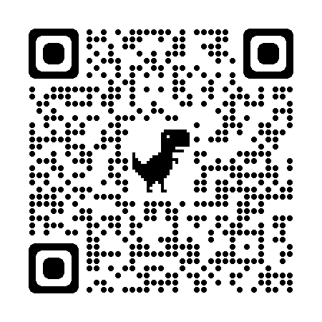
Upcoming Satellite Training
AMS Joint Satellite Short Course
January 8, 2023 before AMS Annual Meeting (hybrid)
“Making Beautiful Images of NOAA Satellite Data using Python”
GOES-R DataJam 2023 - Undergraduate and graduate students interested in participating: send an email to goesr.hackathon@noaa.gov to be added to our mailing list and we will send you more information when it becomes available.
Notes:
put on poster, Training Session 1, (Marcial/Diego) WMO November, SatMOC

Slide 4


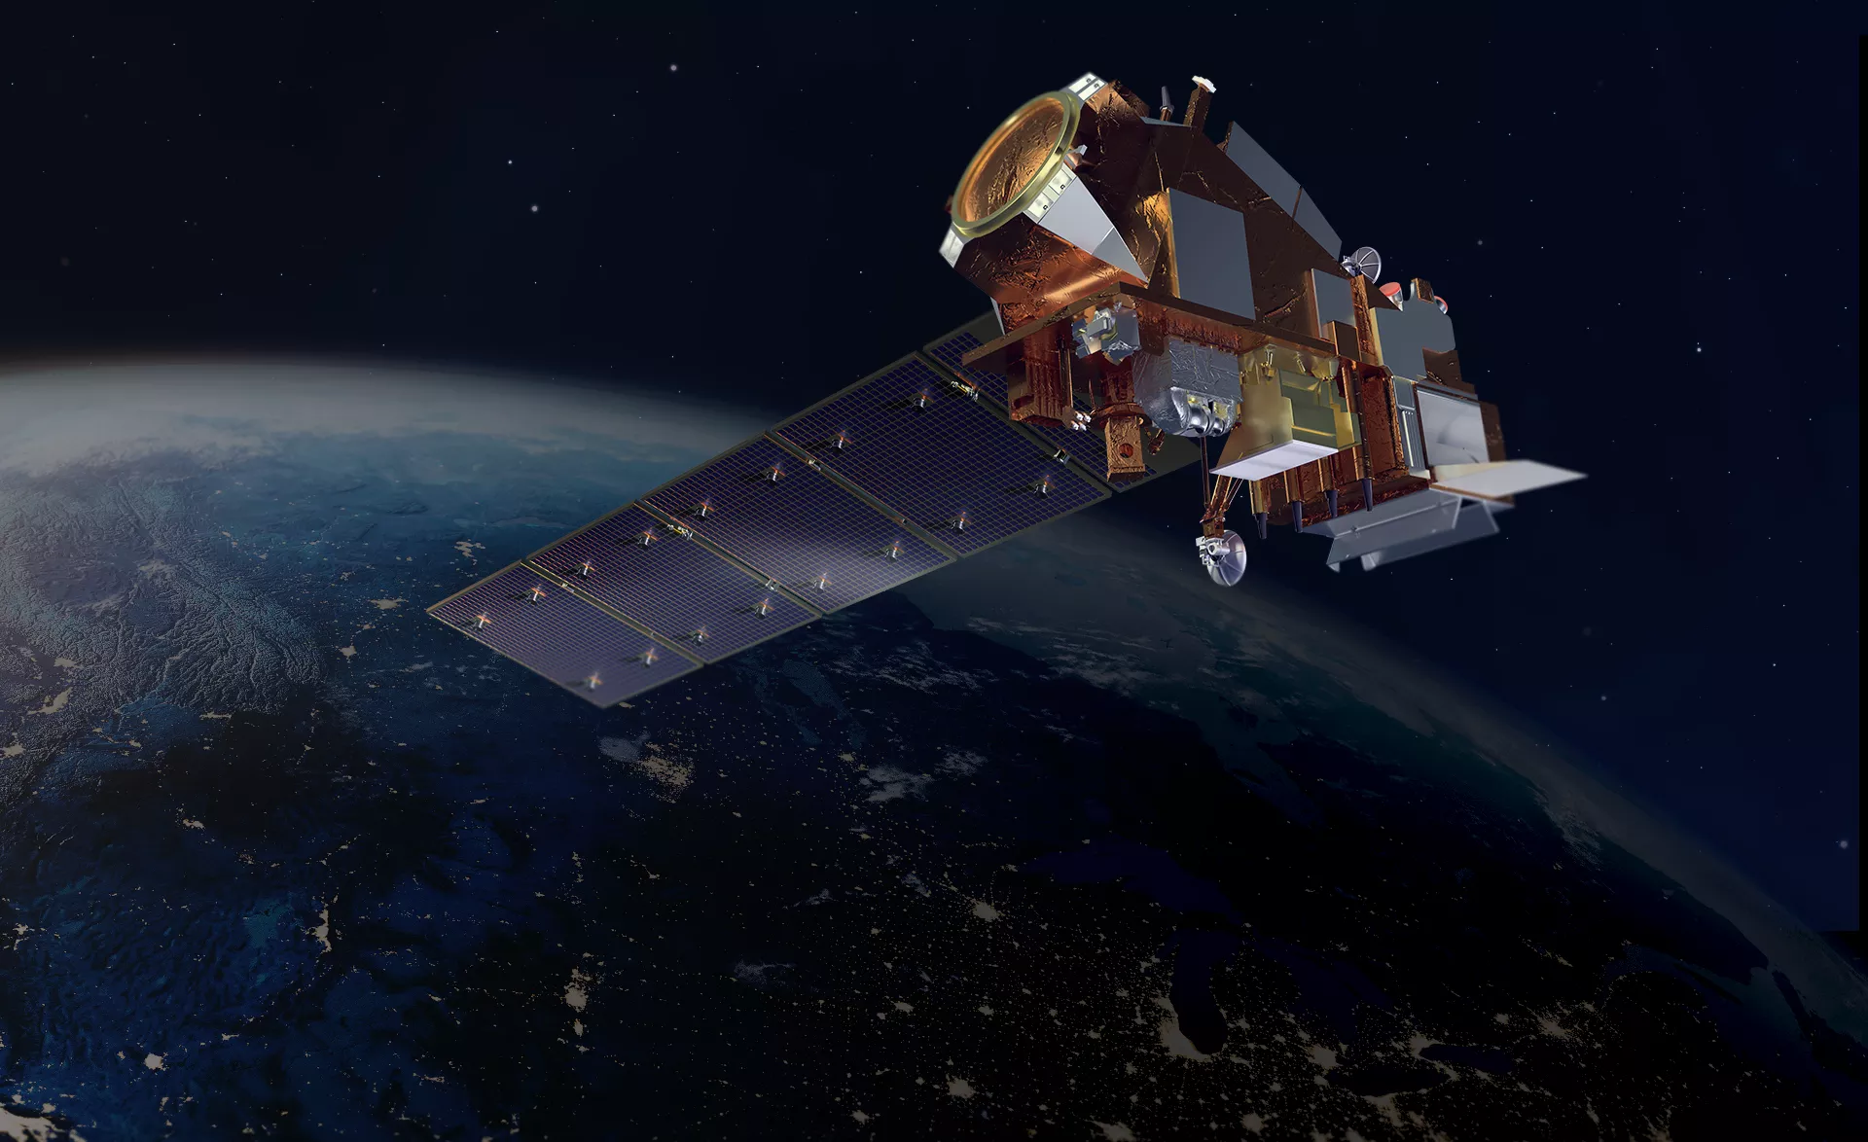
Upcoming Satellite Training
NOAA/World Meteorological Organization (WMO) RA IV: (English) Barbados/Trinidad and Tobago Workshop Hybrid, Nov 28-Dec 5(?)
SatMOC Vitual Training Series - for students and early career
  Four 2-hour sessions on specific topics
November 1, 2022 is targeted as the new launch date for NOAA’s Joint Polar Satellite System-2 (JPSS-2) mission

Slide 5
Plenary Sessions on Monday
Session 1A: Satellite Data Users Perspective - Monday, 8:45AM-10:15AM, Madison Ballroom CD
Session J2A: Shaping the Future Together - Providing Observations for the Coupled Earth System - Monday, 10:45AM-12:00PM, Madison Ballroom CD
Panel Discussion PD3: Emerging Needs for Operational Space-Based Observations: Monday, 1:45PM-3:00PM, Madison Ballroom CD

Slide 6

Events During CMM
https://www.ametsoc.org/index.cfm/ams/meetings-events/ams-meetings/collective-madison-meeting/events1/
Student Activities
AMS opening Ice Breaker on Terrace Monday evening
Separate area for students and request VIP introductions
Wednesday Student Engagement Luncheon: Conversations with Professionals Networking Lunch on Wednesday, August 10th, 12:15-1:45PM in the Exhibit Hall
Happy Hour at the Wisconsin Memorial Union Terrace Wednesday 6:30 PM
Student and early career professionals please come to the Wisconsin Memorial Union to mingle and meet your peers
Student Poster Competition with AMS funding for awards
Sponsored by:

Slide 7
Take full advantage of this conference
Attend a new topic session
Network and meet new people
Check out the NOAA Booth in the Exhibition Hall
Walk through the posters
See you tomorrow at 8:45AM
Enjoy!!
Notes:
https://www.mononaterrace.com/meetings-conventions/room-rentals/

