Slide 1
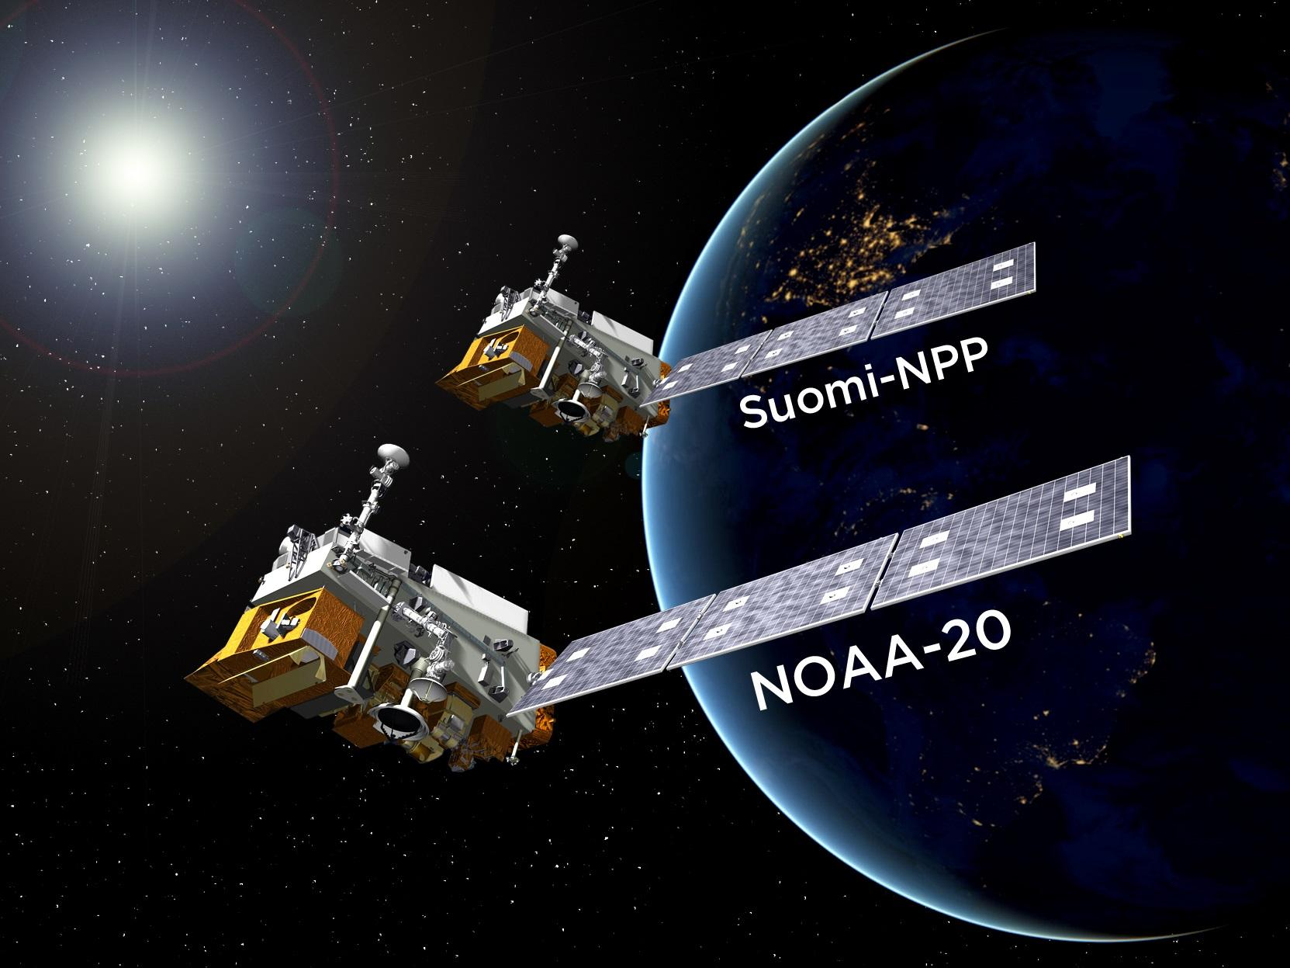
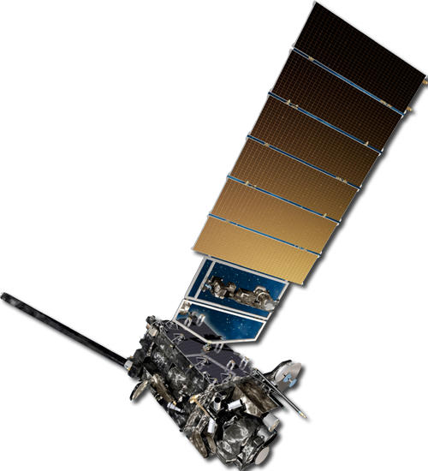
2020 JPSS/GOES-R Satellite product overview
GOES-17
GOES-16
Presented by
Bill Sjoberg (JPSS), Chris Schmidt (CIMSS)
William Straka III (CIMSS)

Slide 2
Outline:
Introduction (Bill Sjoberg)
GOES Fire Detection(Chris Schmidt)
Polar Fire Detection (William Straka)
HRRR Smoke Model (William Straka and Ravan Ahmadov)
Into the Future - RGBs and NUCAPS (William Straka, Emily Berndt (NASA) and Rebekah Esmaili (STC))
Supporting the IMET Conference
for the 5th Year

Slide 3
Overview

Slide 4
Who we are
Bill Sjoberg (GST/JPSS) * - bill.sjoberg@noaa.gov
Chris Schmidt (CIMSS) * - chrissch@ssec.wisc.edu
William Straka (CIMSS) * - william.straka@ssec.wisc.edu
With contributions from
Ravan Ahmadov (CIRES) - ravan.ahmadov@noaa.gov
Emily Berndt (NASA) - emily.b.berndt@nasa.gov
Rebekah Esmaili (STC) - rebekah@stcnet.com
* Will be at in person IMET training

Slide 5
Proving Ground/Risk Reduction Overview
Proving Ground – Using satellite data and capabilities the way they were meant to be used.
Risk Reduction – Consider new ways to use current capabilities or identify and evaluate new capabilities.
Establish and maintain forums where developers and users closely collaborate.
Use Call for Proposals (CFPs) to fund thorough operational evaluations and encourage study of leading-edge technologies.
Three CFPs completed and work has begun on a fourth.
Initiatives have looked for opportunities to interact with satellite data/product users. The IMET Conference is PERFECT!!

Slide 6
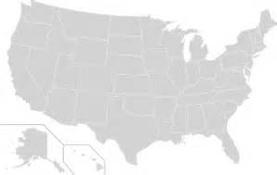
PGRR Partners
IMETS
MBFRC
NCFRC
NEFRC
CIMSS
CCNY
STaR
NCEP
GMU
Howard
JCSDA
CICS
NESDIS
NIC
OAR
UMD
CIRA
COMET
CIRES
NGDC
NRL
NEXSAT
AWC
SPC
WGFRC
SPoRT
UAH
NHC
AOML
NWS AK
GINA
APRFC
NWS Pacific

Slide 7
How the Proving Ground works
Clear Objectives
Transition to Operations
Frequent Interaction
Key Milestones
Working Groups

Slide 8
Keys to Initiative Success
Where PGRR Initiatives and
Operational Applications Meet
Responding to Events with Focused Support
Tracking
Real World Events
Focusing Satellite Capabilities
Establishing
Developer-User Familiarity

Slide 9
PGRR Initiatives
Initiative | Start Date
River Ice and Flooding | November 2013
Fire and Smoke | May 2014
Sounding Applications (NOAA Unique CrIS/ATMS Processing System (NUCAPS)) | July 2014
Hydrology | July 2015
NWP Impact Studies and Critical Weather Applications | October 2015
Oceans and Coasts | March 2016
Arctic Initiative | June 2016
Hurricanes and Tropical Storms Initiative | August 2018
Aviation Initiative | August 2018
Volcano Hazards Initiative | August 2018
Training Initiative | February 2019

Slide 10
ABI Fire detection
Presented by Chris Schmidt (SSEC/CIMSS)
GOES-17
GOES-16

Slide 11
GOES-R
Section prepared by Chris Schmidt
ABI offers high temporal refresh allowing for early detection of fires
  Traditional imagery channels are the 3.9um channel (band 7) as well as the NIR (1.6um and 2.2um) channels at night.
  Current temporal resolution is 10 min FD, 5 min CONUS and two 1 minute Mesoscale (1000x1000km) sectors.
    Current GOES-17 Meso1 default location is over California
    NWS WFOs can request Mesoscale images over locations via appropriate channels
In addition, the GOES-R ABI Fire Detection and Characterization Algorithm (FDCA, aka Fire Hot-Spot [FHS]) provides 2 km fire detection and characterization data
  Currently the product is produced operationally ever 5 minutes over CONUS and every 10 minutes over FD
  The one minute mesoscale sectors are not produced operationally at this time, but that could change if sufficient demand arises. (If you want it, ask for it)

Slide 12
GOES-R ABI Fire Detection and Characterization Algorithm (FDCA)
Brief overview
The algorithm is contextual, it considers a candidate fire pixel in comparison to its neighbors, but there are some fixed thresholds involved.
  Performs its own opaque cloud screening
  Also accounts for surface emissivity and atmospheric attenuation of the fire signal by water vapor in the atmosphere.
  Future work includes additional persistent hotspot flag (ex. Gas flare, solar farm, etc.)
Due to the subpixel nature of fires:
  The Dozier Method and FRP are describing a hypothetical, uniform fire with those properties that produces the same radiance signature
  The size should not be taken literally
  FRP (currently in AWIPS) is the best proxy for intensity

Slide 13
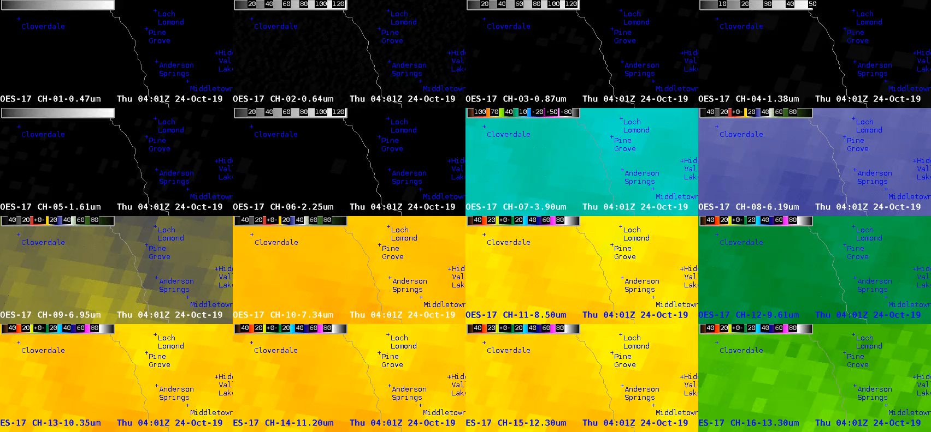
GOES-R ABI Fire Detection Imagery example
Kincade Fire, 24 October 2019, AWIPS view

Slide 14
GOES-R ABI Fire Detection and Characterization Algorithm (FDCA)
Kincade Fire, near IR camera and coincident FDCA and ABI data
The Kincade Fire started in Sonoma County on October 23, 2019, at about 9:20 pm PDT (4:20 UTC on 24 October 2019). The ALERTWildfire camera at Barham near Santa Rosa, CA captured the start of the fire. It appears that a light on the horizon went out when a power line fell between 9:19:51 and 9:19:54 pm PDT, the same event that apparently started the fire. The fire intensified rapidly. GOES-17 picked up the first signs at 9:21 pm PDT, and by 9:25 pm PDT the FDCA had detected the fire.
On the next slide, five panels from ABI and the FDCA are synchronized with the ALERTWildfire loop from 9-10 pm PDT. The min and max in the frame are listed on each panel. From left to right:
3.9 μm – midwave infrared window image (sees fires, clouds, and surface)
11.2 μm – longwave infrared window image (sees clouds and surface)
“3.9 μm-11.2 μm radiance” – This is the radiance difference between the two key bands, but the 11.2 μm data has been converted to 3.9 μm “space” to make it directly comparable.
FDCA Mask – algorithm output indicating its decisions about each pixel, including detected fires
Fire FRP – algorithm output of FRP, for all detected fires (dynamically scaled)

Slide 15
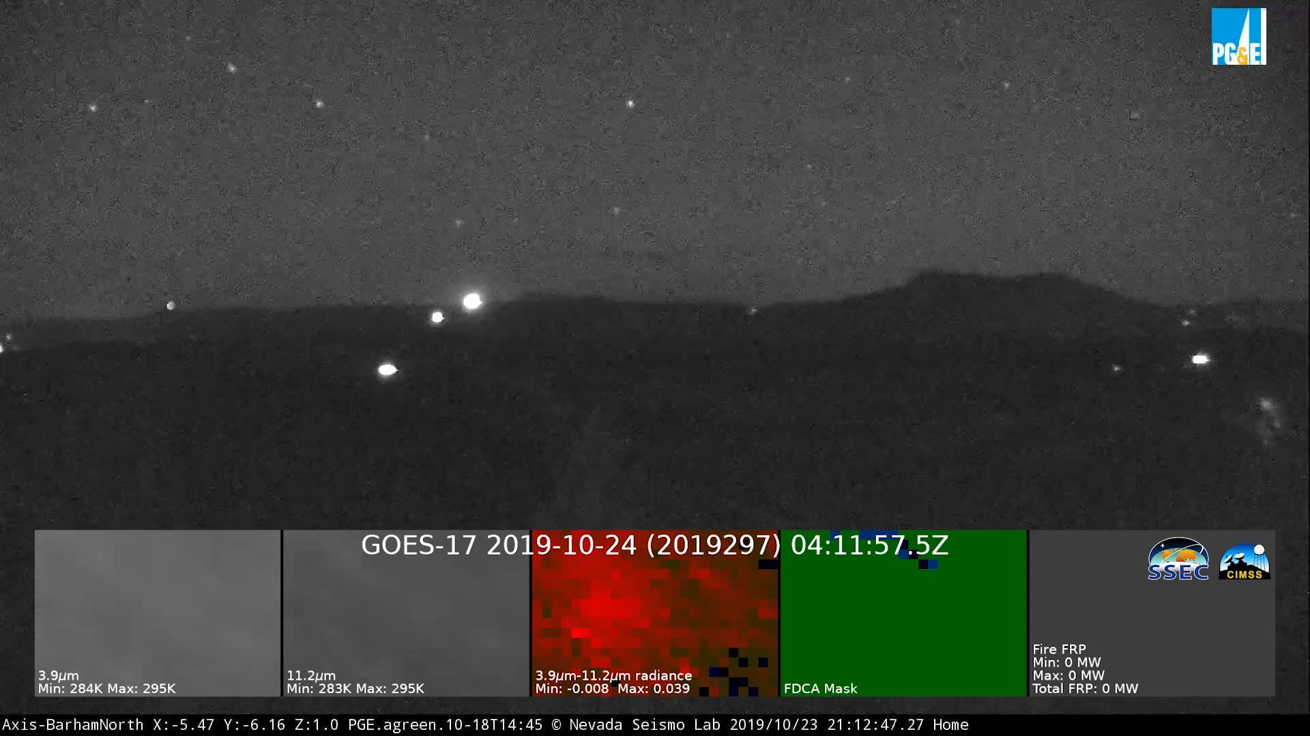
GOES-R ABI Fire Detection and Characterization Algorithm (FDCA)
Kincade Fire, near IR camera and coincident FDCA and ABI data

Slide 16
GOES-R ABI Fire Detection FDCA example
Kincade Fire
Key takeaways
  ABI is very sensitive to heat signatures, but finding fires early requires enhancements and/or band differencing
  Large heat signatures appear in many bands
  The human eye is quicker than the FDCA, but the FDCA isn’t too slow, either
  Fire size and temperature from the FDCA are only available for some fires and do not mean what forecasters and the public might think they mean
  FRP is a good proxy for intensity

Slide 17
Polar Imagery and Fire detection
Presented by William Straka (SSEC/CIMSS)

Slide 18
Key VIIRS Channels used for fire detection
Fire detection Algorithms | Fire detection Imagery in AWIPS | VIIRS Band | Central Wavelength (μm) | Band Explanation | Spatial Resolution (m) @ nadir
 |  | M1 | 0.412 | Visible/ Reflective | 750 m
 |  | M2 | 0.445
 |  | M3 | 0.488
 |  | M4 | 0.555
 |  | M5 | 0.672
 |  | M6 | 0.746 | Near IR
 |  | M7 | 0.865
 |  | M8 | 1.240 | Shortwave IR
 |  | M9 | 1.378
 |  | M10 | 1.61
 |  | M11 | 2.25
 |  | M12 | 3.7 | Medium-wave IR
 |  | M13 | 4.05
 |  | M14 | 8.55 | Longwave IR
 |  | M15 | 10.76
 |  | M16 | 12.01
 |  | DNB | 0.7 | Visible / Reflective | 750 m across full scan
 |  | I1 | 0.64 | Visible / Reflective | 375 m
 |  | I2 | 0.87 | Near IR
 |  | I3 | 1.61 | Shortwave IR
 |  | I4 | 3.74 | Medium-wave IR
 |  | I5 | 11.45 | Longwave IR
Only available during day
Available Day/Night
Notes:
Some channels are available in Thinclient, but most are not. Ex. M13 channel. NIR radiances are not available on the web or AWIPS

Slide 19
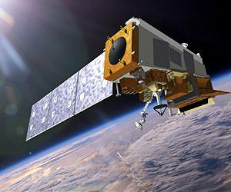
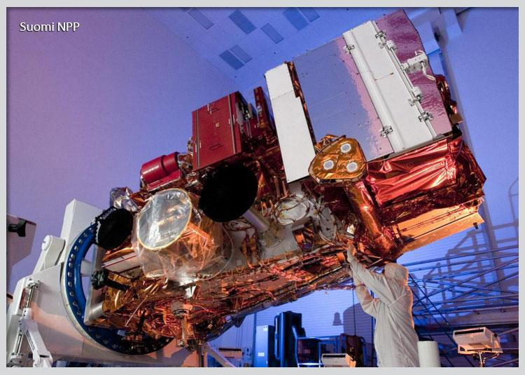
The VIIRS Day/Night Band (DNB)
Part of the 22-band Visible Infrared Imaging Radiometer Suite (VIIRS)
3000 km swath (SNPP, slightly larger on NOAA-20 due to extended granule), 742 m resolution
Extremely sensitive (can see low-light features) and well calibrated
VIIRS
At 275 kg, VIIRS is the largest sensor on Suomi NPP and NOAA-20
Notes:
Brief overview of the DNB

Slide 20
VIIRS Active Fire
Section prepared by Ivan Csiszar
750m “M-band” product
  Current NOAA operational product
  MODIS heritage
  Primary band is VIIRS dedicated fire band (M13)
  Available in CSPP (Community Satellite Processing Package), JPSS direct broadcast processing system
375m “I-band” product
  Currently in NOAA experimental production
  Primary band is I4 for detection; M13 is used for characterization due to low I4 saturation
  Much higher sensitivity than the 750m product
  Available in CSPP and RealEarth
    (http://realearth.ssec.wisc.edu/?products=AFIMG-Points.100)
Both algorithms
  Work at daytime and nighttime
  Process Suomi NPP and NOAA-20 (50 minutes apart on the 1:30 orbit)
  Provide fire radiative power (FRP)
    Used as input to HRRR model
  Provide full fire mask (fire detections, clear land, water, cloud, etc.)
  Contains persistent fire source flag (will be transitioned to CSPP in coming months)
  Current schedule is I-Band product to go into operations late 2020
  VIIRS product currently not in AWIPS
Notes:
Brief overview of the DNB

Slide 21
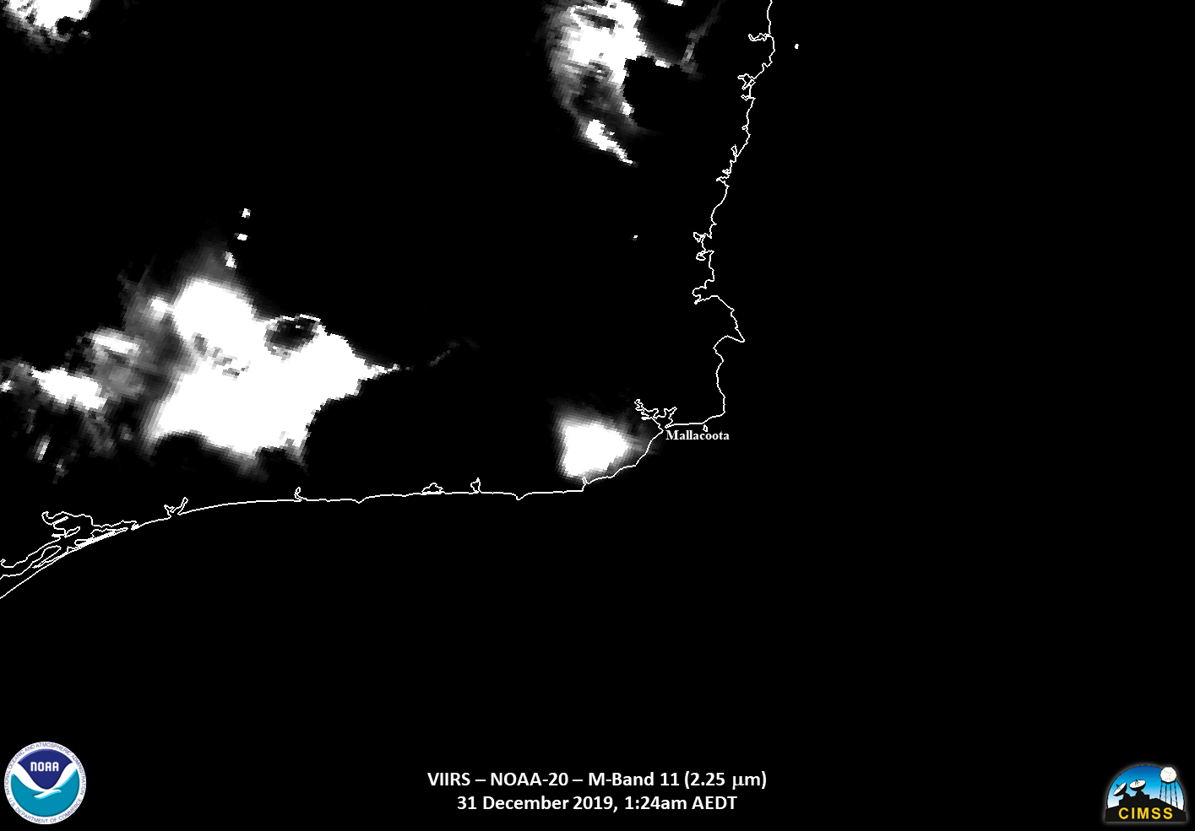
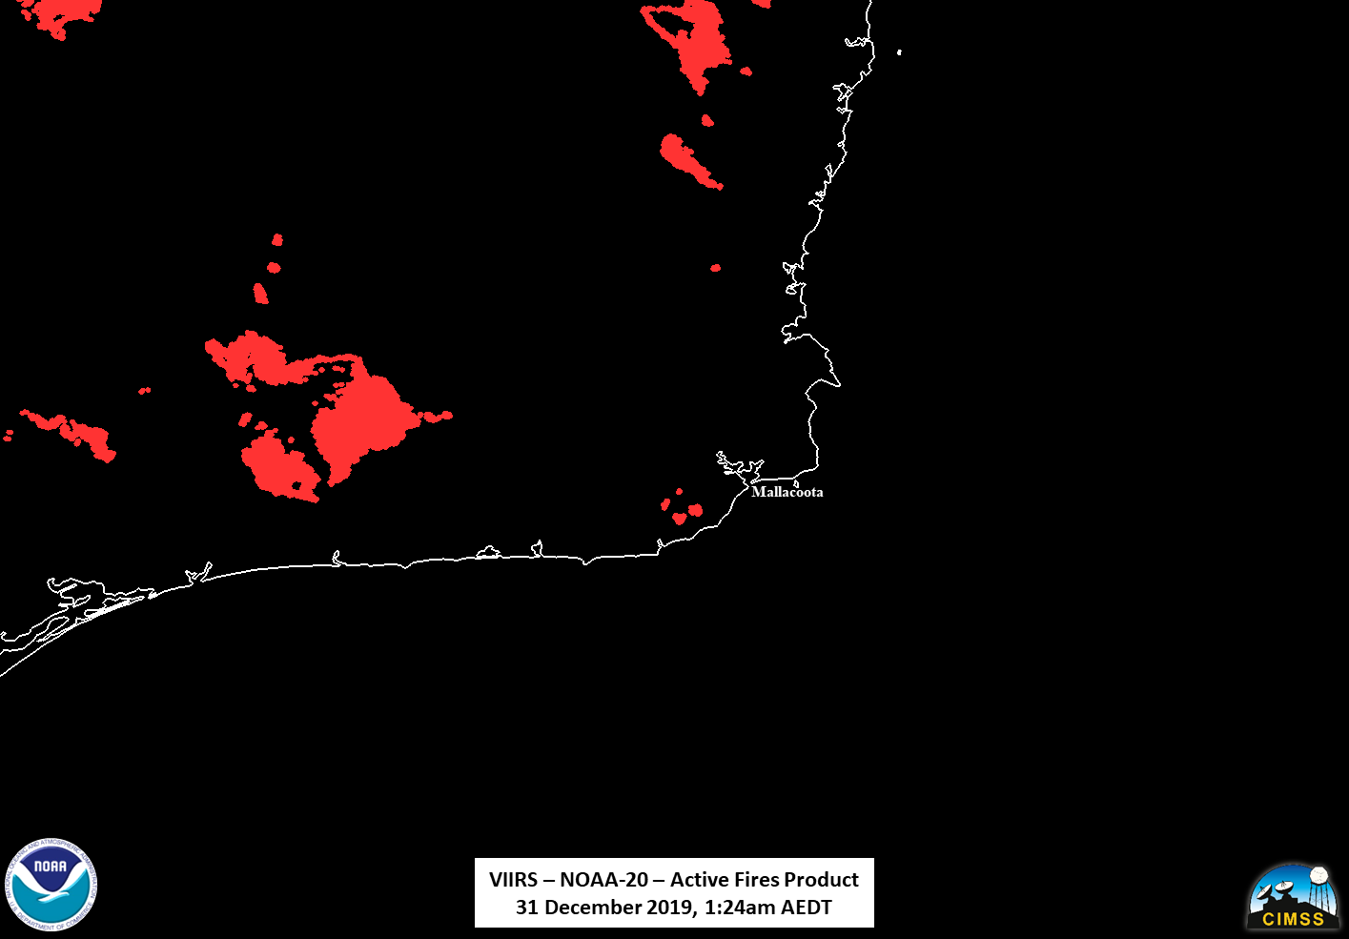
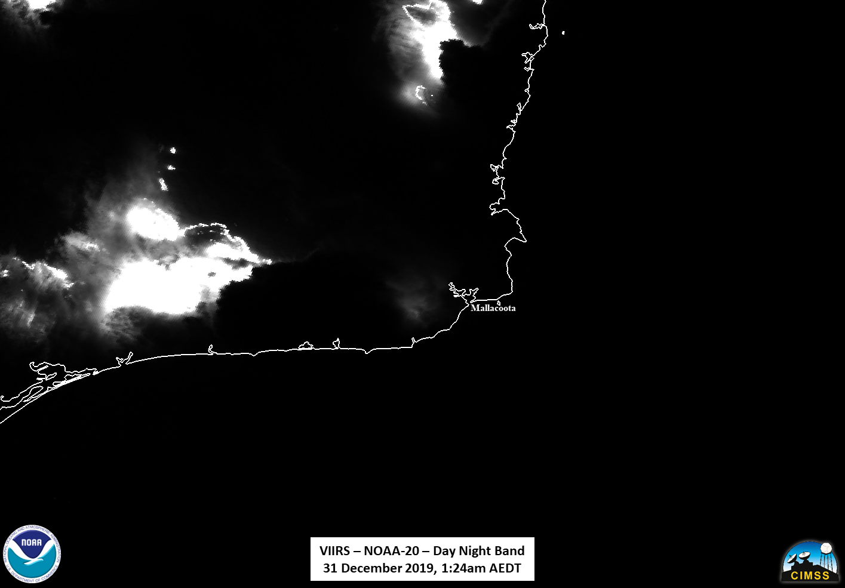
VIIRS - Example: Australian Wildfires

Slide 22
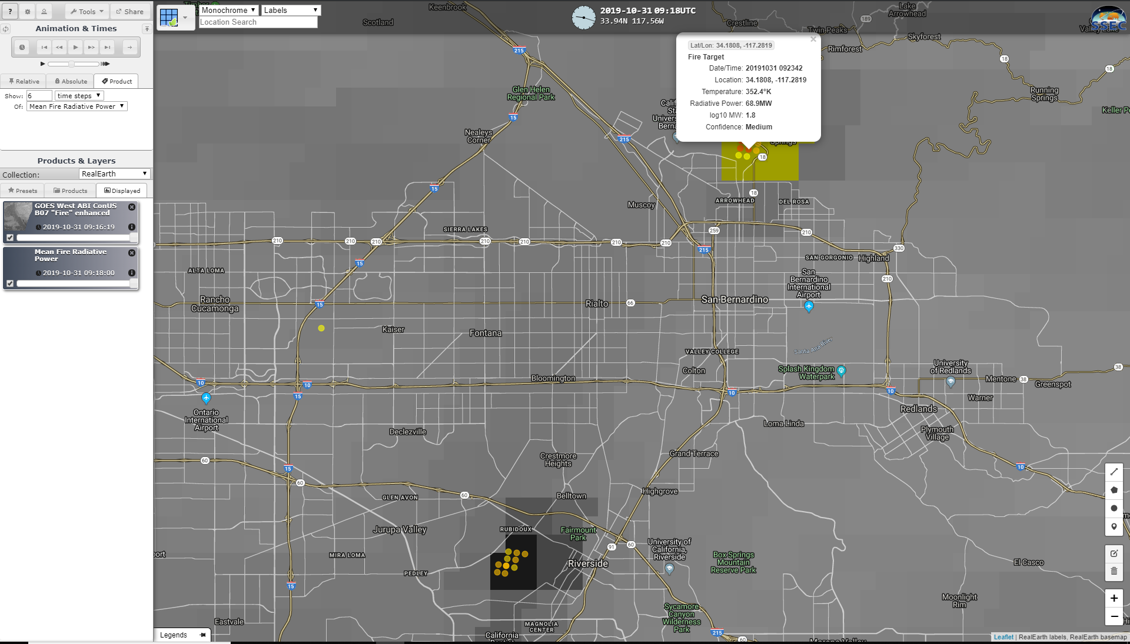
VIIRS Active Fire in Real Earth- Example
Southern California Wildfires (October 2019)

Slide 23
RAP/HRRR-Smoke model
Section prepared by Ravan Ahmadov (CIRES)

Slide 24
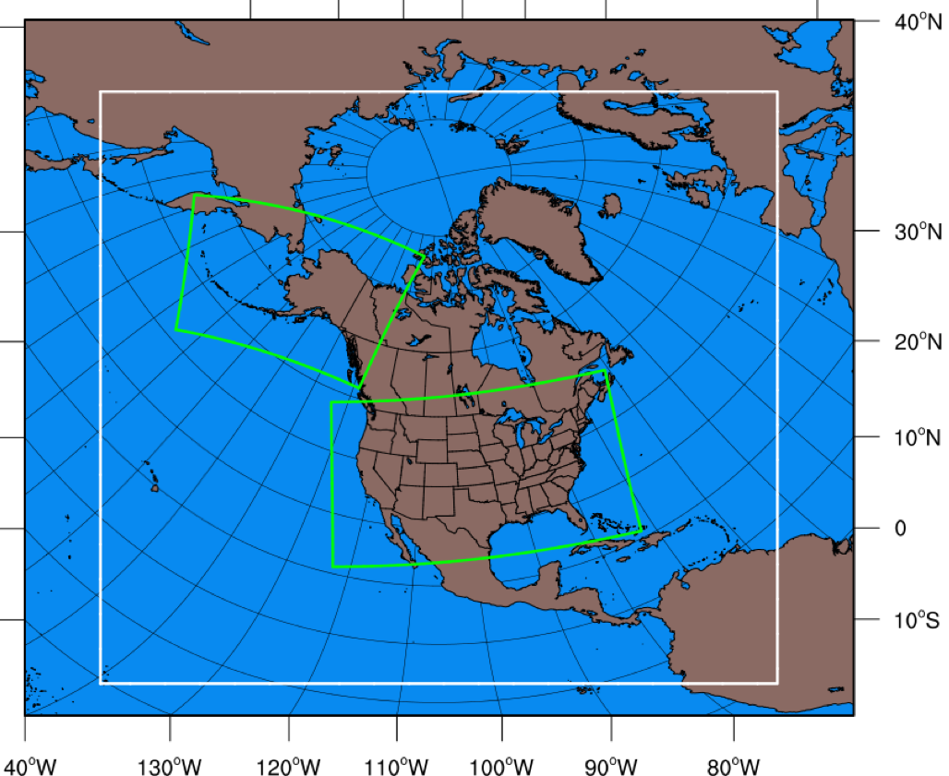
RAP/HRRR-Smoke models
We take advantage of the existing NWP systems by adding a single tracer (smoke) to NOAA’s experimental RAP and HRRR weather forecasting models.
RAP-Smoke enables forecasting smoke from all the fires in North America. It provides boundary conditions for smoke to HRRR-Smoke.
HRRR-Smoke is running on high spatial resolution (3km) to allow simulation of mesoscale flows and smoke dispersion over complex terrain.
Full coupling between meteorology and smoke: feedback of smoke on predicted radiation, cloudiness, and precipitation. The coupling also helps to improve the visibility forecasting.
Biomass burning emissions and inline plume rise parameterization based on the satellite FRP data.
A rapidly updating data assimilation cycle for meteorology;
The smoke forecasting capability is a part of the next update of NOAA’s operational RAP, HRRR-CONUS and HRRR-Alaska models. The update is planned for summer 2020!
Operational weather forecast models at NCEP:
RAP (white), 13km resolution
HRRR model domains (green), 3km resolution
(https://rapidrefresh.noaa.gov/)

Slide 25
The limitations of the input data and model that need to be considered in utilizing
the experimental RAP/HRRR-Smoke forecast products
  Fire detections in the model could be missing due to cloudiness, or infrequent overpass times by the polar orbiting satellites. If smoke over a fire is too dense, then satellite detections will be missed (it happened during the Camp fire).
  A simple diurnal cycle is applied for the emissions, and fire behavior is not simulated by the model. HRRR-Smoke assumes persistence in forecasting fire emissions. Also, it is hard to forecast the duration of fires (e.g. wildfires vs. controlled burns in forested areas, uncertainties due to fire suppression activities).
  Inaccuracies in weather forecasting by HRRR will also affect smoke forecasts. For example, a slight bias in forecasted wind speed/direction can have profound impact on modeled smoke concentrations!
  HRRR-Smoke does NOT include anthropogenic pollution, dust, or chemistry of the aerosols. Therefore, the smoke from the model output is not exactly the same as PM_{2.5} measured by the ground stations.
  The local NWS forecasters play a critical role in interpreting the model forecasts.
For questions or feedback please contact:
Ravan.Ahmadov@noaa.gov
Eric.James@noaa.gov

Slide 26
Different ways and tools to visualize the HRRR-Smoke forecasts
Web-based tool (zoomable map) by ESRL/GSD: https://hwp-viz.gsd.esrl.noaa.gov/smoke/index.html
WAVE - interactive zooming capability, available to all NOAA staff, the talks by Bill Rasch (NWS) and Jebb Stewart (ESRL/GSD) at the IMET conference;
NOAA/ESRL/GSD’s version of WAVE https://hwp-viz.gsd.esrl.noaa.gov/wave/
AWIPS2 (M.Loefelbein, NWS)
RealEarth (https://realearth.ssec.wisc.edu/); You can overlay locations and reports for large wildfires over the HRRR-Smoke forecast fields.
GeoCollaborate (https://fs.geocollaborate.com/dashboard/)
Several apps provided by the private sector

Slide 27
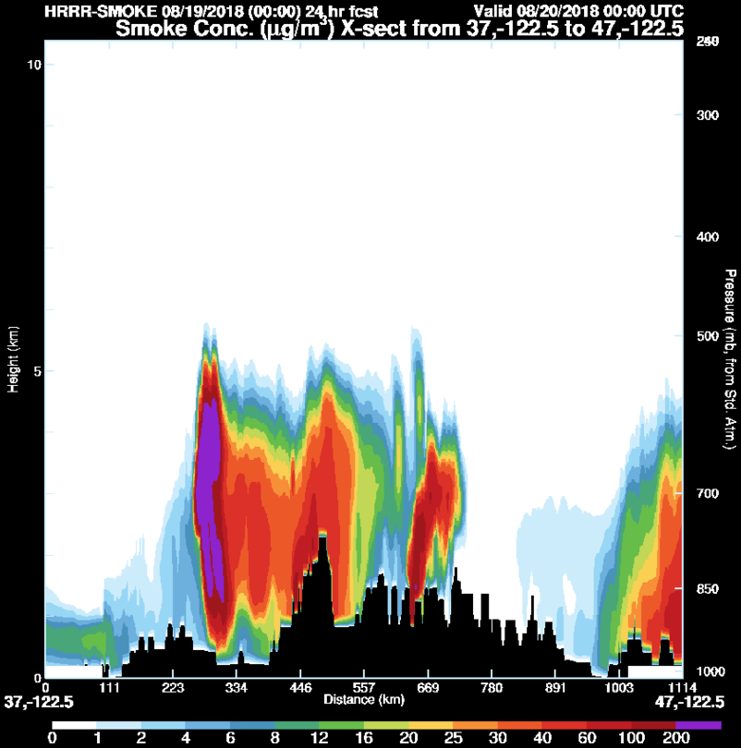
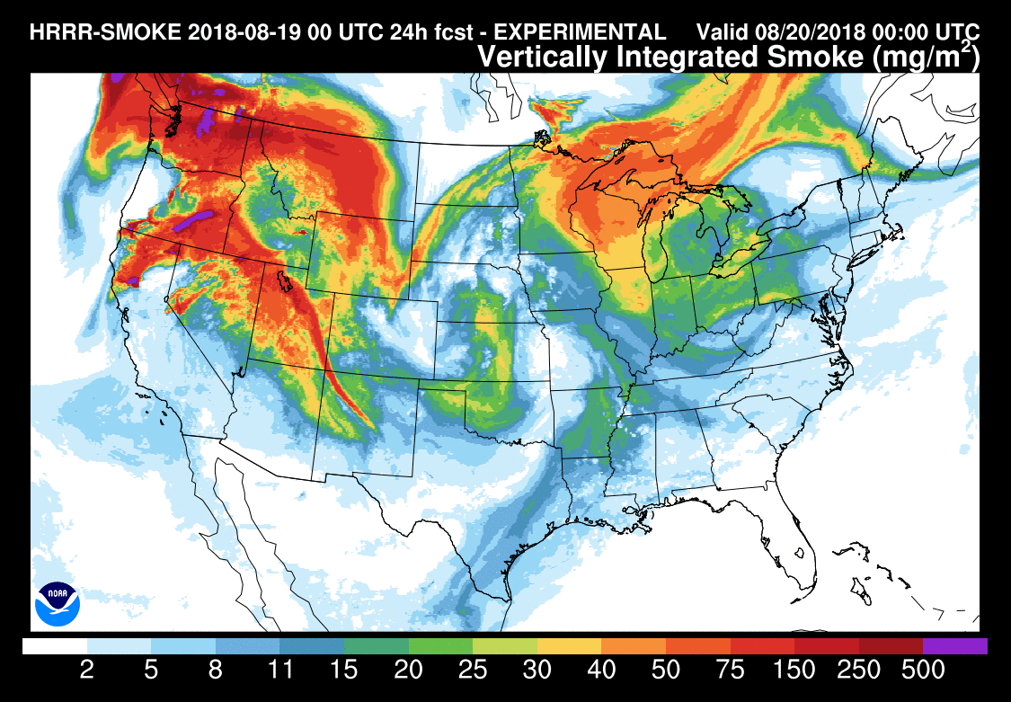
Experimental smoke forecast for August 19, 2018 (rapidrefresh.noaa.gov/hrrr/HRRRsmoke/)
This plot shows simulated vertically integrated fire emitted fine particulate matter (PM2.5 or fire smoke) concentrations for the same forecast date/time as in previous slide.
South-north vertical x-section
Mendocino Complex fire

Slide 28
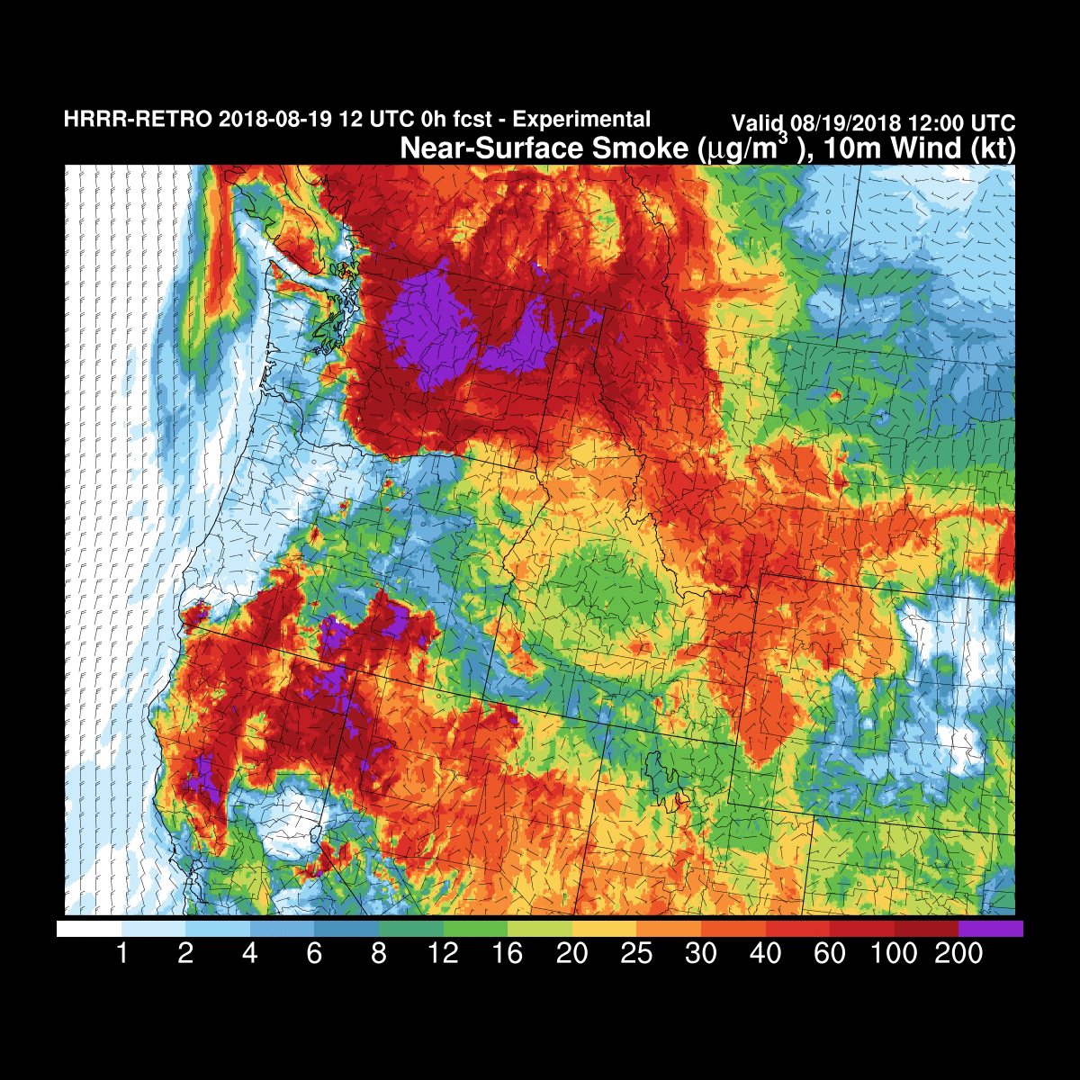
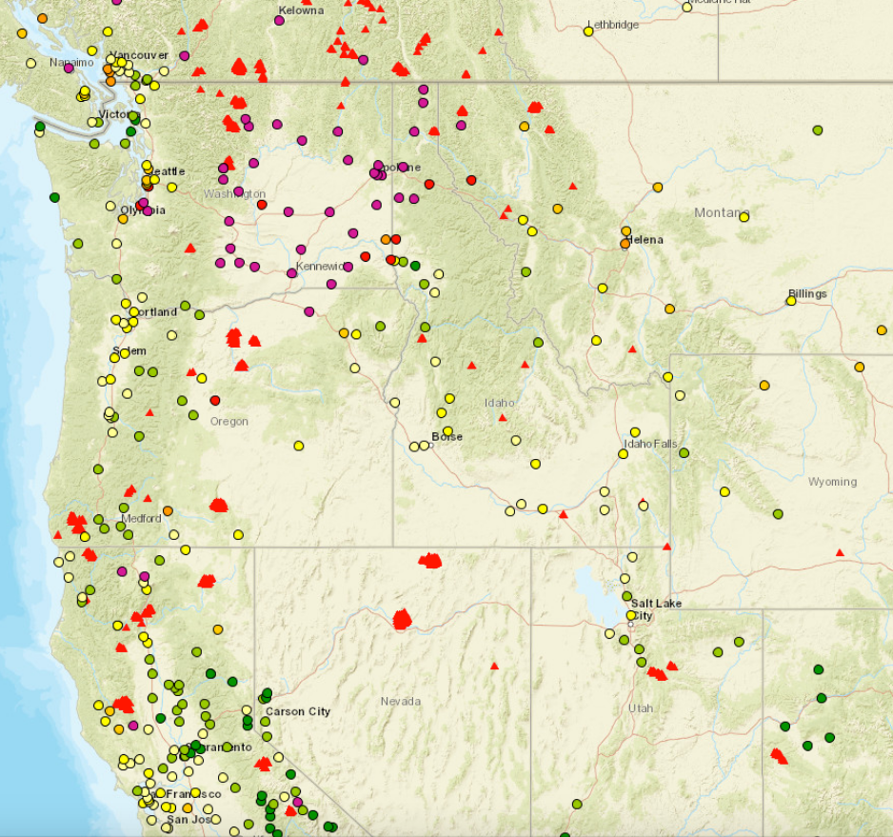
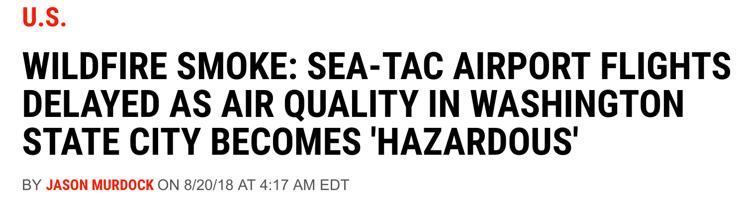
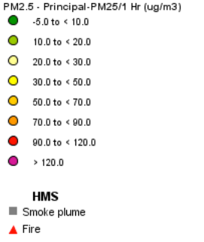
title
PM2.5 concentrations (AirNow network)
8pm PDT, August 19, 2018
Newsweek.com
https://www.airnowtech.org/navigator/#

Slide 29
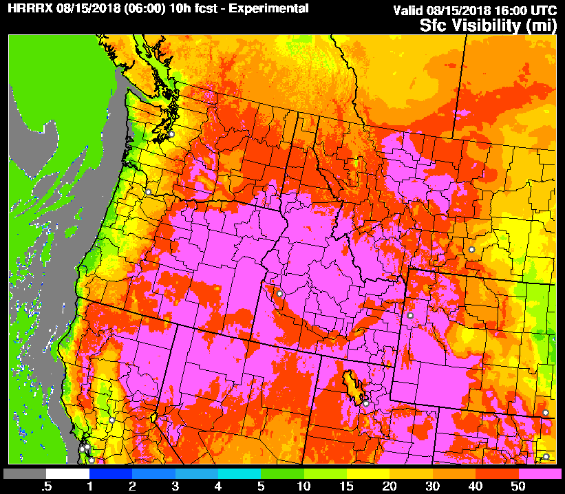
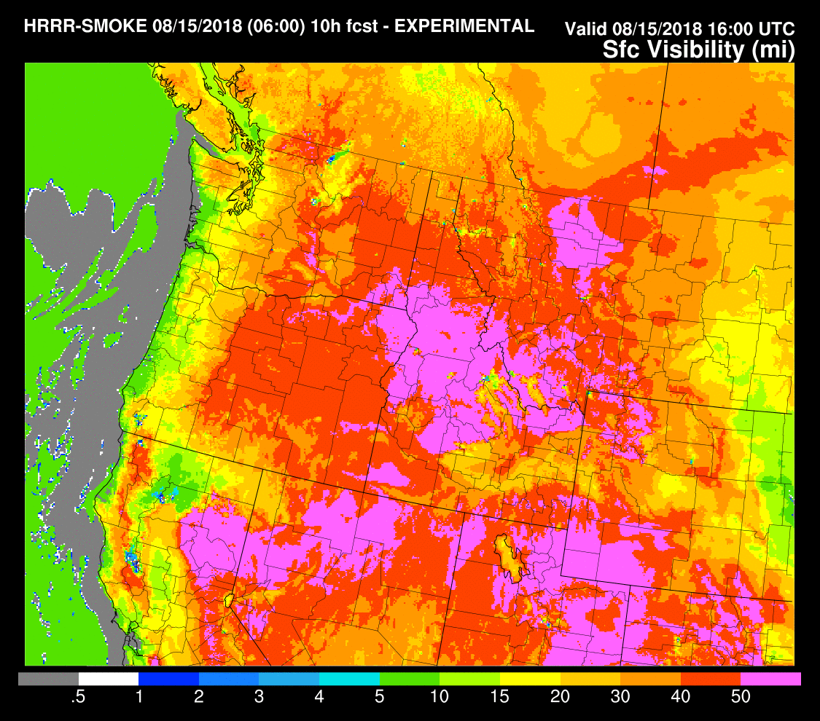
Surface visibility forecasts by HRRR-Smoke
Reduced visibility due to smoke
Experimental NWP model w/o smoke
Experimental NWP model with smoke
Visibility is an important forecast product (traffic, aviation…)

Slide 30
New and Future Products

Slide 31
RGBs
Presented by William Straka (SSEC/CIMSS)

Slide 32
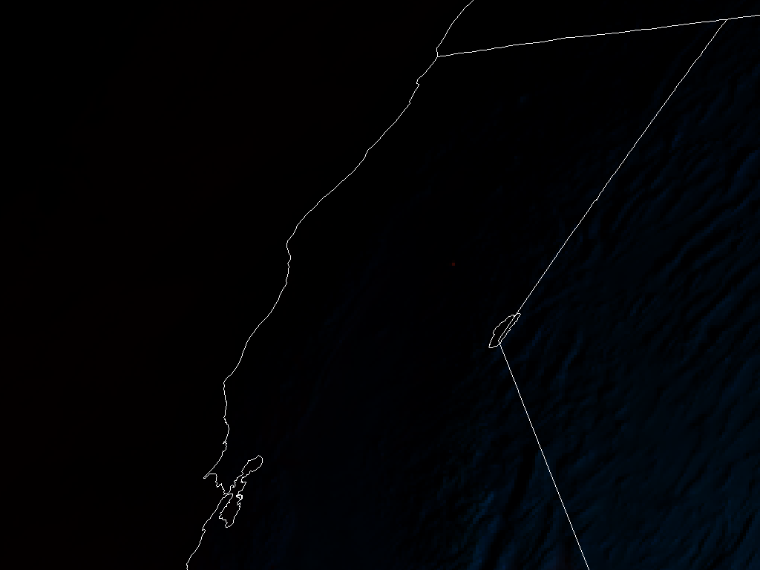
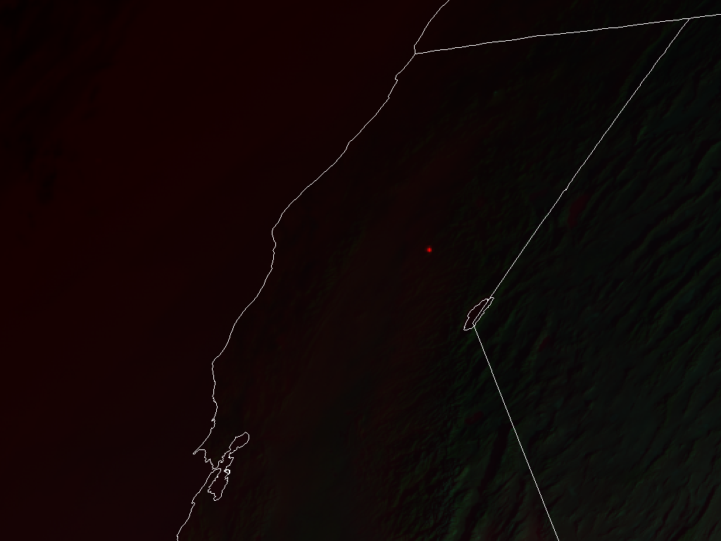
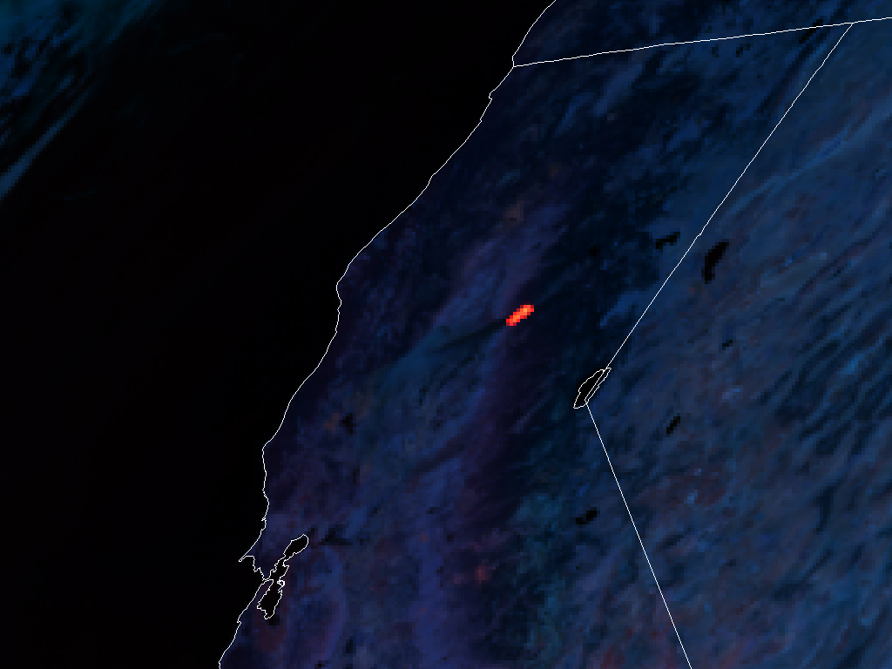
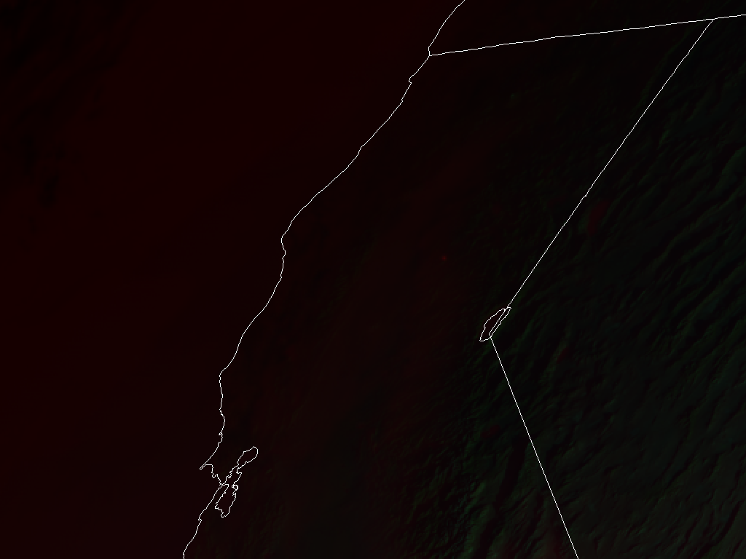
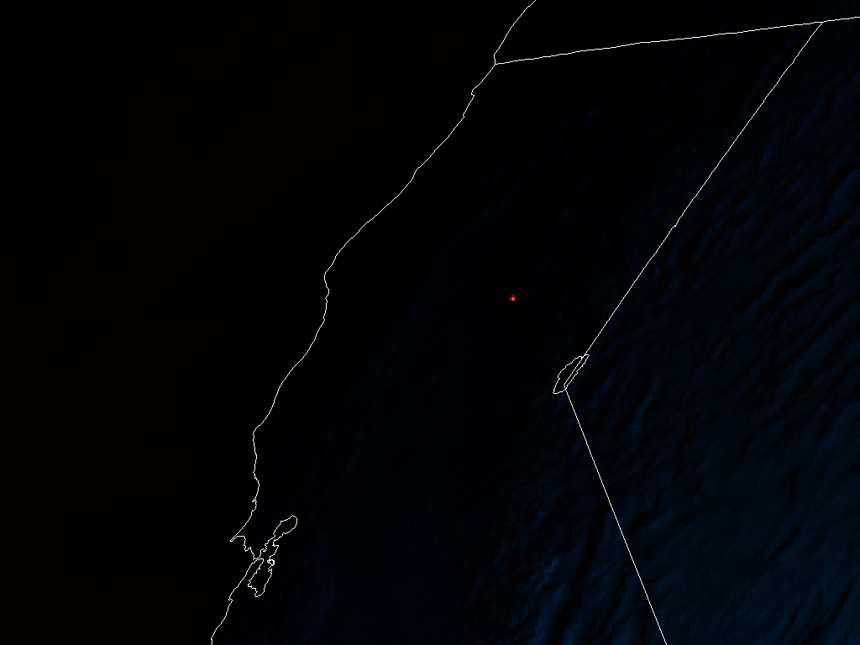
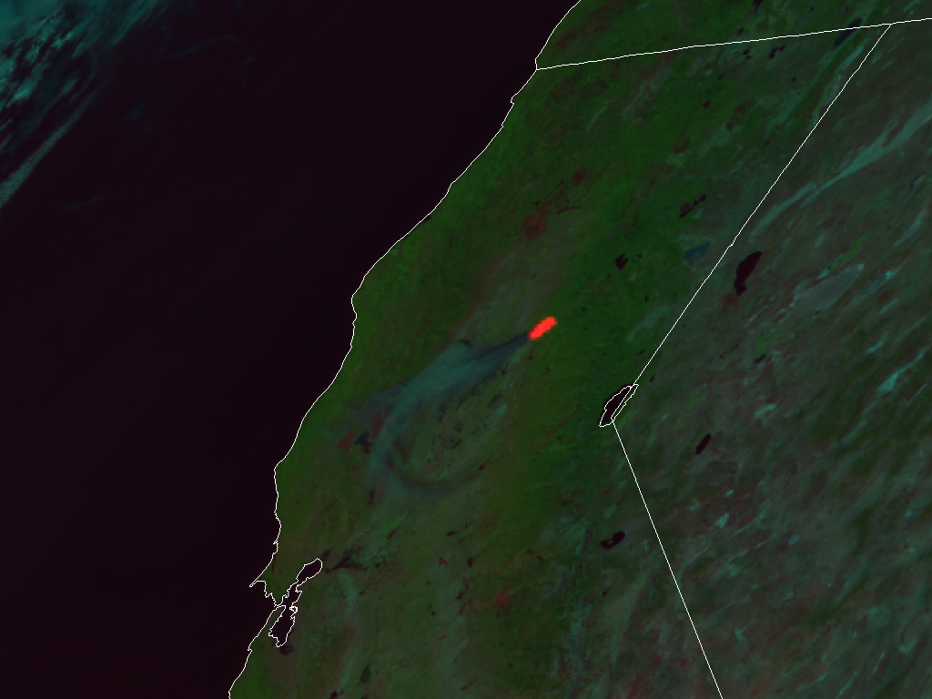
RGBs
CIRA Fire Temperature RGB
(in AWIPS)
CIRA Natural Fire Color RGB
(Day Land Cloud Fire RGB in AWIPS)
Band 5 (1.6 µm) BLUE
See Backup slides for animated image
Band 2 (0.64 µm) BLUE
Band 6 (2.3 µm) GREEN
Band 3 (0.86 µm) GREEN
Band 7 (3.9 µm) RED
Band 7 (3.9 µm) RED
8 November 2018, 1452UTC
8 November 2018, 1447UTC
8 November 2018, 1832UTC
Qualitative information on fire intensity
Fire mask with smoke and vegetation health signal
Small/non-intense fires appear red
Moderately intense/large fires appear orange to yellow
Very intense fires show up in all three bands and appear white
Liquid clouds are blue, ice clouds are dark green
Snow and Ice appear black
Little to no sensitivity to smoke
Fires show up red
Moderate sensitivity to smoke, which appears blue or cyan
Near IR vegetation band shows vegetation health in green
Lose the ability to discriminate Cloud Phase, Snow, Ice, Salt Flats, although thin cirrus can appear pink
Not good for individuals that are red-green colorblind

Slide 33
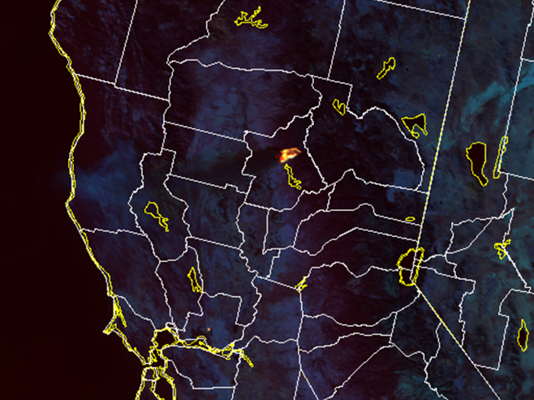
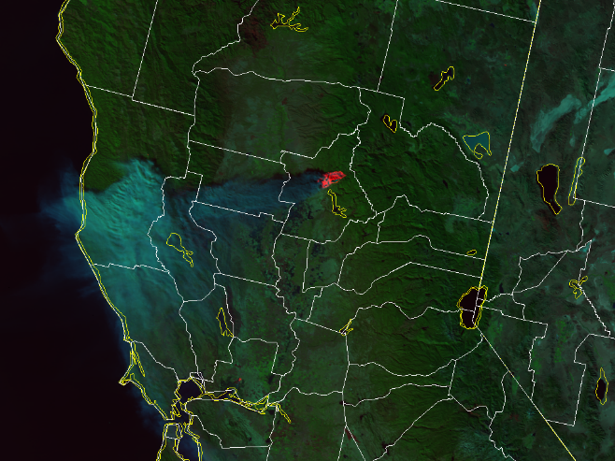
VIIRS Fire and Smoke Imagery
Fire Temperature RGB
Natural Fire Color/Day Land Cloud Fire RGB
M-10 (1.6 µm) BLUE
I-1 (1.6 µm) BLUE
M-11 (2.3 µm) GREEN
750 m resolution
I-2 (2.3 µm) GREEN
375 m resolution
M-13 (3.9 µm) RED
I-4 (3.9 µm) RED
Camp Fire 20:40 UTC 8 November 2018
VIIRS provides fire-related imagery at higher spatial resolution than GOES-16/17
3000 km-wide swath and two satellites (S-NPP and NOAA-20) provide full global coverage twice per day (~1:30 AM/PM) with ~50 min. separation
GINA/U. Alaska-Fairbanks has been providing these RGBs to Alaska Fire Service, Alaska National Weather Service offices
CIRA is currently working on making these products available to users throughout CONUS
  GeoTIFFs to be made available on the web
  “On the fly” RGB capability within AWIPS
  Polar SLIDER: http://rammb-slider.cira.colostate.edu/?sat=jpss

Slide 34
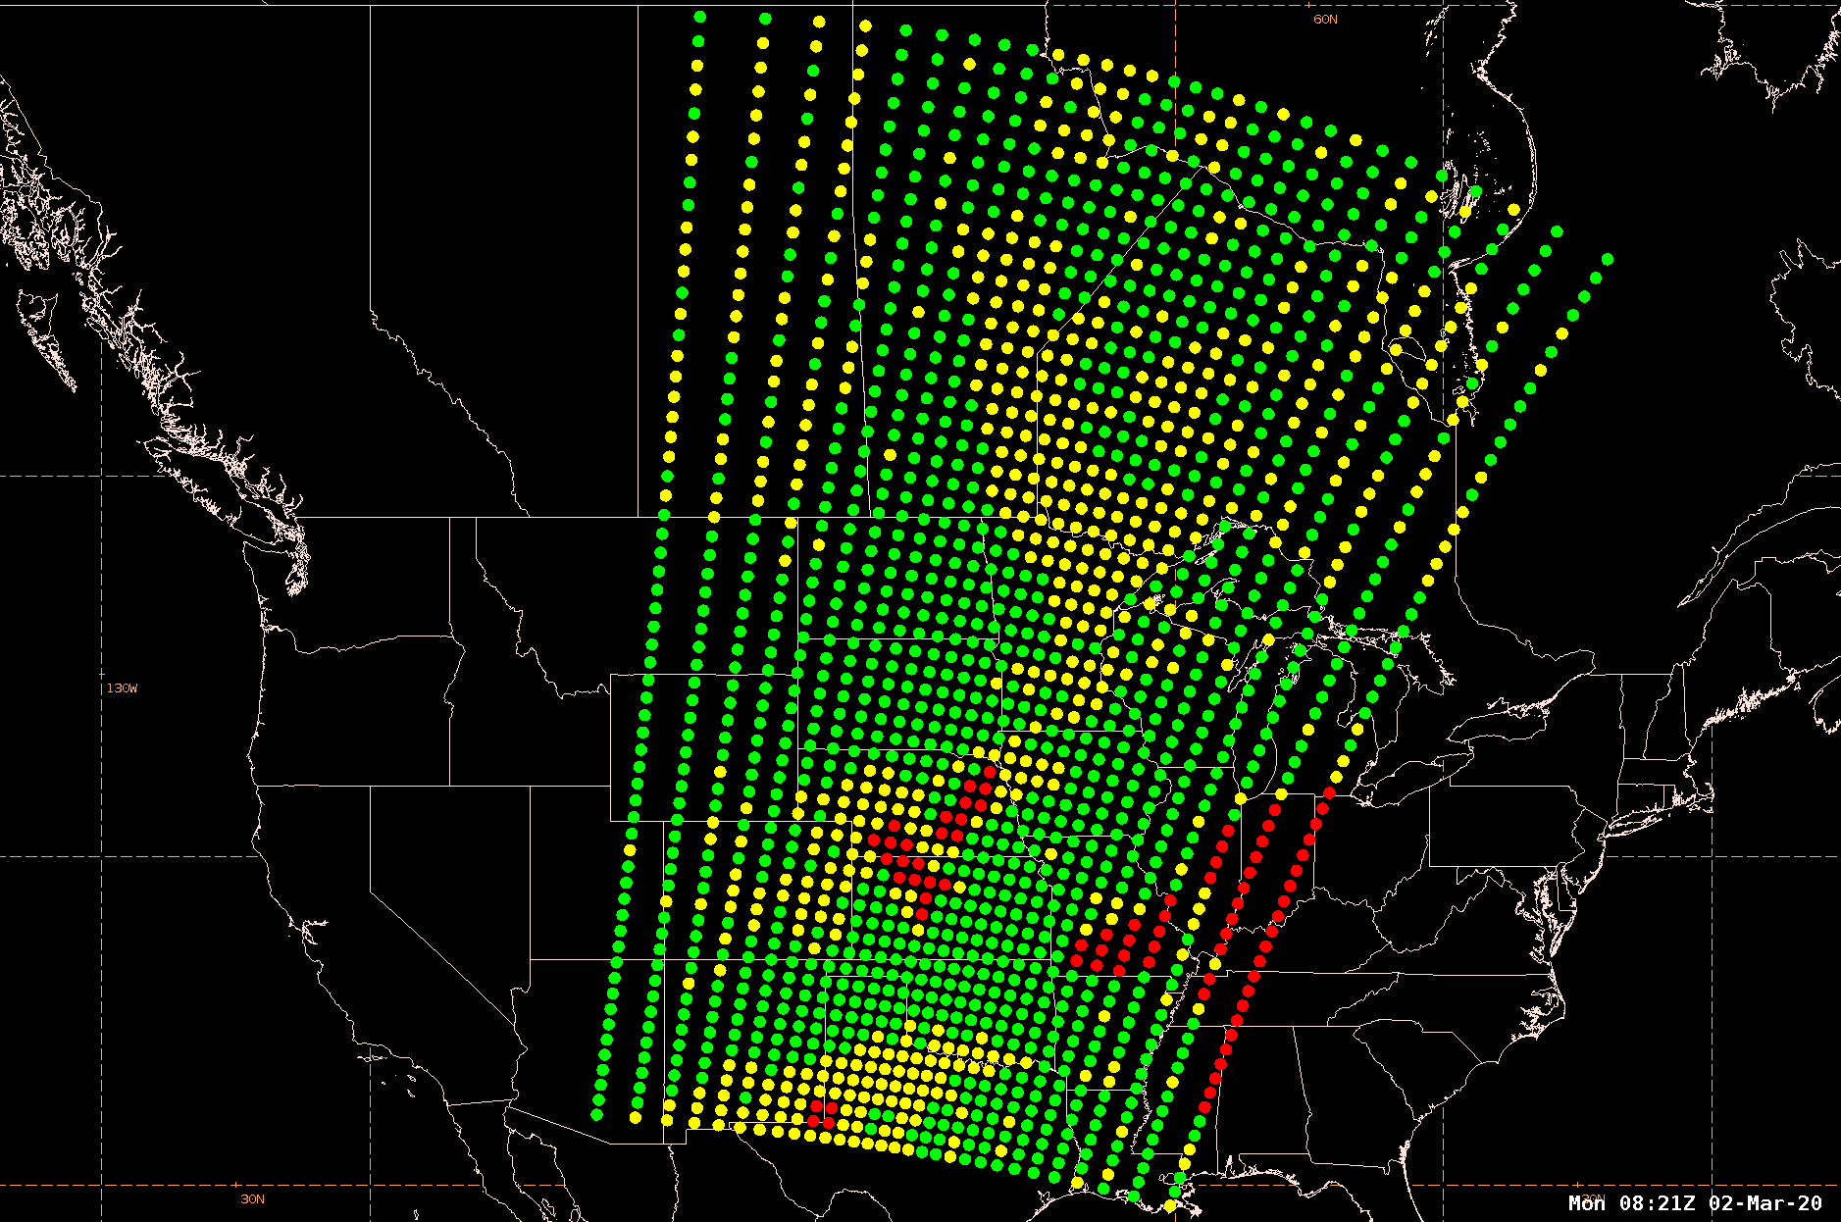
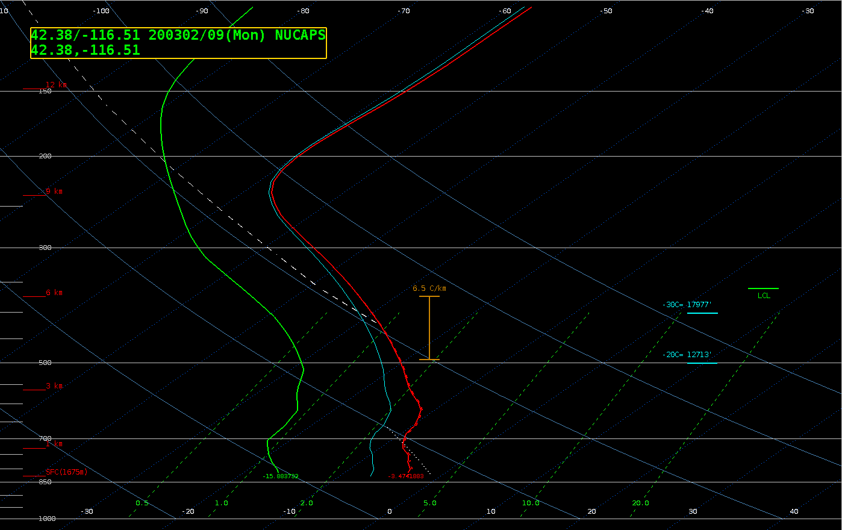
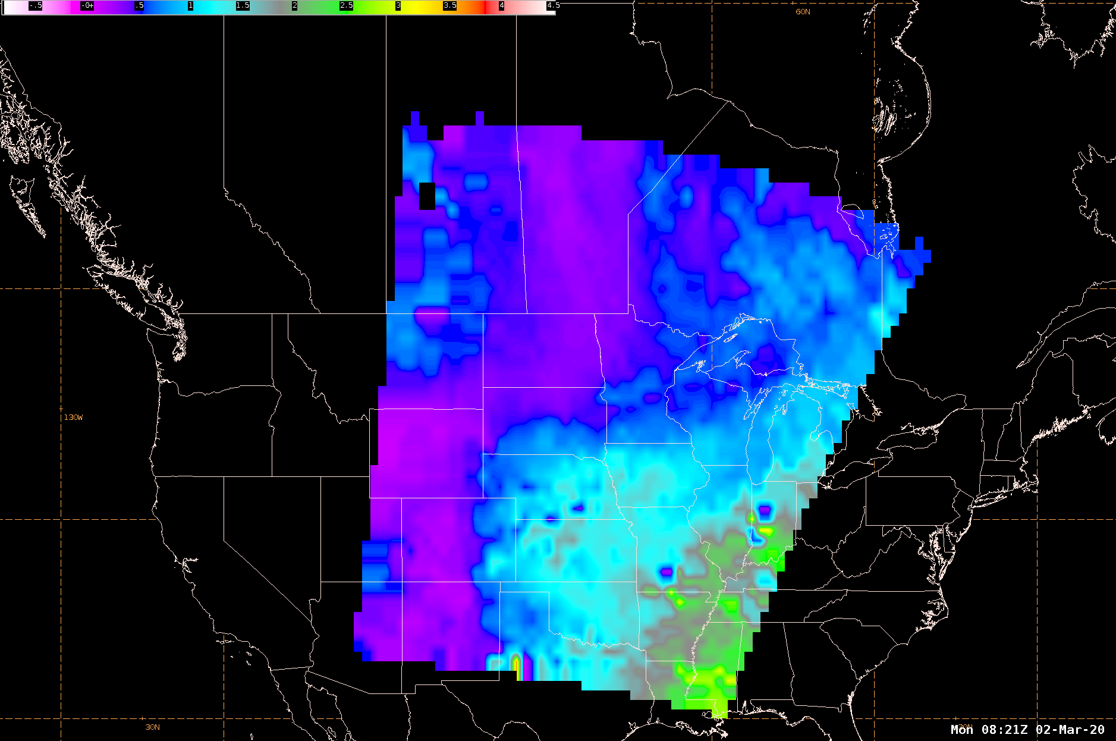
NUCAPS
Presented by Emily Berndt (NASA) and
Rebekah Esmaili (STC)
NUCAPS Locations
NUCAPS
Skew-T
Gridded
NUCAPS

Slide 35
NUCAPS Summary
Section prepared by Emily Berndt and Rebekah Esmaili
NUCAPS vertical soundings are used to assess the presence of moist or dry layers, especially between radiosonde observations.
NUCAPS plan view fields (i.e. Gridded NUCAPS) are used to assess the context of warm, dry conditions favorable for increased wildfire risk.
NUCAPS excels at identifying spatial gradients for the analysis of features such as a Low-Level Thermal Trough.
Derived fields from NUCAPS such as the Haines Index and Total Precipitable Water add value to the verification of model forecasts.
Suggested Analysis Fields: Vertical Soundings, Plan-view temperature, relative humidity, TPW, Haines Index, Lapse Rates
NUCAPS trace gases, especially CO, can be used to monitor thick smoke at 500 mb and above both day/night

Slide 36

How to interpret NUCAPS relative to other sources
RADIOSONDES | NUCAPS | GOES LAP
Point-source measurement | Averaged columnar measurement that can be interpreted as a stack of many thick layers | Averaged columnar measurement that can be interpreted as a stack of only 1-2 layers
Launched from specific Lat/Lon | Represents 50km (nadir) to 150km (edge of scan) | 10 km resolution
Detailed vertical structure | High vertical structure with details smoothed out (i.e smoother than radiosondes), but more structured than GOES LAP products | Very smooth vertical structure
Model independent | Model independent; statistical regression as first guess | Model dependent; GFS as first guess
Single sounding observations at 1200 and 0000 UTC | Spatially dense swath of sounding observations at overpass times… SNPP – 1:30am/pm, NOAA-20 – 50mins after SNPP | High temporal frequency products (30 mins)
NUCAPS soundings provide environmental context for radiosondes.
High vertical resolution NUCAPS observations verify GOES LAP products.

Slide 37
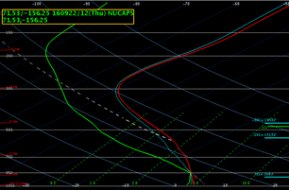
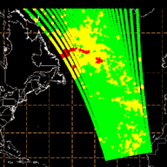
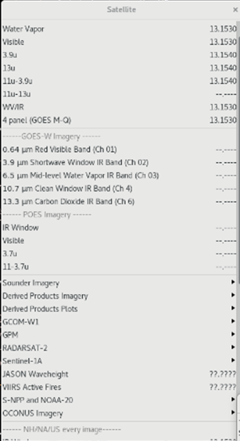
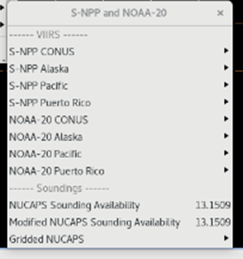
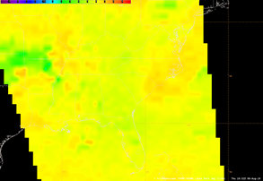
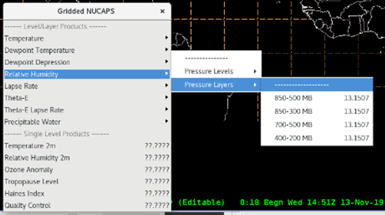
NUCAPS in AWIPS-II

Slide 38
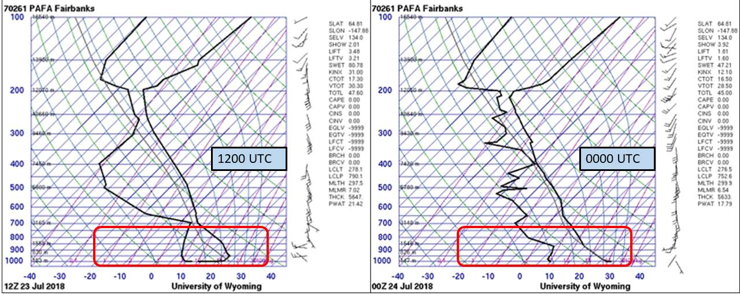
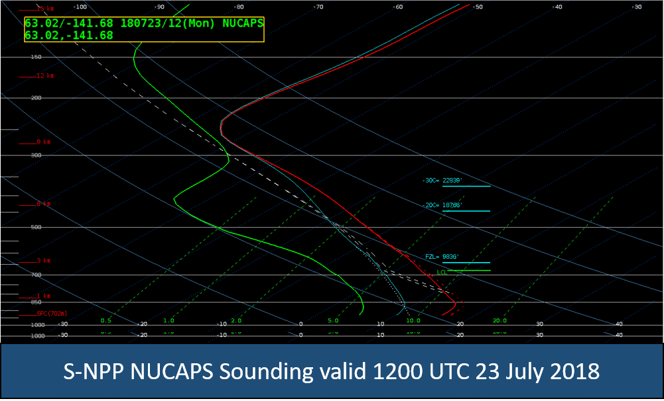
Fire Weather Example: Taixsalda Hill Fire in Alaska
The 1200 UTC Fairbanks Radiosonde indicates dry conditions just above the surface and significantly drier air at mid-levels.
By 0000 UTC, the near-surface layer was much warmer and drier.
A NUCAPS Sounding near Northway, AK, about 250 miles away from Fairbanks, indicates drier air throughout the atmospheric column. Either 700 mb conditions are drier at Northway or NUCAPS has missed the fine detail of the moisture signature. Analysis of plan view fields can help assess the spatial gradients rather than interrogating individual soundings.

Slide 39
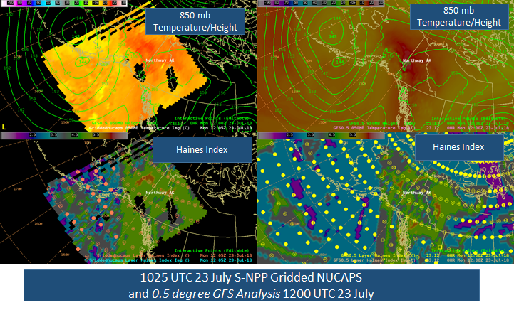
Fire Weather Example: Taixsalda Hill Fire in Alaska
•Gridded NUCAPS 850 mb temperatures compared to GFS, indicate a region of higher temperatures in southern AK and near Northway
•The AWIPS-derived Haines Index indicates a moderate potential for fire growth
•The Gridded NUCAP spatial pattern for temperature and Haines Index match the GFS analysis

Slide 40
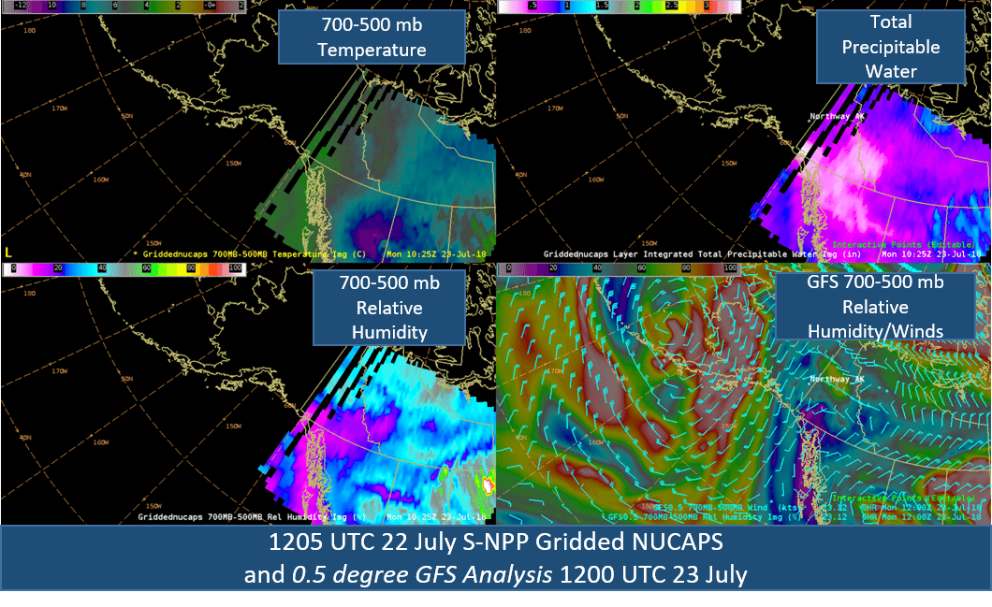
Fire Weather Example: Taixsalda Hill Fire in Alaska
•Assessing Gridded NUCAPS fields over a layer can be valuable.
•Warmer 700-500 mb temperatures and lower precipitable water values were present over southern Alaska
•The warmer, drier air persisted into 23 July as the fire began
•Compared to the GFS analysis, Gridded NUCAPS captured the spatial gradients in relative humidity

Slide 41
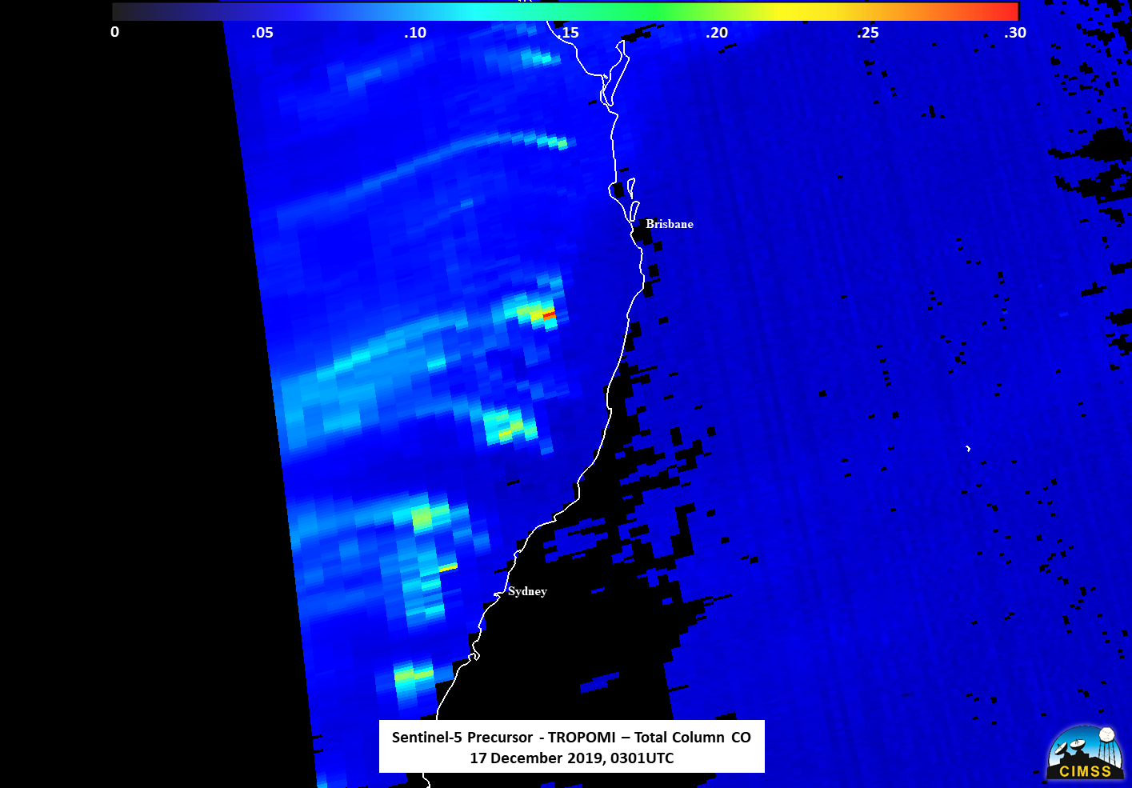
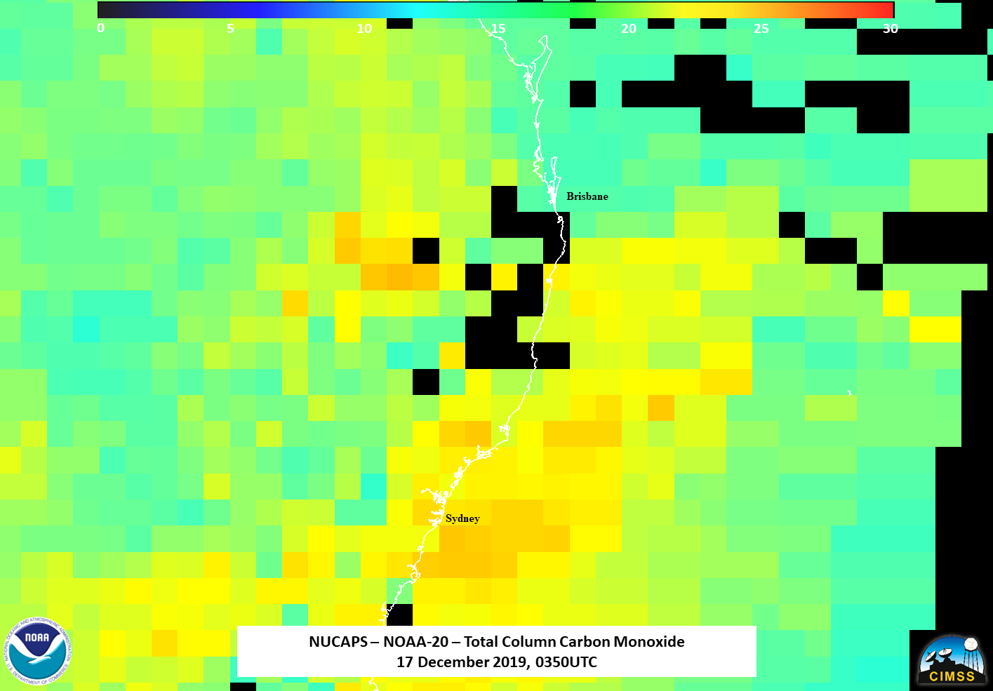
Gridded NUCAPS Example - Australia (CO)
Note that CO and Methane retrievals peak and have the most skill at about 500 mb. Therefore if the smoke is below ~500 mb, there may not be a trace gas signal in the NUCAPS retrieval.
Real-time trace gas visualization
Additional examples and caveats of using NUCAPS trace gas retrievals are discussed in the 2020 AMS presentation: Monitoring Atmospheric Composition and Long-Range Smoke Transport with NUCAPS Satellite Soundings in Field Campaigns and Operations

Slide 42
Resources
Please refer to list of training links
https://docs.google.com/document/d/1ZErpljgI8Gl36cXX8sA2-jG3Ux4oKMJfoxWsQQvNq2M/edit#

Slide 43
Thank you very much!
Questions

Slide 44
Extra slides

Slide 45
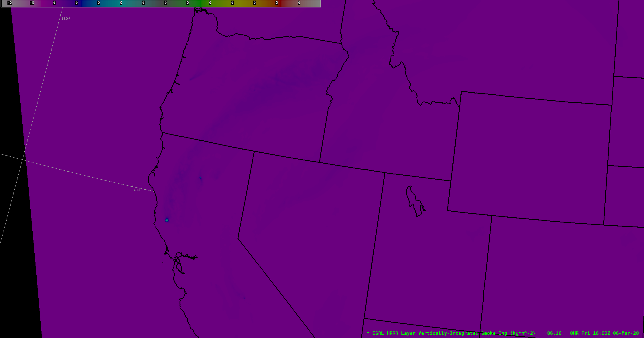
HRRR in AWIPS Example

