Slide 1




Understanding GOES-16 and -17
Advanced Baseline Imager (ABI) Data Files
Dr. Amy Huff, IMSG at NOAA/NESDIS/STAR
GOES-R/JPSS Hands-On Training to Process, Display, and Analyze Satellite Data Products
2021 AMS Sponsored Short Course Virtual Sessions
March 18, 2021

Slide 2
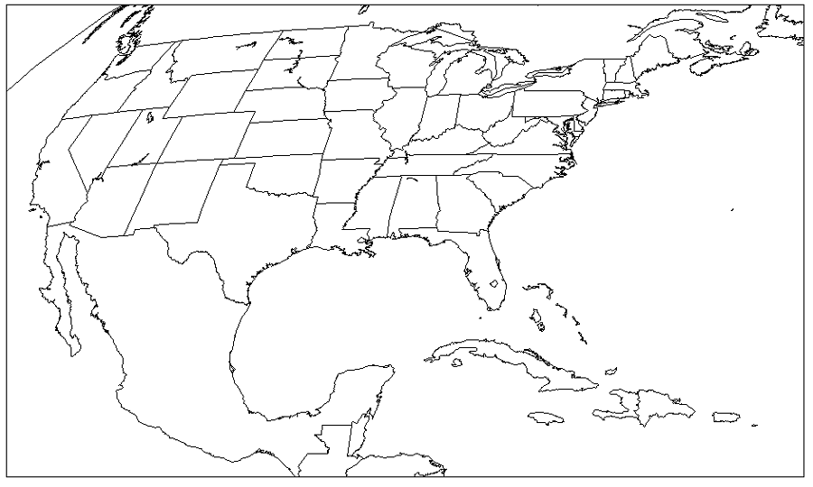
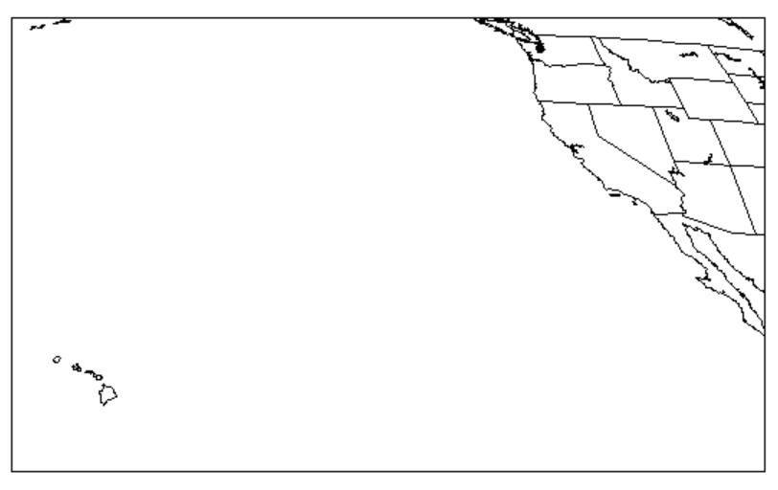
ABI Data File Classification
ABI data are classified by the following characteristics:
  Data processing level
    Level 1b (L1b) – channel 1-16 radiances
    Level 2 (L2) – products derived from radiances
  Product name (see slides 4, 6-7)
  Scan sector
    Full Disk (F) – full hemispheric disk (GOES-16 centered 75.2 °W,
    GOES-17 centered 137.2 ° W)
    CONUS (C) – subset of full disk covering CONUS (GOES-16) or
    PACUS (GOES-17) (3000 x 5000 km)
    Mesoscale (M) – two zoom-in regions adjusted based on current
    hazards (1000 x 1000 km)
  Scan mode
    M6 – flex mode; default since 4/2/19 (F every 10 min, C every 5 min, 2-M every 1 min)
    M3 – previous flex mode (F every 15 min, C every 5 min, 2-M every 1 min)
    M3G – GOES-17 cooling mode (F every 15 min, 2-M every 2 min, no C)
    M4 – continuous full disk (F every 5 min; no C or M)
  Satellite:
    GOES-16 – current GOES-East
    GOES-17 – current GOES-West
GOES-16 CONUS sector
GOES-17 PACUS sector
Figures courtesy of NOAA OSPO

Slide 3
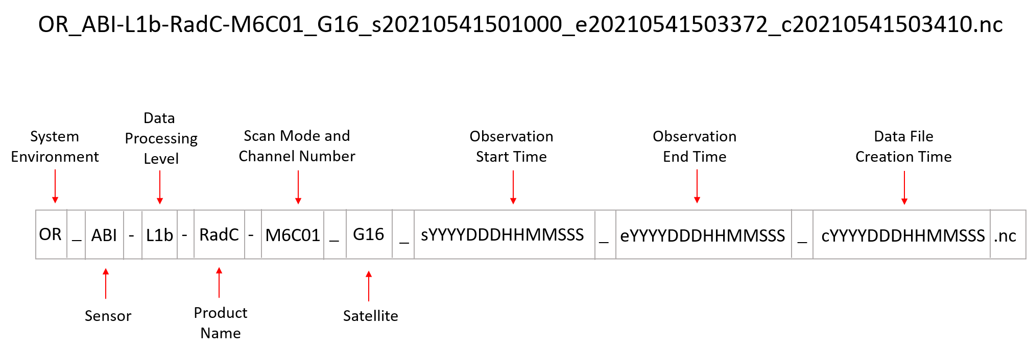
Decoding ABI L1b Data File Names (Channel 1-16 Radiances)
System Environment: Operational system using Real-time data
Sensor: Advanced Baseline Imager
Data Processing Level: Level 1b
Product Name: RadC; also RadF, RadM
Scan Mode: Mode 6 (current “flex mode”); also M3, M4
Channel Number: Channel 01; also 02, 03, 04, 05, 06, 07, 08,
09, 10, 11, 12, 13, 14, 15, 16
Satellite: GOES-16; also G17
Observation start/end, file creation time:
  YYYY (4-digit year, e.g. 2021)
  DDD (3-digit Julian day, e.g. 054)
  HHMM (4-digit hour/minutes in UTC, e.g. 1501)
  SSS (3-digit seconds to tenth of second)
.nc extension: indicates Network Common Data Format (netCDF) version 4 file

Slide 4
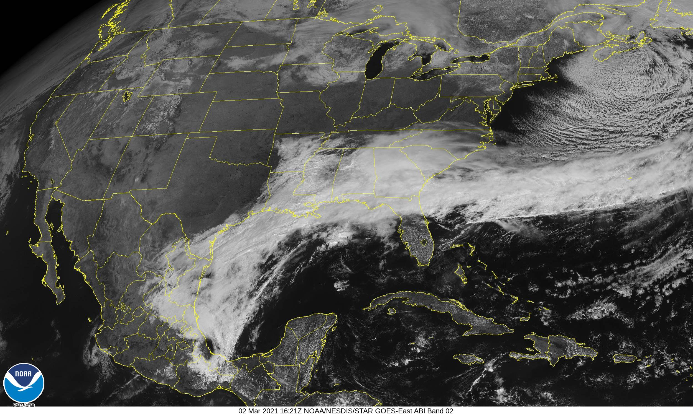
ABI L1b Product Names (Channel 1-16 Radiances)
Radiances:
  RadF
  RadC
  RadM
Scan Sector Abbreviations
F = Full Disk
C = CONUS
M = Mesoscale
Example: “RadC” Channel 2 from NOAA's GOES Image Viewer website
Link to detailed information on ABI L1b and L2 products, including “read me” docs

Slide 5
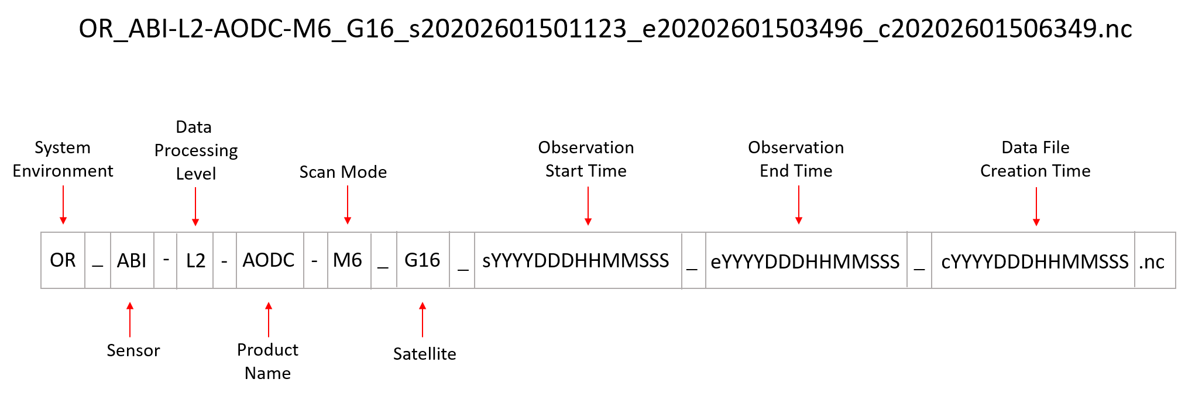
Decoding ABI L2 Data File Names (Derived Products)
System Environment: Operational system using Real-time data
Sensor: Advanced Baseline Imager
Data Processing Level: Level 2
Product Name: see list on Slides 6-7 (e.g., AODC)
Scan Mode: Mode 6 (current “flex mode”); also M3, M4
Satellite: GOES-16; also G17
Observation start/end, file creation time:
  YYYY (4-digit year. e.g. 2020)
  DDD (3-digit Julian day, e.g. 260)
  HHMM (4-digit hour/minutes in UTC, e.g. 1501)
  SSS (3-digit seconds to tenth of second)
.nc extension: indicates Network Common Data Format (netCDF) version 4 file

Slide 6
ABI L2 Product Names (Derived Products)
Aerosol Detection:
  ADPF
  ADPC
  ADPM
Aerosol Optical Depth:
  AODF
  AODC
Clear Sky Masks:
  ACMF
  ACMC
  ACMM
Cloud and Moisture Imagery:
  CMIPF
  CMIPC
  CMIPM
Cloud and Moisture Imagery Multiband:
  MCMIPF
  MCMIPC
  MCMIPM
Cloud Optical Depth:
  CODF
  CODC
Cloud Particle Size Distribution:
  CPSF
  CPSC
  CPSM
Cloud Top Height:
  ACHAF
  ACHAC
  ACHAM
Cloud Top Phase:
  ACTPF
  ACTPC
  ACTPM
Cloud Top Pressure:
  CTPF
  CTPC
Scan Sector Abbreviations
F = Full Disk
C = CONUS
M = Mesoscale
Link to detailed information on ABI L1b and L2 products, including “read me” docs

Slide 7
ABI L2 Product Names, continued
Cloud Top Temperature:
  ACHTF
  ACHTM
Derived Motion Winds:
  DMWF
  DMWC
  DMWM
Derived Stability Indices:
  DSIF
  DSIC
  DSIM
Downward Shortwave Radiation:
  DSRF
  DSRC
  DSRM
Fire/Hot Spot Characterization:
  FDCF
  FDCC
Land Surface Temperature (Skin):
  LSTF
  LSTC
  LSTM
Legacy Vertical Moisture Profile:
  LVMPF
  LVMPC
  LVMPM
Legacy Vertical Temperature Profile:
  LVTPF
  LVTPC
  LVTPM
Rainfall Rate/QPE:
  RRQPEF
Reflected Shortwave Radiation:
  RSRF
  RSRC
Sea Surface Temperature:
  SSTF
Total Precipitable Water:
  TPWF
  TPWC
  TPWM
Volcanic Ash (Detection and Height):
  VAAF
Scan Sector Abbreviations
F = Full Disk
C = CONUS
M = Mesoscale

Slide 8
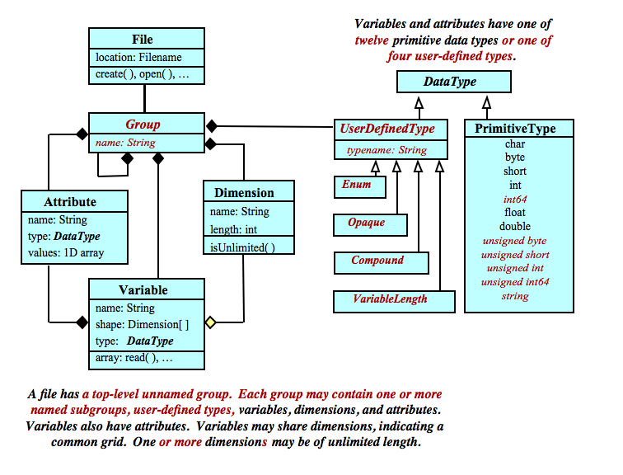
Structure and Content of netCDF Files
netCDF is a set of software libraries and data formats for creation, access, and sharing of array-oriented scientific data
netCDF files have a common organizational structure:
  Top-level group (“root group”)
  Contents organized by optional sub-groups
  Data organized as variables
  Groups and variables have
    Attributes (descriptive information)
    Dimensions
  Attributes and variables have data types
  Common data types you may encounter in satellite files:
    String (str)
    Integer (int)
    Unsigned integer (uint)
    Floating point number (float)
In an ABI data file, the data we want to work with (e.g., radiances) are variables
Image courtesy of Unidata

Slide 9
Example: Variables for L1b Data File
variables(dimensions): int16 Rad(y, x), int8 DQF(y, x), float64 t(), int16 y(y), int16 x(x),…
This is an excerpt of the list of variables in an ABI L1b radiances (RadC) data file
Key data variables are bolded:
  Rad (ABI radiance)
  y (GOES fixed grid projection y-coordinate in radians)
  x (GOES fixed grid projection x-coordinate in radians)
Notice that each variable name is preceded by its data type and followed by its dimensions in parentheses

Slide 10
Example: Variables for ABI L2 AOD Data File
variables(dimensions): uint16 AOD(y,x), uint8 DQF(y,x), uint16 AE1(y,x), uint16 AE2(y,x), uint8 AE_DQF(y,x), float64 t(), int16 y(y), int16 x(x), …
This is an excerpt of the list of variables in an ABI L2 aerosol optical depth (AODC) data file
We’ll have a chance to look at the full list of variables in Hands-On Exercise 6
Key data variables are bolded:
  AOD (aerosol optical depth, a quantitative measure of amount of aerosols in atmospheric column)
  DQF (data quality flags, used to select high, medium, or low quality AOD data)
  y (GOES fixed grid projection y-coordinate in radians)
  x (GOES fixed grid projection x-coordinate in radians)
Notice that each variable name is preceded by its data type and followed by its dimensions in parentheses

Slide 11
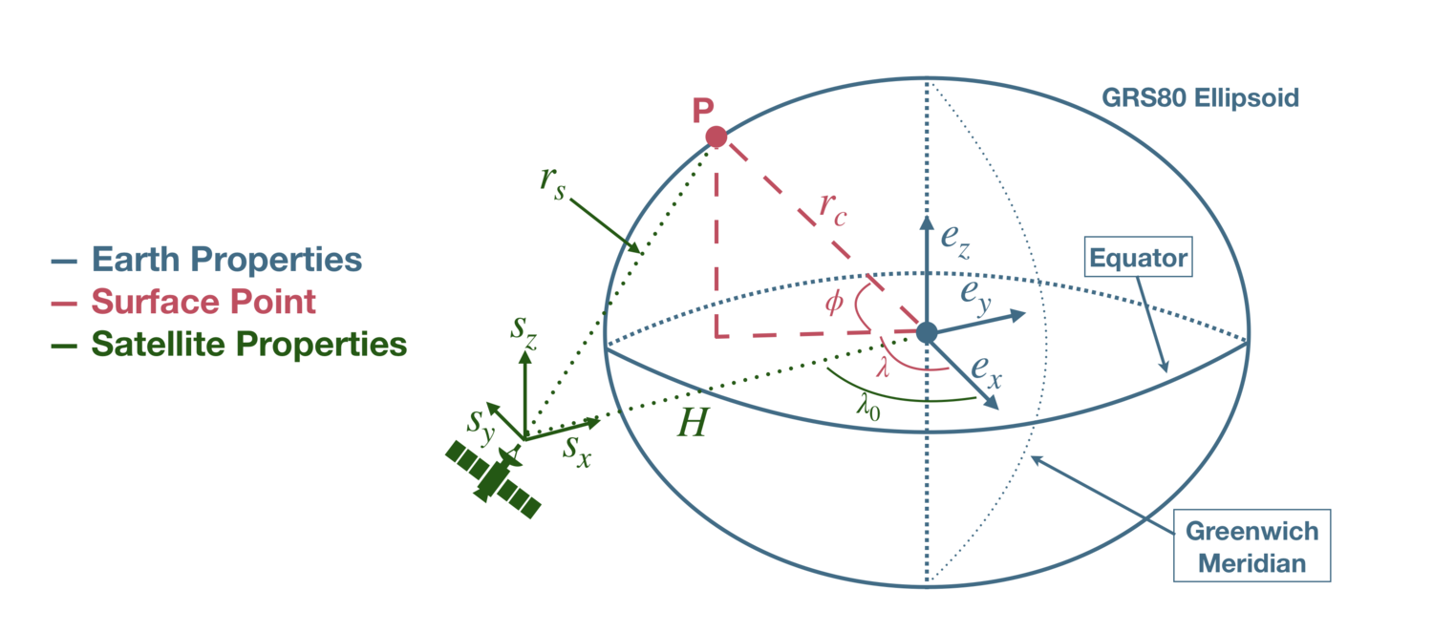
GOES ABI Fixed Grid
To save file space, ABI L1b and most L2 data files do NOT include latitude and longitude as variables
Instead, the files contain information on the GOES ABI fixed grid, which is a projection based on the viewing perspective of the GOES-16 or GOES-17 satellite
If we want to plot ABI data on a map projection, we need to use the GOES fixed grid information to calculate latitude and longitude in units of degrees!
  We will do this calculation in Hands-On Exercise 7
  ABI data files contain all the necessary information:
    “x” (fixed grid E/W scan angle in radians)
    “y” (fixed grid N/S scan angle in radians)
    Several constants (e.g., H, λ₀)
Details about the fixed grid and examples of the calculation of latitude and longitude are given in the GOES-R Product User Guides (PUG):
  Volume 3, L1b products: Section 5.1.2
  Volume 5, L2 products: Section 4.2
This blog by Joshua Hrisko also has a nice summary of the theory and math behind the calculation
We will calculate φ (latitude) and λ (longitude) for point P given information about the fixed grid (constants) and “x” and “y” variables
Image courtesy of Joshua Hrisko, based on diagram in GOES-R PUG
Notes:
The ABI fixed grid is the projection associated with the data in the ABI Level 1b Radiances products, and all the ABI Level 2+ products except for the Derived Motion Winds, Hurricane Intensity, Downward Shortwave Radiation: Surface, and Reflected Shortwave Radiation: Top-Of-Atmosphere products.

Slide 12
ABI Data File Access
The primary archive to access ABI data files is NOAA’s Comprehensive Large Array-Data Stewardship System (CLASS)
  Registration (free!) is required to order data
  Tutorials from our group on how to register, search for and order data:
    Slide tutorial
    Video tutorial on YouTube
NOAA’s Big Data Program is providing a new, easier way to access ABI data files in the “cloud”!
We will access ABI data files using the Amazon Web Services (AWS) open data registry of GOES-16 and GOES-17 data with Python in Hands-On Exercise 5
  GOES-16 “bucket”: https://noaa-goes16.s3.amazonaws.com/index.html
  GOES-17 “bucket”: https://noaa-goes17.s3.amazonaws.com/index.html
    Search manually:
      Click on data product abbreviation (see slides 4, 6-7)
      Then click on year, Julian day, hour of interest
      List of data files – click on individual file name to download file

Slide 13
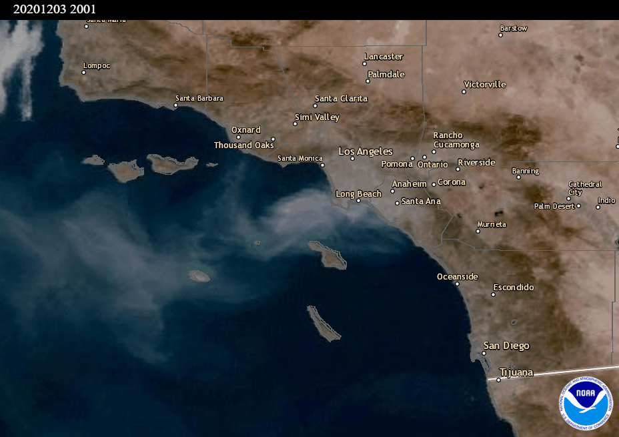
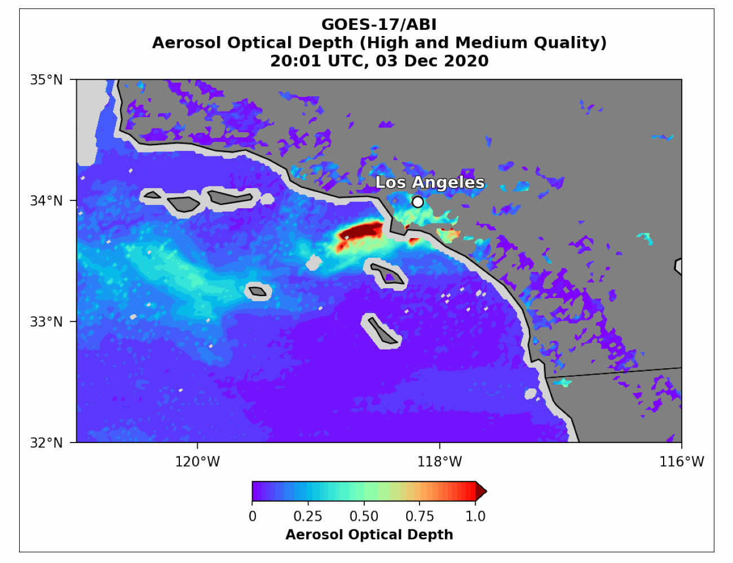
Hands-On with Python
GOES-17 ABI GeoColor
We will use Python to get hands-on with ABI data files!
Case study example:
GOES-17 ABI data, December 3, 2020, 20:00-20:30 UTC
  Smoke from Airport and Bond wildfires, near Los Angeles
  We will work with L2 aerosol optical depth CONUS view (AODC) data files, as an example of ABI data files
Hands-on Exercise 5: Download ABI data files from AWS
Hands-on Exercise 6: Open, explore, and read the metadata of an ABI data file
Hands-on Exercise 7: Process and visualize ABI data
BONUS: Create an animation of multiple graphics files
GeoColor animation from the AerosolWatch website

Slide 14
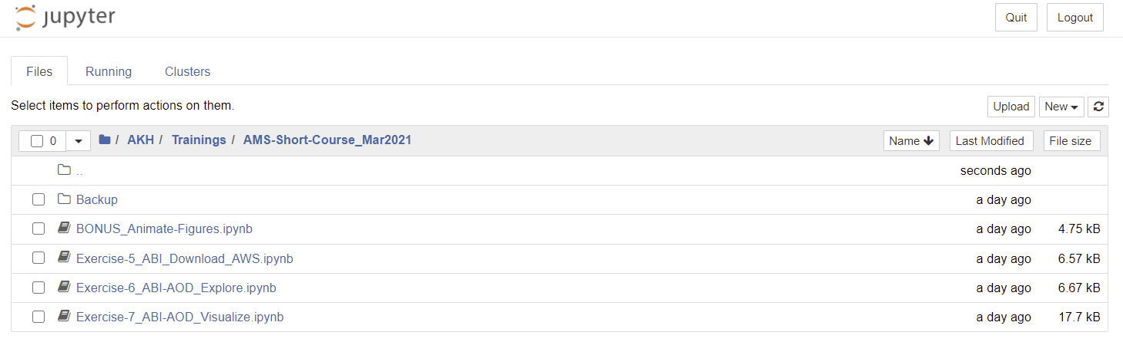
Logistics for Python Hands-On Exercises
Attendees who want to participate in the Python hands-on exercises should have downloaded the 4 provided code files and uploaded them into a folder on Jupyter Notebook, as shown above
If you don’t have Anaconda/Jupyter Notebook on your computer, you can just follow along as I go through the files and demonstrate the code
Full annotation and explanation of the code is provided via the links on the Short Course Training website
  Note that “Exercise-6” returns information about the ABI file and metadata in a step-by-step fashion, and is best utilized in Jupyter Notebook
  The other 3 code files (“Exercise-5,” “Exercise-7,” “BONUS”) are more traditional “programs” and can be used in Jupyter Notebook or converted to .py files and run in Spyder or other Python IDEs

