Slide 1


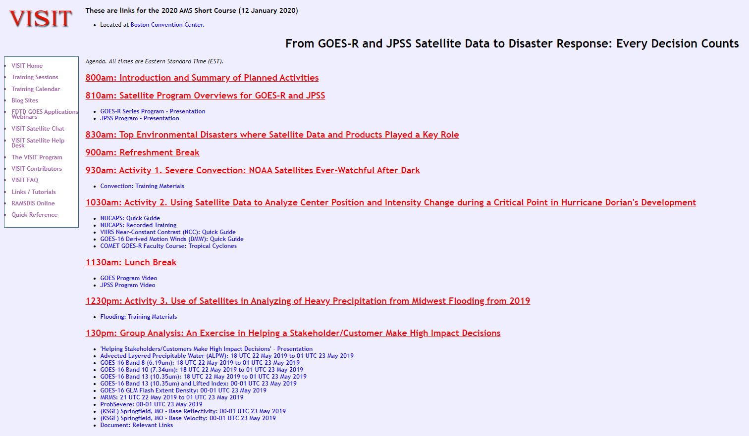
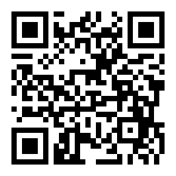
Reminder: Course materials can be found at the following link:
https://tinyurl.com/2020-AMS-Sat-Short-Course

Slide 2

Please Join Us at these notable events this week!
16th Annual Symposium on New Generation Operational Environmental Satellite Systems (16GOESRJPSS) All Week
Rooms 253 B: Monday – Thursday
Concurrently Room 255 Wednesday – Thursday
Speed Networking Event for Students and Early Career Professionals
Monday 7:30 – 10:00 PM on the Exhibit Level/East Registration (Foyer)
Side Panel Discussion (lunch seminar)
Tuesday Room 235 B (Box lunches will be provided)

Slide 3
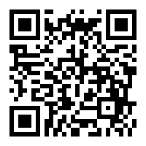
From GOES-R and JPSS Satellite Data to disaster response: every decision counts Short Course Feedback Survey
Please take a moment to share your feedback regarding the “from goes-r and jpss satellite data to disaster response: every decision counts” short course so that we can evaluate our materials to better serve our users in the future by scanning the qr code or visiting this link:
https://tinyurl.com/AMS20SatShortSurvey

