Slide 1


From GOES-R and JPSS Satellite Data to disaster response: every decision counts
100th American Meteorological Society Annual Meeting
Sunday, January 12, 2020
Boston Convention and Exhibition Center, Room 153A

Slide 2

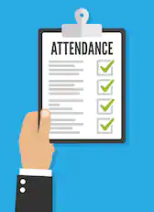


Need To Know:
This session is being recorded
Attendance Sign-In Sheet (please sign-in if you haven’t already)
Emergency Exit
Restrooms

Slide 3
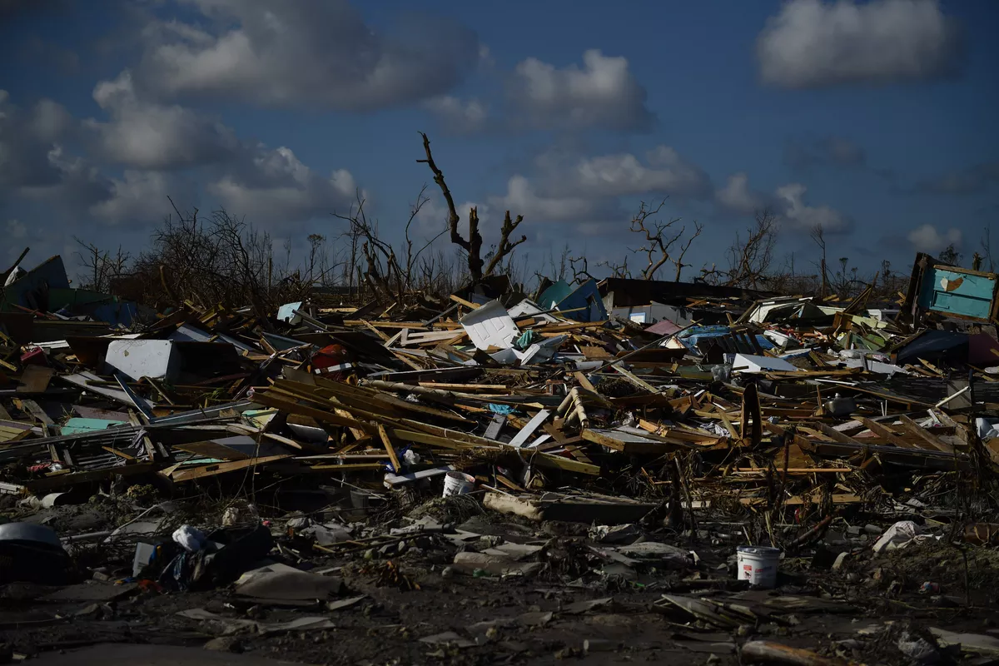
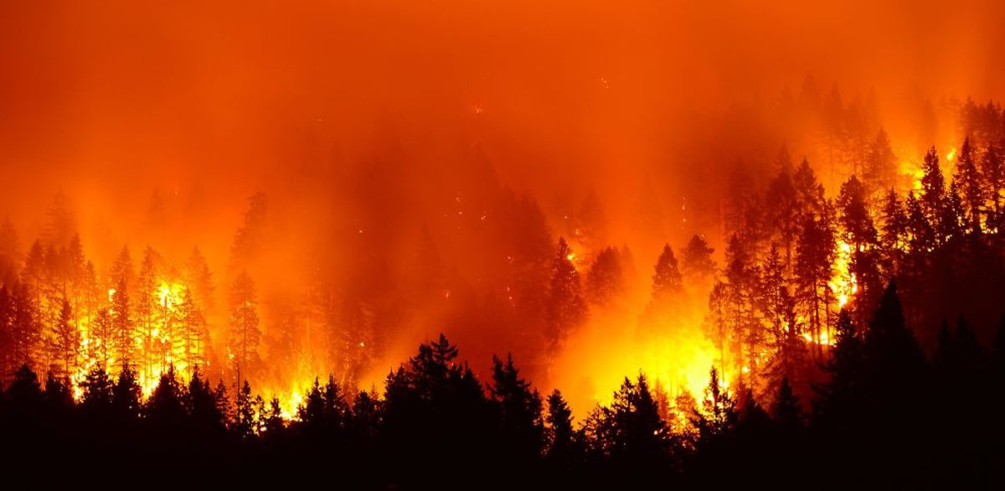
Agenda Outline
8:10 AM Satellite Program Overviews for (20 min)
  Steve Goodman, Senior advisor to GOES-R program
  Mitch Goldberg, JPSS Program Office
8:30 AM TOP ENVIRONMENTAL DISASTERS WHERE SATELLITE DATA AND PRODUCTS
PLAYED A KEY ROLE (30 min)
  William Straka, CIMSS/University of Wisconsin – Madison
9:00 AM Coffee Break (30 Min)

Slide 4
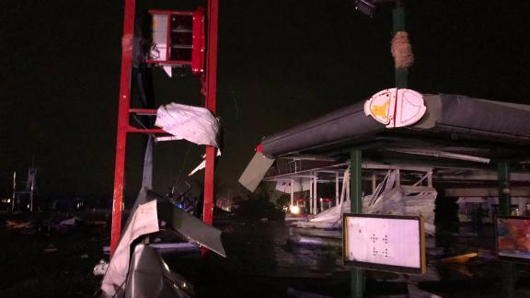
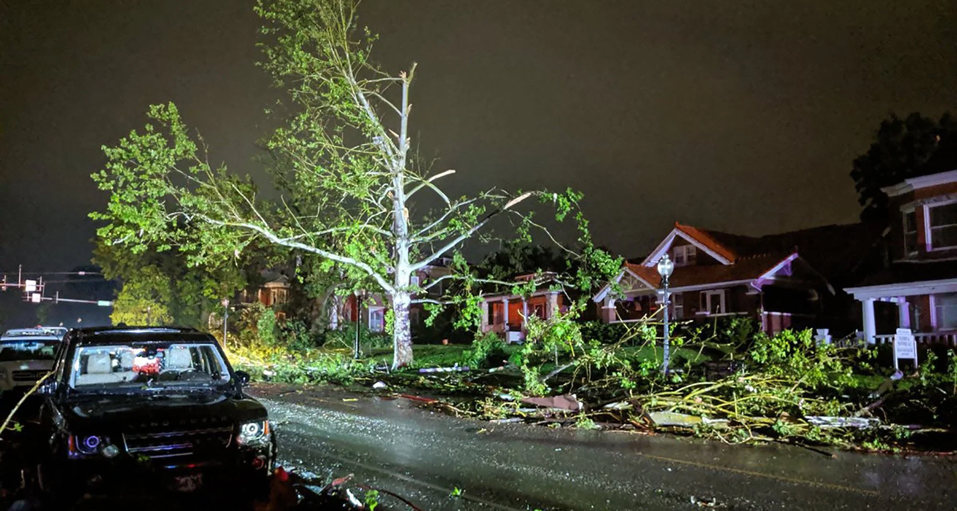
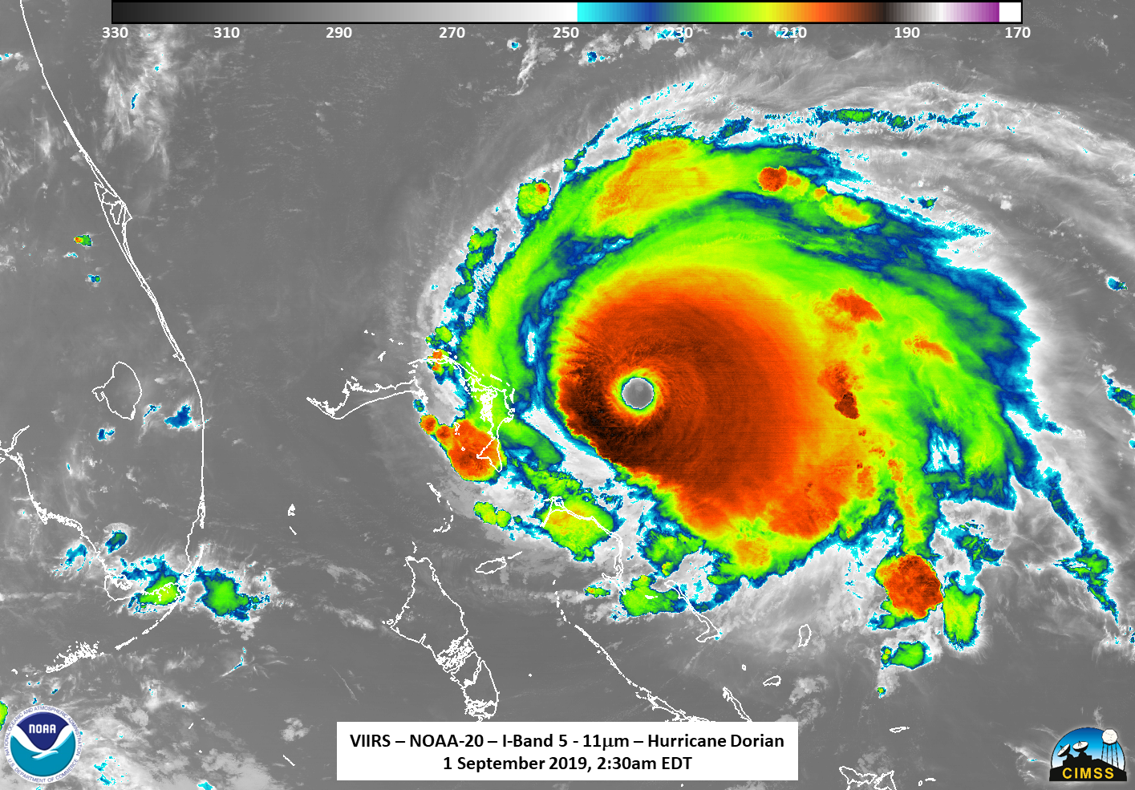
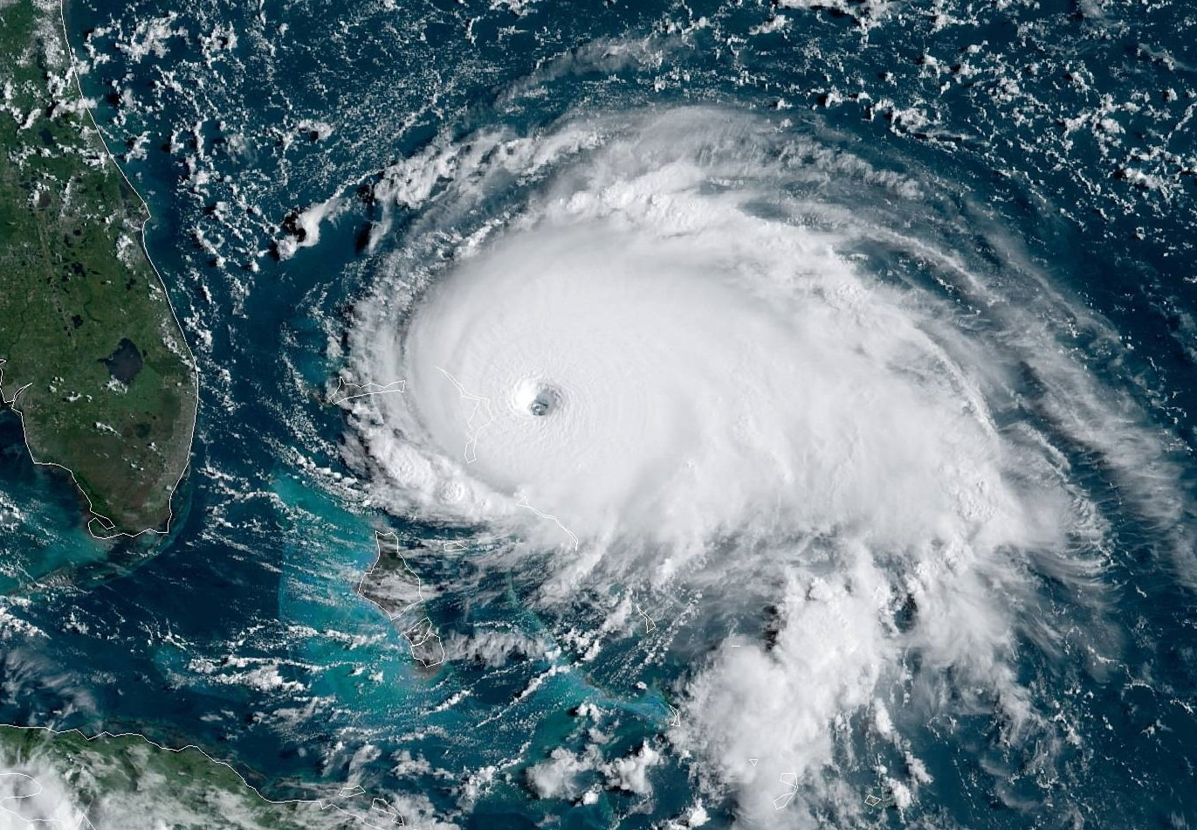
Agenda Outline
9:30 AM ACTIVITY 1: SEVERE CONVECTION: NOAA SATELLITES EVER-WATCHFUL AFTER DARK (1 hr)
  Jonathan Smith, CISESS/UMD
  Steve Goodman, Senior advisor to GOES-R program
  Rebekah Esmaili, STC contractor for JPSS
10:30 AM ACTIVITY 2: USING SATELLITE DATA TO ANALYZE CENTER POSITION AND INTENSITY CHANGE DURING A CRITICAL POINT IN HURRICANE DORIAN’S DEVELOPMENT
  Andrea Schumacher, CIRA/Colorado State University
  Kate Musgrave, CIRA/Colorado State University
  Chris Slocum, NESDIS/STAR
Notes:
Activity 1: What products can you use at night-time to ascertain the likelihood of severe weather? Students will be led through an exercise of a severe weather event from May 2019 and will use ProbSevere, ABI Bands (and level 2 products), ABI RGBs, GLM and NUCAPS data to diagnose where convection might be most likely.
Activity 2: Aircraft reconnaissance is currently on its way to investigate TS Dorian and forecasters believe there has been an unexpected shift in center location since the last advisory. You’ll be the forecasters in charge of analyzing the latest satellite data to help direct the aircraft to the current center and analyze intensity change at this this critical point in future-Hurricane Dorian’s development.

Slide 5

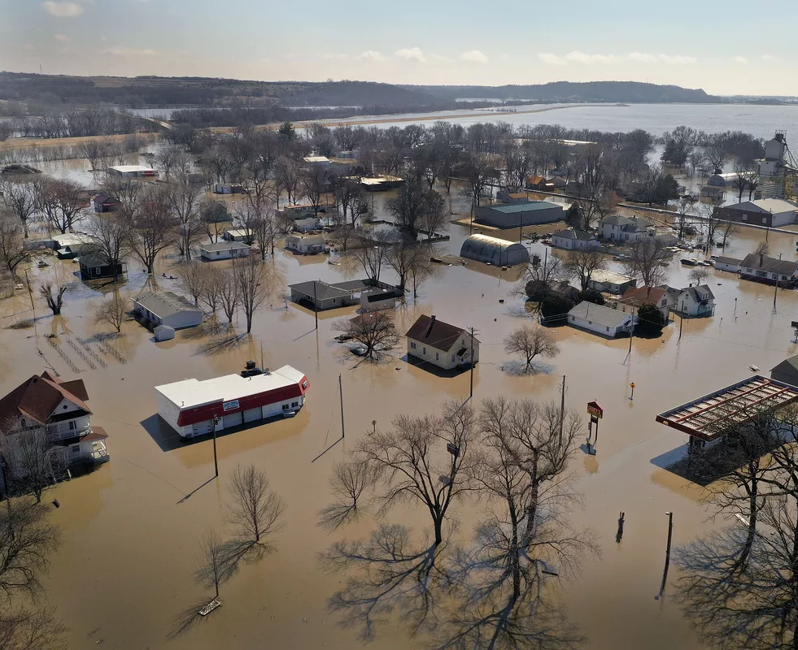
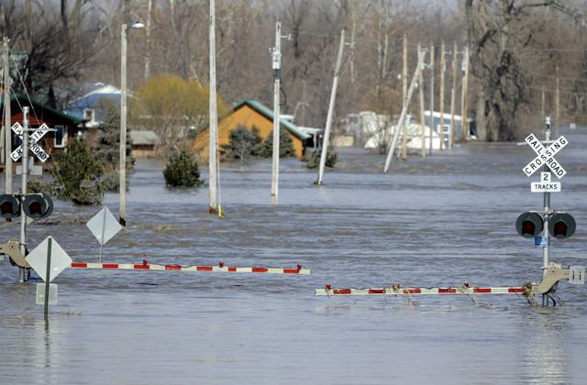
Agenda Outline
11:30 AM Lunch Break (1 hr)
  Boxed lunch is provided and will be delivered to the back of the room.
  Optional Lunch Presentations:
    The Promise of GOES-R (video)
    The Promise of JPSS (video)
    Real-Time Access and Synchronous Sharing of NOAA JPSS &amp; GOES Data into Decision Making Environments: Some examples of Putting NOAA Data to Work (demo)
12:30 PM ACTIVITY 3: USE OF SATELLITES IN ANALYZING OF HEAVY PRECIPITATION FROM MIDWEST FLOODING FROM 2019 (1 hr)
  William Straka, CIMSS/University of Wisconsin – Madison
Notes:
Activity 3: What products can you use to ascertain the likelihood of where heavy precipitation is going to occur or how can you determine where to direct resources as snow melts causing large areas of flooding? Students will be lead through an event where late Spring snow storm followed by convection lead to flooding along a major river in the United States, utilizing tools that can help show where heavy precipitation is likely to occur, how much moisture is contained in snow and
showing where the flooding occurred.

Slide 6

Agenda Outline
1:30 PM GROUP ANALYSIS: AN EXERCISE IN HELPING A STAKEHOLDER /CUSTOMER MAKE HIGH IMPACT DECISIONS (1 HR)
  Frank Alsheimer, NWS/WFO Columbia, SC
  Bill Sjoberg, GST contractor for JPSS
2:30 PM REFRESHMENT BREAK ( 30 Min)
3:00 PM OUTBRIEF OF GROUP ANALYSIS (30 MIN)
3:30 PM COURSE SUMMARY AND EVALUATION (15 MIN)
  Janel Thomas, STC contractor for GOES-R
3:45 COURSE END
Notes:
Group Analysis: In this exercise, students will be presented with a myriad of satellite data for a convective event. Groups will work together to create a short briefing for a stakeholder/customer on how the event will evolve, and answer direct questions from the stakeholder/customer to help him/her make a specific high-impact decision.

Slide 7
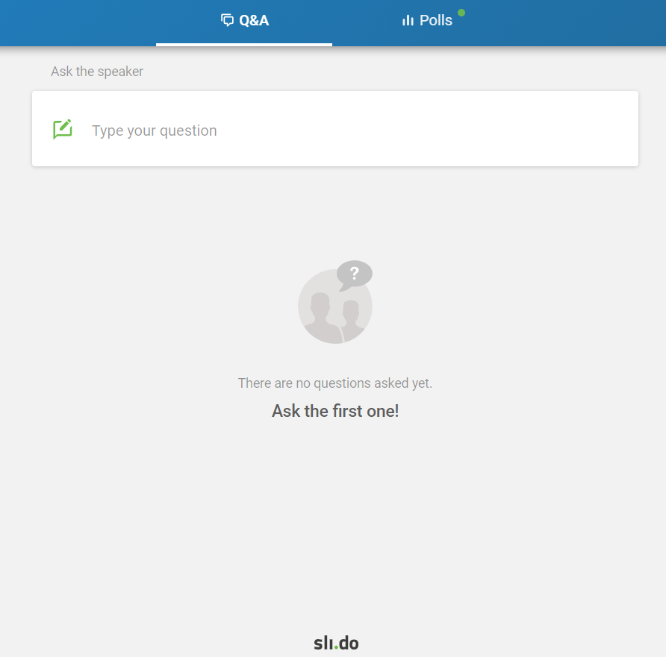
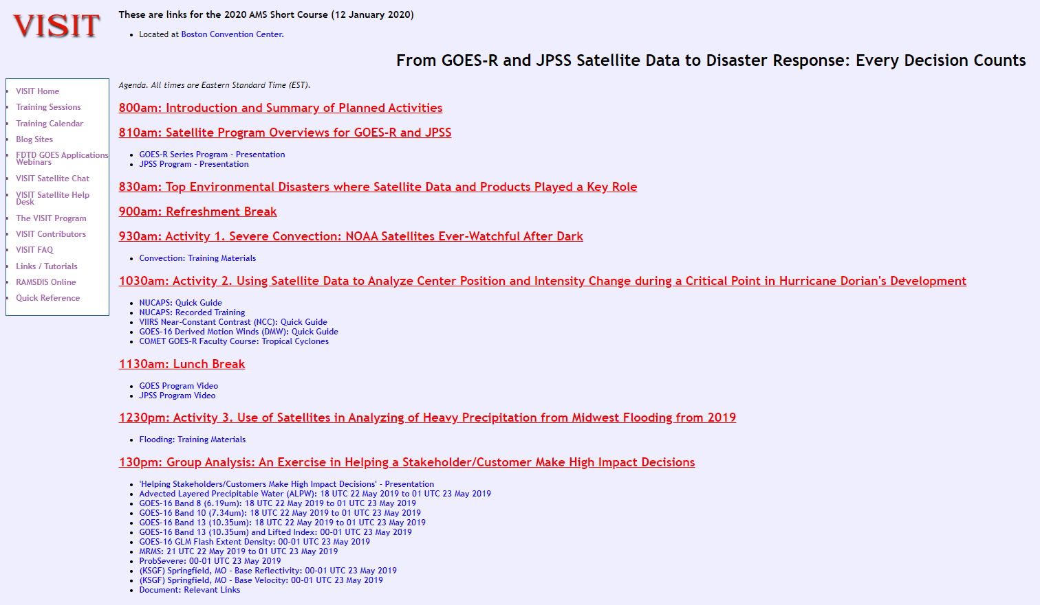
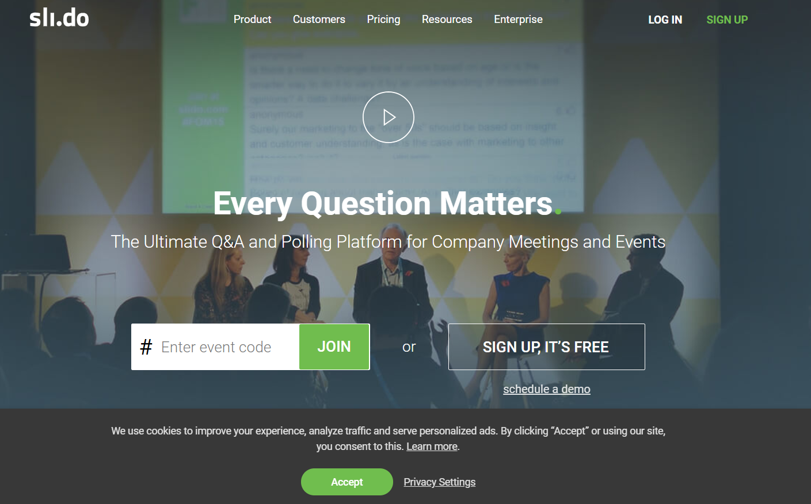
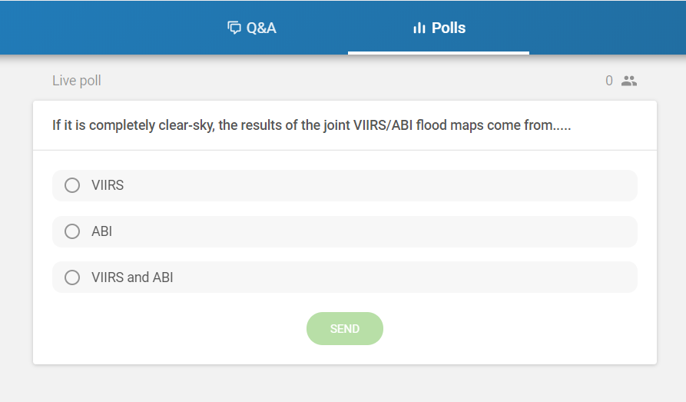
Interactive Polls & Website
https://tinyurl.com/2020-AMS-Sat-Short-Course
https://www.sli.do
Enter Code: #AMS2020SatShort

Slide 8
Notable activities this week:
16th Annual Symposium on New Generation Operational Environmental Satellite Systems (16GOESRJPSS) All Week
  Rooms 253 B: Monday – Thursday
  Concurrently Room 255 Wednesday – Thursday
Speed Networking Event for Students and Early Career Professionals
  Monday 7:30 – 10:00 PM on the Exhibit Level/East Registration (Foyer)
Side Panel Discussion (lunch seminar)
  Tuesday Room 235 B (Box lunches will be provided)
Please Join Us!!!

Slide 9


Celebrate Our Centennial at the
Annual Meeting
Centennial Sessions and Presentations
  Flagged in the mobile app and in the online program
Historical Instruments Display
  In the Exhibit Hall
Birthday Card
  All are welcome to sign
  In the Exhibit Hall
Meteorology/Atmospheric Science Family Tree
  Check it out and add yourself
  In the Poster Hall
AMS Oral History Project
  Share your story in a fifteen-minute interview to become part of the AMS archives
  Email amsoralhistoryproject@ametsoc.org or stop by Elm I&II in the Westin
Centennial Celebration
  Wednesday, 6:30-9pm in the Grand Ballroom

Slide 10


Introductions:
Tell us a little bit about yourself

