Slide 1
Helping Stakeholders/Customers Make High Impact Decisions
Bill Sjoberg
Frank Alsheimer

Slide 2
Objectives of Exercise
Forecast the threat of hazardous weather for a specific event, using satellite products as one of the main data sources.
Brief decisions makers on several aspects of the event, including:
Types of hazardous weather expected.
Timing of onset of hazardous weather.
Timing of ending of hazardous weather.

Slide 3



Thursday, May 23, 2019
Adkins Football Stadium
610 Union St
Jefferson City, Missouri
Doors Open at 5pm, Music Starts at 6pm, Music Ends at 11pm

Slide 4
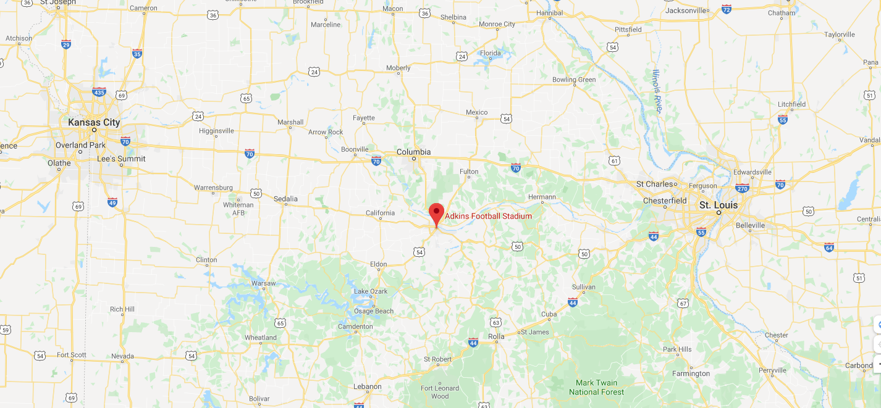
Adkins Football Stadium

Slide 5
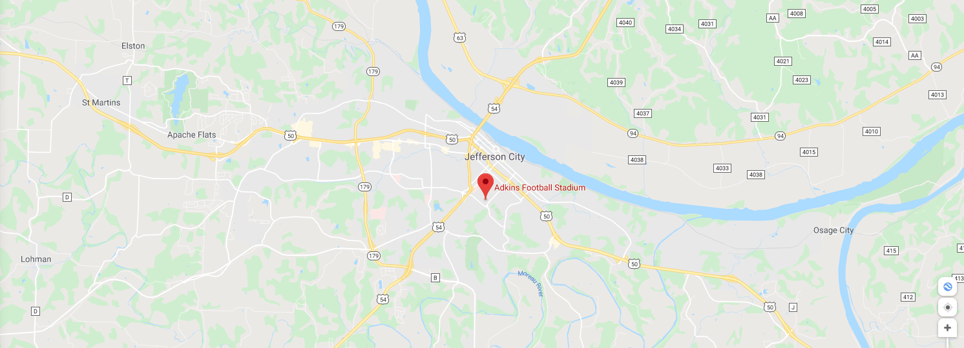
Adkins Football Stadium

Slide 6
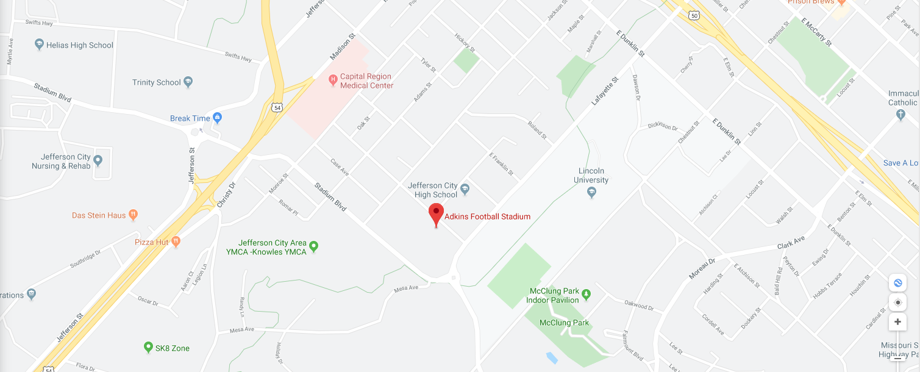
Adkins Football Stadium

Slide 7
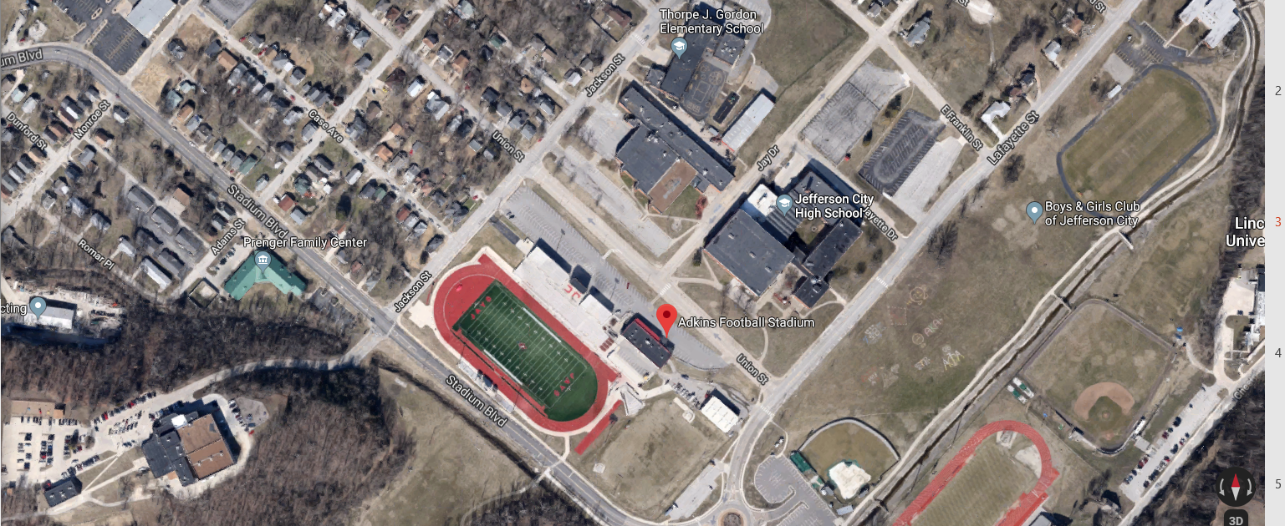
Adkins Football Stadium

Slide 8
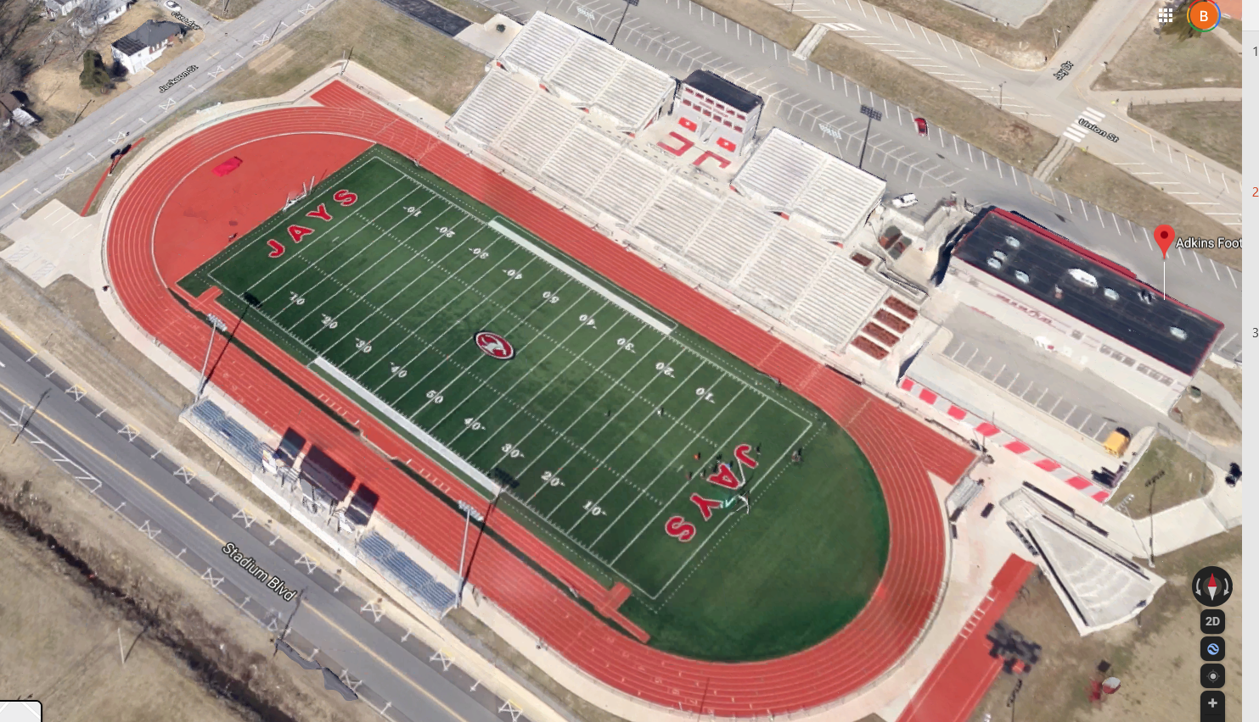
Adkins Football Stadium Concert Set-Up Capacity: 4000 normal – 8000 event
Portable Bleachers
Incident CP
VIP Seating
First Aid
STAGE
Portable Bleachers

Slide 9
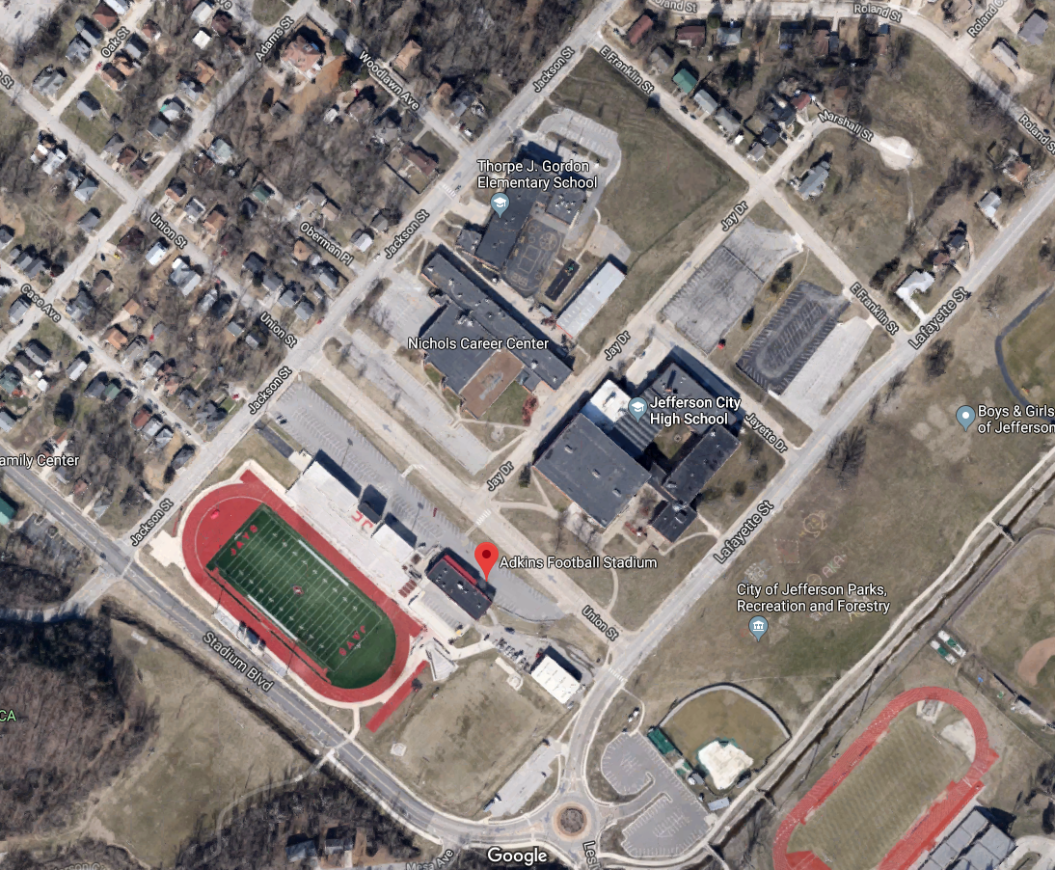
Adkins Football Stadium Parking

Slide 10
Adkins Football Stadium Severe Weather Shelters

Slide 11
Stakeholders
Nathaniel Hawthorne (Frank Alsheimer)
Sherriff of Cole County.
Incident Commander.
Manages first responders for the event, as well as the surrounding county.
Jackson Solomon (Jeff Weinrich)
Superintendent of Cole County Schools.
Manages nearby shelters.

Slide 12
Stakeholders (Cont.)
Mark Twain (Scott Lindstrom)
Co managing partner of Jazz Events Inc.
Responsible for the safety of the Jazz Groups they booked for the event.
John Steinbeck (Bill Sjoberg)
Manager of Adkins Football Stadium
Responsible for the safety of the patrons while in attendance

Slide 13
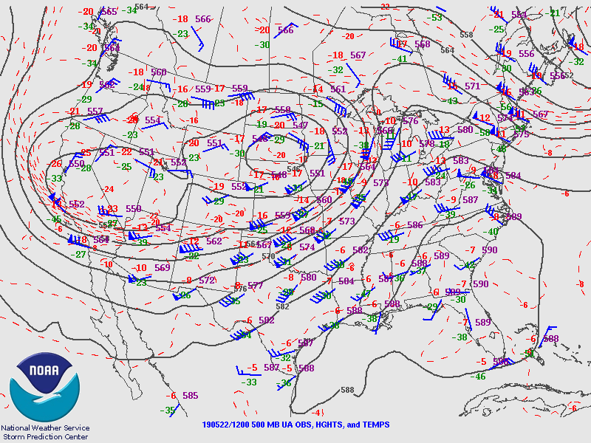
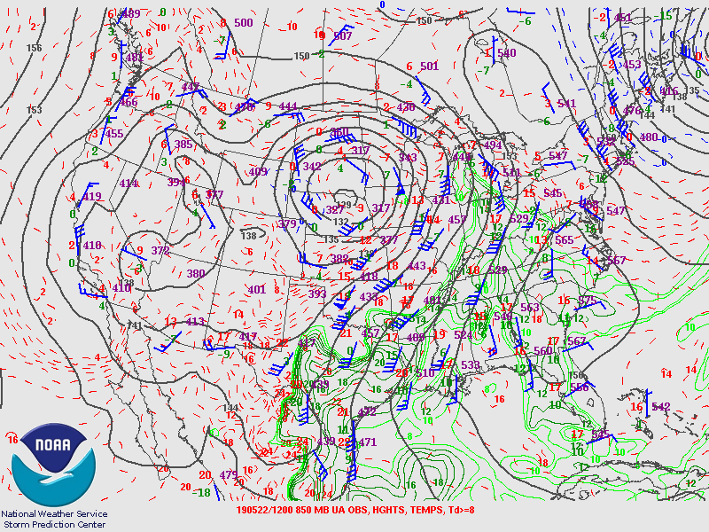
Synoptic Overview

Slide 14
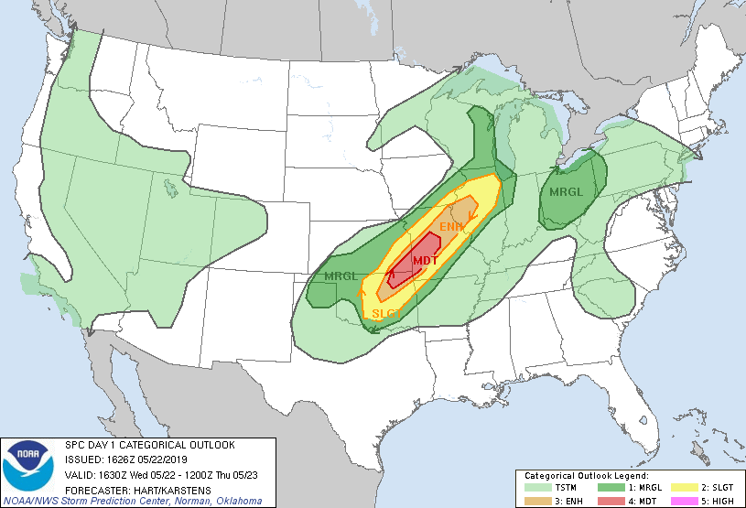
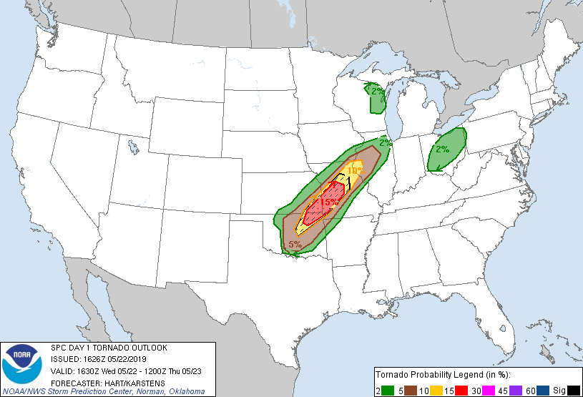
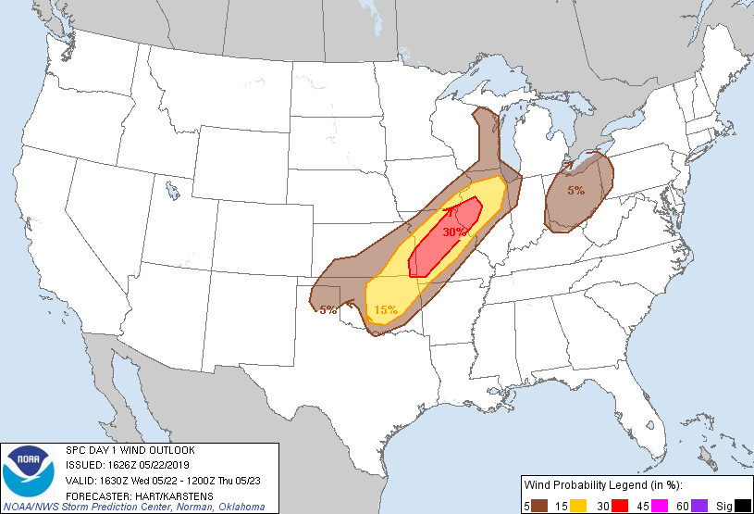

SPC Outlook 1630 UTC
Combined
Tornado
Wind
Hail

Slide 15
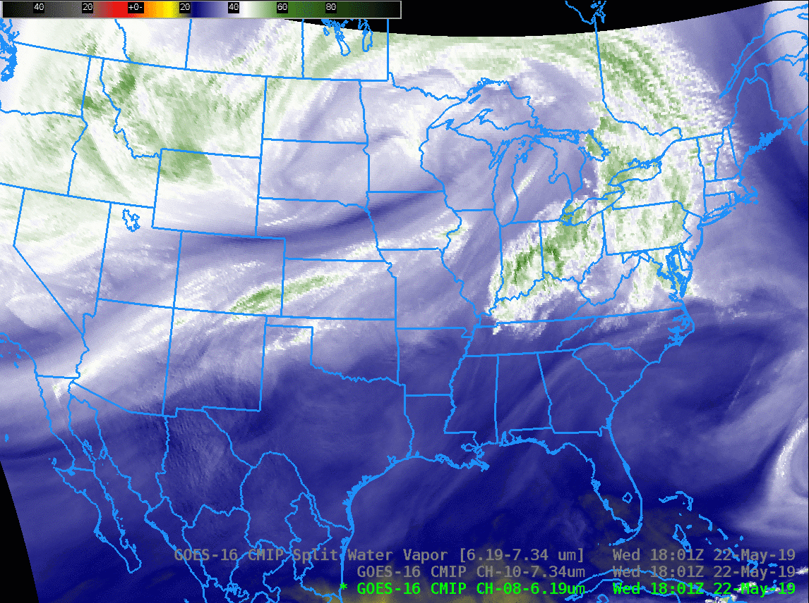
IR Band 8 18Z 5/22 to 01Z 5/23

Slide 16
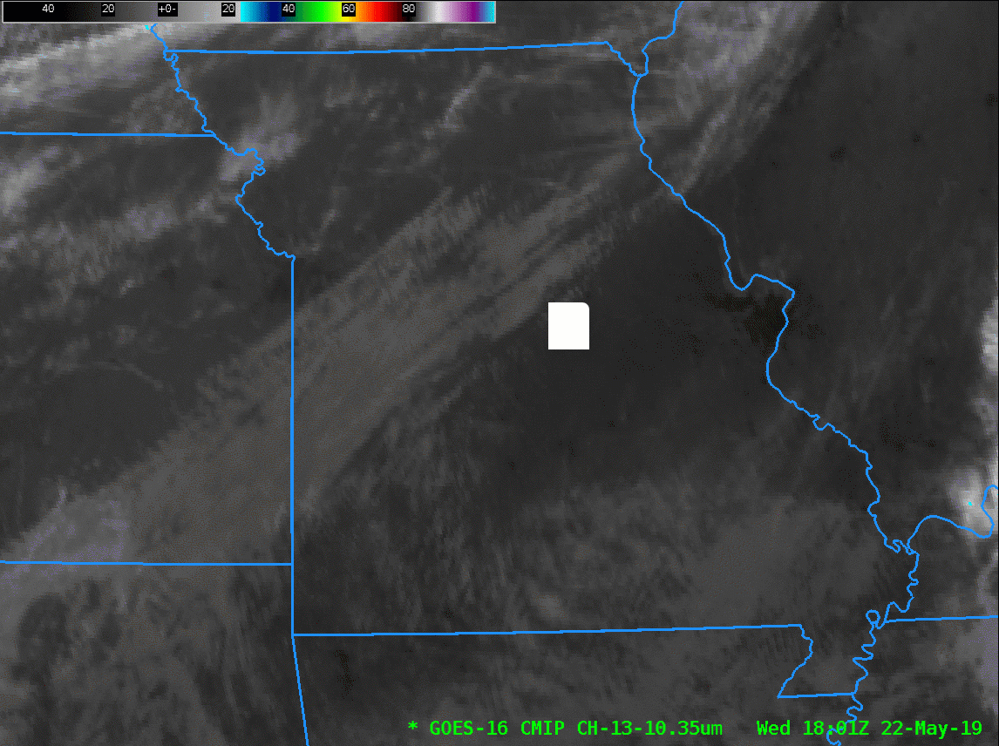
IR Band 13 18Z 5/22 to 01Z 5/23

Slide 17
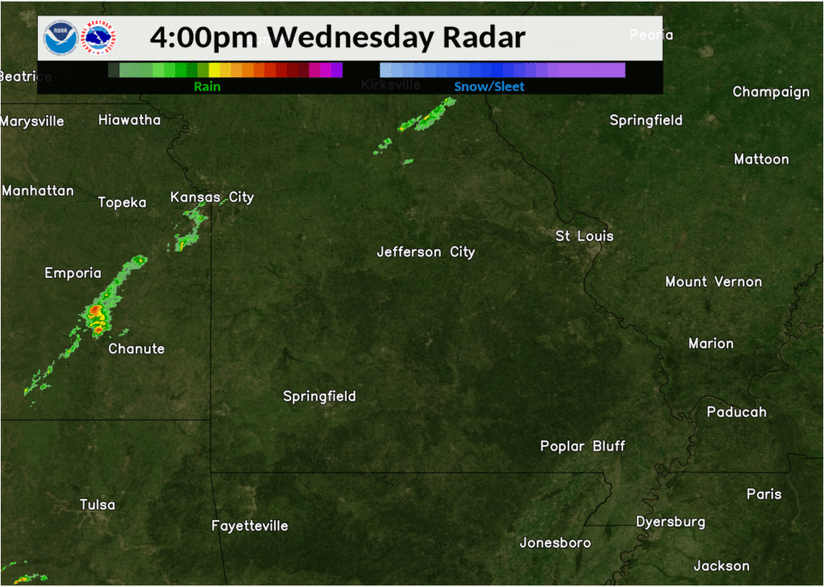

Slide 18
Through the day…
Stakeholders have been made aware of the severe weather threat through the day by previous briefings.
Jazz Events Inc.
Hired SuperBestWeather, a private contractor for events.
SuperBestWeather forecaster gave a briefing at 3 PM to the Jazz Event representatives, one hour prior to the start of the event.
The Sherriff/IC
Has been co-located with a NWS WFO Jefferson City Decision Support Service (DSS) Met at the incident command center at 3 PM.
Weather Briefing:
Severe weather is expected in the late evening near the end of the concert. But the biggest risk of severe weather will be northwest of the concert venue

Slide 19
Questions
When do we need to be concerned about the first threat to the concert?
How much time will we have to evacuate?
Would we consider directing people to the shelters or allow them to go to their cars?
How long will the threat last?
How would we empty out the shelters?
Do we have sufficient first aid resources in a worst case scenario

Slide 20
During the early evening…
7 PM:
Downstream satellite and radar indicate severe weather continues to approach from the southwest.
A tornado watch is now in effect for the Jefferson City area through 11 PM.
The Incident Commander is becoming very concerned, and would like a DSS briefing with the principals at 8 PM at the Incident Command Center. The SuperBestWeather will listen in remotely.

Slide 21
Where to find Exercise Data
https://tinyurl.com/2020-AMS-Sat-Short-Course

Slide 22
Briefing Contents
Provide current conditions and changes from last briefing
Highlight the types of threats expected (lightning, strong winds, flooding, etc.)
Highlighting the timing of the threats
Be prepared for questions!

