Slide 1
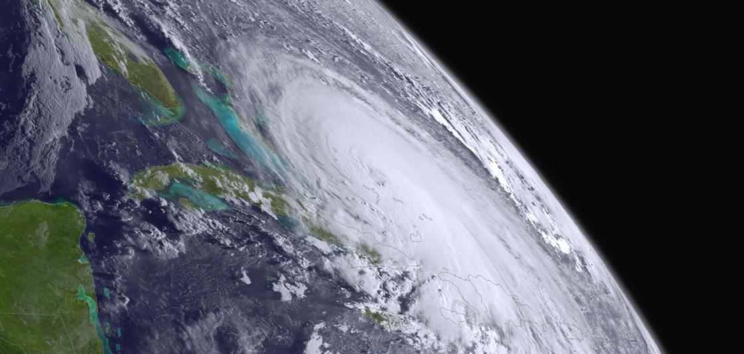
JPSS Program Overiew
Satellite and Information Service
Mitch Goldberg, JPSS Program Scientist
12 Jan. 2019
AMS JPSS/GOESR
Short Course

Slide 2
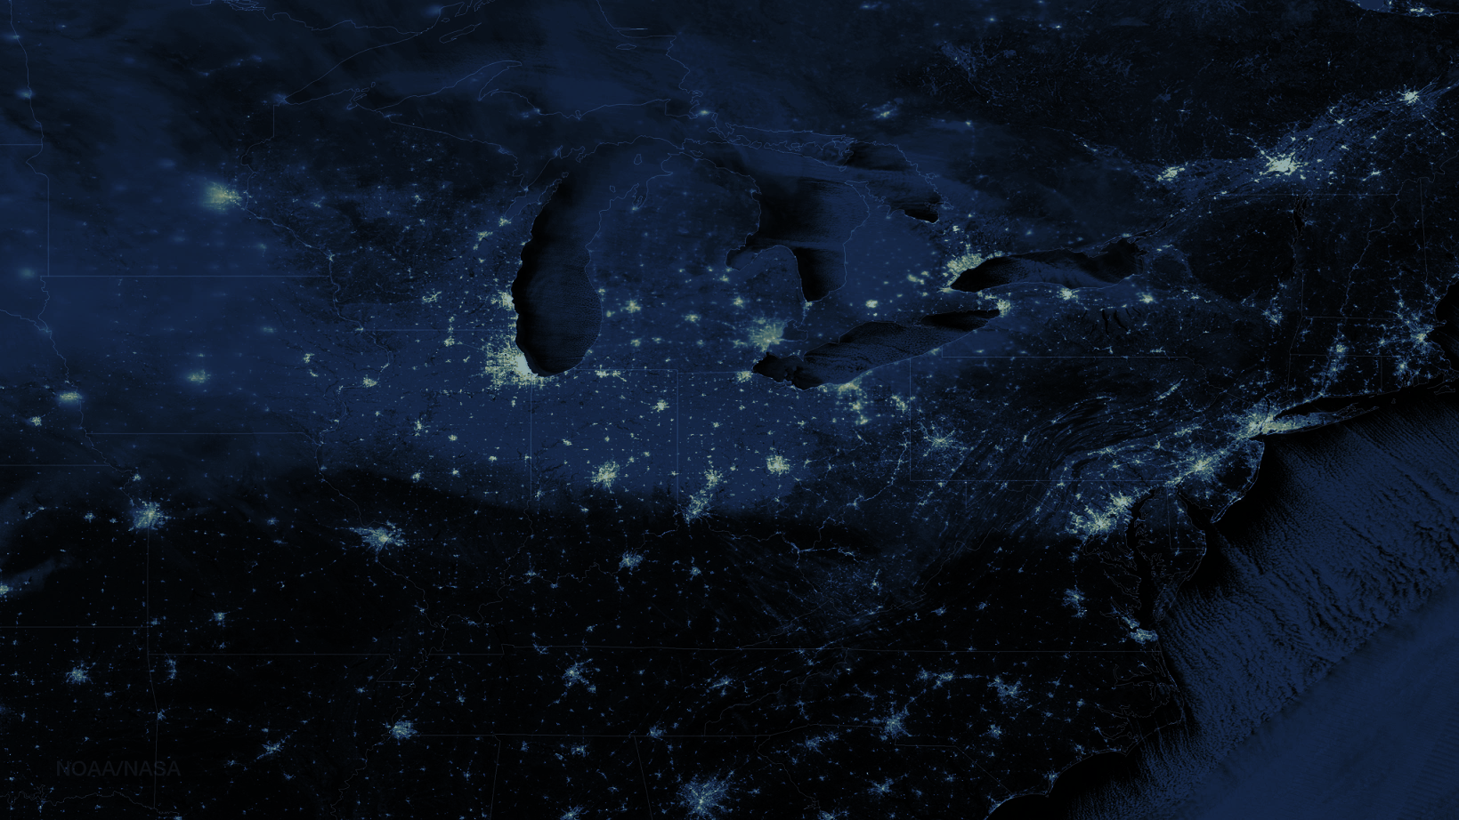

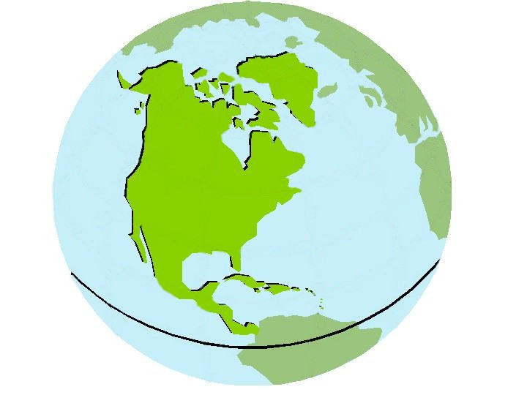

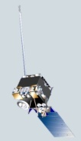

NOAA’s Operational Weather Polar and Geostationary Orbiting Satellites – JPSS and GOES-R Series
Polar-orbiting Operational Environmental Satellites (POES)
Operating since 1970
Geostationary Operational Environmental Satellites (GOES)
Operating since 1975
N
N
S
22,300 Miles
540 Miles
S
Primarily source of synoptic, global observations feeding Numerical Weather Models and forecasts
Primarily source of near real time observations for nowcasting and imaging of severe weather events
S-NPP image of North America
Notes:
Our standard way of presenting our mission through 2014.
[Image: via Suomi NPP’s Day/Night Band, January 8, 2015, 2:45 am EST]

Slide 3
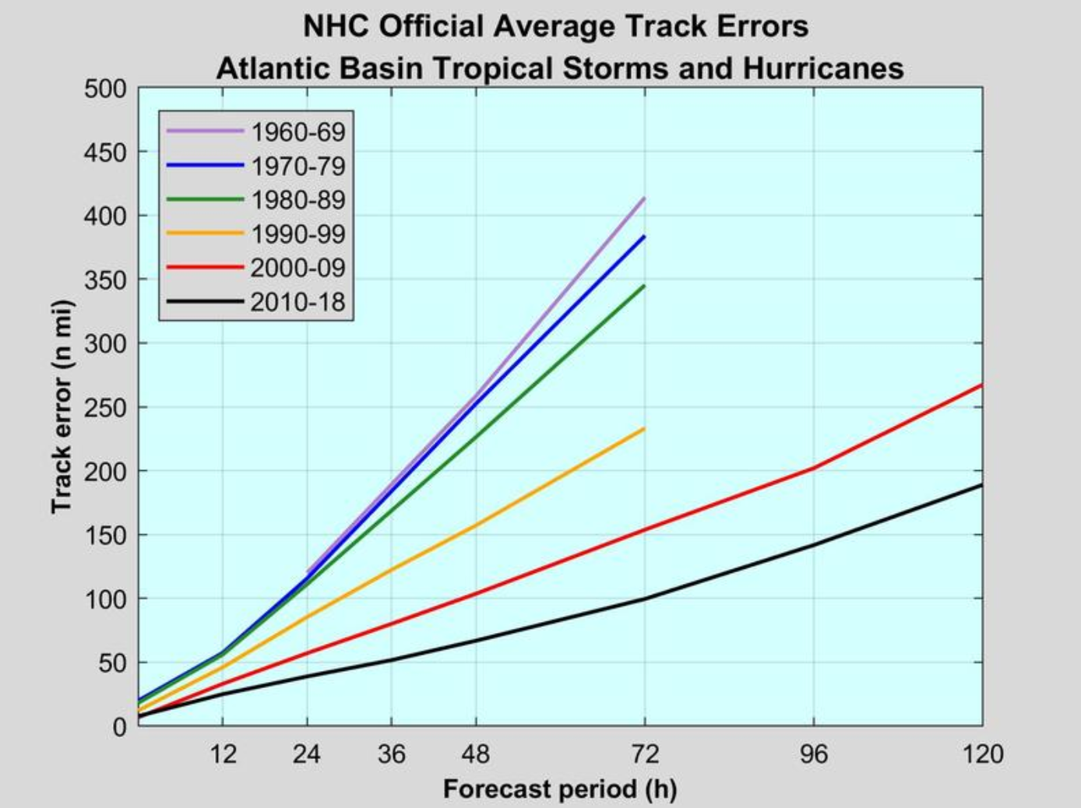
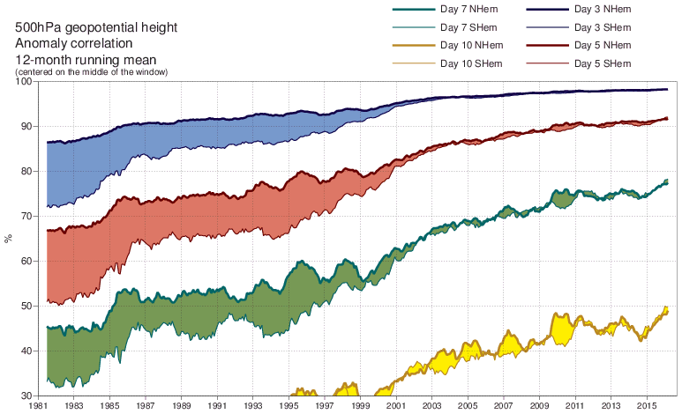




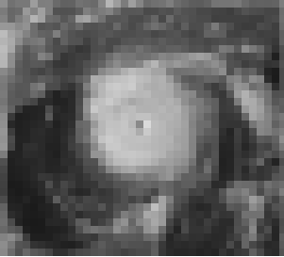

This approach has produced great returns over the years
From ECMWF
Significant Improvements in 3–7 day weather forecasts
Improved NRT severe storm warnings & alerts
20% increase in hurricane track and intensity forecasts from 2010–2015
Improved severe storm warnings & alerts
Tornado warning lead time from
3 to 14 minutes since 1980
Collection Services (A-DCS): 14,000 environmental platforms, almost 50% used by NOAA
3 DAY
AMSUs (98,05,09), AIRS(2002), IASI/AMSU(2006,2012), ATMS & CrIS(2011,2017)
5 DAY
7 DAY
10 DAY
~210km
~63km
~39 km
~16km
~8-10km
Notes:
Time series of the annual running mean of anomaly correlations of HRES 500 hPa height forecasts evaluated against the operational analyses for the period January 1981 till present.
Values plotted at a particular month are averages over that month, the previous 5 months and the following 6 months.
Forecast lead times of 3, 5, 7 and 10 days are shown, for scores averaged over the northern (bold lines) and southern (thin lines) extratropics.
The shading shows differences in scores between the two hemispheres at the forecast ranges indicated.
Source:
Adapted and extended from Simmons,A.J., Hollingsworth,A., 2002: Some aspects of the improvement in skill of numerical weather prediction. Q. J. R. Meteorol. Soc., 128, 647-677.
Verification follows updated WMO/CBS guidelines as specified in the Manual on the GDPFS, Volume 1, Part II, Attachment II.7, Table F, (2010 Edition - Updated in 2012)
Anomalies are computed with respect to ERA-Interim-based climate.

Slide 4
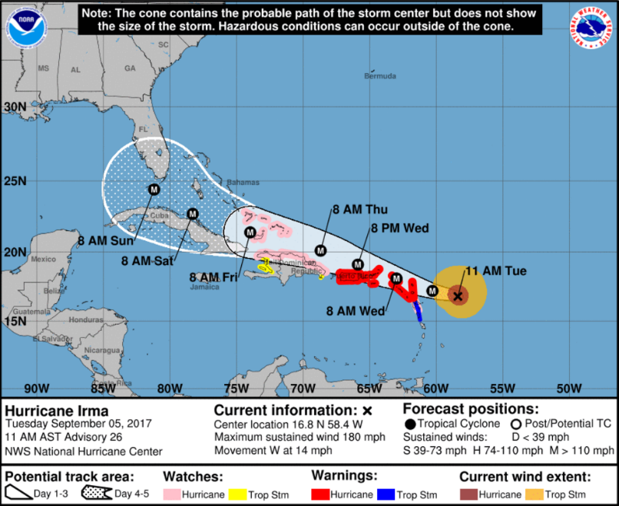
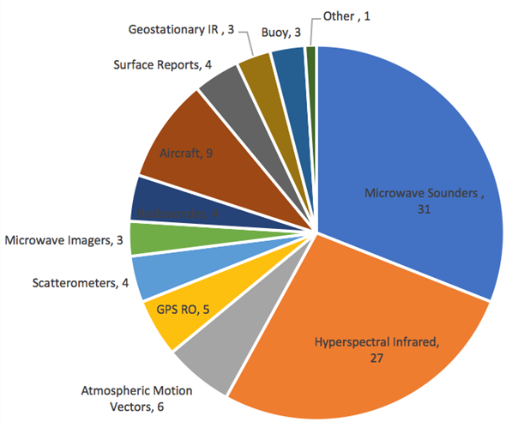
JPSS is a Core Component of the Weather Forecast Enterprise
85% of all data used in forecast models are from polar-orbiting satellites and attribute to nearly 60% of the reduction in forecast error.
Observation type attributed to forecast error reduction
Derived from ECMWF data

Slide 5
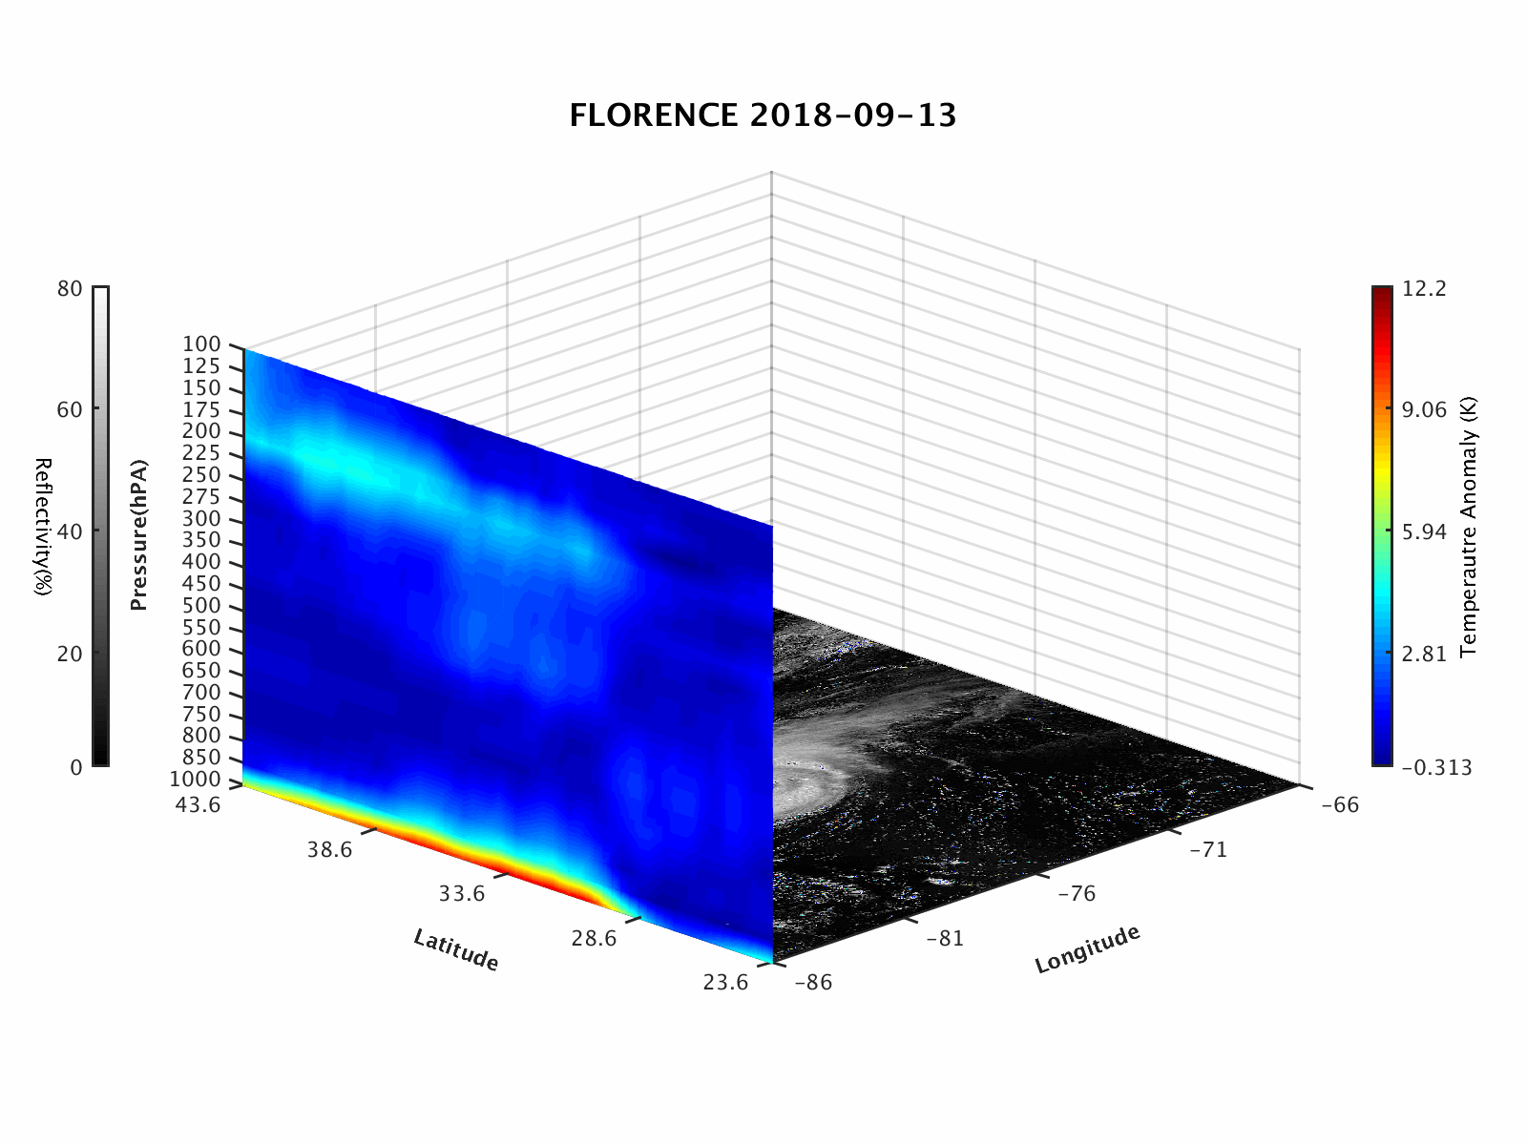
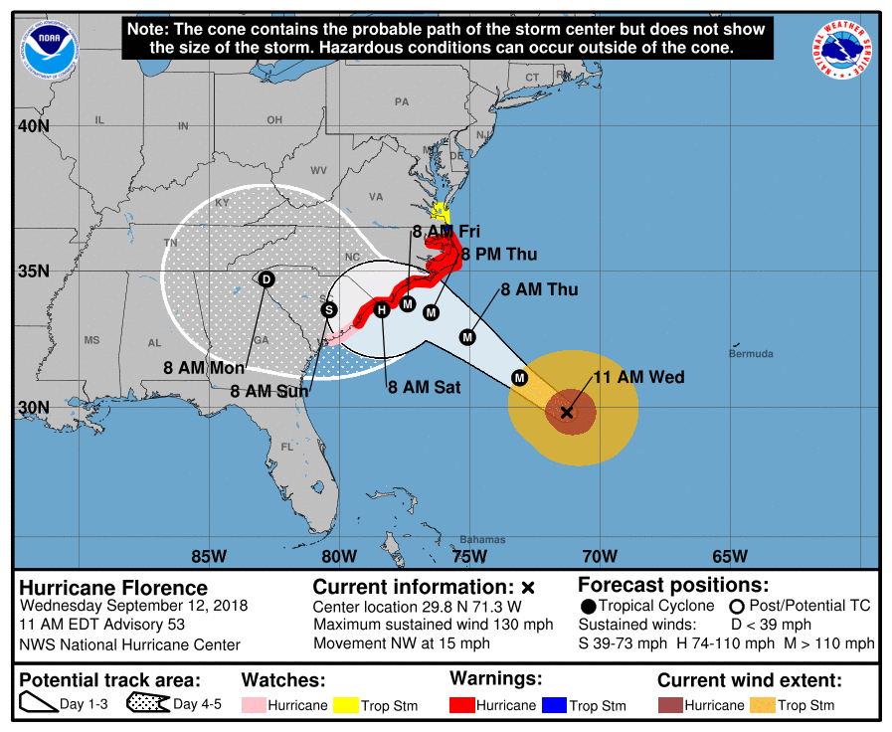
JPSS vertical sounding capability is critical for weather forecasting
Vertical temperature slices from ATMS soundings - warm core temperature
anomaly can clearly be seen.

Slide 6
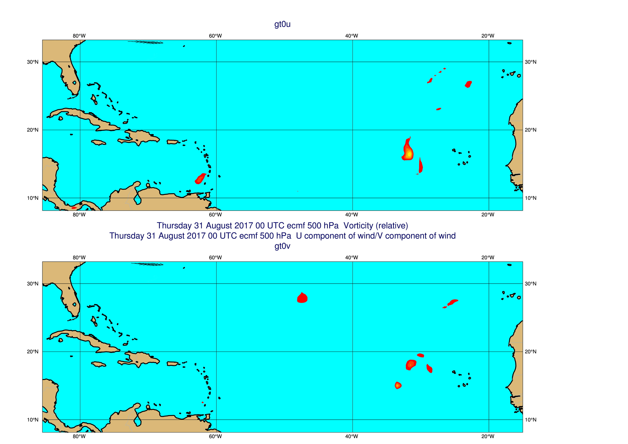
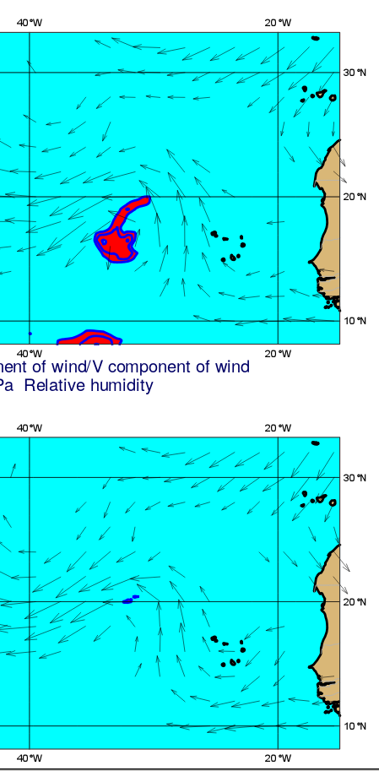

Benefits to users Impact of satellites on forecasting of Irma
Forecast with satellites
700hPa initial conditions (humidity and wind) with satellites
700hPa initial conditions (humidity and wind) without satellites
Forecast without satellites
Notes:
If we examine the initial conditions of the failed forecast we see the cause is an absence of humidity around 700hPa …humidity which is critical for enhancing convection and TC development.

Slide 7
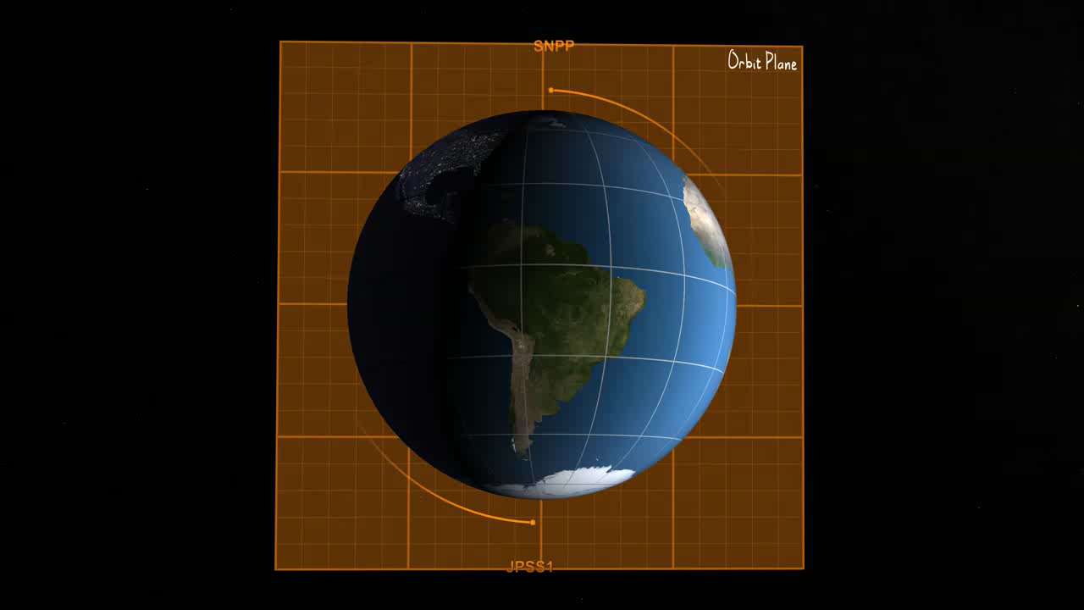
Improving Forecast Accuracy & Timeliness
JPSS satellites:
Circle the Earth from pole-to-pole and cross the equator 14 times daily in the afternoon orbit—providing full global coverage twice a day.
Provide critical data to the numerical forecast models that produce 3- to 7-day mid-range forecasts.
Provide support for zero to 3-day operational forecasting in Polar Regions

Slide 8





JPSS Payload Capability
JPSS Instruments |  | Measurements & Products | Vendor
 | ATMS – Advanced Technology Microwave Sounder | High vertical resolution temperature and water vapor information critical for forecasting extreme weather events, 5 to 7 days in advance | NGES
 | CrIS – Cross-track Infrared Sounder
 |  |  | Harris
 | VIIRS – Visible Infrared Imaging Radiometer Suite | Critical Imagery products, including snow/ice cover, clouds, fog, aerosols, fire smoke plume, vegetation health, phytoplankton abundance/chlorophyll | Raytheon
 | OMPS – Ozone Mapping Profiler Suite (Nadir Mapper, Nadir Profiler, Limb - S-NPP, JPSS-2+) | Ozone spectrometers for monitoring ozone hole health, recovery of stratospheric ozone, and for UV index forecast | Ball Aerospace
 | CERES – Clouds and the Earth’s Radiant Energy System (S-NPP & JPSS-1) New procurement (JPSS-3, 4) | Scanning radiometer that supports studies of Earth Radiation | CERES – NGAS

Slide 9
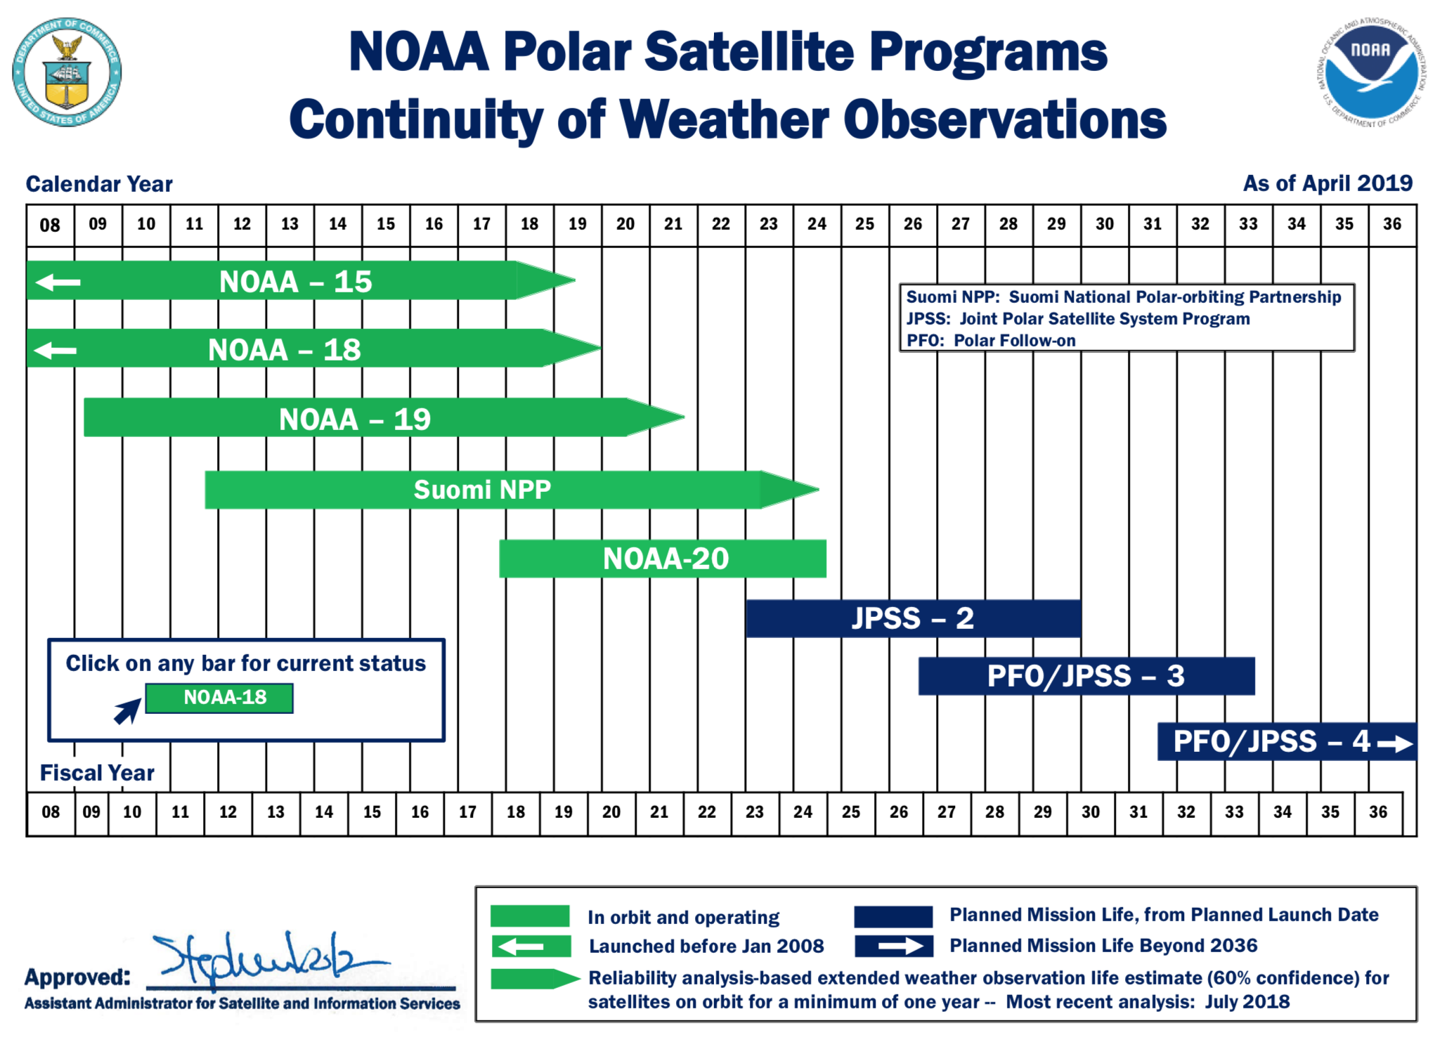

Slide 10
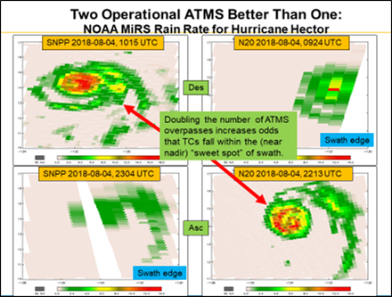
Better with two - 50 minute separation is useful!!

Slide 11
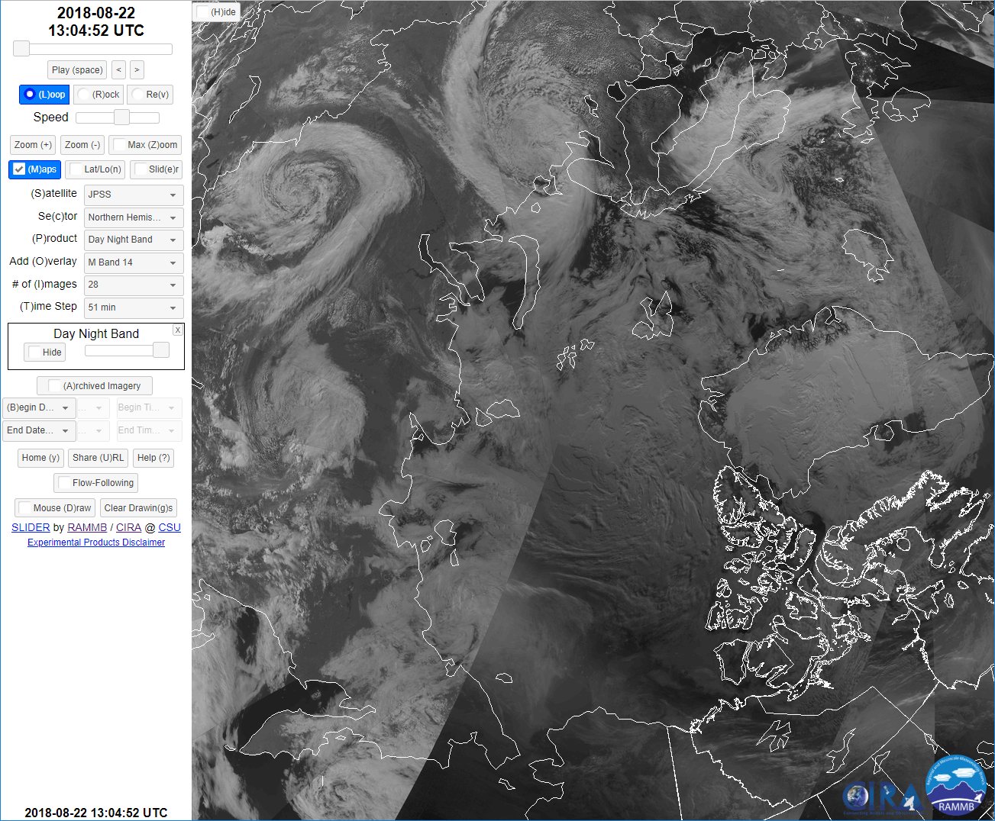
Twice the VIIRS

Slide 12
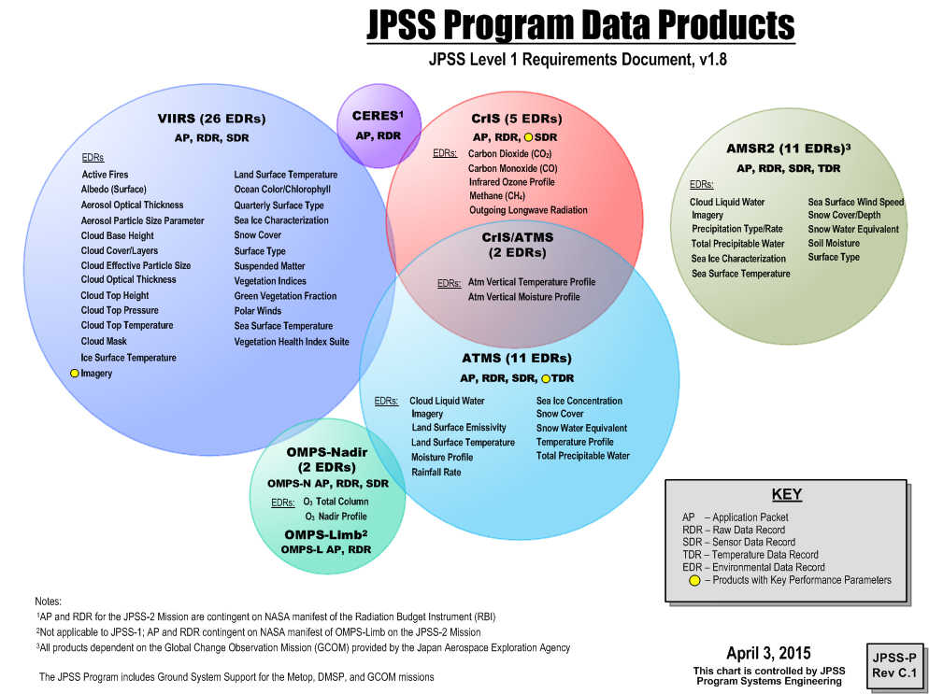
JPSS Program Data Products
Notes:
‘Here is where we transition from what we needed to what we created.’

Slide 13
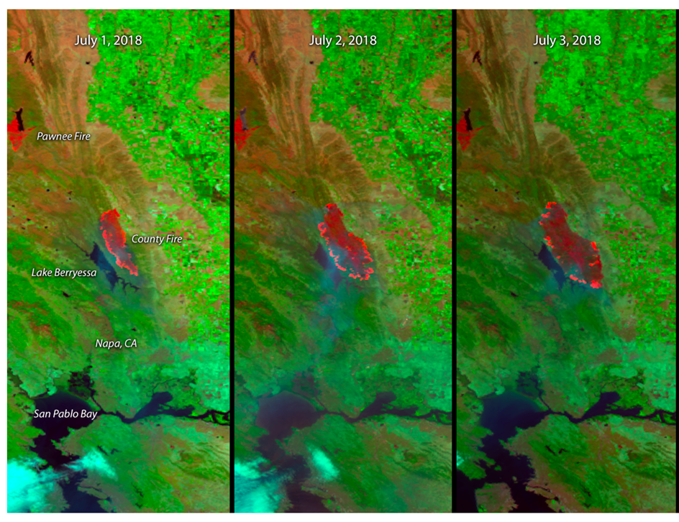
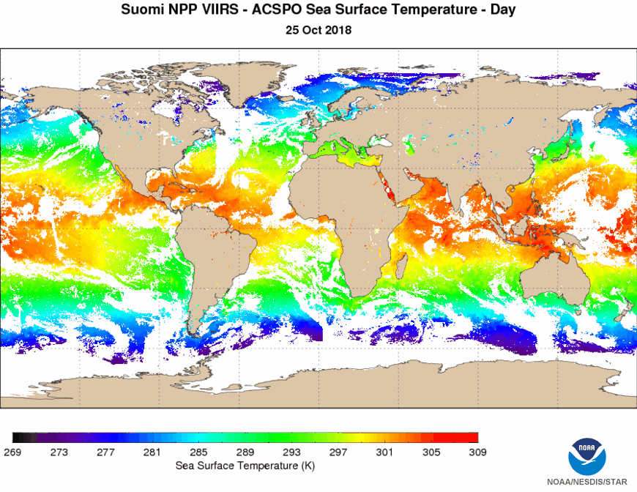
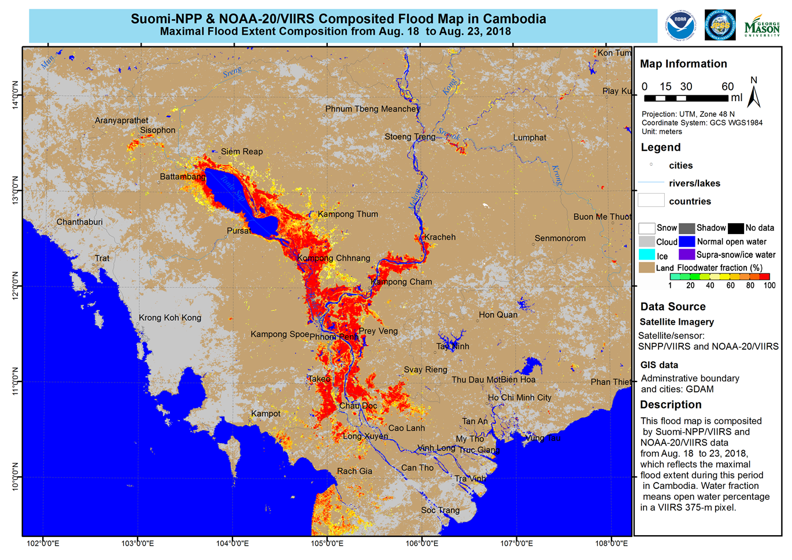
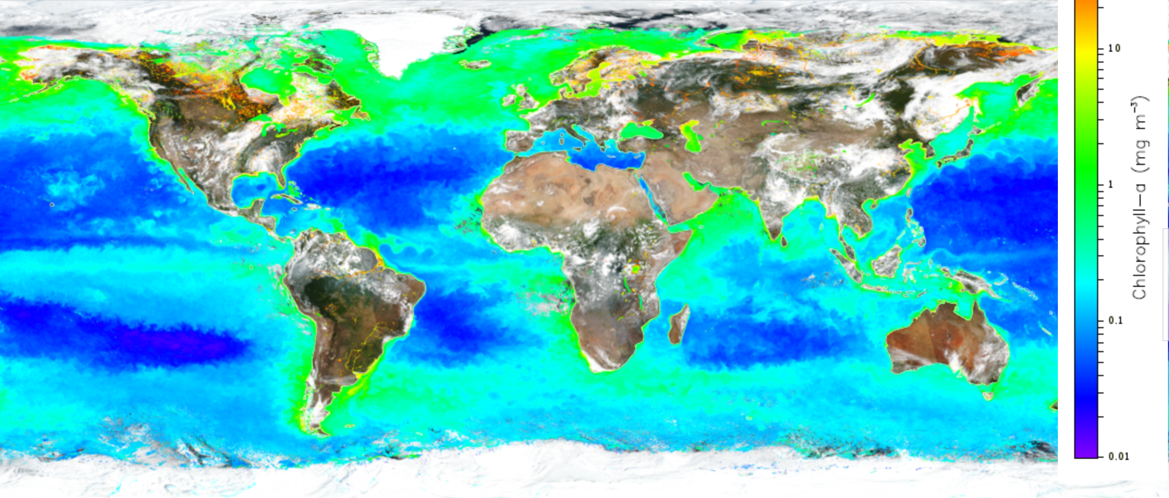
VIIRS examples

Slide 14
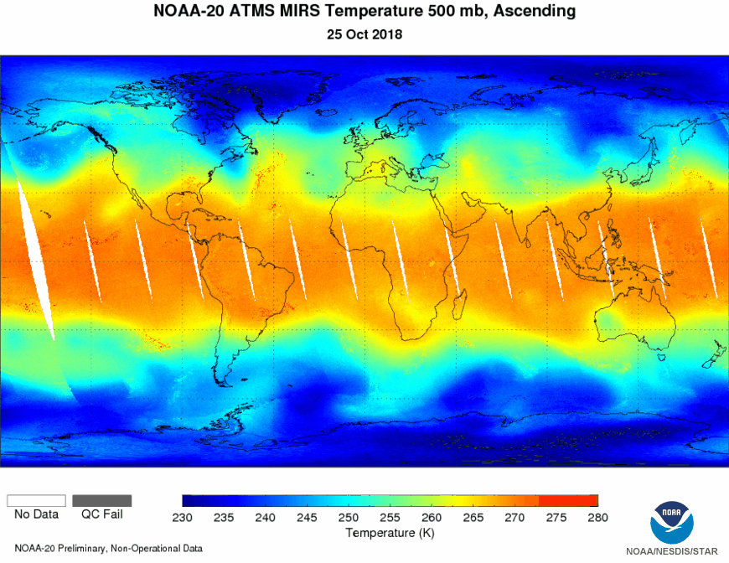
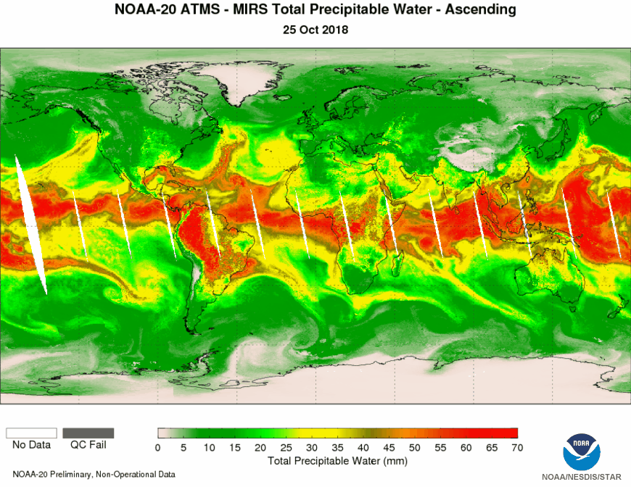
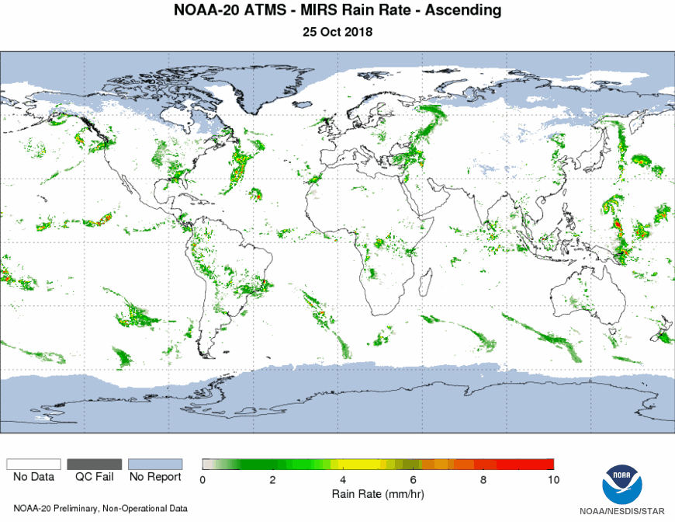
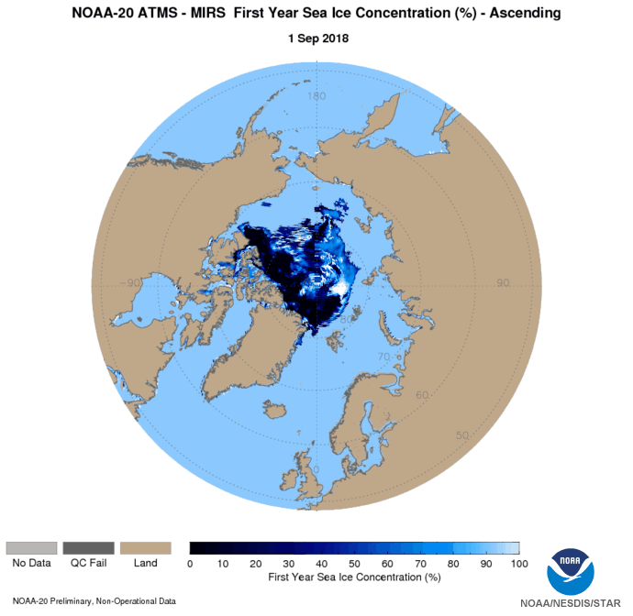
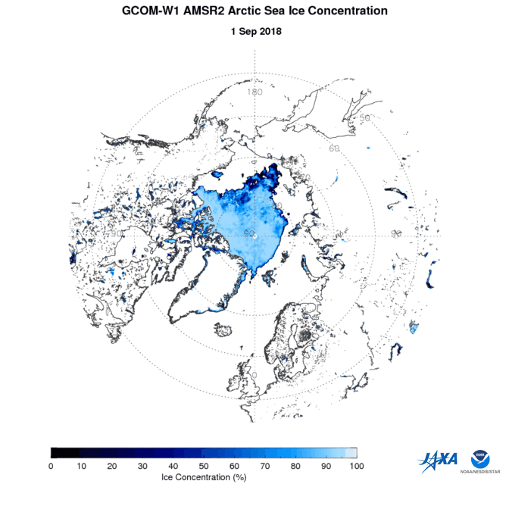
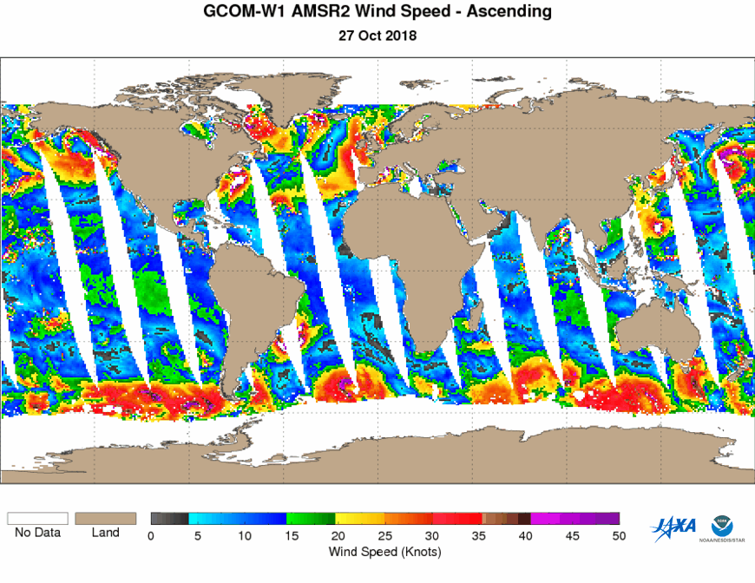
ATMS and GCOM examples

Slide 15
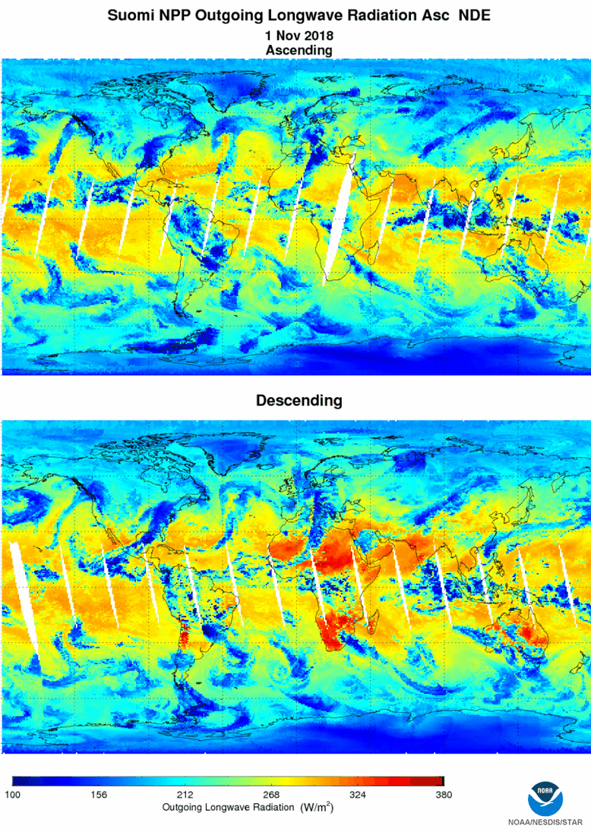
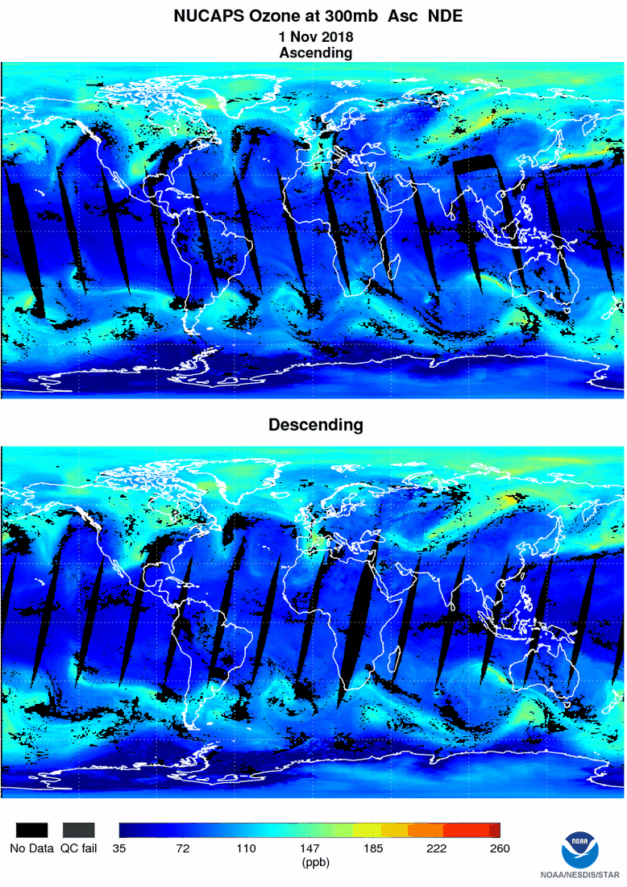
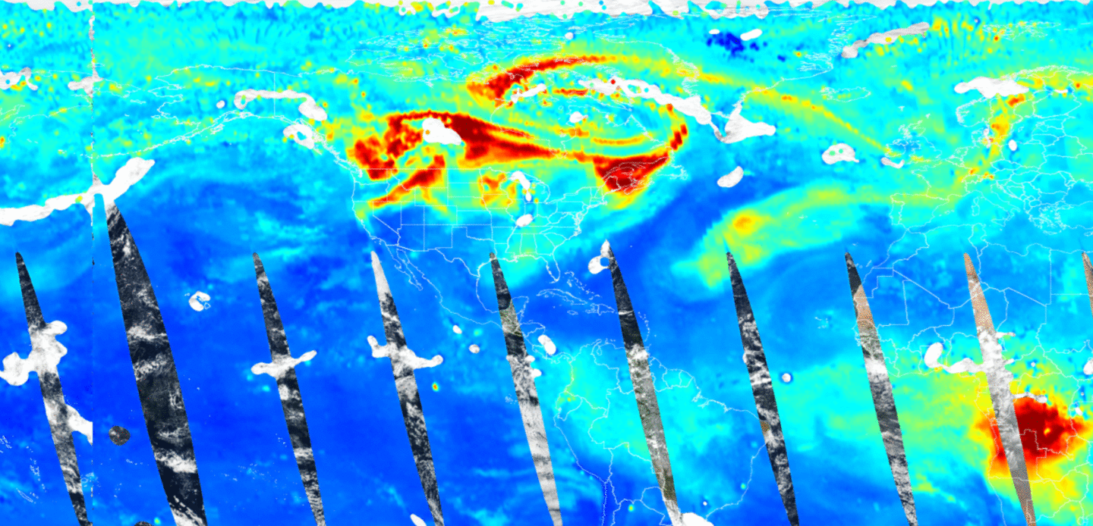
CriS Examples
500 hPa CO (August 24 – 30, 2018)

Slide 16
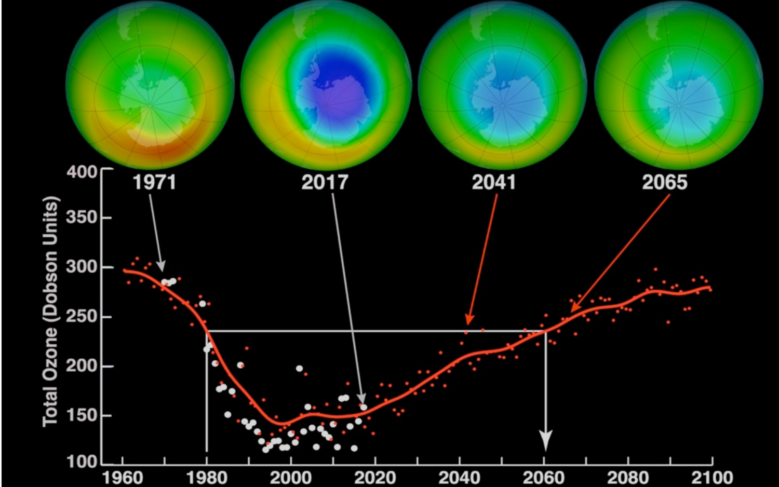
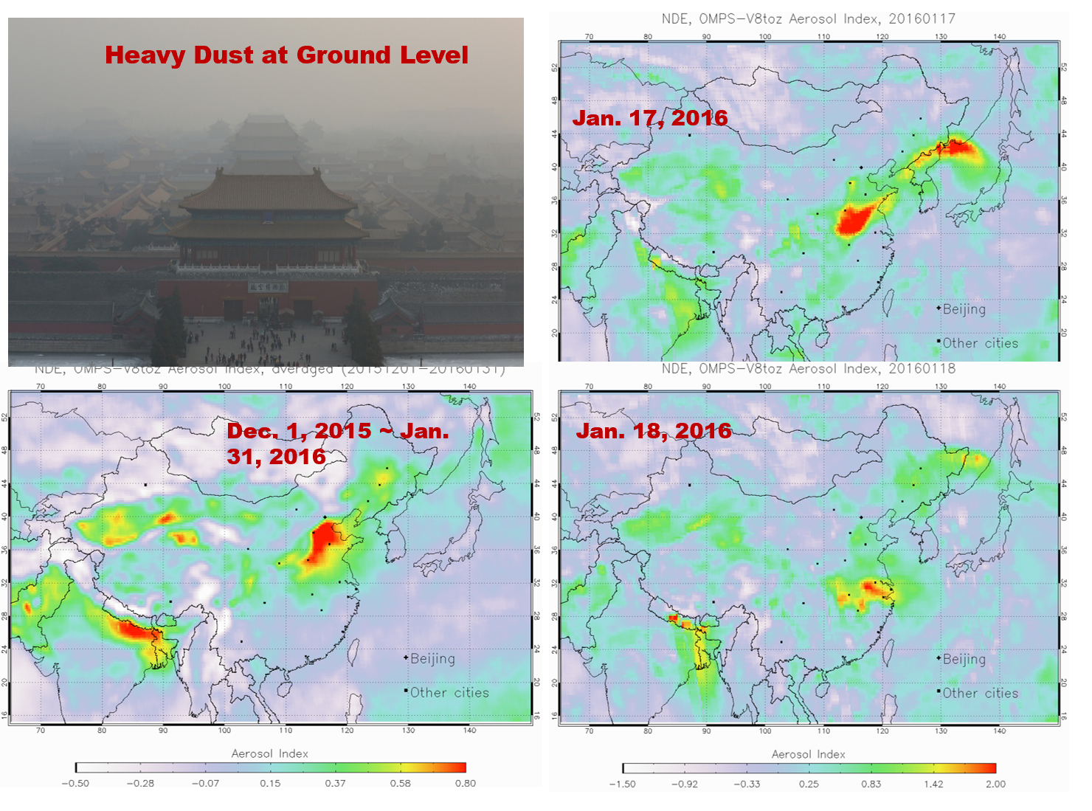
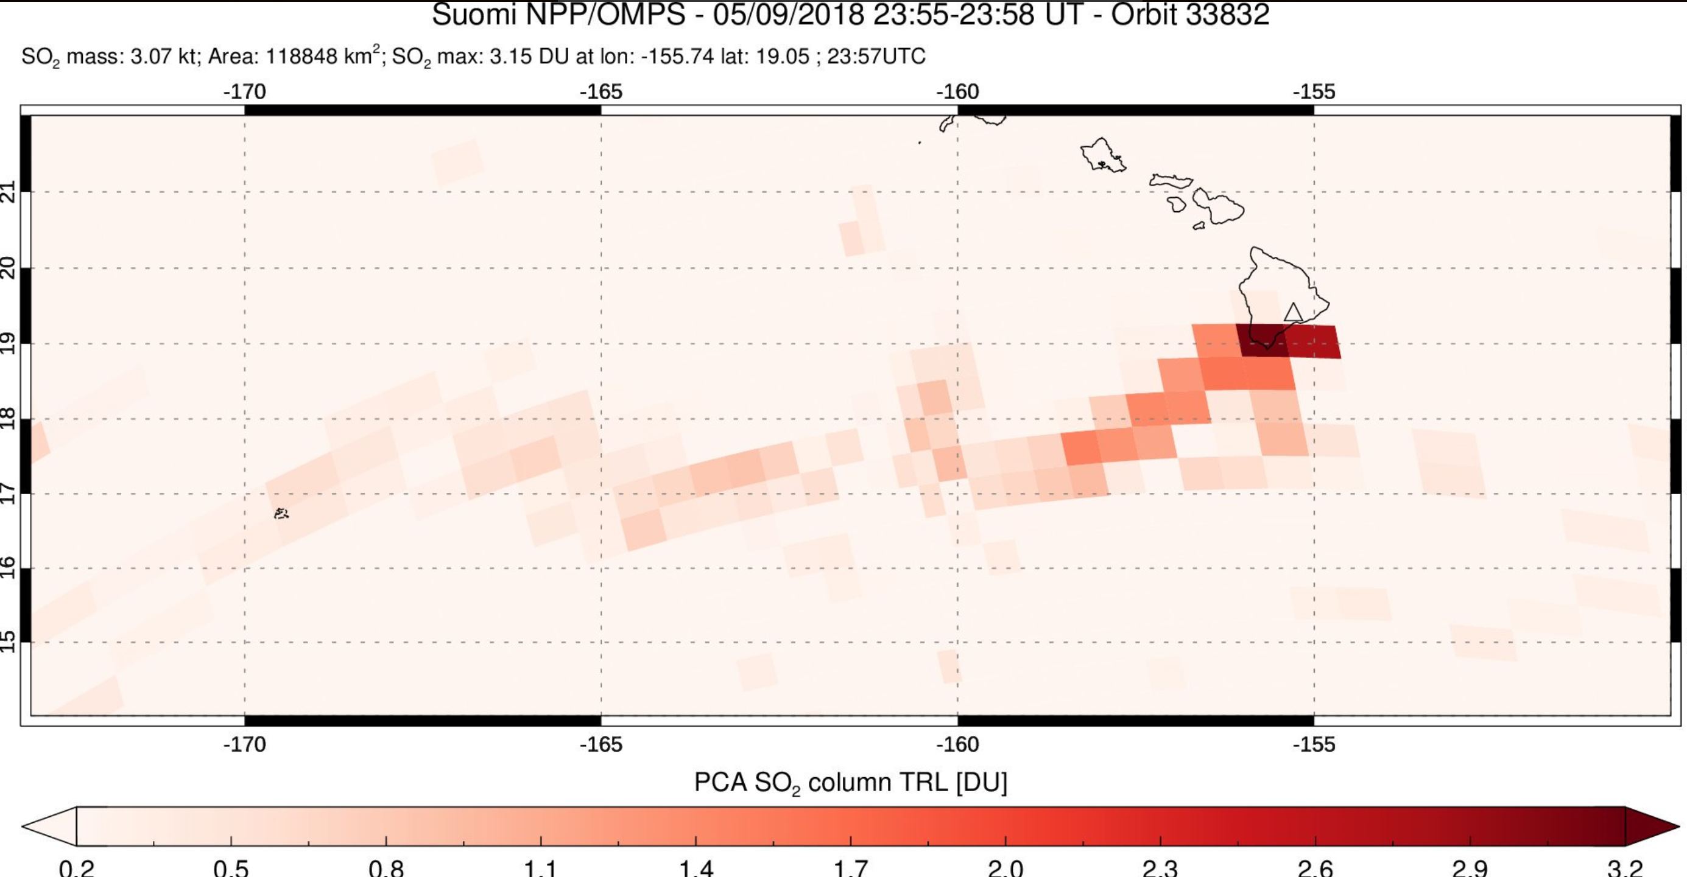
OMPS examples

Slide 17
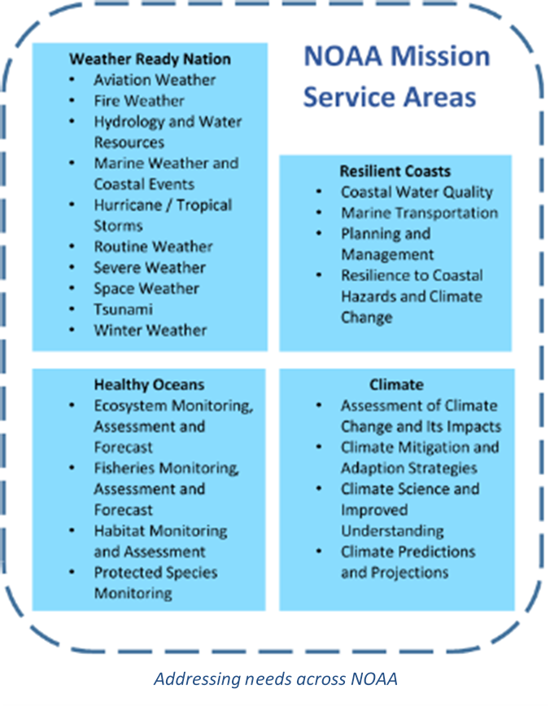

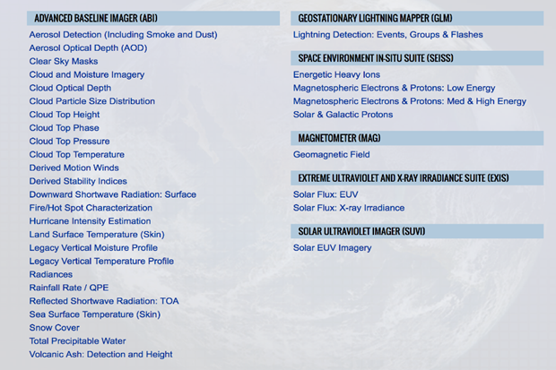
Goal is to improve NOAA Services through optimizing the use of satellite data along with other sources of data & information
Observations/Products to Services to Stakeholders
GOES-R Baseline Products

Slide 18
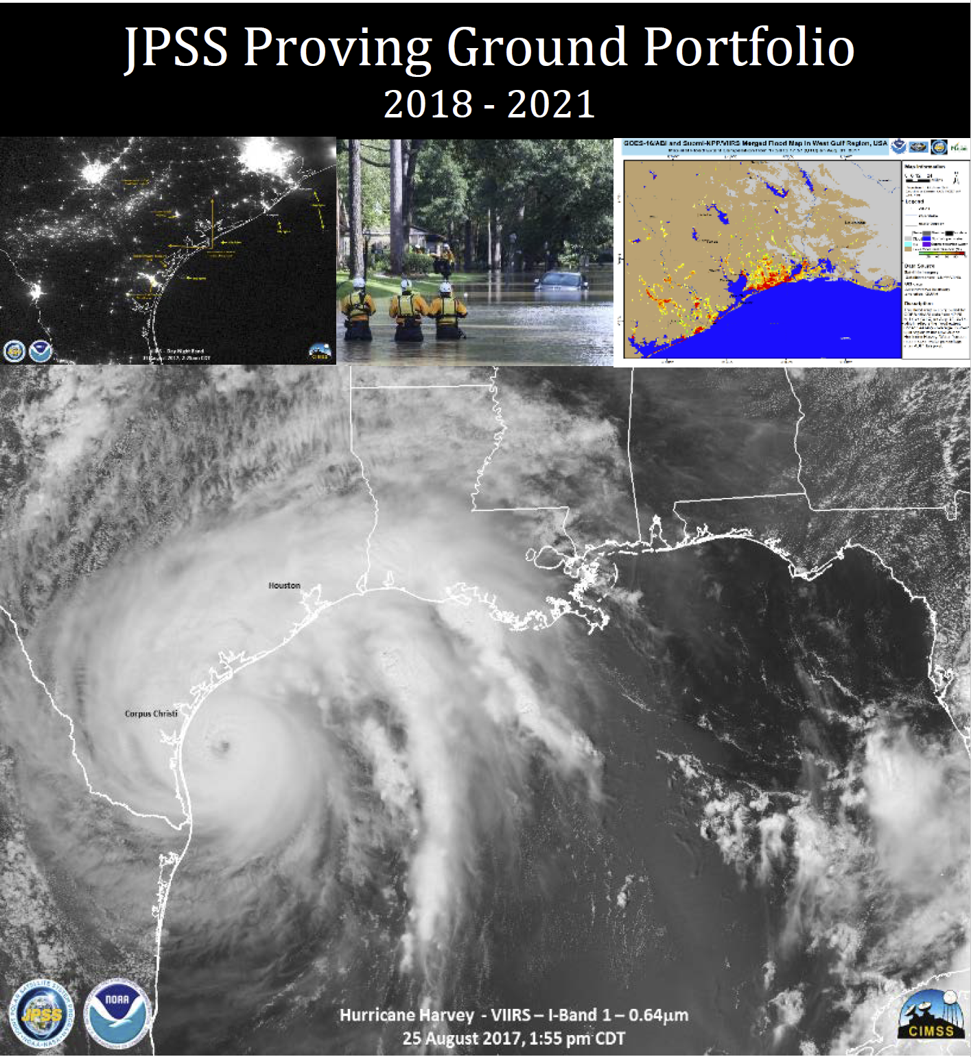
The Initiatives
The initiatives comprise of a team of developers and users working together to improve an application
in a testbed environment providing assessments of utility from the users and feedback to the developers.
Arctic
Aviation
Fire and Smoke - will include GOES-R in 2018
Hurricanes and Tropical Storms
Hydrology
NWP
Oceans and Coasts - includes Sentinel 3
River Ice and Flooding - includes GOES-R since 2017
Sounding - includes EUMETSAT MeTOP
Training
Volcanic Hazards - new and includes both JPSS and GOES-R

Slide 19
Summary
NOAA Satellite Programs are end-to-end
Provides the sustained robust and accurate set of key observables needed to support a wide variety of critical applications and decisions impacting lives, properties, economies, and security
Work with the user community through the Satellite Proving Ground and Short Courses to realize the benefits of JPSS and GOES-R series
19

