Slide 1
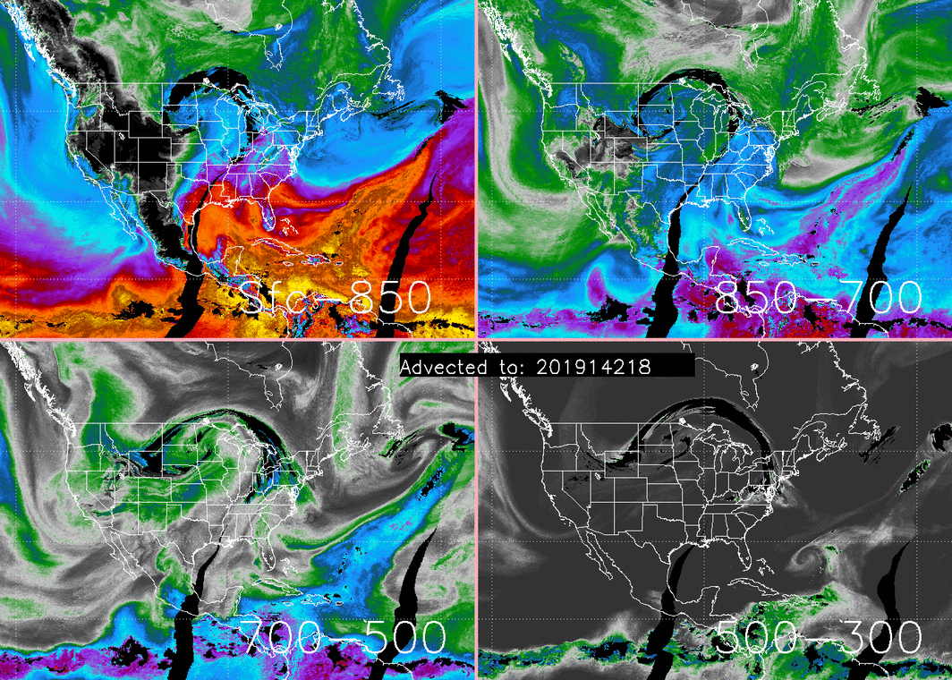
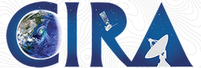

CIRA Advected Layered Precipitable Water (ALPW) Loop with Hourly Images for the Period 1800 UTC 22 May to 0100 UTC 23 May 2019
Special thanks to John Forsythe for the images
mm
Movie loop prepared by Sheldon Kusselson

