Slide 1
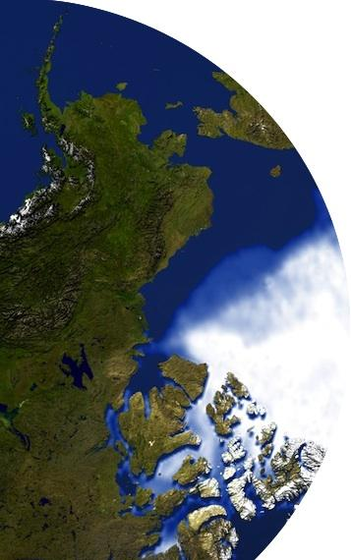
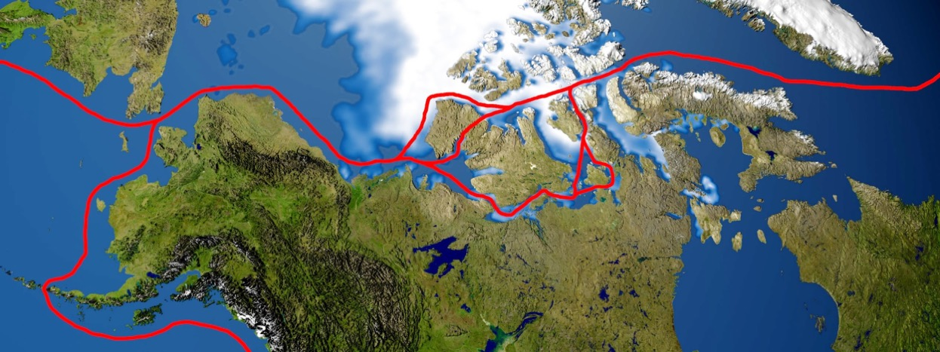


JPSS Short course:
Monitoring and Predicting the Opening of the Northwest Passage
Breakout Groups
Breakout group monitors:
Yinghui Liu, Kyle Obremski,
Jeff Key, Scott Lindstrom
NOAA Satellite and Information Service
Cooperative Institute for Meteorological Satellite Studies (CIMSS)
Madison, Wisconsin USA
JPSS Short Course, 27 June 2023, virtual

Slide 2
Purpose
In this breakout session you will work through a case study like the one we just covered but for different years: 2012 and 2014. You will examine the thermodynamic and dynamic factors from the beginning of the year through August and try to determine if the Northwest Passage will be open or closed in each of these years.
Case Study Questions
How do the thermodynamical and dynamical factors evolve differently in these two years from those in 2013 and 2016?
Do the thermodynamic anomalies (i.e. freezing degree days) or dynamic anomalies (winds) play a larger part in the opening (or not) of the NWP?
Looking at the months leading up to the NWP openings provides clues, is there a particular month that may represent a “tipping point” signal for the NWP opening or not?
Which figures were the most helpful for you when investigating the NWP?
Which of the two years the NW Passage is more likely to be open, 2012 or 2014?
Broader Questions (time permitting)
What other factors might impact whether or not the NPW is open or closed?
Similarly, what other data would be useful in monitoring and predicting the opening of the NWP?
What specific tools can be used to predict the opening of the NWP? A numerical model or machine learning? What inputs would be needed (variables, which months, etc.)?
Everybody is welcome to write your answers in the online documents for Group 1, Group 2, Group 3, Group 4

Slide 3
Slides on FDD anomalies from January to August in 2012 and 2014

Slide 4
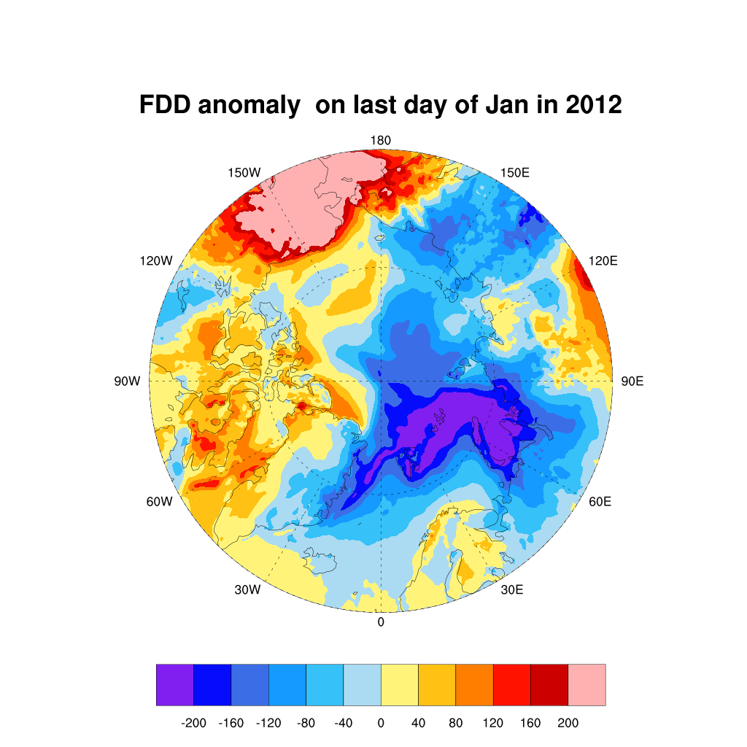
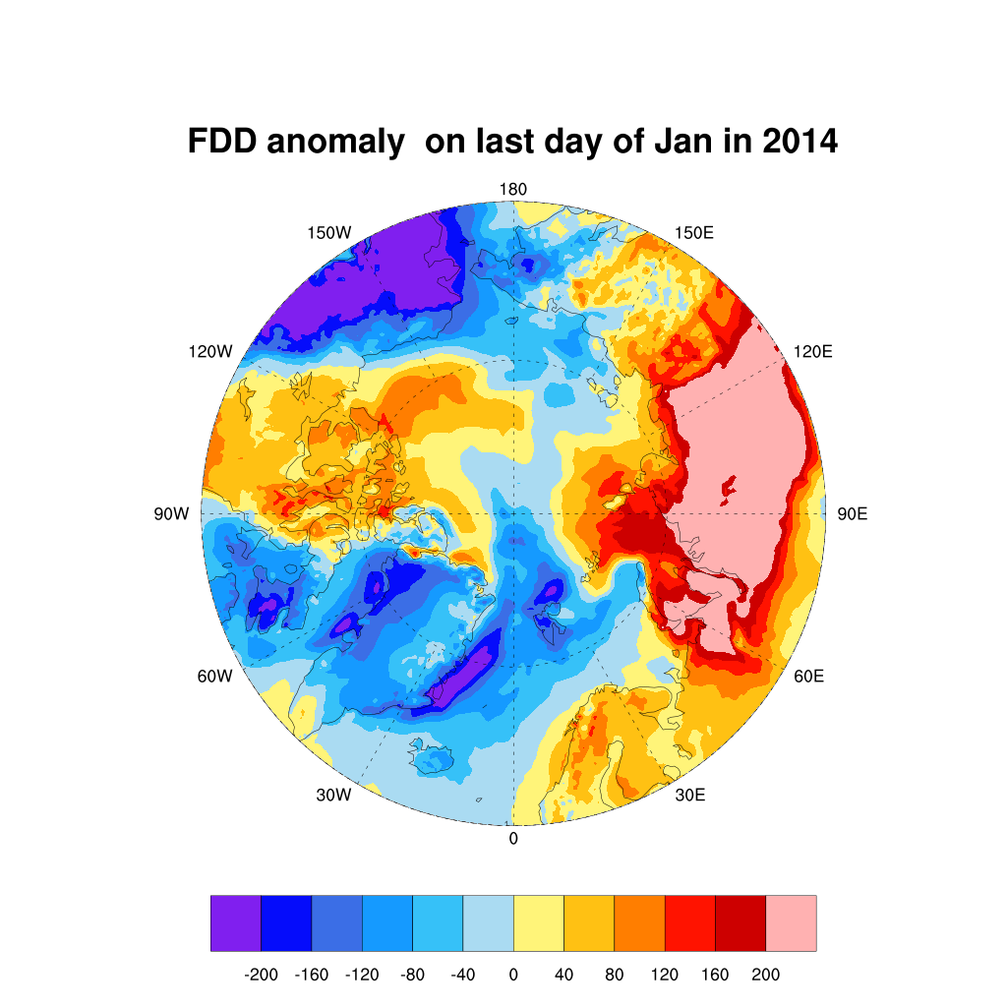
FDD Anomaly in January 2012 and 2014

Slide 5
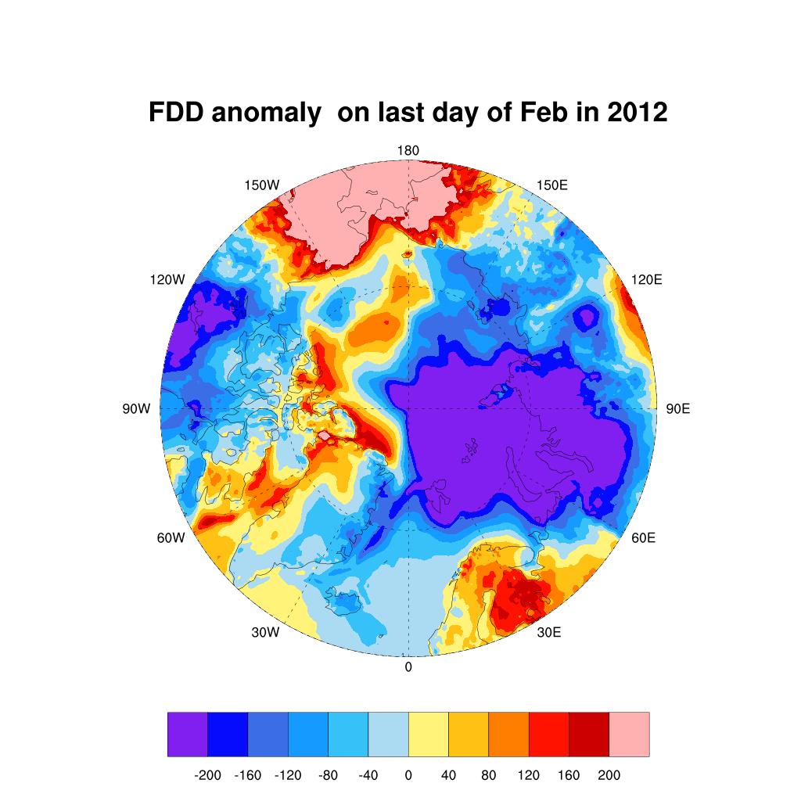
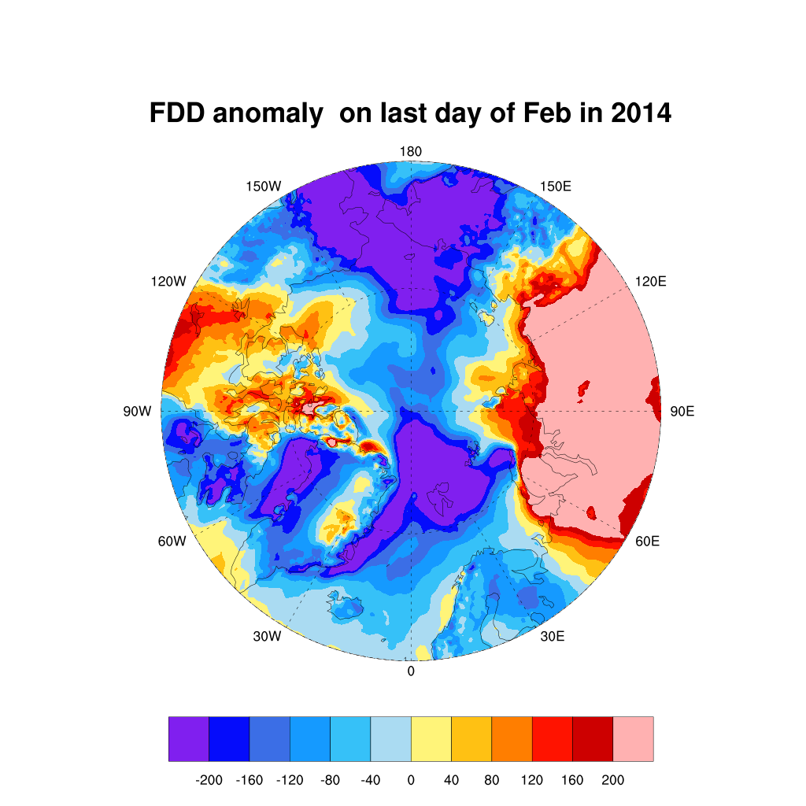
FDD Anomaly in February 2012 and 2014

Slide 6
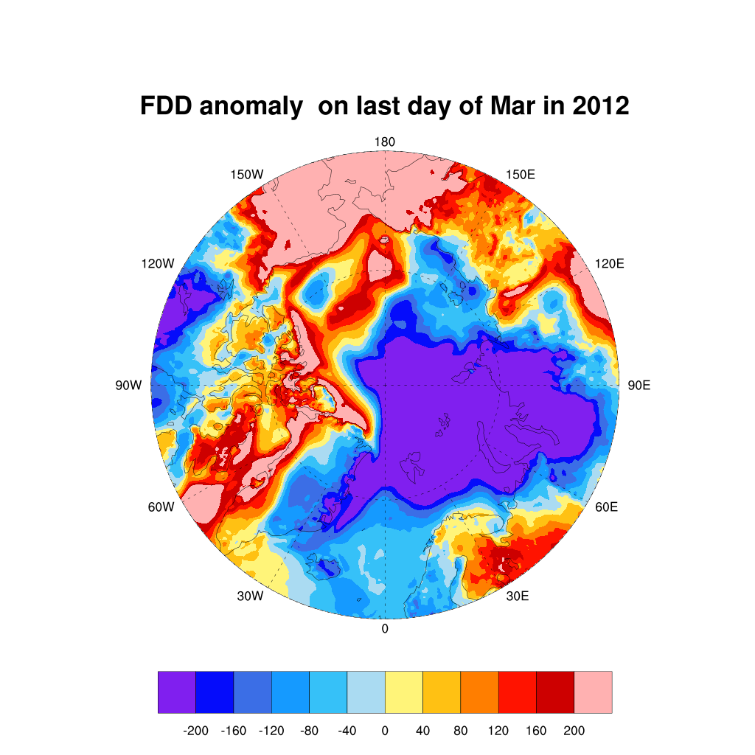
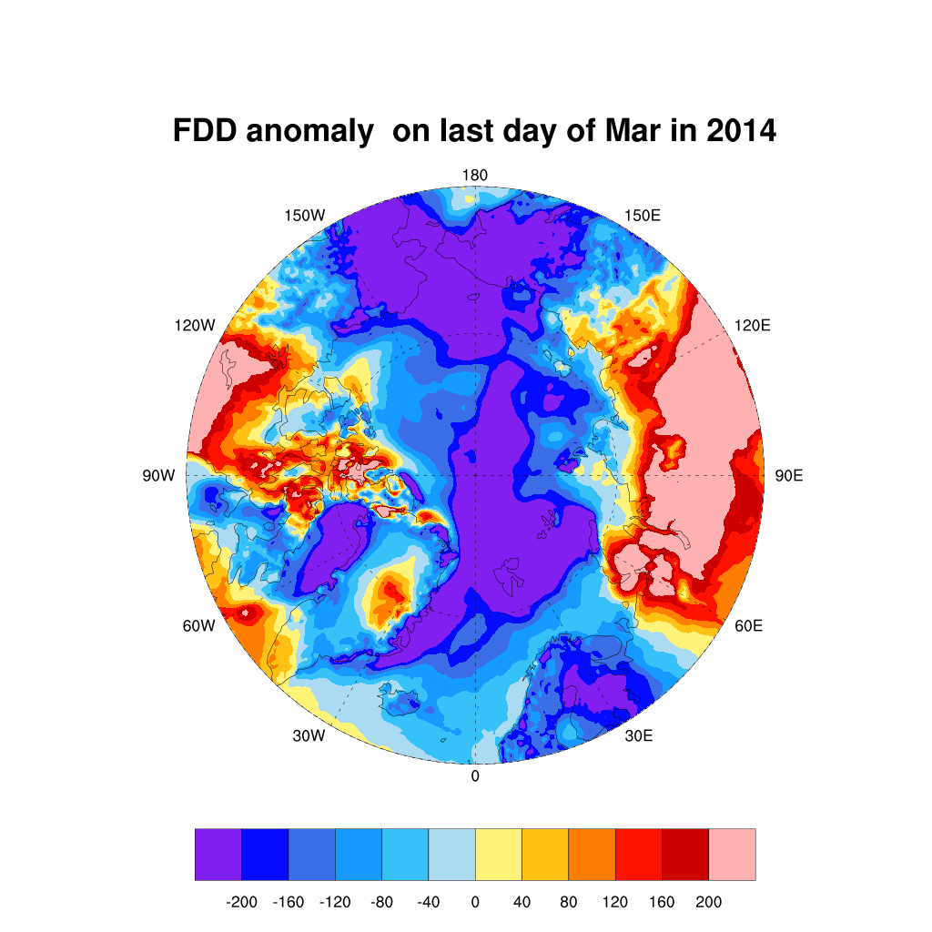
FDD Anomaly in March 2012 and 2014

Slide 7
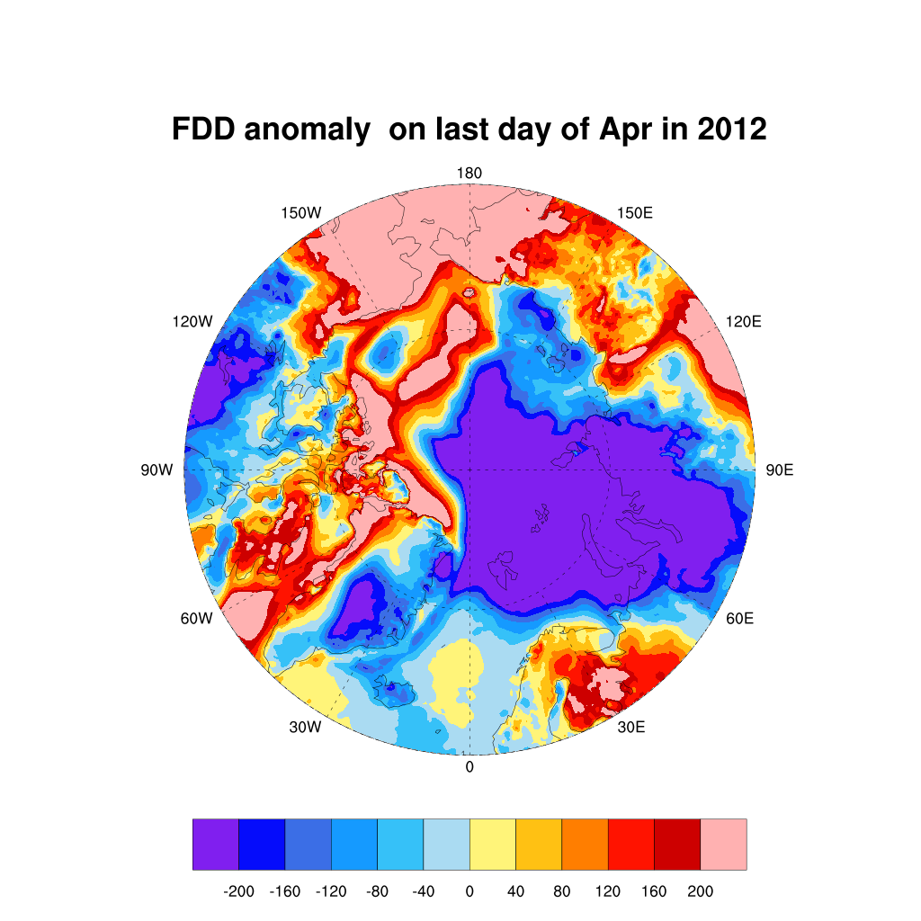
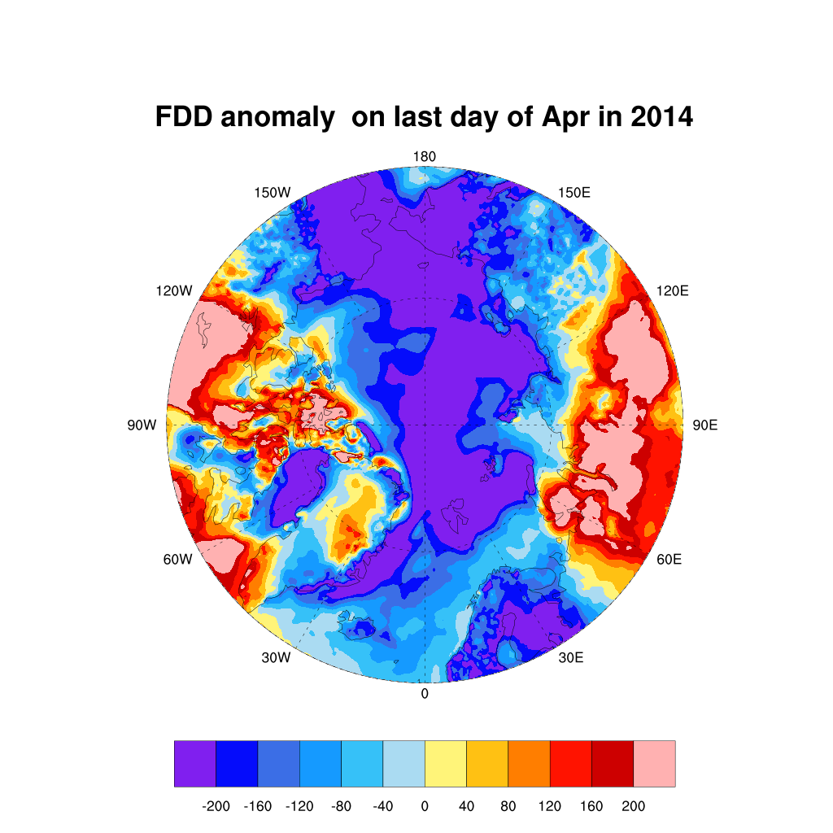
FDD Anomaly in April 2012 and 2014

Slide 8
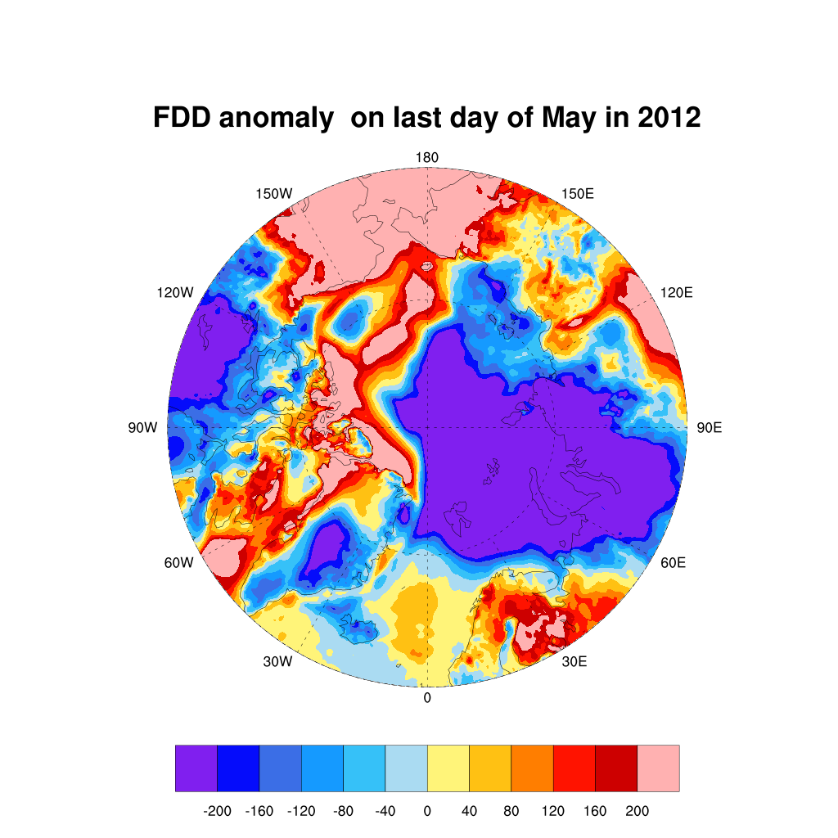
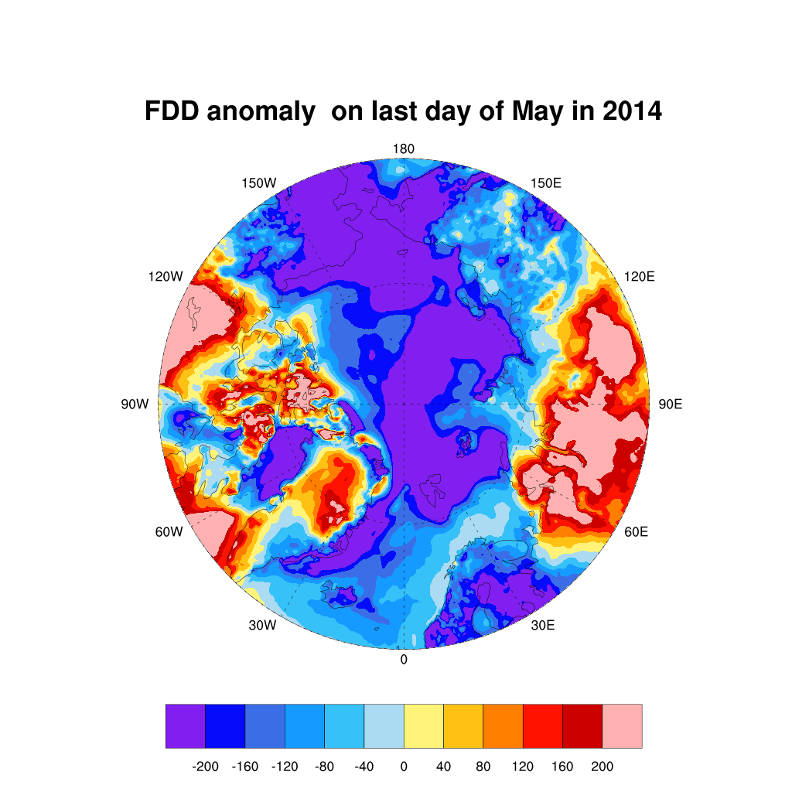
FDD Anomaly in May 2012 and 2014

Slide 9
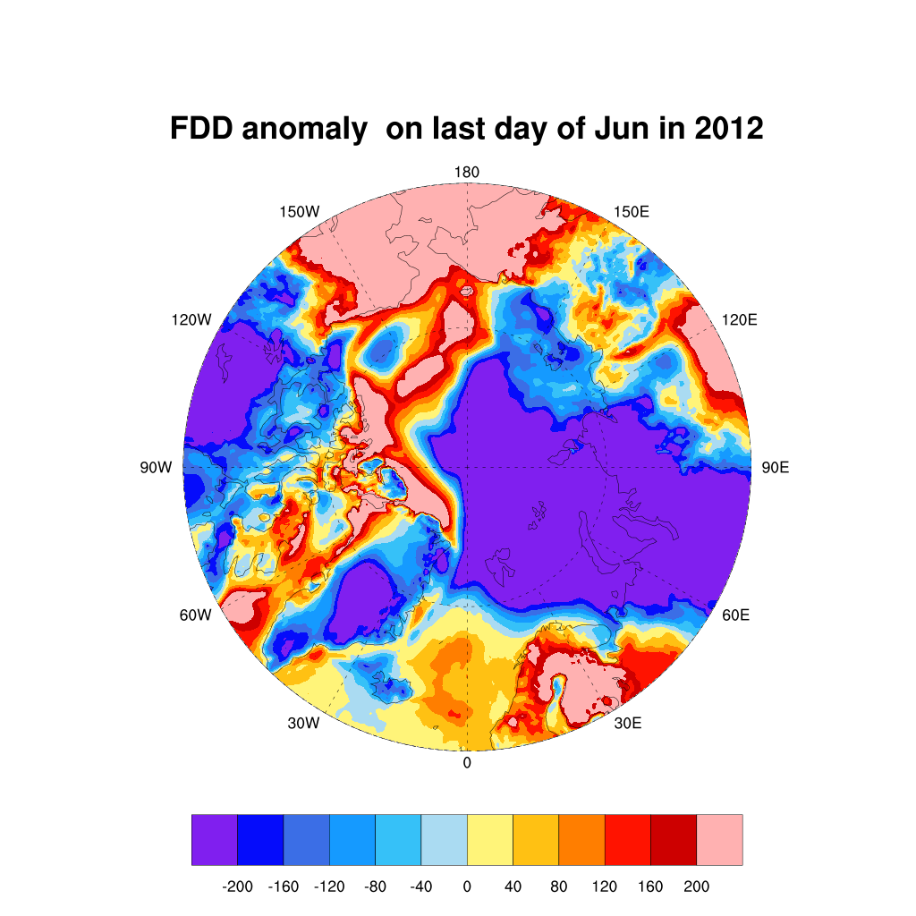
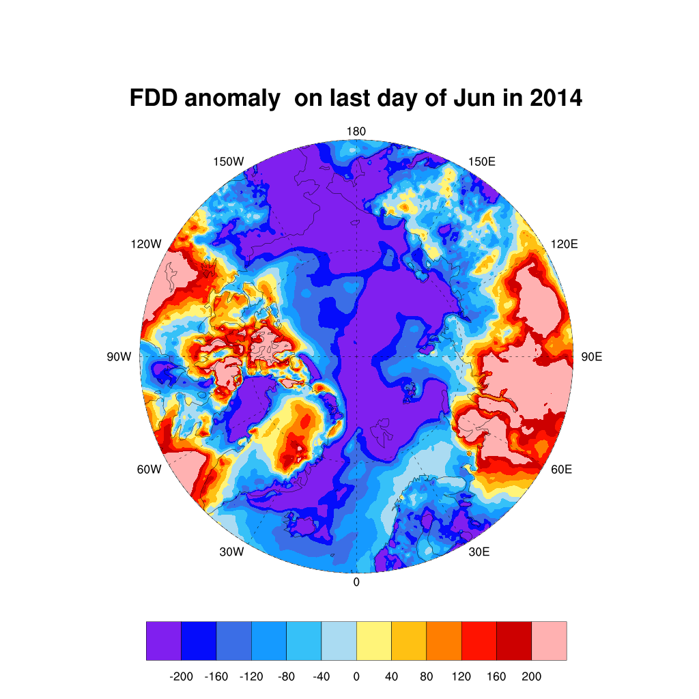
FDD Anomaly in June 2012 and 2014

Slide 10
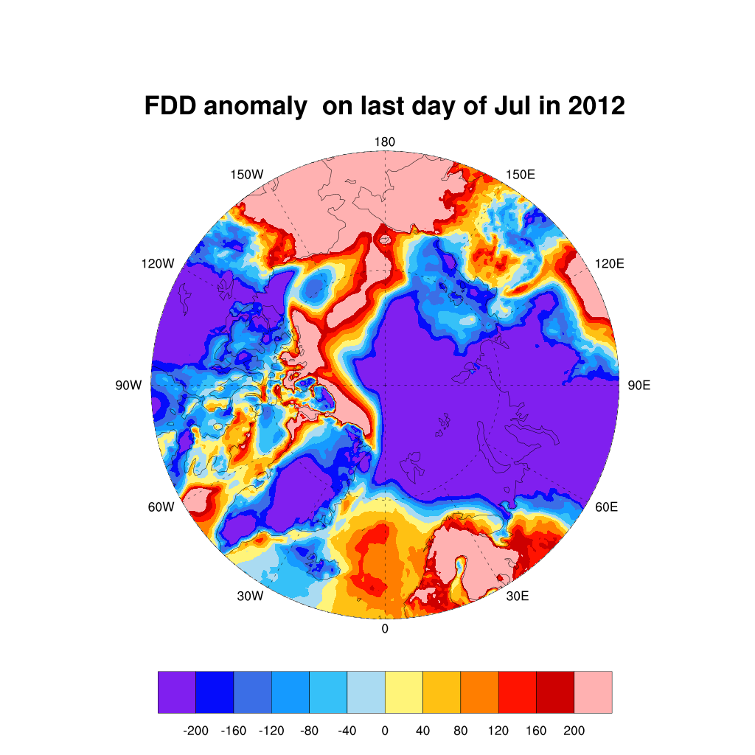
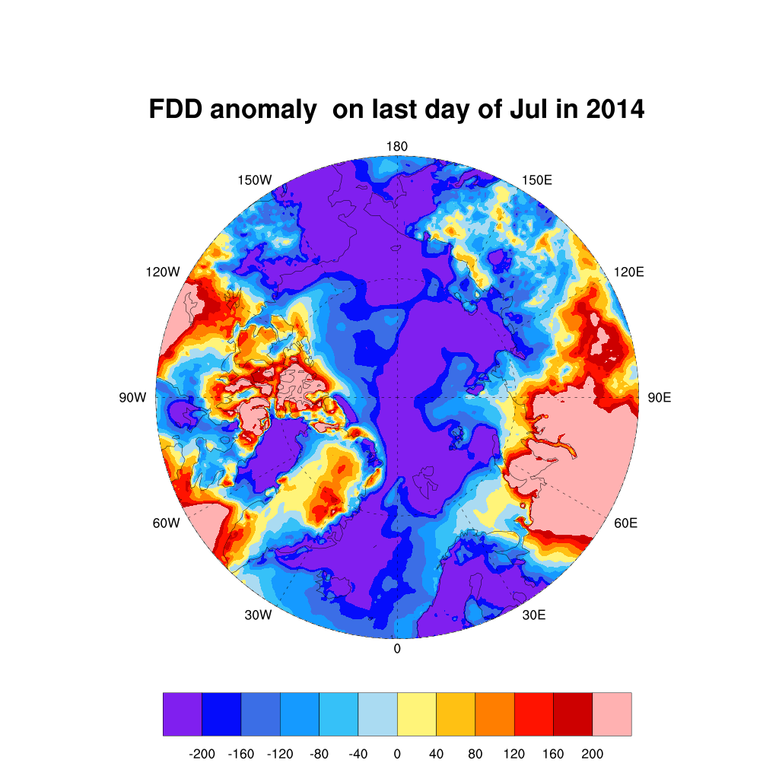
FDD Anomaly in July 2012 and 2014

Slide 11
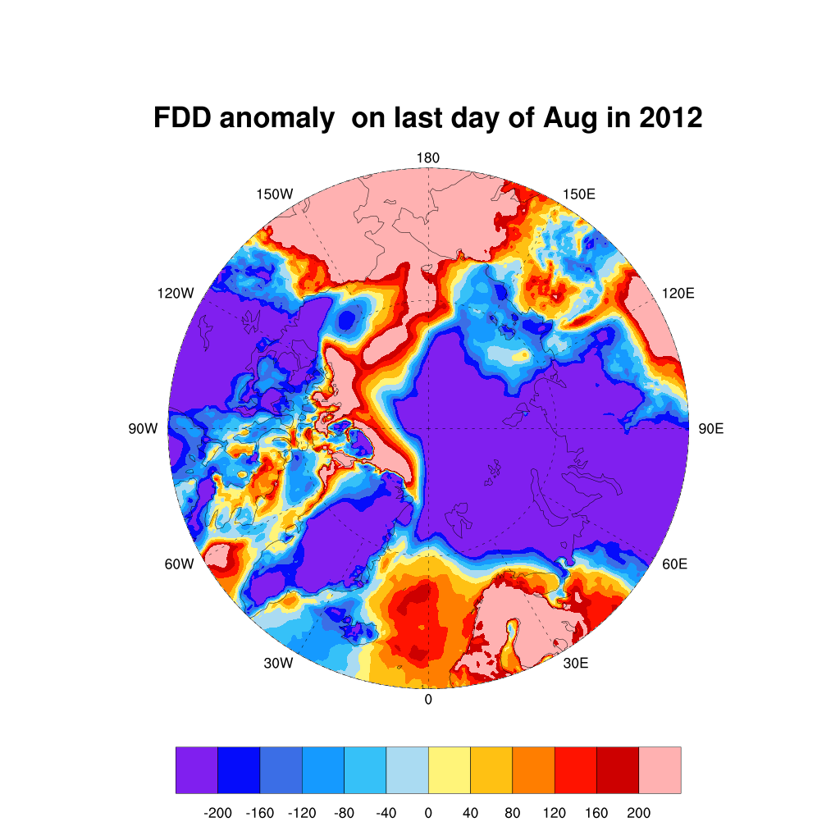
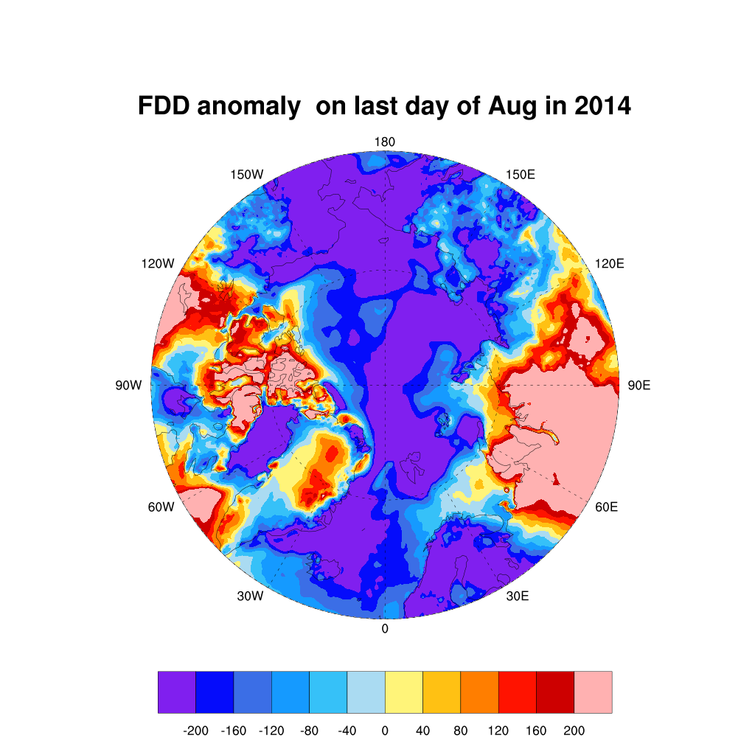
FDD Anomaly in August 2012 and 2014

Slide 12
Slides on wind anomalies from January to August in 2012 and 2014

Slide 13
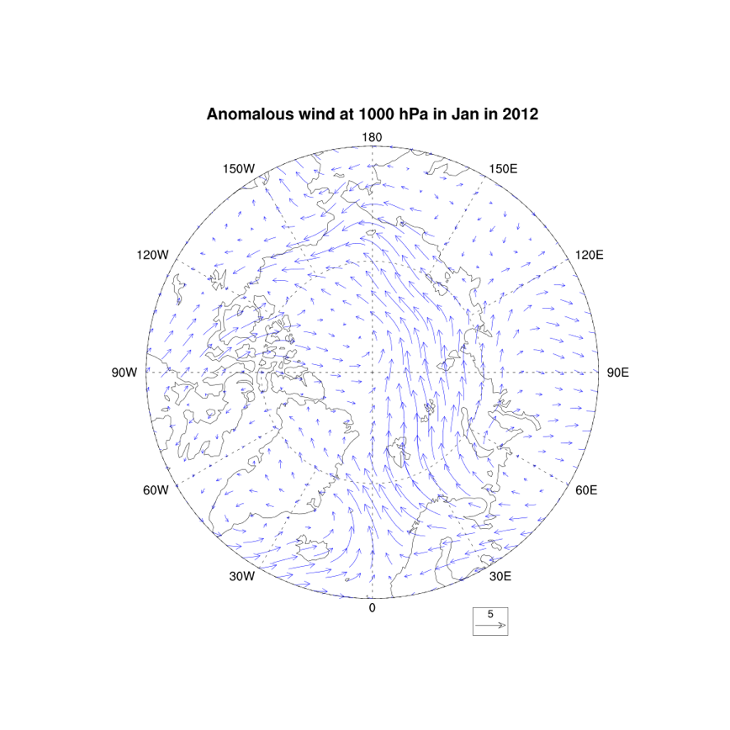
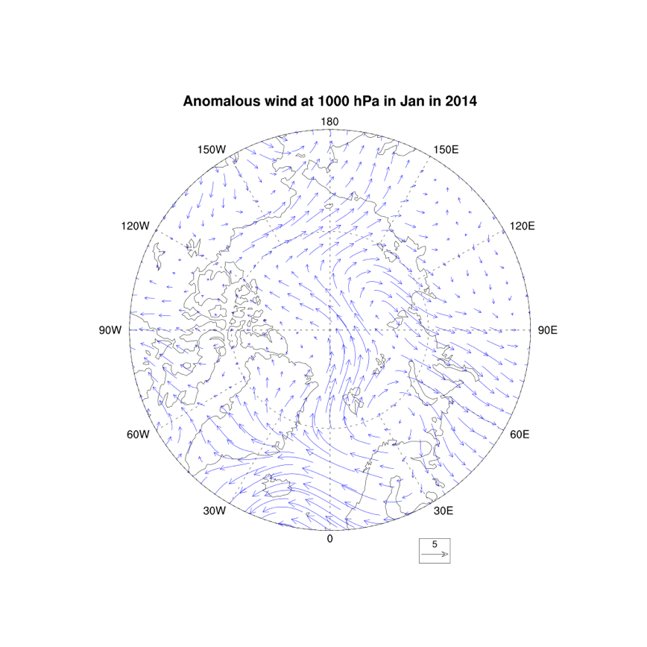
Wind Anomaly in January 2012 and 2014

Slide 14
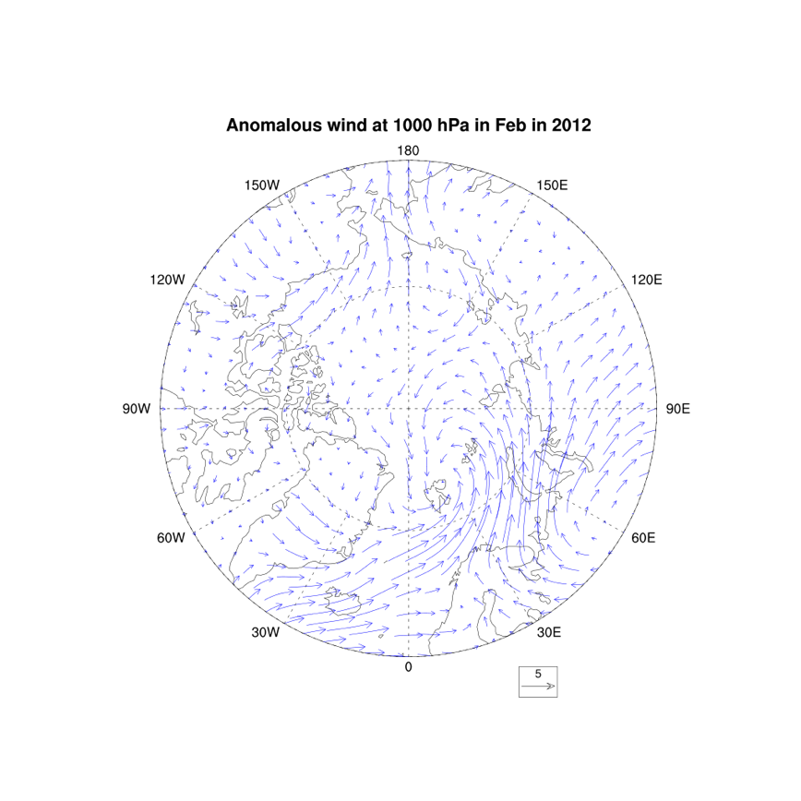
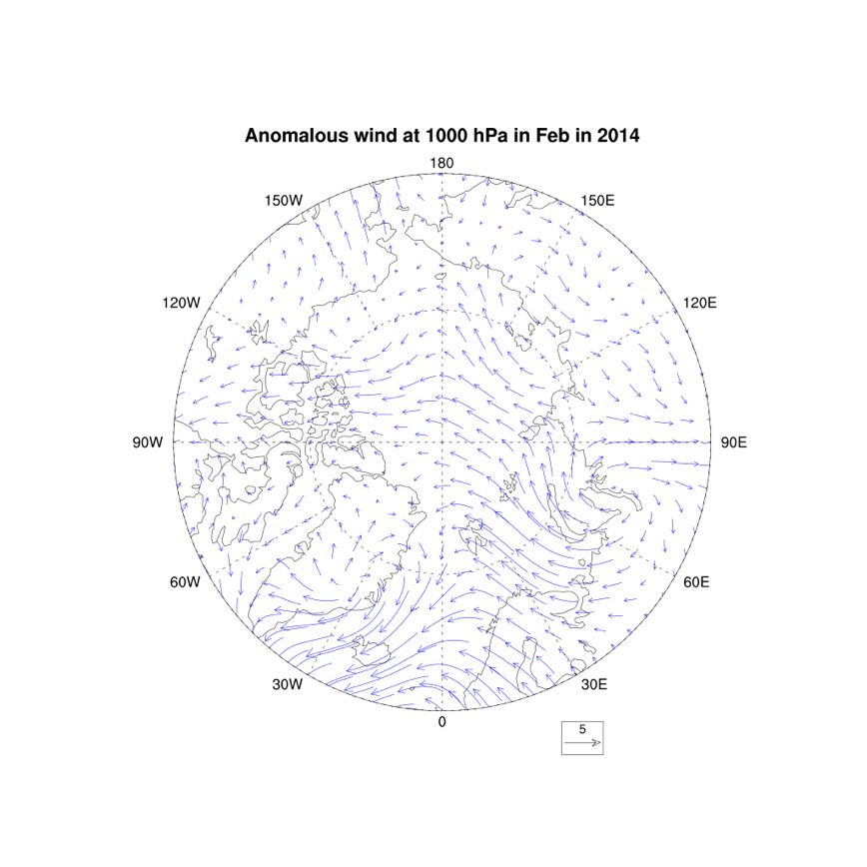
Wind Anomaly in February 2012 and 2014

Slide 15
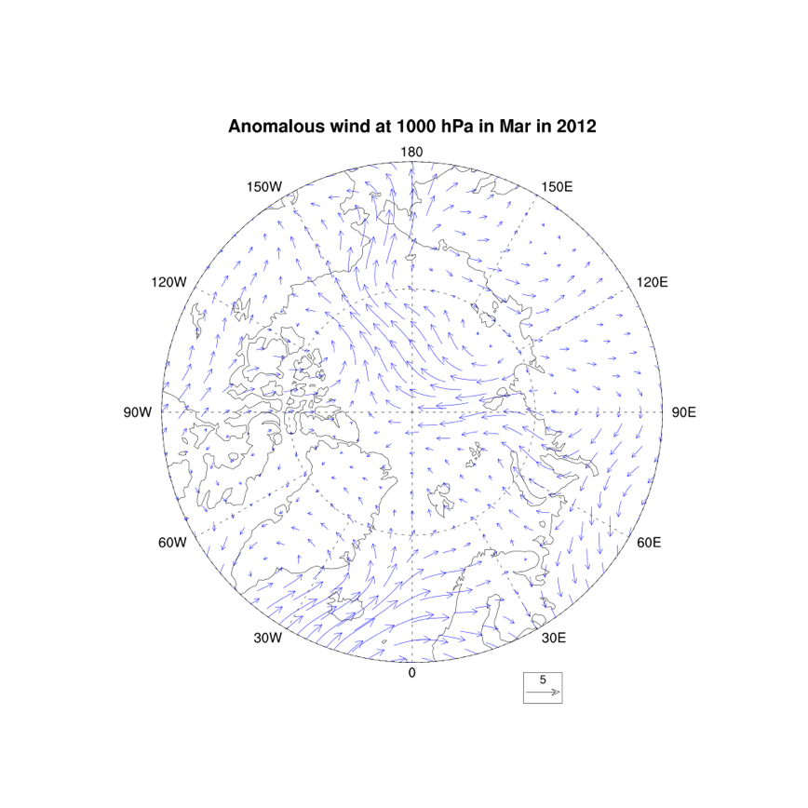
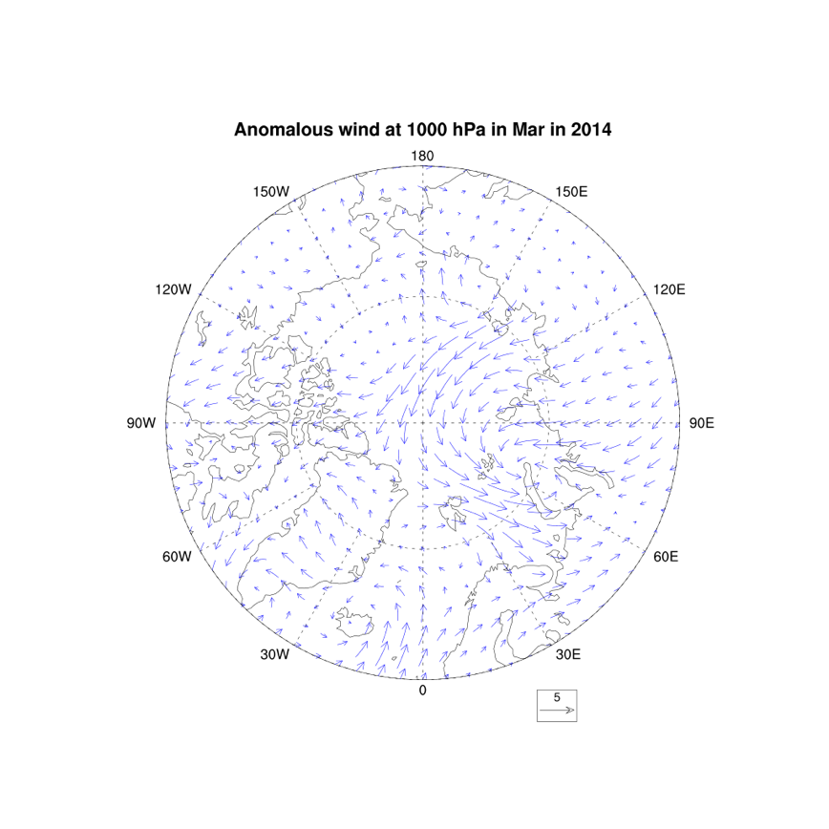
Wind Anomaly in March 2012 and 2014

Slide 16
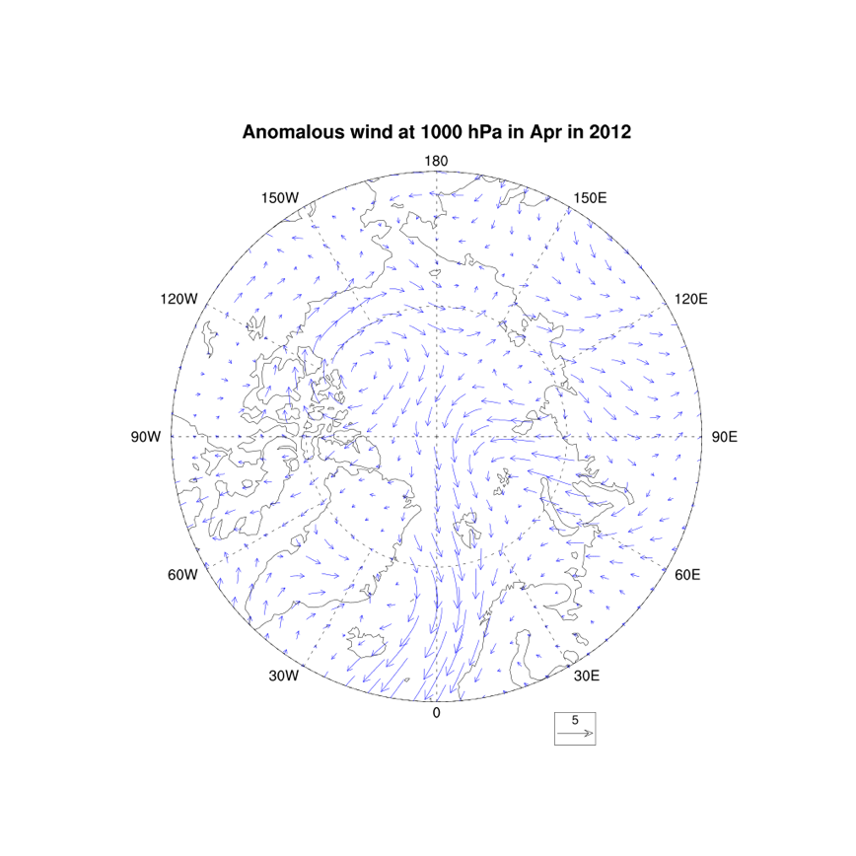
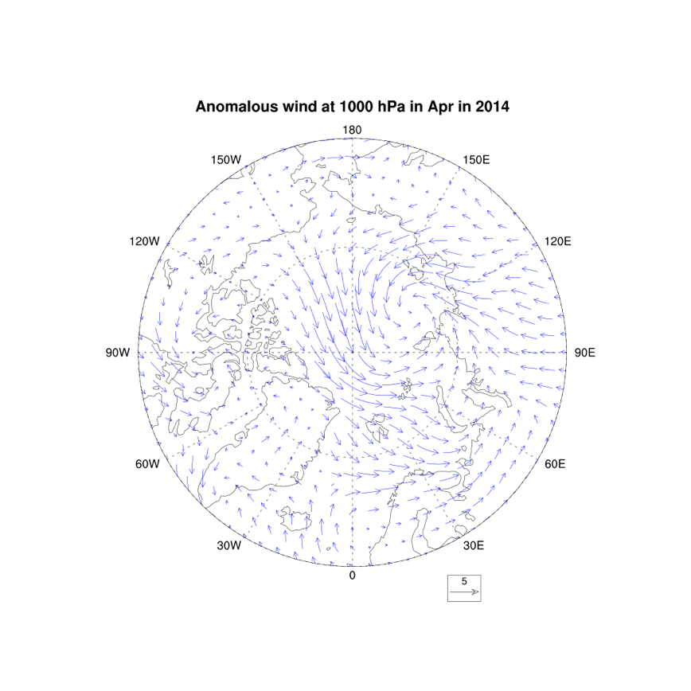
Wind Anomaly in April 2012 and 2014

Slide 17
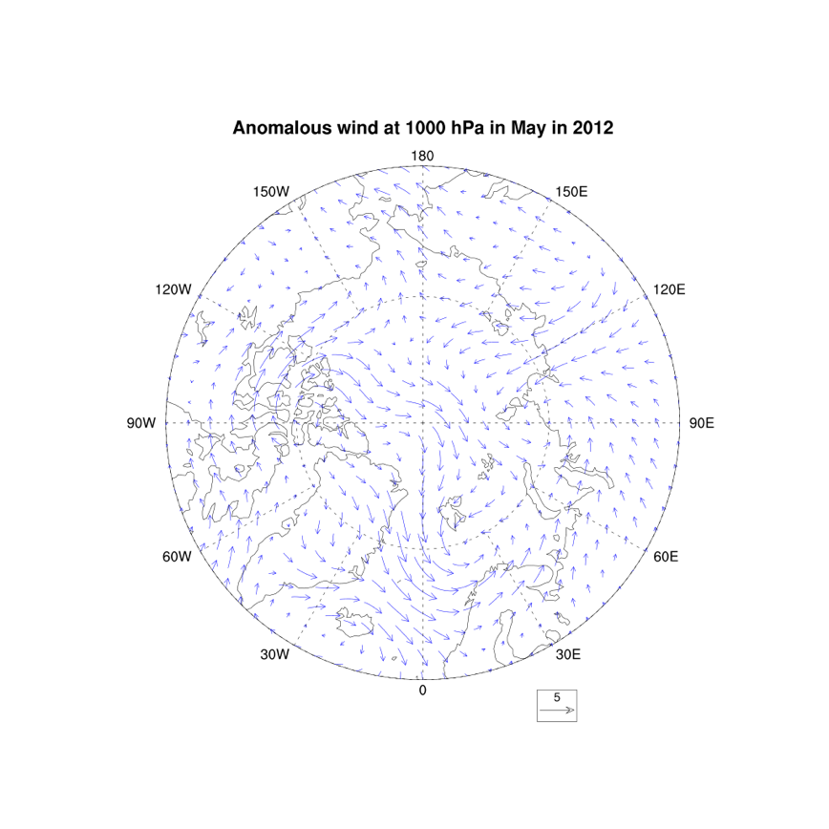
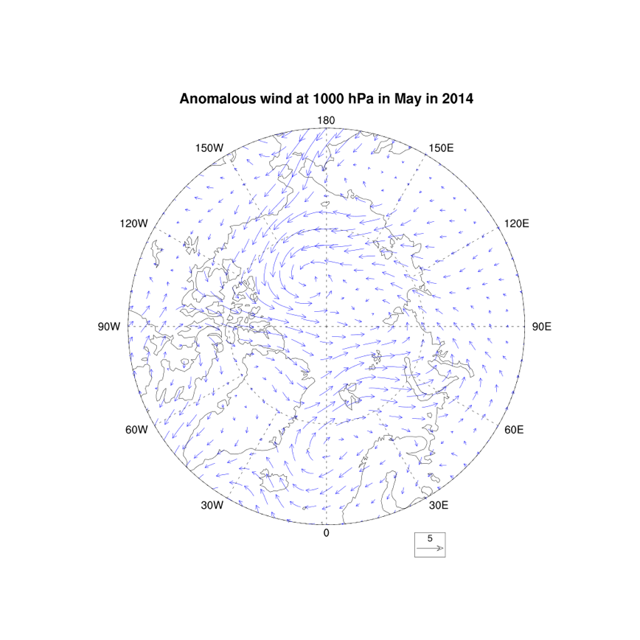
Wind Anomaly in May 2012 and 2014

Slide 18
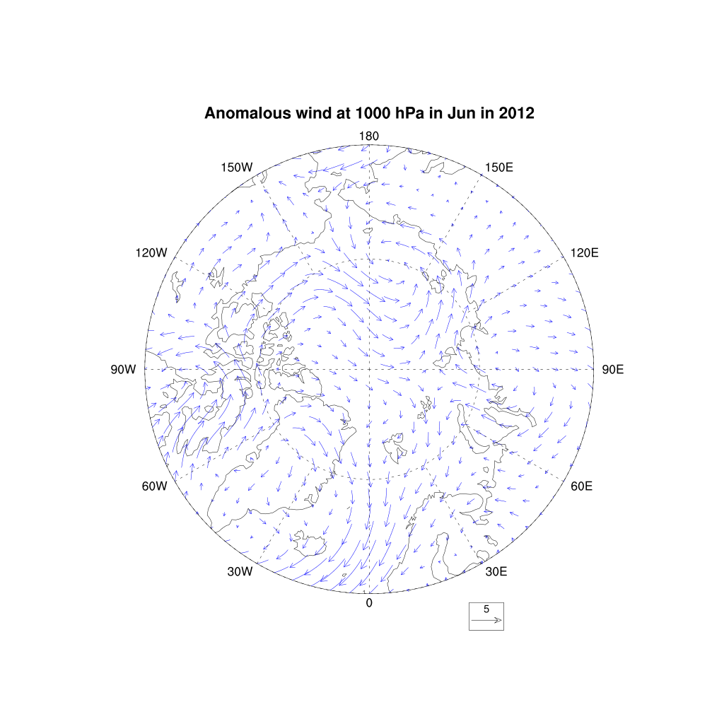
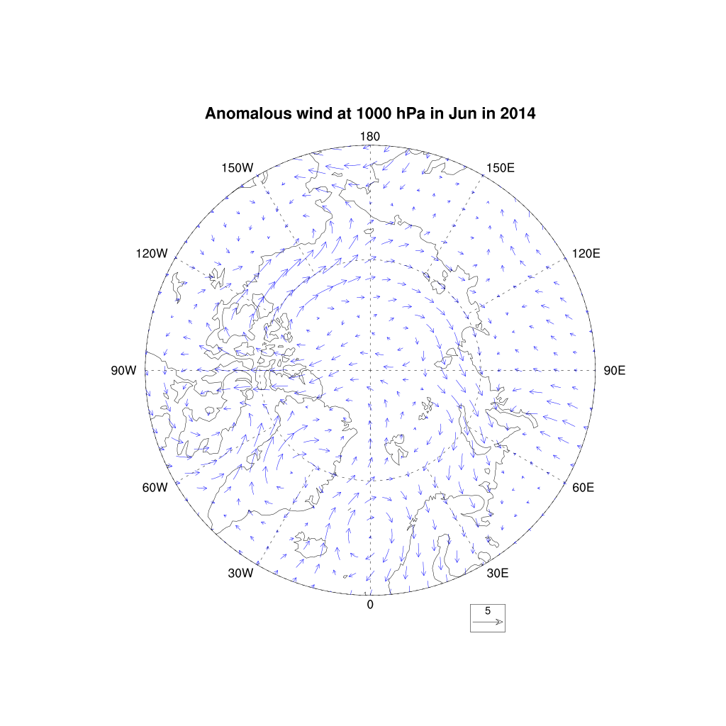
Wind Anomaly in June 2012 and 2014

Slide 19
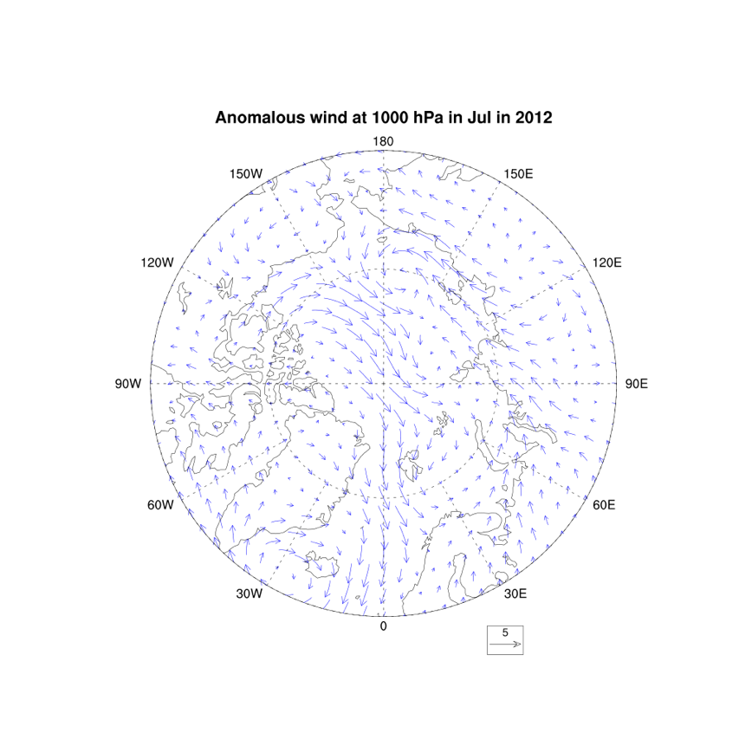
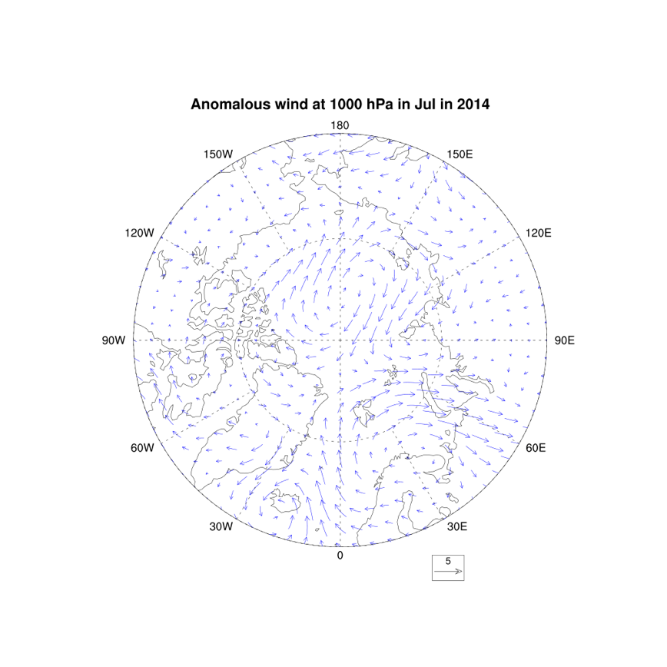
Wind Anomaly in July 2012 and 2014

Slide 20
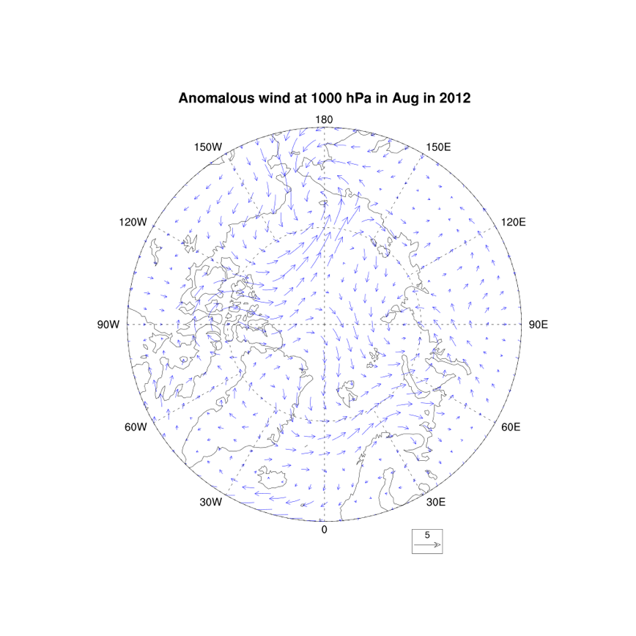
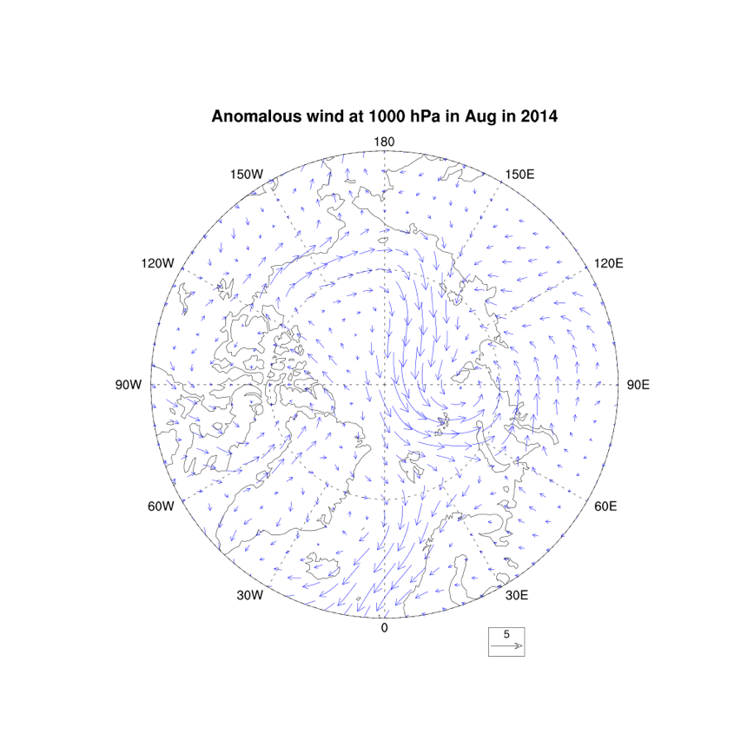
Wind Anomaly in August 2012 and 2014

Slide 21
Slides on ice concentration and ice thickness anomalies from January to August in 2012 and 2014

Slide 22
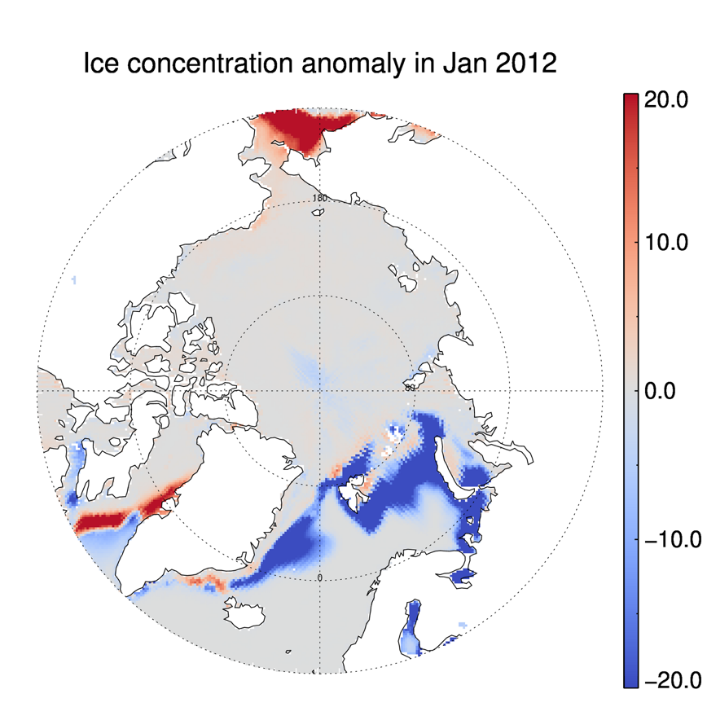
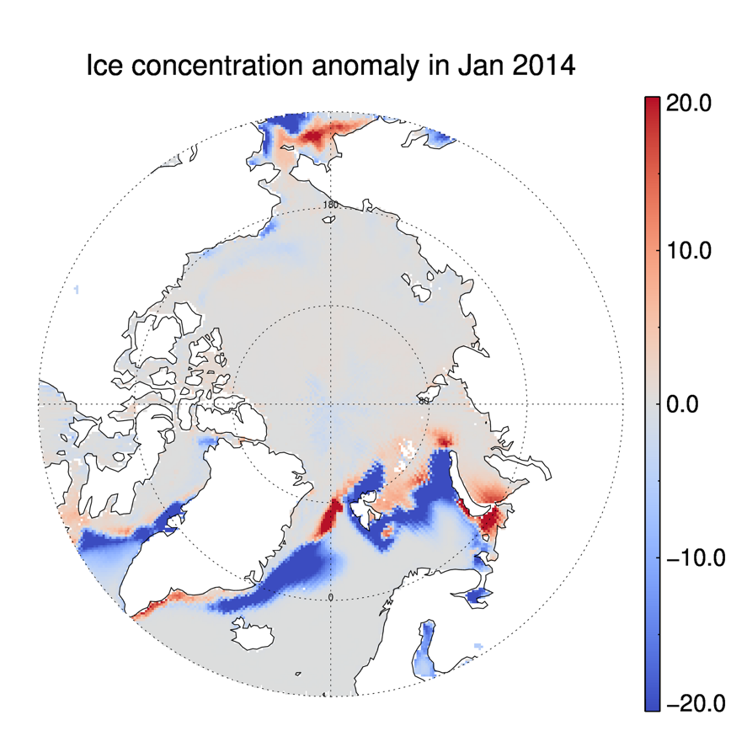
Ice Concentration Anomaly in January 2012 and 2014

Slide 23
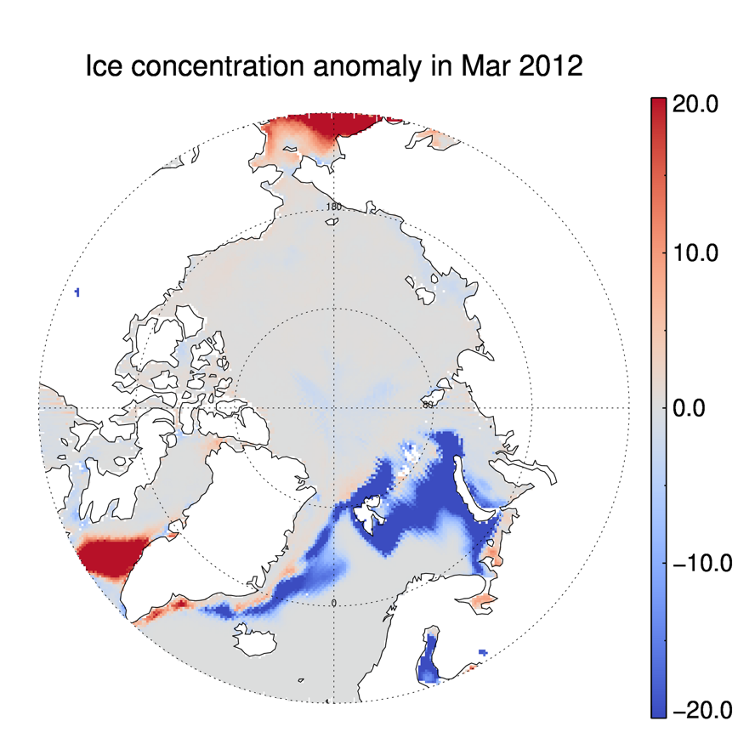
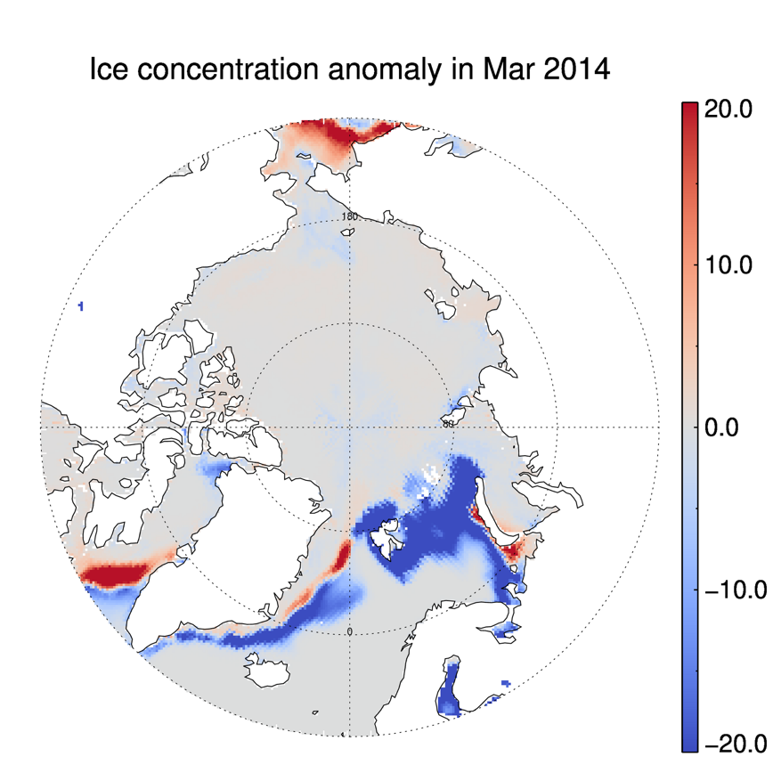
Ice Concentration Anomaly in March 2012 and 2014

Slide 24
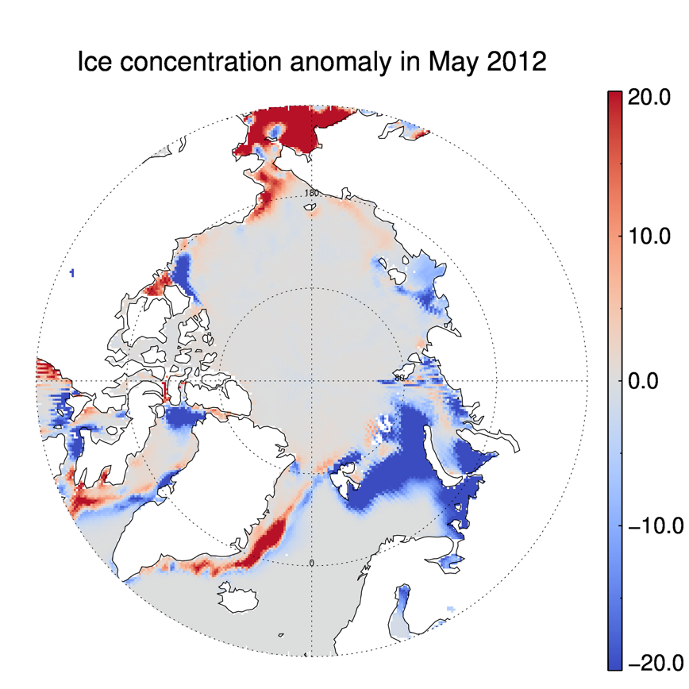
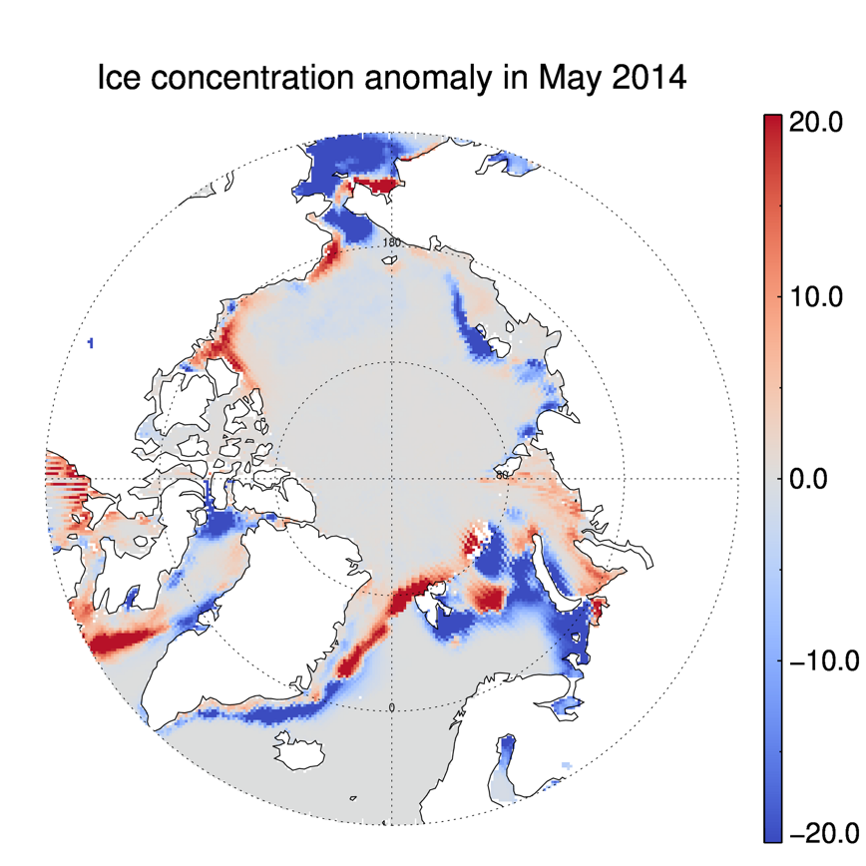
Ice Concentration Anomaly in May 2012 and 2014

Slide 25
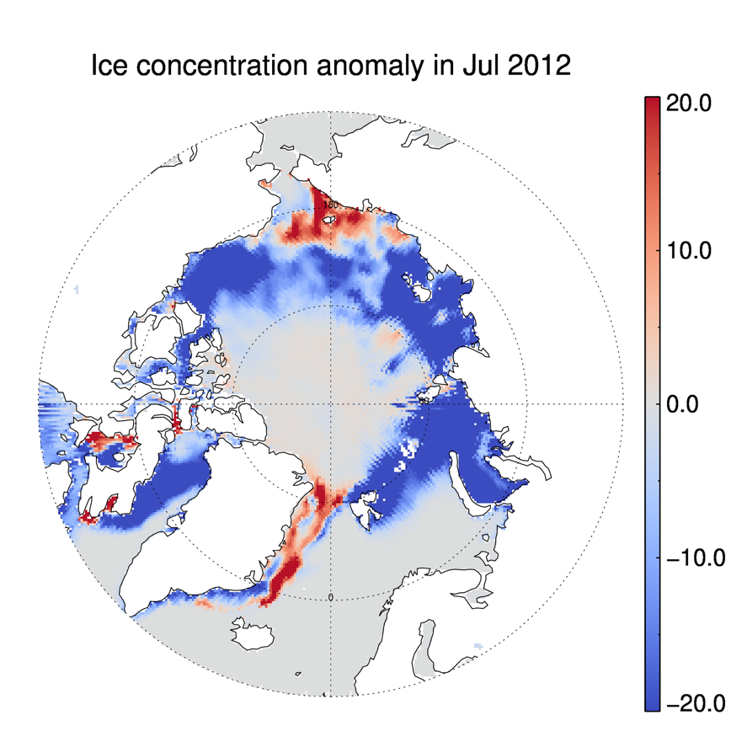
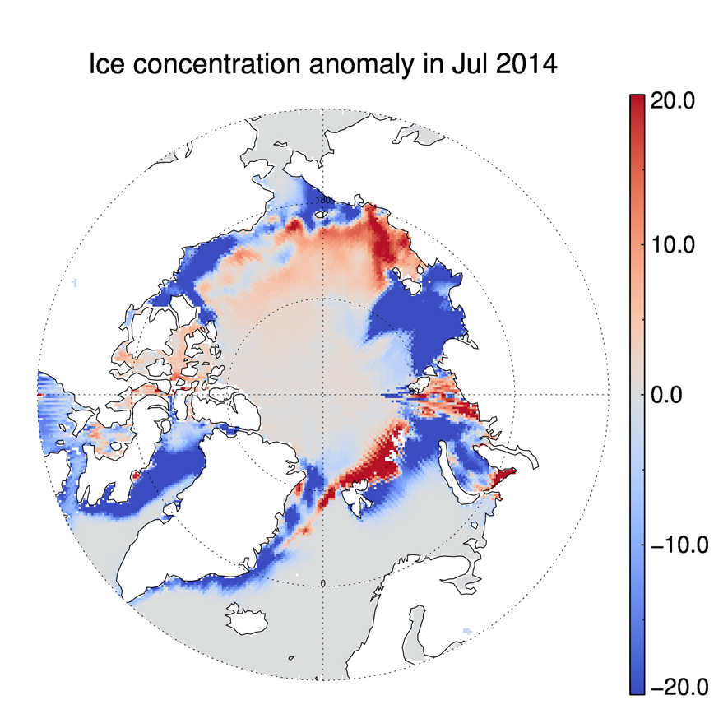
Ice Concentration Anomaly in July 2012 and 2014

Slide 26
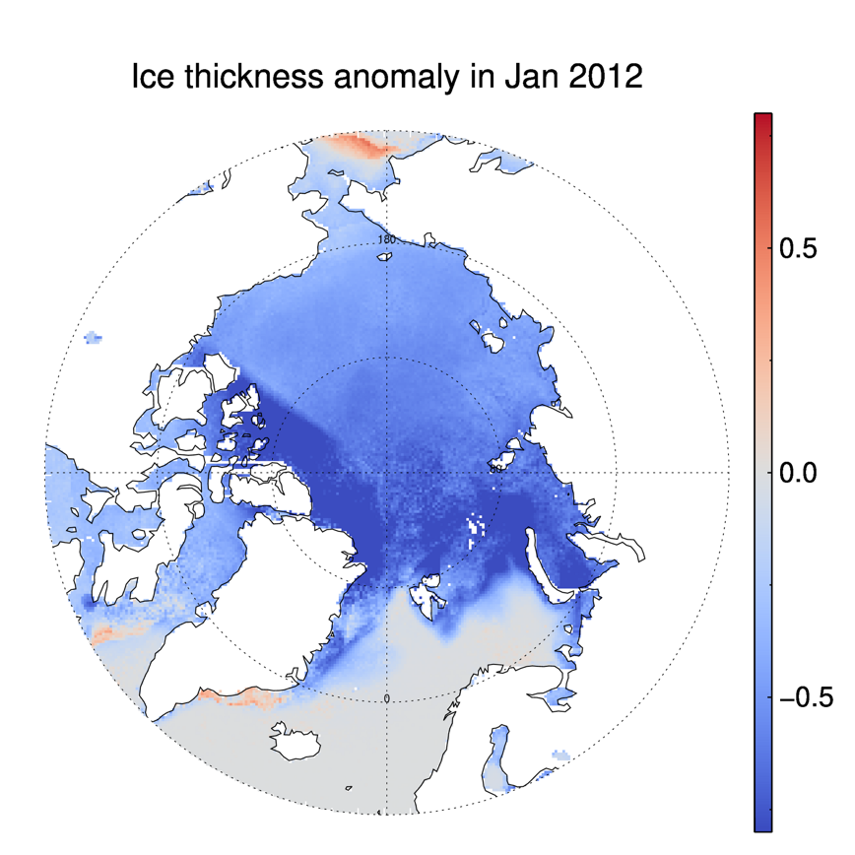
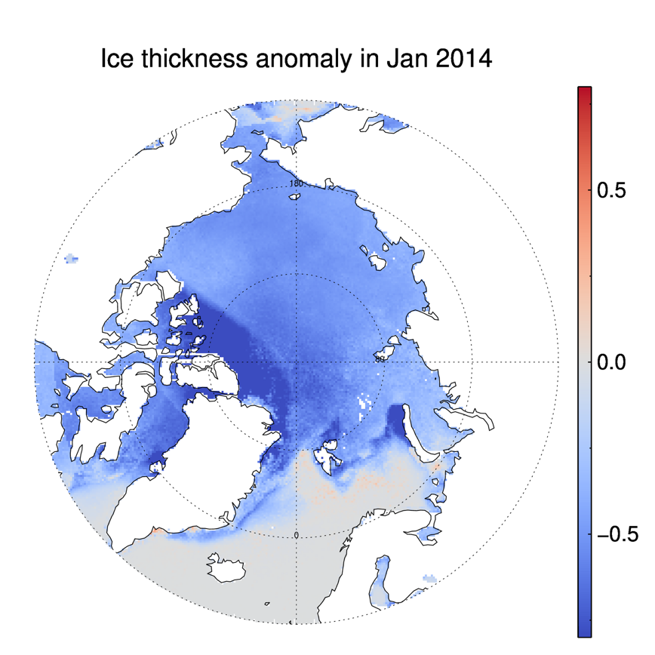
Ice Thickness Anomaly in January 2012 and 2014

Slide 27
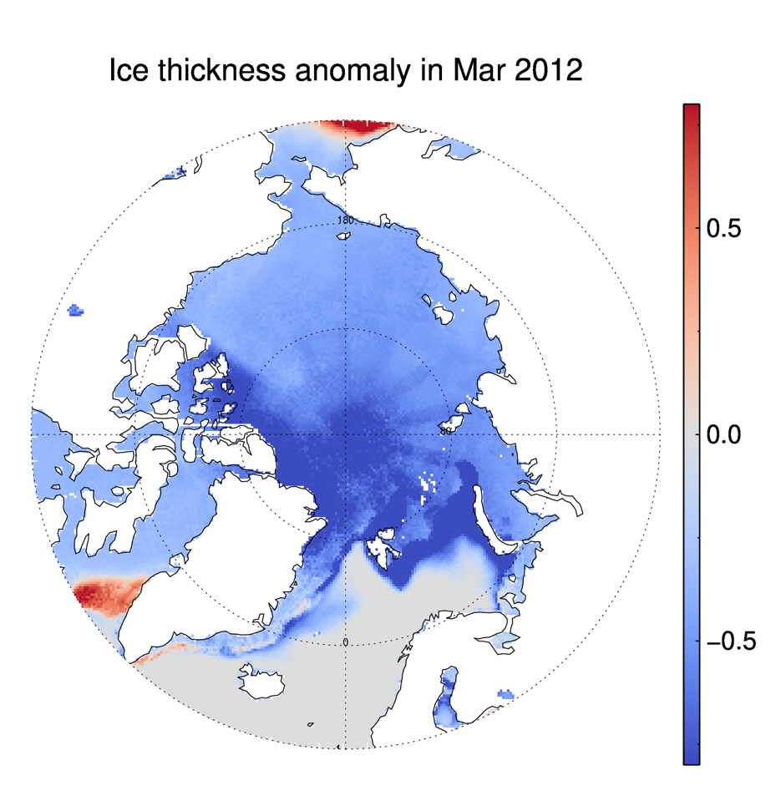
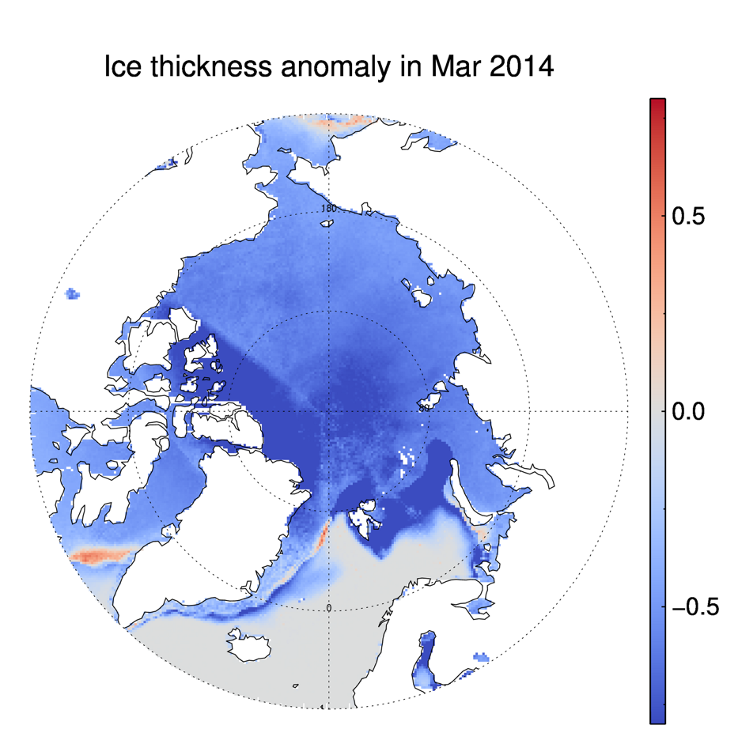
Ice Thickness Anomaly in March 2012 and 2014

Slide 28
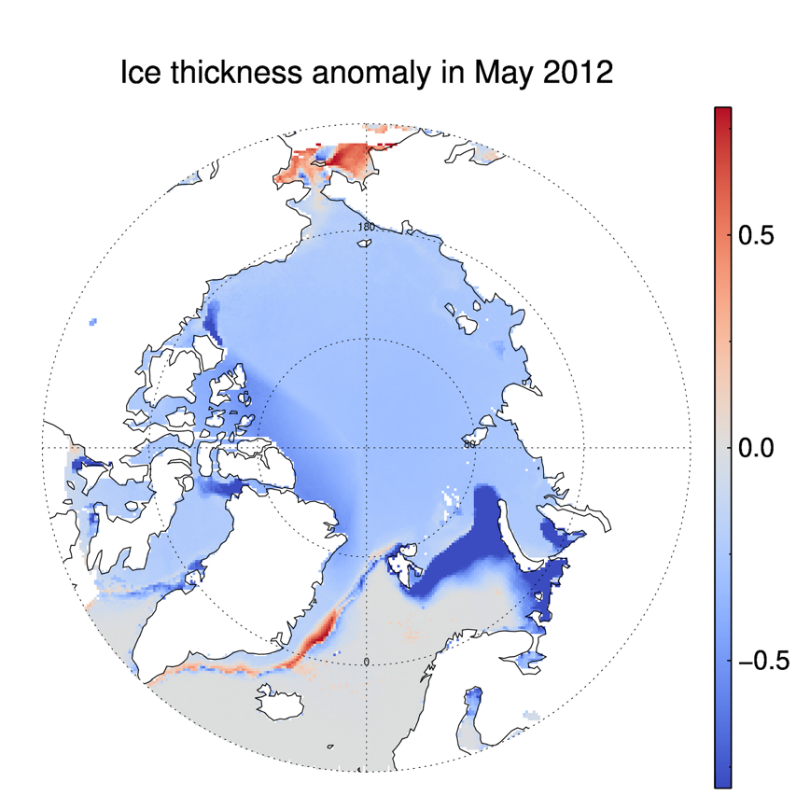
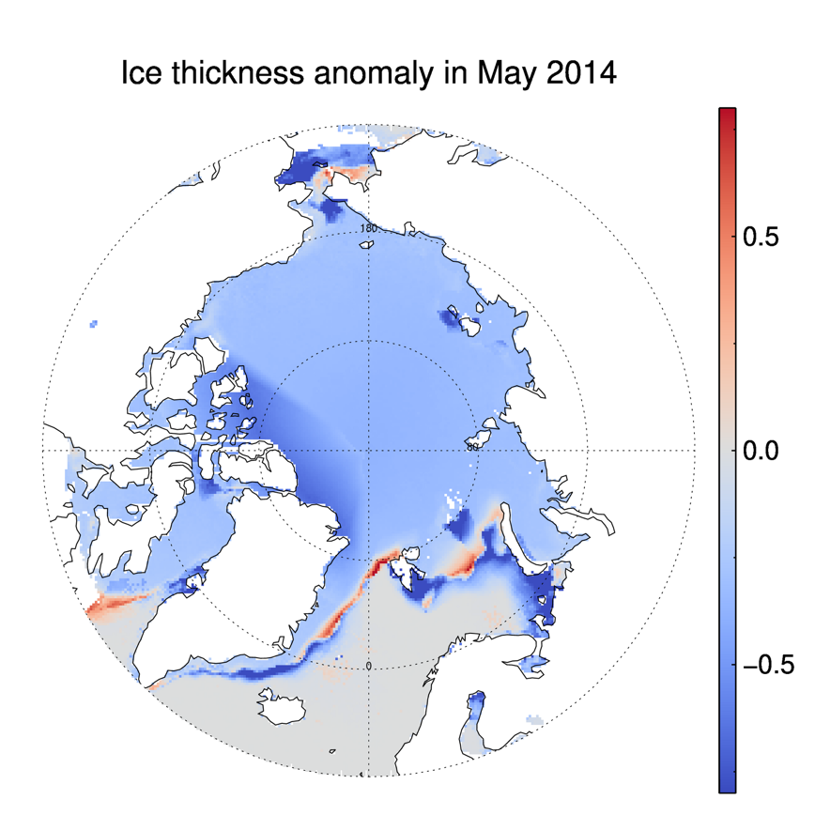
Ice Thickness Anomaly in May 2012 and 2014

Slide 29
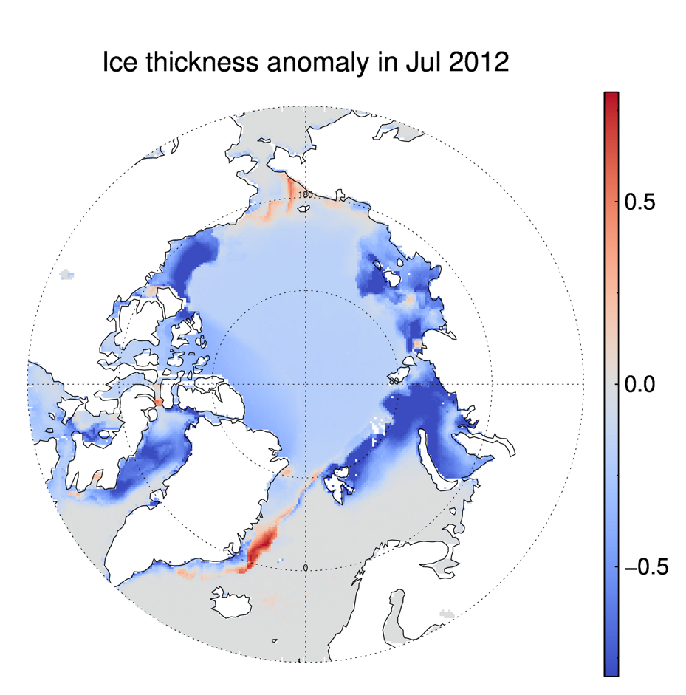
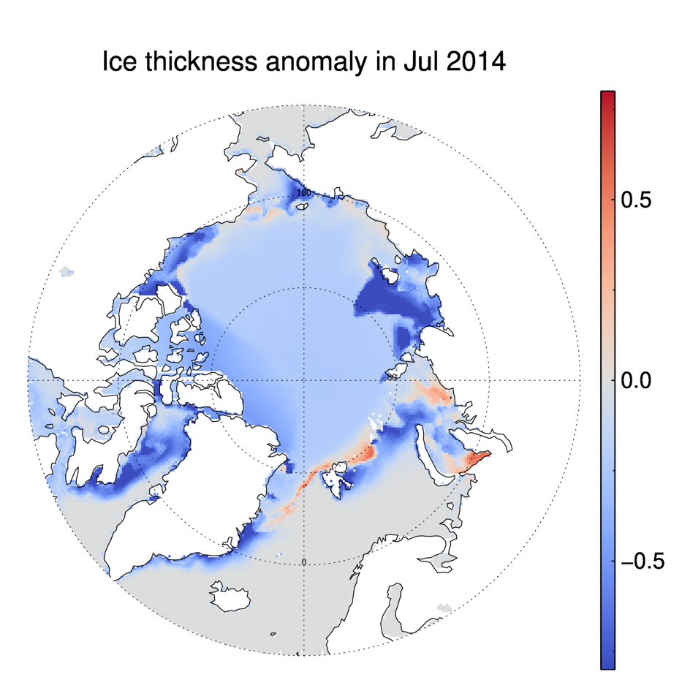
Ice Thickness Anomaly in July 2012 and 2014

Slide 30

End Breakout Session
Please return to the main session for discussion and wrap-up of this short course module.

