Slide 1
Where can you find data online?
Scott Lindstrom, CIMSS

Slide 2
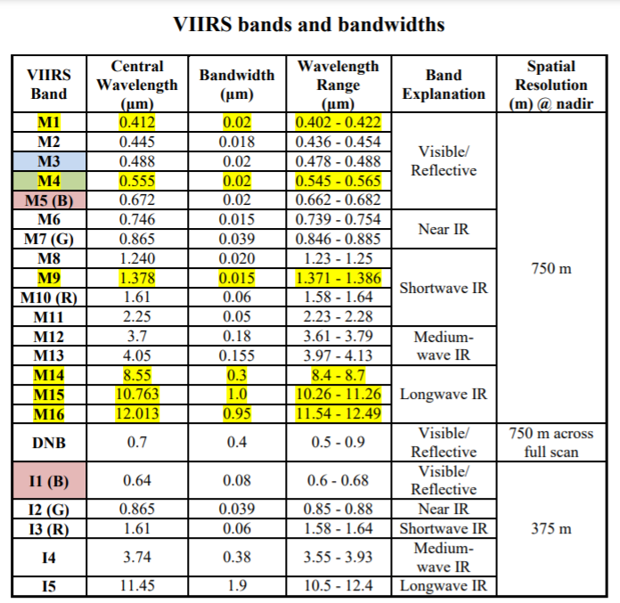
Data from NOAA-20 (21!) / VIIRS
List of VIIRS Channels
https://rammb.cira.colostate.edu/projects/npp/VIIRS_bands_and_bandwidths.pdf
“M” Bands: Moderate Resolution
“I” Bands: Imager resolution
JPSS-2 launch scheduled for early November

Slide 3
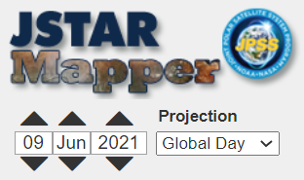
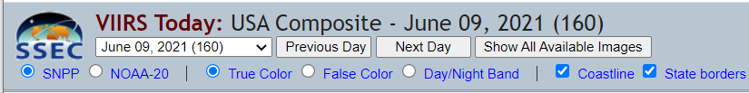
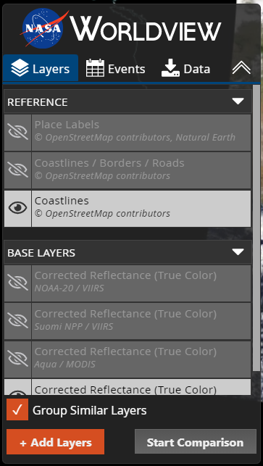
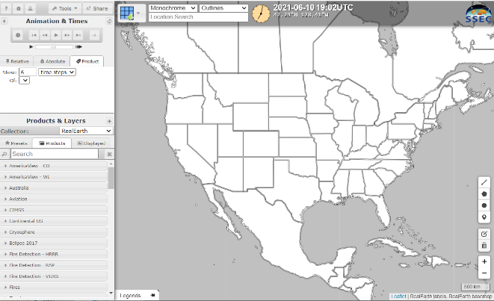
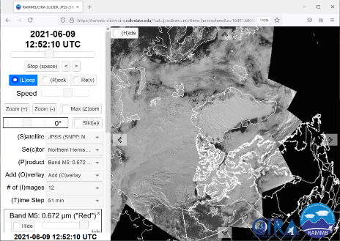
Where can you find VIIRS Imagery online?
JSTAR Mapper
VIIRS Today
RealEarth
NASA Worldview
ftp-like servers at Direct Broadcast sites
CIRA Slider
(also includes GCOM, TROPOMI and JPSS Products and VIIRS Granules)
The thumbnails are clickable!

Slide 4
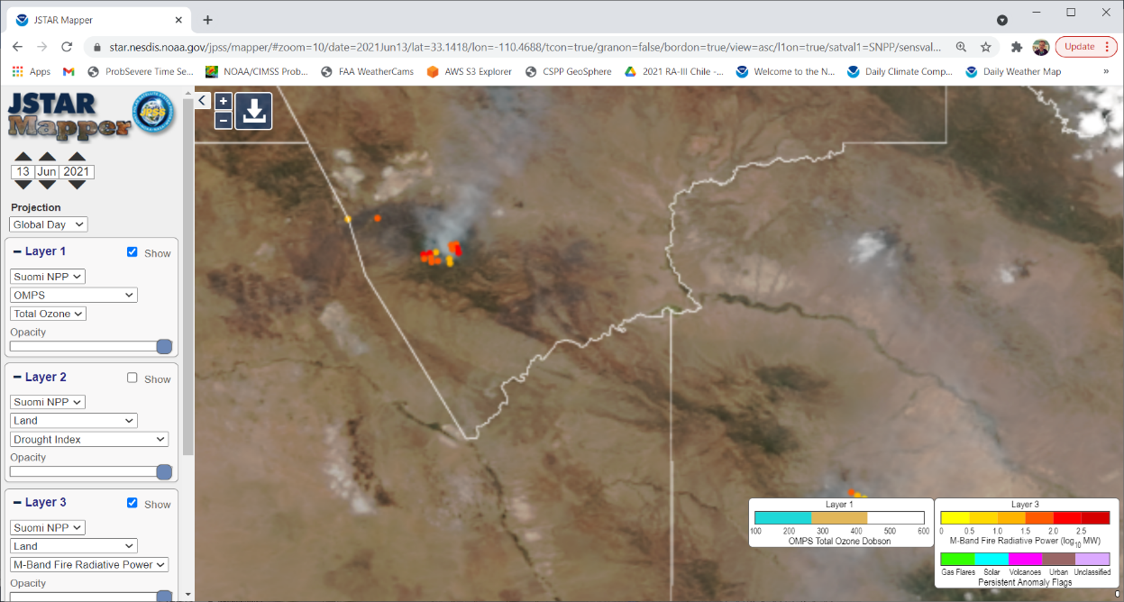
JSTAR Mapper
Includes imagery from Suomi-NPP, NOAA-20, GCOM-W2, Sentinel
Some of these are very hard to find elsewhere
https://www.star.nesdis.noaa.gov/jpss/mapper/

Slide 5
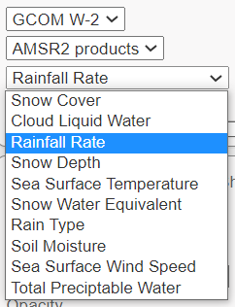
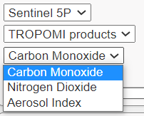
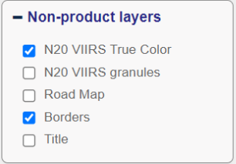
Some things that you can find at JSTAR Mapper
https://www.star.nesdis.noaa.gov/jpss/mapper/

Slide 6
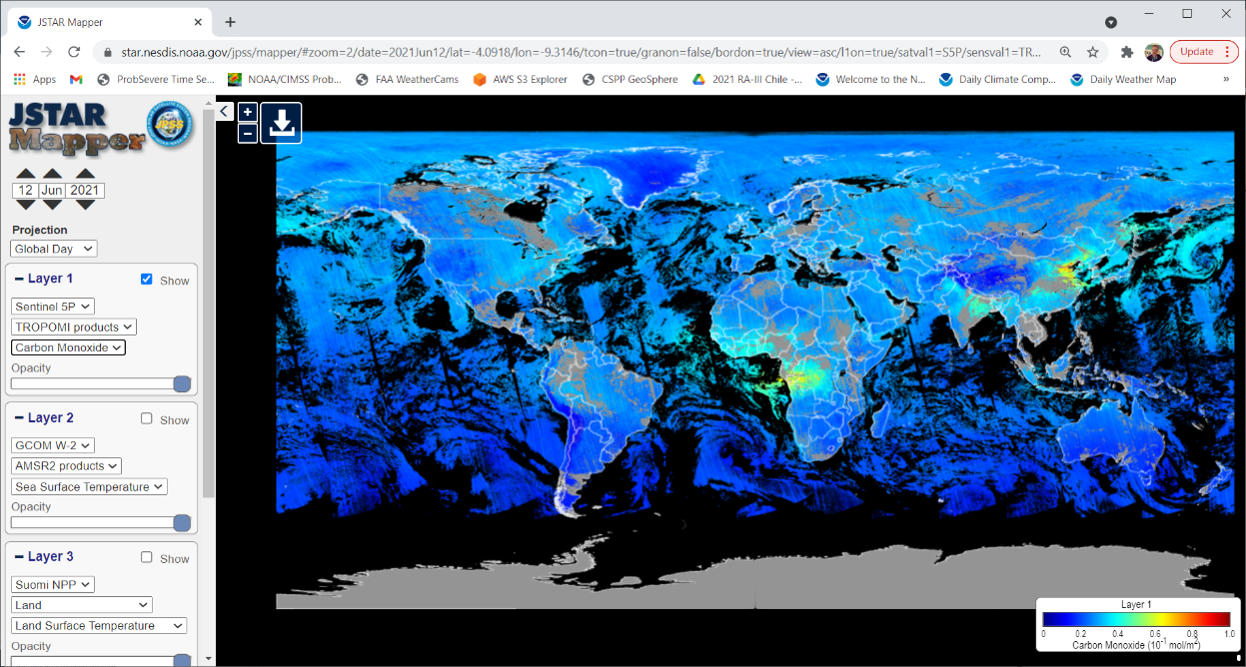
JSTAR Mapper: TROPOMI Imagery: CO
https://www.star.nesdis.noaa.gov/jpss/mapper/

Slide 7
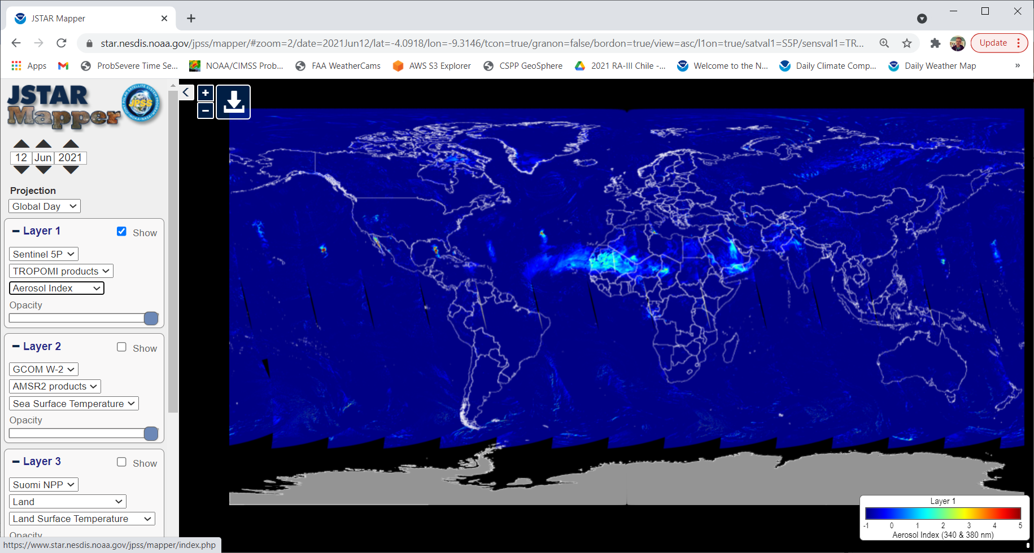
JSTAR Mapper: TROPOMI Imagery: Aerosol Index
This could be dust or smoke?
Nice capture of a SAL event
https://www.star.nesdis.noaa.gov/jpss/mapper/

Slide 8
VIIRS Today
This is data from Direct Broadcast sites over CONUS, and it only shows VIIRS.
  True Color imagery (Red/Green/Blue imagery with Red/Green/Blue bands)
  ‘False Color’ imagery (Combines visible and near-infrared imagery)
  Day Night Band imagery
Also links to orbits!
https://ge.ssec.wisc.edu/viirs-today/

Slide 9
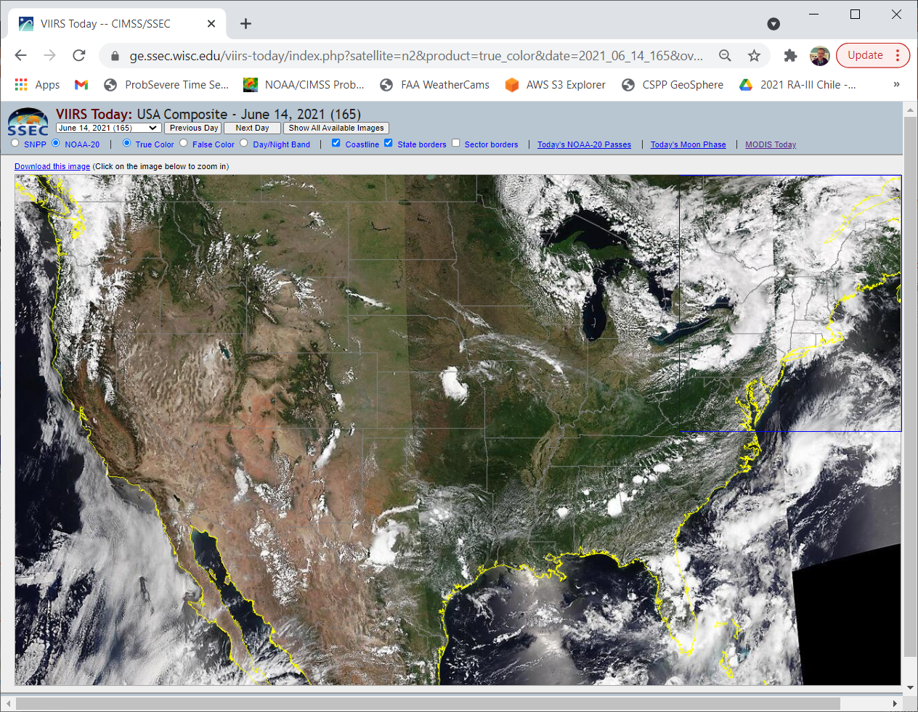
VIIRS Today Website
Note: S-NPP and VIIRS
True Color
False Color
Day Night Band
Coastline toggle
State Borders toggle
Sector Borders
Today’s NOAA-20 Passes
Today’s Moon Phase
MODIS Today
Click on a sector!
https://ge.ssec.wisc.edu/viirs-today/

Slide 10
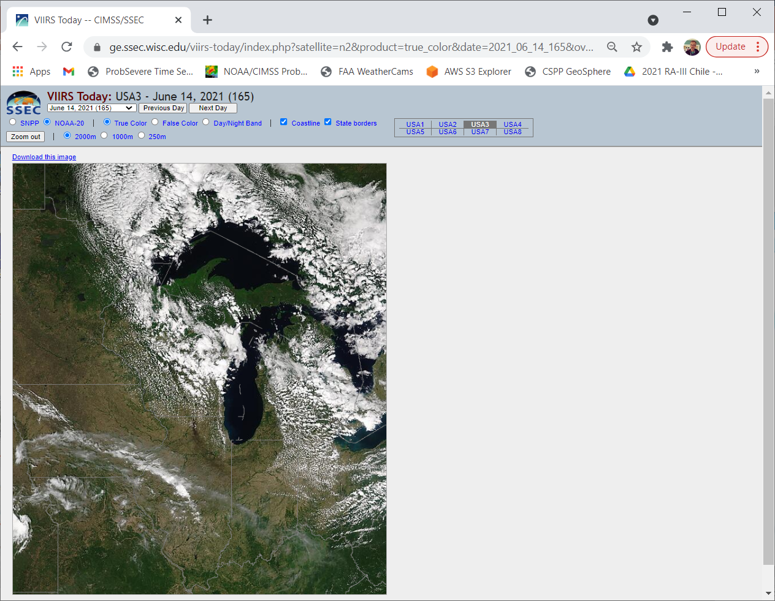
VIIRS Sectors – there are 8 of them
2000 m, 1000 m and 250 m resolutions
https://ge.ssec.wisc.edu/viirs-today/

Slide 11
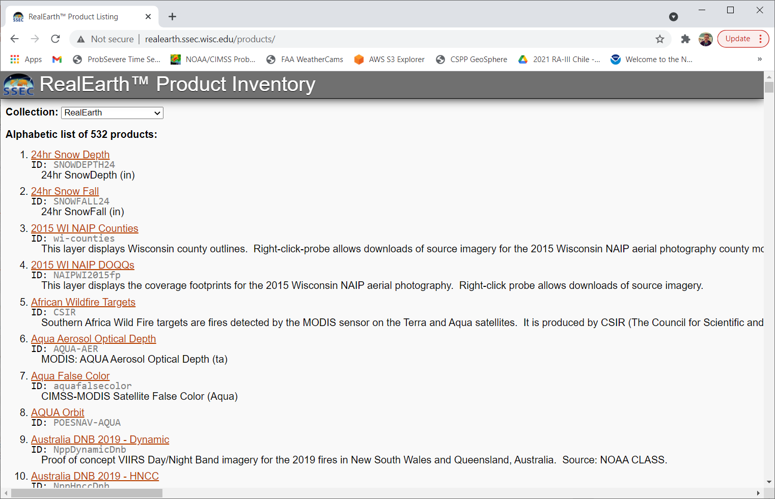
RealEarth: a data Aggregator!
Gathers imagery from many places and puts then in a common environment.
http://realearth.ssec.wisc.edu/products/
Alphabetic list of products in RealEarth
Note: 500+ of them!
Alternatively, enter RealEarth and use the Search
http://realearth.ssec.wisc.edu/

Slide 12
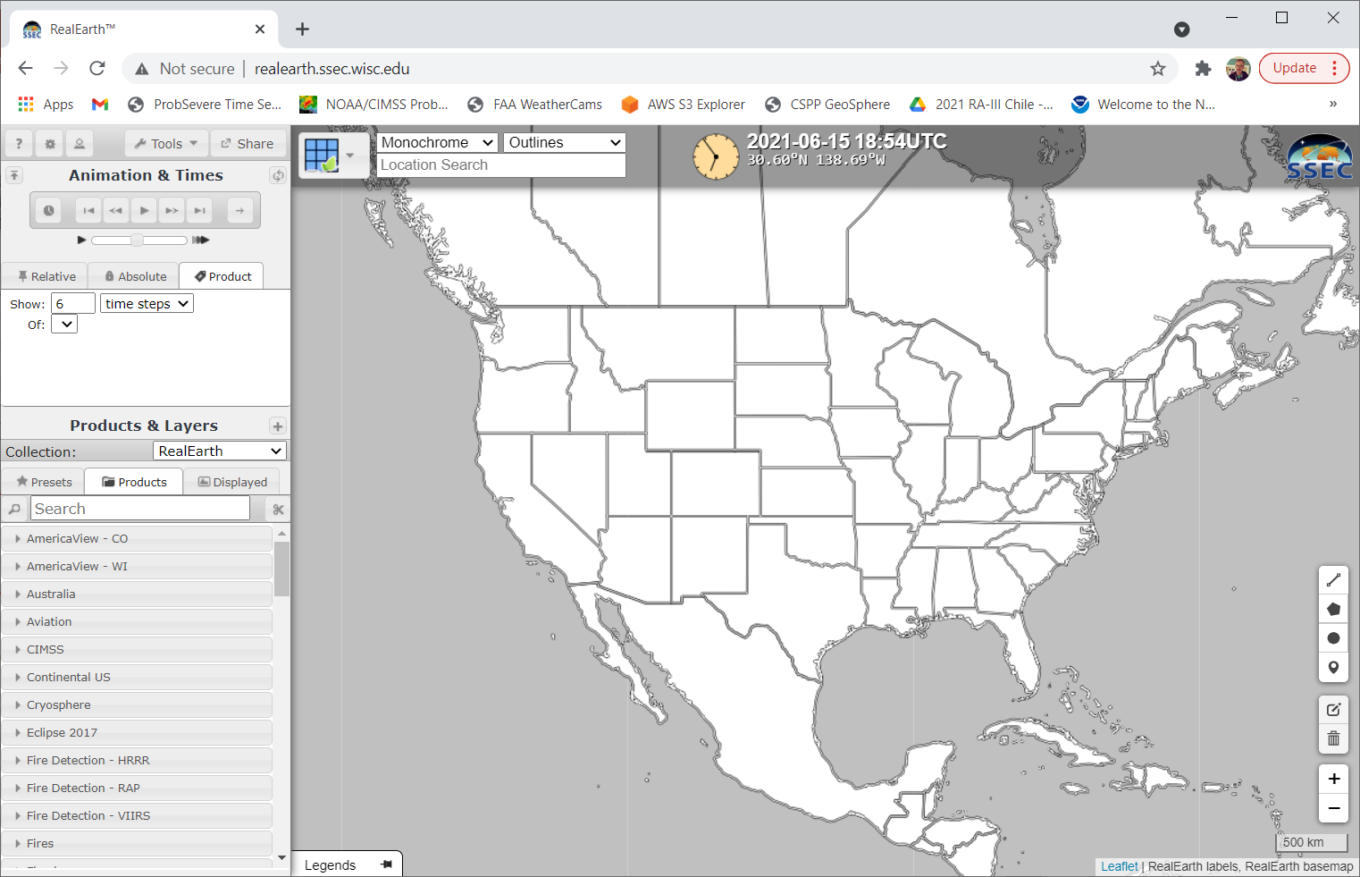
RealEarth Front Page: Use the Search Tool
Some products in RealEarth – like CMORPH – are very very hard to find elsewhere
There are many ‘Presets’ and ‘Products’ that you can look through. The labels are mostly self-explanatory.
Enter something like ‘CMORPH’
http://realearth.ssec.wisc.edu/

Slide 13
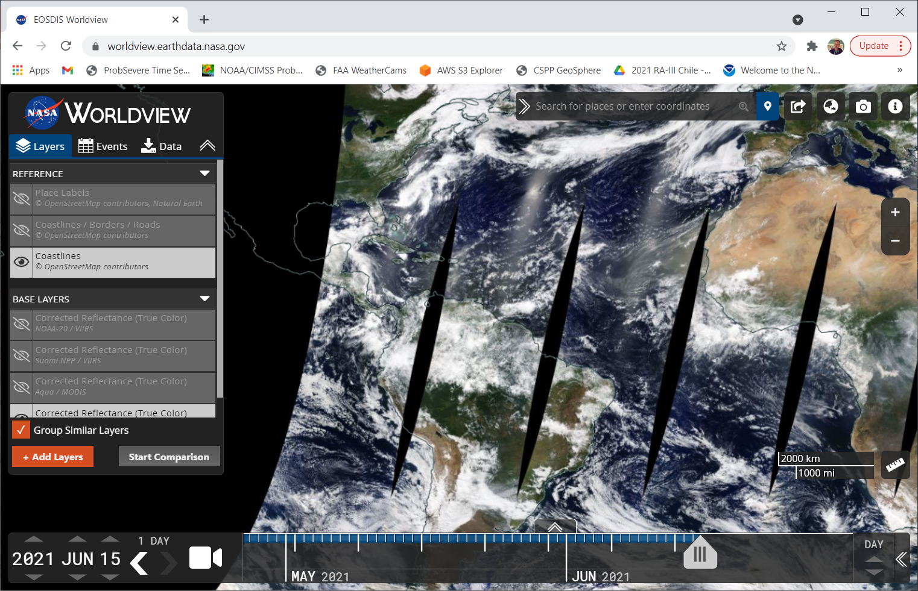
NASA Worldview
Note that you can slide back in time – and you can change that ‘DAY’ to ‘YEAR’ to slide through more quickly
As with RealEarth – many different products (all from polar orbiters) – use the Search tools after you + Add Layers
https://worldview.earthdata.nasa.gov/

Slide 14
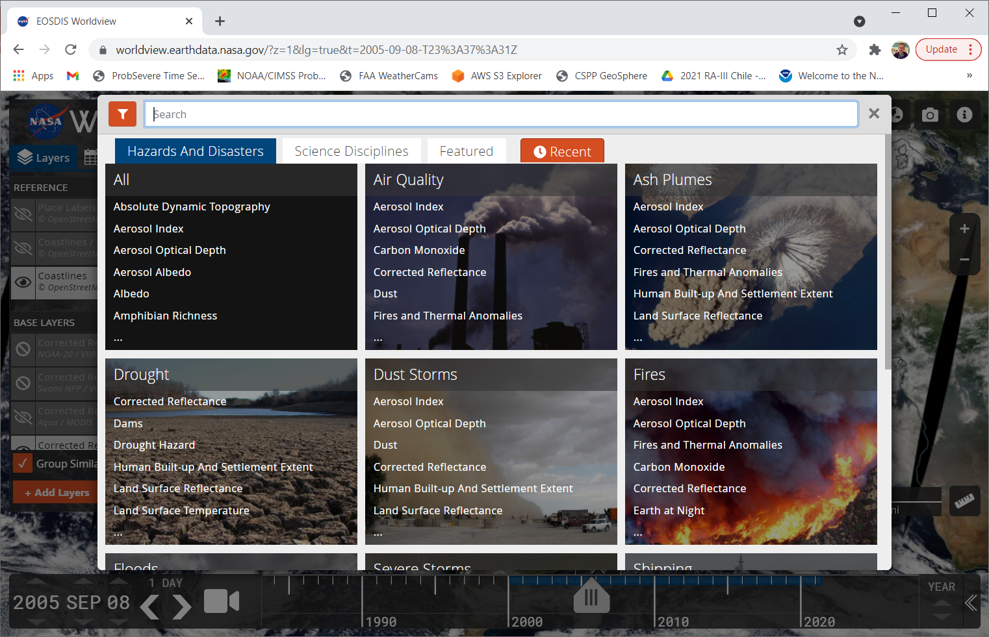
NASA Worldview
It keeps track of what you’ve selected in the past, and there are different categories
If you know what you want, just enter that “Ozone” or “Day Night Band”
(Note I’ve scrolled all the way back to 2008!
https://worldview.earthdata.nasa.gov/

Slide 15
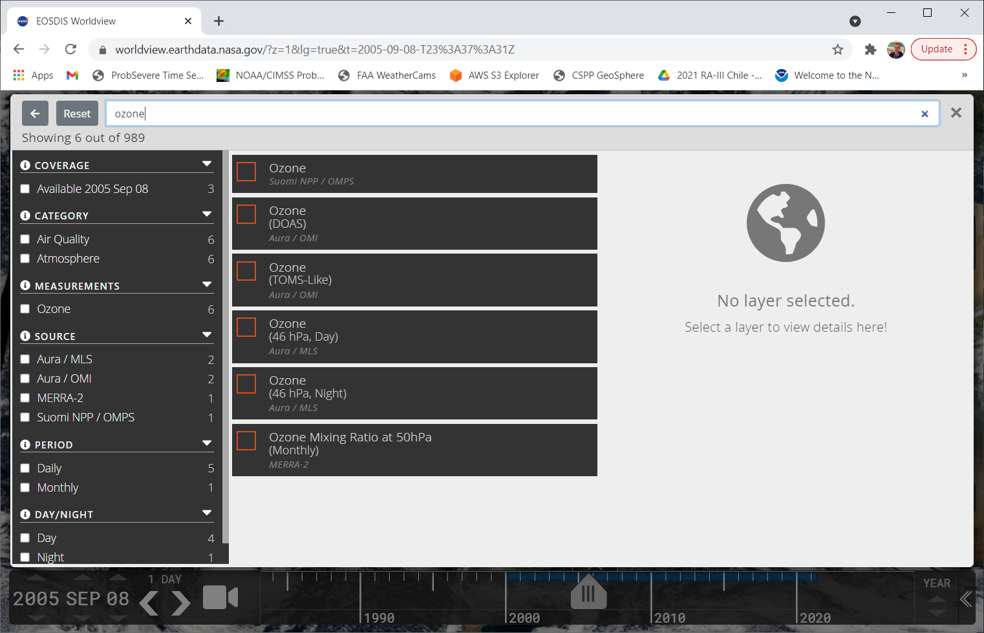
When you type in something – search looks for all the matches
https://worldview.earthdata.nasa.gov/

Slide 16
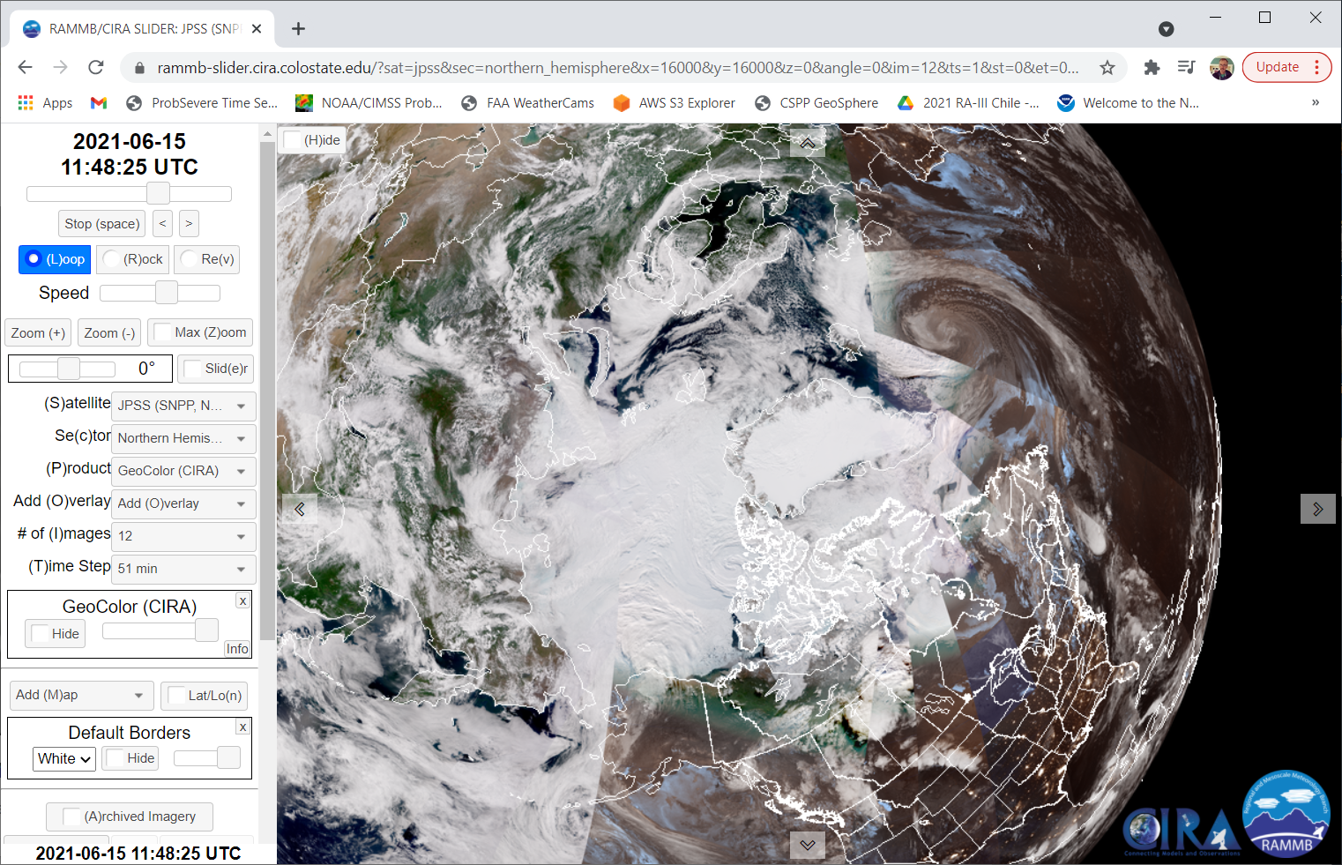
CIRA Slider (Polar version)
Change Satellite from default (GOES-16) to JPSS
https://rammb-slider.cira.colostate.edu/?sat=jpss&sec=northern_hemisphere&x=22016.533203125&y=22021.8671875&z=0&angle=0&im=12&ts=1&st=0&et=0&speed=130&motion=loop&maps%5bborders%5d=white&lat=0&p%5b0%5d=band_m05&opacity%5b0%5d=1&pause=0&slider=-1&hide_controls=0&mouse_draw=0&follow_feature=0&follow_hide=0&s=rammb-slider&draw_color=FFD700&draw_width=6

Slide 17
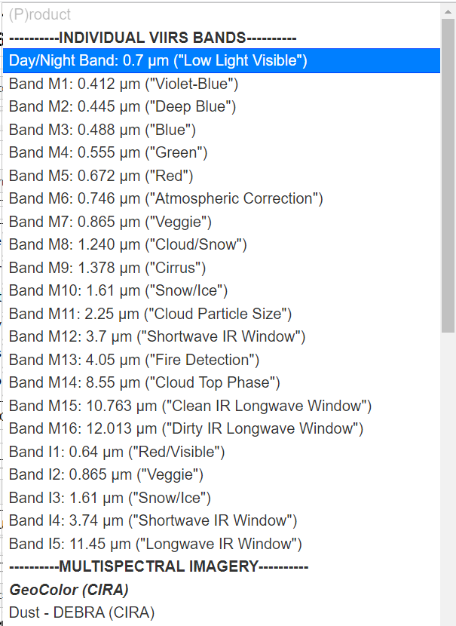
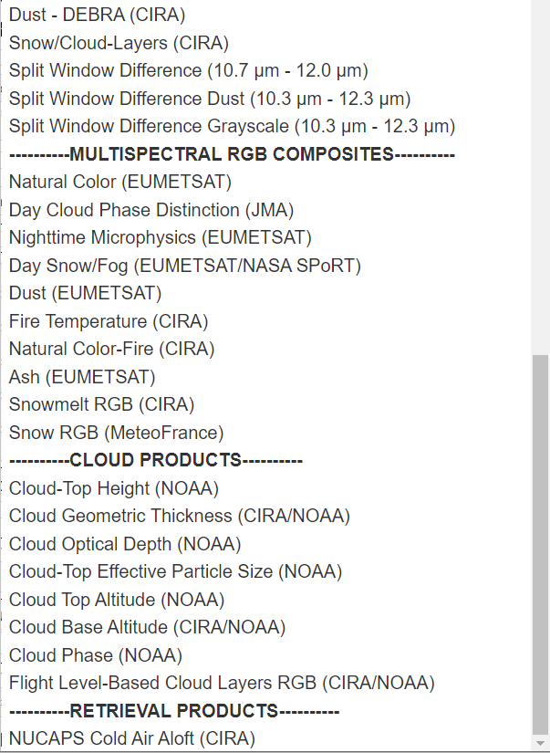
Polar Slider: Different Channels and Products
JPSS – related, so derived from VIIRS

Slide 18
More Sites using Polar-orbiting satellite data
SO2 monitoring site
  https://so2.gsfc.nasa.gov/
Finnish site that has Direct Broadcast estimates of Ozone and SO2 from OMPS (Northern Hemisphere)
  https://sampo.fmi.fi/products

Slide 19
Direct Broadcast sites
UW-Madison: (NOAA-20, NPP, MODIS)
( https://ftp.ssec.wisc.edu/pub/eosdb )
  Contains imagery – and also output from CSPP that (1) mimics what you will find in NOAA CLASS and (2) can be fed into Polar2Grid to create imagery
Alaska-Fairbanks (GINA): http://hippy.gina.alaska.edu/distro/nrt/
Miami (Imagery only): https://dbps.aoml.noaa.gov/browser/
  Excellent for Tropical information
Hawaii: http://soest-hcc1.hcc.hawaii.edu/browser/
Blog posts on Polar2Grid: https://cimss.ssec.wisc.edu/satellite-blog/?s=Polar2Grid

Slide 20
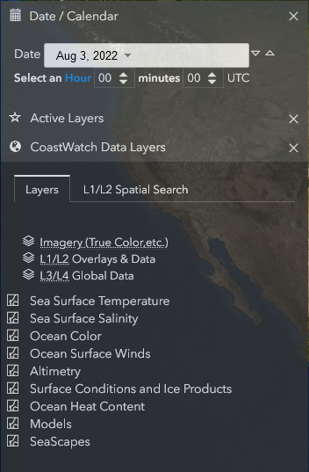
NOAA Coastwatch
https://coastwatch.noaa.gov/cw_html/cwViewer.html?
Choose the variable you’d like to display
Imagery – global – are created from VIIRS data

Slide 21
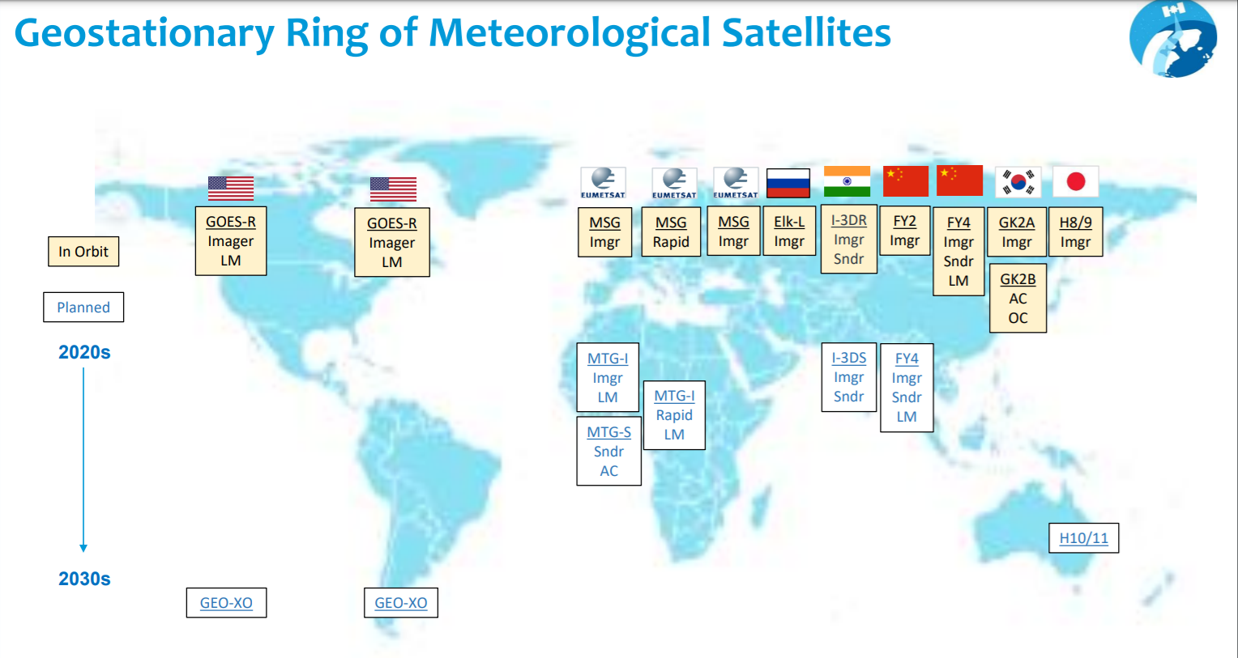
Geostationary Imagery

Slide 22
Where can you find Geo Imagery online?
Himawari-8
FY-4A
GeoKompsat2A
Meteosat-11
Meteosat-IODC
EWS – G1
GOES-16
GOES-17
Japan
China
South Korea
EUMETSAT
EUMETSAT
US Space Force
USA NOAA/NESDIS
USA NOAA/NESDIS

Slide 23
This is not a Slide Deck including Training
You are familiar with the various bands on the different satellites – or you know where to find that information
For example, GOES-16 band information is available on Fact Sheets here in English, here in Spanish (Click on Imágenes Satelitales, and then on the individual Canale; you can also find Tutorials on RGBs at that site) and here in French!

Slide 24
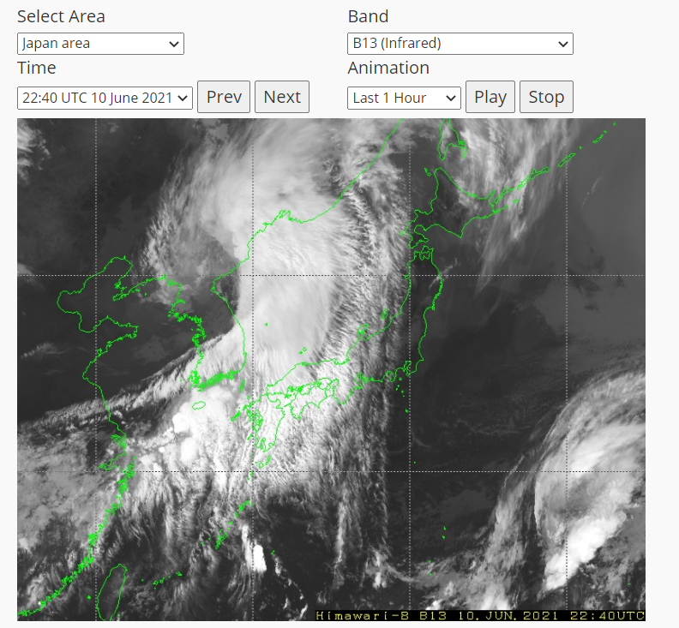
Himawari data are from JMA (Japan Meteorological Agency) MSC (Meteorological Satellite Center)
https://www.data.jma.go.jp/mscweb/data/himawari/sat_img.php?area=fd
You can choose some imagery, and a lot of different RGBs
Many different areas scattered through the Pacific Region, shown here: https://www.data.jma.go.jp/mscweb/data/himawari/index.html
Also can view data from USA sources
  https://www.ssd.noaa.gov/imagery/jma.html
  https://rammb-slider.cira.colostate.edu/?sat=himawari

Slide 25
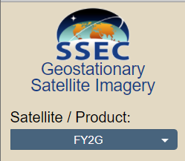
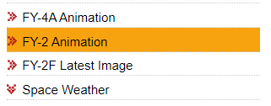
FY-4A from CMA
FY-4A is CMA (China Meteorological Administration) Geostationary. It is experimental. The operational satellite, FY-4B, was launched in early June 2021, data should be available by early 2022.
FY-2G is an older satellite, but giving imagery over China
You can register at the site to acquire data in near-real time via ftp
https://www.ssec.wisc.edu/data/geo/#/animation?satellite=fy2g
http://www.nsmc.org.cn/en/NSMC/Channels/Animation.html?reg=LAN-pas=VIS-col=GRA-t=24#tabs-1
More FY information from CMA is here: http://www.virtuallab.bom.gov.au/files/9316/2339/2765/RFG_meeting_8th_June_2021_PART_1.mp4

Slide 26
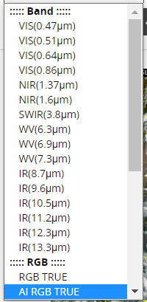
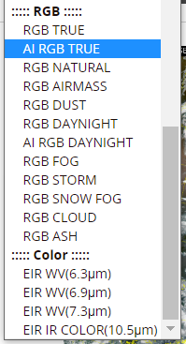
GK2A – From South Korea Meteorological Administration
The AMI, ABI and AHI imagers are all close cousins. Slight differences in channel selection. AHI doesn’t have 1.38 ; ABI doesn’t have 0.51 ; AMI doesn’t have 2.24
Imagery is here https://nmsc.kma.go.kr/enhome/html/satellite/viewer/selectGk2aSatViewer.do?view=basic
Products (many!) are here https://nmsc.kma.go.kr/enhome/html/satellite/viewer/selectGk2aSatViewer.do?view=product#
Archived imagery as well

Slide 27
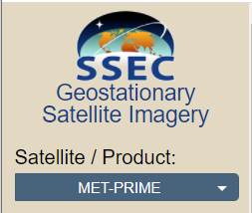
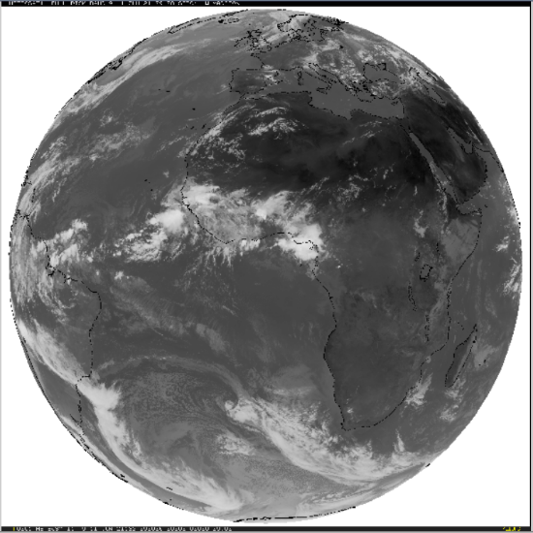
Meteosat-11 – primary satellite over Europe
11 Channels
Some imagery is free, some is not
Coverage over Africa, Europe, eastern Atlantic
EUMETVIEW: https://view.eumetsat.int/productviewer?v=default (basic imagery)
https://pics.eumetsat.int/viewer/index.html
https://www.ssec.wisc.edu/data/geo/#/animation?satellite=met-prime (11 bands)
Also on CIRA Slider: https://rammb-slider.cira.colostate.edu/?sat=meteosat-11 (all bands, and some RGBs)

Slide 28
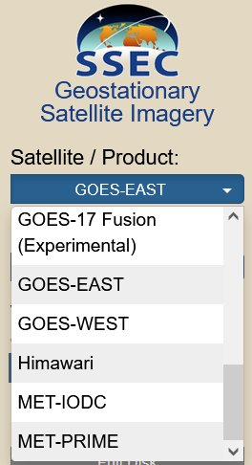
Meteosat-IODC (Indian Ocean Data Coverage)
This is a Meteosat (-8) satellite viewing the Indian Ocean and eastern Africa.
https://rammb-slider.cira.colostate.edu/?sat=meteosat-8 (CIRA Slider, all bands, and some RGBs)
https://www.ssec.wisc.edu/data/geo/#/animation (4 bands)

Slide 29
EWS-G1 – the former GOES-13
Electro-optical Infrared Weather System Geostationary – GOES-13 ‘adopted’ and repurposed by the US Space Force. Sits over the Indian Ocean
1st geostationary satellite owned by the US Department of Defense
https://www.ssec.wisc.edu/data/geo/#/animation?satellite=ews-g1
All 5 GOES Channels – remember those?
  0.64, 3.9, 6.5, 10.7, 12.3

Slide 30
GOES-16 and GOES-17 (and GOES-18)
Many many sites have current data. Common to have ~24 hours online
Many many sites have RGB products.
Fewer sites have Level2 Products in real time. (RealEarth does)
Some sites have archived data
CIRA Slider goes back ~9 days
CSPP GeoSphere goes back ~2 weeks.
RealEarth goes back about a week

Slide 31
GOES Data Viewers (there are many)
https://geosphere.ssec.wisc.edu/#coordinate:0,0 CSPP Geosphere
https://www.star.nesdis.noaa.gov/GOES/index.php NOAA STAR
https://rammb-slider.cira.colostate.edu/ CIRA Slider
https://www.ssec.wisc.edu/data/geo/#/animation SSEC Geo Data Browser
https://weather.cod.edu/satrad/ College of DuPage
You can find even more here: https://cimss.ssec.wisc.edu/goes/goesdata.html/

Slide 32
Global Composites
RealEarth has these https://realearth.ssec.wisc.edu

Slide 33
Many websites have imagery.
Few websites have archived imagery
How do you get data to make archived imagery?
Like with so many data sources (from the USA) – they are in NOAA CLASS. Both radiances and Level 2 Products
You can also get data from Amazon and Google cloud services (Brian Blaylock’s link at University of Utah)
Ways to display the geostationary data that you download are varied
  McIDAS-V / McIDAS-X
  Geo2Grid
  SIFT

Slide 34
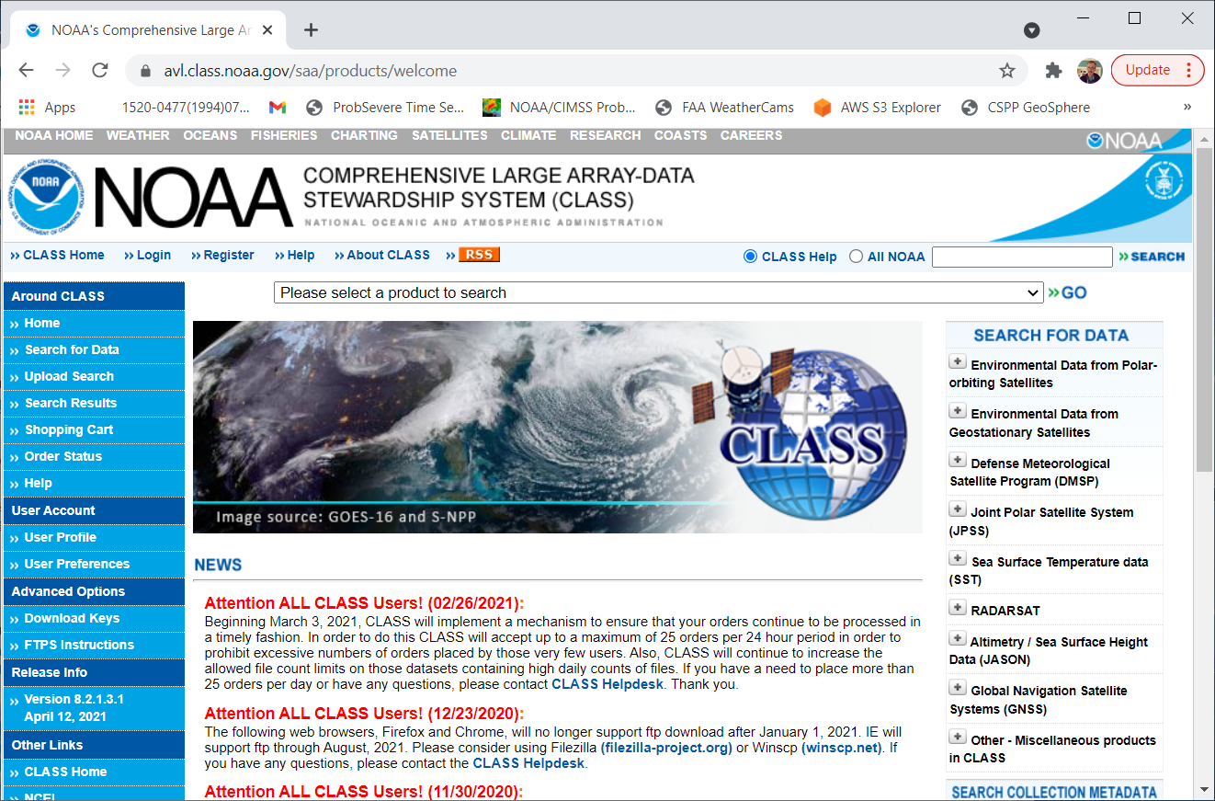
NOAA CLASS
After logging in: Choose what you’re looking for
It can be kind of hard to see this drop-down menu
Click on the down arrow
To find this website, enter ‘NOAA CLASS’ into your favorite search engine

Slide 35
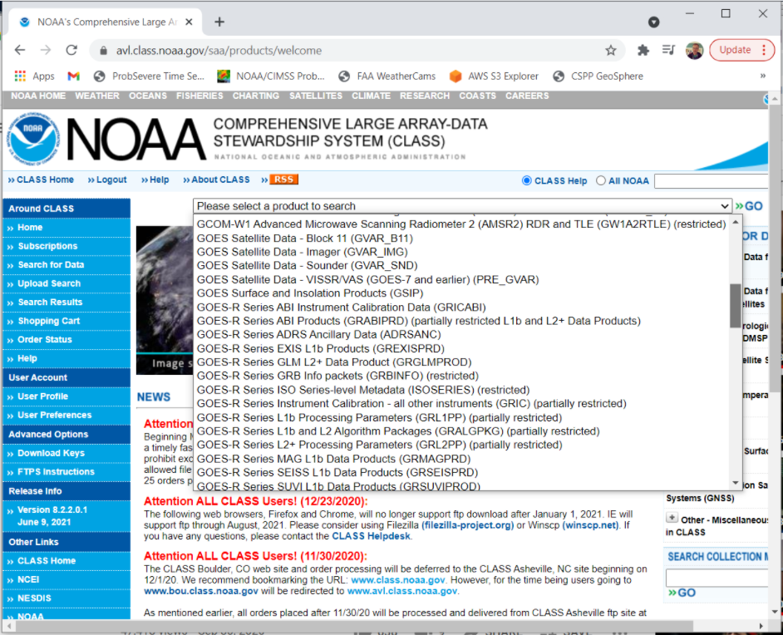
Notice how many there are!
You can scroll to see many products
Choose GRABIPRD (what does partially restricted mean?)

Slide 36
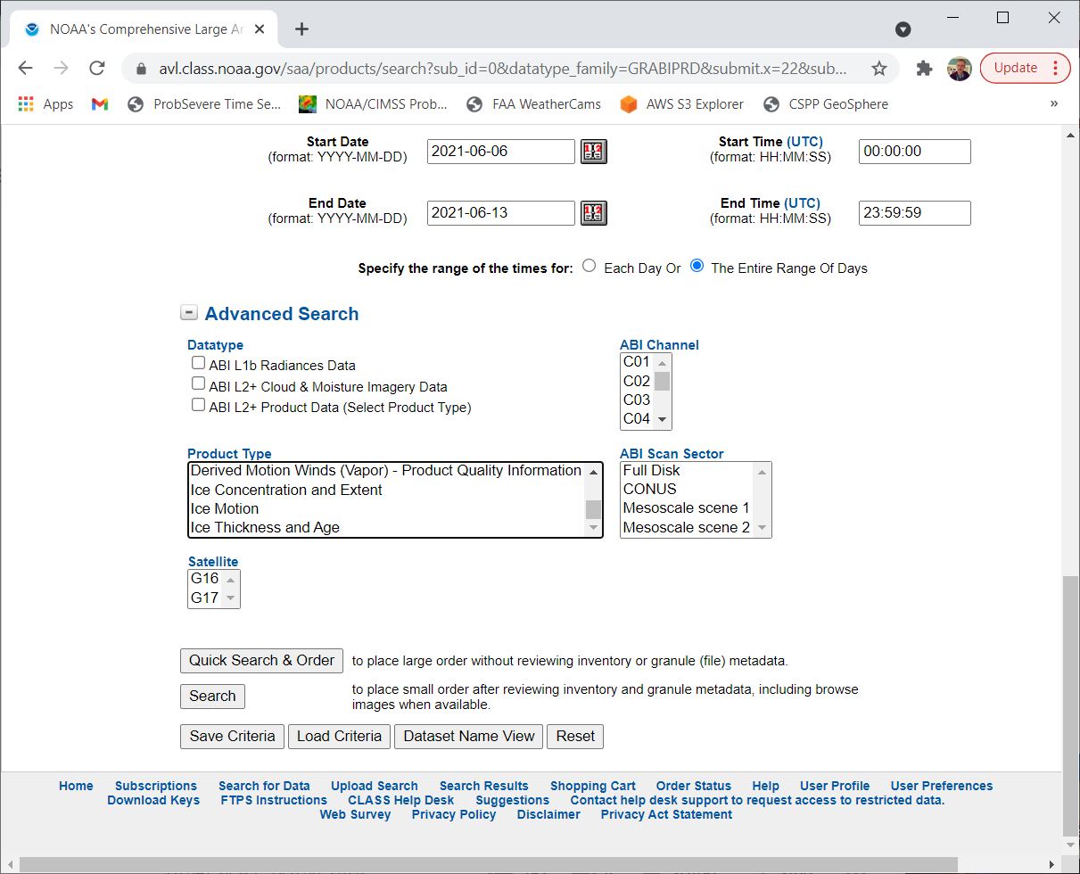









Click on Partially Restricted L1b and L2+ Data Products
Select the Start/End Date and Time
G16 and G17
  Full Disk/CONUS/Meso1/Meso2
Channels
Product Types

Slide 37
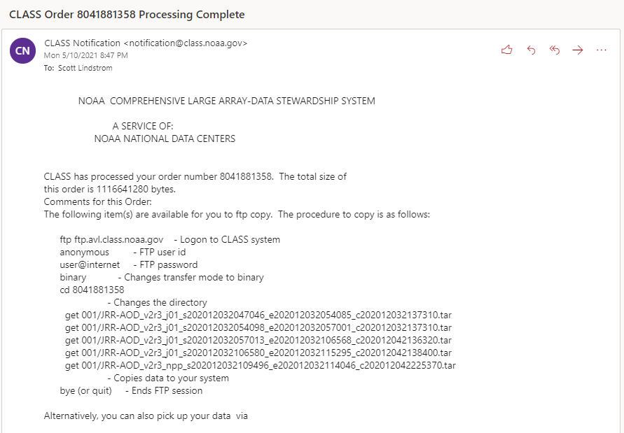
CLASS Sends an email when the data are ready
(This is an example of VIIRS data)

Slide 38
GOES data are also on AWS and Google servers
https://home.chpc.utah.edu/~u0553130/Brian_Blaylock/cgi-bin/goes16_download.cgi

Slide 39
Once you have the Geo data – how do you display it?
Geo2Grid can do this (based on Satpy; Polar2Grid will display Polar data)
SIFT can do this (Geo only)
McIDAS-V can do this (McV can to Polar too!)

Slide 40
Geo2Grid
You’ll need a linux box for this
Download it : http://download.ssec.wisc.edu/files/csppgeo/ Documentation: https://www.ssec.wisc.edu/software/geo2grid/
You’ll get a gzipped tar-ball: put it in a unique directory, say /home/name/Geo2Grid
  export $GEO2GRID_HOME=/home/name/Geo2Grid
  There are shell scripts in $GEO2GRID_HOME/bin

Slide 41
Geo2Grid works well with AHI, AMI and AHI
../p2g_grid_helper.sh mapname -99.0 52.0 500 -500 960 720 > $GEO2GRID_HOME/mapfile.conf
  -99.0 W (Longitude) 52.0 (Latitude) 500/-500 (resolution, meters) 960x720: size of domain
../geo2grid.sh -r abi_l1b -w geotiff -p firergb -g FIRERGB --grid-configs $GEO2GRID_HOME/FIRERGB.conf --method nearest -f /arcdata/goes_restricted/grb/goes16/2021/2021_05_18_138/abi/L1b/RadF/*s2021138190*.nc
  -r reader: abi_l1b (also ahi_hsd ; ami_l1b); -w writer (geotiff); -p (product, do –list-products to see possibilities); -g gridded map name; --grid-configs – where is the map defined? ; --method nearest (how to interpolate?); -f where are the raw data sitting?
../add_coastlines.sh --add-borders --borders-outline='blue' --borders-resolution=f --add-grid --grid-text-size 20 --grid-d 5.0 5.0 --grid-D 5.0 5.0 GOES-16_ABI_RadF_firergb_20210518_190019_FIRERGB.tif
  Documentation here: https://www.ssec.wisc.edu/software/geo2grid/utilscripts.html or in Polar2Grid

Slide 42
SIFT: Satellite Information Familiarization Tool
This is a tool that can be used in Linux / MacOS / Windows environments
Download it from here: https://sift.ssec.wisc.edu
Download the data to some place accessible

Slide 43
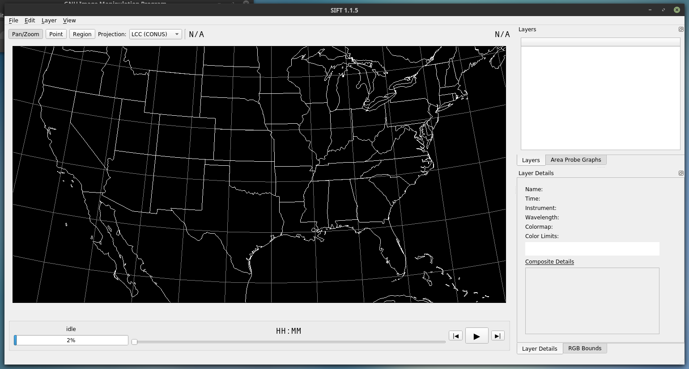
SIFT Window

Slide 44
SIFT Window
The first thing you’ll want to do: Load Data. Ctrl-o opens the File Wizard

Slide 45
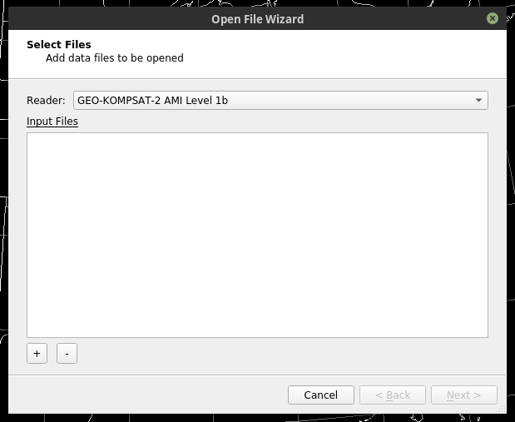
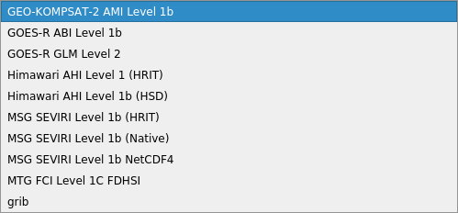
The File Wizard steps you through opening data

Slide 46
SIFT is useful for developing RGBs
This is possible in Geo2Grid as well, by adding definitions to abi.yaml (or ahi.yaml) in $GEO2GRID_HOME/etc/satpy/composites/ and $GEO2GRID_HOME/etc/satpy/enhancements/ but in SIFT things change on the fly, allowing you to quickly iterate to a solution.

Slide 47
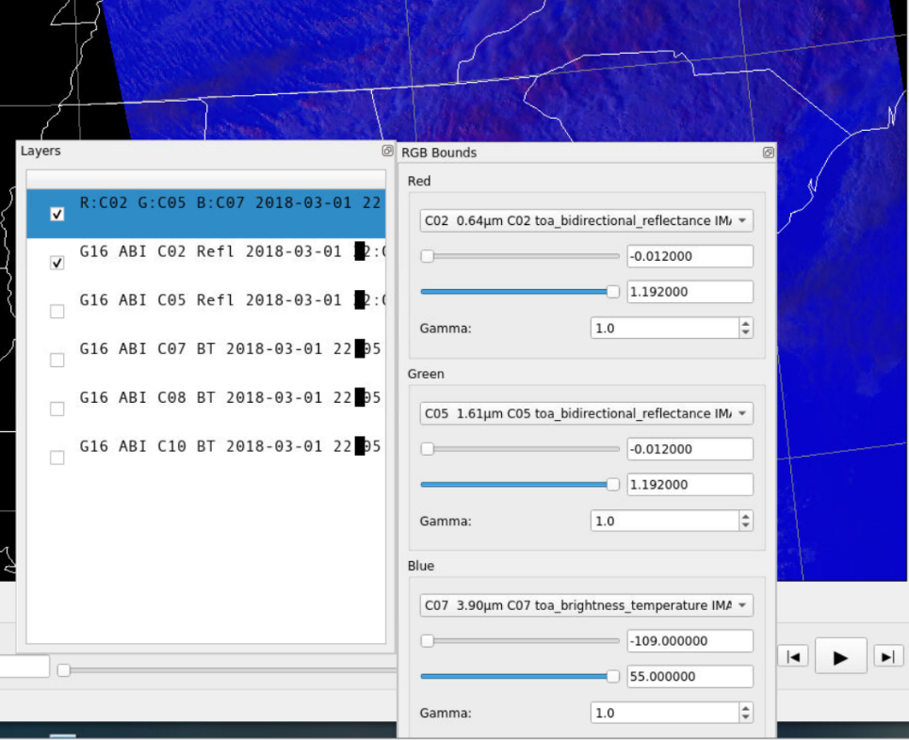
Different windows that can pop out of the main SIFT window – Layers that are loaded, and RGB bounds (which you can see when you create a Composite)
Under RGB Bounds, you see drop-down menus that allow you to choose any Layer that is listed – either the single bands or, if you create them, algebraics.
As you change values, you’ll see instantaneous changes in the window behind.
Layers show what is loaded. Then I typed ‘C’ (alternatively, under the ‘Layer’ tab, see Create Composite; ‘Create Algebraic’ under that same tab can be used to create a difference field)

Slide 48
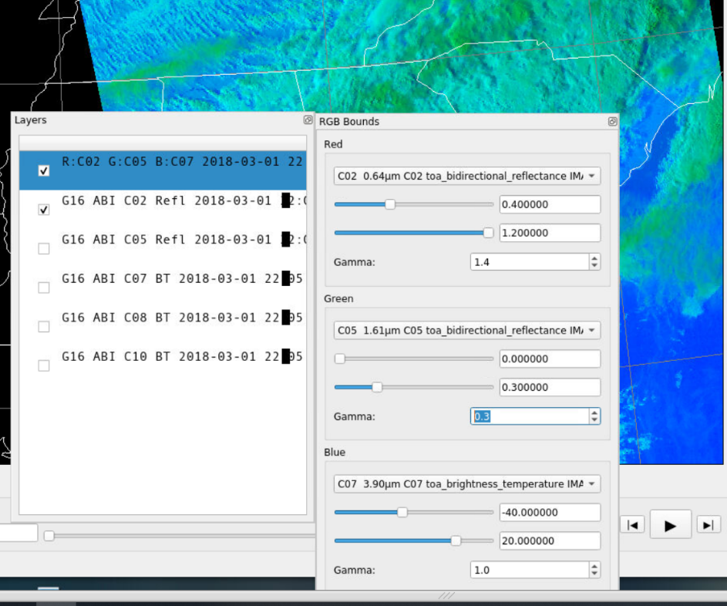
Altered RGB

Slide 49
Other accumulators/aggregators of imagery
erddap! https://coastwatch.pfeg.noaa.gov/erddap/index.html
Aerosol Watch: https://www.star.nesdis.noaa.gov/smcd/spb/aq/AerosolWatch/

Slide 50
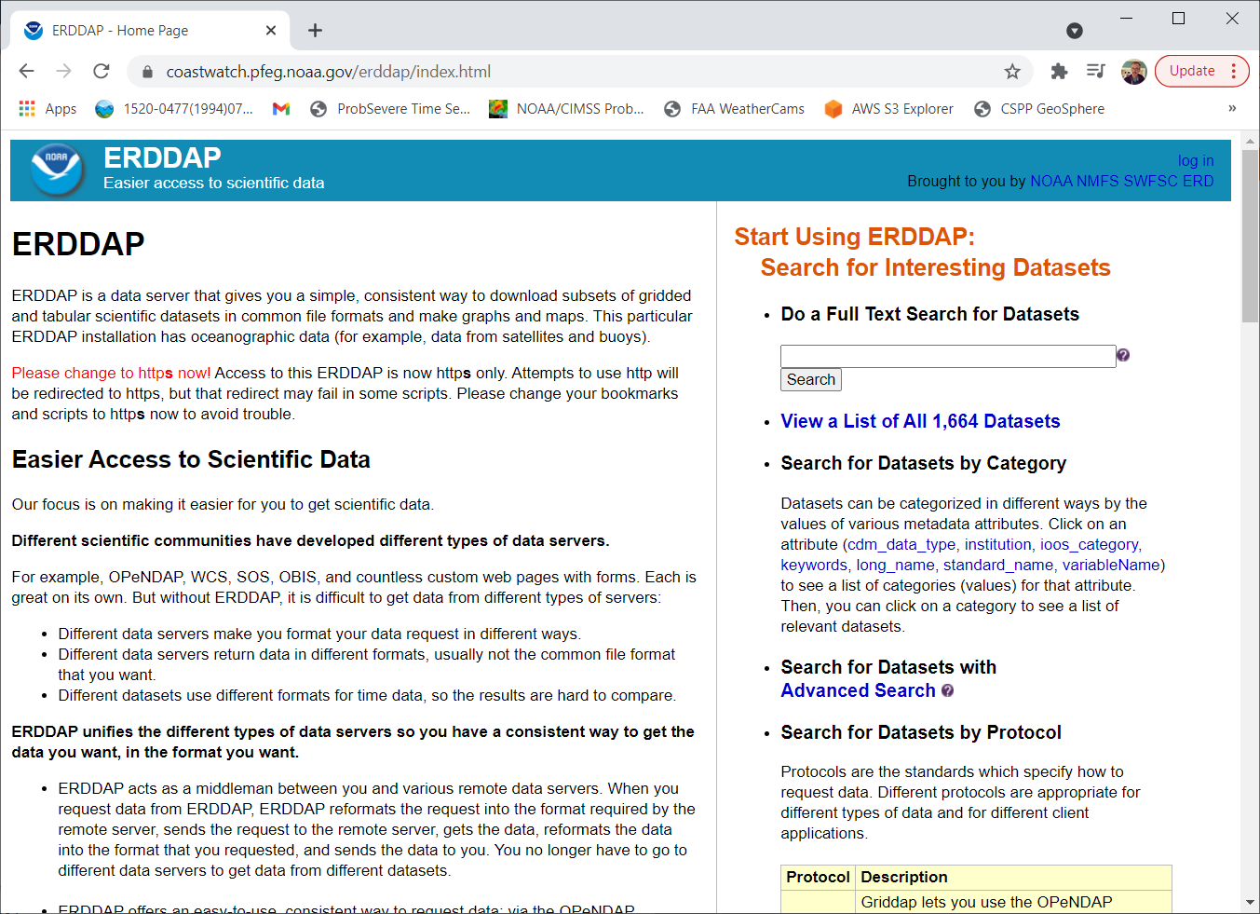
ERDDAP: https://youtu.be/6DSa0qh7wNQ
The Front Page is shown at left. ERDDAP is a former acronym – kind of like ‘COMET*’ – that has outgrown its original meaning (Environmental Research Division’s Data Access Program)
Think of ERDDAP as a gateway to many types of data. This presentation focuses on oceanographic data
There is a helpful Search function – do you see it?
*Cooperative Program for Operational Meteorology, Education and Training

Slide 51
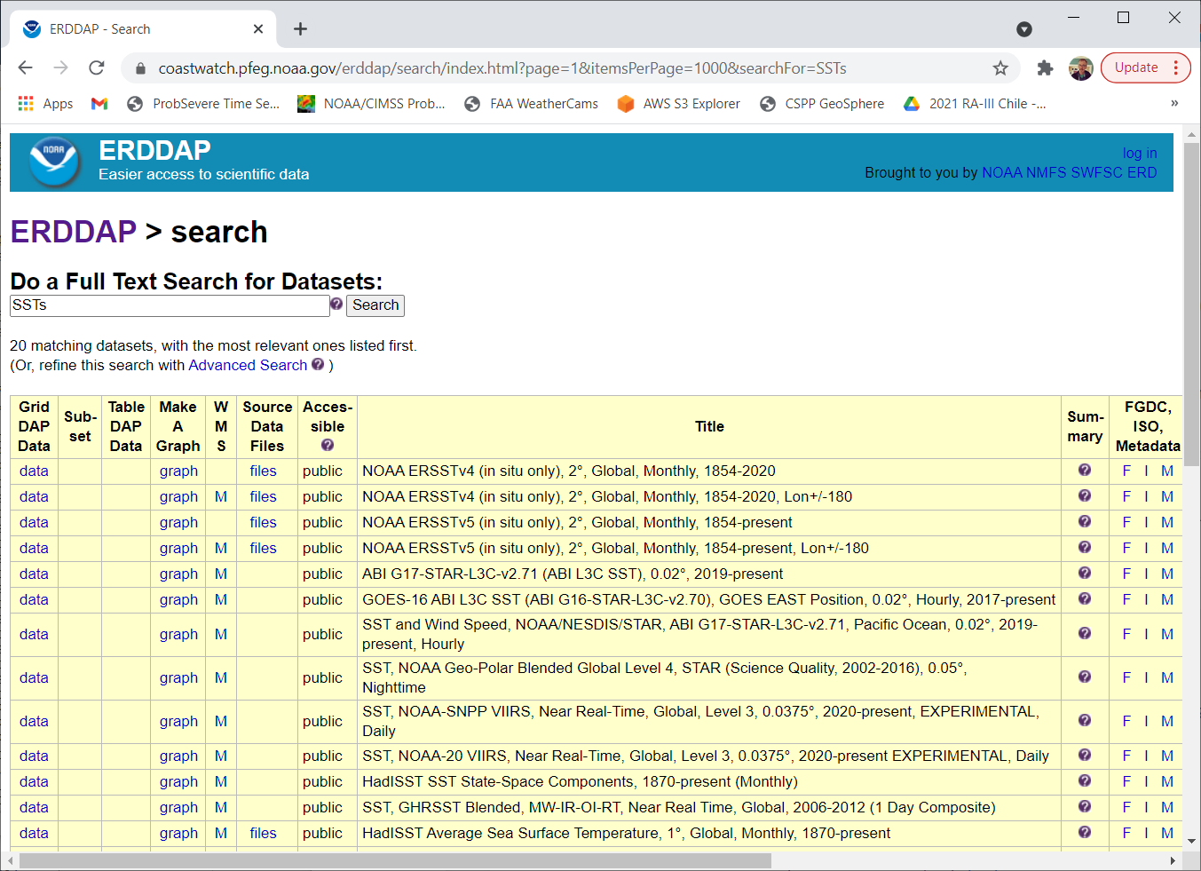
Useful resources for ERDDAP
The amount of data in ERDDAP can overwhelm in a “where do I start” kind of way.
Here’s a short YouTube video on getting one type of data: https://www.youtube.com/watch?v=18xZoXu1USM
The “Search” utility (upper right part of the main window) can help winnow down to what you actually need to view
Search on “SSTs” yields a long list:
Notice the “Make a Graph” column!

Slide 52
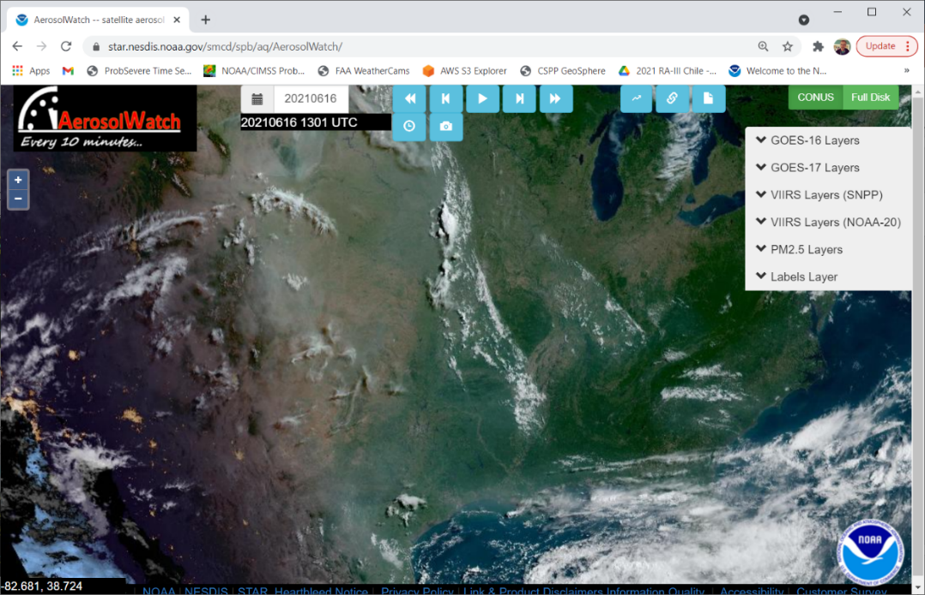
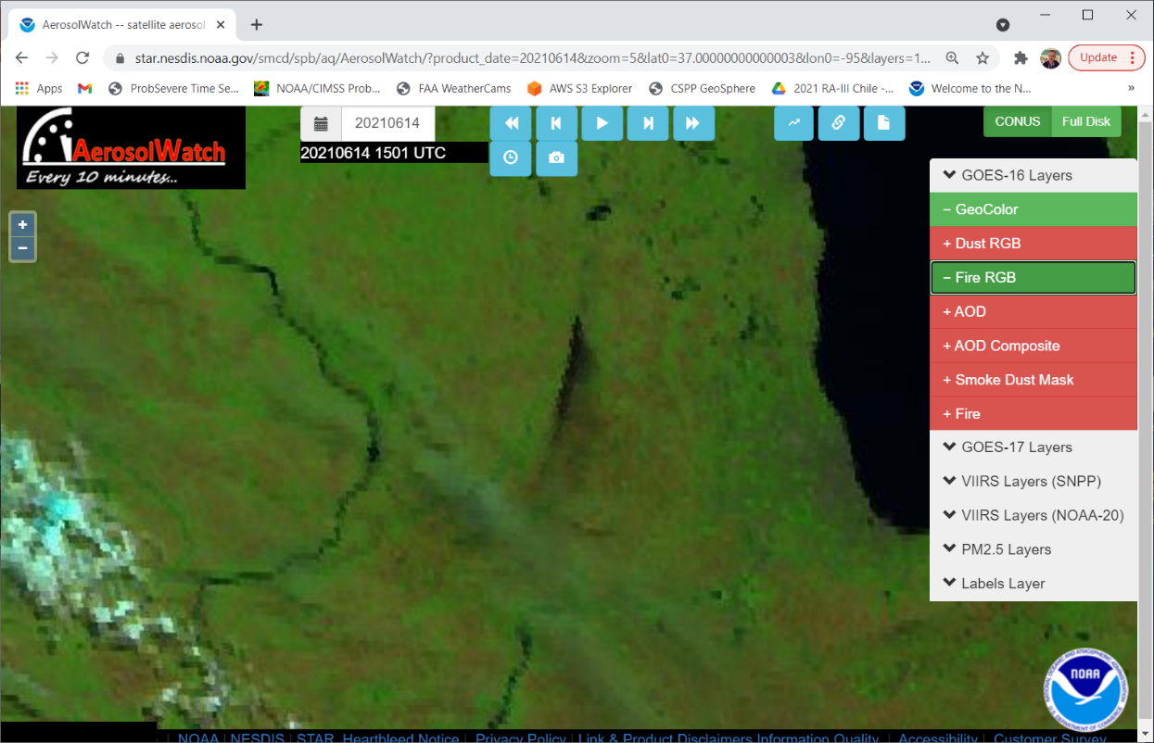
Aerosol Watch: https://www.star.nesdis.noaa.gov/smcd/spb/aq/AerosolWatch/
Very long archive

Slide 53
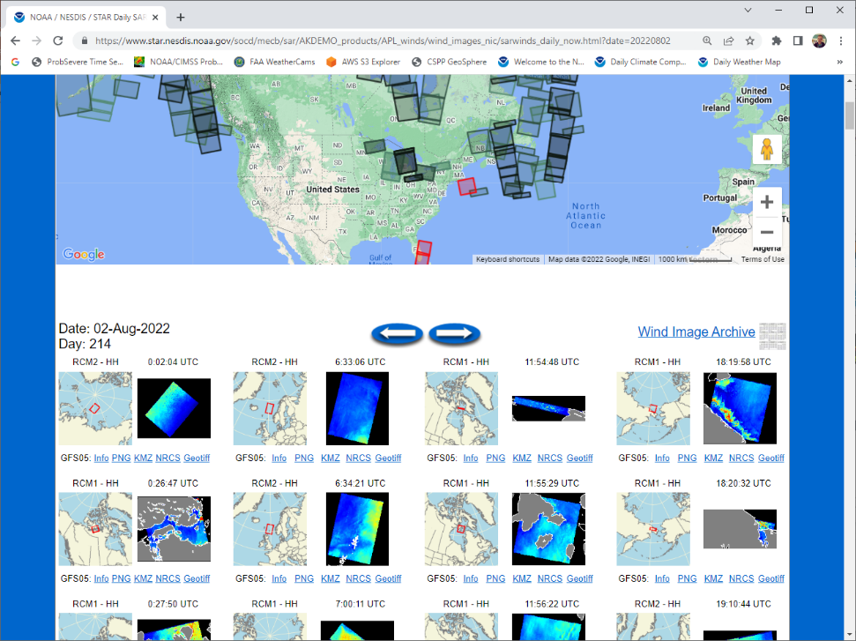
Synthetic Aperture Radar (SAR) Winds
https://www.star.nesdis.noaa.gov/socd/mecb/sar/AKDEMO_products/APL_winds/wind_images_nic/sarwinds_calendar_now.html
The link above takes you to the website at left. Click on the small shaded areas and you’ll see wind observations there.
Mostly North America

Slide 54
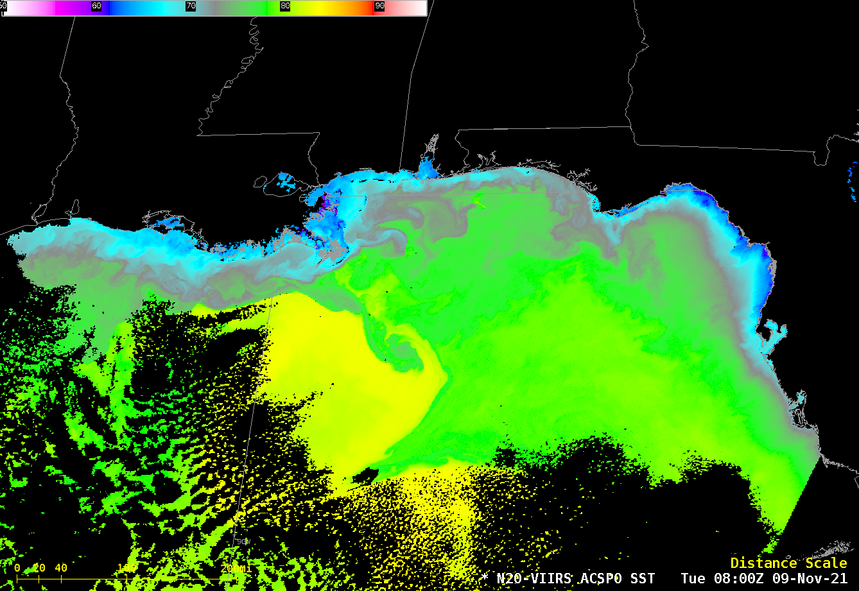
VIIRS SST Files suitable for display (with Polar2Grid, for example)
https://www.ncei.noaa.gov/data/oceans/ghrsst/L2P/VIIRS_NPP/OSPO/
Daily files of data
Example of how to view these with Polar2Grid is in the Polar2Grid documentation (at this link)
You can find SST files at the CIMSS Direct Broadcast site as well (https://ftp.ssec.wisc.edu/pub/eosdb/j01/ ) , or in AWIPS.

Slide 55
Rainfall Estimates
GsMAP – data from Passive Microwave Sensors, and infrared radiometers. From JAXA.
https://sharaku.eorc.jaxa.jp/GSMaP/
Very long archive. 1-hour, 12-h, 24-h and 72-h accumulations.
CMORPH – Go to the RealEarth site (https://realearth.ssec.wisc.edu ) and enter ‘CMORPH’ in the search box
https://www.ncei.noaa.gov/products/climate-data-records/precipitation-cmorph -- contains data fields as well

Slide 56
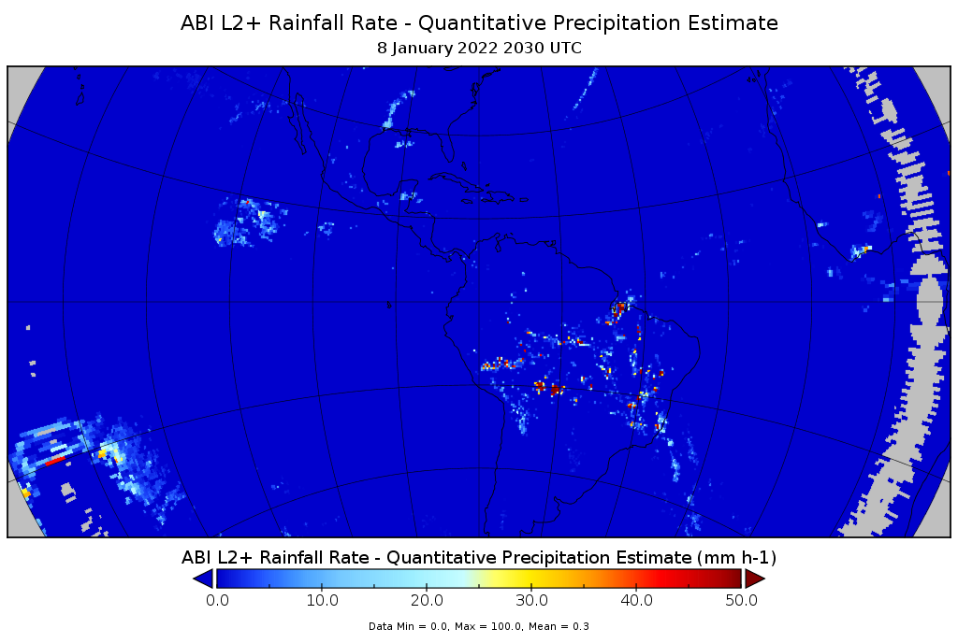
NOAA Enterprise Rain Rate Algorithm
https://www.star.nesdis.noaa.gov/smcd/emb/ff/SCaMPR.php
‘SCaMPR’: Self-Calibrating Multivariate Precipitation Retrieval
You can instantaneous rain rates as well as accumulations (1-h, 3-h, 6-h, 12-h, 24-h, 48-h, 72-h)
You can also find the Level 2 GOES-R Rain Rate product in NOAA-CLASS, download it, and display the netCDF file (with Panoply, for example)

Slide 57
MIRS Rain Rate
MIRS: Microwave Integrated Retrieval System: includes many derived products, including Rain Rate, Snow-water Equivalent, Total Precipitable Water….
  https://www.star.nesdis.noaa.gov/mirs/
Generated from microwave data from Polar-Orbiting satellites
Calibrated so that intra-satellite differences in microwave imagery are minimized
https://www.ospo.noaa.gov/Products/atmosphere/mirs/rainrate.html
https://www.ospo.noaa.gov/Products/atmosphere/mirs/swe.html
(etc)

Slide 58
Total Precipitable Water Fields
MIMIC Total Precipitable Water (Link)
  Total Atmosphere moisture
    http://tropic.ssec.wisc.edu/real-time/mtpw2/product.php?color_type=tpw_nrl_colors&prod=global2&timespan=24hrs&anim=html5
    Archive: https://ftp.ssec.wisc.edu/pub/mtpw2/images/tpw_nrl_colors/
Advected Layer Precipitable Water (Link)
  Splits atmospheric moisture into discrete layers.
    http://cat.cira.colostate.edu/ALPX/ADVLUT/ALPX_hourly.htm
    Archive: ftp://ftp.cira.colostate.edu/ftp/Forsythe/LPW/Anim_GIF
Blended TPW Product
  https://www.ospo.noaa.gov/Products/bTPW/

Slide 59
Great Lakes-Specific Sites
https://coastwatch.glerl.noaa.gov/ Contains information on LSTs, Ice, SAR winds, etc.
  Average LST values over the Great Lakes are available here: https://coastwatch.glerl.noaa.gov/statistic/statistic.html
  Ocean Color: https://coastwatch.glerl.noaa.gov/ocean-color/ocean-color.html
  SAR NRCS data: https://coastwatch.glerl.noaa.gov/nrcs/nrcs.php
  SAR Wind data: https://coastwatch.glerl.noaa.gov/wind/wind.php

Slide 60
Do you have any questions or additions to suggest?
scott.lindstrom@ssec.wisc.edu or you can call me
Enjoy using Satellite Data

