Slide 1


ERDDAP: Providing Easy Access to Remote Sensing Data and other Environmental Data
Cara Wilson^{1,3}, Dale Robinson^{2,3} and Robert A. Simons¹
¹NOAA/SWFSC/ERD, Monterey, CA
²UC Santa Cruz
³NOAA CoastWatch West Coast Node
AMS Meeting, January 2021
Notes:
I’m Cara Wilson, I work at the NOAA SWFSC in Monterey Ca and today I’m going to be talking about how ERDDAP can provide Easy Access to Remote Sensing Data. My co-authors are Dale Robinson, at UC Santa Cruz, and Bob Simons, who is also from the SWFSC.

Slide 2
Accessing satellite data can be challenging
a short list of data servers
NOAA CoastWatch Central Operations
NOAA Center for Satellite Applications and Res.
NOAA Office of Satellite and Products
NOAA National Centers for Environmental Info.
NOAA Comprehensive Large Array-data Stewardship System (CLASS)
NASA Jet Propulsion Laboratory PO.DAAC
NASA Ocean Biology (OB.DAAC)
NASA Goddard Space Flight Center
European Space Agency
EUMETSAT
Japan Aerospace Exploration Agency
each with its own
Data products
File formats
Download protocols
Subsetting abilities
Previewing abilities
Notes:
Accessing satellite data, or any environmental data for that matter, can be challenging. There are lots of different places to get data, and they all have different ways of organizing their data. Some let you subset the data or preview it first through visualization, but not all do. Different servers can have different download protocols and different file formats. If you have to get multiple datasets from different places it can be overwhelming, even to experienced data users. In this presentation I will give a brief introduction to ERDDAP, a data server that tries to mitigate these issues.

Slide 3



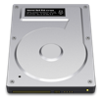




ERDDAP¹ – designed to make data access easier
Data Aggregation
Data Distribution
ERDDAP provides a simple, consistent way to:
Subset datasets temporally and spatially
Distribute both gridded and non-gridded (tabular) data
Download data in > 30 formats
Data requests defined within URLs, allowing:
  Access data within analysis tools (R, Matlab, python)
  Machine-to-machine data exchange
Local Storage
Internal Servers
Automated Scripts
Database
Web-Based
Applications
RAID
ERDDAP
Download
By Hand
Remote Servers
NSIDC
NCEI
Software
Applications
Over 85 ERDDAPs exist worldwide
Over a dozen different ERDDAPs in NOAA
ERDDAP is one of the recommended data servers
in NOAA's Data Access Procedural Directive
Search for data across multiple ERDDAPs at erddap.com
JPL PO.DAAC
NESDIS STAR
¹ERDDAP was developed at NOAA/NMFS/SWFSC/ERD by Bob Simons
Notes:
ERDDAP was developed at the NOAA Southwest Fisheries Science Center by Bob Simons. It provides a simple, consistent way to subset and download data. The data can also be visualized in customizable graphs. Data can be downloaded in over 30 formats, as both graphs and data. ERDDAP is a restful service, meaning that the data requests are completely defined by a URL, which allows for easy access from computer programs like R or Matlab, as well as allowing machine-to-machine access. Over 85 ERDDAPs exist worldwide. in this presentation I will show examples using the ERDDAP maintained jointly by the NOAA SWFSC Environmental Research Division and the West Coast Node of NOAA’s CoastWatch program.

Slide 4
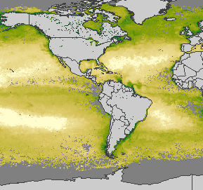
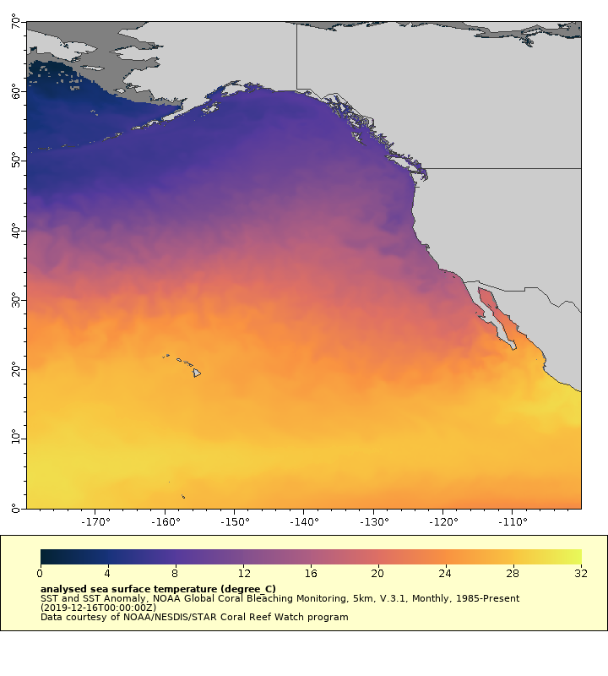
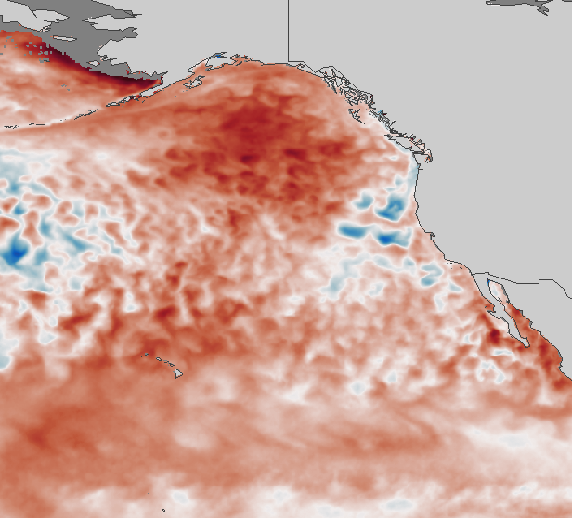
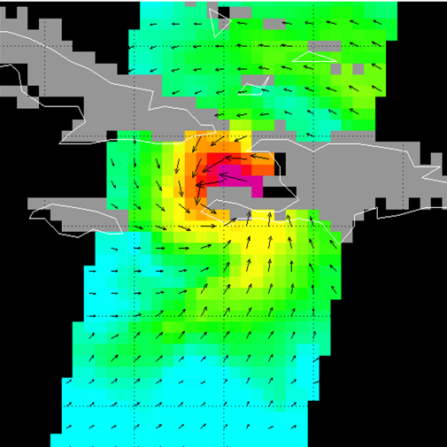
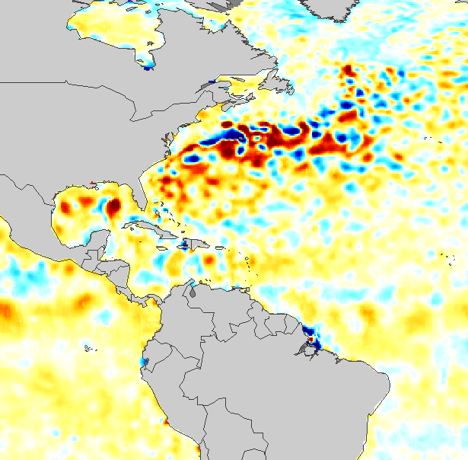
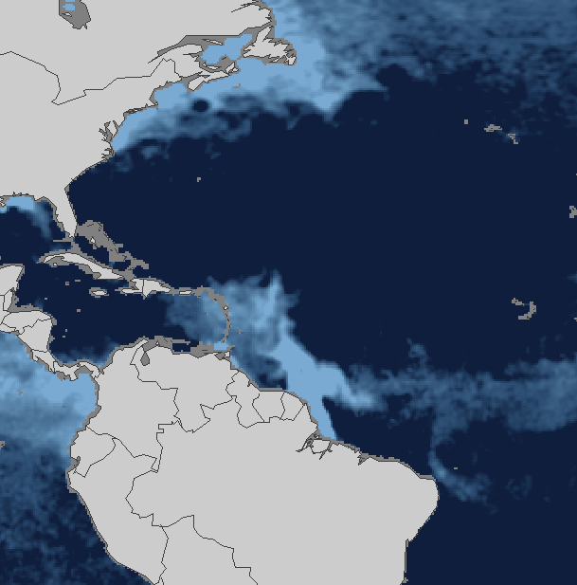
NOAA/ERD ERDDAP contains > 1000 satellite datasets
0.5 – 1 million data requests per day
Daily, weekly, and monthly composites
Blended products
Interpolated products (gap free)
All level 3 or 4 products (i.e. on a regular XY grid)
Chlorophyll
Primary Productivity
SST
SST Anomaly
This ERDDAP is maintained jointly by the
SWFSC Environmental Research Division and the
West Coast Node(WCN) of NOAA’s CoastWatch program
Surface Winds
Sea Surface Salinity
Sea Surface Height and Anomaly
Notes:
The NOAA ERD ERDDAP has over a thousand oceanographic satellite datasets on it, most of them having global coverage. Most products are available in daily, weekly or monthly composites

Slide 5
ERD ERDDAP data catalog has >400 non-satellite datasets
In Situ Measurements
Animal Telemetry Network
ARGO floats
TAO/TRITON, RAMA, &
PIRATA Buoys
IOOS In Situ Sensors
Glider Data
Global Temperature and Salinity Profile Programme
HF Radar Currents
GLOBEC Northeast Pacific
NOAA CO-OPS Sensors
NDBC buoys
Field Sampling
CalCOFI
California Fish Landings
Farallon Island Seabirds
NWFSC Habitat Use
SWFSC Rockfish
Underway Data
NOAA Vessels
UNOLS Vessels
Models, Climatologies
OSCAR Sea Surface Velocity
SODA Model
Models, Climatologies (cont.)
NOAA Coastal Relief Model
NOAA RTOFS Forecast Model
NOAA RTOFS Nowcast Model
NOAA World Ocean Atlas
NOAA Seafloor Topography
SWFSC Upwelling Index
Navy NAVGEM Model
Navy NOGAPS Model
NCEP/NCAR Reanalysis
USGS Topography
NASA/NOAA CCMP Wind Atlas
Navy HYCOM Model
Navy FNMOC Forecast Model
Notes:
There is more than just satellite data on the ERD ERDDAP. There are also in situ measurements from a number of different platforms and projects, underway data from NOAA and UNOLS research vessels and a variety of model data.

Slide 6
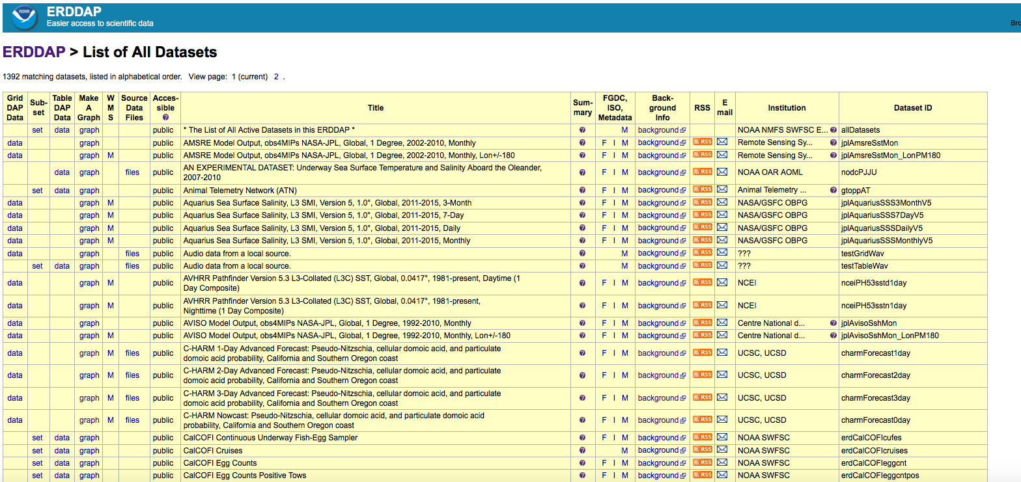
The ERDDAP interface is functionally beautiful
Notes:
The main ERDDAP interface can be a little overwhelming at first. Datasets are listed alphabetically by their dataset title, seen here in the middle of the table. Different columns of the table provide different information about the datasets, such as their metadata, source institution and the local dataset id. If you want to download data from this interface you would click the data link to the left of the dataset title, which brings up a form that easily lets you subset the data temporally and spatially. To create a graph of the data click on the graph column to the left of the dataset title, which brings up an online form that lets you customize a graph of the data. We’ll see what these two forms look like on the next slides.

Slide 7
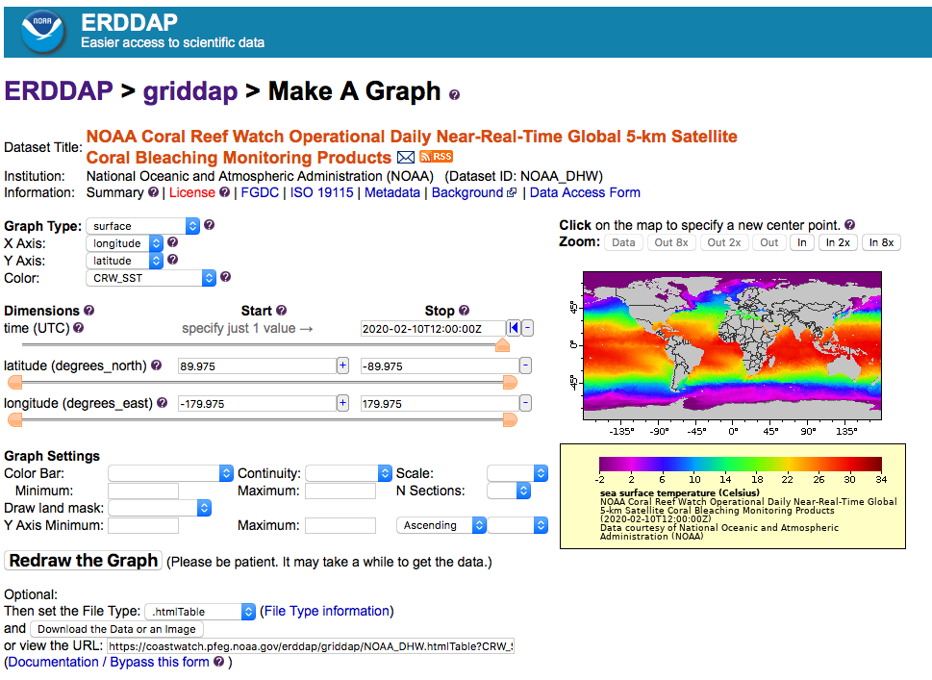
Online interface to create custom graphs
Graph Type:
Maps (surface)
Time-series (lines)
Hovmöller (surface)
Vectors (vectors)
Color:
Choose variable in dataset
Scale:
Choose linear or log
Color Bar:
Choose from > 40 color palettes
File Type:
Choose from > 40 file formats
(data and graphics)
Notes:
This is the ERDDAP graphing interface for gridded data. Data can be shown as maps, timeseries, and hovmollers, which is a hybrid map with either latitude or longitude on one axis and time on the other, to show both temporal and spatial variability. I’ll show an example of one of these later in the presentation. The date and spatial boundaries of the map can all be changed by either manually entering values, or moving the slider bar under the dimensions listed. The map domain can also be changed by using the zoom in or zoom out buttons above the map on the right. The ranges of the color are adjustable, as is the color palette, there are over 40 different palettes to choose from.

Slide 8
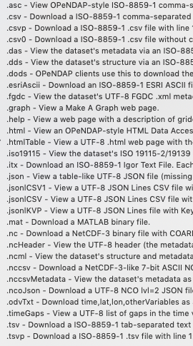
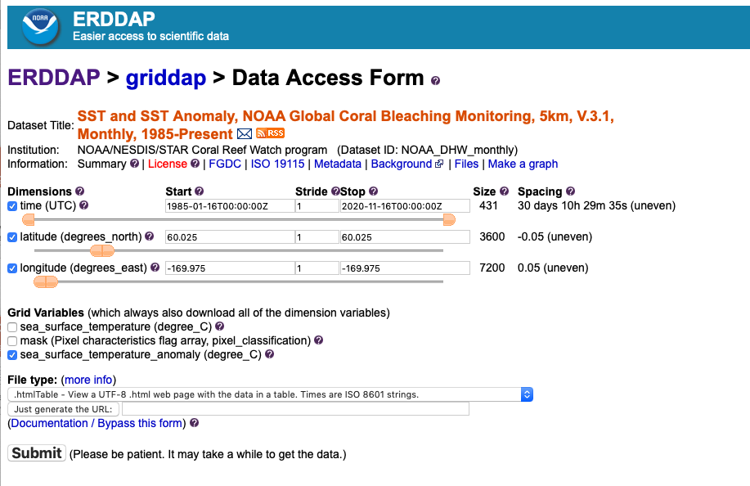
Online interface to download data
Can subset by time, latitude or longitude (for gridded datasets)
File Type:
Choose from > 40 file formats
(data and graphics)
Notes:
This is the ERDDAP Data Access Form for gridded data. You can select the temporal and spatial bounds by either directly entering values or by moving the sliders under the variable. If you access this form from the Make a graph page your spatial constraints will be copied across. By default the stride is set to 1, if you change this value, you will reduce the numbers of values you will obtain in that dimension. If there are multiple variables in a dataset, like there are for this one, you can chose which ones you want to download by checking the variables you want. Clicking on the dropdown list under file type gives you the list, partially shown here, of over 40 different file types. These graphical interfaces provide a user-friendly way to create a customized graph, or download data, but since all data requests are given as a URL, once can make changes by directly changing the URL. To do that it helps to understand the grammar of the ERDDAP URL data request.

Slide 9
Deconstructing an ERDDAP data request URL
NOAA_DHW_monthly.largePng?sea_surface_temperature[(2019-09-21T12:00:00Z)]
Example of a URL data request
Base URL:
Dataset ID:
File Type:
Data Request Begins
Variable:
Time range:
Latitude Range:
Longitude Range:
https://coastwatch.pfeg.noaa.gov/erddap/griddap/
NOAA_DHW_monthly
.largePng (.nc, .mat, .json, .geotif, .kml, .csv…)
?
sea_surface_temperature
[(2019-09-15T12:00:00Z):(2019-09-15T12:00:00Z)]
[(70):(-10)]
[(-180):(-100)]
coastwatch.pfeg.noaa.gov/erddap/griddap/
[(70):(-10)][(-180):(-100)]
https://coastwatch.pfeg.noaa.gov/erddap/griddap/NOAA_DHW_monthly.largePng?sea_surface_temperature[(2019-09-15T23:00:00Z)][(70):(-10)][(-180):(-100)]
Notes:
Here the text wrapped around the slide is an actual URL. I’ve marked different parts of it in different colors to help identify the different components. The red text marks the dataset id, the green text the file type, the purple text the variable name, the black text the time range and the blue text the latitude and longitude ranges. So by simply reading this URL I can tell that it will produce a png image of SST for September 2019 in the North Pacific, which is shown on the next slide.

Slide 10
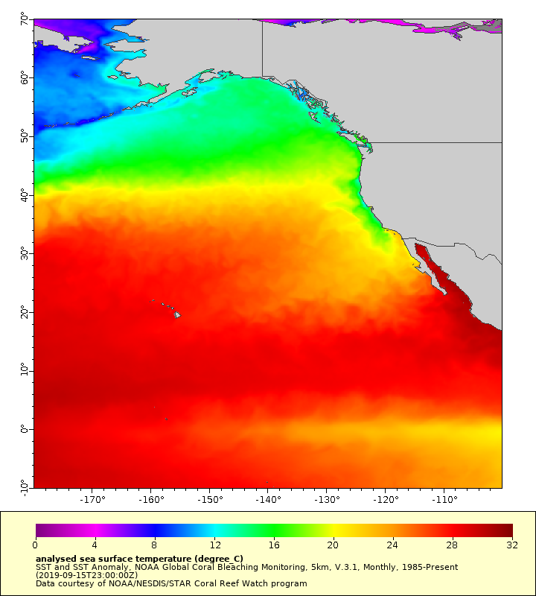
This URL:
SST Sept 2019
https://coastwatch.pfeg.noaa.gov/erddap/griddap/NOAA_DHW_monthly.largePng?sea_surface_temperature[(2019-09-15)][(70):(-10)][(-180):(-100)]
Produces this figure
Note:
  You can download the data in a netCDF file
  by changing .largePng to .nc in the URL
Notes:
This is the map produced by the URL shown on the previous slide.

Slide 11
Change the variable:
SST Sept 2019
https://coastwatch.pfeg.noaa.gov/erddap/griddap/NOAA_DHW_monthly.largePng?sea_surface_temperature[(2019-09-15)][(70):(-10)][(-180):(-100)]
Change the variable displayed to see the SST anomaly
For this dataset we will change it to sea_surface_temperature_anomaly
Notes:
Let’s modify the graph by making some changes to the URL. Let’s first change the variable name from ‘sea surface temperature’ to ‘sea surface temperature anomaly’

Slide 12
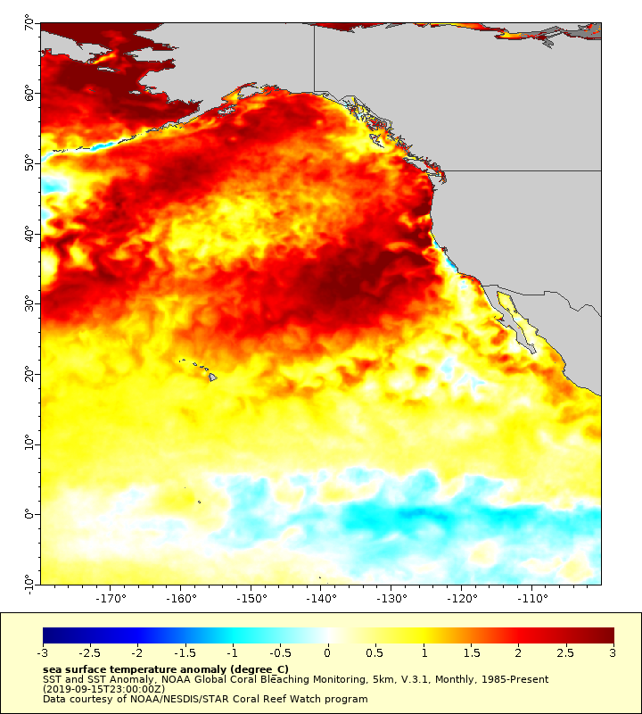
Visualize the Pacific marine heat wave:
SSTA Sept 2019
https://coastwatch.pfeg.noaa.gov/erddap/griddap/NOAA_DHW_monthly.largePng?sea_surface_temperature_anomaly[(2019-09-15)][(70):(-10)][(-180):(-100)]
Produces this figure
Note: Changing the variable name produces an anomaly because this dataset has a variable with the SST anomaly in it. Most datasets do not have an anomaly variable in them, so this modification will only work for this dataset.
Notes:
Now we see a map of the SST anomaly for this same timeperiod. The red values show the extent of the marine heat wave that has developed in the Pacific the last few years. Note that in this example changing the variable name produces an anomaly because this dataset has a variable within it with the SST anomaly in it. Most datasets do not have an anomaly variable in them, so this specific modification will only work for this dataset.
How long has this marine heat wave been around? How can we see that graphically?

Slide 13

Create a 2D timeseries:
SSTA Sept 2019
https://coastwatch.pfeg.noaa.gov/erddap/griddap/NOAA_DHW_monthly.largePng?sea_surface_temperature_anomaly[(2019-09-15)][(70):(-10)][(-180):(-100)]
Next we will examine the temporal evolution of the warm “blob” by making a Hovmöller diagram, a hybrid map with time on one axis, and latitude or longitude on the other. We will make a slice through 30°N.
We can do this by setting the y-axis to time on the “Make a Graph” page:
Notes:
We can determine how long this heat wave has been around by making a hovmoller graph, which is a hybrid map, with time on one axis. We will take a cross-section along 30N and plot it over time. We can do this on the “make a Graph” page by the changing the Y axis from latitude to time.

Slide 14
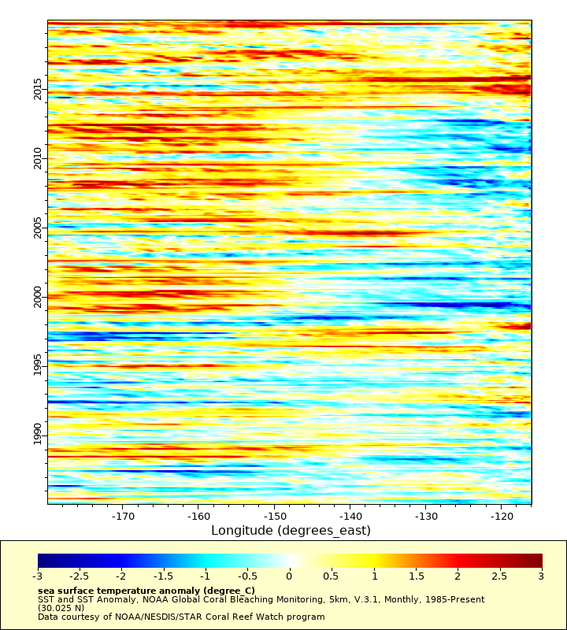
Generate a Hovmöller diagram
https://coastwatch.pfeg.noaa.gov/erddap/griddap/NOAA_DHW_monthly.largePng?sea_surface_temperature_anomaly[(1985-01-15):(2019-12-16)][(30)][(-180):(-116)]
Produces this figure
While most of the last 20 years the N. Pacific (at 30°N) has experienced warmer than usual temperatures, only in the past few years has this phenomena spread to coast (east of 120°W).
Notes:
Here we are looking at SST along 30N from 1985 at the bottom of the plot to the end of 2019. We can see that while most of the last 20 years there have been warmer than usual temperatures in the Central Pacific, only since 2015 has this phenomena spread to the coast, as seen by the positive anomalies east of 120W in the upper right hand side of the plot.

Slide 15
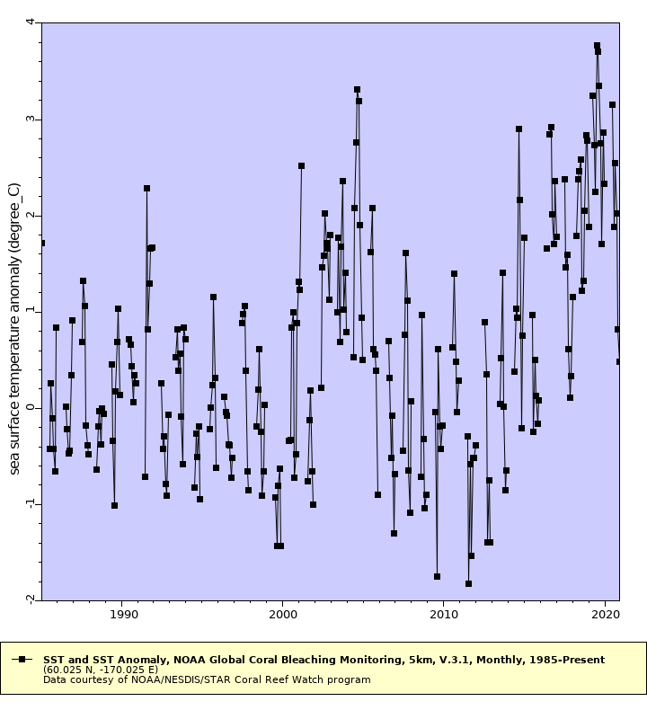
Generate a Timeseries
∆SST 60°N, 170°W
https://coastwatch.pfeg.noaa.gov/erddap/griddap/NOAA_DHW_monthly.largePng?sea_surface_temperature_anomaly[(1985-01-16):(2020-11-16)][(60)][(-170)]
Produces this figure
Select ‘linesAndMarkers’ under Graph Type on the Make a Graph page (.graph) to create a timeseries at any point in the dataset
Notes:
You can also make just a simple timeseries of the data at one of the points. Select ‘linesAndMarkers’ under Graph Type on the Make a Graph page, pick the latitude and longitude that you want, and select the time range that you want. Here I am showing the complete dataset from 1985 onward of the SST anomaly in the Bering Sea at 60°N, 170°E.

Slide 16
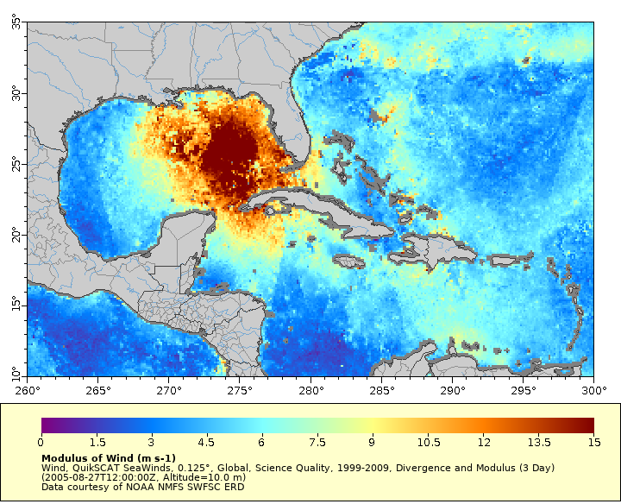
Visualize wind speeds produced by Hurricane Katrina
https://coastwatch.pfeg.noaa.gov/erddap/
griddap/erdQSdivmod3day.largePng?mod
[(2005-08-27)][(10)][(10):(35)][(260):(300)]
Produces this figure
Notes:
Next, let’s take a look at Hurricane Katrina using QuikSCAT ocean winds data.
The URL shown on this slide produces the map of wind speed on Aug. 27, 2005 in the Gulf of Mexico. But what is we also want to see the wind directions? ERDDAP can also plot vector data, although it can not do overlays, so we will have to make another plot.

Slide 17
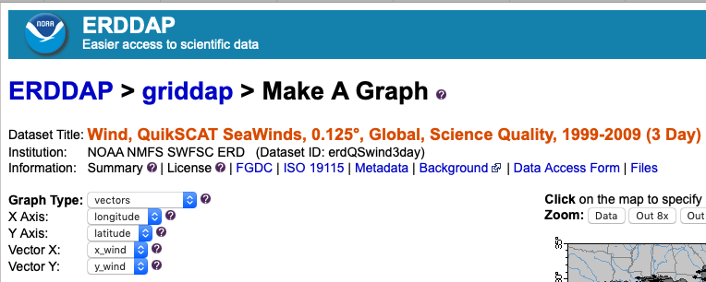
Visualize wind vectors produced by Hurricane Katrina
Notes:
From the “Make a Graph” page we simply select vectors as the graph type. Note that the vector graph option is only available for those datasets that contain vector data.

Slide 18
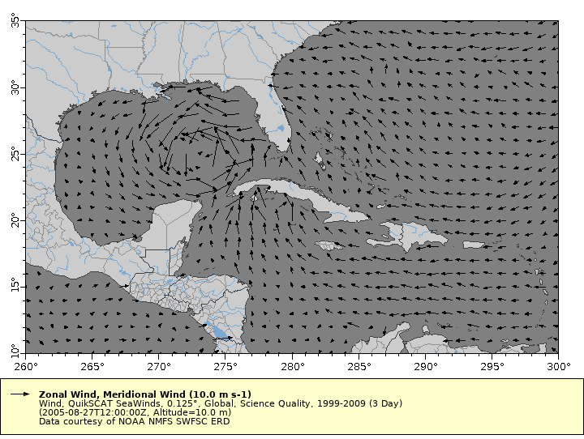
Visualize wind vectors produced by Hurricane Katrina
Notes:
And now we can see the wind vectors associated with Hurricane Katrina in the Gulf of Mexico.

Slide 19
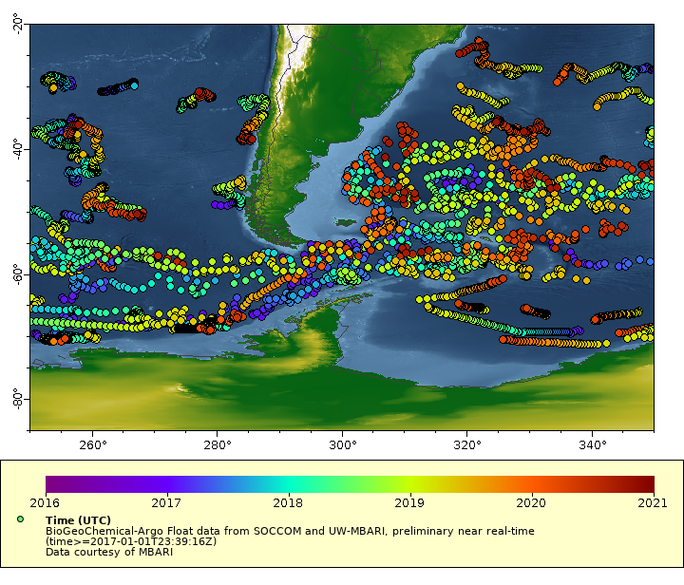
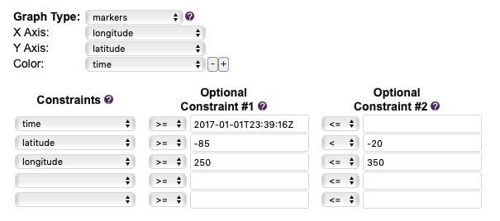
Access tabular data like BGC-Argo Float data
Map of all BGC-Argo floats since 2017-01-01 in the Southern Ocean around South America. Float profiles are colored by date.
https://polarwatch.noaa.gov/erddap/
tabledap/SOCCOM_BGC_Argo.graph
Notes:
ERDDAP also serves tabular data like in-situ data. Here we are looking at a map of all of the BGC-Argo data since the beginning of 2017 in the Southern Ocean around South America. These are profiling floats that are equipped with sensors that can make biological or chemical measurements like oxygen, nitrate, pH, etc. This data is served on the PolarWatch ERDDAP. Here the float locations are colored by time, but they could also be colored by float number, or any of the variables in the dataset. The Make a Graph interface works a little differently for tabular datasets, and one can constrain the data shown by any of the variables in the dataset. Next we will look at some different graphs made from one of these floats.

Slide 20
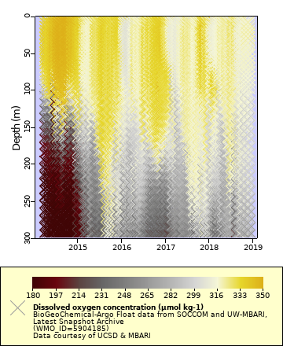
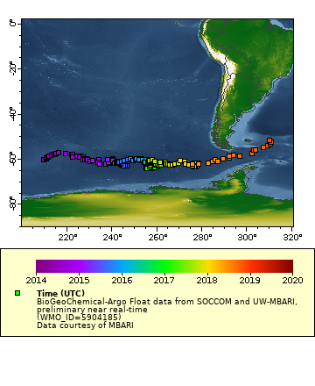
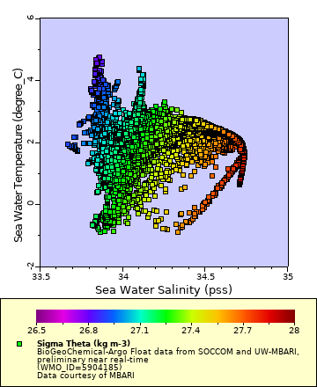
Visualizations of tabular data
Oxygen Section for 0-350 m depth
https://polarwatch.noaa.gov/erddap/tabledap/SOCCOM_BGC_Argo.graph
Float WMO_ID = 5904185
Temperature-Salinity Diagram
Map of float trajectory
Notes:
By changing the constraint selections one can easily make maps and different types of graphs for tabular data. On the left is the float track for one of the SOCCOM Bio-Argo floats, color-coded by time. In the middle is a Temperature-Salinity diagram, color-coded by density, for that same float data, and on the right is a section plot showing oxygen in the surface 300 m for the 5-year duration of the float. For the oxygen section a color palette has been chosen that is perceptually uniform.

Slide 21
Downloading Data
NOAA_DHW_monthly.largePng?sea_surface_temperature[(2019-09-21T12:00:00Z)]
Example of a URL data request
Base URL:
Dataset ID:
File Type:
Data Request Begins
Variable:
Time range:
Latitude Range:
Longitude Range:
https://coastwatch.pfeg.noaa.gov/erddap/griddap/
NOAA_DHW_monthly
.largePng (.nc, .mat, .json, .geotif, .kml, .csv…)
?
sea_surface_temperature
[(2019-09-15T12:00:00Z):(2019-09-15T12:00:00Z)]
[(70):(-10)]
[(-180):(-100)]
coastwatch.pfeg.noaa.gov/erddap/griddap/
[(70):(-10)][(-180):(-100)]
Notes:
So far I have been focusing on different ways of visualizing data on ERDDAP. What if we want the data associated with one of these figures? Lets revisit that URL I showed at the beginning of the talk when I introduced the different components of the ERDDAP data request. This URL has the File type, the text in green, given as a large PNG file, so it will create an image on your browser. But if you changed that bit of the url to .mat it would produce a matlab file of that same data, which would be automatically downloaded to your computer. There are many different file formats to chose from, including netCDF, .json, kml, csv etc. Now since we were just looking at one time increment in this map, this url will only download one timeperiod. Most likely you will want to download a range of times, and that can be done by setting the time range to actually represent a range of values, rather than having it be only one time period as shown here. Talking about the time range reminds me of another cool feature of ERDDAP I need to tell you about, and that is the ‘last’ function that can be used in the time range.

Slide 22
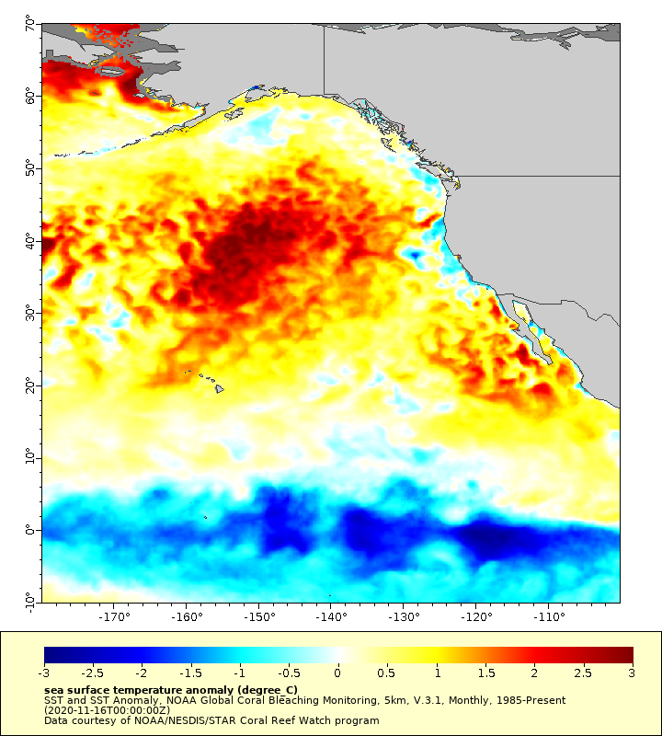
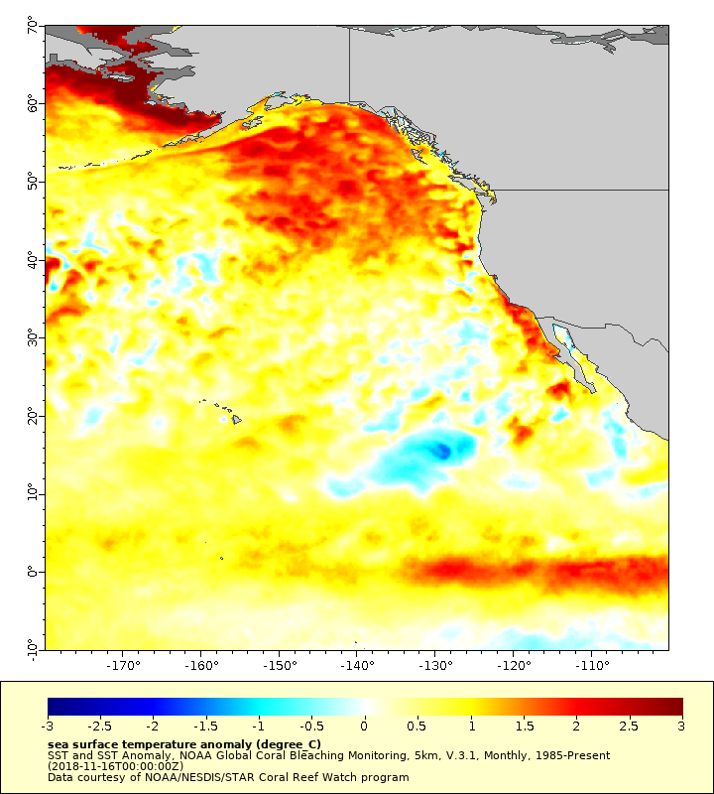
“Last” Data
https://coastwatch.pfeg.noaa.gov/erddap/griddap/
NOAA_DHW_monthly.largePng?sea_surface_temperature_anomaly
[last][(70):(-10)][(-180):(-100)]
https://coastwatch.pfeg.noaa.gov/erddap/griddap/
NOAA_DHW_monthly.largePng?sea_surface_temperature_anomaly
[last-24][(70):(-10)][(-180):(-100)]
Nov 2020
Nov 2018
Notes:
If you replace a specific date in the url with the word last, you will get the most recent image. That’s what we are showing on the left. That url, in December of 2020, produced a map of the data from Nov 2020. If I access that same url in January of 2021 it should show me data from December of 2020. This is a very convenient way to embed images in a website to always show the most recent data for a region of interest. You can also do simple math with the last function. The url on the right is requesting “last-24”, so is getting the data from 24 time increments before the most recent data. Since this is a data product with monthly timesteps, that is getting data 2 years before the most recent data. For a daily dataset last-24 will return data 24 days before the most recent data.

Slide 23
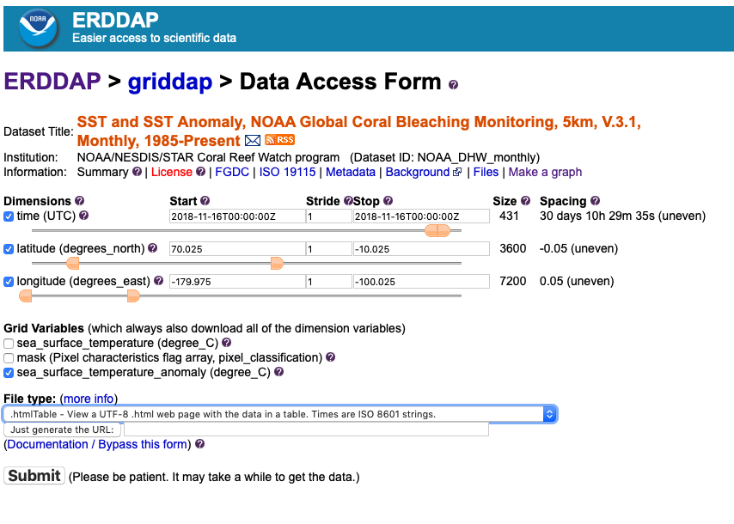
Data Access Form
https://coastwatch.pfeg.noaa.gov/erddap/griddap/
NOAA_DHW_monthly.html?sea_surface_temperature_anomaly
Notes:
Now you might be thinking this is all very well and good, but there is no way you will ever be able to figure out how to put one of these long cumbersome URLs together. You don’t have to. I have been showing the URLs associated with graphs to demonstrate how the URLs work. But remember you can download data directly from the Data Access Form for a dataset. You get there by clicking the data link to the left of a dataset title on the main ERDDAP data listing, or by changing the filetype in the url to .html. The screen shot shown here is the Data Access Form for the sea surface temperature product we were just looking at. If you just want the url of what this download request would be, to use in some other software, you can generate it by clicking on the “Just generate the URL” button. The “just generate the URL” feature is also available on the Make a Graph page.

Slide 24
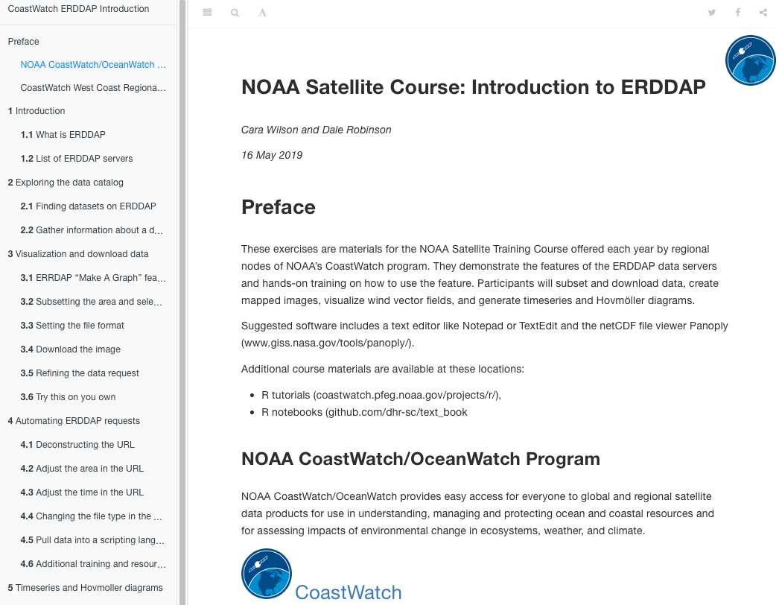
Online “Introduction to ERDDAP” provided by NOAA CoastWatch
Online ERDDAP tutorial
Developed by CoastWatch West Coast Node for the NOAA satellite course
  coastwatch.noaa.gov/cw/user-resources/
  satellite-data-training-courses.html
Walks users through using ERDDAP
Demonstrates visualizing both gridded and tabular datasets
Shows how to subset and download datasets in a variety of different formats
https://coastwatch.pfeg.noaa.gov/projects/ERDDAP/
Notes:
I’ve provided a very quick introduction to ERDDAP capabilities. We also have an online tutorial which demonstrates the main features of ERDDAP. It is available at the link shown here, coastwatch.pfeg.noaa.gov/projects/ERDDAP

Slide 25
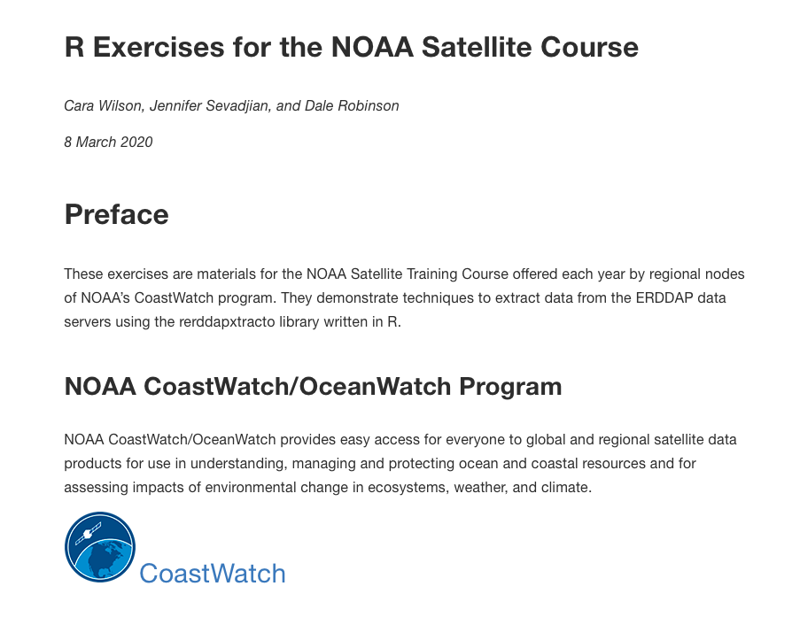
Online tutorial for using R with ERDDAP provided by NOAA CoastWatch
Online ERDDAP tutorial
Developed by CoastWatch West Coast Node for the NOAA satellite course
  coastwatch.noaa.gov/cw/user-resources/
  satellite-data-training-courses.html
Demonstrates techniques to extract data from the ERDDAP data servers using the rerddapxtracto library written in R
https://coastwatch.pfeg.noaa.gov/projects/r/
Notes:
The previous slides showed examples of using ERDDAP's web pages to download data or make a customized graph. Since ERDDAP has an underlying RESTful service, one can make requests for data from with programs like curl and wget, or by writing scripts which automate the process of making 100's, 1000's, or 1000000's of requests. We have an online tutorial that demonstrates ways to extract data from ERDDAP using R software. It is available at coastwatch.pfeg.noaa.gov/projects/r

Slide 26
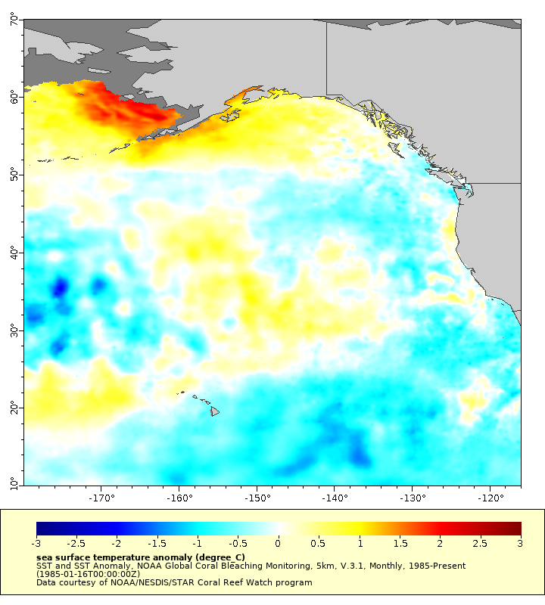
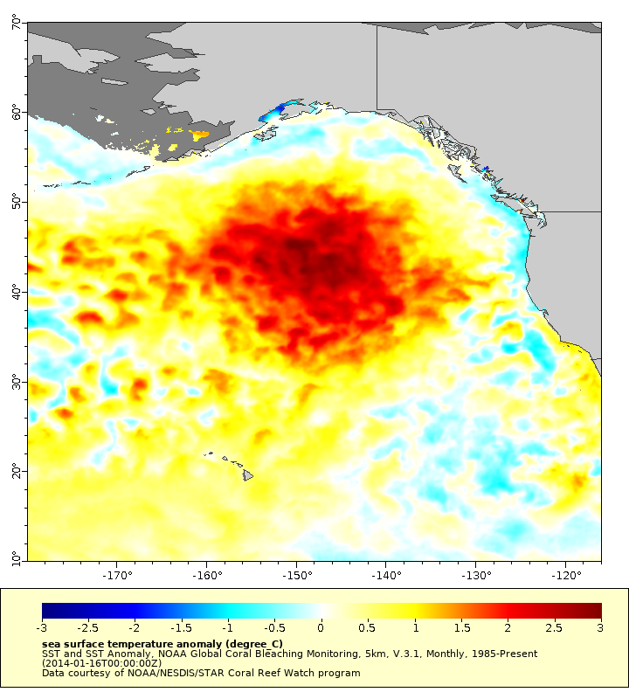
Questions???
Jan 1985
Jan 2014
Cara.Wilson@noaa.gov
Dale.Robinson@noaa.gov
Bob.Simons@noaa.gov
Notes:
If you have any questions feel free to contact me or my co-authors by email. Thank you for your attention.

