Slide 1

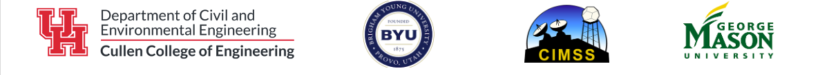

FIER VIIRS Water Fraction Forecasting using GEOGloWS and National Water Model
Amirhossein Rostami, Hyongki Lee, Chi-Hung Chang
American Meteorological Society SatMOC Virtual Training
Session 2: Extreme Hydro-meteorological Forecasting and Flood Mapping
June 2024

Slide 2

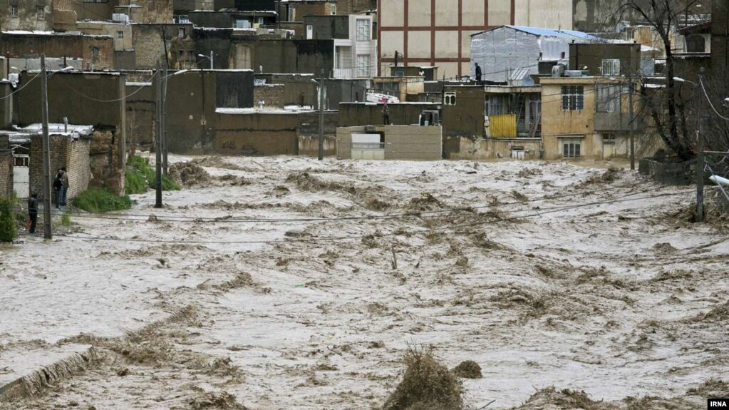
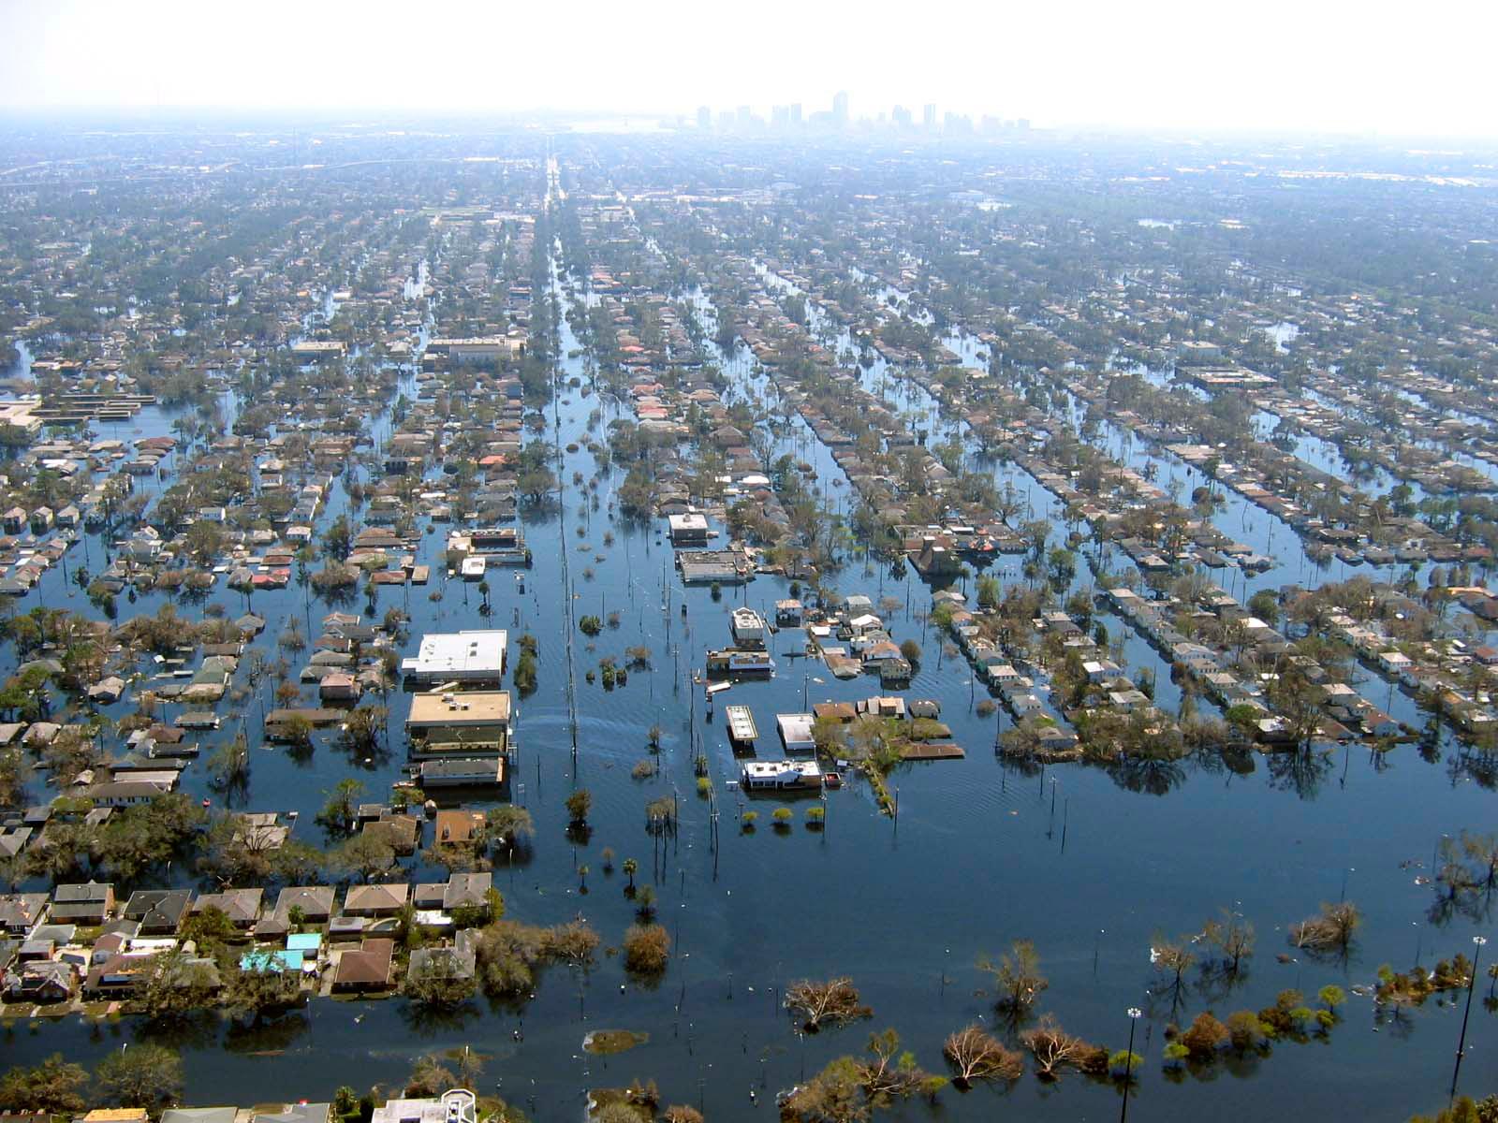
Floods in 21st century
Climate change, global warming, extreme events
More water vapor in the Earth’s atmosphere
More frequent and intense extreme floods
Hurricane Katrina (2005): New Orleans
Hurricane Florence (2018): North/South Carolina
April floods: Alabama, Florida
Economic damages and life loss due to the floods
Reliable flood forecasting systems are needed
Accurate, scalable, fast, and operational methods
Inundation maps are essentials for flood management
AMS SatMOC Virtual Training, June 2024

Slide 3
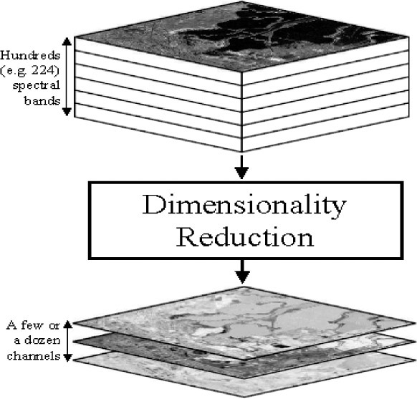
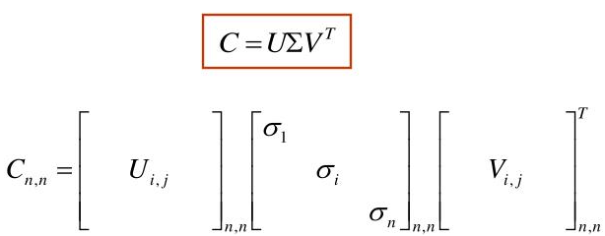
What is FIER?
Forecasting Inundation Extents using Rotated Empirical Orthogonal Function (REOF) analysis (FIER) (Chang et al., 2020, 2023, 2024)
Historical Remote-sensing satellite images (Synthetic Aperture Radar (SAR), Optical imagery)
VIIRS WF: Visible Infrared Imaging Radiometer Suite Water Fraction product (since 2012-present)
Sentinel-1 SAR GRD images
Principle Component Analysis (PCA)
Capture the maximum information in the dataset
Reduce the number of dimensions of the dataset
Simpler visualization of the complex dataset
How PCA works?
Covariance matrix of the RS cube data
Eigenvalues and associated eigenvectors (Singular Value Decomposition-SVD)
Sort eigenvectors based on the magnitude of eigenvalues (max variance)
Project the data points on those vectors (synthesize)
Adopted from Shen-En Qian (2011)
AMS SatMOC Virtual Training, June 2024

Slide 4
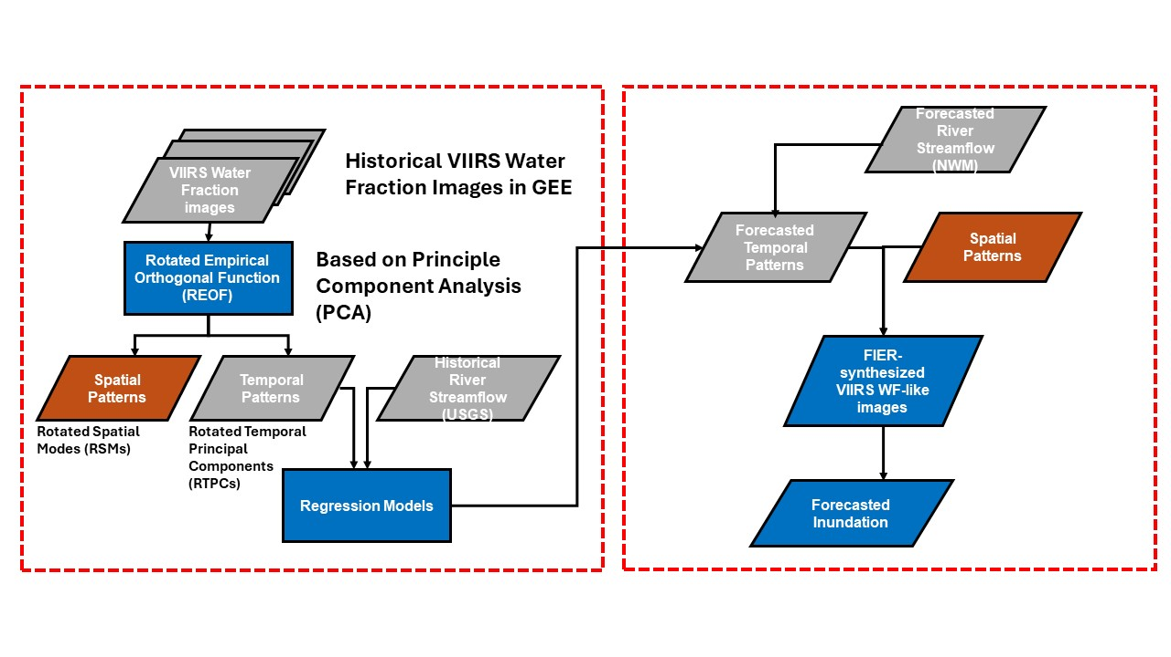
How FIER Works?
Meaningful relationship between hydrological variables (river water level/streamflow) and inundation extent
Decomposition (SVD) of remote sensing imagery Temporal (eigenvalues) and Spatial (eigenvectors) pattern (modes). (Step2 in the previous slide)
Build a regression model, hydrological data and temporal patterns of RS imagery
Forecasted hydrological data how affect the RS images? Regression analysis synthesizing RS images (Step4 in the previous slide)
AMS SatMOC Virtual Training, June 2024

Slide 5
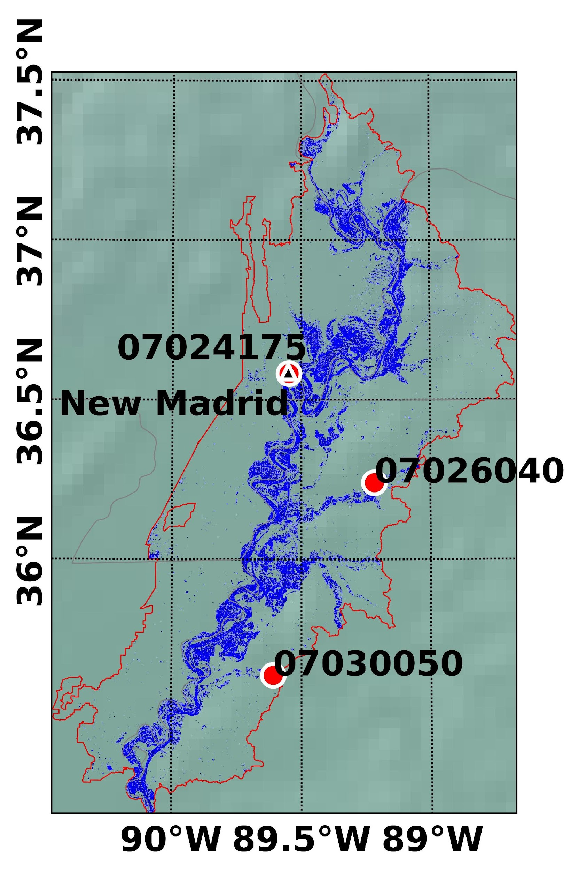
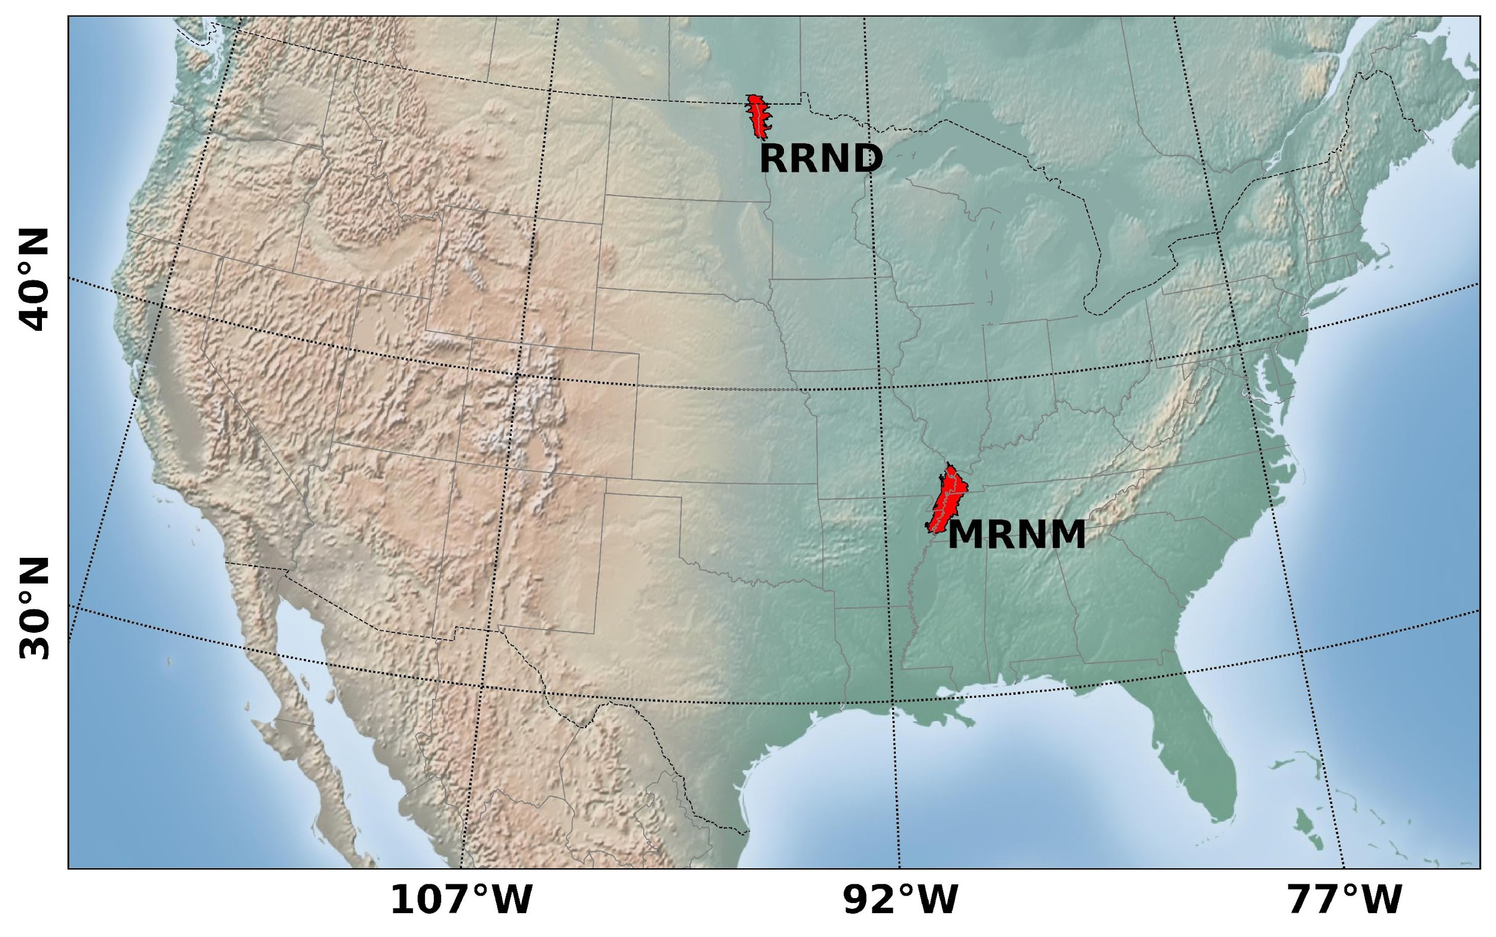
Study area and datasets
Mississippi River near New Madrid, MO
Model building
Historical Satellite images: VIIRS water fraction from 2012 – 2023
Historical Hydrological data:
USGS-07024175, 07030050
Forecasting
Forecasting Hydrological data:
NWM-7469392, 14073444
GEOGloWS (retrospective)-760600230, 760660047
AMS SatMOC Virtual Training, June 2024

Slide 6

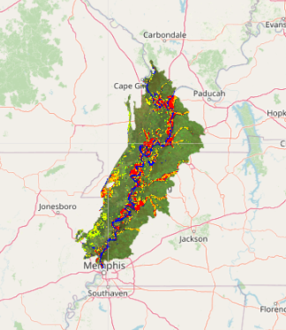
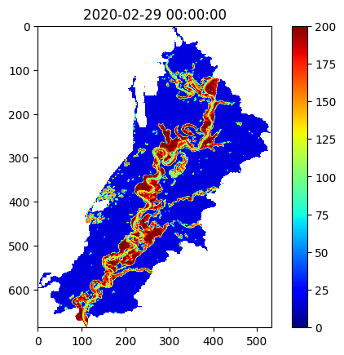
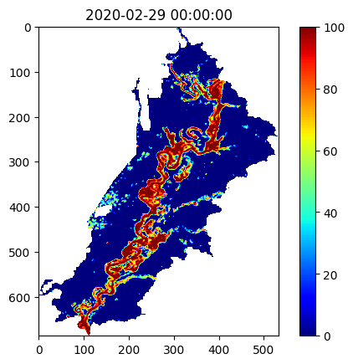
FIER-Step-by-Step
Step-1: Gathering and preprocessing datasets
VIIRS water fraction:
Google Earth Engine: XEE package in python
An array extension for GEE
JPSS AWS portal
VIIRS preprocessing:
Pertain VIIRS images with cloud coverage less than 5%
Crop images based on the Region of Interest (ROI) shapefile
Remove other classes (snow, ice, land,…) in the dataset
Before pre-processing
After pre-processing
AMS SatMOC Virtual Training, June 2024

Slide 7
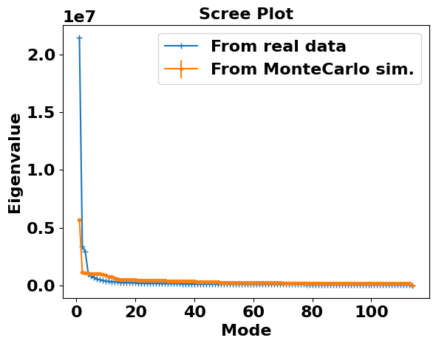
FIER-Step-by-Step
Step-2: Significant test
Which spatial mode(s) is (are) significant?
Which spatial mode(s) represents the most dominant(s) changes over the ROI?
Monte-Carlo Simulation
Shuffle selection of VIIRS water fraction pixels
Calculating Eigenvalues
AMS SatMOC Virtual Training, June 2024

Slide 8
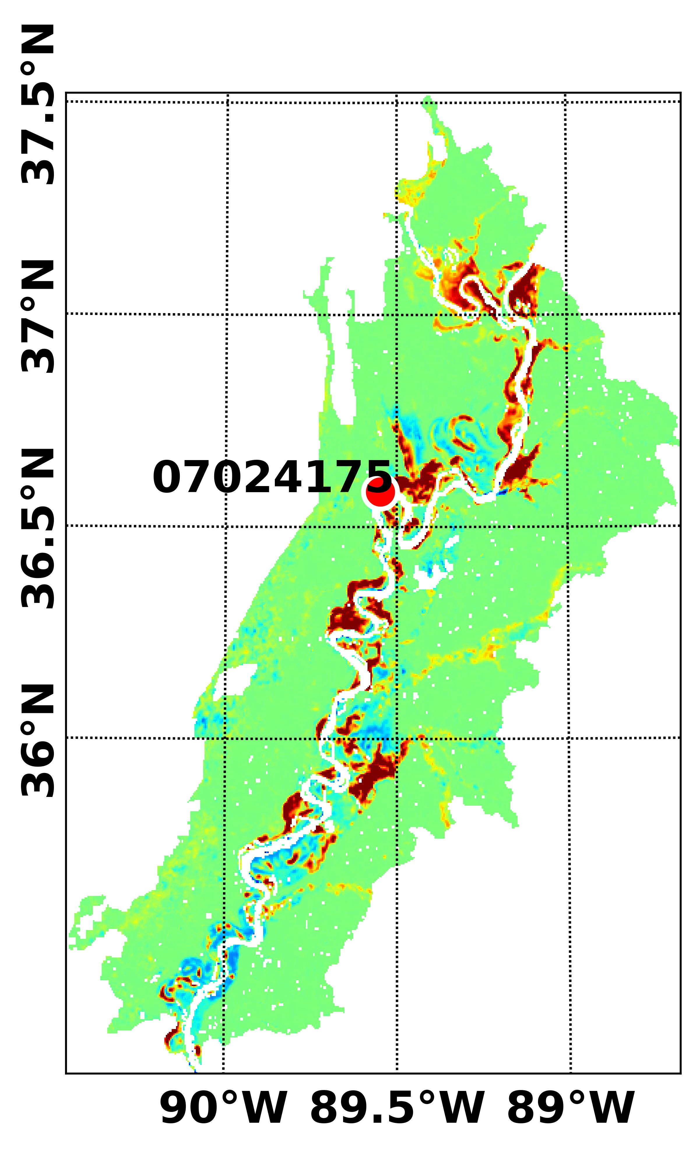
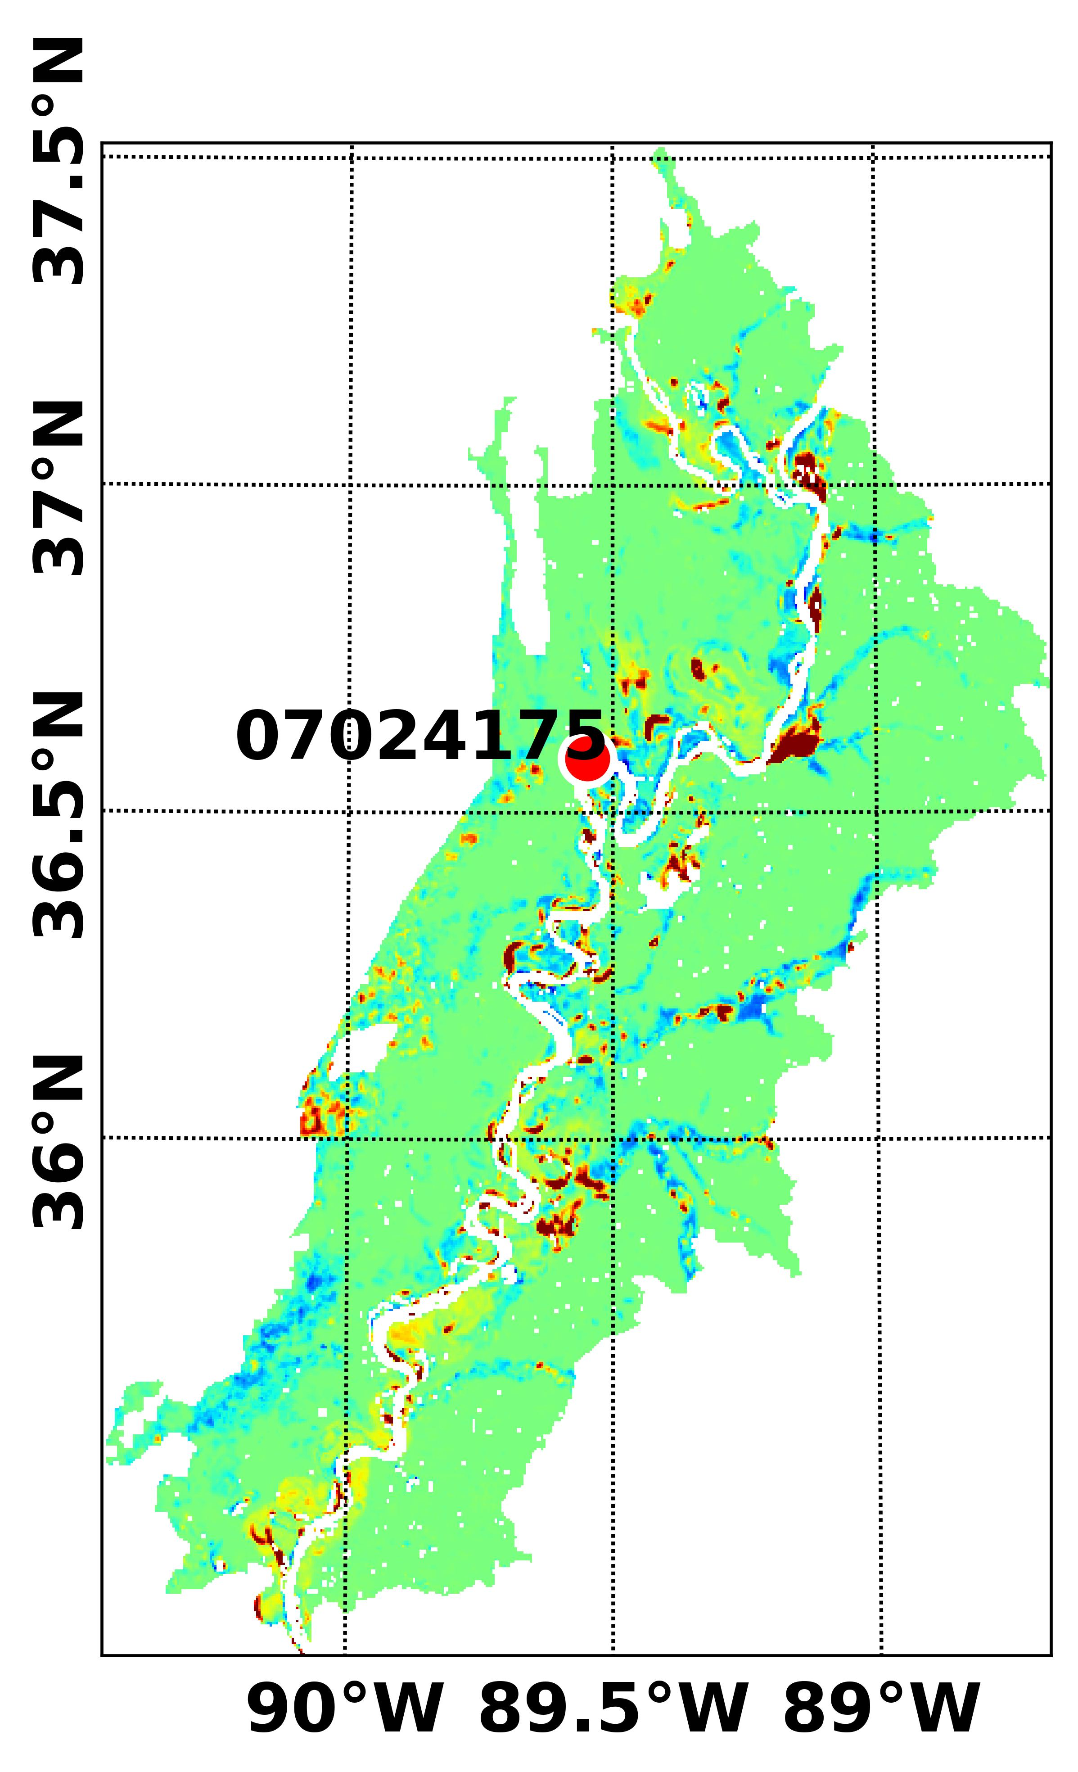
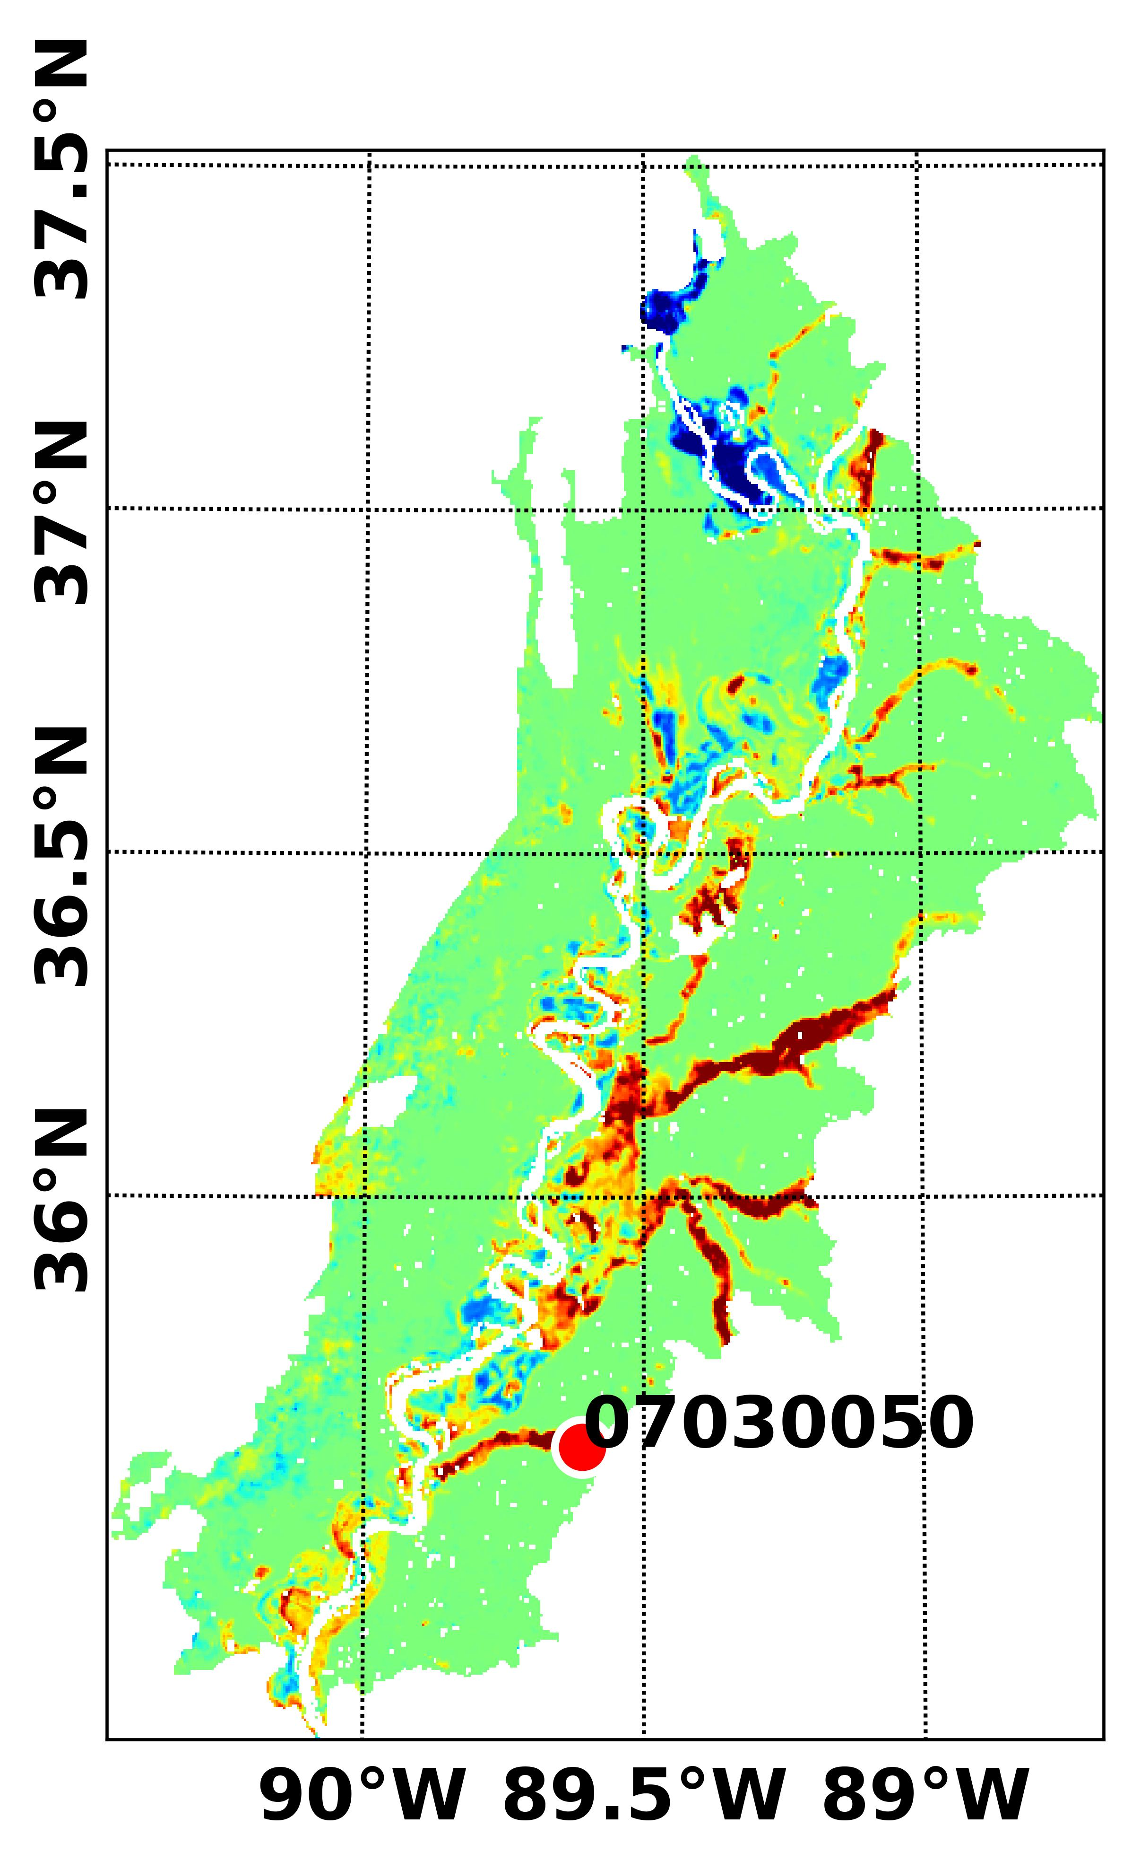
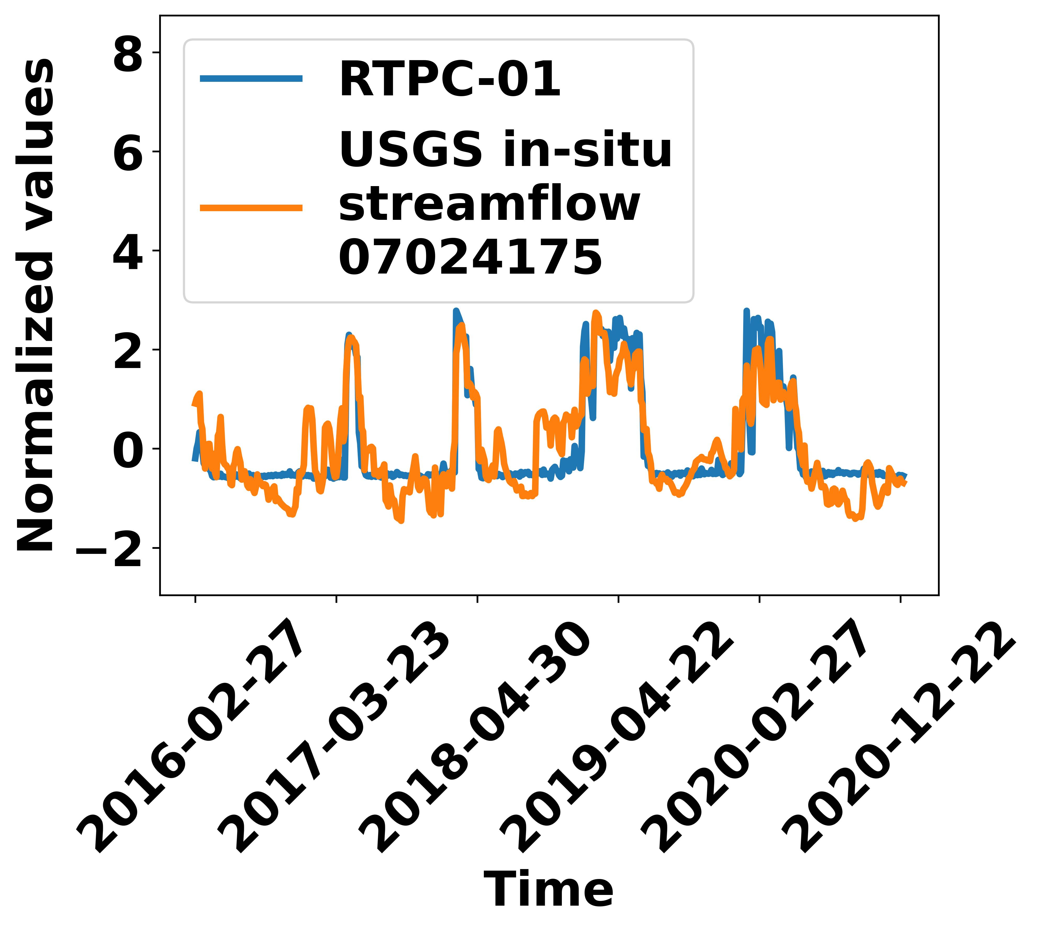
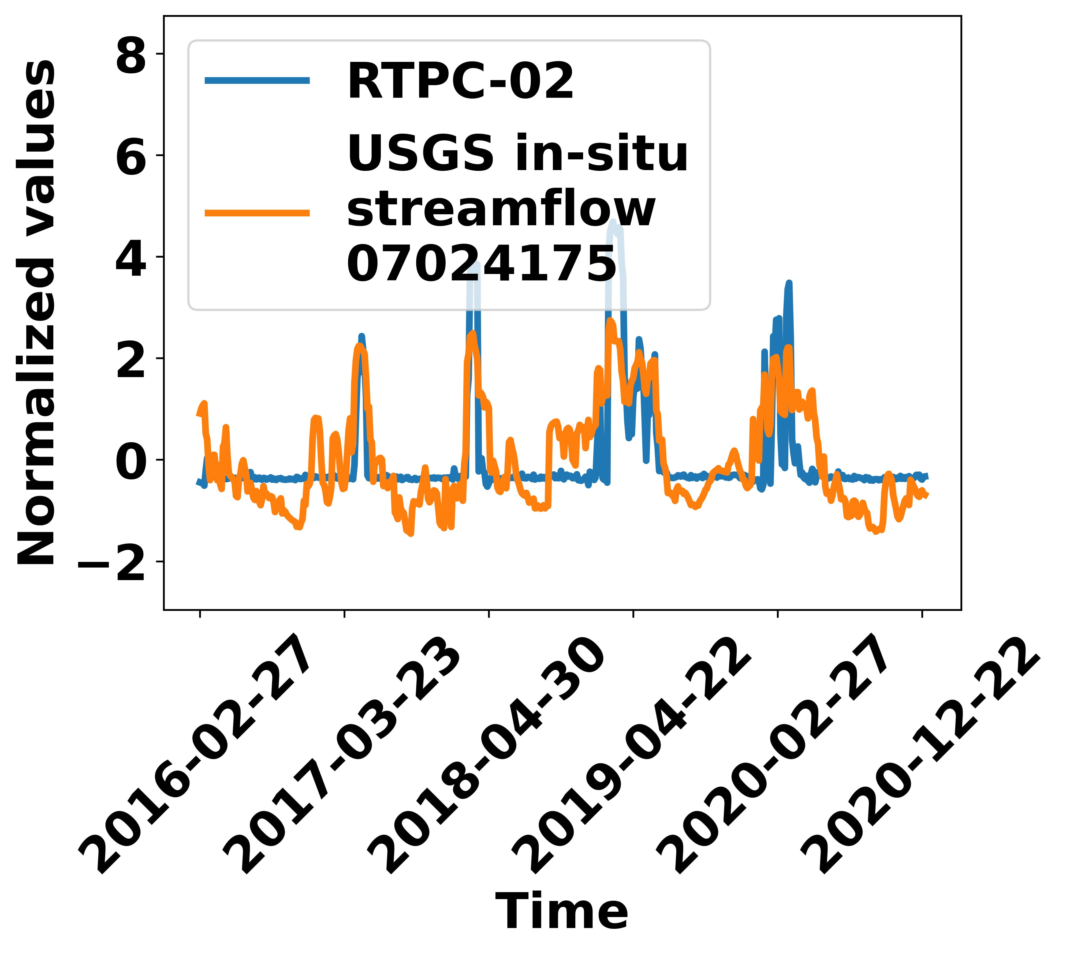
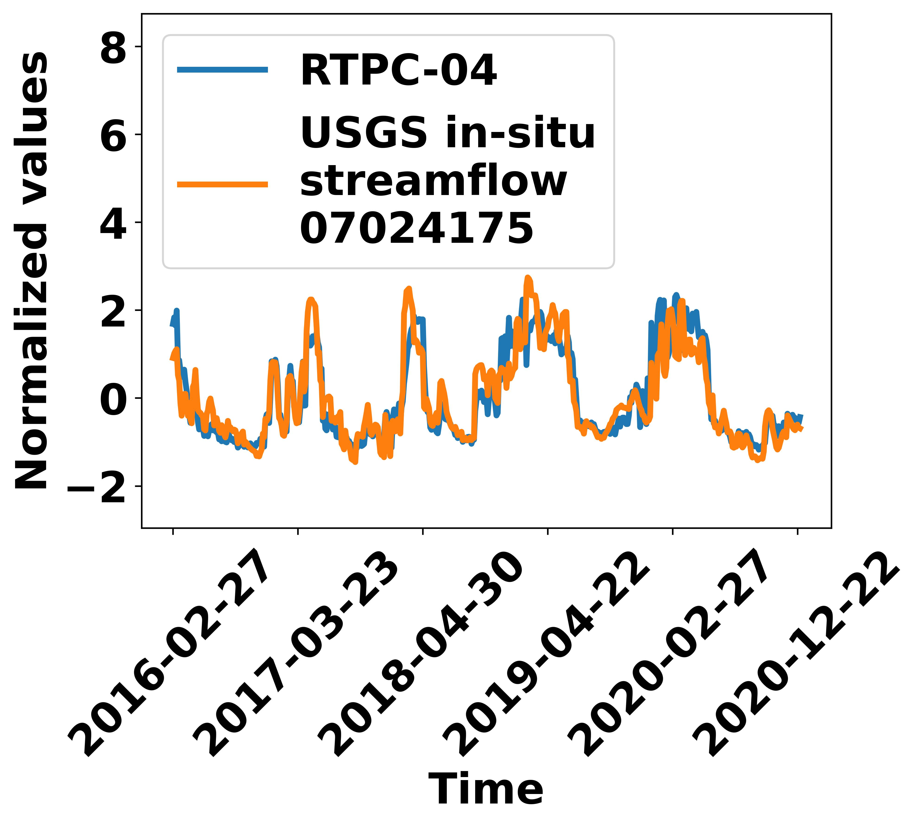
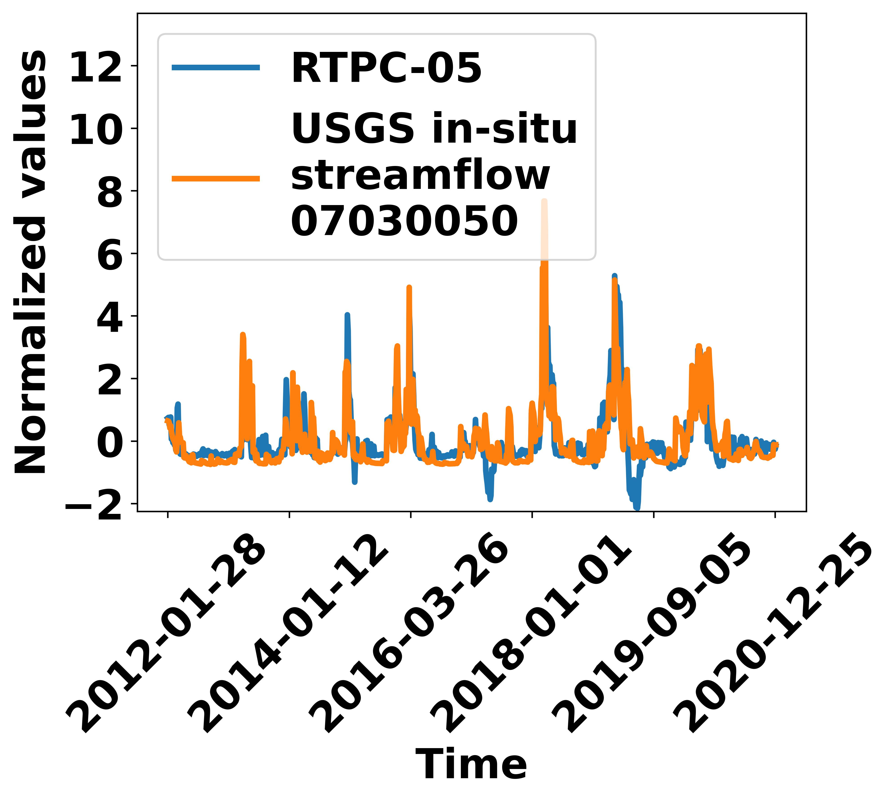
FIER-Step-by-Step
Step-3: Rotated Empirical Orthogonal Function (REOF) analysis
In which direction the dataset have the highest value of variance?
In the other word, we are going to find the direction with most changes (spatial and temporal)
RSM-01
RSM-02
RSM-04
RSM-05
AMS SatMOC Virtual Training, June 2024

Slide 9
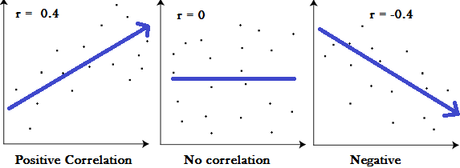
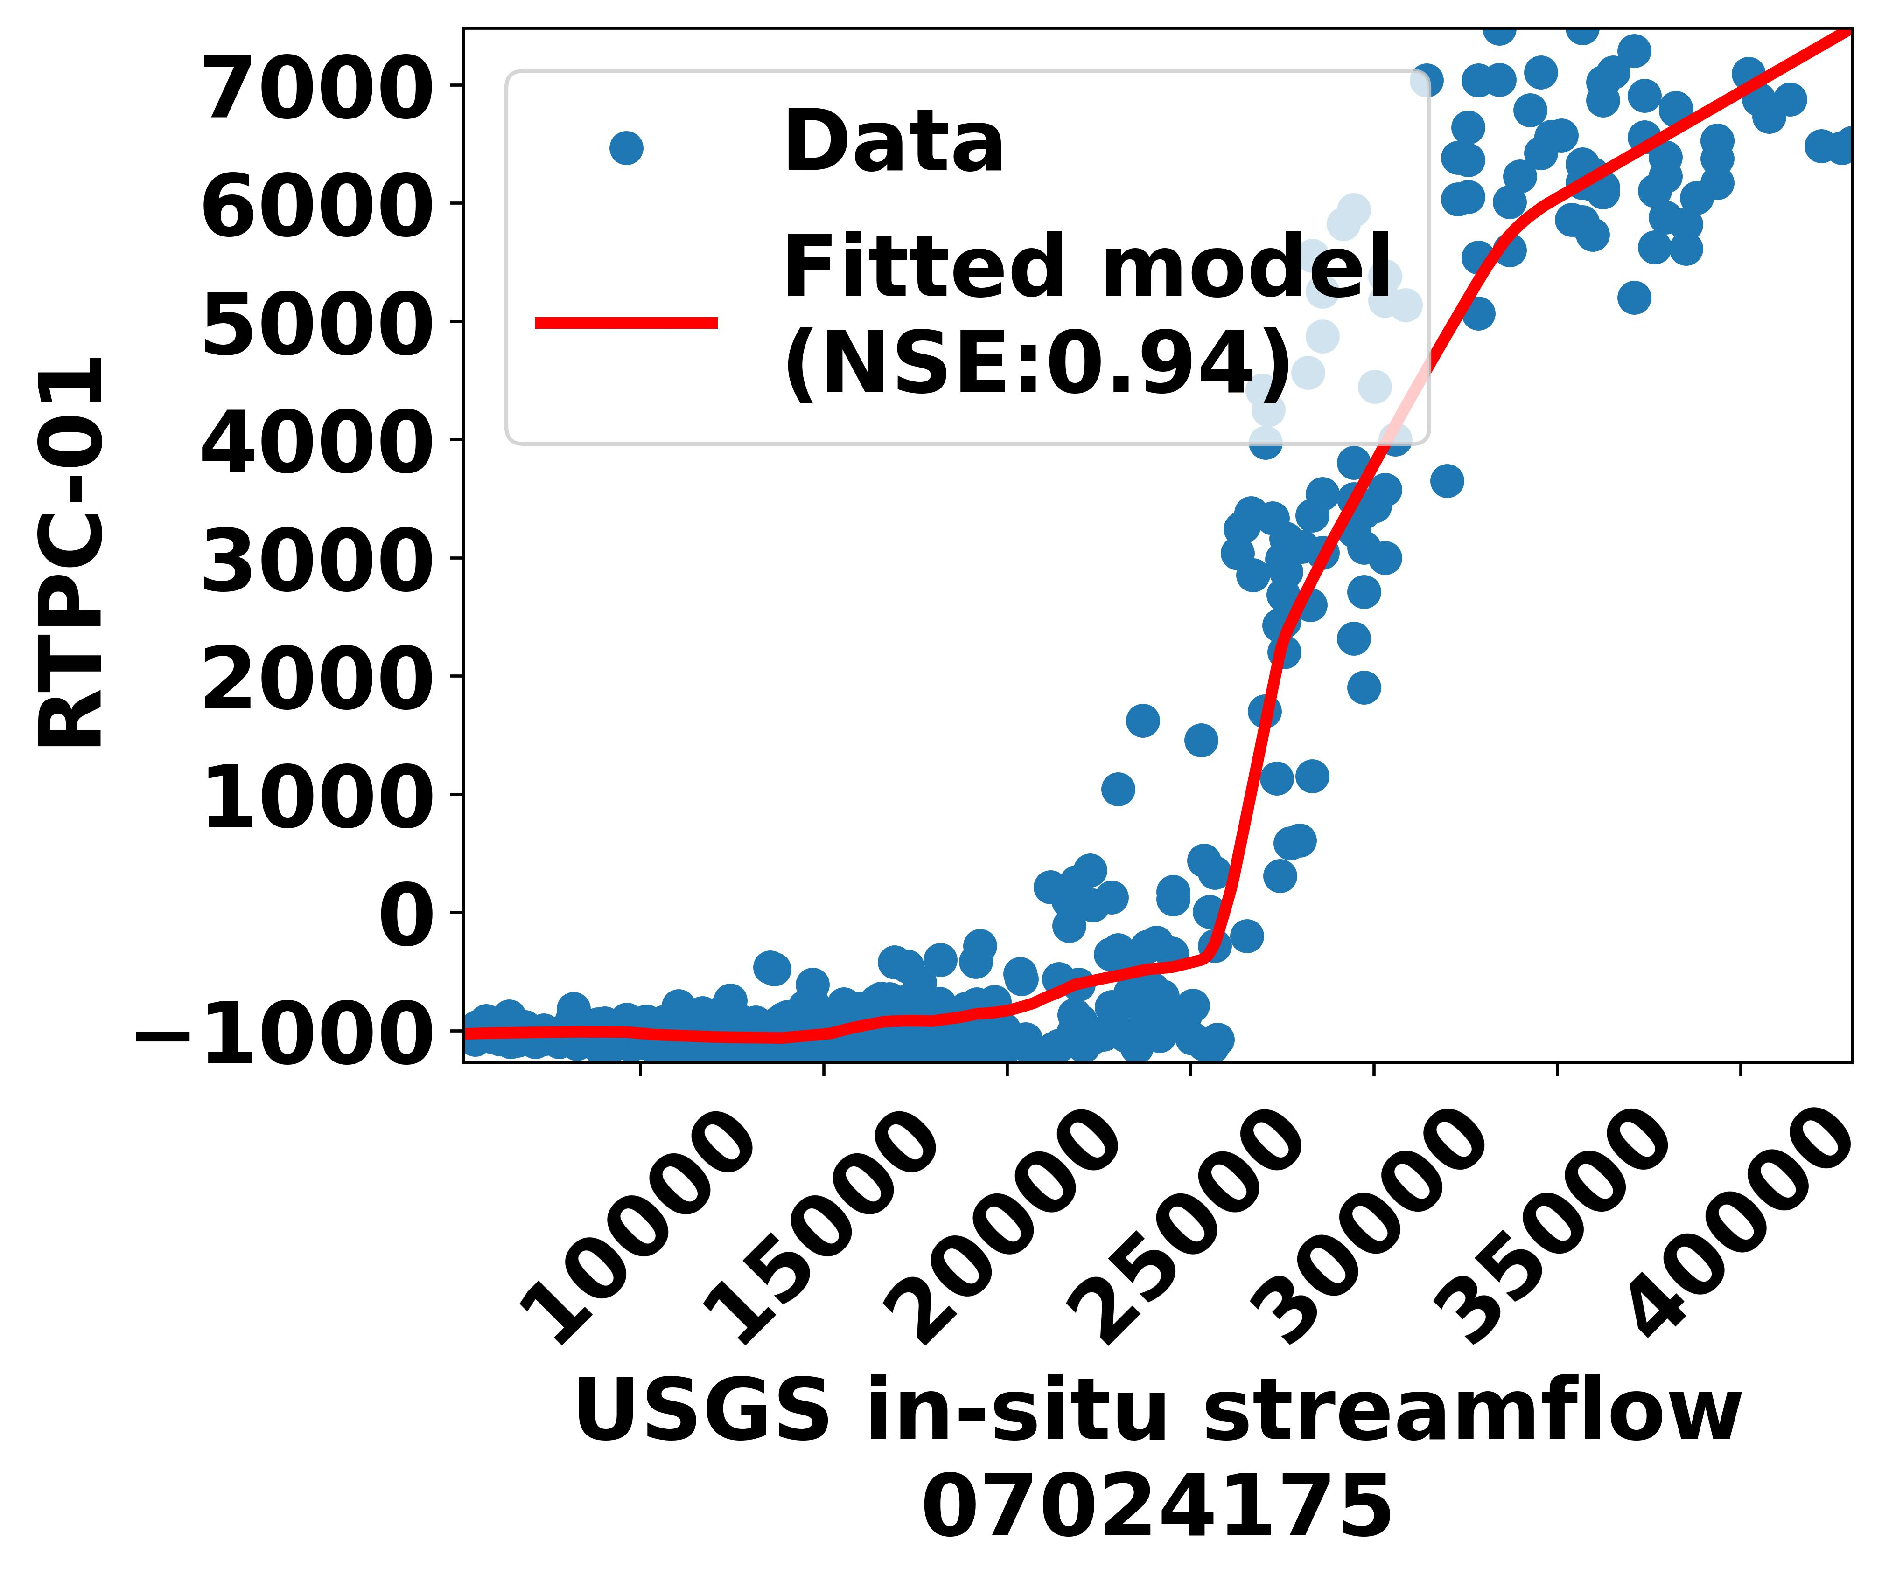
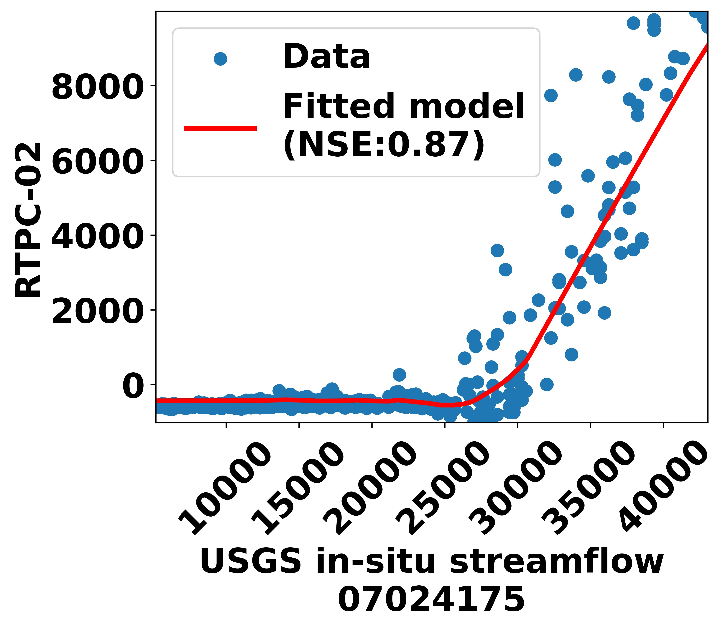
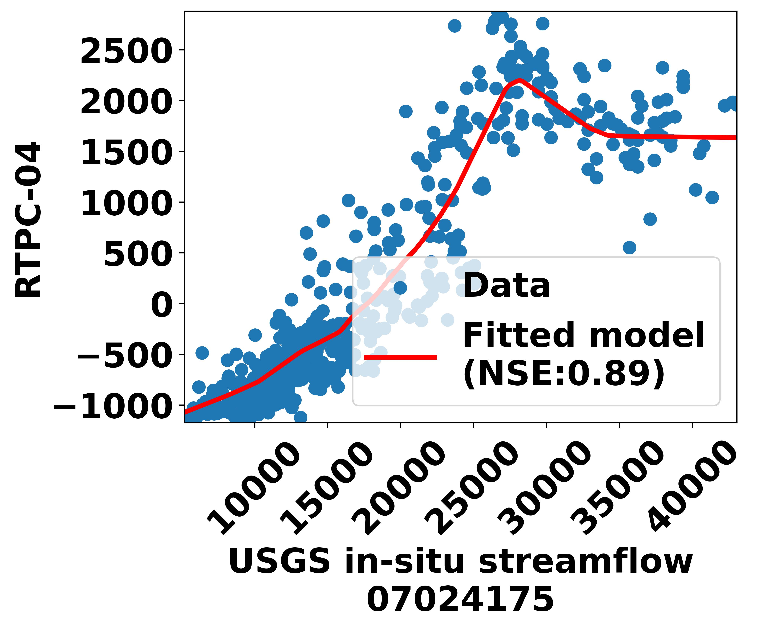
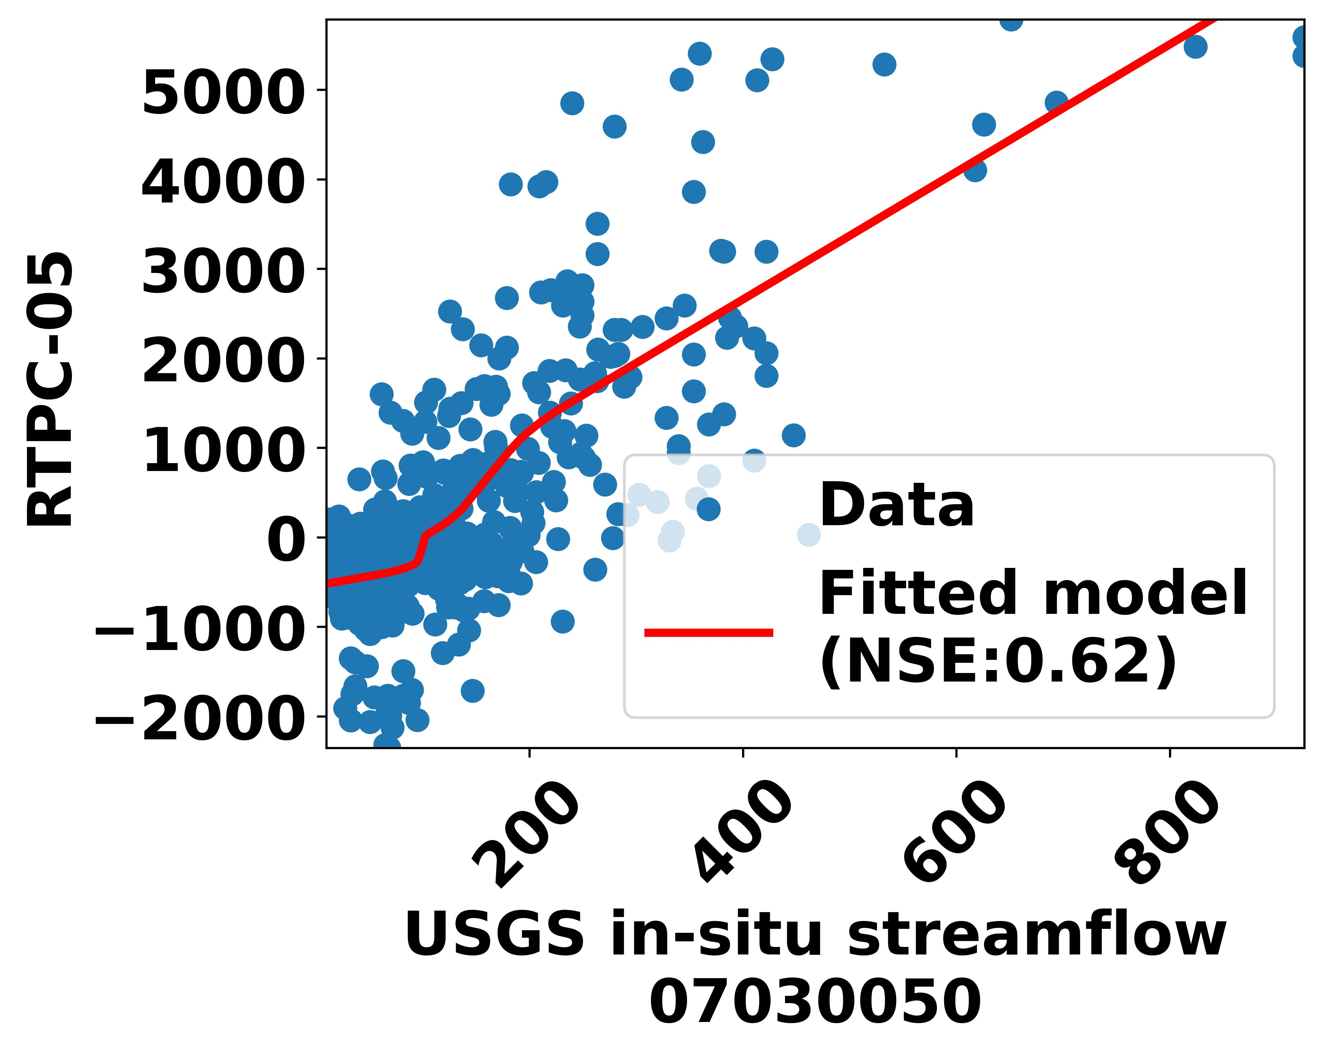
FIER-Step-by-Step
Step-4: Correlation analysis
Which modes are the water-related signals?
Which hydrologic stations should be used?
Step-5: Regression model
?
Forecast hydrologic data Forecast RTPC
? = a regression model to create a relationship between them
based on historical hydrologic variable (USGS) and RTPCs
AMS SatMOC Virtual Training, June 2024

Slide 10
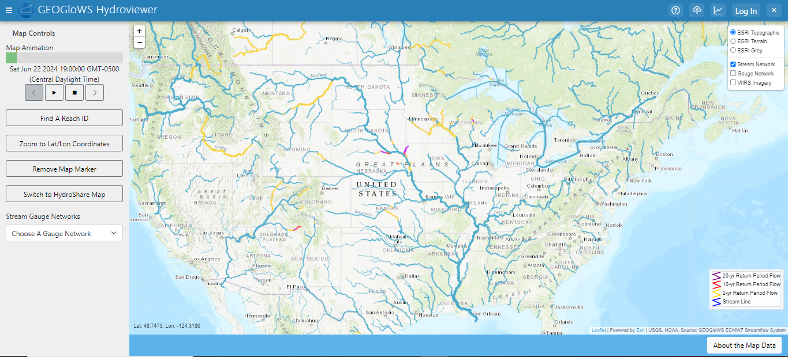
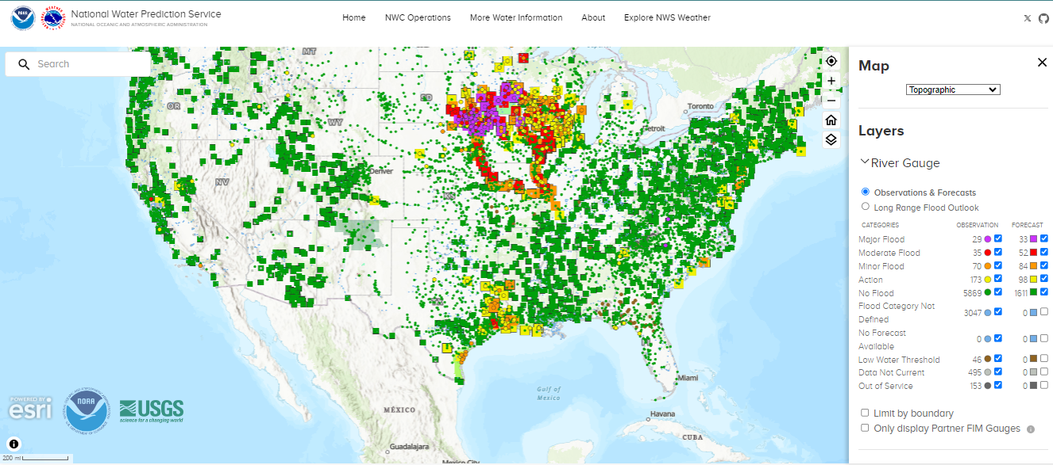
FIER-Step-by-Step
Forecast hydrologic data (streamflow):
GEOGloWS
National Water Model
AMS SatMOC Virtual Training, June 2024

Slide 11
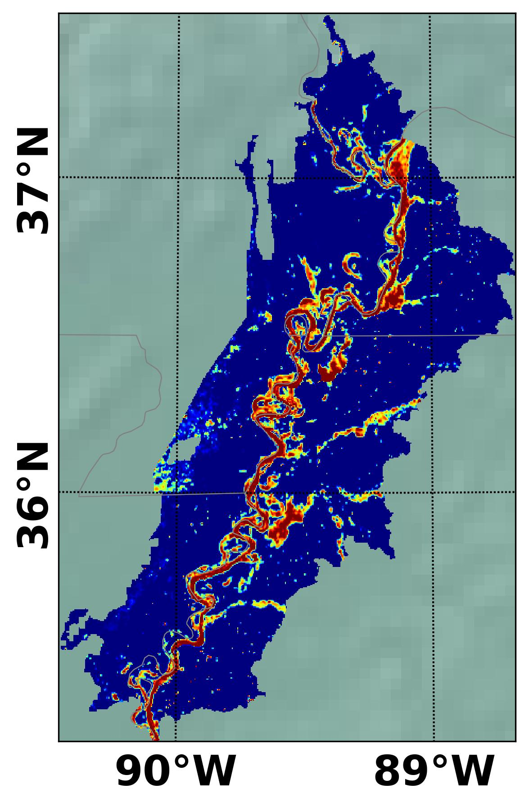

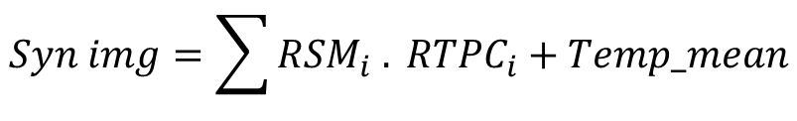
FIER-Step-by-Step
Step-6: Synthesizing VIIRS WF images
Backward procedure
RSM
Dot Multiply + Temp mean
projection
Decomposition
RTPC
Synthesized VIIRS WF
VIIRS WF Images
Regression Model
Forecast RTPCs
Historical HD
Forecast HD
*HD: Hydrologic Data
USGS
GEOGloWS, NWM
$$Syn img=\sum{RSM_{i} . RTPC_{i}}+Temp_mean$$
AMS SatMOC Virtual Training, June 2024

Slide 12
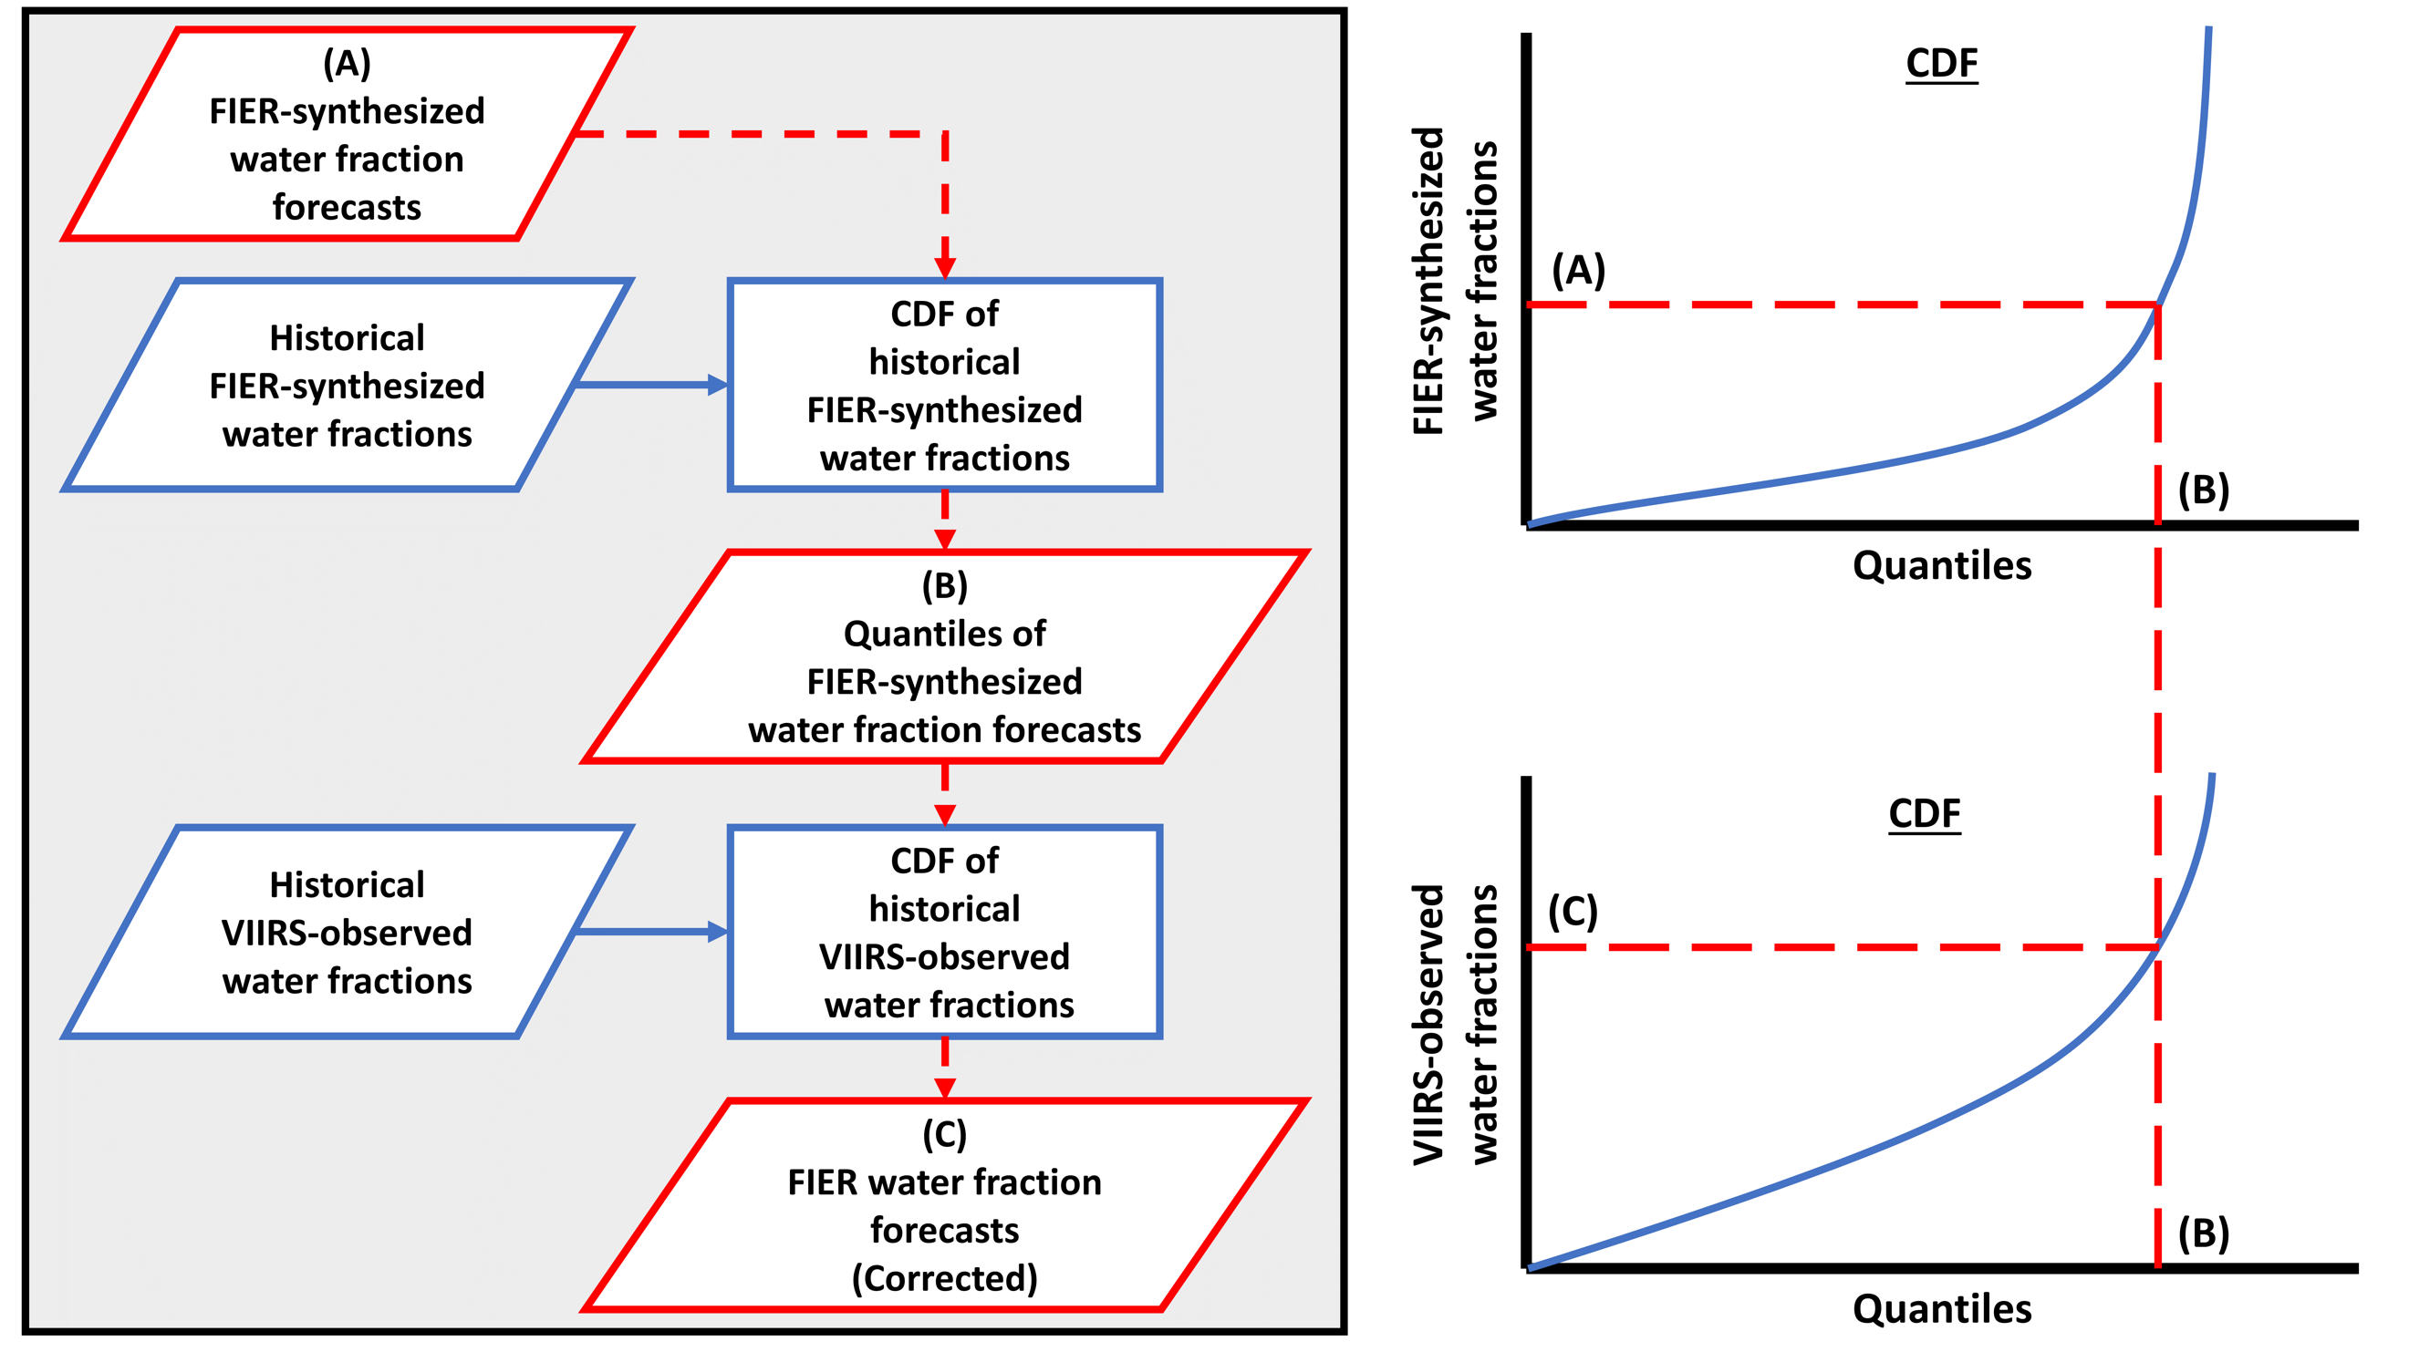
FIER-Step-by-Step
Step-7: Quantile-Scale Mapping
AMS SatMOC Virtual Training, June 2024

Slide 13
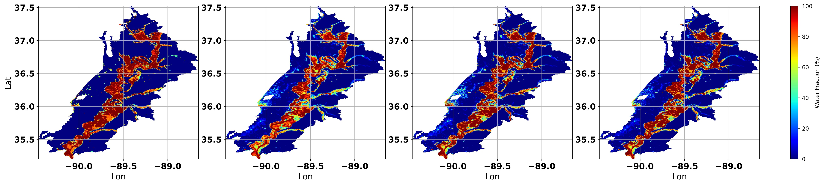
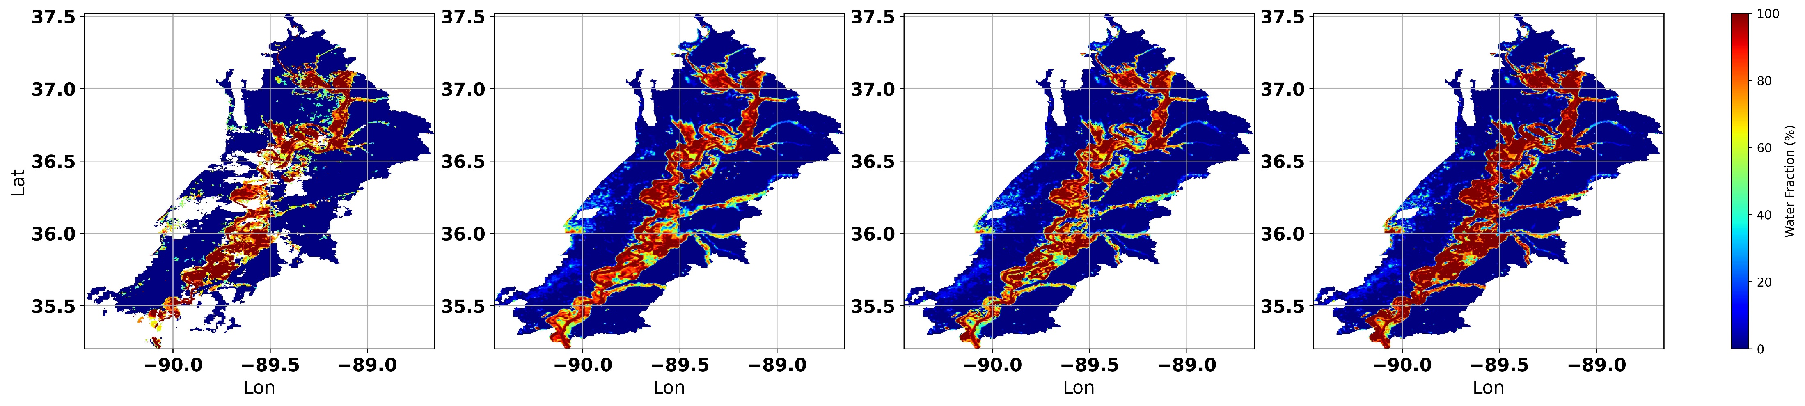
FIER water fraction forecasting results
Observed (VIIRS WF)
FIER pseudo nowcasts (USGS)
FIER pseudo forecasts (NWM)
FIER pseudo forecasts (GEOGloWS)
19-Mar-2019
10-Mar-2019
13
AMS SatMOC Virtual Training, June 2024

Slide 14
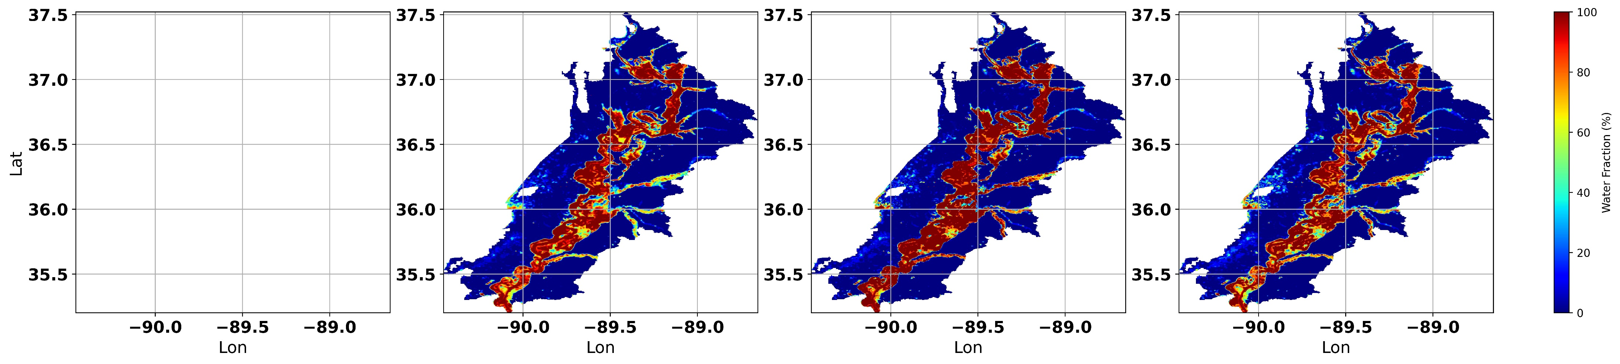
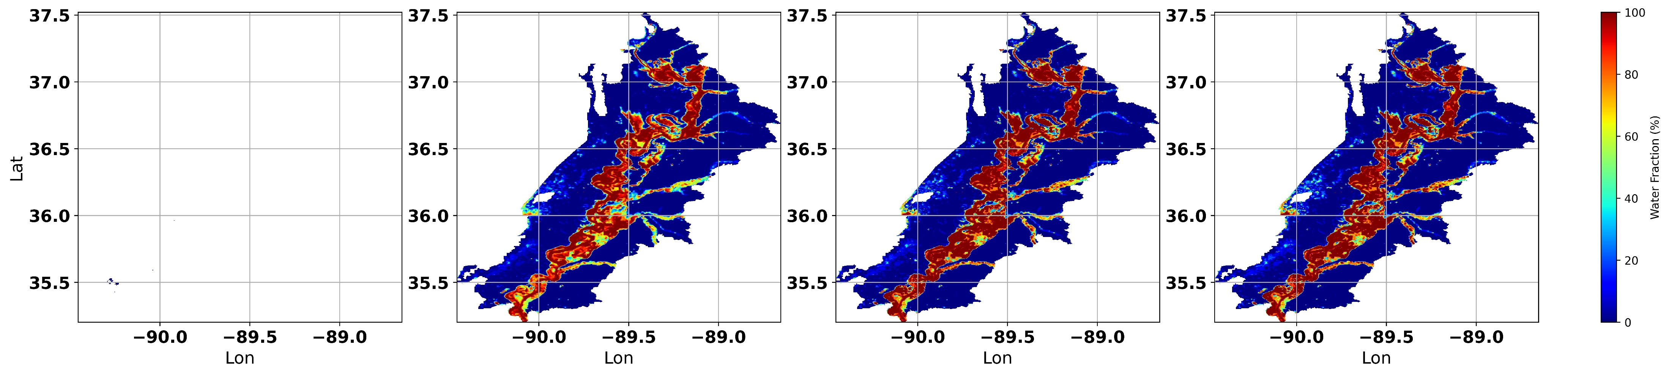
FIER water fraction forecasting results
Observed (VIIRS WF)
FIER pseudo nowcasts (USGS)
FIER pseudo forecasts (NWM)
FIER pseudo forecasts (GEOGloWS)
07-Mar-2019
09-Mar-2019
14
AMS SatMOC Virtual Training, June 2024

Slide 15
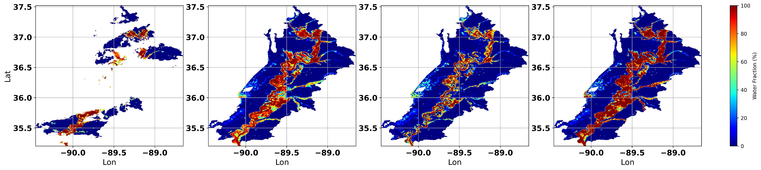
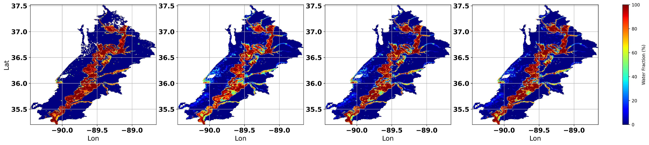
FIER water fraction forecasting results
Observed (VIIRS WF)
FIER pseudo nowcasts (USGS)
FIER pseudo forecasts (NWM)
FIER pseudo forecasts (GEOGloWS)
11-Mar-2019
18-Mar-2019
15
AMS SatMOC Virtual Training, June 2024

Slide 16
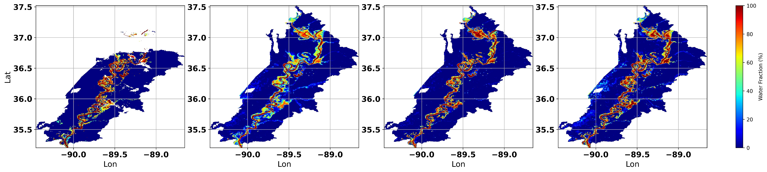
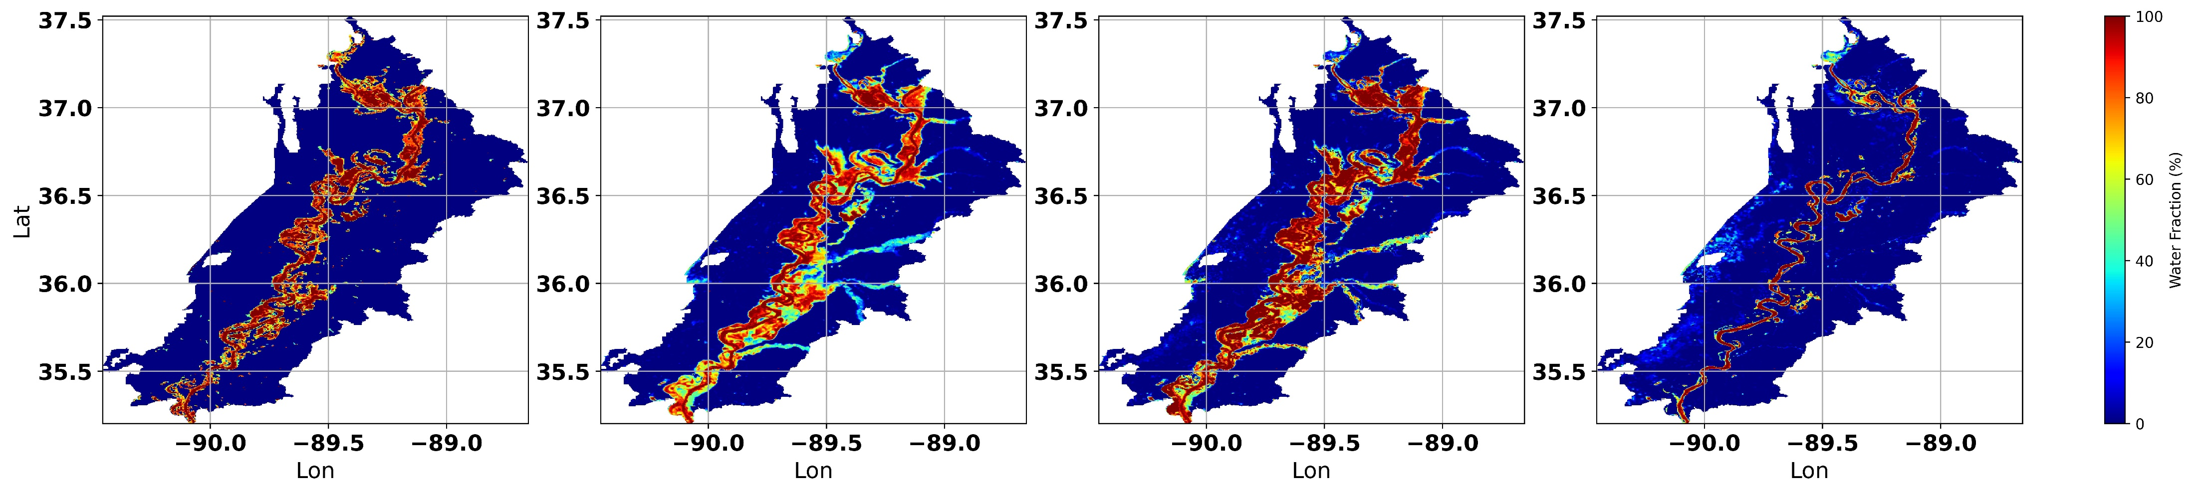
FIER water fraction forecasting results
Observed (VIIRS WF)
FIER pseudo nowcasts (USGS)
FIER pseudo forecasts (NWM)
FIER pseudo forecasts (GEOGloWS)
06-Apr-2019
14-May-2019
16
AMS SatMOC Virtual Training, June 2024

Slide 17
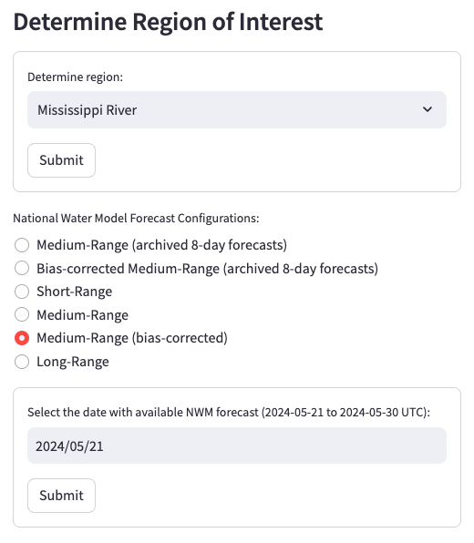
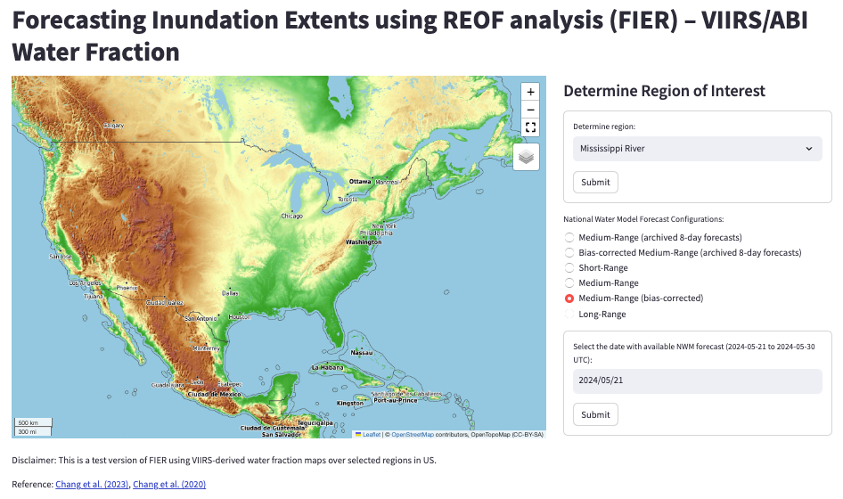
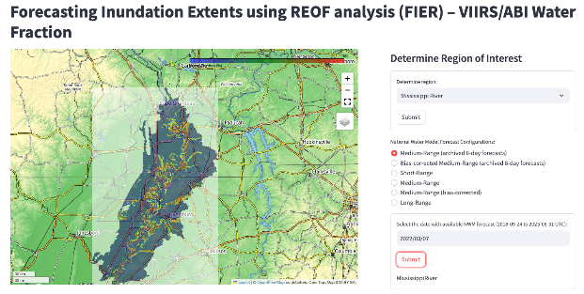
FIER operational web app tool
https://fier-biascorrected-nwm-viirs.streamlit.app/
1. Select area-of-interest (AOI) and submit
2. Select NWM forecast configuration type
3. Select date and submit
AMS SatMOC Virtual Training, June 2024

Slide 18
Thanks for your attention!
AMS SatMOC Virtual Training, June 2024

Slide 19
Backup slides
AMS SatMOC Virtual Training, June 2024

Slide 20
FIER with SAR data
Forecasted River water level
Sentinel-1 SAR images
Sentinel-1 SAR images
Historical Sentinel-1 Images in GEE
Sentinel-1 SAR images
Forecasted
Temporal Patterns
Spatial Patterns
Rotated Empirical Orthogonal Function (REOF)
Based on Principle Component Analysis (PCA)
FIER-synthesized
SAR-like images
Spatial Patterns
Temporal Patterns
Historical River water level
Rotated Spatial Modes (RSMs)
Rotated Temporal Principal Components (RTPCs)
Regression Models
Z-score water mapping
Forecasted Inundation
AMS SatMOC Virtual Training, June 2024

Slide 21
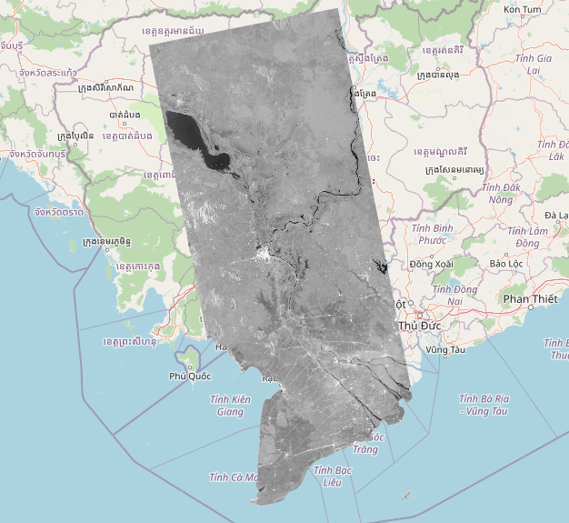
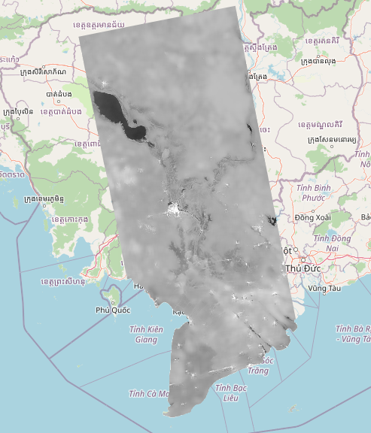
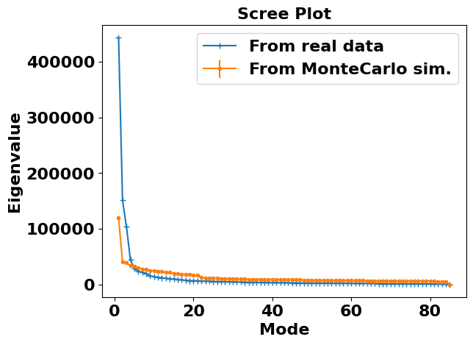
FIER with SAR data
Step-1: Gathering and preprocessing Sentinel-1 data
Mekong River Basin, Southeast Asia
Sentinel-1 GRD data:
Google Earth Engine
Copernicus portal
Sentinel-1 data preprocessing:
Mosaic
Slope correction
Speckle filtering
Mean Raw S1 (2017-2019)
Preprocessed(2017-2019)
Step-2: Significant test
Step-3: Correlation analysis
AMS SatMOC Virtual Training, June 2024

Slide 22
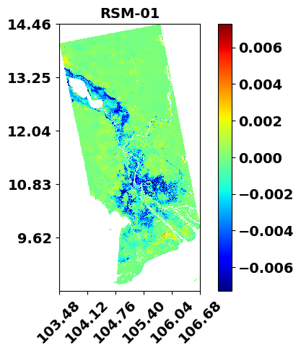
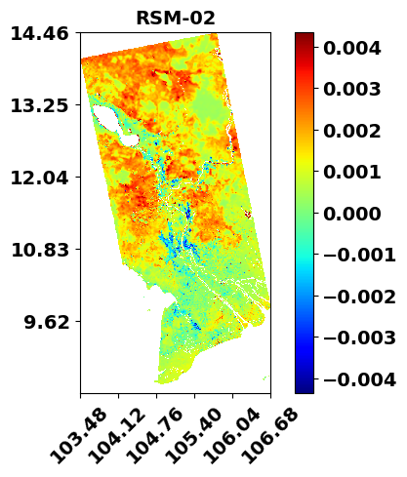
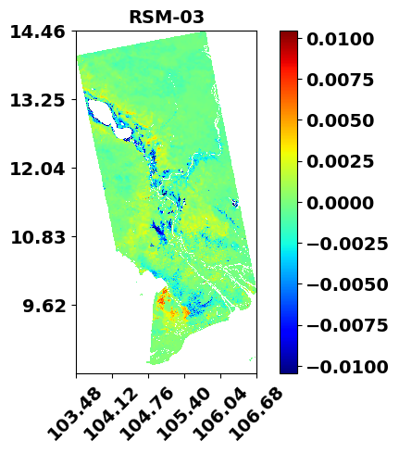
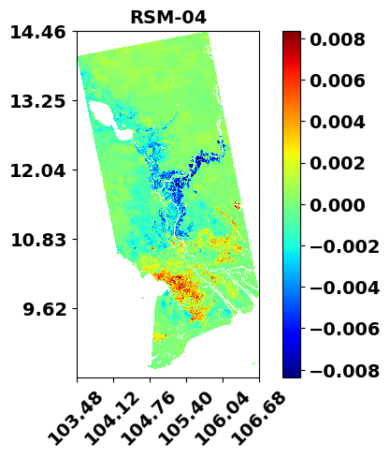
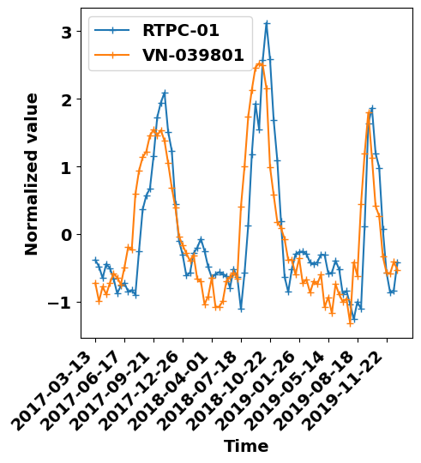
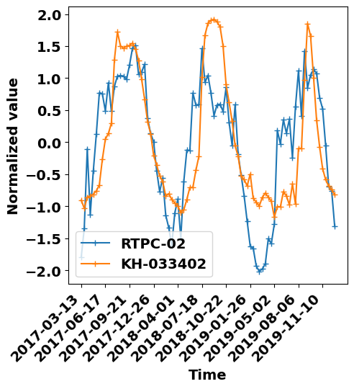
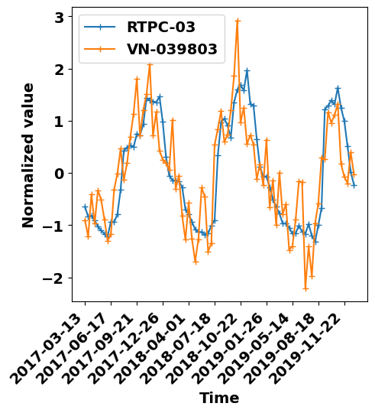

FIER with SAR data
Step-4: REOF analysis
AMS SatMOC Virtual Training, June 2024

Slide 23






FIER with SAR data
Step-5: Regression model
Step-6: Synthesizing Sentinel-1 SAR images
Dot Multiply + Temp mean
Synthesized SAR
Regression Model
Forecast RTPCs
SAR Images
Historical HD
Forecast HD
AMS SatMOC Virtual Training, June 2024

Slide 24





FIER with SAR data
Step-7: Z-score water mapping
AMS SatMOC Virtual Training, June 2024

Slide 25


FIER with SAR data
Step-8: Flood depth estimation
AMS SatMOC Virtual Training, June 2024

Slide 26



FIER with SAR data
Step-9: Rice damage assessment
AMS SatMOC Virtual Training, June 2024

