Slide 1
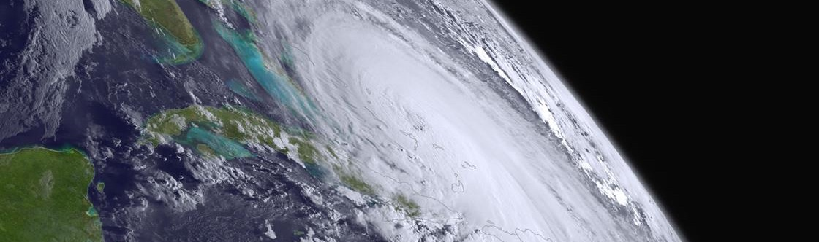
The use of tools for processsing and displaying satellite data
Satellite and Information Service
Tom Atkins, IMSG for NOAA STAR
10 November 2020
GOES-R / JPSS Hands-On Training To Process, Display and Analyze Satellite Data Products
Notes:
Hello everyone, it’s a great pleasure to be here to kick off the RAIV satellite application training workshop. At NOAA, our new strategic plan underscores the importance of User Engagement and Training and we greatly value these meetings. We are here to listen to your needs and respond to the user community as best as we can in an enriching forum. We are here for the long run and looking forward to continued collaboration and coordination.

Slide 2









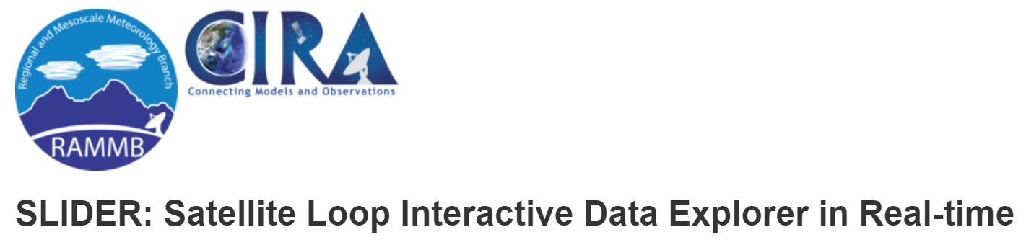



There are a lot of ways to get satellite data and imagery!!
Notes:
Satellite Missions

Slide 3
How do you decide which site is right?
Which type of satellite? Geostationary or polar-orbiting.
What domain or product area are you interested in? Ocean, atmosphere, cryosphere, aerosols, fires, cloud cover, etc.
What product types are you looking for? Radiances, imagery, derived products, blended products, observations, models, etc.
What time frame should the data cover? Near real time. Daily updates. Weekly or climatological averages?
Do you want to be able to access the data directly? Do you want to be able to chart the data? Or just look at and download maps?
What data or image format are you looking for? PNG, GIF, NetCDF, GeoTiff, HDF, BUFR
Notes:
Our role in improving the user of satellite information for the user community is very clear. (Then transcribe as written)

Slide 4
RealEarth Overview
RealEarth is a server-based data visualization system developed at SSEC/CIMSS, University of Wisconsin-Madison that provides satellite imagery and related data products to desktop and mobile clients.
It is built on open source software including, MapServer, GDAL, Proj4, PHP, and Python.
The purpose of RealEarth is to provide a simple interface for data visualization and comparison across the atmospheric, oceanic, and Earth science domains.
https://realearth.ssec.wisc.edu/

Slide 5



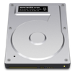




ERDDAP¹ – designed to make data access easier
Data Aggregation
Data Distribution
ERDDAP provides a simple, consistent way to:
Subset datasets temporally and spatially
Distribute both gridded and non-gridded (tabular) data
Download data in > 30 formats
Data requests defined within URLs, allowing:
Access data within analysis tools (R, Matlab, python)
Machine-to-machine data exchange
Local Storage
Internal Servers
Automated Scripts
Database
Web-Based
Applications
RAID
ERDDAP
Download
By Hand
Remote Servers
NSIDC
NCEI
Software
Applications
Over 85 ERDDAPs exist worldwide
Over a dozen different ERDDAPs in NOAA
ERDDAP is one of the recommended data servers in NOAA's Data Access Procedural Directive
Search for data across multiple ERDDAPs at erddap.com
JPL PO.DAAC
NESDIS STAR
¹ERDDAP was developed at NOAA/NMFS/SWFSC/ERD by Bob Simons
Notes:
ERDDAP was developed at the NOAA Southwest Fisheries Science Center by Bob Simons. It provides a simple, consistent way to subset and download data. The data can also be visualized in customizable graphs. Data can be downloaded in over 30 formats, as both graphs and data. ERDDAP is a restful service, meaning that the data requests are completely defined by a URL, which allows for easy access from computer programs like R or Matlab, as well as allowing machine-to-machine access. Over 85 ERDDAPs exist worldwide. in this presentation I will show examples using the ERDDAP maintained jointly by the NOAA SWFSC Environmental Research Division and the West Coast Node of NOAA’s CoastWatch program.

Slide 6





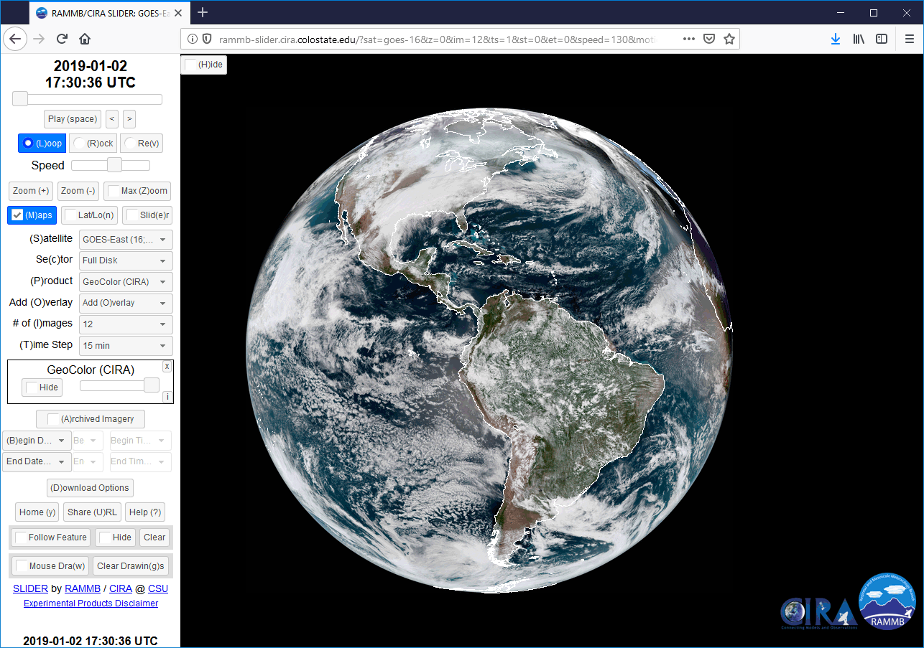

Hands-on Excersize #3: Using CIRA’s SLIDER
A website for viewing realtime satellite imagery at full resolution
Curtis Seaman, CIRA/Colorado State University K Micke, D Lindsey, S Miller, YJ Noh, N Tourville, S Finley, D Hillger, J Dostalek, G Chirokova, and M Niznik
Learn how to use SLIDER
Explore geostationary and polar-orbiting satellite data in realtime at full resolution
GOES, JPSS, Himawari, Meteosat
Type “CIRA SLIDER” into your favorite search engine and it should be the first link
Alternately, scan the QR code with your phone
https://rammb-slider.cira.colostate.edu

Slide 7
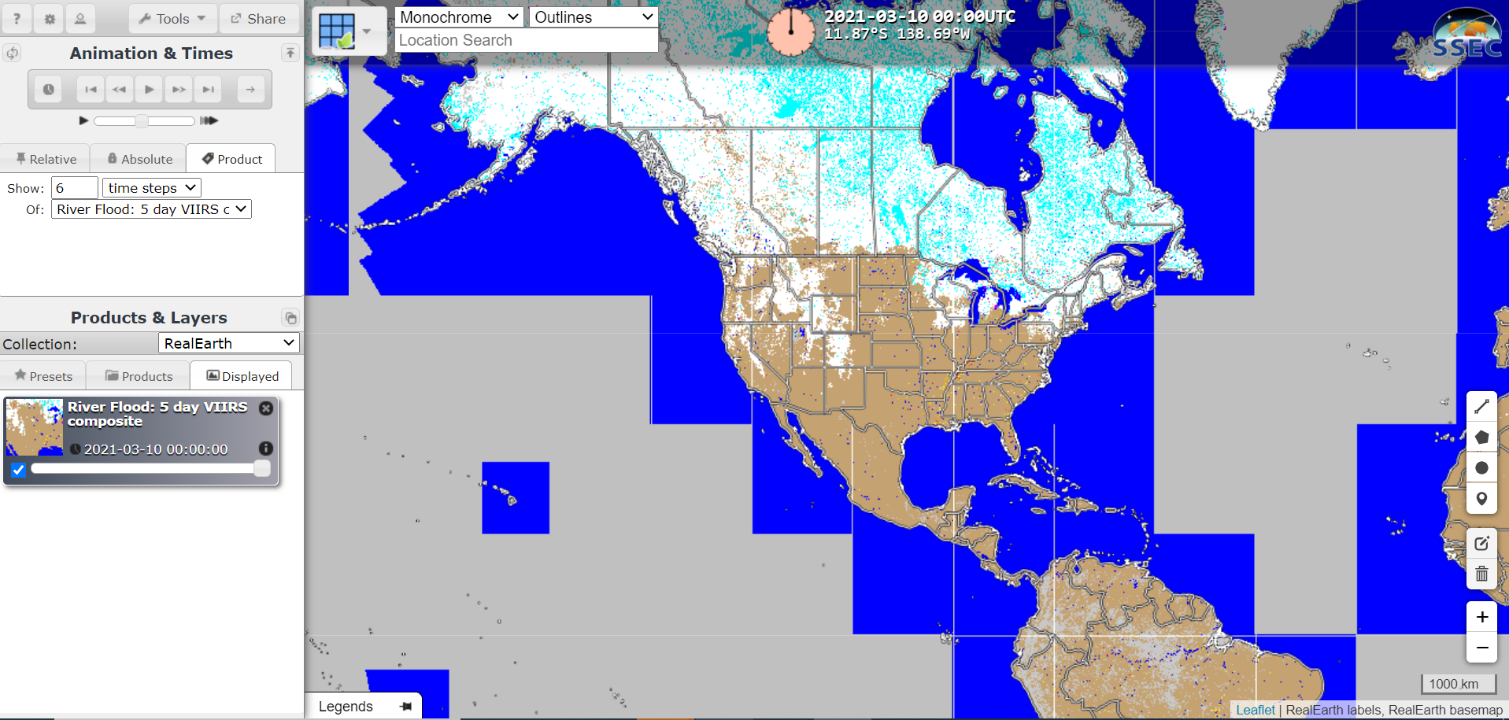
RealEarth - https://realearth.ssec.wisc.edu/

Slide 8
JSTAR Mapper Overview
JSTAR Mapper was developed at STAR to provide dynamic, global, daily maps of JPSS EDR (L2) products from both JPSS satellites at their native resolution. The maps can be layered on top of one another to provide interesting comparisons.
JSTAR Mapper has expanded to include select non-EDR imagery (VIIRS true color) and non-JPSS (Sentinel aerosols and trace gasses) products and will include JPSS-2 and MetOp-SG products produced at STAR when those satellites come online.
The site’s simple interface provides users easy access to several years worth of polar satellite data from several instruments.

Slide 9
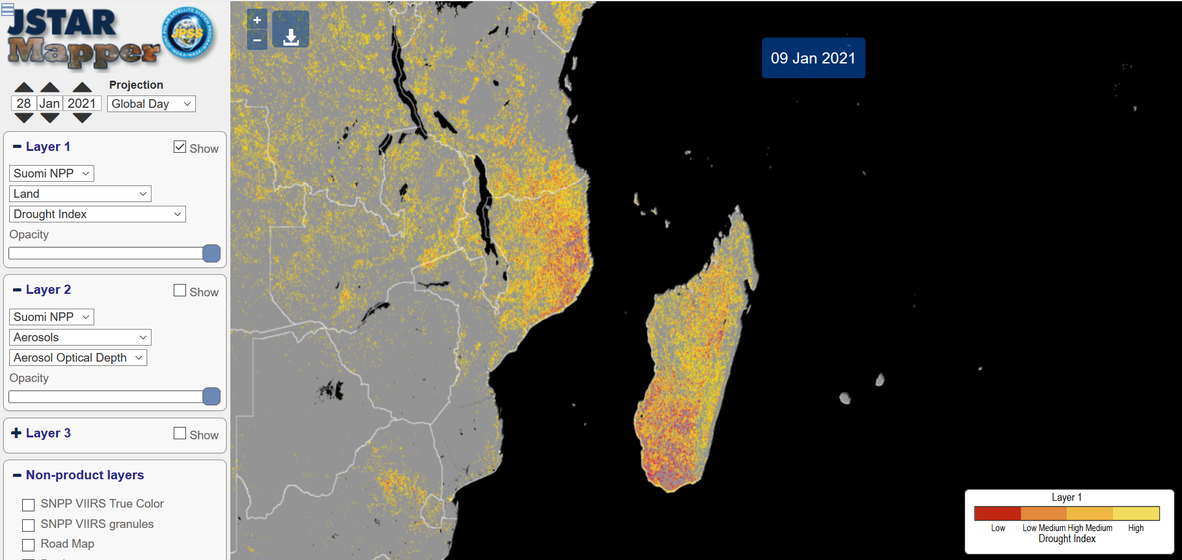
JSTAR Mapper – https://star.nesdis.noaa.gov/jpss/mapper

Slide 10
Additional tools for exploring satellite data and imagery
Broad based imagery – GOES Imagery, NASA Worldview, NOAA Vislab
Product/Domain Specific – Coastwatch Data Portal, Aerosol Watch, OCView, MIMIC, NASA FIRMS, and many, many others.
Data access – NOAA CLASS, Amazon Web Services (AWS)/NOAA Big Data
Display platforms – Google Earth, Leaflet, OpenLayers, ESRI

Slide 11
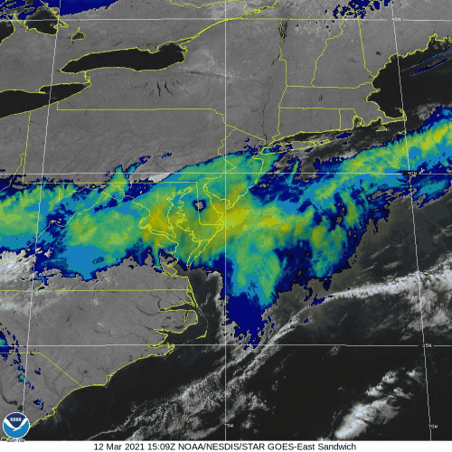
GOES Imagery - https://www.star.nesdis.noaa.gov/GOES/index.php

Slide 12
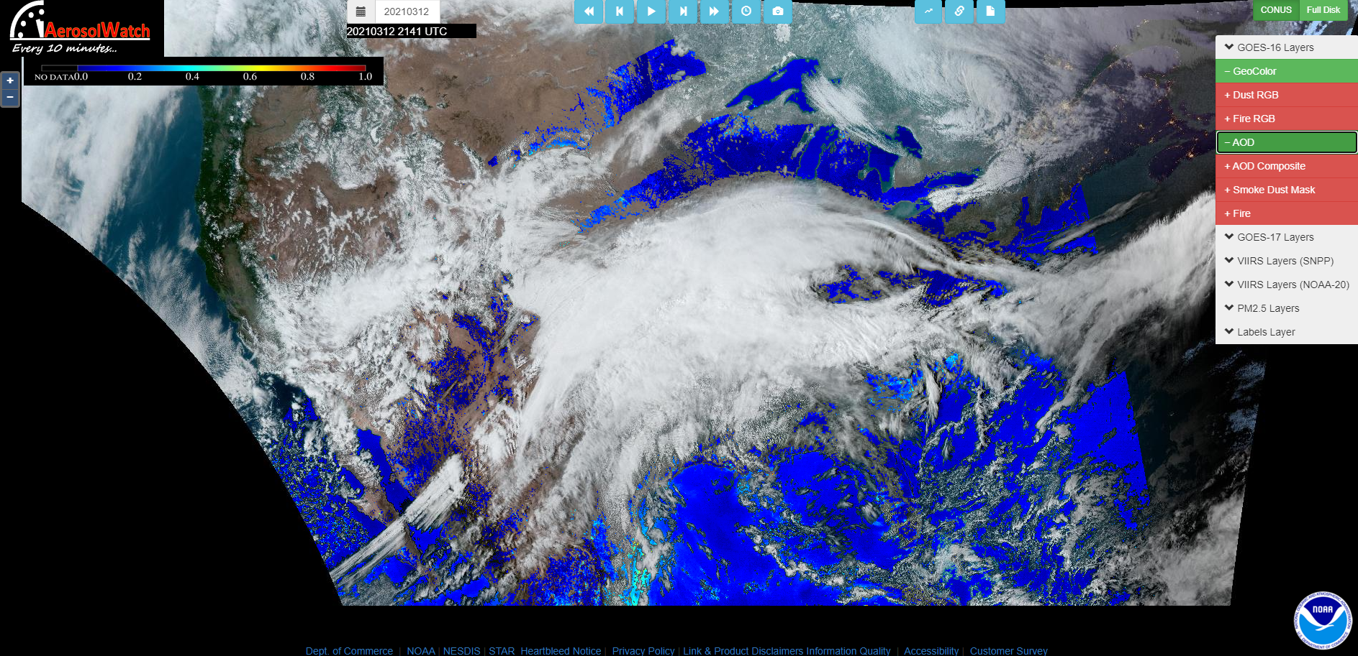
Aerosol Watch https://www.star.nesdis.noaa.gov/smcd/spb/aq/AerosolWatch/

Slide 13
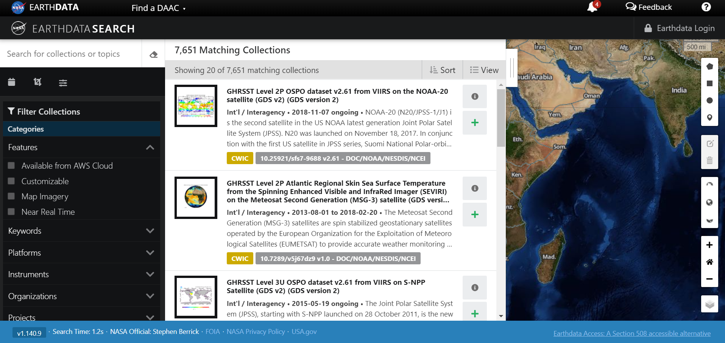
NASA Worldview/EarthData - https://search.earthdata.nasa.gov/search

Slide 14
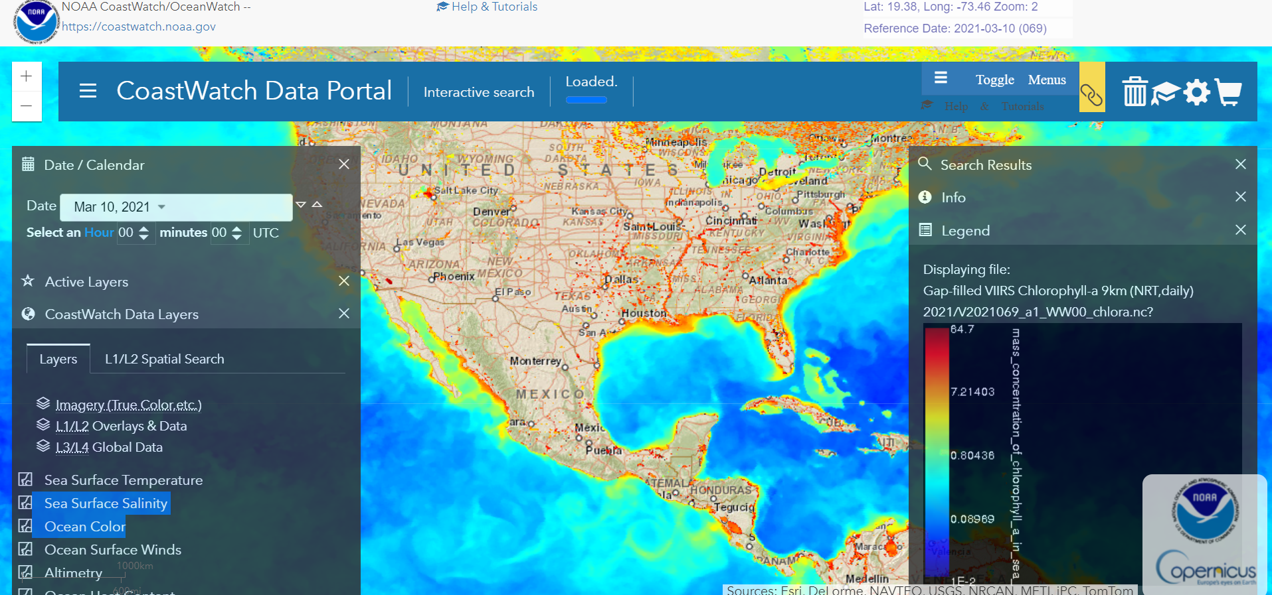
CoastWatch Data Portal - https://coastwatch.noaa.gov/cw_html/cwViewer.html

Slide 15
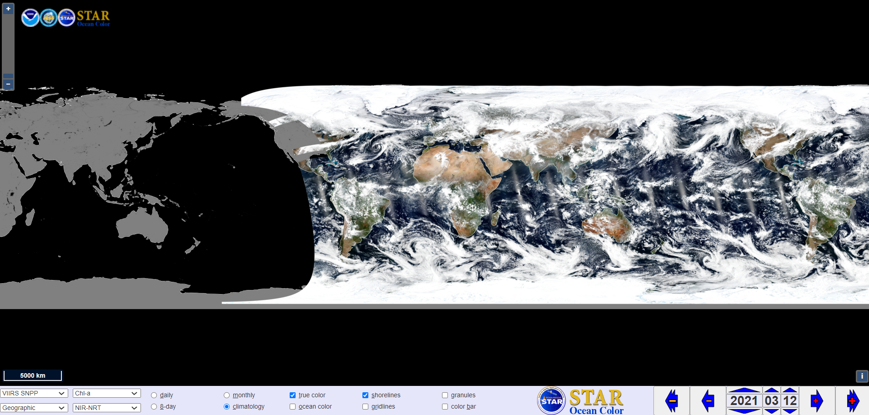
OCView - https://www.star.nesdis.noaa.gov/socd/mecb/color/ocview/ocview.html

Slide 16
NOAA Big Data Project - https://registry.opendata.aws/collab/noaa/
Began in 2015 with NexRAD radar data
Began with five vendors – Amazon, Google, Open Common Consortium, Microsoft, and IBM, although the latter two are no longer involved
Satellite datasets include GOES-16 and -17 ABI L1b, L2, and GLM data; DMSP; Gridded Global IR, VIIRS Day/Night Band, and AVHRR
A majority of archive data requests are now through Collaborators rather than NOAA.
Amy Huff will detail how to access GOES ABI data from Amazon Web Service in tomorrow’s session.

Slide 17
Hands On Training Schedule
12:20 – JSTAR Mapper (Tom Atkins)
1:05 – CIMSS RealEarth (William Straka)
1:35 – CIRA Slider (Curtis Seaman)
2:05 – ERDDAP (Cara Wilson)

Slide 18
Summary
There are many places to obtain and display satellite data
Before you start using satellite data, think about how you plan on using it. All of the sites mentioned here fill different niches.
More focused sites are often quite useful, but sometimes hard to find.
Questions?
18
Notes:
In summary our NOAA……. The transcribe the rest.

