Slide 1

Rain and flooding from Ana
Scott Lindstrom, William Straka
UW-Madison CIMSS

Slide 2
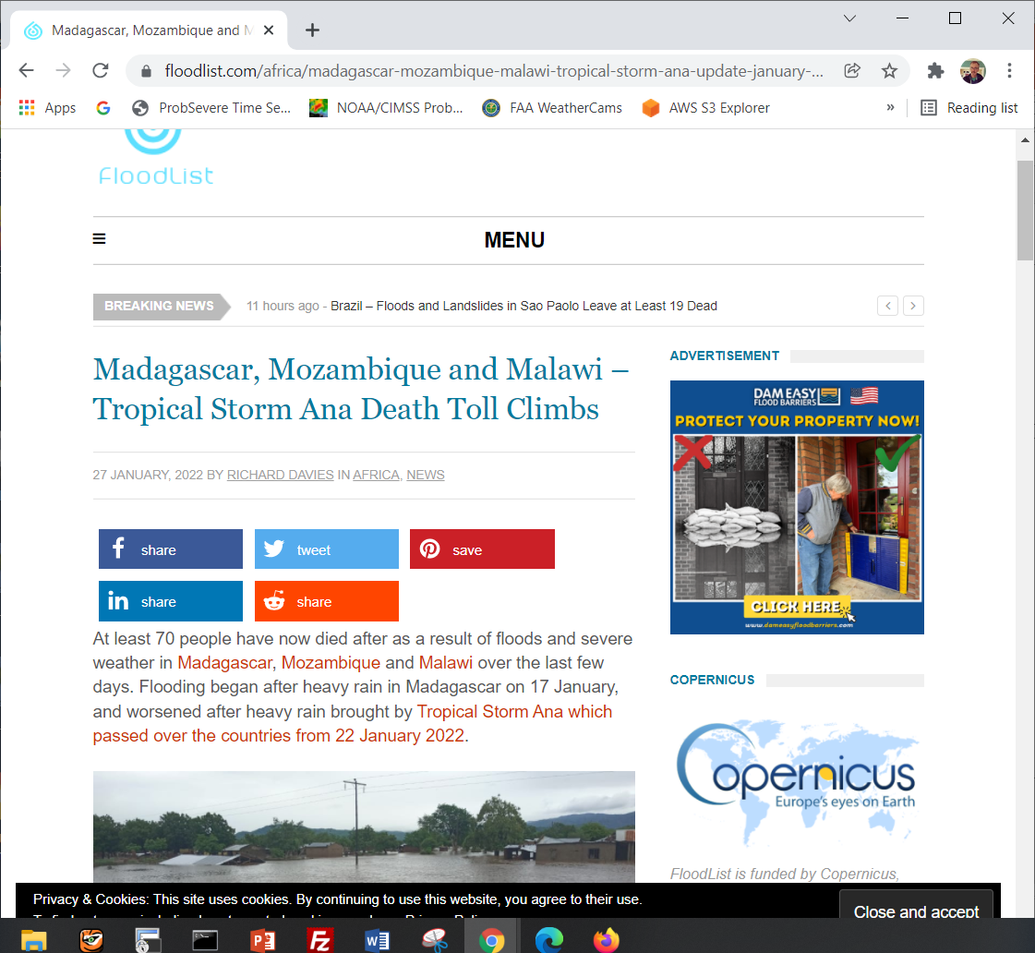
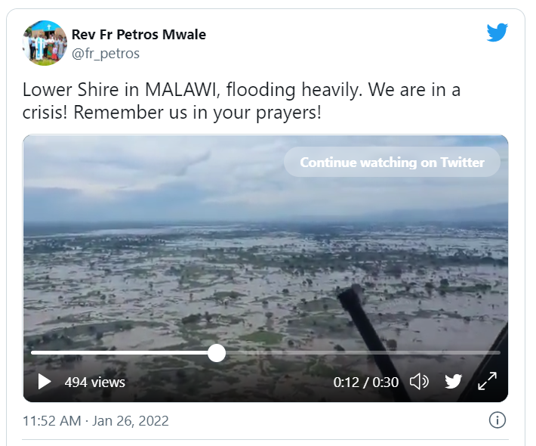
News item from floodlist.com
https://floodlist.com/africa/madagascar-mozambique-malawi-tropical-storm-ana-update-january-2022
Link to Tweet
Note the vast flood :
Should be detectable from satellite

Slide 3
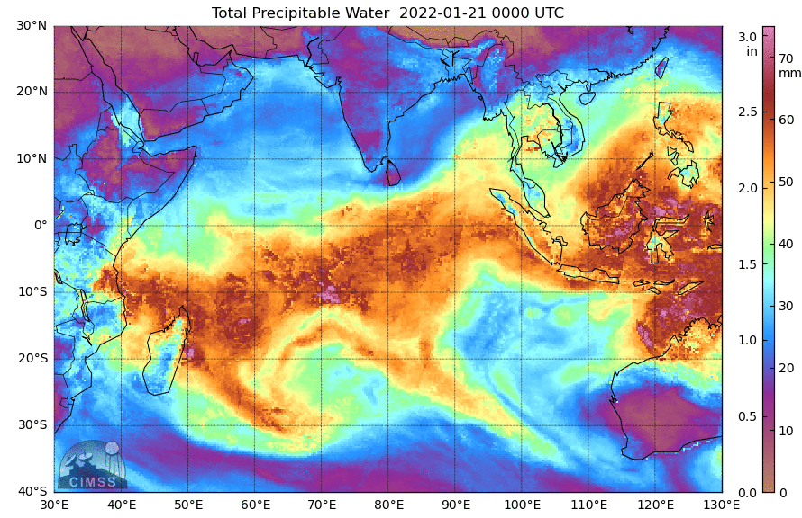
Antecedent conditions https://ftp.ssec.wisc.edu/pub/mtpw2/images/tpw_nrl_colors/indo/202201/
You can download imagery (Indian Ocean imagery) from the website and create an animation

Slide 4
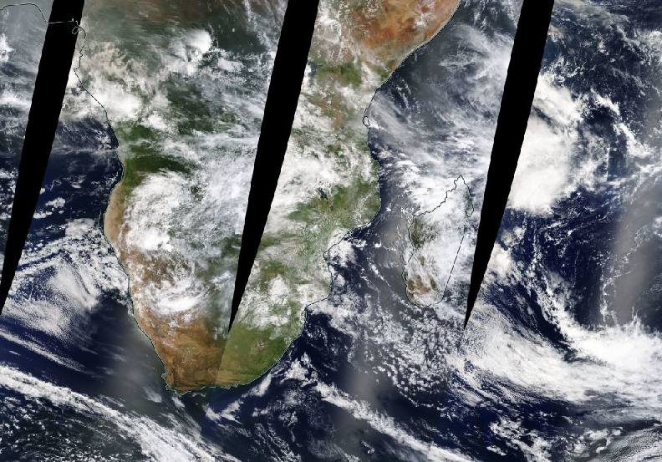
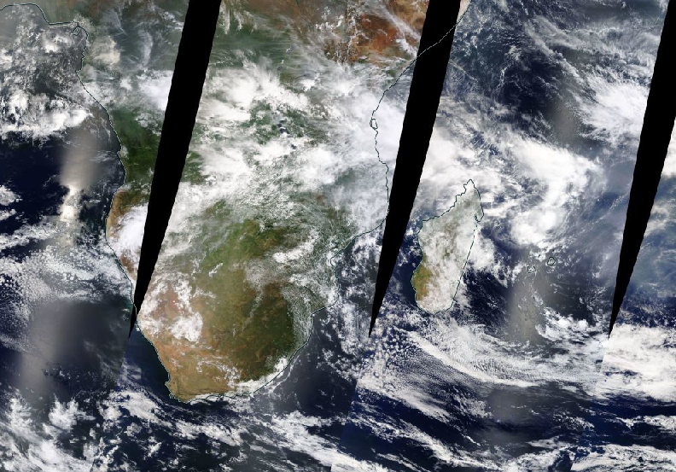
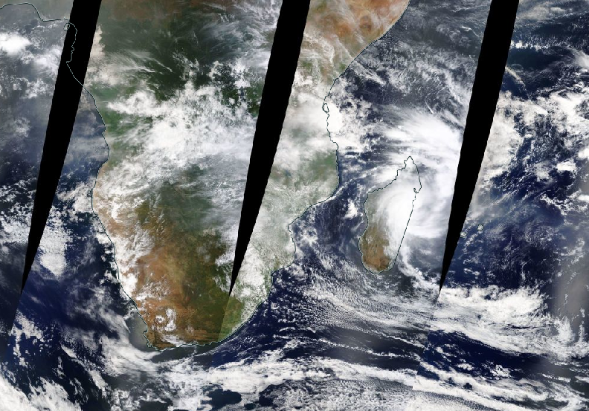
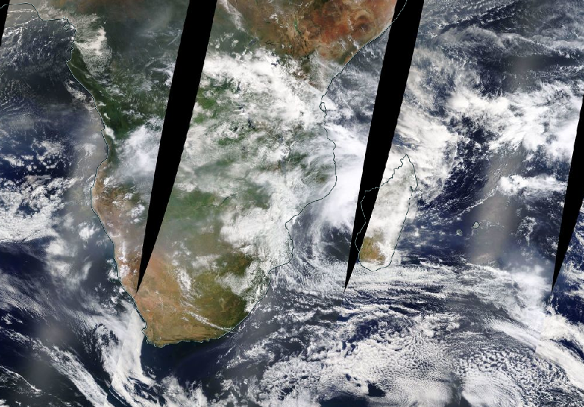
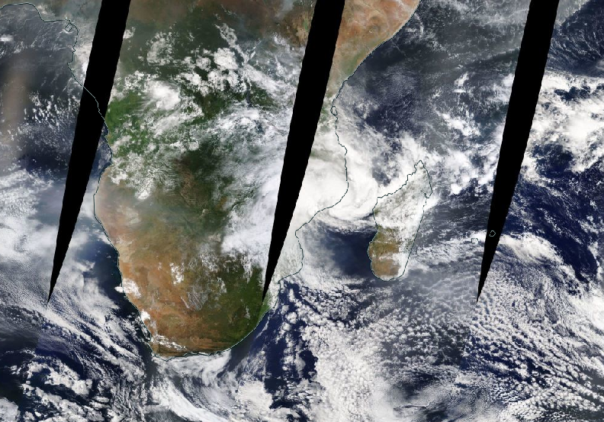
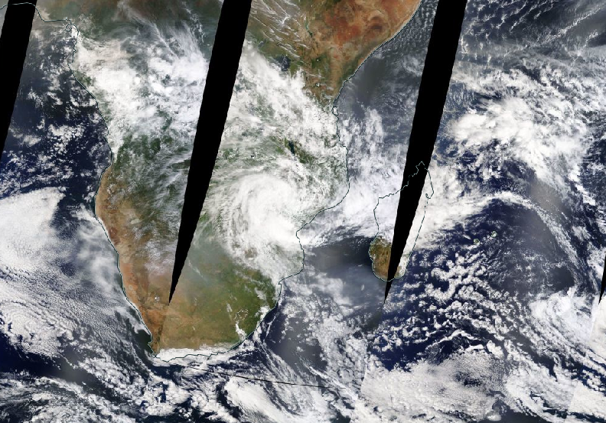
Snapshots of true-color from nasa worldview (Link)
20 January
21 January
22 January
23 January
24 January
25 January

Slide 5
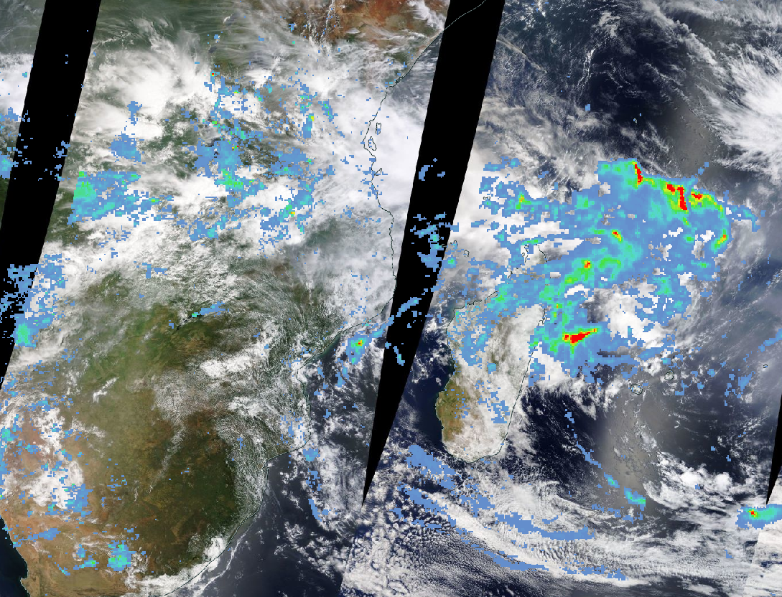
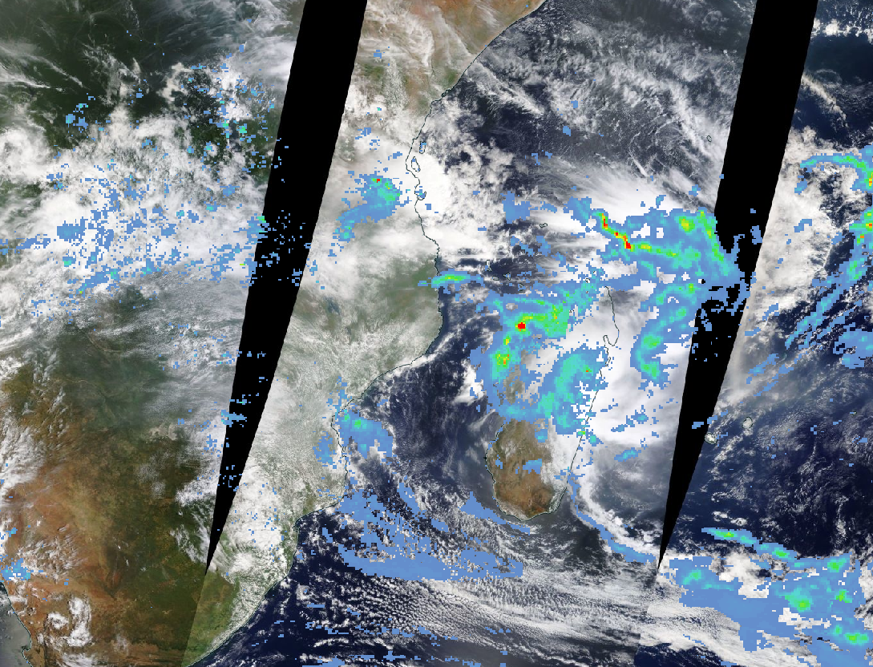
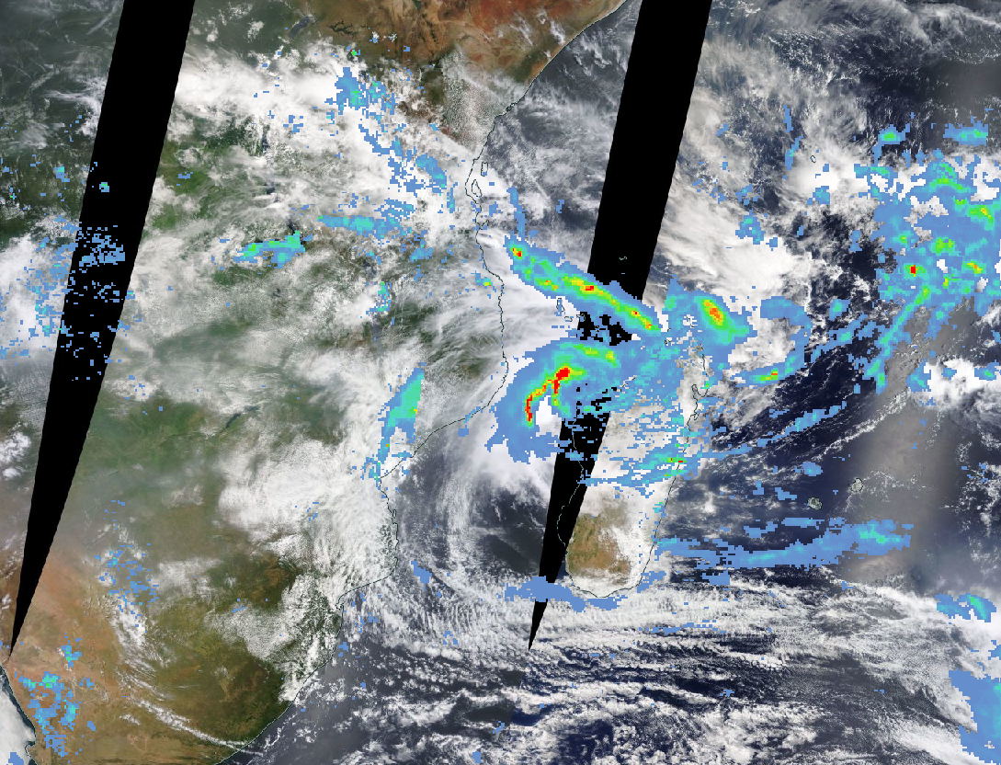
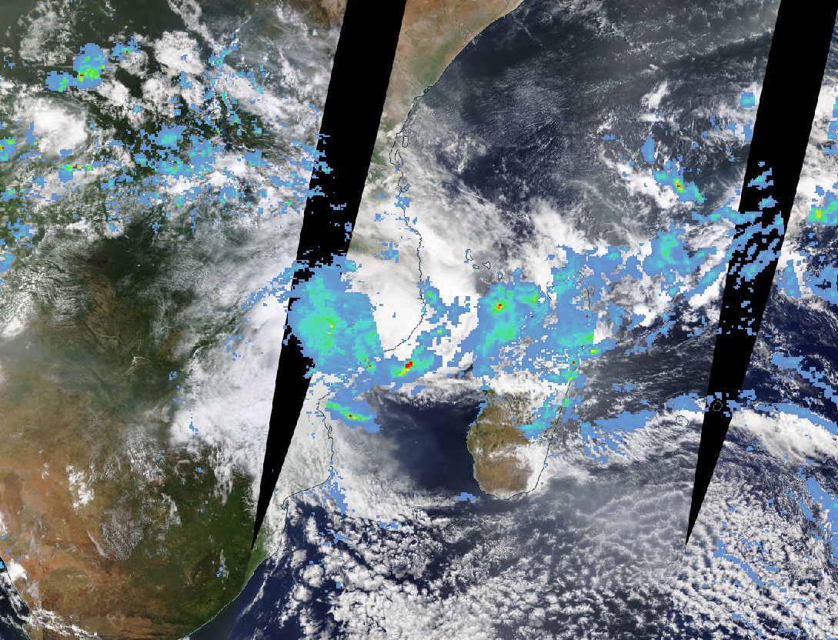
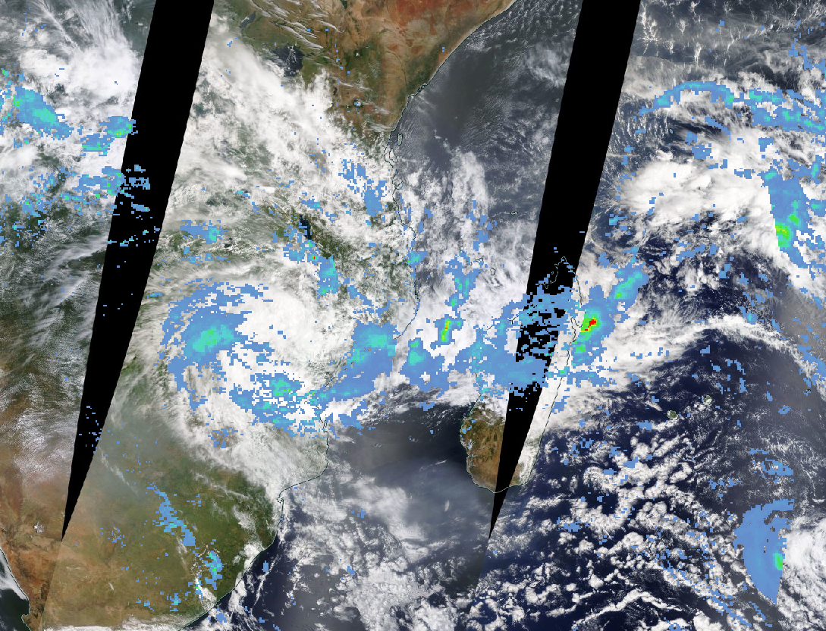
Snapshots of true-color from nasa worldview (Link)
20 January
21 January
22 January
23 January
24 January
25 January
True Color Overlain with GCOM AMSR-2 estimates of rainfall

Slide 6
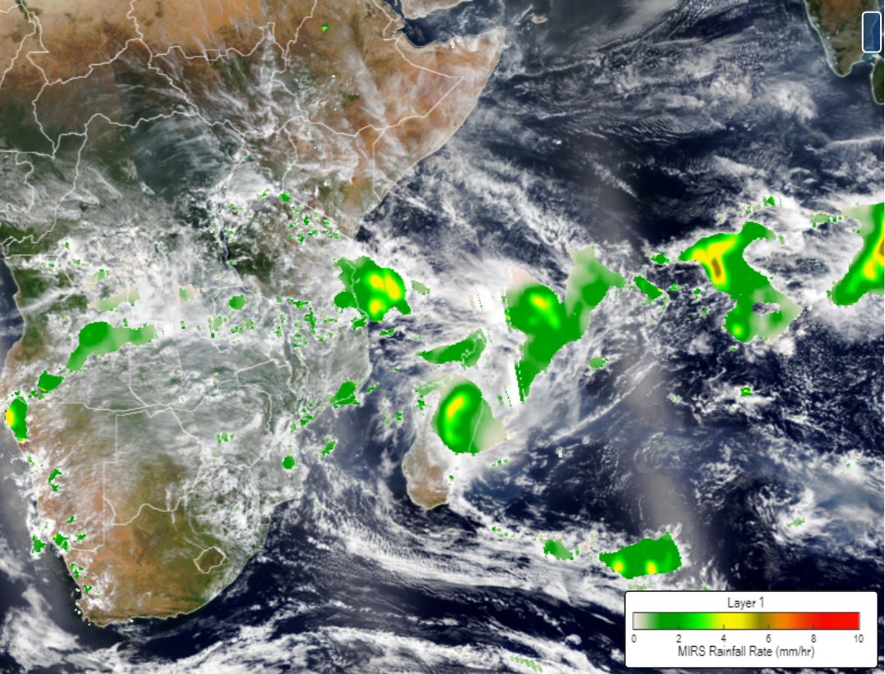
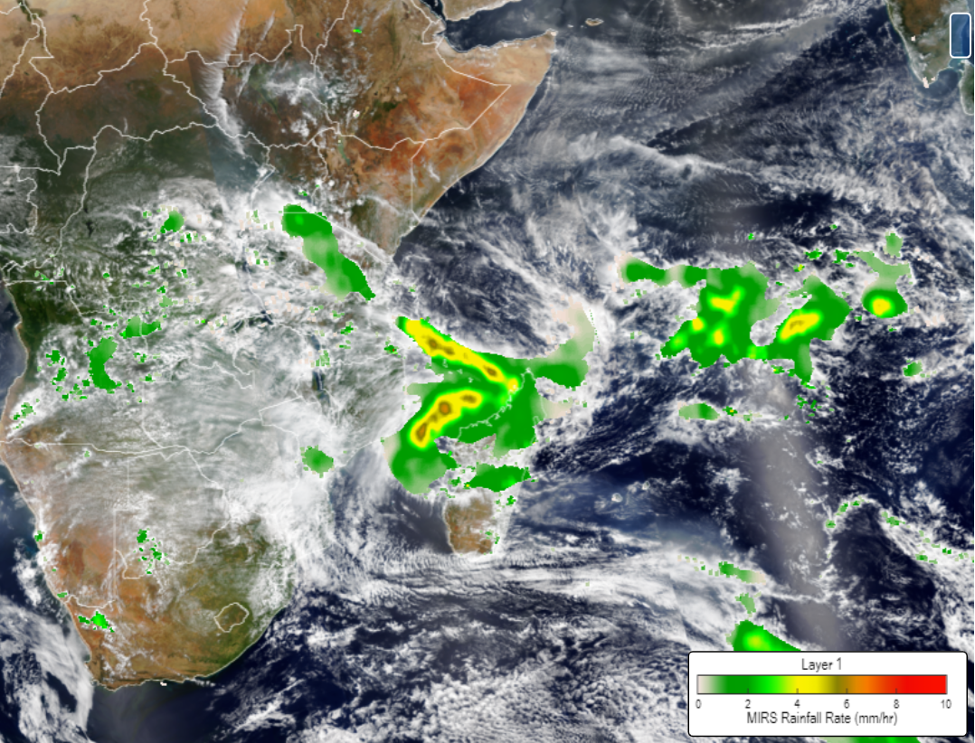
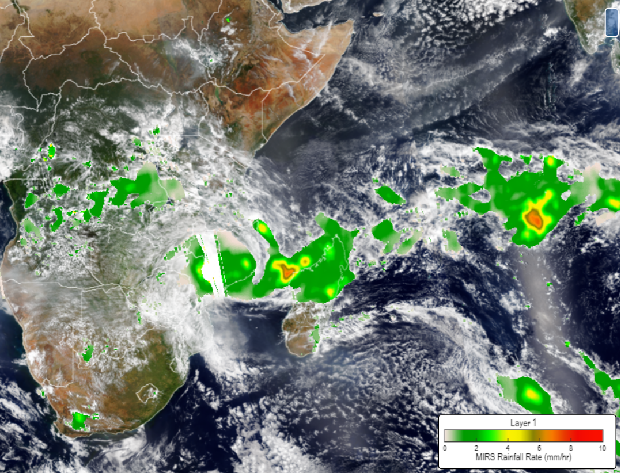
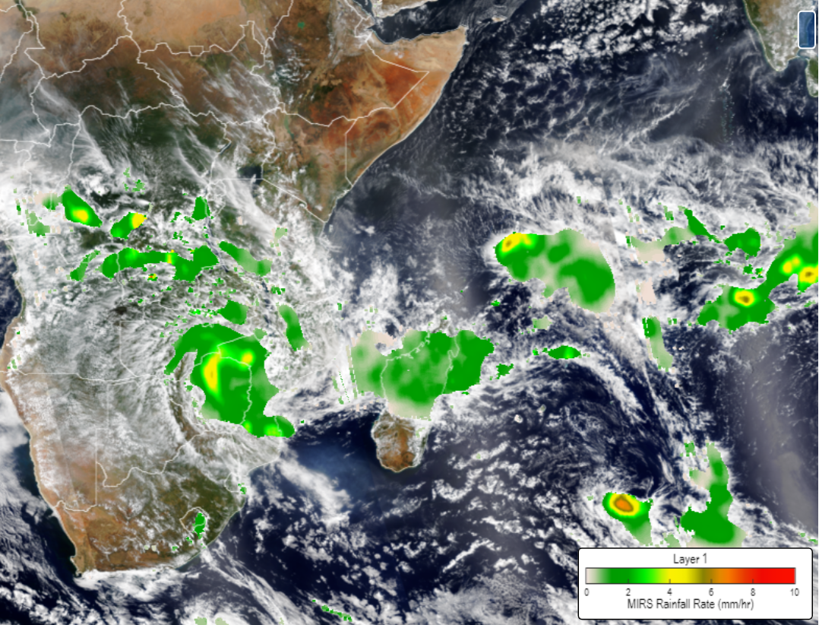
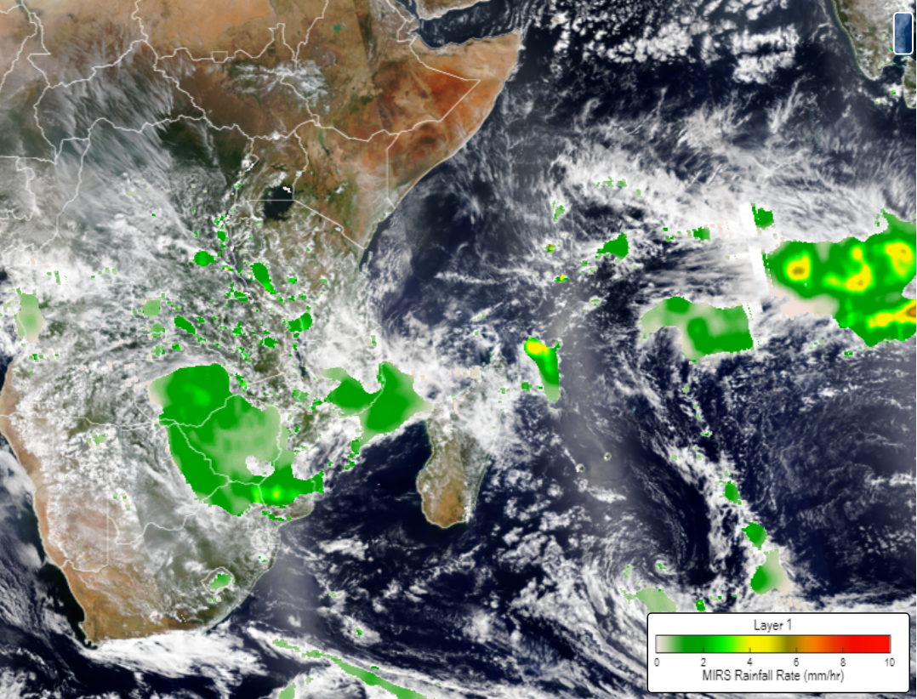
Also imagery from the jstar mapper (link)
22 January
23 January
24 January
25 January
26 January

Slide 7
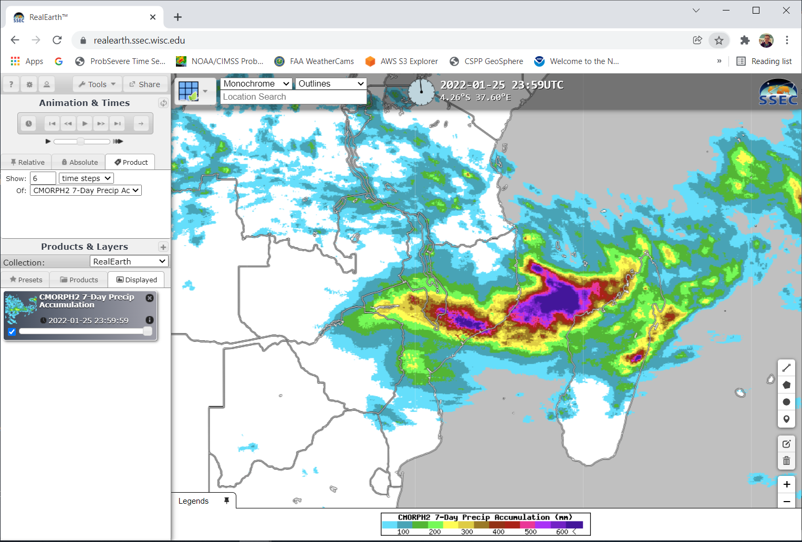
What kind of rain fell?
CMORPH estimates of 1-week rains from https://realearth.ssec.wisc.edu
Note that you have to retrieve these within a 1-week window
Too late to retrieve the 1-day views, they had been overwritten
Value exceeded 600 mm over Mozambique

Slide 8
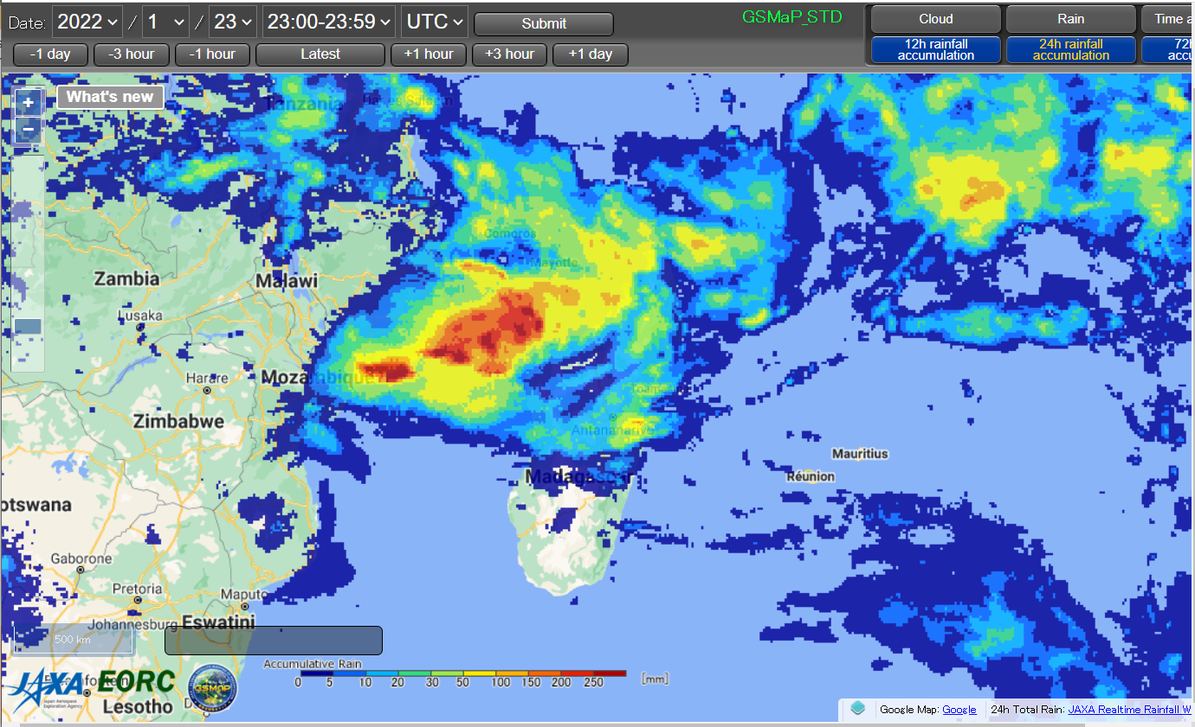
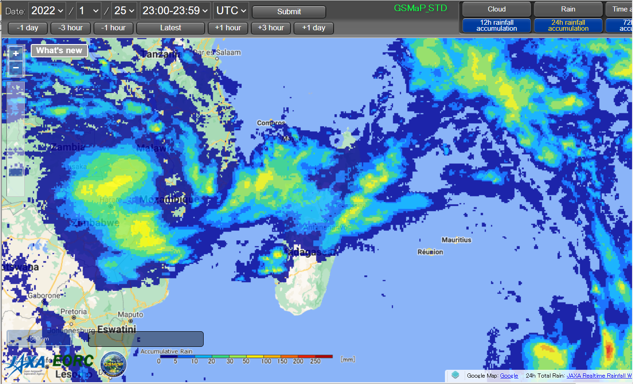
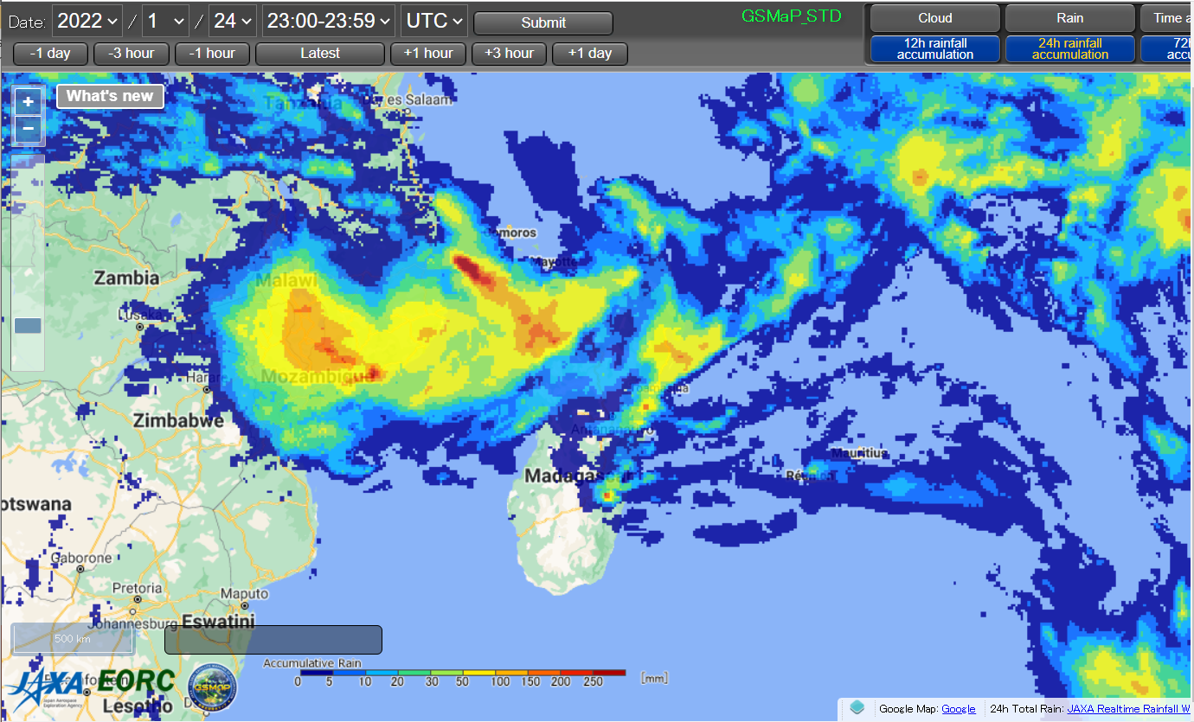
GsMAP IMagery

Slide 9
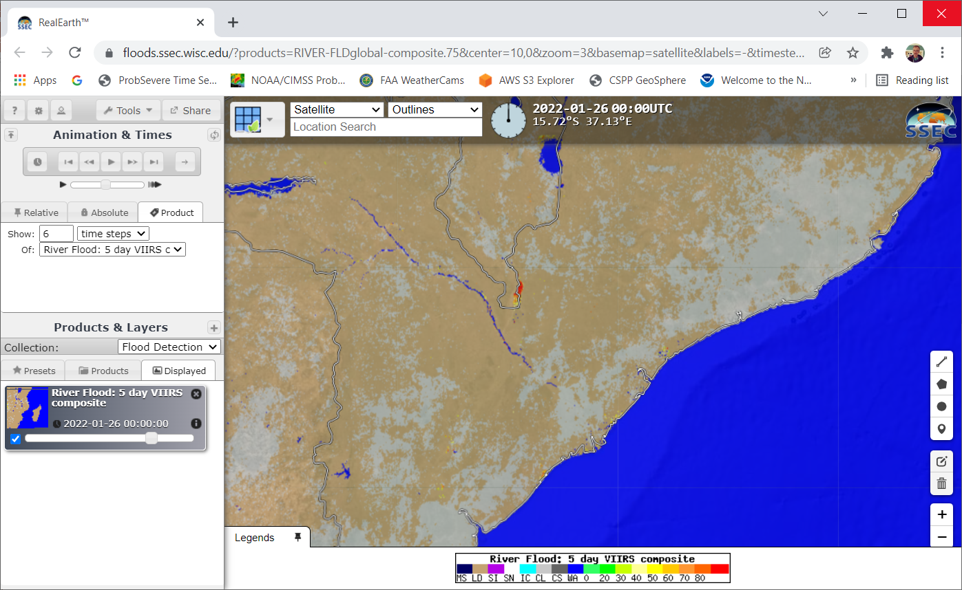
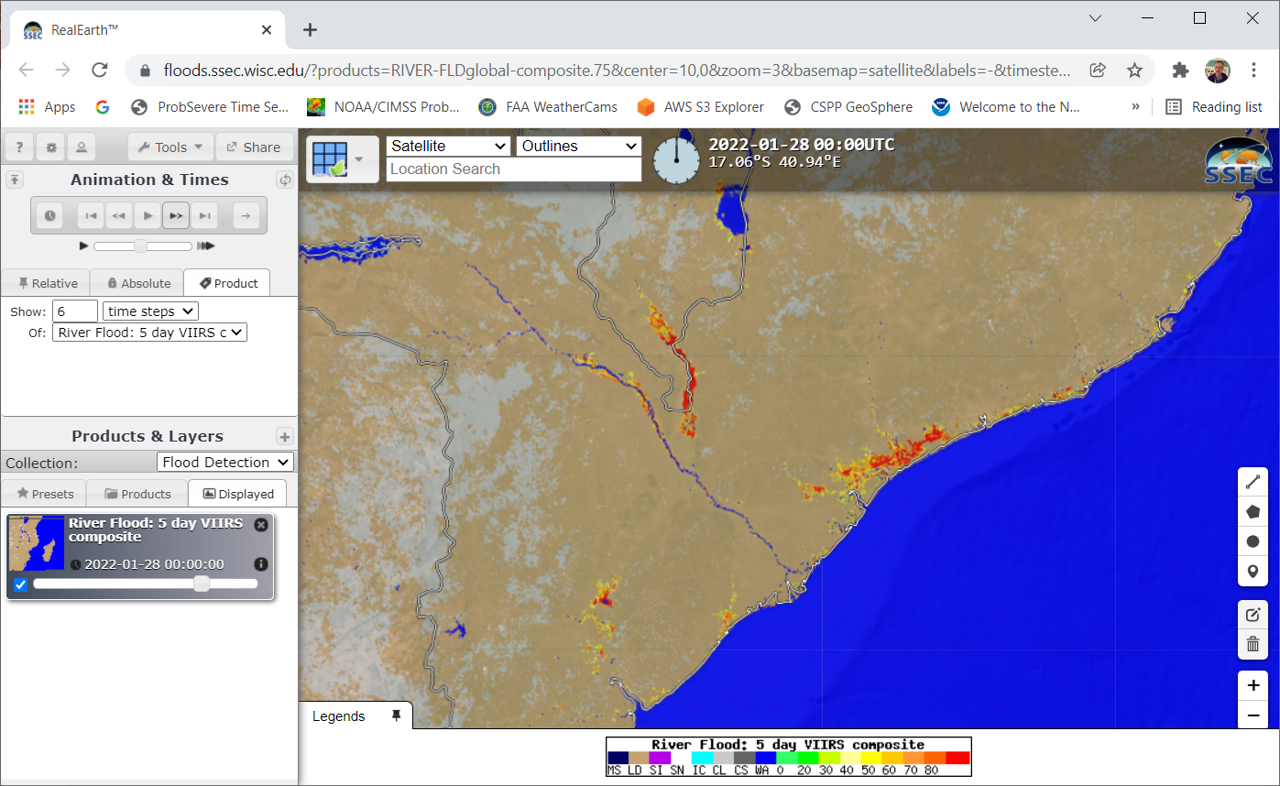
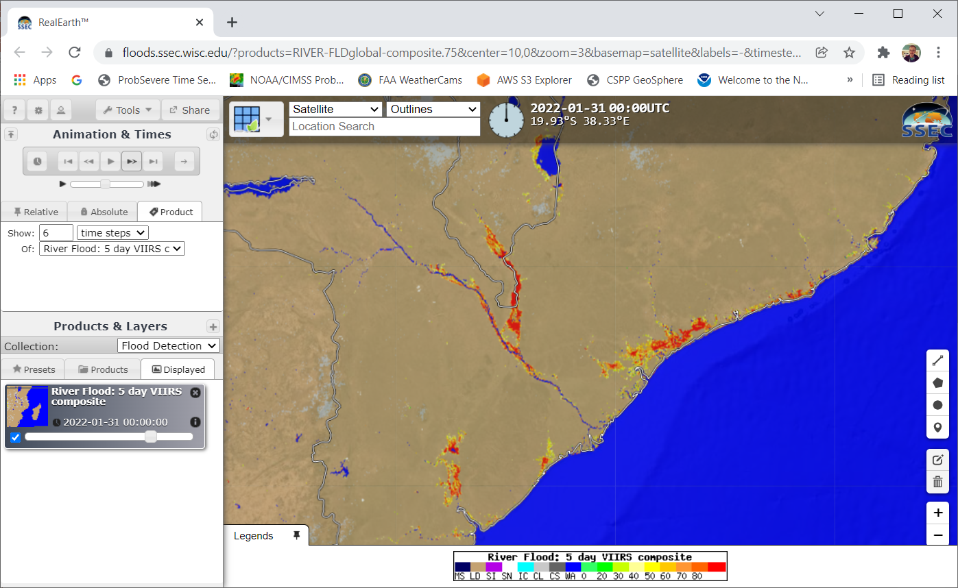
Did floods occur?
26 January
28 January
31 January

Slide 10
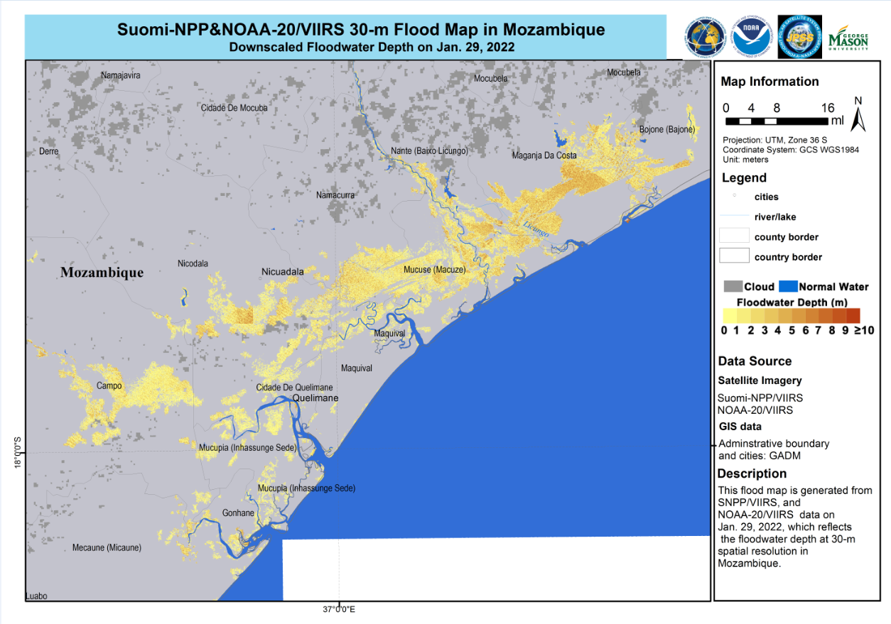

Also: Zoomed-in (Downscaled) regions of flooding (as warranted)

