Slide 1
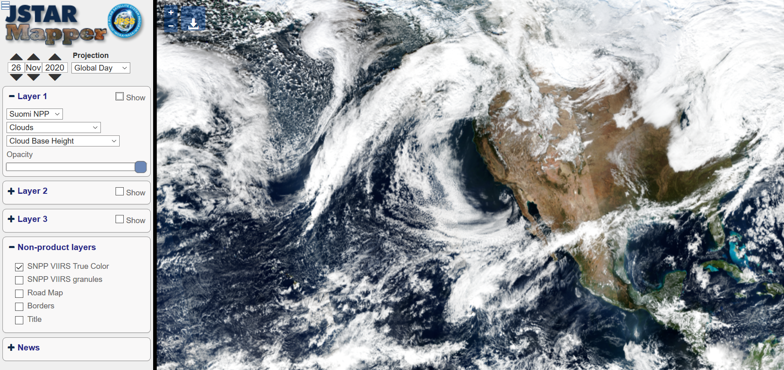


JSTAR Mapper Hands On Training
EDR LTM Team: Thomas Atkins¹, Ryan Smith¹ , Charlie Brown¹, Lori Brown²
https://star.nesdis.noaa.gov/jpss/mapper
1. IM Systems Group 2. Caelum Research Corp

Slide 2
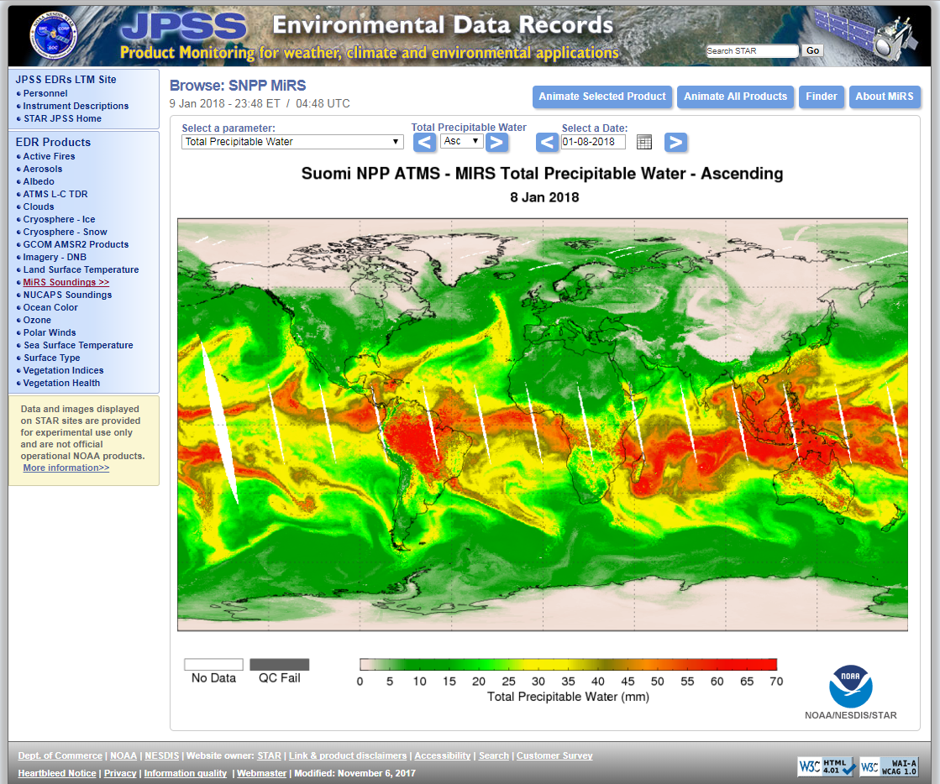
JPSS EDR LTM Website
We currently produce roughly 2000 images for Suomi-NPP and NOAA-20 daily
Includes global images as well as polar images depending on the product
Website location:
https://www.star.nesdis.noaa.gov/jpss/EDRs/

Slide 3
Why JSTAR Mapper?
The EDR LTM team received increased requests for images of specific events (e.g. hurricanes, fires, intense snow events).
The existing EDR LTM website was not capable of providing area-specific images of products, which limited our ability to meet these requests in a timely fashion.
EDR LTM team is uniquely situated to create this product because of NRT access to data via SCDR or offline products, existing EDR LTM processing, and great relationships with the scientists
The solution: an interface that will allow EDR products to be displayed in a high resolution fashion with multiple zoom levels

Slide 4
What is JSTAR Mapper?
JSTAR Mapper is built upon the interface already established and used by STAR’s Ocean Color team, OCView
Some features of JSTAR Mapper include:
Multiple zoom levels, allowing products to be shown at (or close to) their full resolution (up to 131k x 65.5k pixels - ~ 300 meters at the equator)
Up to three layers of products can be overlayed plus various preset backgrounds (blank map, VIIRS True Color during day or I5 Band at night, road map, borders)
Optional granule layer to let users identify which data belong to which granule (Presently VIIRS and ATMS Only)

Slide 5
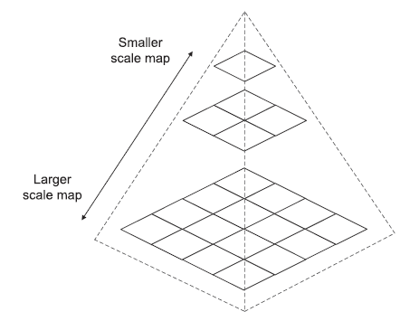
Map Creation Process
Products come in a range of resolutions – from OMPS (50 km footprint) to VIIRS Imagery Band derived products (375 m at nadir)
Each product is produced from the lowest resolution (1024x512 global map) to the highest possible resolution for the product.
Images saved as 512x512 pixel “tiles” in a pyramid format – each level is 2 times the resolution of the previous level.
A free software tool – OpenLayers – is used to display the tiles on the JSTAR Mapper website.
Most products made daily as of now – but some are in near real time (True Color, Aerosols, Fire Radiative Power)

Slide 6
JSTAR Mapper Functions
View selection
Product selection
Non-Product overlays
News Tab

Slide 7
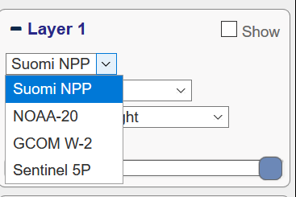
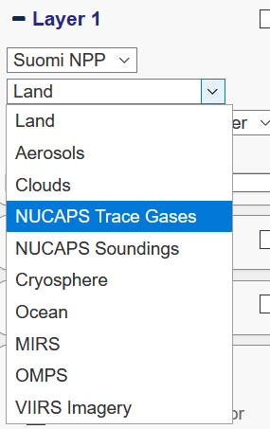
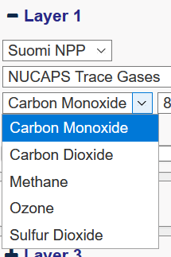
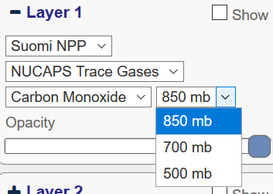
Product Selection Menus

Slide 8
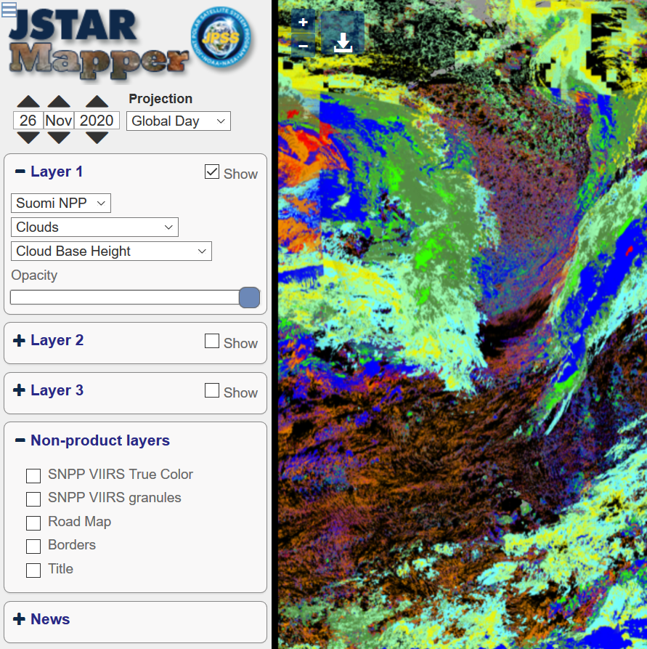
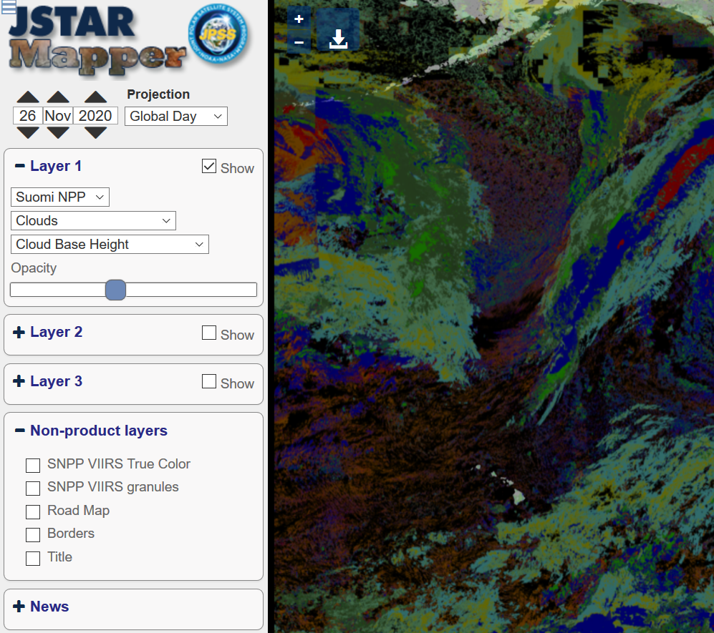
Product Layer Opacity

Slide 9
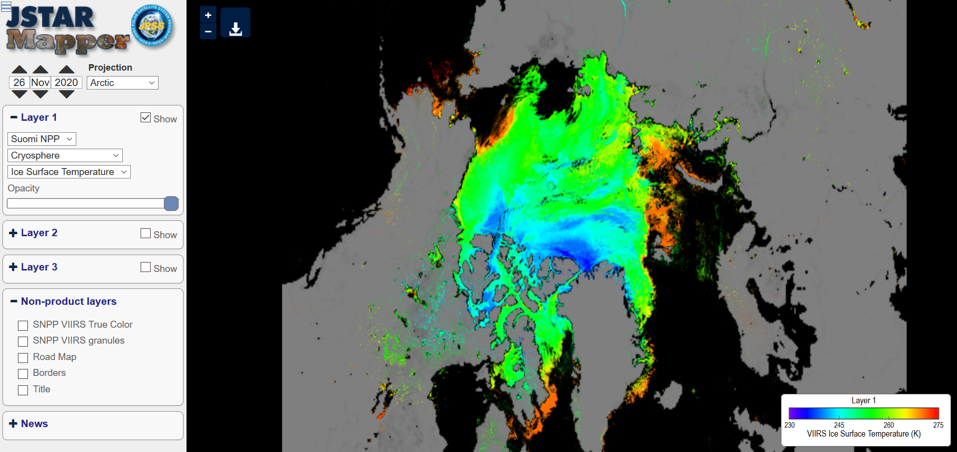
Map Projections

Slide 10
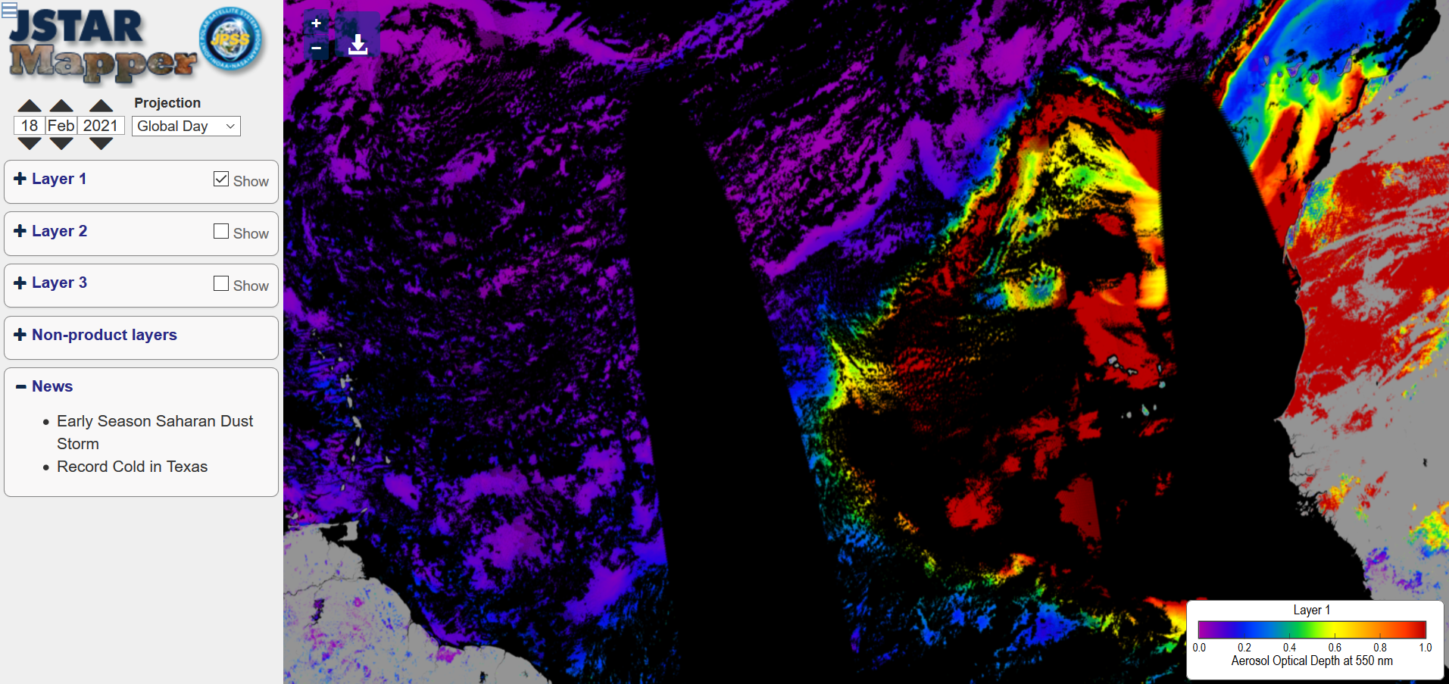
News Feature
Anomalous Early Season Saharan Dust Storm Covers Eastern Atlantic
The VIIRS instrument on the JPSS satellites was able to capture an anomalous early season Saharan dust plume on mid-February 2021. The dust, which was initially centered over the Eastern Atlantic, eventually moved over France and other parts of western Europe. Map URL

Slide 11
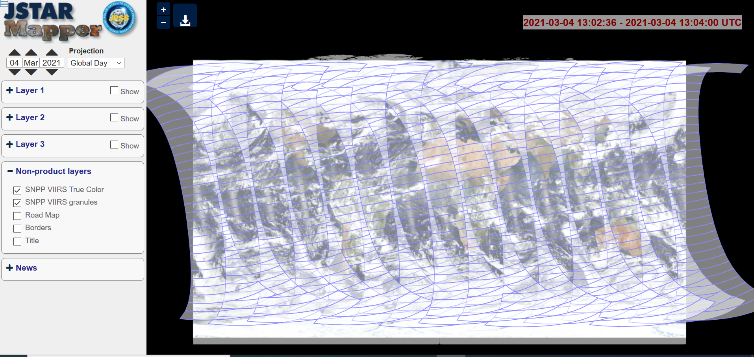
VIIRS & ATMS Granule Display

Slide 12
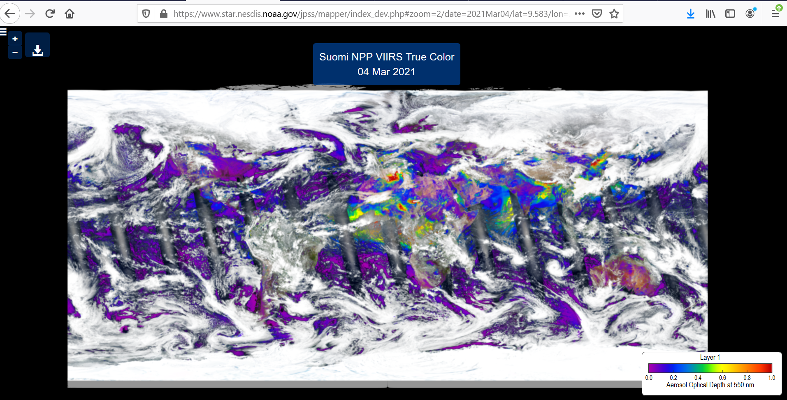
Additional Features
Image Download Button
URL includes map details
Title and colorbar can be toggled on and off for image downloads.

Slide 13
Hands on Training at https://www.star.nesdis.noaa.gov/jpss/mapper Example 1: Distinguishing smoke from dust from clouds Example 2: Comparing two similar products from different satellites Example 3: Using VIIRS granules to obtain data Example 4: Downloading images Example 5: Pinpointing active fires with the road map layer

