Slide 1
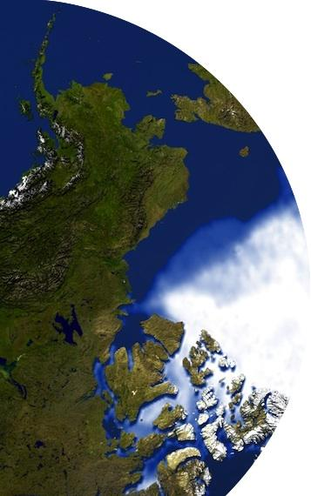
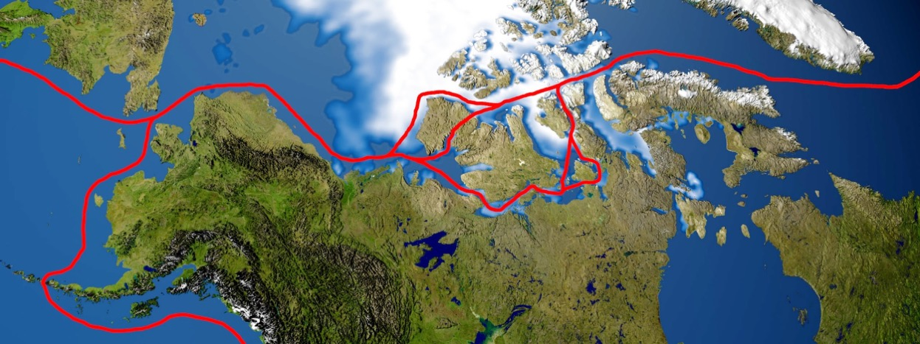


JPSS Short course:
Monitoring and Predicting the Opening of the Northwest Passage
Part 2: Hands-on Exercises
Yinghui Liu, Kyle Obremski,
Jeff Key, Scott Lindstrom
NOAA Satellite and Information Service
Cooperative Institute for Meteorological Satellite Studies (CIMSS)
Madison, Wisconsin USA
JPSS Short Course, 27 June 2023, virtual

Slide 2
Contents
Background
What is sea ice?
The cruise of the Crystal Serenity
What/where is the Northwest Passage (NWP)?
Why is it important?
Economic Impact
Remote Sensing of the NWP
Open vs. Closed: A Case Study
Satellite and reanalysis product for the 2013 and 2016 NWP
Contributing factors
Breakout groups
Summary

Slide 3
Before going further…What is sea ice?
Defined as ice that is formed at the sea surface by the freezing of seawater, the formation of sea ice occurs at a lower temperature than pure water (~28.8˚F vs 32˚F, respectively) due to its salinity. In contrast to icebergs, glaciers, ice sheets, and ice shelves, sea ice is formed and melts entirely in the ocean. Sea ice is relatively thin, ranging from a few centimeters to a few meters in thickness.
Sea ice is categorized by age, thickness, and form. In terms of age, sea ice is most commonly divided into first-year and multiyear ice. Multiyear ice has survived one or more melt seasons. Other age and thickness categories include new ice (less than 5cm), nilas (5~10cm), grey (10~15cm), grey-white (15~30cm), thin first-year (30~70cm), medium first-year (70~120cm), and thick first-year (120~180cm).
Frazil ice is the first stage of sea ice growth, where crystals or plates of ice are suspended in the water. Grease ice is frazil ice that has coagulated to form a "greasy" or soupy layer on the surface without distinct ice floes. Other sea ice forms include pack ice (relatively uniform ice cover over a large area), floes (an individual piece of ice at least 20 m in diameter), pancake ice (pieces less than 3 m in diameter), drift ice (pack ice in concentrations less than six-tenths), and fast ice (attached or frozen or fastened to the shore, also called "landfast ice"). (…continued in the Notes section of this slide)
Notes:
Sea ice is characterized by unique features often found on the ice. Melt ponds are a common response to summer melting of the sea ice surface. Warm temperatures also contribute to the formation of polynyi (singular; polynya), which are nonlinear-shaped openings in sea ice that may be open water or covered with new, thin ice. Leads are a feature that are similar to polynya but are formed by dynamics, not temperature, as sea ice pulls apart and creates long channels. Pressure also contributes to the formation of ridges and hummocks. Ridges form when sea ice is haphazardly piled one piece over another, and hummocks are ridges that have been smoothed by melting and other forms of erosion.
Ice shelves are floating (though they may be grounded) parts of glaciers and ice sheets; i.e., land ice. When portions of glaciers and ice sheets and ice shelves break off and float away they are ice bergs. Neither are sea ice.
Sea ice should never be referred to as an ice sheet. Expanses of sea ice are referred to as pack ice (even that’s older terminology), the sea ice cover, or drift ice.

Slide 4
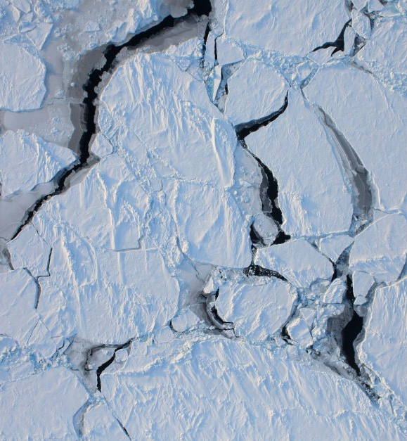
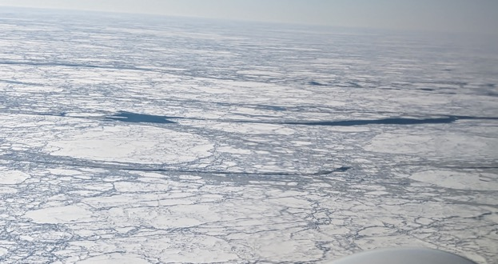
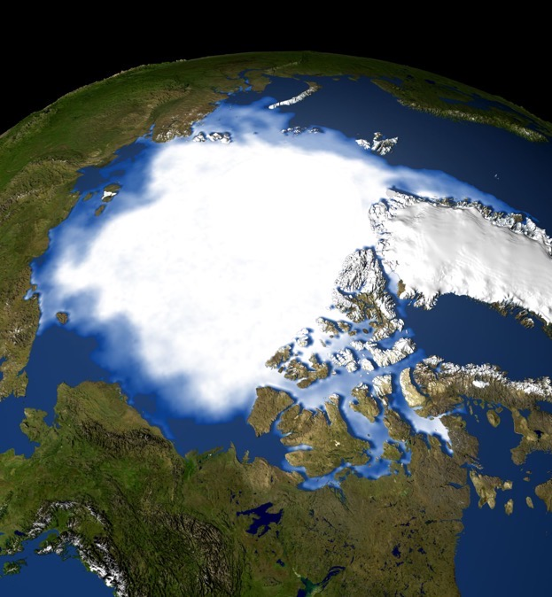
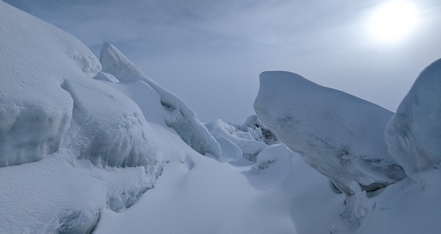
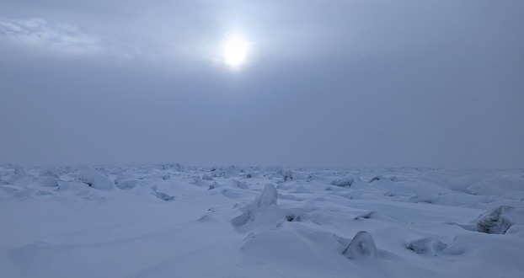
Sea Ice

Slide 5
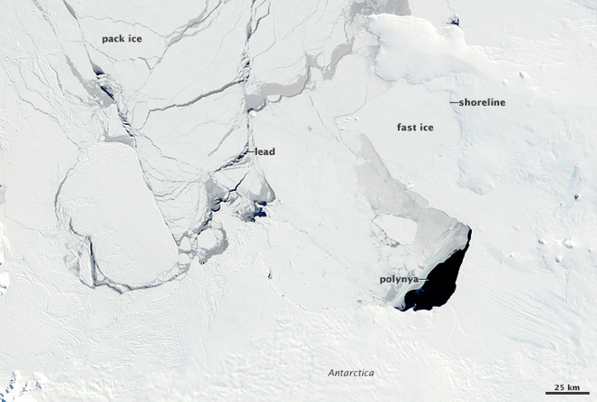
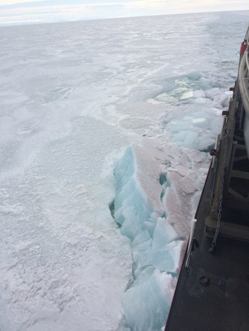
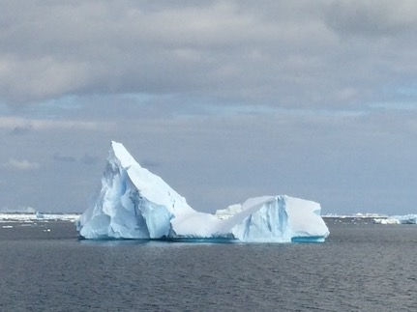
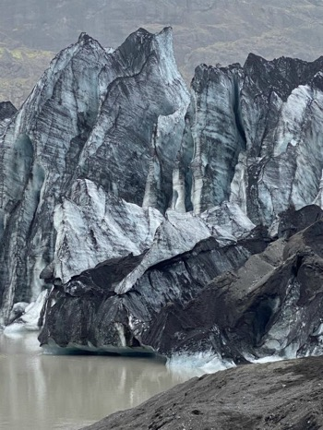
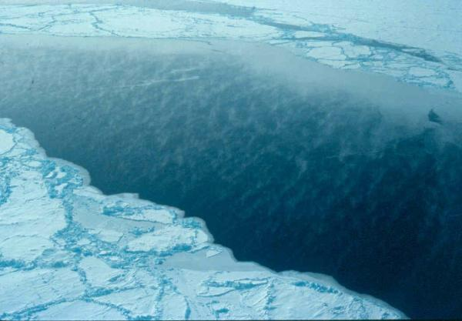
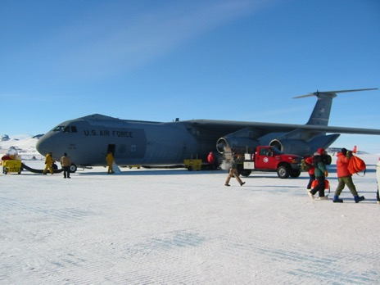
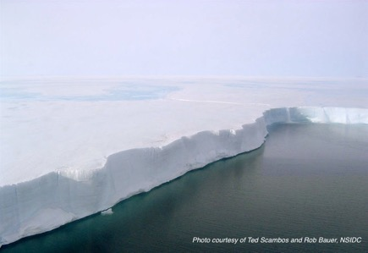
Which are Sea Ice?
(1)
(2)
Which of these pictures show sea ice? (Answer in the chat)
(3)
X
The pictures on the right and below are not of sea ice. What are they? (Answer in the chat)
(From earthobservatory.nasa.gov)
(7)
(4)
(5)
X
(6)
X
Take a couple minutes to look at some video and pictures here.
(stratus.ssec.wisc.edu/jpss/satmoc2023)
The NOAA Observer’s Guide to Sea Ice has lots of information on sea ice types.

Slide 6
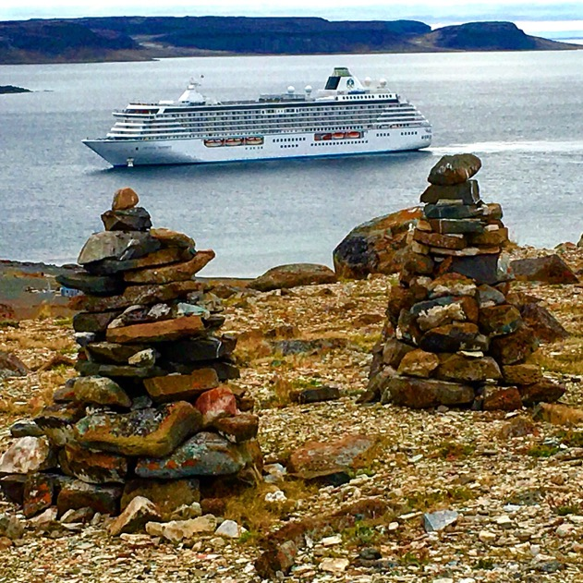
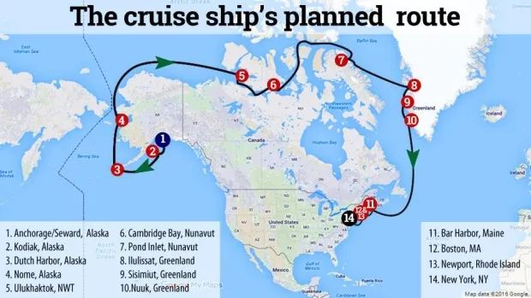
Background: Cruise Ship Traverses the Northwest Passage
History was made in 2016 when the Crystal Serenity cruise ship spent 32 days sailing through the Northwest Passage with more than 1,000 people on board. The Crystal Serenity is 820 feet long and 68,870 gross tons. It has 544 cabins and can carry up to 1,070 passengers. Staterooms start at about $20,000 and run as high as $120,000.
The 32-day cruise started in Seward, Alaska, and made stops in Ulukhaktok, N.W.T., and Cambridge Bay and Pond Inlet in Nunavut before moving on to Greenland. The cruise ended in New York City.

Slide 7
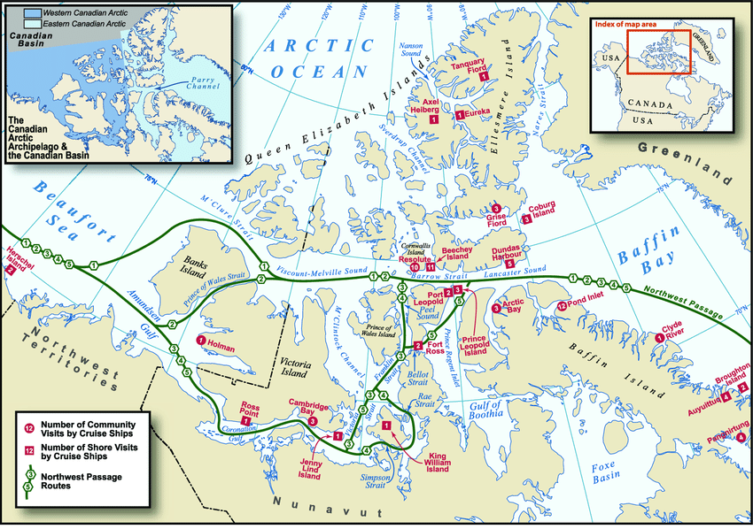
What is the Northwest Passage?
Stewart et al. 2007, DOI:10.14430/arctic194

Slide 8
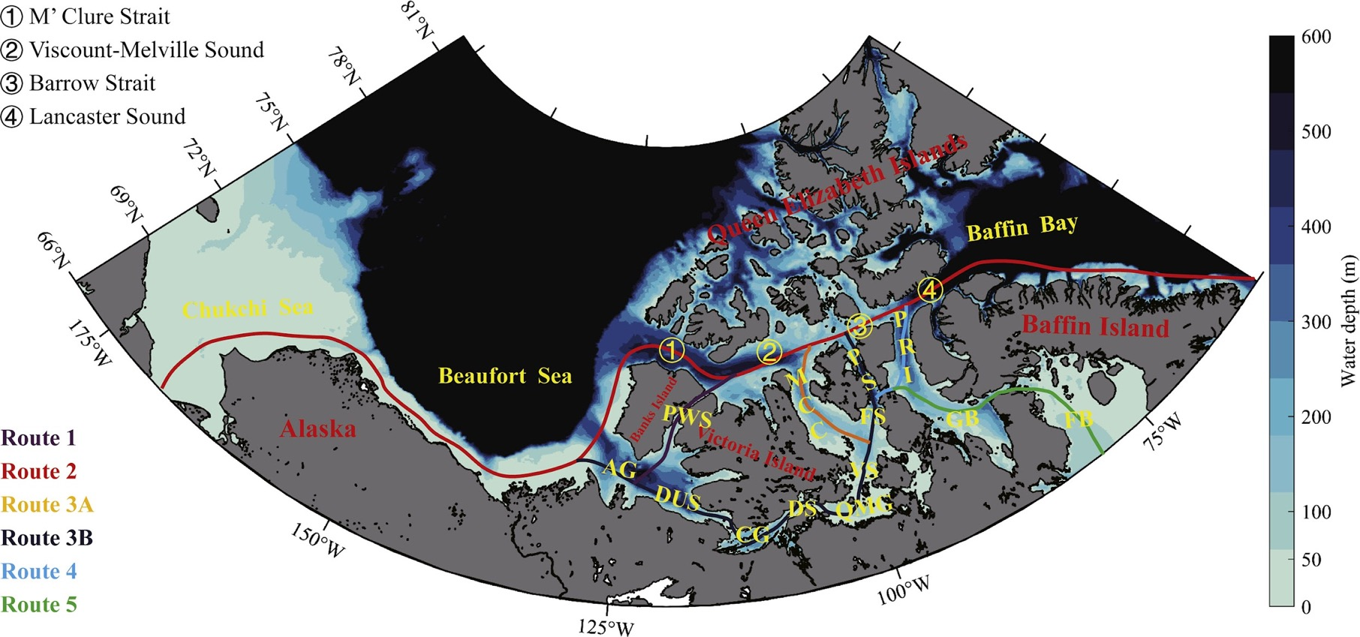
Possible Routes Through the Northwest Passage
Russia
Alaska
Bering Sea
St. Matthew Island
Nunivak Island
Kiska Sea
St. Paul
St. George
Aleutian Islands
Chen et al. 2021, https://doi.org/10.1016/j.accre.2021.02.002

Slide 9
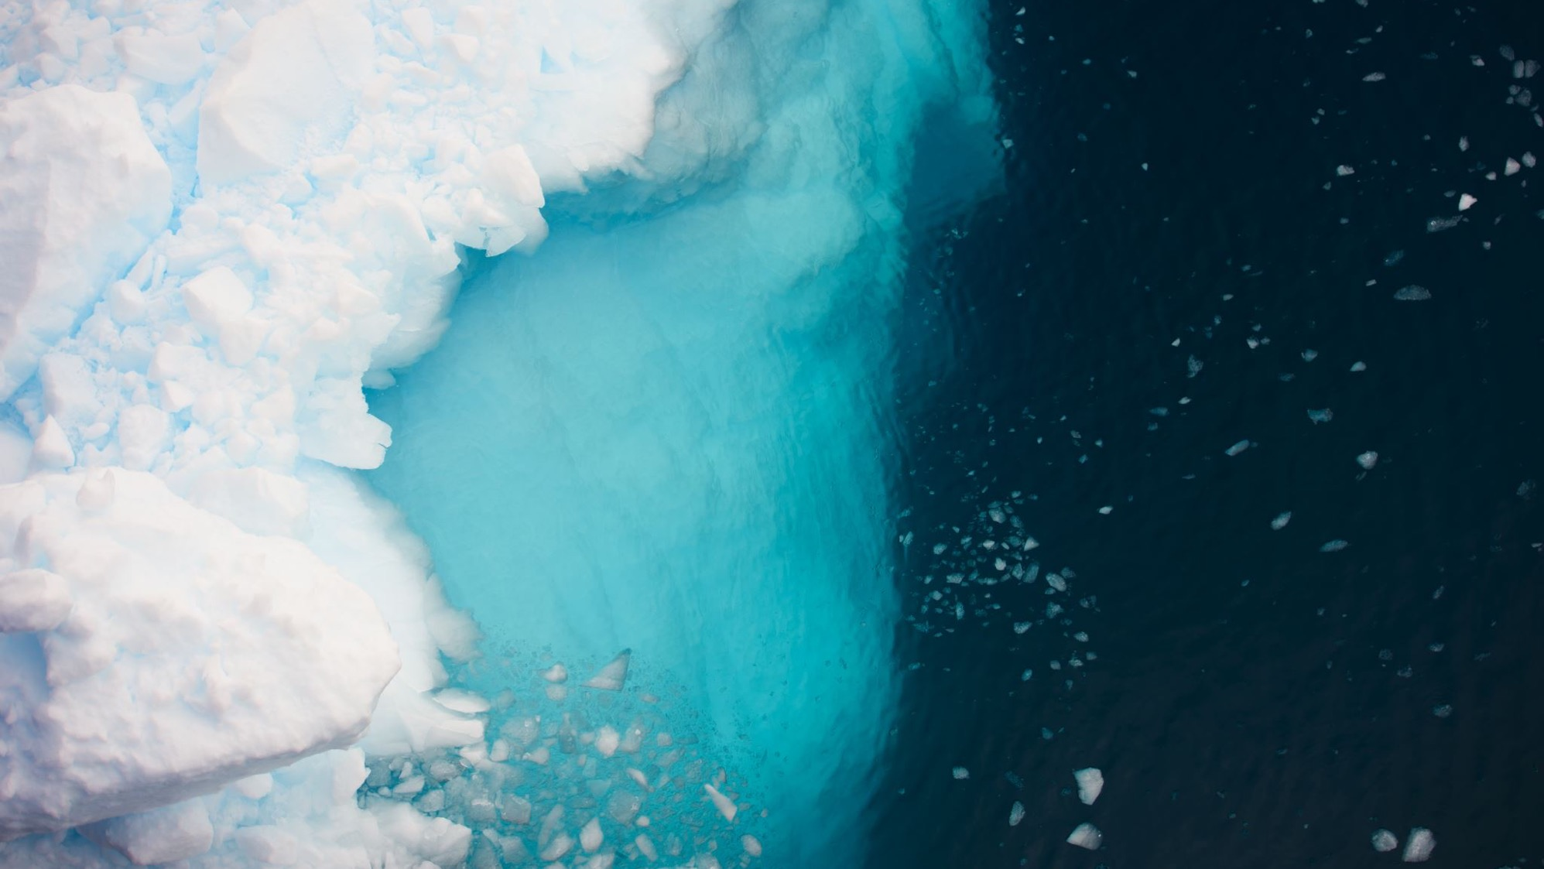
Importance of the NWP
As a climate signal
An open Northwest Passage signals a decline in sea ice, but also a warming Arctic.
As a trade route
Trade has always been the main reason for explorers to look for the NWP, and with the passage opening more frequently there will be economic implications.
The passage runs through Canadian territory, but there is some argument as to whether certain straits of the NWP are in international waters.
As a tourism hotspot
Arctic cruises already exist, but passenger ships going through the NWP are still a rare occurrence. If the NWP is open more frequently and/or longer, the cruise industry stands to capitalize.
NWP is commonly referred to as Numerical Weather Prediction. In this presentation it refers to the Northwest Passage.

Slide 10
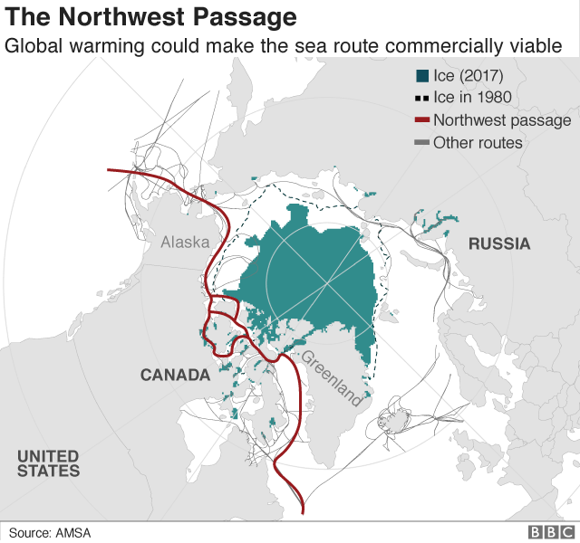
Economic Impact
The NWP has the potential to replace certain shipping lanes for trade.
Saran Somanathan and Jozef Szymanski (2006) concluded that trade between Japan and the Northeast United States is more efficient through the NWP than through the Panama Canal.
As mentioned, Canada sees the NWP as within its territory which would heighten the Canadian economic presence on the world stage. However, there is debate as to whether some routes fall into the international water category.
Geopolitical relations and economic strategy will be impacted as the NWP becomes a more viable trade route.
Saran Somanathan and Jozef Szymanski (2006), doi: 10.1109/WSC.2006.322929

Slide 11
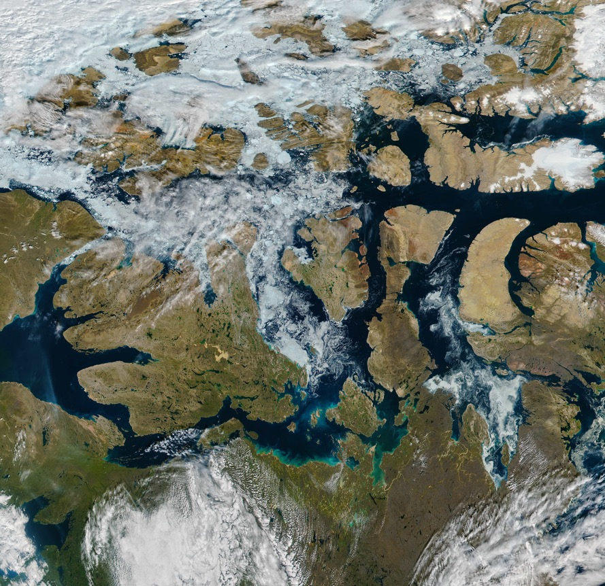
Remote Sensing of the NWP
In order to use the NWP for shipping, sea-ice conditions must be monitored.
The remote nature of the NWP reduces the ability to measure sea ice conditions directly.
Spaceborne observations allow for large swathes of the NWP to be measured at specified resolutions.
Remote sensing and in situ observations complement one another for a better understanding of ice conditions.

Slide 12
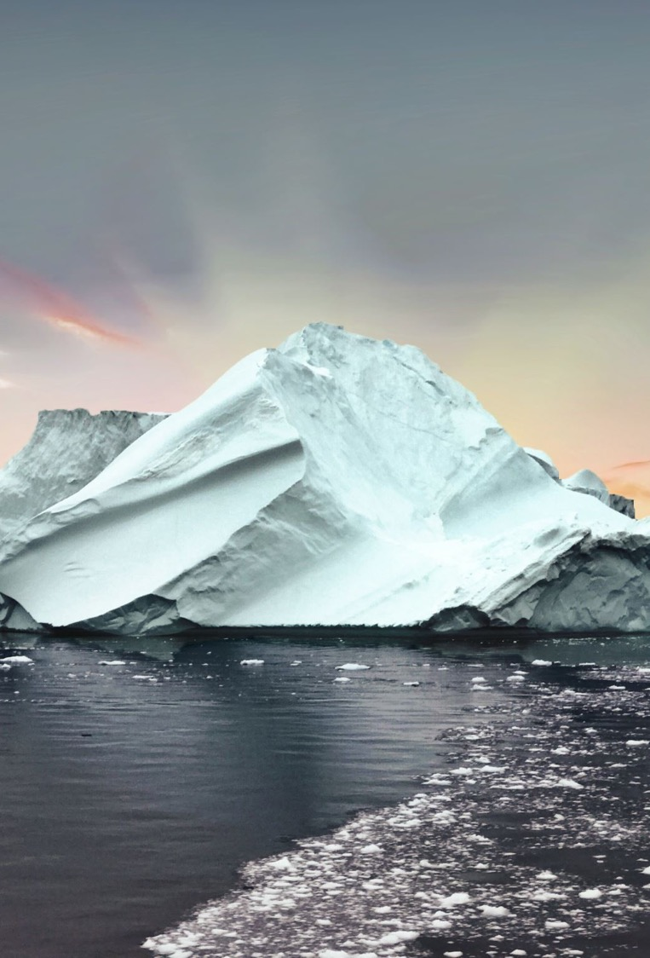
Open vs. Closed
The NWP being ”open” describes the point at which a ship not rated as an icebreaker can make it through the NWP. One example is the Crystal Serenity passing through the southernmost route in 2016.
A “closed” NWP means each route within the NWP has enough ice to effectively block the passage from being traversed by any non-icebreaking ship.
Useful variables to look at to determine whether the NWP is, or will be, open or closed include surface temperature, ice depth, ice concentration, freezing degree days, and wind strength/direction.
2013 vs. 2016 slider: https://earthobservatory.nasa.gov/images/88597/a-nearly-ice-free-northwest-passage

Slide 13
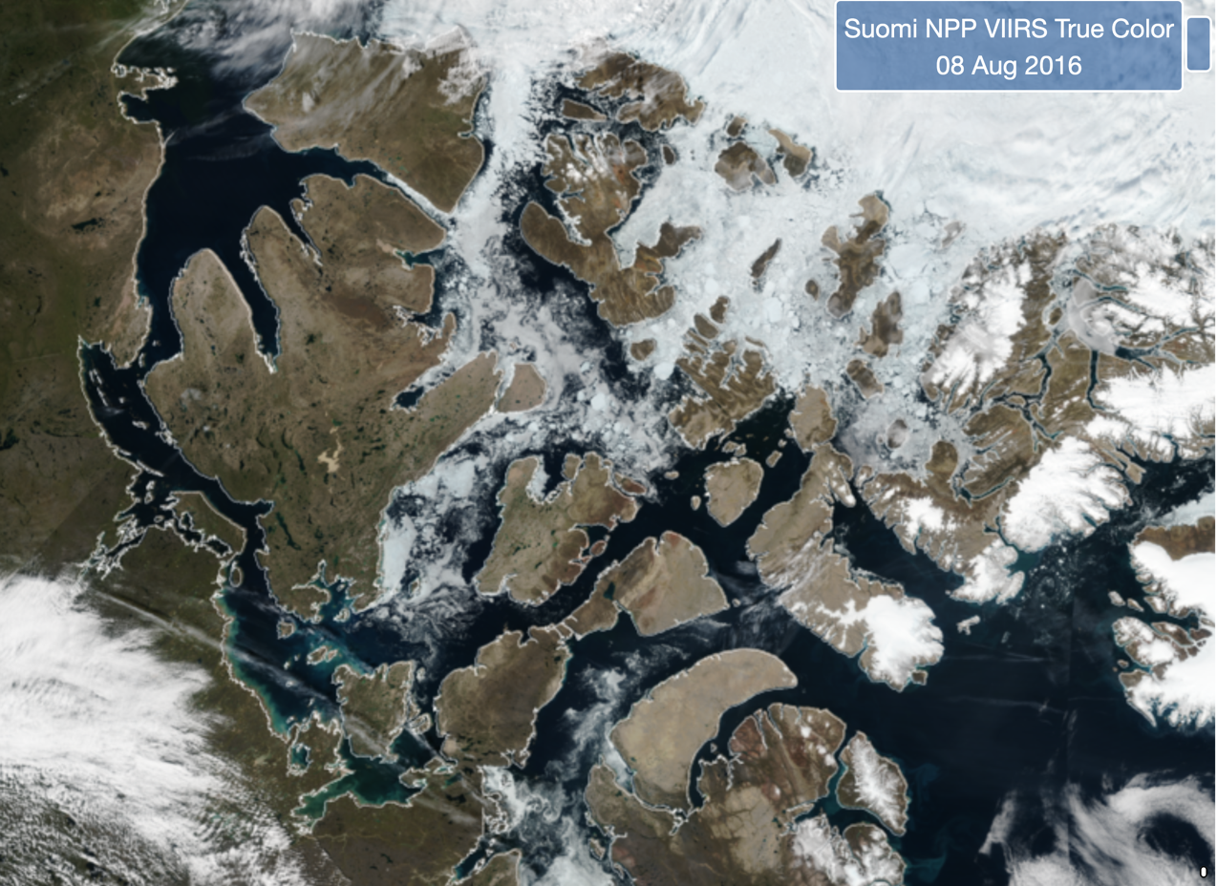
Banks
Island
Victoria
Island
Open
Prince of Wales Island
Somerset
Island
Baffin
Island
https://www.star.nesdis.noaa.gov/jpss/mapper

Slide 14
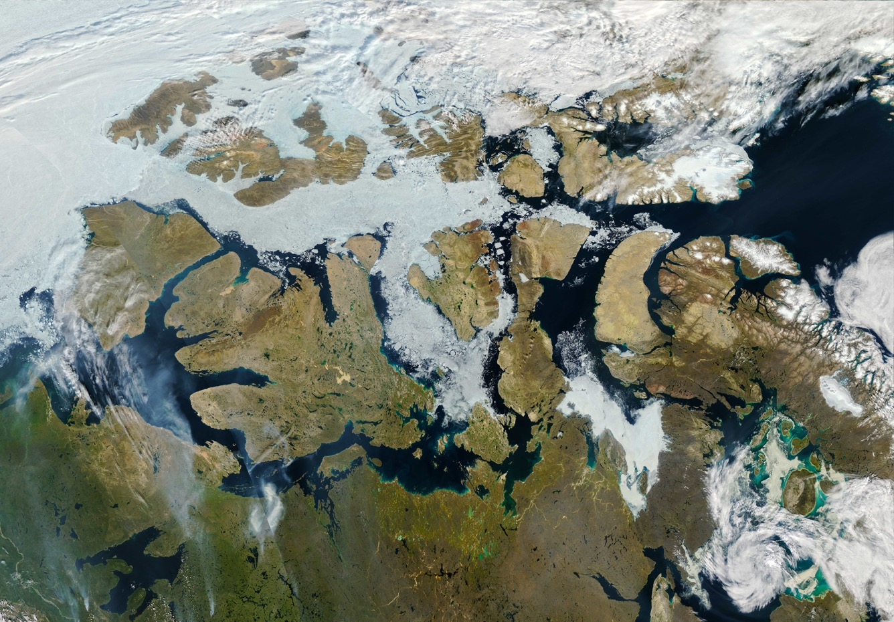
Banks
Island
Somerset
Island
Prince of Wales Island
Closed
Baffin
Island
Victoria
Island
MODIS True-color image on Aug 9, 2013
https://earthobservatory.nasa.gov/

Slide 15
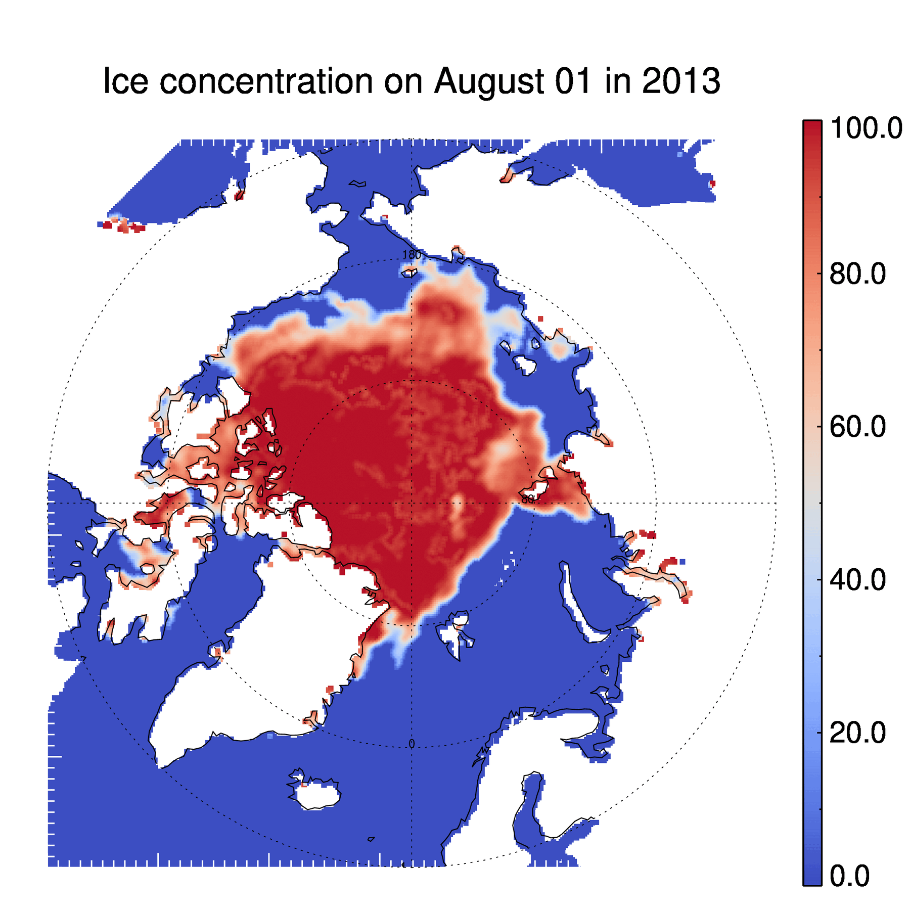
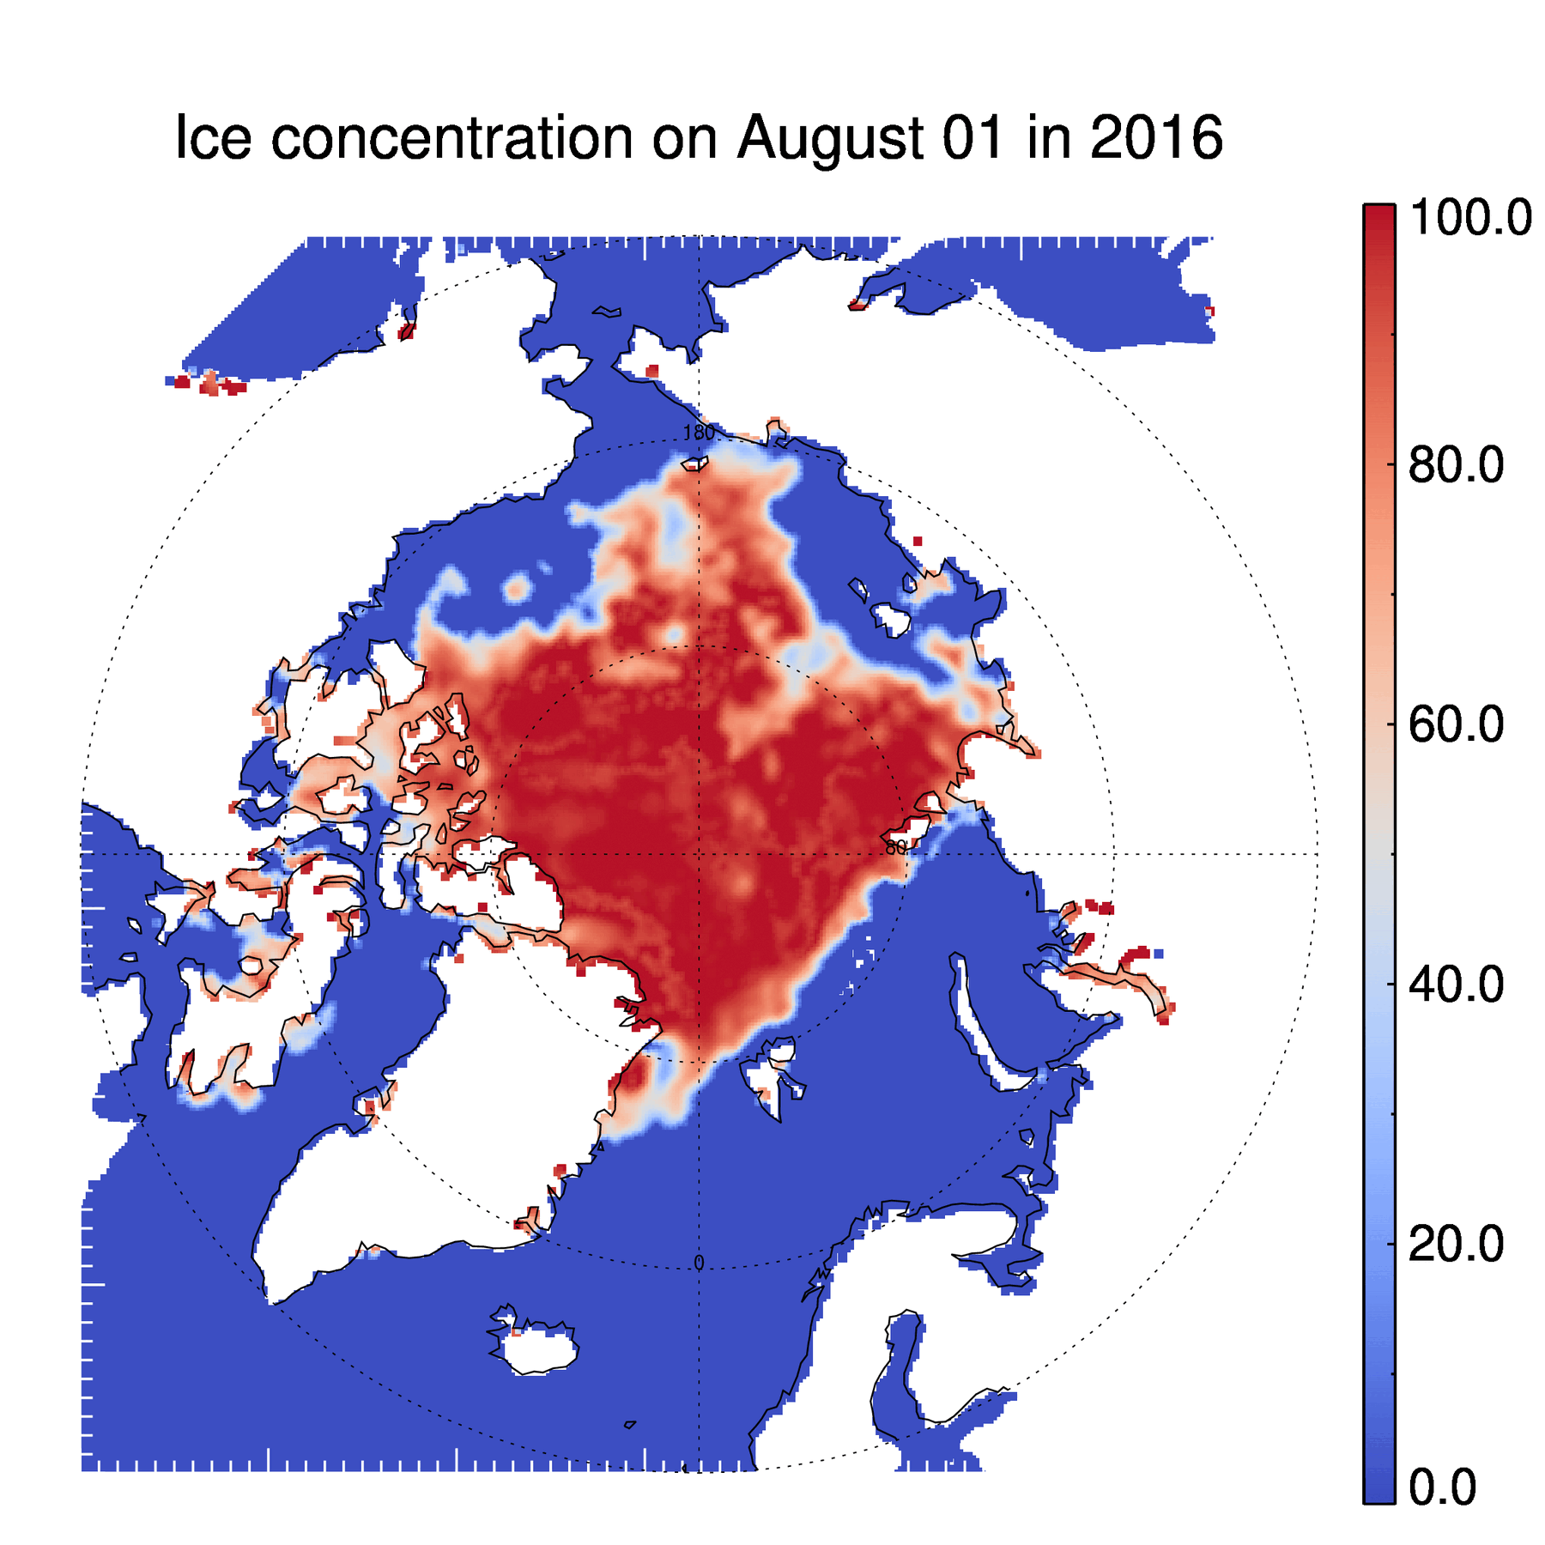
AMSR2 Ice Concentration in 2013 and 2016
Question: In which year is the NWP open? How long did it take? Answer in the chat.

Slide 16
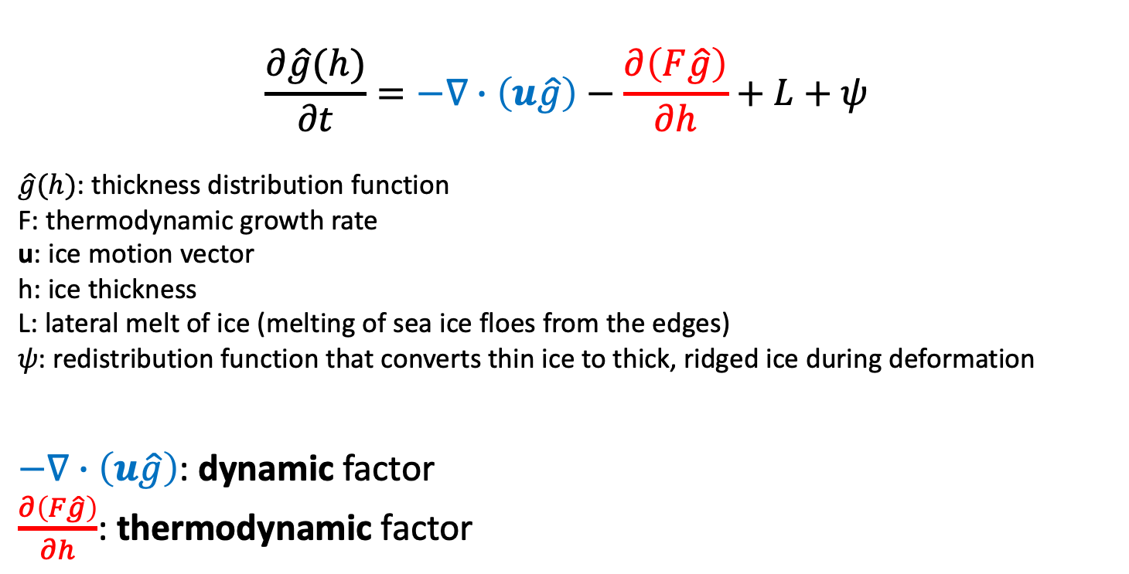
Factors influencing the ice conditions in 2013 and 2016
$$\frac{∂\hat{g}(h)}{∂t}=−∇∙\left(u\hat{g}\right)−\frac{∂\left(F\hat{g}\right)}{∂h}+L+ψ$$
$\hat{g}(h)$: thickness distribution function
F: thermodynamic growth rate
u: ice motion vector
h: ice thickness
L: lateral melt of ice (melting of sea ice floes from the edges)
𝜓: redistribution function that converts thin ice to thick, ridged ice during deformation
$−∇∙\left(u\hat{g}\right)$: dynamic factor
$\frac{∂\left(F\hat{g}\right)}{∂h}$: thermodynamic factor

Slide 17
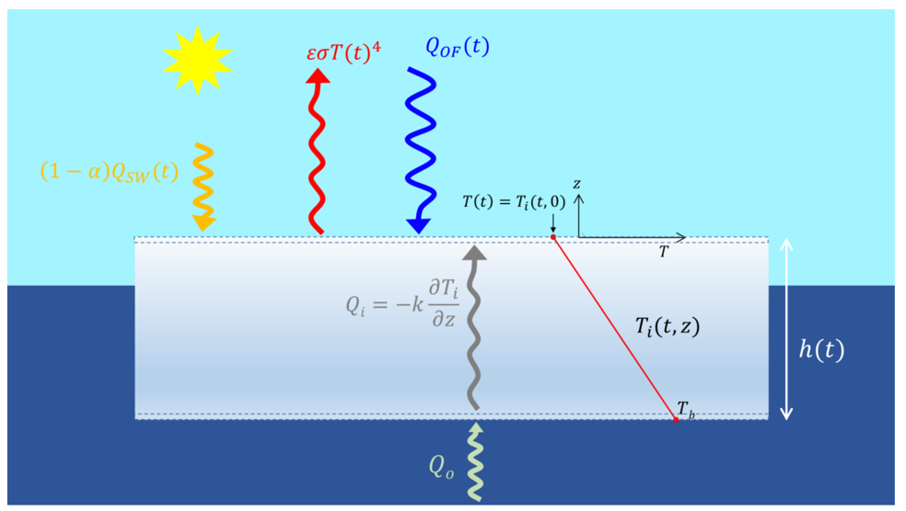
A thermodynamic-only sea ice model
F. Massonnet 2017 in sea ice symposium at UW, Seattle, 12-13 July 2017

Slide 18
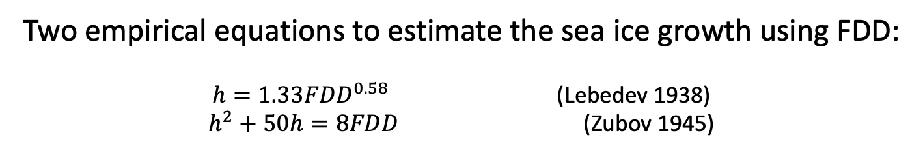
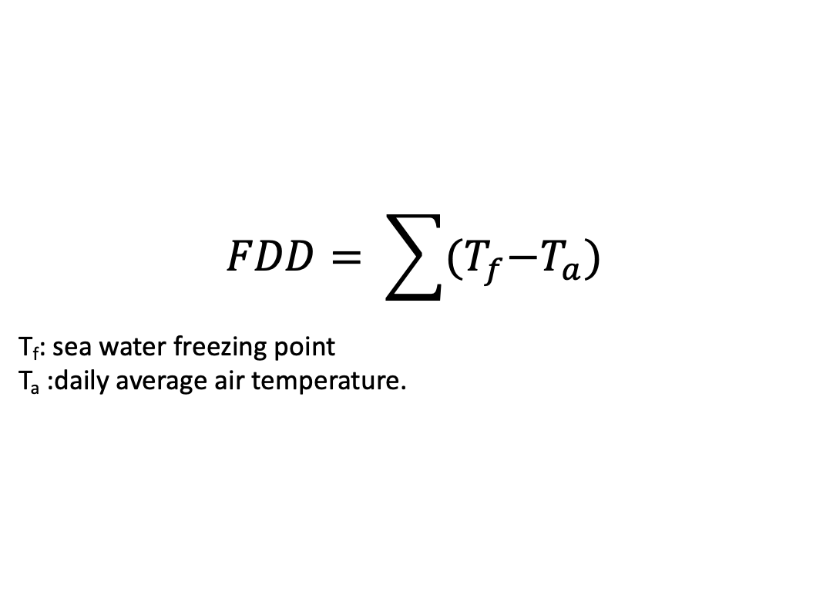
Sea ice thermodynamic growth with empirical equations using Freezing Degree Days (FDD)
$$FDD= \sum{{(T}_{f}−T_{a})}$$
T_{f}: sea water freezing point
T_{a} :daily average air temperature.
Two empirical equations to estimate the sea ice growth using FDD:
$h=1.33{FDD}^{0.58}$ (Lebedev 1938)
$h^{2}+50h=8FDD$ (Zubov 1945)
FDD relates the air (surface) temperature with sea ice growth. FDD can be used as a measure of sea ice growth in the growing season.
Question: Does a larger FDD mean that sea ice will grow more or less? Answer in the chat.

Slide 19
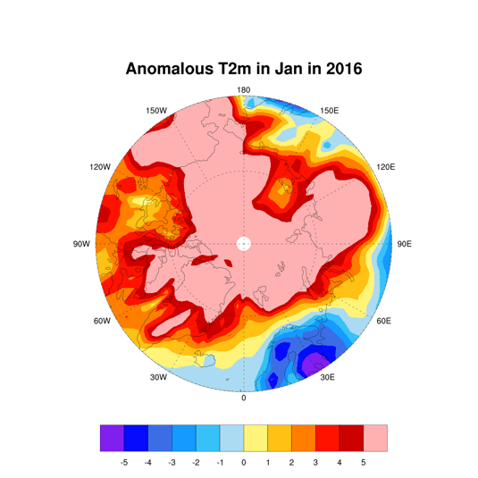
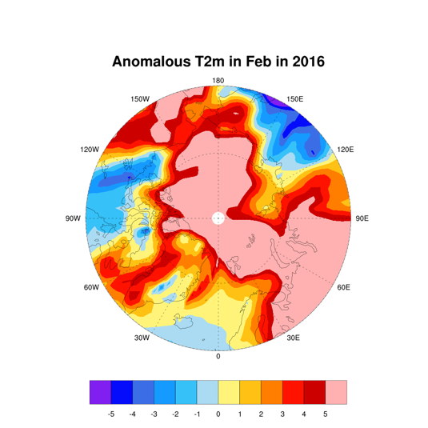
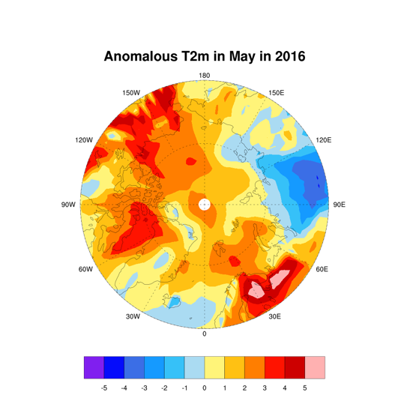
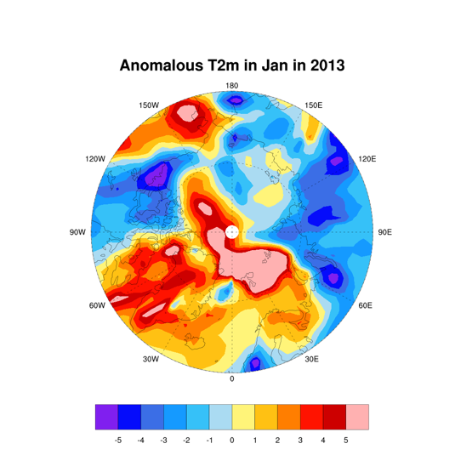
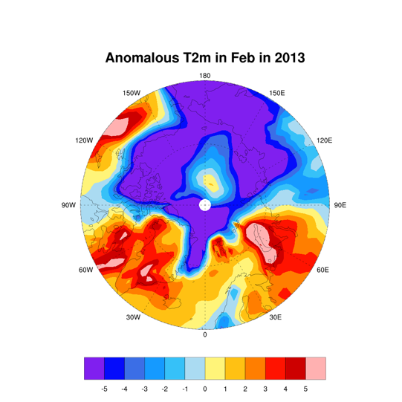
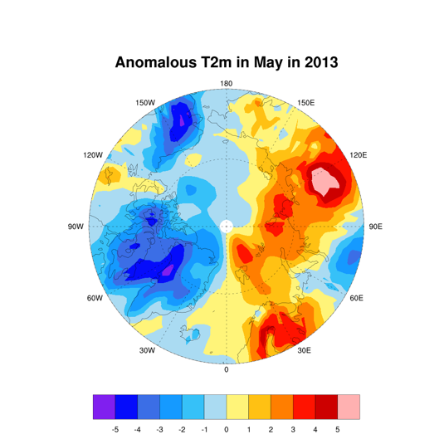
Temperature Anomalies in Jan, Feb, May, 2016 and 2013
2016
Warmer
2013
Colder

Slide 20
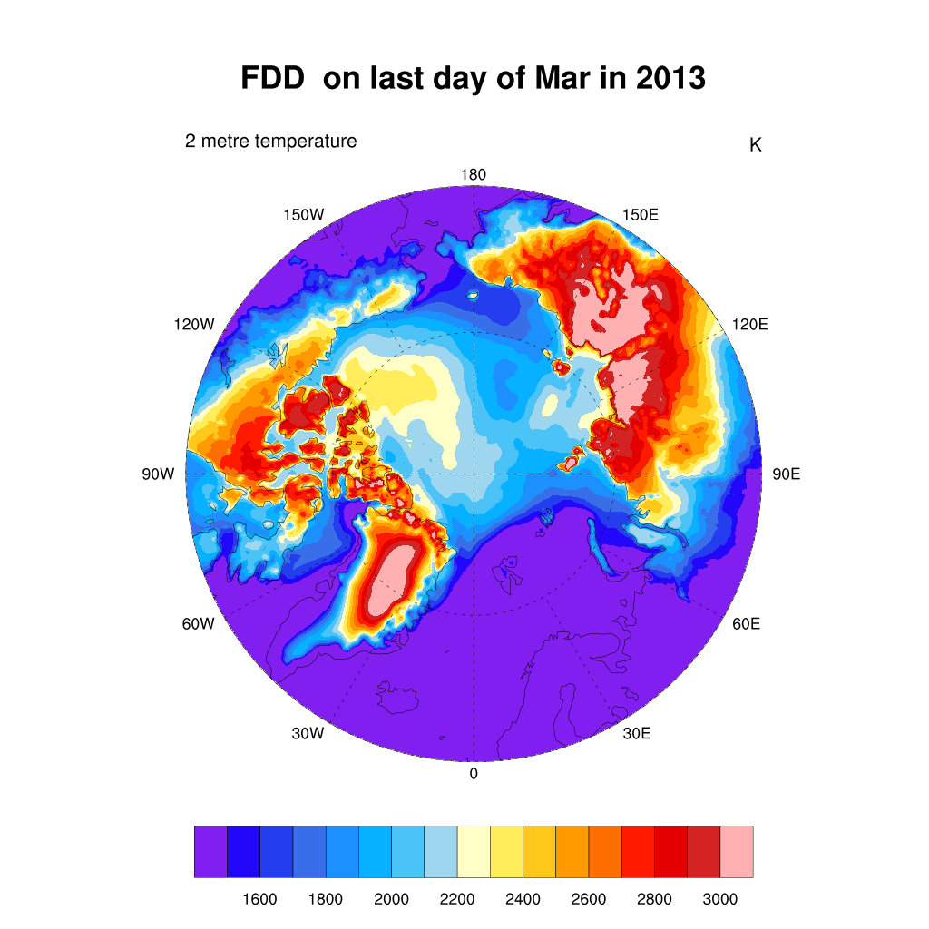
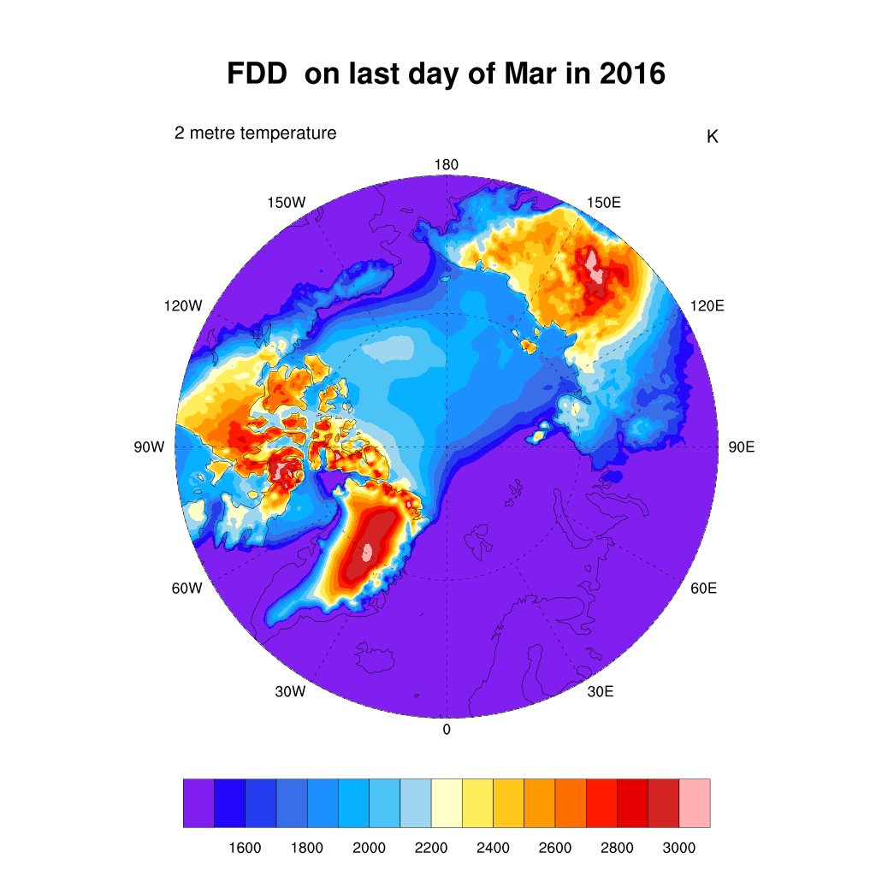
Freezing Degree Days in March of 2013 and 2016
2013
Colder
2016
Warmer
Question: Which year is colder based on FDD? Answer in the chat.

Slide 21
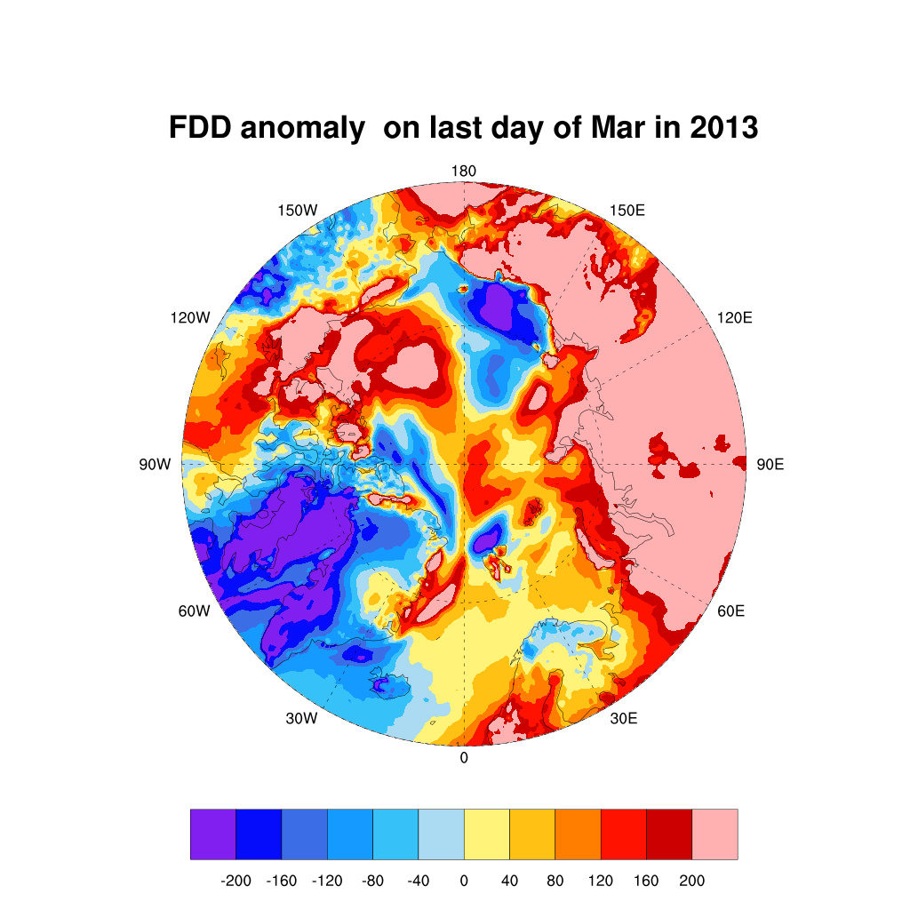
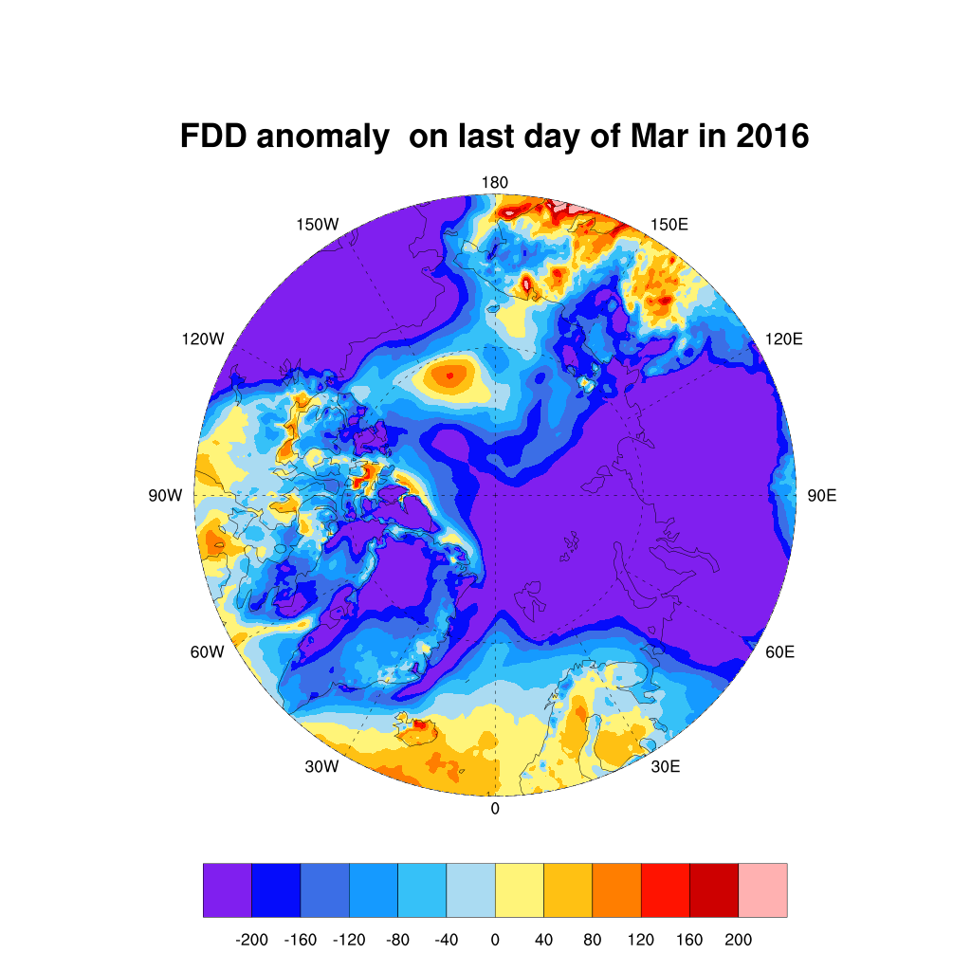
Freezing Degree Day Anomaly in March of 2013 and 2016
2013
Colder
2016
Warmer

Slide 22
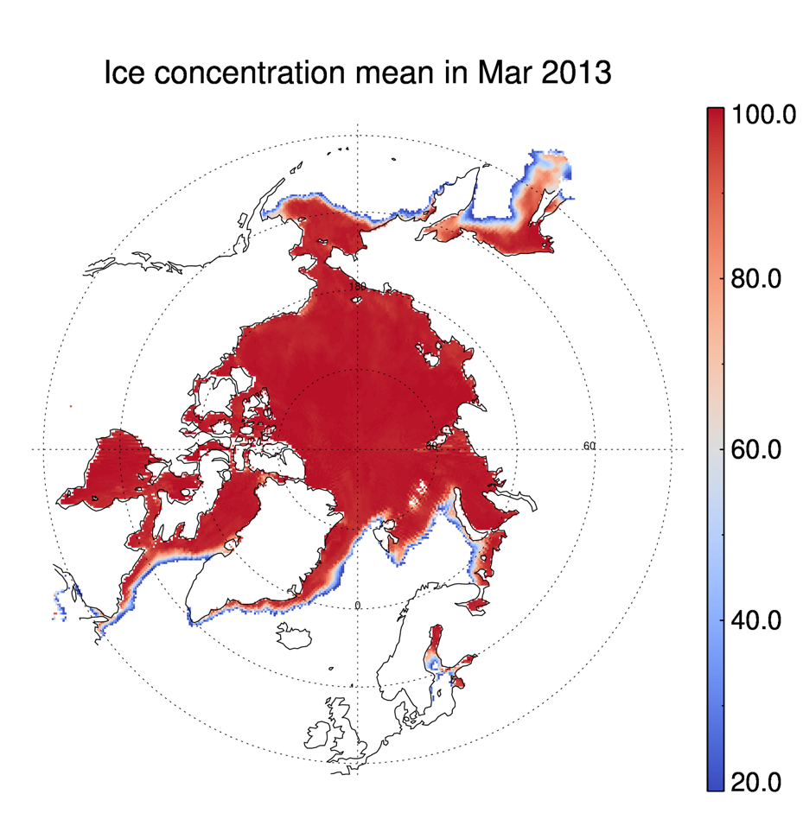
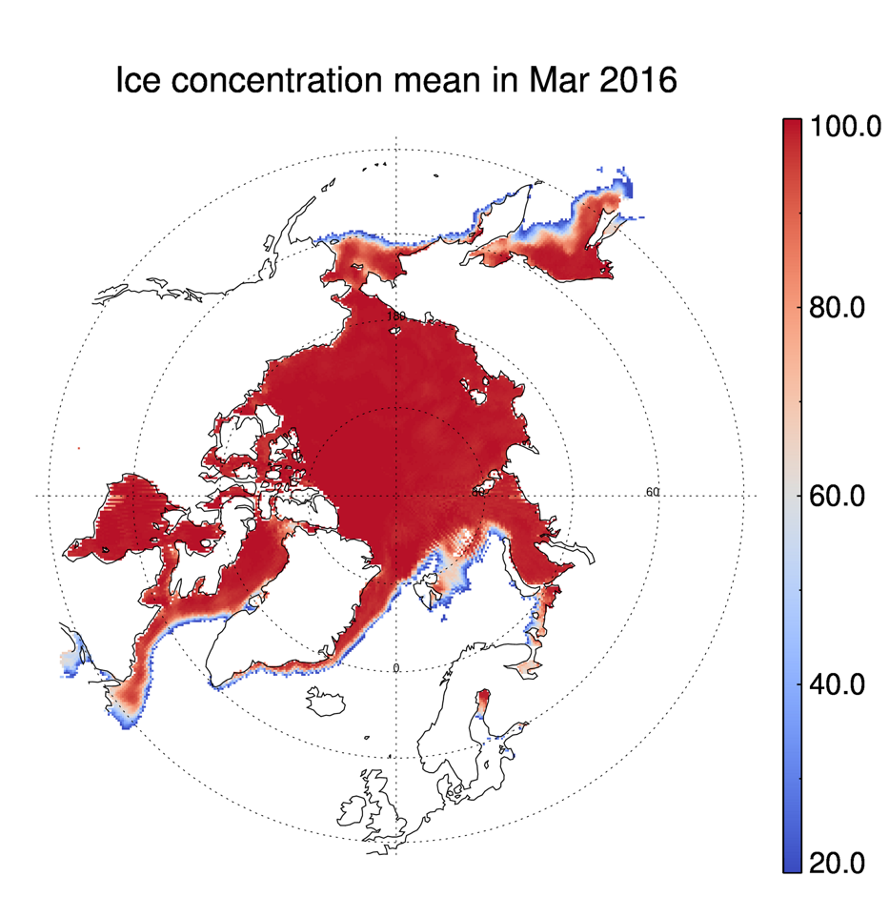
The cold/warm winter sea ice concentration in late winter
Question: Does March ice concentration seem like a good indicator of NWP ice conditions in the summer? Answer in the chat.

Slide 23
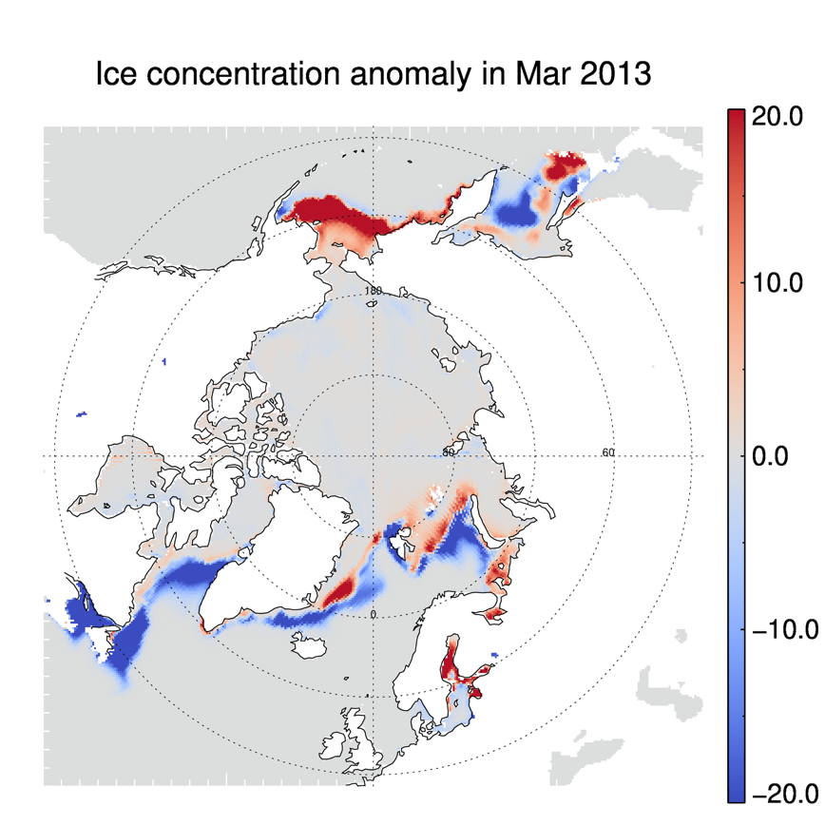
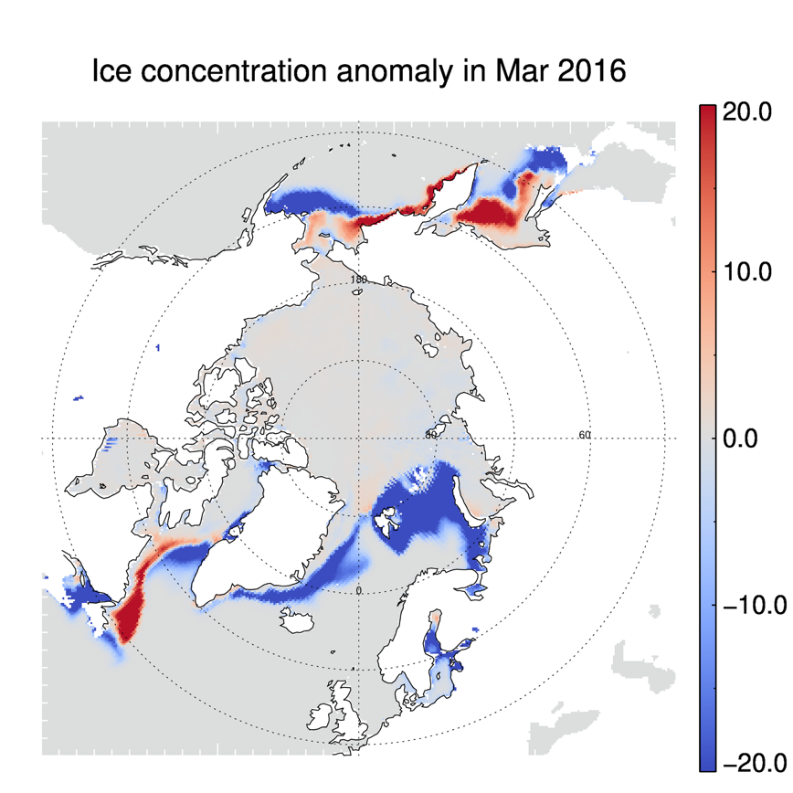
The cold/warm winter sea ice concentration anomaly in late winter

Slide 24
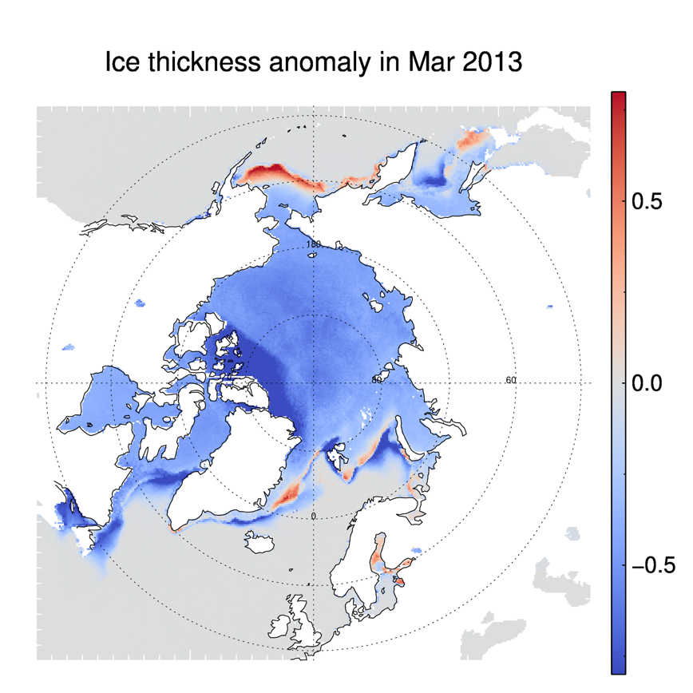
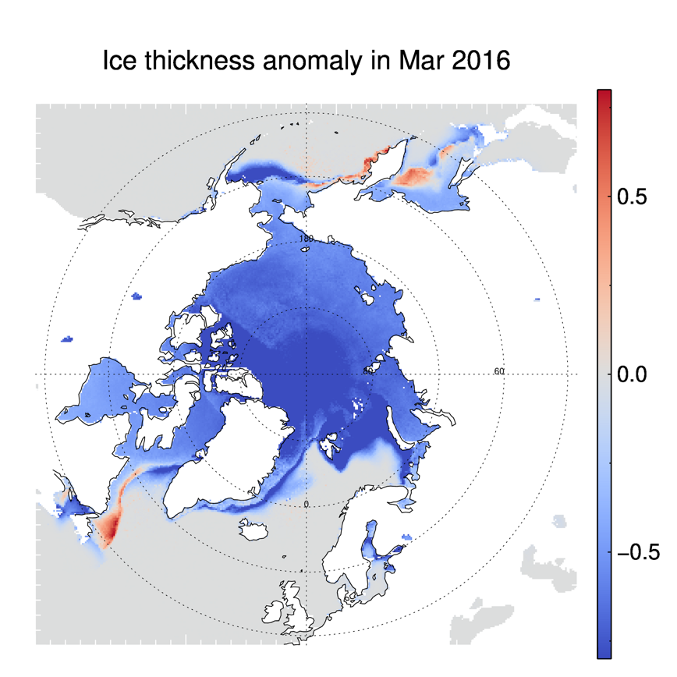
The cold/warm winter sea ice thickness in late winter
Question: Does March ice thickness seem like a good indicator of NWP ice conditions in the summer? Answer in the chat.

Slide 25
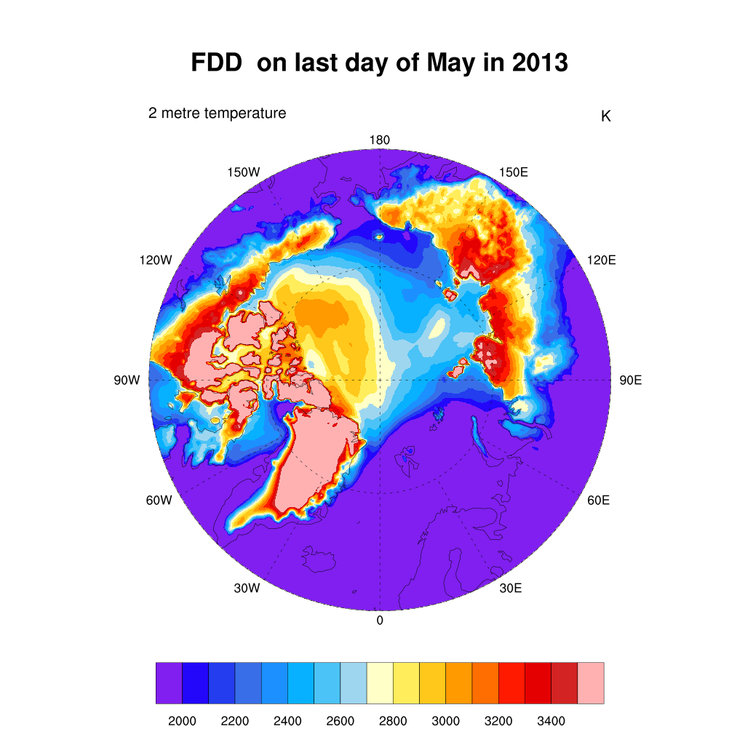
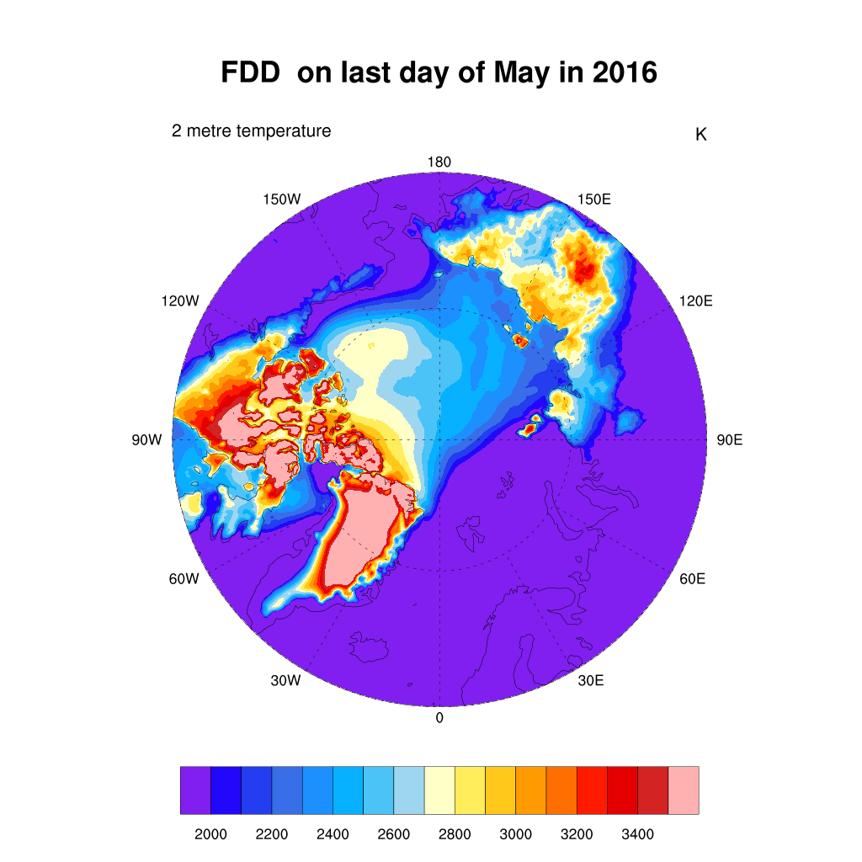
Freezing Degree Days in May of 2013 and 2016

Slide 26
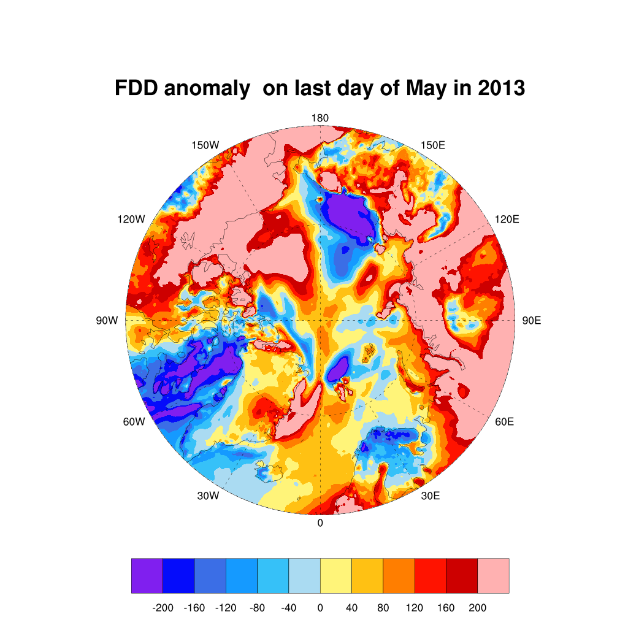
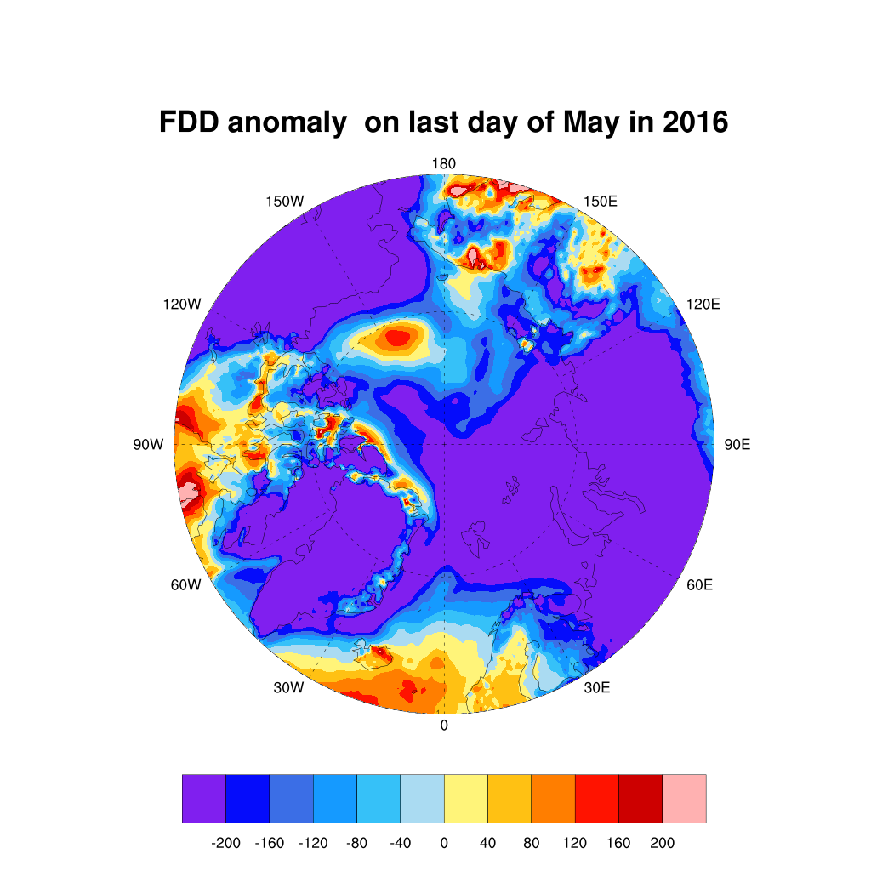
Freezing Degree Day Anomaly in May of 2013 and 2016

Slide 27


The cold/warm winter sea ice concentration in late spring

Slide 28


The cold/warm winter sea ice concentration anomaly in late spring

Slide 29


The cold/warm winter sea ice thickness in late spring

Slide 30


Question: With these FDD anomaly patterns in 2013 and 2016, which year would you expect that the NW Passage is more likely to be open? Answer in the chat.

Slide 31
Observation:
The thermodynamic factor (primarily temperature) certainly favors sea ice growth in the NW Passage in 2013. The NW Passage is more likely to be open in 2016 than in 2013.
Now let’s examine dynamics.

Slide 32



Winds Toward the Canadian Archipelago Favor a Closed NWP (and vice versa)
Wind direction
Wind direction
Does NOT favor opening of NWP
Favors opening of NWP
Question: What other wind directions might favor opening of the NWP? Answer in the chat.

Slide 33


Wind Anomaly in January 2013 and 2016
A checkmark means that the wind pattern is favorable for ice export from the NWP area.

Slide 34


Wind Anomaly in February 2013 and 2016

Slide 35


Wind Anomaly in March 2013 and 2016
A checkmark means that the wind pattern is favorable for ice export from the NWP area.

Slide 36


Wind Anomaly in April 2013 and 2016

Slide 37


Wind Anomaly in May 2013 and 2016
A checkmark means that the wind pattern is favorable for ice export from the NWP area.

Slide 38


Wind Anomaly in June 2013 and 2016
A checkmark means that the wind pattern is favorable for ice export from the NWP area.

Slide 39


Wind Anomaly in July 2013 and 2016
A checkmark means that the wind pattern is favorable for ice export from the NWP area.

Slide 40


Wind Anomaly in August 2013 and 2016
Question: With these wind anomaly patterns in 2013 and 2016, which year would you expect that the NW passage is more likely to be open? Answer in the chat.

Slide 41
Observations:
The dynamic factor favors sea ice export from the NW Passage in 2016. The NW Passage was more likely to be open in 2016 than in 2013.

Slide 42

Summary of the 2013/2016 case study
The opening and closing of the NWP can be analyzed through the use of spaceborne observations, but direct observation is an important supplement.
Analysis of environmental variables over the region in the months leading up to a NWP opening shows that there are likely early indicators that can be used as predictors for the sea ice conditions in the NWP.
Both thermodynamic and dynamic processes play a role in the opening of the NWP, but it is not easy to identify which is more dominant.

Slide 43
Breakout Session
In the breakout session you will work through a case study like the one we just covered but for different years.
Please proceed to the breakout group that you have been randomly assigned.

Slide 44
Purpose
In this breakout session you will work through a case study like the one we just covered but for different years: 2012 and 2014. You will examine the thermodynamic and dynamic factors from the beginning of the year through August and try to determine if the Northwest Passage will be open or closed in each of these years.
Case Study Questions
How do the thermodynamical and dynamical factors evolve differently in these two years from those in 2013 and 2016?
Do the thermodynamic anomalies (i.e. freezing degree days) or dynamic anomalies (winds) play a larger part in the opening (or not) of the NWP?
Looking at the months leading up to the NWP openings provides clues, is there a particular month that may represent a “tipping point” signal for the NWP opening or not?
Which figures were the most helpful for you when investigating the NWP?
Which of the two years the NW Passage is more likely to be open, 2012 or 2014?
Broader Questions (time permitting)
What other factors might impact whether or not the NPW is open or closed?
Similarly, what other data would be useful in monitoring and predicting the opening of the NWP?
What specific tools can be used to predict the opening of the NWP? A numerical model or machine learning? What inputs would be needed (variables, which months, etc.)?
Everybody is welcome to write your answers in the online documents for Group 1, Group 2, Group 3, Group 4

Slide 45


FDD Anomaly in January 2012 and 2014

Slide 46


FDD Anomaly in February 2012 and 2014

Slide 47


FDD Anomaly in March 2012 and 2014

Slide 48


FDD Anomaly in April 2012 and 2014

Slide 49


FDD Anomaly in May 2012 and 2014

Slide 50


FDD Anomaly in June 2012 and 2014

Slide 51


FDD Anomaly in July 2012 and 2014

Slide 52


FDD Anomaly in August 2012 and 2014

Slide 53


Wind Anomaly in January 2012 and 2014

Slide 54


Wind Anomaly in February 2012 and 2014

Slide 55


Wind Anomaly in March 2012 and 2014

Slide 56


Wind Anomaly in April 2012 and 2014

Slide 57


Wind Anomaly in May 2012 and 2014

Slide 58


Wind Anomaly in June 2012 and 2014

Slide 59


Wind Anomaly in July 2012 and 2014

Slide 60


Wind Anomaly in August 2012 and 2014

Slide 61


Ice Concentration Anomaly in January 2012 and 2014

Slide 62


Ice Concentration Anomaly in March 2012 and 2014

Slide 63


Ice Concentration Anomaly in May 2012 and 2014

Slide 64


Ice Concentration Anomaly in July 2012 and 2014

Slide 65


Ice Thickness Anomaly in January 2012 and 2014

Slide 66


Ice Thickness Anomaly in March 2012 and 2014

Slide 67


Ice Thickness Anomaly in May 2012 and 2014

Slide 68


Ice Thickness Anomaly in July 2012 and 2014

Slide 69


Ice Concentration in August 2012 and 2014

Slide 70
Review of Responses to Questions
Group 1 – Jeff Key
Group 2 – Scott Lindstrom
Group 3 – Yinghui Liu
Group 4 – Kyle Obremski

Slide 71
Summary of the Hands-on Exercise
The importance of the NWP as a trade route will likely impact economic and geopolitical relations both in the region and globally.
The opening and closing of the NWP can be analyzed through the use of spaceborne observations, but direct observation is an important supplement.
Remote sensing of the region in the months leading up to a NWP opening shows that there are, in fact, early indicators that can be used as predictors for the sea ice conditions in the NWP.
Both thermodynamic and dynamic processes play a role in the opening of the NWP, but they do not always carry the same weight in determining the state of sea ice in the Northwest Passage.
Questions?

Slide 72
Resources
All material from the cryosphere portion of this short course, including pictures and videos (https://stratus.ssec.wisc.edu/jpss/meetings/satmoc2023)
NOAA Observer’s Guide to Sea Ice
VIIRS ice products at CIMSS
Alaska Sea Ice Program (NWS)
National Ice Center (NIC)
Geographic Information Network of Alaska (GINA)
Alaska Sea Ice Program charts in the AOOS Arctic Integration Portal
WMO Egg Code description
Global Cryosphere Watch (WMO)

