Slide 1




RealEarth Tutorial AMS 2021 Short Course
William Straka (CIMSS) with help from Sam Batzli (CIMSS)

Slide 2
RealEarth Overview
RealEarth is a server-based data visualization system developed at SSEC/CIMSS, University of Wisconsin-Madison that provides satellite imagery and related data products to desktop and mobile clients.
It is built on open source software including, MapServer, GDAL, Proj4, PHP, and Python.
The purpose of RealEarth is to provide a simple interface for data visualization and comparison across the atmospheric, oceanic, and Earth science domains.

Slide 3
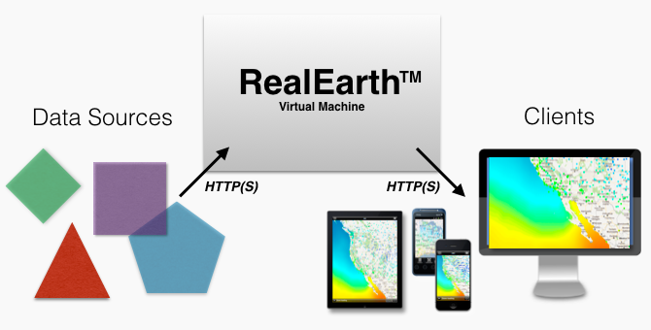
RealEarth Overview
Notes:
The design allows for users to upload their data source (geoTIF, kmz, etc. ) into a

Slide 4
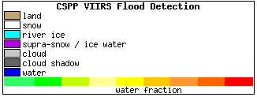
RealEarth Supported files
RealEarth can ingest imagery and shape data.
Image formats
GeoTIFF
McIDAS-X AREA
Shape (point/line/polygon) formats:
GeoJSON
ESRI Shapefile
Files for registered products can be uploaded via users through scripts or via a browser form
Color enhancements and custom legends can be created for an given product.

Slide 5
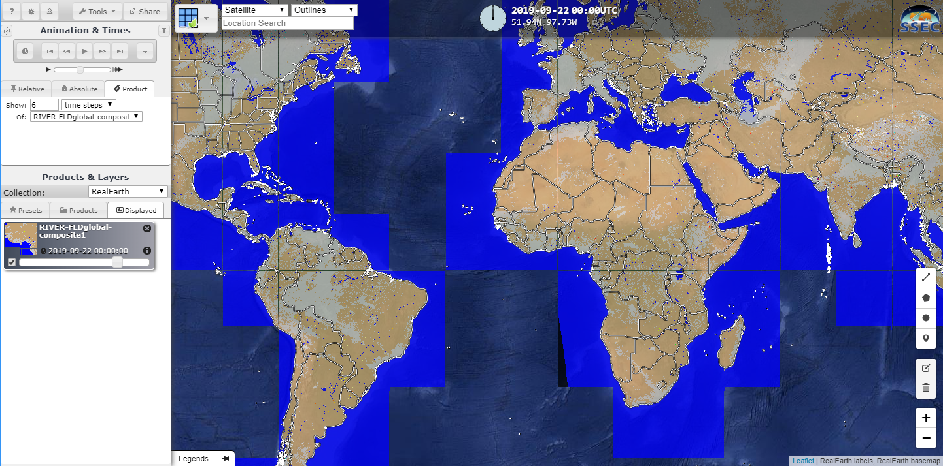
RealEarth Browser Interface

Slide 6
RealEarth Browser Interface
Settings
Login
Help
Transparency level

Slide 7
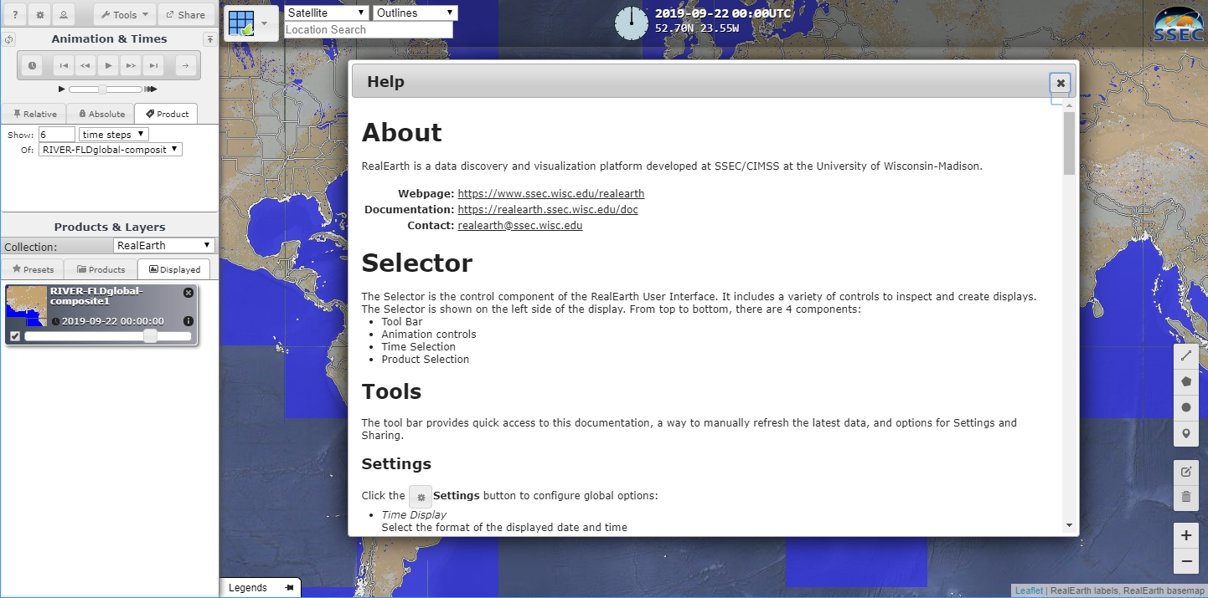
RealEarth website – Help
Displays information on settings, etc. for RealEarth.
Contains documentation on how to operate RealEarth

Slide 8
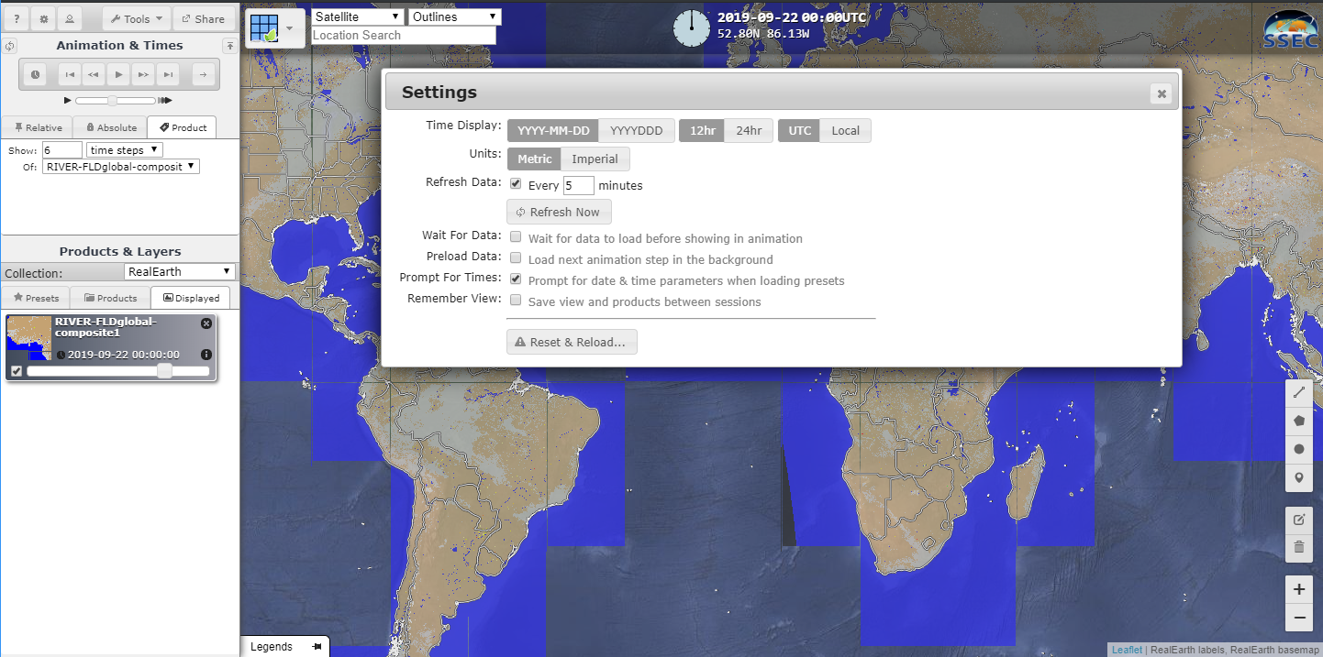
RealEarth website – Settings
Allows user to change settings of RE session

Slide 9
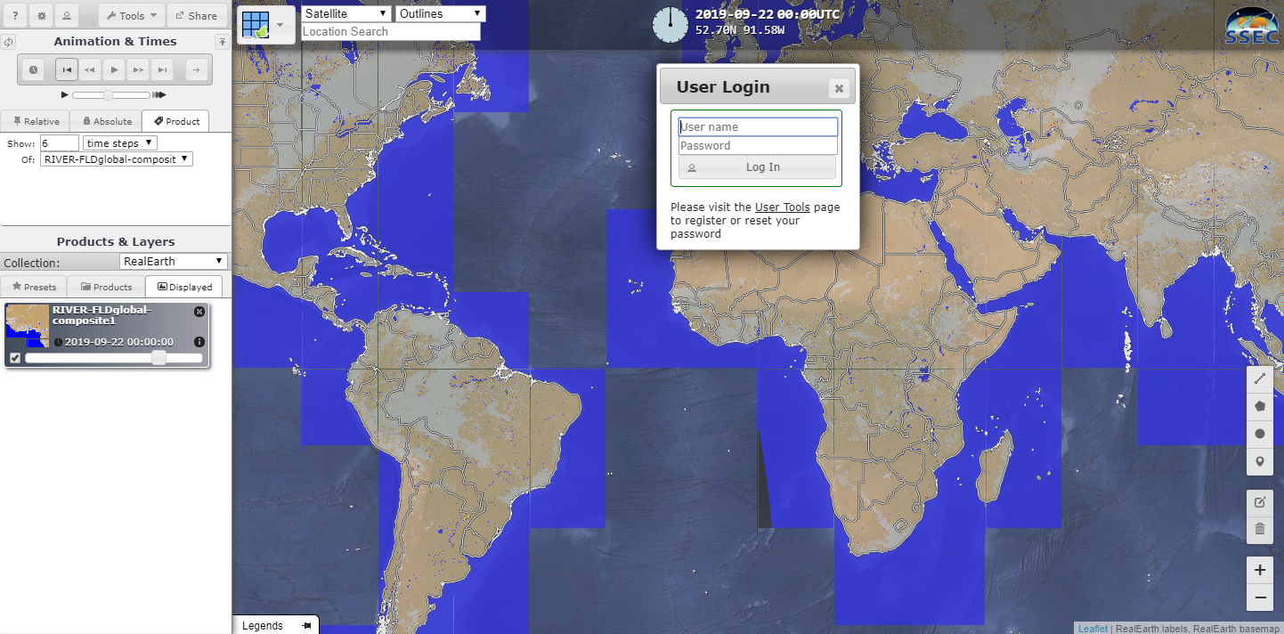
RealEarth website – Login
RealEarth has a limited number of frames per day for a given IP address. Having a free login will double the quota. Not necessary unless you are refreshing a log of data constantly

Slide 10
RealEarth Browser – Stepping through timesteps
You can step though timesteps by using the forwards and backwards buttons, indicated by arrows, or by using the left (backwards) and right (forwards) buttons on the keyboard
Backward Forward

Slide 11
RealEarth Browser – Animate product
You can animate the timesteps by clicking on the “play” button.

Slide 12
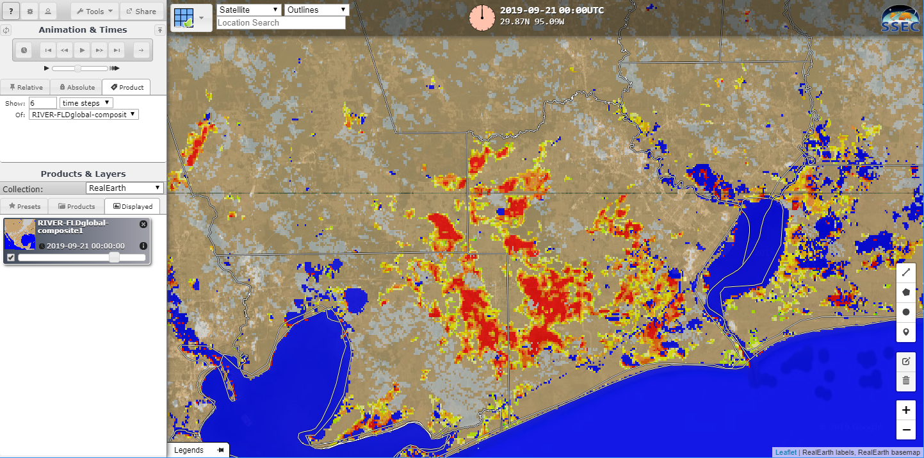
RealEarth Browser – Change transparency level
The default transparency level for the links provided is 70%. However, users can change this to see if flooding is impacting a population center or just open land.
This example will look over the Beaumont area after TD Imelda on 21 September
Transparency level at 70%

Slide 13
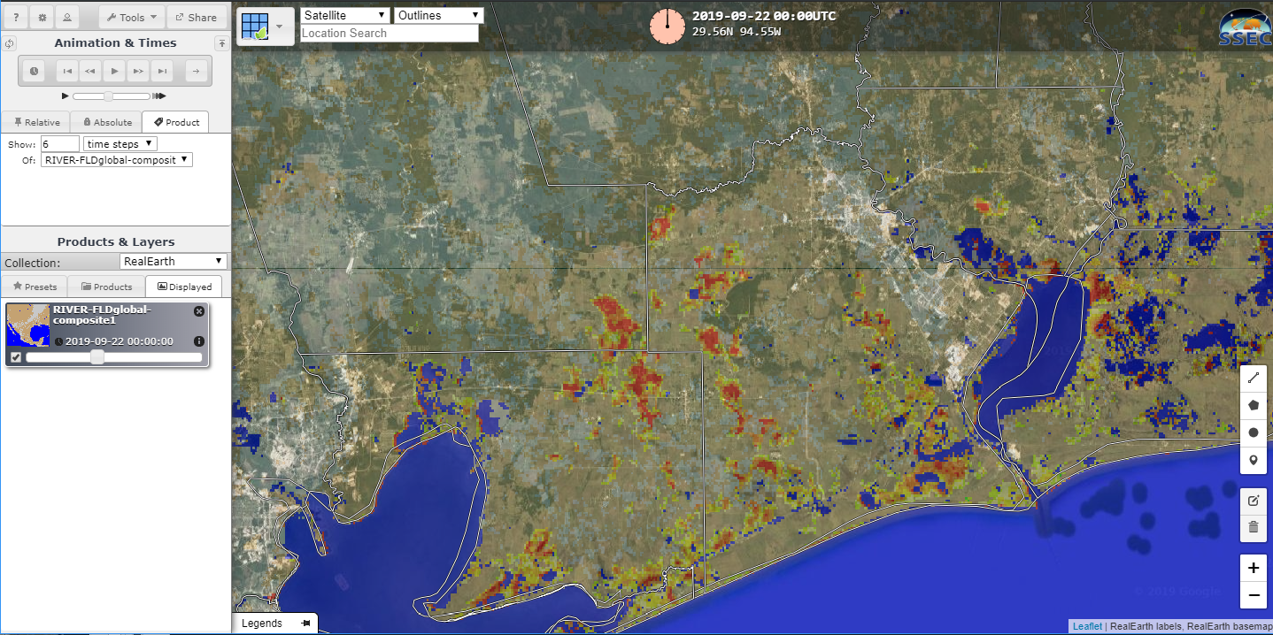
RealEarth Browser – Change transparency level
By sliding the transparency level bar with the mouse to the left, the transparency is now at 40%. Note how features such as highways and cities can be seen from the background satellite map
Transparency level at 40%

Slide 14
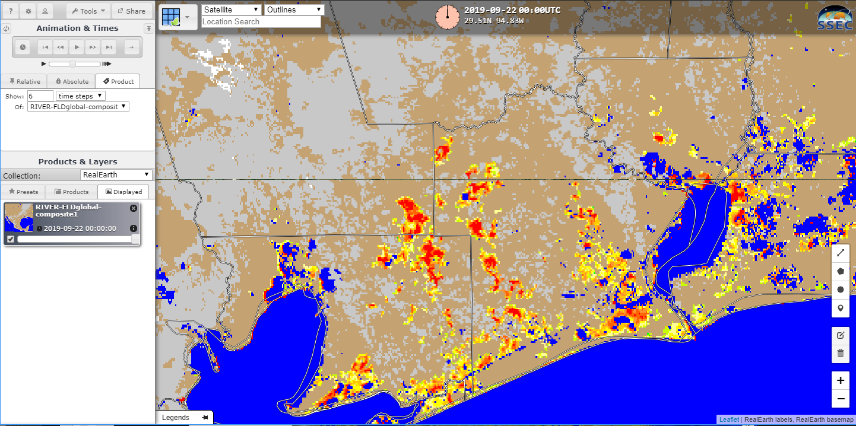
RealEarth Browser – Change transparency level
By sliding the transparency level bar all the way to the right,, the transparency is now at 100%. Note how the background satellite map can no longer be seen.
Transparency level at 100%

Slide 15
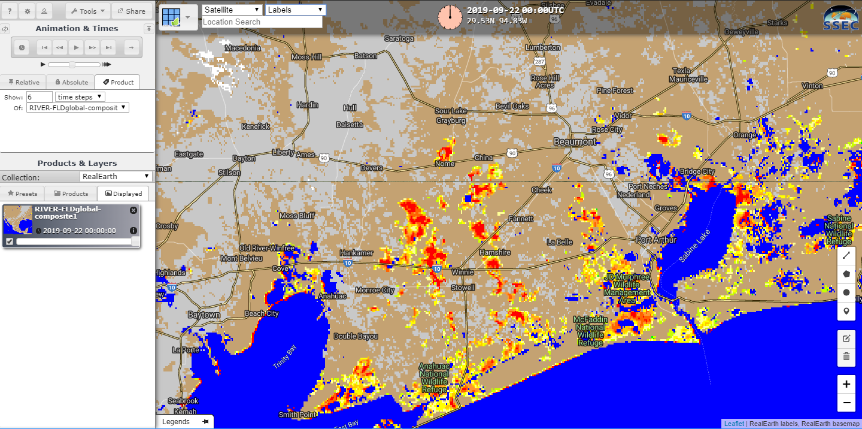
RealEarth Browser – Change labels
You can also change what labels are displayed by using the pull down tab in the display window and making a selection (“Labels” in this case)

Slide 16
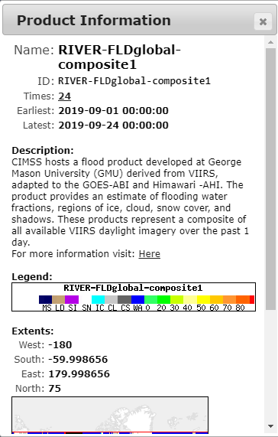
RealEarth Browser – Product Information
By clicking on the “i” button (indicated by red arrow), you can get information on the product being displayed.

Slide 17
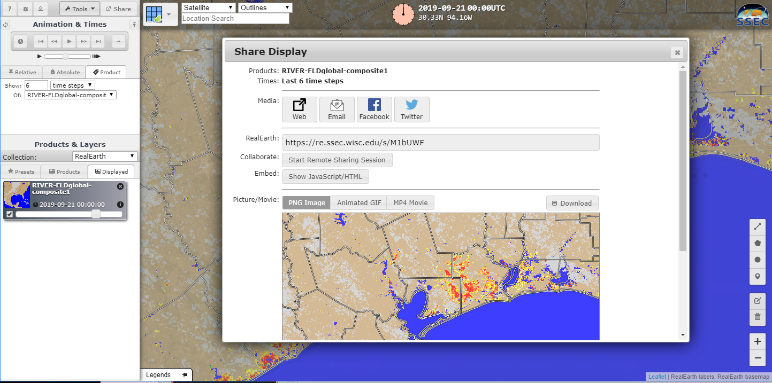
RealEarth Browser – Sharing
You can also share links and images by clicking on the “Share” button. This will put bring up a display which will provide a variety of methods of sharing, including limited GIS-friendly outputs as well as GIS links.
Share options window

Slide 18
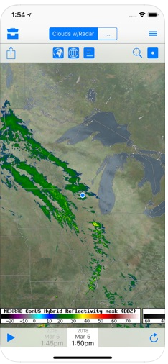
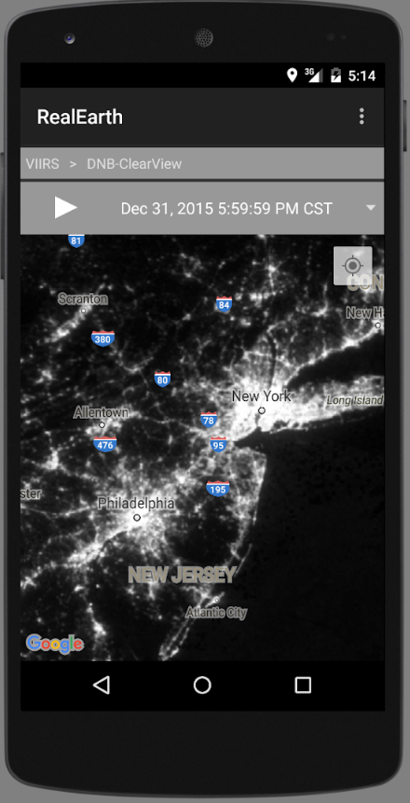


RealEarth App
https://play.google.com/store/apps/details?id=edu.wisc.ssec.realearth
https://itunes.apple.com/us/app/ssec-realearth/id1143965363#?platform=iphone

Slide 19


Sharing of RealEarth products
Share with shortcut web links, PNG, animated GIF/MP4, embed code, or post directly to social media ( , )
Built-in remote session sharing (like screen sharing in web-ex or gotomeeting)
Access through GIS with WMS, WMTS, KML, or ArcGIS x,y,x format
Note that these products are not supported 24/7 but do have a high reliability of uptime.
This allows for GIS tools (ex. GeoCollaborate, QGIS, ArcGIS) to directly access data already within RealEarth
Questions can be directed to realearth@ssec.wisc.edu

Slide 20
Hand on portion
Go to: https://realearth.ssec.wisc.edu for the hands on portion

