Slide 1
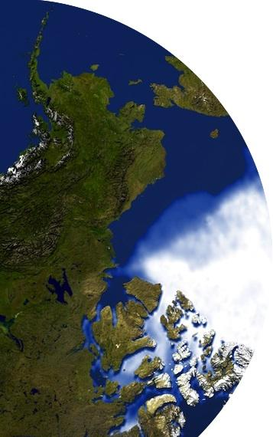
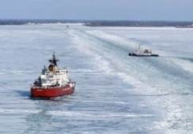
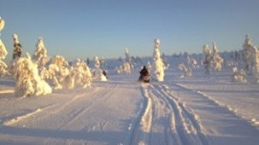
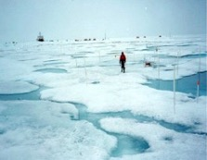
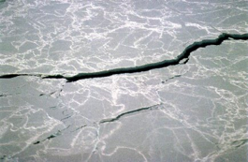
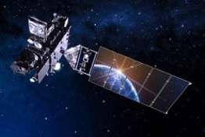


JPSS Short course:
Monitoring and Predicting the Opening of the Northwest Passage
Part 1: Remote Sensing of the Cryosphere
Jeff Key and Yinghui Liu
NOAA Satellite and Information Service
Madison, Wisconsin USA
JPSS Short Course, 27 June 2023, virtual

Slide 2
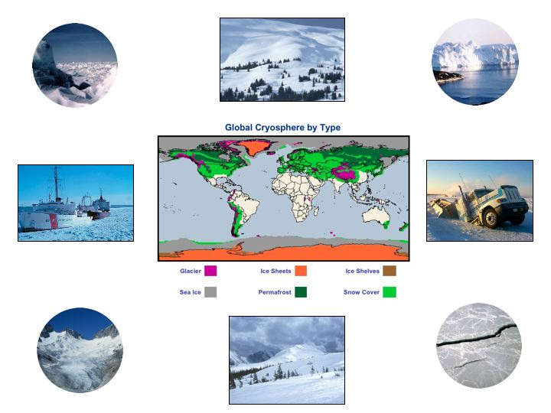
The cryosphere collectively describes elements of the earth system containing water in its frozen state and includes:
solid precipitation, snow cover, sea ice, lake and river ice, glaciers, ice caps, ice sheets, ice shelves, permafrost and seasonally frozen ground.
The cryosphere is global, ~100 countries
Question: What are some of the impacts of a changing cryosphere? Answer in the chat.

Slide 3
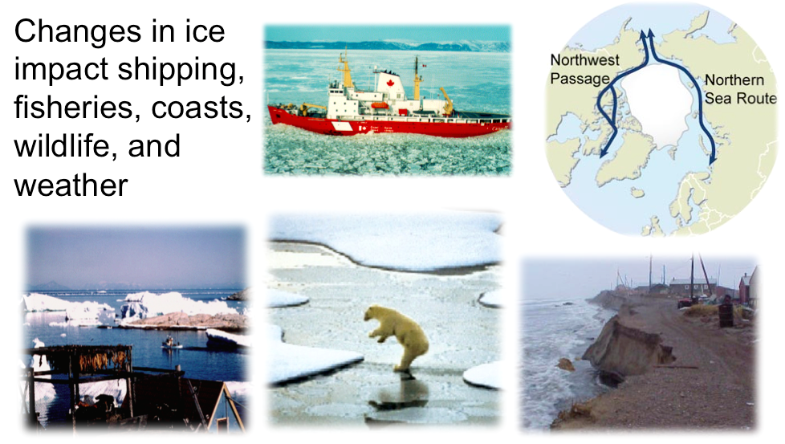
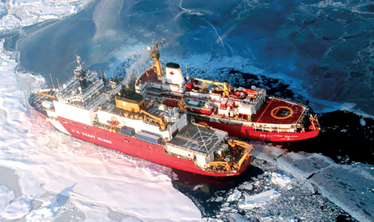
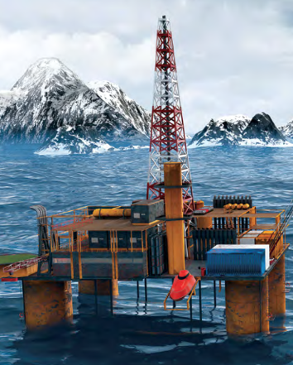

Importance of the Cryosphere
Notes:
Ship photo: USCG

Slide 4
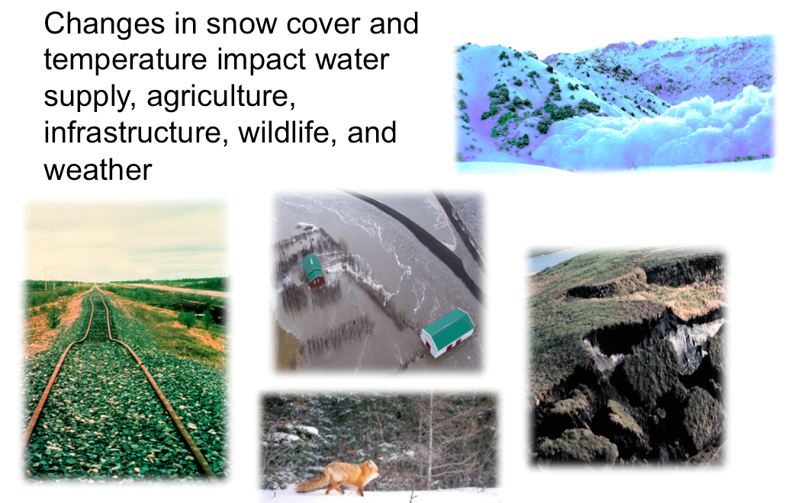
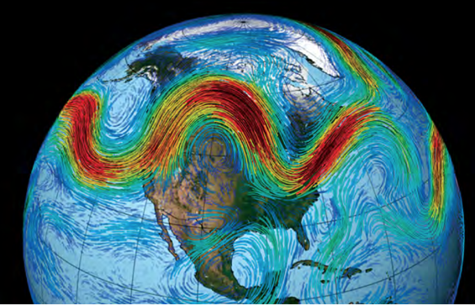
Importance of the Cryosphere
Notes:
Atmospheric circulation image: NASA
New Consensus: Possibility that continued Arctic warming will increase winter storm events that are regional (eastern North America and northeastern Asia), episodic, and extremes of existing weather patterns

Slide 5
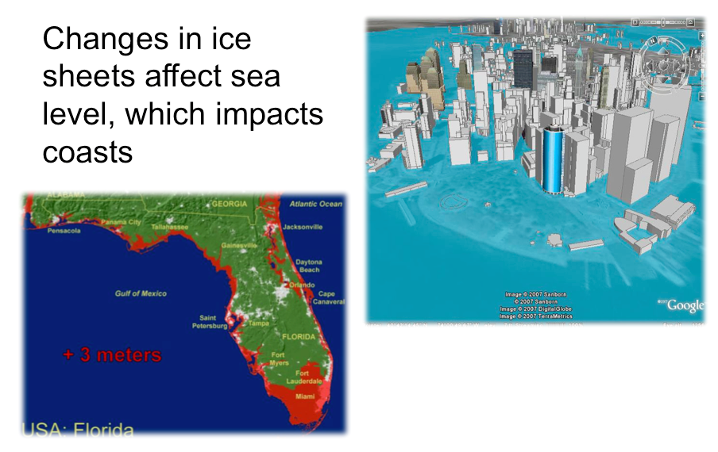
Importance of the Cryosphere
Notes:
Manhattan figure from http://freegeographytools.com/2007/high-resolution-sea-level-rise-effects-in-google-earth

Slide 6
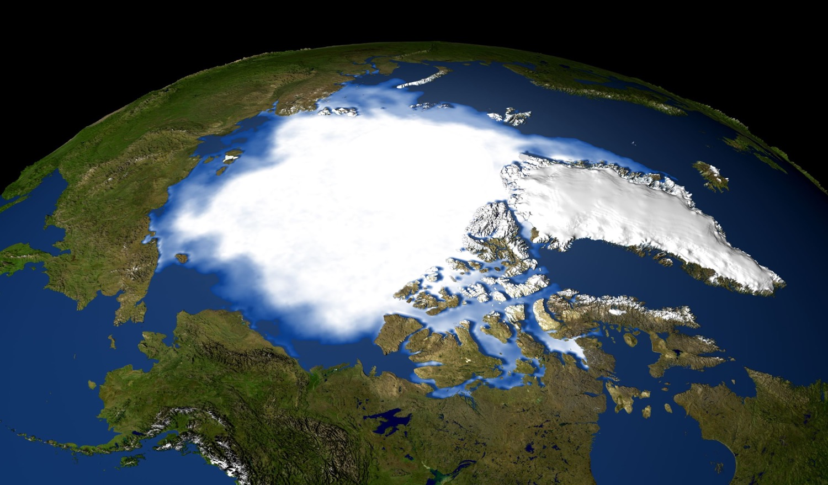
How the Arctic looks from space
Question: How are the Arctic and Antarctic different? Answer in the chat.
Notes:
There is a very important difference between our two polar regions: the Arctic is an ocean surrounded by land; the Antarctic is land surrounded by ocean. The meteorological and climatological differences and reactions to global climate change are significant.
The Arctic, with the March 2009 sea extent. Image by Matt Savoie, National Snow and Ice Data Center, University of Colorado, Boulder, using SSM/I data overlaid onto the NASA Blue Marble. The 60º N latitude circle is shown.

Slide 7
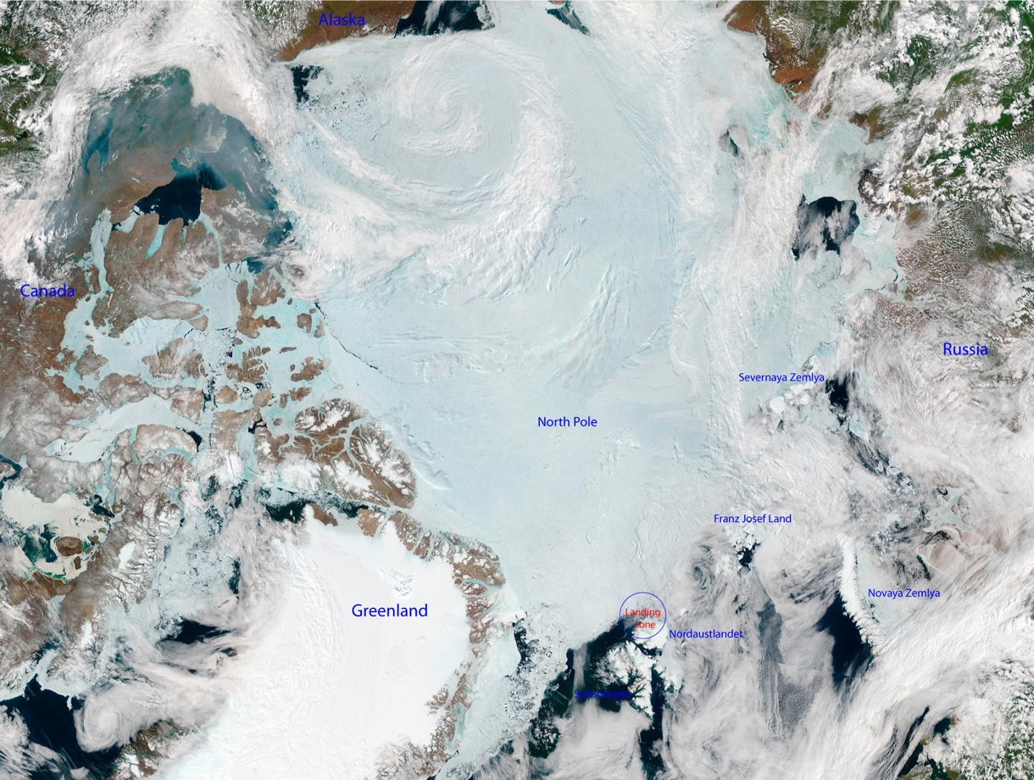
How the Arctic looks from space
Notes:
Another important point is that the Arctic is a complex physical system, with sea ice, unfrozen ocean, ice sheets and glaciers, snow-free and snow-covered land, permafrost, and a unique atmosphere.
MODIS

Slide 8
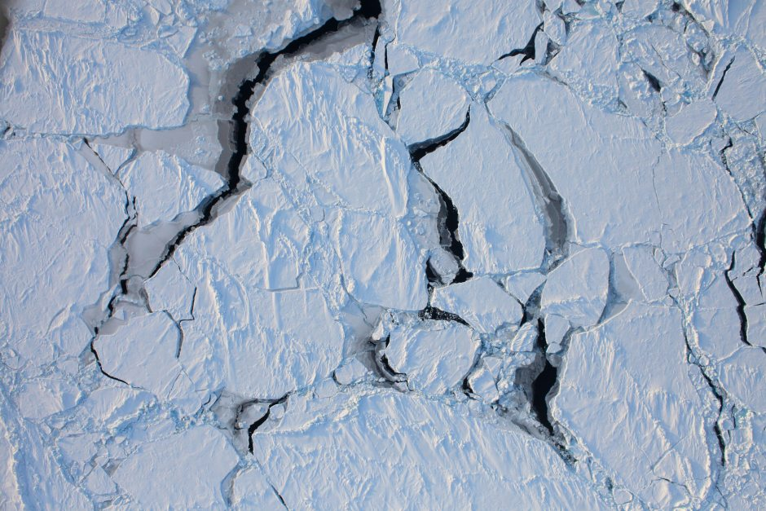
How the Arctic looks from space
Sea ice
Notes:
MODIS

Slide 9
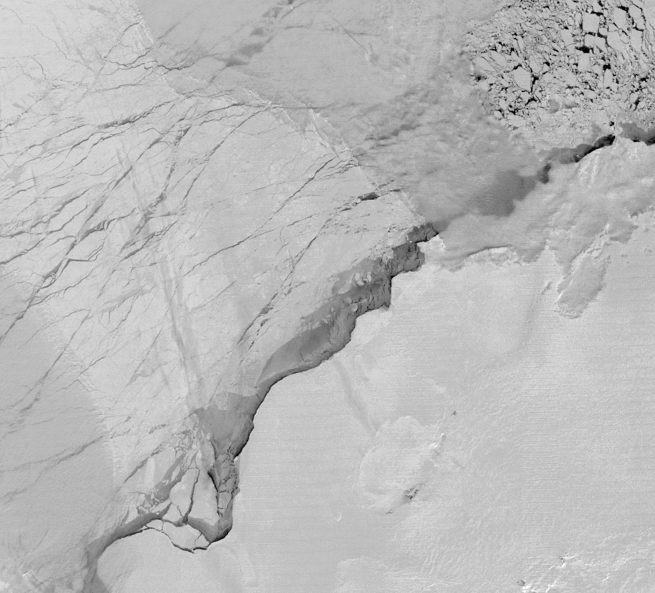
How the Arctic looks from space
sea ice
thin clouds
sea ice
VIIRS Day-Night Band (DNB) NCC EDR Albedo, 21-Aug-2013 02:29-02:35
Full Moonlight Night Scene
thin clouds
Sea ice, open water, and thin clouds are distinguishable under full moonlight, night conditions with either the VIIRS Day Night Band (DNB) or Near Constant Contrast EDR. Useful imagery most likely will be good for half moon conditions as well but distinguishing features will be become difficult for less than quarter moon phase. (Courtesy of C. Seaman and S. Miller)

Slide 10
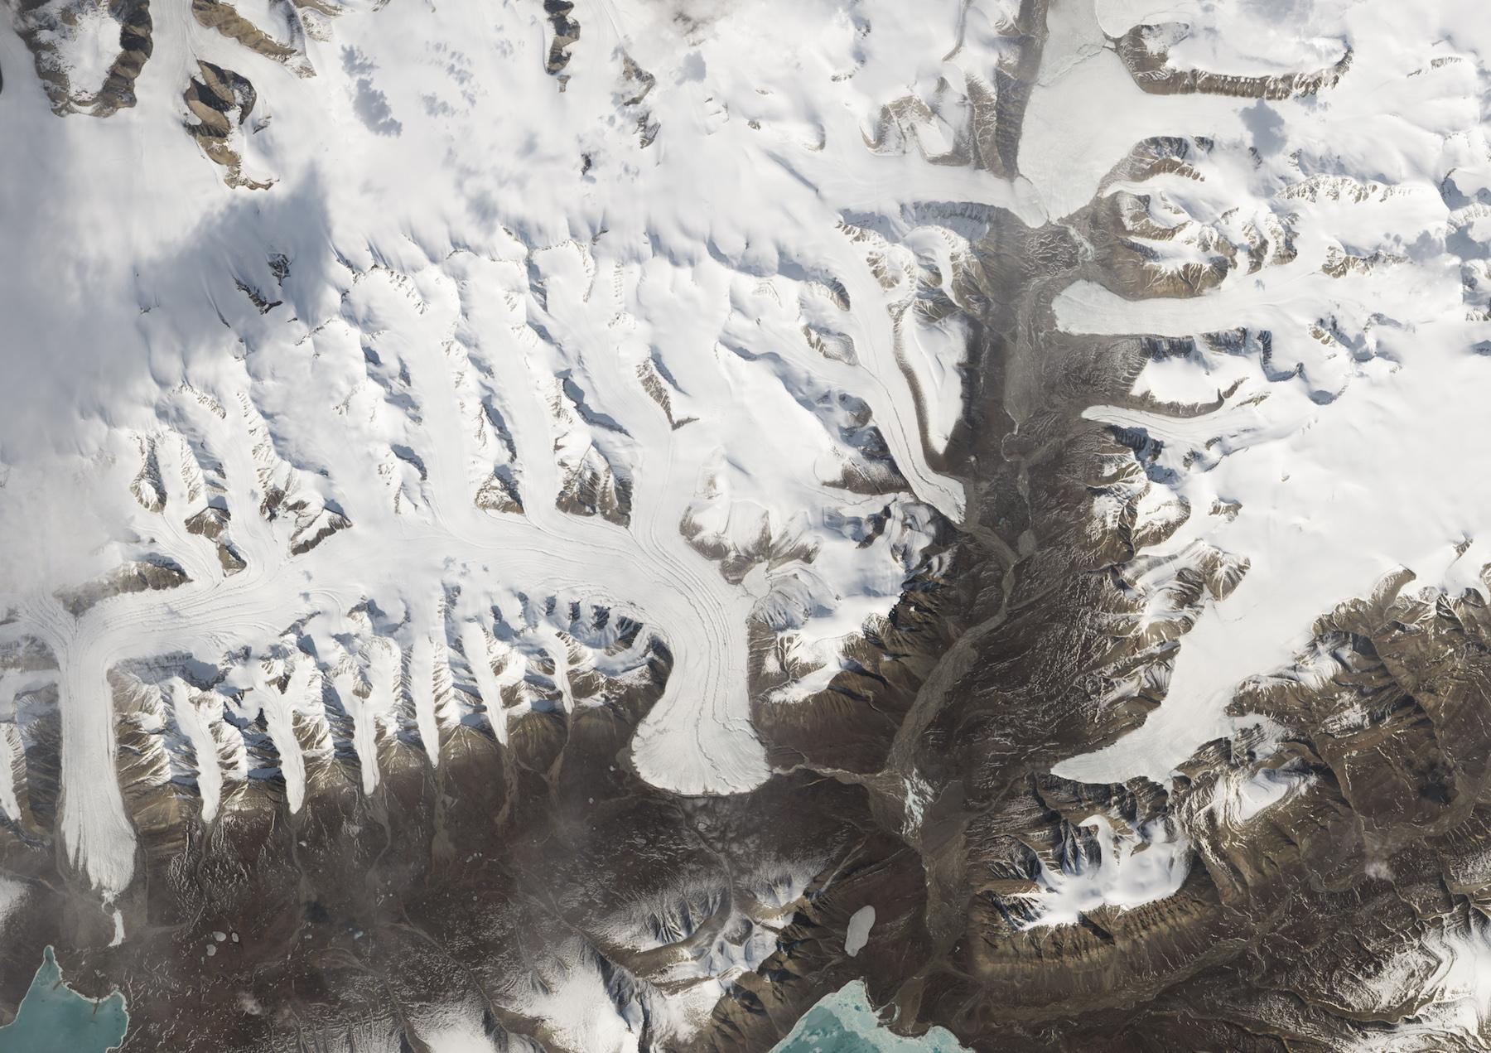
How the Arctic looks from space
Glaciers
Notes:
Glaciers: On June 21, 2014—the summer solstice—the Operational Land Imager (OLI) on Landsat 8 acquired 52 individual scenes that were subsequently stitched together into one long swath. http://earthobservatory.nasa.gov/IOTD/view.php?id=85296&src=eorss-iotd

Slide 11
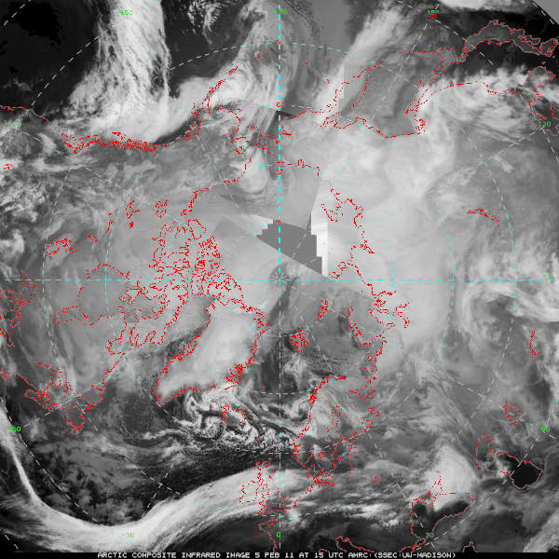
How the Arctic looks from space
Large-scale circulation from geostationary and polar-orbiting satellites
(animation)
Notes:
Animation: Multi-satellite infrared composite, courtesy of M. Lazzara (AMRC). NOAA’s GOES satellites, NOAA and NASA polar-orbiters.

Slide 12
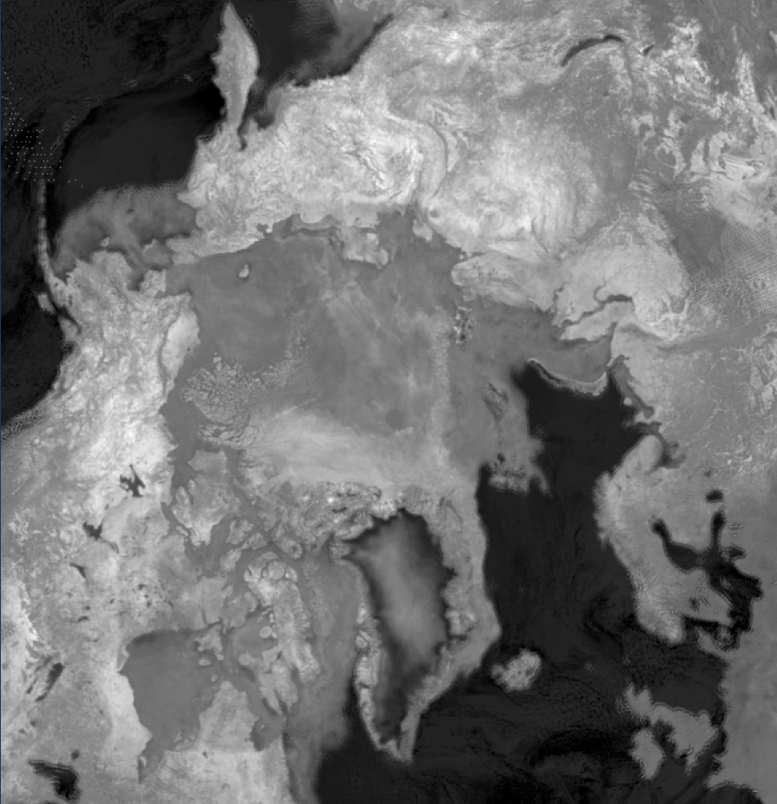
How the Arctic looks with “alien vision”
Active (radar) and passive microwave see snow and ice through clouds
Notes:
Unfortunately, some physical variables look the same in the visible, e.g., clouds and snow or ice. So we have to look at different parts of the spectrum, like infrared and microwave. Active microwave is where a pulse of microwave radiation is sent from the satellite to the surface, and the satellite measure the return. Passive microwave measures emission from the surface and atmosphere.
Note that NOAA purchases SAR (radar) data from Canada because we don’t have our own SAR.
Passive microwave: 18H-37H Tb, March 1, 2008 from NSIDC (Walt Meier); lidar: NASA CALIPSO

Slide 13
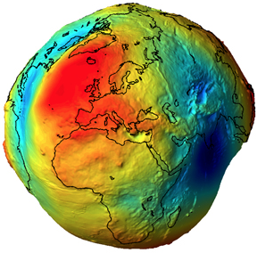
How the Arctic looks with “alien vision”
Gravity sees ice sheets
From GRACE (NASA)
Notes:
We can also measure the earth’s gravity field from space. Changes in the gravity field tell us about changes in the mass of the Greenland and Antarctic ice sheets.

Slide 14
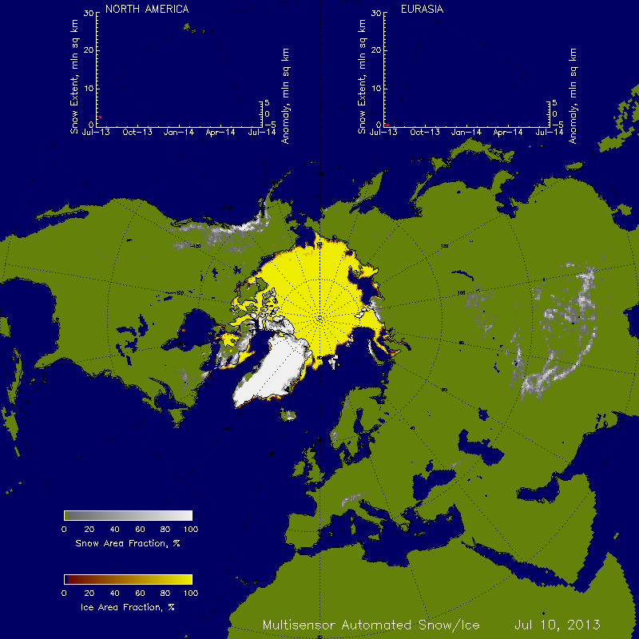
Turning raw data into information: Products
Annual Cycle of Snow and Ice
From raw satellite data we can derive:
Snow cover, depth
Sea ice cover, thickness, motion, age
Ice sheet mass, motion
Glacier area, motion
Cloud cover, thickness, particle size, phase
Atmospheric chemistry (water vapor, ozone, etc.)
Atmospheric temperatures
Winds
Surface temperature, albedo
(animation)
(Courtesy of P. Romanov)
Notes:
Satellite measure many other properties of the surface and atmosphere than are shown here. These illustrations are for products that are unique, or most relevant, to the polar regions.

Slide 15
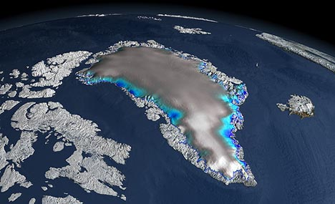
Turning raw data into information: Products
Ice Sheet Elevation
Question: What kind of instrument can be used to measure elevation? Answer in the chat.

Slide 16
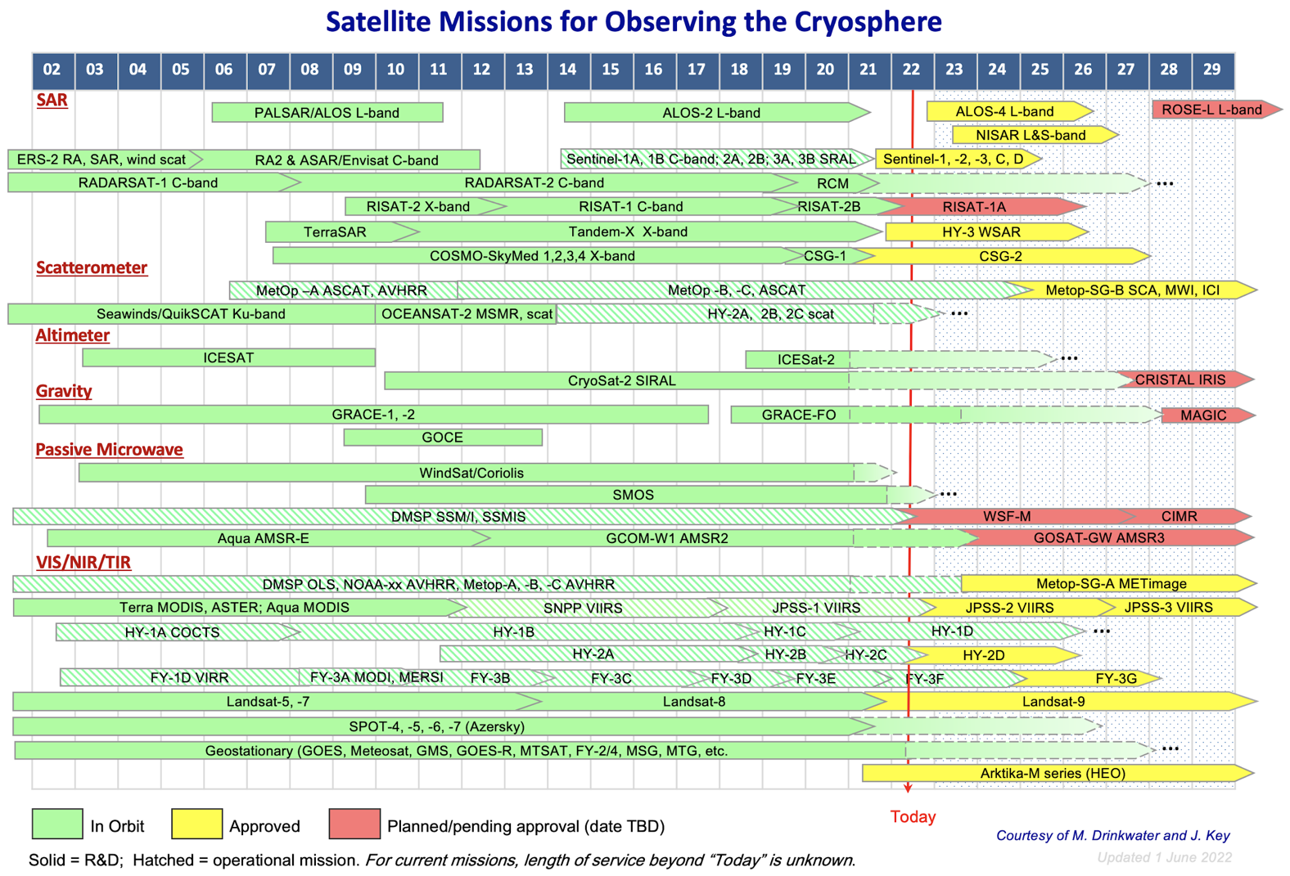
A few of these are NOAA and partner satellites. A few others are used by NOAA scientists for research (not operational) products.

Slide 17
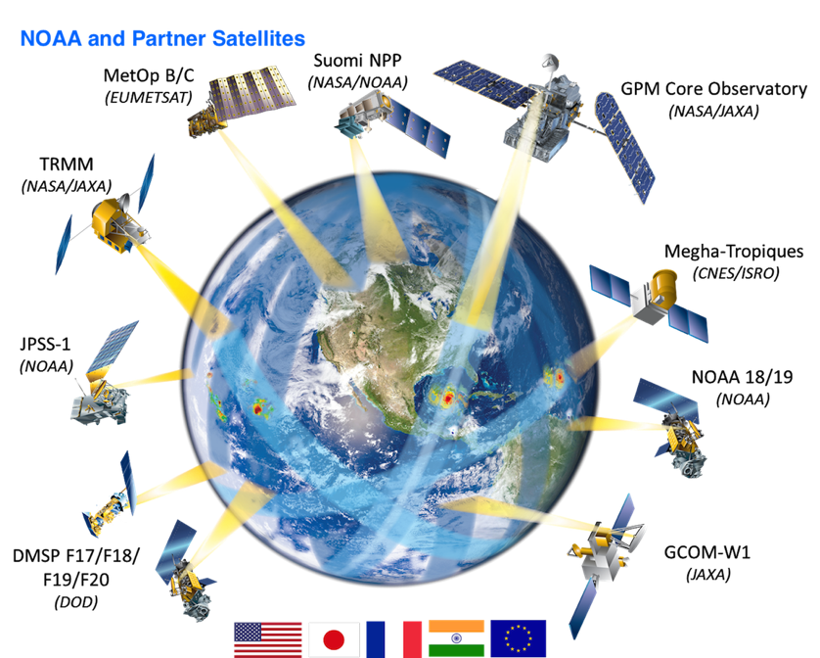
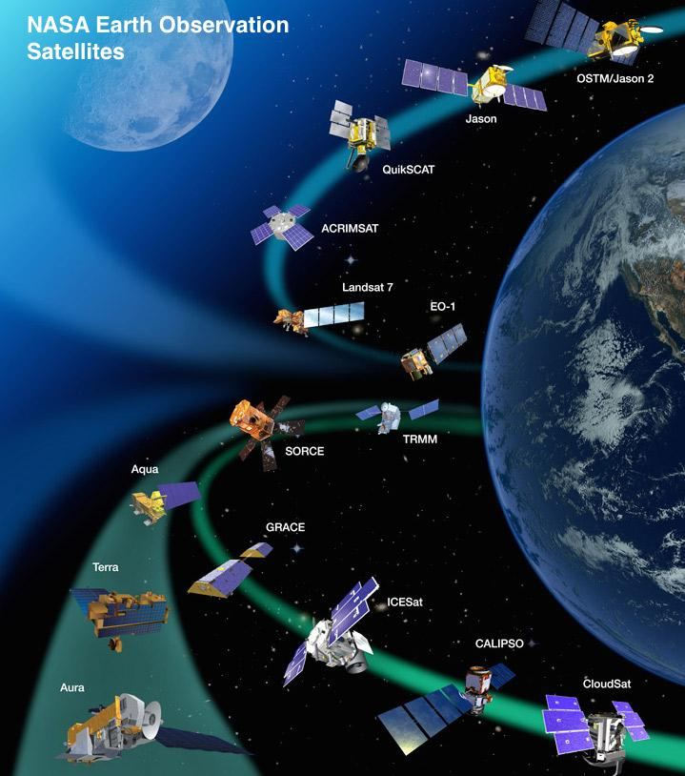
Observing the Arctic requires many satellites
NOAA satellites are a major component of a comprehensive, space-based cryosphere observing program. However, interagency and international partnerships are essential.
Notes:
NOAA satellites alone do not provide the broad spectrum of observations that we need. Fortunately, NOAA has been forging partnerships with international space agencies such as EUMETSAT and JAXA. These, and the satellites on the next (NASA) slide, are some of the satellites used for the previous illustrations.

Slide 18
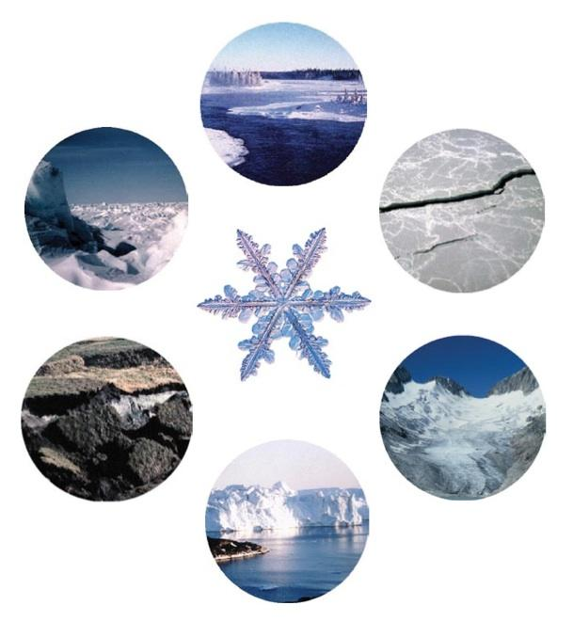
The JPSS Cryosphere
River and lake ice
✓
Ice sheets, ice caps, ice shelves
✘
✓
Sea ice
Permafrost and seasonally-frozen ground
Snow
✓
✘
✘
Glaciers

Slide 19
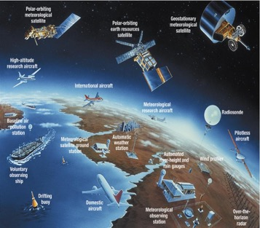
NOAA’s Snow and Ice Products
JPSS VIIRS
Snow cover (binary)
Snow fraction
Ice thickness and age
Ice concentration
Ice surface temperature
Ice motion (experimental)
Sea ice leads (future)
GOES-R ABI
Fractional snow cover (baseline)
Ice cover and concentration*
Ice thickness/age*
Ice motion*
*Future capabilities
AMSR-2 on GCOM-W1 (JPSS)
Snow cover
Snow depth
Snow water equivalent (SWE)
Ice characterization
Ice age class (first-, multi-year)
Ice concentration
Ice motion (experimental)

Slide 20
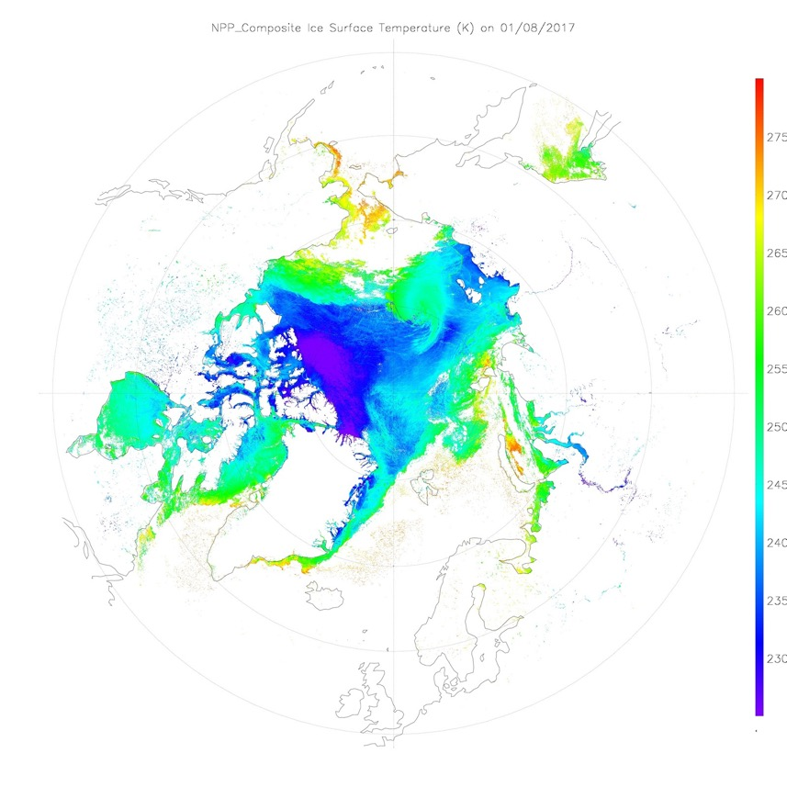
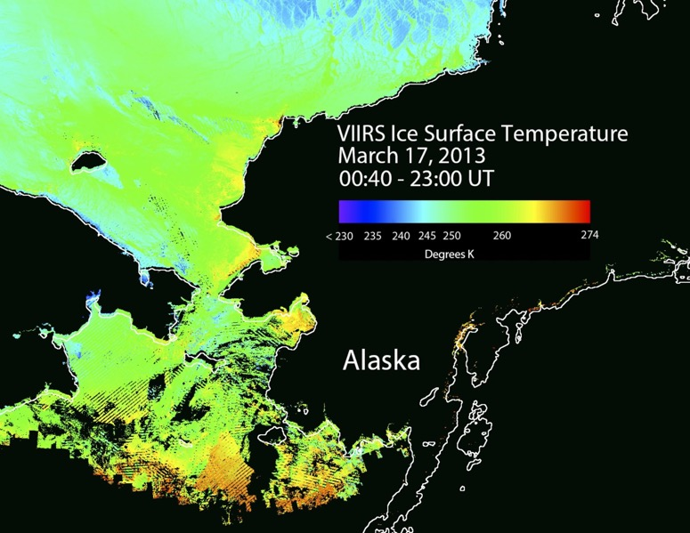
VIIRS Ice Surface Temperature

Slide 21
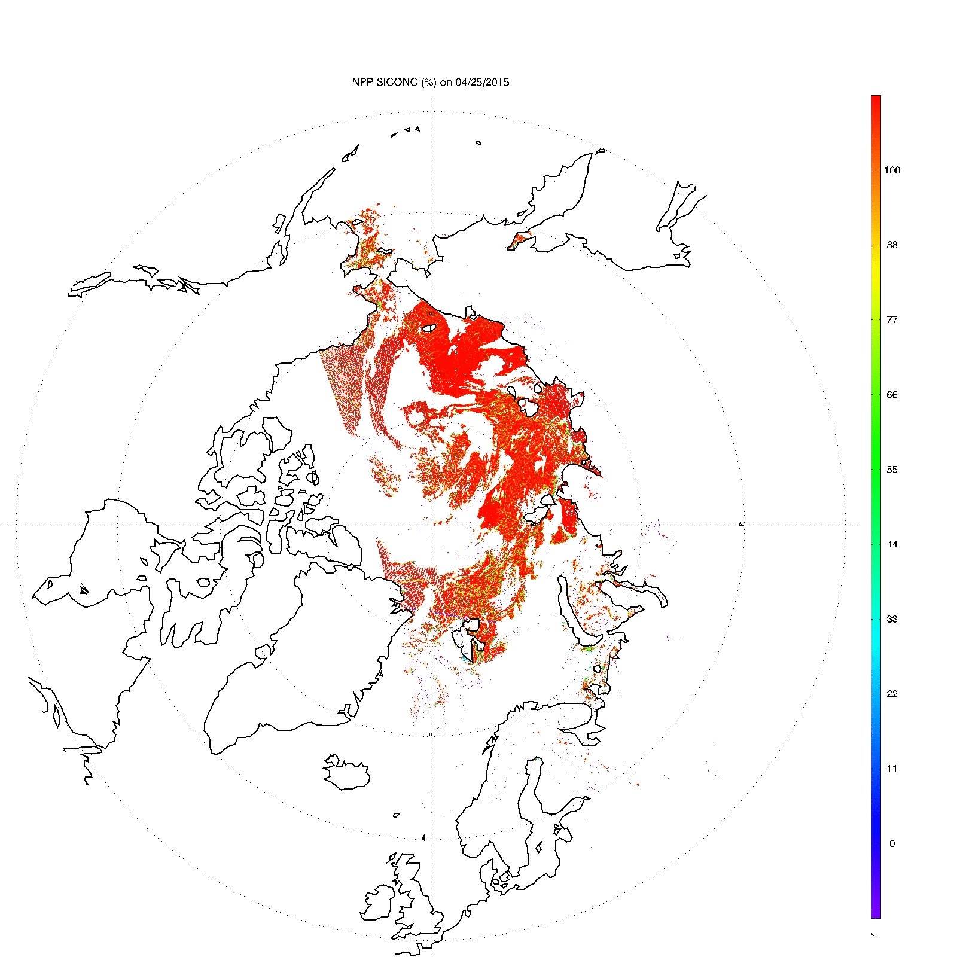
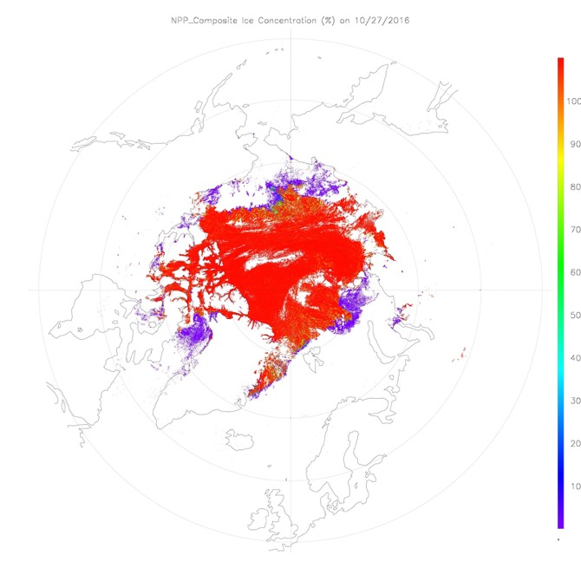
VIIRS Ice Concentration
Weekly Composite, 27 Oct 2016
(animation)

Slide 22
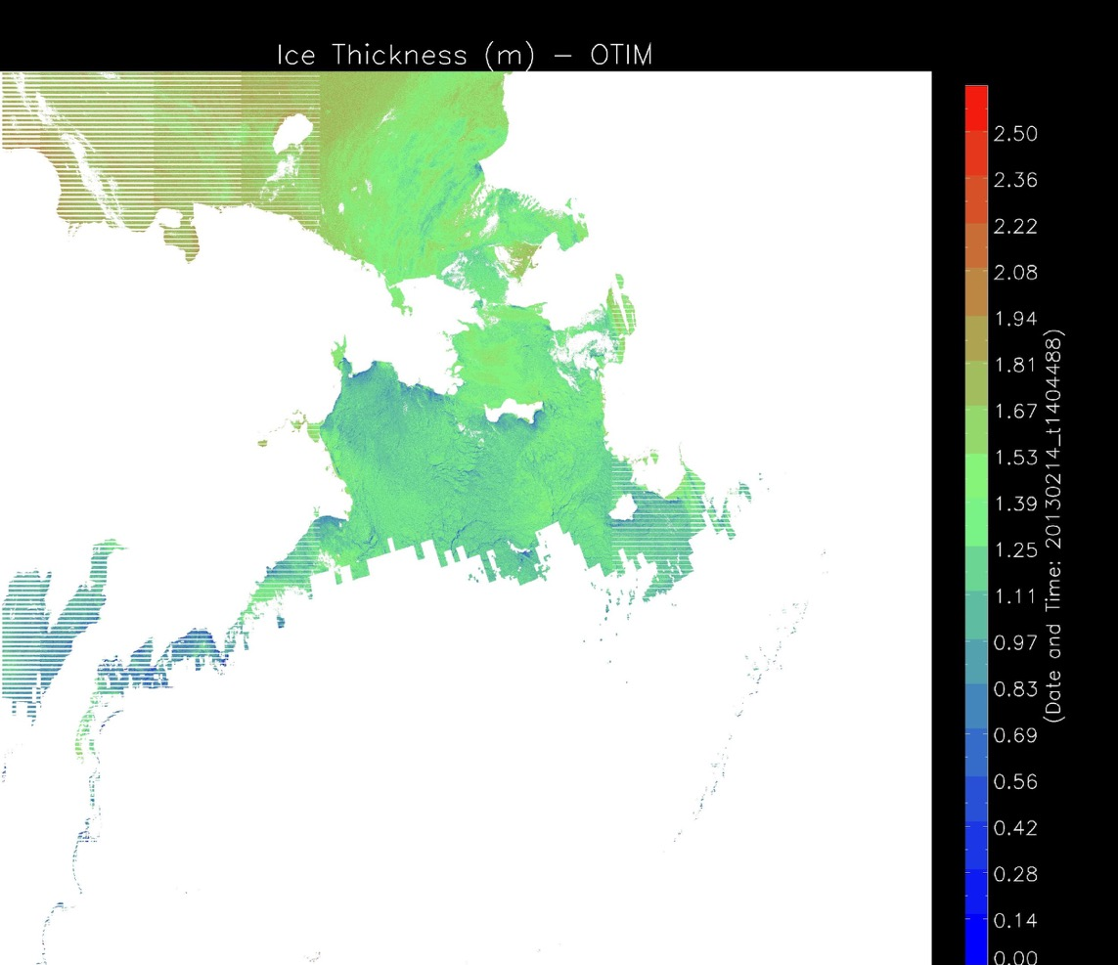
VIIRS Sea Ice Thickness
Question: Who cares about sea ice thickness? Answer in the chat.
Alaska
Russia
14 Feb 2013
14:10 UTC
Notes:
This is a new NOAA product using a relatively new NOAA-NASA satellite and sensor: the VIIRS instrument on Suomi NPP. VIIRS is NOAA’s baseline, operational sensor. It will also be on future NOAA polar-orbiting satellites.

Slide 23
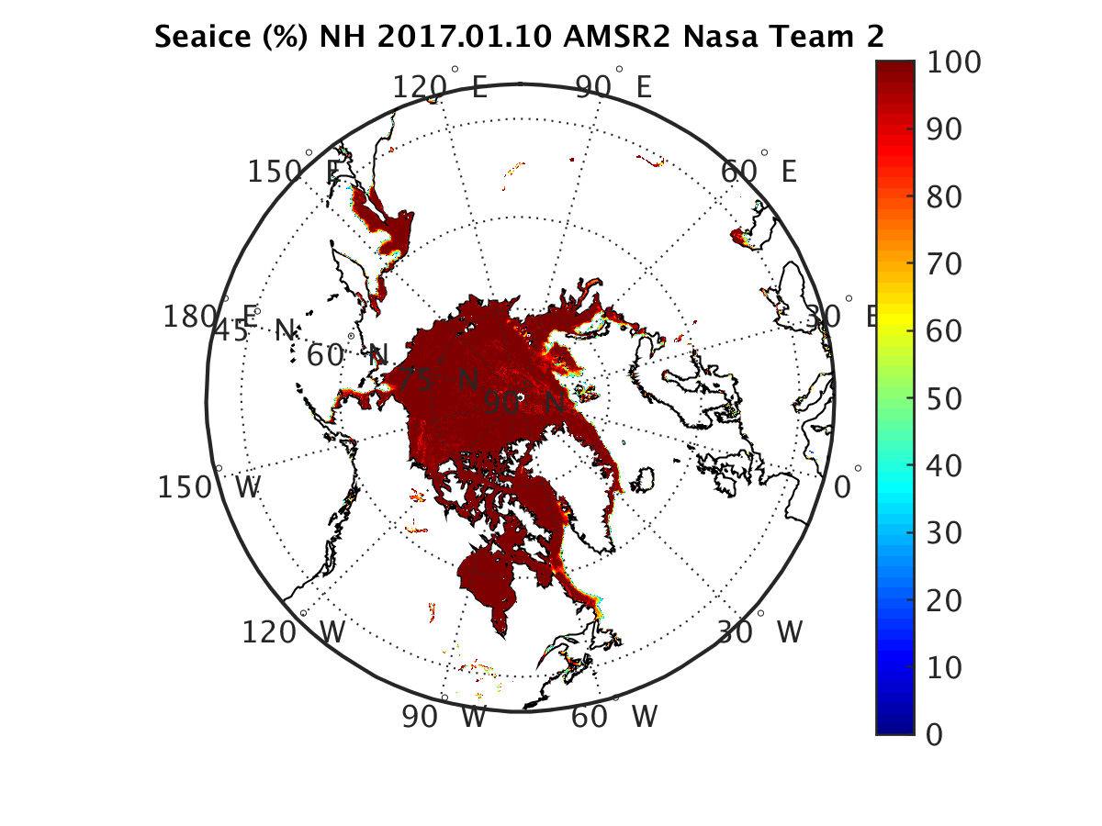
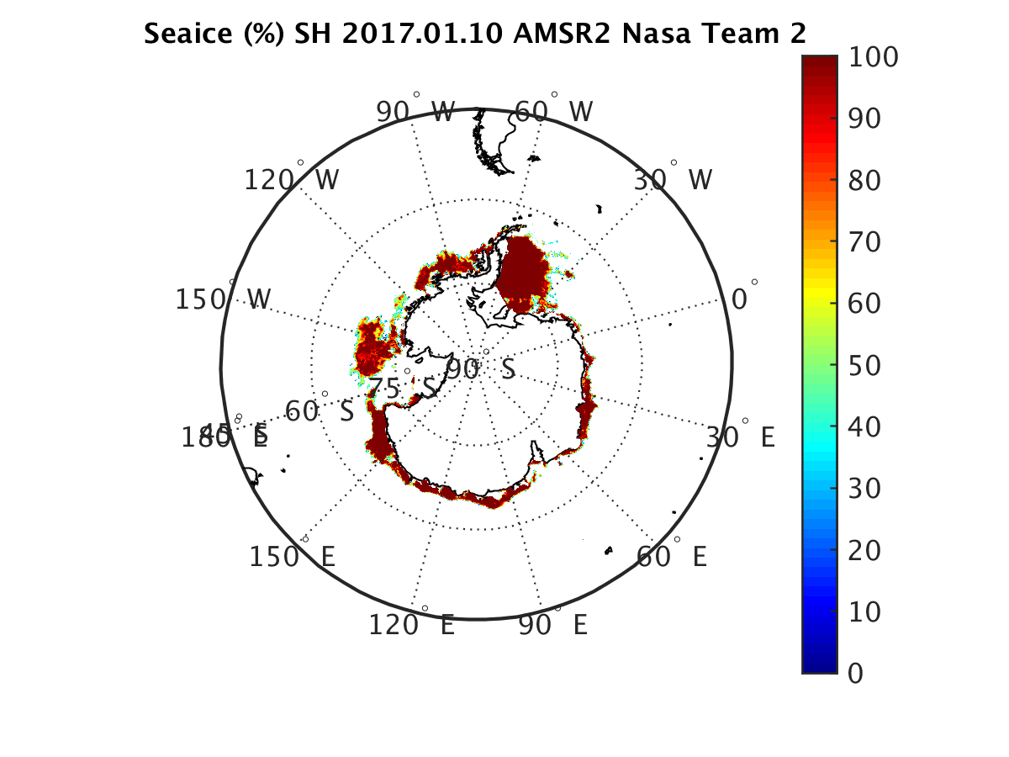
AMSR2 Ice Concentration

Slide 24
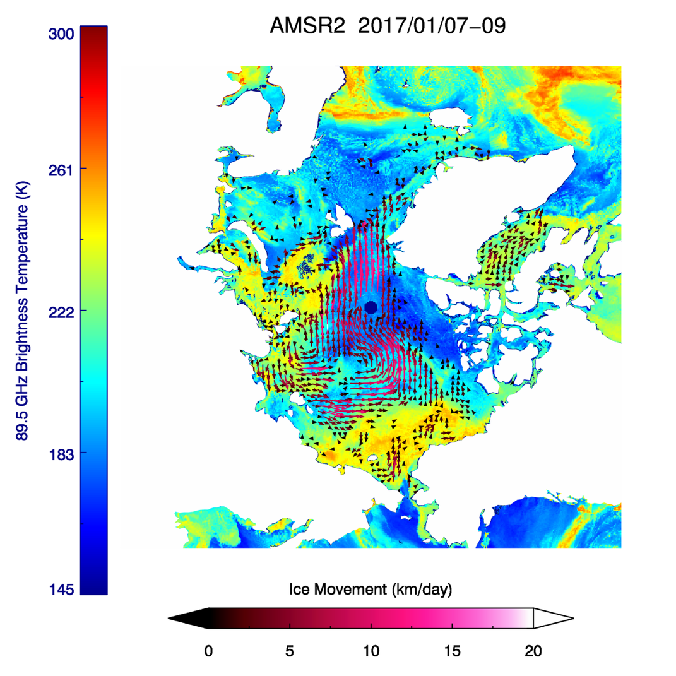
AMSR2 Ice Motion
Snow depth (left) and snow water equivalent product (right) on 25 December 2012

Slide 25
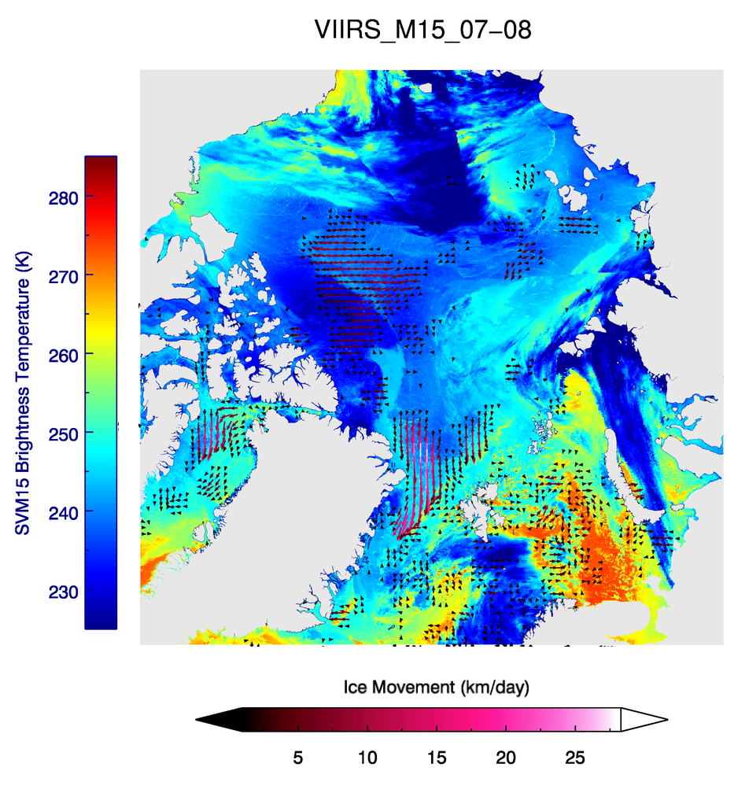
VIIRS Ice Motion
7-8 January 2017

Slide 26
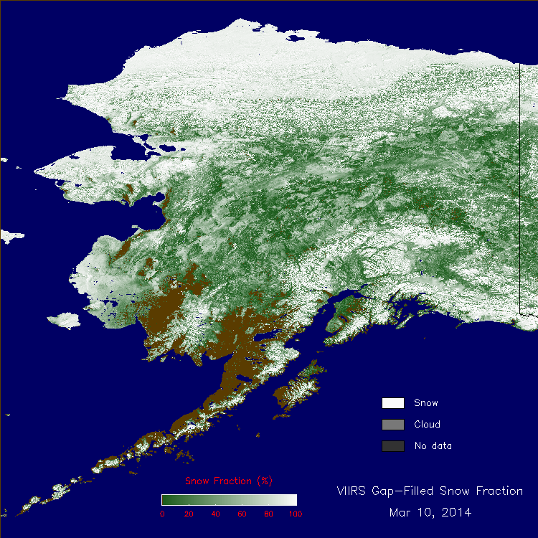
VIIRS Snow Fraction
Some artifacts exist due to the cloud mask
(animation)
Notes:
Gridded 1km resolution global maps of VIIRS reflectance-based snow fraction have been generated daily since the beginning of 2014.

Slide 27
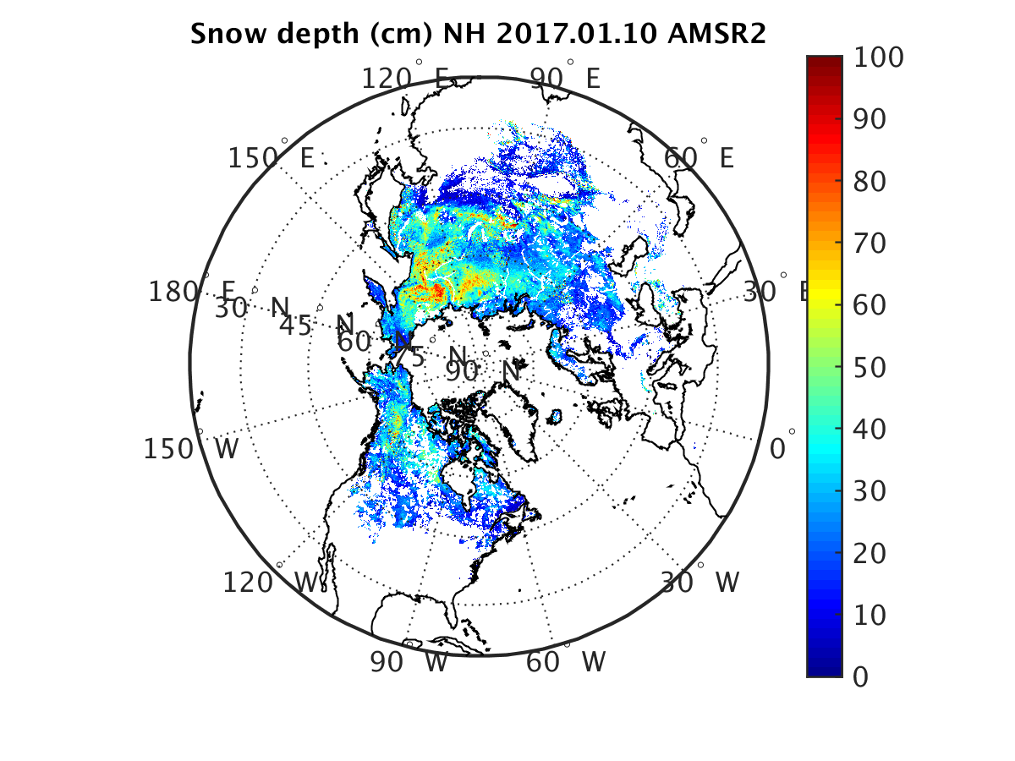
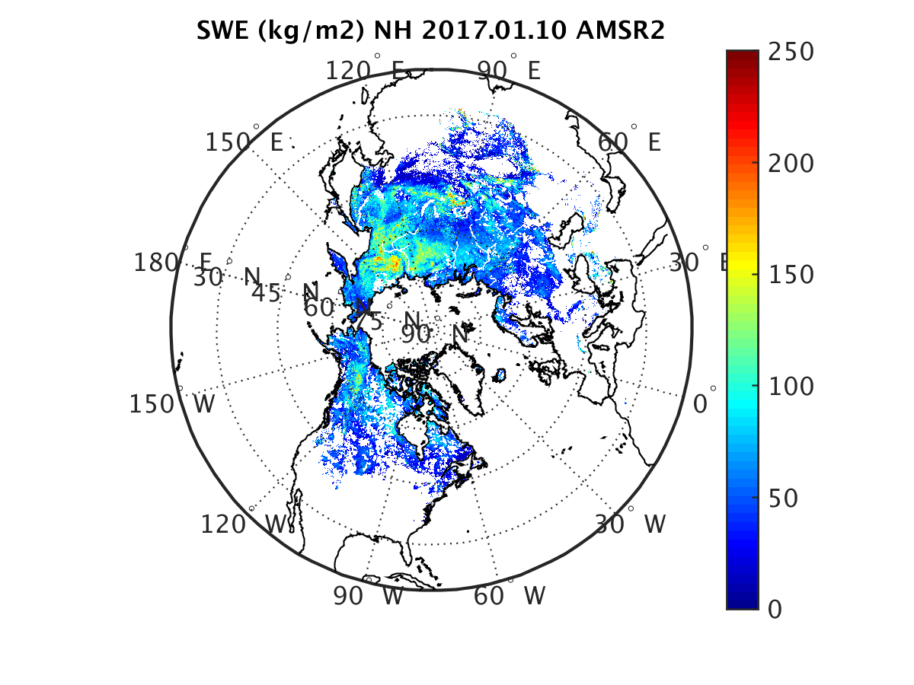
AMSR2 Snow Depth and Snow Water Equivalent (SWE)
Question: What’s more important, snow depth or SWE? Answer in the chat.

Slide 28
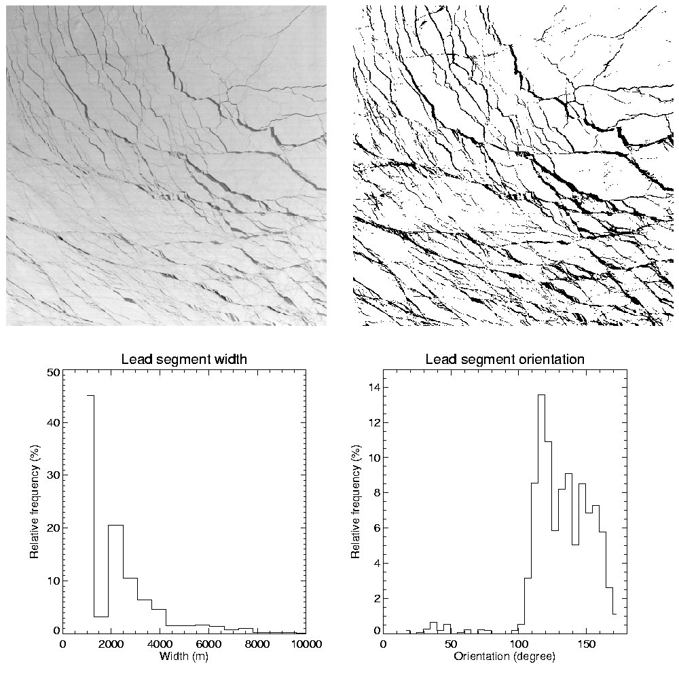
Sea Ice Leads
The reflectance at 0.64 μm from MODIS (upper left), mask of leads derived using group thresholds method (upper right), distributions of lead segment width (lower left), and lead segment orientation (lower right) based on the mask of leads. The scene is over the Beaufort and Chukchi Seas on March 11, 2009.
Notes:
28

Slide 29
Applications, Users, and Partners
All of these products have operational applications. For example, ice products are used for shipping and fisheries; polar wind products are used in numerical weather prediction. All of these products are also used in climate studies.
NOAA and U.S. users and partners:
U.S. National Ice Center (NIC)
NWS Alaska Ice Desk
National Centers for Environmental Prediction (NCEP)
National Snow and Ice Data Center
DoD, US Coast Guard, NASA, universities
International:
North American Ice Service (NAIS)
WMO Global Cryosphere Watch (GCW)
Numerical weather prediction centers
Application areas:
Weather forecasting
Navigation, shipping
Agriculture
Fisheries
Hazards
Recreation
Process studies
Climate

Slide 30
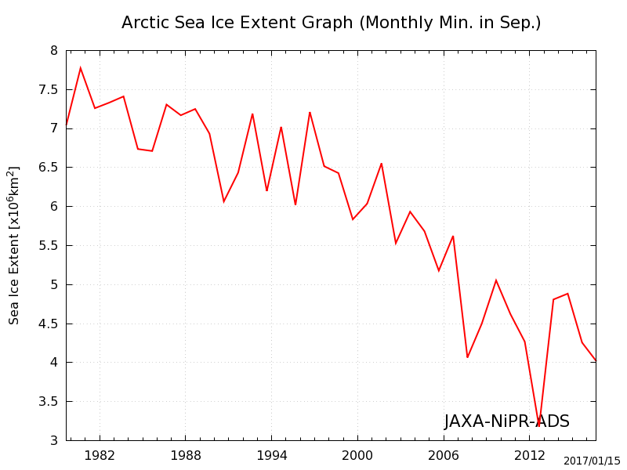
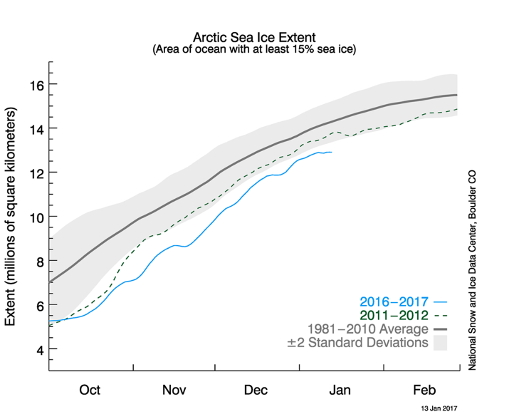
Discoveries of Arctic change from space
Based on AMSR2 and other passive microwave data, using an algorithm essentially the same as NOAA’s.
Sea ice extent has decreased about 13% per decade in the satellite era. This October was a record low (for October).
Notes:
This is the second level of the satellite science: assessing spatial and temporal variability of the individual derived variables.
Sea ice trend: 1953-2014 trend = -48,000 km²/yr
S-NPP was launched in October 2011 and GCOM-W1 was launched in May 2012 so they do not provide a long enough record for studying change.

Slide 31
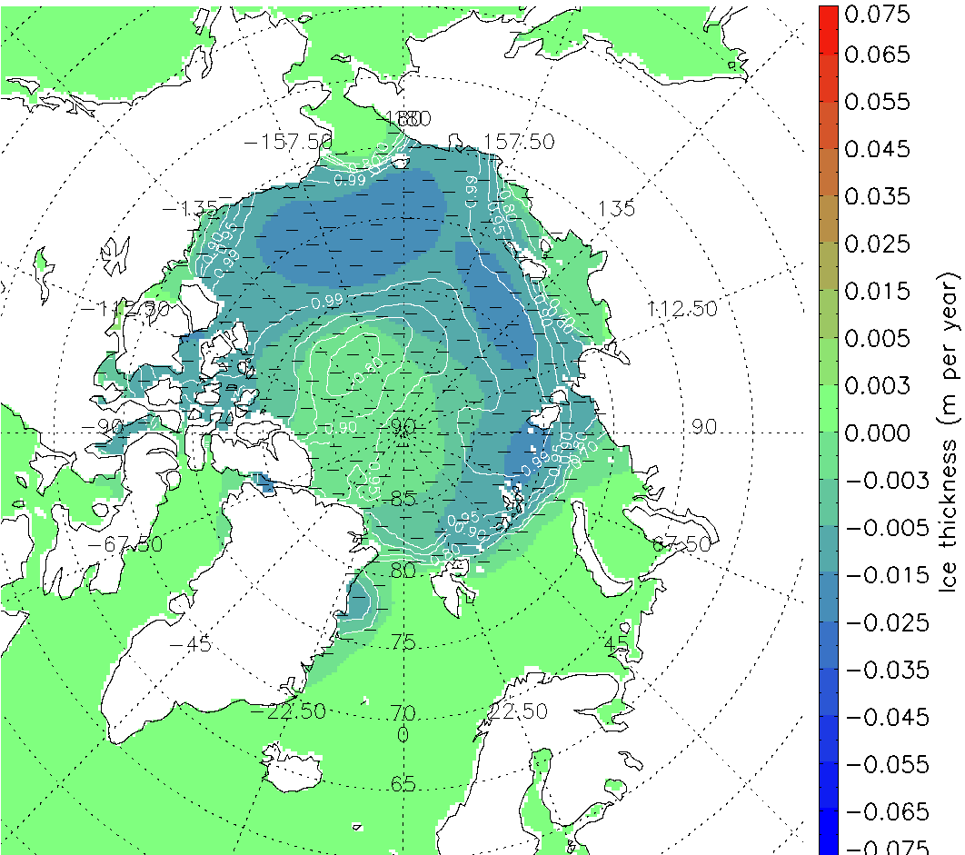
Discoveries of Arctic change from space
Sea Ice Thickness Trend, 1982-2013
September
From AVHRR using the VIIRS algorithm
Sea ice thickness has decreased 1-6 cm/yr though there is large regional variability.
Notes:
Sea ice trend: 1953-2014 trend = -48,000 km²/yr

Slide 32
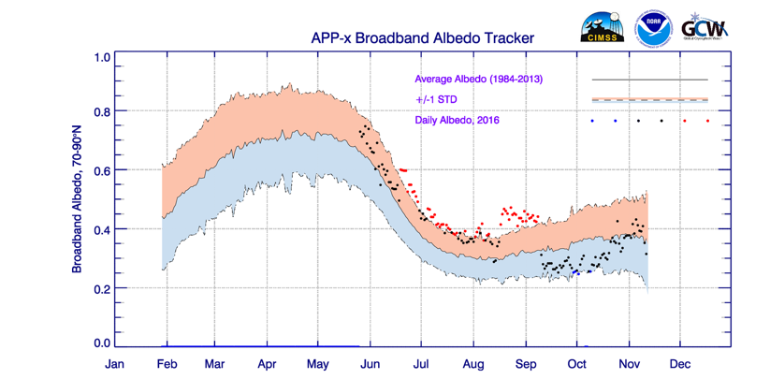
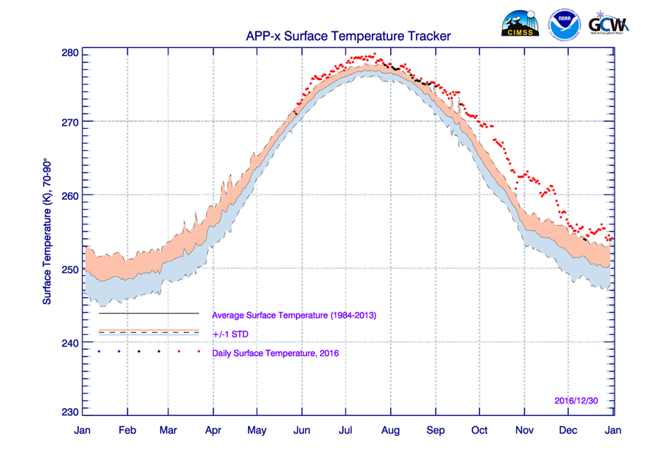
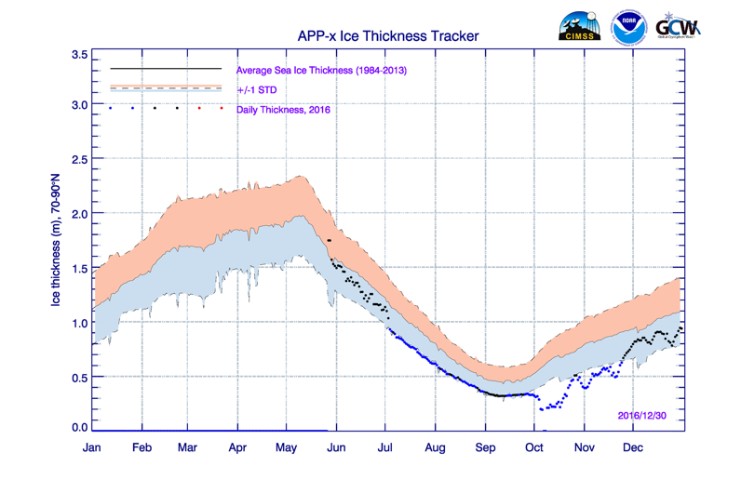
Monitoring Change: “Trackers”
From AVHRR using the VIIRS algorithms

Slide 33
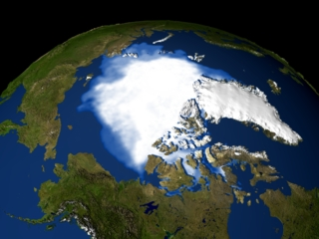
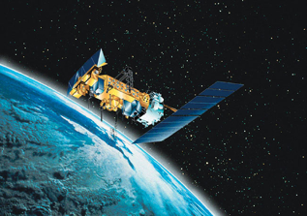
Conclusions
Conclusions
WMO
Many types of satellites are needed for a robust Arctic observing system.
NOAA has products that are essential to monitoring change in the polar regions. JPSS (VIIRS & AMSR2) products include:
Snow cover, fraction, water equivalent (SWE)
Ice cover, concentration, surface temperature, thickness, and motion
These products have many applications, notably:
VIIRS winds are used in operational models to improved weather forecasts.
Some snow and ice products are used for model verification, others as model input. Some, notably ice thickness, are just beginning to be examined by modelers.
Climate change: 4 decades of AVHRR ice thickness using VIIRS algorithms has shown that sea ice thickness is decreasing.

Slide 34


Slide 35
Resources
Papers:
Meier, W., J.S. Stewart, Y. Liu, J. Key, and J. Miller, 2017, An operational implementation of sea ice concentration and ice type characterization estimates from the AMSR2 sensor, IEEE J. Selected Topics Appl. Earth Obs. Remote Sens. (J-STARS), (submitted Dec 2017).
Wang, X., J. Key, R. Kwok, and J. Zhang, 2016, Comparison of sea ice thickness from satellites, aircraft, and PIOMAS data, Remote. Sens., 8, 713, doi:10.3390/rs8090713.
Liu, Y., J. Key, and R. Mahoney, 2016, Sea and Freshwater Ice Concentration from VIIRS on Suomi NPP and the Future JPSS Satellites, Remote. Sens., 8(6), 523; doi:10.3390/rs8060523.
Key, J., X. Wang, Y. Liu, R. Dworak, A. Letterly, 2016, The AVHRR Polar Pathfinder Climate Data Records, Remote Sens, 8(3), 167, doi:10.3390/rs8030167.
Lee, K.-L., C. Kongoli, and J. Key, 2015, An in-depth evaluation of heritage algorithms for snow cover and snow depth using AMSR-E and AMSR2 measurements, J. Atmos. Oceanic Tech., 32, 2319-2336, doi: 10.1175/JTECH-D-15-0100.1.
Liu, Y., J. Key, M. Tschudi, R. Dworak, R. Mahoney, and D. Baldwin, 2015, Validation of the Suomi NPP VIIRS Ice Surface Temperature Environmental Data Record, Remote Sensing, 7, 17258–17271, doi:10.3390/rs71215880.
Key, J. R., R. Mahoney, Y. Liu, P. Romanov, M. Tschudi, I. Appel, J. Maslanik, D. Baldwin, X. Wang, and P. Meade, 2013, Snow and ice products from Suomi NPP VIIRS, J. Geophys. Res. Atmos., 118, doi:10.1002/2013JD020459.

Slide 36
Resources, cont.
Web pages:
NOAA/NESDIS/STAR product monitoring page
VIIRS ice products at CIMSS
Geographic Information Network of Alaska (GINA)
WMO Global Cryosphere Watch (GCW)

