Slide 1
Tulsa Oklahoma
NOAA/CIMSS ProbSevere
Graph courtesy John Cintineo, UW-Madison CIMSS

Slide 2
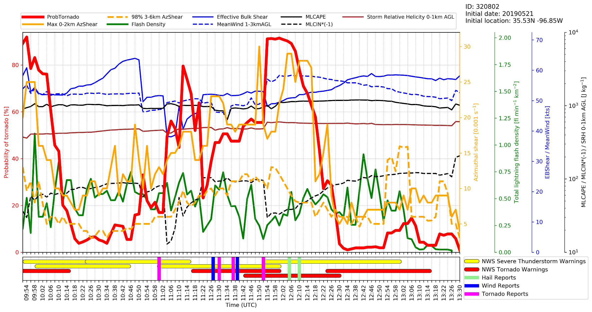

Slide 11
