Slide 1
Understanding and Using the Geostationary Lightning Mappers (GLM)
Joseph Patton, University of Maryland-College Park/CISESS
AMS Short Course
18 March 2021

Slide 2
Part 1: How Do the GLMs Work and What Products Do They Create?

Slide 3
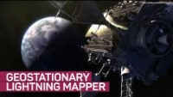

Slide 4
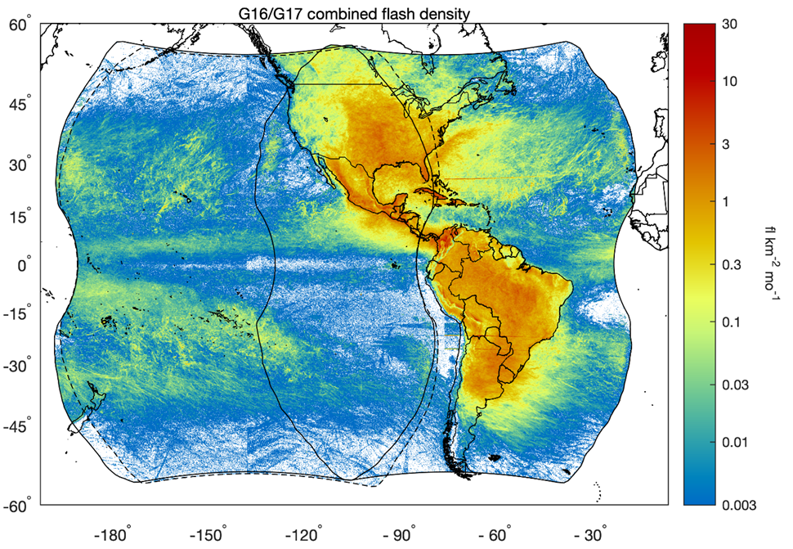
How the GLMs Detect Lightning
Bright optical sources are observed with an imager on the GOES-16 and GOES-17 satellites with a very narrow wavelength corresponding to lightning
Sources observed every two milliseconds and compared with a background image updated every 2.5 minutes
Each individual pixel which is illuminated past the detection threshold on each two-millisecond frame is an “event”
Events are amassed into “groups” of simultaneous, adjacent events
Groups are amassed into “flashes” by combining one or more sequential groups
Field of view of the two GLMs stretches across most of the Western Hemisphere

Slide 5
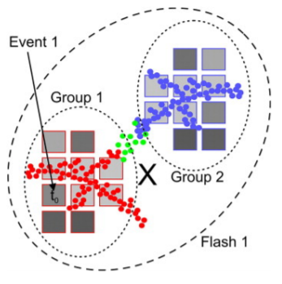
How the GLMs Detect Lightning
Events: individual pixels indicating lightning
Groups: simultaneous adjacent (horizontally and diagonally) events occurring within one 2 ms time frame
Flashes: consecutive groups occurring within 330 ms and 16.5 km of each other
Exceptionally large and long flashes may not be well-resolved with this algorithm
Read more about this process in Bruning et al. (2019)

Slide 6
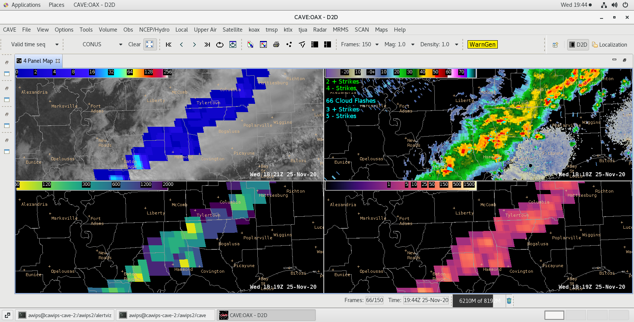
GLM Products Overview
Three operational GLM products are produced each minute in real-time:
Flash Extent Density [FED] – Count of how many flashes are coincident with each GLM pixel (8 km by 8 km)
Minimum Flash Area [MFA] – Area (in km²) of the smallest flash within any given pixel in which a flash was detected
Total Optical Energy [TOE] – Total amount of optical energy (in femtojoules) received by the instrument on the GOES satellites
FED
MFA
TOE

Slide 7
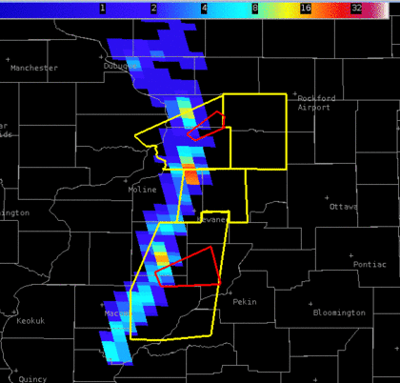
GLM Products: Flash Extent Density
Flash Extent Density [FED] – Count of how many flashes are coincident in each GLM pixel (8 km by 8 km)
Higher FED -> more flashes -> more lightning activity -> stronger storms
Cool colors (blue) -> small flash counts warm colors (orange/red) -> large flash counts
QLCS example (right) quickly shows which sections have more lightning activity and therefore might lead to severe weather
Jumps in lightning activity have been shown to correlate closely with severe weather (Schultz et al. 2009)
FED + NWS Warnings

Slide 8
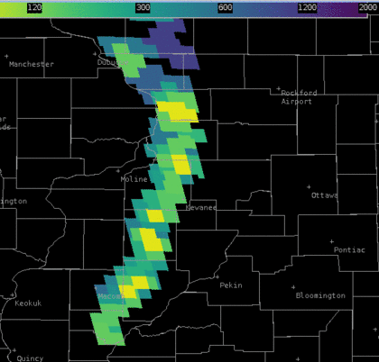
GLM Products: Minimum Flash Area
Minimum Flash Area [MFA] – Area (in km²) of the smallest flash within any given pixel in which a flash was detected
Smaller flashes -> strengthening convection; larger flashes -> weakening convection
MFA replaces Average Flash Area as it is more indicative of the smallest flashes
Storms or sections of mesoscale convective systems which are strengthening can be quickly identified by the yellow and green pixels
Likewise, storms which are weakening can be identified by the purple and blue pixels
MFA

Slide 9
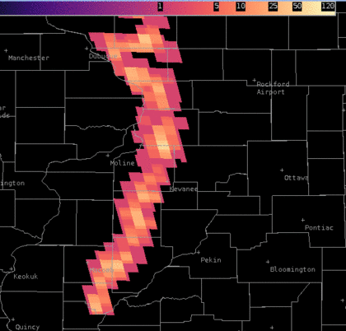
GLM Products: Total Optical Energy
Total Optical Energy [TOE] – Total amount of optical energy (in femtojoules) received by the instrument on the GOES satellites
Brighter, more energetic flashes indicate stronger or more numerous lightning flashes
Brighter flashes (higher TOE) are sometimes associated with sections of storms which are strengthening, but not always
Other GLM gridded products as well as ground-based lightning networks should be used to confirm lightning activity and build a conceptual model of how thunderstorms are evolving
TOE

Slide 10
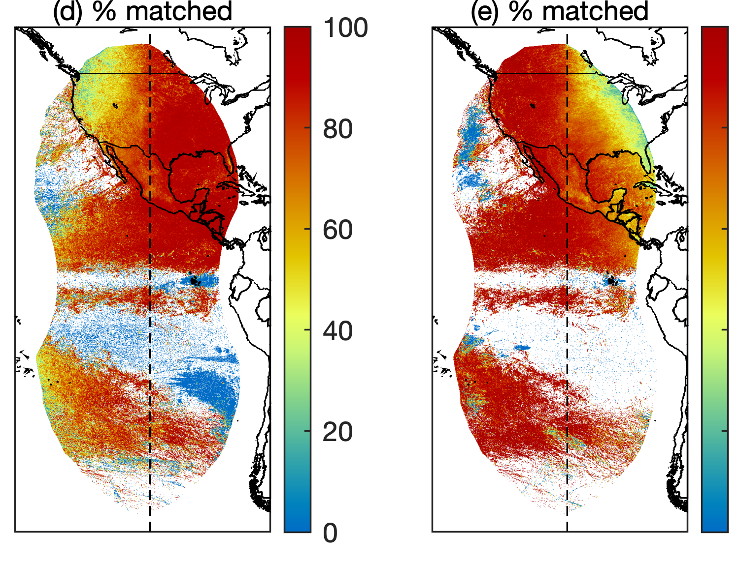
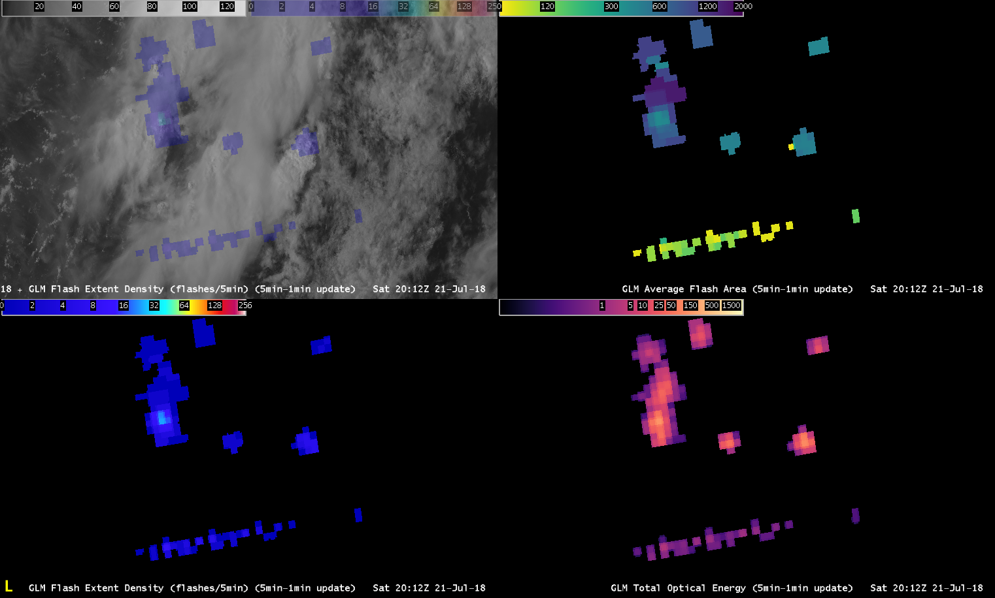
GLM Data Quality
Detection efficiency (DE) > 70% averaged over the full disk and 24 hours (Bateman and Mach 2020)
DE increases at night (> 90%) with dark backgrounds
DE decreases near the edge of the field of view of both GLM instruments as pixel sizes increase
False alarm (FA) rate < 5% averaged over the full disk and 24 hours
FAs can be caused by solar artifacts such as sun glint (sunlight reflecting over water), as well as “Bar” artifacts (lines of false flashes along subarray boundaries when high clouds are present near local solar noon)
Filters have recently significantly reduced FAs
% of G17 flashes observed by G16
% of G16 flashes observed by G17
Overlap region of G16 & G17 GLMs
Source: Rudlosky and Virts (2021)
“Bar” artifact example
False flashes appear abnormally small and dim in the flash area and energy fields

Slide 11
References
Bateman, M. and D. Mach, 2020: Preliminary detection efficiency and false alarm rate assessment of the Geostationary Lightning Mapper on the GOES-16 satellite. J. Appl. Remote Sens., 14(3), 032406. https://doi.org/10.1117/1.JRS.14.032406
Bruning, E., C.E. Tillier, S.F. Edgington, S.D. Rudlosky, J. Zajic, C. Gravelle, et al., 2019: Meteorological imagery for the geostationary lightning mapper. J. Geophys. Res.: Atmosphere, 124, 14285– 14309. https://doi.org/10.1029/2019JD030874
Rudlosky, S.D. and K. S. Virts, 2021: Dual Geostationary Lightning Mapper Observations. Mon. Weather Rev., Early Online Release. https://doi.org/10.1175/MWR-D-20-0242.1
Schultz, C. J., W. A. Petersen, and L. D. Carey, 2009: Preliminary development and evaluation of lightning jump algorithms for the real-time detection of severe weather. J. Appl. Meteor. Climatol., 48, 2543–2563. https://doi.org/10.1175/2009JAMC2237.1

Slide 12
Summary and Q+A
The Geostationary Lightning Mappers (GLMs) cover much of the Western Hemisphere, with a significant overlap area over the central U.S.
GLMs produce three gridded products: Flash Extent Density, Minimum Flash Area, and Total Optical Energy
Flash Extent Density represents a count of the number of flashes within each pixel
Minimum Flash Area represents the smallest area of any flash detected within each pixel
Total Optical Energy represents the amount of optical energy or brightness detected within each pixel
Detection Efficiency is > 70% averaged over the full disk and 24 hours, increasing overnight
False Alarm Rate is < 5%, and filters are being developed to improve this further

Slide 13
Part 2: GLM Hands-On Activities with Selected Case Studies

Slide 14
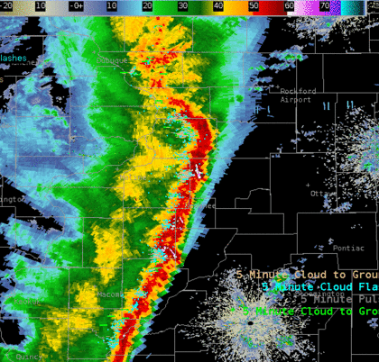
Example 1: Quasi-Linear Convective System
FED + NWS Warnings
Question: What do the GLM products show about this QLCS? Is there a preferred region for severe weather to continue?
MFA
Radar + ENI/GLD
TOE

Slide 15
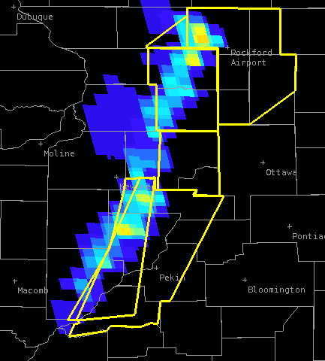
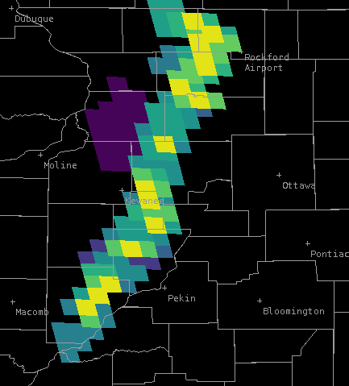
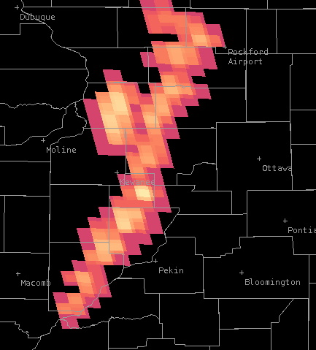
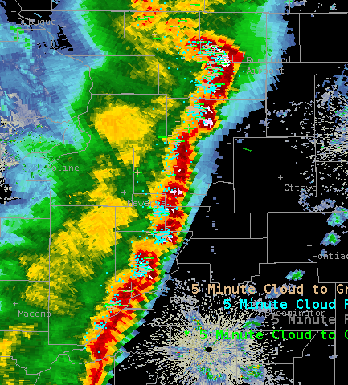
Example 1: QLCS
Bowing segment near Rockford, IL produced damaging wind gusts leading to downed power lines and overturned box trucks. Gusts estimated up to 70 mph
Trailing stratiform region CG flashes can be seen in the GLM imagery and confirmed by ground-based networks (white ovals below)
Very energetic, large CG flashes often break “30/30 rule” and are particularly hazardous to life and property
FED + NWS Warnings
MFA
TOE
Radar + ENI/GLD

Slide 16
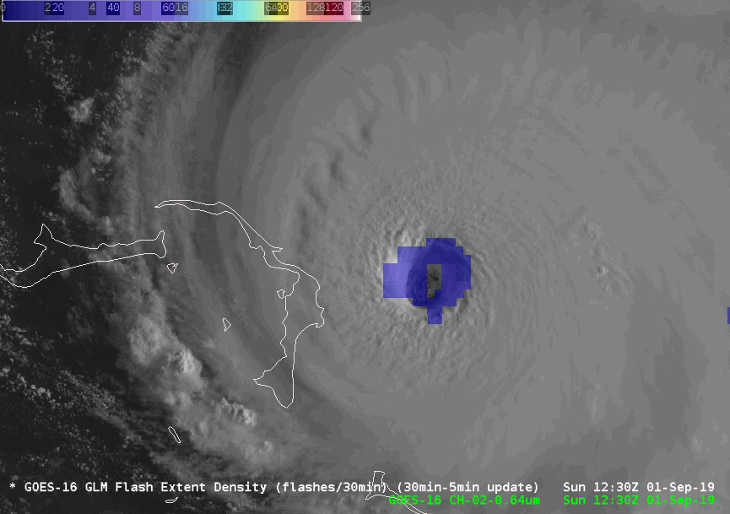
Example 2: Hurricane Dorian (2019)
Question: What is Flash Extent Density showing here? Based on this satellite imagery, would you expect Hurricane Dorian to weaken, strengthen, or stay the same intensity?

Slide 17
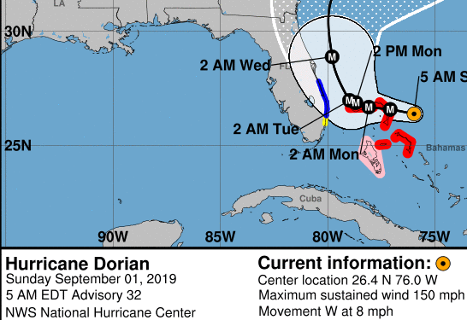
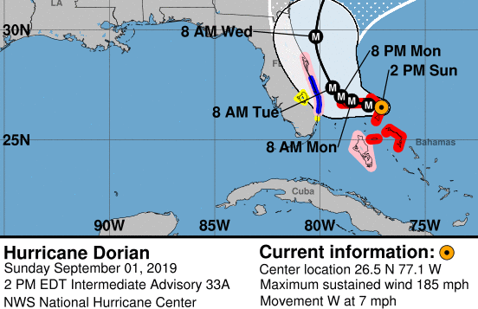
Example 2: Hurricane Dorian (2019)
Flash Extent Density (FED) shows a large increase in lightning activity associated with a convective burst within the eye of Hurricane Dorian
Significant strengthening was observed as maximum sustained winds according to the National Hurricane Center increased from 150 mph to its peak intensity of 185 mph

Slide 18
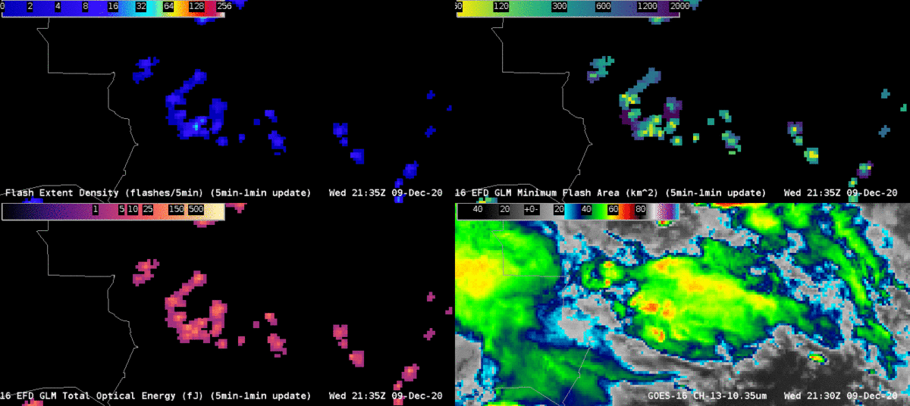
Example 3: Mesoscale Convective Complex
Question: Which storms stick out in this satellite imagery? Why?

Slide 19




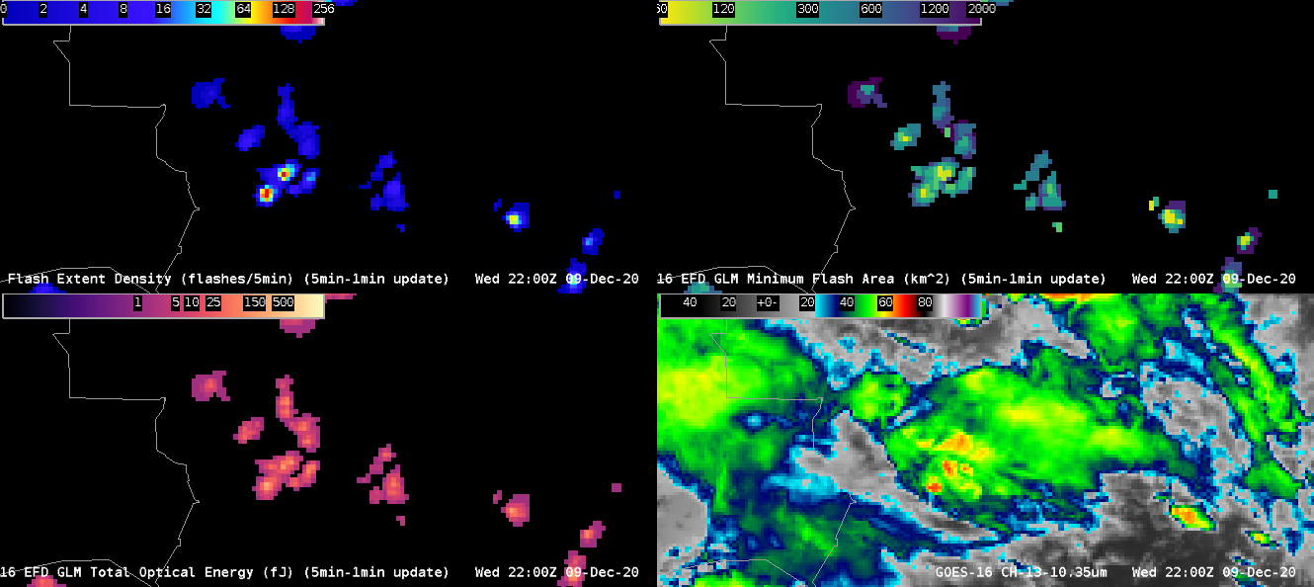


Example 3: Mesoscale Convective Complex
2157-2211 z
Storm 1 (white ovals)
Low MFA values coincide with high FED values
Mature storms ongoing
Storm 2 (red ovals)
Low MFA values precede increasing FED values
Smaller flashes indicate strengthening convection
2200 z
2157 z
2211 z
FED
MFA
TOE
CH. 13

Slide 20
Final Discussion and Q+A
GLM gridded products provide valuable insight into lightning activity and thunderstorm evolution
Integrating FED, MFA, and TOE into the operational forecasting environment can help warning decision-making
Using available ground-based lightning networks along with GLM gridded products can improve confirmation and better understand of lightning activity
Questions/comments?
Thank you for attending!

