Slide 1
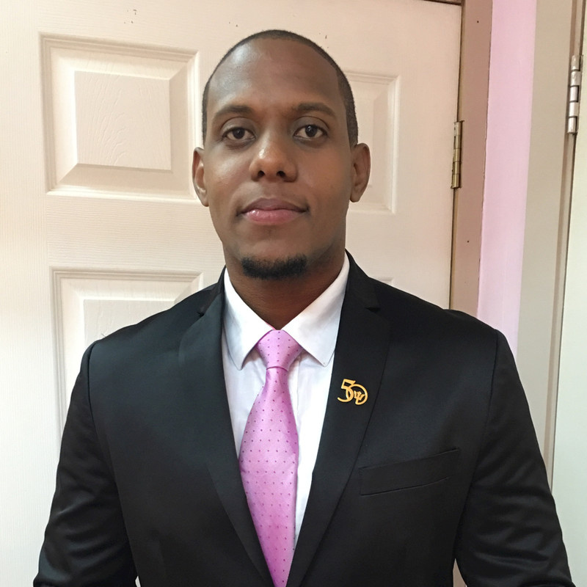



WAYNE MCGEARY
METEOROLOGICAL SPECIALIST
CARIBBEAN INSTITUTE FOR METEOROLOGY AND HYDROLOGY

Slide 2
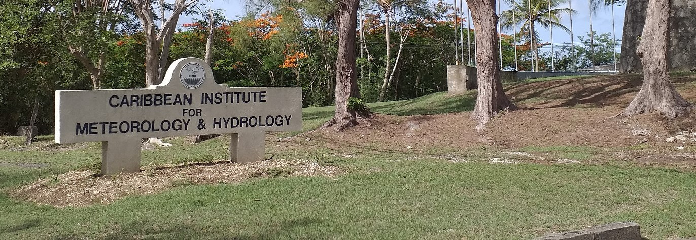
ABOUT THE CIMH
  Established 1967
  Institute of the Caribbean Community (CARICOM)
  Technical organ of the Caribbean Meteorological Organisation (CMO)
  Globally recognized as:
    The World Meteorological Organization (WMO) Regional Training Centre for the Caribbean;
    A centre for applied research and development in meteorology, hydrology/water resources, climatology and related areas including disaster risk reduction and impacts forecasting;
    The WMO Regional Instrument Centre for the Caribbean;
    A WMO Centre of Excellence for Training in Satellite Meteorology;
    The WMO Regional Climate Centre (RCC) for the Caribbean;
    The Caribbean Centre for Climate and Environmental Simulations;
    The Climate Data Archive for CMO Member States;
    The Pan American Centre for the WMO Sand and Dust Storm Warning Advisory and Assessment System (SDS-WAS).

Slide 3
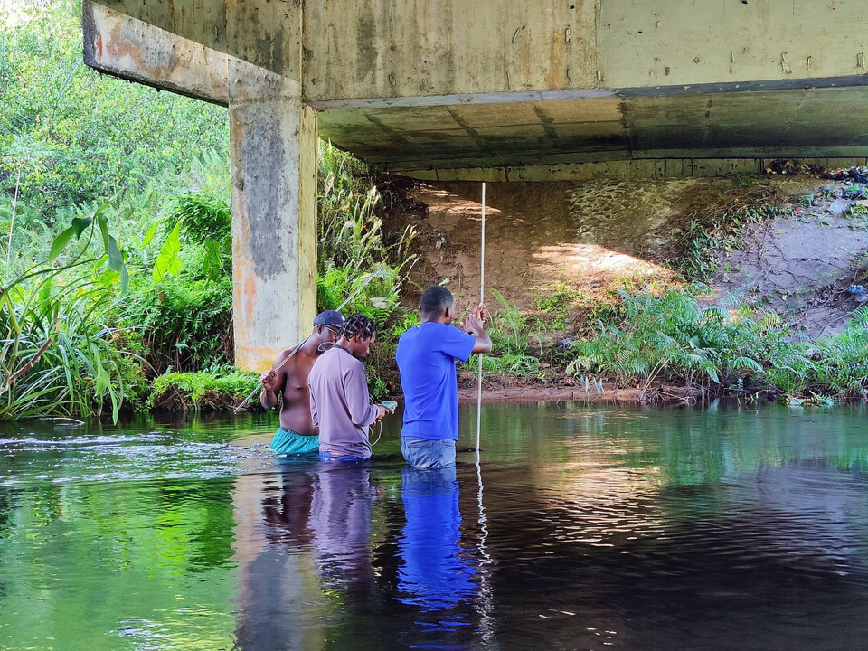
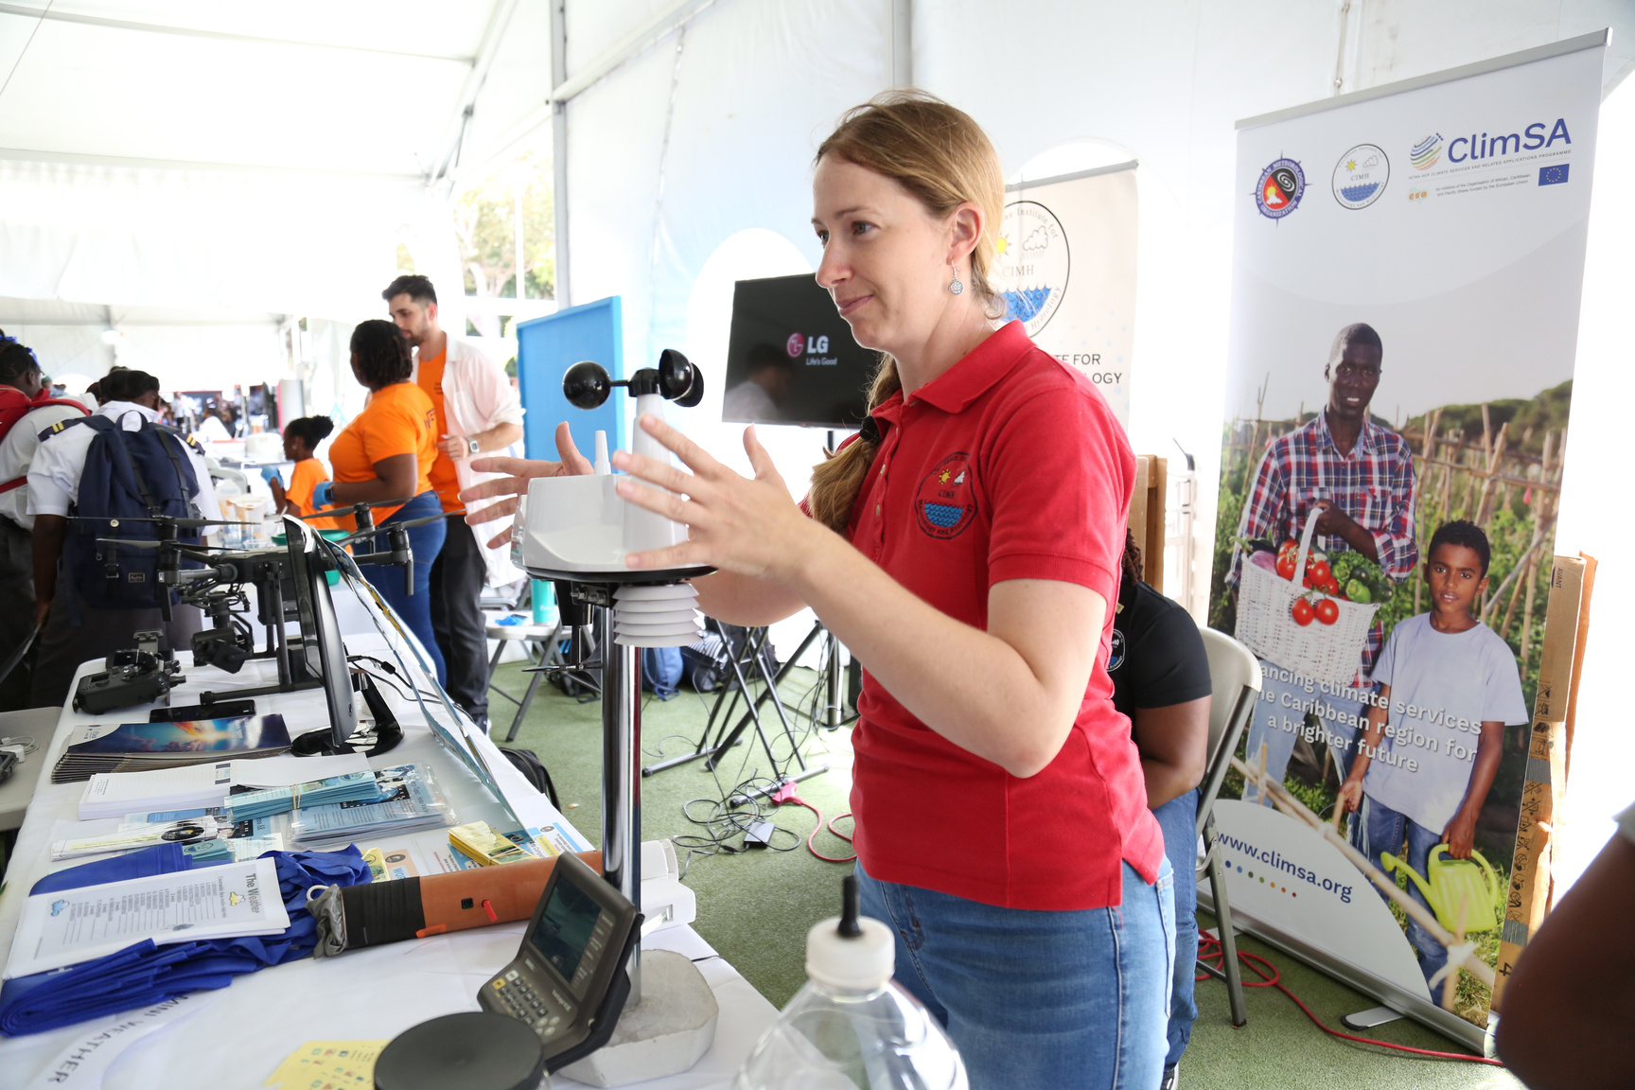
Sixteen CMO member countries:
  Anguilla
  Antigua and Barbuda
  Barbados
  Belize
  British Virgin Islands
  Cayman Islands
  Dominica
  Grenada
  Guyana
  Jamaica
  Montserrat
  St. Kitts/Nevis
  St. Lucia
  St. Vincent and the Grenadines
  Trinidad and Tobago
  Turks and Caicos Islands
ABOUT THE CIMH
Primary functions:
  Provide facilities for the training of various categories of meteorological and hydrological personnel.
  Operate as a centre of research in meteorology and hydrology and associated sciences.
  Operate as contractors and consultants on various meteorological and hydrological projects.
  Maintain a service for the upkeep, repair, and calibration of meteorological instruments.
  Provide advice to participating governments on meteorological and hydrological matters.
  Collect, analyse and publish meteorological and hydrological data.

Slide 4




EDUCATION BACKGROUND
UNDERGRADUATE STUDIES
B.S. Meteorology and Computer Science (Minor)
(Honors)
2011-2014
GRADUATE STUDIES
Applied Meteorology and Climate with Management
2020-2021
Notes:
So how did it all start?

Slide 5

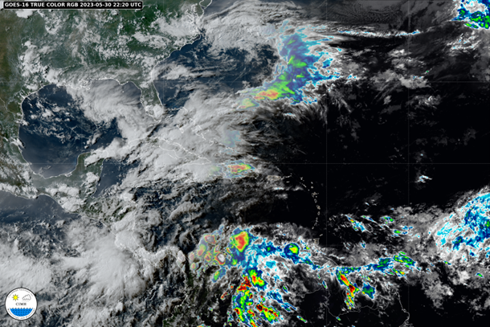
HOW I GOT HERE:
CAREER PATH
  Interest was sparked in 1995
  Began working at the Barbados Meteorological Service (BMS) in 2003
  Later decided to pursue my Bachelor’s degree in Meteorology and a minor in Computer Science
  Took a keen interest in Satellite Meteorology during the bachelor
  Worked at the BMS for 18+ years
  Began my role at the CIMH in 2021
  Training Along the Way
    Workshop on Hurricane Forecasting and Public Weather Service RAIV, National Hurricane Centre (NHC) – 2016
    International Training Course on the Application of Meteorological Satellite Products, China Meteorological Administration (CMA) - 2018
    Severe Weather Forecasting Demonstration Project (SWFDP) Workshop on Numerical Weather Prediction (NWP) and Public Weather Service (PWS), Caribbean Institute for Meteorology and Hydrology (CIMH) – 2018

Slide 6
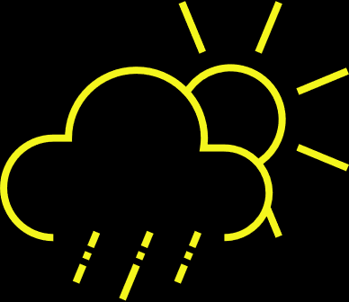
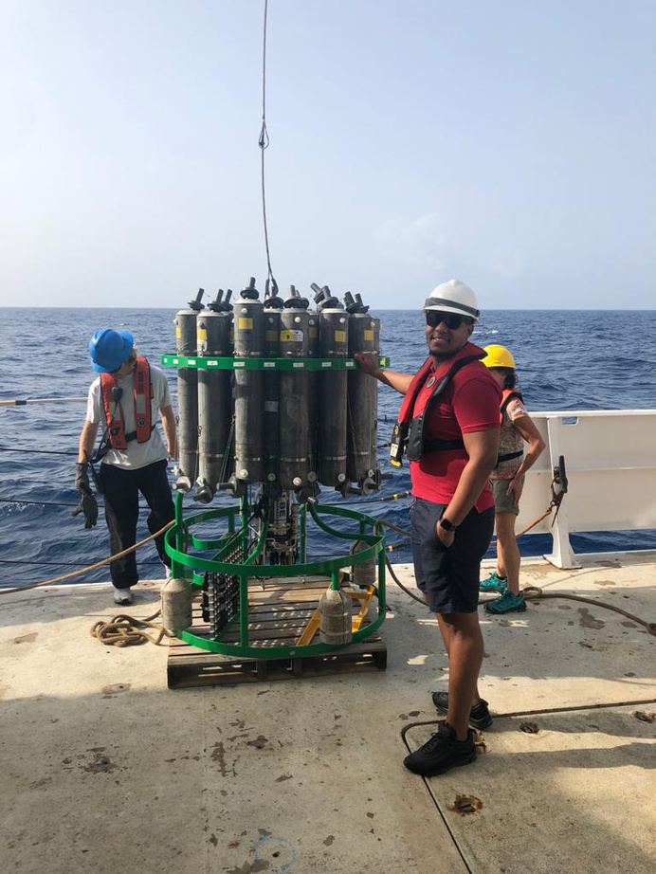

CURRENT POSITION
METEOROLOGICAL SPECIALIST
  Lecturing/teaching courses, maintain meteorological technicians' training in accordance with WMO standards.
  Support and promote research and development activities in accordance with the Caribbean Institute for Meteorology and Hydrology (CIMH) mandate.
  Provide severe weather updates to CIMH stakeholders.
  Prepare organization reports and briefings for internal and external agencies.
  Represent CIMH at local, regional and international meetings/workshops and or seminars when assigned and travel on behalf of CIMH.
  Support research initiatives with CIMH Interns.
Notes:
Conducting a course in 2024 where persons can utilize the Geonetcast to generate imagery

Slide 7
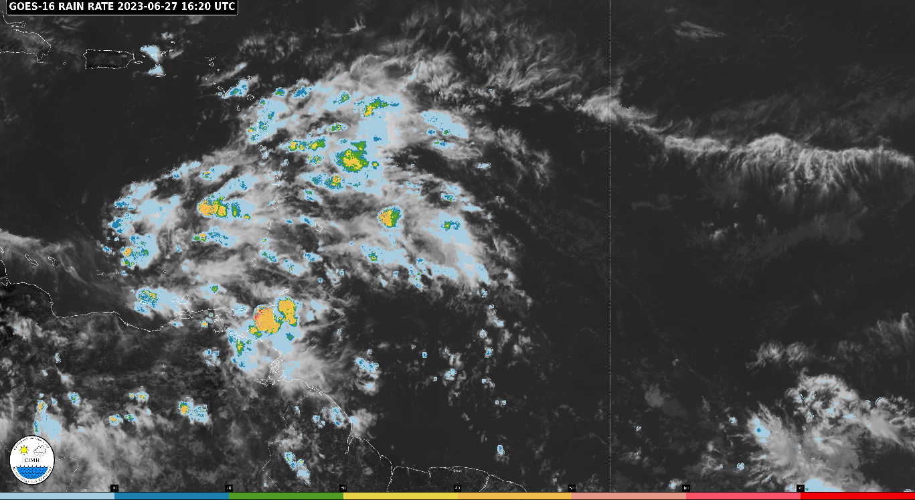
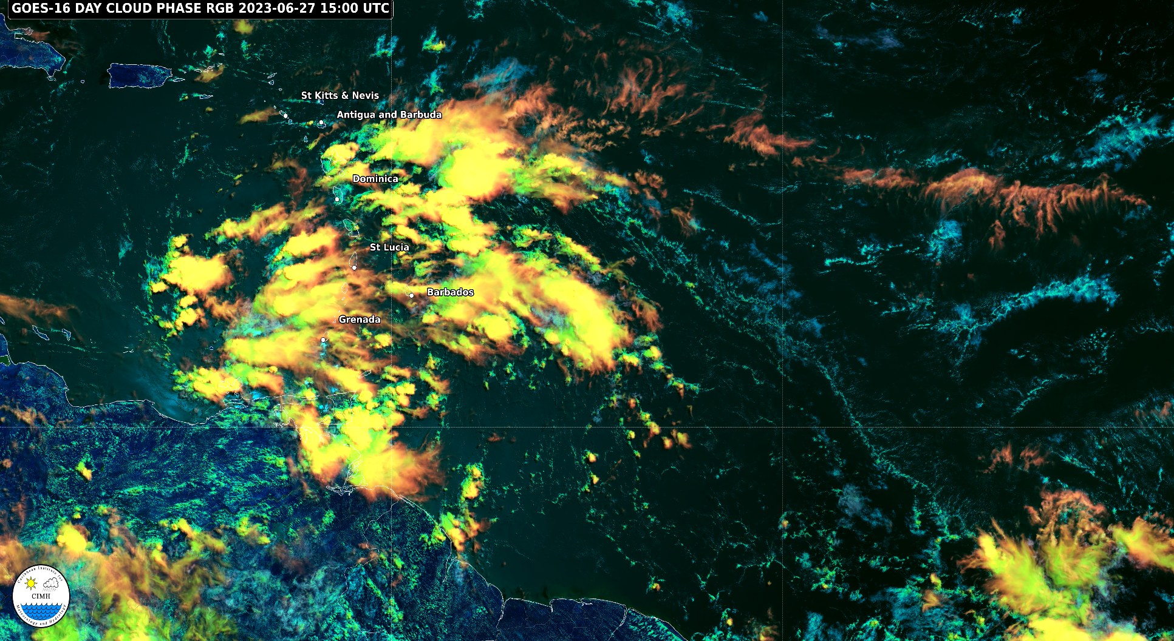
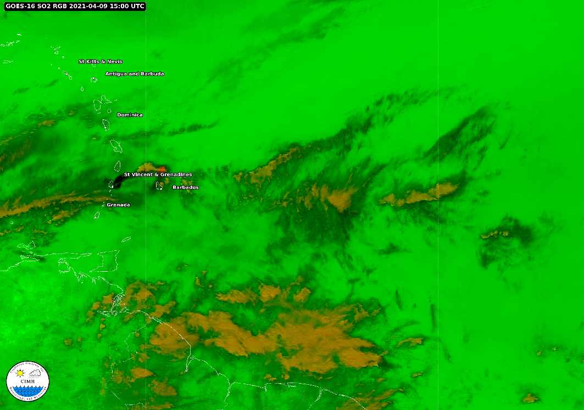
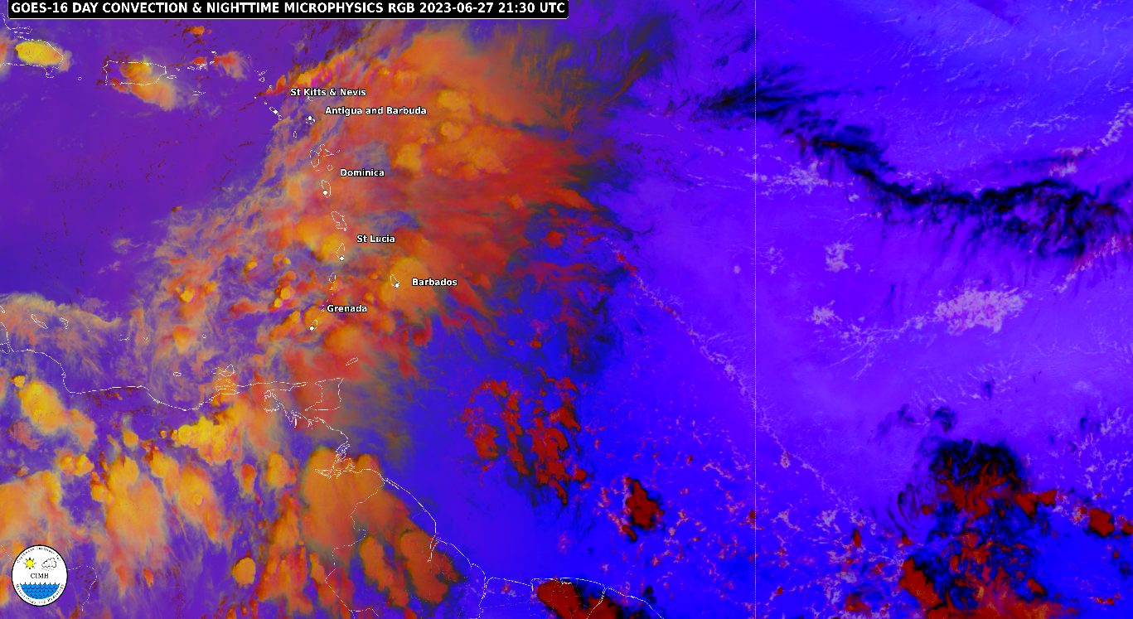
SATELLITE PRODUCTS
Notes:
Diego Souza

Slide 8
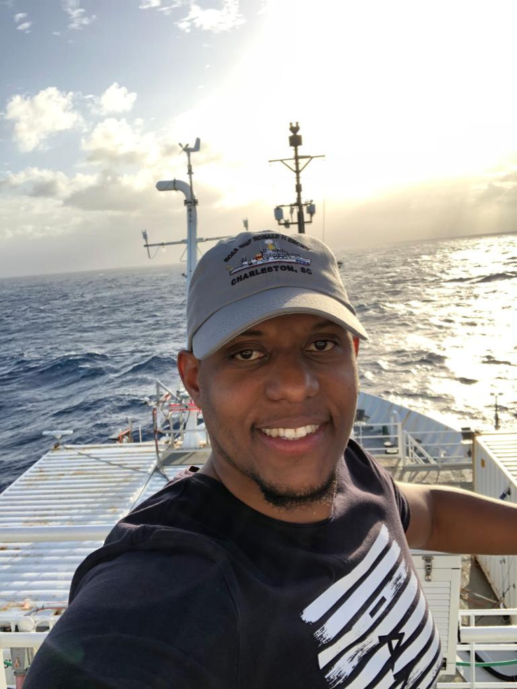
THANK YOU!
WAYNE MCGEARY
METEOROLOGICAL SPECIALIST
CARIBBEAN INSTITUTE FOR METEOROLOGY AND HYDROLOGY

