Slide 1






FDTD GOES-16 Applications
Nighttime Microphysics RGB
-for-
Detection of fog, low stratus and nighttime boundary layer gradients.
Presented by
Kristopher White (HUN)
for the Forecast Decision
Training Division (FDTD)

Slide 2
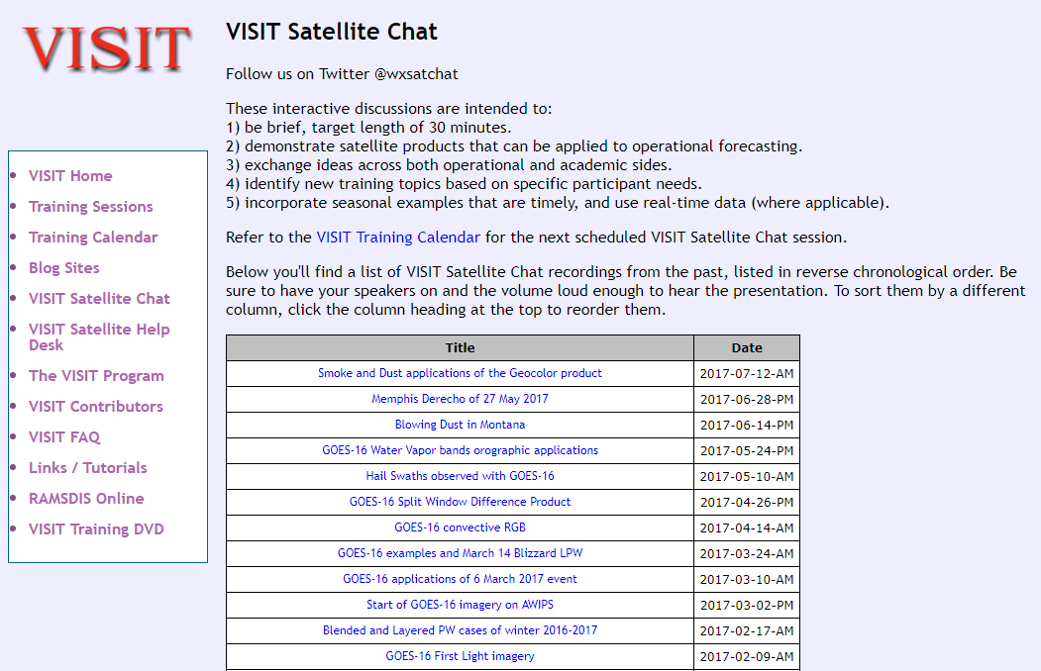
FDTD “Satellite Chat” Library
http://rammb.cira.colostate.edu/training/visit/satellite_chat/
Recorded Content includes Q&A
Call for speakers! Let us know if you want to speak on a topic!

Slide 3

FDTD GOES-16 Applications
Webinar Protocol
~20 minutes for speaker
  Send questions via GoTo Chat
  Or ask during Q&A period via phone
Followed by Q&A
  Open discussion forum
  Done by 1730 UTC
Do NOT press hold!!!
Mute your phone when not talking
Notes:
WDTD talks to this slide

Slide 4
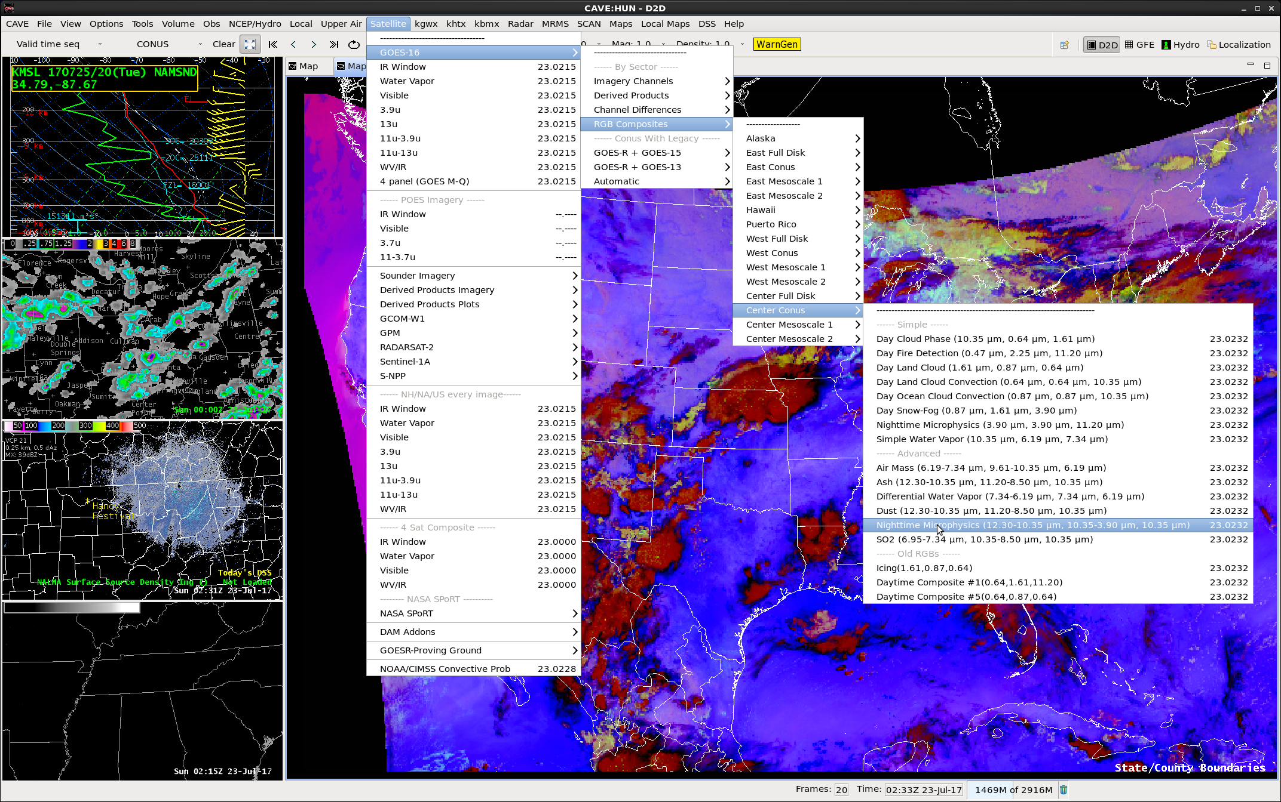
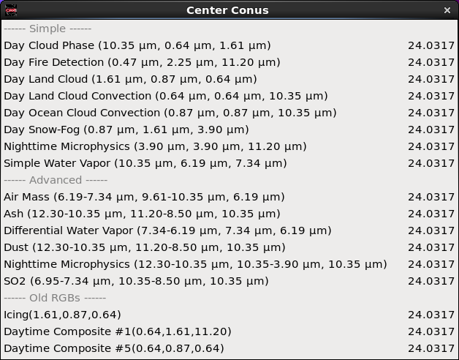
The Nighttime Microphysics RGB
Notes:
The Nighttime Microphysics RGB (Advanced) is found under the GOES-16 menu → RGB composites → Center CONUS → Nighttime Microphysics (under Advanced section)

Slide 5
The Nighttime Microphysics RGB
Color | Band / Band Diff | Also known as… | Small Contribution | Large Contribution
Red | 12.3 – 10.35 µm | Split window difference | Translucent clouds, Higher relative low-level moisture (clear sky) | Opaque clouds, Lower relative low-level moisture (clear sky)
Green | 10.35 – 3.9 µm | Fog product | Ice particles | Water clouds with large droplets (med) to small droplets (large)
Blue | 10.35 µm | “Clean” window | Colder temps | Warmer temps

Slide 6
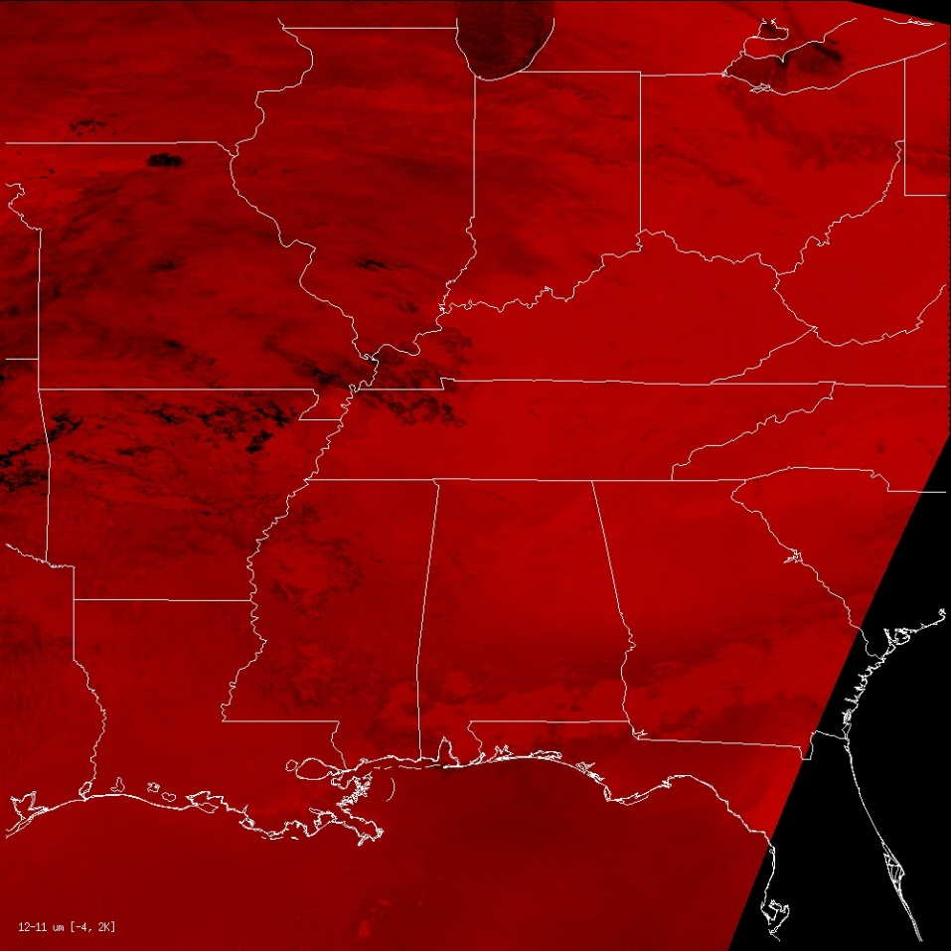
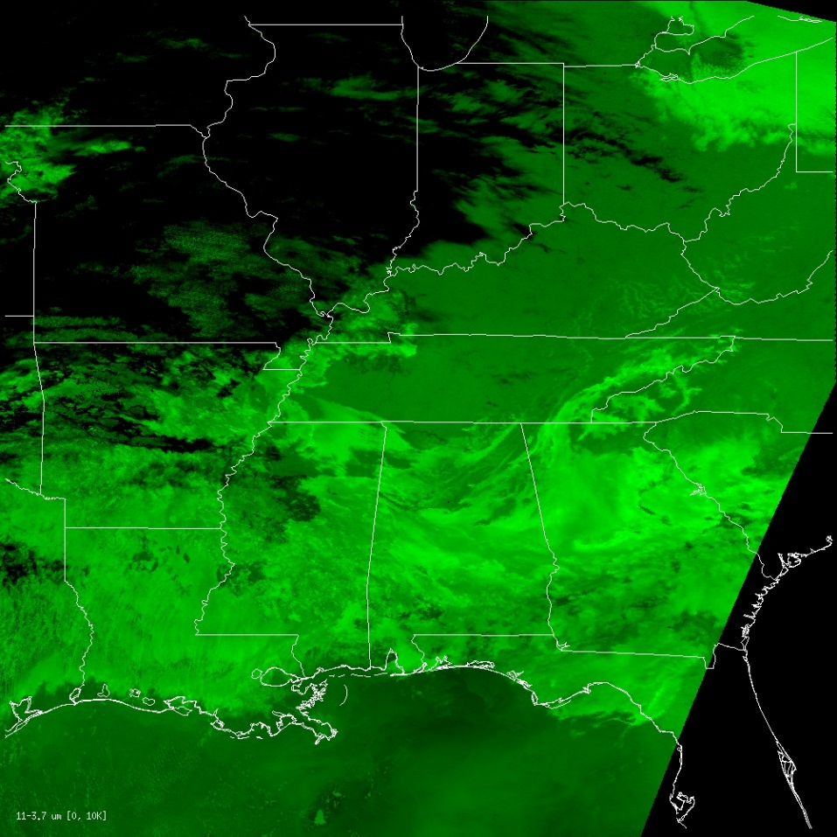
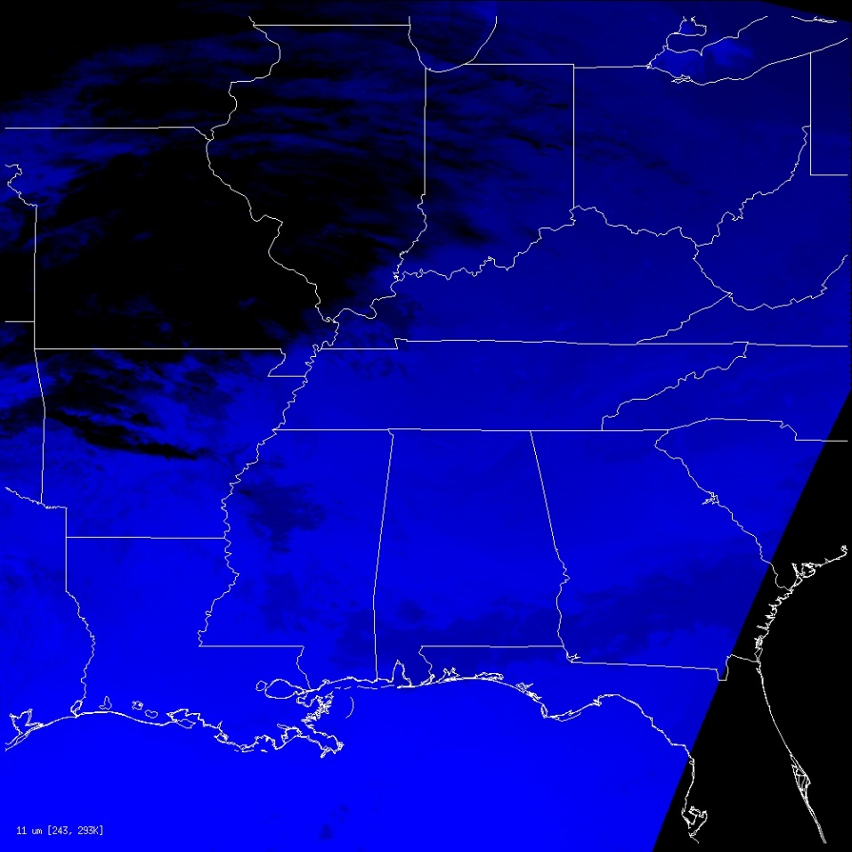
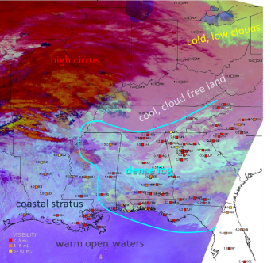
The Nighttime Microphysics RGB
RGB imagery assigns pixel values for the Red, Green, and Blue color components using 8-bit values (0-255), resulting in a 24-bit image.
  16,777,216 possible colors!
Remember, the RGB is constructed in 3D color space, with combinations from each color lending to the final pixel color.
R
R: 12.3-10.35 μm
G: 10.35-3.9 μm
G
B: 10.35 μm
NT Micro RGB
B

Slide 7
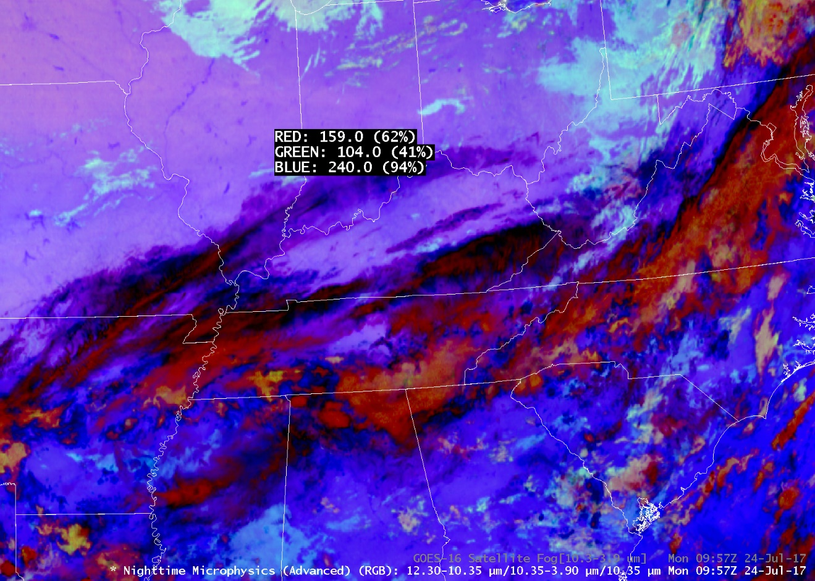
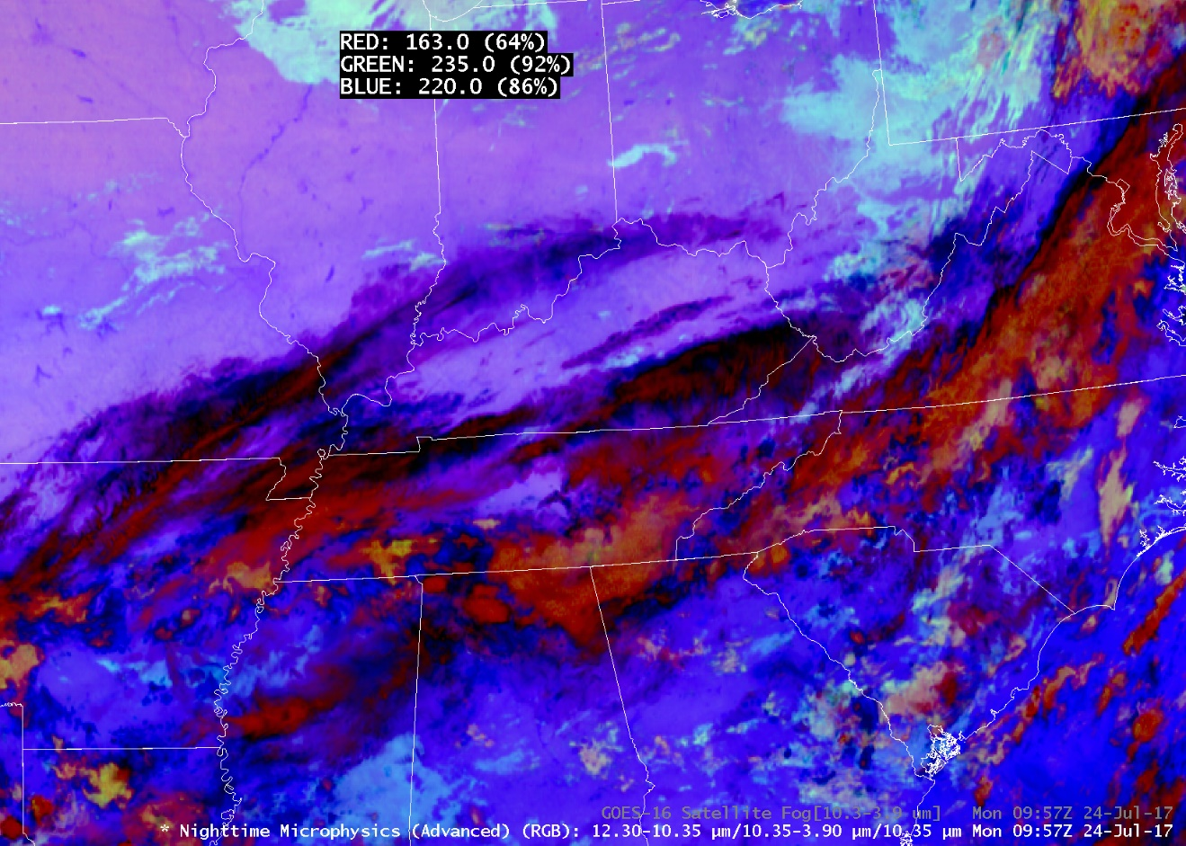
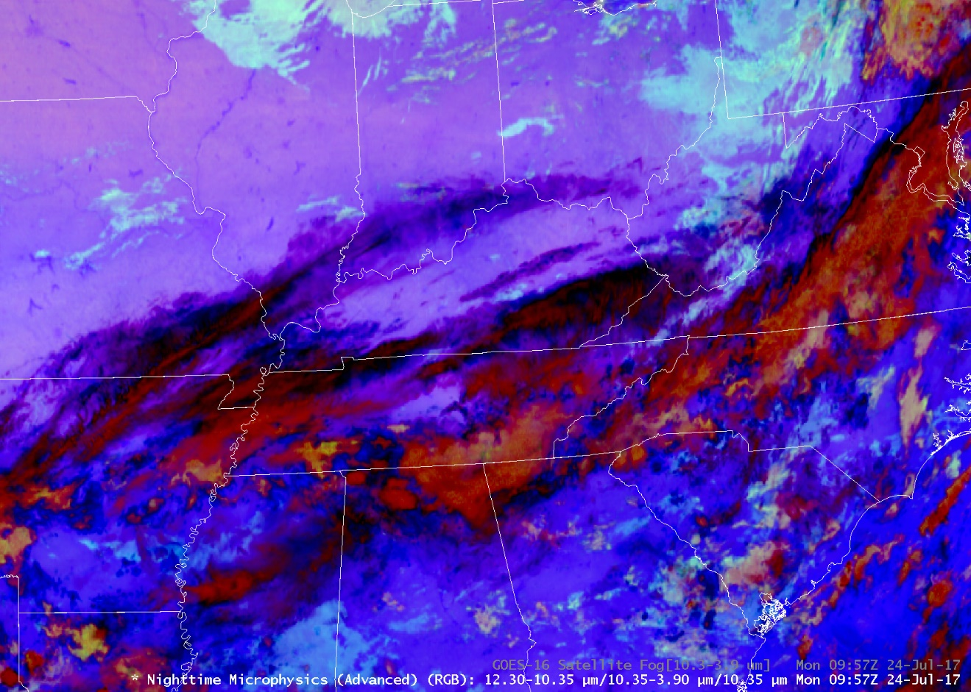
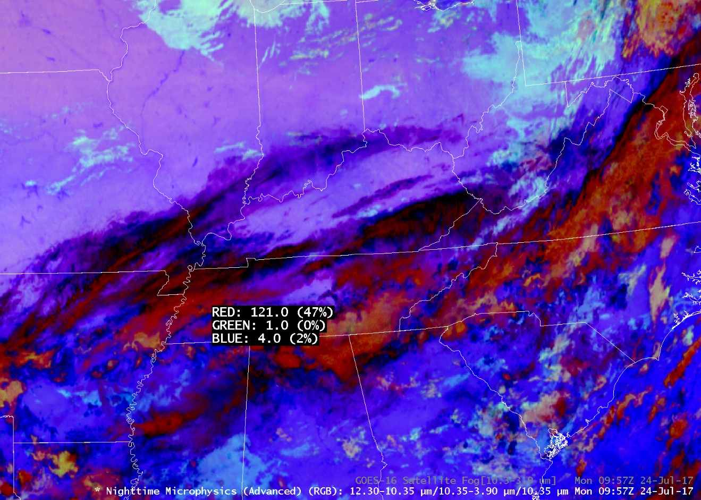
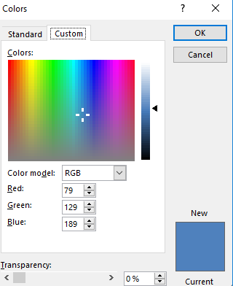
The Nighttime Microphysics RGB
It may not be a bad idea to revisit color theory!
  Use a standard color wheel and notice how the colors change with different red, green, and blue contributions
Individual color contributions may not be as they seem…
X
X
X
Notes:
It may be a good idea to revisit color theory, or get online and play around with a color wheel. There are color wheels available in programs like

Slide 8
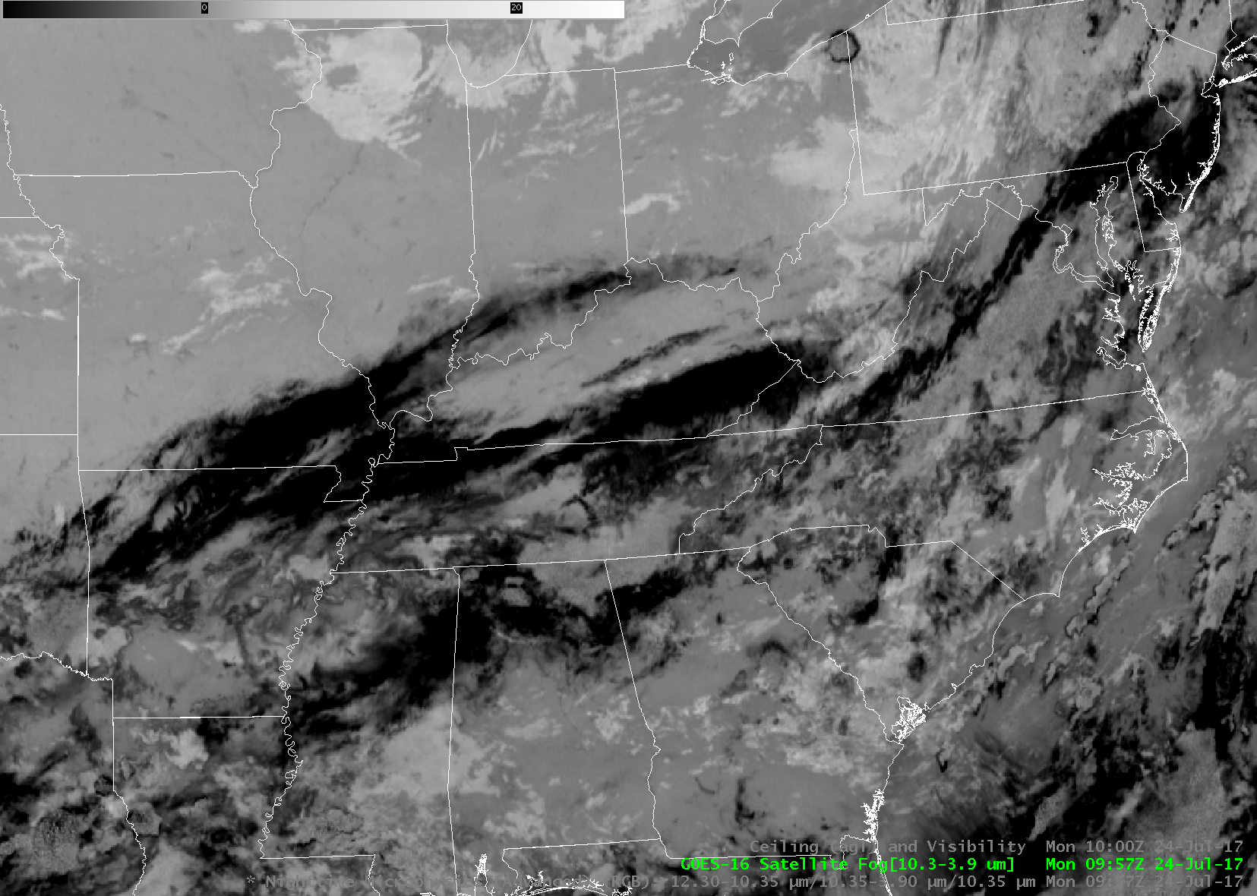
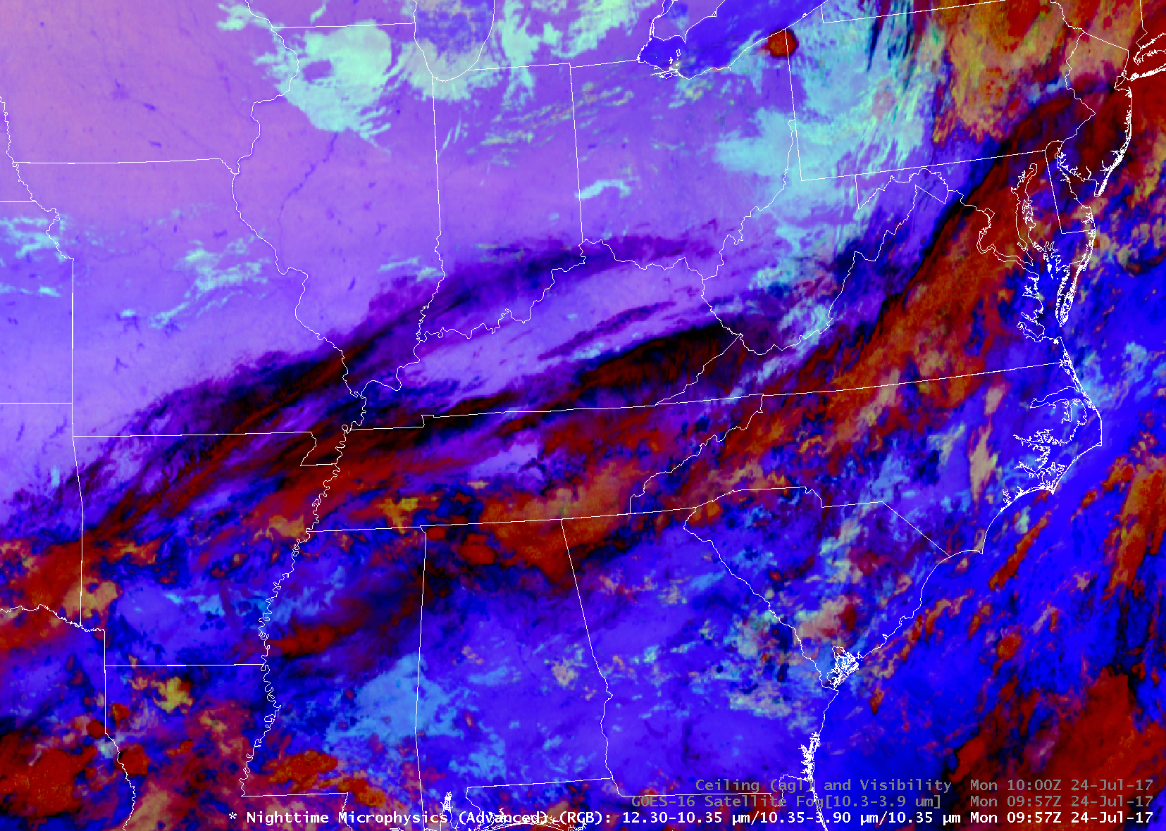

The Nighttime Microphysics RGB
Nighttime Microphysics RGB (Advanced)
10.35-3.9 µm (Fog Product)
Low stratus
Notes:
Fog shows up reasonably well in the legacy 10.35-3.9 um imagery. However, the color contrast in the Nighttime Microphysics RGB is easier for many to see. Also, the NT Micro RGB shows color contrast between different types of low clouds. In this case,

Slide 9
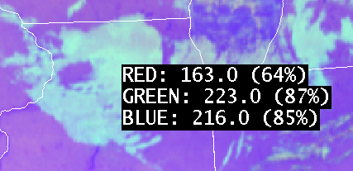

The Nighttime Microphysics RGB
Low clouds in the Nighttime Microphysics RGB (Advanced) over two different regions may appear different…
X
X
Cloud scene over northern Illinois
Cloud scene over eastern Mississippi
Red
Cloud opacity
Red
Cloud opacity
Grn
Water droplet size
Grn
Water droplet size
Blu
Temperatures
Blu
Temperatures
Notes:
Fog shows up reasonably well in the legacy 10.35-3.9 um imagery. However, the color contrast in the Nighttime Microphysics RGB is easier for many to see. Also, the NT Micro RGB shows color contrast between different types of low clouds. In this case,

Slide 10
The Nighttime Microphysics RGB
Each color pixel is the result of specific combinations of red, green and blue. So, similar colors indicate similar cloud conditions. Forecasters may use this information to determine characteristics of clouds across a cloud scene where observations do not exist.
Notes:
Because each color pixel is the result of specific combinations of red, green and blue…one can generally assume homogenous conditions across an area with similar colors. Also, relatively small changes in colors may occur across a cloud type, which are tied to physical phenomena (i.e., temperature, low-level moisture). Thus, variations in colors in a low stratus deck may indicate thicker/thinner clouds in some locations. This can have ramifications on the cloud evolution following sunrise and the onset of deeper mixing. For example, where clouds are thinner, they may tend to dissipate faster after deep mixing begins.

Slide 11
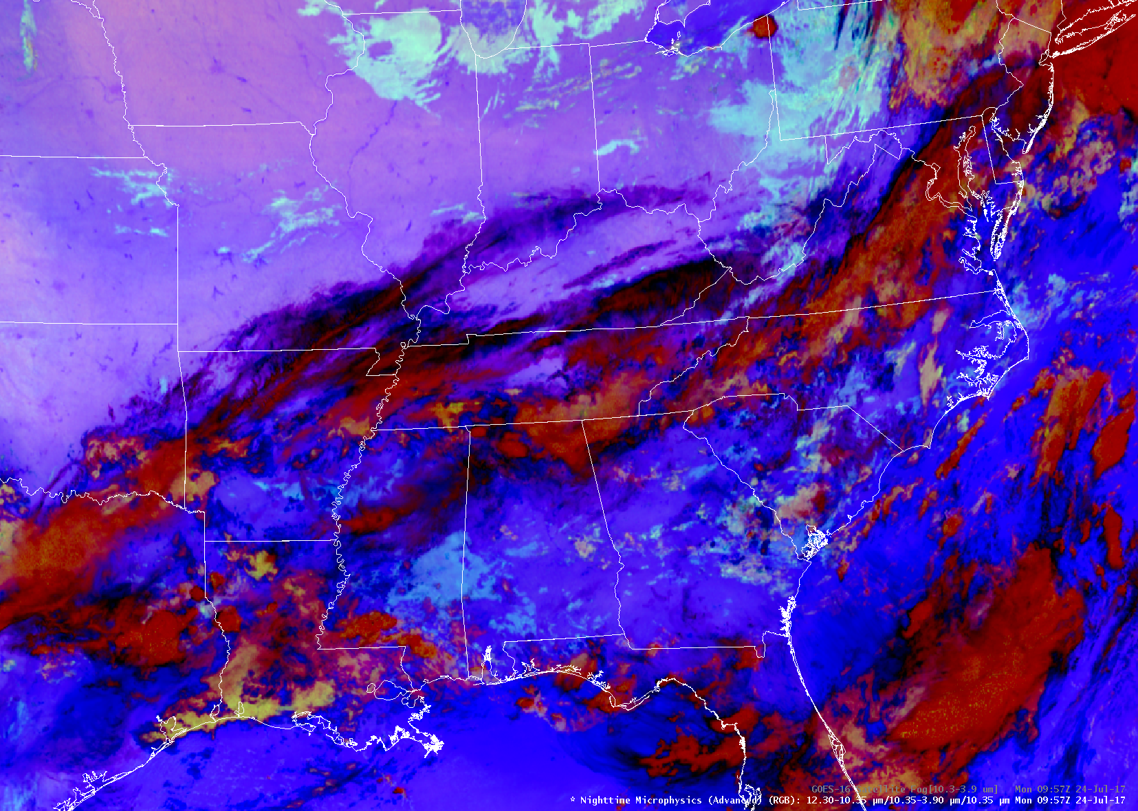

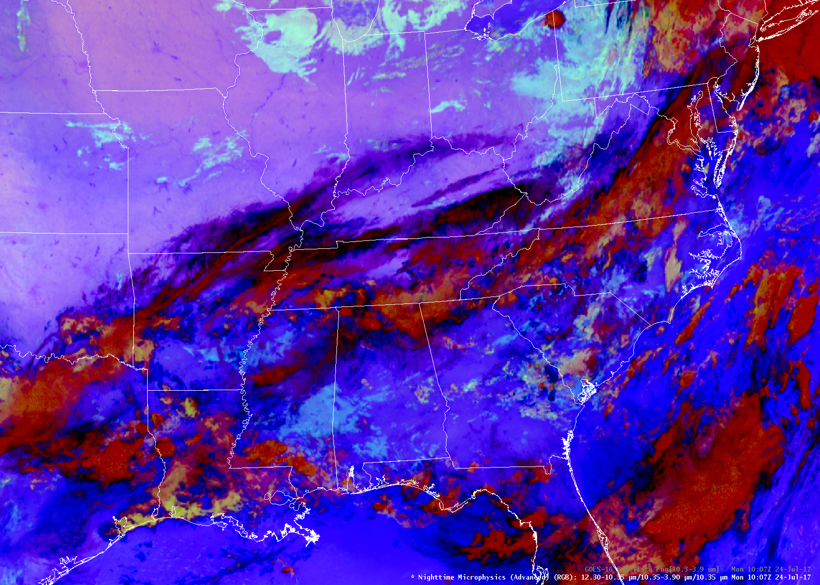



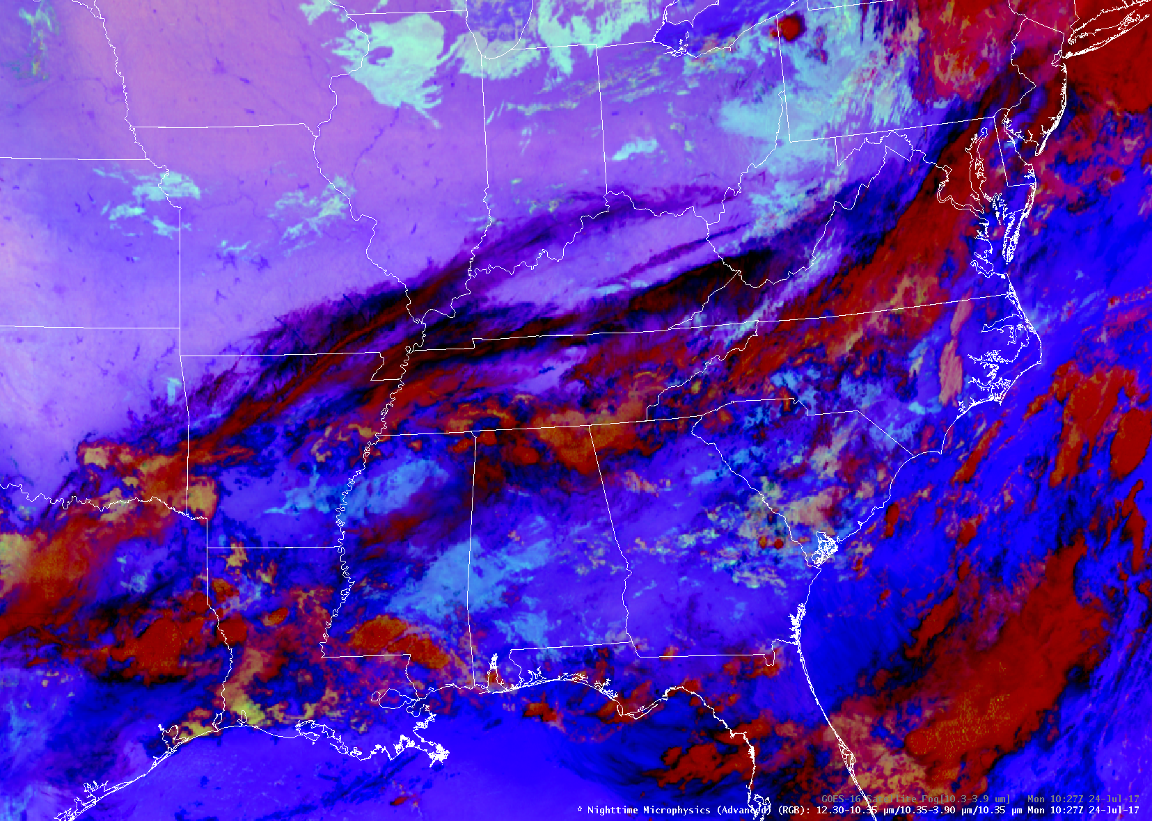
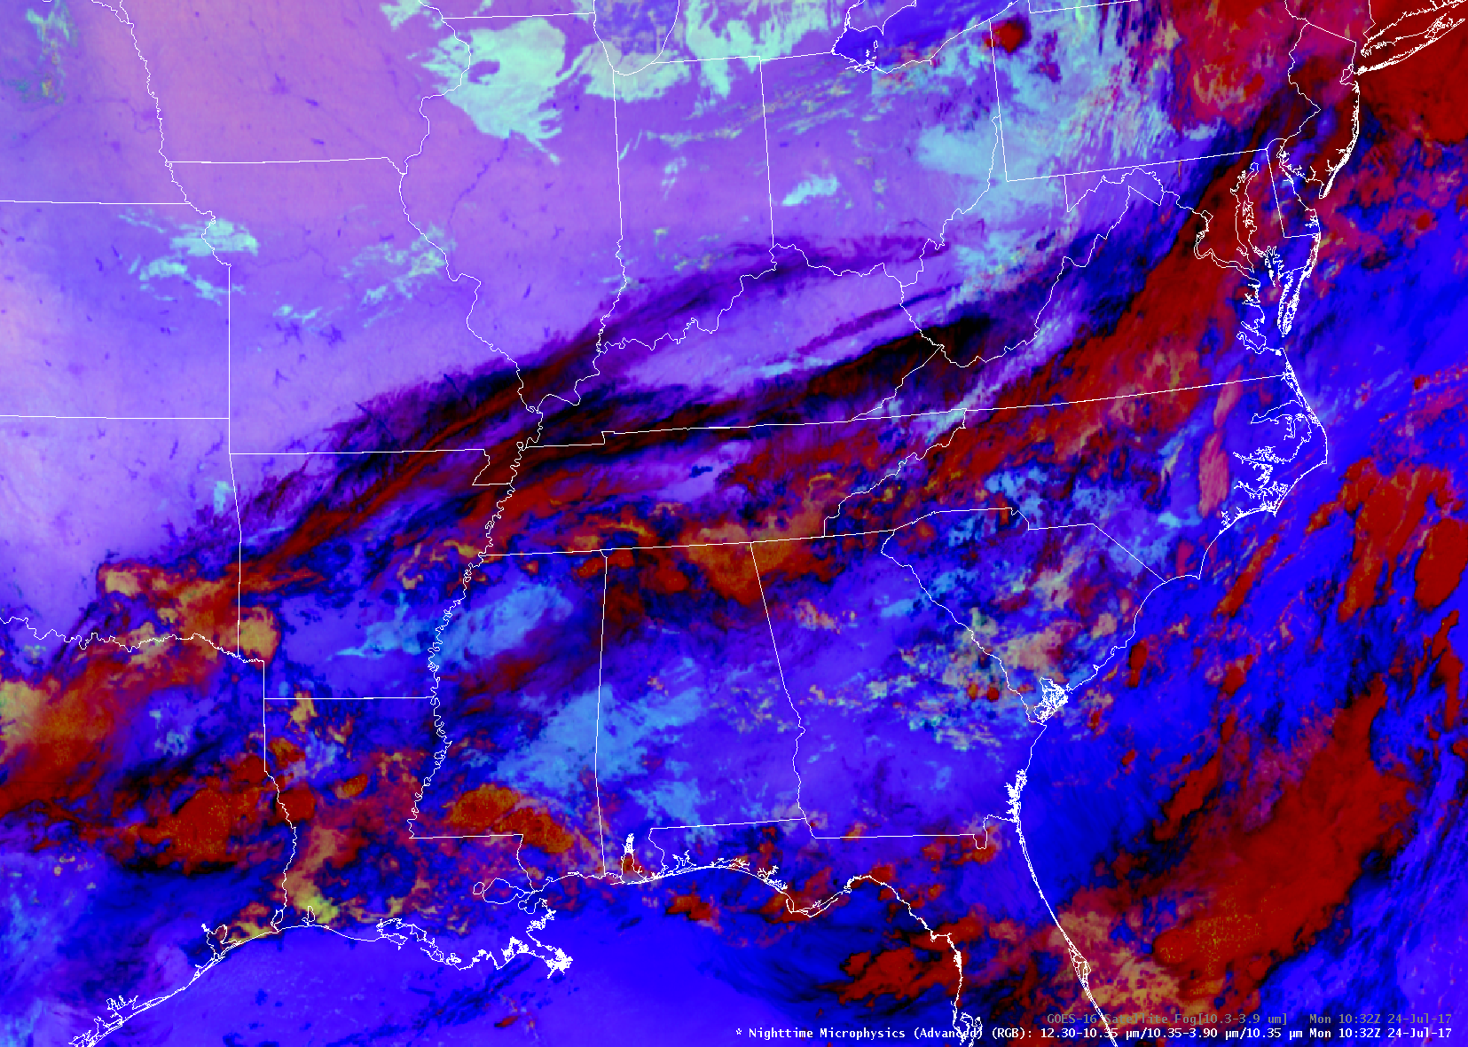
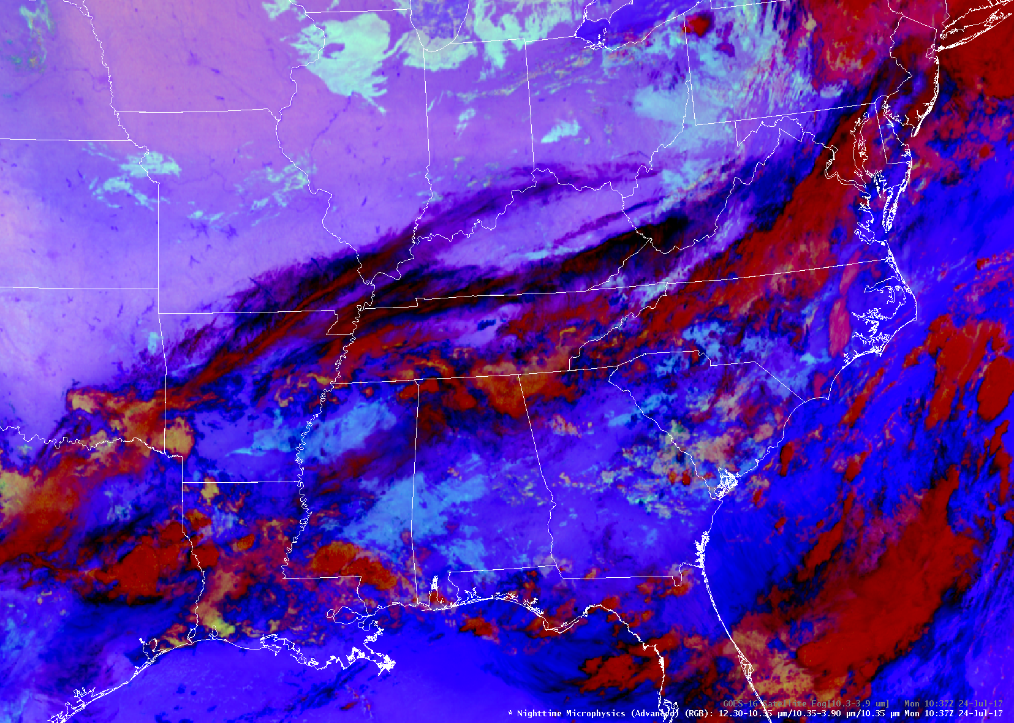
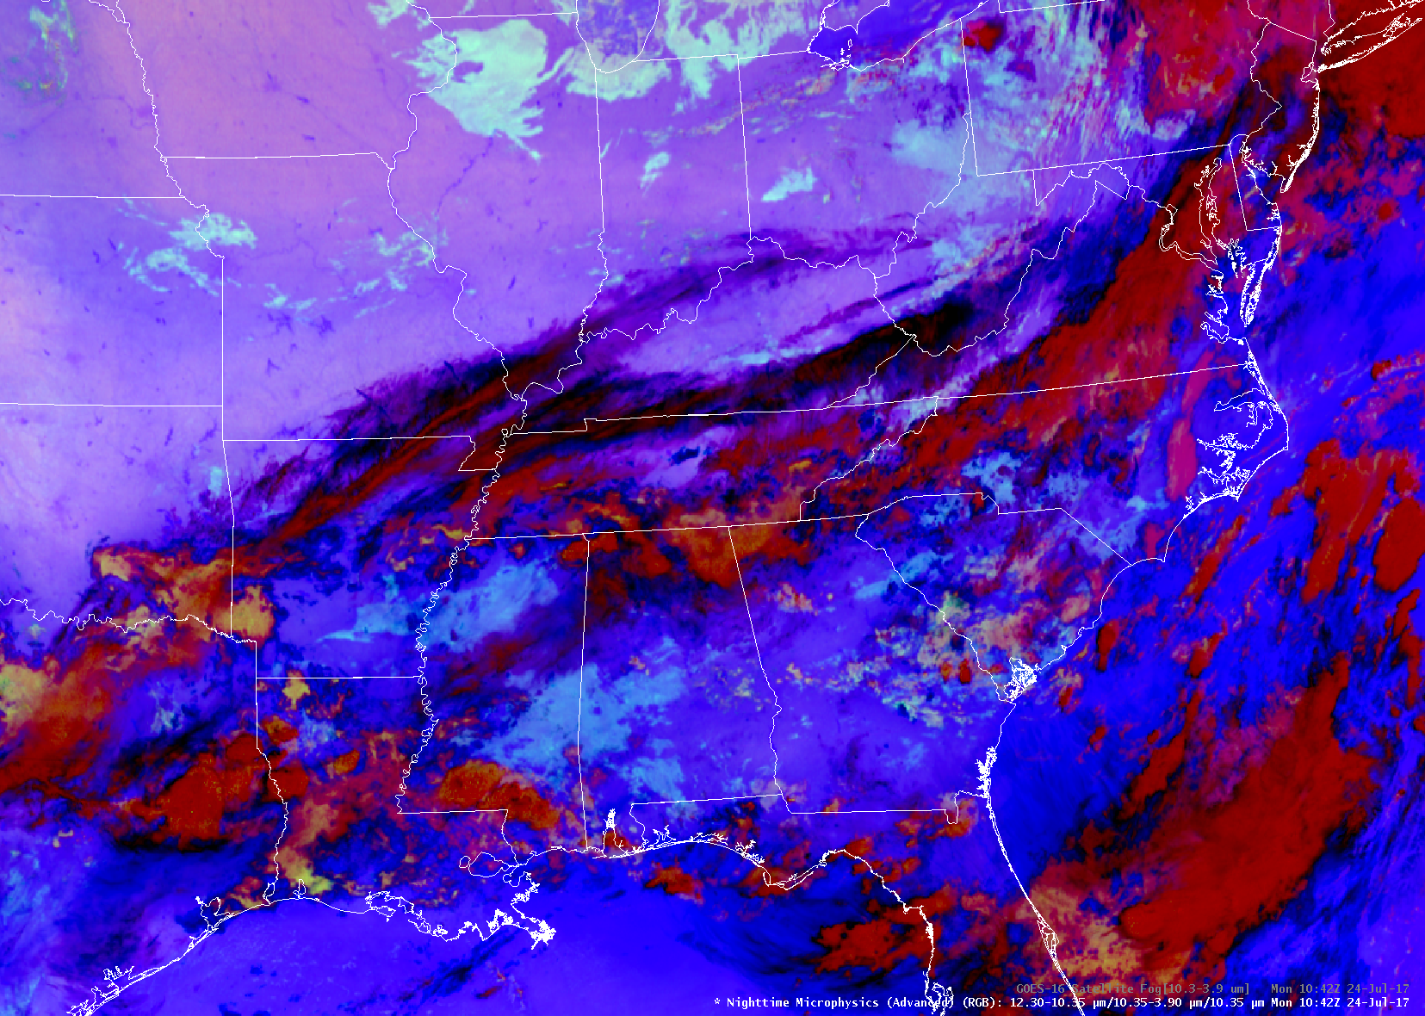
The Nighttime Microphysics RGB
Notes:
Because each color pixel is the result of specific combinations of red, green and blue…one can generally assumer homogenous conditions across an area with similar colors. However, relatively small changes in colors may occur across a cloud type, which are tied to physical phenomena (i.e., temperature, low-level moisture). Thus, variations in colors in a low stratus deck may indicate thicker/thinner clouds in some locations. This can have ramifications on the cloud evolution following sunrise and the onset of deeper mixing. For example,

Slide 12
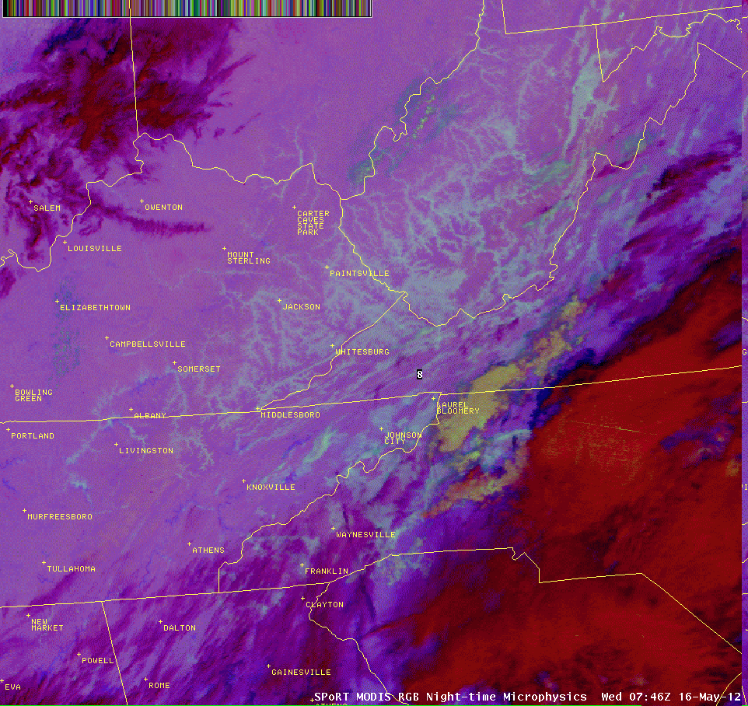
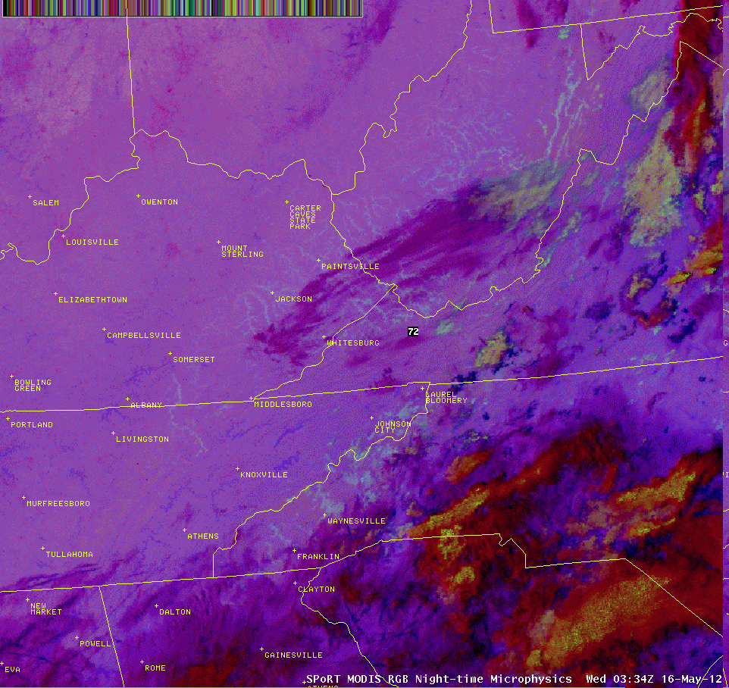
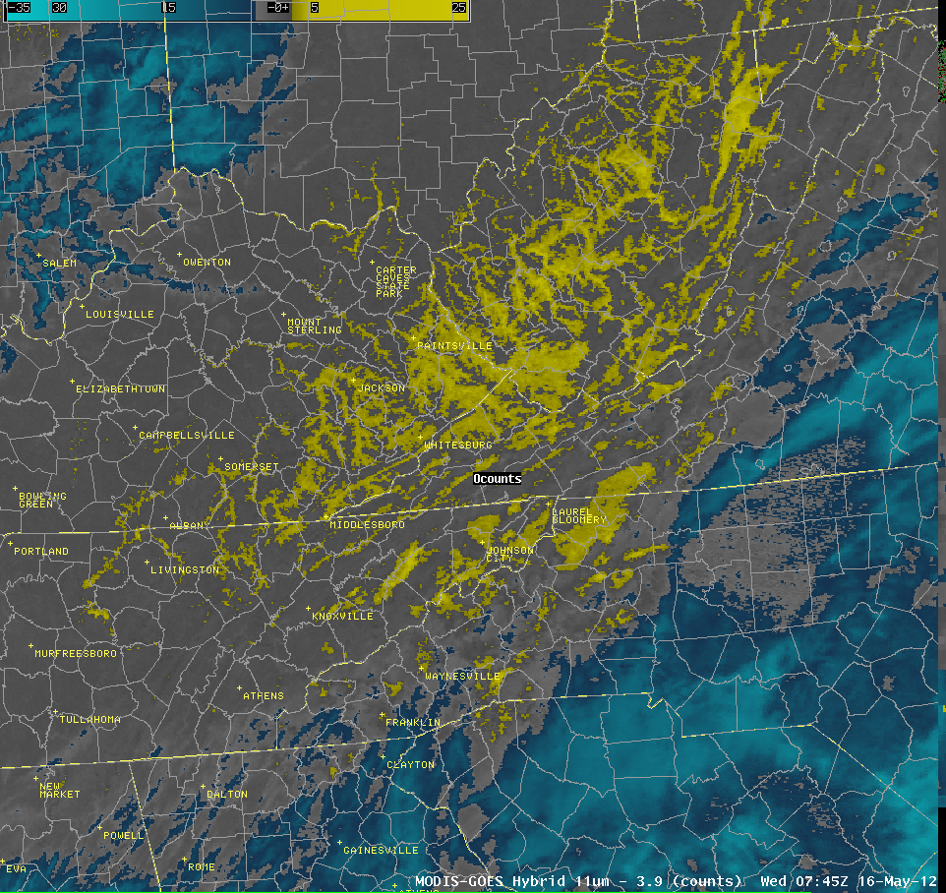
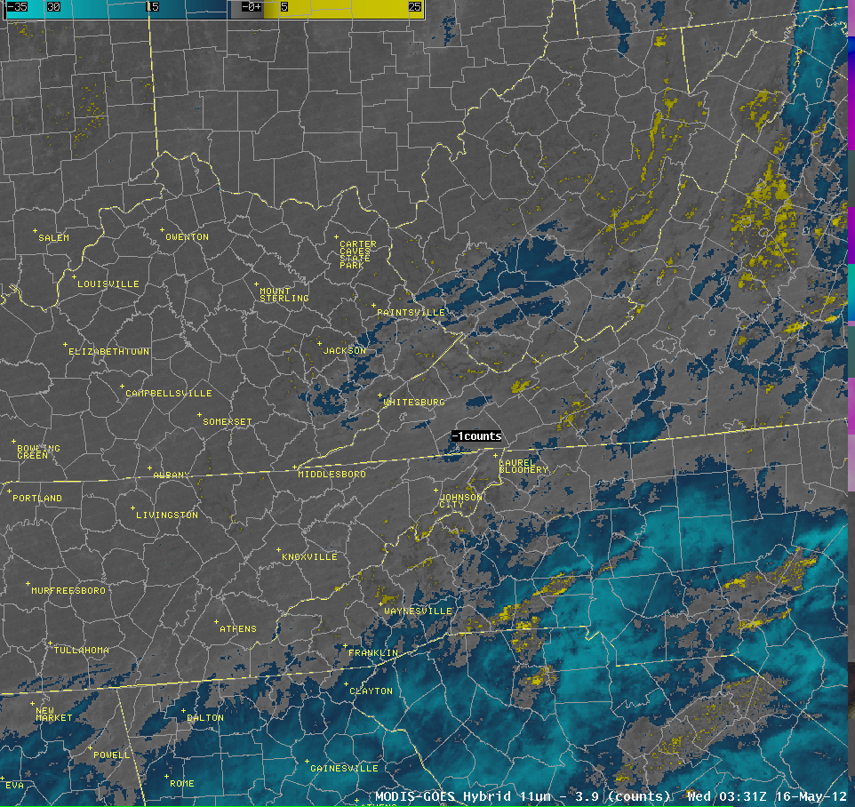
The Nighttime Microphysics RGB
Notes:
Fog shows up reasonably well in the legacy 10.35-3.9 um imagery. However, the color contrast in the Nighttime Microphysics RGB is easier for many to see. Also, the NT Micro RGB shows color contrast between different types of low clouds. In this case, mid clouds in NW North Carolina are more easily distinguished from fog and low stratus in the Nighttime Microphysics RGB vs the legacy 11-3.9 um imagery.

Slide 13
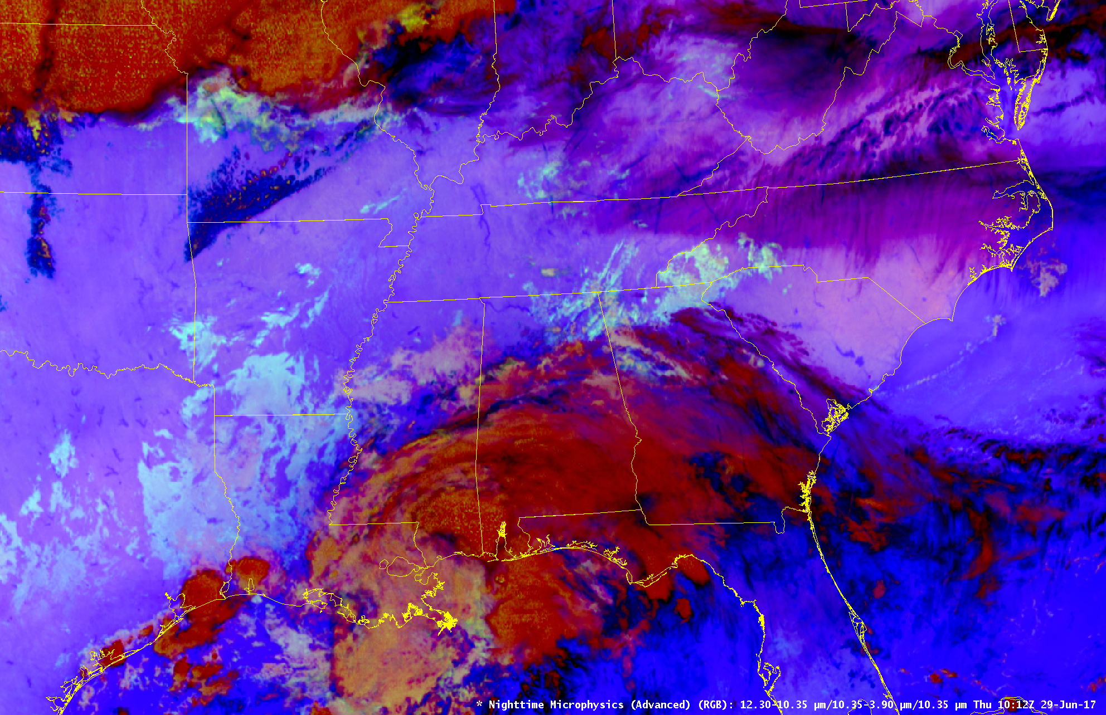
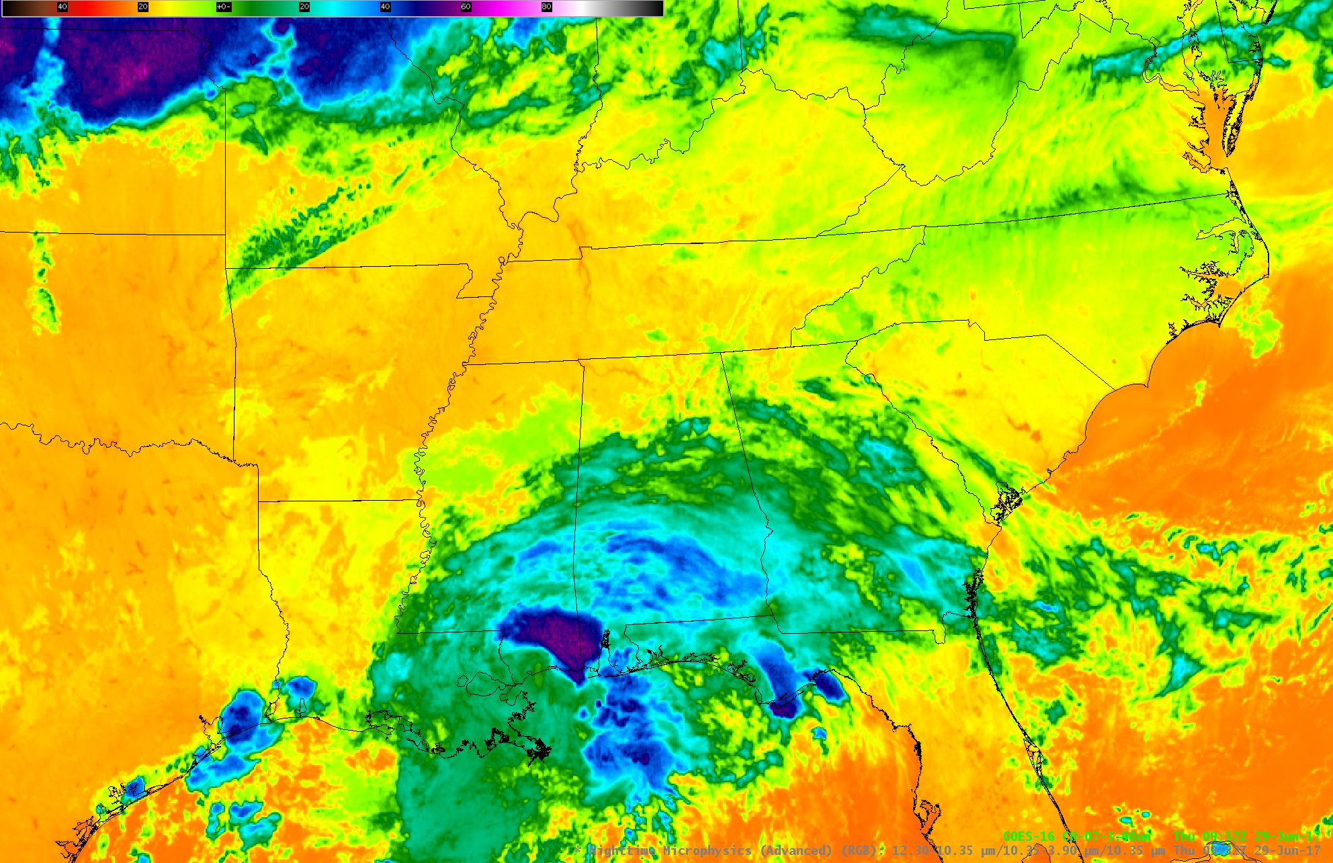
The Nighttime Microphysics RGB
Similar values in the 10.35-3.9 um, but very different cloud types
Notes:
Fog shows up reasonably well in the legacy 10.35-3.9 um imagery. However, the color contrast in the Nighttime Microphysics RGB is easier for many to see. Also, the NT Micro RGB shows color contrast between different types of low clouds. In this case,

Slide 14
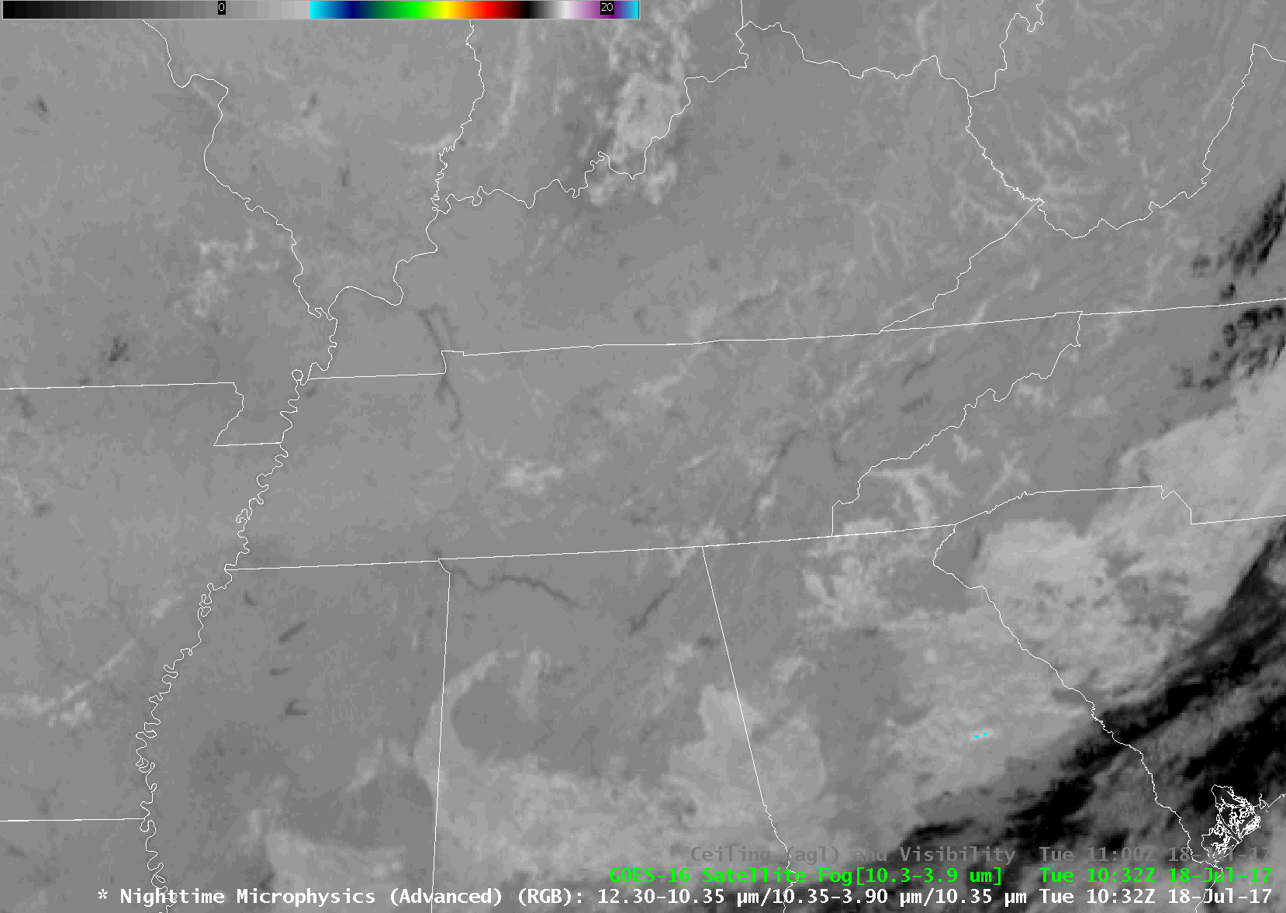
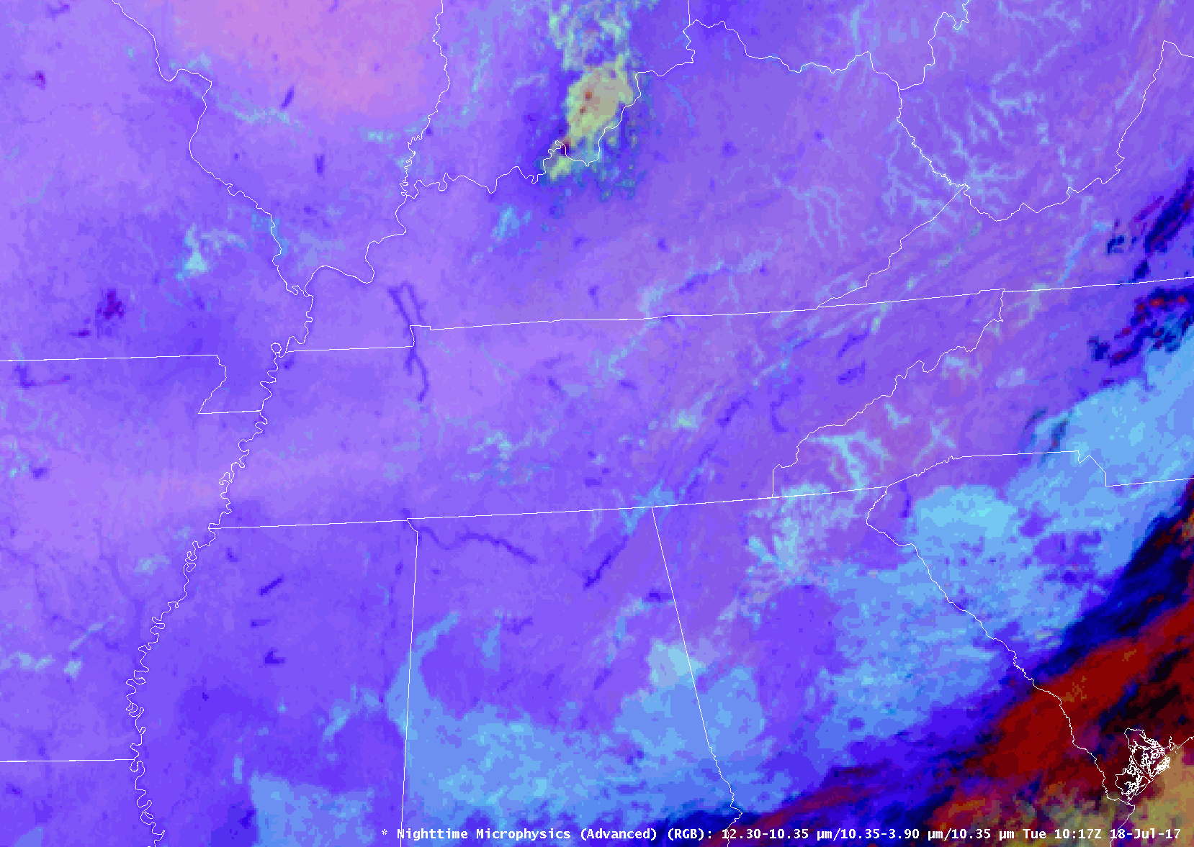
The Nighttime Microphysics RGB
Colder, thicker clouds with higher bases
Notes:
Fog shows up reasonably well in the legacy 10.35-3.9 um imagery. However, the color contrast in the Nighttime Microphysics RGB is easier for many to see. Also, the NT Micro RGB shows color contrast between different types of low clouds. In this case,

Slide 15
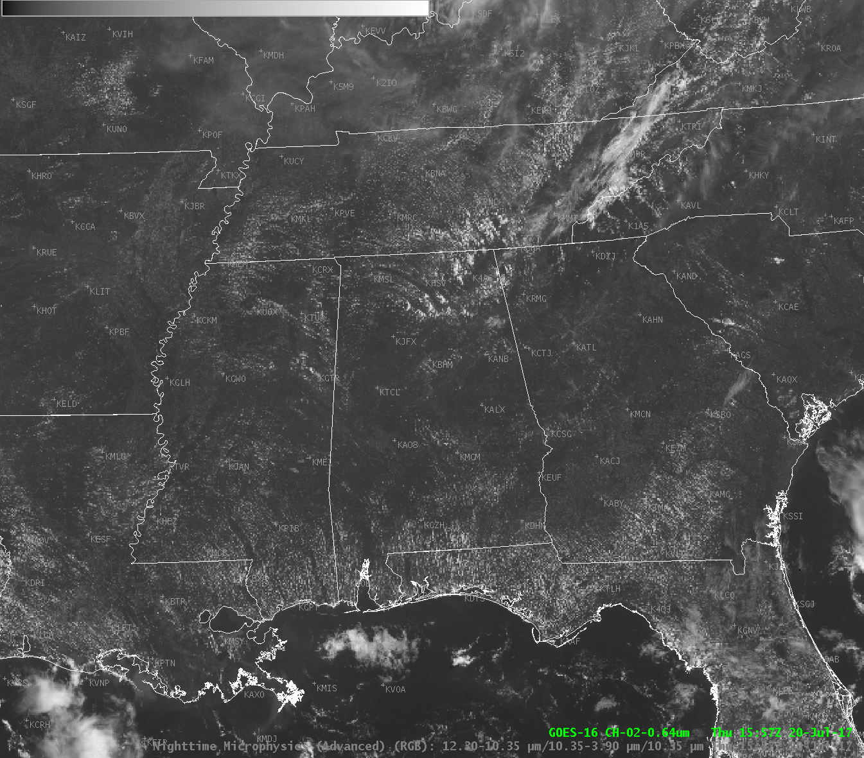
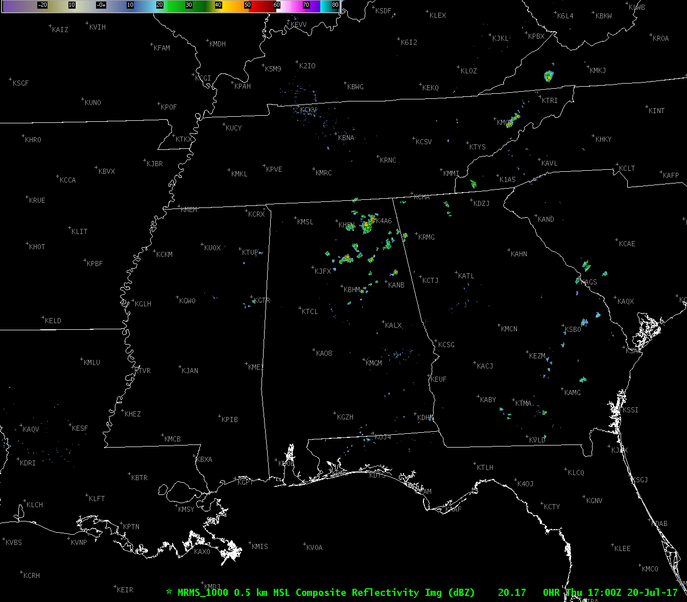
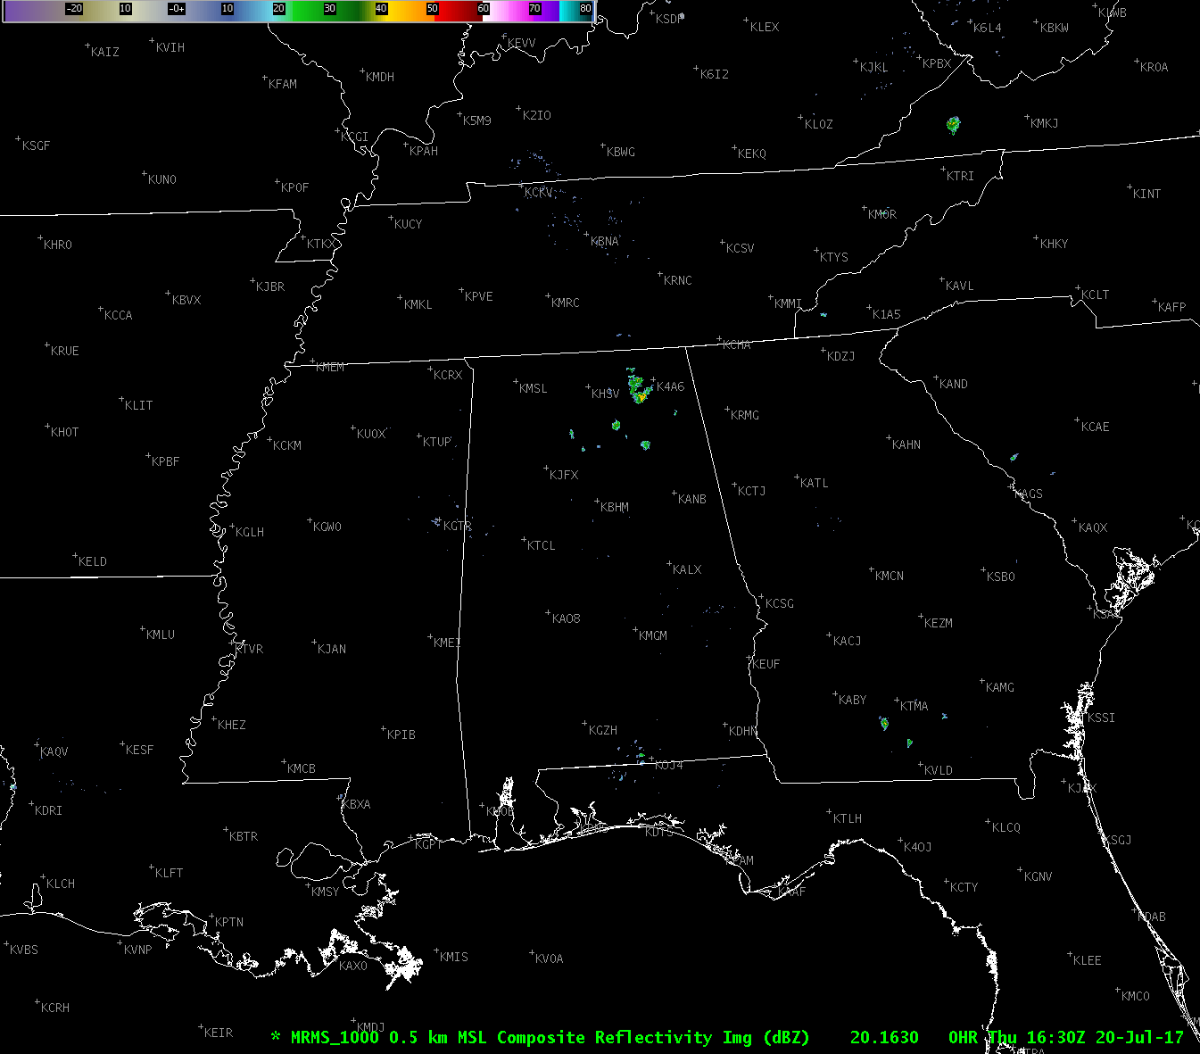
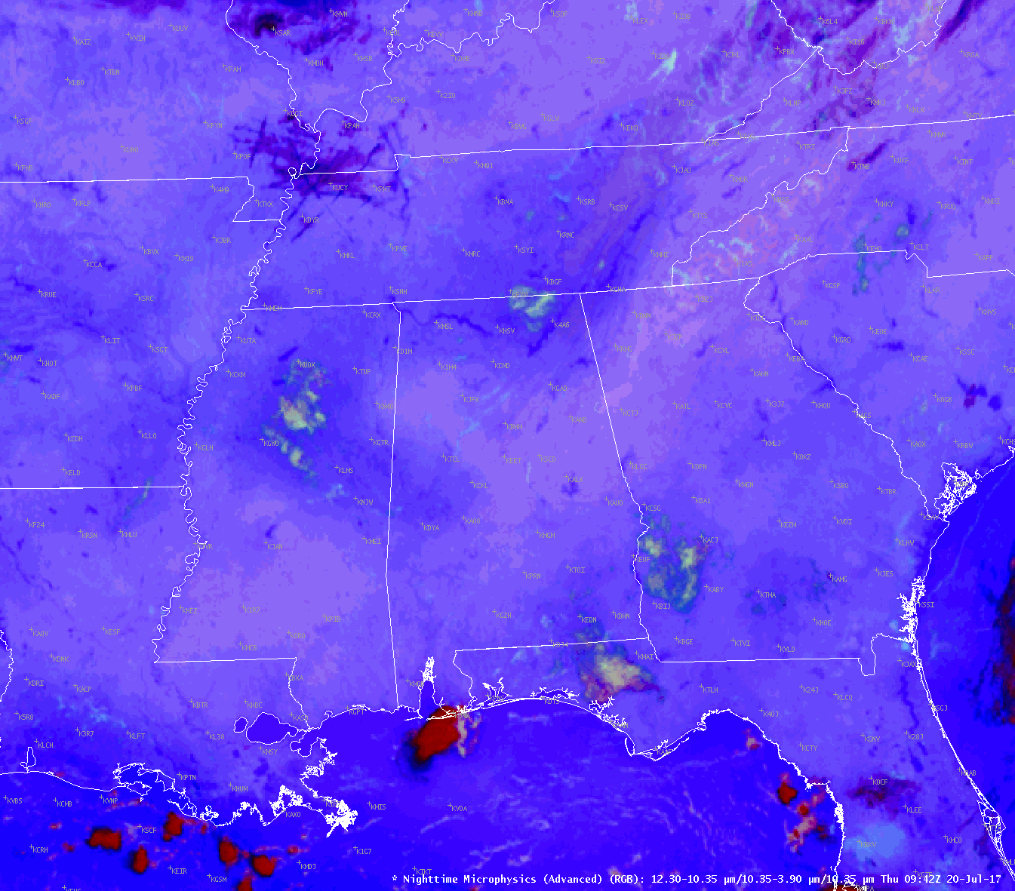
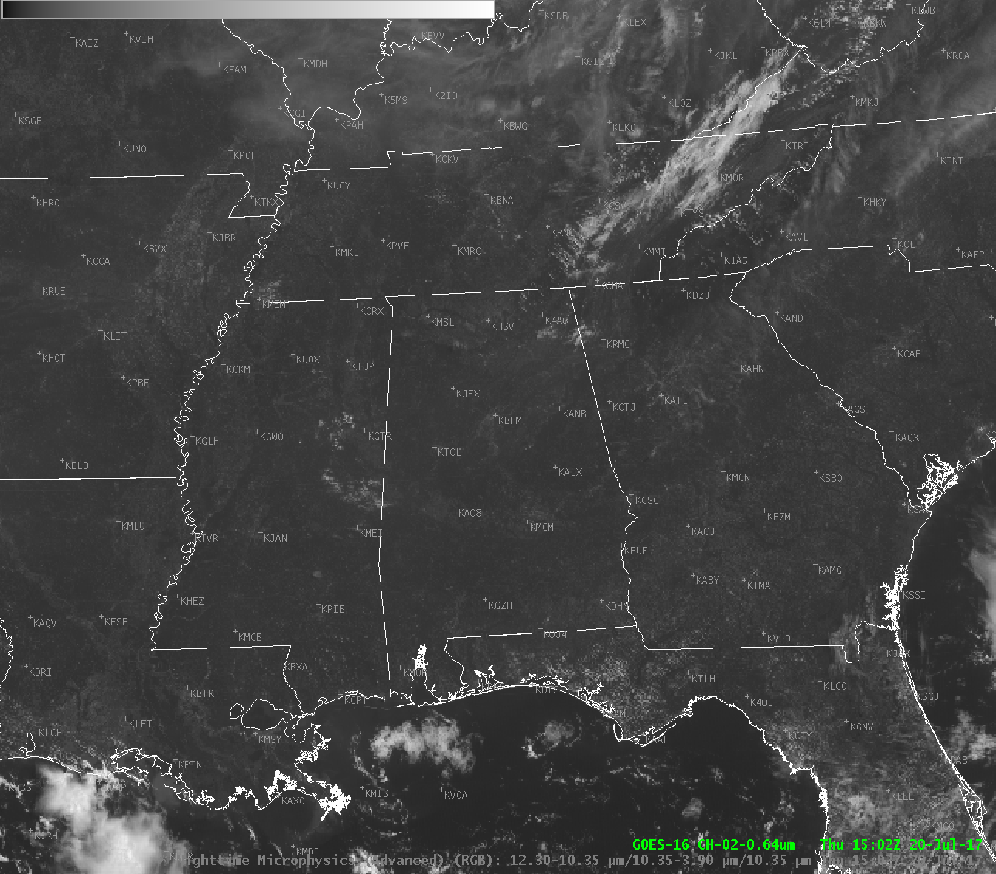
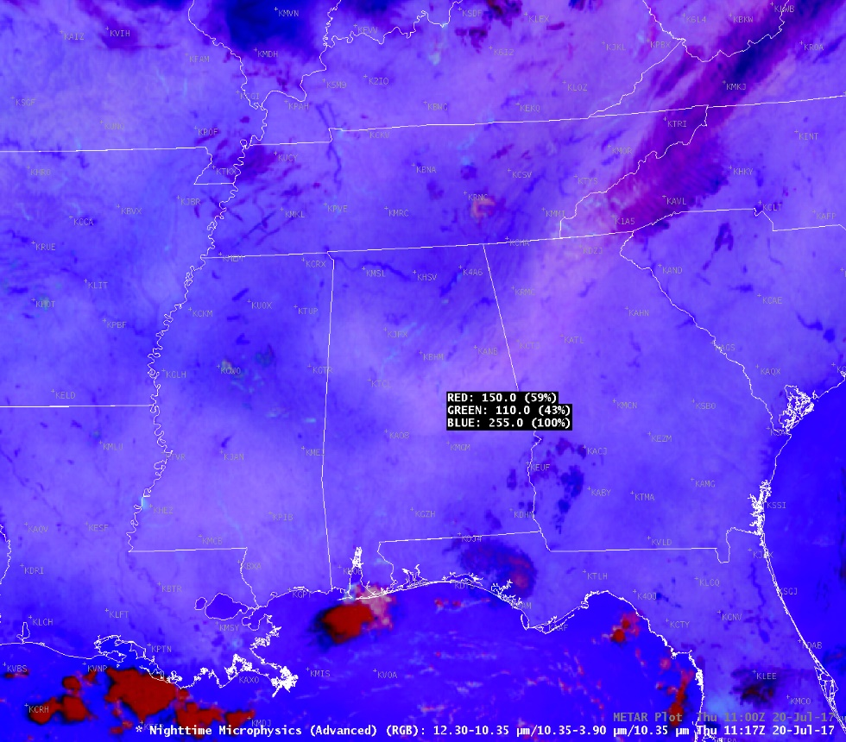
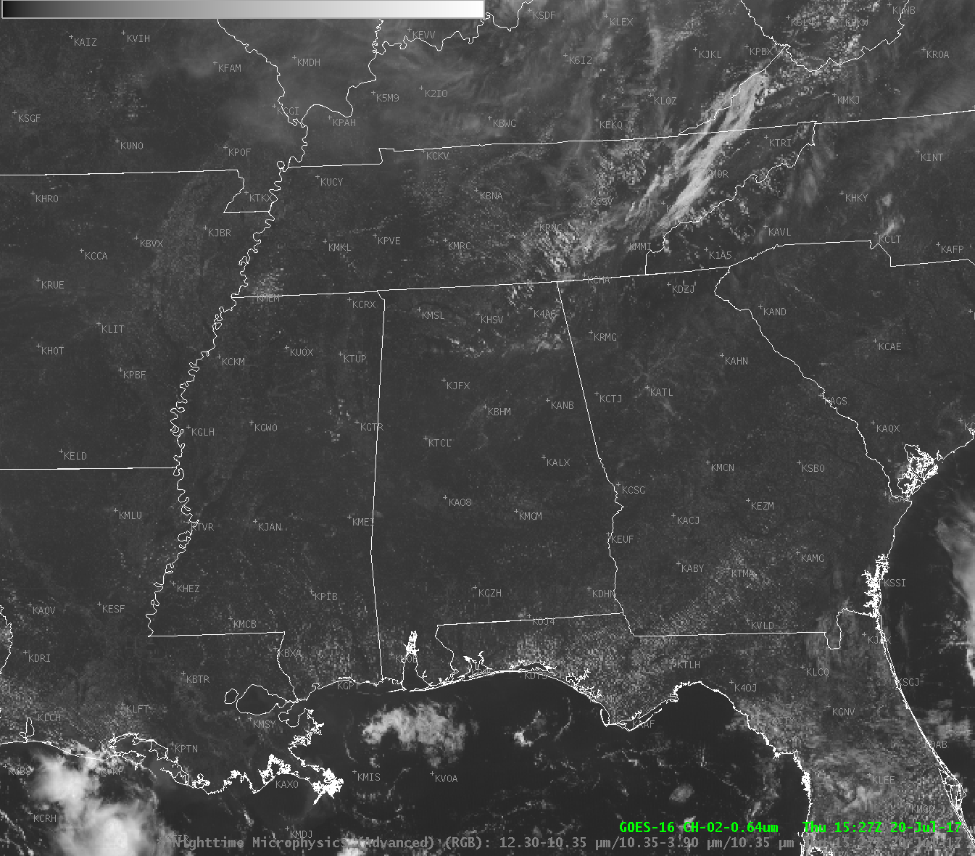
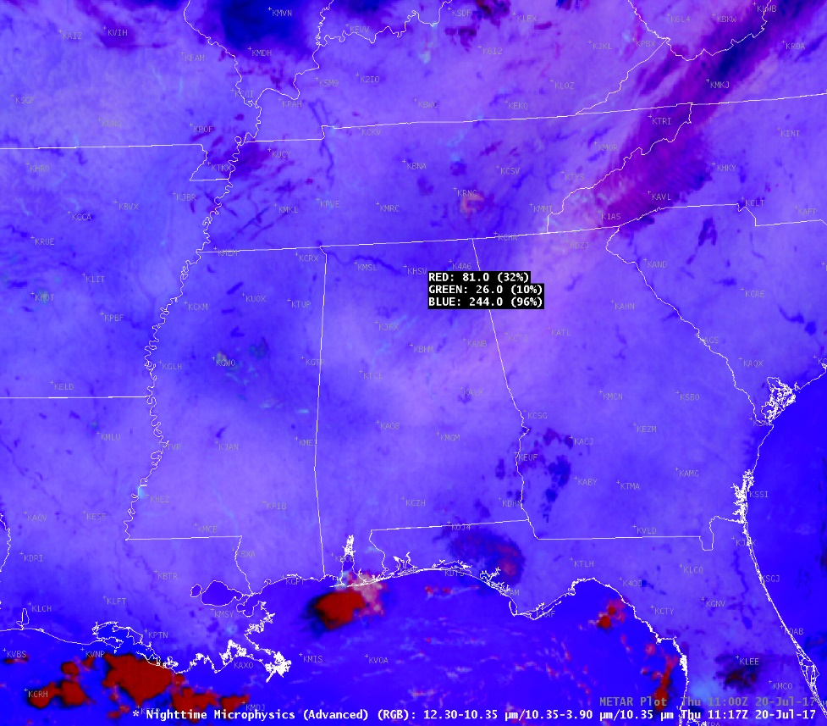
The Nighttime Microphysics RGB
Red
Low-level moisture
Red
Low-level moisture
Notes:
Fog shows up reasonably well in the legacy 10.35-3.9 um imagery. However, the color contrast in the Nighttime Microphysics RGB is easier for many to see. Also, the NT Micro RGB shows color contrast between different types of low clouds. In this case,

Slide 16
The Nighttime Microphysics RGB
Relatively dry air mass
Relatively moist air mass
Notes:
Changes in the red color contribution, which is the split window difference can be used to show contrasting air mass and help with the location of frontal boundaries.

Slide 17
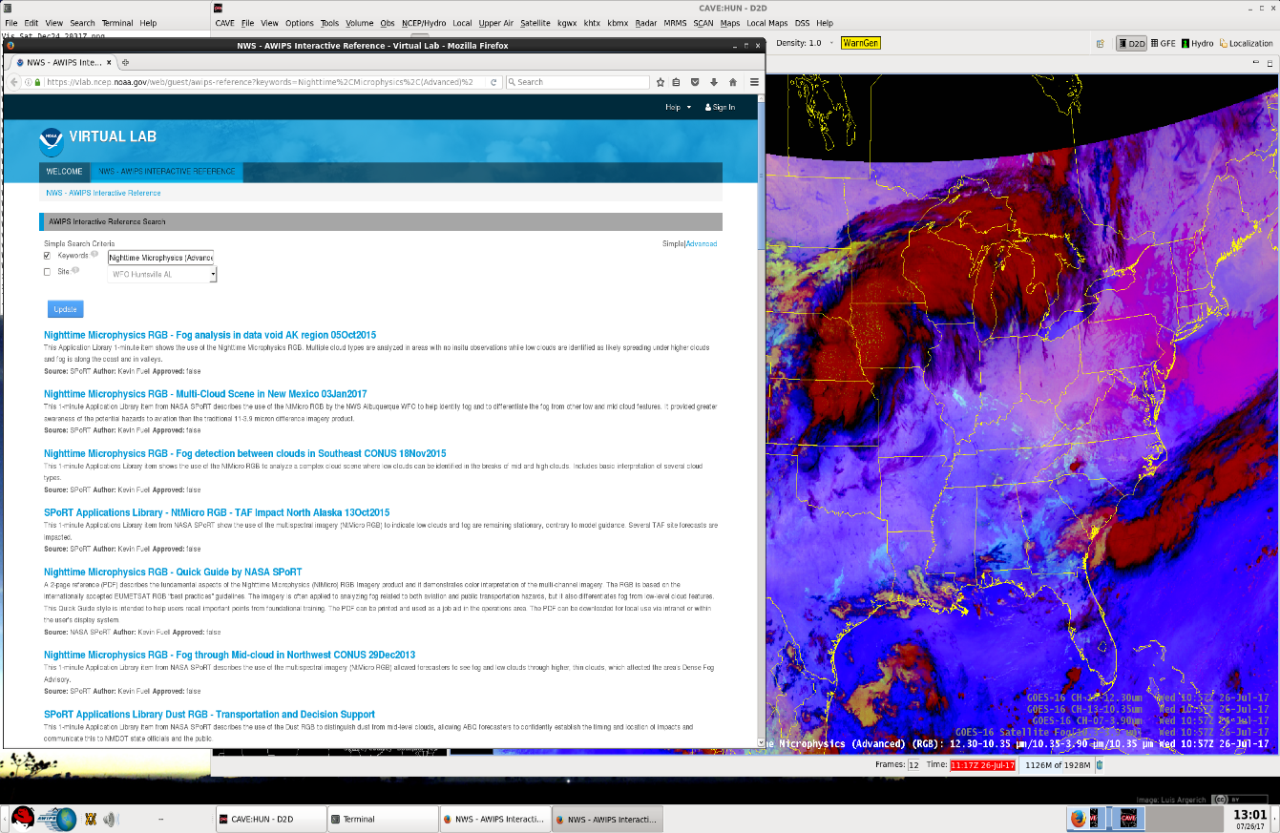
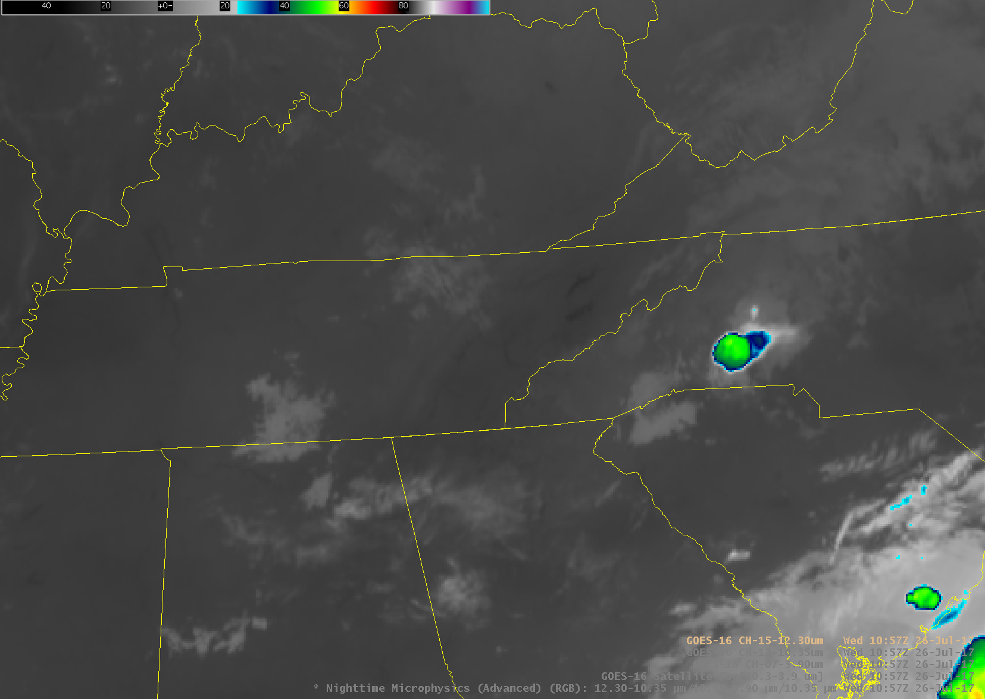
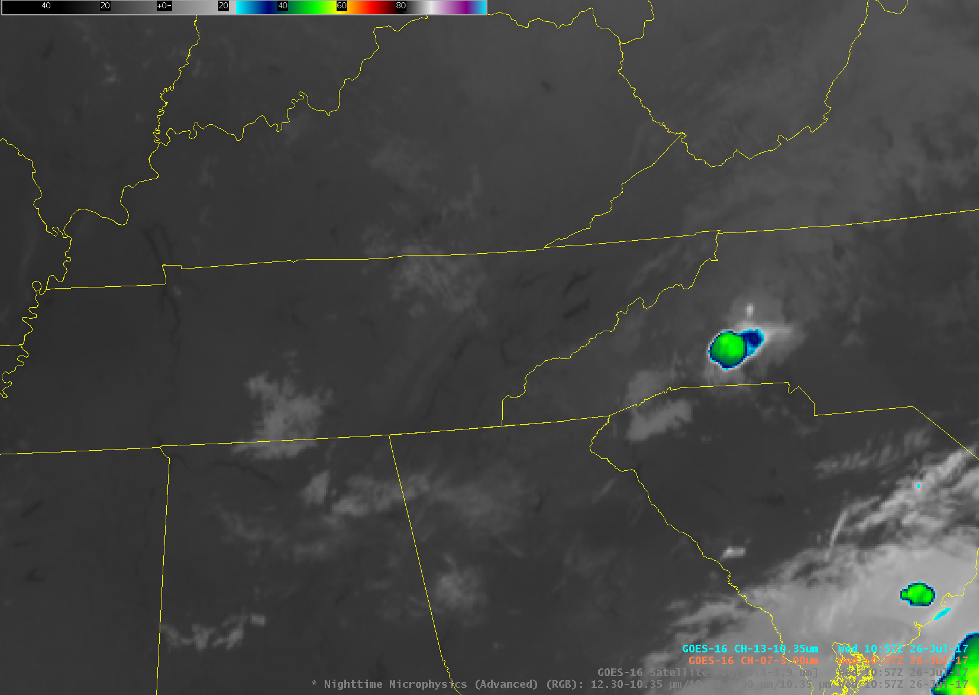
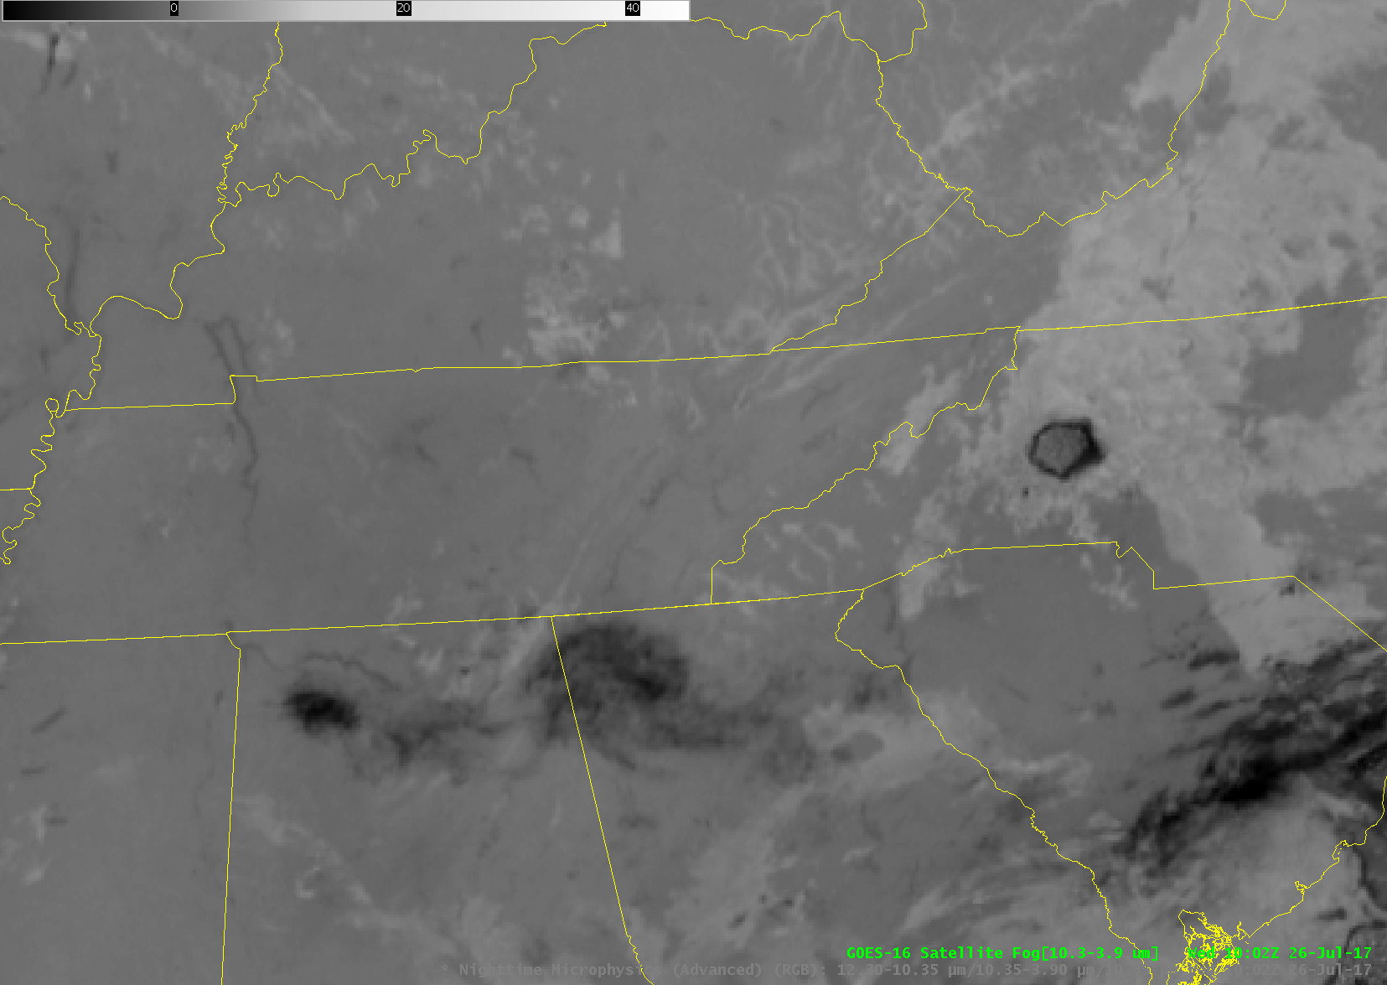
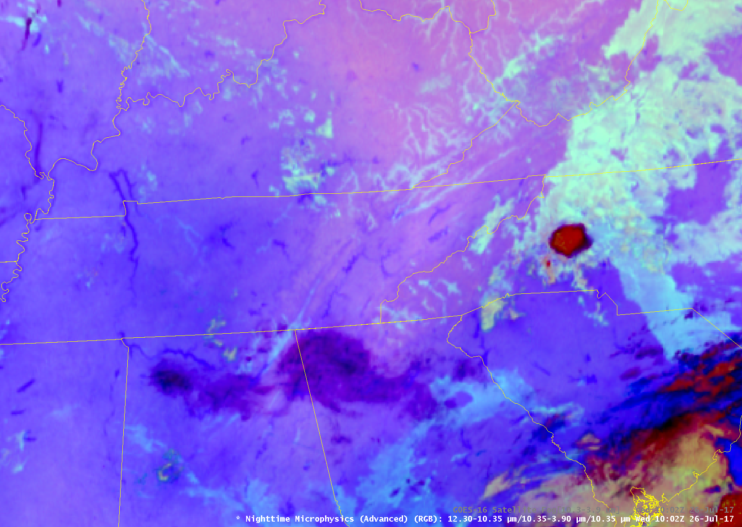
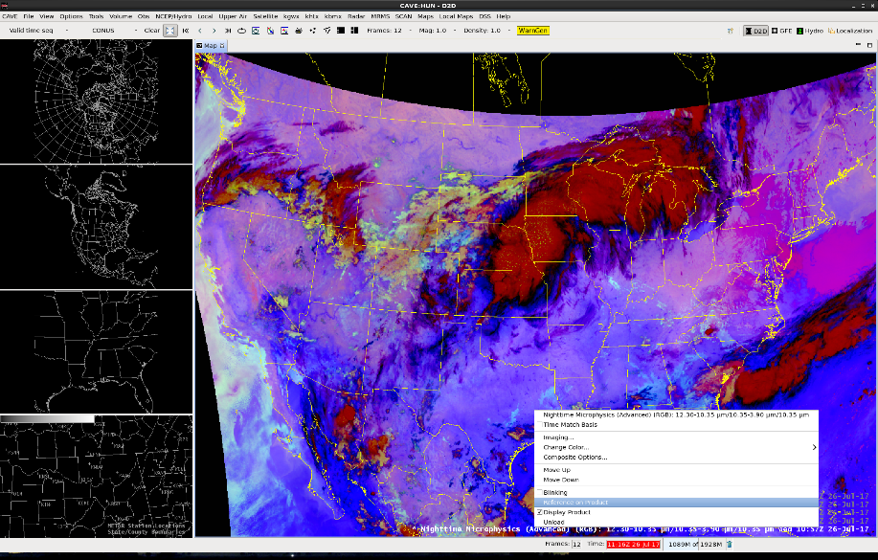
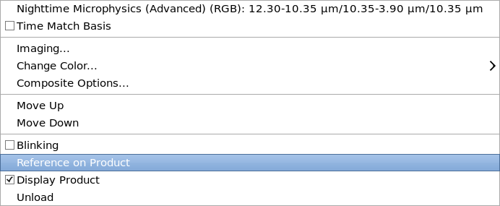
Learning tips…
Use the Nighttime Microphysics (or other RGBs) with other imagery with which you are familiar
Observe the constituent bands that comprise the RGB to see how values are changing
Access reference materials through the AIR tool in AWIPS

Slide 18
Main Takeaways
The Nighttime Microphysics RGB can be used to identify low cloud features such as fog and low stratus and offers better contrast than legacy imagery.
The Nighttime Microphysics RGB can be used to help identify areas of contrasting low-level moisture.
Use unfamiliar imagery along with what you do know

Slide 19
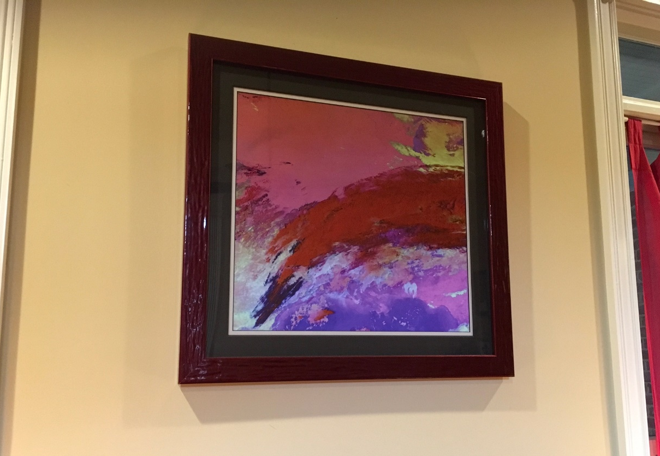
Takeaways
Lastly, if you don’t like any of these applications, you could consider the Nighttime Microphysics RGB for wall art…
Notes:
Lastly, the Nighttime Microphysics makes for nice abstract art. I’m not kidding, this hangs on the living room in my girlfriend’s home. She peered over my shoulder one day while I was working and said she loved the imagery. So, I had one blown up, printed and framed. This image was from the night we met. =)

Slide 20
Questions?
FDTD GOES-16 Applications
Nighttime Microphysics RGB (Advanced)
Thanks to: Dan Bikos, Scott Lindstrom, Brian Motta, Emily Berndt, Kevin Fuell
Contact:
kris.white@noaa.gov
Do you want to lead a future Webinar?
scott.lindstrom@noaa.gov / dan.bikos@colostate.edu
Notes:
WDTD will moderate Q & A

