Slide 1

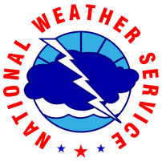



FDTD GOES-16 Applications North Bay Wildfires
Presented by
Matt Mehle
NWS WFO Monterey, CA

Slide 2
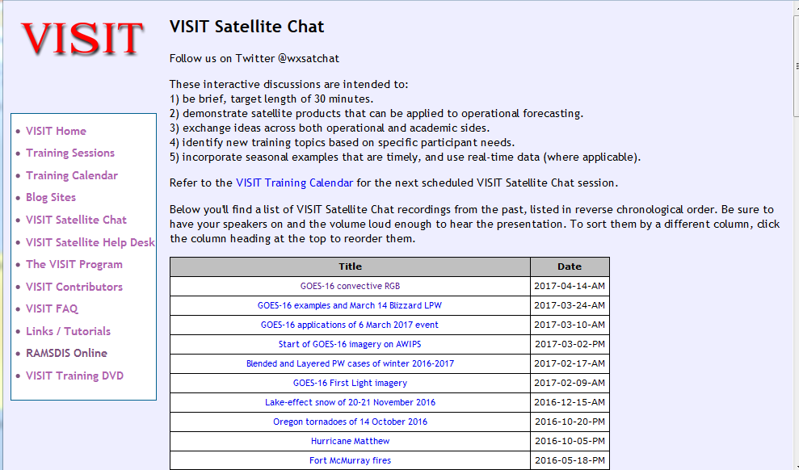
FDTD “Satellite Chat” Library
http://rammb.cira.colostate.edu/training/visit/satellite_chat/
Recorded Content includes Q&A
Call for speakers! Let us know if you want to speak on a topic!
Contact: scott.lindstrom@noaa.gov OR dan.bikos@noaa.gov

Slide 3

FDTD GOES-16 Applications Webinar Protocol
~20 minutes for the speaker
Send questions via GoTo Chat
Or ask during Q&A period via phone
Followed by Q&A
Open discussion forum
Done by 1930 UTC
Do NOT press hold!!!
Mute when not speaking
Notes:
WDTD talks to this slide

Slide 4
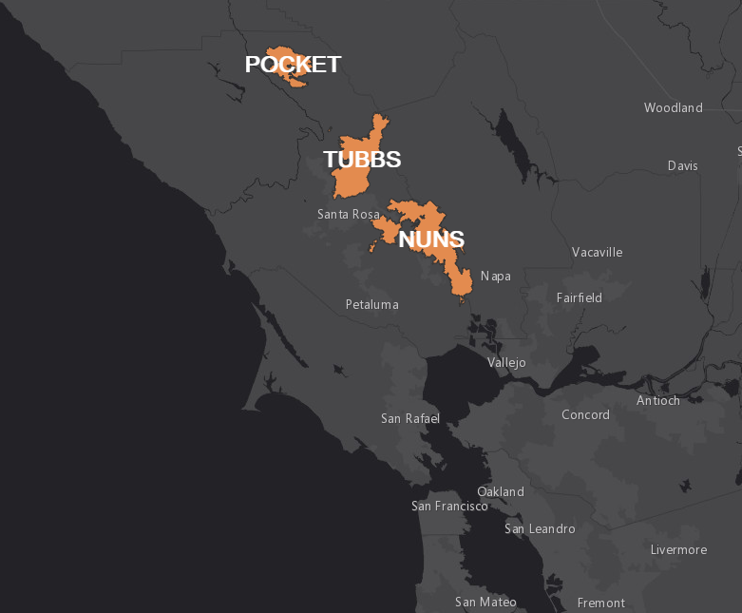
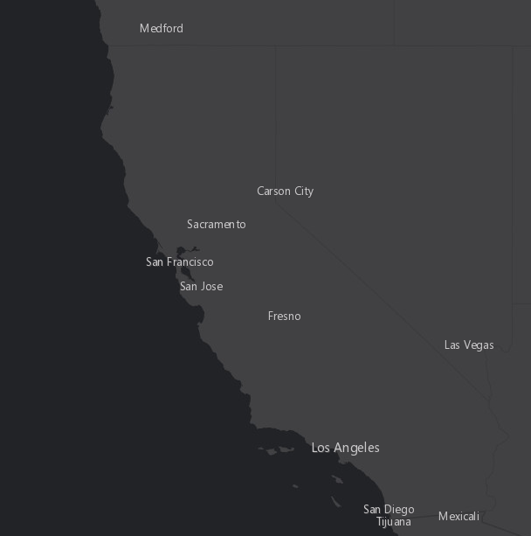
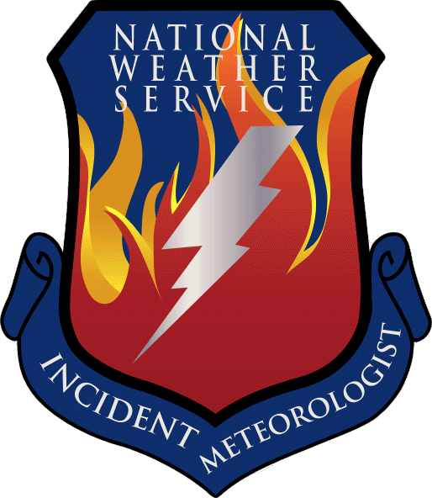

North Bay Wildfires
Matt Mehle - Incident Meteorologist
San Francisco Bay Area
Weather Forecast Office
Monterey, CA

Slide 5
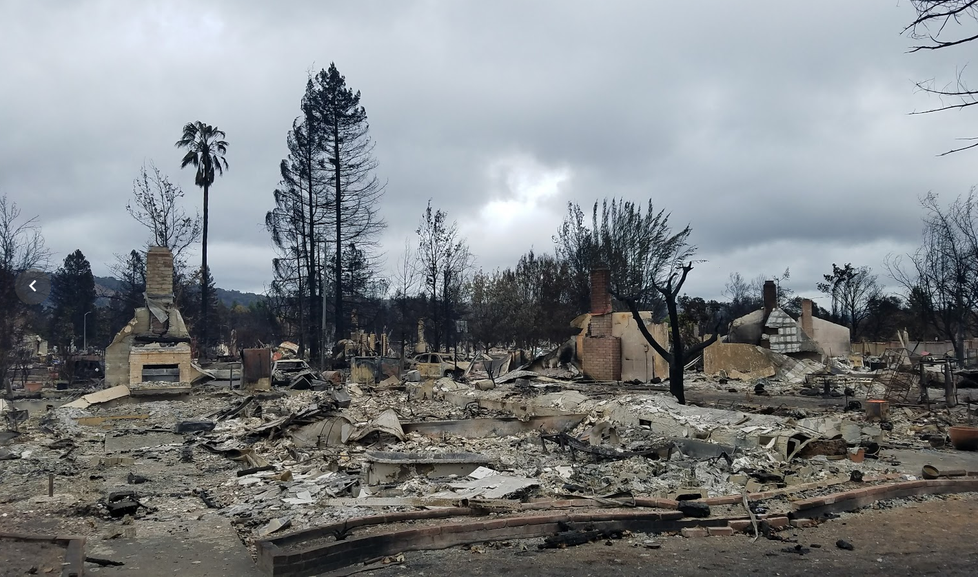
Firestorm of the North Bay
*Photo By: Matt Mehle – Coffey Park
Unprecedented damage – partial/total lose 14,700 homes
Costliest Urban Wildfire in U.S. history ~$3.3 billion
42 fatalities
Notes:
Previous costliest fire was Oakland – 2.7 billion in 1991

Slide 6
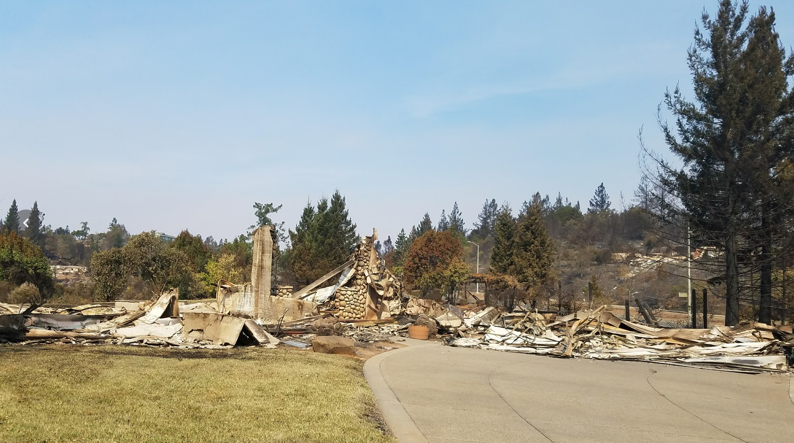
Firestorm of the North Bay
*Photo By: Matt Mehle – Fountain Grove
Notes:
Previous costliest fire was Oakland – 2.7 billion in 1991

Slide 7
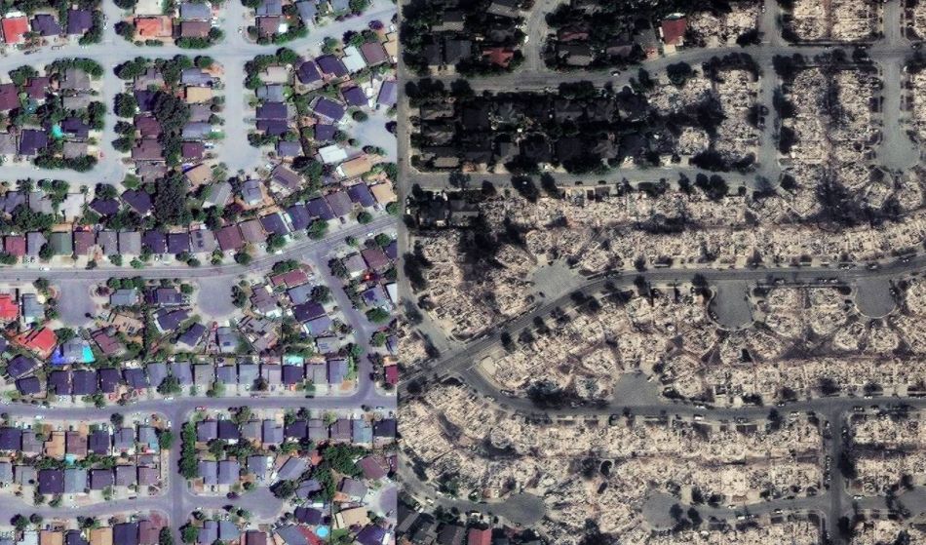
Satellite View of Damage
Before/After Fountain Grove
*source-Overview News // DigitalGlobe 2017

Slide 8
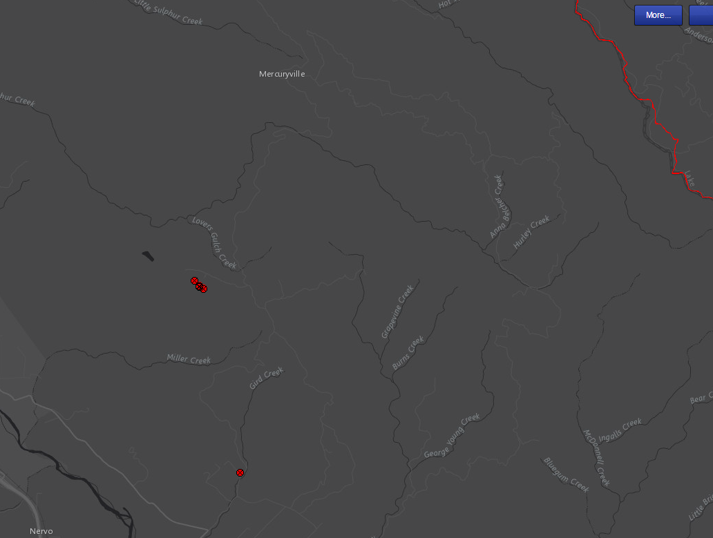
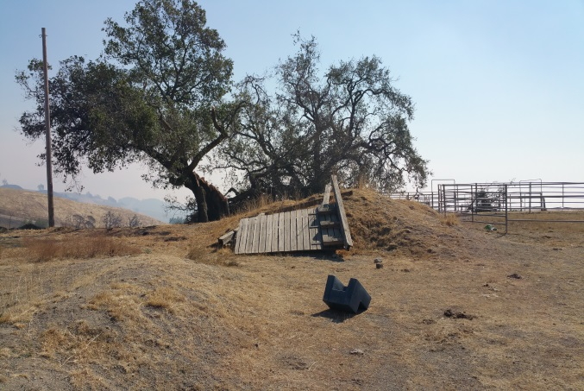
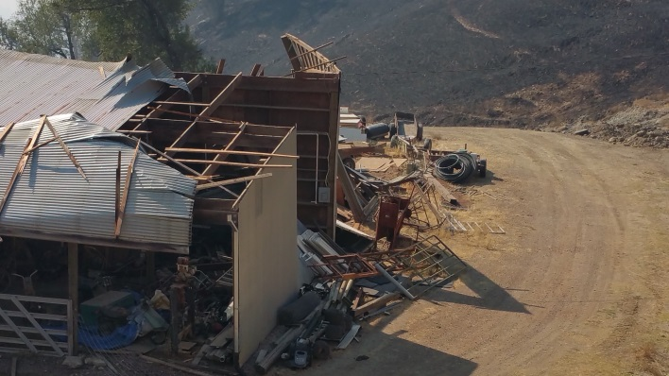
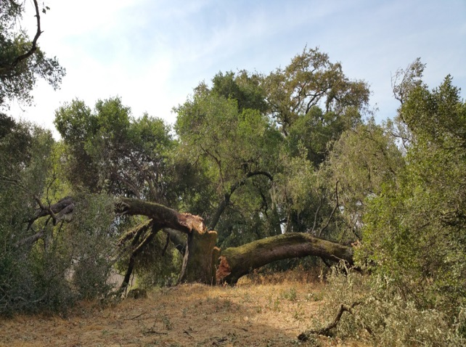
Wind Damage
Geyser Peak
Hawkeyes RAWS
Geyserville
Damage Indicators equivalent to low end EF1 tornado
Notes:
Highest on record or RAWS site. Indicates magnitude of event.

Slide 9
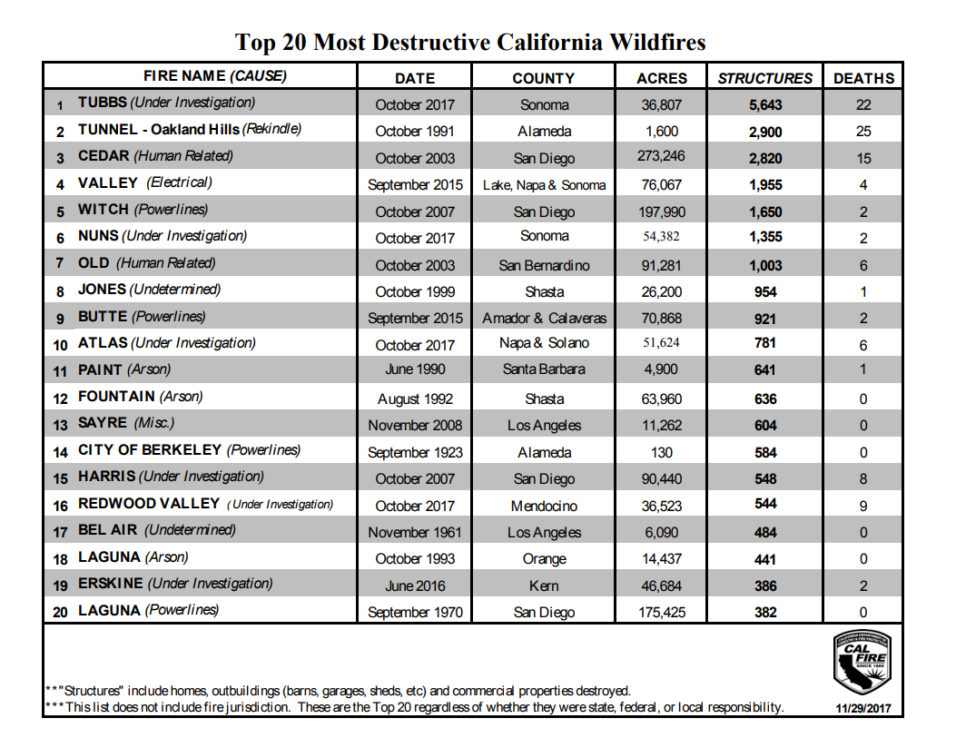
By the Numbers

Slide 10
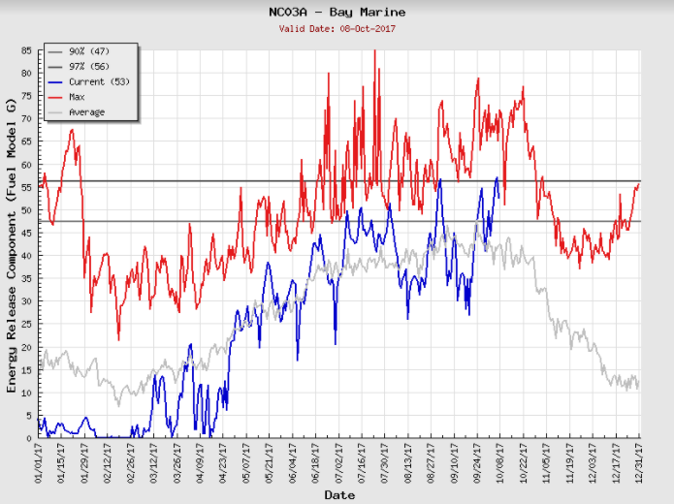
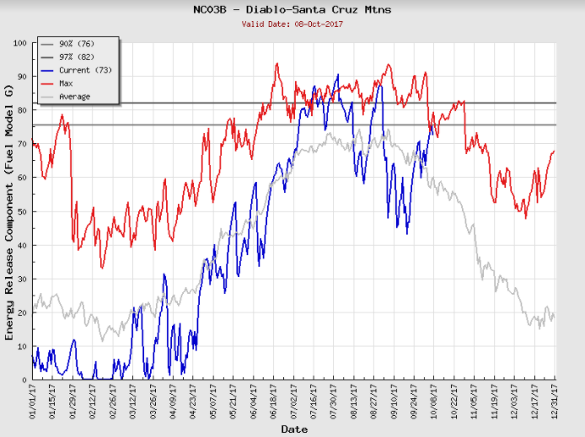
Antecedent Conditions
Five years of record breaking drought
Stressed trees both morbidity and mortality
Above normal rainfall Winter 2016/2017
Rapid growth of finer fuels
Short lived Red Flag Event less than one week prior
Energy Release Component (ERC) 90-97%
10 hr fuel moisture 4-5%
90%
97%
Notes:
History leading up to the Firestorm. “Setting the Stage”

Slide 11
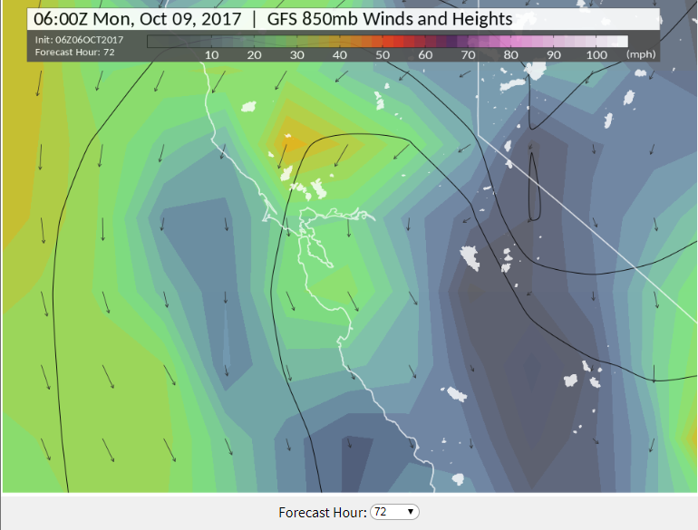
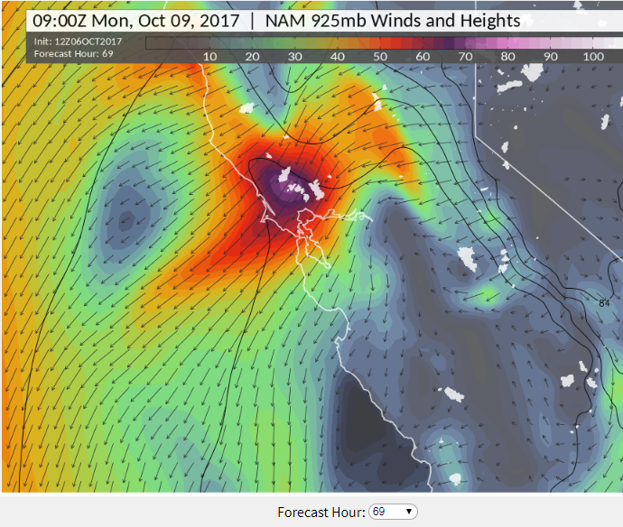
Meteorology
‘Classic’ setup for offshore flow – inland high pressure
Offshore flow pressure gradient forecast >20 mb
Notes:
White polygons are all current fire perimeters in addition to the North Bay
Even large scale models captured winds
Offshore flow gradient >10-11 mb is a decent offshore flow event

Slide 12
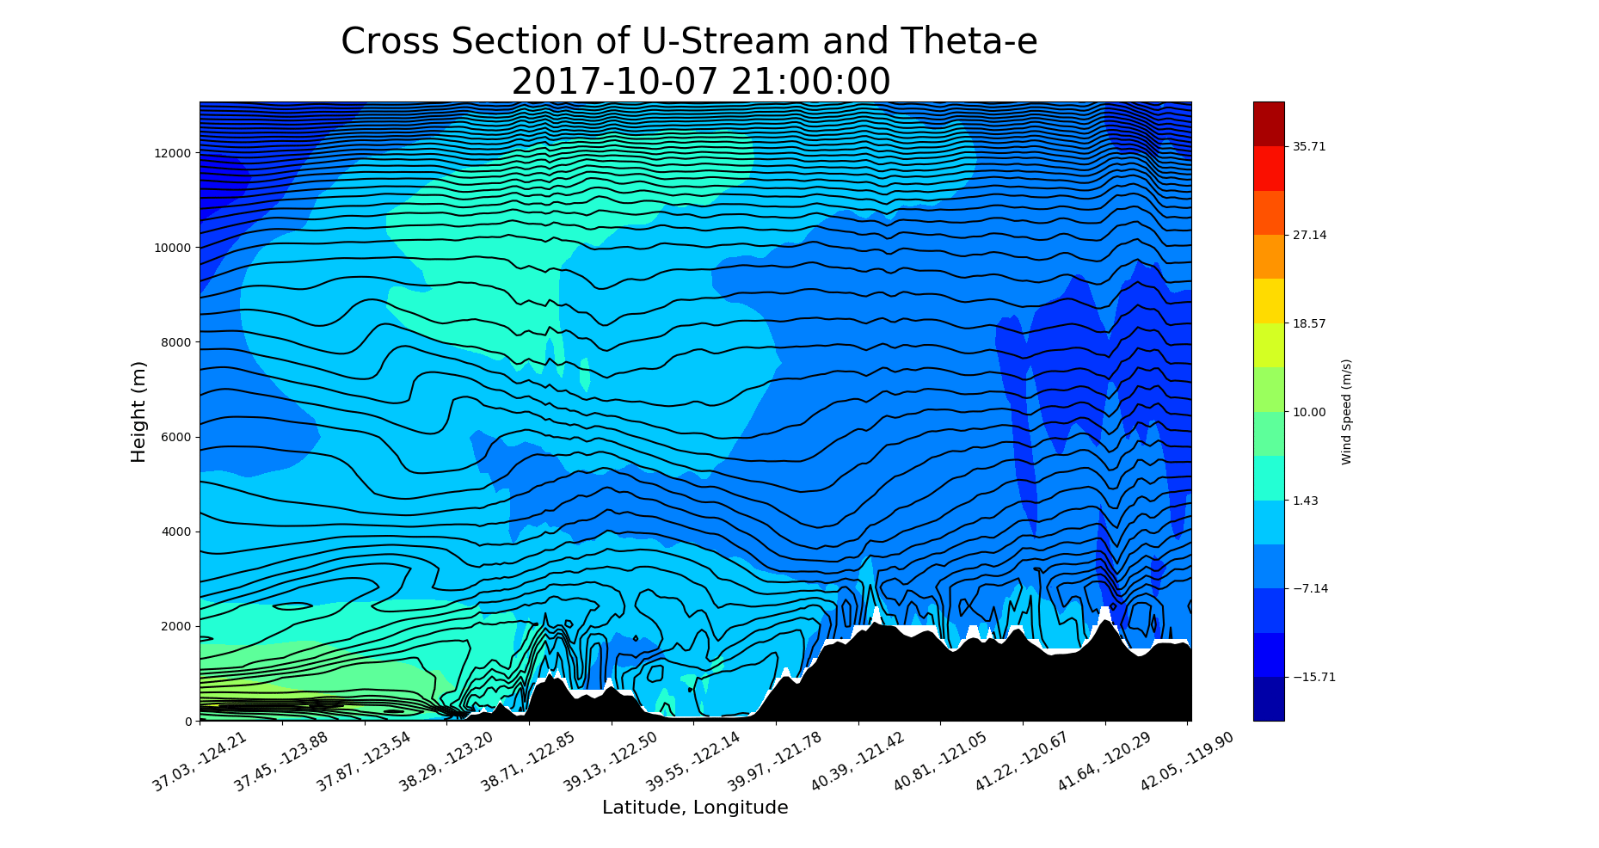
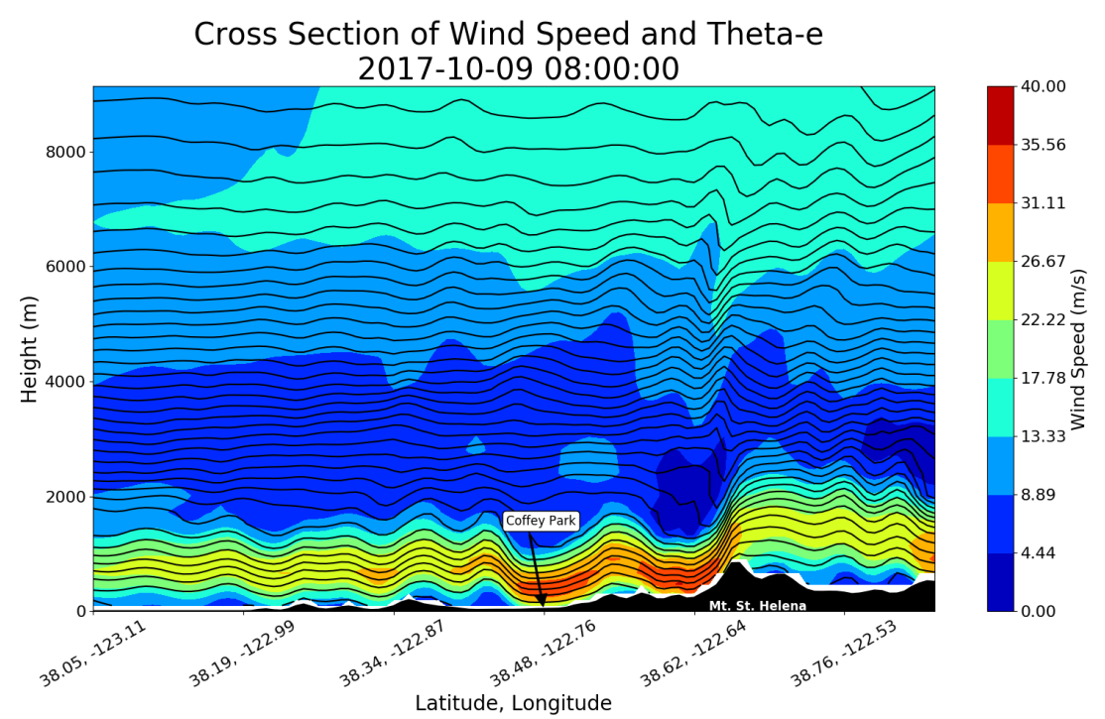
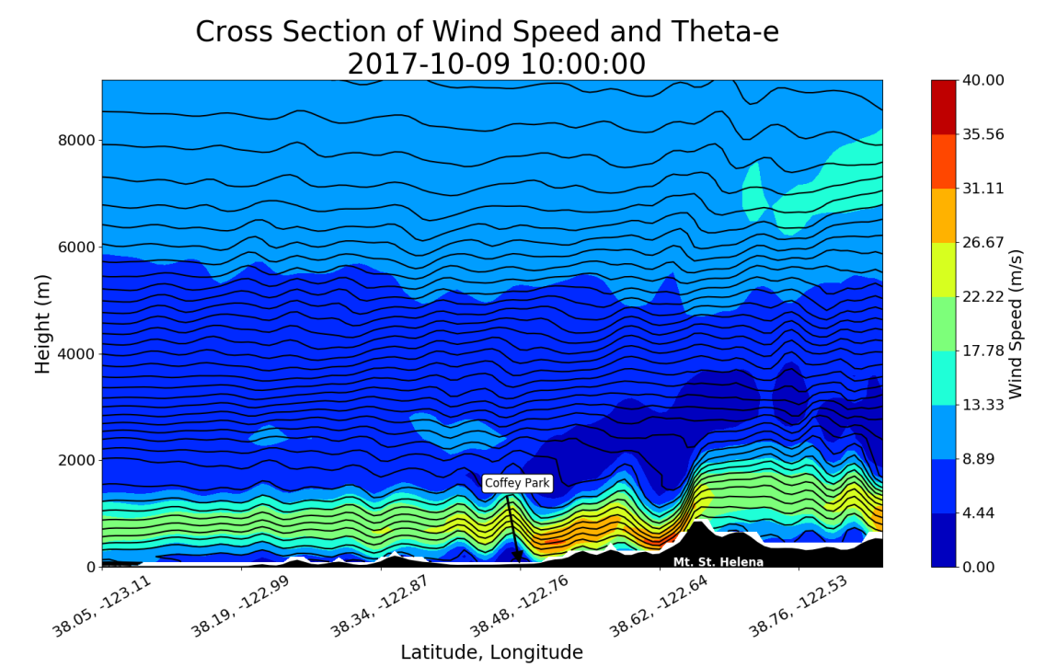
Weather Model Reanalysis
*WRF Model:
Carrie Bowers
SJSU Fire Wx Lab
Notes:
Mountain wave with hydraulic jump.

Slide 13
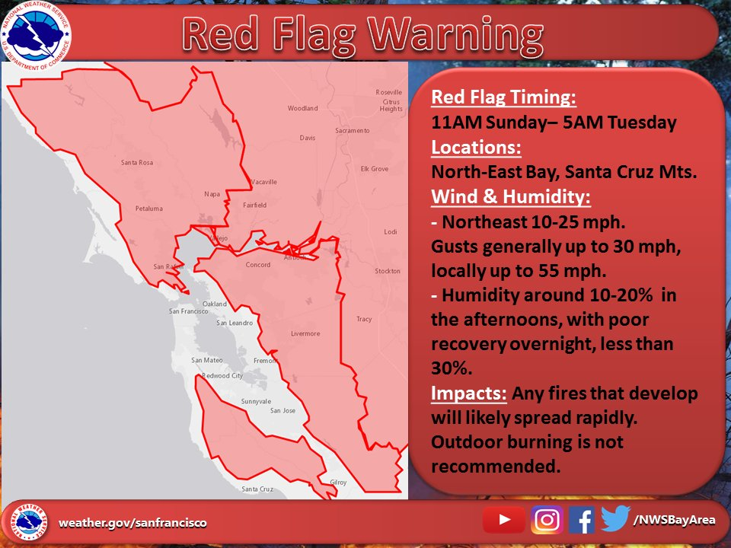
Getting the Word Out
Social Media Outlets, Partner Briefings and Weather.gov

Slide 14
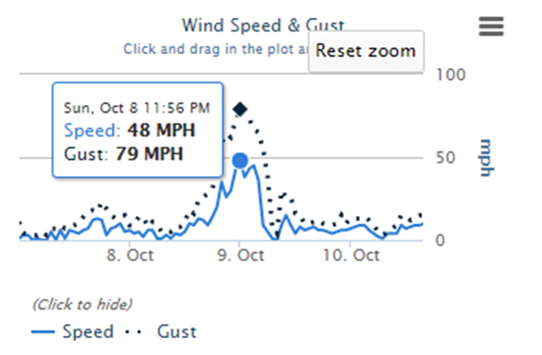

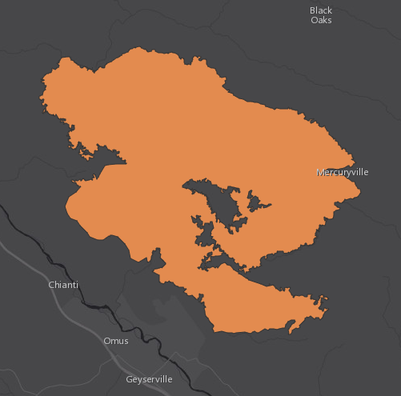

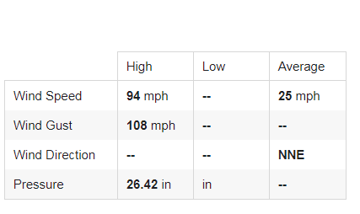
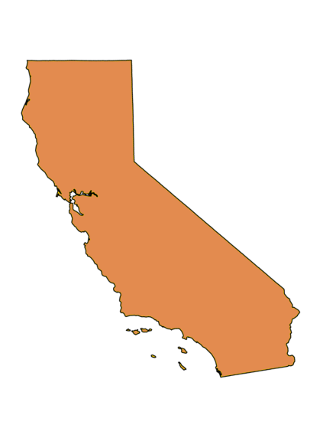
Offshore Flow Oct 8-9
Geyser Pk
Pocket Fire
Hawkeye
RAWS
Notes:
Strongest winds on record for Hawkeye

Slide 15
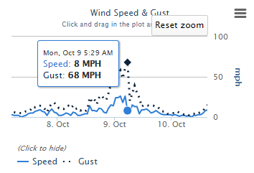

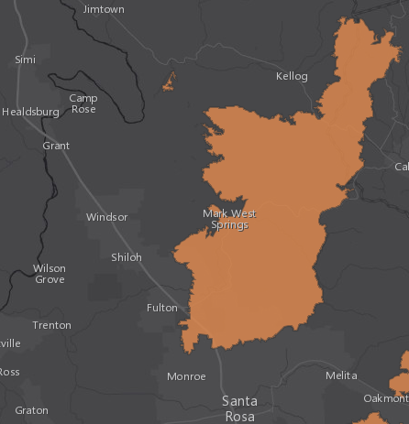

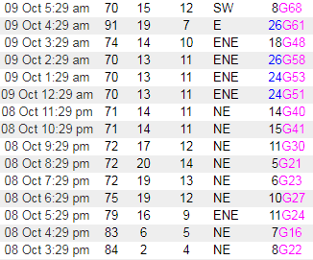
Offshore Flow Oct 8-9
Cont.
Tubbs Fire
Santa Rosa
RAWS
Notes:
Strong winds even at lower elevations

Slide 16
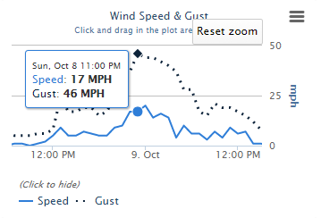

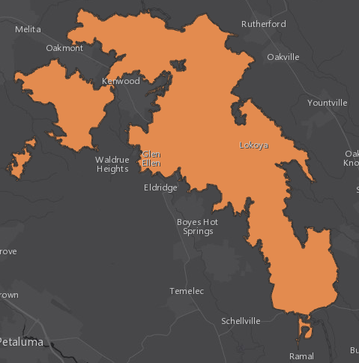
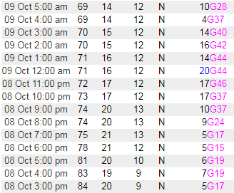
Offshore Flow Oct 8-9
Cont.
Kenwood
Nuns Fire

Slide 17
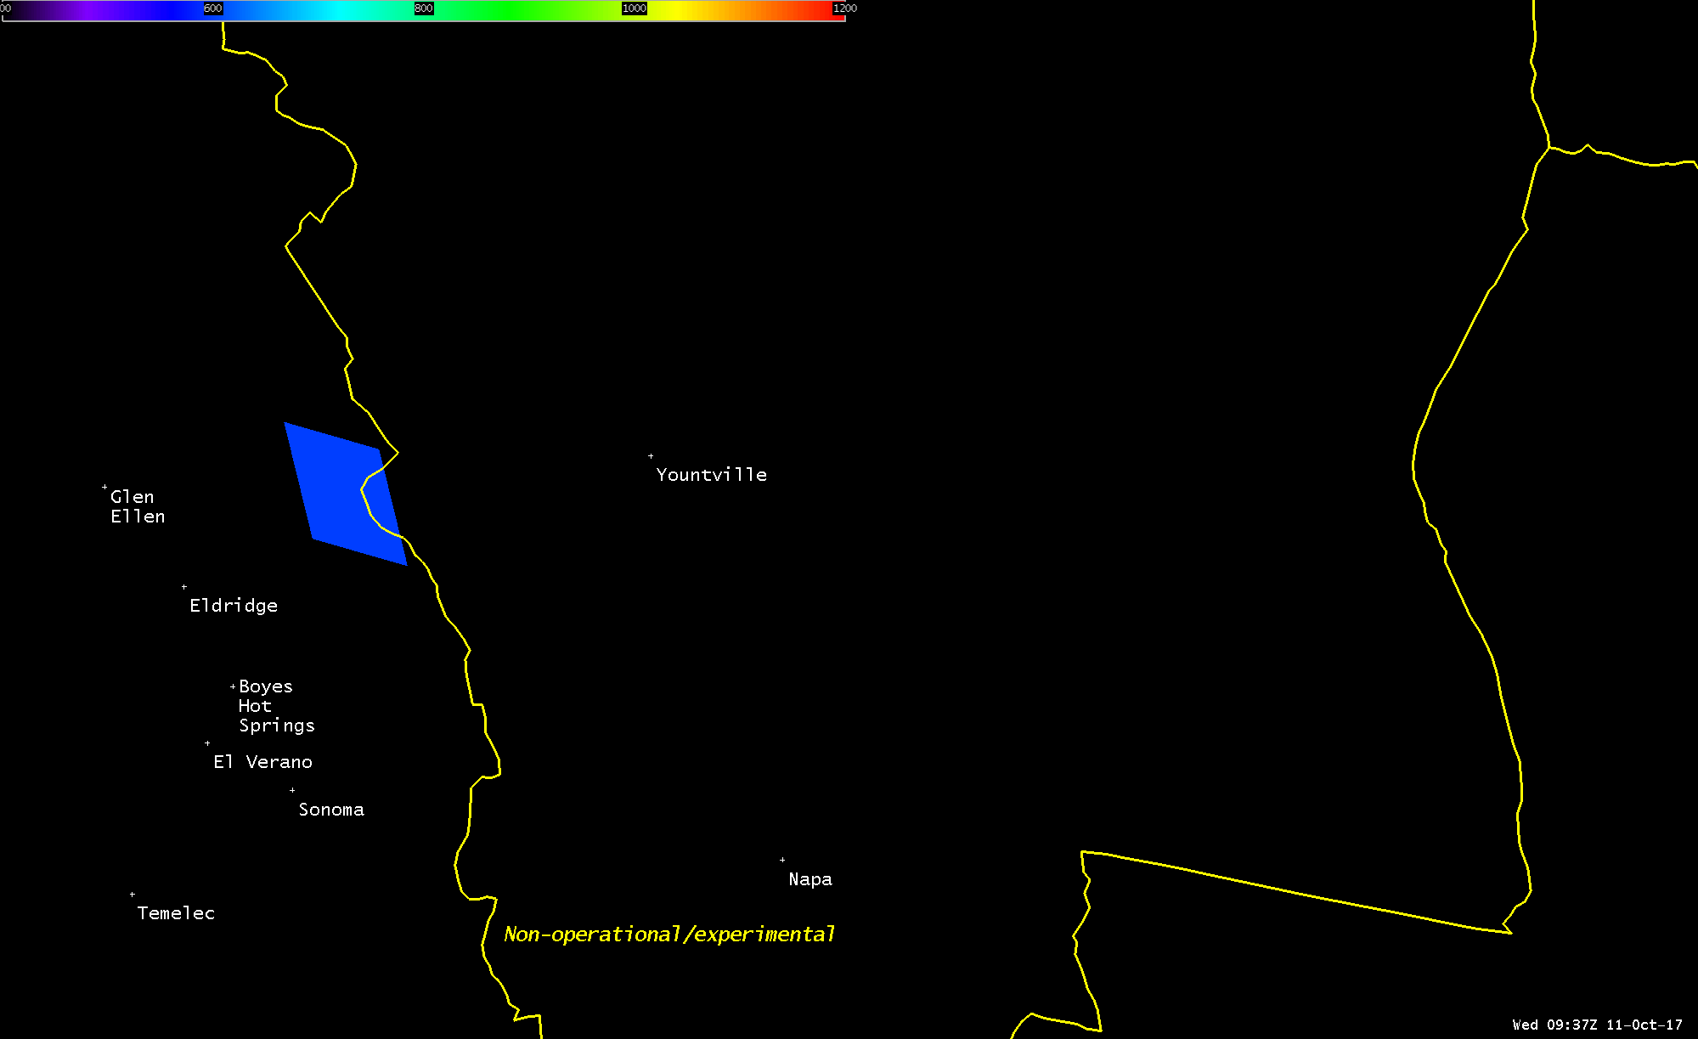
First Detection of North Bay Fires
*Fire Temperature example and not actual first detection
NWS Forecasters alerted to “hit”
on GOES16 Fire Temperature

Slide 18
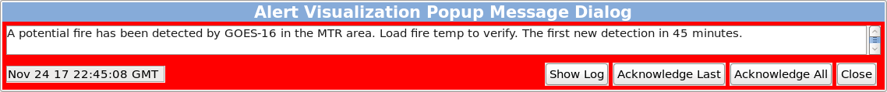
First Detection of North Bay Fires
Cont.
Script runs every 5 mins looking for a “hit”
A “hit” = Fire Temp > 600K with in our forecast area
Alerts NWS Forecasts for potential fire with red banner
Provides lead-time on issuing NWS Spot Weather Forecast
*script developed by Jeremy Martin, SOO – NWS Goodland

Slide 19
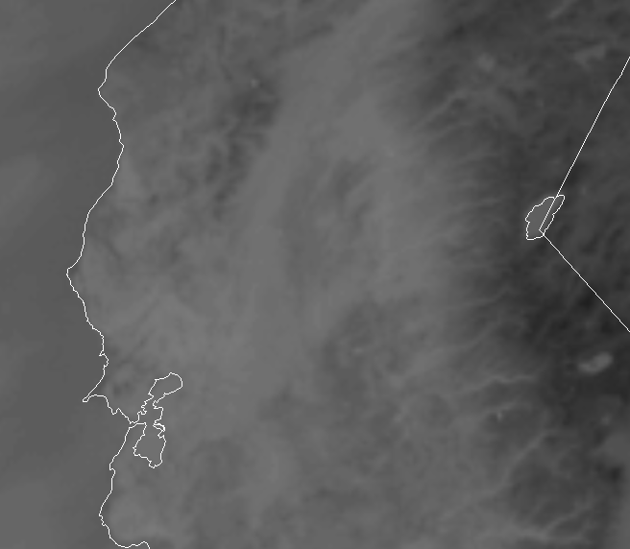
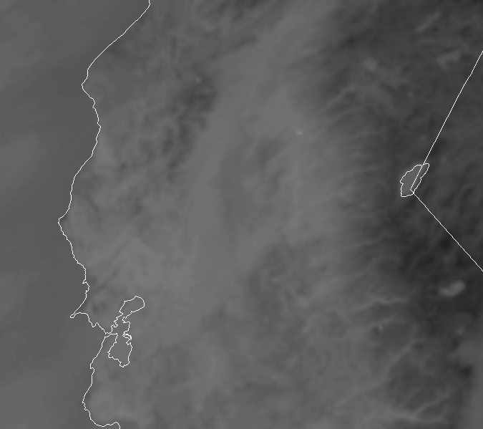

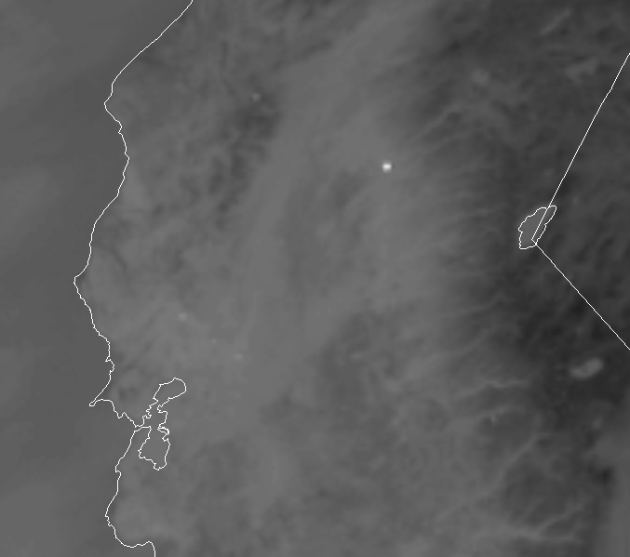
GOES 16 Imagery
9:27 PM PDT
9:32PM PDT
9:37 PM PDT
9:42PM PDT
*Imagery courtesy Warren Blier, SOO – NWS Monterey

Slide 20
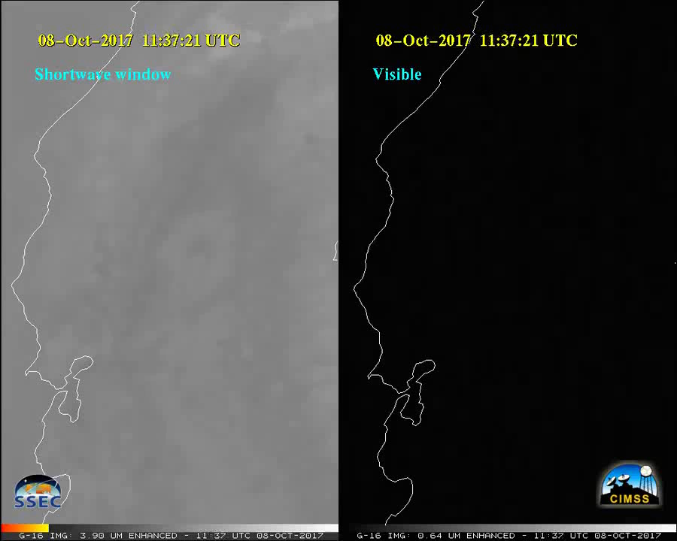
GOES 16 Imagery
Animation courtesy: CIMSS Blog
Notes:
Clouds near Monterey Bay shows developing offshore flow
Rapid rate of spread

Slide 21
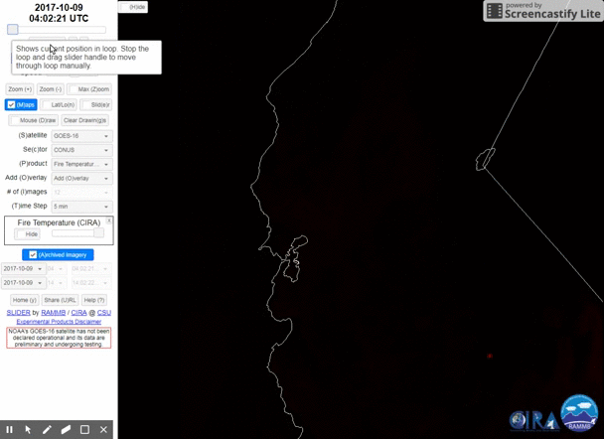
GOES 16 Imagery
Notes:
Rapid Rate of spread

Slide 22
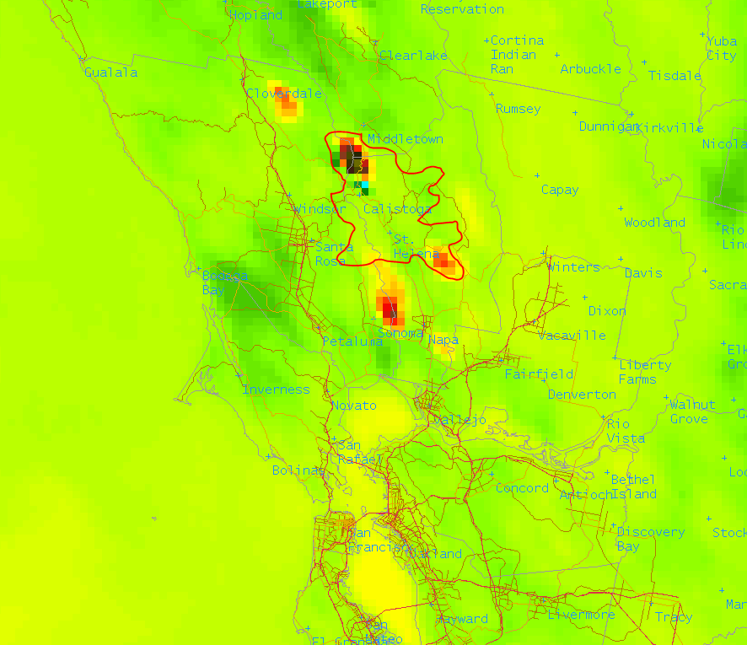
Monitor ‘Real-time’ Fire Activity
Most active in Div Bravo
*Imagery mock up for example purposes only
Supplement IR imagery from aviation assets on wildfires
Be mindful of possible parallax issues – correlate with radar
Notes:
Wildfires Management Teams rely heavily on IR from airplanes for fire mapping/monitoring. Aircraft is not always available (maintenance, wx, other fires). GOES 16 meso-sector helped tremendously.

Slide 23
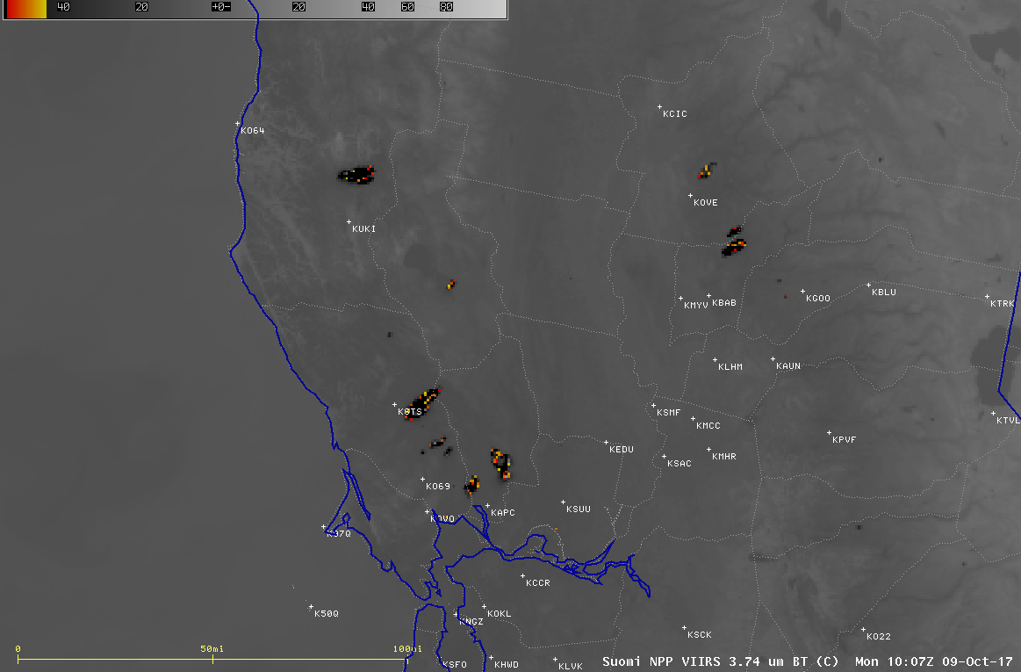
VIIRS Imagery
Suomi NPP VIIRS Shortwave Infrared (3.74 µm) and Day/Night Band (0.7 µm)
Animation courtesy: CIMSS Blog

Slide 24
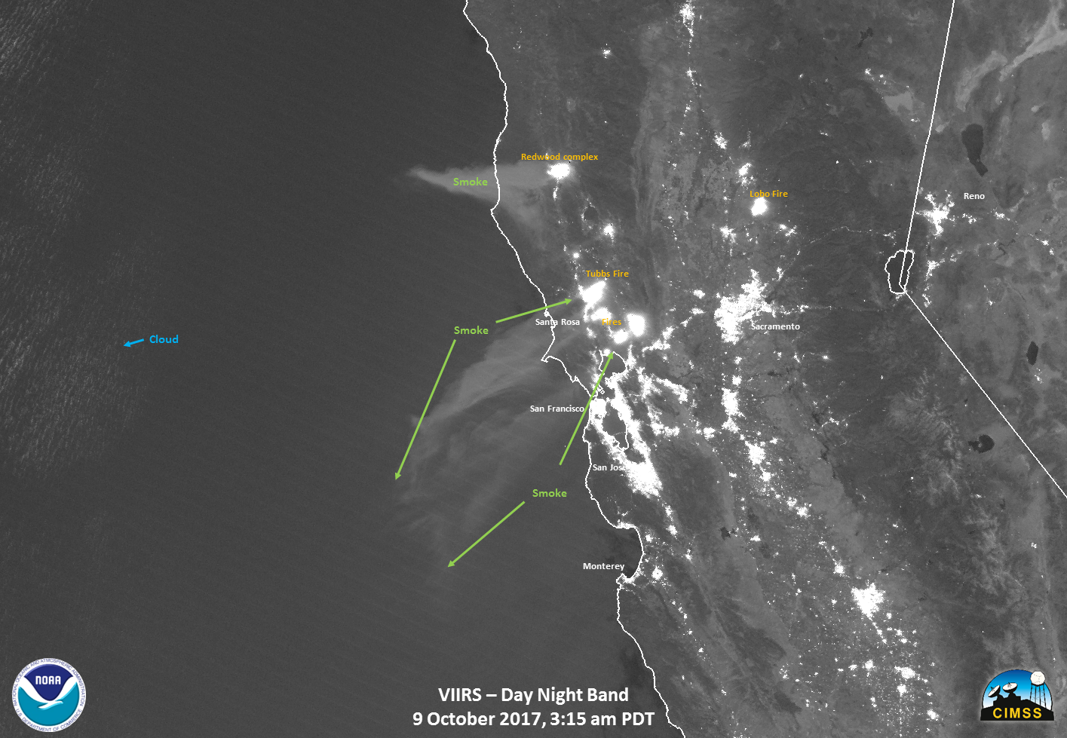
VIIRS Imagery
Suomi NPP VIIRS Shortwave Infrared (3.74 µm) and Day/Night Band (0.7 µm)
Image courtesy: William Straka – SSEC WISC

Slide 25
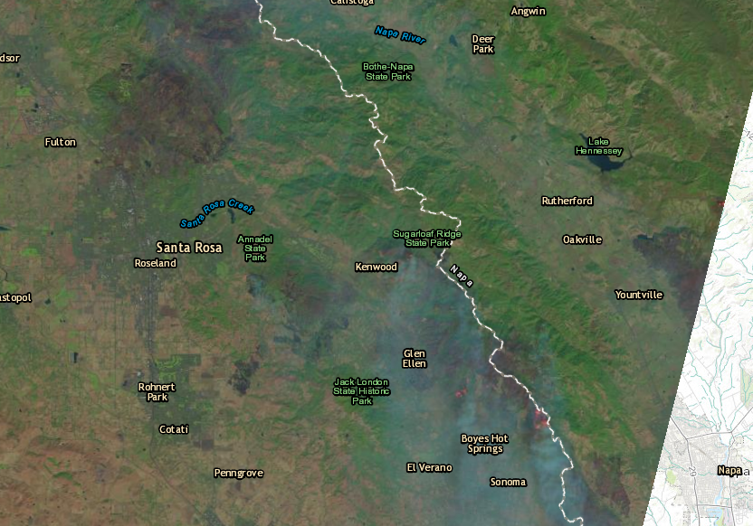
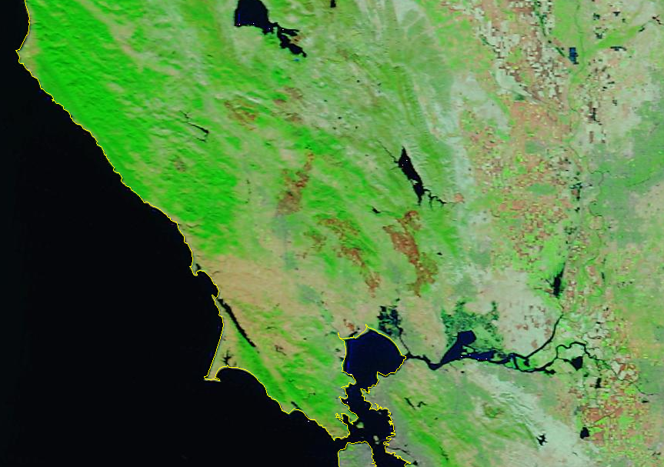
Satellite View
Landsat Imagery October 11, 2017
Modis Terra False Color October 25, 2017

Slide 26
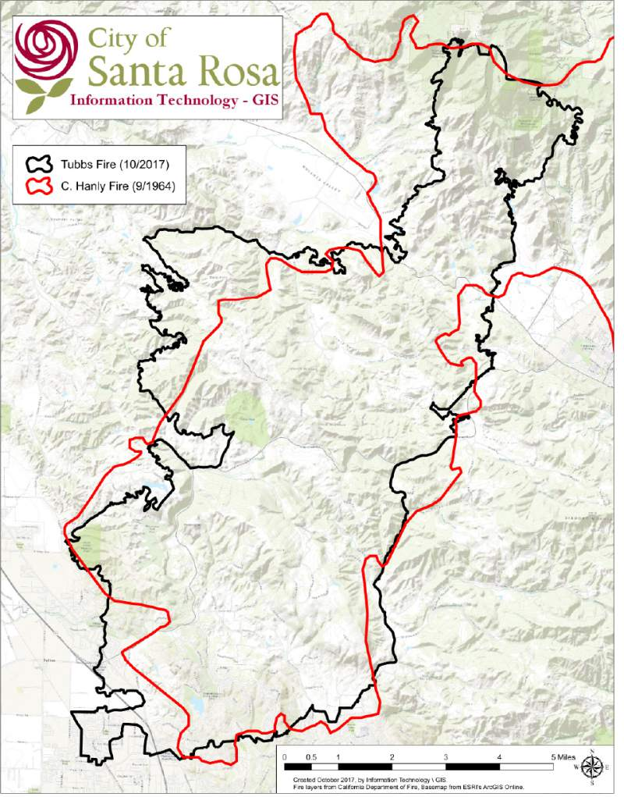
Repeating History?
Hanly Stats
September 19, 1964
52,700 acres
84 homes
24 summer cabins
Hanly Weather
Heat Wave – 100+
Mt. St. Helena Lookout
71 mph G 122 mph
Lookout demolished
Buildings destroyed
Numerous powerlines down
43 fires in Sonoma District

Slide 27
Takeaways
Only scratching the surface of GOES16 potential – still lots to learn
First full fire season utilizing GOES16
Supplement fire mapping when IR mapping is not available
Fire intensity/rate of spread – more frequent updates than MODIS/VIIRS
Could be the first detection/alert to a fire
Web interface (Slider by RAMMB/CIRA) – huge asset for deployed IMETs

Slide 28
Questions?
FDTD GOES-16 Applications
North Bay Wildfires
Contact:
Mattthew.Mehle@noaa.gov
Want to share information in a future FDTD Webinar?
Scott.lindstrom@noaa.gov / Dan.Bikos@noaa.gov

