Slide 1





FDTD GOES-16 Applications Day Cloud Phase Distinction RGB Composite: Gaining Situational Awareness for DSS
Presented by
Chad Gravelle
NWS Operations Proving Ground
Kansas City, MO

Slide 2
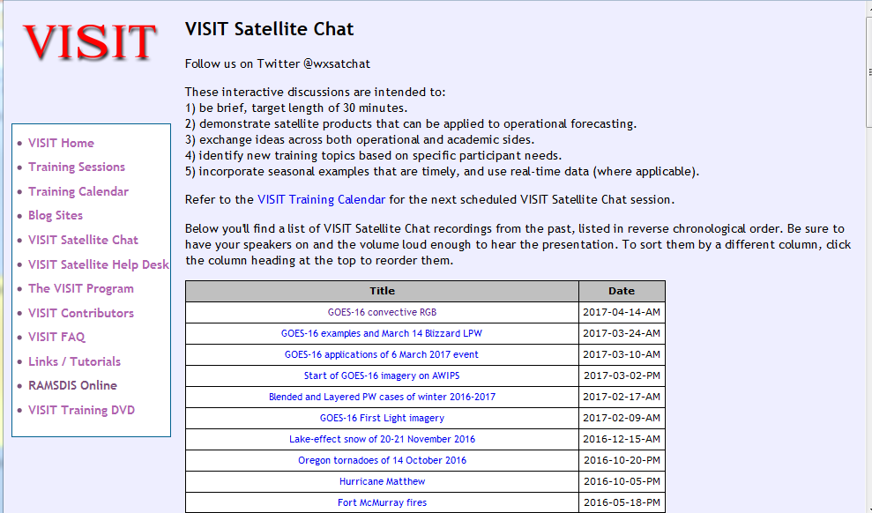
FDTD “Satellite Chat” Library
http://rammb.cira.colostate.edu/training/visit/satellite_chat/
Recorded Content includes Q&A
Call for speakers! Let us know if you want to speak on a topic!
Contact: scott.lindstrom@noaa.gov OR dan.bikos@noaa.gov

Slide 3

FDTD GOES-16 Applications Webinar Protocol
~20 minutes for the speaker
Send questions via GoTo Chat
Or ask during Q&A period via phone
Followed by Q&A
Open discussion forum
Done by 1730 UTC
Do NOT press hold!!!
Mute when not speaking

Slide 4
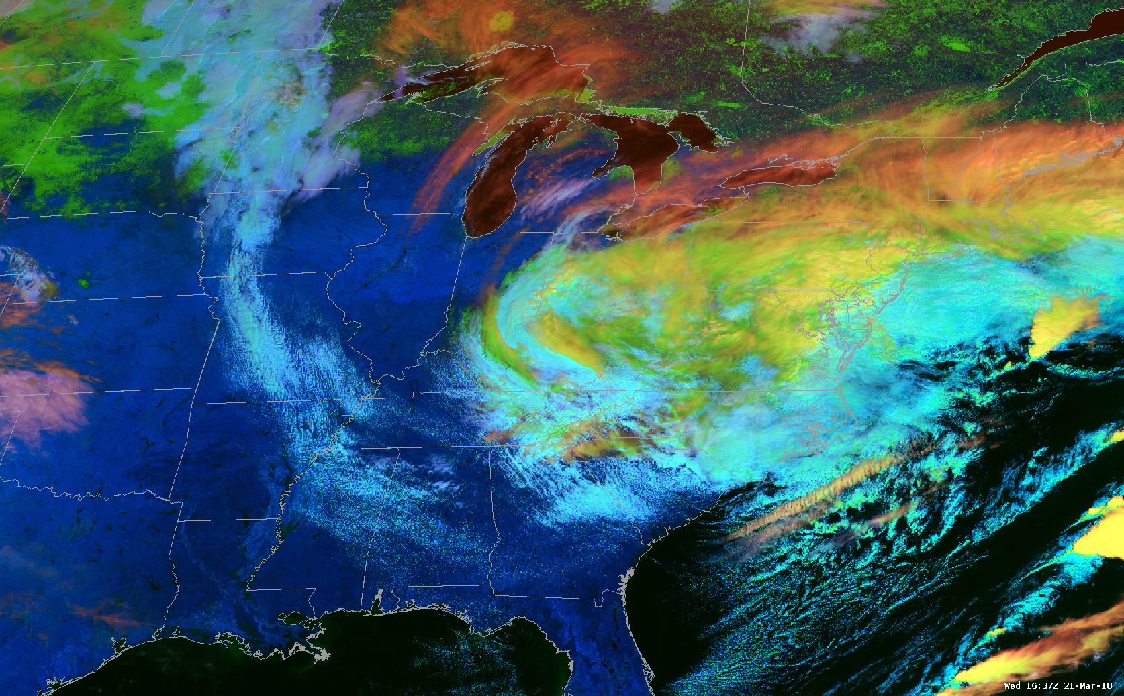
Day Cloud Phase Distinction RGB Composite:
Gaining Situational Awareness for DSS
Chad M. Gravelle, PhD Chief Scientist
NWS Operations Proving Ground University of Oklahoma – CIMMS

Slide 5
Day Cloud Phase RGB Composite
Red Component: 10.3 µm (7.5 to -53.5º C)
Green Component: 0.64 µm (0 to 78%)
Blue Component: 1.6 µm (1 to 59%)
RGB Interpretation
Thin Upper-Level
Ice Clouds
Low-Level Liquid Clouds
Midlevel Liquid Clouds
Snow or Ice
Snow or Ice
Low-Level
Liquid Clouds
Glaciating Clouds
Thick Upper-Level
Ice Clouds
Thick
Upper-Level
Ice Clouds
Thin Upper-Level
Ice Clouds
Midlevel
Liquid Clouds
Land Surface
Water
Glaciating
Clouds

Slide 6
Day Cloud Phase RGB Composite
Red Component: 10.3 µm (7.5 to -53.5º C)
Green Component: 0.64 µm (0 to 78%)
Blue Component: 1.6 µm (1 to 59%)
RGB Interpretation
Thin Upper-Level
Ice Clouds
Low-Level Liquid Clouds
Midlevel Liquid Clouds
Snow or Ice
Snow or Ice
Low-Level
Liquid Clouds
Glaciating Clouds
Thick Upper-Level
Ice Clouds
Thick
Upper-Level
Ice Clouds
Thin Upper-Level
Ice Clouds
Midlevel
Liquid Clouds
Land Surface
Water
Glaciating
Clouds

Slide 7
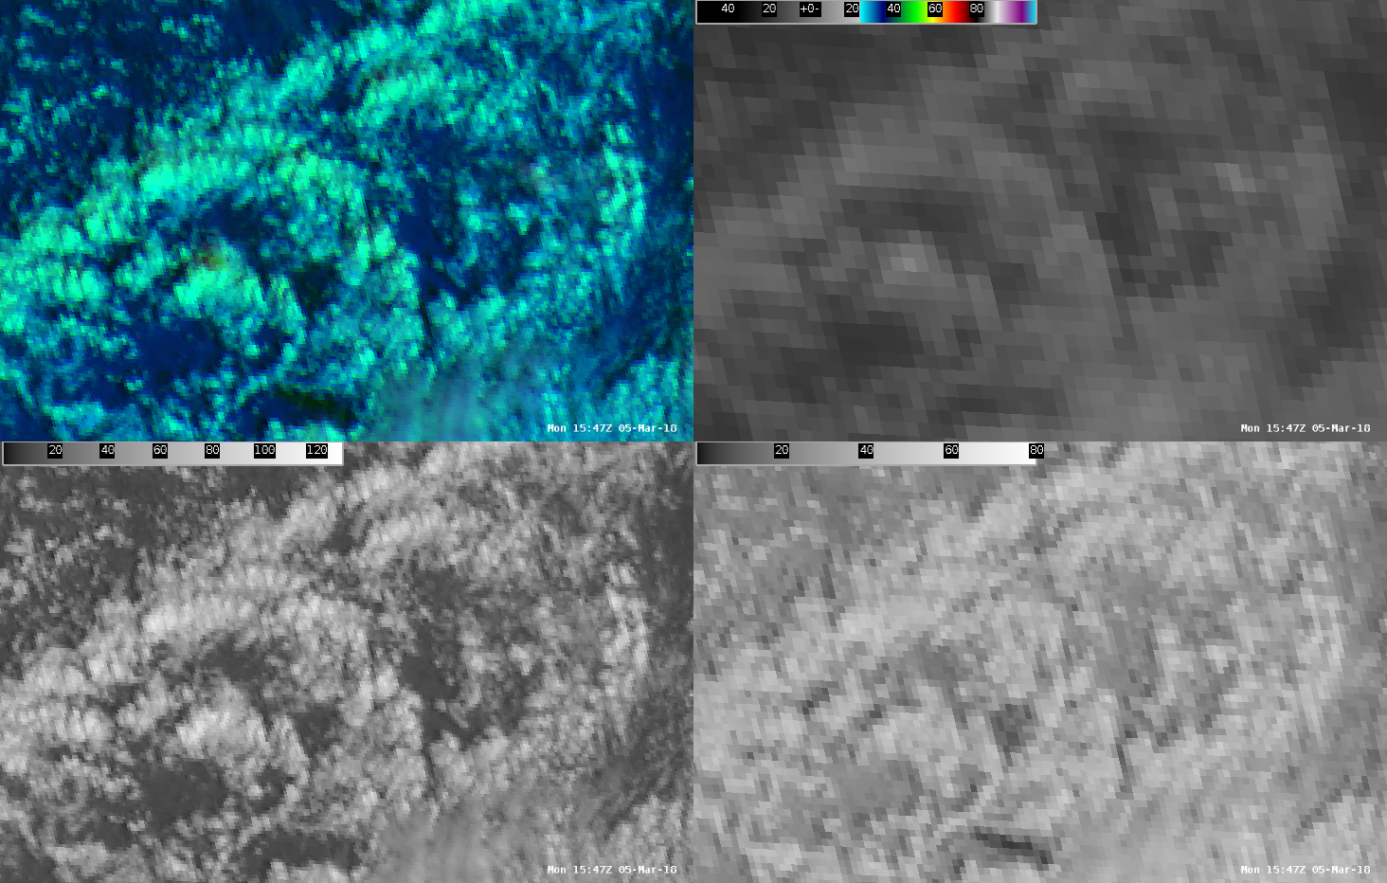
Day Cloud Phase RGB Composite – Breaking it Down
Day Cloud Phase RGB Composite – 1547 UTC 5 March 2013
Red Component: 10.3 µm (7.5 to -53.5º C)
Shallow Cumulus (liquid)
Red: 0%
warm clouds, low contribution
Green: 47%
somewhat reflective
Blue: 53%
somewhat reflective
R: 1/255 (0%)
G: 119/255 (47%)
B: 136/255 (53%)
10.9º C
Green Component: 0.64 µm (0 to 78%)
Blue Component: 1.6 µm (1 to 59%)
49.0%
32.1%

Slide 8
Day Cloud Phase RGB Composite – Breaking it Down
Day Cloud Phase RGB Composite – 1547 UTC 5 March 2013
Red Component: 10.3 µm (7.5 to -53.5º C)
Shallow Cumulus (liquid)
R: 0% G: 47% B: 53%
Deep Cumulus (liquid)
Red: 3%
warm clouds, low contribution
Green: 100%
very reflective, high contribution
Blue: 84%
very reflective, high contribution
R: 8/255 (3%)
G: 255/255 (100%)
B: 215/255 (84%)
5.6º C
Green Component: 0.64 µm (0 to 78%)
Blue Component: 1.6 µm (1 to 59%)
94.2%
50.1%

Slide 9
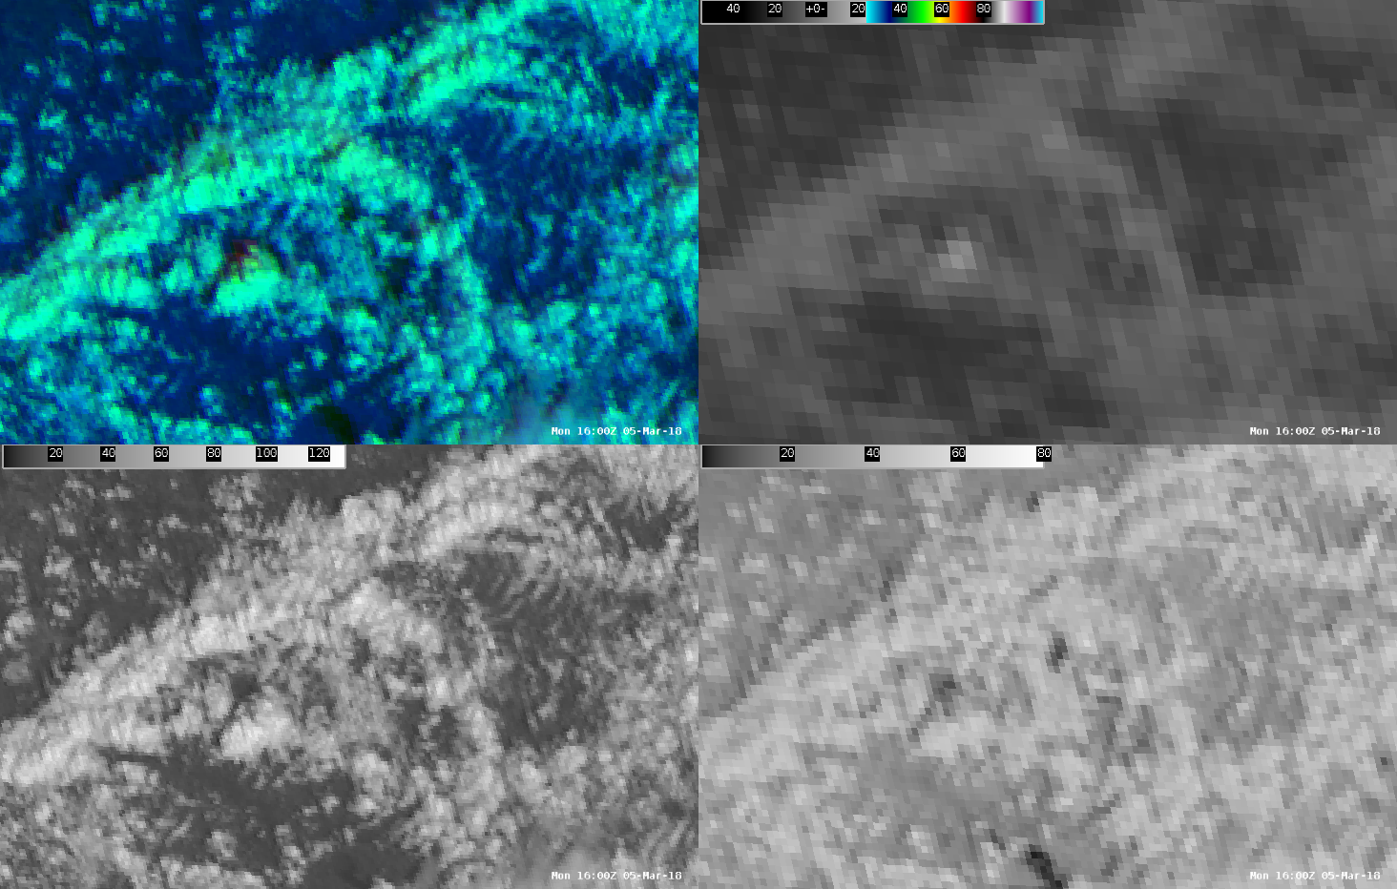
Day Cloud Phase RGB Composite – Breaking it Down
Day Cloud Phase RGB Composite – 1600 UTC 5 March 2013
Red Component: 10.3 µm (7.5 to -53.5º C)
Shallow Cumulus (liquid)
R: 0% G: 47% B: 53%
Deep Cumulus (liquid)
R: 3% G: 100% B: 84%
Towering Cumulus (supercooled)
Red: 21%
warm clouds, low contribution
Green: 97%
very reflective, high contribution
Blue: 55%
somewhat reflective
R: 54/255 (21%)
G: 248/255 (97%)
B: 140/255 (55%)
-5.6º C
Green Component: 0.64 µm (0 to 78%)
Blue Component: 1.6 µm (1 to 59%)
55.0%
40.3%

Slide 10
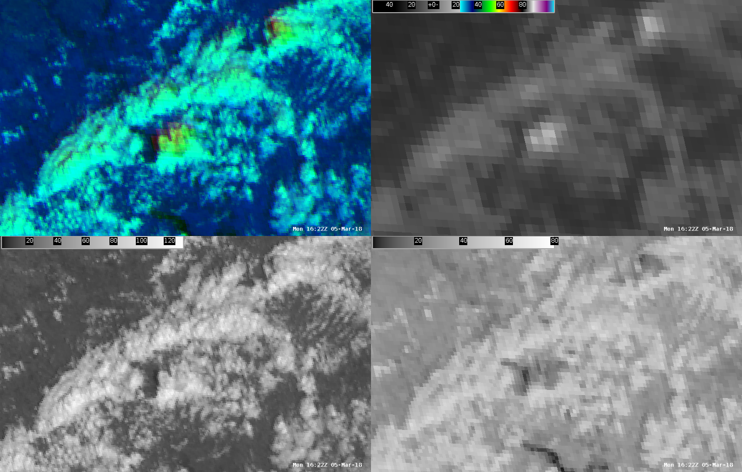
Day Cloud Phase RGB Composite – Breaking it Down
Day Cloud Phase RGB Composite – 1622 UTC 5 March 2013
Red Component: 10.3 µm (7.5 to -53.5º C)
Shallow Cumulus (liquid)
R: 0% G: 47% B: 53%
Deep Cumulus (liquid)
R: 3% G: 100% B: 84%
Towering Cumulus (supercooled)
R: 21% G: 97% B: 55%
R: 119/255 (47%)
G: 168/255 (66%)
B: 67/255 (26%)
-21.0º C
Towering Cumulus (mixed)
Red: 47%
cooling clouds
Green: 66%
somewhat reflective
Blue: 26%
low reflectance, low contribution
Green Component: 0.64 µm (0 to 78%)
Blue Component: 1.6 µm (1 to 59%)
57.1%
18.3%

Slide 11
Why for DSS?

Slide 12
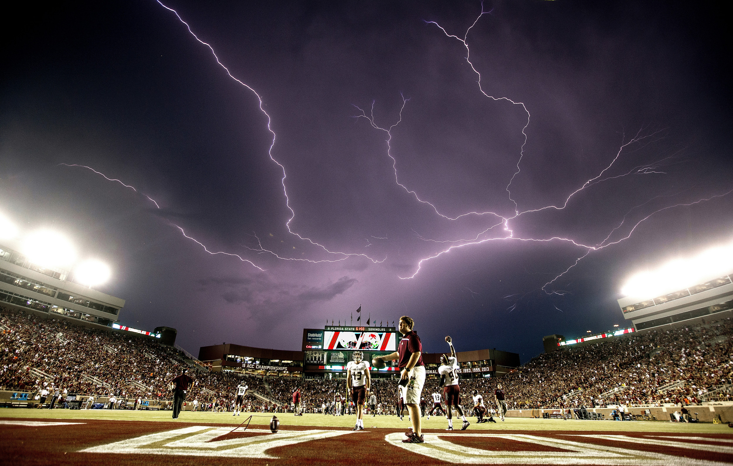

Slide 13
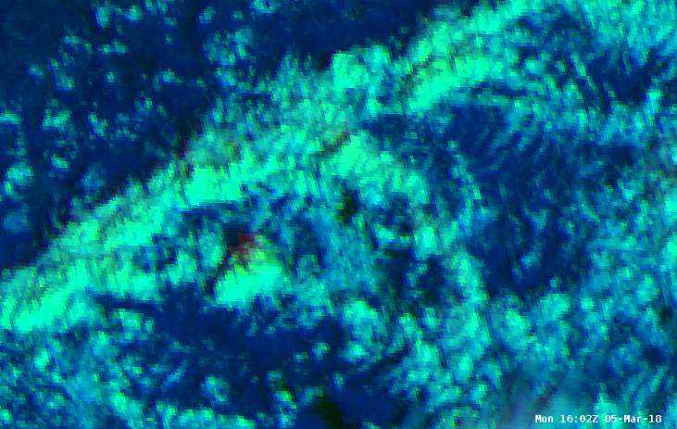
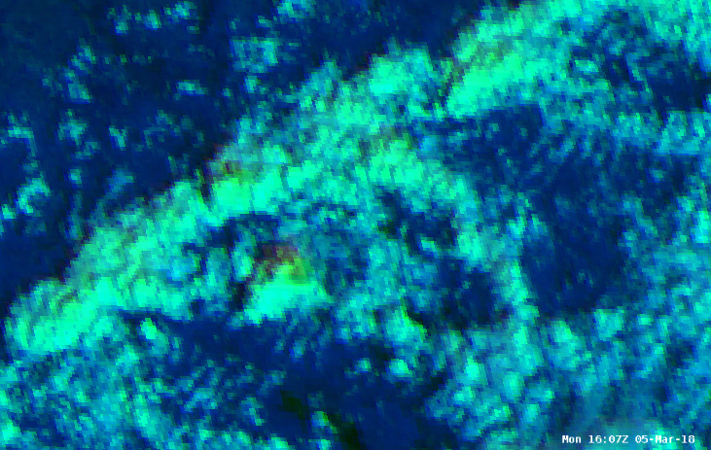
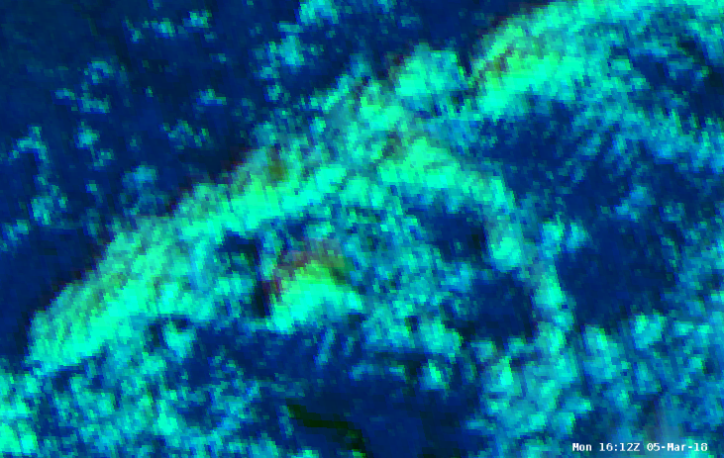
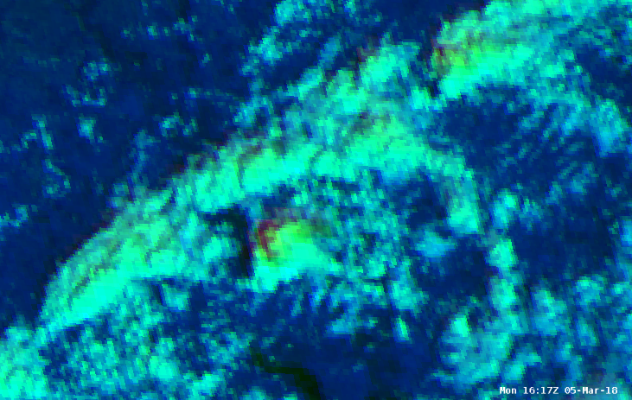
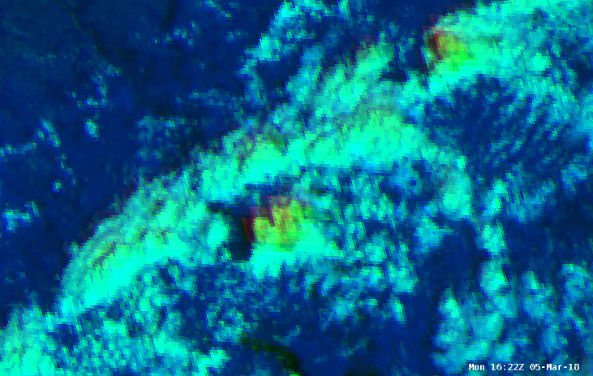
Day Cloud Phase RGB Composite – Why for DSS?
Deep Cumulus (liquid)
Towering Cumulus (supercooled)
Towering Cumulus (mixed)
1602 UTC 1607 UTC 1612 UTC 1617 UTC
ENTL ENTL ENTL ENTL
NLDN NLDN NLDN NLDN
1622 UTC
ENTL
NLDN

Slide 14
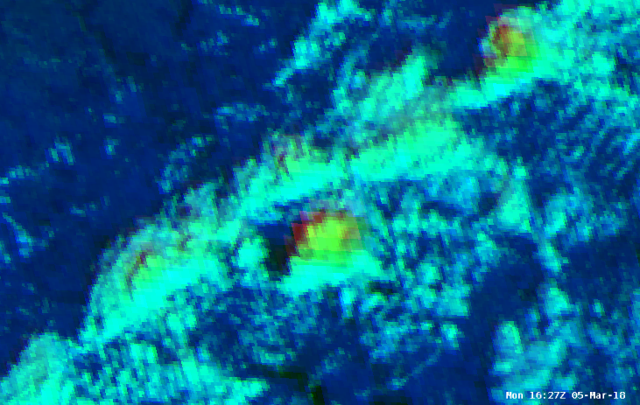
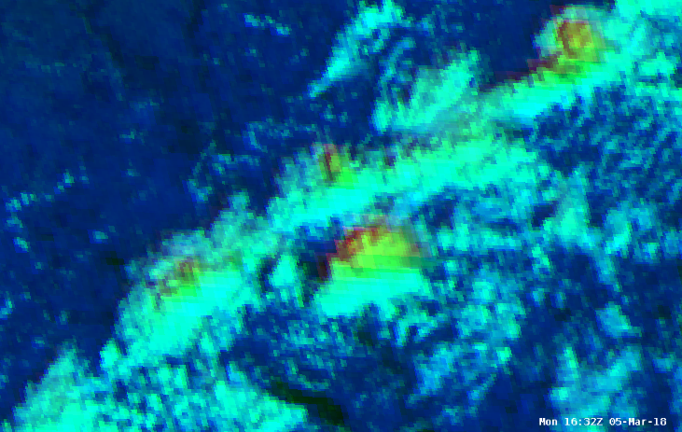
Day Cloud Phase RGB Composite – Why for DSS?
Deep Cumulus (liquid)
Towering Cumulus (supercooled)
Towering Cumulus (mixed)
1602 UTC 1607 UTC 1612 UTC 1617 UTC
ENTL ENTL ENTL ENTL
NLDN NLDN NLDN NLDN
1622 UTC 1627 UTC 1632 UTC
ENTL ENTL ENTL
NLDN NLDN NLDN
Ice crystals begin to form and grow in the cloud within abundance of supercooled water droplets.
Graupel develops, collides with ice crystals, and ends up with opposite polarity (< -15º C ice crystals + and graupel -)
Different sizes and fall velocities of the particles allow separation after the collision (i.e., charge separation).

Slide 15
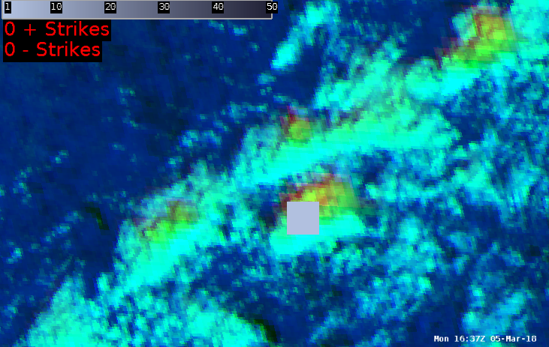
Day Cloud Phase RGB Composite – Why for DSS?
Deep Cumulus (liquid)
Towering Cumulus (supercooled)
Towering Cumulus (mixed)
1602 UTC 1607 UTC 1612 UTC 1617 UTC
ENTL ENTL ENTL ENTL
NLDN NLDN NLDN NLDN
1622 UTC 1627 UTC 1632 UTC
ENTL ENTL ENTL
NLDN NLDN NLDN
1637 UTC
ENTL
NLDN
Ice crystals begin to form and grow in the cloud within abundance of supercooled water droplets.
Graupel develops, collides with ice crystals, and ends up with opposite polarity (< -15º C ice crystals + and graupel -)
Different sizes and fall velocities of the particles allow separation after the collision (i.e., charge separation).
When the electrical attractive forces between the two charge centers is high enough…lightning occurs.

Slide 16
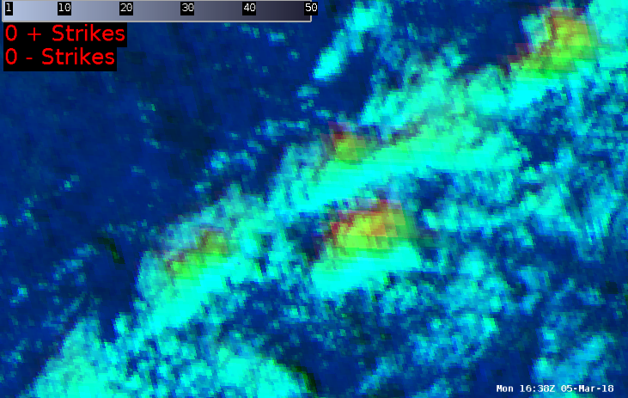
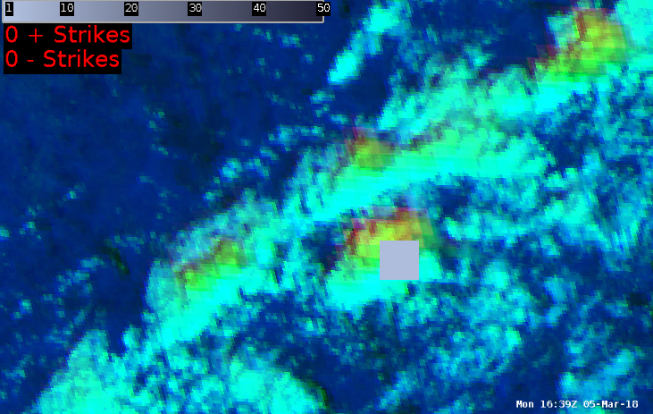
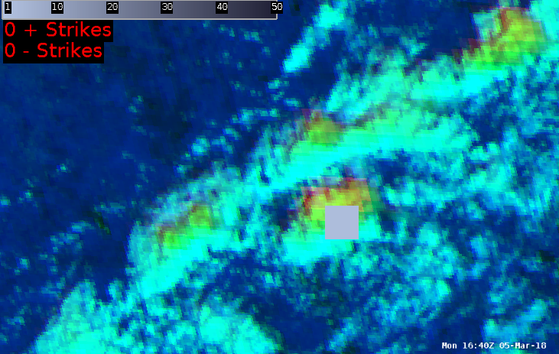
Day Cloud Phase RGB Composite – Why for DSS?
Deep Cumulus (liquid)
Towering Cumulus (supercooled)
Towering Cumulus (mixed)
1602 UTC 1607 UTC 1612 UTC 1617 UTC
ENTL ENTL ENTL ENTL
NLDN NLDN NLDN NLDN
1622 UTC 1627 UTC 1632 UTC
ENTL ENTL ENTL
NLDN NLDN NLDN
1637 UTC
ENTL
NLDN
1638 UTC 1639 UTC 1640 UTC
ENTL ENTL ENTL
NLDN NLDN NLDN

Slide 17
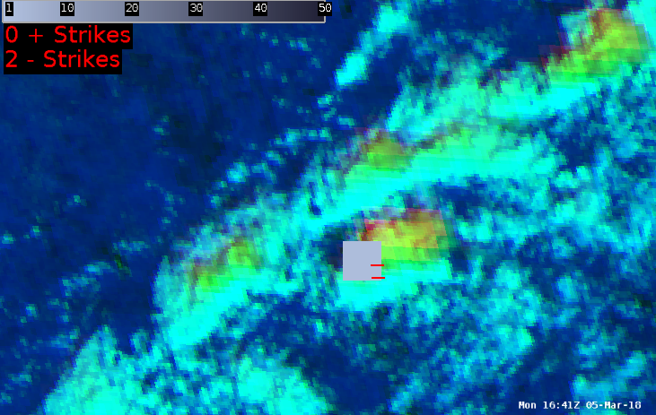
Day Cloud Phase RGB Composite – Why for DSS?
Deep Cumulus (liquid)
Towering Cumulus (supercooled)
Towering Cumulus (mixed)
1602 UTC 1607 UTC 1612 UTC 1617 UTC
ENTL ENTL ENTL ENTL
NLDN NLDN NLDN NLDN
1622 UTC 1627 UTC 1632 UTC
ENTL ENTL ENTL
NLDN NLDN NLDN
1637 UTC
ENTL
NLDN
1638 UTC 1639 UTC 1640 UTC 1641 UTC
ENTL ENTL ENTL ENTL
NLDN NLDN NLDN NLDN
–
–

Slide 18
An Applied Example
Proof of Concept

Slide 19
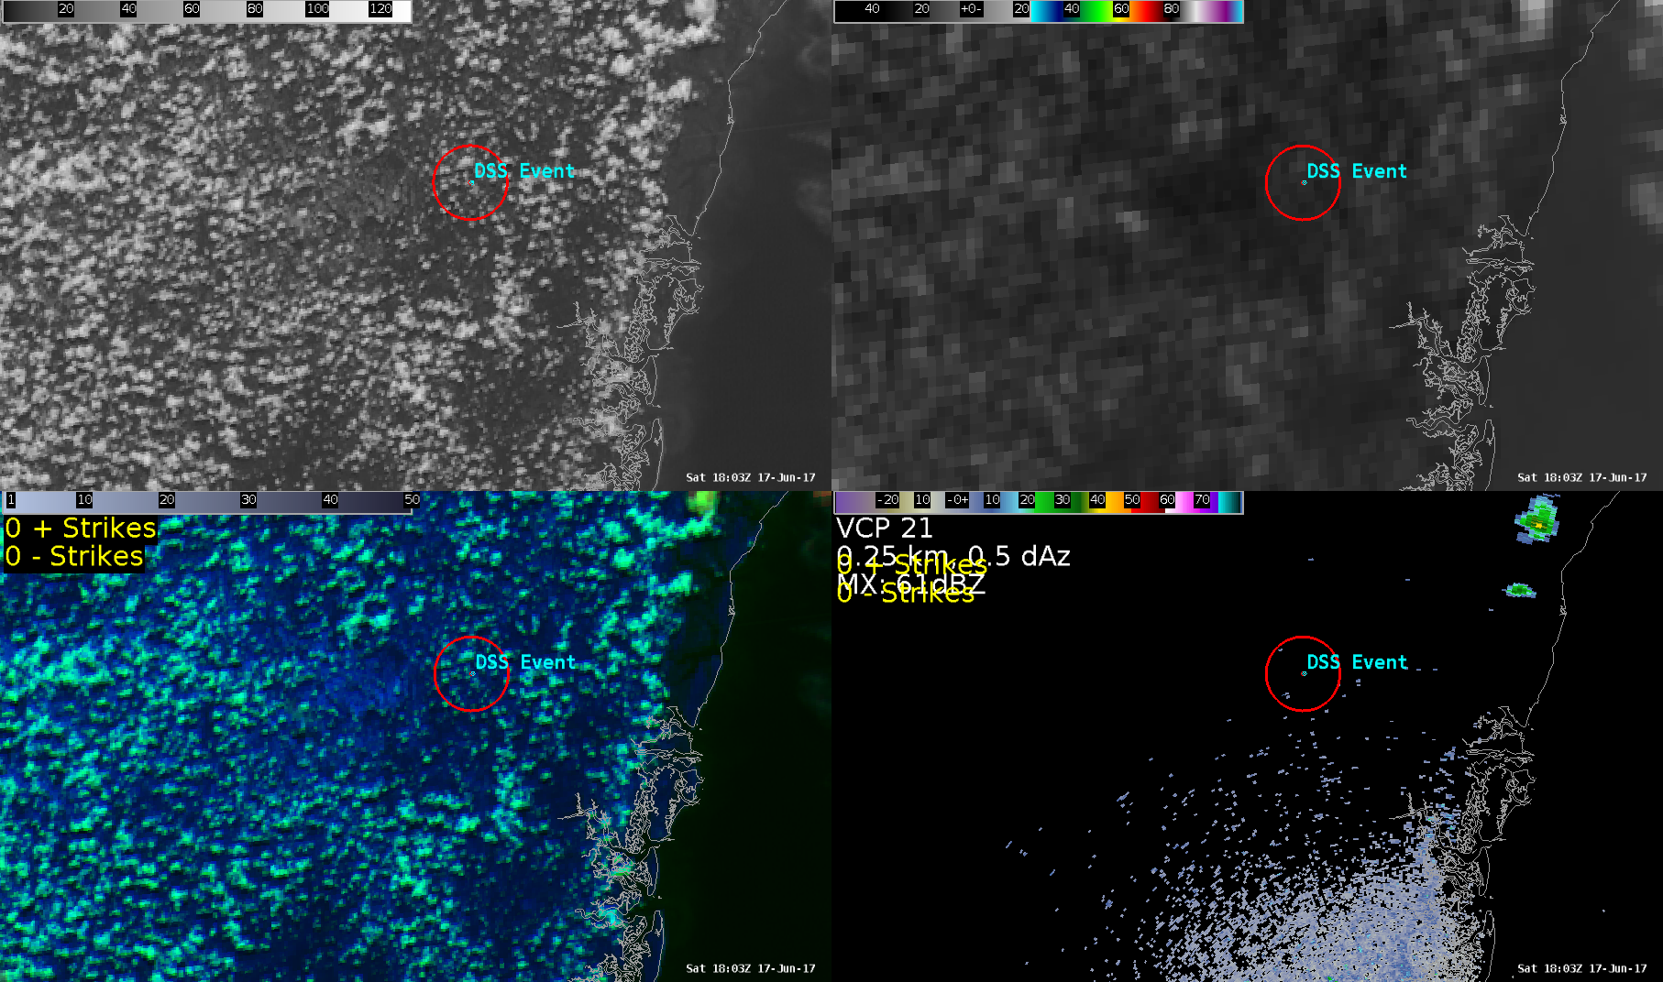
Proof of Concept – 17 June 2017 1803 UTC
5 mile radius
0.64 µm
10.3 µm
Local Emergency Manager would like 30-min lead time on lightning within
5 miles of Wayne County Fair.
Day Cloud Phase
KJAX 0.5º Z

Slide 20
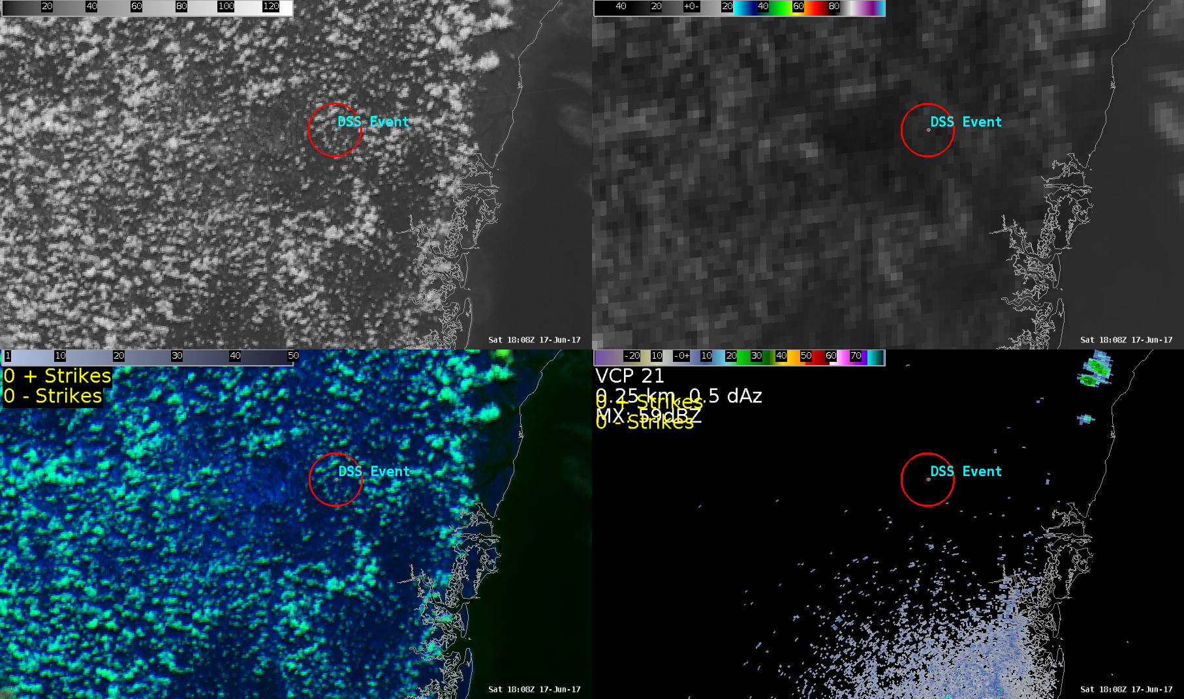
Proof of Concept – 17 June 2017 1808 UTC
0.64 µm
10.3 µm
Day Cloud Phase
KJAX 0.5º Z

Slide 21
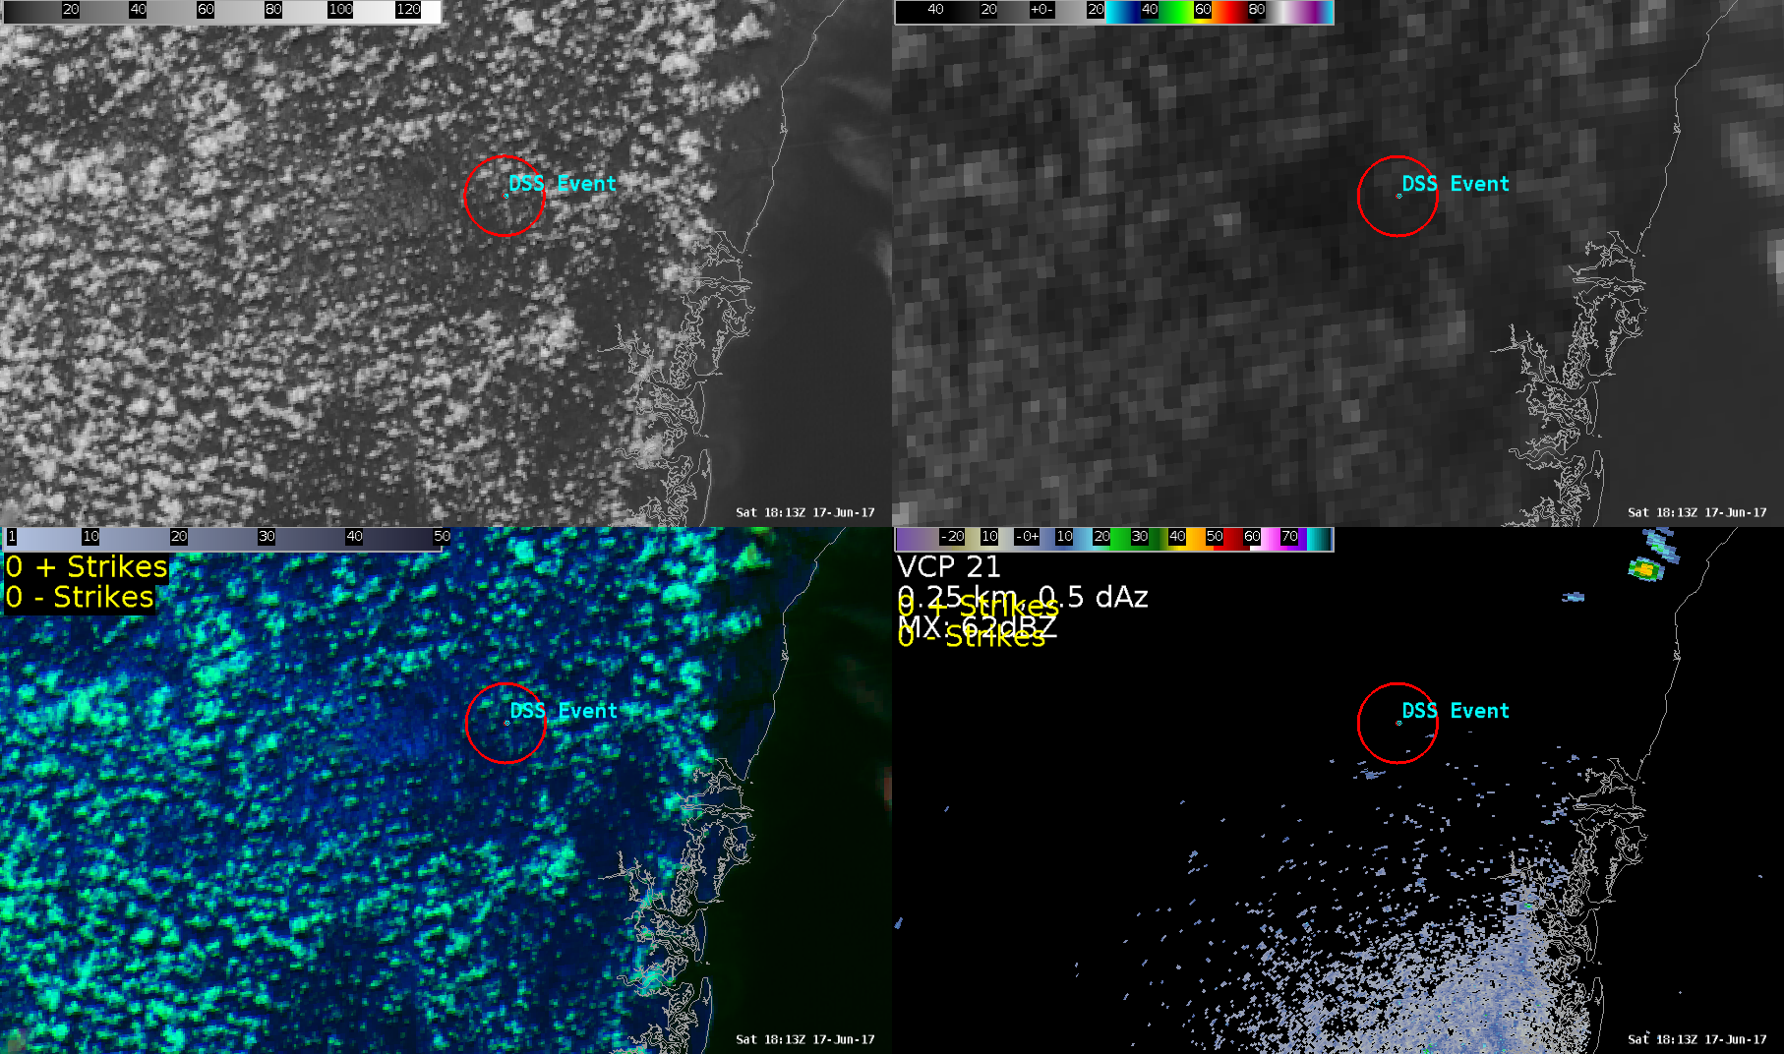
Proof of Concept – 17 June 2017 1813 UTC
0.64 µm
10.3 µm
Day Cloud Phase
KJAX 0.5º Z

Slide 22
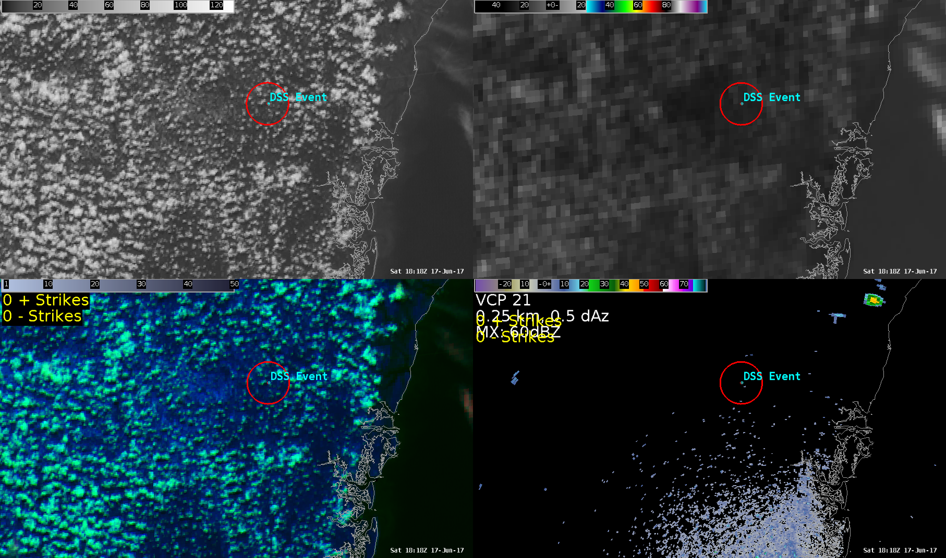
Proof of Concept – 17 June 2017 1818 UTC
0.64 µm
10.3 µm
Day Cloud Phase
KJAX 0.5º Z

Slide 23
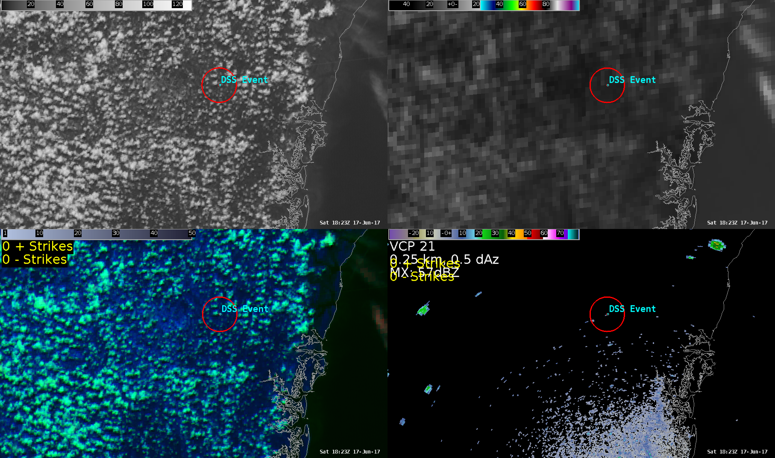
Proof of Concept – 17 June 2017 1823 UTC
0.64 µm
10.3 µm
Day Cloud Phase
KJAX 0.5º Z

Slide 24

Proof of Concept – 17 June 2017 1828 UTC
0.64 µm
10.3 µm
Day Cloud Phase
KJAX 0.5º Z

Slide 25

Proof of Concept – 17 June 2017 1833 UTC
0.64 µm
10.3 µm
Day Cloud Phase
KJAX 0.5º Z

Slide 26
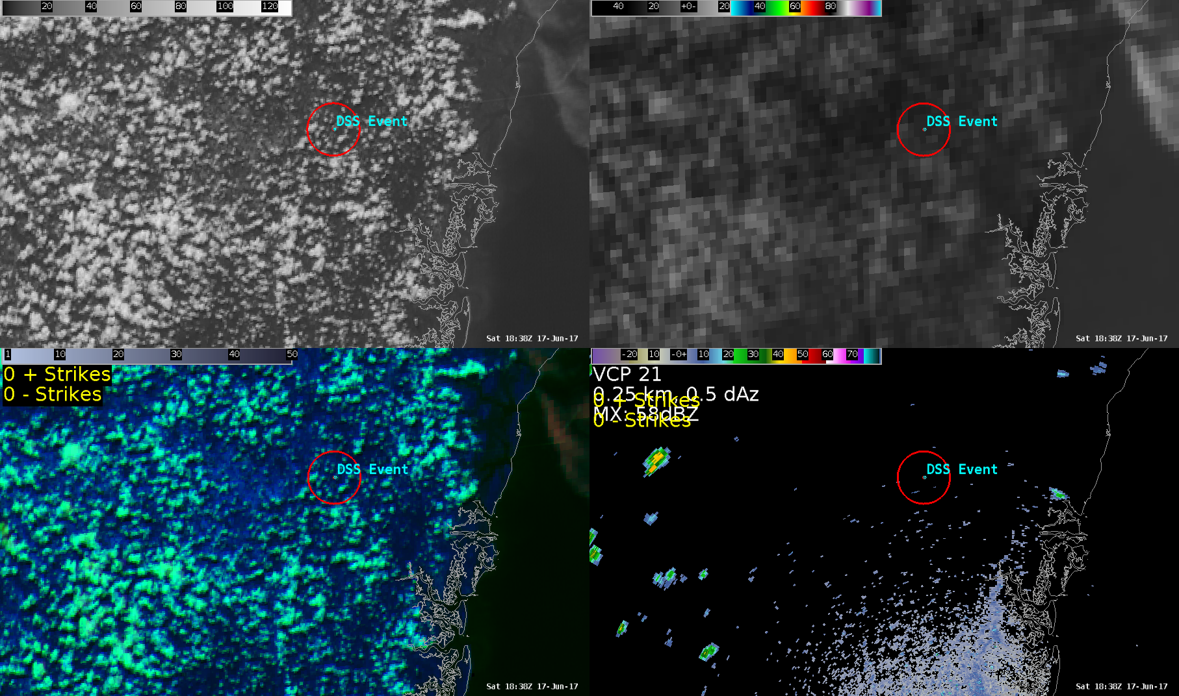
Proof of Concept – 17 June 2017 1838 UTC
0.64 µm
10.3 µm
Day Cloud Phase
KJAX 0.5º Z

Slide 27

Proof of Concept – 17 June 2017 1843 UTC
0.64 µm
10.3 µm
Day Cloud Phase
KJAX 0.5º Z

Slide 28
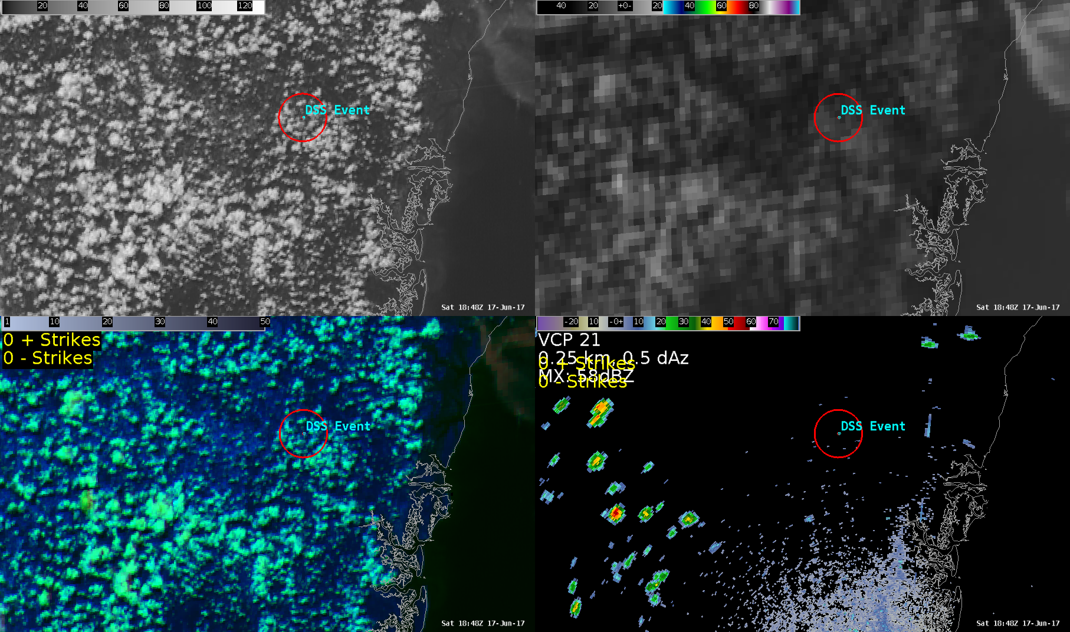
Proof of Concept – 17 June 2017 1848 UTC
0.64 µm
10.3 µm
Day Cloud Phase
KJAX 0.5º Z

Slide 29
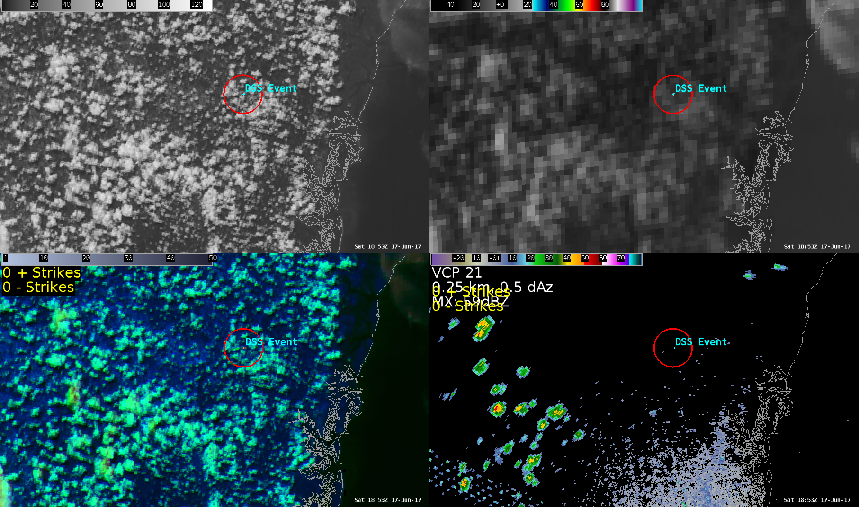
Proof of Concept – 17 June 2017 1853 UTC
0.64 µm
10.3 µm
Day Cloud Phase
KJAX 0.5º Z

Slide 30
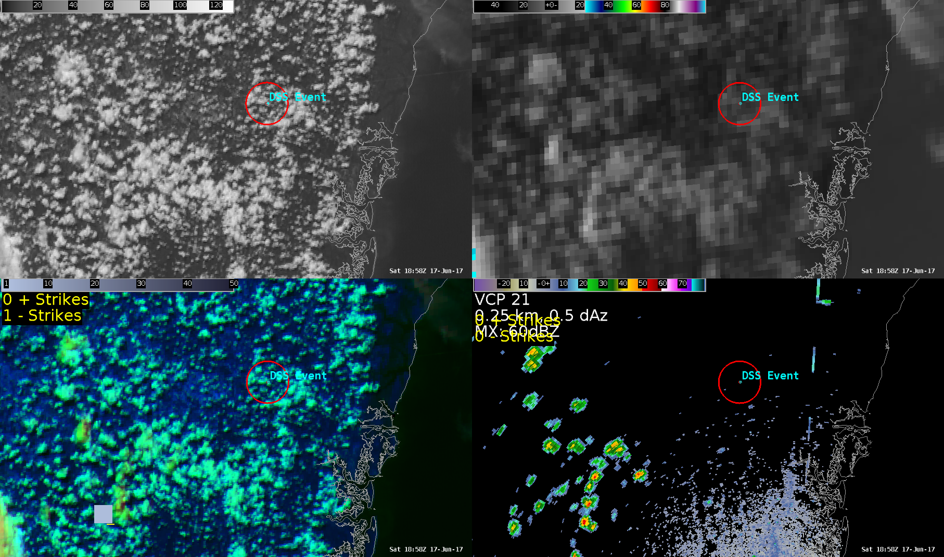
Proof of Concept – 17 June 2017 1858 UTC
0.64 µm
10.3 µm
Day Cloud Phase
KJAX 0.5º Z

Slide 31

Proof of Concept – 17 June 2017 1858 UTC
Time of Arrival Tool Used Data from 1800-1858 UTC
0.64 µm
10.3 µm
30 min lead time on “lightning” within 5 miles of Fair is ~ 2000 UTC
Day Cloud Phase
KJAX 0.5º Z

Slide 32
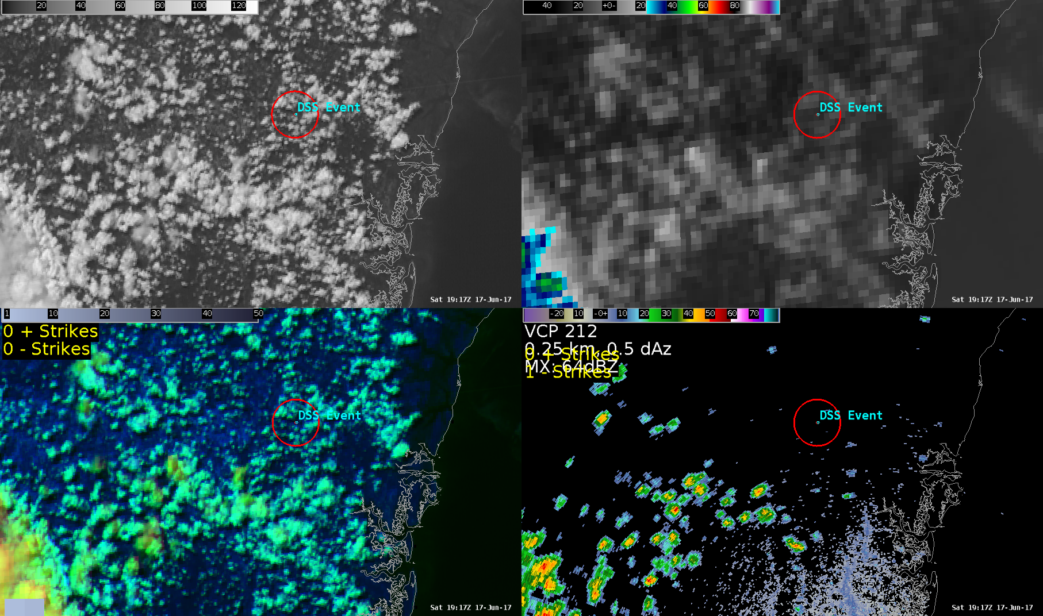
Proof of Concept – 17 June 2017 1917 UTC
0.64 µm
10.3 µm
Day Cloud Phase
KJAX 0.5º Z

Slide 33
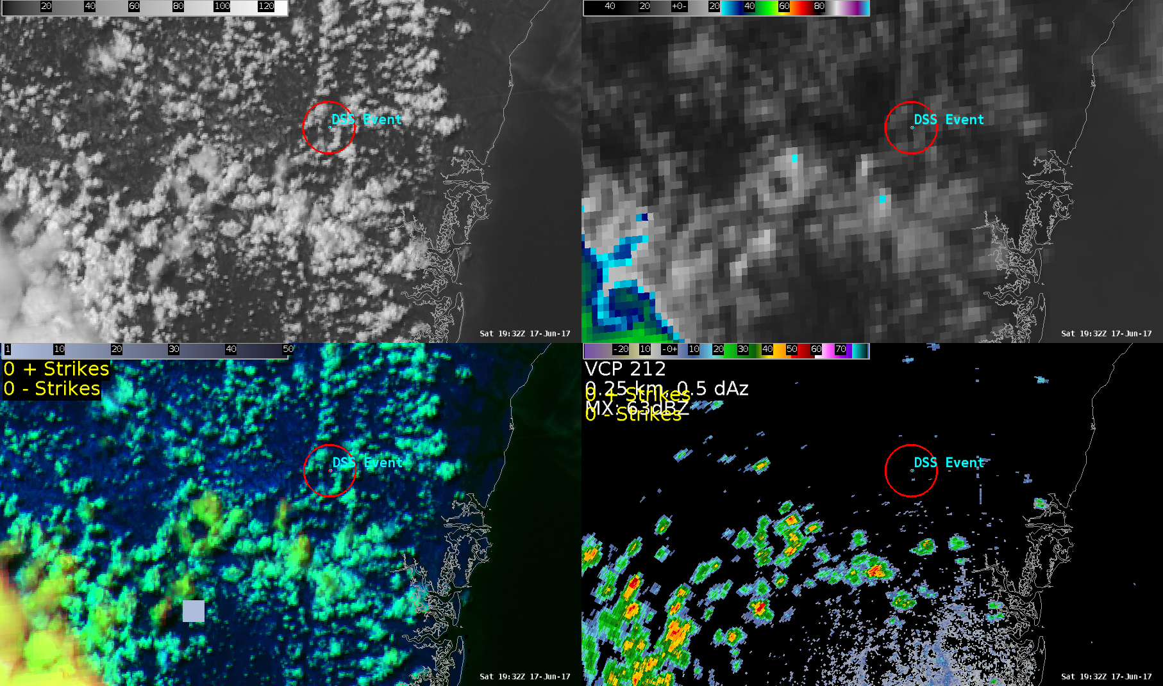
Proof of Concept – 17 June 2017 1932 UTC
0.64 µm
10.3 µm
Day Cloud Phase
KJAX 0.5º Z

Slide 34
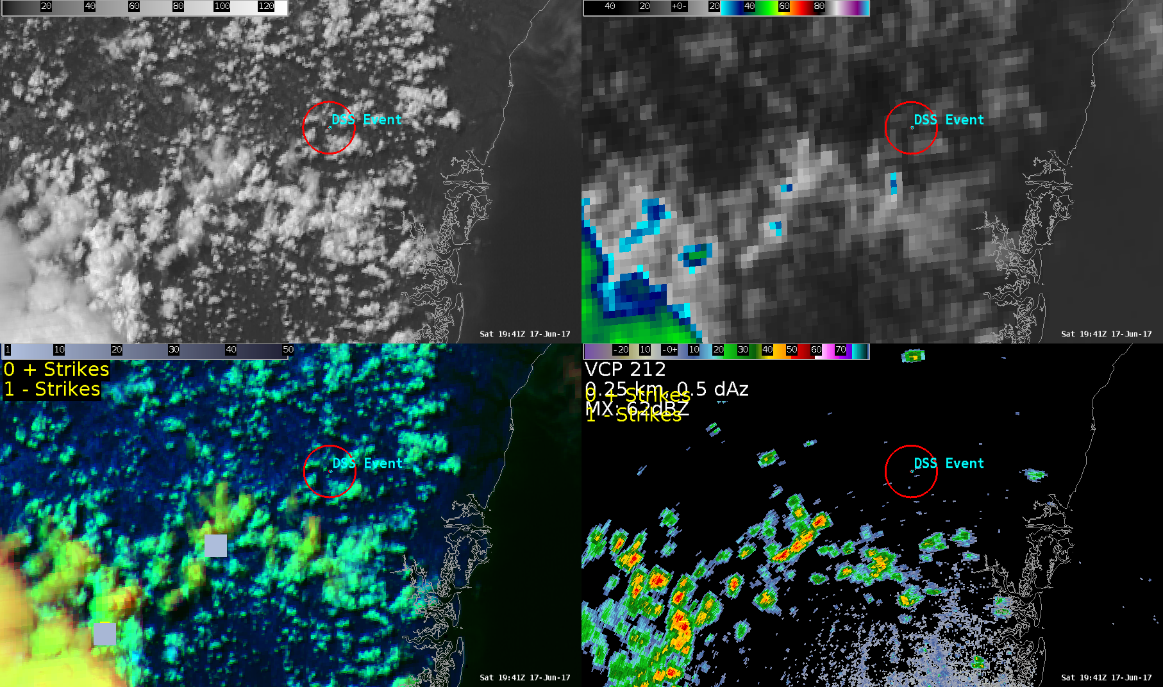
Proof of Concept – 17 June 2017 1941 UTC
0.64 µm
10.3 µm
Frist In-Cloud Lightning With Showers Approaching DSS Event
Day Cloud Phase
KJAX 0.5º Z

Slide 35
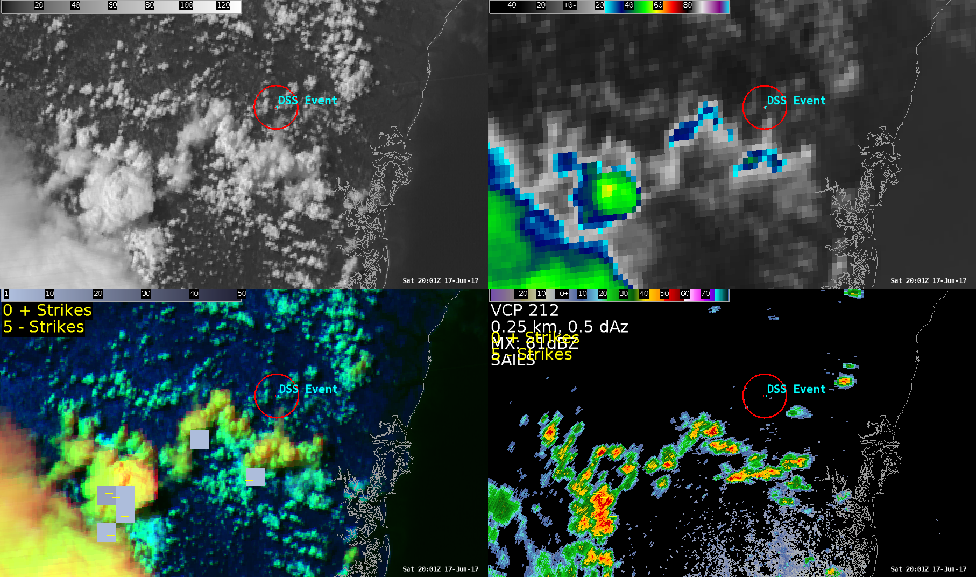
Proof of Concept – 17 June 2017 2001 UTC
0.64 µm
10.3 µm
–
Frist
Cloud-to-Ground Lightning
Day Cloud Phase
KJAX 0.5º Z

Slide 36
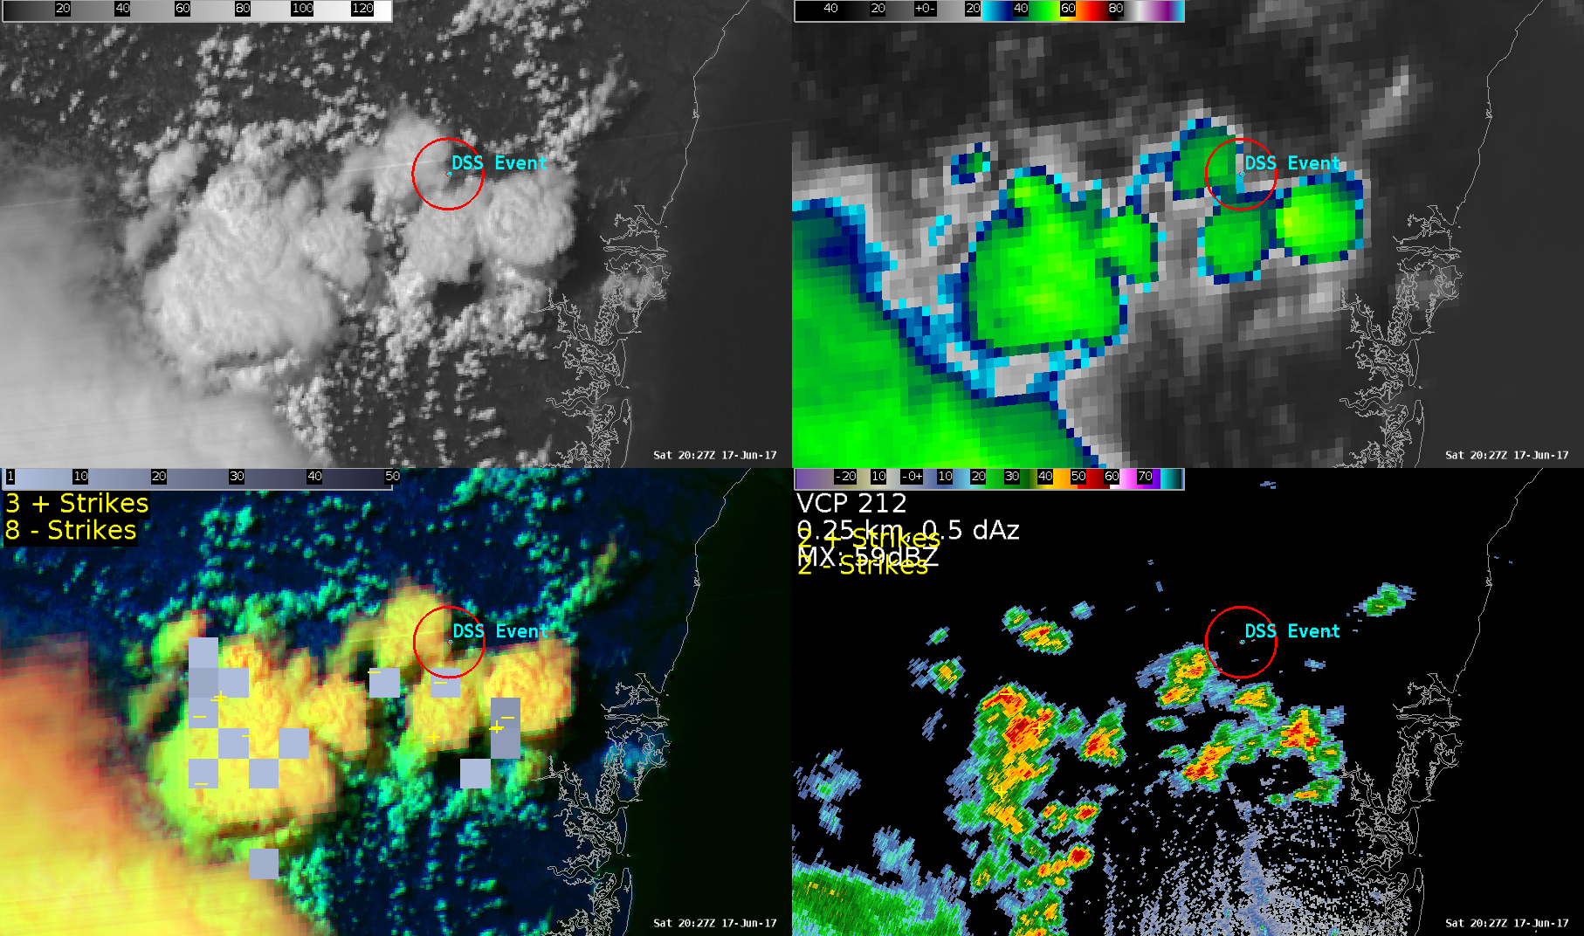
Proof of Concept – 17 June 2017 2027 UTC
0.64 µm
10.3 µm
–
Day Cloud Phase
KJAX 0.5º Z

Slide 37
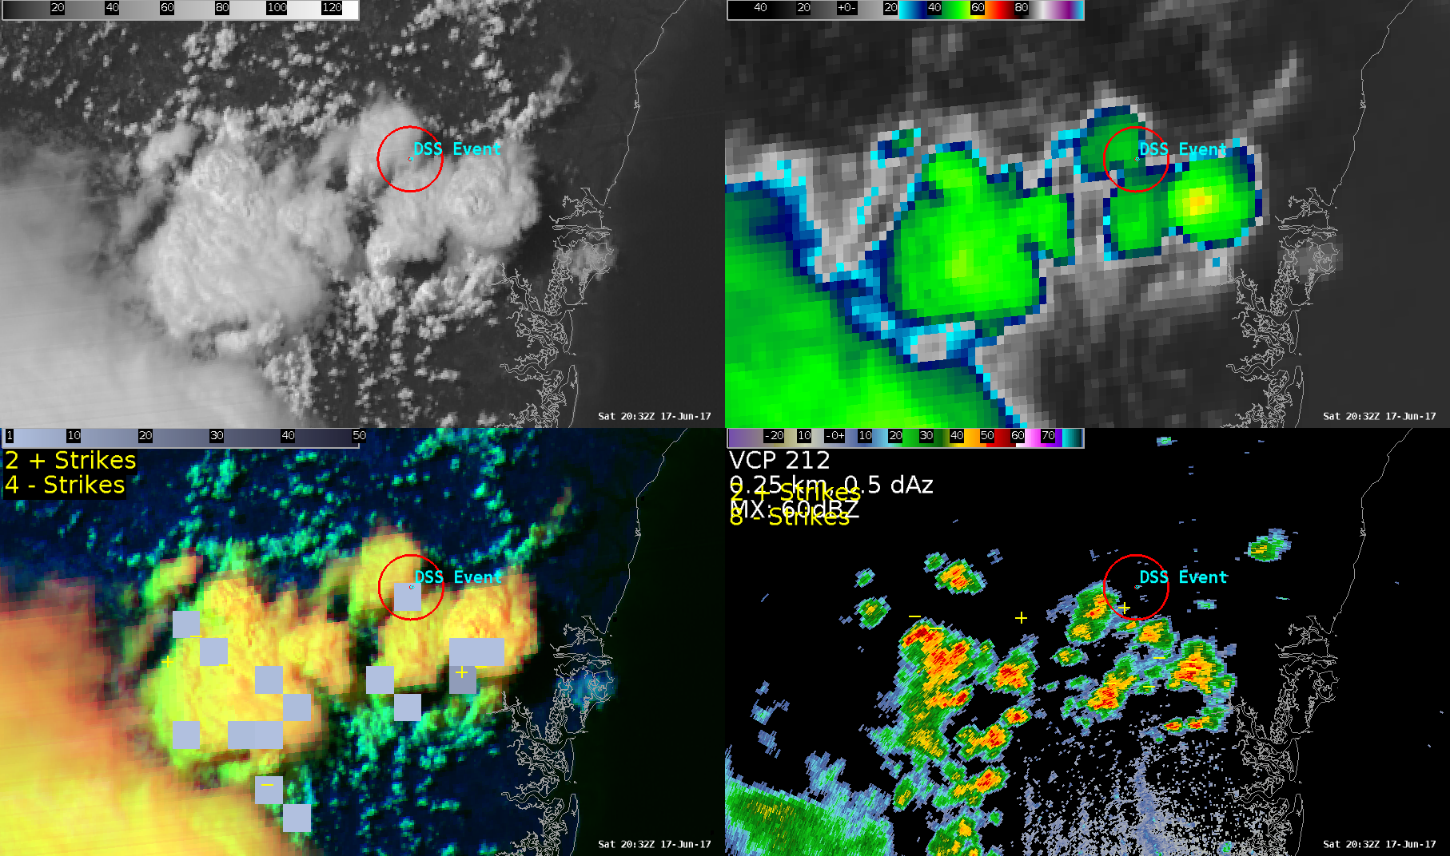
Proof of Concept – 17 June 2017 2032 UTC
0.64 µm
10.3 µm
First In-Cloud Lightning Within
5 miles of
DSS Event
Day Cloud Phase
KJAX 0.5º Z

Slide 38
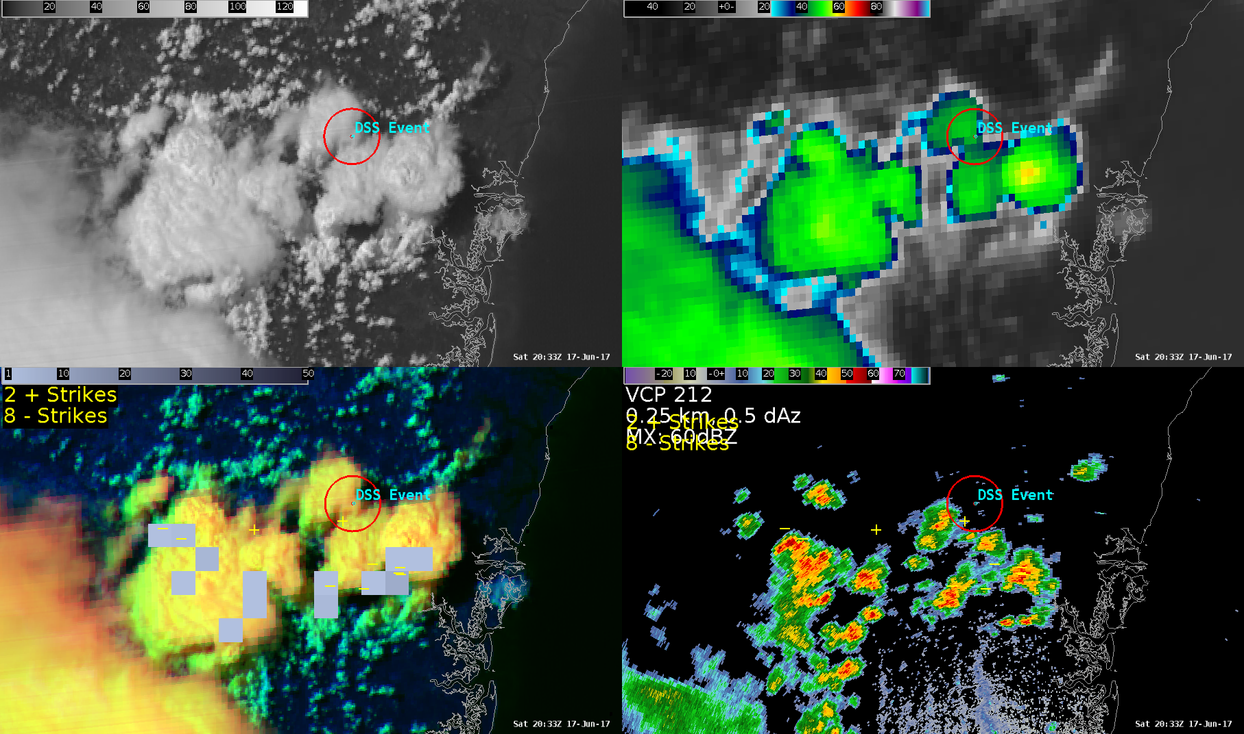
Proof of Concept – 17 June 2017 2033 UTC
0.64 µm
10.3 µm
First
Cloud-to-Ground Lightning Within
5 miles of
DSS Event
+
Day Cloud Phase
KJAX 0.5º Z

Slide 39
GOES-16 Geostationary Lightning Mapper

Slide 40
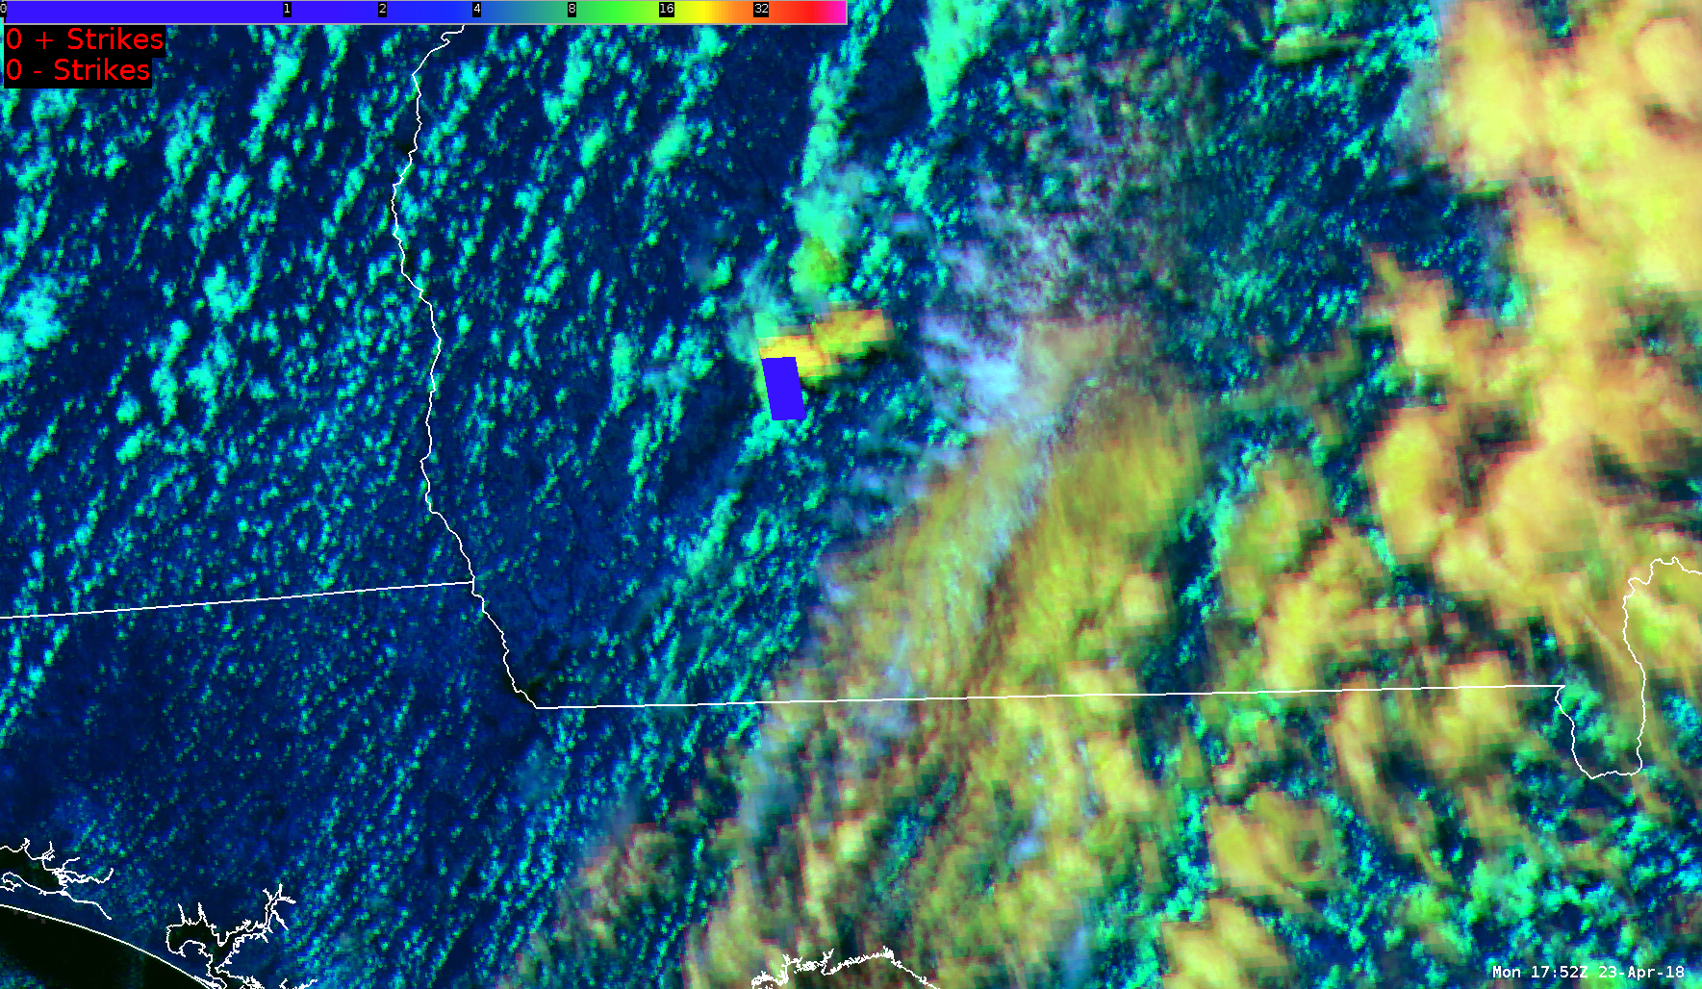
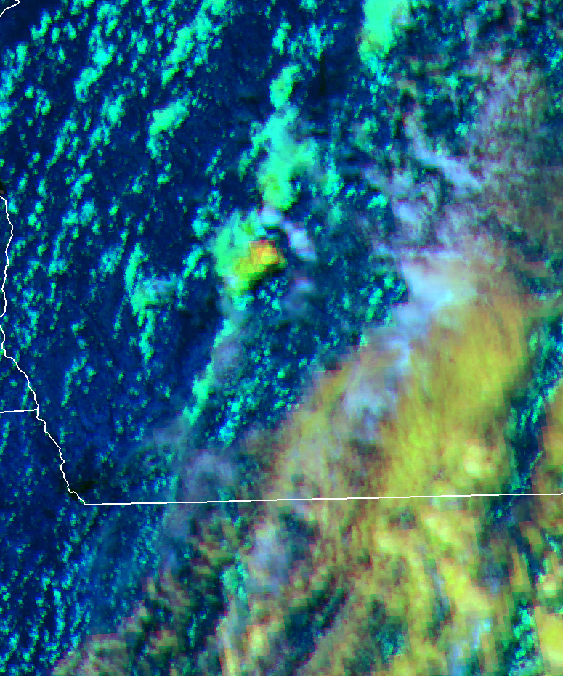
GLM Flash Extent Density – 23 April 2018
1737 UTC
GA
FL

Slide 41

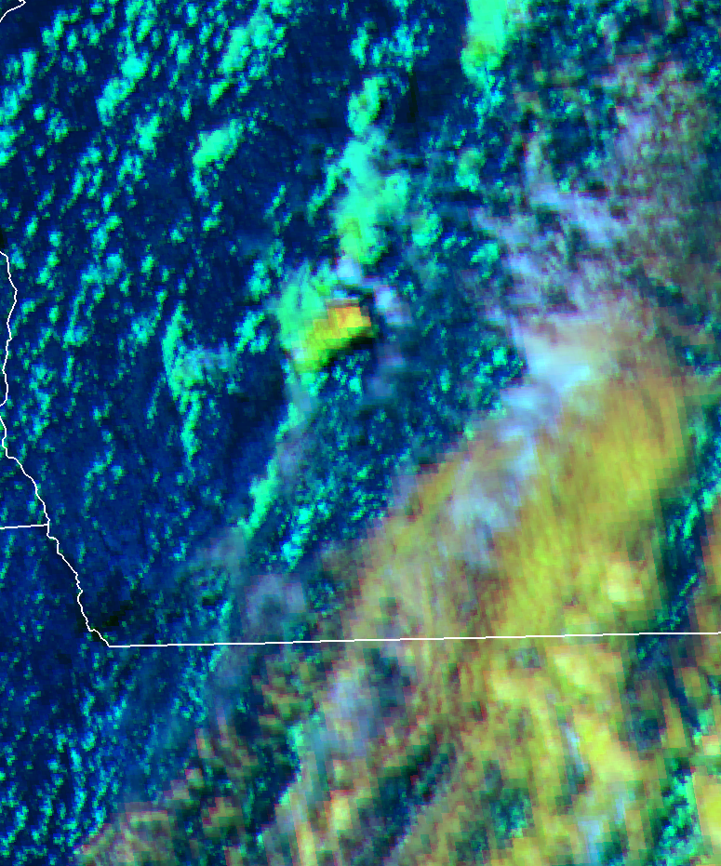
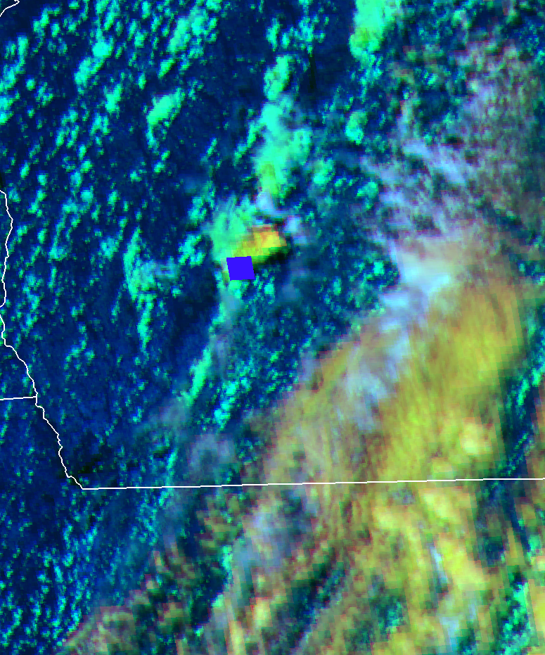
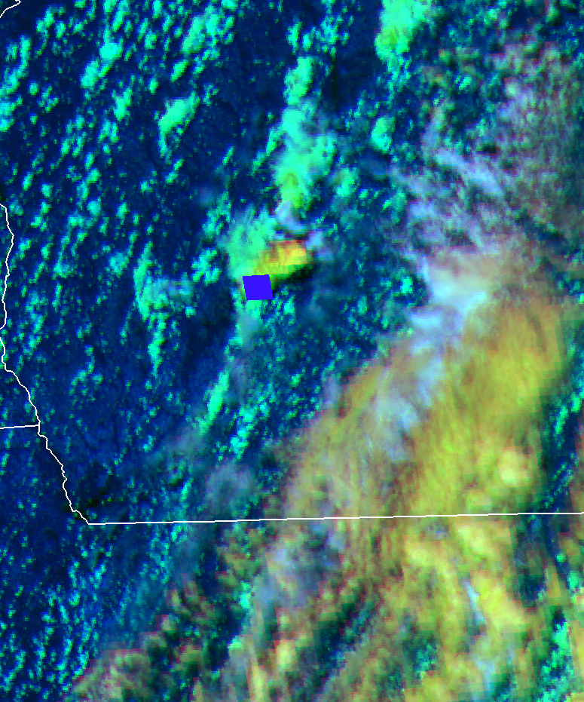
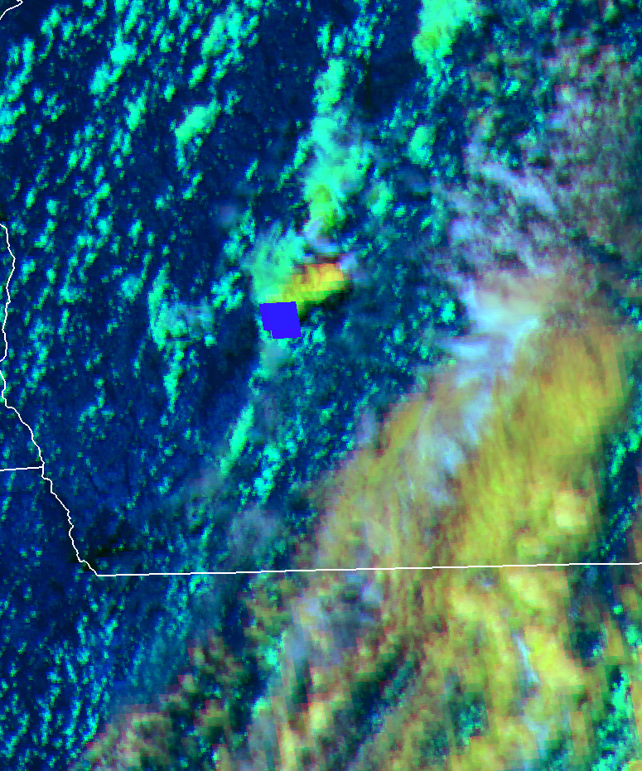
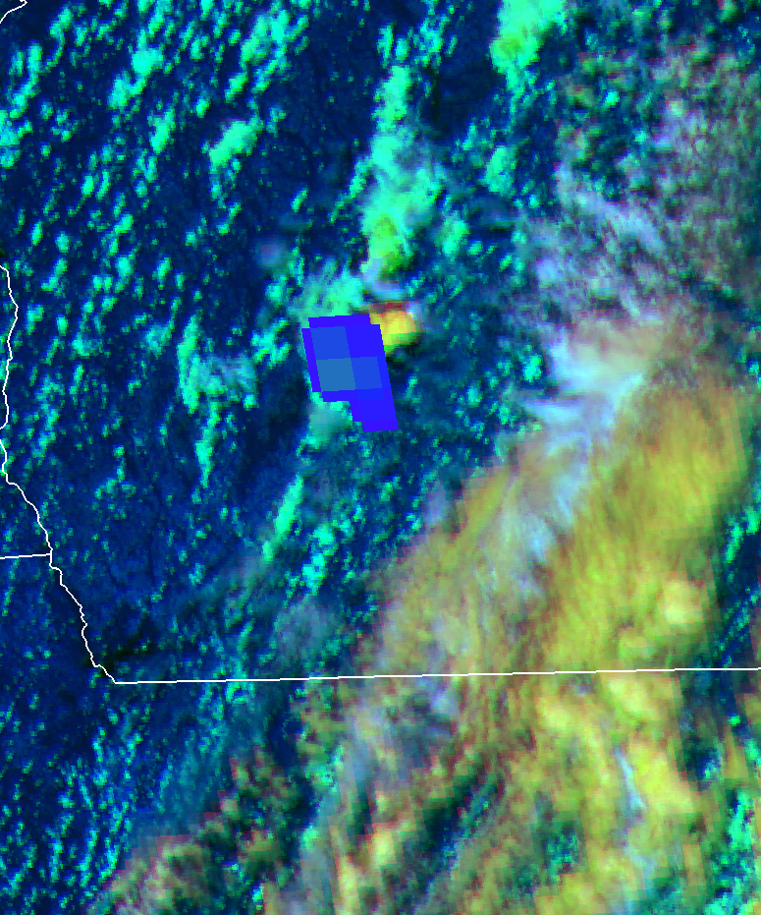
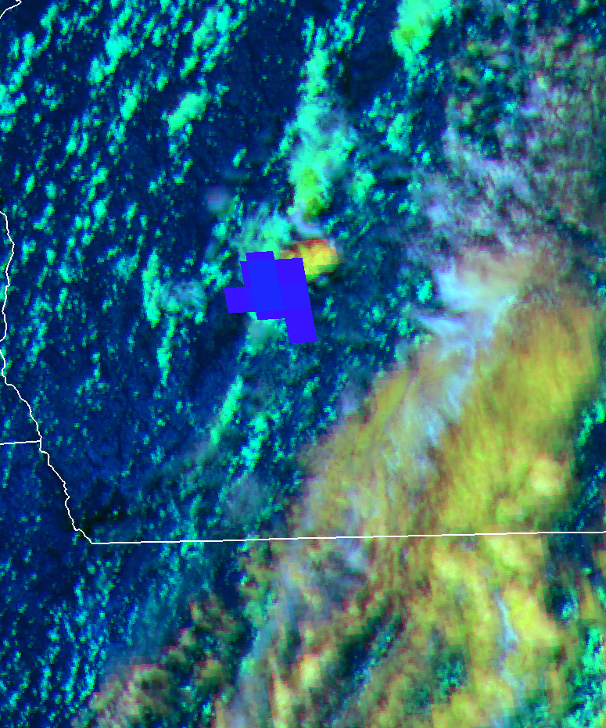

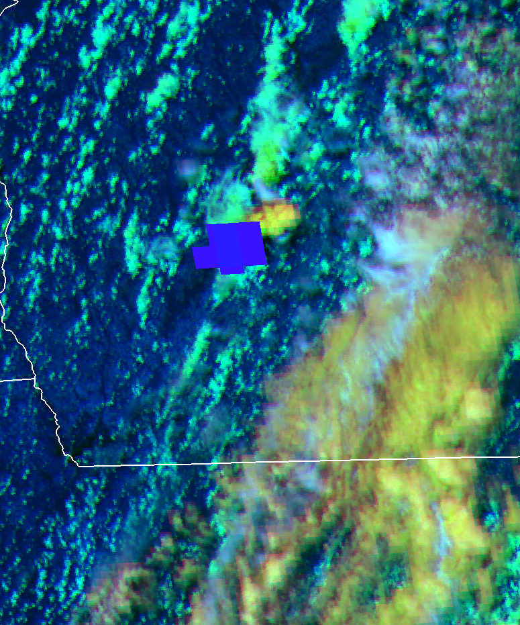
GLM Flash Extent Density – 23 April 2018
1737 UTC
1738 UTC
1739 UTC
1740 UTC
1741 UTC
GA
FL
1742 UTC
1743 UTC
1744 UTC
1745 UTC
1746 UTC

Slide 42
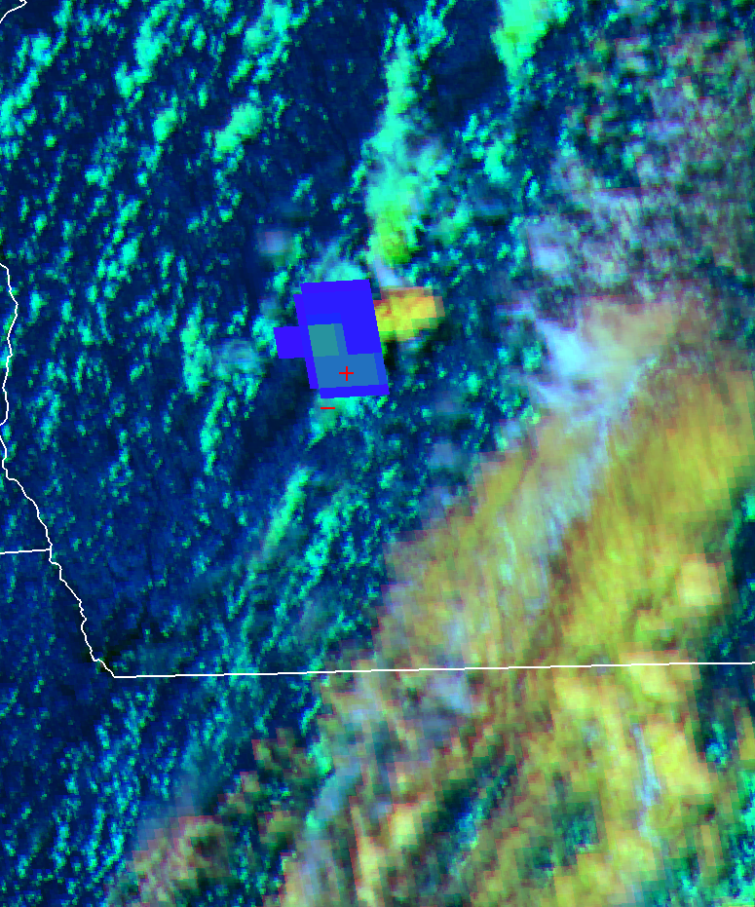
GLM Flash Extent Density – 23 April 2018
1737 UTC
1738 UTC
1739 UTC
1740 UTC
1741 UTC
GA
1747 UTC
FL
+
–
1742 UTC
1743 UTC
1744 UTC
1745 UTC
1746 UTC

Slide 43
Day Cloud Phase RGB Composite For DSS
Things To Remember
Without exploiting the GOES-16 1.6 µm band, this capability is not possible.

Slide 44
Day Cloud Phase RGB Composite For DSS
Things To Remember
Without exploiting the GOES-16 1.6 µm band, this capability is not possible.
The “proof of concept” is a hypothetical example of how the RGB could be used to provide DSS when convection is expected to impact an outdoor event. But what else?

Slide 45
Day Cloud Phase RGB Composite For DSS
Things To Remember
Without exploiting the GOES-16 1.6 µm band, this capability is not possible.
The “proof of concept” is a hypothetical example of how the RGB could be used to provide DSS when convection is expected to impact an outdoor event. But what else?
This application should be used with caution in cool-season environments and near sunrise/sunset.

Slide 46
Day Cloud Phase RGB Composite For DSS
Things To Remember
Without exploiting the GOES-16 1.6 µm band, this capability is not possible.
The “proof of concept” is a hypothetical example of how the RGB could be used to provide DSS when convection is expected to impact an outdoor event. But what else?
This application should be used with caution in cool-season environments and near sunrise/sunset.
Thanks to Jayson Gosselin (NWS St. Louis, MO) for initially investigating this concept using the Daytime Composite #1 RGB in May 2017.
Special thanks to a handful of the JAX WFO forecast staff for providing me the opportunity to introduce this concept to them before putting this presentation together.
chad.gravelle@noaa.gov

