Slide 1





FDTD GOES Applications Webinar
Use of Low-Level Water Vapor in diagnosing the elevated mixed layer
Presented by
John Stoppkotte, SOO
NWS North Platte, NE / WFO LBF

Slide 2
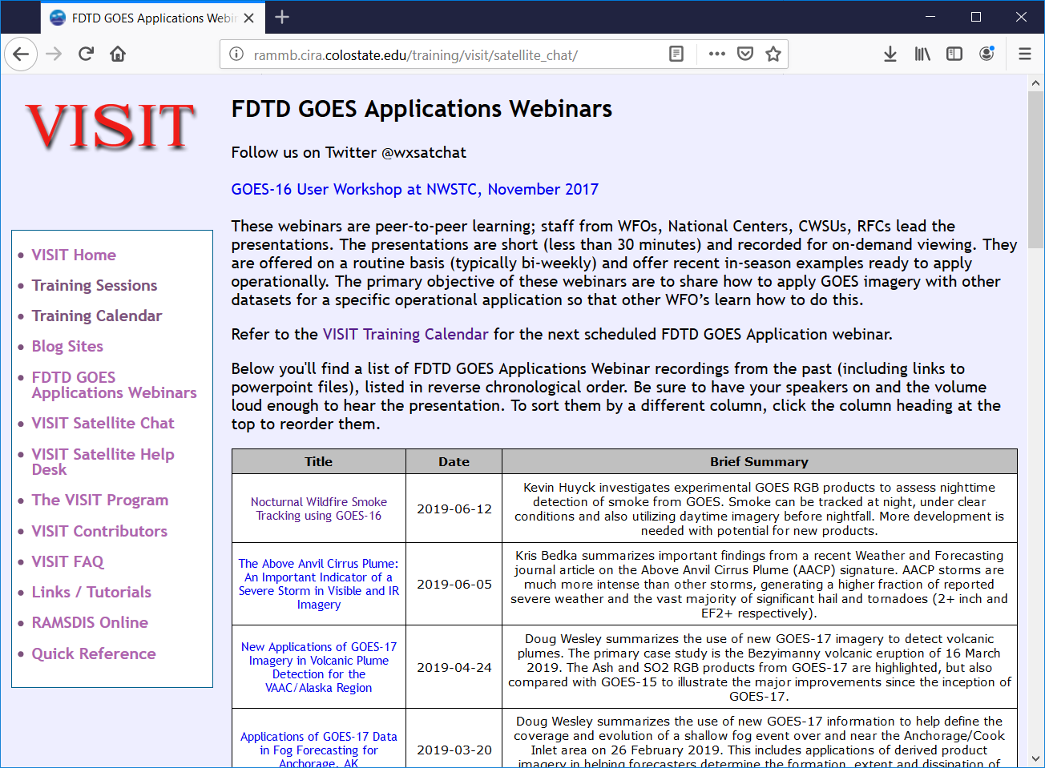
FDTD “Satellite Chat” Library
http://rammb.cira.colostate.edu/training/visit/satellite_chat/
Recorded Content includes Q&A
Call for speakers! Let us know if you want to speak on a topic!
Contact: scott.lindstrom@noaa.gov OR dan.bikos@noaa.gov

Slide 3

FDTD GOES Applications
Webinar Protocol
~20 minutes for the speaker
  Send questions via GoTo Chat
  Or ask during Q&A period via phone
Followed by Q&A
  Open discussion forum
  Done by 1830 UTC
Do NOT press hold!!!
Mute when not speaking

Slide 4
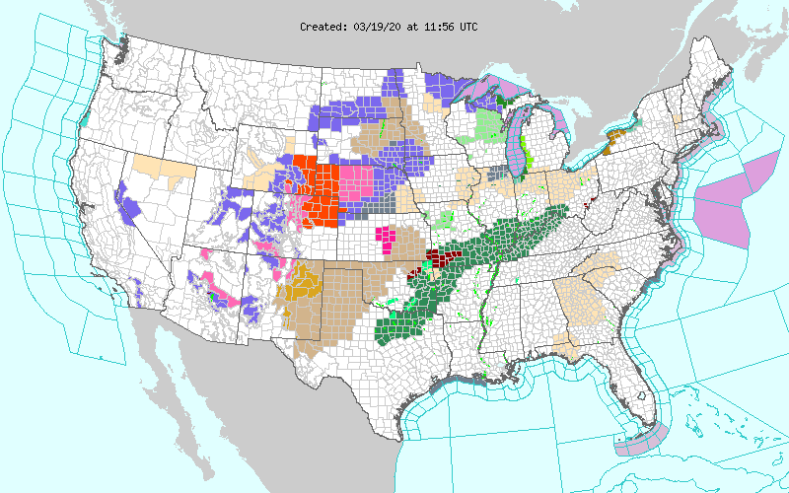
Highlights Across the Area on the day in question: March 19 2020

Slide 5
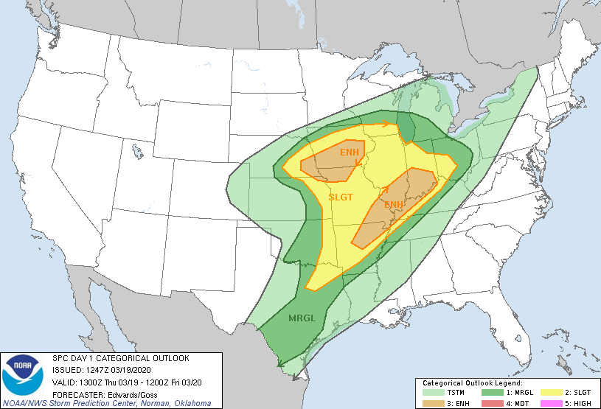
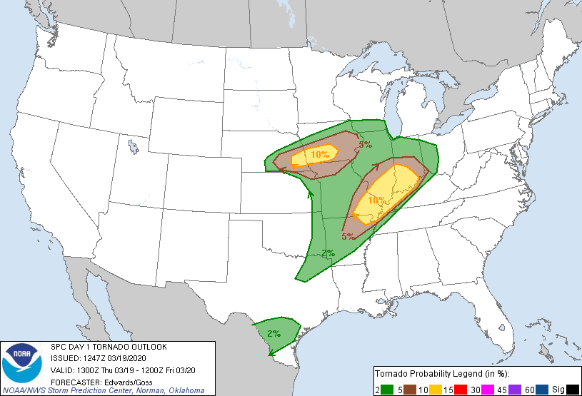
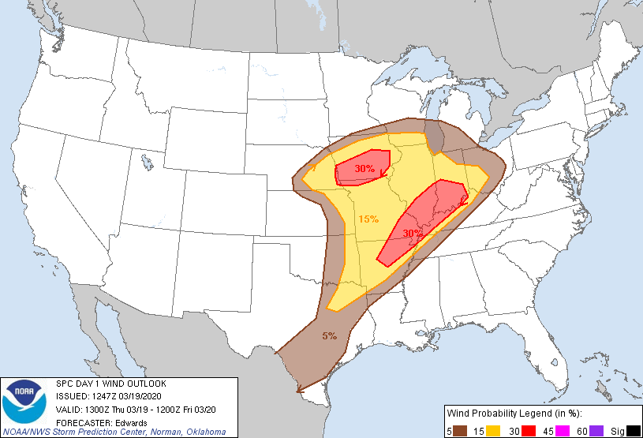
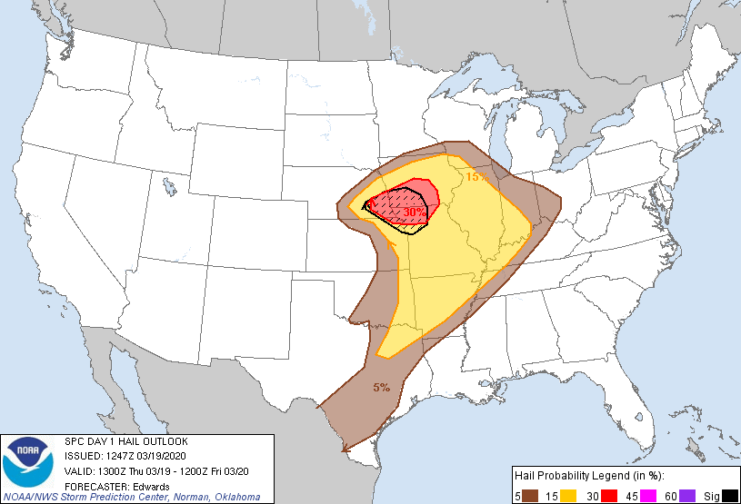
Active Day across the Plains
WFO LBF was expecting a few T-storms in our southern CWA, but also blizzard conditions in our northwest
Meanwhile WFO OAX/GID were expecting severe weather
Enhanced risk and 10% TOR threat for OAX CWA
Day 1 Outlook
Day 1 TOR Outlook
Day 1 Wind Outlook
Day 1 Hail Outlook

Slide 6
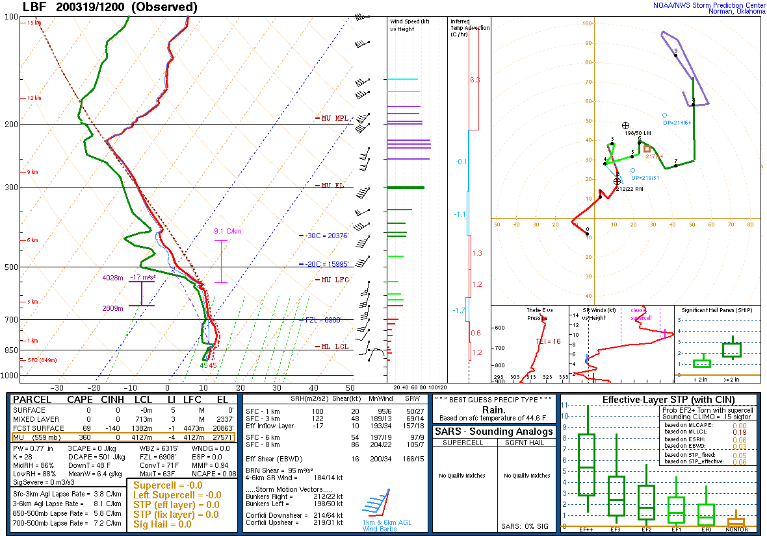
1200 UTC 19 March 2020 LBF Sounding
Dew points in the mid 40s on LBF morning sounding
Some CAPE aloft but well above the surface

Slide 7
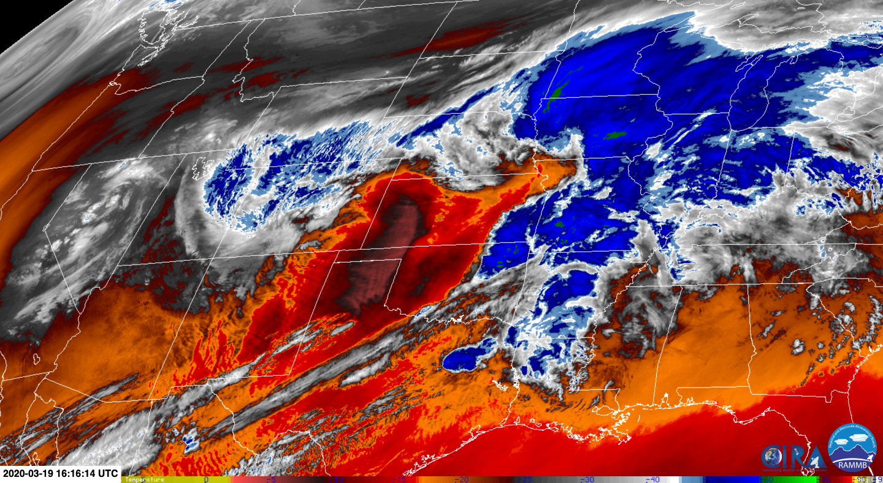
1616 UTC 7.3um GOES-East Low-Level Water Vapor
Mid-level FGEN producing rain then snow
By mid morning there was good moisture in the BL north of the front
Across KS the elevated mixed layer was developing as seen in red colors on GOES-East image (black circle)

Slide 8
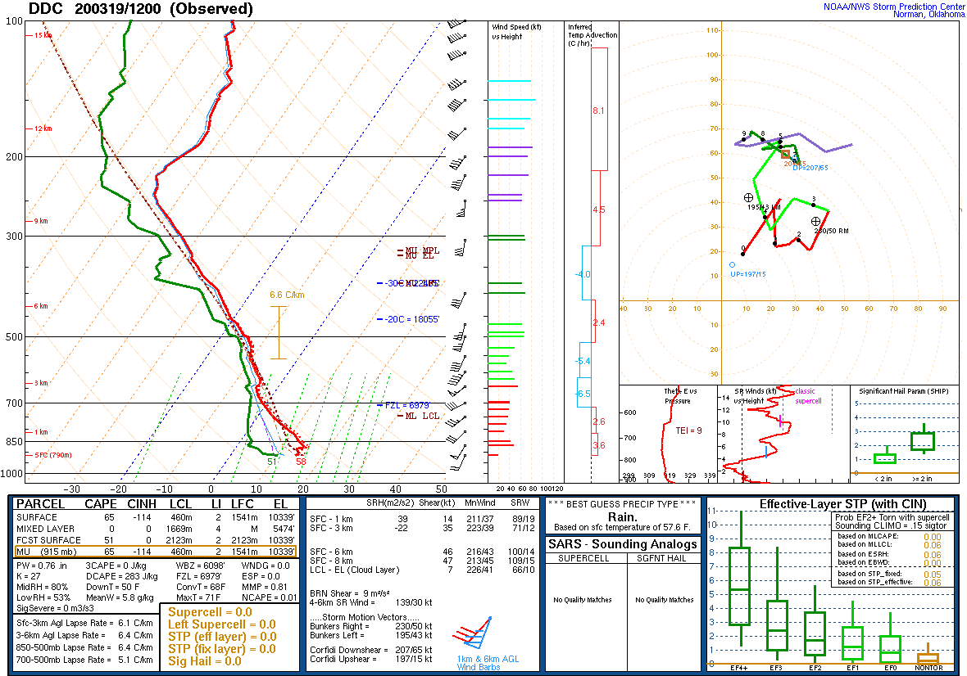
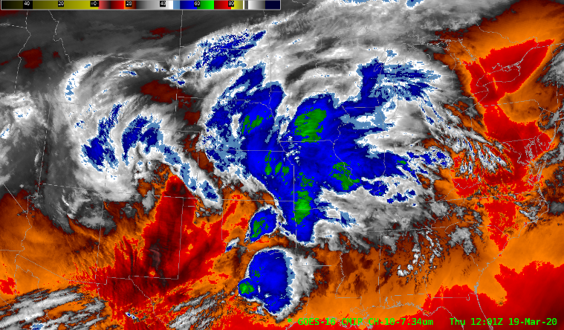
1200 UTC 19 March 2020 DDC sounding
Early morning sounding from DDC showed somewhat drier low-levels but the EML was not explicitly captured
Still surface dew point of 51!

Slide 9
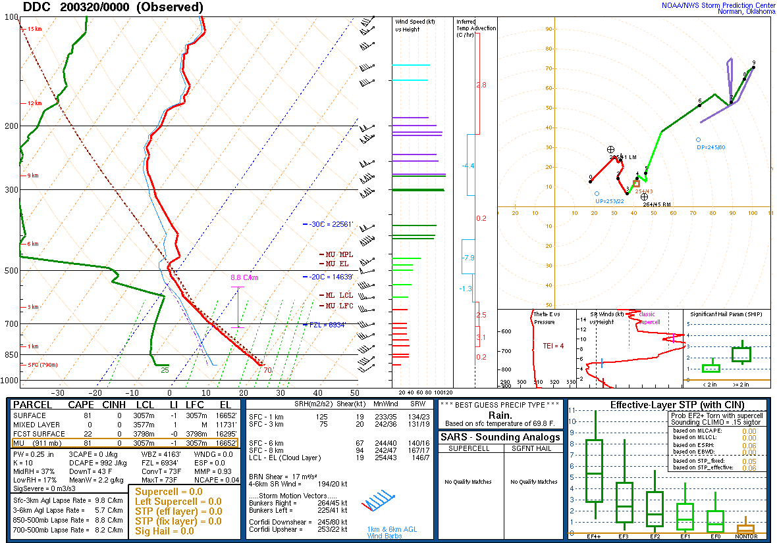
0000 UTC 20 March 2020 DDC sounding
However By 0000 UTC you can see that the EML did mix out and a nearly inverted-V profile remained
Surface dew point in the mid 20s!

Slide 10
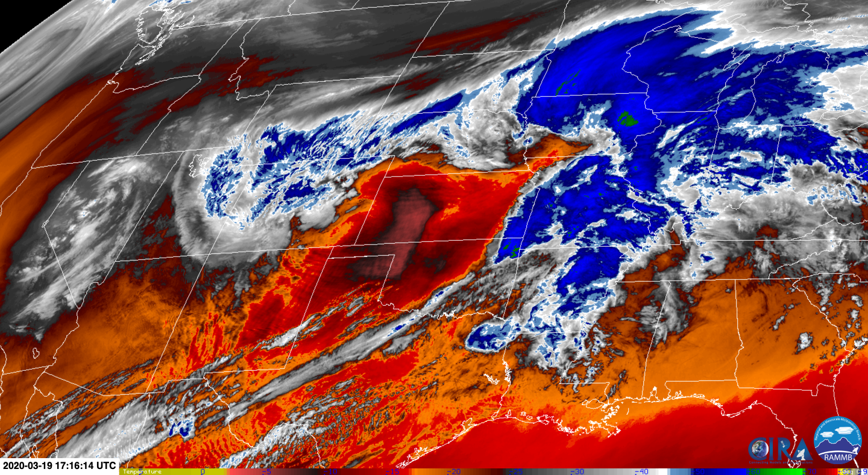
1716 UTC 7.3um GOES-East Low-Level Water Vapor
Mid-level FGEN producing mostly snow
By late morning the mid-level FGEN band intensified while EML progressed eastward across KS

Slide 11
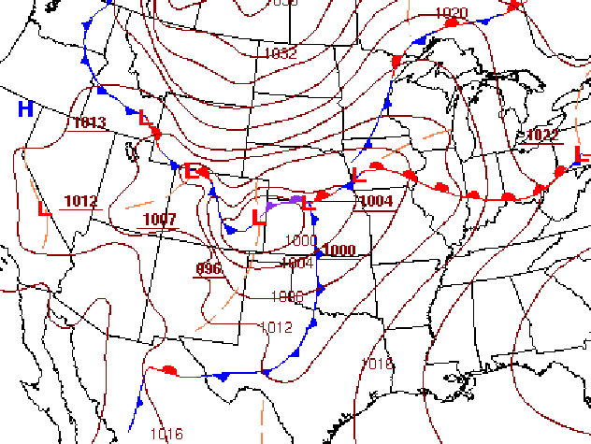
1800 UTC 19 March 2020 WPC SFC Frontal Positions

Slide 12
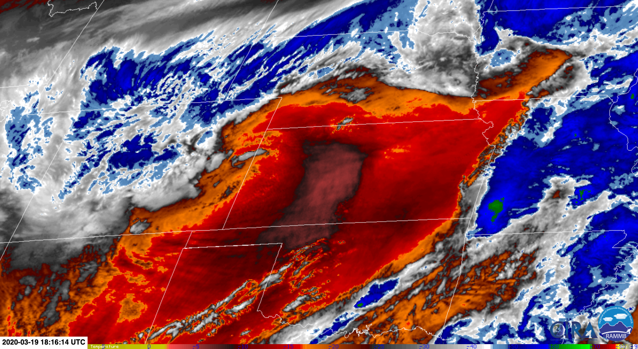
1816 UTC 7.3um GOES-East Low-Level Water Vapor
Mid-level FGEN producing snow
By early afternoon the mid-level FGEN expanded while EML progressed eastward across KS
Notice the two yellow circles marking convective initiation
Occurring on the northern fringe of the EML
Notice also that moisture just above the surface has decreased in southwest NE

Slide 13
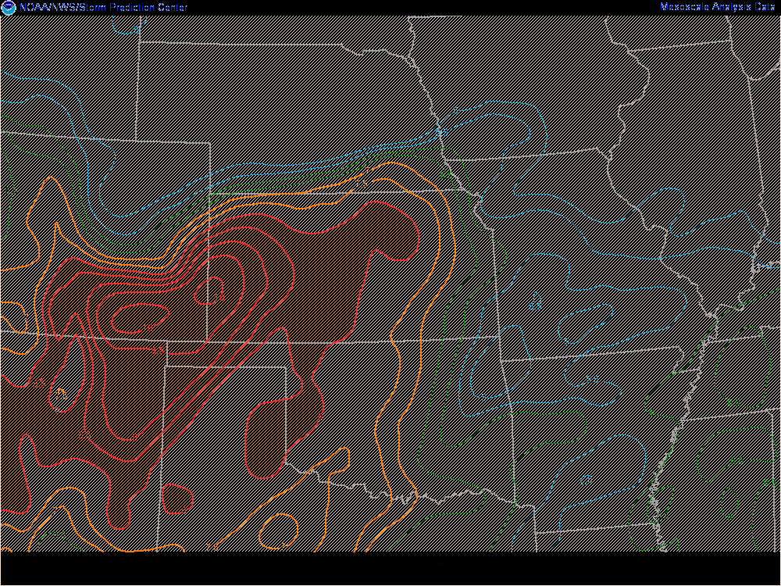
1816 UTC 7.3um GOES-East Low-Level Water Vapor
At the same time, low-level lapse rates were steepening across eastern CO and western KS
The lapse rate gradient was increasing as well as low-level cold air to the north was trying to move south
Further indicating better low-level FGEN and related forcing along the front

Slide 14
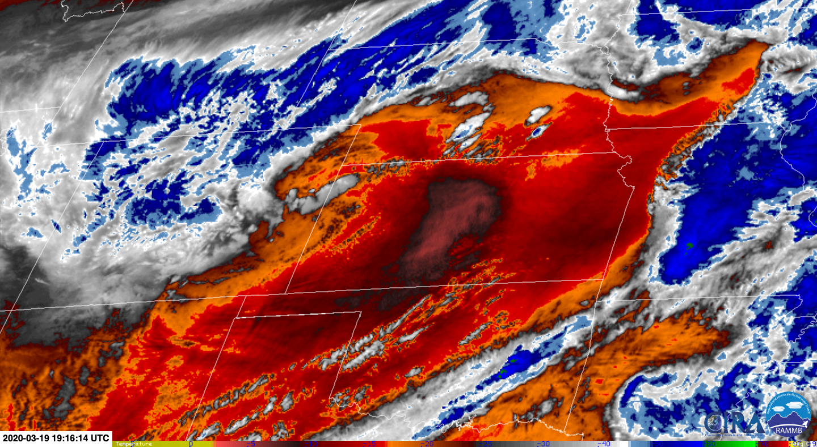
1916 UTC 7.3um GOES-East Low-Level Water Vapor
Mid-level FGEN producing snow
Mid-level FGEN continues to expand while EML progressed eastward across KS
More convective initiation has occurred
Still occurring on the northern fringe of the EML
Dashed circle shows elevated convection

Slide 15
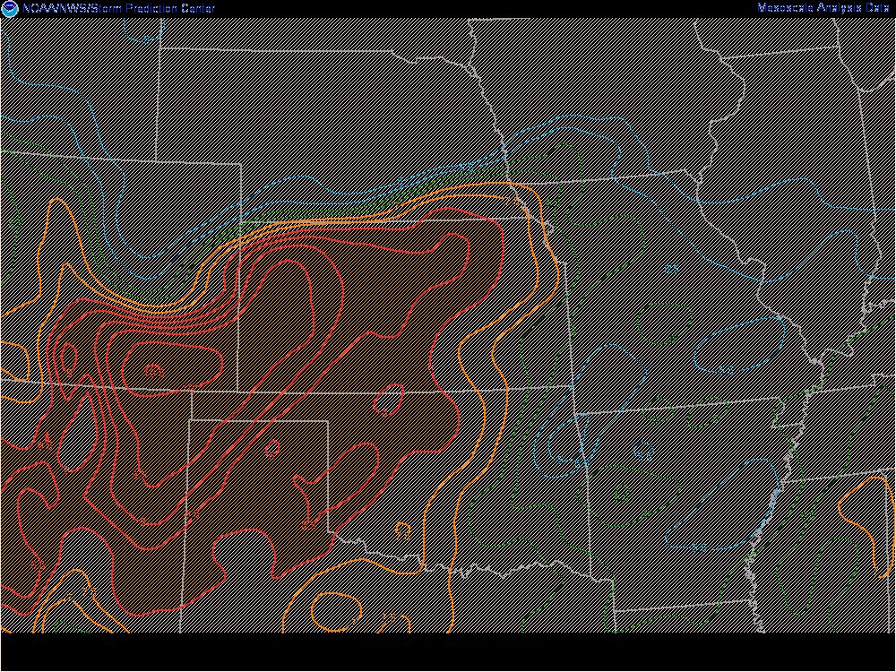
1916 UTC 7.3um GOES-East Low-Level Water Vapor
The lapse rate gradient continued to increase into southeast NE - but also northwest KS/Southwest NE

Slide 16
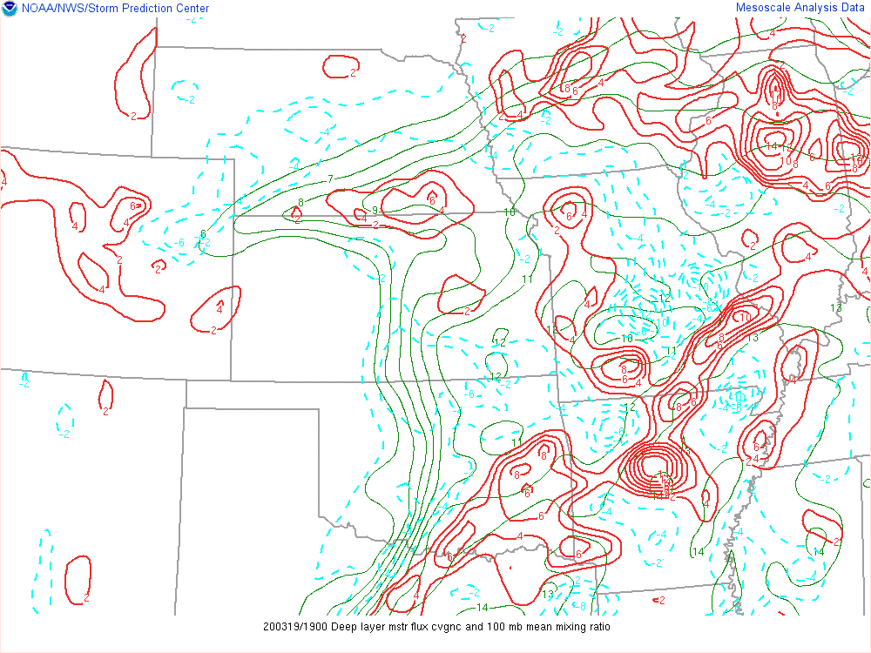
1916 UTC 7.3um GOES-East Low-Level Water Vapor
In addition, the deep layer moisture convergence is increasing and becoming more focused
100mb mean mixing ratio shows higher values along and just behind the front
  Also aligned with the lapse rate gradient

Slide 17
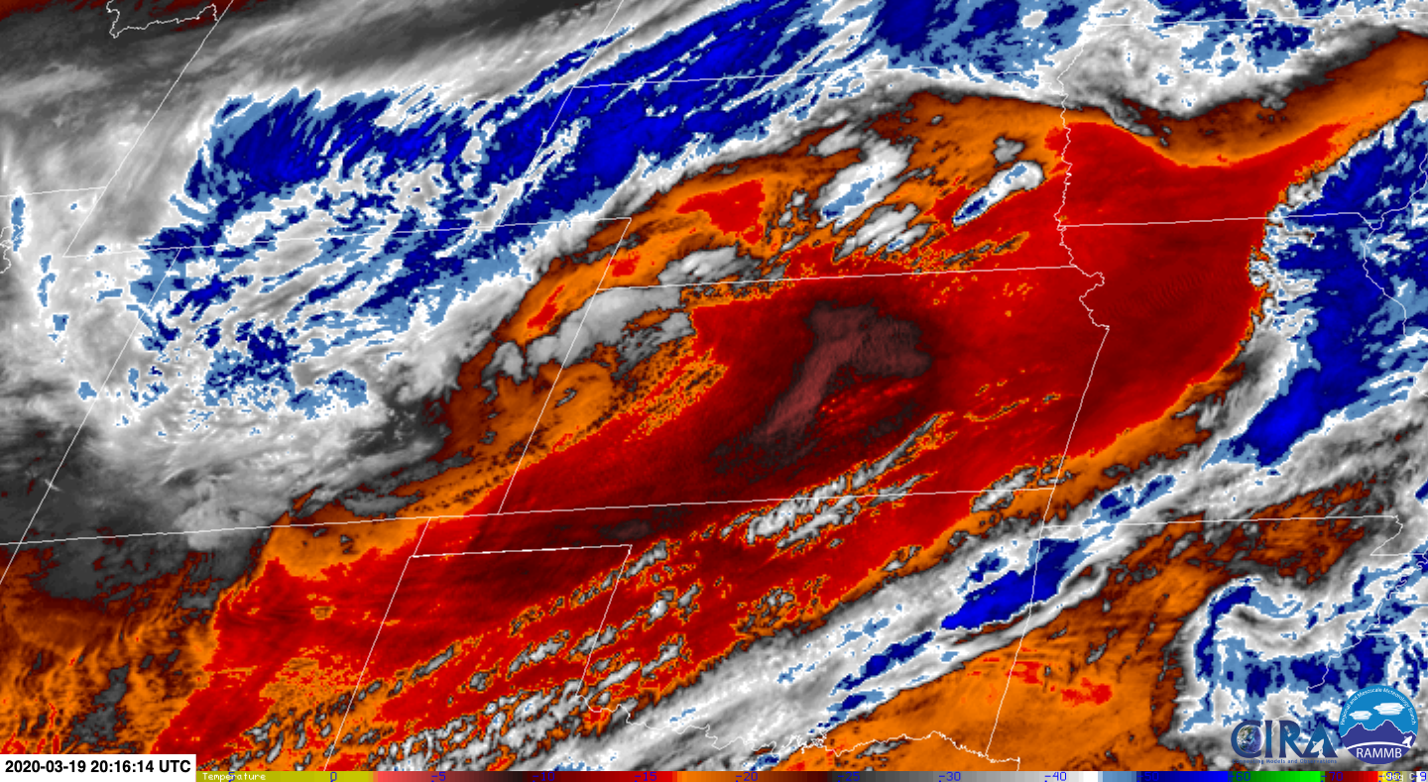
2016 UTC 7.3um GOES-East Low-Level Water Vapor
Mid-level FGEN producing snow
Mid-level FGEN continues to intensify
EML progression eastward across KS continues
More convective initiation has occurred
Occurring on the north and west side of the EML
  EML wrapped westward thanks to low positioning in CO/KS border
Hayes/Frontier counties now involved

Slide 18
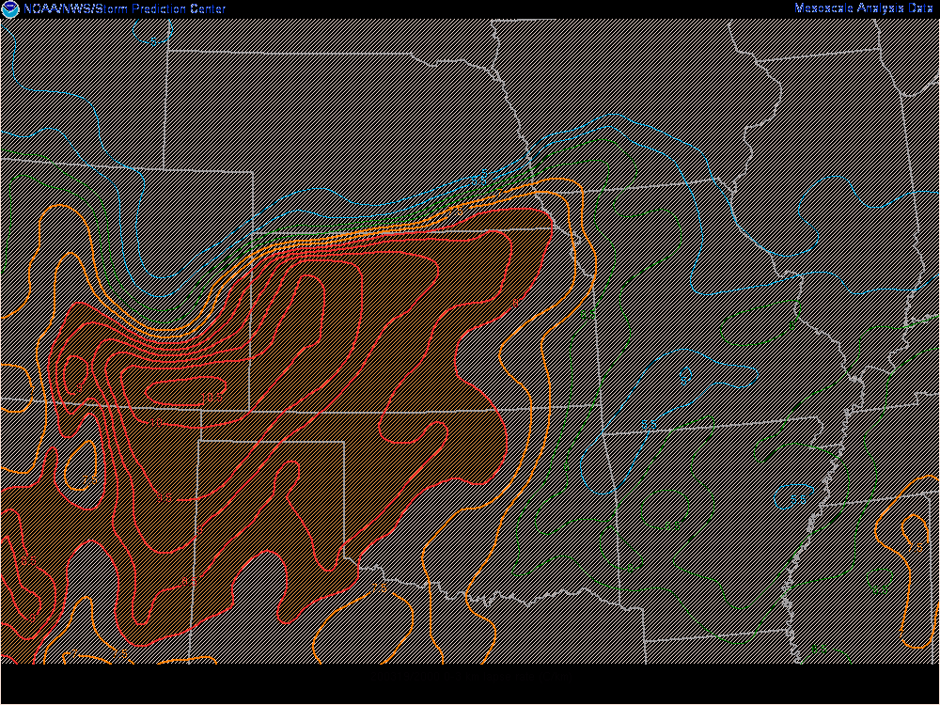
2016 UTC 7.3um GOES-East Low-Level Water Vapor
Notice the very tight lapse rate gradient from southern NE into northwest KS!
North and westward push of higher lapse rates clearly seen here contributing to the instability near the surface
As a result convection increasing

Slide 19
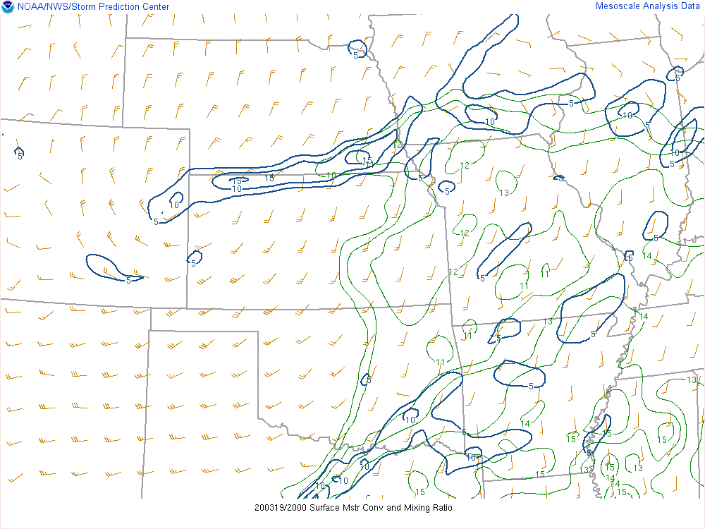
2016 UTC 7.3um GOES-East Low-Level Water Vapor
Good low level moisture convergence now as well

Slide 20
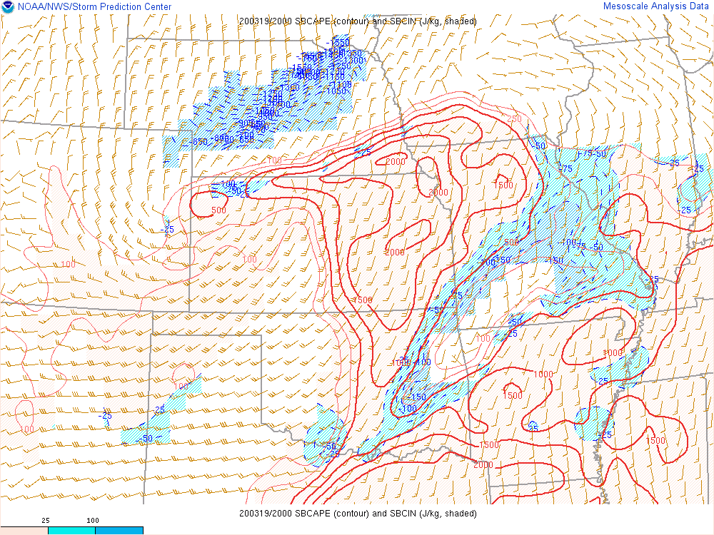
2016 UTC 7.3um GOES-East Low-Level Water Vapor
In addition decent low-level CAPE is available to surface parcels as well

Slide 21
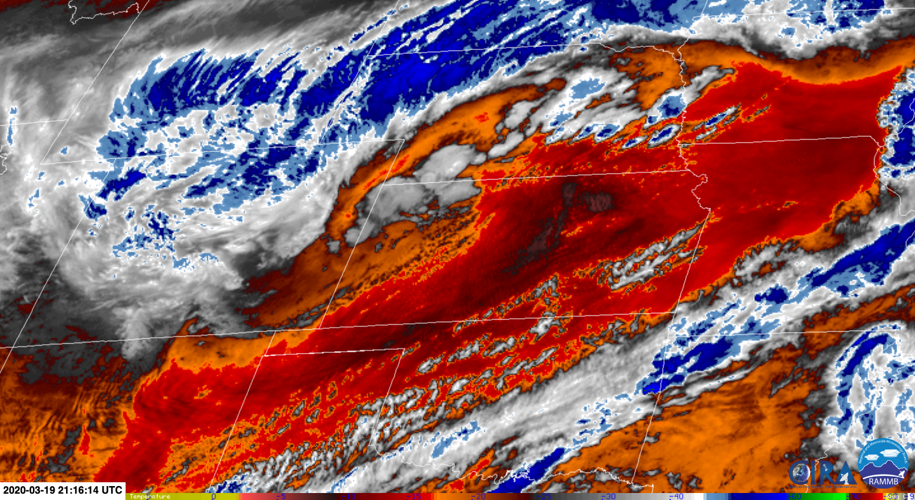
2116 UTC 7.3um GOES-East Low-Level Water Vapor
Mid-level FGEN producing snow
Mid-level FGEN continues to intensify in northwest NE
EML progression eastward across KS continues
Convection increasing across southern NE and northwest KS
Hayes/Frontier counties continue to be monitored for possible large hail

Slide 22
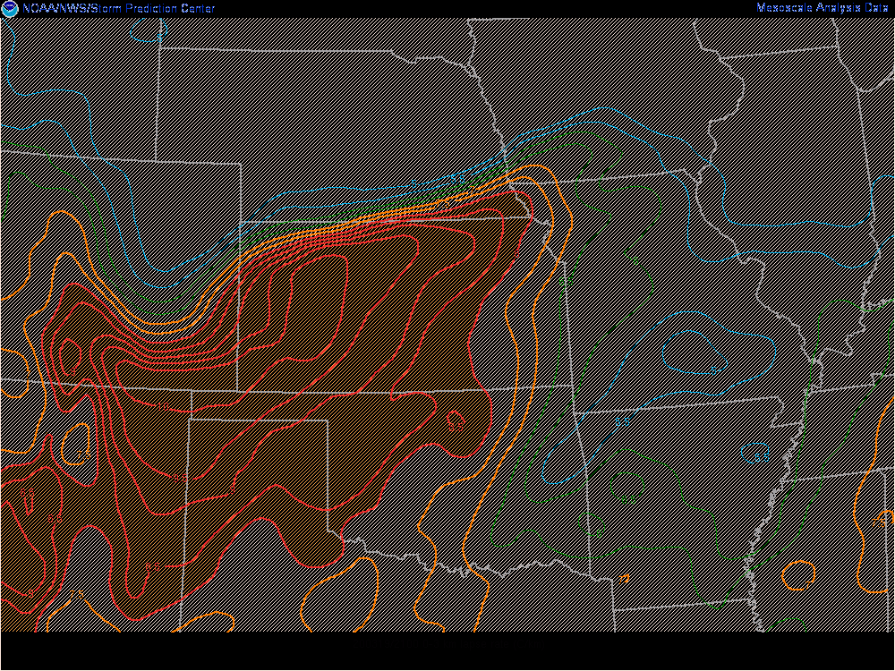
2116 UTC 7.3um GOES-East Low-Level Water Vapor
Very tight lapse rate gradient from southern NE into northwest KS remains
Supporting surface-based parcel acceleration to LCL and LFC
Convection increasing

Slide 23
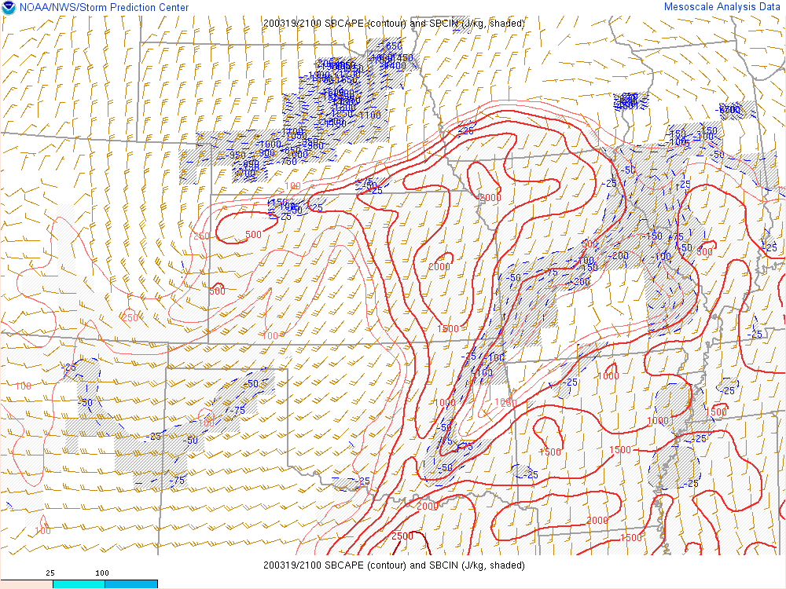
2116 UTC 7.3um GOES-East Low-Level Water Vapor
Still decent surface-based CAPE
CIN increasing north of the front
  Would suggest northward advancement of convective elements beyond Hayes/Frontier counties should decrease potential severe threat quickly

Slide 24
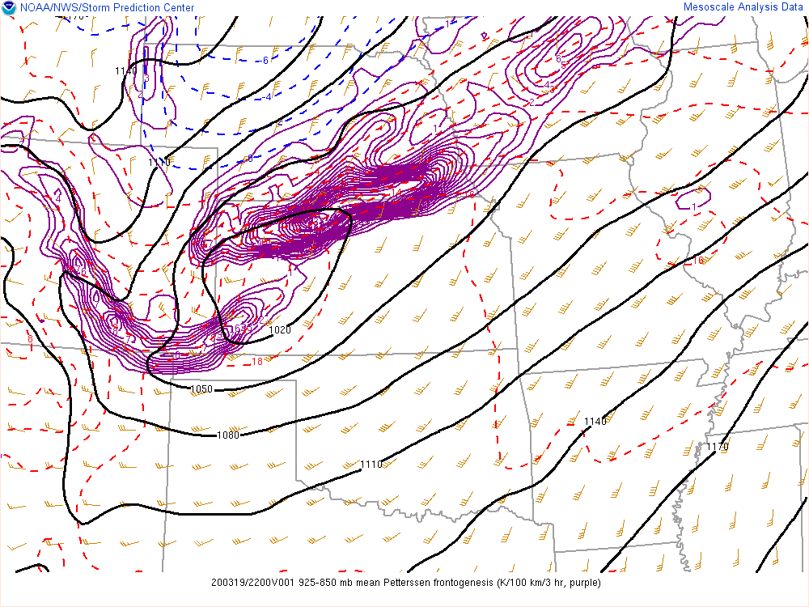
2116 UTC 7.3um GOES-East Low-Level Water Vapor
But strong low-level forcing near the front remains

Slide 25
Take Home Points
Low-level water vapor imagery is very beneficial in tracking the EML
The EML usually resides above low-level moist layer
  This allows convection to be “capped” initially
Once low-level forcing develops, the cap will serve to limit convective development in space to favor the most rigorous parcel accelerations
  CAPE then available to a few storms rather than having widespread convection competing
When paired with various SPC mesoanalysis graphics can help focus attention to where convection initiation may occur and to what degree
Should be used routinely by all forecasters but especially the Mesoanalysis Forecaster (MA MET)

