Slide 1





FDTD Satellite Applications Webinar
NWS Central Region Remote Mesoanalyst Proof of Concept: The 17 March 2021 Tornado Event in Southwest Missouri
Presented by
Jason Schaumann, SOO, NWS Springfield MO, WFO SGF
Corey Mead, Meteorologist, NWS Omaha/Valley NE WFO OAX
Pat Spoden, SOO, NWS Paducah KY, WFO PAH
5 May 2021

Slide 2
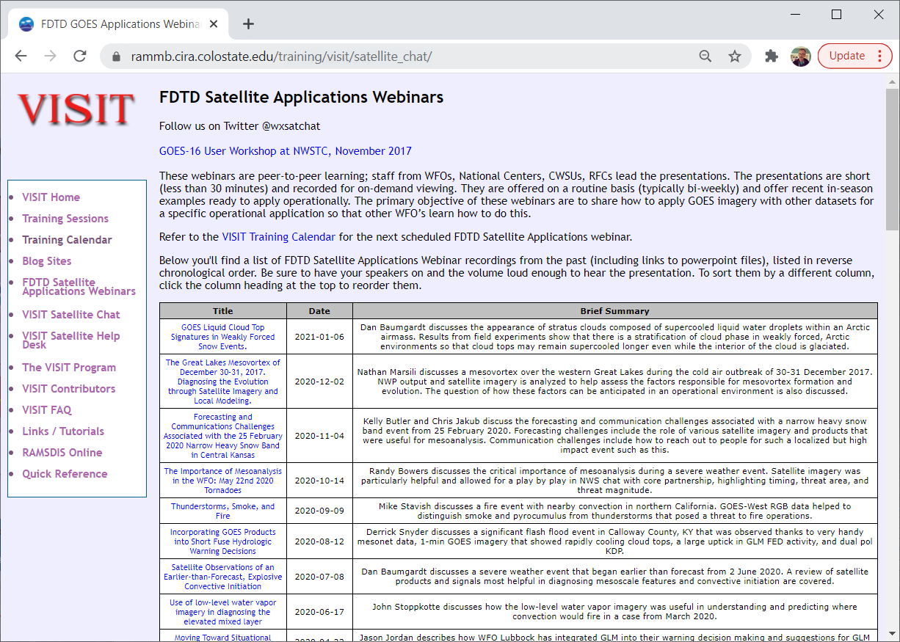
FDTD “Satellite Chat” Library
http://rammb.cira.colostate.edu/training/visit/satellite_chat/
Recorded Content includes Q&A
Call for speakers! Let us know if you want to speak on a topic!
Contact: scott.lindstrom@noaa.gov OR dan.bikos@noaa.gov

Slide 3


FDTD GOES Applications
Webinar Protocol
~20 minutes for the speaker
  Send questions via GoTo Chat
  Or ask during Q&A period via phone
Followed by Q&A
  Open discussion forum
  Done by 1830 UTC
Do NOT press hold!!!
Mute when not speaking

Slide 4
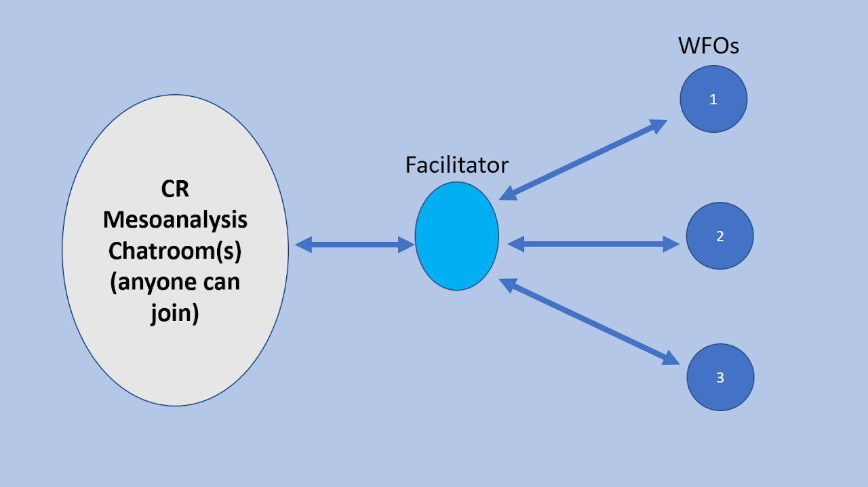
Central Region Remote MesoAnalyst Program
*Group learning
*Mutual Aid
*Limited number of events this year as we learn and grow
*Not meant to replace in-office mesoanalyst
*Has been known to grow organically

Slide 5
RMA
Open Chat
-Professional
-Focused on the next 1-3 hours
-Try to stay out of “eye candy” (radar)(but some is necessary)
-Opened by CRH ROC
-Announced in Chat
-Try to set it up the day before
-No OT/CT
-Includes WoFs folks
Facilitator
-Conduit between open chat room and WFO(s)
-Only 15 ATTM
-More will be added
-Can earn OT/CT (MIC approval)
-Strives to keep the chat focused
-Determines important information to provide to WFO(s)
WFO(s)
-Usually the Mesoanalyst, potentially IDSS person
-Passes information from facilitator to warning/IDSS mets
-Can always ask questions of the facilitator
-Too much information for warning forecasters
-Feedback so far has been positive
RMA can be requested by Office in need, Facilitators, or CRH
-Demo last November
-At least 3 “official” events so far this year
-Unable to fulfill a couple of requests

Slide 6
17 March 2021 Case Study
Remote Mesoanalyst Proof-of-Concept

Slide 7
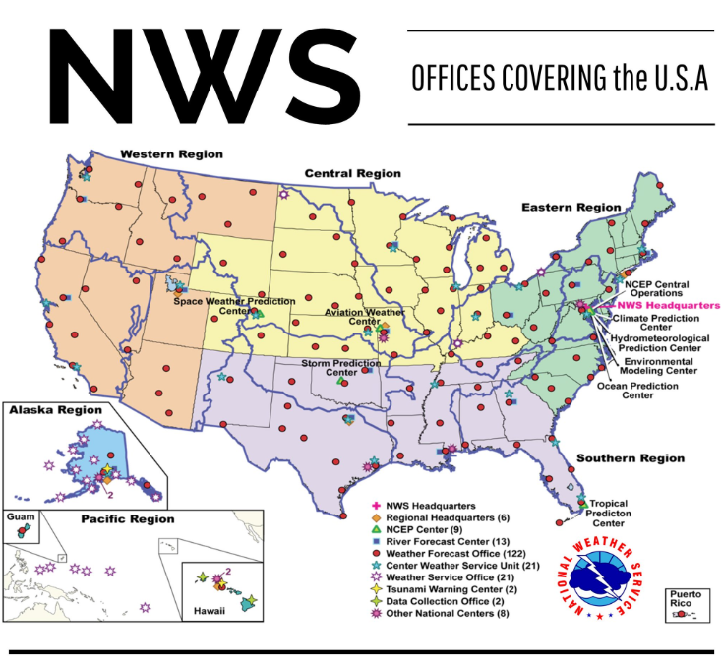
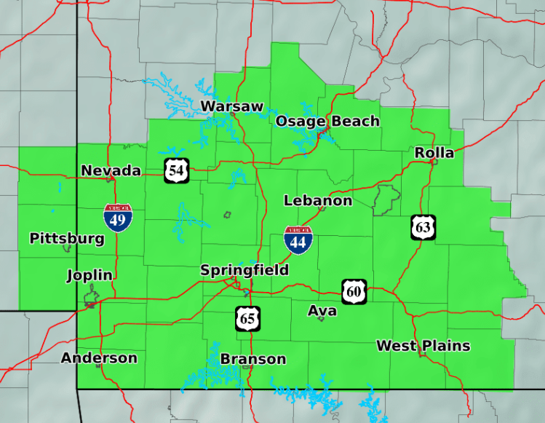
NWS Springfield, MO County Warning Area

Slide 8
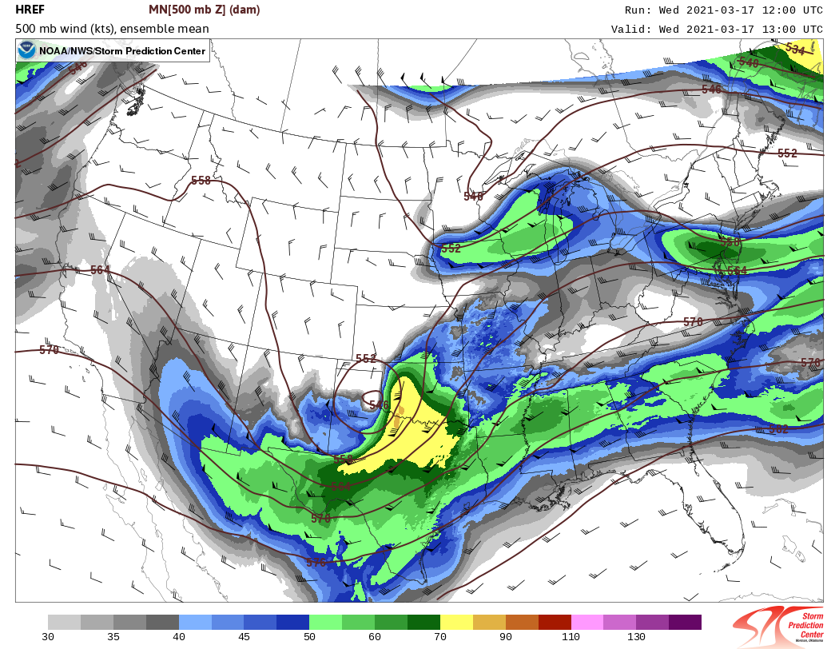
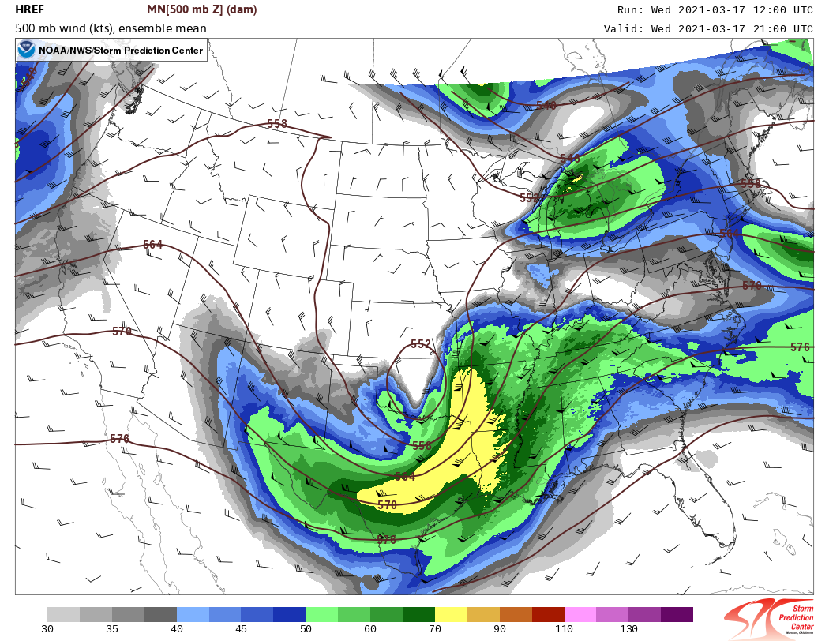
HREF (12z) 500-mb Mean Height and Wind
13z
21z

Slide 9
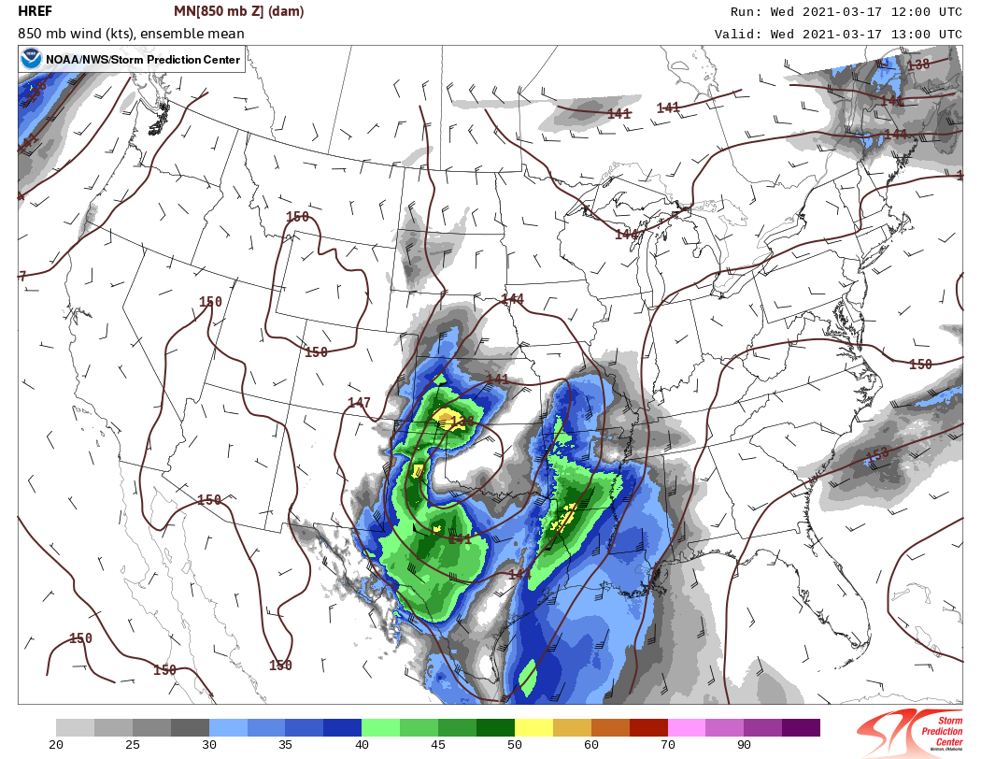
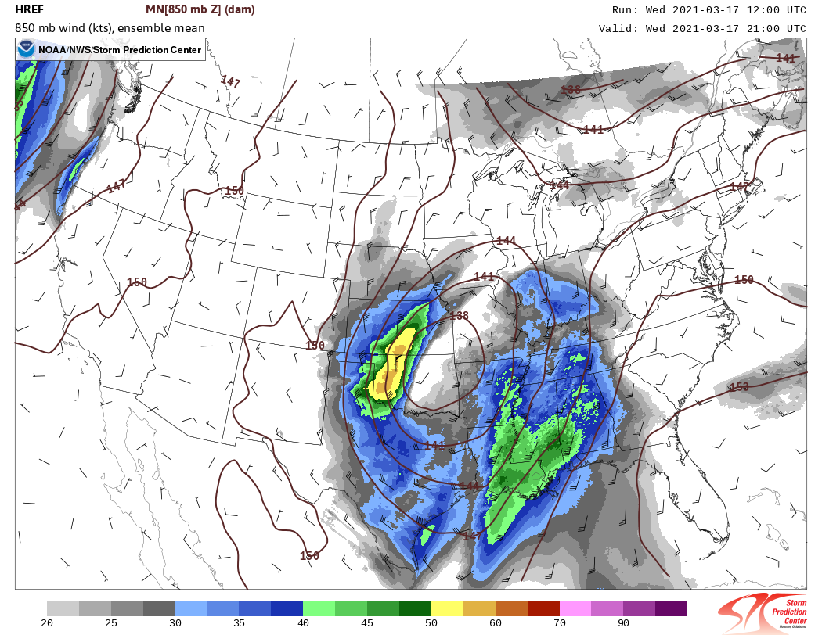
HREF (12z) 850-mb Mean Height and Wind
13z
21z

Slide 10
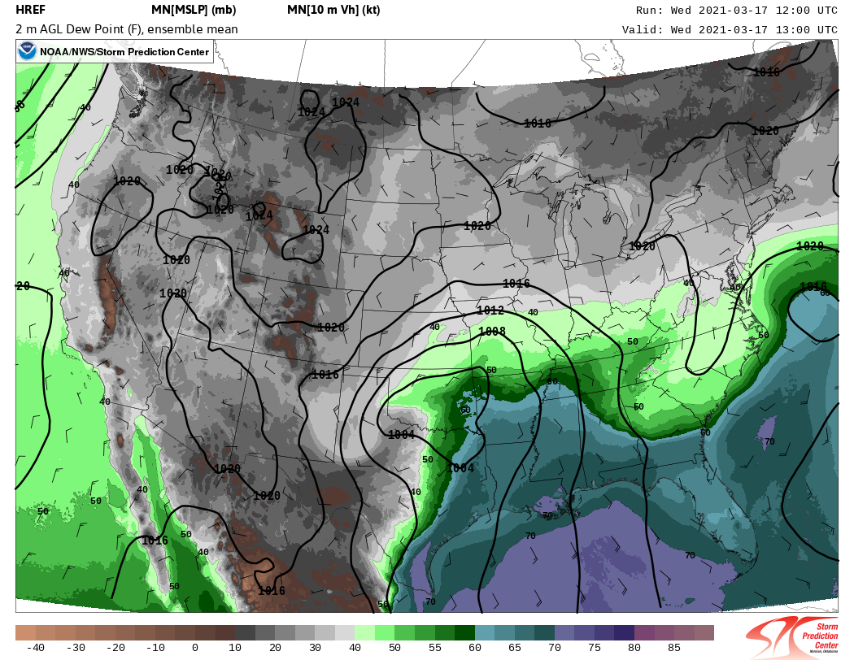
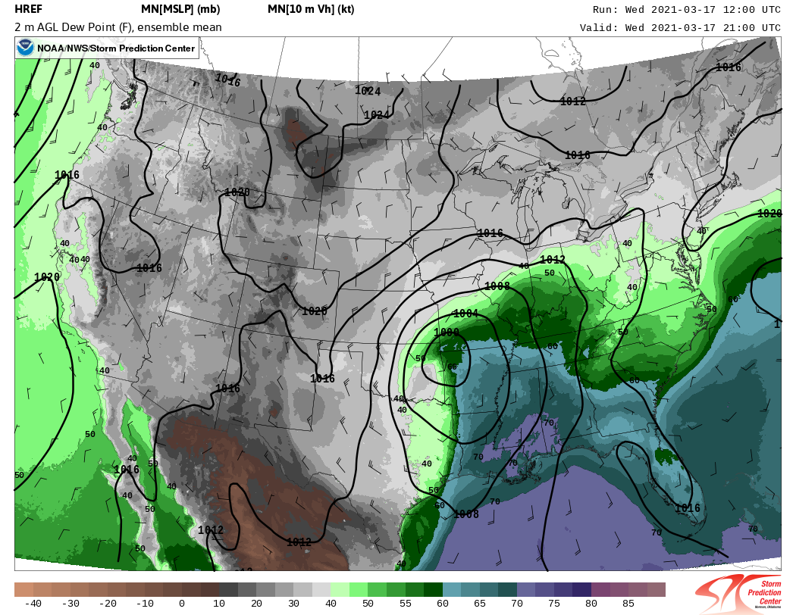
HREF (12z) 2-m-AGL Mean Dewpoint and MSL Pressure
13z
21z

Slide 11
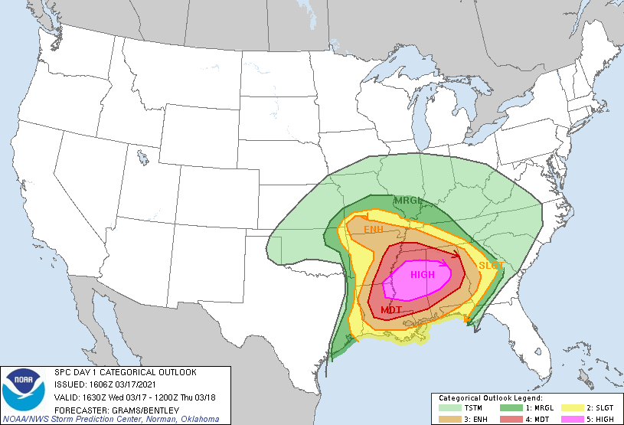
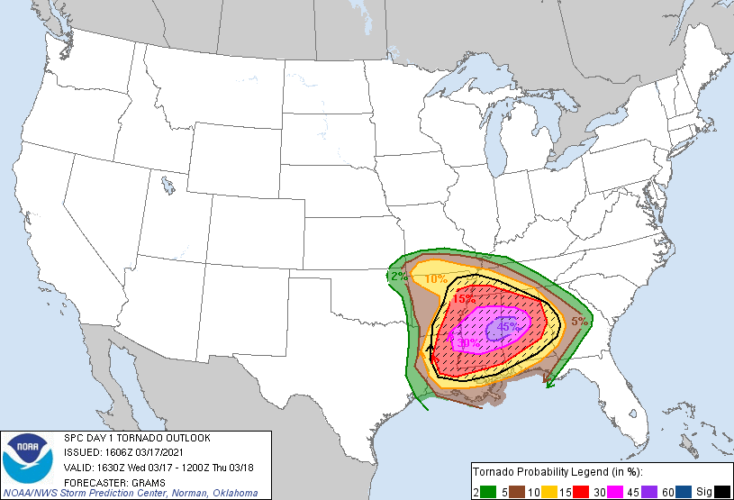
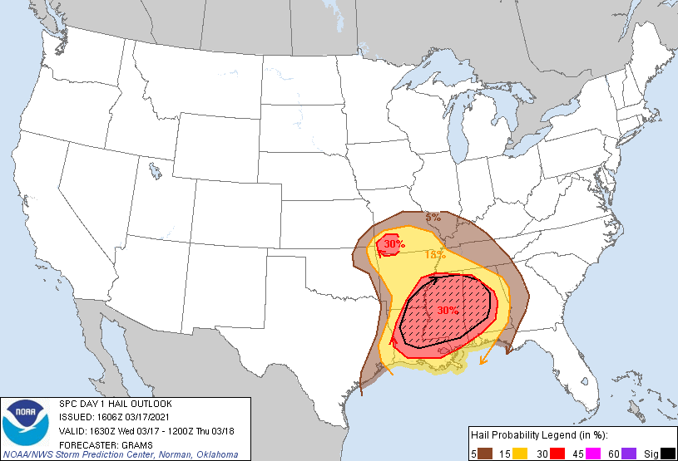
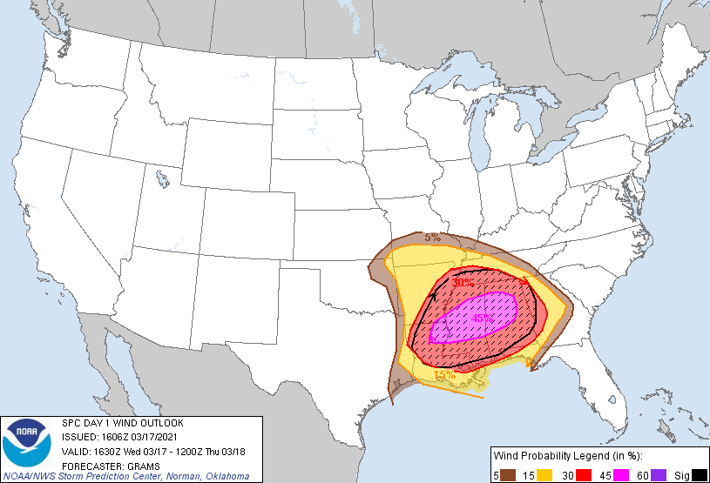
SPC 1130 AM (1630z) Day 1 Convective Outlook

Slide 12
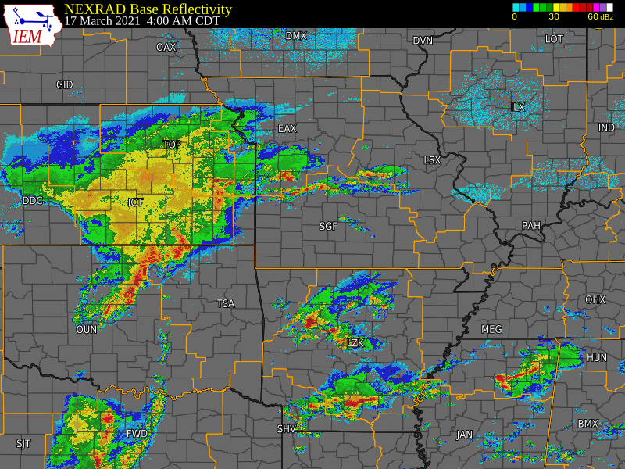
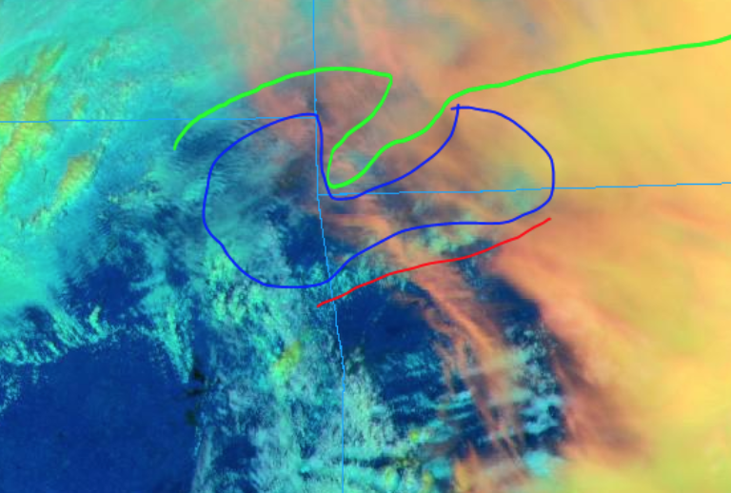
Radar Mosaic 4 AM - 1 PM (09z-18z)
RMA Chat Room 1257 PM (1757z)
”Departing cirrus is thinning enough over SW MO to reveal extent of low stratus near SGF. Wonder if this will serve as northern "bound" for deepening low clds gradually lifting N across NW AR now (red)? Window for destabilization in blue area seems pretty limited given rapid uptick in clds upstream and lingering clds E/NE”
RMA Graphic

Slide 13
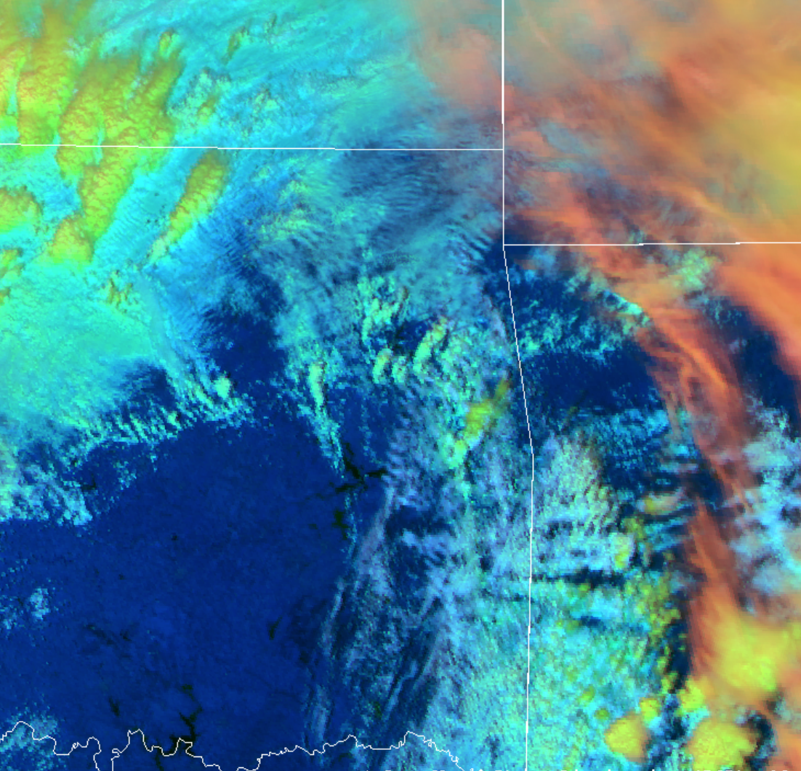
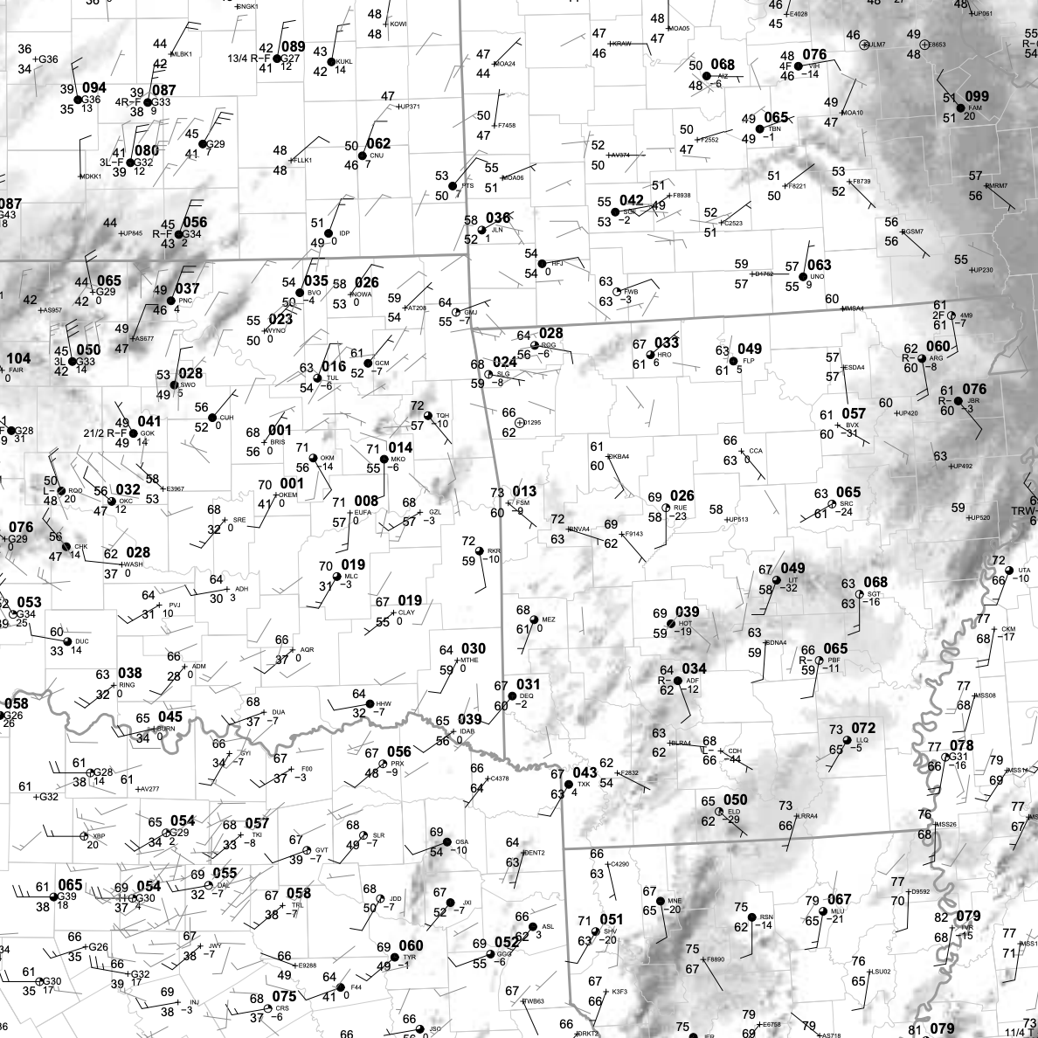
Surface Analysis at 1 PM (18z)
Storm Motion
Cold Sector
Transition
L
L
Warm Sector
Greatest surface-based storm threat?

Slide 14
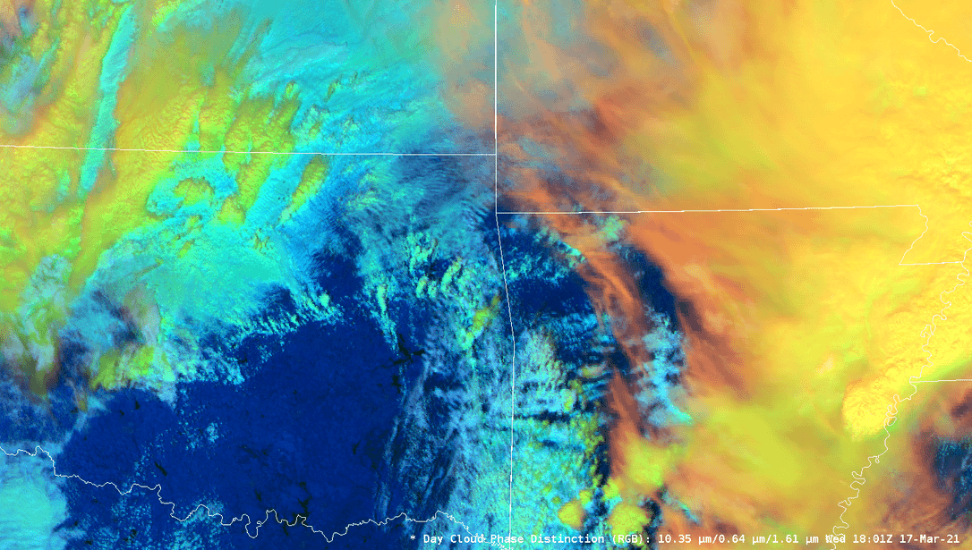
Air-Mass Changes 1 PM - 4 PM (18z - 21z)

Slide 15
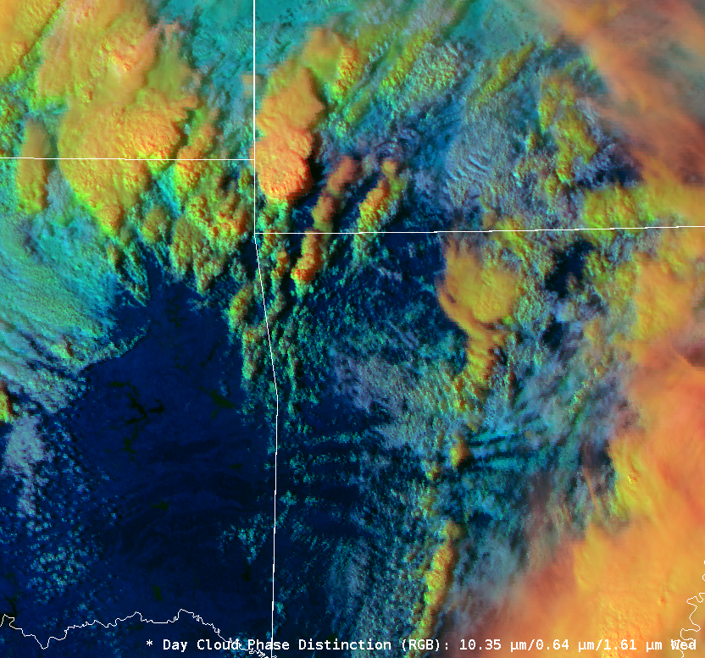
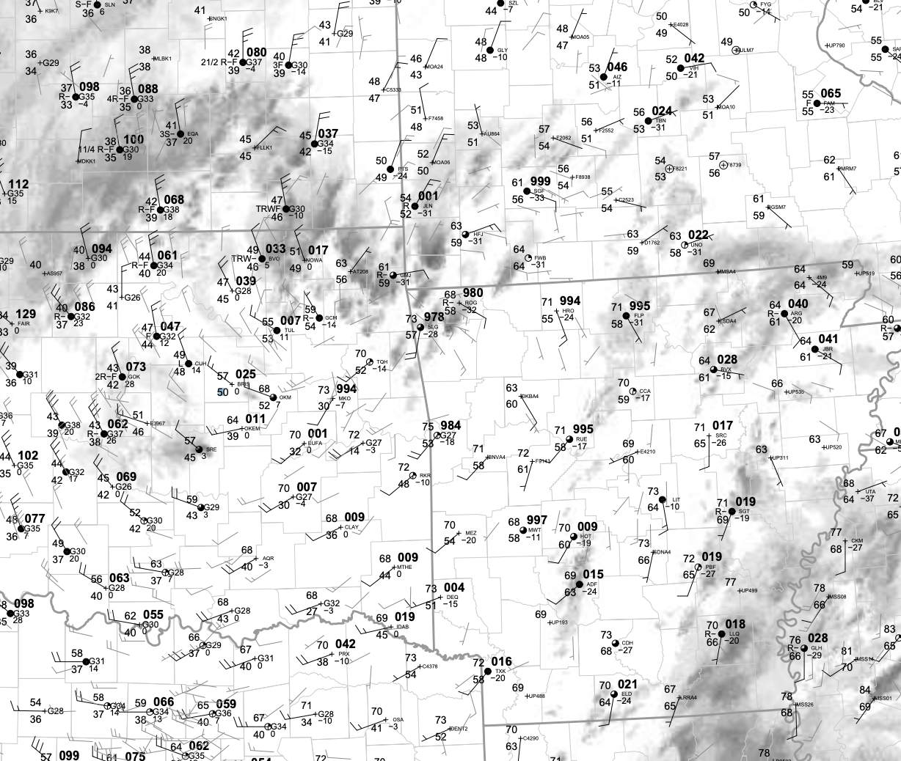
Surface Analysis at 4 PM (21z)
Storm Motion
L
L
Greatest surface-based storm threat?

Slide 16
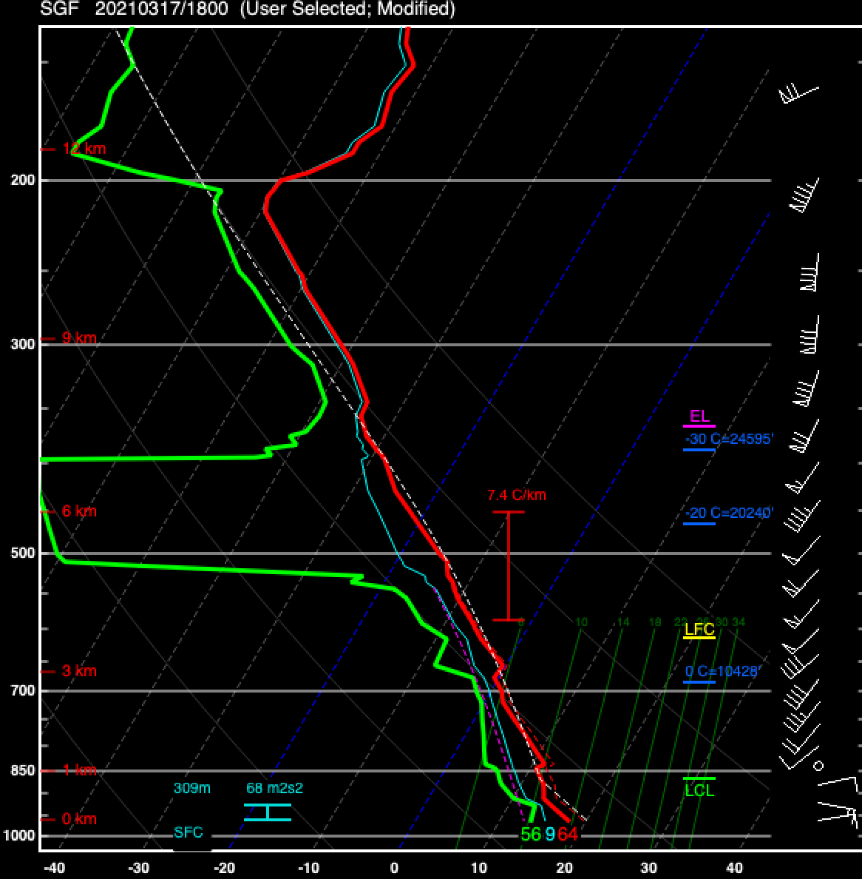
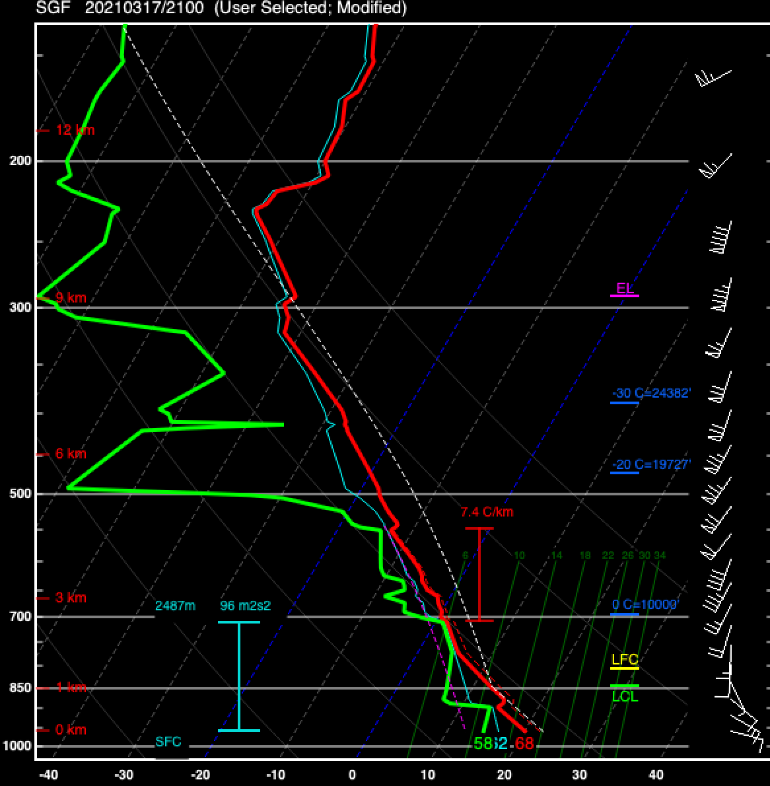
Air-Mass Changes 1 PM - 4 PM (18z - 21z)
MLCAPE ~ 100 J/kg
MLCAPE ~ 1000 J/kg
Surface Conditions:
KROG 64/56 - near warm front.
Surface Conditions:
KROG 68/58 - near warm front.
18z
21z

Slide 17
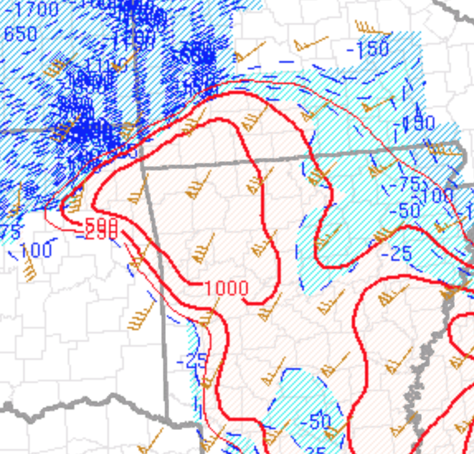
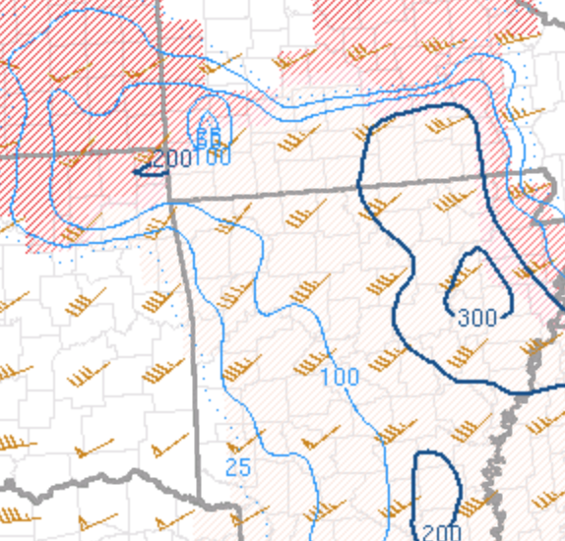
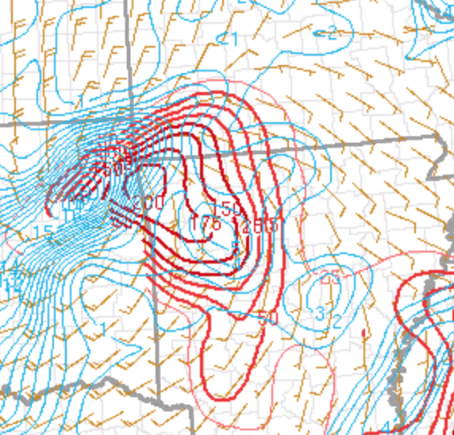
SPC Mesoanalysis Data as of 4 PM (21z)
MLCAPE and Eff. Bulk Shear
Eff. SRH
0-3-km MLCAPE and Surface Vorticity
Astute RMA observations → potential tornadogenesis mechanisms
“It's interesting that the highest 0-3km CAPE is currently co-located with min in 0-1km shear”
“So perhaps more landspout-y than meso in the short term?”
“Certainly leads to more LL stretching.”

Slide 18
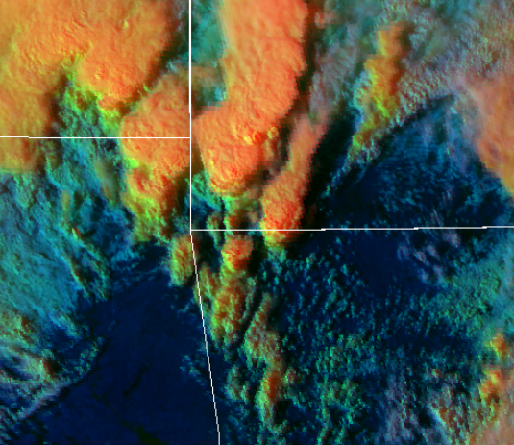
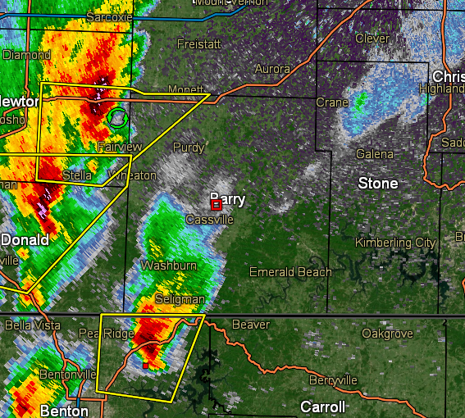
RMA Chat Room Discussion 430 PM - 5 PM (2130z-22z)
“I would watch the Benton Co., AR storm as it continues north and interacts with the warm front near the state line. It might be a prime candidate for a quick spin up if it continues to intensify.”
“The Benton Co., AR storm continues to intensify per radar and satellite. I would watch that one close as it moves into your area.”
Likely
Elevated
L
Nearing
WF

Slide 19
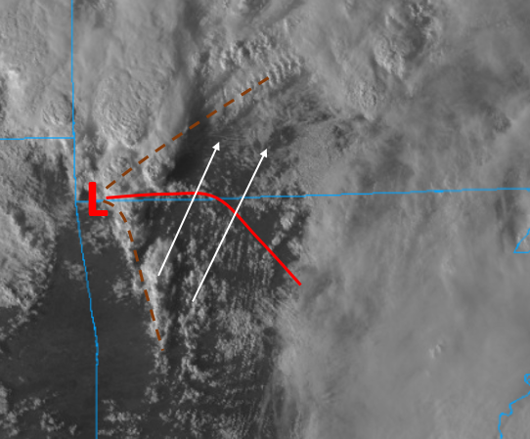
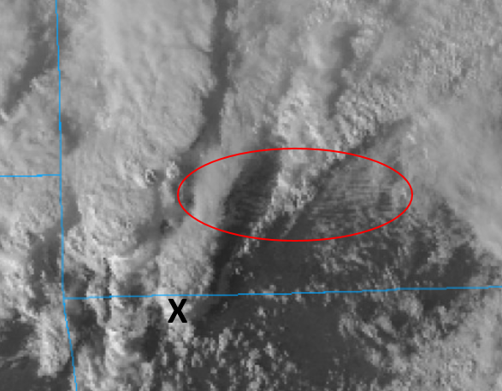
RMA Chat Room Discussion 5 PM - 6 PM (22z-23z)
“The billows (highlighted in red) indicate some capping, but also potentially stronger low-level shear. The Barry County storm can probably continue unimpeded into that zone, especially if it can develop a robust non-hydrostatic vertical pressure perturbation.”
“...I would keep an eye on the maturing storms over northeast AR... Similar to the Barry County storm, the AR storms will likely interact favorably with the warm front slowly pivoting north ahead of the surface low.”
RMA Graphic
RMA Graphic

Slide 20
Main Takeaways
Visible satellite analysis combined with soundings, surface obs, and SPC mesoanalysis fields were instrumental in assessing changes in air mass stability over southwest MO.
A relative weakness in low-level shear was identified with subsequent dialog between the RMA group and WFO SGF mets focused on other potential mechanisms that could enhance tornado potential.
That dialog, in part, led to WFO Springfield issuing a preemptive tornado warning on a storm crossing the warm front into southwest Missouri.

Slide 21
17 March 2021 Case Study
Radar Analysis

Slide 22
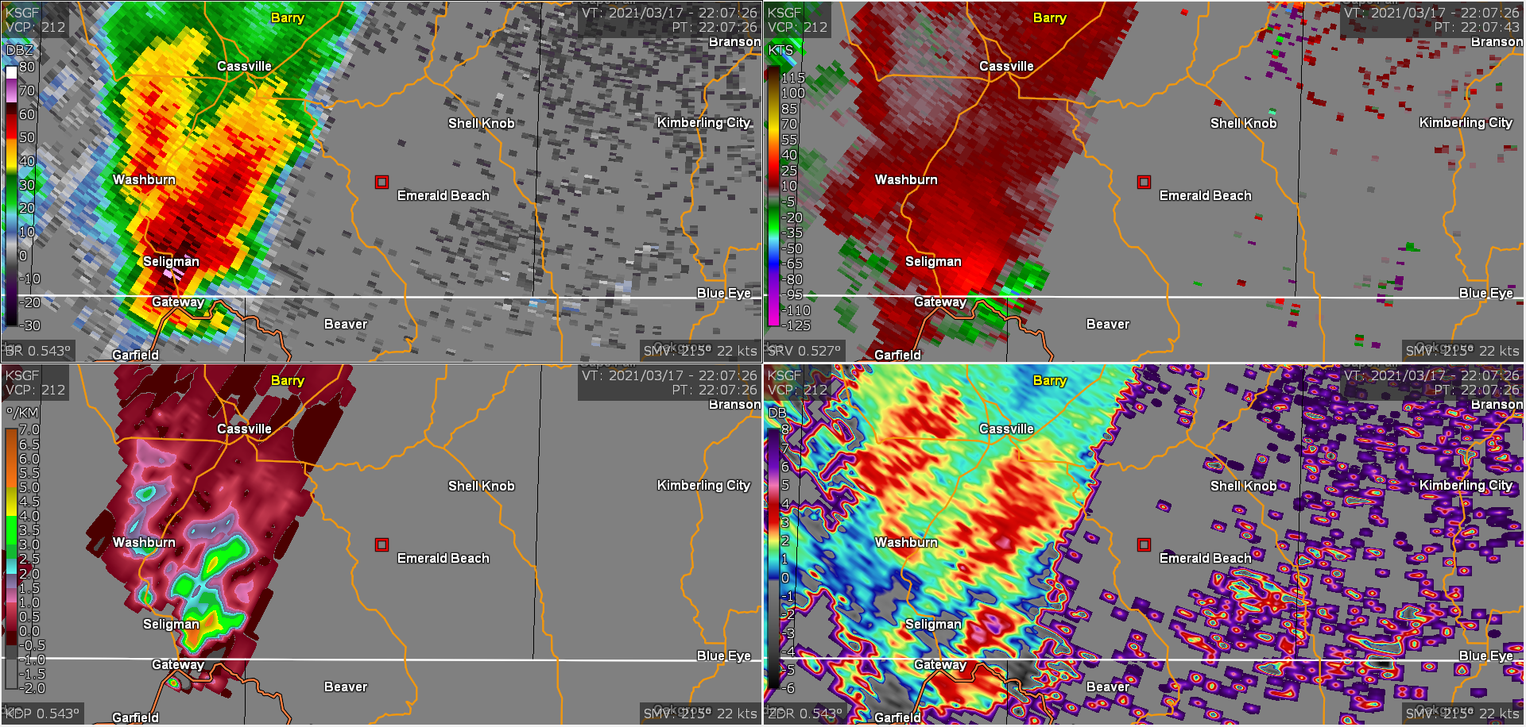
2207 UTC
MRLE 2
≈ 49 nm from KSGF RDA
≈ 4300 ft ARL
0.5° BR
0.5° SRV
0.5° KDP
0.5° ZDR

Slide 23
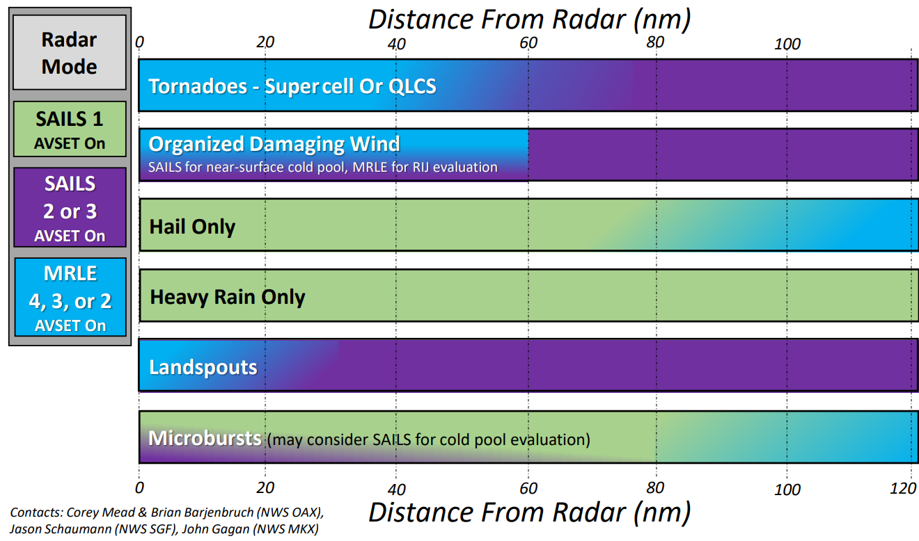
Radar Settings Guidance

Slide 24
2207 UTC
MRLE 2
0.5° BR
0.5° SRV
ZDR Arc
0.5° KDP
0.5° ZDR

Slide 25

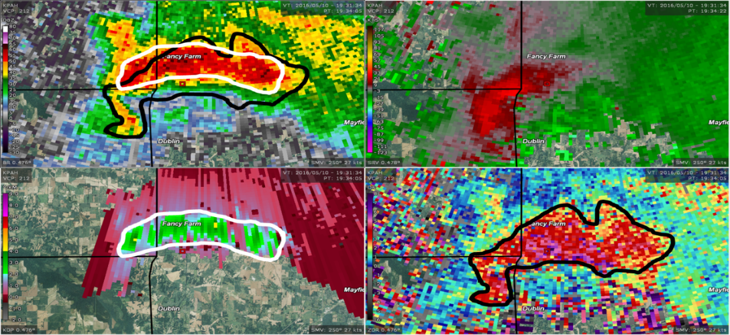
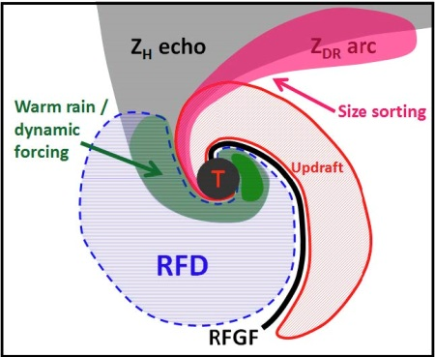
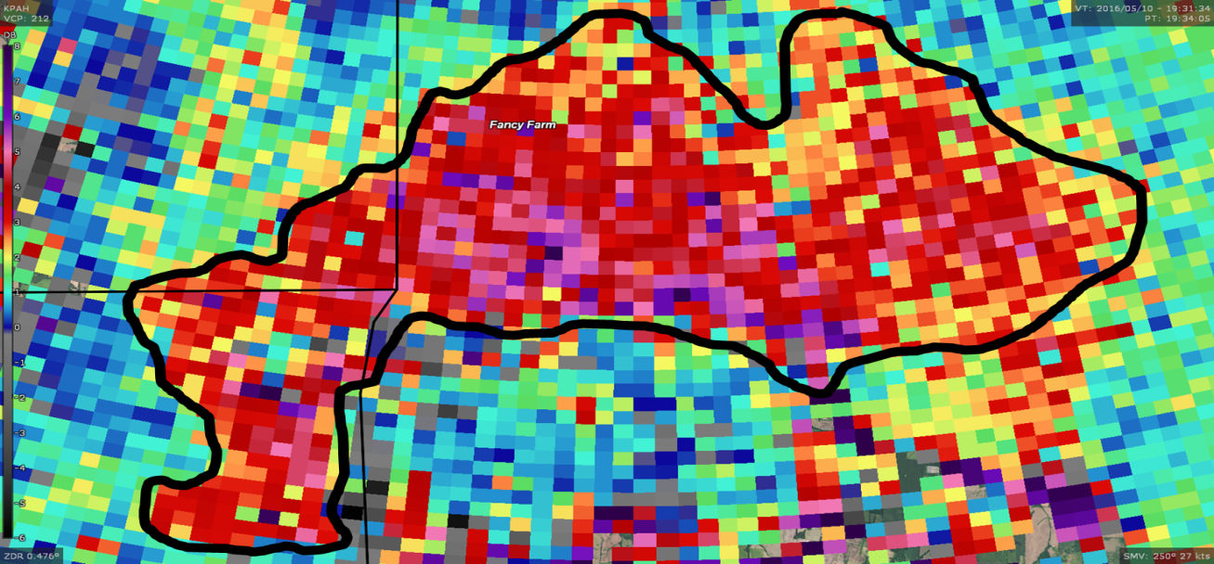
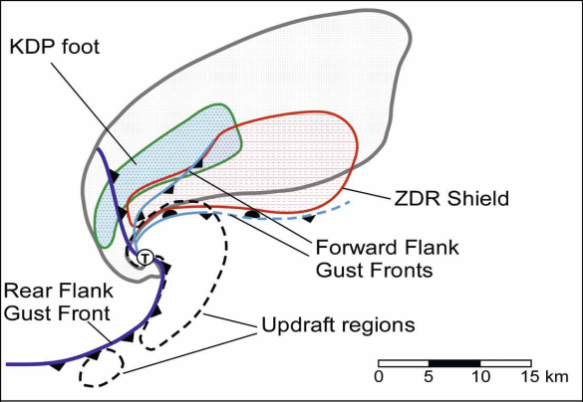
NWS CR TWIP Supercell-based Tornadogenesis – Radar Feature Reference Guide
Feature | Primary Application | Skill to Anticipate Tornadogenesis | Important Note
Z_{DR} Arc | Anticipate low-level meso intensity trends | Moderate – Infers dynamic lift potential from low-level meso ahead of time | Combine with separation vector angle in weak to moderate low-level SRH (0-1-km <200) environments
10 May 2016 Mayfield, KY
EF-3 Tornado
Z_{DR} Arc
T – 10 mins
Kumjian 2011
Romine et al. 2008

Slide 26
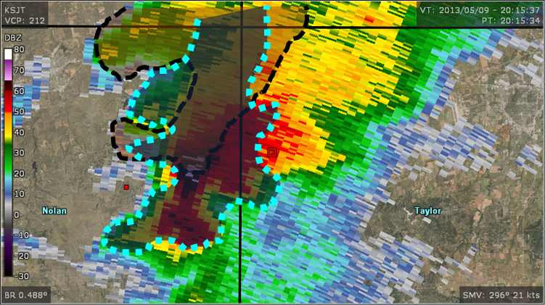
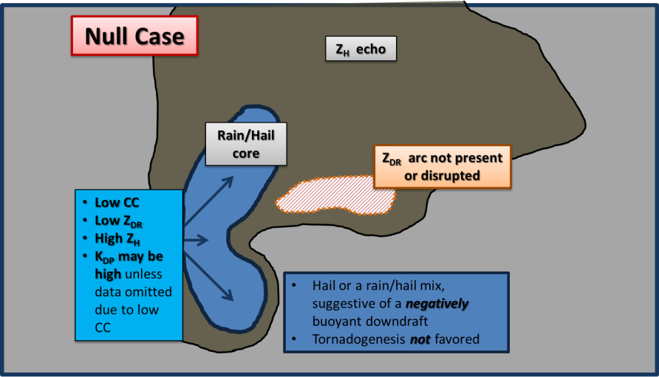
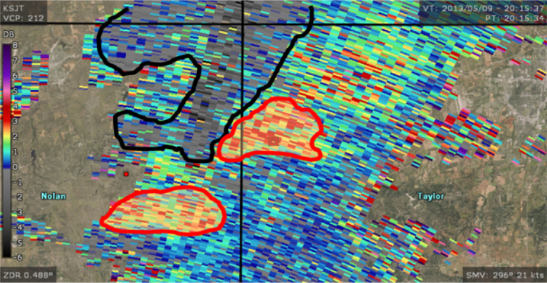
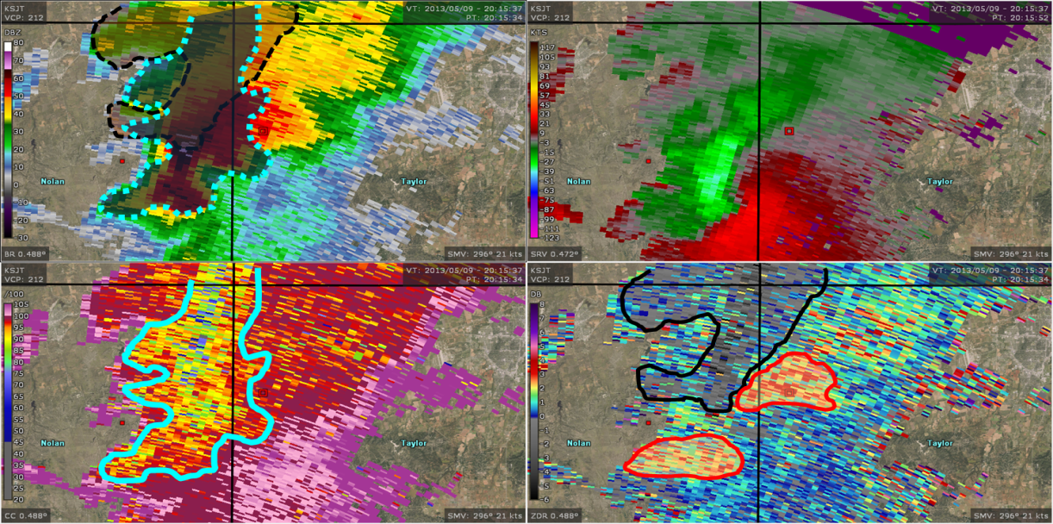
NWS CR TWIP Supercell-based Tornadogenesis – Radar Feature Reference Guide
Feature | Primary Application | Skill to Anticipate Tornadogenesis | Important Note
Z_{DR} Arc Disruption | Degree of negative buoyancy in near-surface airstream below meso | High – Stronger negative buoyancy typically inhibits tornadogenesis | Indicates a surge in negatively buoyant airstream below low-level meso with genesis inhibited
Negative buoyancy implied by zero/negative Z_{DR}
Non-uniform Beam Filling

Slide 27
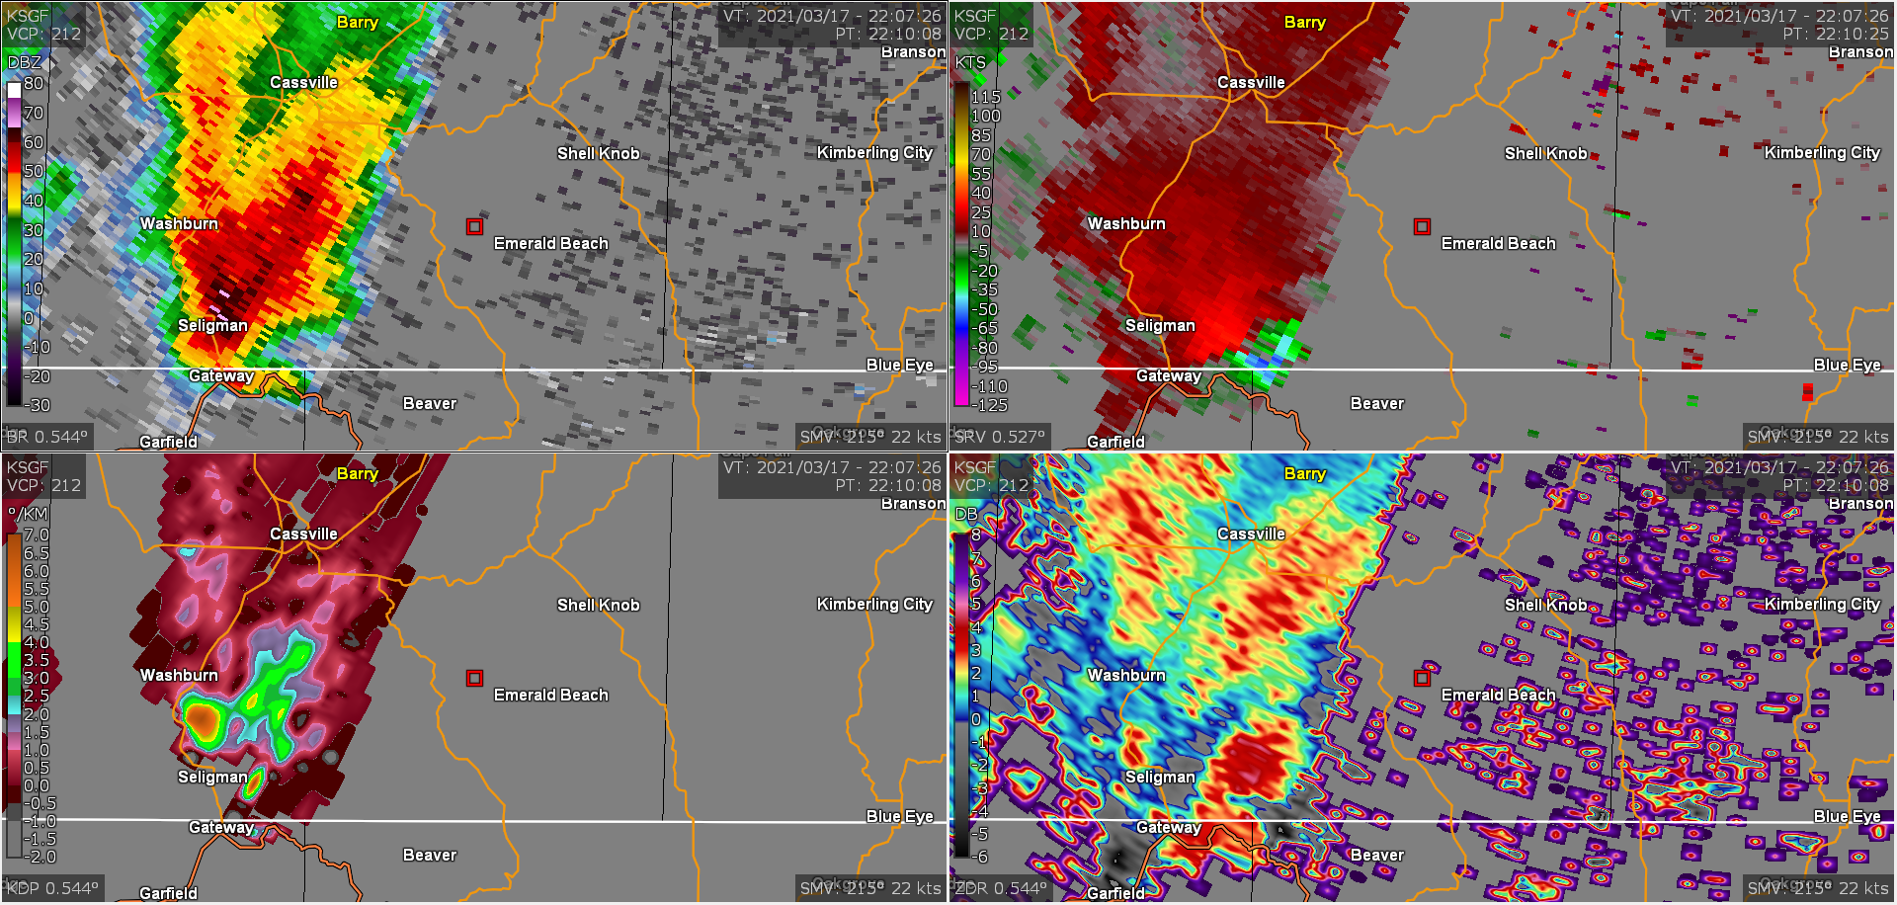
2210 UTC
MRLE 2
0.5° BR
0.5° SRV
ZDR Arc Persists
0.5° KDP
0.5° ZDR

Slide 28
2210 UTC
MRLE 2
Hmmm?
0.5° BR
0.5° SRV
0.5° KDP
0.5° ZDR

Slide 29
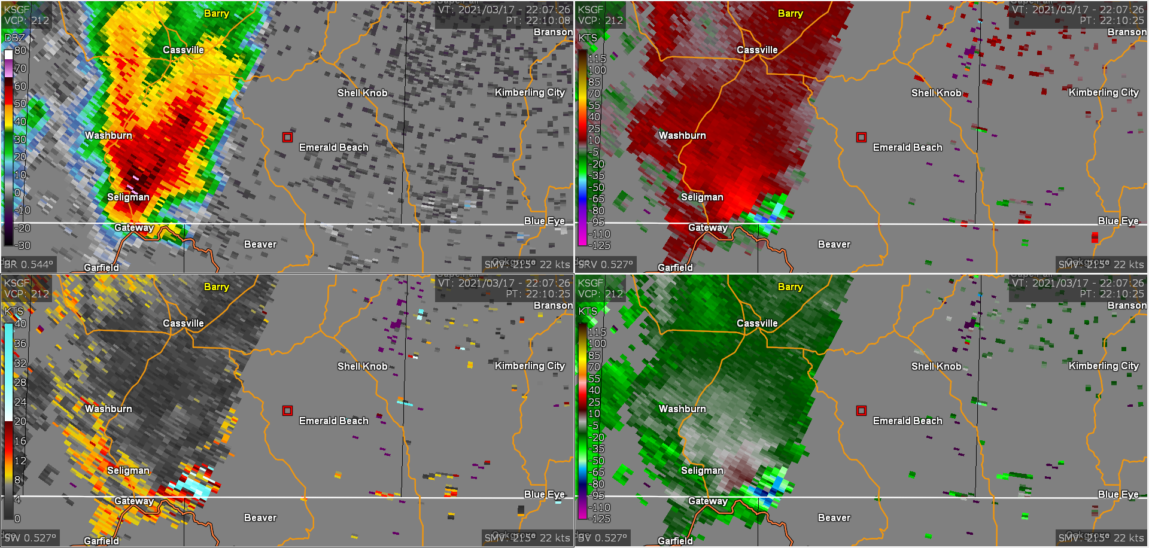
2210 UTC
MRLE 2
0.5° BR
0.5° SRV
Likely a vertical sidelobe!
High Spectrum Width Values
0.5° SW
0.5° BV

Slide 30
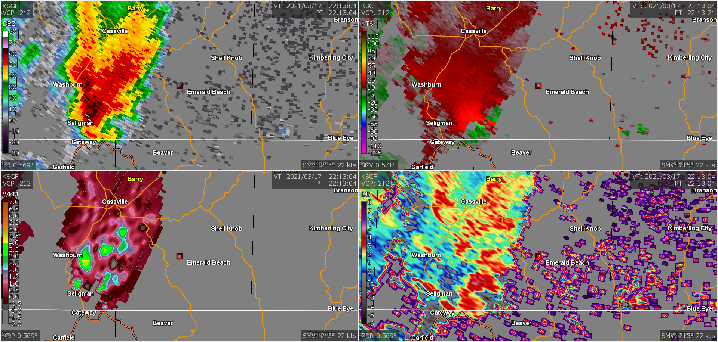
2213 UTC
MRLE 2
0.5° BR
0.5° SRV
ZDR Arc Persists
0.5° KDP
0.5° ZDR

Slide 31
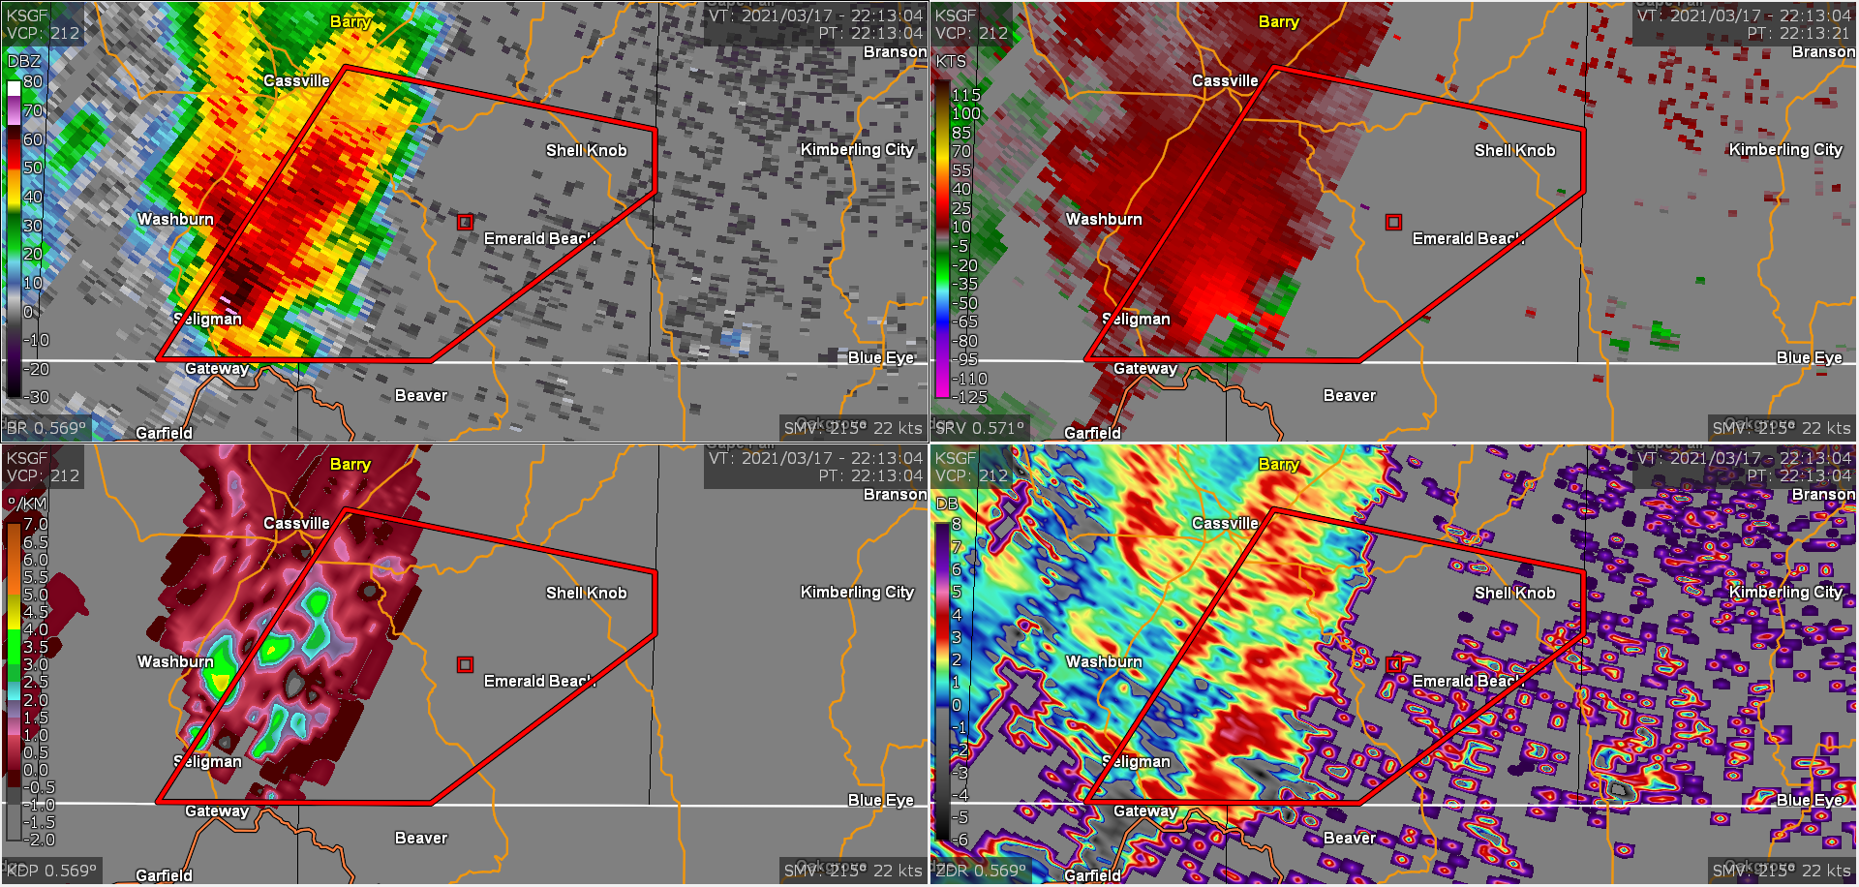
2213 UTC - Initial Tornado Warning
MRLE 2
0.5° BR
0.5° SRV
0.5° KDP
0.5° ZDR
Notes:
2 out of 3 rule met

Slide 32
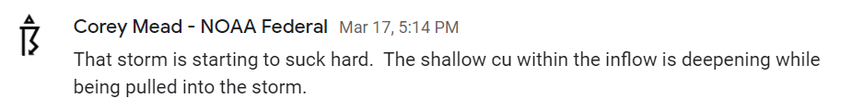
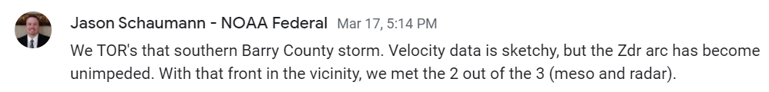
Remote MesoAnalyst Chatroom
d

Slide 33
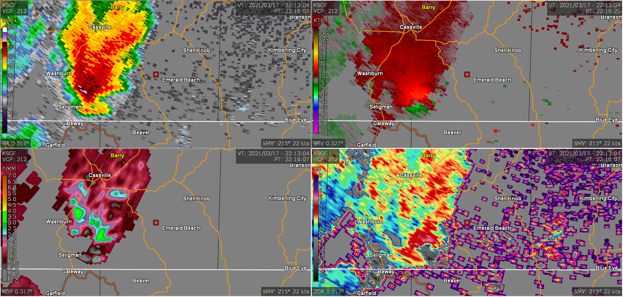
2216 UTC
MRLE 2
0.5° BR
0.5° SRV
0.5° KDP
0.5° ZDR

Slide 34
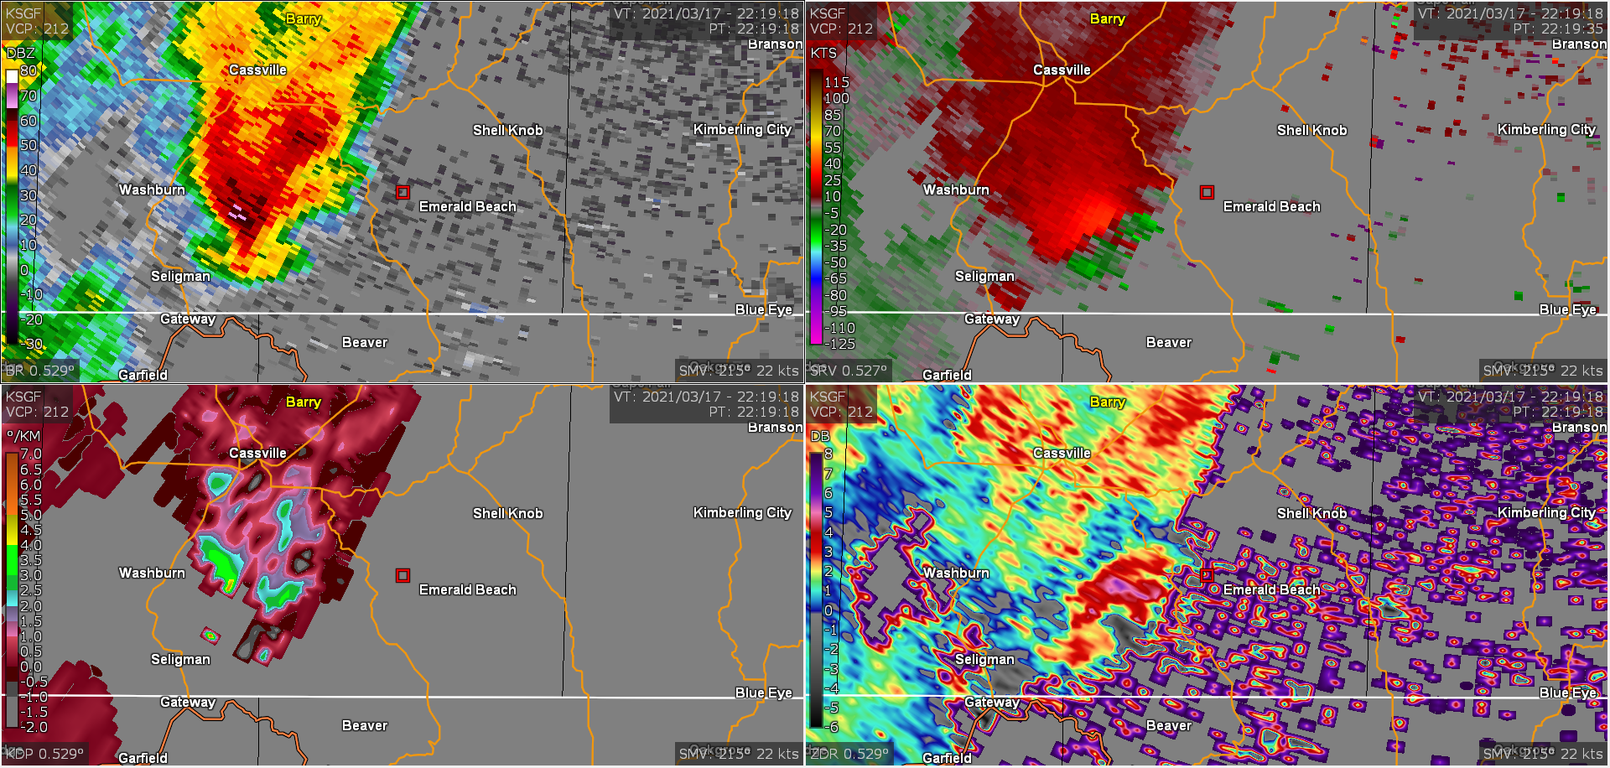
2219 UTC
MRLE 2
0.5° BR
0.5° SRV
0.5° KDP
0.5° ZDR

Slide 35
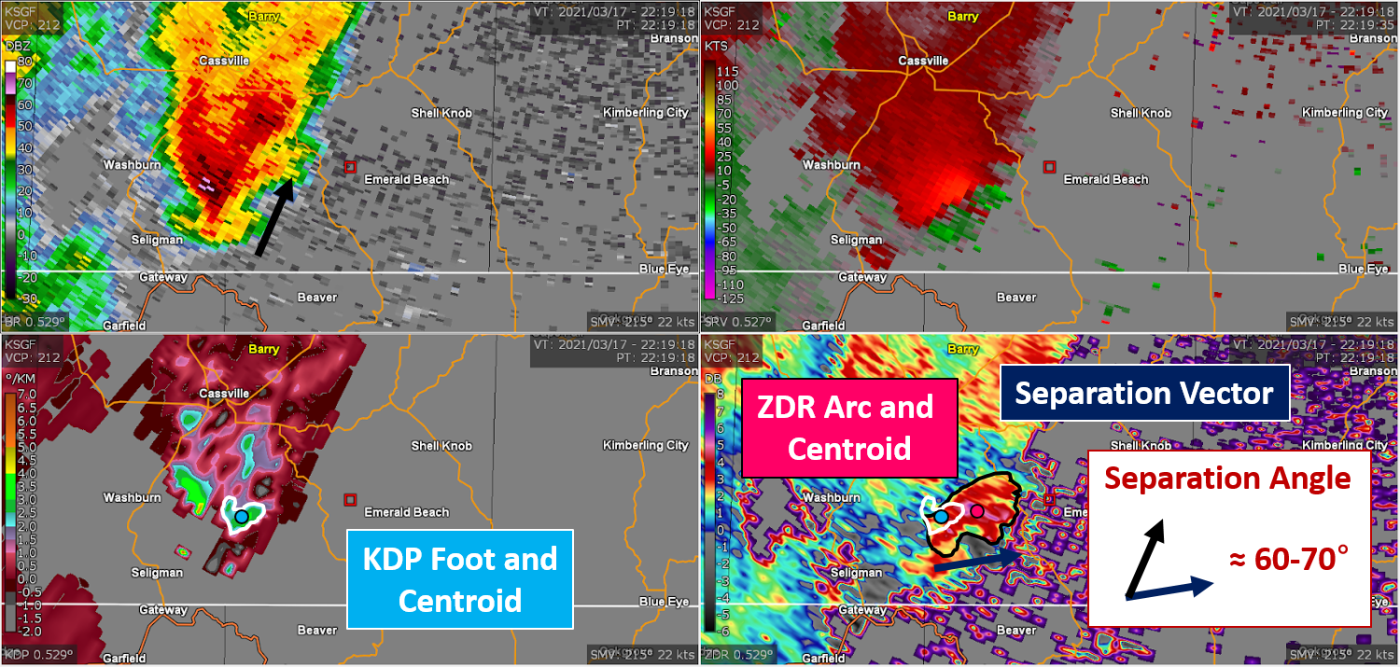

Slide 36
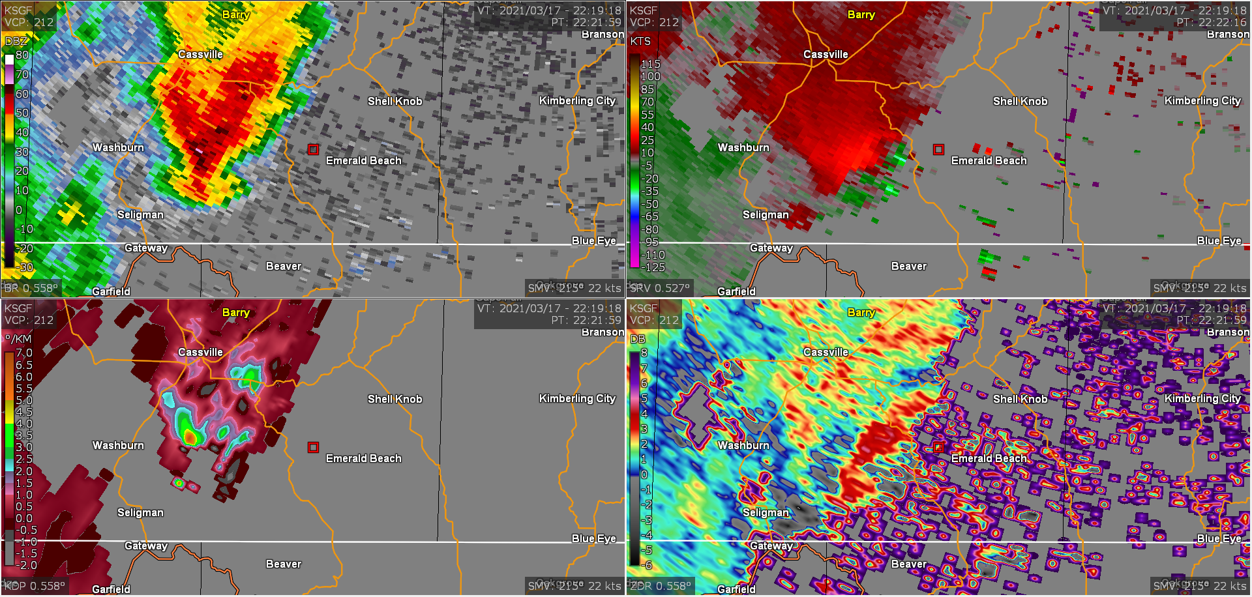
2222 UTC
MRLE 2
0.5° BR
0.5° SRV
0.5° KDP
0.5° ZDR

Slide 37

2225 UTC
MRLE 2
0.5° BR
0.5° SRV
0.5° KDP
0.5° ZDR

Slide 38

2227 UTC
MRLE 2
0.5° BR
0.5° SRV
0.5° KDP
0.5° ZDR

Slide 39

2230 UTC
MRLE 2
Start of intermittent tornado path!
0.5° BR
0.5° SRV
0.5° KDP
0.5° ZDR

Slide 40

2308 UTC - MRLE-3 Invoked
MRLE 3
≈ 30 nm from KSGF RDA
≈ 2400 ft ARL
0.5° BR
0.5° SRV
0.5° ZDR
0.5° CC

Slide 41
Radar Settings Guidance

Slide 42
2308 UTC - New Warning Decision?
MRLE 3
0.5° BR
0.5° SRV
ZDR Arc Persists
0.5° ZDR
0.5° CC

Slide 43

2311 UTC - New Warning Decision?
MRLE 3
0.5° BR
0.5° SRV
ZDR Arc Persists
0.5° ZDR
0.5° CC

Slide 44

2315 UTC - New Warning Decision
MRLE 3
0.5° BR
0.5° SRV
0.5° ZDR
0.5° CC

Slide 45

2318 UTC - TDS
MRLE 3
0.5° BR
0.5° SRV
0.5° ZDR
0.5° CC

Slide 46

2318 UTC - TDS (Zoomed)
MRLE 3
≈ 26 nm from KSGF
≈ 1900 ft ARL
Vr = 49kts
0.5° BR
0.5° SRV
ZDR ≈ 0 db
CC = 0.43
0.5° ZDR
0.5° CC

Slide 47

2319 UTC - TDS (Vertical Continuity)
MRLE 3
3000 ft ARL
Vr = 46 kts
0.9° BR
0.9° SRV
ZDR ≈ 0 db
CC = 0.56
0.9° ZDR
0.9° CC

Slide 48

2322 UTC - Radar Observed Tag
MRLE 3
0.5° BR
0.5° SRV
0.5° ZDR
0.5° CC

Slide 49

17 March 2021 - Intermittent EF-0/EF-1 Tornado Track
Length: 25 miles
Max. Width: 75 yards
Est. Peak Wind: 87 mph

Slide 50
NWS CR TWIP Supercell-based Tornadogenesis – Radar Feature Reference Guide
Radar Feature
Feature | Primary Application | Skill to Anticipate Tornadogenesis | Important Note
Z_{DR} Arc | Anticipate low-level meso intensity trends | Moderate – Infers dynamic lift potential from low-level meso ahead of time | Combine with separation vector angle in weak to moderate low-level SRH (0-1-km <200) environments
Separation Vector Angle | Anticipate low-level meso intensity trends | Moderate – Infers potential dynamic lift from low-level meso ahead of time | Value of angle is less critical in stronger low-level SRH (0-1-km >200) environments
Z_{DR} Arc Disruption | Degree of negative buoyancy in near-surface airstream below meso | High – Stronger negative buoyancy typically inhibits tornadogenesis | Indicates a surge in airstream below low-level meso with genesis inhibited
Storm Relative Velocity Enhancement (SRVE) | Track near-surface airstream feeding into region below low-level meso | High – Positioning of airstream convergence relative to low-level meso critical for genesis | Convergence signature under meso infers crosswise to streamwise vorticity change needed for genesis
Low-level V_{r} (not illustrated) | Diagnostic tracking of low-level meso intensity trends | Minimal – Diagnostic nature limits skill to largely reactionary rather than predictive | Can be used as a diagnostic intensity tool for an ongoing tornado
Storm Depth Max V_{r} (not illustrated) | Diagnostic tracking of maximum full volume meso intensity trends | Minimal – Diagnostic nature limits skill to largely reactionary rather than predictive | Can be used as a prognostic intensity tool for an ongoing tornado
Z_{H} “Hook” Signature (not illustrated) | Infers strength of mid-level meso to redistribute precipitation | Minimal – Many non-tornadic supercells have hooks | Some hooks infer strong negative buoyancy that inhibits genesis

Slide 51
Acknowledgements and Links
Eric Wise (WFO SGF Warning Forecaster)
Central Region HQ
  For their encouragement and support of the RMA Project
Central Region Tornado Warning Improvement Project Team
  Google Site
  VLab Site
  Supercell-based Tornadogenesis - Radar Feature Reference Guide
Radar Settings Reference Materials
  “Driving the Radar” YouTube Presentation - John Gagan and Brian Barjenbruch
  Radar Scanning Strategy Guidance - Mead et al.
  MRLE Tornado Range Rings Placefiles for GR2 - Zach Hiris

