Slide 1





FDTD Satellite Applications Webinar Utilizing NUCAPS for Supplemental Observations in a Convective Environment
Presented by
Kaitlin Rutt
NWS WFO Amarillo, TX
16 June 2021

Slide 2
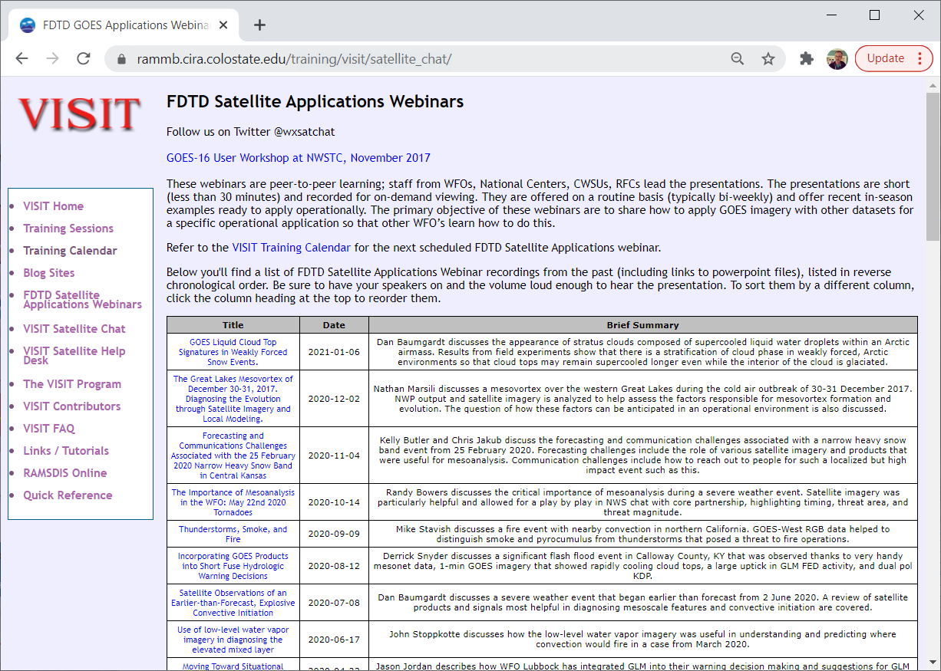
FDTD “Satellite Chat” Library
http://rammb.cira.colostate.edu/training/visit/satellite_chat/
Recorded Content includes Q&A
Call for speakers! Let us know if you want to speak on a topic!
Contact: scott.lindstrom@noaa.gov OR dan.bikos@noaa.gov

Slide 3
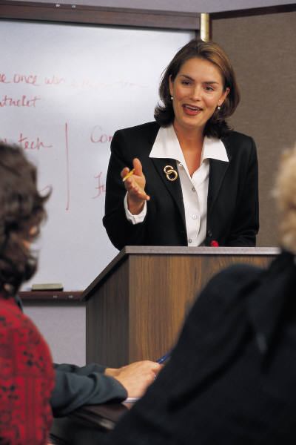

FDTD GOES Applications Webinar Protocol
~20 minutes for the speaker
Send questions via GoTo Chat
Or ask during Q&A period via phone
Followed by Q&A
Open discussion forum
Done by 1830 UTC
Do NOT press hold!!!
Mute when not speaking

Slide 4
Utilizing NUCAPS for Supplemental Observations in a Convective Environment
Kaitlin Rutt
NWS Amarillo

Slide 5
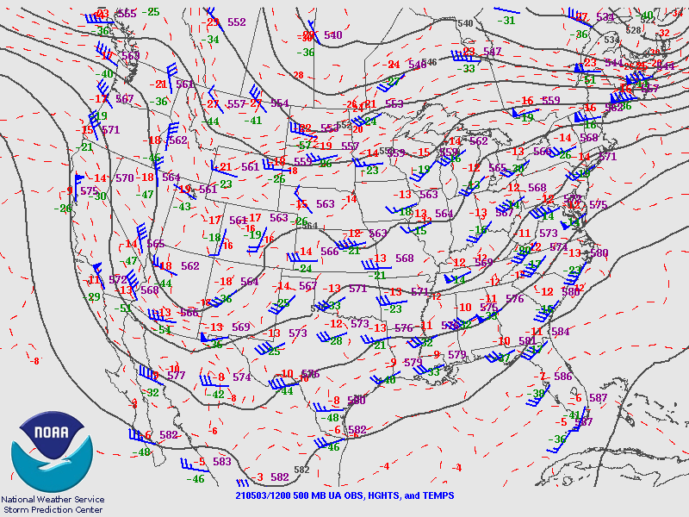
500mb Analysis

Slide 6
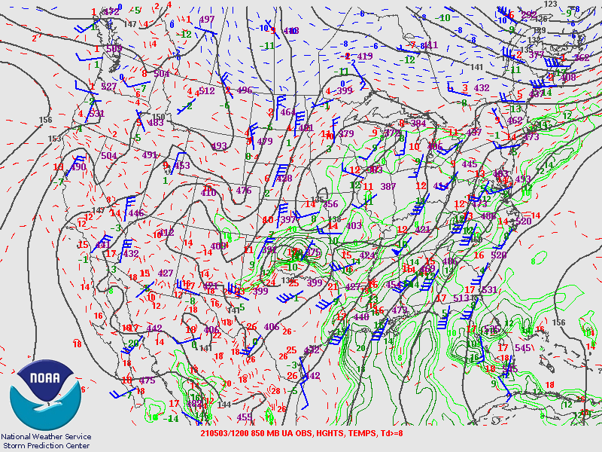
850mb Analysis

Slide 7
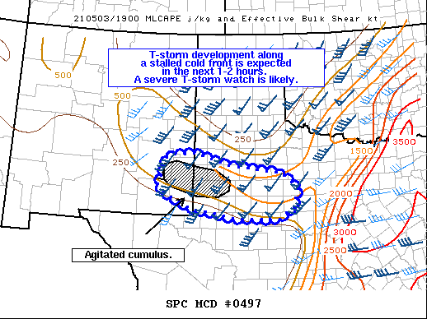

Slide 8
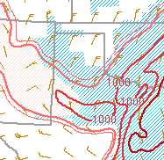
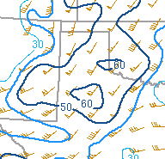
20z MLCAPE/MLCIN
20z 0-6km Bulk Shear

Slide 9
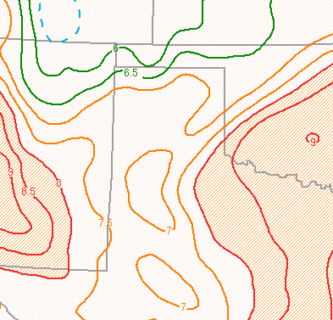
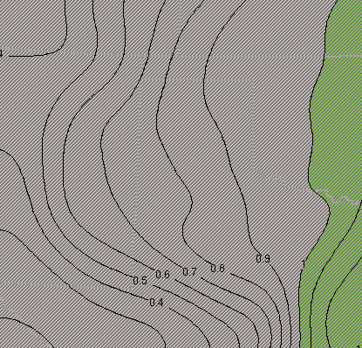
20z Mid-Level Lapse Rates
20z Precipitable Water

Slide 10
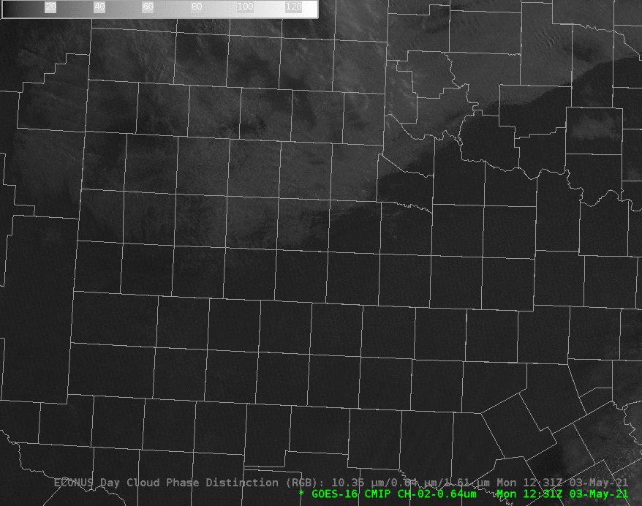
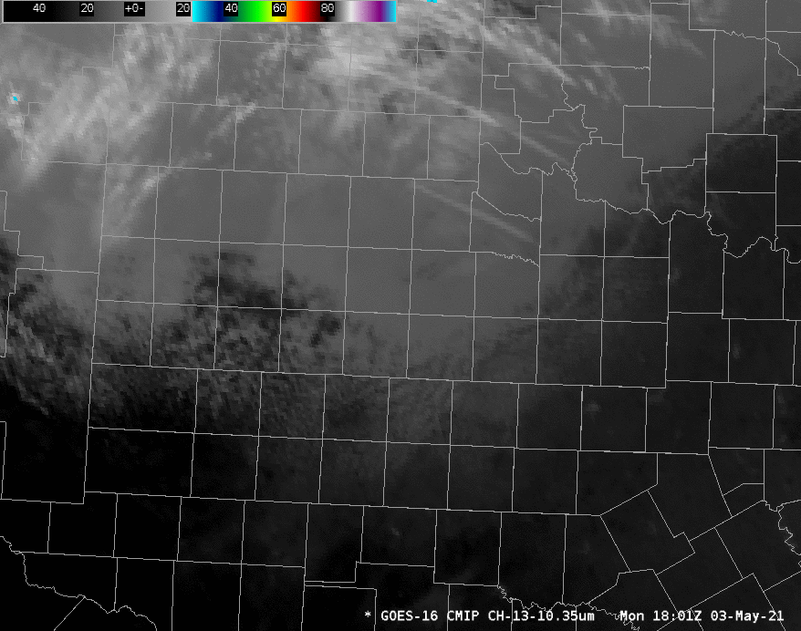
G16 Visible
G16 Clean IR Window

Slide 11
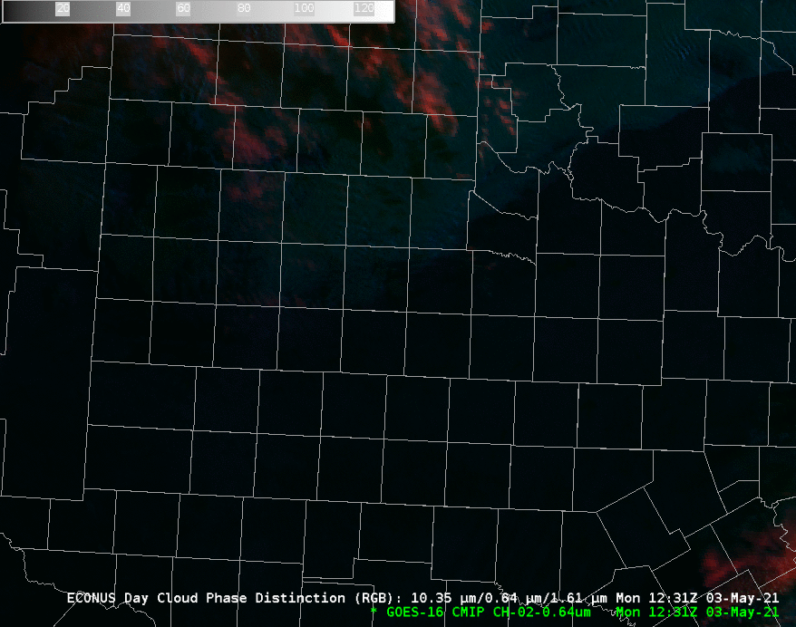
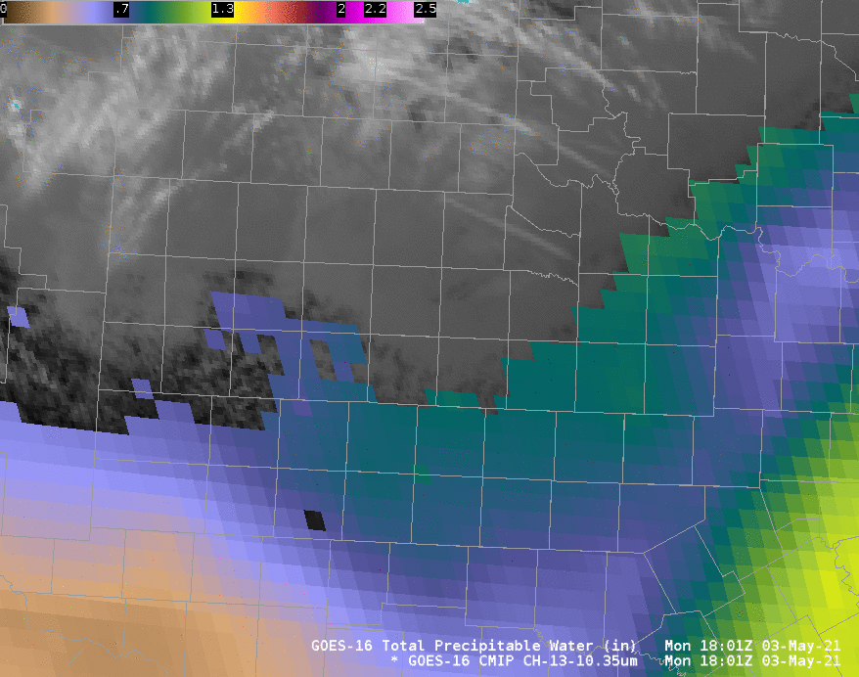
G16 Clean IR Window + G16 Total Precipitable Water
G16 Day Cloud Phase Distinction RGB

Slide 12
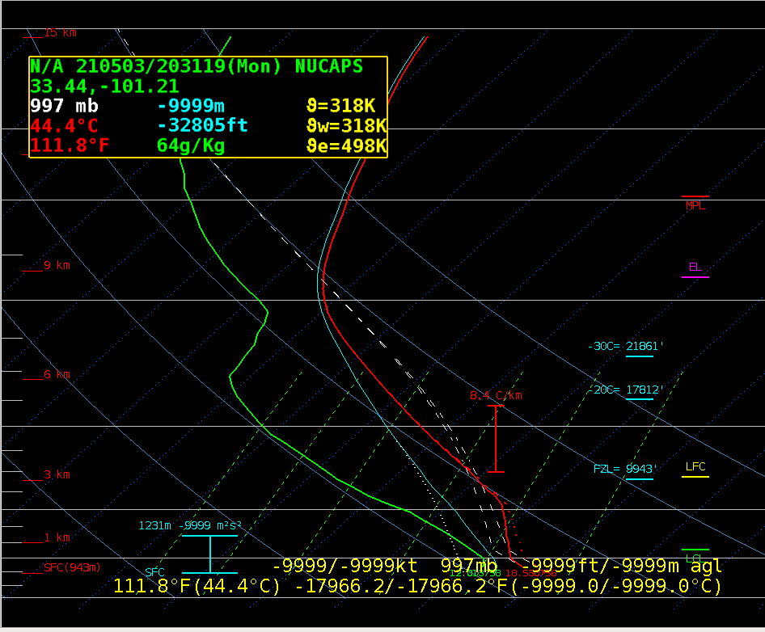
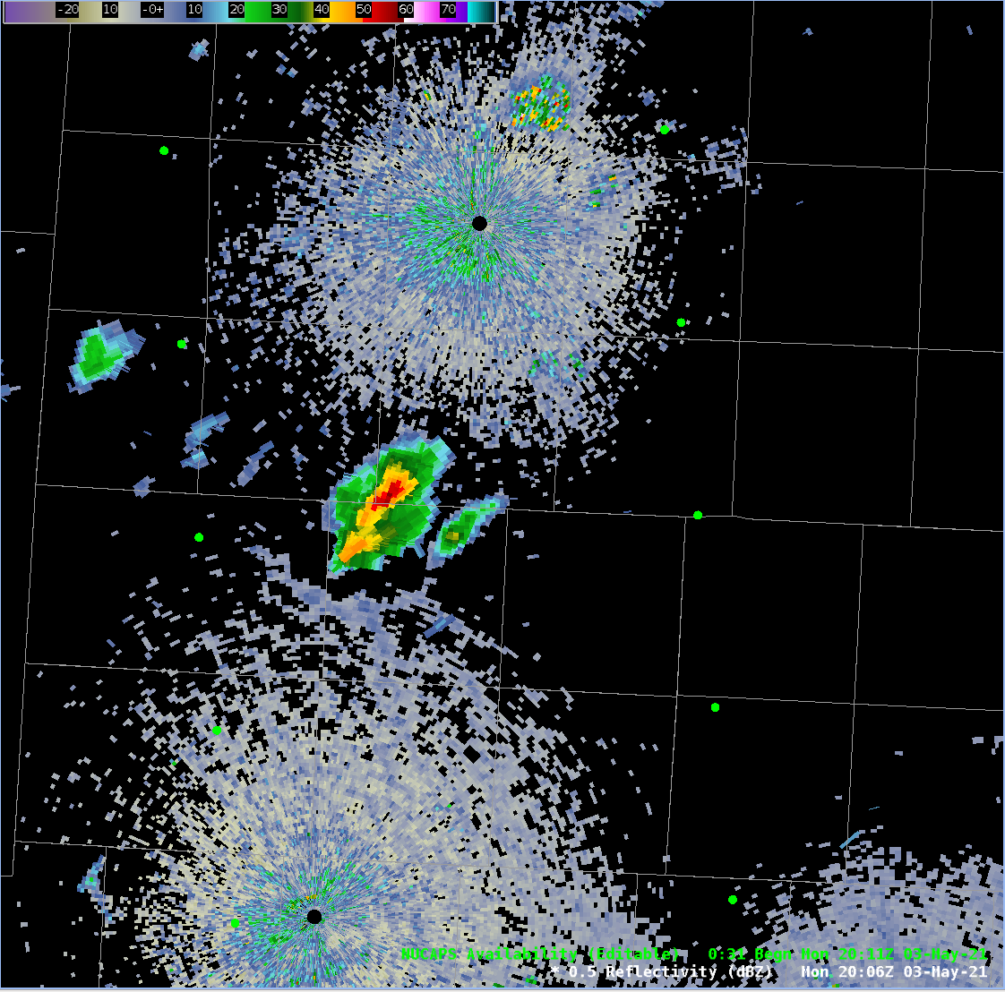
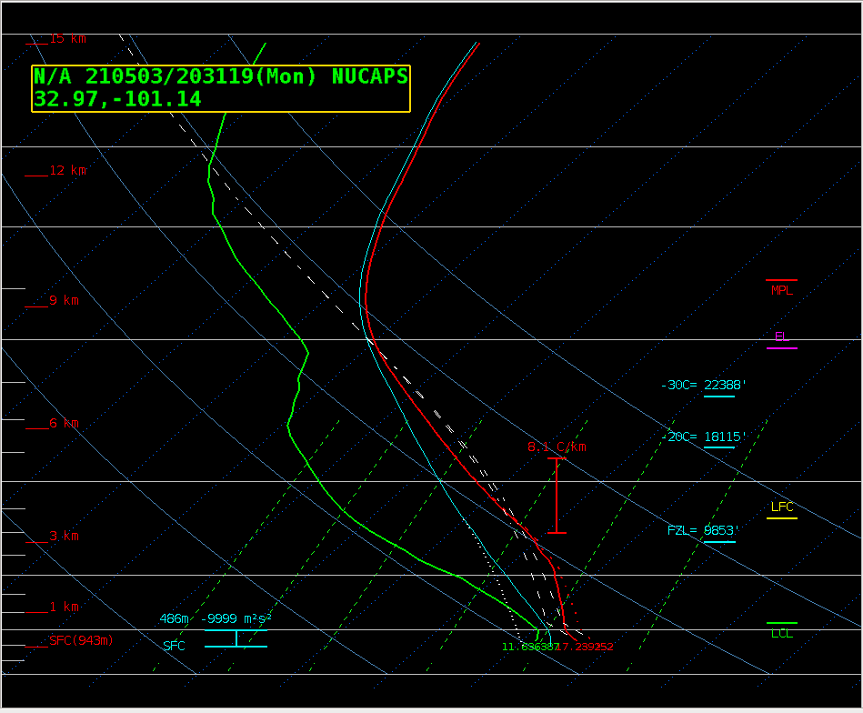
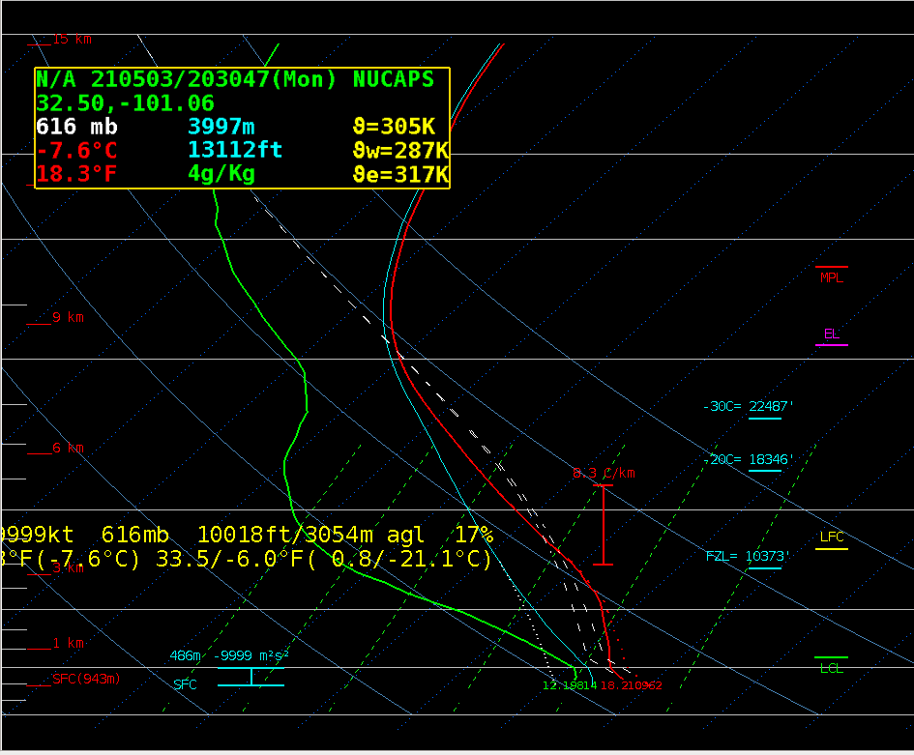
2031z
A
2006z
Lubbock, TX
A
2031z
B
B
2030z
C
C

Slide 13
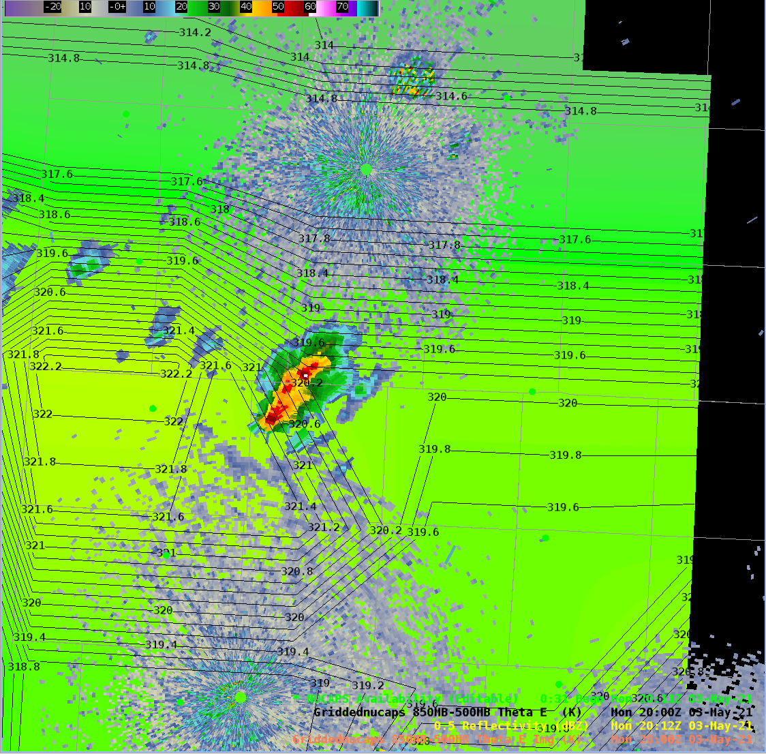
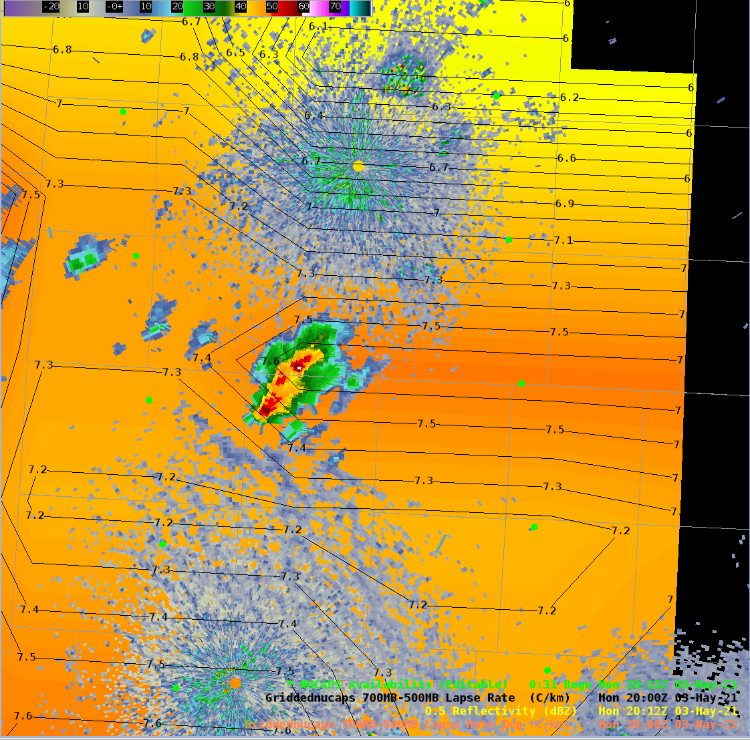
Gridded NUCAPS 850-500mb Theta-E and Radar
Gridded NUCAPS 700-500mb Lapse Rate and Radar
Lubbock, TX
Lubbock, TX

Slide 14
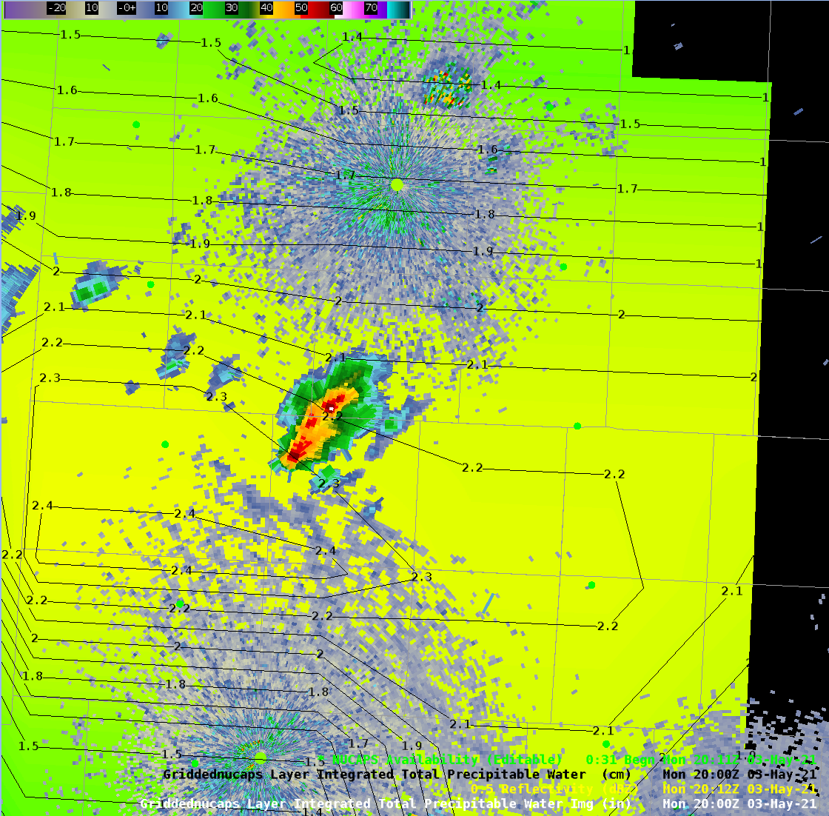
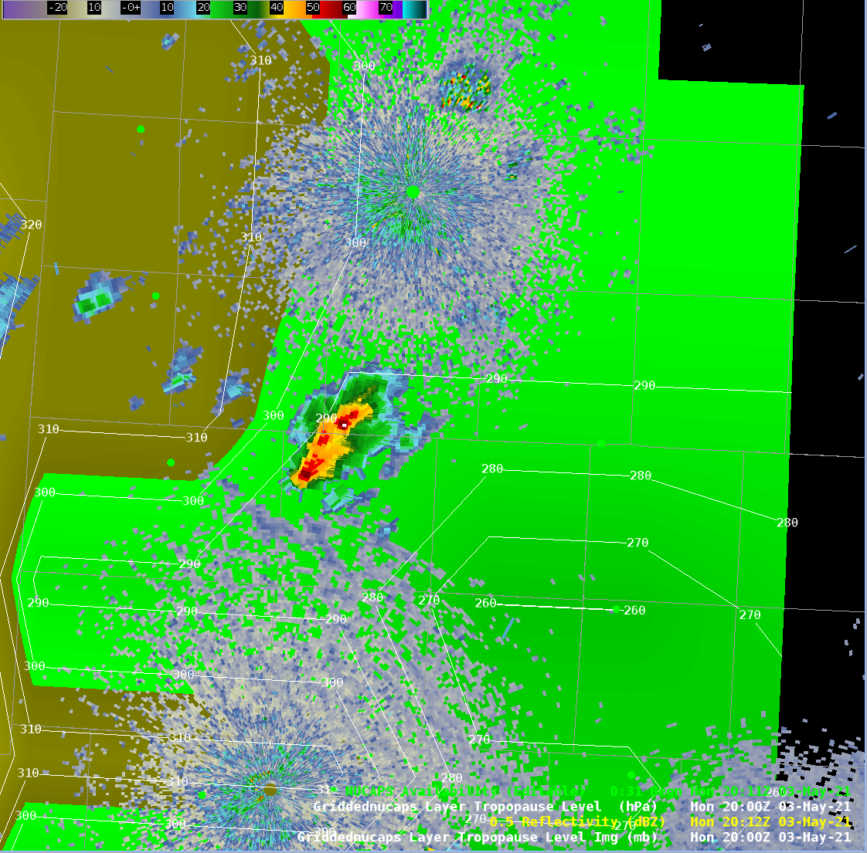
Gridded NUCAPS Total Precipitable Water and Radar
Gridded NUCAPS Tropopause Level and Radar
Lubbock, TX
Lubbock, TX

Slide 15
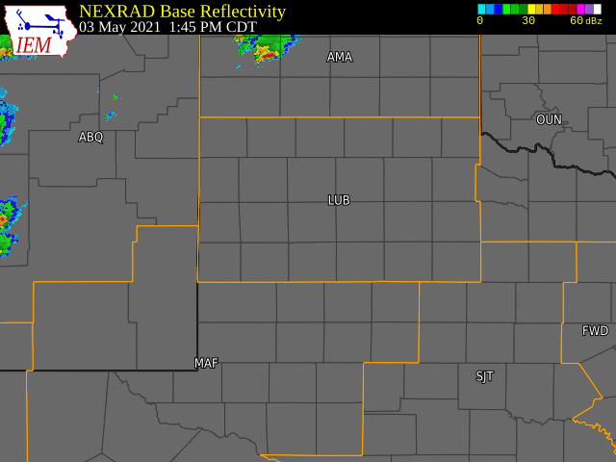
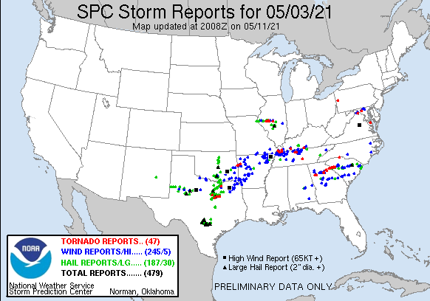
Multiple hail and wind reports with a few large hail (2.5 to 2.75 inch) and high wind (84 mph) reports as the storms move further east into north central Texas

Slide 16
Thank you!

